Slide 1
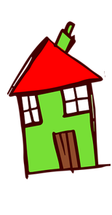
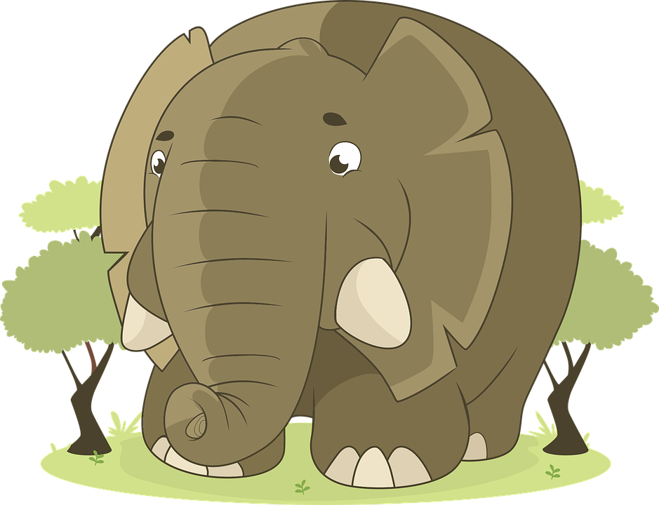
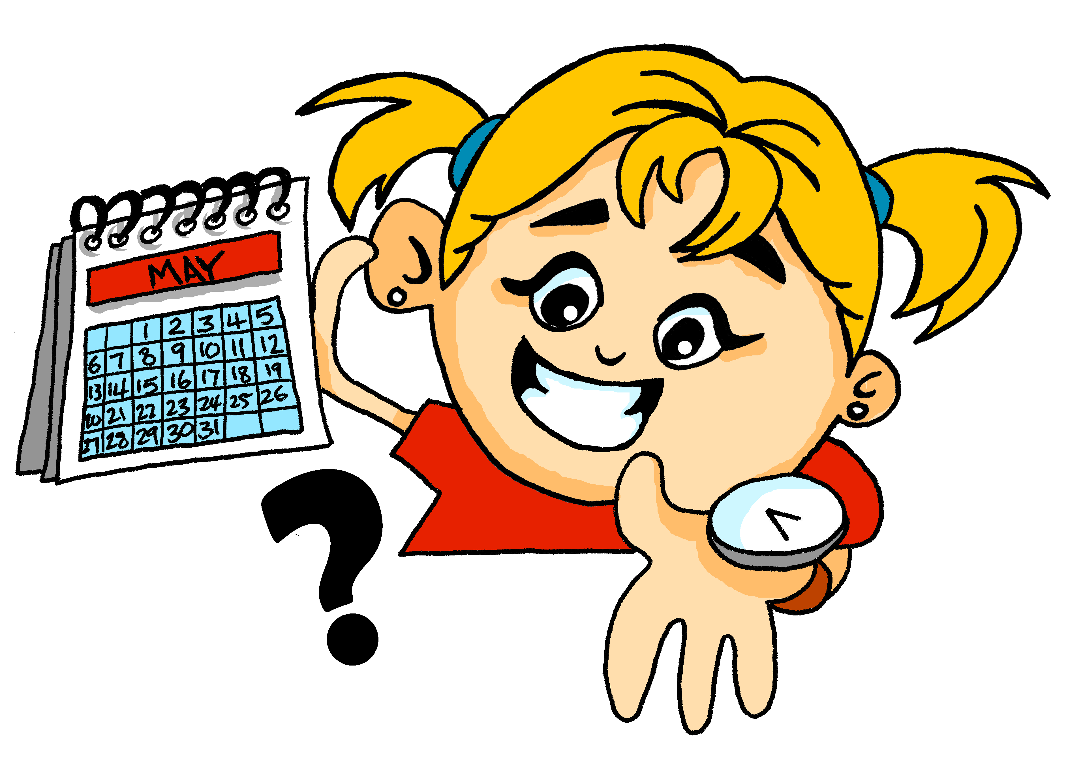
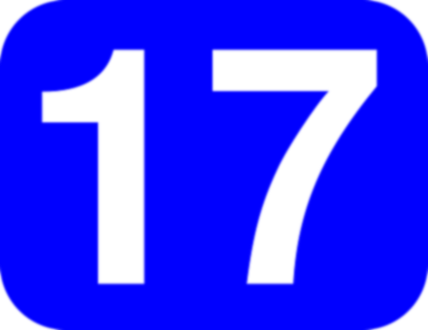
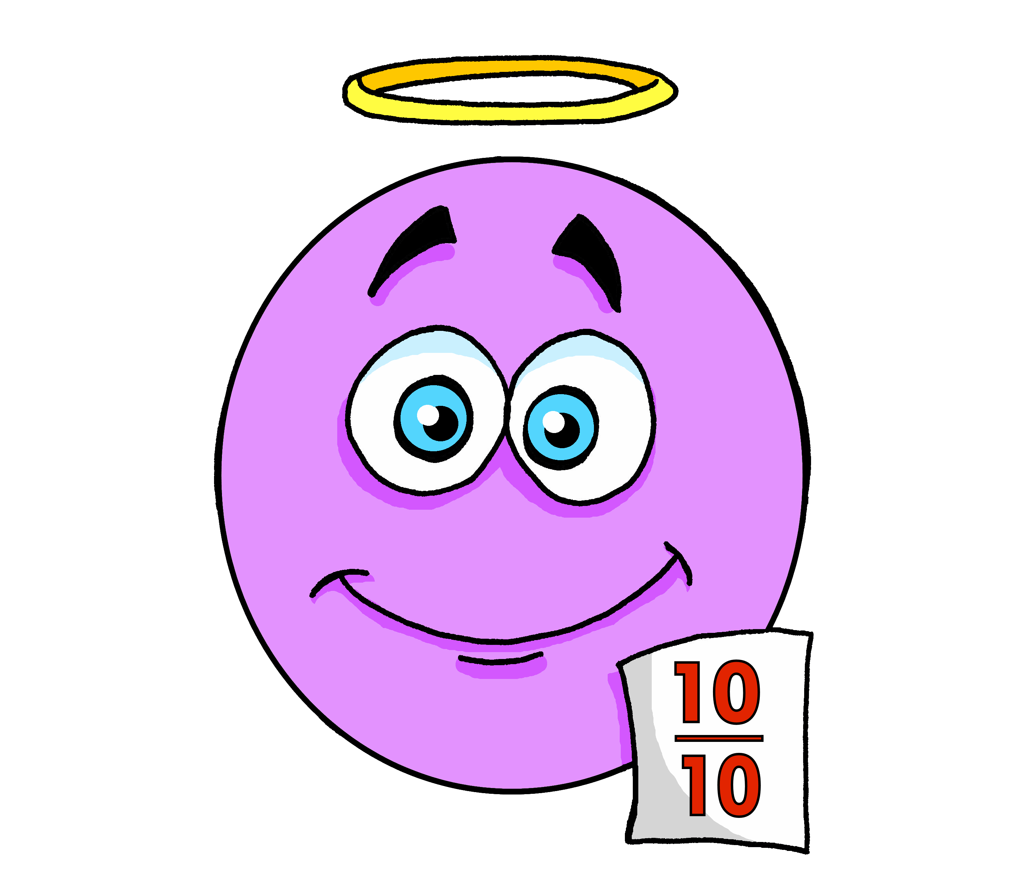
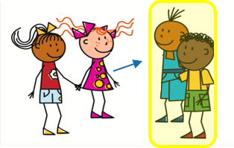
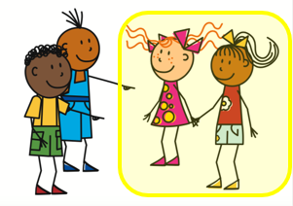
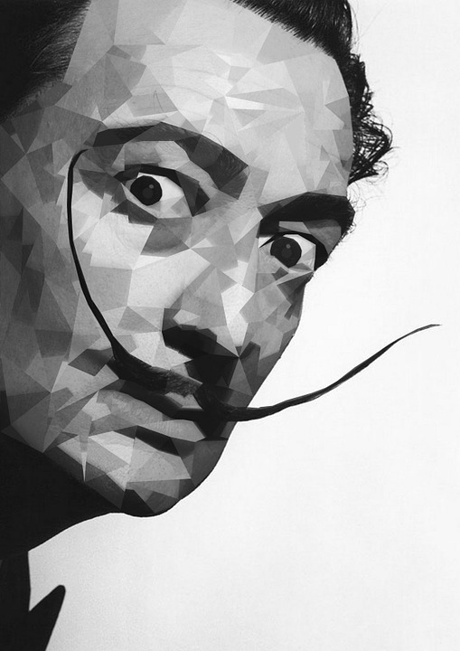
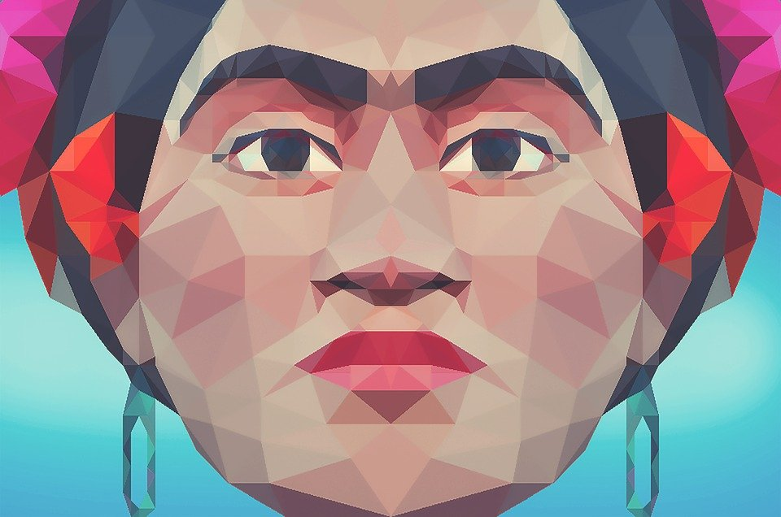
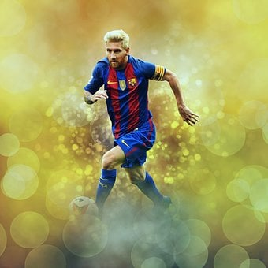
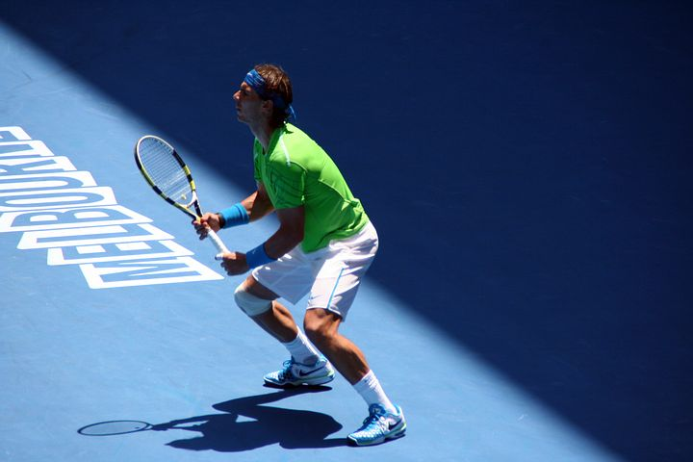
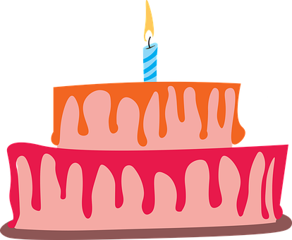
Verde Knowledge Organiser - Autumn Term A
¿Cuándo es…?
estar – to be | being (location, state)
estamos – we are
están – they are
compañero – (male) classmate (m)
compañera – (female) classmate (f)
concierto – concert (m)
espectáculo – show (m)
exposición – exhibition (f)
fecha – date (f)
trece – 13
catorce – 14
quince – 15
dieciséis – 16 | veintiséis - 26
diecisiete – 17 | veintisiete – 27
dieciocho – 18 | veintiocho - 28
diecinueve – 19 | veintinueve – 29
veinte – 20
veintiuno – 21
veintidós – 22
veintitrés – 23
veinticuatro – 24
veinticinco - 25
treinta – 30
treinta y uno - 31
Los amigos
ser – to be | being (trait)
somos – we are
son – they are
perfecto, perfecta – perfect (m), (f)
negativo, negativa – negative (m), (f)
capaz – capable (m/f)
En la ciudad
escuela – school (f)
hotel – hotel (m)
piscina – swimming pool (f)
puente – bridge (m)
¿cuál? – which?
¿quién? – who?
demasiado - too
y – and
pero - but
también – also
bastante - quite
Phonics
[a] | [o] | [u] | [e] | [i]
casa
dos
universo
elefante
idea
Spanish words often have consonant-vowel pairs, pronounced equally, e.g., in-te-re-san-te
Pronounce strong Spanish vowels [a], [e] and [o] separately. e.g. idea (when next to each other)
The weak vowels [i] and [u] merge with [a], [e] and [o] to make a single syllable, e.g., cuando.
Describing location and state with the verb estar | Adjective agreement for gender | Numbers 13 - 31
Describing permanent traits with the verb ser | More adjective patterns | Dates
For numbers 16-19 use the combination “dieci“ + the number (6, 7, 8, 9).
estás
In Spanish, adjectives ending in –o change to –a to describe feminine nouns. Add –s for plural nouns.
you are
dieciséis
estoy
está
diecisiete
I am
estar
s/he, it is
➜
➜
to be|being
Están perfectos.
For 21 to 29 use veinti- and a number from 1-9, all in one word.
están
estamos
They (m, m/f) are (feeling) perfect.
they are
we are
Están perfectas.
For 31 to 39, use treinta + y + 1-9, in separate words.
They (f) are (feeling) perfect.
⚠ If the final syllable is stressed and the word ends in a vowel or ‘n’ or ‘s’, there is an accent on the final vowel.
Adjectives already ending in –e or –z (or –l) stay the same for singular nouns and add-s for plual:
Use el before the number to mean ‘on the’.
➜
eres
➜
you are
Es inteligente.
¿Cuándo es tu cumpleaños?
soy
es
She, he is intelligent.
¡Mi cumpleaños es el 27 de noviembre!
I am
ser
s/he, it is
Son inteligentes.
to be|being
They (m,f) are intelligent.
Treinta días tiene noviembre, con abril, junio y septiembre. veintiocho solo hay uno y los demás treinta y uno.
Es capaz.
son
somos
She, he is capable.
they are
we are
Son capaces.
They (m,f) are capable.

Slide 2
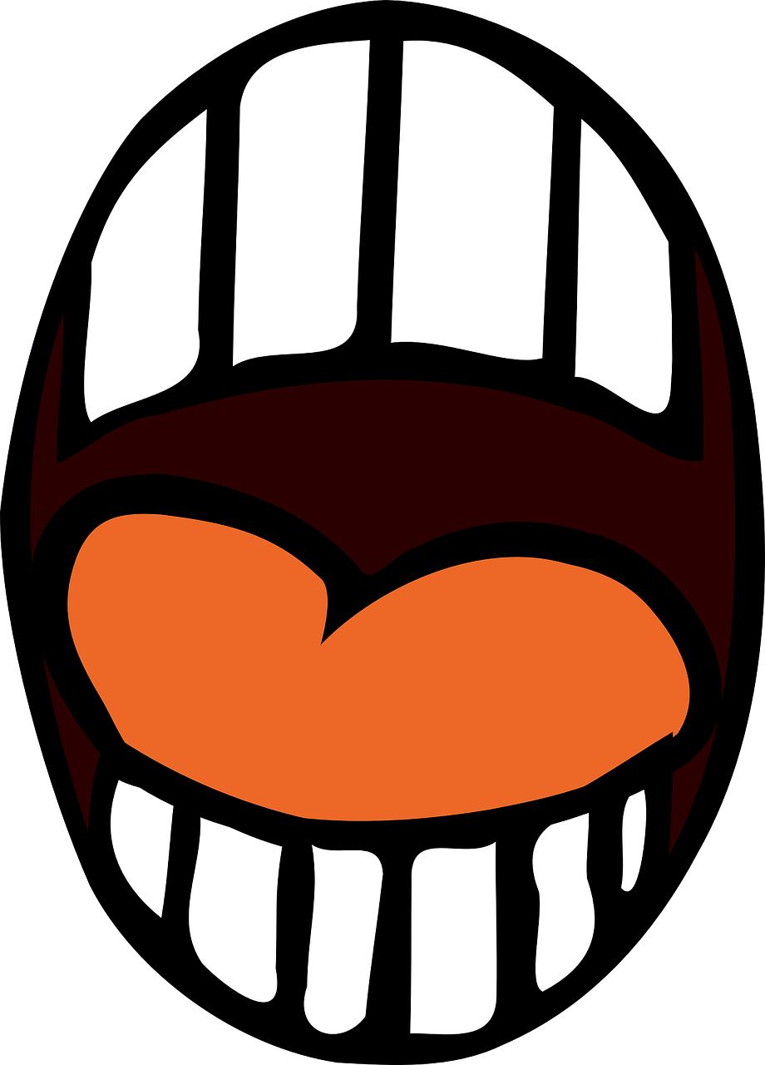
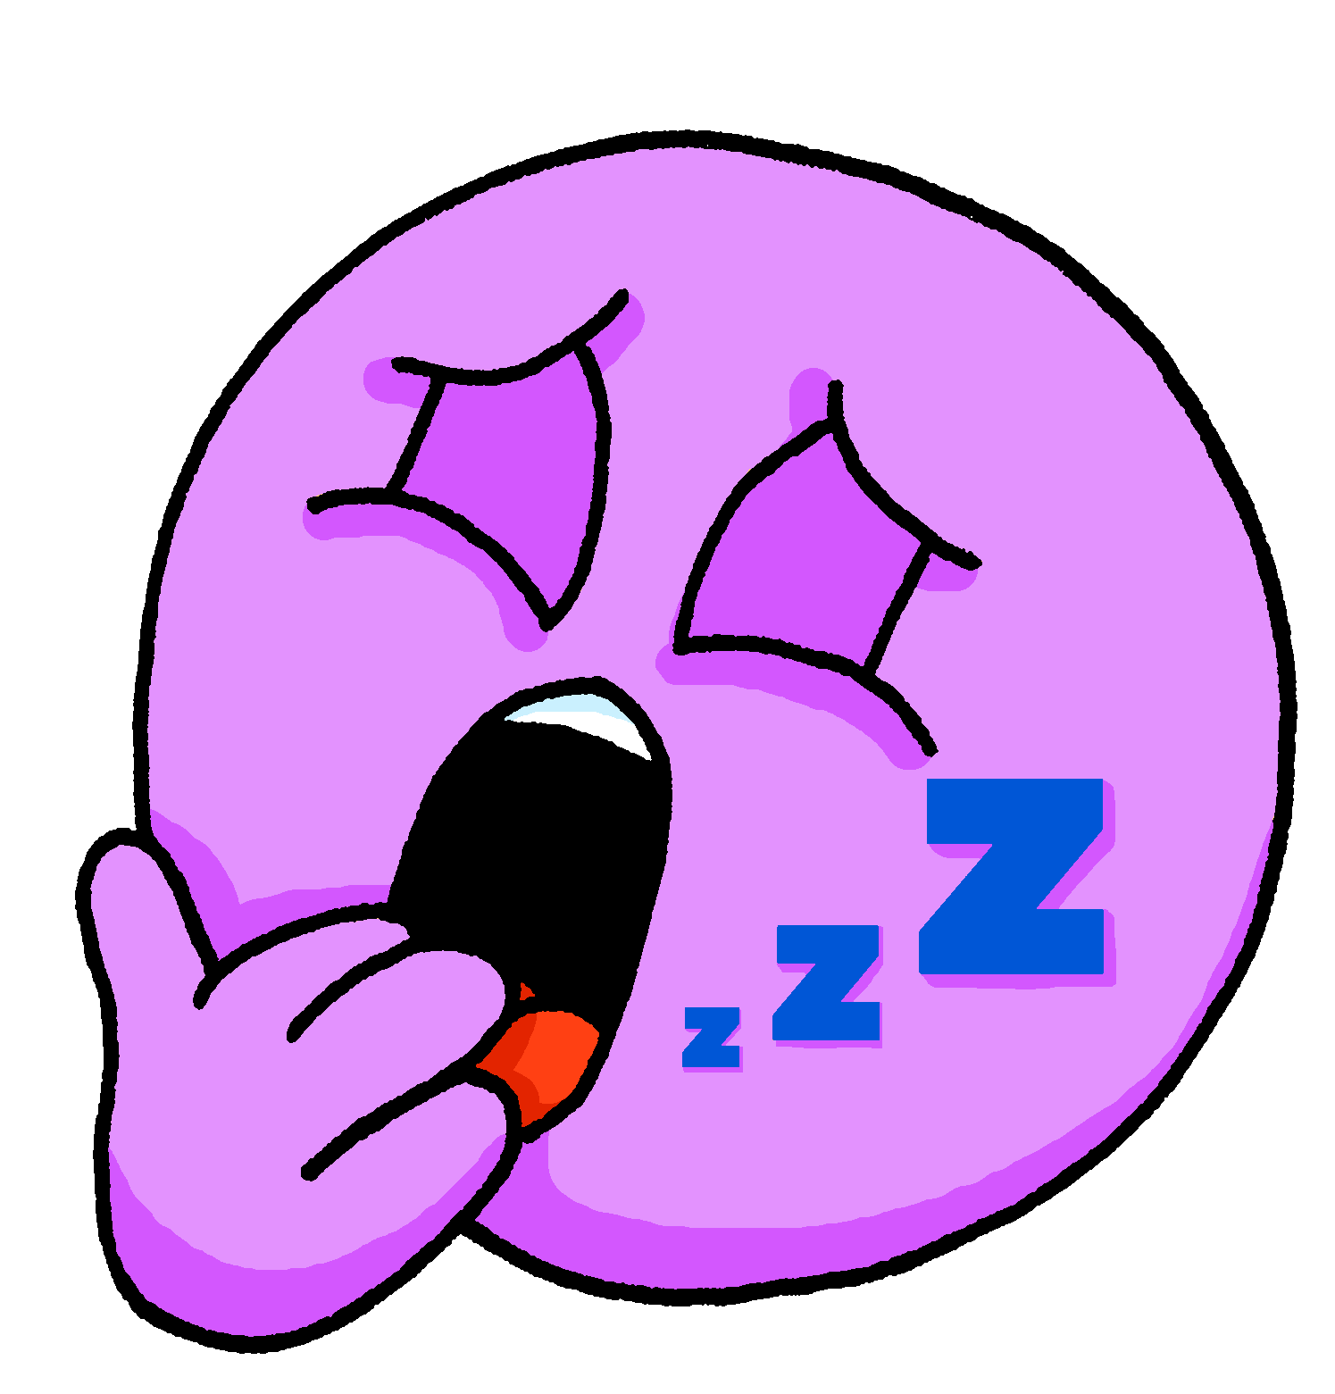
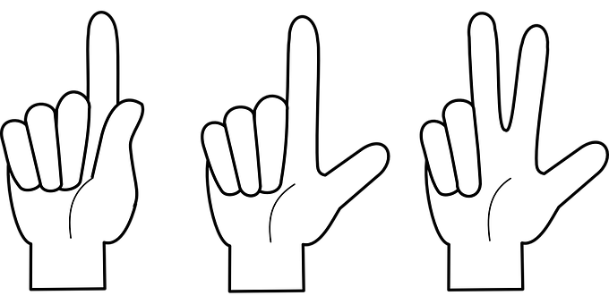
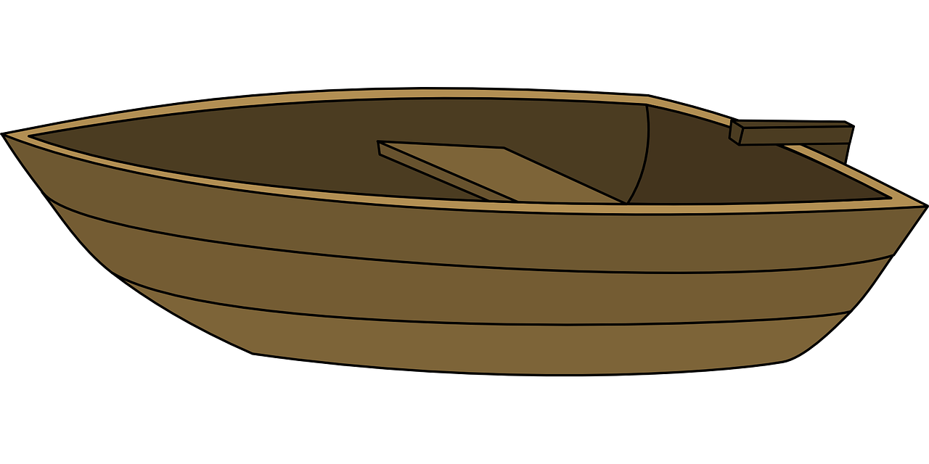
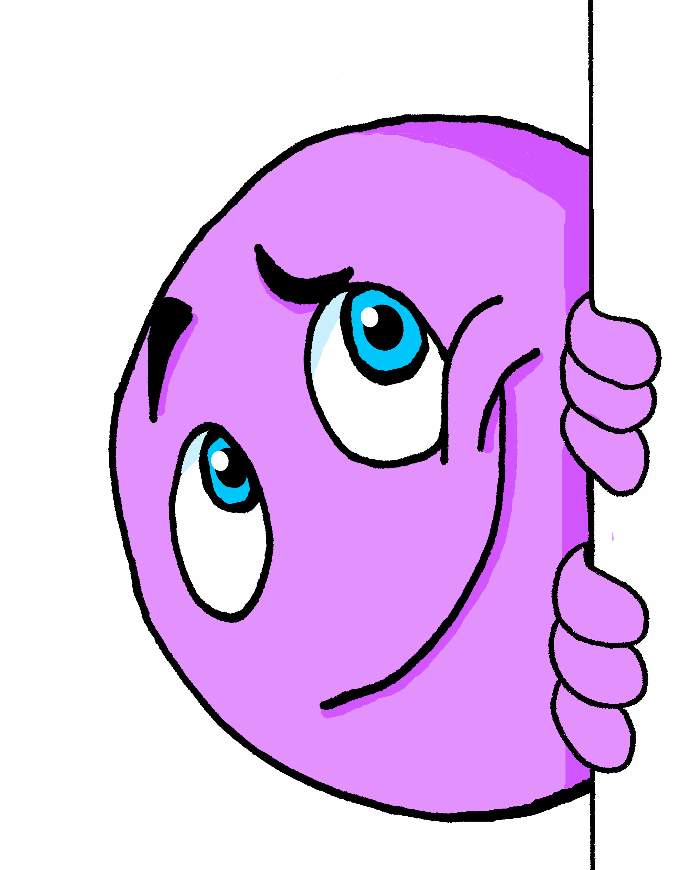
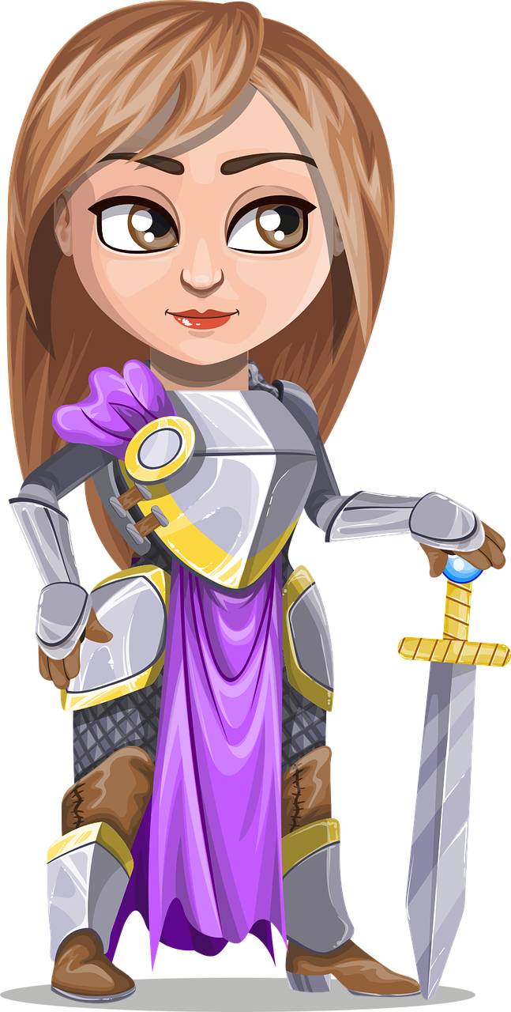
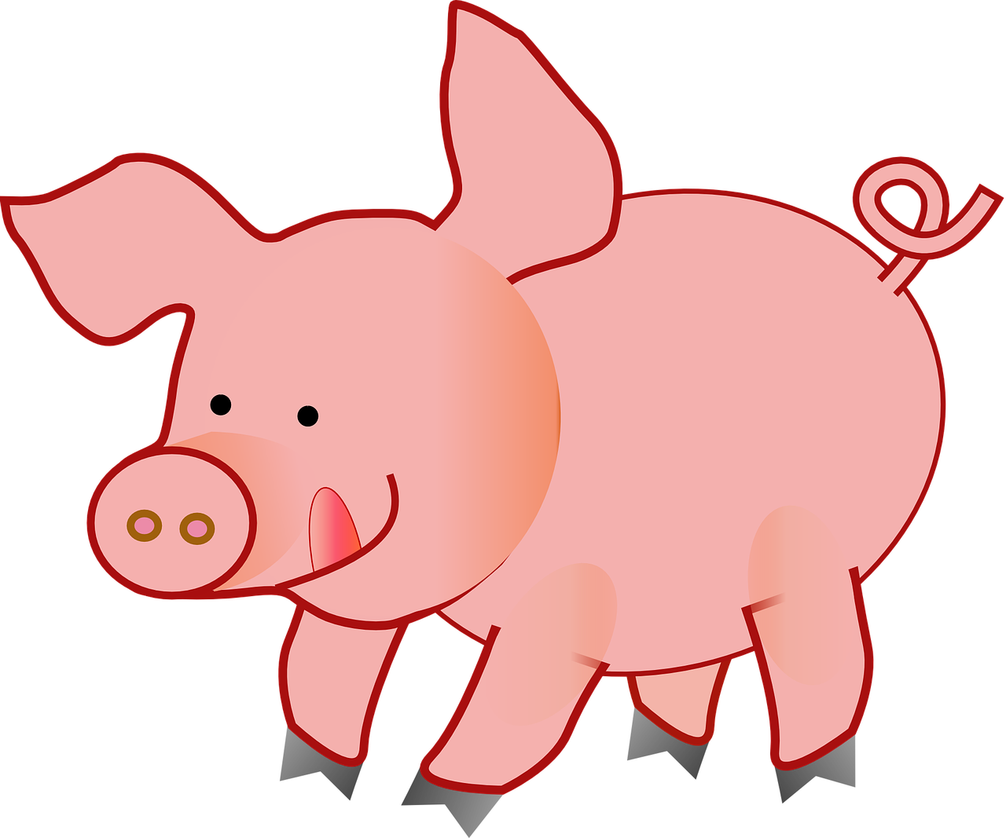
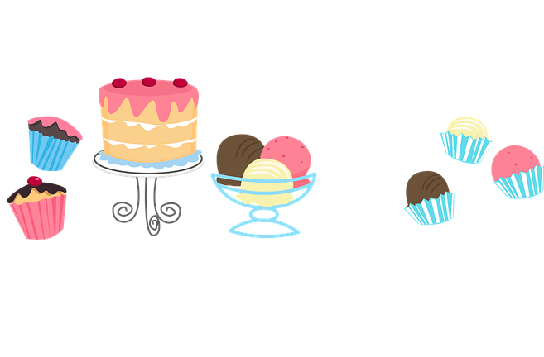
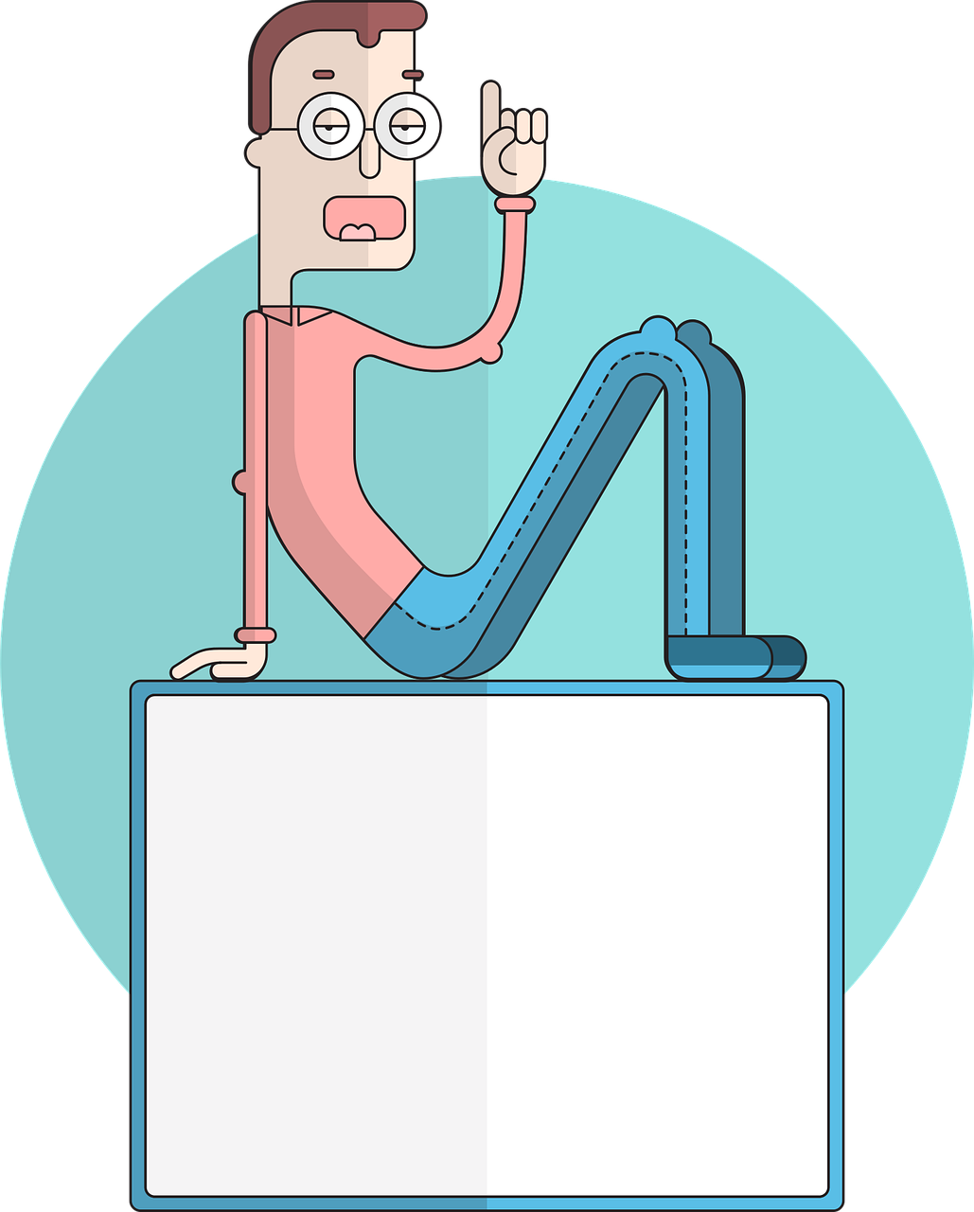
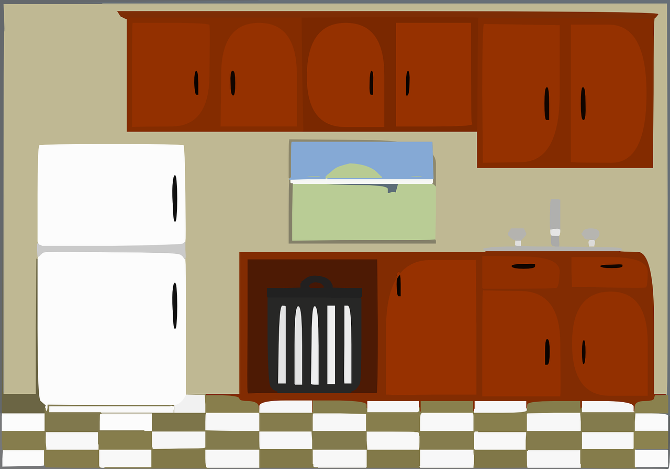
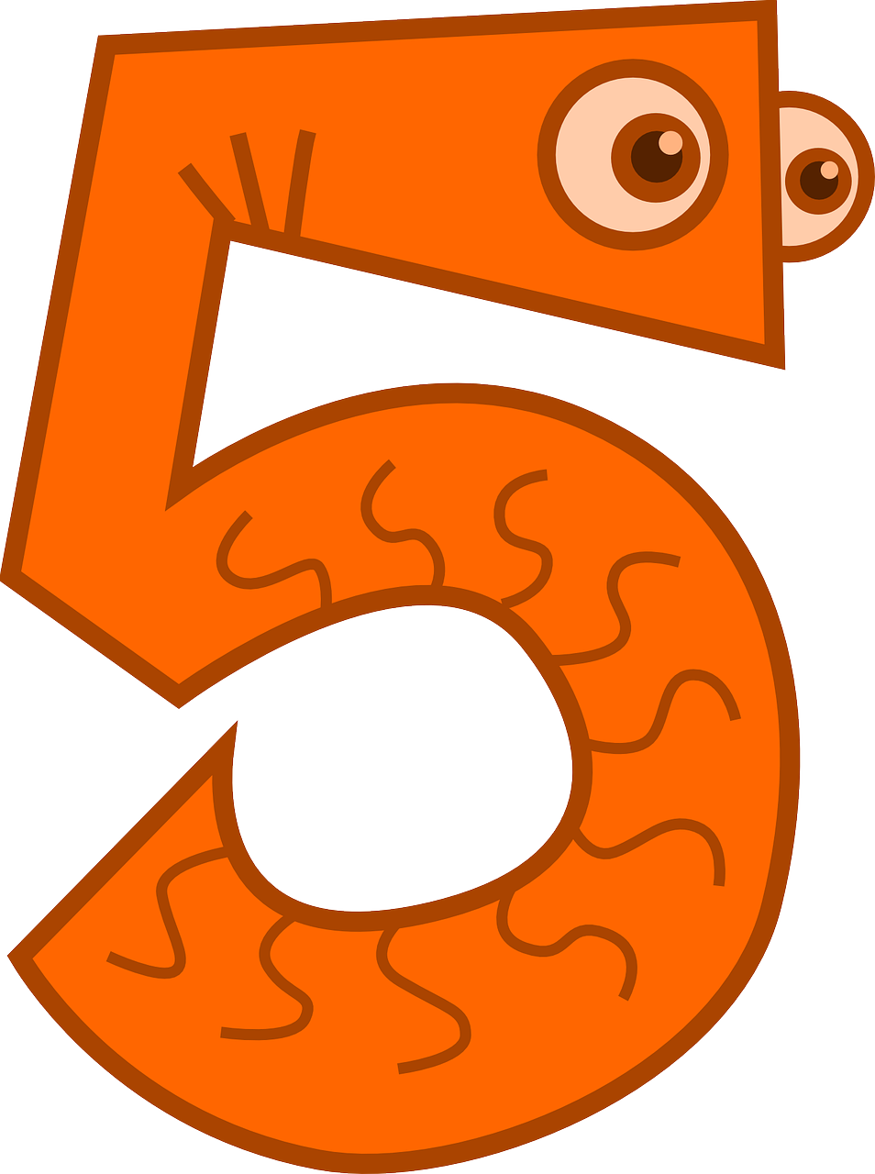
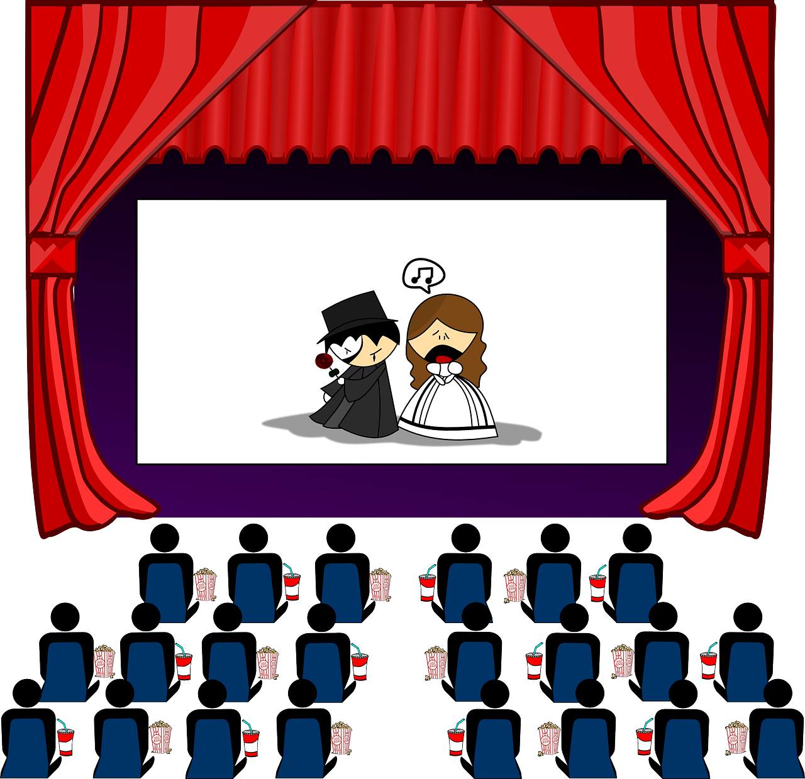
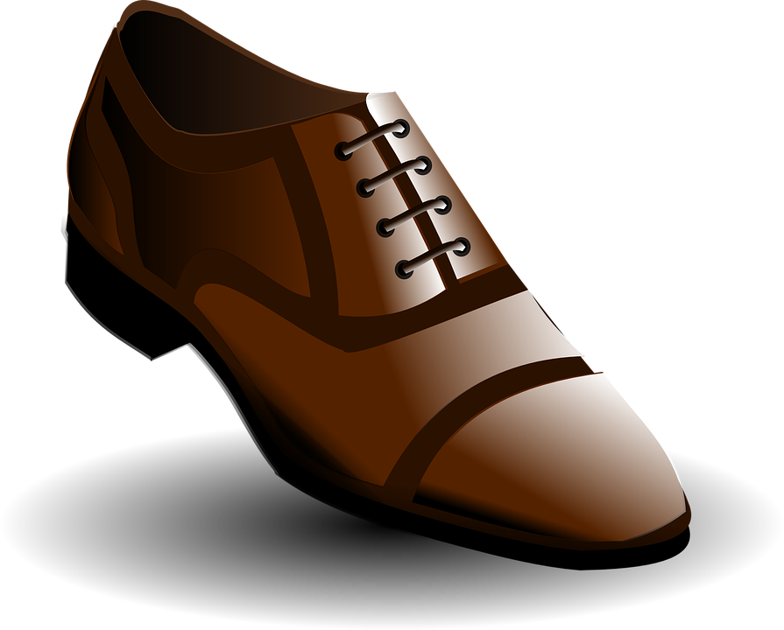
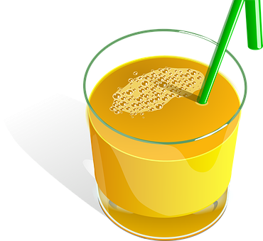
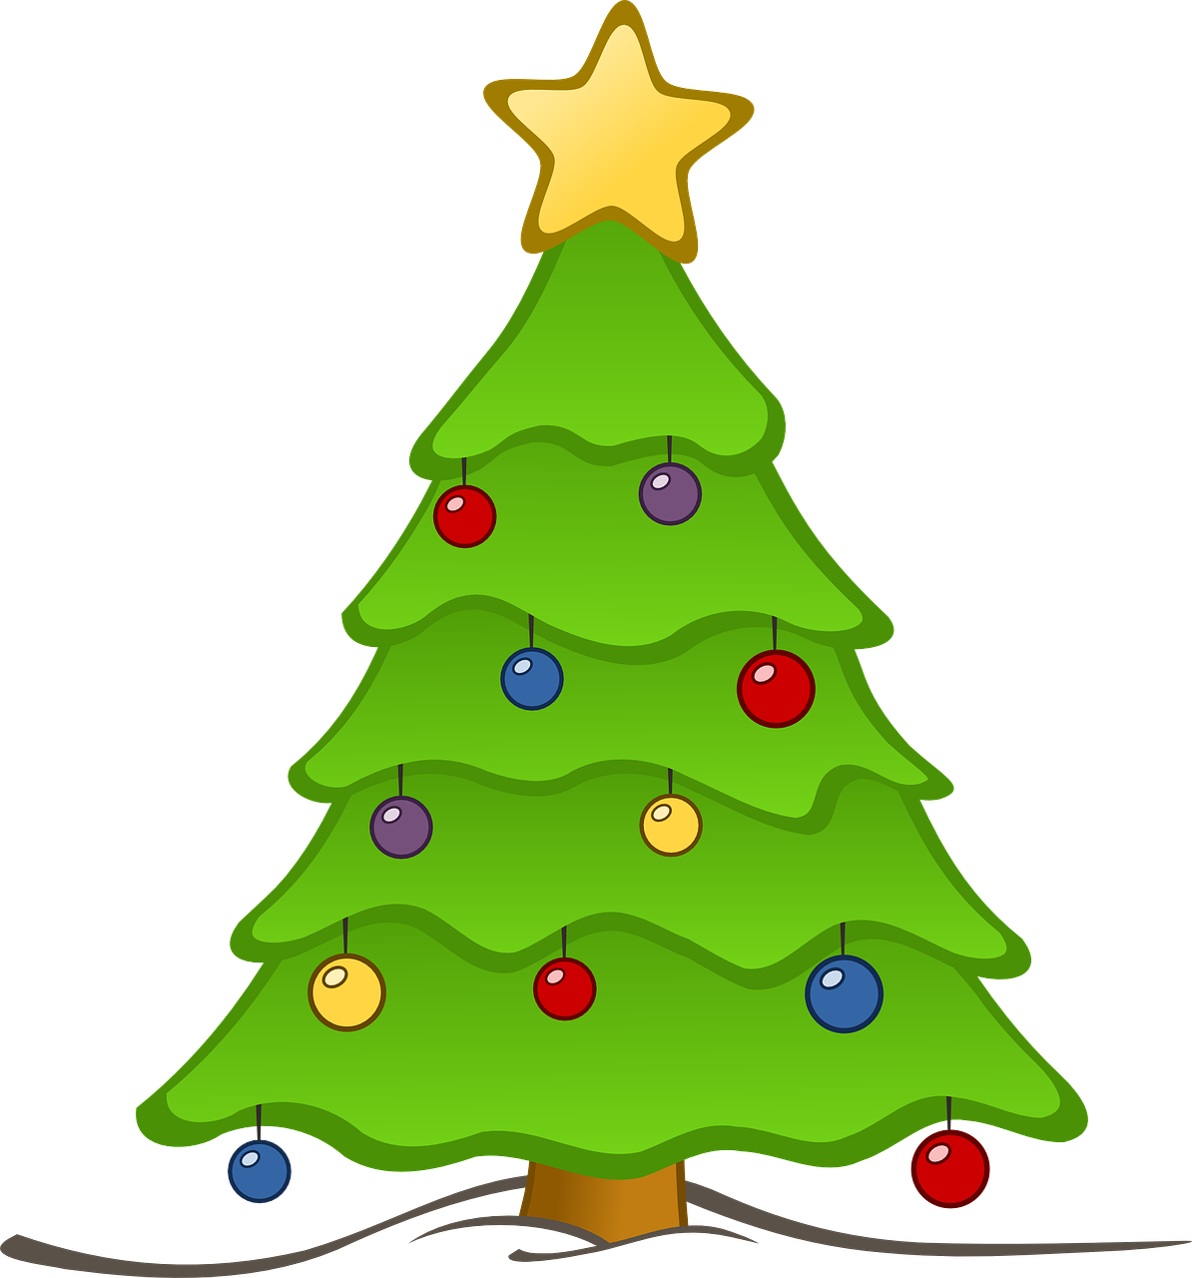
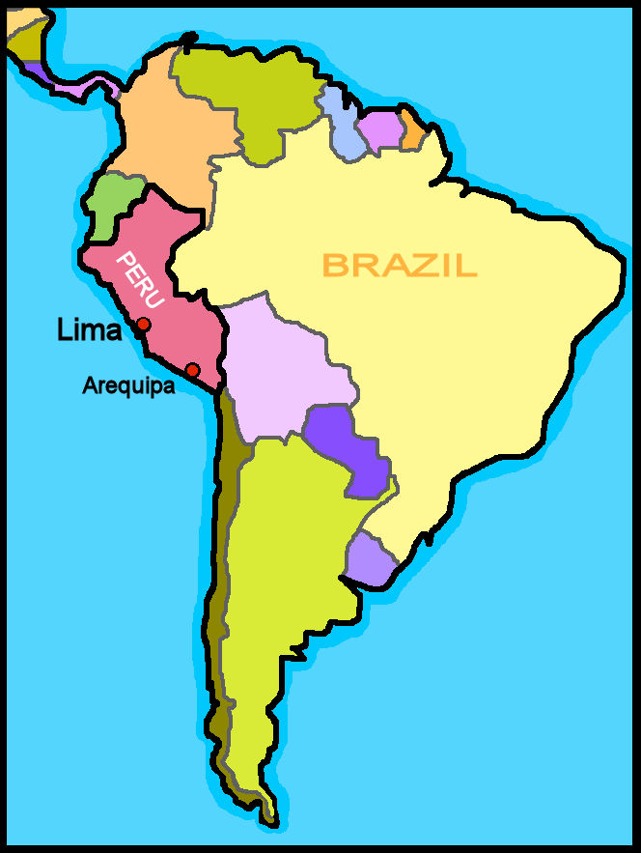
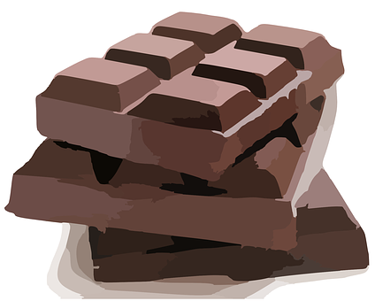
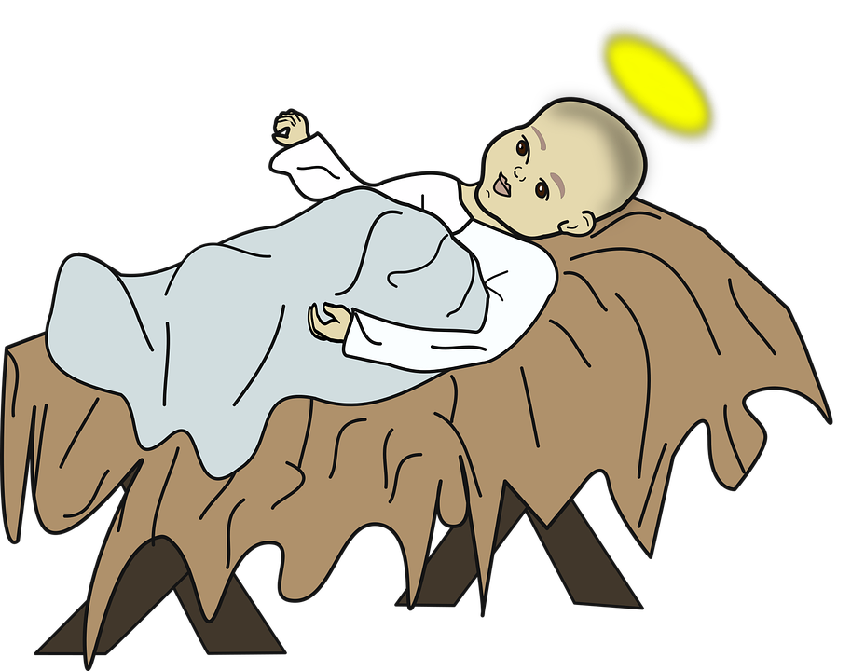
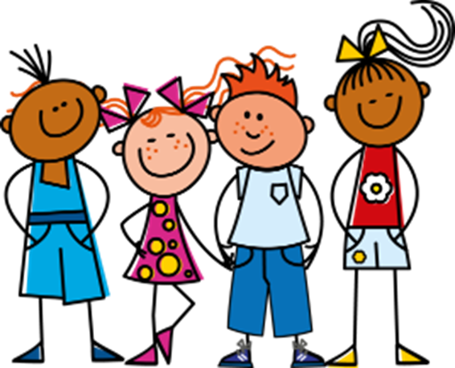
Verde Knowledge Organiser - Autumn Term B
En la ciudad
tener – to have|having
tenemos – we have
tienen – they have
unos – some (m, m/fpl)
unas – some (fpl)
árbol – tree (m)
calle – street (f)
cine – cinema (m)
edificio – building (m)
mentira – lie (m)
verdad – truth (f)
delante de – in front of
detrás de - behind
entre - between
Descripción física
cantante – singer (m/f)
cara – face (f)
pelo – hair (m)
gafas – glasses (fpl)
corto, corta – short (m), short (f)
largo, larga – long (m), long (f)
moreno, morena – dark (m), dark (f)
negro, negra – black (m), black (f)
redondo, redonda – round (m), (f)
rubio, rubia, blond (m), blond (f)
solo – only
un poco – a bit
Phonics
[ca]
cama
cantar
música
boca
cansado
[co]
contar
barco
con
correcto
un poco
[to count]
[cu]
cucaracha
escuchar
cultura
curioso
escuela
[ci]
centro
princesa
cerdo
celebrar
dulce
decir
[ci]
[to say, tell]
cocina
cinco
cine
bici
[z]
¡Es mentira! It’s false!
zapato
manzana
brazo
zona
zumo
¡Es verdad! It’s true!
In Spain, [z] and [c] (before e and i)sound like [th] in English. In Latin America [z] and [c] (before e and i)sound like [s].
[ch] noche
Feliz Navidad ! Happy Christmas!
fecha
24
chocolate
leche
chino
Indefinite articles – ‘a’ To say some in Spanish use unos before a masculine noun and unas before a feminine noun. unos edificios unas calles | Saying what people have with the verb tener
Negation with ‘no’ | Articles with physical description in Spanish we always use the definite article ‘the’ in these descriptions. In English, we leave it out or use ‘a’, e.g., has a round face. | Un villancico (carol)
tienes
In Spanish, to say what you or others don’t have, put ‘no’ before the verb. This makes a negative.
Campana sobre campana,
Y sobre campana una,
Asómate a la ventana,
Verás al Niño en la cuna.
Bell after bell,
And after bell, one!
Lean out the window
You'll see the Child in his crib.
you have
tengo
tiene
I have
tener
s/he, it has
➜
to have|having
Sofía no tiene una hermana.
➜
tienen
tenemos
Sofía does not have a sister.
Tiene la cara redonda y el pelo corto.
they have
we have

