Slide 1
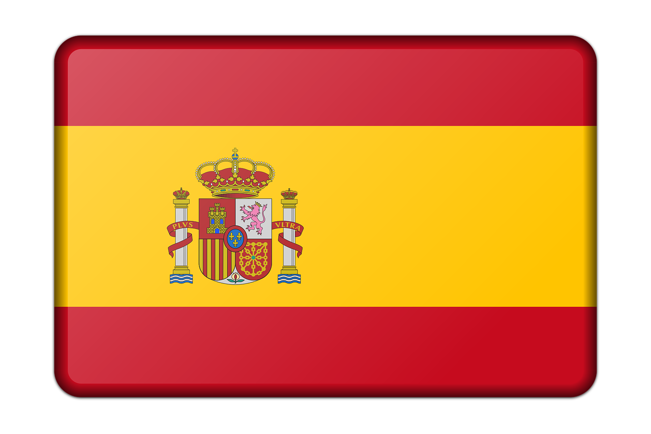
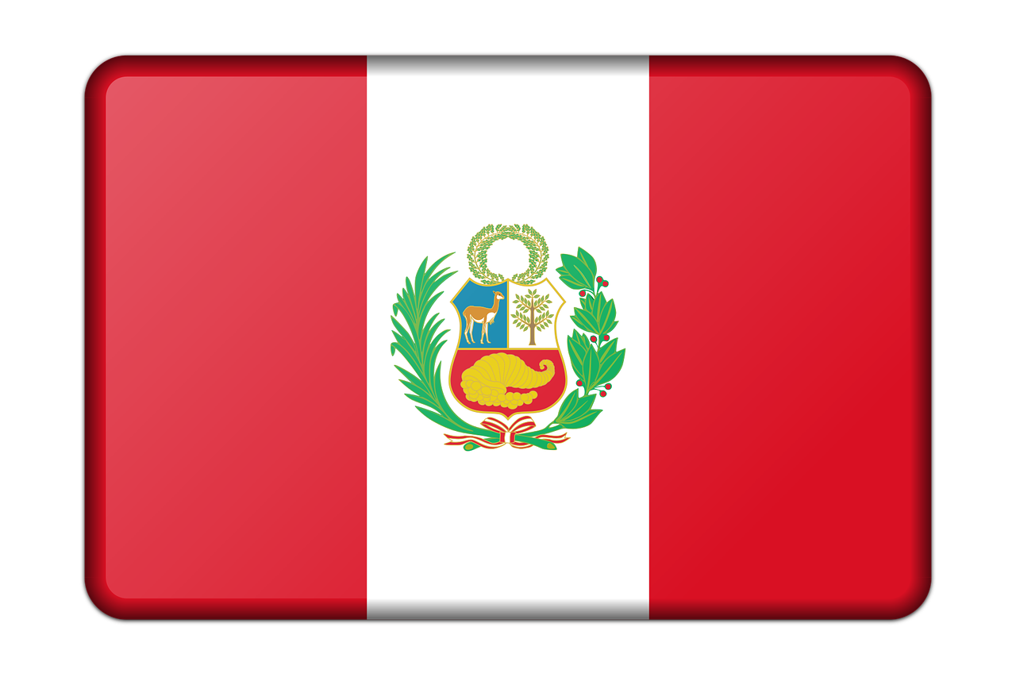

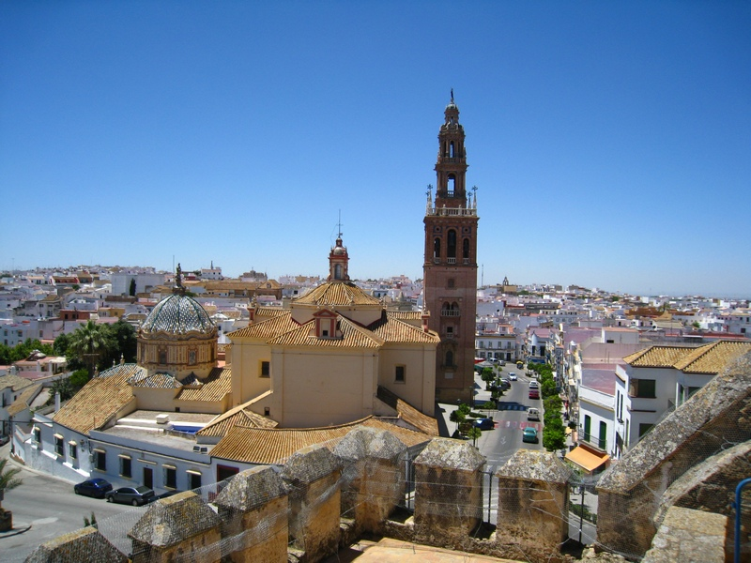
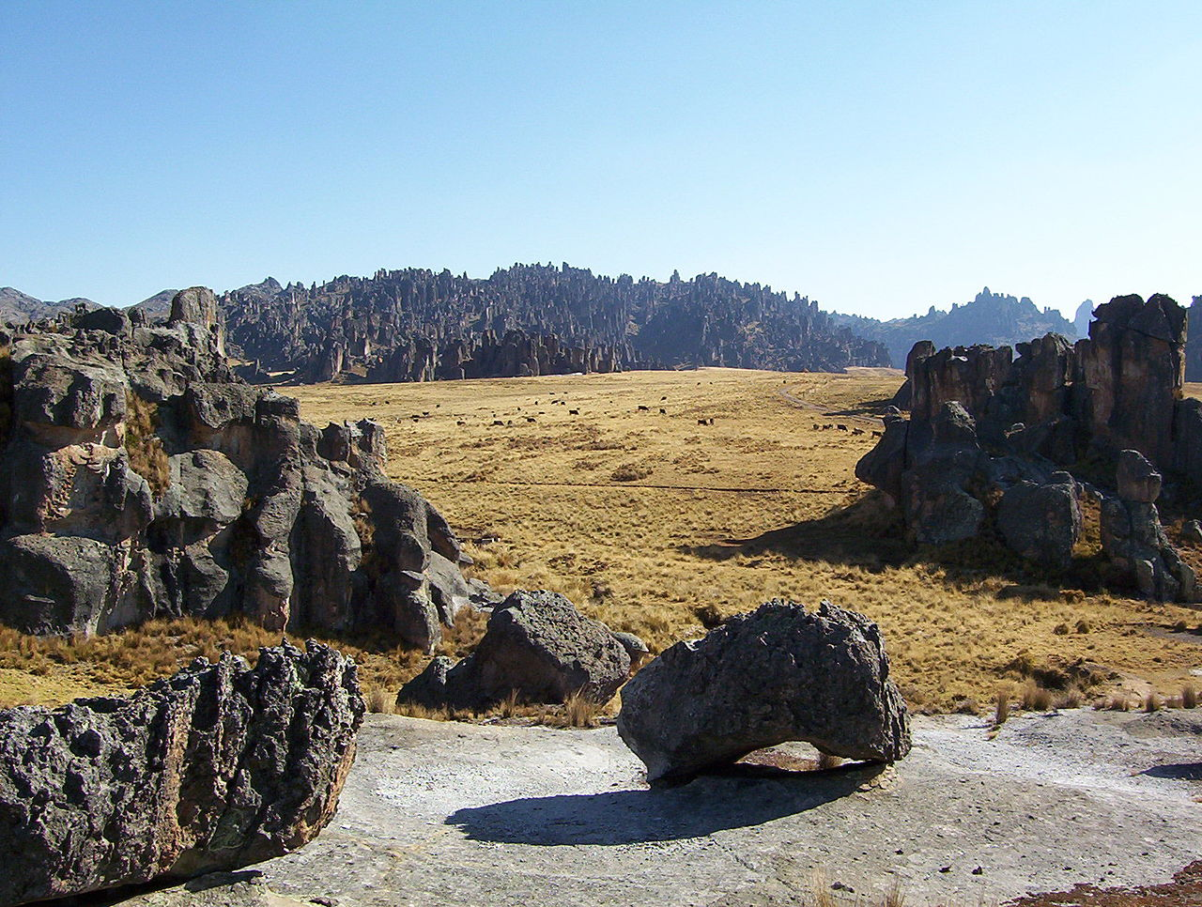
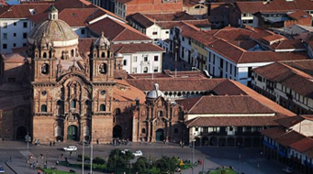
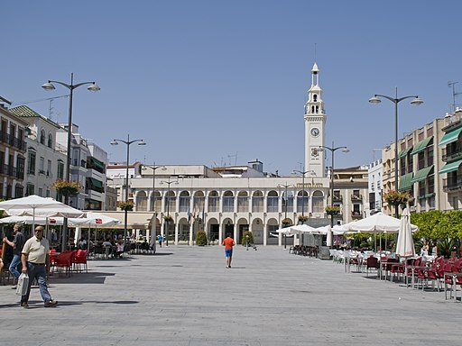
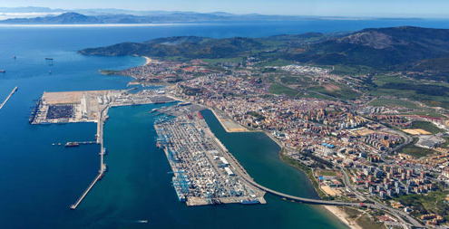
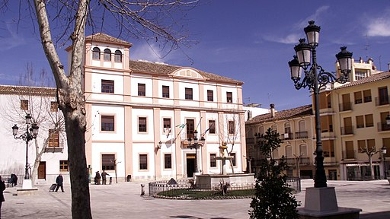
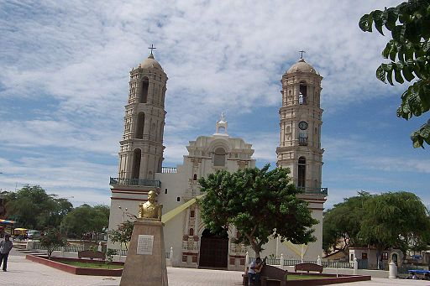
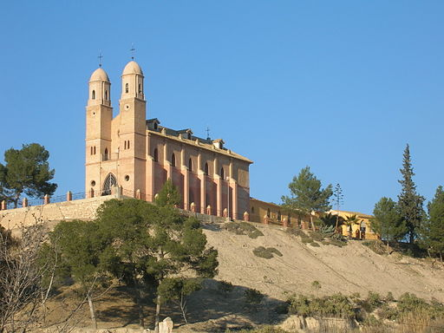
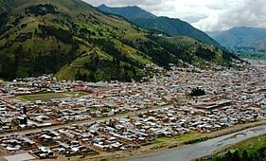
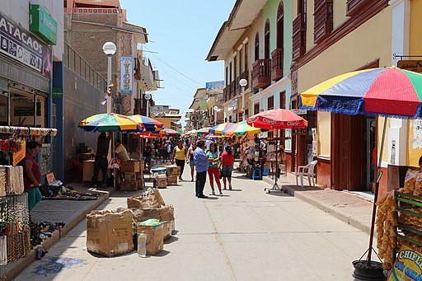
España y Perú
Read aloud the Spanish name of each place.
Pupil name: ___________________________________
Total score: _____ / 10
You have not learnt these words so just use what you know about how to pronounce Spanish. ☺
Concentrate on the underlined letters.
 | City/Town | SSC [sound-symbol correspondence] | p/ x
1 | Carmona | [ca]
2 | Pasco | [co]
3 | Cusco | [cu]
4 | Lucena | [ce]
5 | Algeciras | [ci]
6 | Baza | [z]
7 | Sechura | [ch]
8 | Cieza | weak + strong [ie]
9 | Sicuani | weak + strong [ua]
10 | Catacaos | strong + strong [ao]
1 | 2 | 3
4 | 5 | 6
Carmona
Pasco
Cusco
Lucena
Algeciras
Baza
7 | 8 | 9 | 10
Sechura
Cieza
Sicuani
Catacaos
For numbers 8, 9 and 10 write the number of syllables in each word here: 8. [___] 9. [___] 10. [___]
Notes:
i) Teachers award one point for each SSC.
ii) There are no points for the number of syllables questions, but these are designed to prompt pupils to think about the pronunciation of these three words.
Notes:
Teacher version with audio, for preparation.
Information source:
https://en.wikipedia.org/wiki/List_of_cities_in_Peru
Image attribution:
Carmona - Pufacz, Public domain, via Wikimedia Commons
Pasco - [Bernd Wolniczak], CC BY-SA 4.0 via Wikimedia Commons
Cusco - Peruwikila, CC BY-SA 3.0 <via Wikimedia Commons
Lucena - lberto Cabello from Vitoria-Gasteiz, Spain, CC BY 2.0 via Wikimedia Commons
Algeciras - Paolichy, CC BY-SA 4.0 via Wikimedia Commons
Baza - Rimantas Lazdynas, CC BY-SA 3.0 via Wikimedia Commons
Sechura - No machine-readable author provided. Alfredobi assumed (based on copyright claims)., Public domain, via Wikimedia Commons
Cieza - No machine-readable author provided. Lionni assumed (based on copyright claims)., Public domain, via Wikimedia Commons
Sicuani - Ant.rios2013, CC BY-SA 4.0 via Wikimedia Commons
Catacaos - Bernard Gagnon, CC BY-SA 3.0, via Wikimedia Commons
Links to licences:
https://creativecommons.org/licenses/by/2.0
https://creativecommons.org/licenses/by-sa/3.0
https://creativecommons.org/licenses/by-sa/4.0

Slide 2
Pupil name: ___________________________________
Total score: _____ / 10
Pupil name: ___________________________________
Total score: _____ / 10
 | City/Town | SSC [sound-symbol correspondence] | p/ x
1 | Carmona | [ca]
2 | Pasco | [co]
3 | Cusco | [cu]
4 | Lucena | [ce]
5 | Algeciras | [ci]
6 | Baza | [z]
7 | Sechura | [ch]
8 | Cieza | weak + strong [ie]
9 | Sicuani | weak + strong [ua]
10 | Catacaos | strong + strong [ao]
 | City/Town | SSC [sound-symbol correspondence] | p/ x
1 | Carmona | [ca]
2 | Pasco | [co]
3 | Cusco | [cu]
4 | Lucena | [ce]
5 | Algeciras | [ci]
6 | Baza | [z]
7 | Sechura | [ch]
8 | Cieza | weak + strong [ie]
9 | Sicuani | weak + strong [ua]
10 | Catacaos | strong + strong [ao]
Notes:
i) Teachers award one point for each SSC.
ii) There are no points for the number of syllables questions, but these are designed to prompt pupils to think about the pronunciation of these three words.
Notes:
i) Teachers award one point for each SSC.
ii) There are no points for the number of syllables questions, but these are designed to prompt pupils to think about the pronunciation of these three words.
Notes:
Teacher handout
Information source:
https://en.wikipedia.org/wiki/List_of_cities_in_Peru

