Slide 1

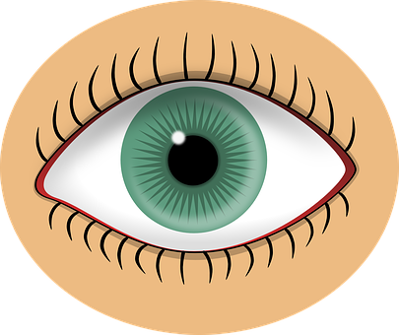

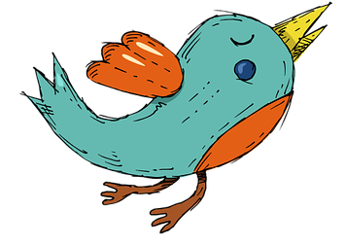




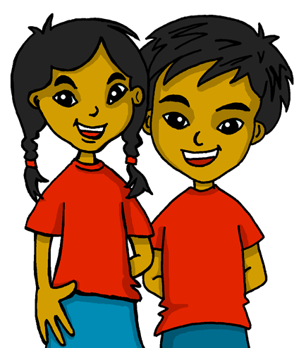




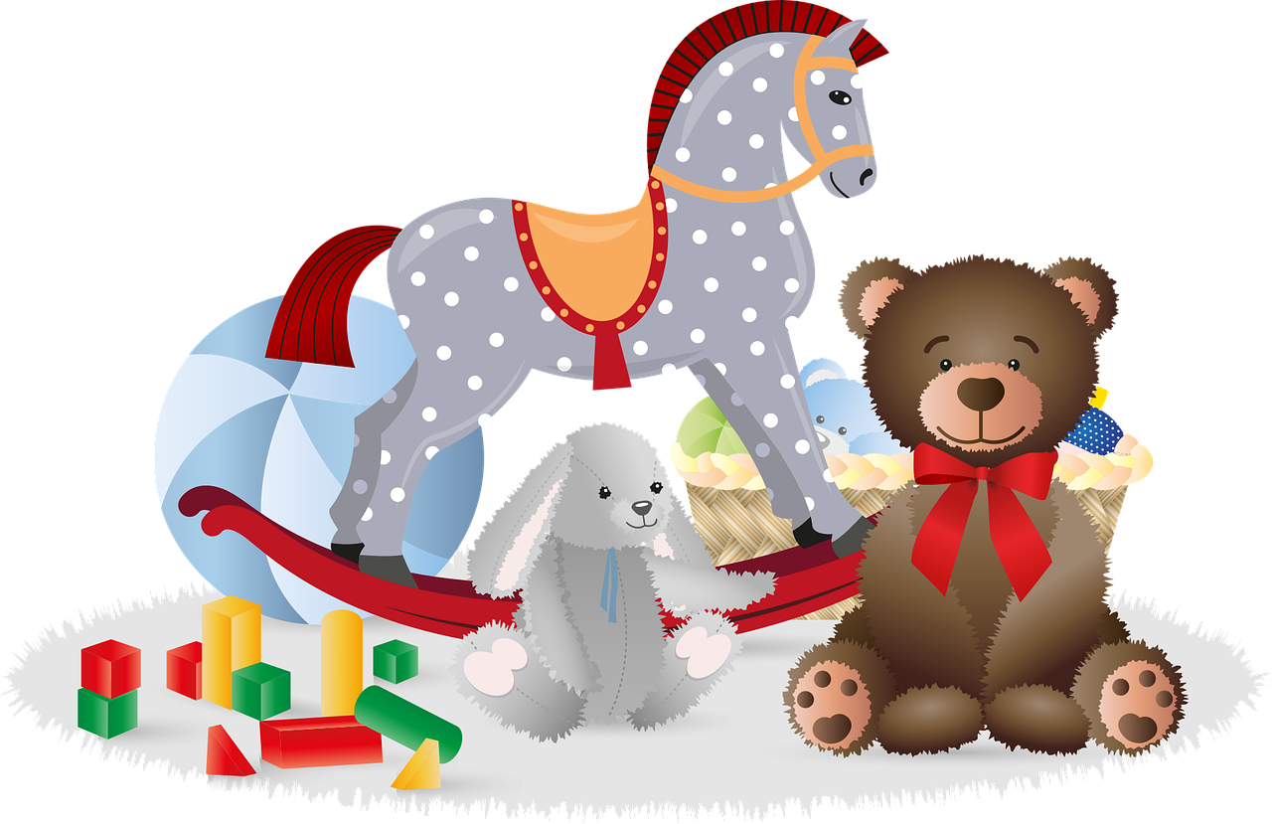


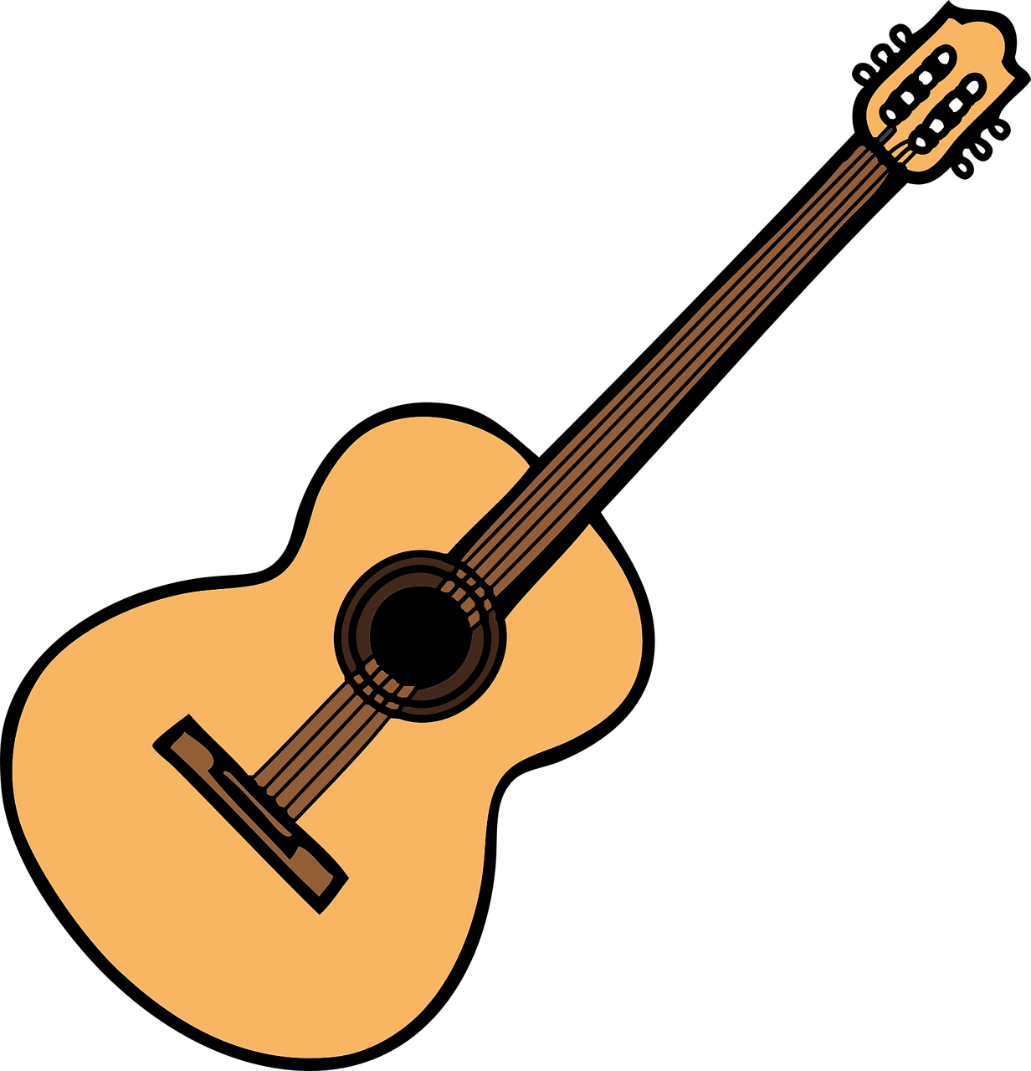

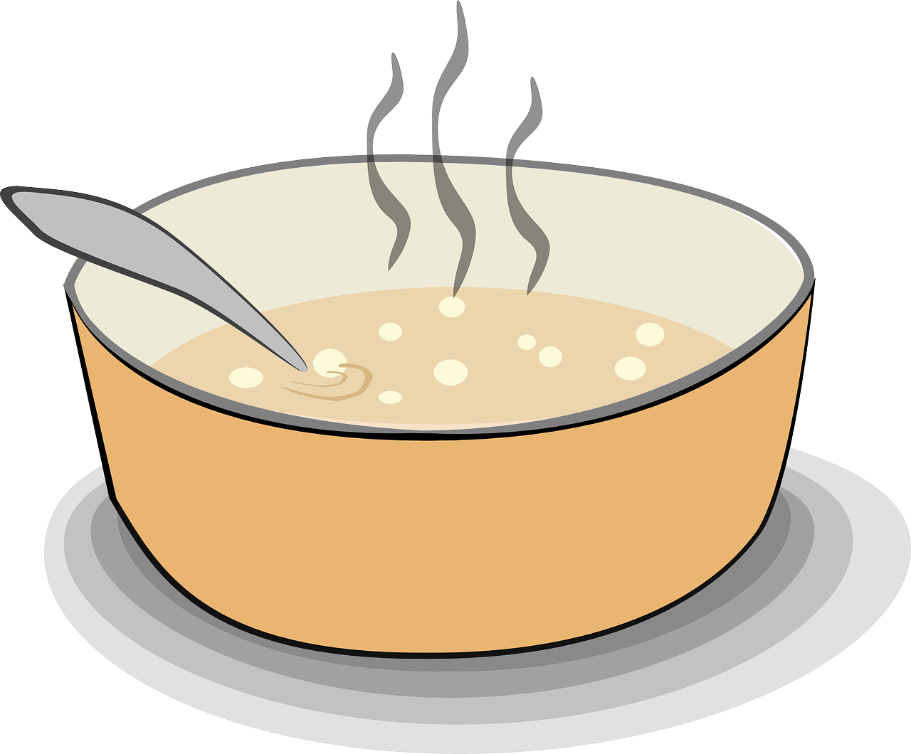

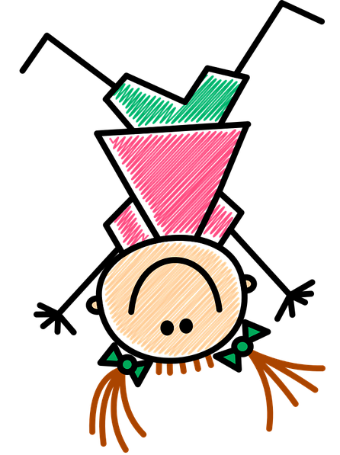





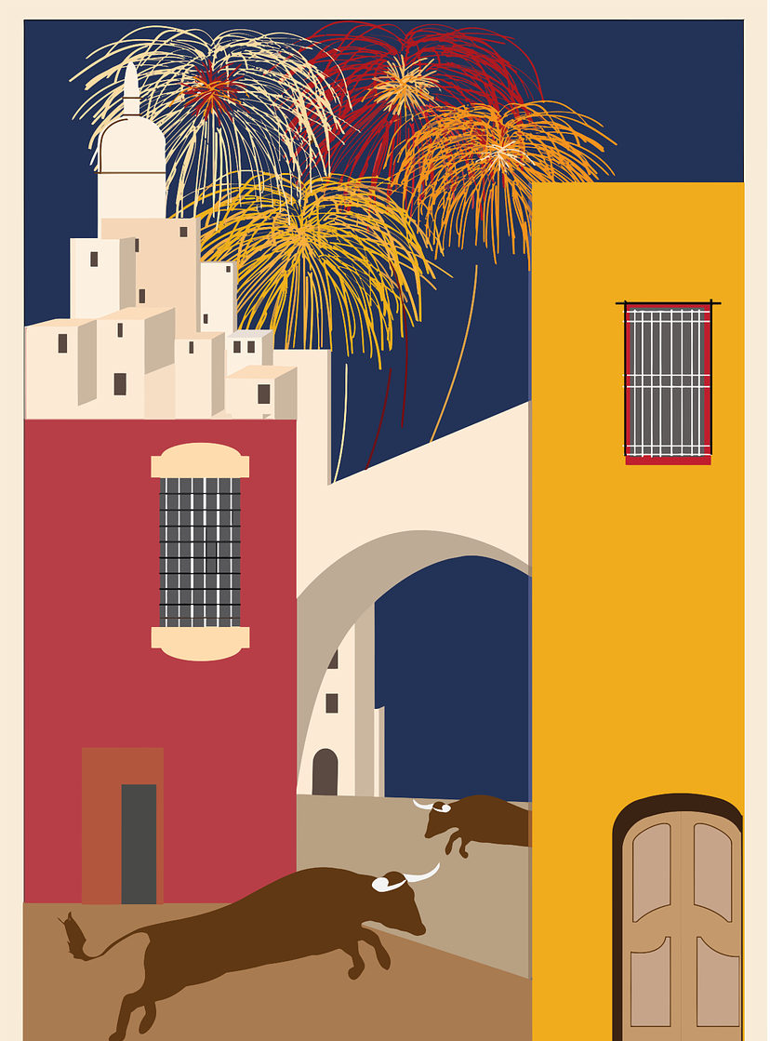
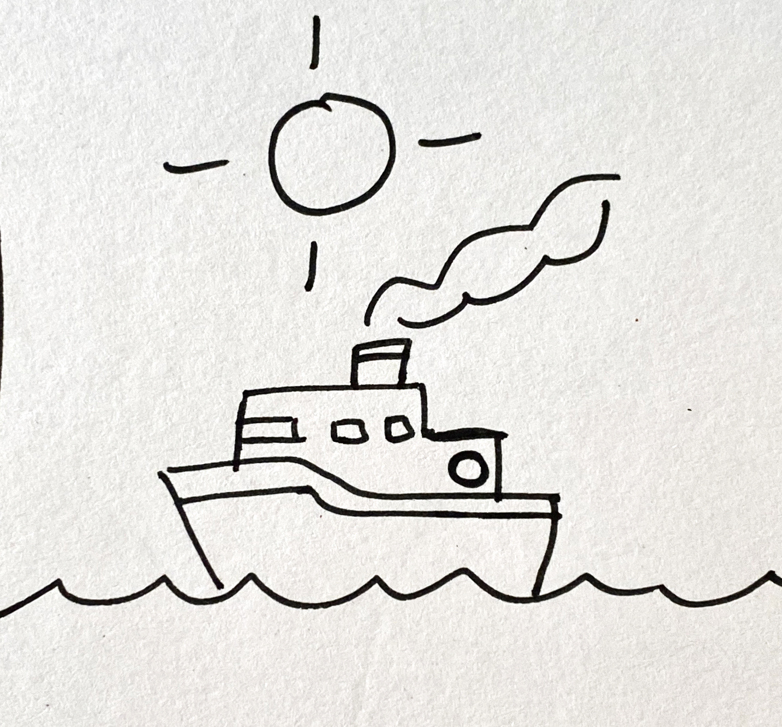

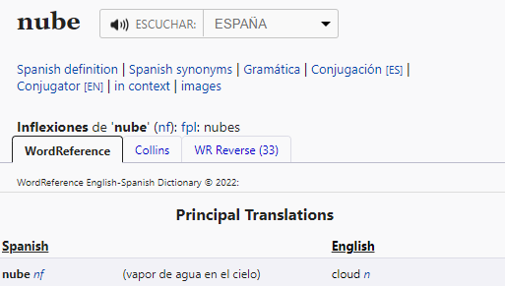
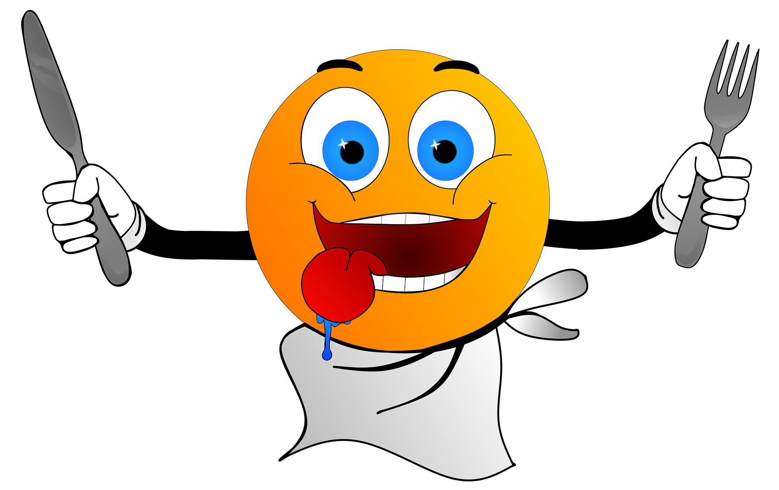




Rojo Knowledge Organiser - Summer Term A
Las cosas
el cielo – sky
el medio - middle
el sol - sun
el conejo - rabbit
la tortuga - tortoise
el grupo - group
el hambre (f)
la razón - reason
la sed - thirst
el año - year
Las personas
él – he
ella - she
tú – you
yo - I
¿Dónde está?
abajo – down, below
arriba – up, above
¿Cómo es?
alto – tall, high
azul – blue
bajo – short, low
gris – grey
amable – kind, nice, friendly
diferente – different
divertido – fun, funny
inteligente - intelligent
muy – very
demasiado – too
y – and
también - also
pero - but
Phonics
[j]
[ga] | [go] | [gu]
ojo
rojo
pájaro
ganar
lago
gusano
[ge]
[gi]
gesto
gemelo
genial
página
colegio
imaginar
[gue]
[gui]
juguete
hoguera
guerra
guitarra
seguir
guiso
➜
[ñ]
[n]
español
niña
pañuelo
mano
nube
novio
El sol arriba
el mar abajo
y, en el medio,
un barco.
Gloria Fuertes es una poetisa de España.
n = noun
Tener (with meaning ‘be’) You know that tener means ‘to have, having’. Tener can also mean ‘to be, being’. Tengo hambre. I am hungry. Tienes sed. You are thirsty. Tiene razón. S/he is right. Also use tener to say age: Tengo nueve años. I am nine years old. | Possessive adjectives (mi, tu) To say ‘my’ before a singular noun use mi. Mi cama es baja. My bed is low. To say ‘your’ before a singular noun use tu. Tu amigo es alto. Your friend is tall. Use mi and tu with masculine AND feminine nouns. | Subject pronouns (yo, tu, él, ella) In Spanish we use pronouns to avoid confusion and make it clear who we are talking about: Él está triste. He is sad. Ella está feliz. She is happy. We can also use pronouns to emphasise a contrast: Yo soy amable pero… tú eres inteligente. I am kind but… you are intelligent.
m = masculine
f = feminine
Using reference materials
www.wordreference.com
All dictionaries have symbols with useful information about the type of word, (e.g., noun, adjective) and noun gender (masculine or feminine).
la nube (the cloud)
una nube (a) cloud
Remember!
Tú (with an accent) means ‘you’.
feminine

Slide 2


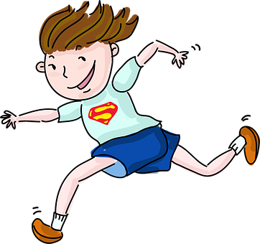
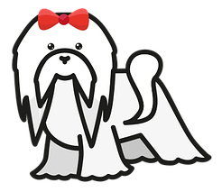

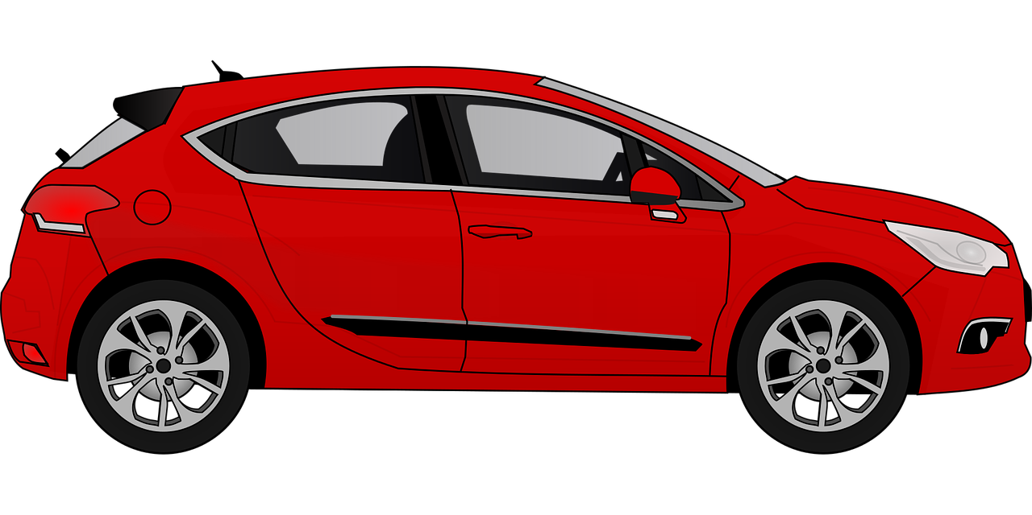

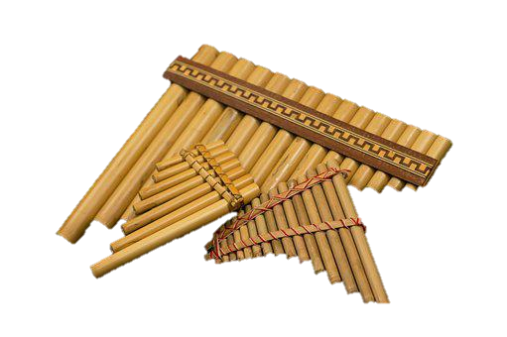
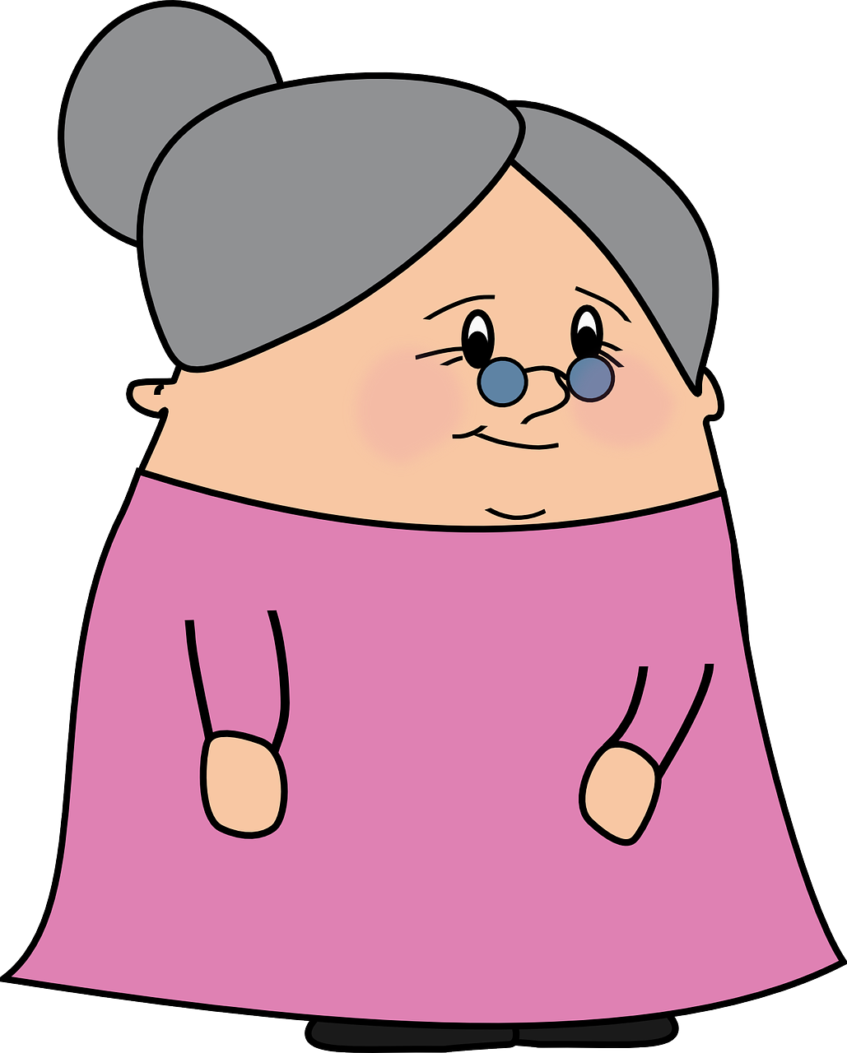


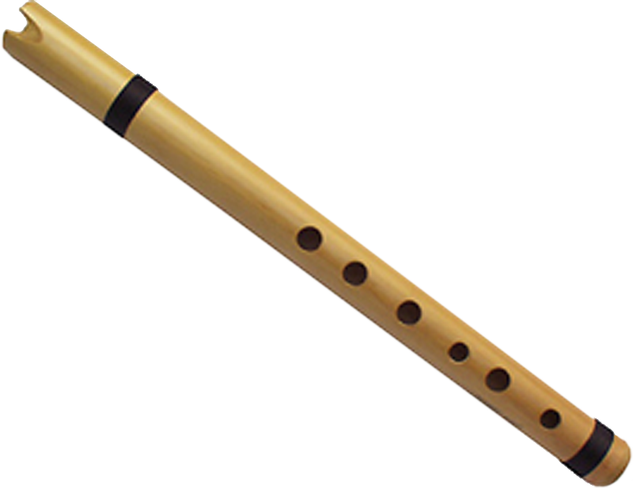



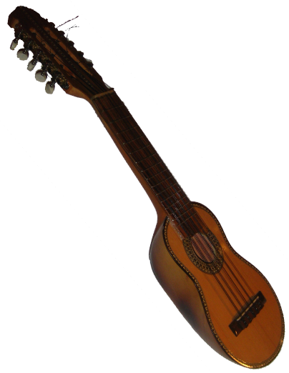
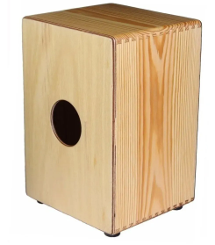


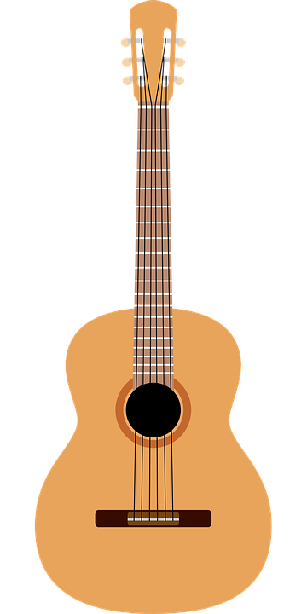
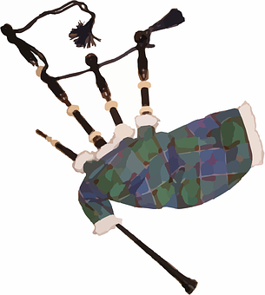

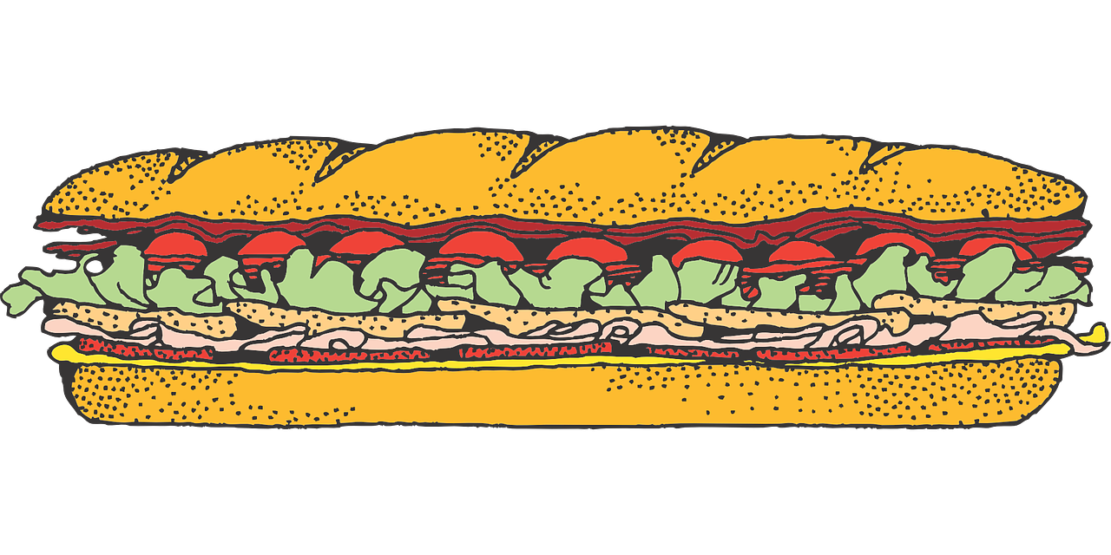


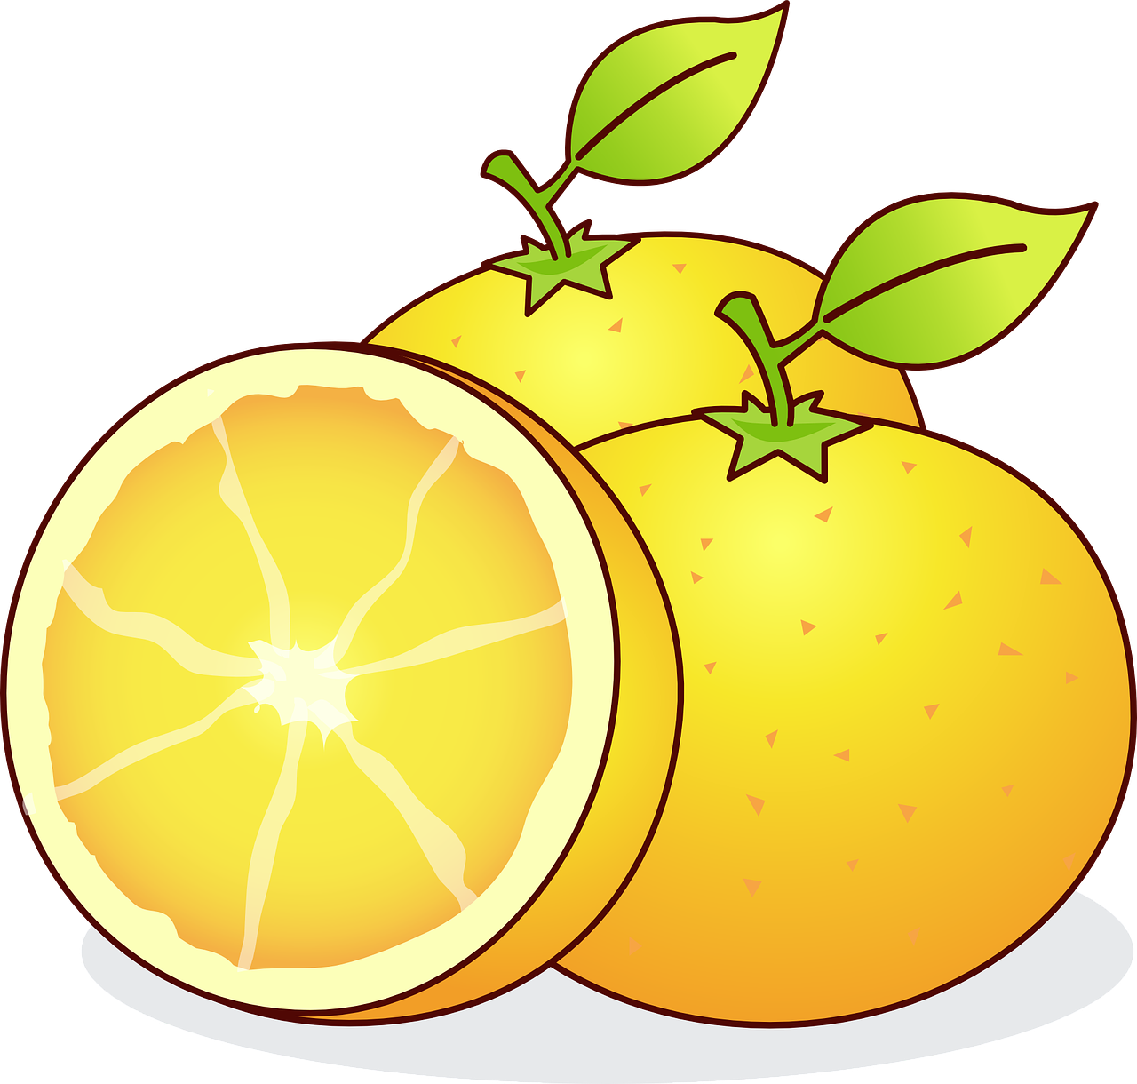

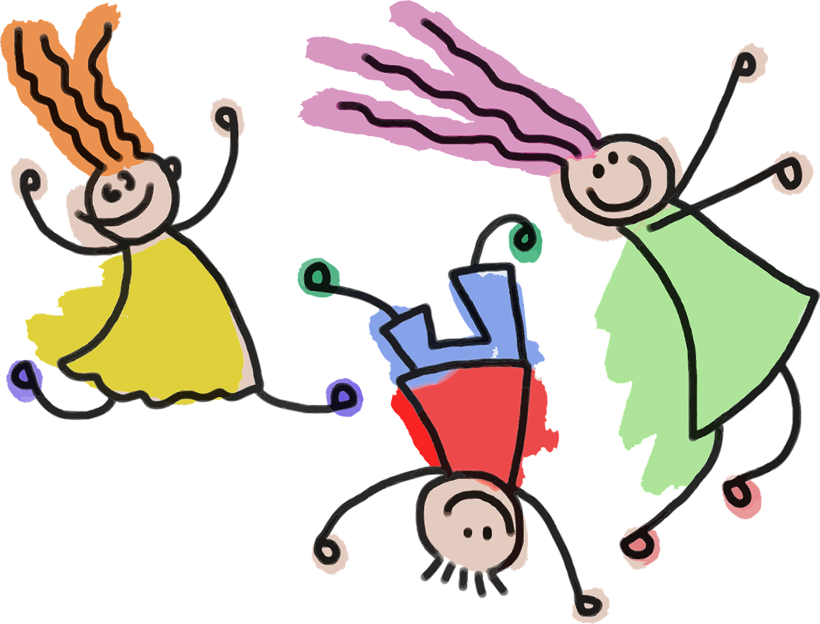

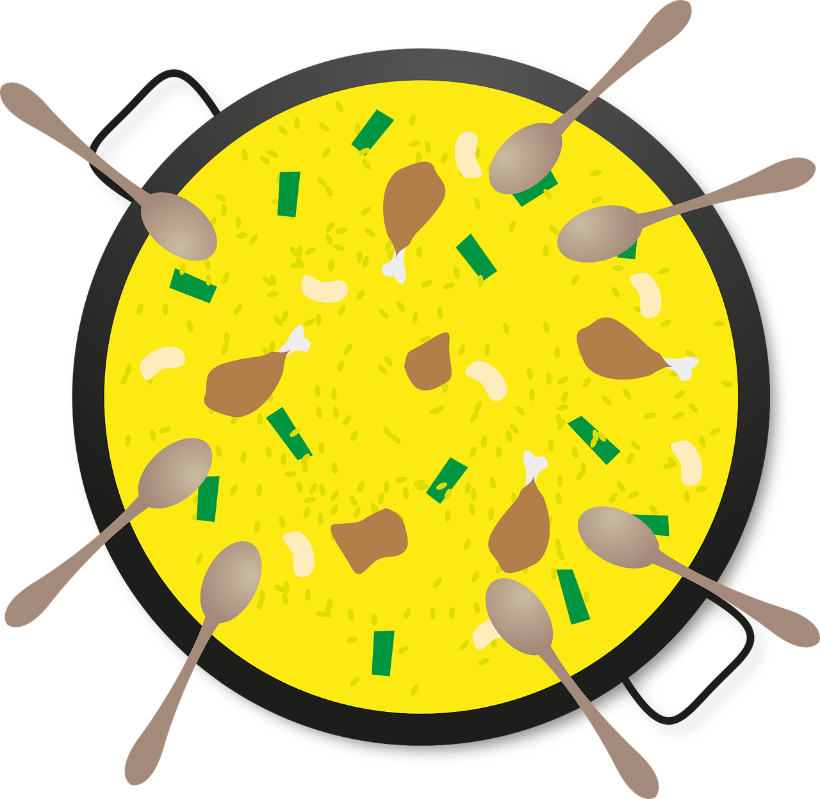
Rojo Knowledge Organiser - Summer Term B
Actividades
amar – to love, loving
comer – to eat, eating
cuidar – to look after, looking after
enseñar – to teach, show
jugar – to play, playing
llevar – to take, bring, wear, carry
odiar – to hate, hating
participar – to participate, participating
practicar – to practise, practising
preparar – to prepare, preparing
después – after(wards)
Las cosas
la canción – song
la comida – food
la guitarra – guitar
el trabajo – work, job
Las personas
el abuelo – grandfather
la abuela - grandmother
el profesor – (male) teacher
la profesora – (female) teacher
el niño – boy, male child
la niña – girl, female child
Phonics
En Perú y España hay unos instrumentos típicos.
¿Amas la música?
[r]
parar
pera
caro
[rr]
correr
perra
carro
la zampoña
[b]
abuela
banco
bolso
la quena
[v]
el charango
ver
vela
viento
[h]
In Latin America carro means ‘car’, in Spain it means ‘cart, trolley’.
el cajón
helado
la guitarra
School assemblies are not very common in Spain but pupils in each year group contribute to the whole school’s end of year show (el festival de fin de curso).
las catañuelas
la gaita
Plural definite articles We use el to mean ‘the’ for masculine and la for feminine singular nouns. To say ‘the’ before a plural noun, use los or las. el grupo – the group los grupos – the groups la tortuga – the tortoise las tortugas – the tortoises | Opinion verbs + articles Use the definite article ‘the’ after opinion verbs (e.g., amar, odiar) Amo los idiomas. I love languages. Odio las mañanas. I hate mornings. | AR-verbs
ER- verbs | Jugar – to play, playing Some verbs, like jugar, do not follow the general rules. juego I play juegas you play juega s/he plays | Personal ‘a’
In Spanish, the verb ending changes to show the person who the verb refers to.
-ER verbs endings are a little different from –AR verbs:
Remember to use ‘a’ after verbs such as ‘ver’ [to see, seeing],‘escuchar’[to listen, listening], and ‘llevar’ if what we see, listen to or take is a person or animal we are fond of. This does not happen in English!
Llevo una tarta.
Como un bocadillo.
‘jug’ changes to ‘jueg’.
I bring a cake.
I eat a sandwich.
Llevas unos globos.
Comes fruta.
Use the same endings as for –AR verbs.
You bring some balloons.
You eat fruit.
Veo a un amigo.
In English, we often don’t use the article with opinion verbs:
e.g. I love languages.
I see a friend.
Lleva un sombrero.
Come comida espaola.
Lleva a la niña.
S/he brings a hat.
S/he eats Spanish food.
S/he brings/takes the girl.

