Slide 1
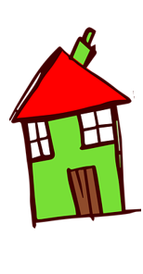
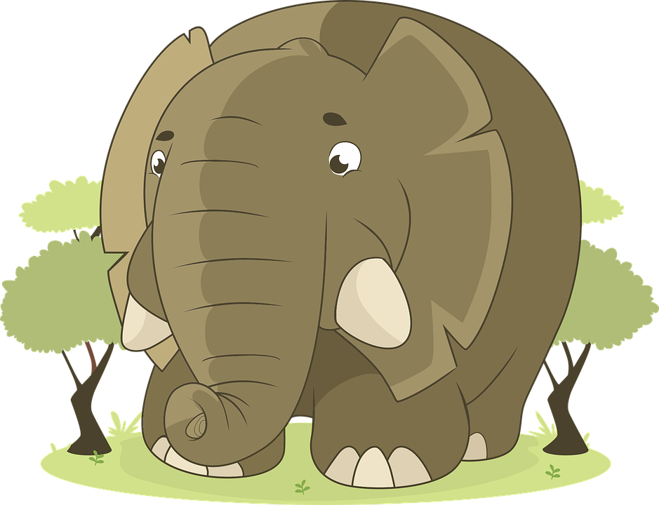
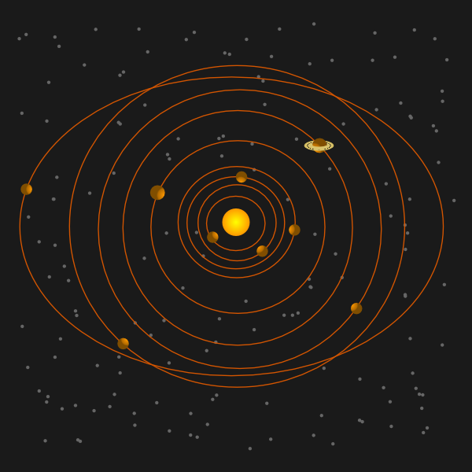
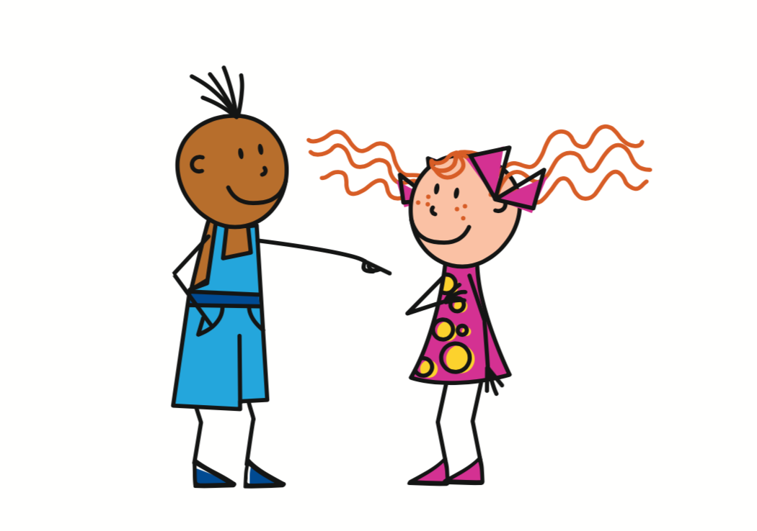
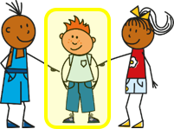
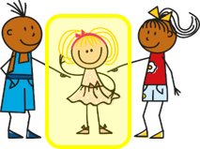
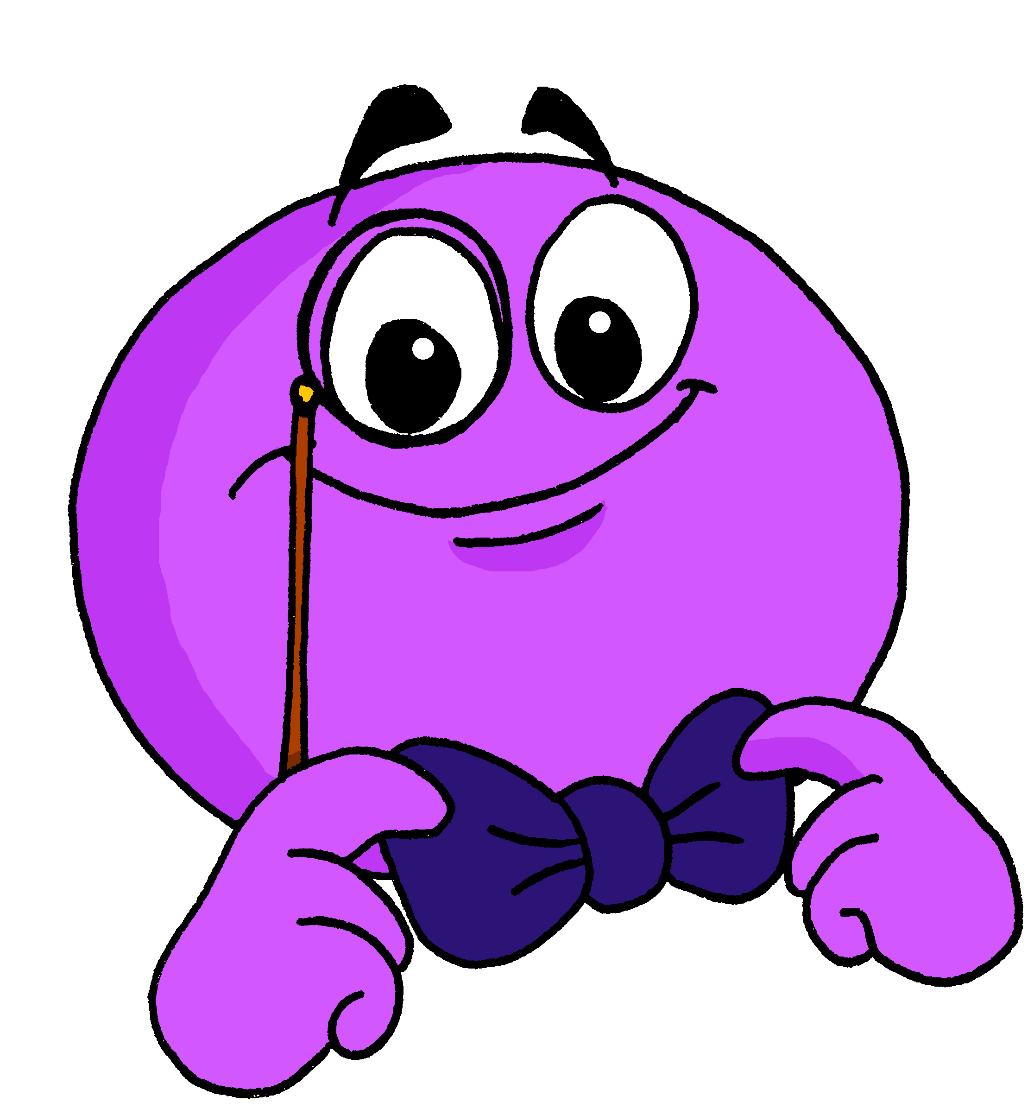
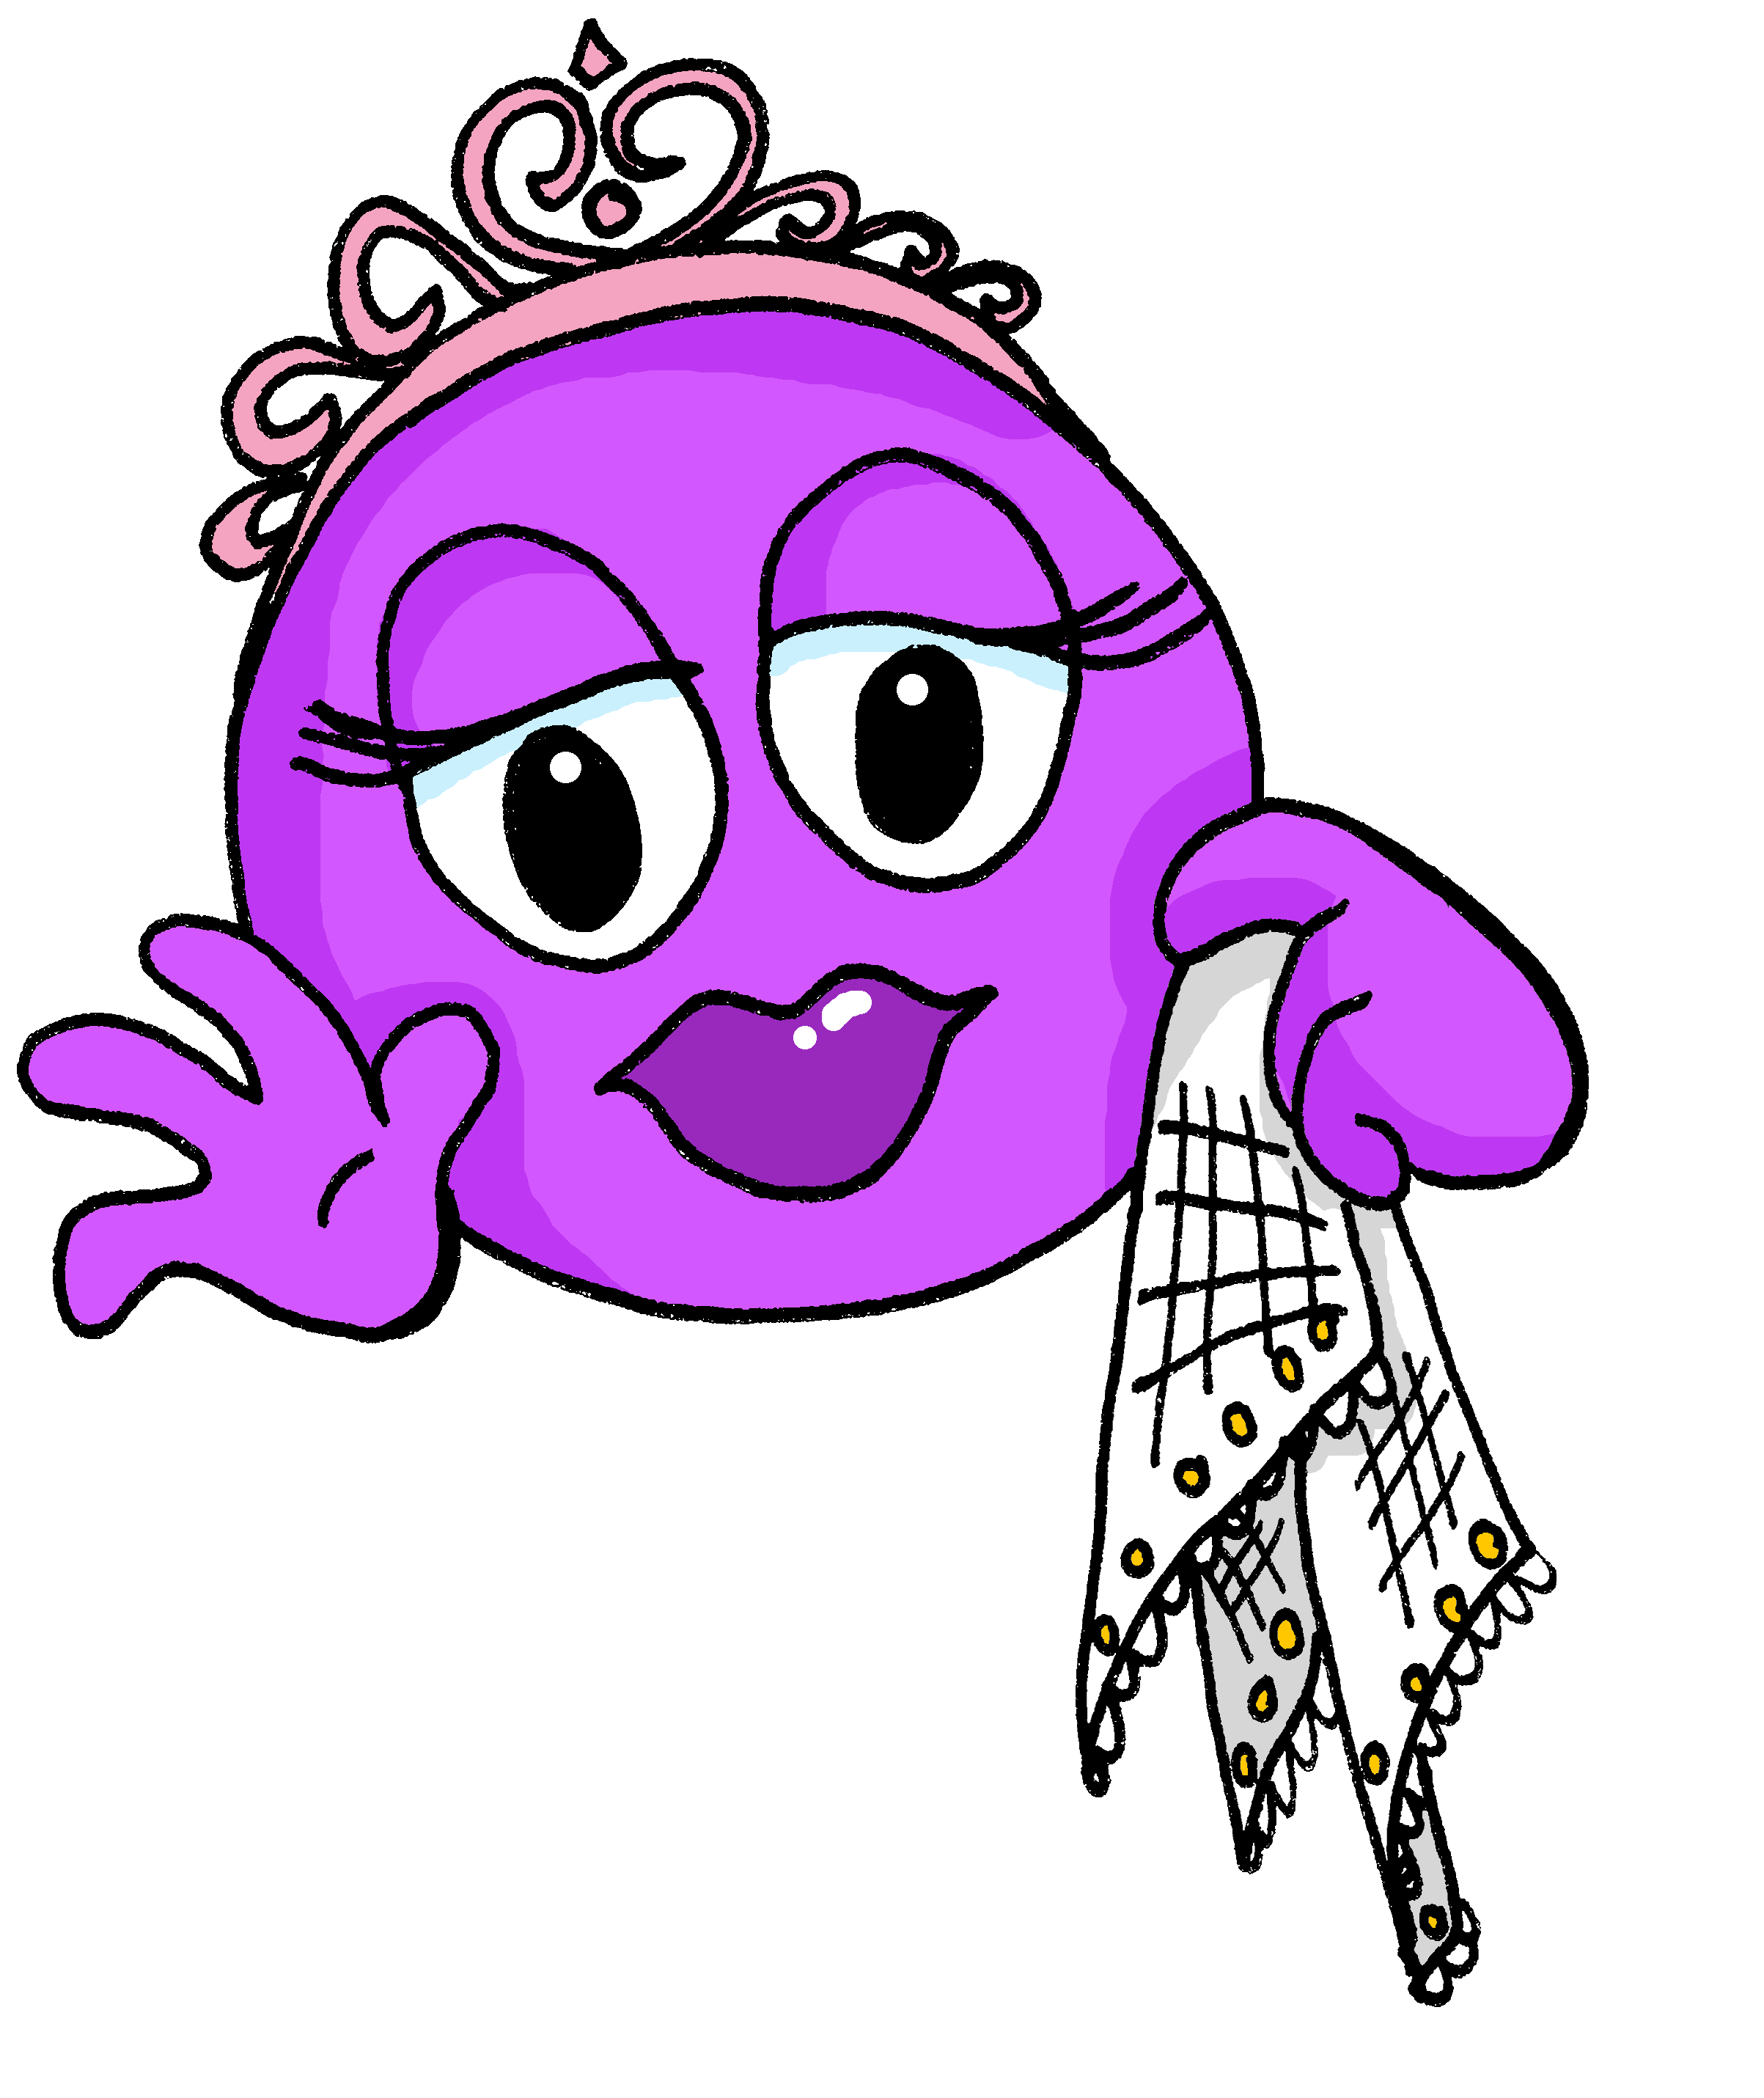
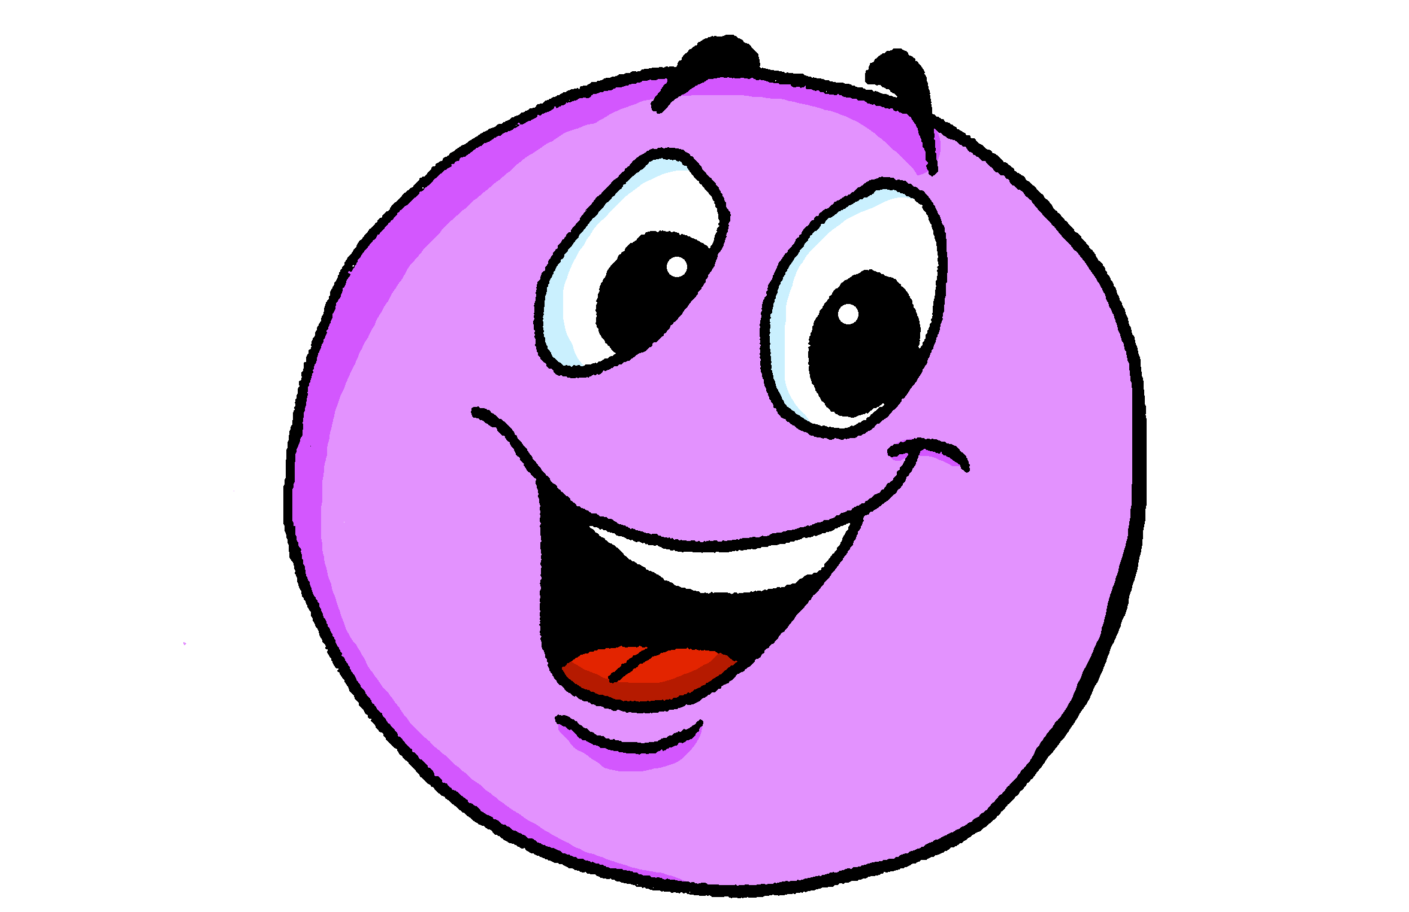
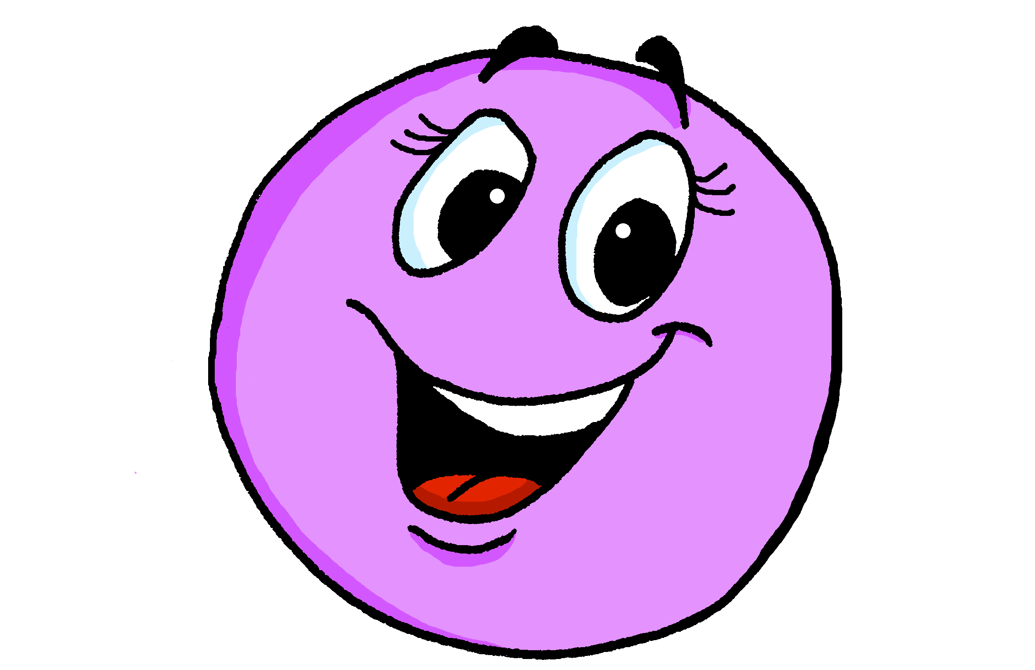
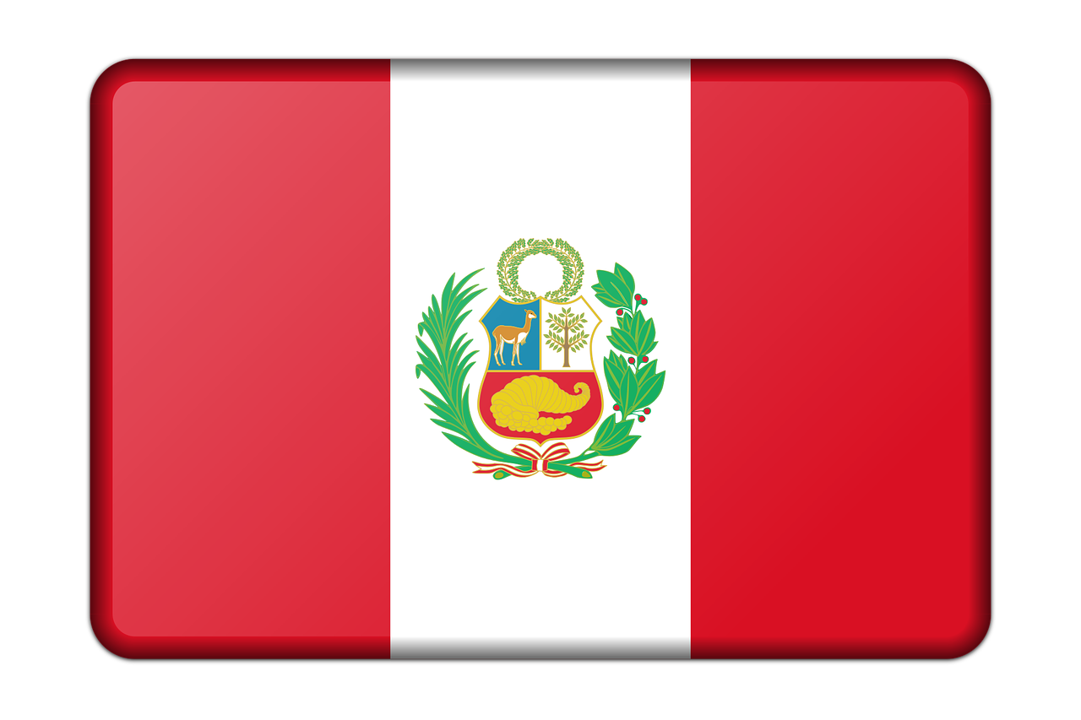
Rojo Knowledge Organiser - Autumn Term A
En clase (In class)
estar – to be | being (location, state)
estoy – I am
estás – you are
está – s/he, it is
presente – present
ausente – absent
aquí – here
allí – there
¡Hola! - hello
¡Buenos días! – good morning
¡Buenas tardes! – good afternoon
hoy – today
ahora – now
siempre – always
normalmente – usually
¿cómo? – how?
¿dónde? – where?
¿qué? – what?
en – in
de – from
sí – yes
no - no
Inglaterra - England
España - Spain
Perú - Peru
La descripción
ser – to be | being (trait)
soy – I am
eres – you are
es – s/he, it is
cansado, cansada – tired (m), tired (f)
contento, contenta – pleased (m), (f)
triste – sad (m, f)
curioso, curiosa – curious (m), curious (f)
elegante - smart (m, f)
feliz – happy (m, f)
lento, lenta – slow (m), slow (f)
nervioso, nerviosa – nervous (m), (f)
rápido, rápida – fast (m), fast (f)
serio, seria – serious (m), serious (f)
tranquilo, tranquila - calm
(un) día – (a) day
lunes – Monday
martes – Tuesday
miércoles – Wednesday
jueves – Thursday
viernes - Friday
sábado – Saturday
domingo - Sunday
Phonics
[a] | [o] | [u] | [e] | [i]
casa
dos
universo
elefante
idea
[ca] [co] [cu]
cama
contar
cucaracha
Describing location and state with the verb estar | Adjective agreement for gender | Asking yes/no questions
Describing permanent traits with the verb ser | More adjective patterns | Asking WH-questions
Change a statement into a question by raising your voice at the end.
estás
In Spanish, adjectives ending in –o change to –a to describe feminine nouns. People are nouns, too.
estoy
you are
está
I am
s/he, it is
Estás en España.
You are in Spain.
estar
➜
¿Estás en España?
Está contento.
Are you in Spain?
to be|being
He is pleased.
Está contenta.
In writing, add a ¿ at the start of a question in Spanish as well as a ? at the end.
She is pleased.
Adjectives already ending in –e or –z stay the same:
To ask information questions, begin with question word and raise your voice at the end.
eres
es
Es elegante.
soy
you are
He is smart.
I am
s/he, it is
Es elegante.
¿Cómo estás?
ser
She is smart.
How are you?
Es feliz.
¿Dónde estás?
to be|being
Where are you?
He is happy.
Es feliz.
¿Cómo eres?
She is happy.
What are you like?

Slide 2
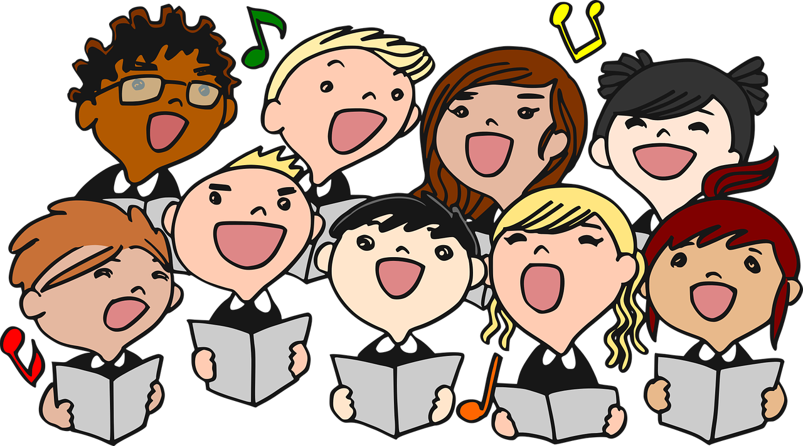
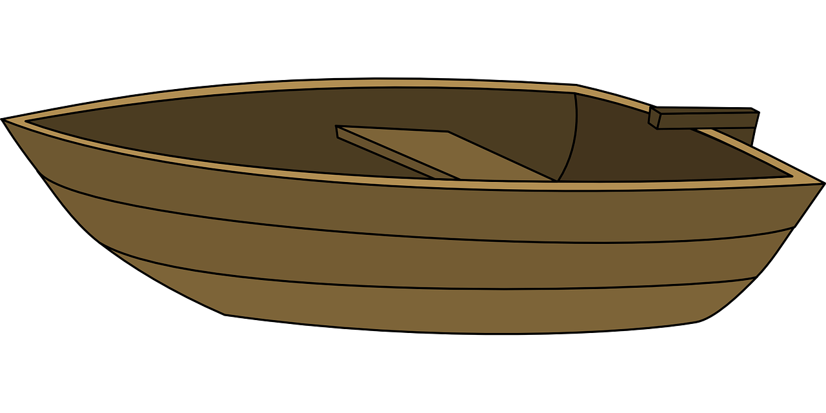
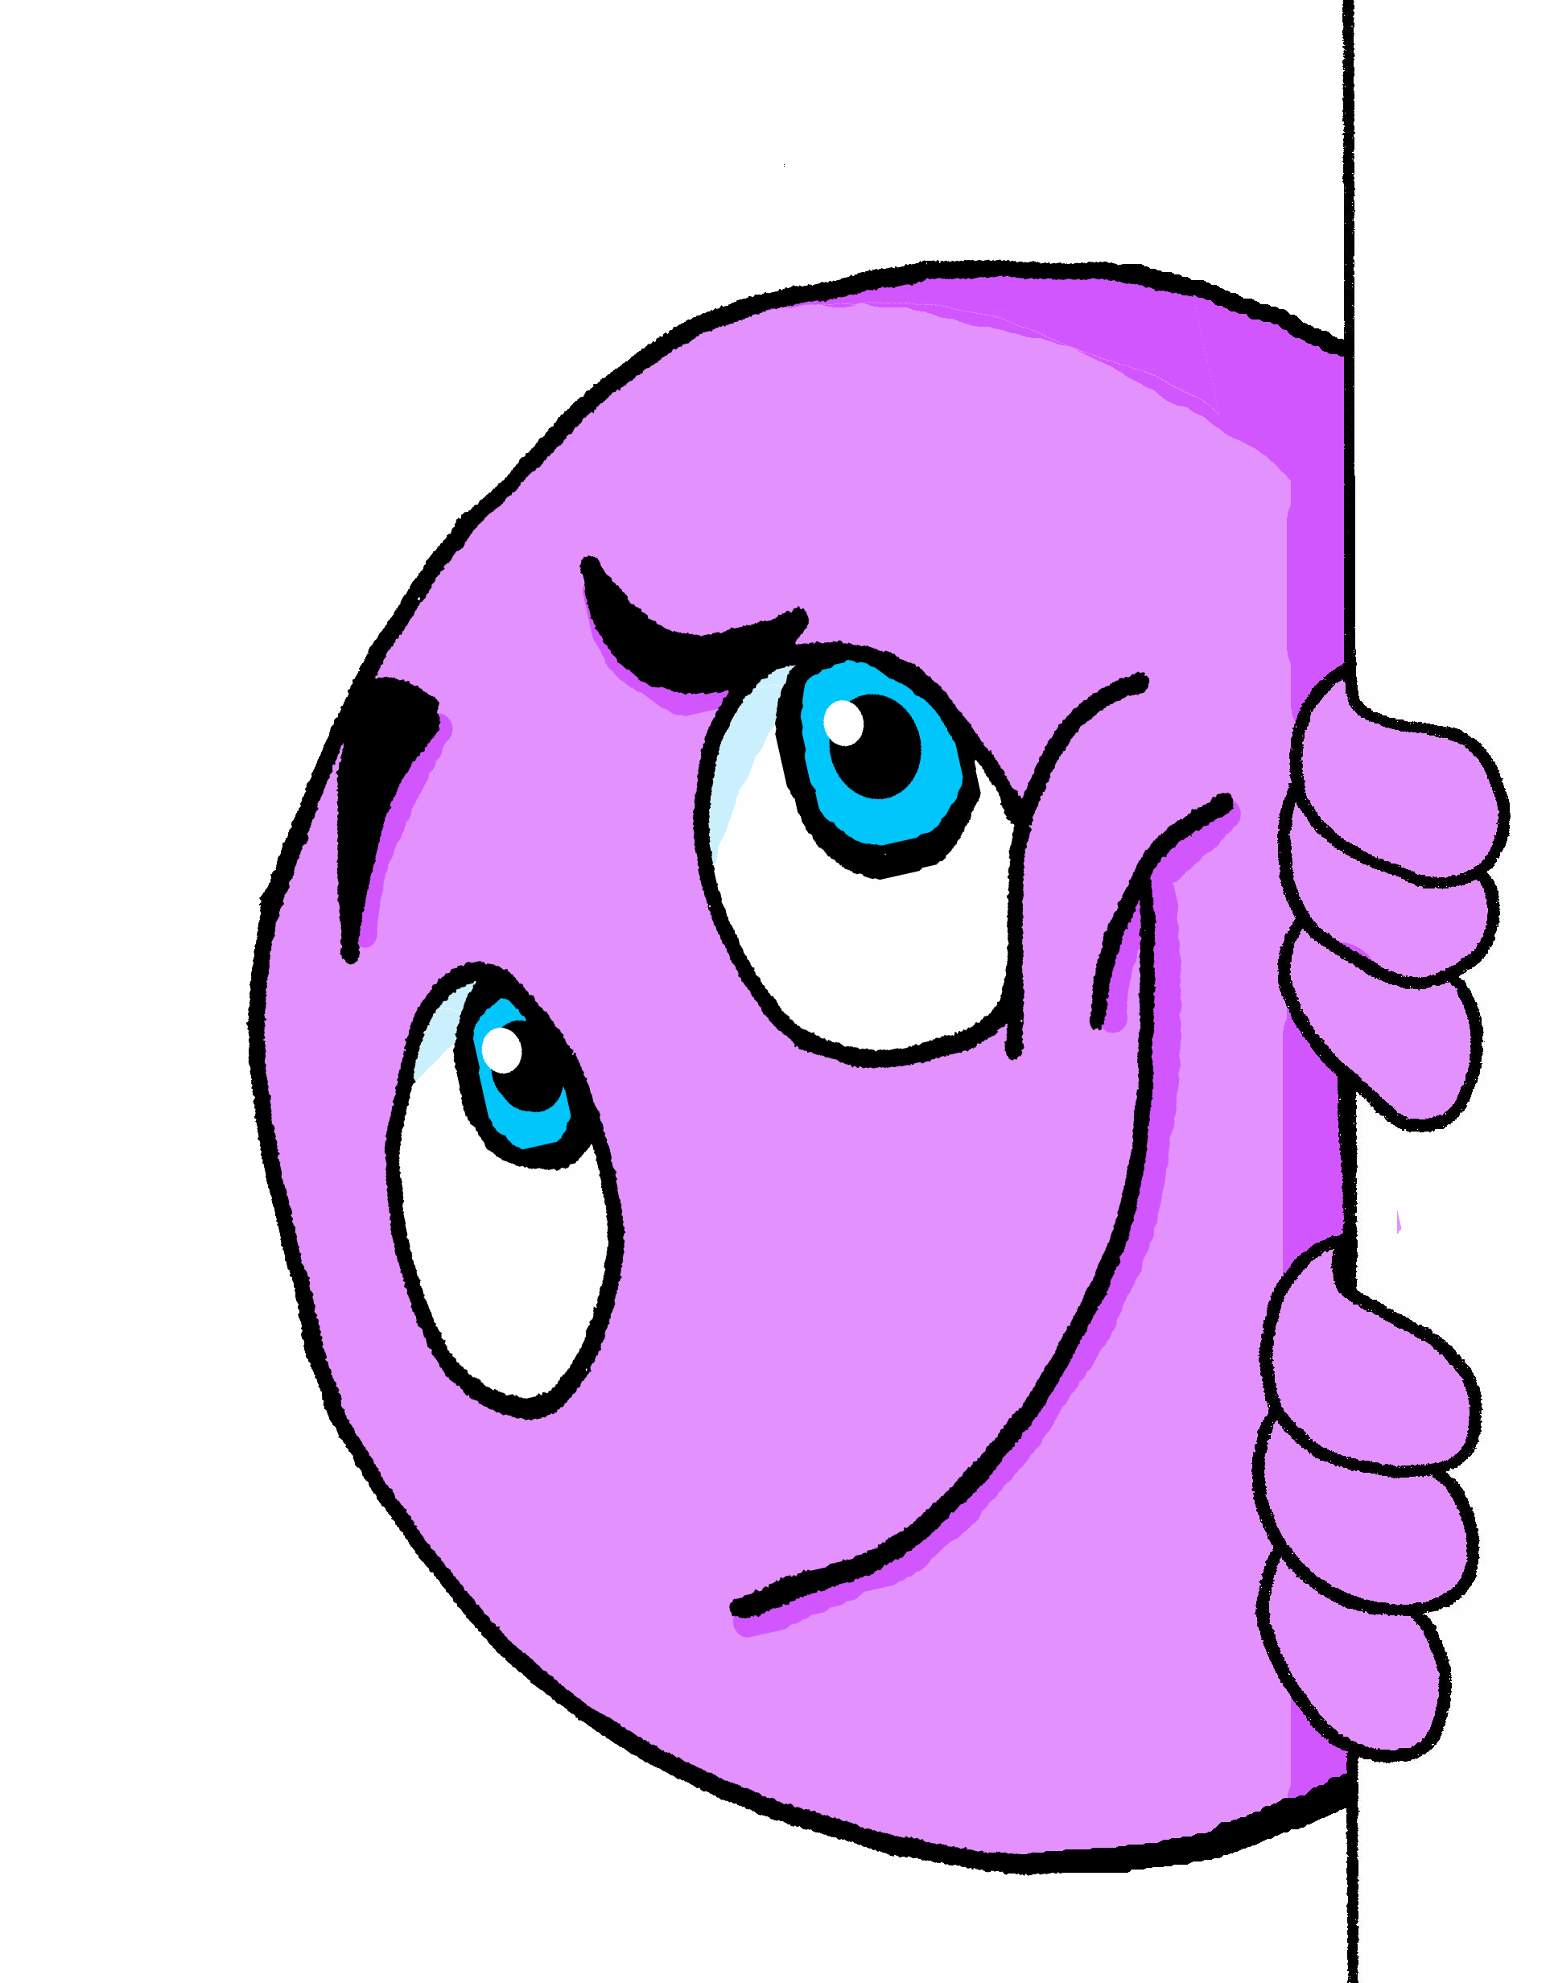
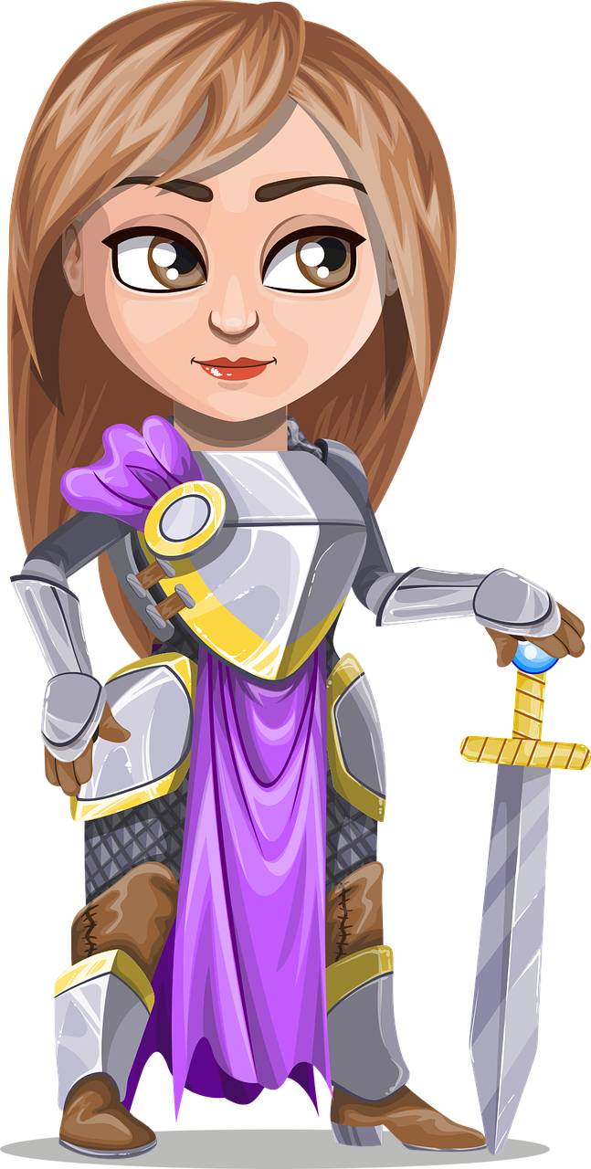
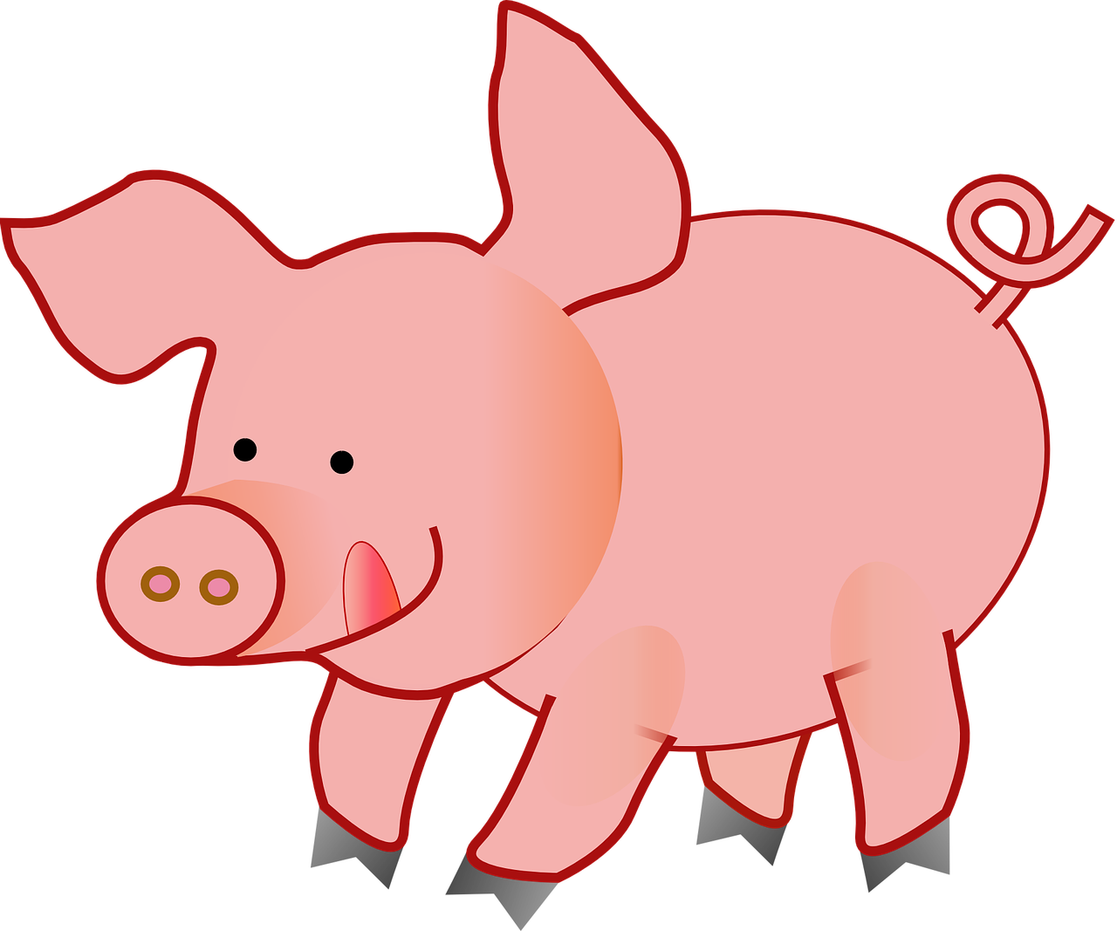
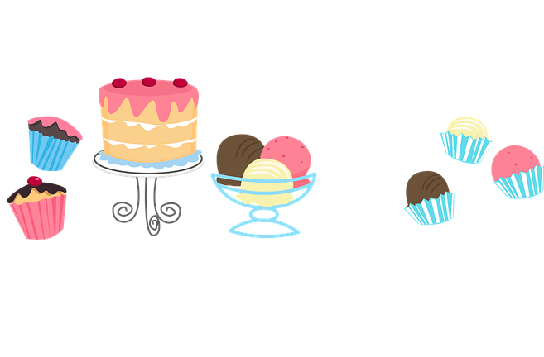
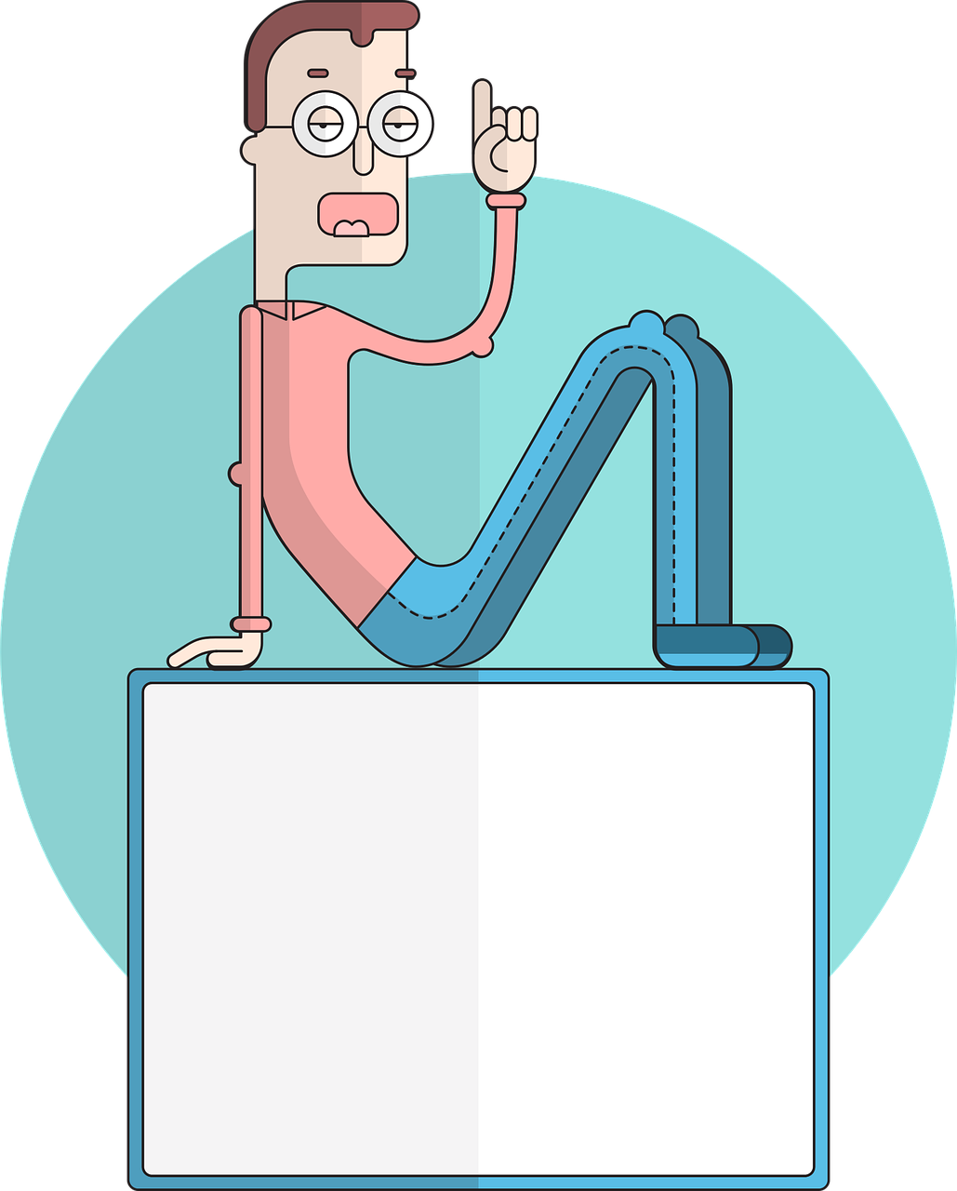
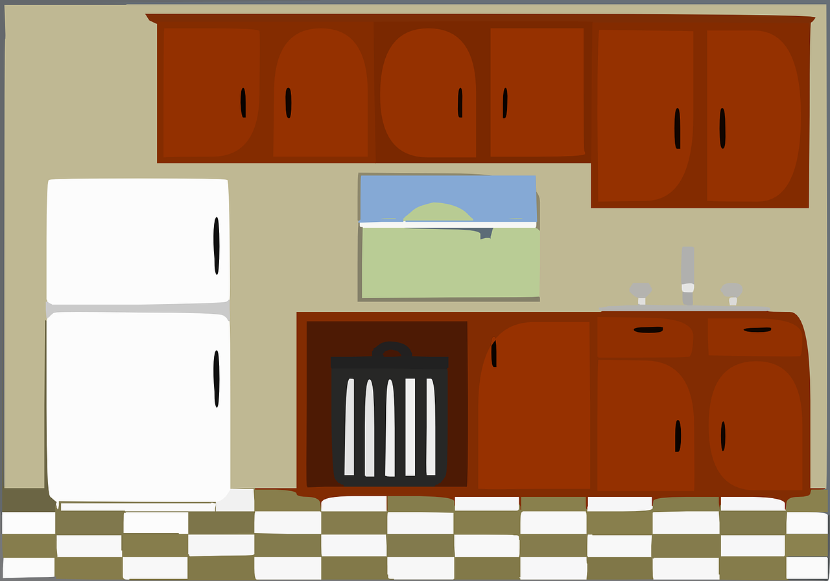
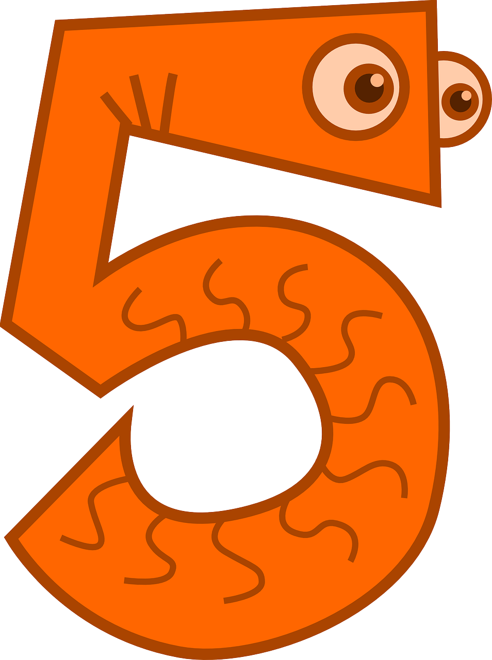
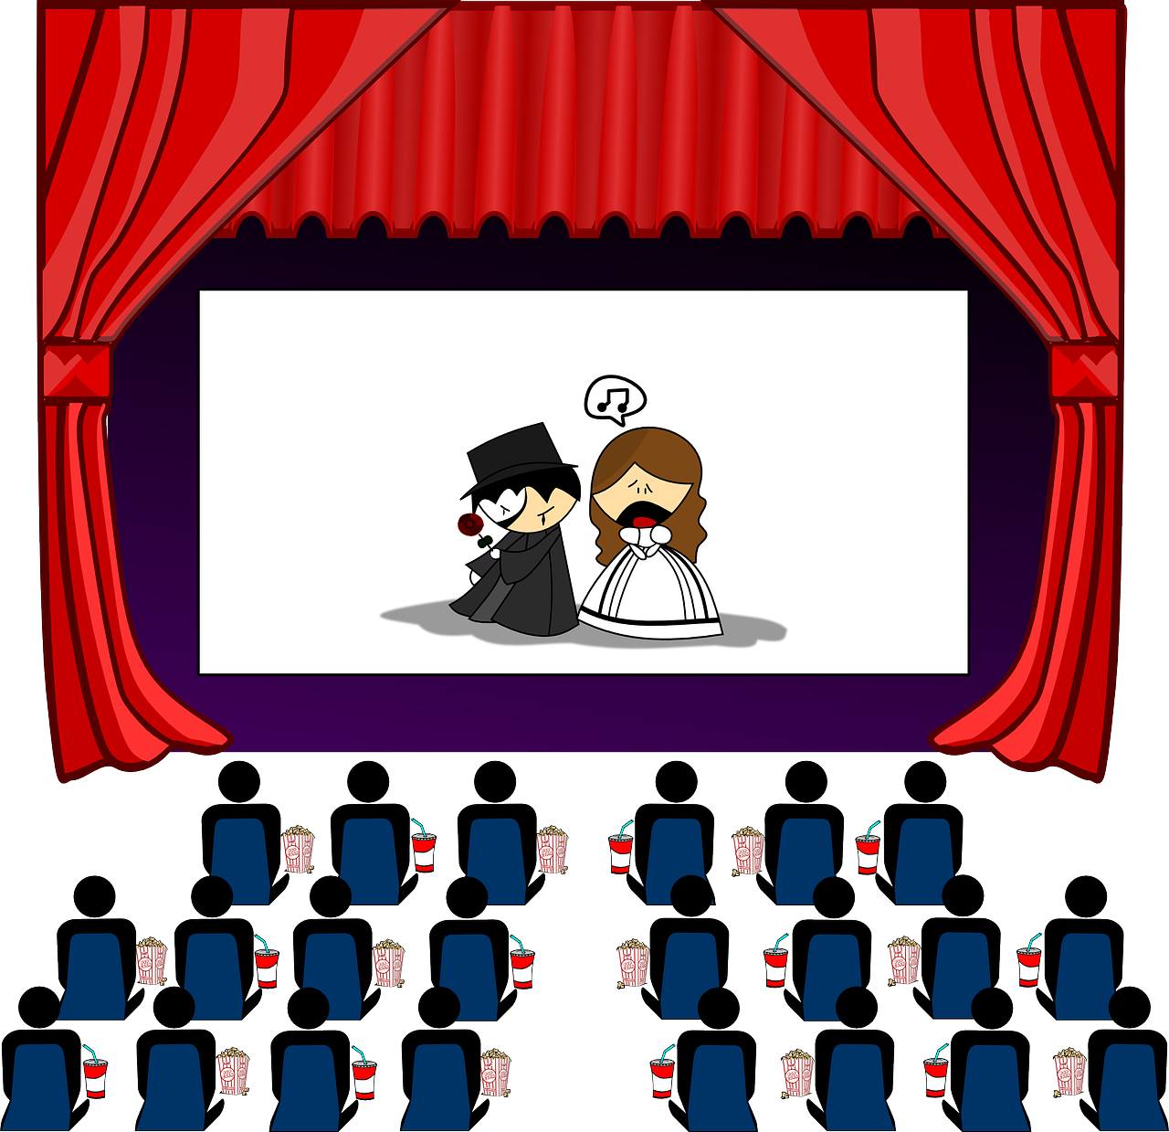
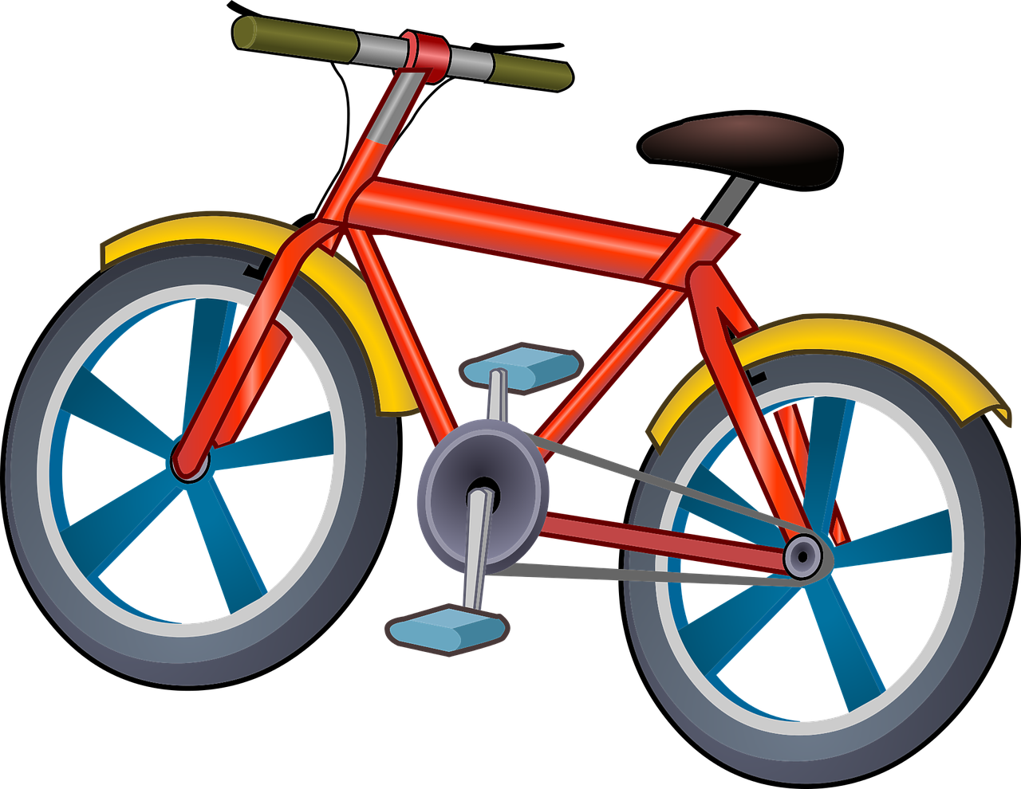
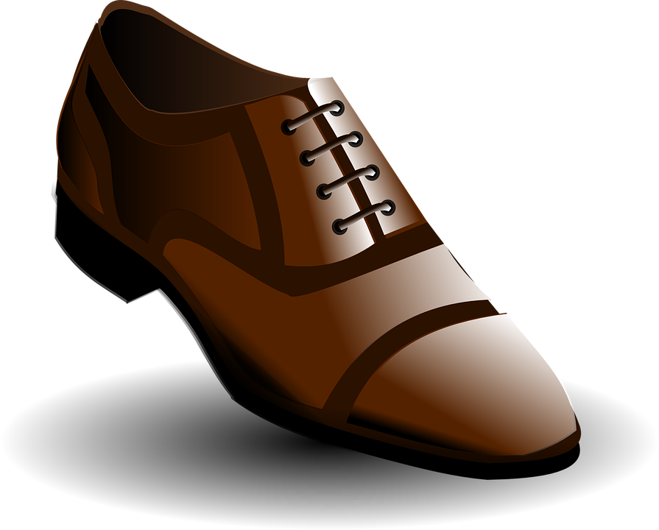
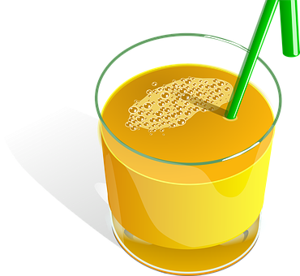
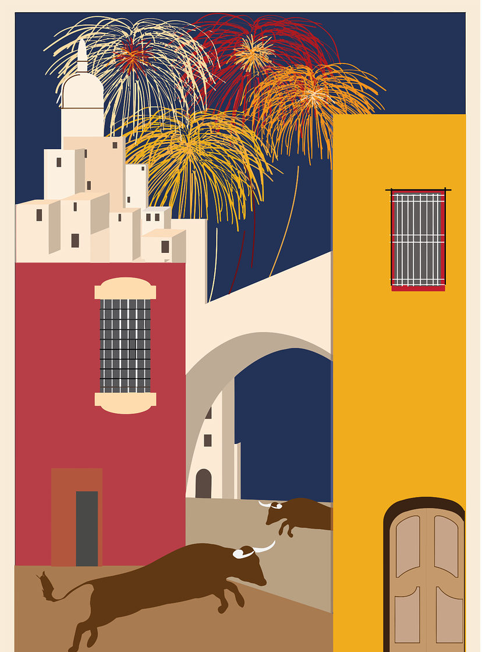
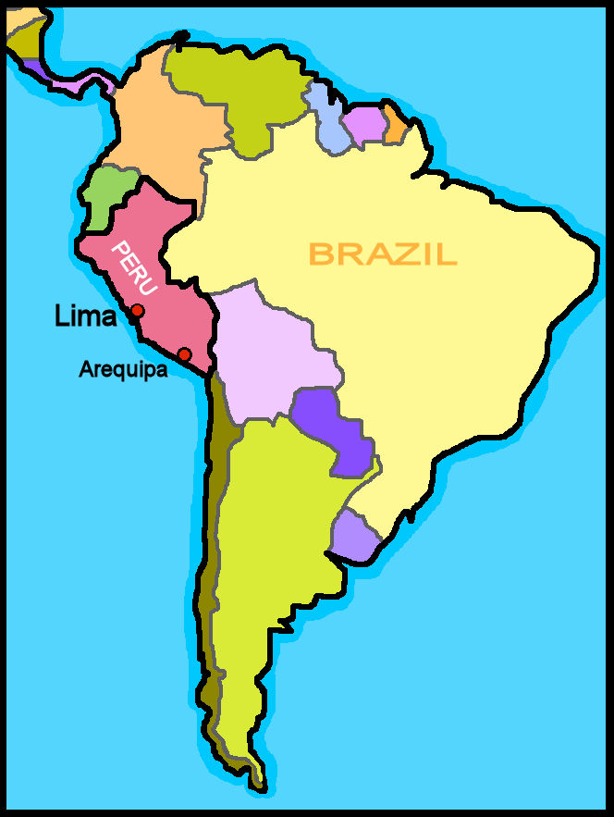
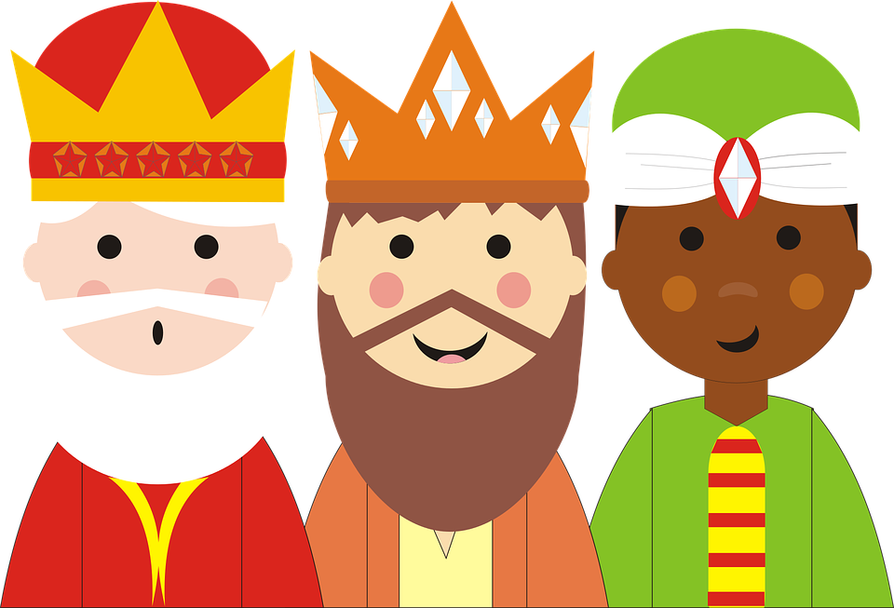
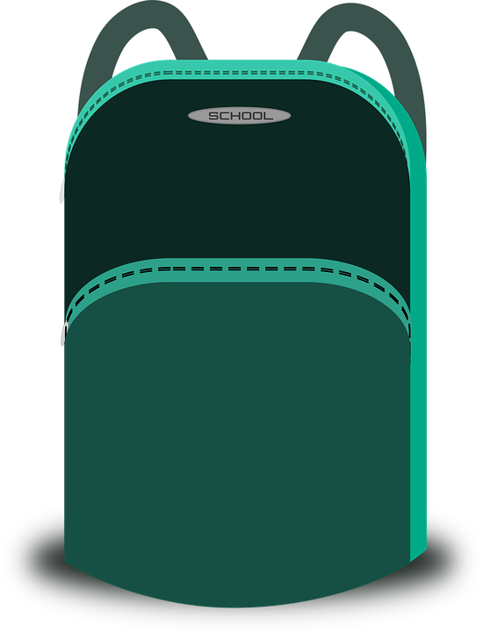
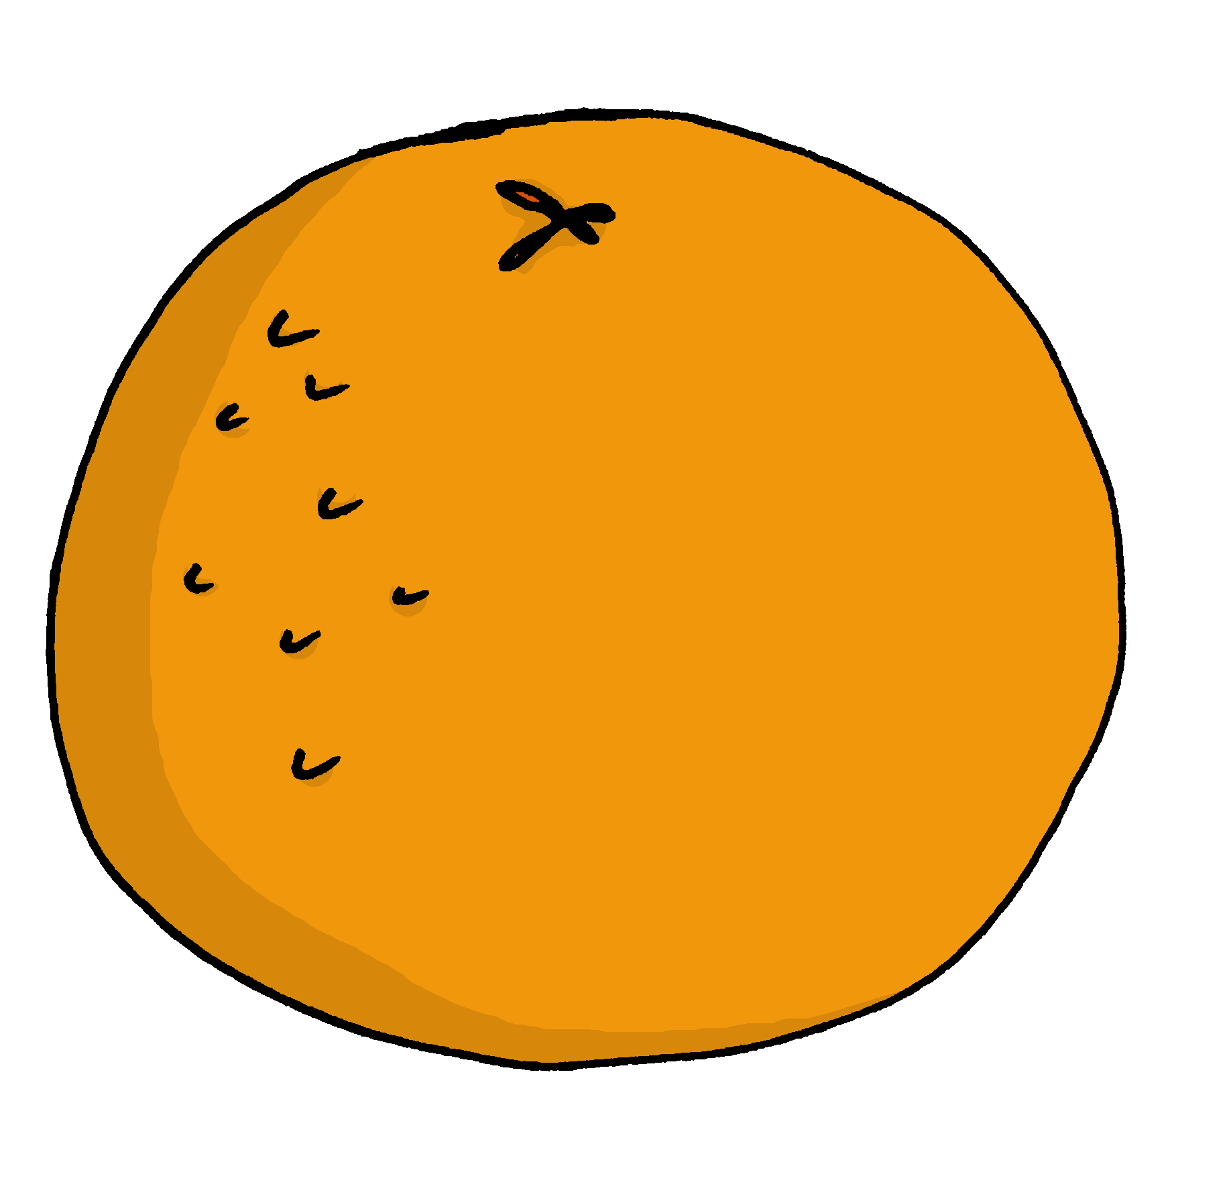
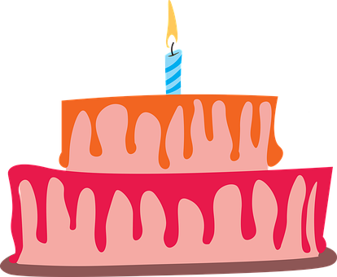
Rojo Knowledge Organiser - Autumn Term B
En clase (in class)
tener – to have|having
tengo – I have
tienes – you have
tiene – s/he, it has
un, una – a/an (m), a/an (f)
bolígrafo (m) – pen
botella (f) – bottle
cámara (f) – camera
cuaderno (m) – exercise book
estuche (m) – pencil case
fruta (f) – fruit
libro (m) – book
mochila (f) – school bag
pregunta (f) – question
respuesta (f) – answer
sacapuntas (m) – sharpener
En casa (at home)
amigo (m) – friend (m)
amiga (f) – friend (f)
bicicleta (f) – bicycle
cama (f) – bed
familiar (m,f) – relative (m, f)
gato (m) – cat (m)
globo (m) – balloon
regalo (m) – present
pelota (f) – ball
silla (f) – chair
tarta (f) – cake
teléfono (m) – phone
amarillo, amarilla - yellow
bonito, bonita - pretty
pequeño, pequeña - small
rojo, roja - red
Phonics
[ca]
cama
cantar
música
boca
cansado
[co]
contar
barco
con
correcto
un poco
[to count]
[cu]
cucaracha
escuchar
cultura
curioso
escuela
[ci]
centro
princesa
cerdo
celebrar
dulce
decir
[ci]
[to say, tell]
cocina
cinco
cine
bici
[z]
zapato
manzana
brazo
zona
zumo
In Spain, [z] and [c] (before e and i)sound like [th] in English. In Latin America [z] and [c] (before e and i)sound like [s].
Gender of nouns In Spanish, things, as well as people and animals, are either masculine or feminine. We say that they have gender. This is grammatical, not biological gender! A school bag (una mochila) is not female, it is a feminine noun. | Indefinite articles – ‘a’ To say a (or an) in Spanish use un before a masculine noun and una before a feminine noun. un libro una fruta | Saying what people have with the verb tener
Asking yes/no questions | Adjectives after the noun In Spanish, many adjectives follow the noun: un regalo pequeño a small present una tarta bonita a pretty cake | Los tres Reyes Magos
Change a statement into a question by raising your voice at the end.
In Spain on the evening of 5th January, the three kings parade through the streets. It is a very happy, colourful celebration.
tengo
tienes
you have
tiene
I have
s/he, it has
tener
Tiene un boli.
People also eat Roscón de Reyes.
to have|having
He has a pen.
➜
➜
¿Tiene un boli?
Children receive presents on 6th January.
➜
Does he have a pen?

