Slide 1
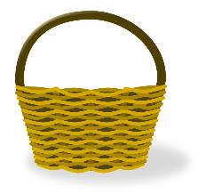
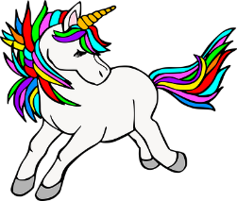
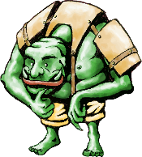
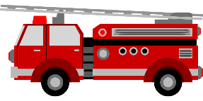
¡Feliz Navidad!
¡Feliz Navidad!
Listen and fill the gaps with the correct letter or letters.
Listen and fill the gaps with the correct letter or letters.
 | Palabras
1 | __ mada
2 | __ nzo
3 | __ __ ncha
4 | __ __ ntia
5 | __ rina
6 | __ ara
7 | __ riol
8 | __ __ ta
9 | __ ma
10 | __ __ sar
 | Palabras
1 | __ mada
2 | __ nzo
3 | __ __ ncha
4 | __ __ ntia
5 | __ rina
6 | __ ara
7 | __ riol
8 | __ __ ta
9 | __ ma
10 | __ __ sar
una cesta
un imán
una cesta
un imán
un cisne
un zafiro
un cisne
un zafiro
un unicornio
un ogro
un unicornio
un ogro
un camión
un avión
un camión
un avión
un enano
una cometa
un enano
una cometa
Read aloud the Spanish name and the Christmas present with the same initial sound. You have not learnt these words so use what you know about how to pronounce Spanish.
Read aloud the Spanish name and the Christmas present with the same initial sound. You have not learnt these words so use what you know about how to pronounce Spanish.

