Slide 1
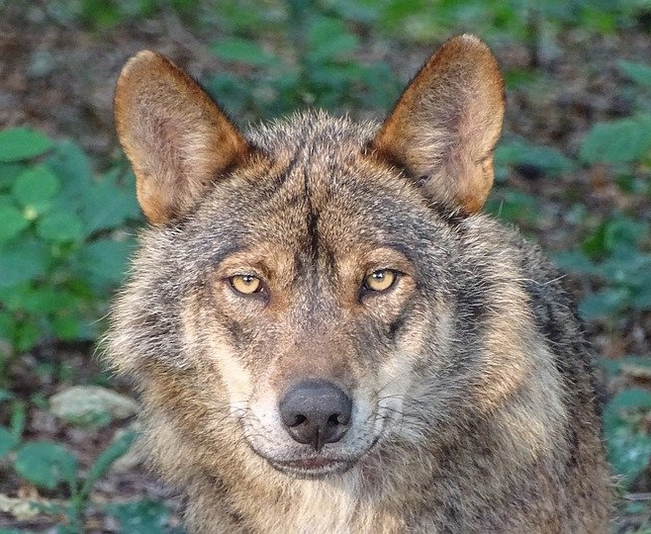
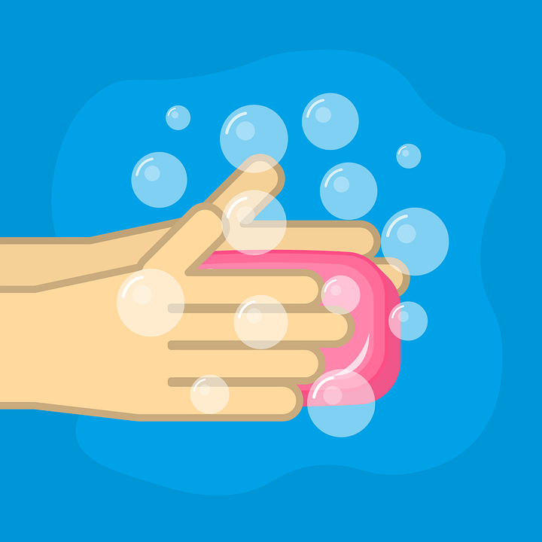
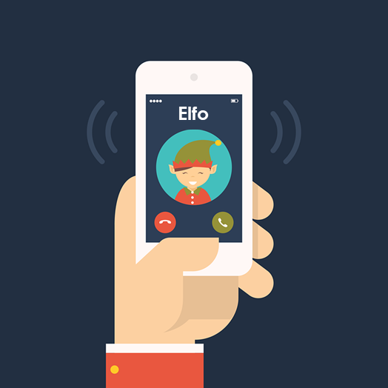
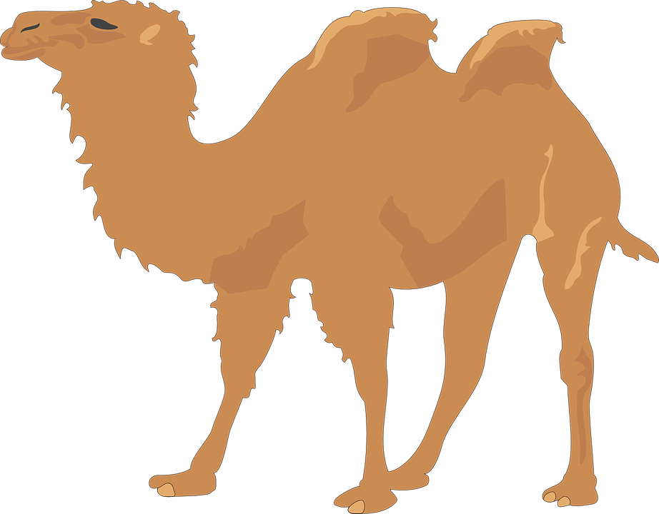
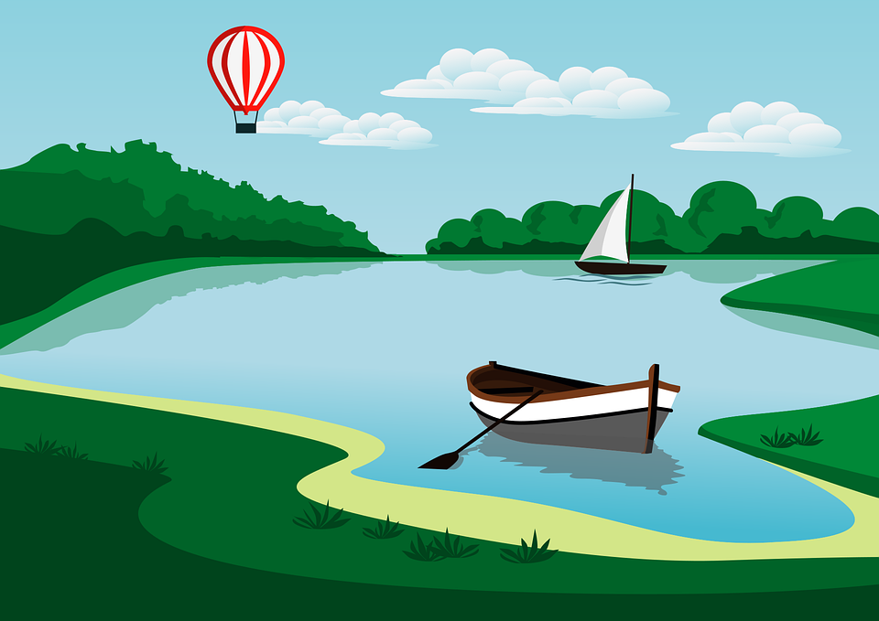
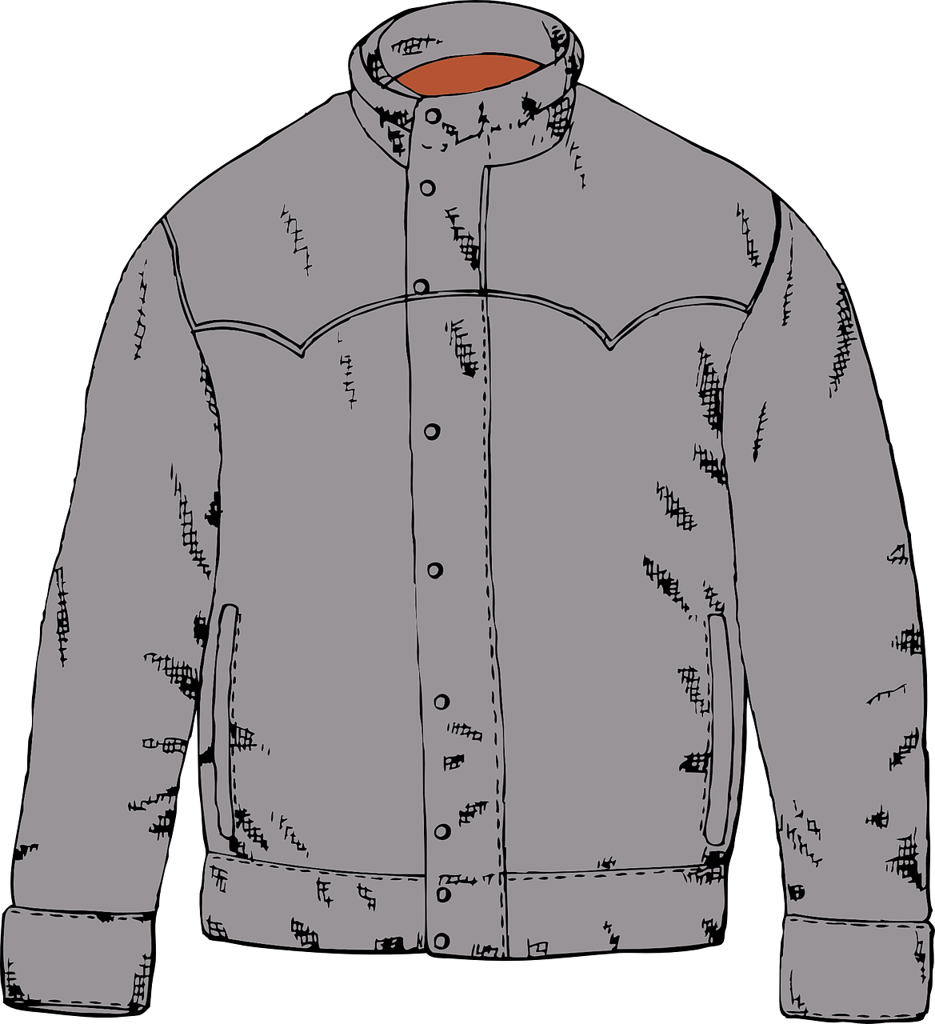
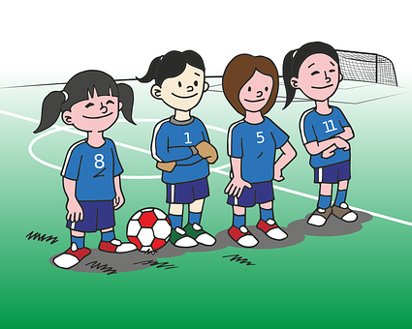
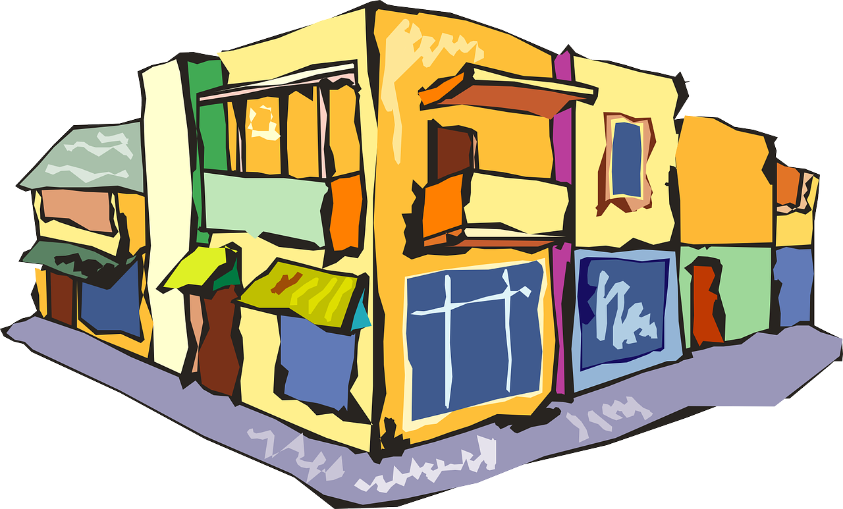
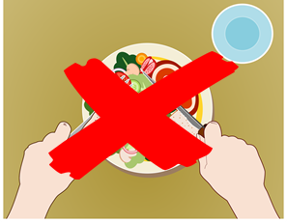
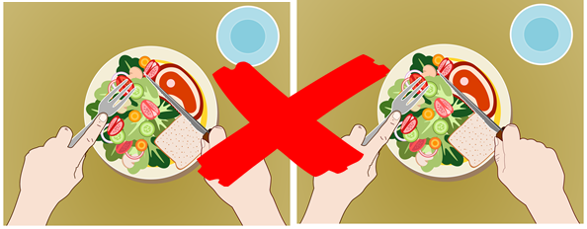
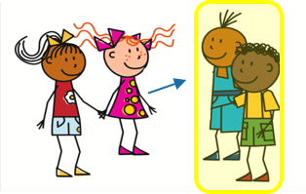
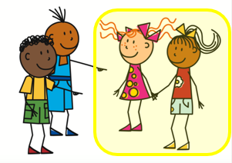
Azul Knowledge Organiser - Spring Term A
Las actividades
ayudar – to help|helping
bailar – to dance|dancing
cocinar – to cook|cooking
limpiar – to clean|cleaning
mandar – to send|sending
mirar – to look,watch
tocar – to touch, play (instrument)
beber – to drink|drinking
comer – to eat|eating
correr – to run|running
vencer – to overcome|overcoming
vender – to sell|selling
La descripción
común – common
dentro – inside
fuera – outside
más – more
sobre – on, on top of
Las cosas
el armario – wardrobe
la cosa – thing
la cultura – culture
el dinero – money
la habitación – (bed)room
la luz – light
el miedo – fear
el patio – playground
el piso – apartment, flat
la prueba – test
la radio – radio
el recreo – break
el suéter – sweater, jumper
la tarjeta – card
la television – television
la vaca - cow
Phonics
[l] | libro | lobo | paloma | lavar | película
[ll] | llamar | amarillo | llover | camello | collar
[to call]
[ga] | ganar | [go] | lago | [gu] | gusano
Stress 1: When reading Spanish aloud, stress any vowel with a written accent.
árbol | último [last] | interés [interest] | corazón
Stress 2: Where there is no written accent, stress the penultimate (second to last) syllable for any word ending in a vowel, ‘n’ or ‘s’.
nunca [never] | pasado [past] | orden [order] | sacapuntas
Stress 3: For all other words, stress the final syllable.
amor [love] | profesional | feroz | verdad
[ferocious]
[que]
paquete
queso
bosque
chaqueta
esquina
[qui]
equipo
quince
aquí
corner
Present tense –AR verbs | Present tense –ER verbs | Using the negative ‘no’
bailas
corres
In Spanish, to say what you or others don’t do, put ‘no’ before the verb. This makes a negative.
Saying ‘my’ and ‘your’
you are
you run
bailo
baila
corro
corre
mi habitación – my (bed)room mis libros – my books tu armario – your wardrobe tus tarjetas – your cards
I dance
bailar
s/he, it dances
I run
correr
s/he, it runs
No come en el patio.
S/he doesn’t eat in the playground.
to dance|dancing
to run|running
No comemos en el patio.
bailan
bailamos
corren
corremos
We don’t eat in the playground.
⚠ It does not matter whether the nouns are masculine or feminine.
they dance
we dance
they run
we run
This works for any verb and any person (e.g., I, you, s/he, we).

Slide 2
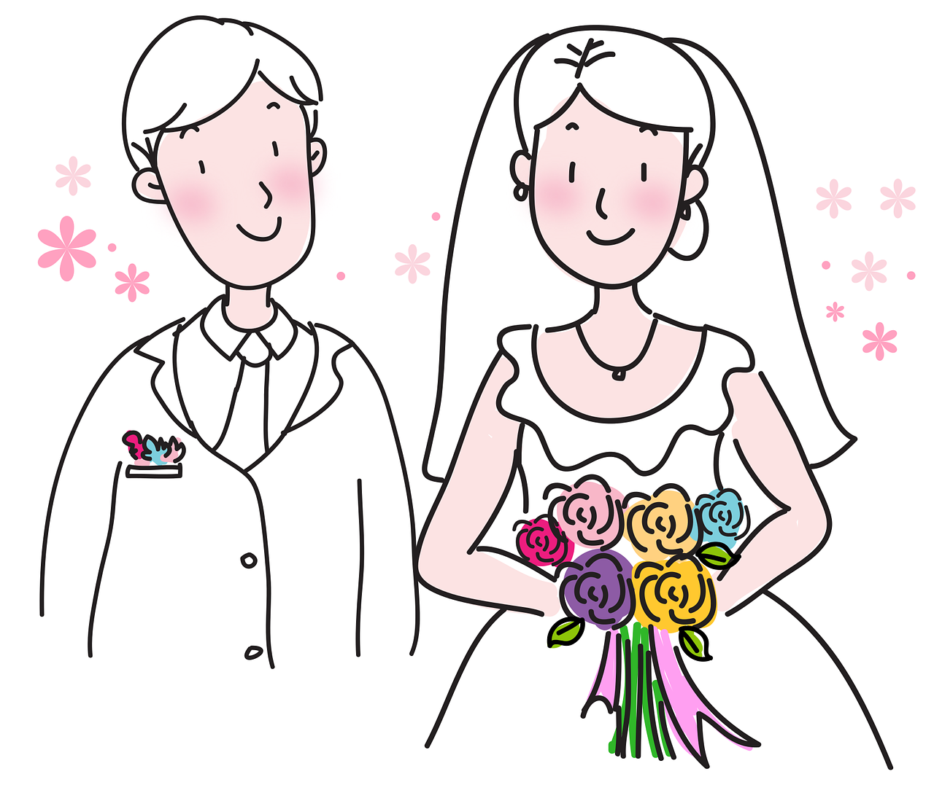
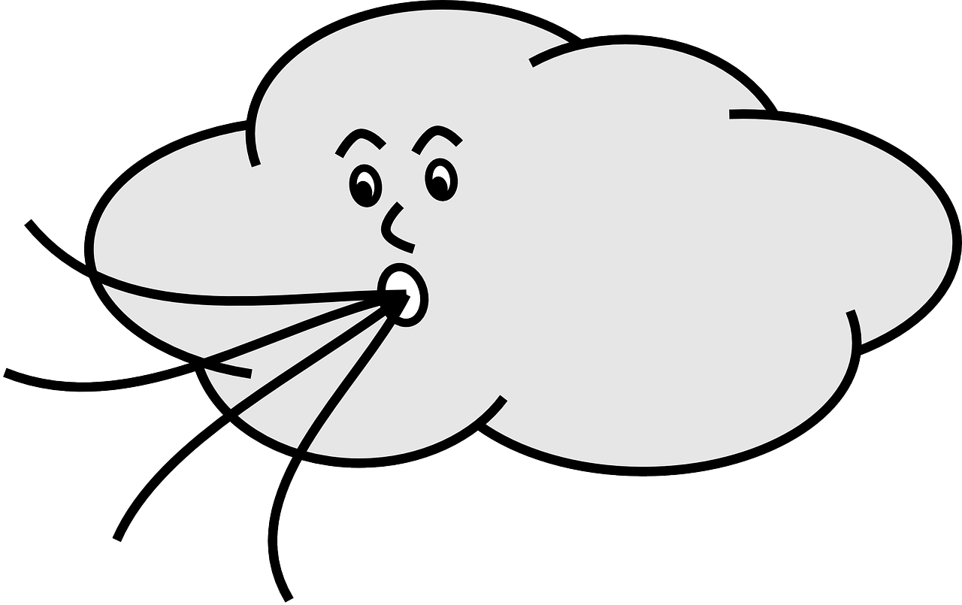
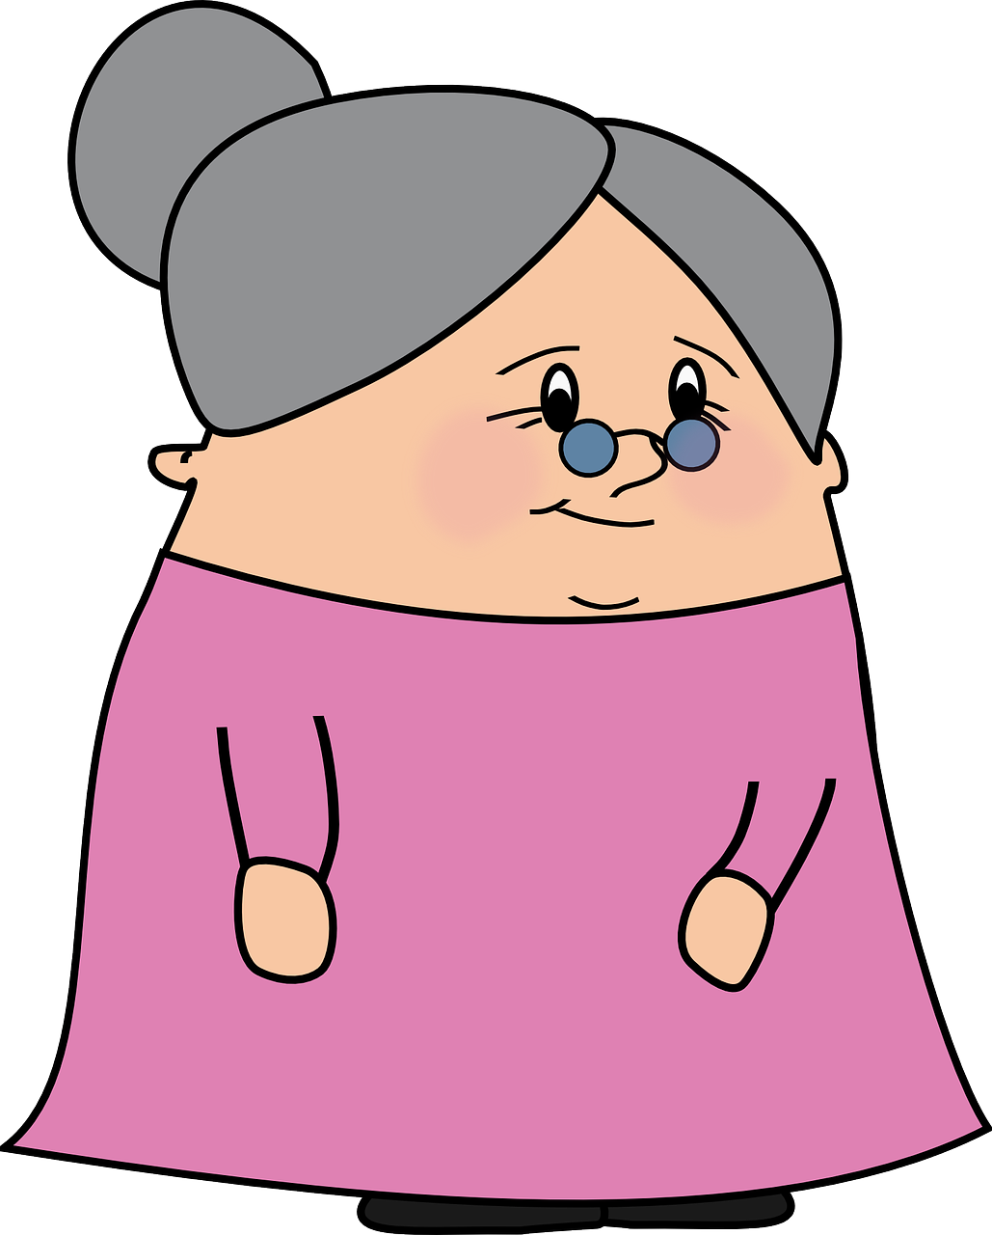
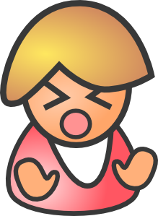
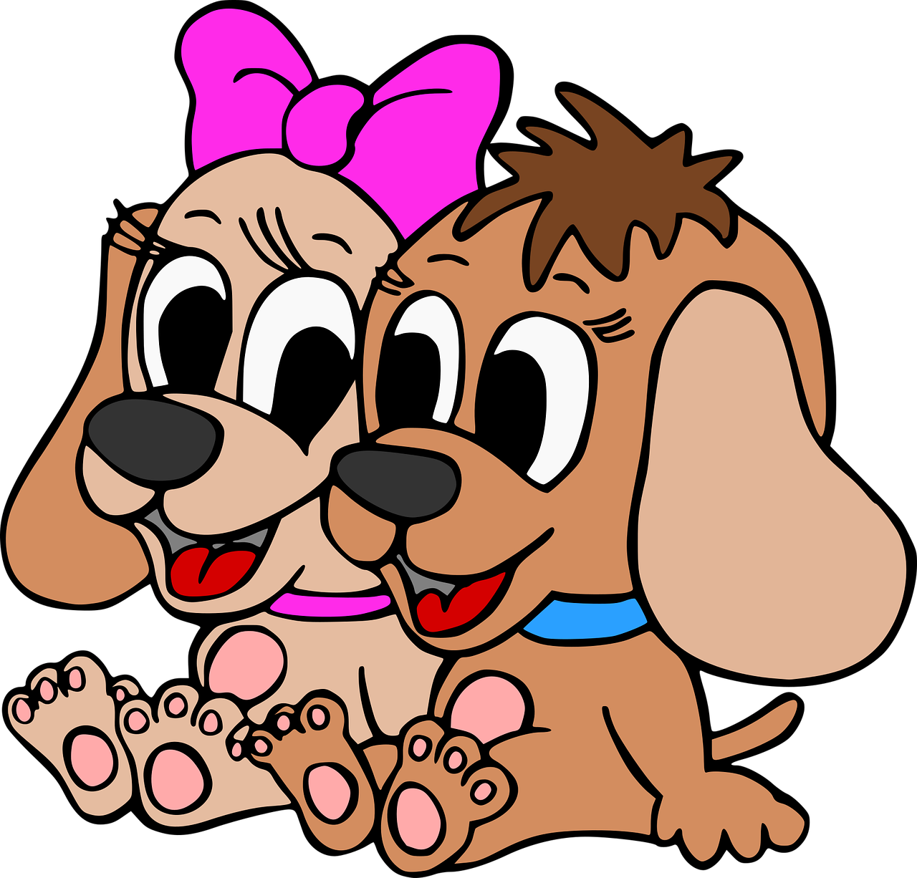
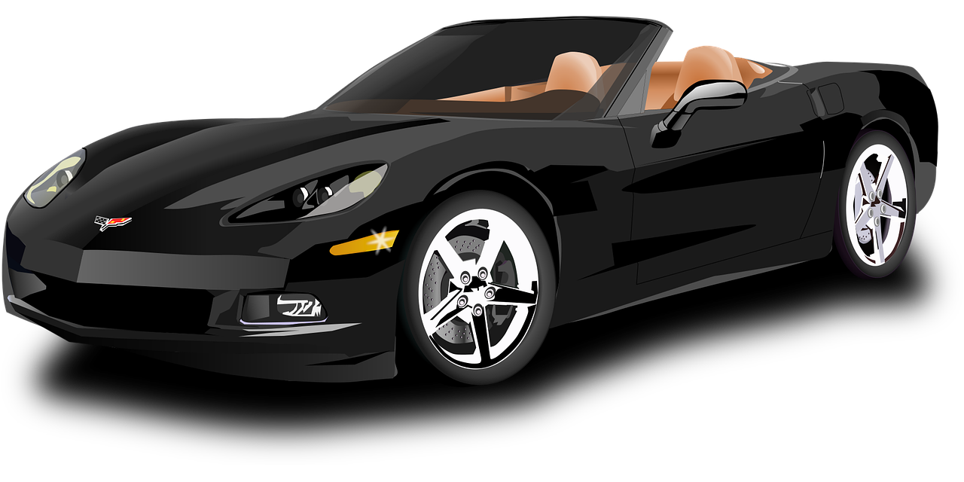
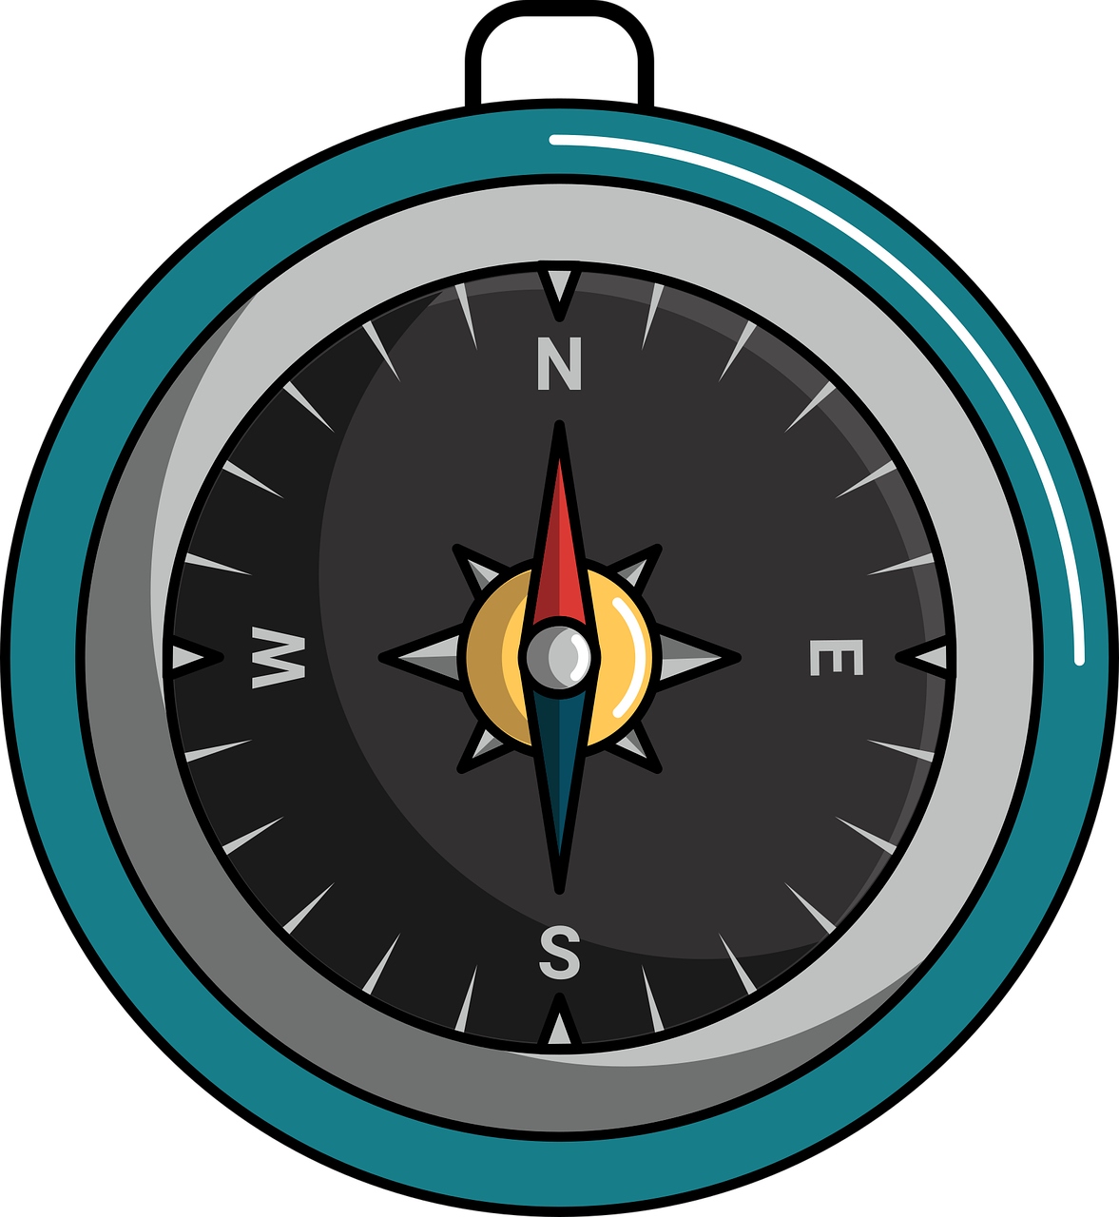
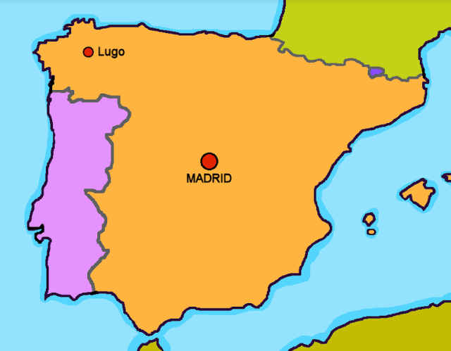
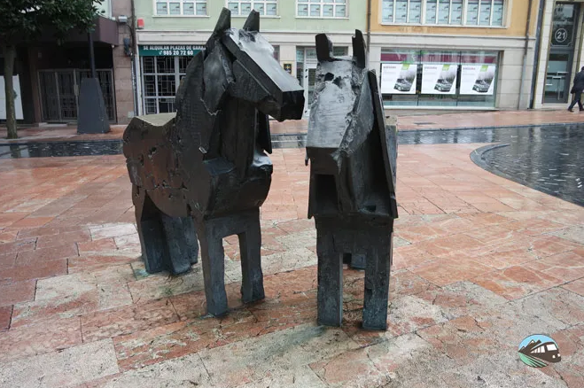
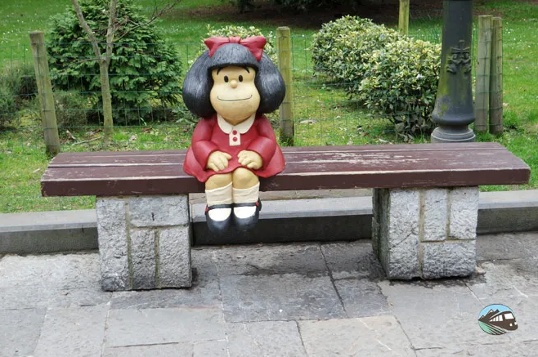
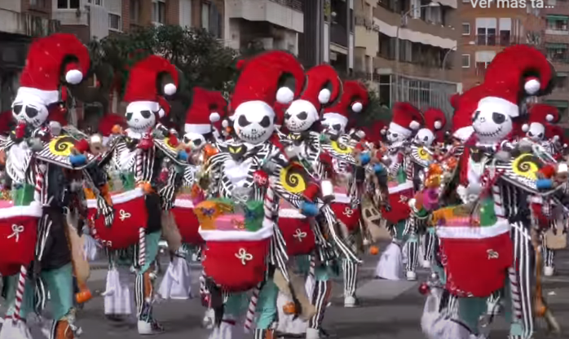
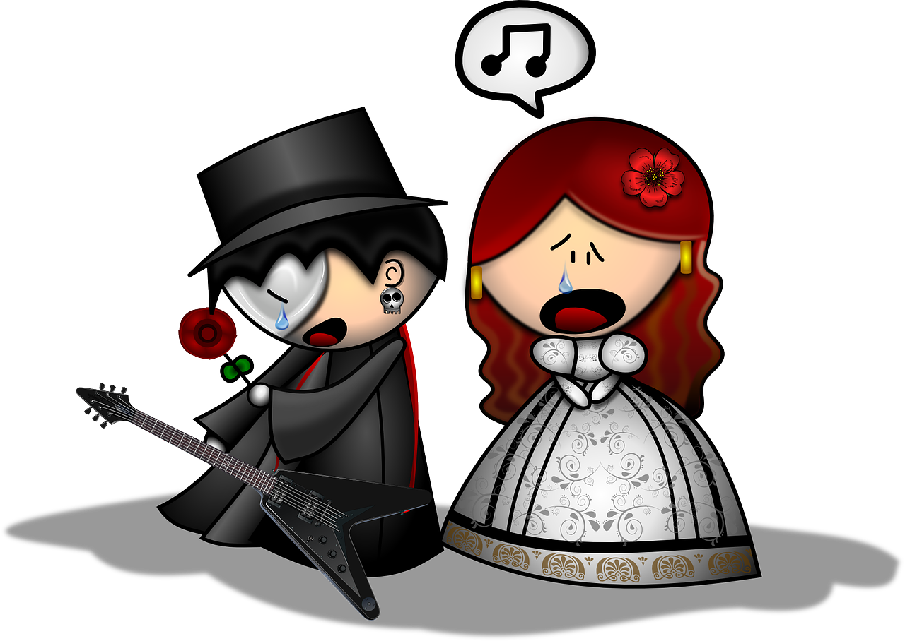
Azul Knowledge Organiser - Spring Term B
Los números
trece – 13
catorce – 14
quince – 15
dieciséis – 16 | veintiséis - 26
diecisiete – 17 | veintisiete – 27
dieciocho – 18 | veintiocho - 28
diecinueve – 19 | veintinueve – 29
veinte – 20
veintiuno – 21
veintidós – 22
veintitrés – 23
veinticuatro – 24
veinticinco - 25
treinta – 30
treinta y uno - 31
hay – there is, there are
Destinos (destinations)
ir – to go | going
voy – I go
vas – you go
va – s/he, it goes
la costa – coast
el mercado - market
el teatro - theatre
el norte – north
el este – east
el sur – south
el oeste - west
Phonics
➜
[n] | mano | novio | nube
[ñ] | español | niña | pañuelo
handkerchief
➜
➜
[v] | ver | vela | viento
[b] | abuela | banco | bolsa
[r] | parar | caro | pero
[rr] | correr | carro | perra
1.000.000
⚠ If the final syllable is stressed and the word ends in a vowel or ‘n’ or ‘s’, there is an accent on the final vowel.
➜
➜
➜
➜
Spanish words can mean different things in different countries. In Peru and most of South America, carro means car. In Spain carro means cart or trolley.
Nunca estás sin orientación. Nunca estás sin orientación.
norte
The verb ir (to go|going) The verb ir is irregular. Other irregular verbs you know are ser, estar, tener, hacer. We call these the big 5! | Saying ‘to the’ To say ‘to the’ with a feminine noun, use a + la: a la costa – to the coast To say ‘to the’ with a masculine noun, use a + el → al: al mercado to the market al teatro to the theatre | Modismos (idioms) An idiom is s a phrase that has a meaning you cannot work out from its individual words.
oeste
este
sur
vas
El mundo es un pañuelo.
Badajoz es una ciudad en el oeste de España. En Badajoz hay un carnaval famoso.
El carnaval de Badajoz es en febrero.
voy
you go
va
Oviedo es una ciudad en el norte de España. Es la capital de la región de Asturias.
Oviedo
I go
s/he, it goes
ir
Literally…
Badajoz
to go| going
The world is a handkerchief.
But it really means…
➜
It’s a small world!

