Slide 1
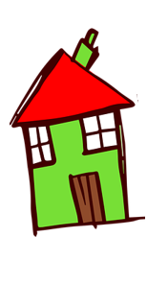

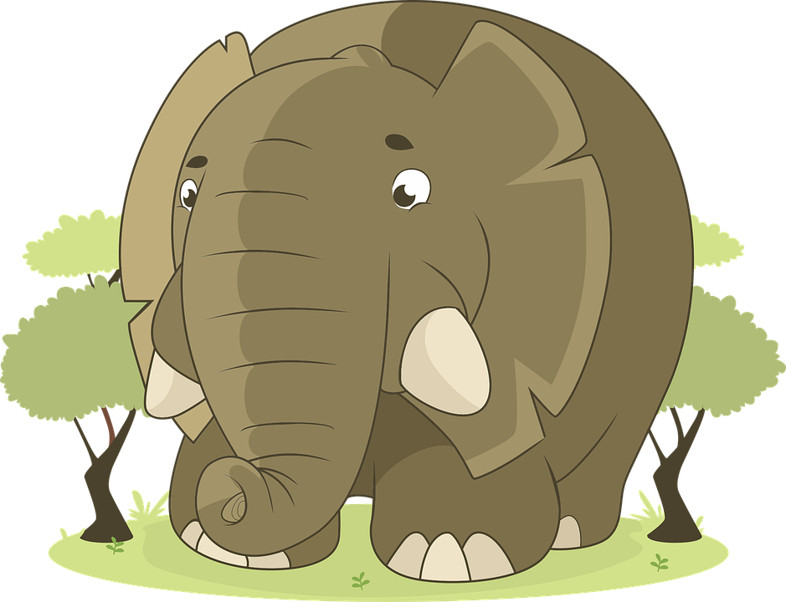

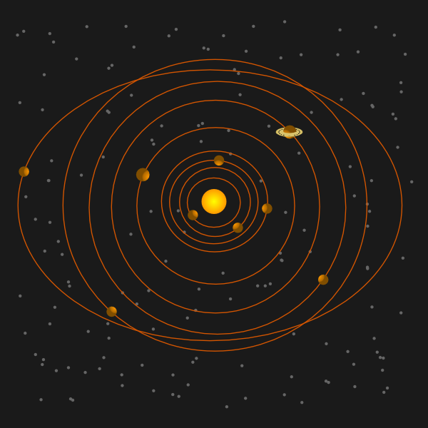

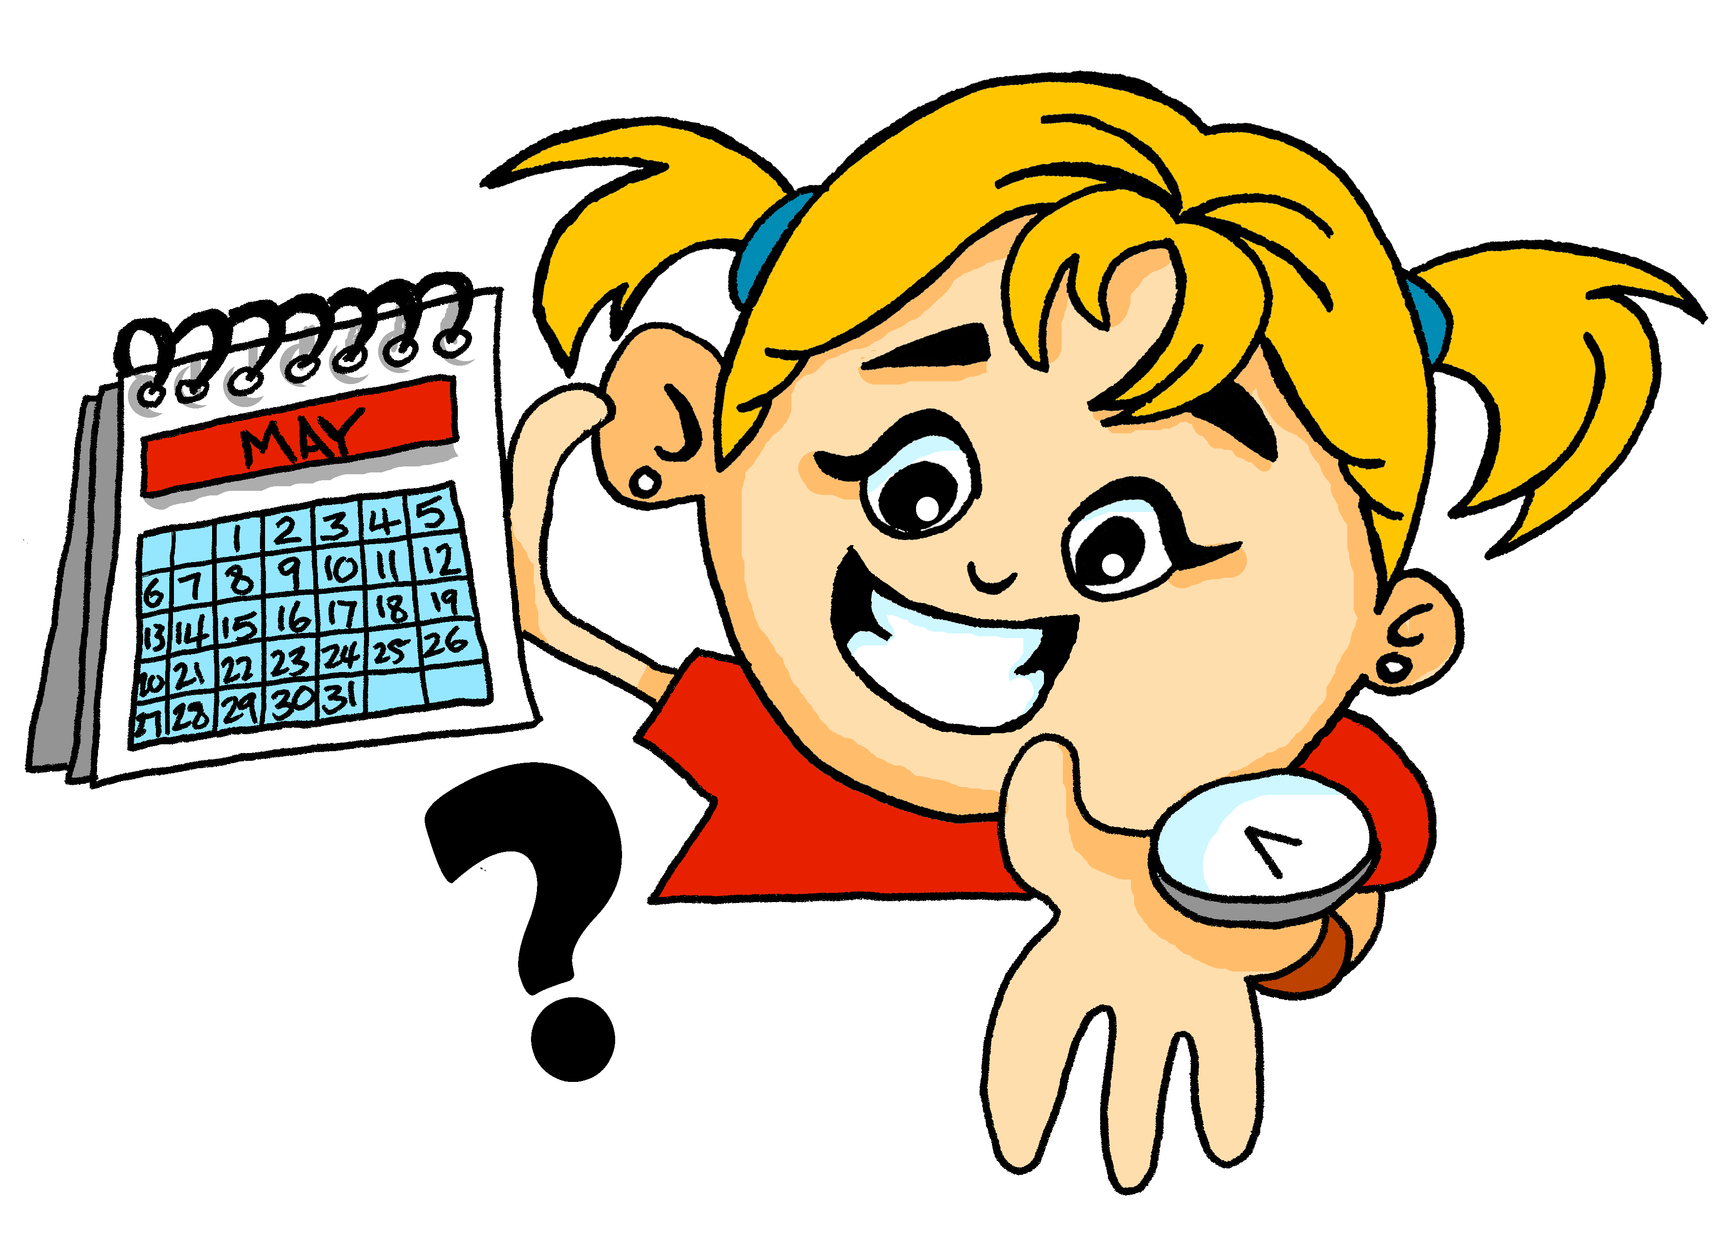


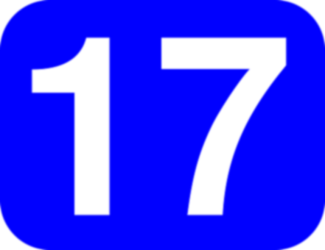
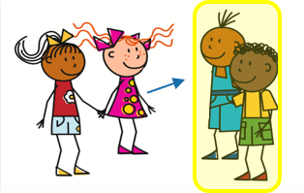
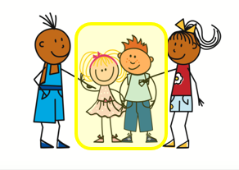
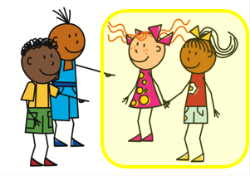
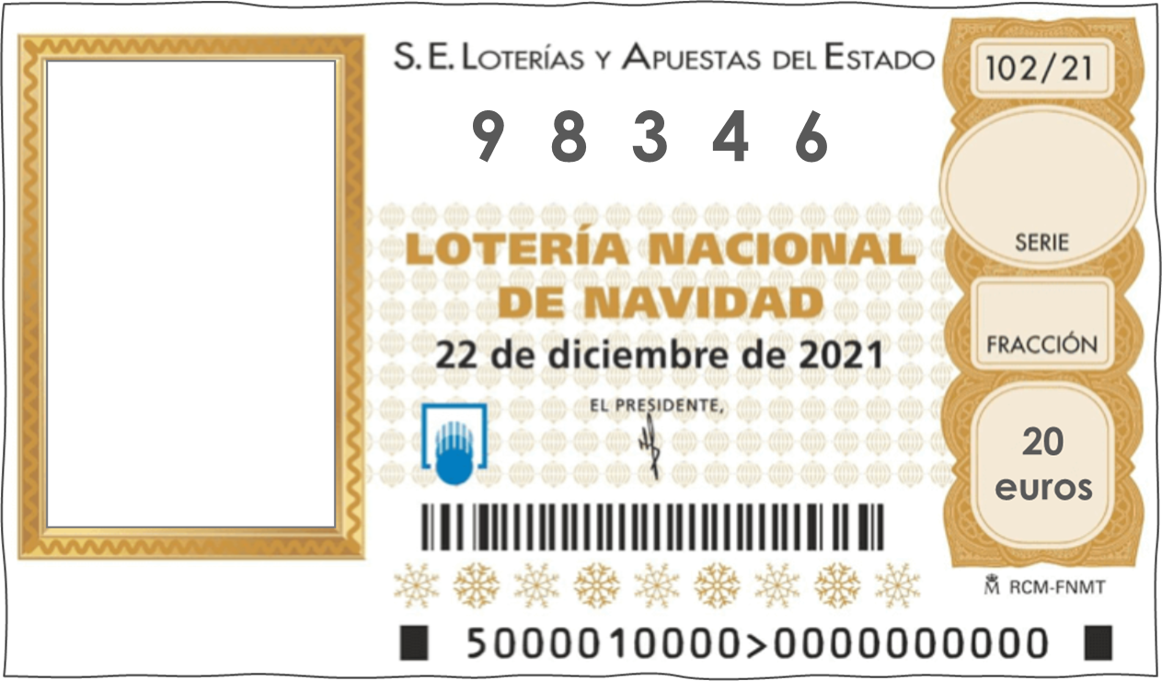
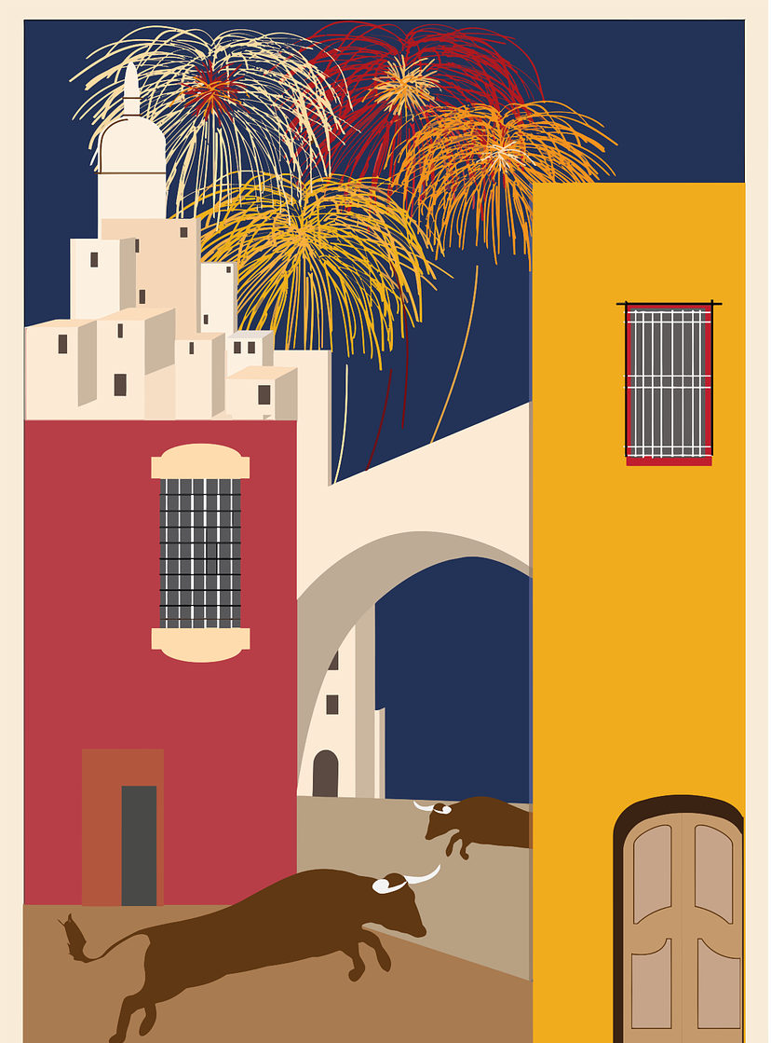

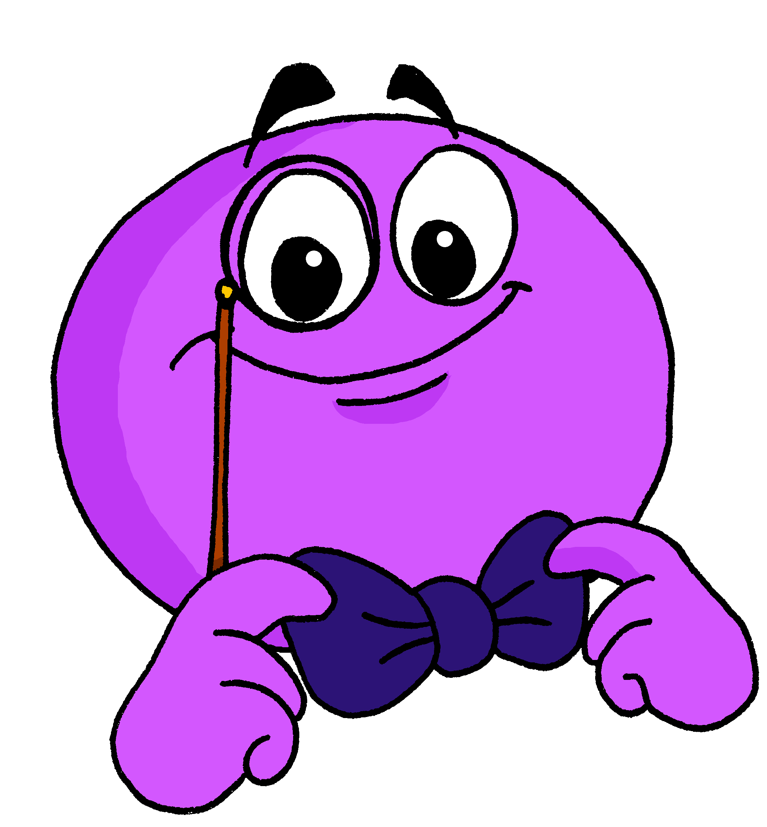
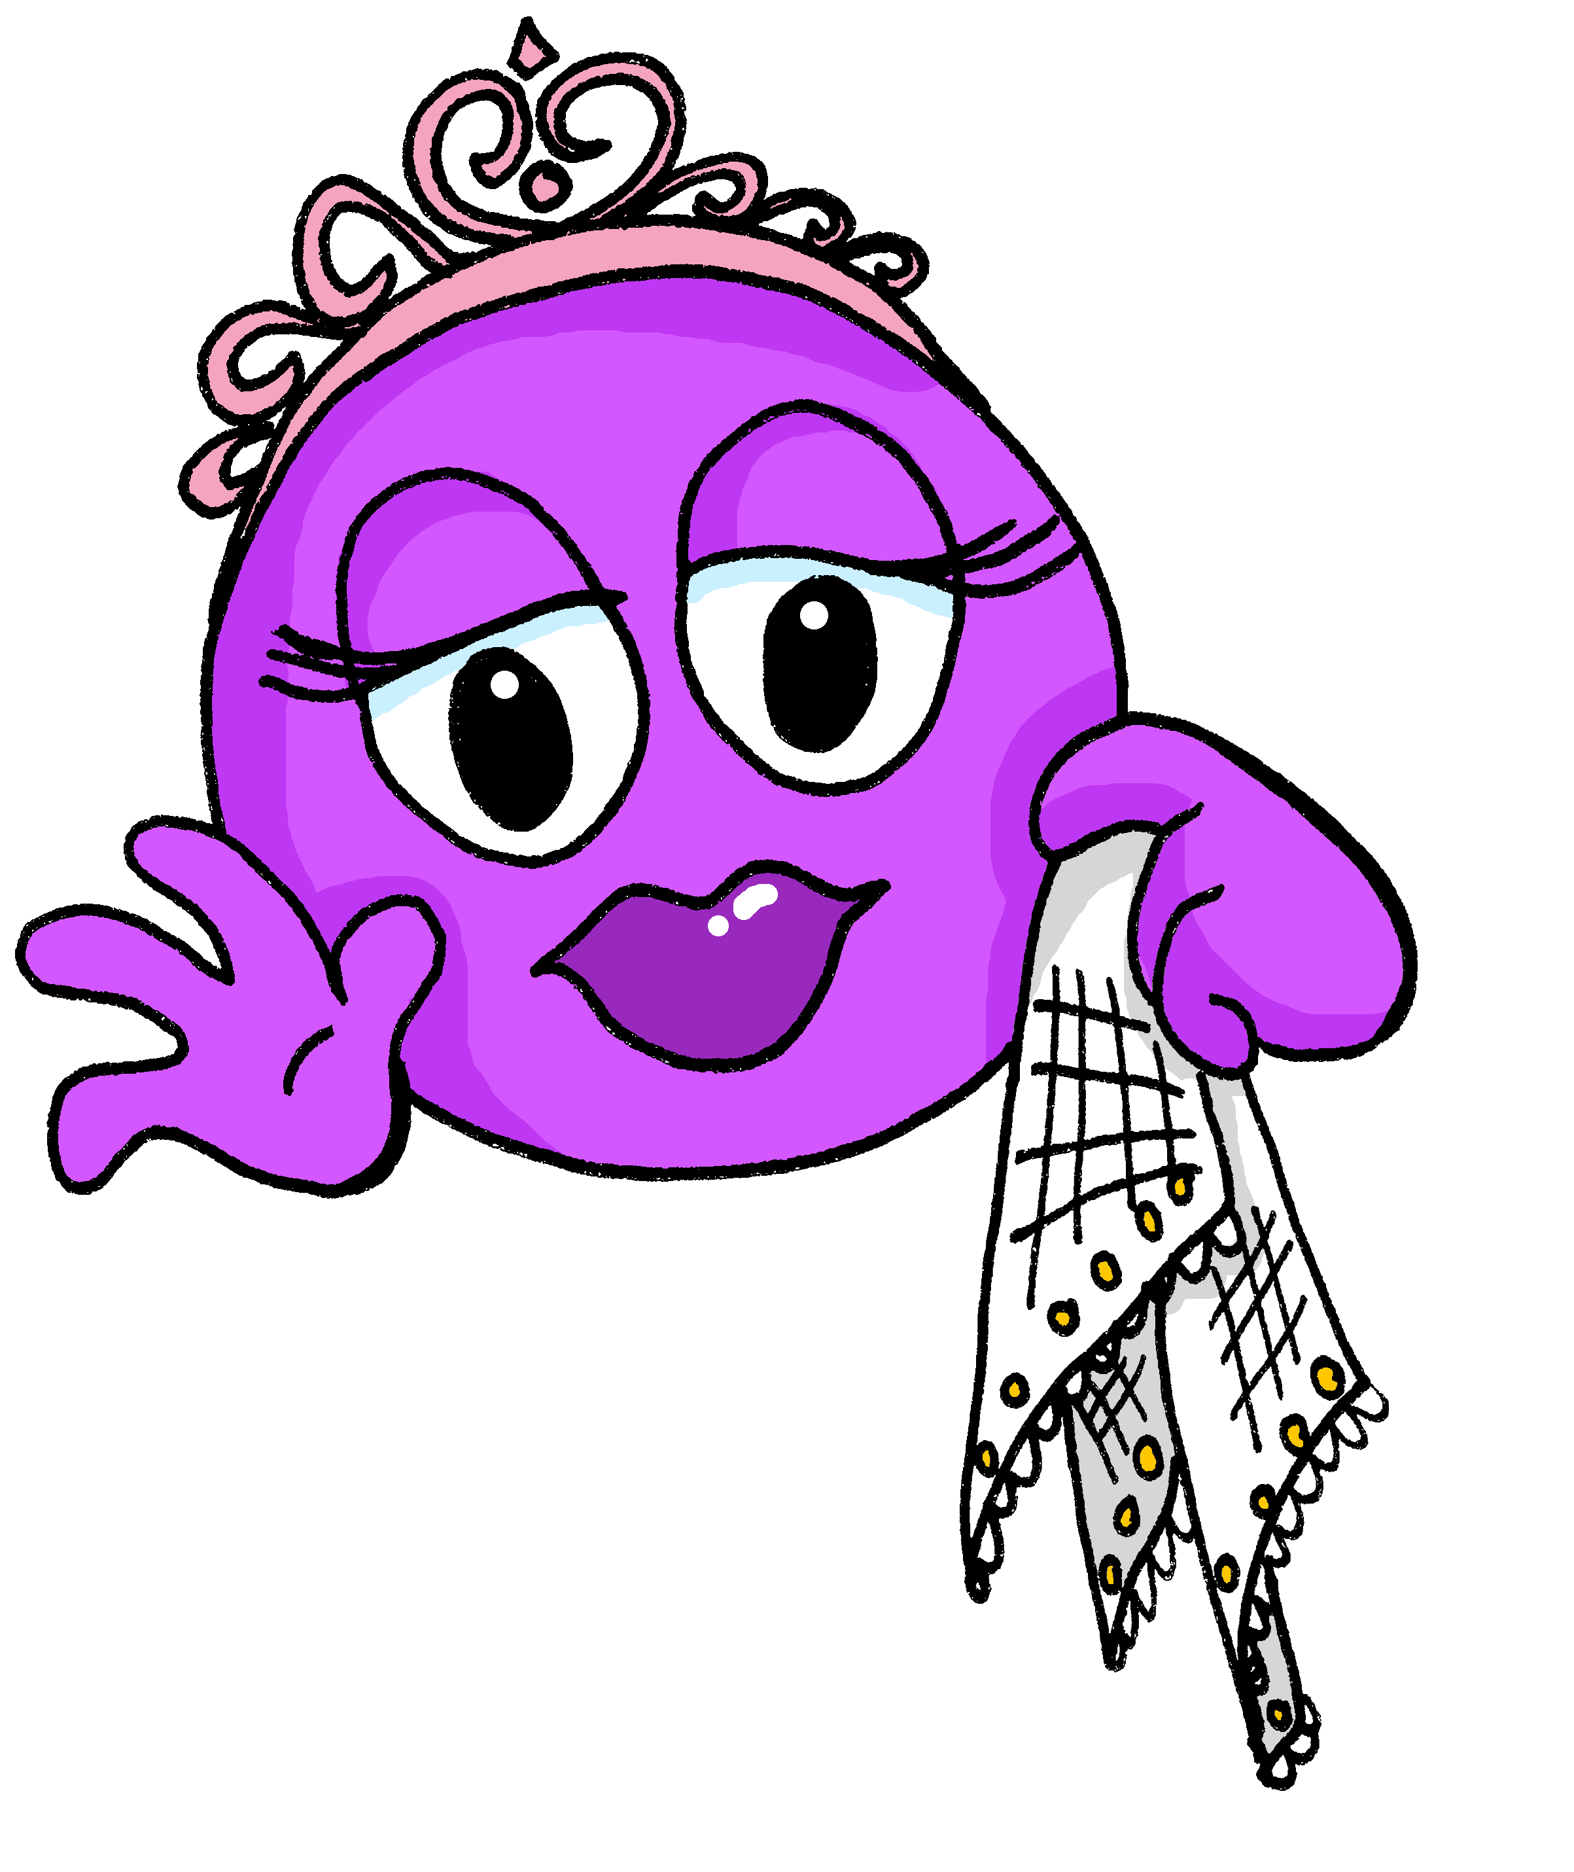



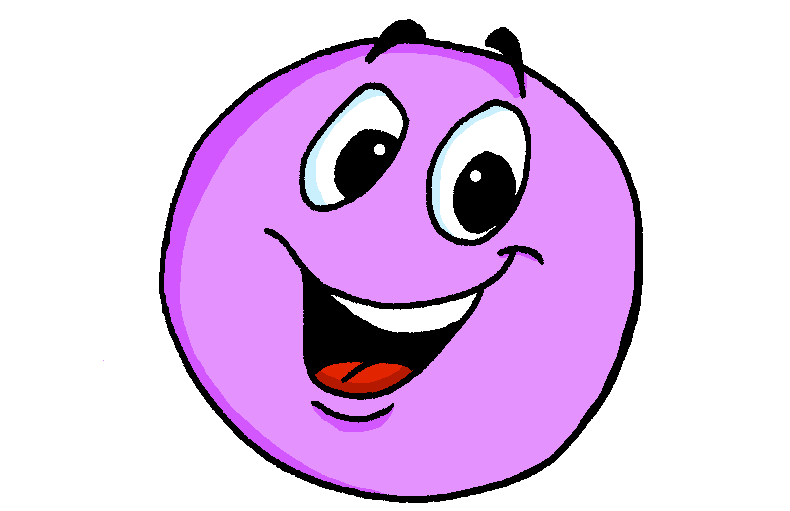
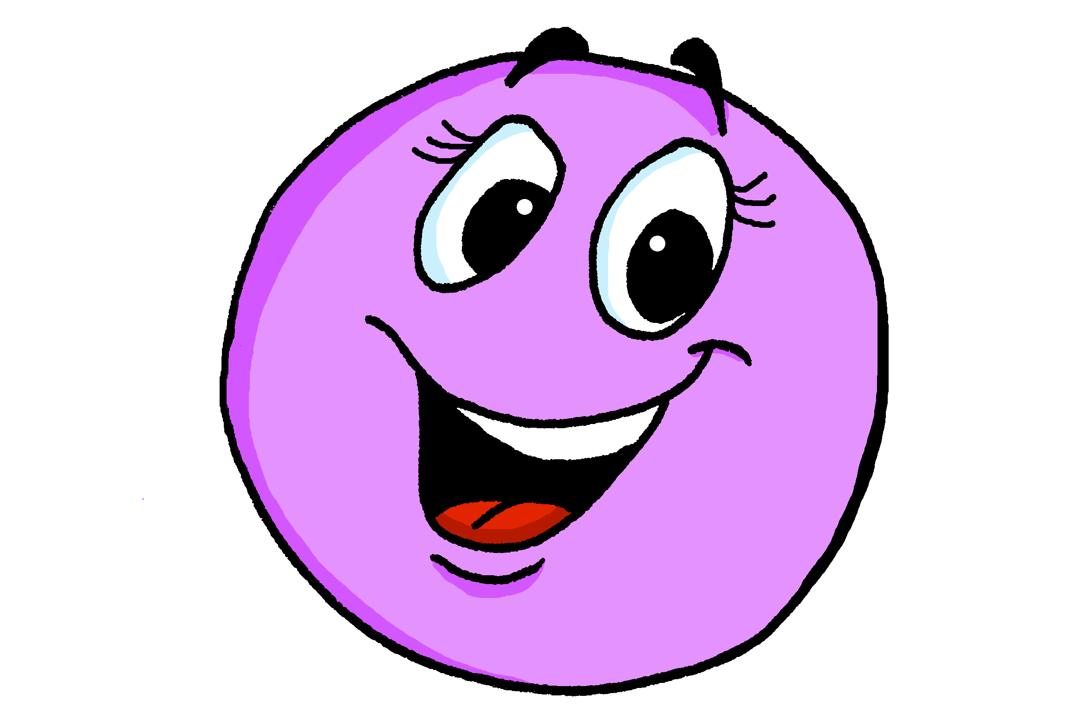
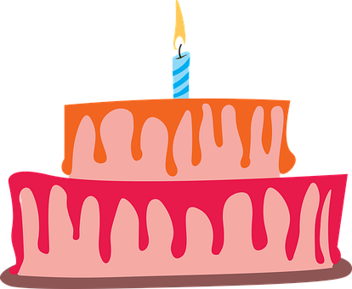
Azul Knowledge Organiser - Autumn Term A
En la escuela (In school)
estar – to be | being (location, state)
estamos – we are
están – they are
Señor – Mr., Sir (in class)
Señora – Mrs., Miss (in class)
diccionario – dictionary (m)
casa – house (f)
familia – family (f)
fecha – date (f)
foto – photo (f)
jardín – garden (m)
problema – problem (m)
¿cuál? – which?
¿quién? – who?
demasiado - too
y – and
pero - but
también – also
La descripción
ser – to be | being (trait)
somos – we are
son – they are
creativo, creativa – creative (m), (f)
estricto, estricta – negative (m), (f)
feo, fea – ugly (m), ugly (f)
negativo, negativa – negative (m), (f)
tonto, tonta – silly (m), silly (f)
terrible – terrible (m, f)
trece – 13
catorce – 14
quince – 15
dieciséis – 16 | veintiséis - 26
diecisiete – 17 | veintisiete – 27
dieciocho – 18 | veintiocho - 28
diecinueve – 19 | veintinueve – 29
veinte – 20
veintiuno – 21
veintidós – 22
veintitrés – 23
veinticuatro – 24
veinticinco - 25
treinta – 30
treinta y uno - 31
Phonics
[a] | [o] | [u] | [e] | [i]
casa
dos
universo
elefante
idea
Spanish words often have consonant-vowel pairs, pronounced equally, e.g., in-te-re-san-te
Pronounce strong Spanish vowels [a], [e] and [o] separately. e.g. idea (when next to each other)
The weak vowels [i] and [u] merge with [a], [e] and [o] to make a single syllable, e.g., cuando.
Describing location and state with the verb estar | Adjective agreement for gender | Numbers 13 - 31
Describing permanent traits with the verb ser | More adjective patterns | Dates
For numbers 16-19 use the combination “dieci“ + the number (6, 7, 8, 9).
estás
In Spanish, adjectives ending in –o change to –a to describe feminine nouns. Add –s for plural nouns.
you are
dieciséis
estoy
está
diecisiete
I am
estar
s/he, it is
➜
➜
to be|being
Están contentos.
For 21 to 29 use veinti- and a number from 1-9, all in one word.
están
estamos
They (m, m/f) are pleased.
they are
we are
Están contentas.
For 31 to 39, use treinta + y + 1-9, in separate words.
They (f) are pleased.
Adjectives already ending in –e or –z (or –l) stay the same for singular nouns and add-s for plual:
Use el before the number
to mean ‘on the’.
⚠ If the final syllable is stressed and the word ends in a vowel or ‘n’ or ‘s’, there is an accent on the final vowel.
➜
eres
you are
Es elegante.
¿Cuándo es tu cumpleaños?
➜
es
She, he is smart.
soy
¡Mi cumpleaños es
el 27 de noviembre!
I am
ser
s/he, it is
Son elegantes.
to be|being
They (m,f) are smart.
En España, el 22 de diciembre hay un sorteo de lotería. El primer premio es ‘El Gordo’ porque es muy grande. ¡Es mucho dinero!
Es feliz.
son
somos
She, he is happy.
they are
we are
Son felices.
They (m,f) are happy.

Slide 2






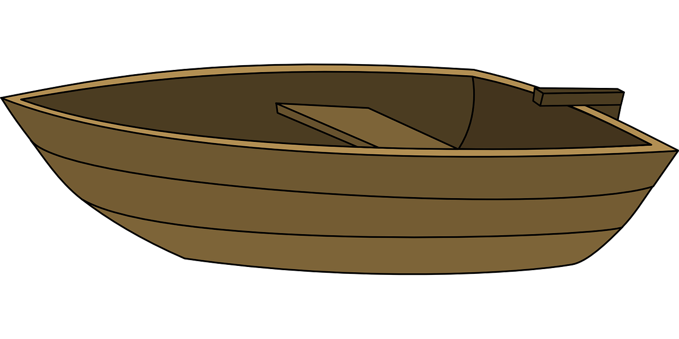





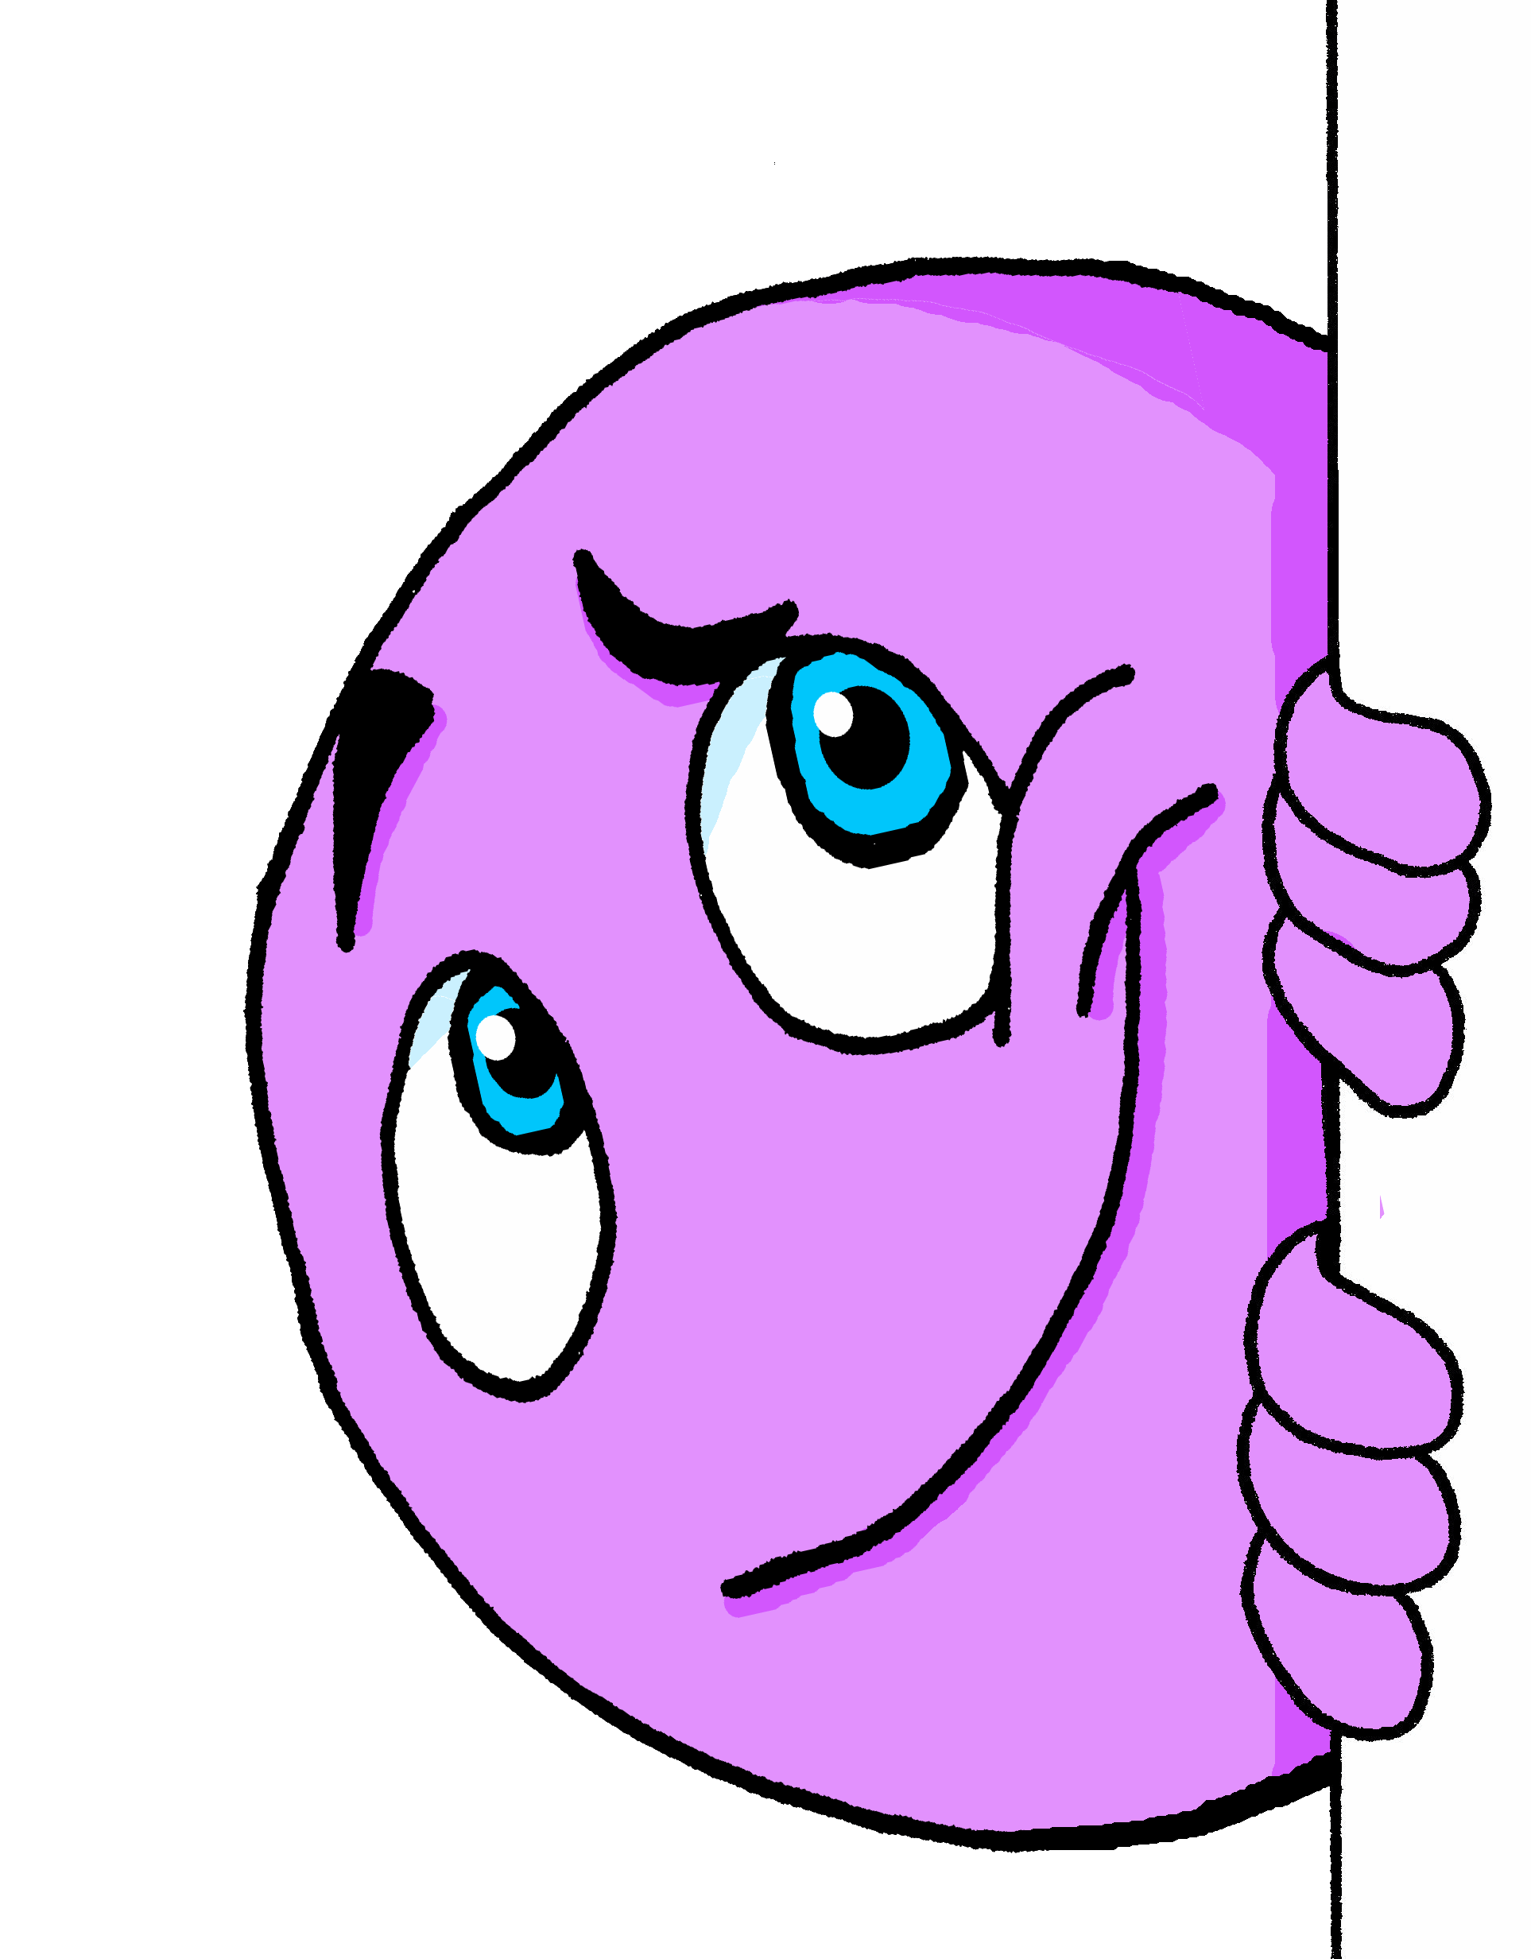



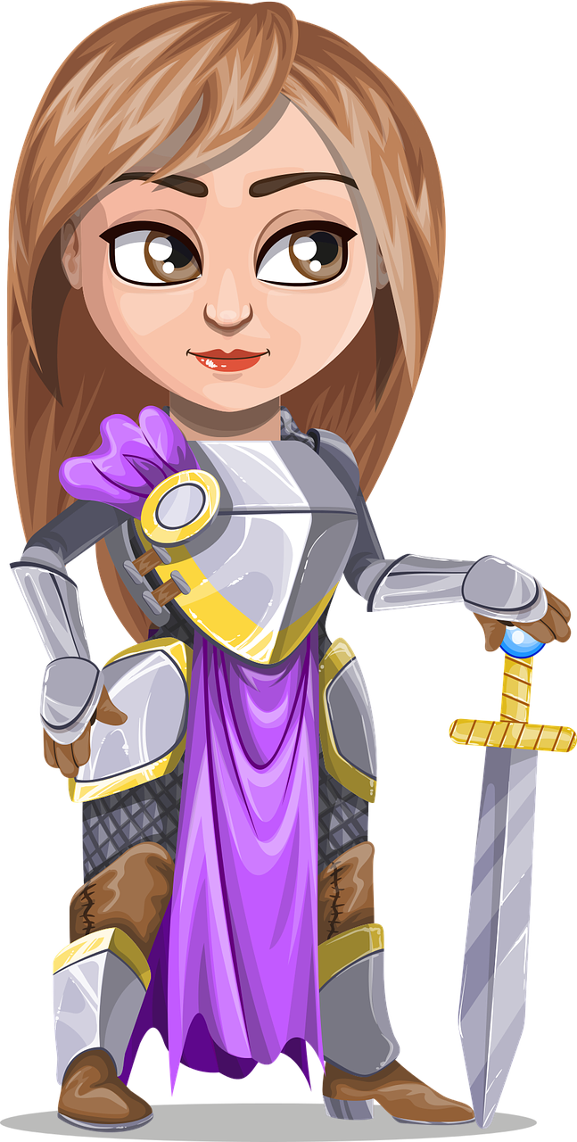
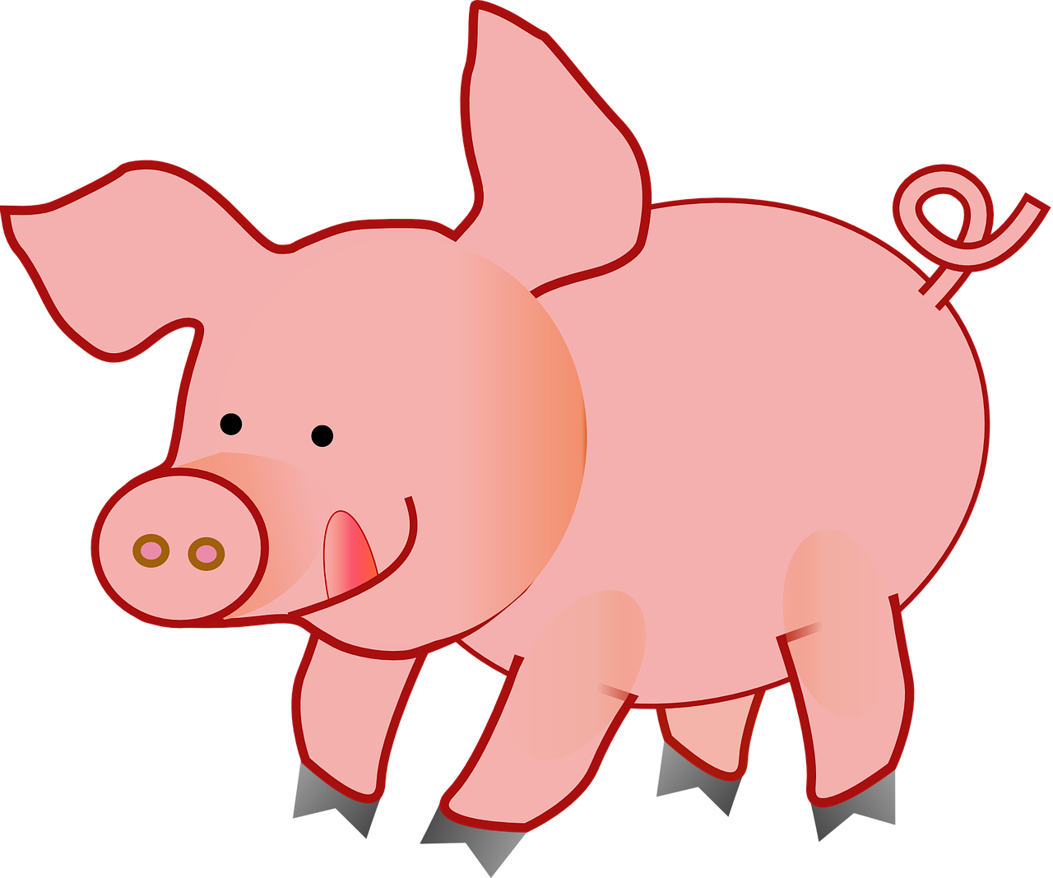


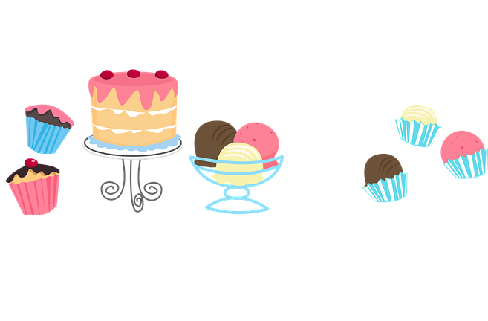
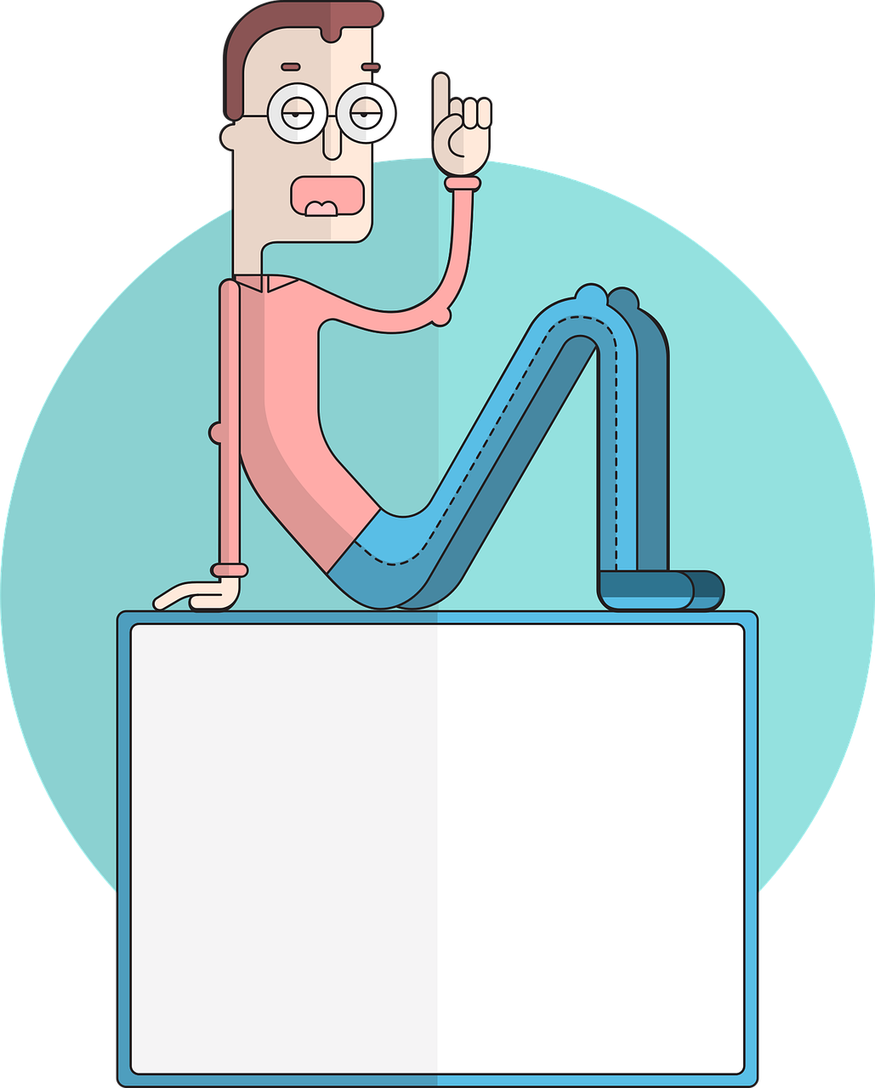
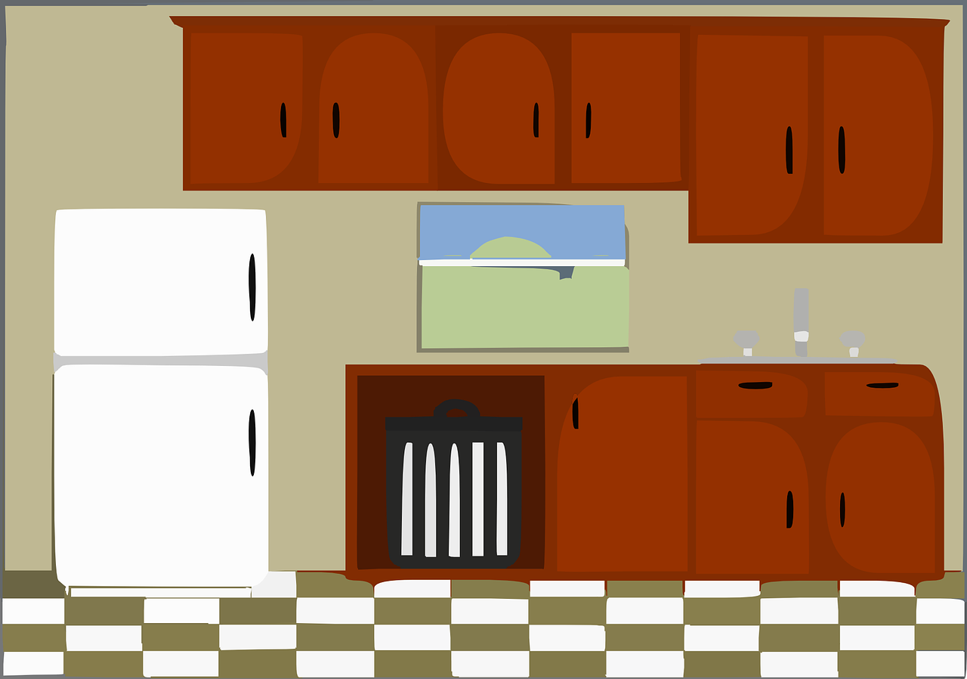
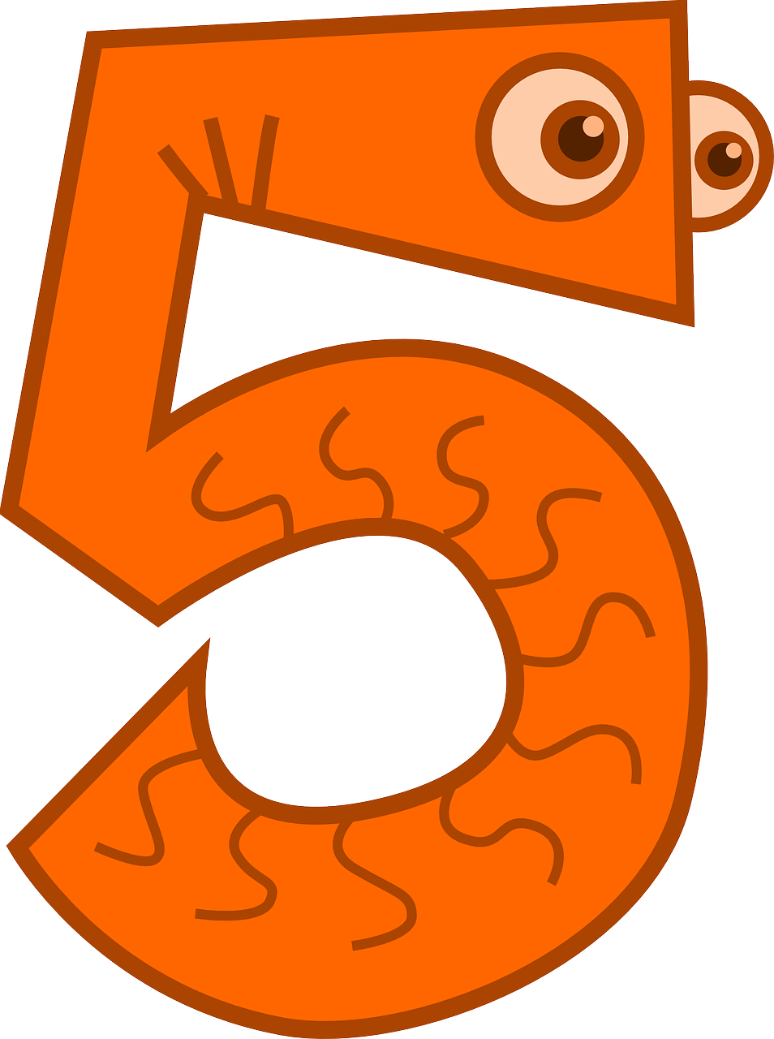
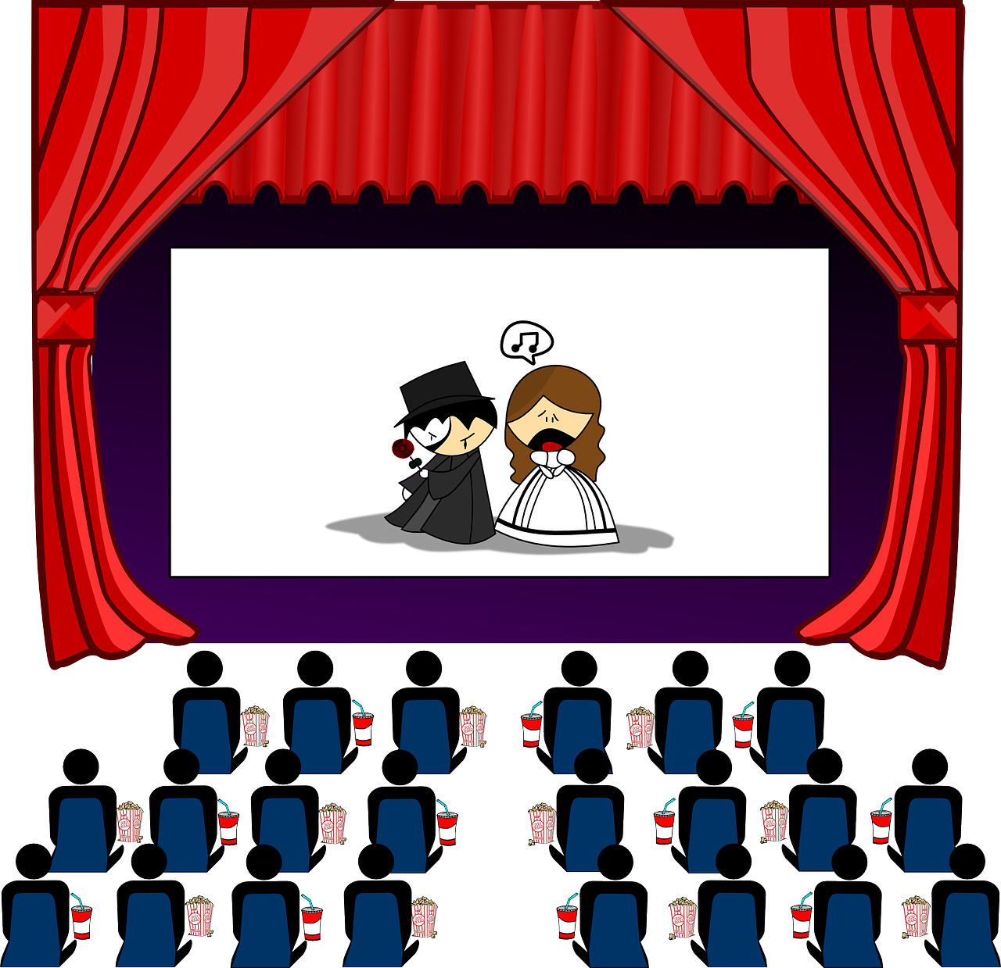
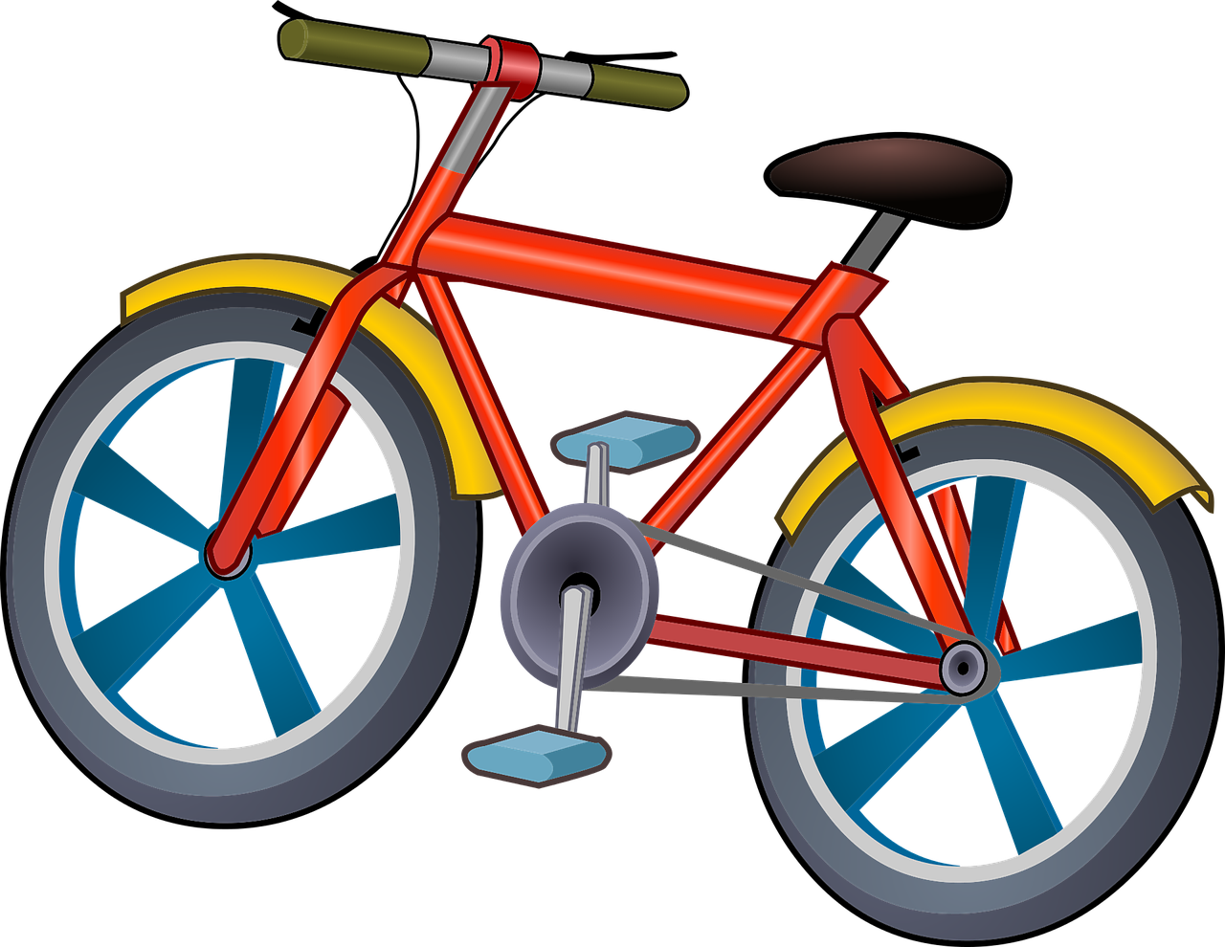

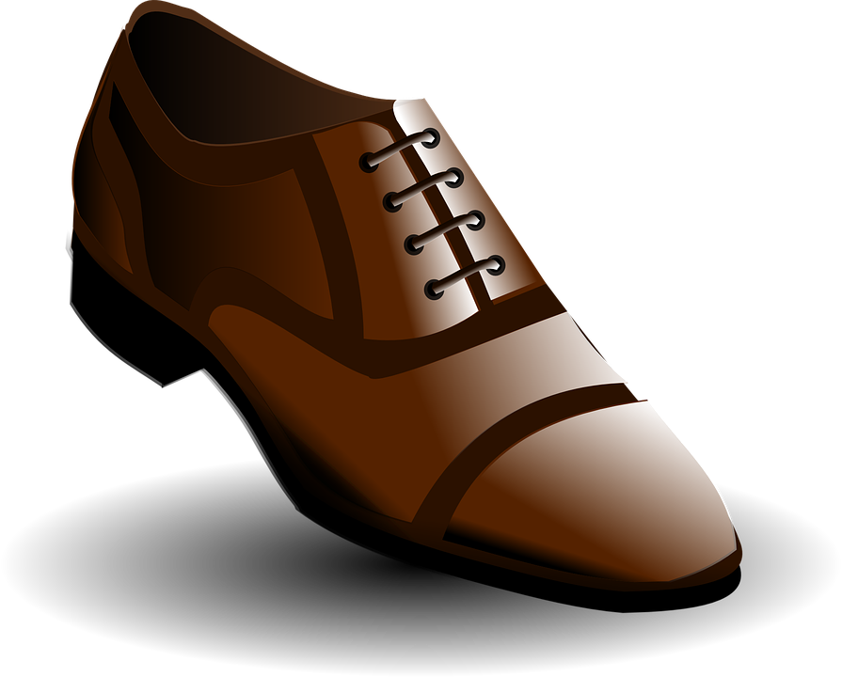



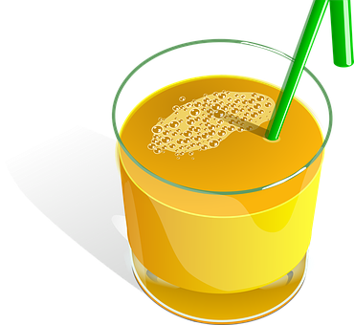
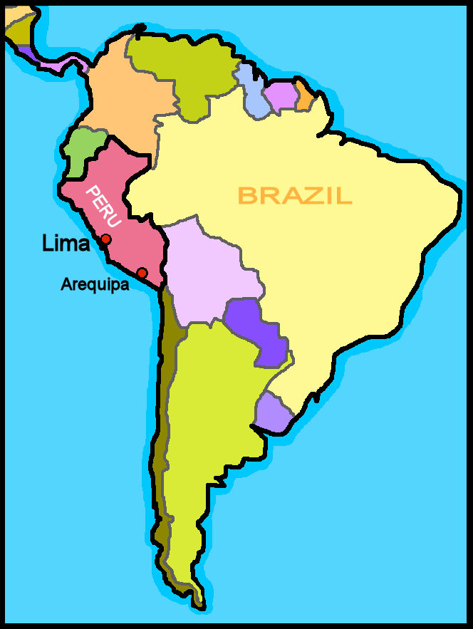


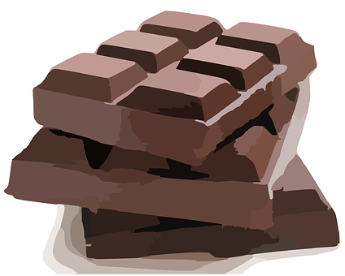


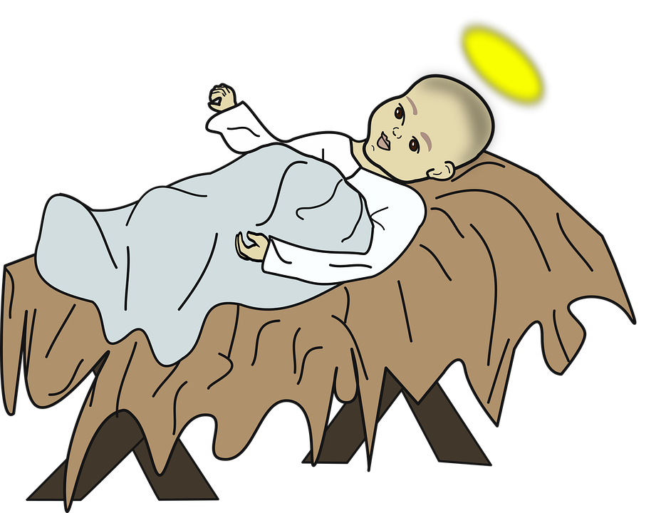


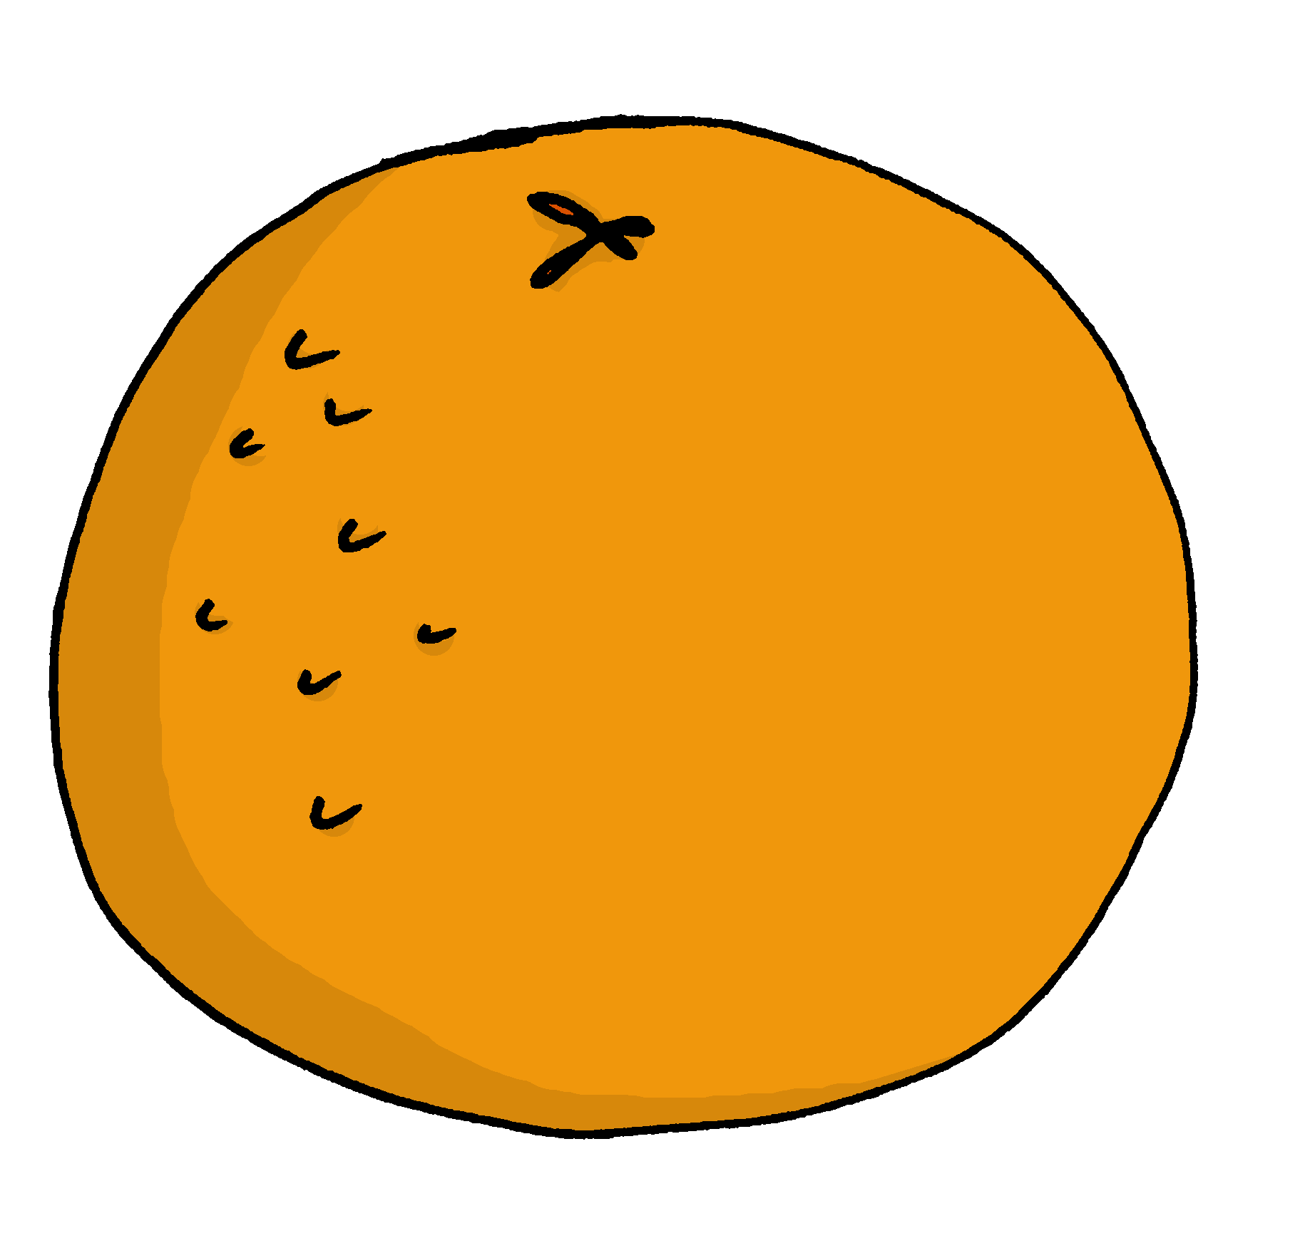
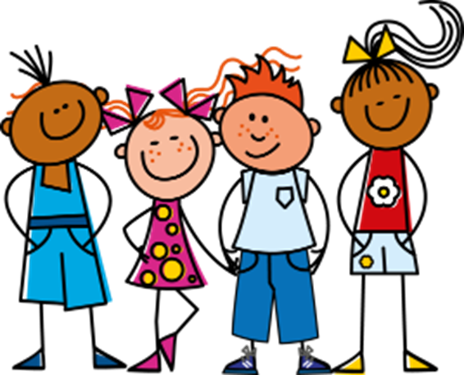

Azul Knowledge Organiser - Autumn Term B
En casa (at home)
tener – to have|having
tenemos – we have
tienen – they have
unos – some (m, m/fpl)
unas – some (fpl)
bocadillo – sandwich (m)
clase – class (f)
espacio – space, room (m)
goma – rubber (f)
lámpara – lamp (f)
mentira – lie (m)
oficina – office (f)
pegamento – glue (m)
verdad – truth (f)
debajo de – under
detrás de - behind
Descripción física
cara – face (f)
medico, médica – doctor (m), (f)
oreja – ear (f)
pelo – hair (m)
corto, corta – short (m), short (f)
enorme – enormous (m/f)
largo, larga – long (m), long (f)
moreno, morena – dark (m), dark (f)
negro, negra – black (m), black (f)
nuevo, nueva – new (m), new (f)
rubio, rubia – blond (m), blond (f)
redondo, redonda – round (m), (f)
viejo, vieja, old (m), old (f)
solo – only
un poco – a bit
Phonics
[ca]
cama
cantar
música
boca
cansado
[co]
contar
barco
con
correcto
un poco
[to count]
[cu]
cucaracha
escuchar
cultura
curioso
escuela
[ci]
centro
princesa
cerdo
celebrar
dulce
decir
[ci]
¡Es mentira!
It’s false!
[to say, tell]
cocina
cinco
cine
bici
[z]
zapato
manzana
brazo
zona
zumo
In Spain, [z] and [c] (before e and i)sound like [th] in English.
In Latin America [z] and [c] (before e and i)sound like [s].
¡Es verdad!
It’s true!
[ch] noche
fecha
24
chocolate
leche
chino
Indefinite articles – ‘a’ To say some in Spanish use unos before a masculine noun and unas before a feminine noun. unos libros unas frutas | Saying what people have with the verb tener
Negation with ‘no’ | Articles with physical description in Spanish we always use the definite article ‘the’ in these descriptions. In English, we leave it out or use ‘a’, e.g., has a round face. | Un villancico (a carol)
tienes
In Spanish, to say what you or others don’t have, put ‘no’ before the verb. This makes a negative.
you have
[estribillo] (chorus)
Veinticinco de diciembre
fum, fum, fum. (x2)
Un niñito muy bonito
ha nacido en el portal
con su carita de rosa
parece una flor hermosa
fum, fum, fum (x2)
tengo
tiene
I have
tener
s/he, it has
➜
to have|having
Sofía no tiene una hermana.
➜
tienen
tenemos
Sofía does not have a sister.
Tiene la cara redonda y el pelo corto.
they have
we have

