Slide 1
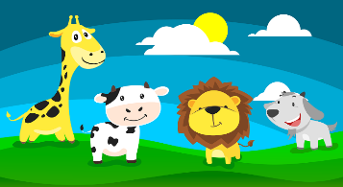
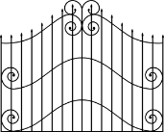
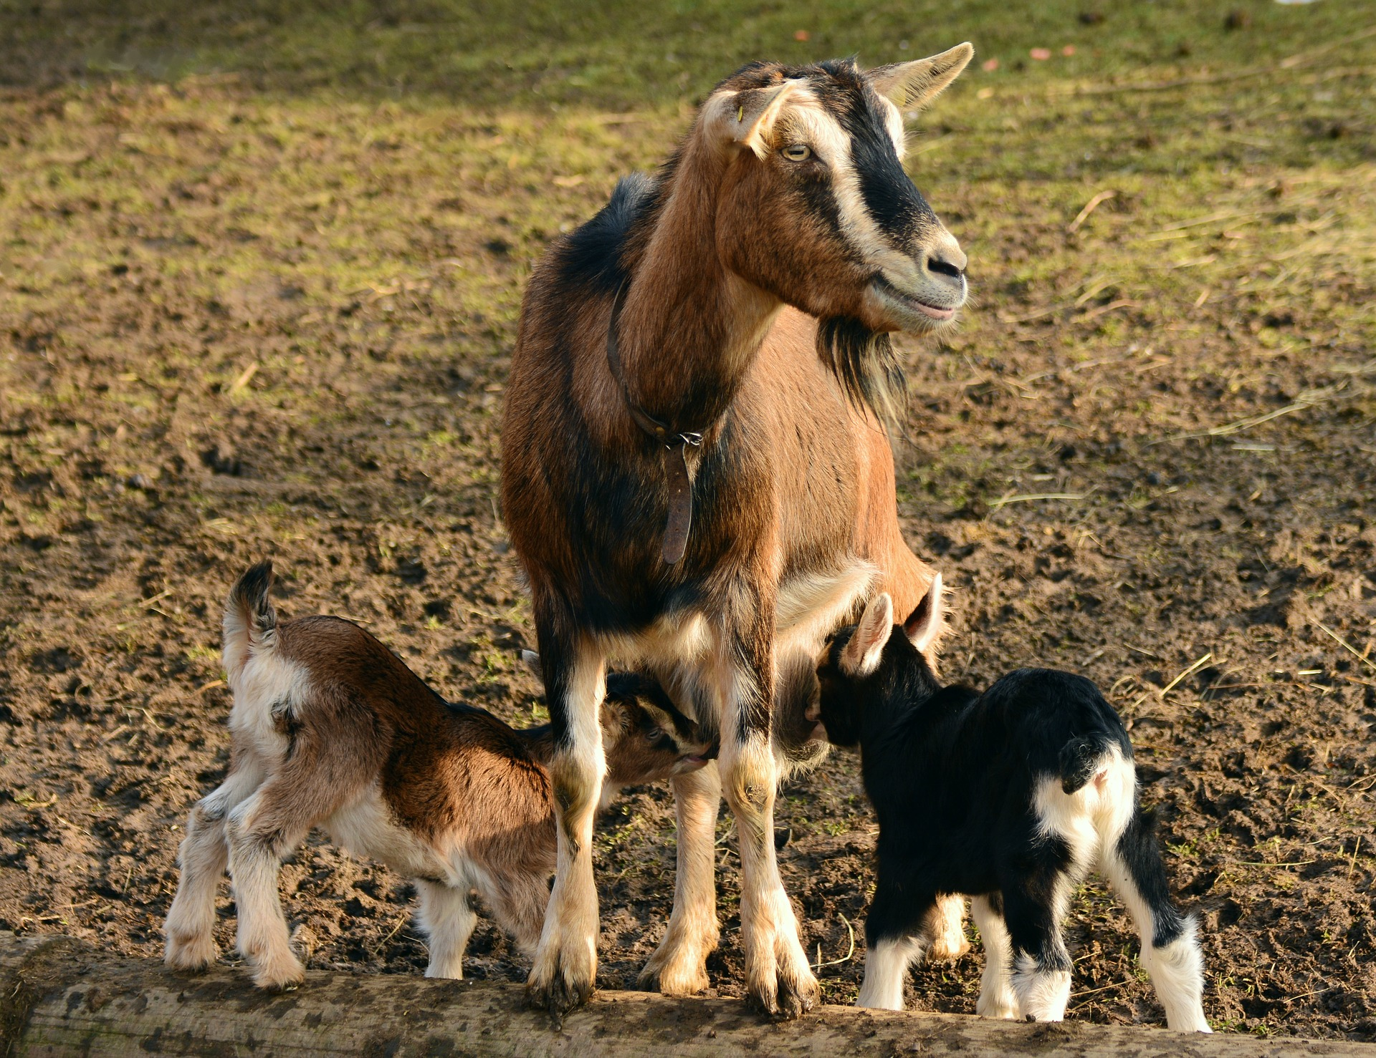
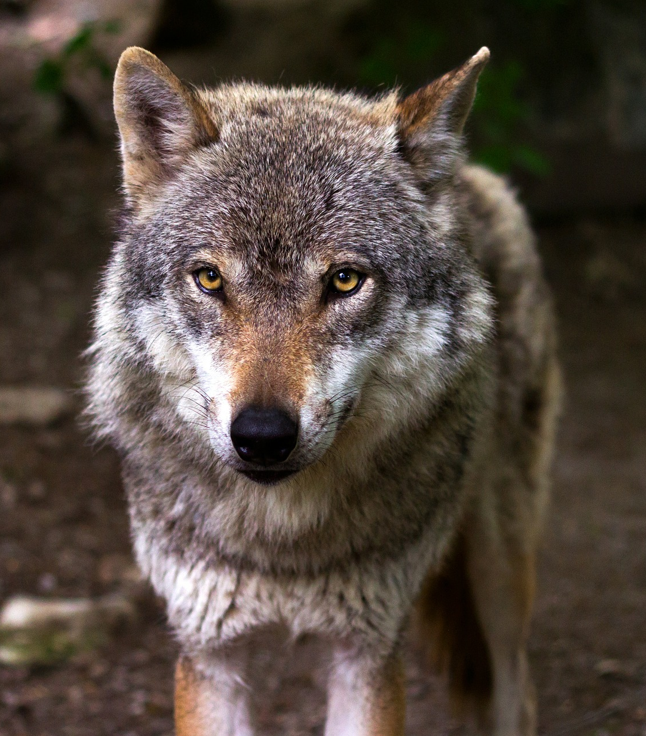
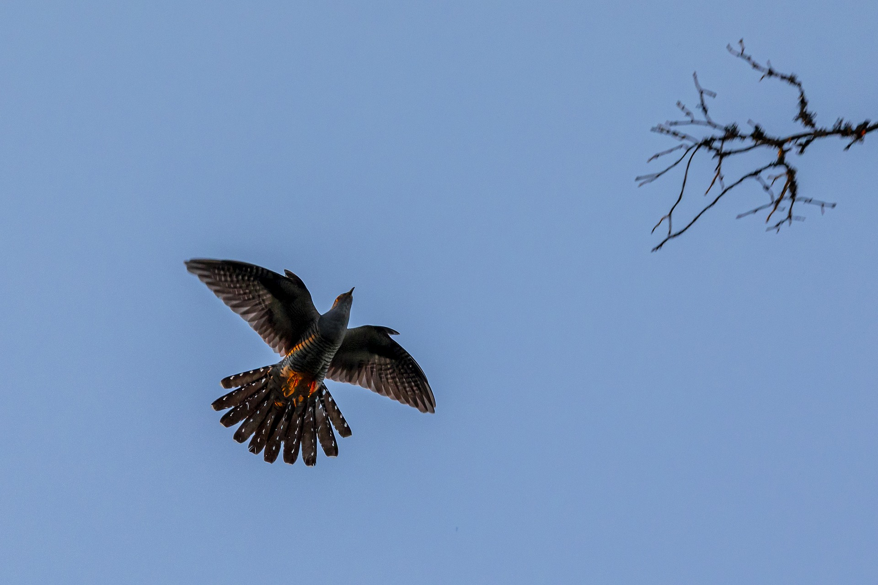
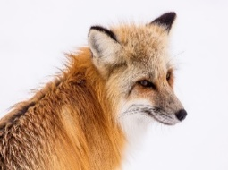
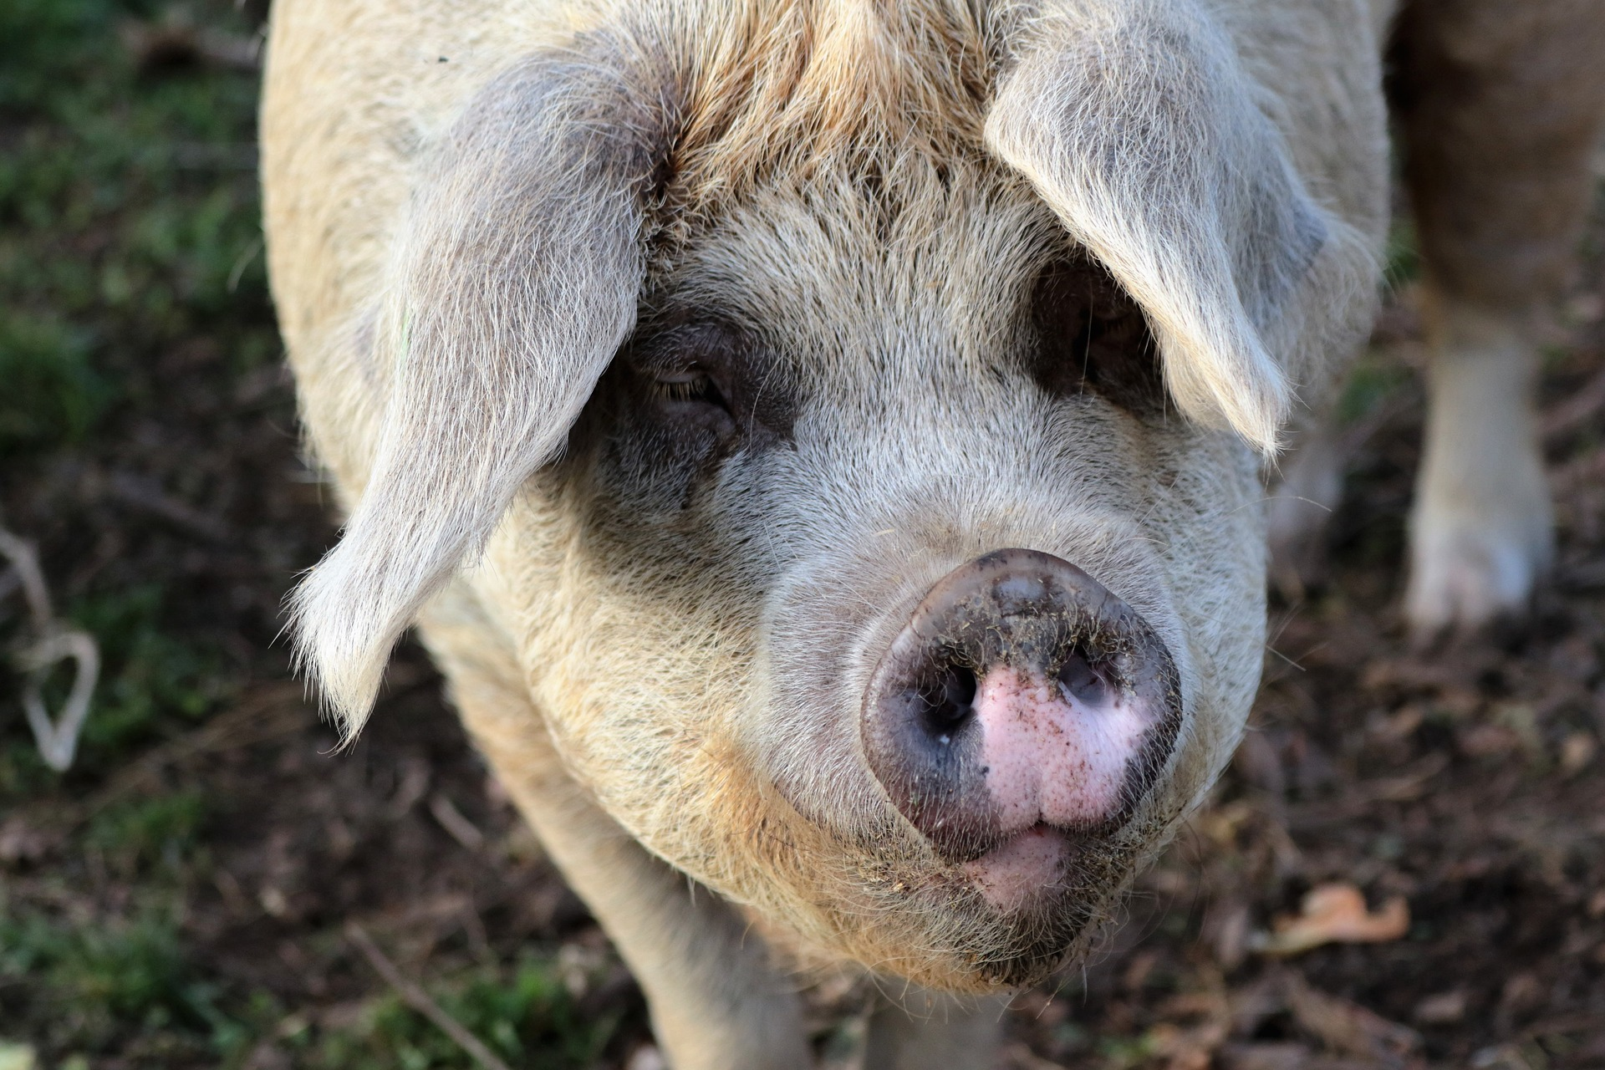
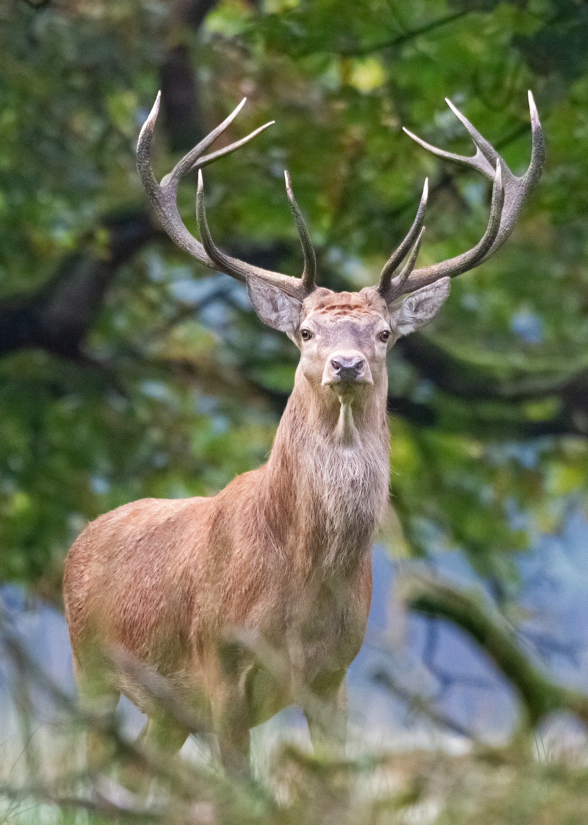
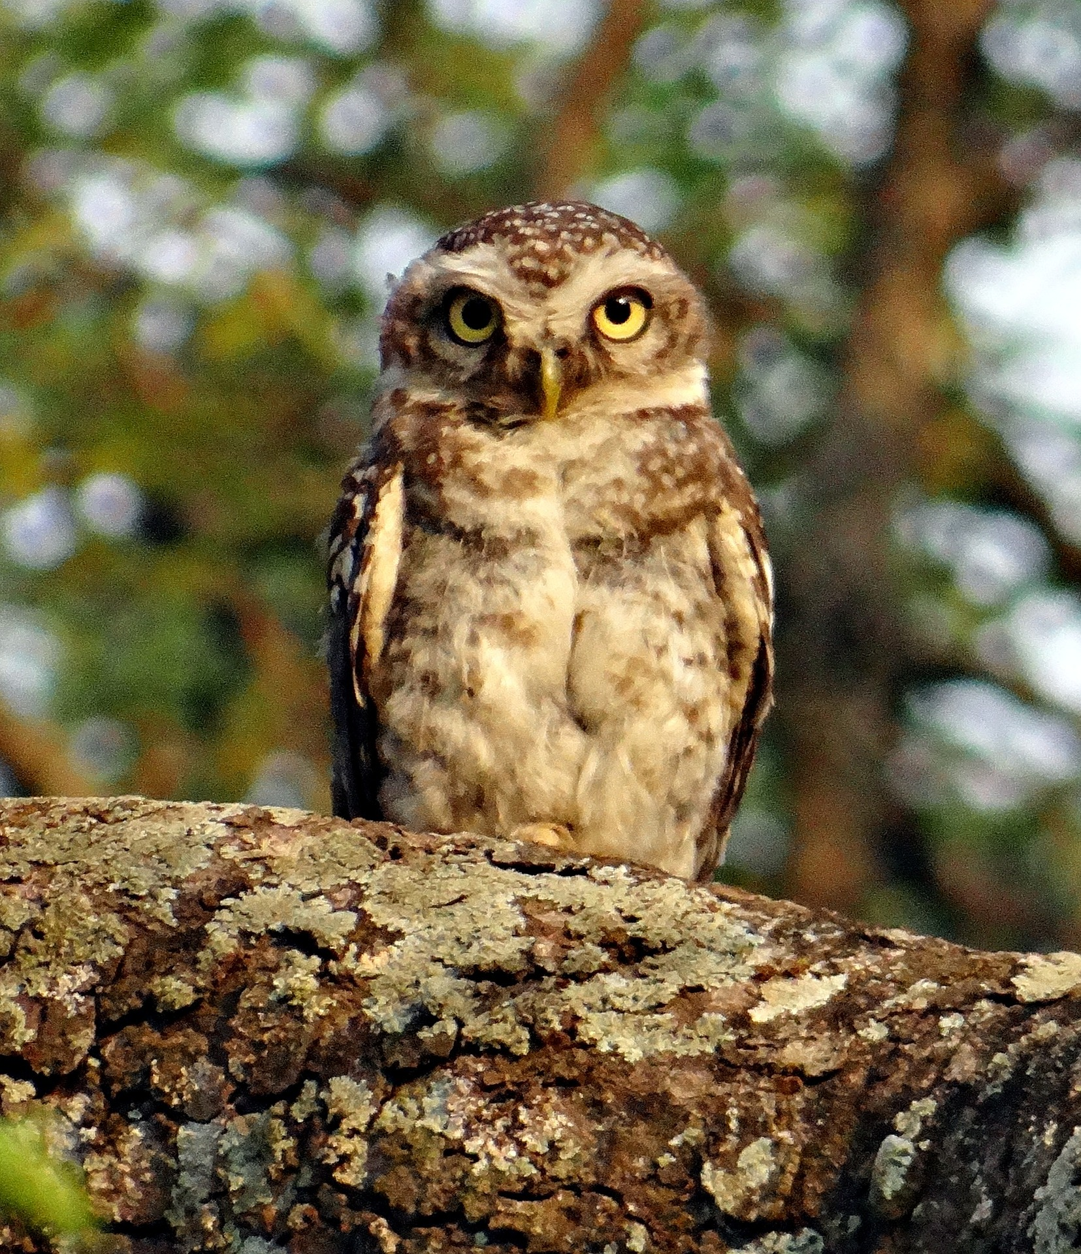
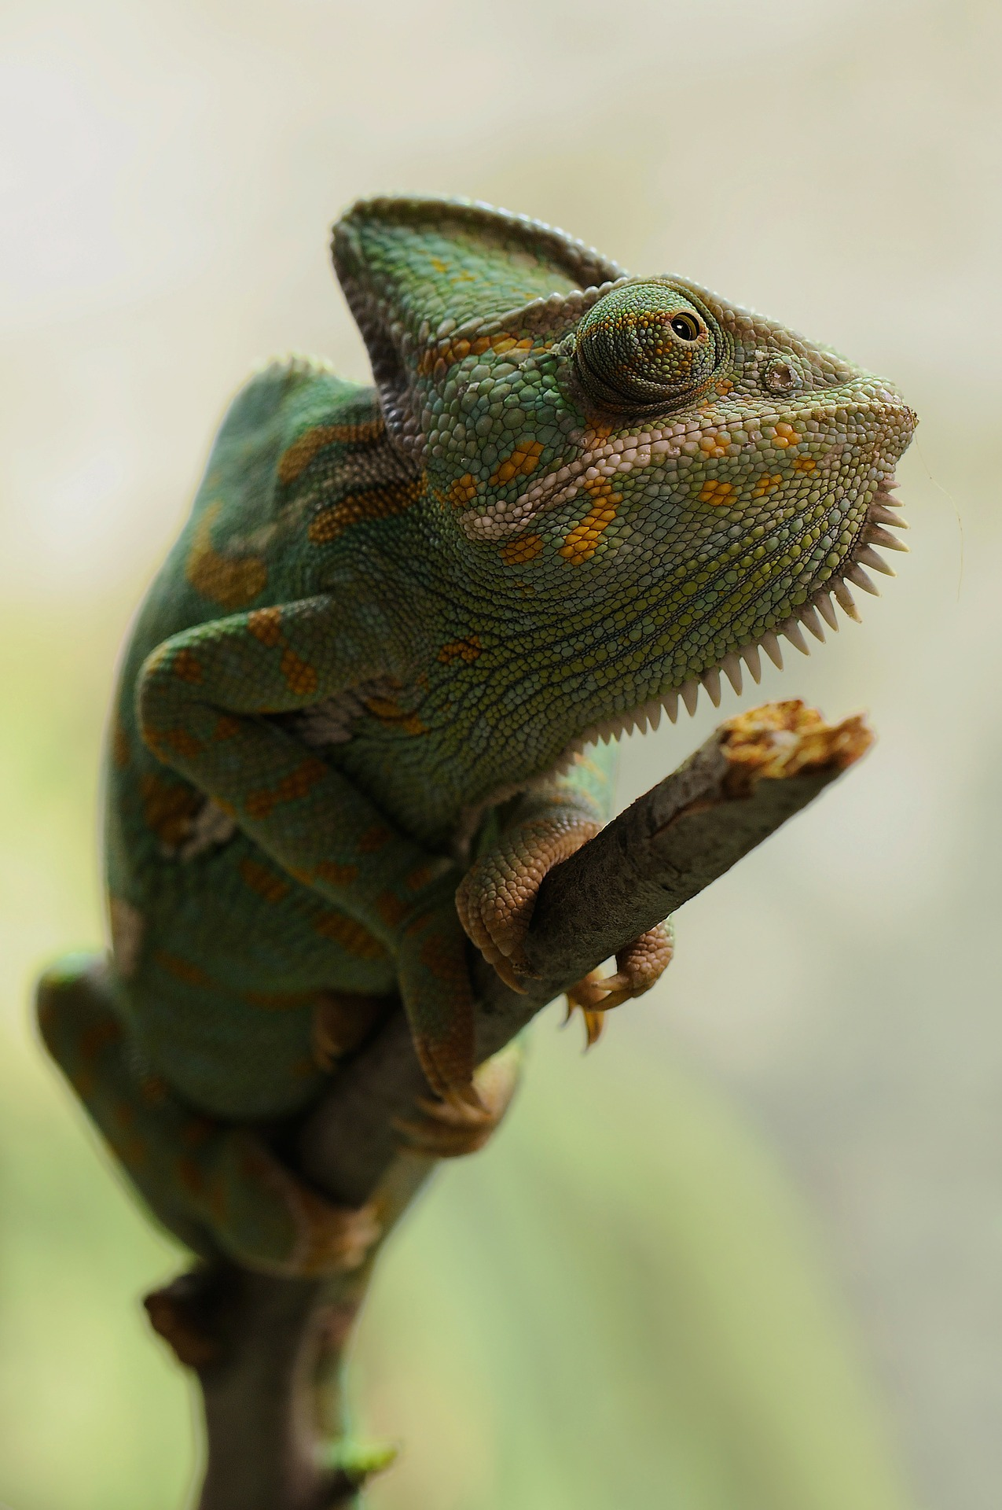
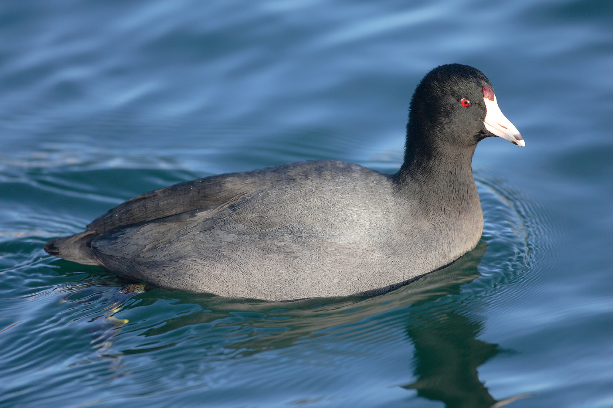
El zoo Read aloud the Spanish name of each animal.
Pupil name: ___________________________________
Total score: _____ / 10
You have not learnt these words so just use what you know about how to pronounce Spanish. ☺
Concentrate on the underlined letters.
ZOO
 | Animal | SSC [sound-symbol correspondence] | p/ x
1 | la cabra | [ca]
2 | el lobo ibérico | [co]
3 | el cuco | [cu]
4 | el lince | [ce]
5 | el porcino | [ci]
6 | el zorro | [z]
7 | la focha | [ch]
8 | el ciervo | weak + strong [ie]
9 | el mochuelo | weak + strong [ue]
10 | el camaleón | strong + strong [eo]
1 | 2 | 3
4 | 5 | 6
la cabra
el lobo ibérico
el cuco
el lince
el porcino
el zorro
7 | 8 | 9 | 10
Notes:
i) Teachers award one point for each SSC. ii) There are no points for the number of syllables questions, but these are designed to prompt pupils to think about the pronunciation of these three words.
la focha
el ciervo
el mochuelo
el camaleón
For numbers 8, 9 and 10 write the number of syllables in each word here: 8. [___] 9. [___] 10. [___]
Notes:
Teacher handout

