Slide 1
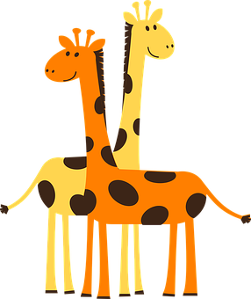
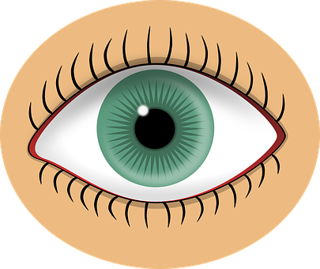
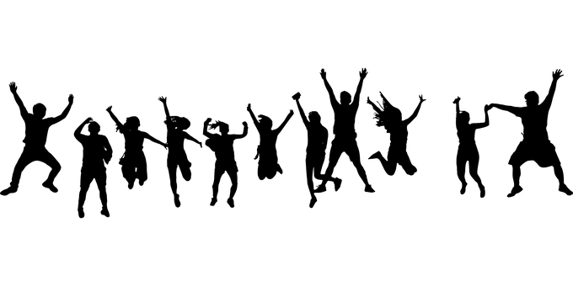
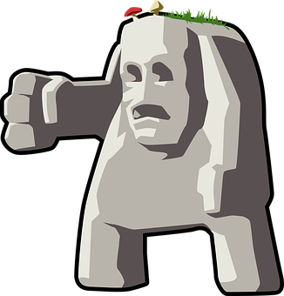
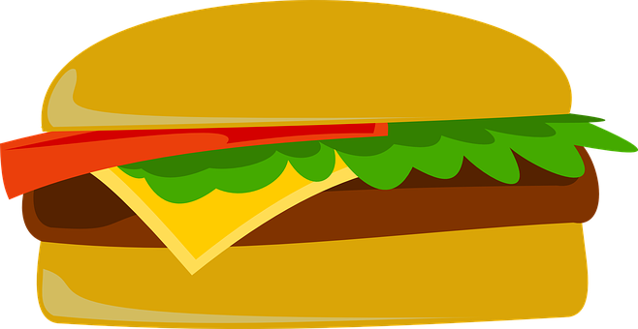
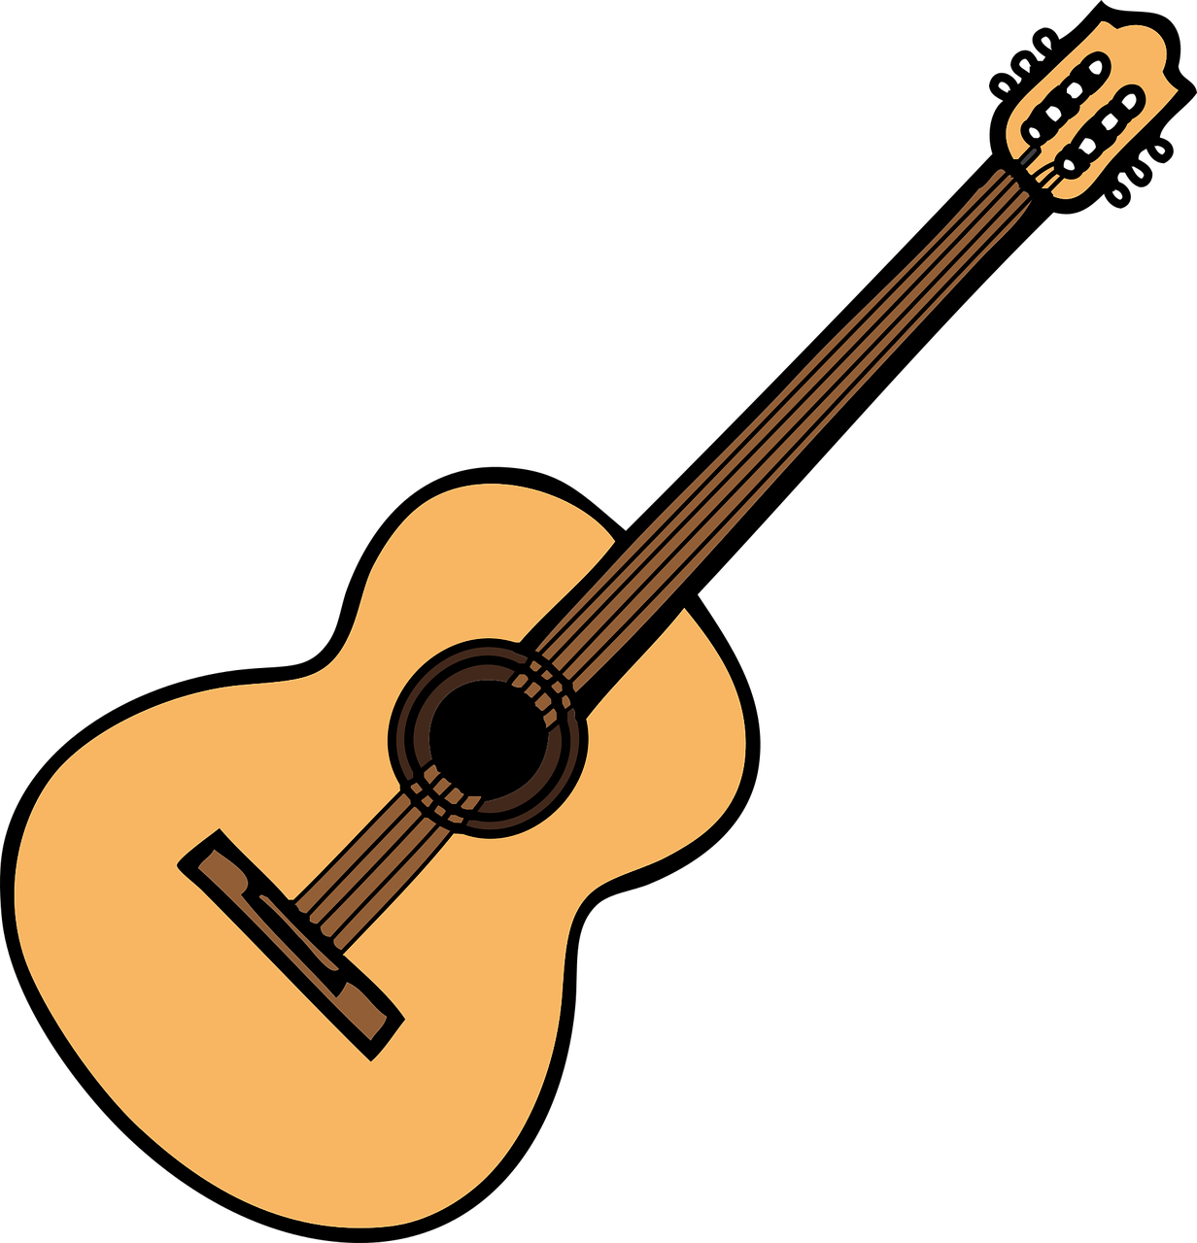
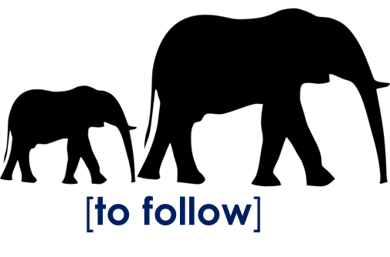
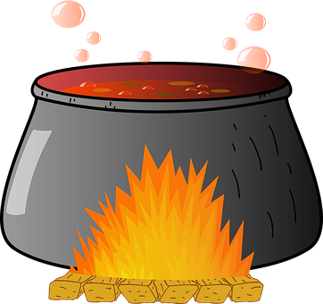
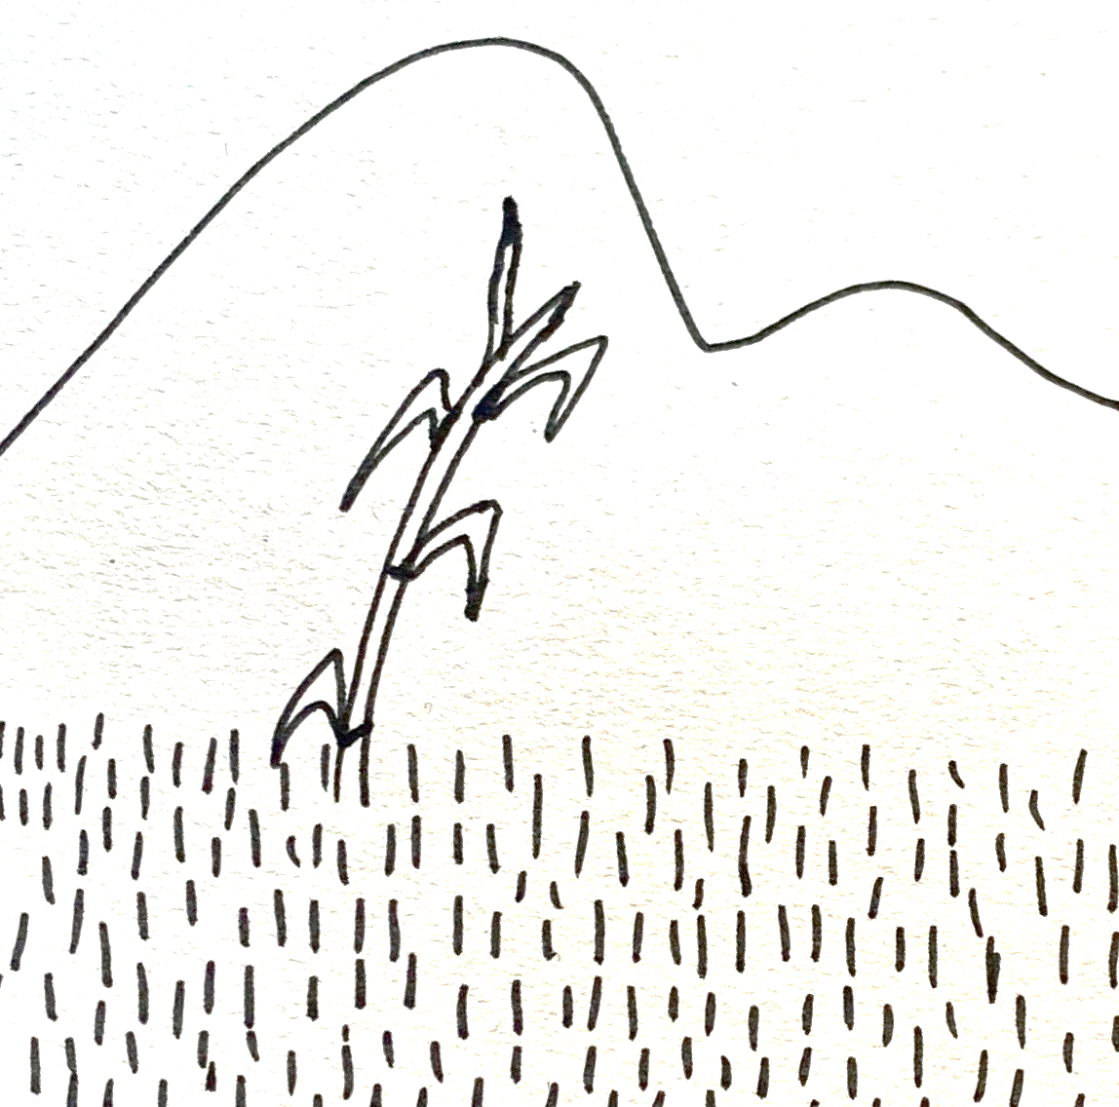
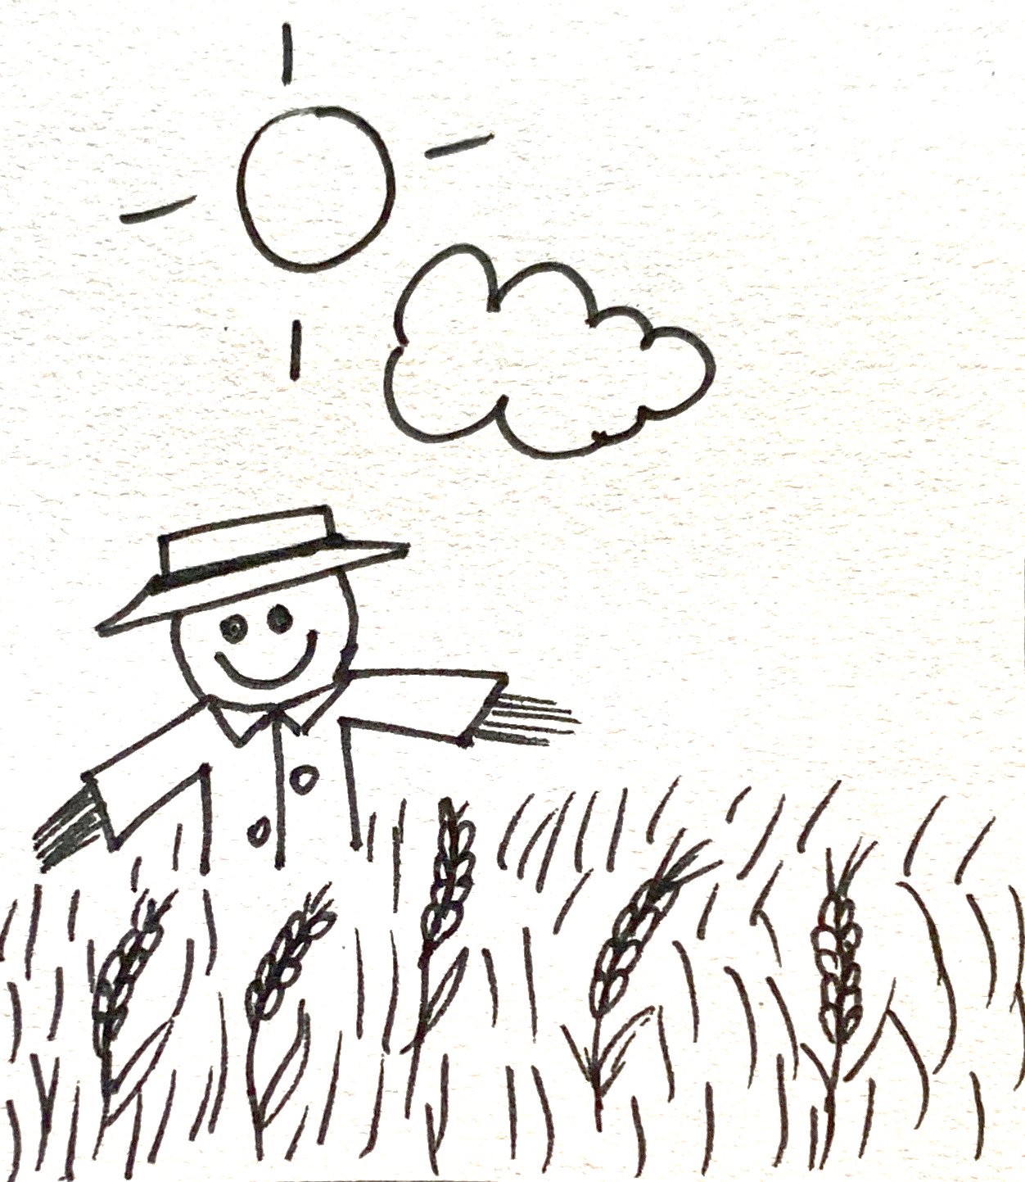
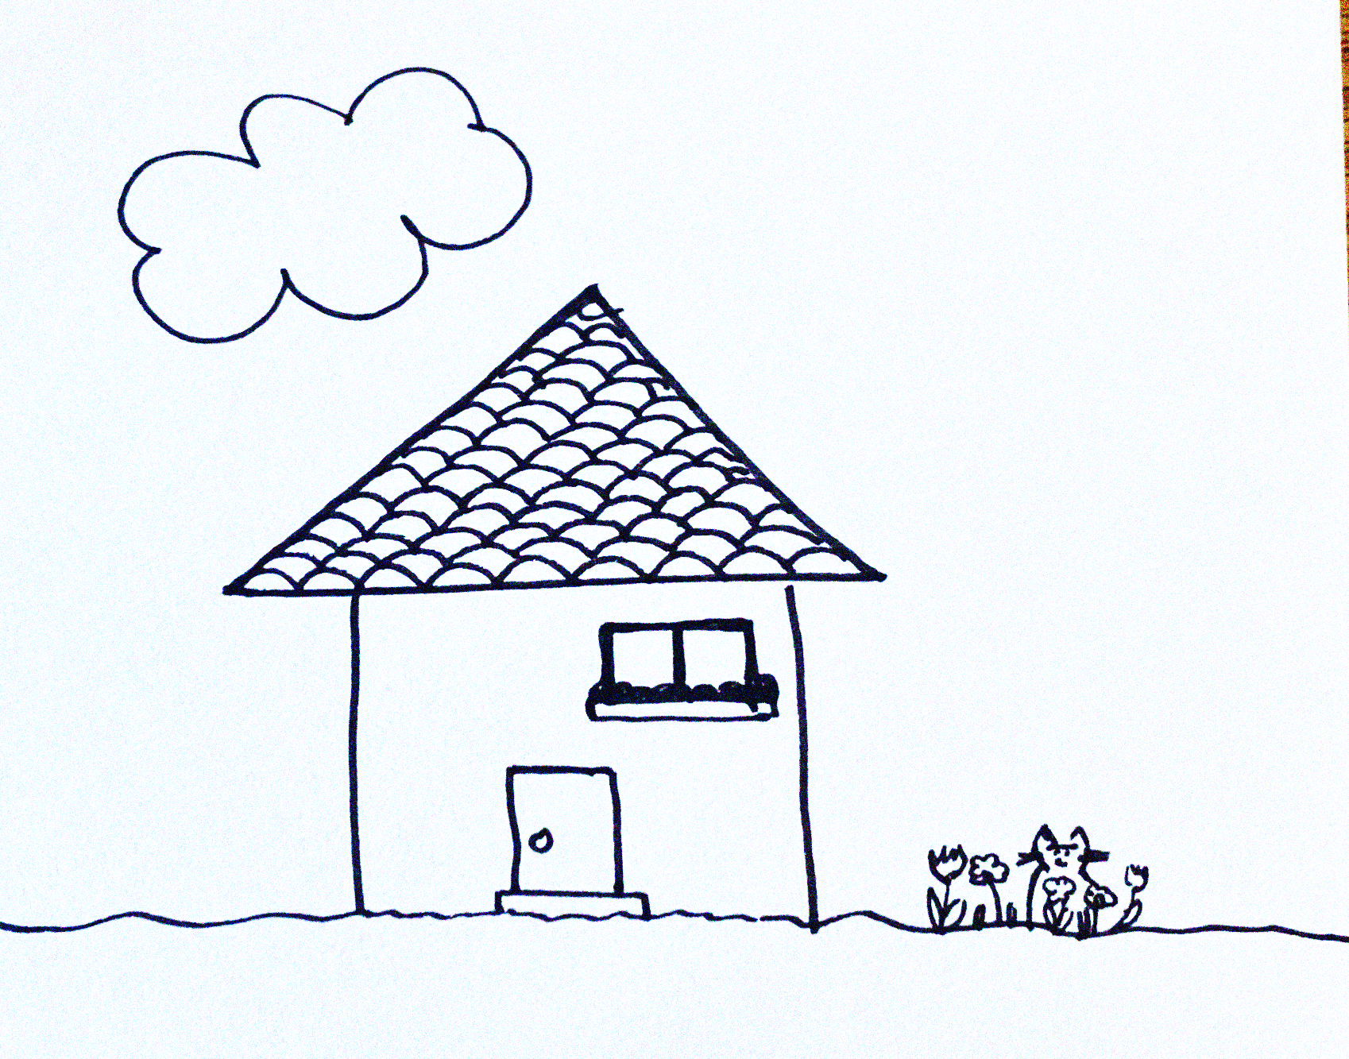
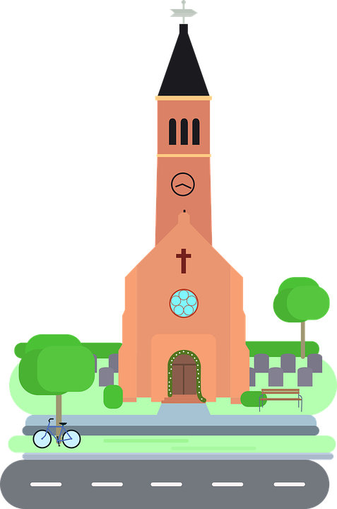
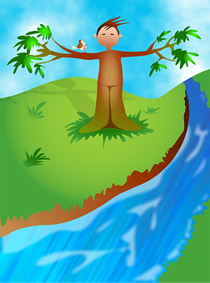
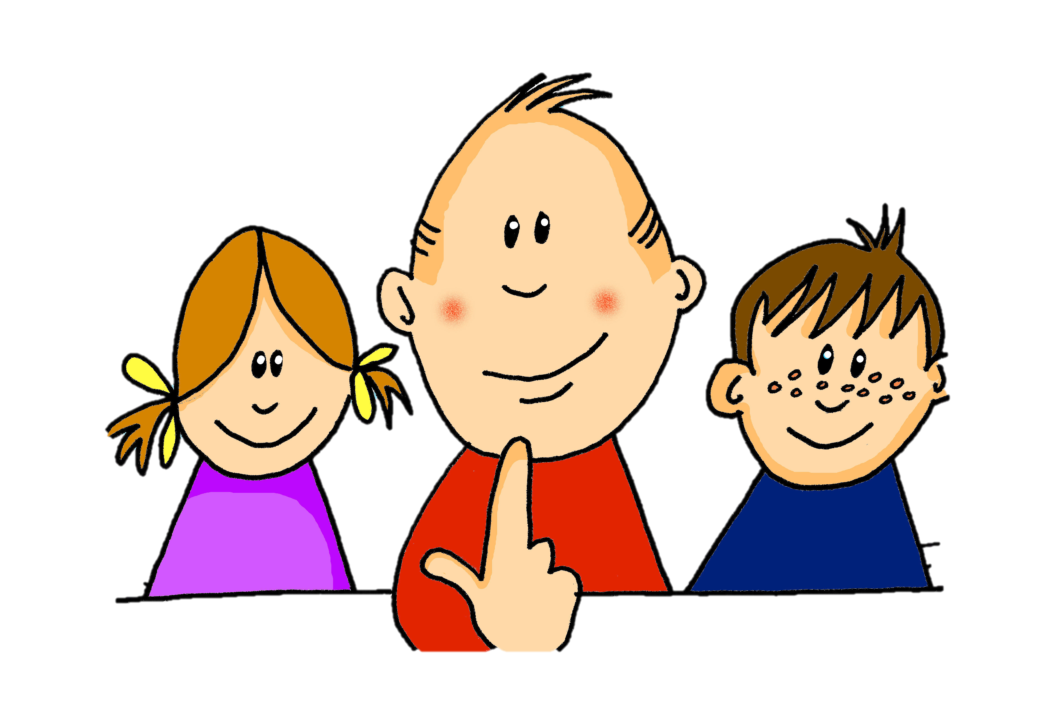
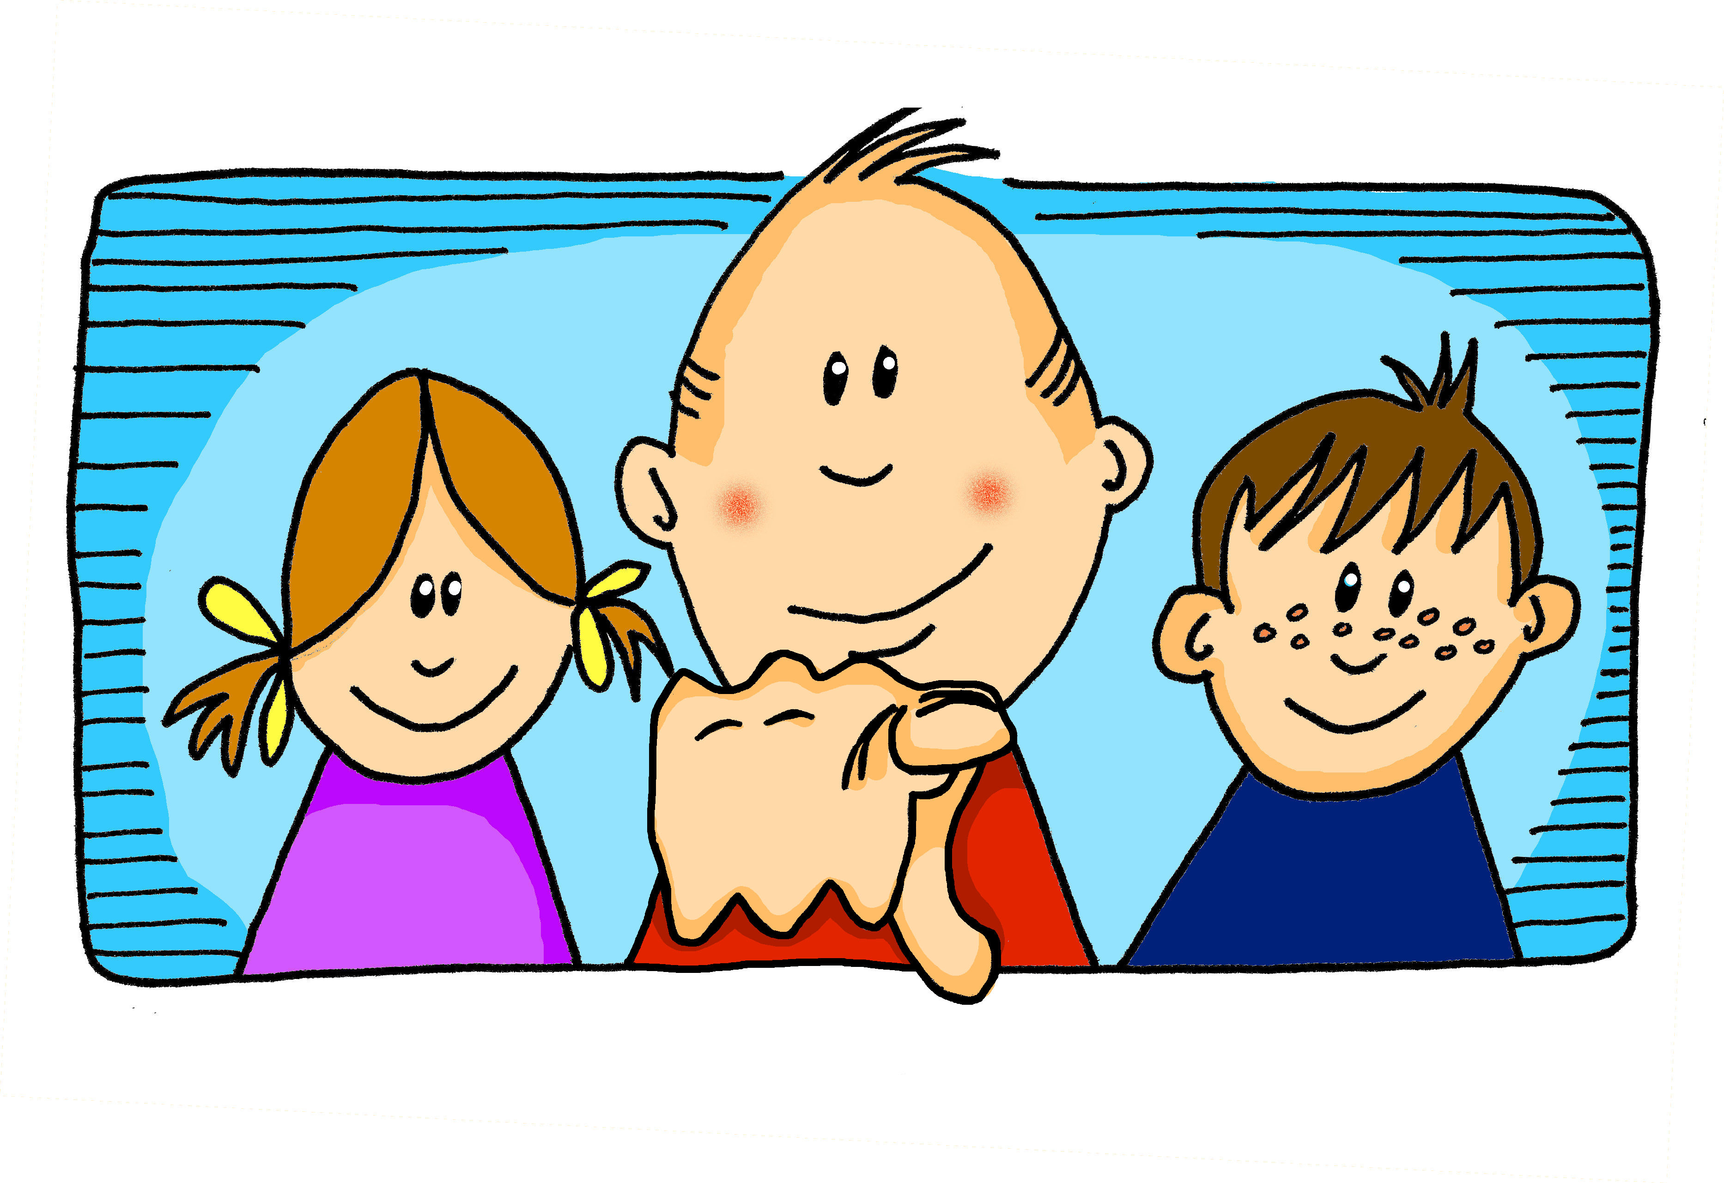
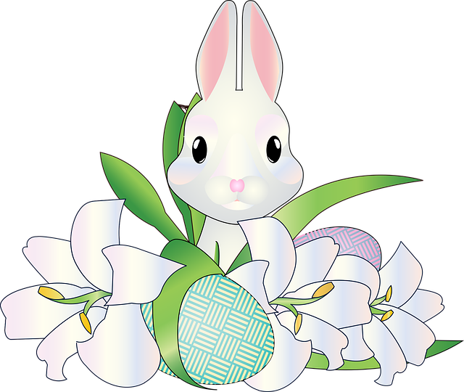
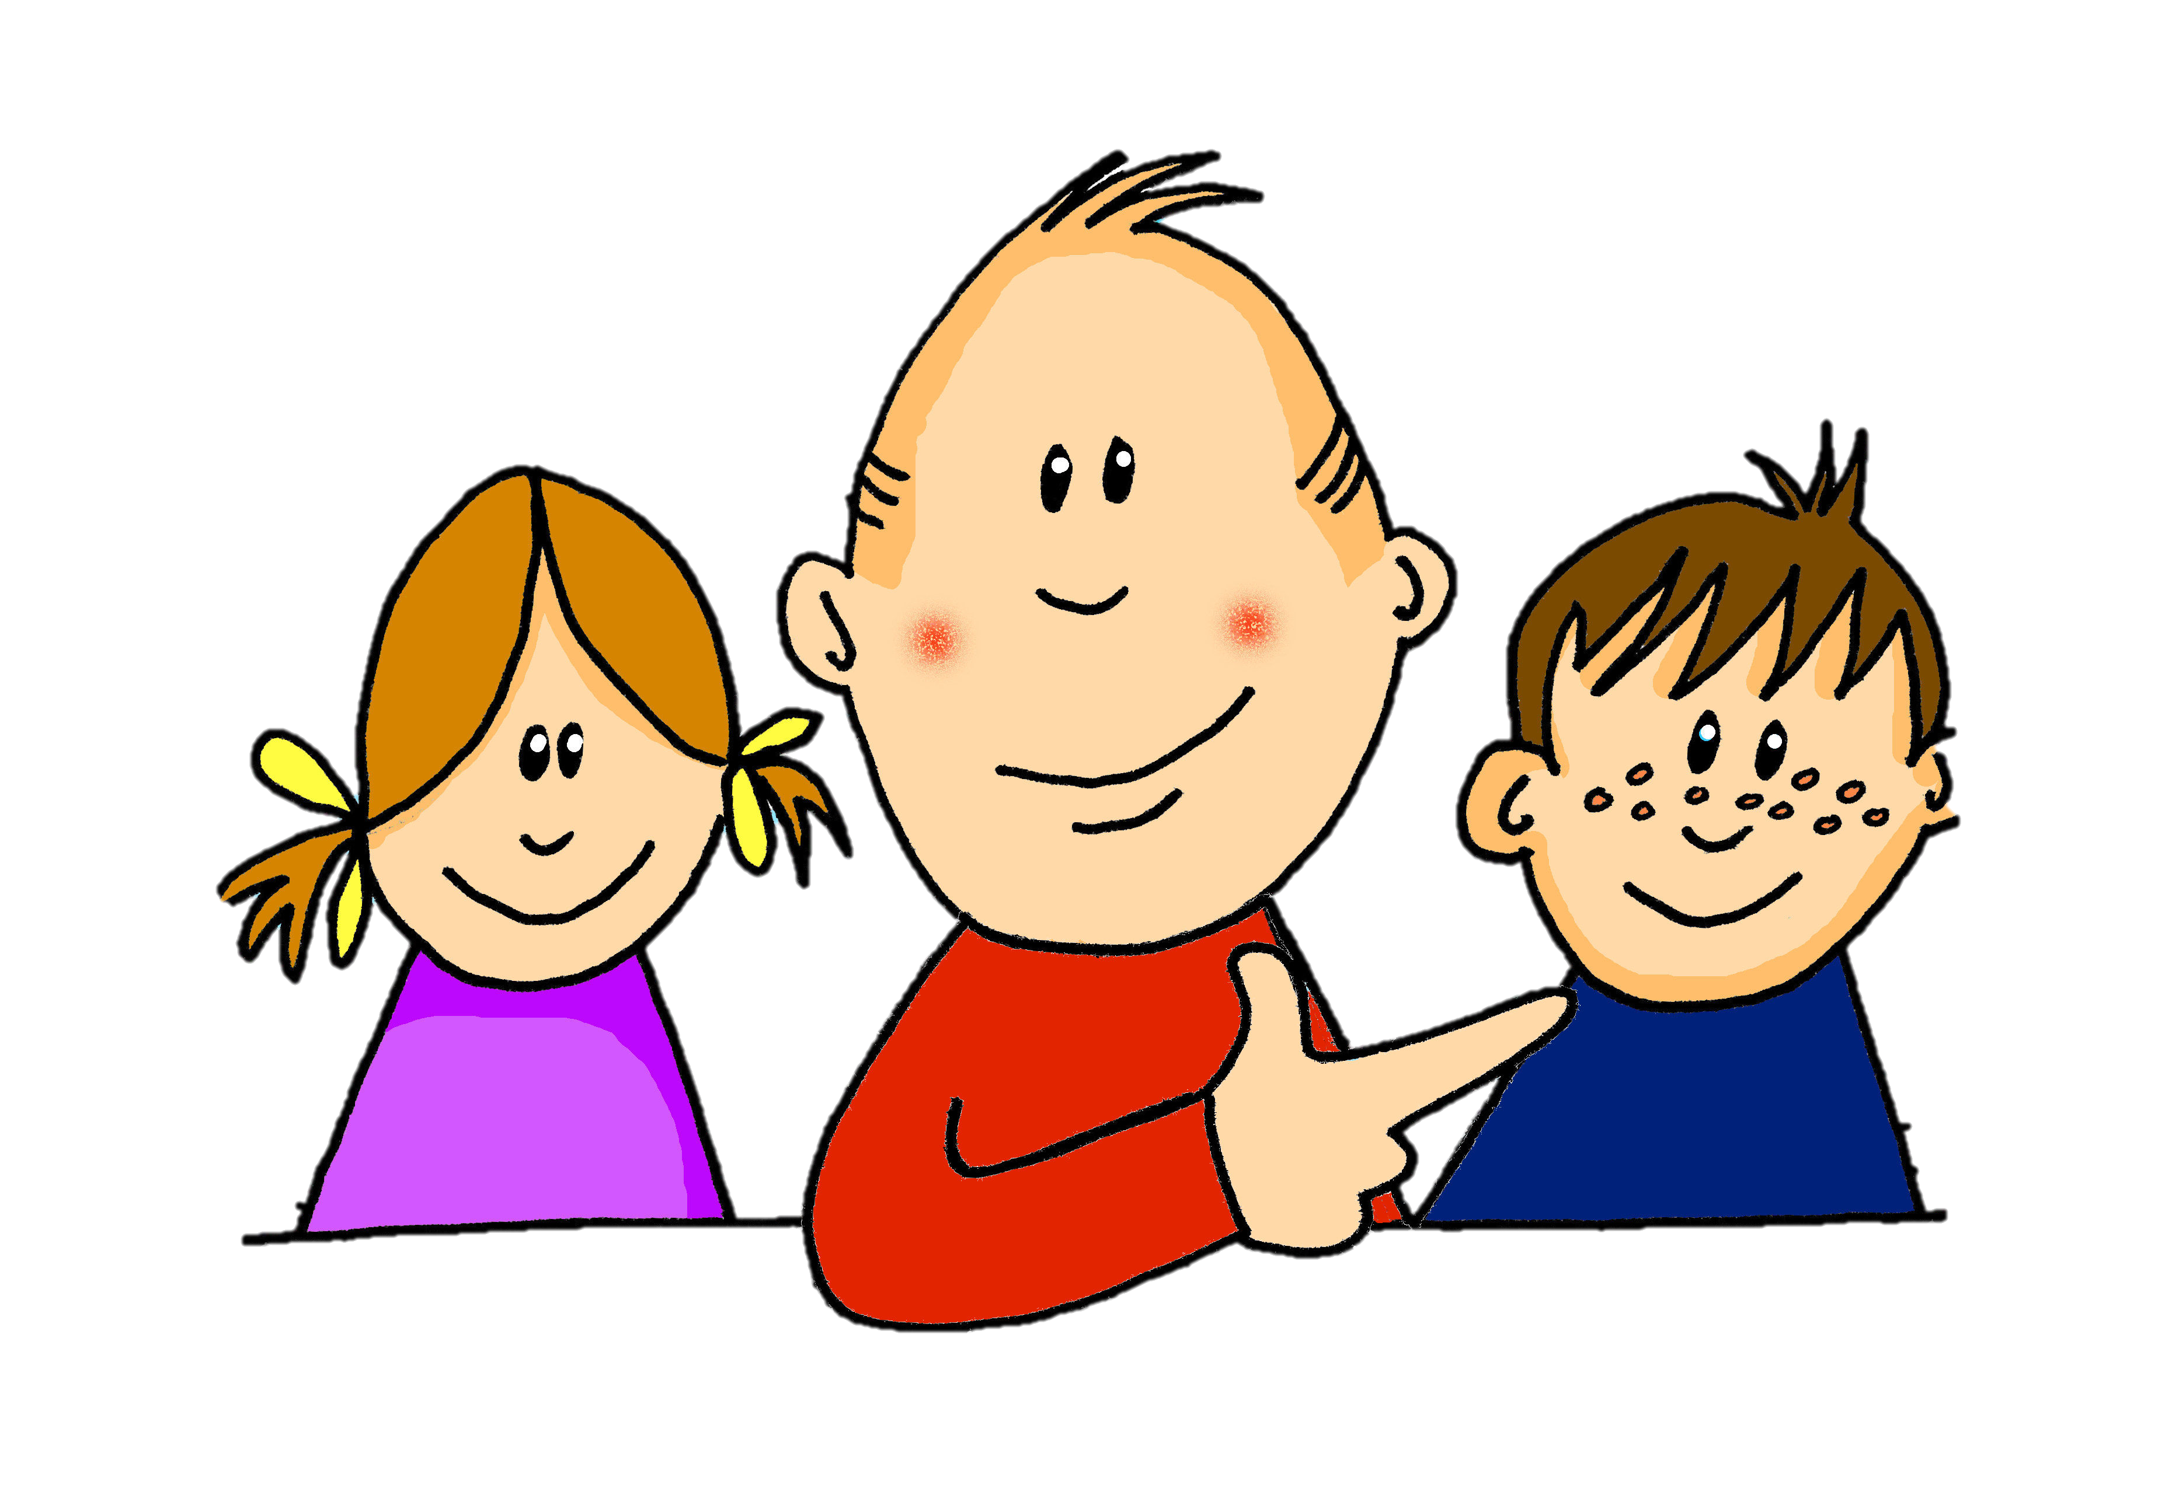
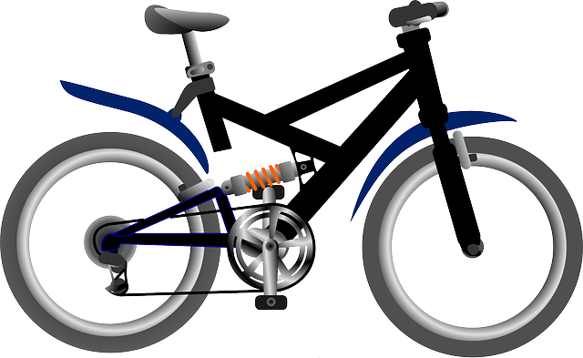
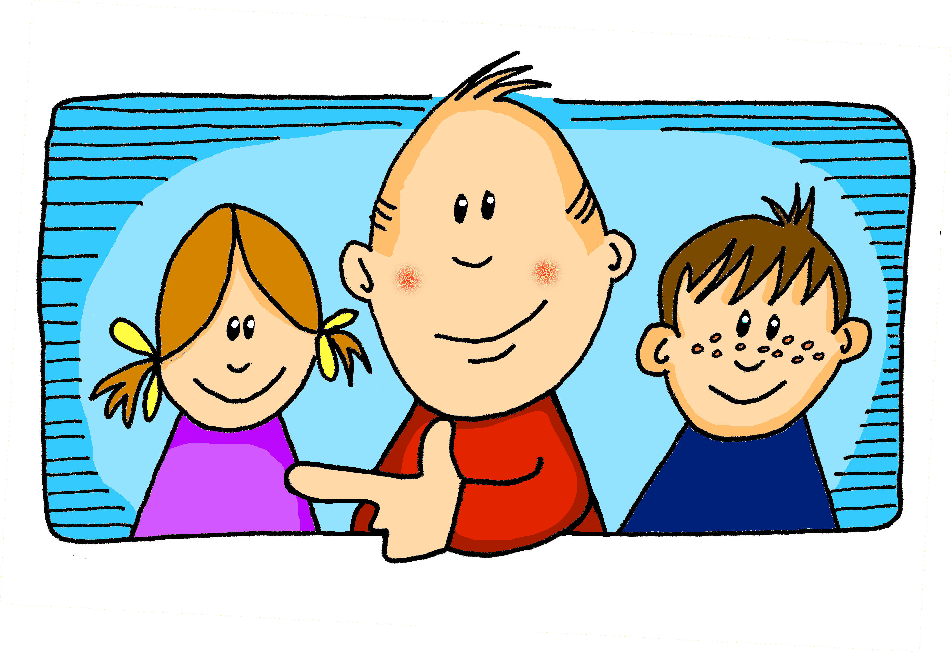
Knowledge Organiser - Summer Term A
El cumpleaños
cumpleaños (m) – birthday
mes (m)– month
en – in
mi – my
tu – your
enero – January
febrero – February
marzo – March
abril – April
mayo – May
junio – June
julio – July
agosto – August
septiembre – September
octubre – October
noviembre – November
diciembre – December
Las cosas
color (m) – colour
ciudad (f) – city
fiesta (f) – party
medio (m) – middle
nube (f) – cloud
persona (f) – person
La posición
abajo – below
arriba – above
Phonics
Amarillo
Gloria Fuertes es una poetisa de España.
[j] | ojo | rojo | pájaro | jirafa
[ge] | gesto | gemelo | Ángel 👼 | gente
[gi] | página | colegio | Imaginar | gigante
[gue] | juguete | guerra | hoguera | hamburguesa
[gui] | guitarra | seguir | guiso | guiar
‘Paisajes para que los pintes’
[Landscapes for you to paint]
Definite & indefinite articles (‘the’ vs. a/an) el río la iglesia un río una iglesia | Adjective agreement on gender Many adjectives follow the noun. Adjectives ending in –o change to –a to describe feminine nouns. When an adjective ends in –e or consonant, it can describe a feminine or masculine noun.
La descripción
alto, alta – tall
blanco, blanca – white
bajo, baja – short
débil – weak
fuerte – strong
grande – big, large
independiente – independent
negro, negra – black
preferido, preferida – preferred
verde – green
To say the use el before a masculine noun and la before a feminine noun.
To say a/an, use un before a masculine noun and una before a feminine noun.
una iglesia alta (a tall church)
En España, el día del padre es en marzo y el día de la madre es en mayo.
una montaña verde (a green mountain)
Las personas
yo – I
tú – you
él – he
ella – she
chico (m) – boy
chica (f) – girl
Using ‘es’ with months. To say ‘it is’ and ‘is’ + month of the year, we use es. Es abril. (It is April.) We also use es with days of the week. Hoy es miércoles. (Today is Wednesday) | Subject pronouns for clarity and emphasis | Possessive adjectives Use ‘mi’ and ‘tu’ before singular nouns. It doesn’t matter if the noun is masculine or feminine. Mi bicicleta es negra. Tu caballo es negro.
Sometimes, when comparing, we use subject pronouns to emphasise the difference.
This can also help us avoid confusion and make it clear who we are talking about.
Conectores 🔗
pero – but
también – also, too
y - and
(My bike is black.)
Ella es fuerte pero yo soy débil.
(Your horse is black.)
(She is strong, but I am weak.)

Slide 2
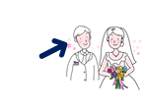
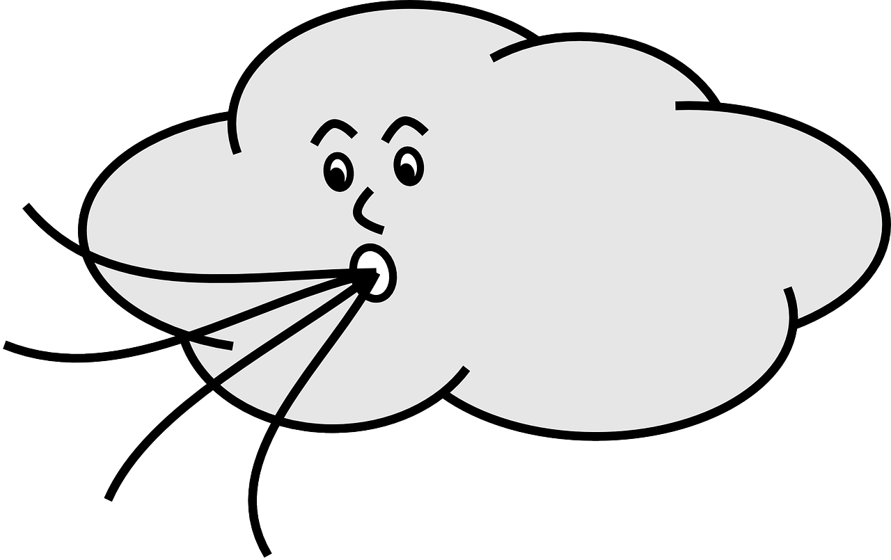
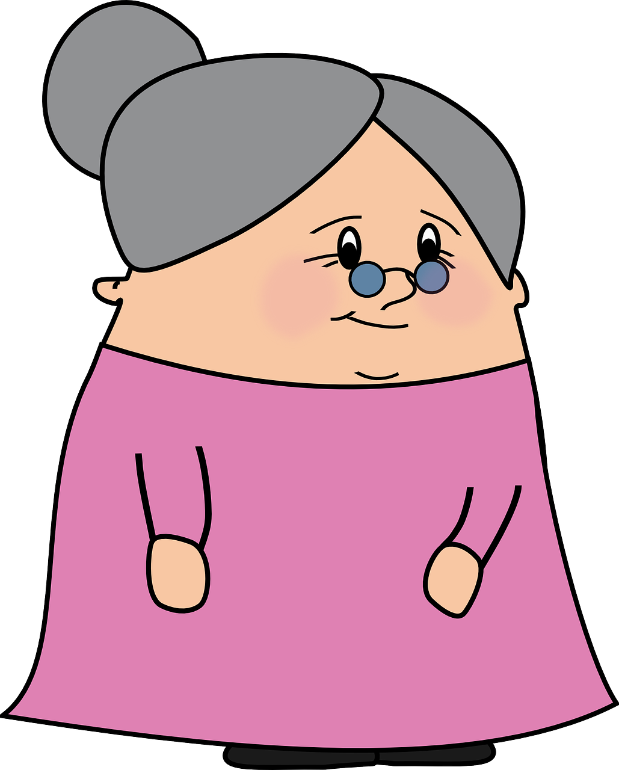
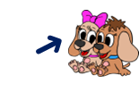
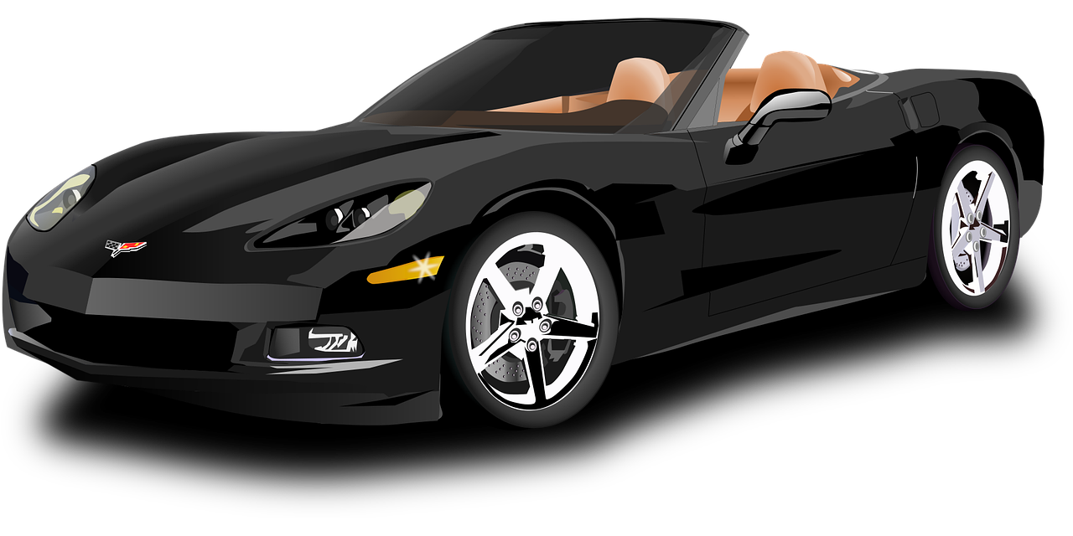
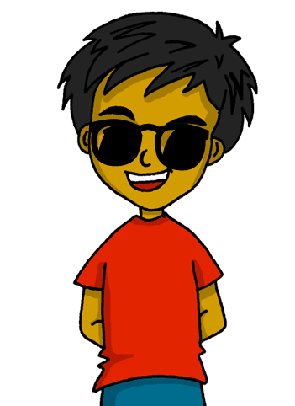
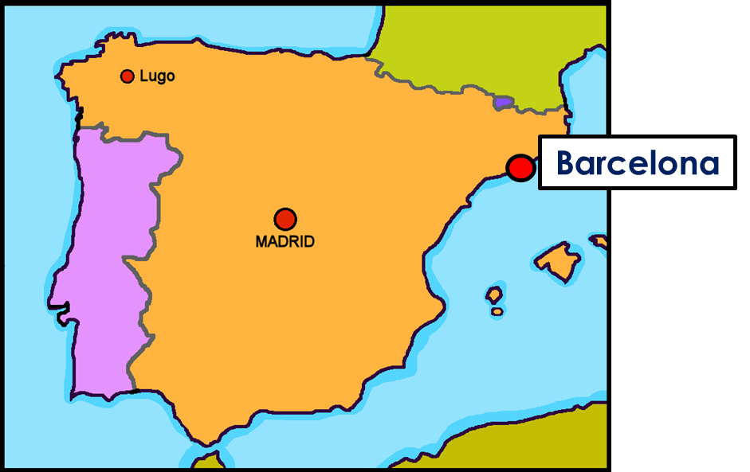
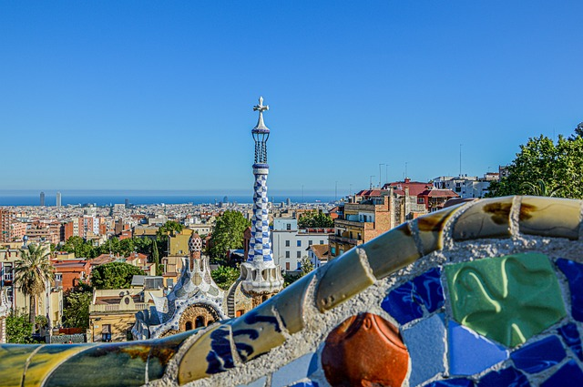
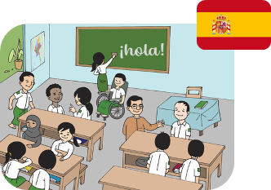
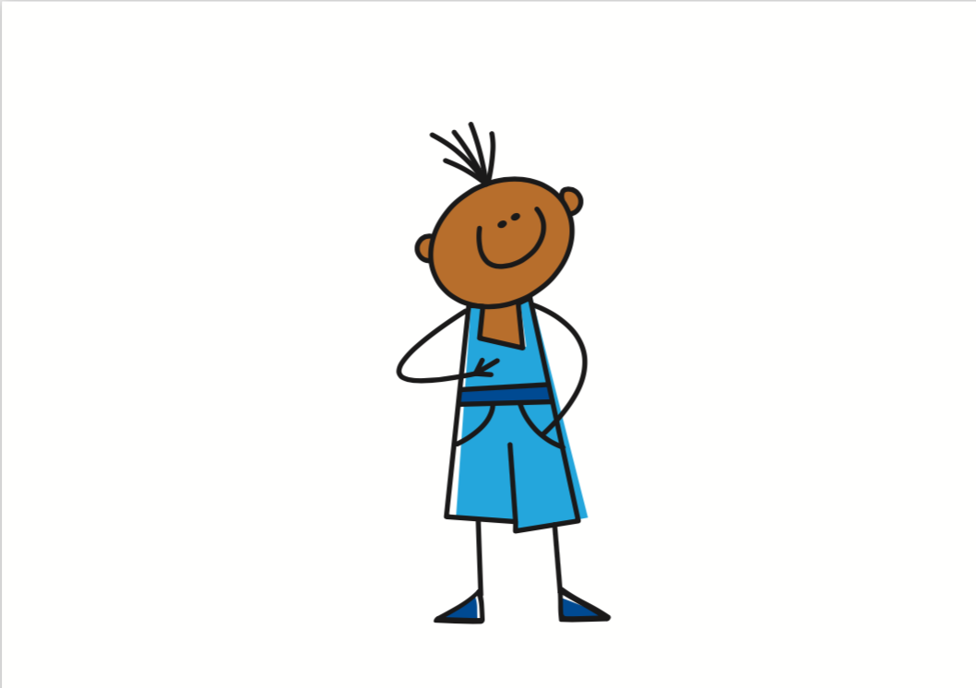
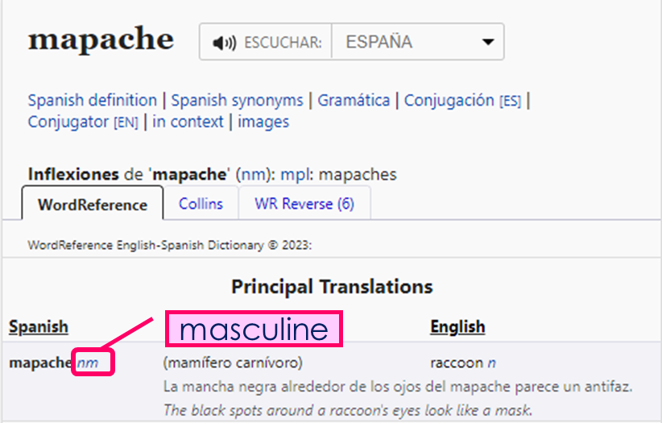
Knowledge Organiser - Summer Term B
Las cosas
cocina (f) – kitchen
lugar (m) – place
música (f) – music
Los estados
calor (m) – heat
frío (m)– cold
miedo (m) – fear
sueño (m) – sleepiness
Las acciones
amar – to plove, loving
escuchar – to listen, listening
hablar – to speak, speaking
odiar – to hate, hating
organizar – to organise, organising
tocar – to play, playing (an instrument)
La descripción
cada – each
difícil – difficult
fácil – easy
famoso, famosa – famous
los – (the, masc., plural.)
las – (the, fem., plural.)
típico,típica– typical
Conectores 🔗
luego - then
pero – but
también – also, too
y - and
Phonics
Amarillo
[n] | mano | novio | nube
[ñ] | español | niña | pañuelo
handkerchief
[v] | ver | vela | viento
[b] | abuela | banco | bolsa
¿Qué es la siesta?
It’s common to take a mid-day break in Spain, also known as ‘siesta time’. The majority of working-age people don’t actually go home to nap though 😉.
[r] | parar | caro | pero
[rr] | correr | carro | perra
[h] | helado | humano | ahí
(there)
Using tener to be 'be’ In Spanish, we sometimes also use tener to mean ‘to be, being’: | Plural definite article [los / las] To say ‘the’ before a plural noun (more than one), use ‘los’ with masculine nouns and ‘las’ with feminine nouns. | Giving your opinion We use the definite article after opinion verbs (amar, odiar).
Present tense –AR verbs | Present tense – ER verbs | Using reference materials [Understanding symbols] Symbols give important information about the word (type of word and gender).
¡Verano!
Tengo calor.
(I am hot.)
Tienes frío.
el libro → los libros
la clase → las clases
Odia el verde.
(s/he hates the colour green)
Amo las fiestas.
(I love festivals)
(You are cold.)
Tiene sueño.
(the book – the books)
(S/he is sleepy.)
Tengo ocho años.
(I am eight years old.)
(the class – the classes)
escuchar – to listen|listening
escucho ➜ I listen escuchas ➜ you listen escucha ➜ he listens escucha ➜ she listens
escucha ➜ it listens
comer - to eat|eating como ➜ I eat comes ➜ you eat come ➜ he eats come ➜ she eats
come ➜ it eats
El parque Güell está en
Barcelona
n = noun
m = masculine
It was designed by Antoni Gaudí, a very famous Spanish architect.
f = feminine

