Slide 1
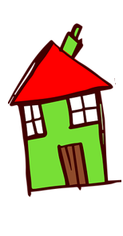
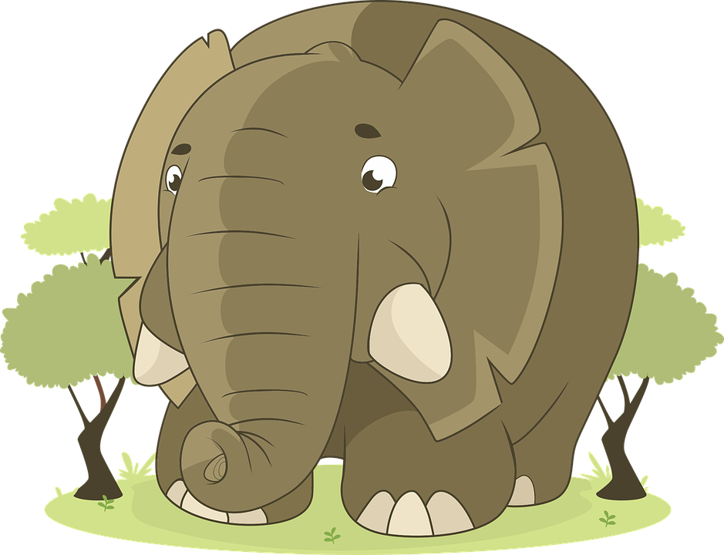
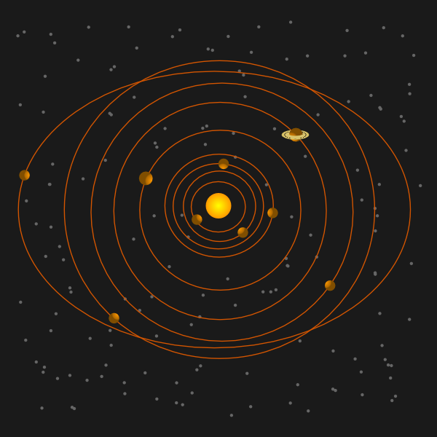
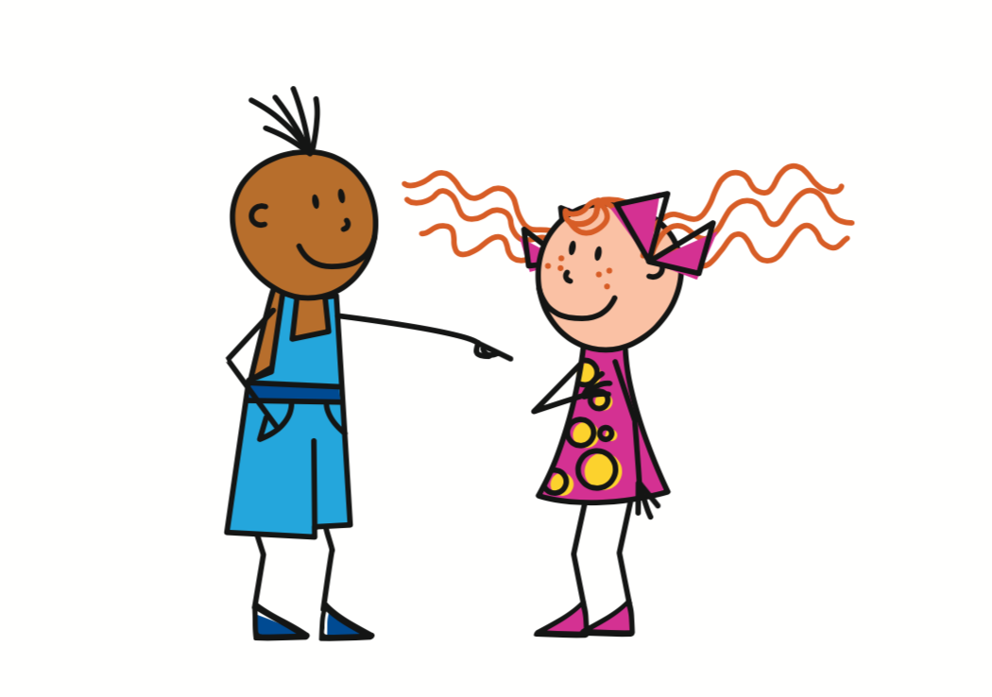
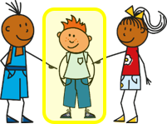
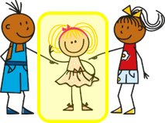
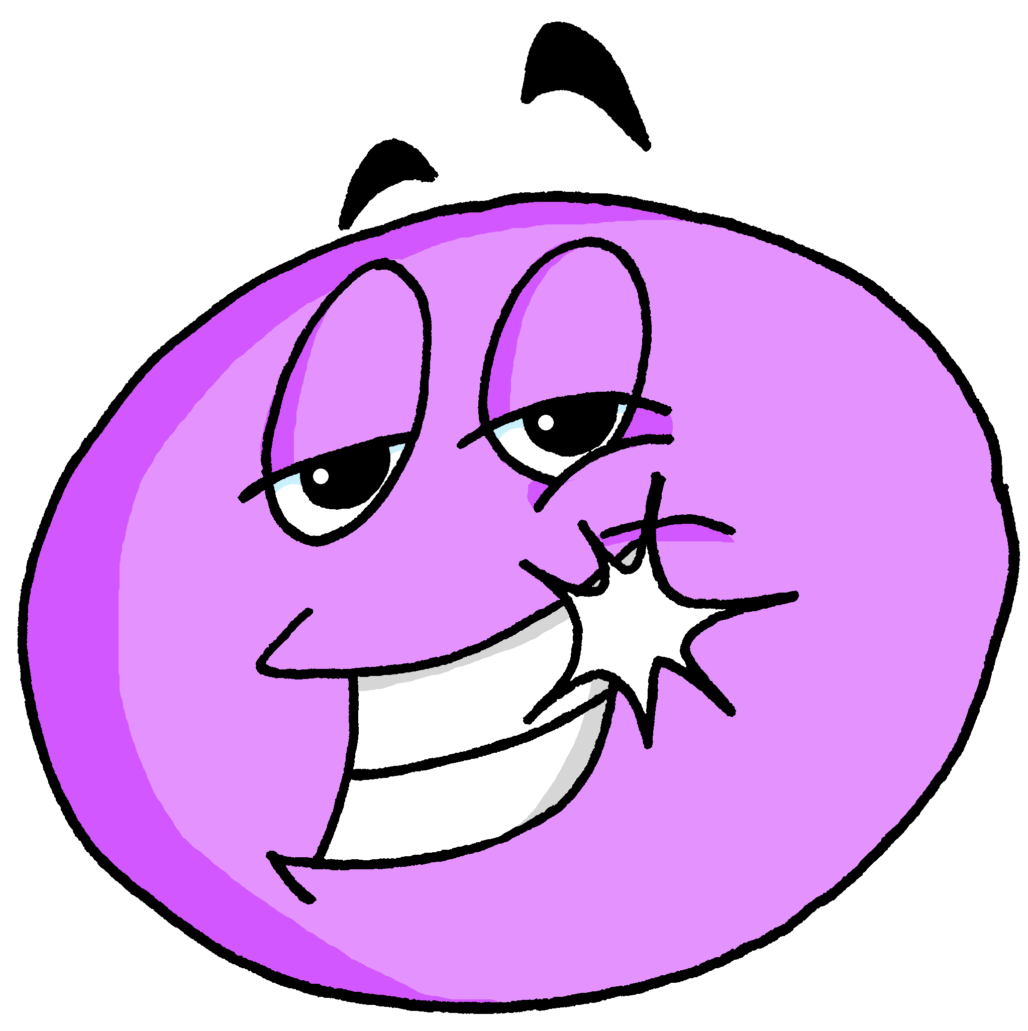
Amarillo Knowledge Organiser - Autumn Term A
En clase (In class)
estar – to be | being (location, state)
estoy – I am
estás – you are
está – s/he, it is
presente – present
ausente – absent
aquí – here
allí – there
¡Hola! - hello
¡Buenos días! – good morning
¡Buenas tardes! – good afternoon
hoy – today
ahora – now
siempre – always
normalmente – usually
¿cómo? – how?
¿dónde? – where?
¿qué? – what?
en – in
de – from
sí – yes
no - no
La descripción
ser – to be | being (trait)
soy – I am
eres – you are
es – s/he, it is
enfermo, enferma – sick, ill (m), sick, ill (f)
perdido, perdida – lost (m), lost (f)
preparado, preparada – ready (m), ready (f)
activo, activa – active (m), active (f)
cómodo, cómoda – comfortable (m, f)
imposible – impossible (m), impossible (f)
increíble – incredible (m), incredible f)
pesado, pesada – annoying (m), annoying (f)
positivo, positiva – positive (m), positive (f)
sano, sana – healthy (m), healthy (f)
(un) día – (a) day
lunes – Monday
martes – Tuesday
miércoles – Wednesday
jueves – Thursday
viernes - Friday
sábado – Saturday
domingo - Sunday
Phonics
[a] | [o] | [u] | [e] | [i]
Only use with estar as these are temporary states.
casa
dos
universo
elefante
idea
[ca] [co] [cu]
cama
contar
cucaracha
Describing location and state with the verb estar | Adjective agreement for gender | Asking yes/no questions
Describing permanent traits with the verb ser | More adjective patterns | Asking WH-questions
Change a statement into a question by raising your voice at the end.
estás
In Spanish, adjectives ending in –o change to –a to describe feminine nouns. People are nouns, too.
estoy
you are
está
I am
s/he, it is
Estás en España.
You are in Spain.
estar
➜
¿Estás en España?
Está contento.
Are you in Spain?
to be|being
He is pleased.
Está contenta.
In writing, add a ¿ at the start of a question in Spanish as well as a ? at the end.
She is pleased.
Adjectives already ending in –e or –z stay the same:
To ask information questions, begin with question word and raise your voice at the end.
eres
es
Es increíble.
soy
you are
He is incredible.
I am
s/he, it is
Es increíble.
¿Cómo estás?
ser
She is incredible.
How are you?
Es capaz.
¿Dónde estás?
to be|being
Where are you?
He is able.
Es capaz.
¿Cómo eres?
She is able.
What are you like?

Slide 2
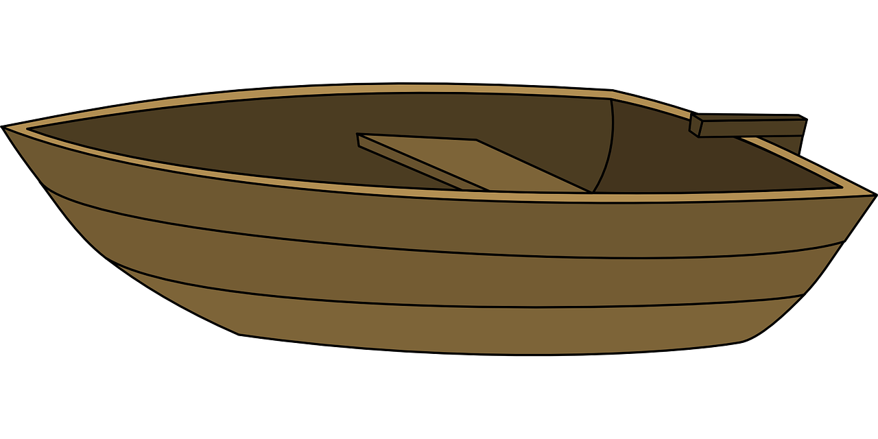
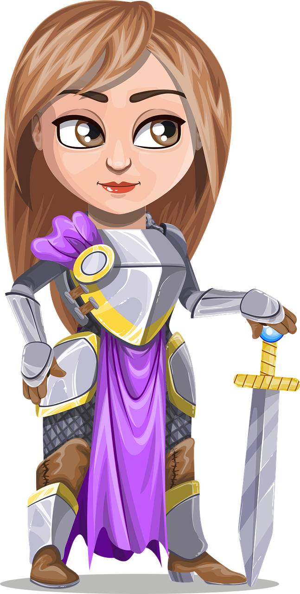
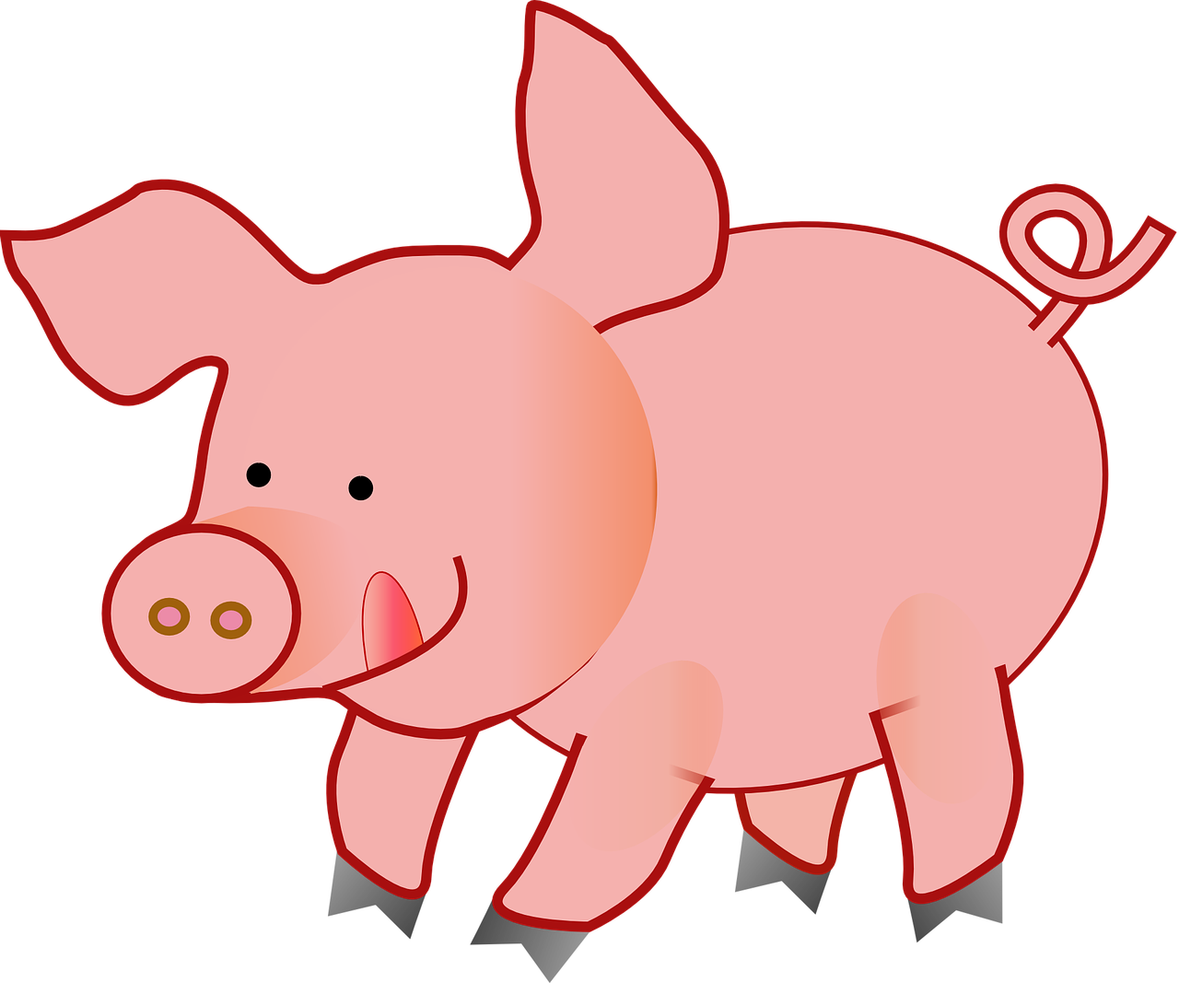
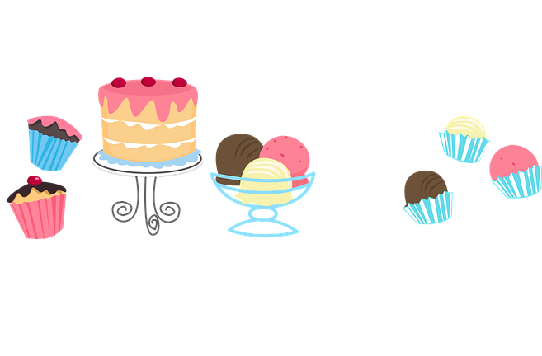
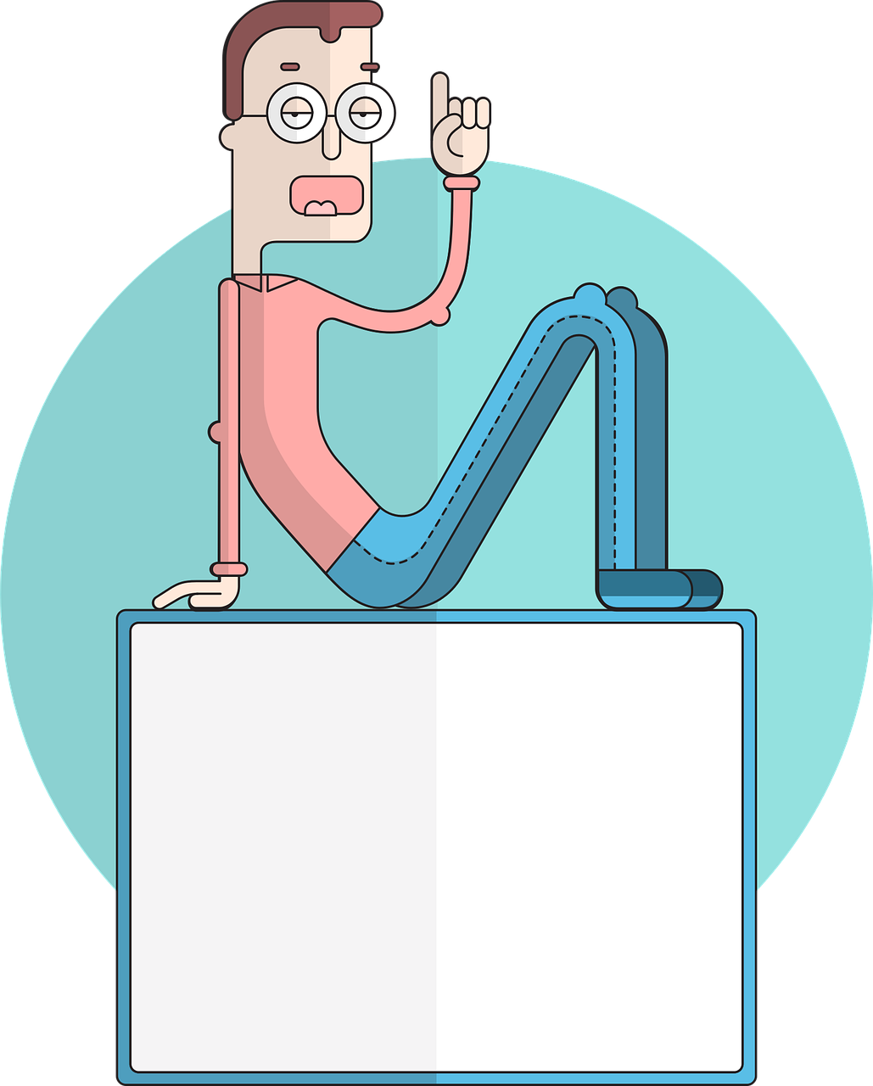
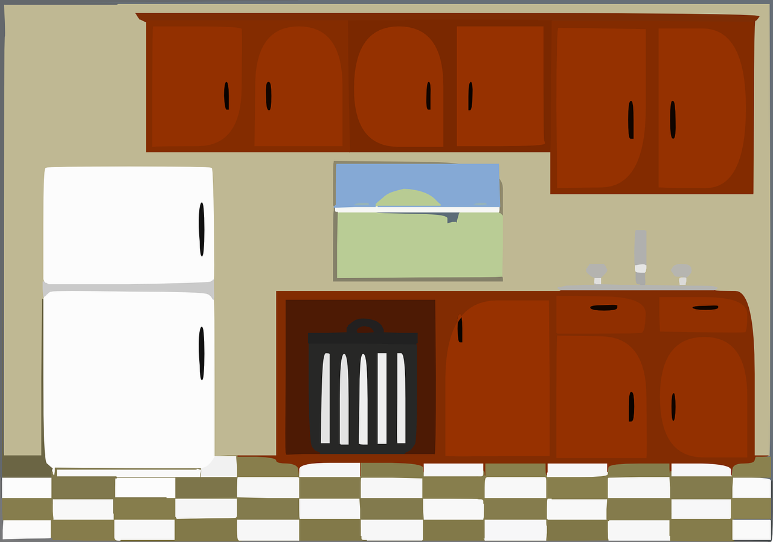
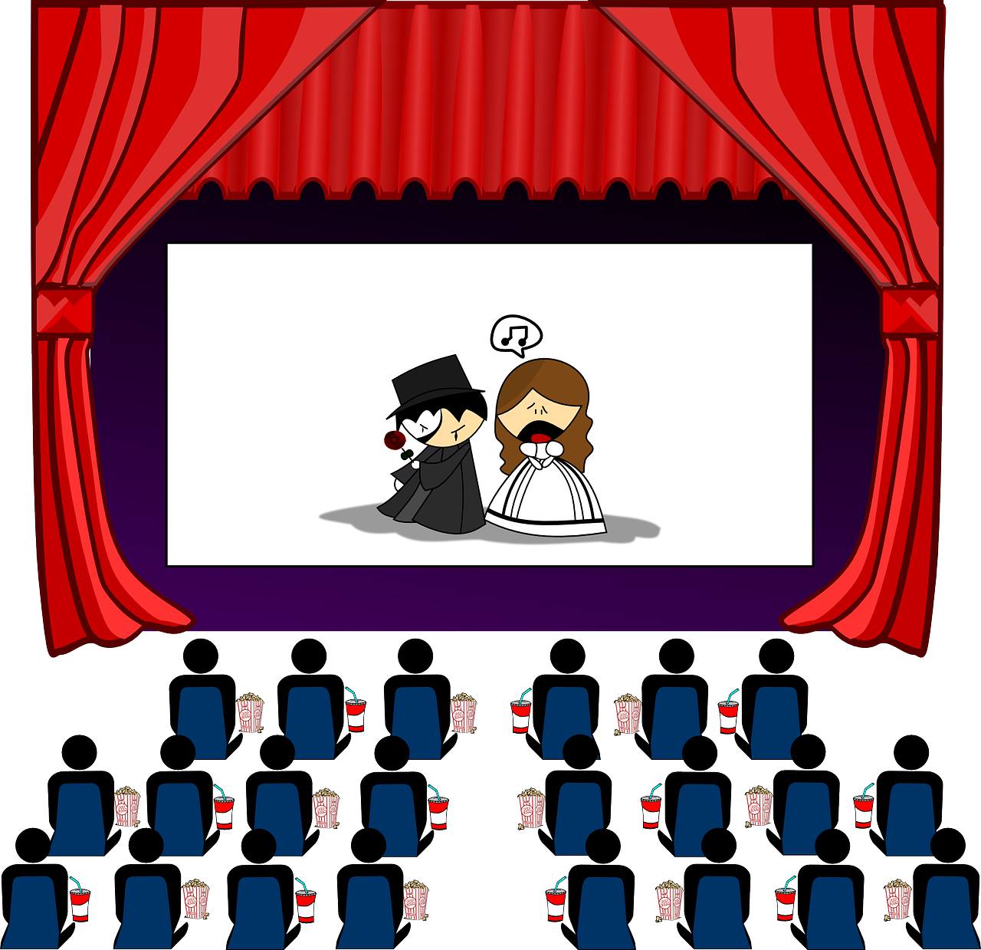
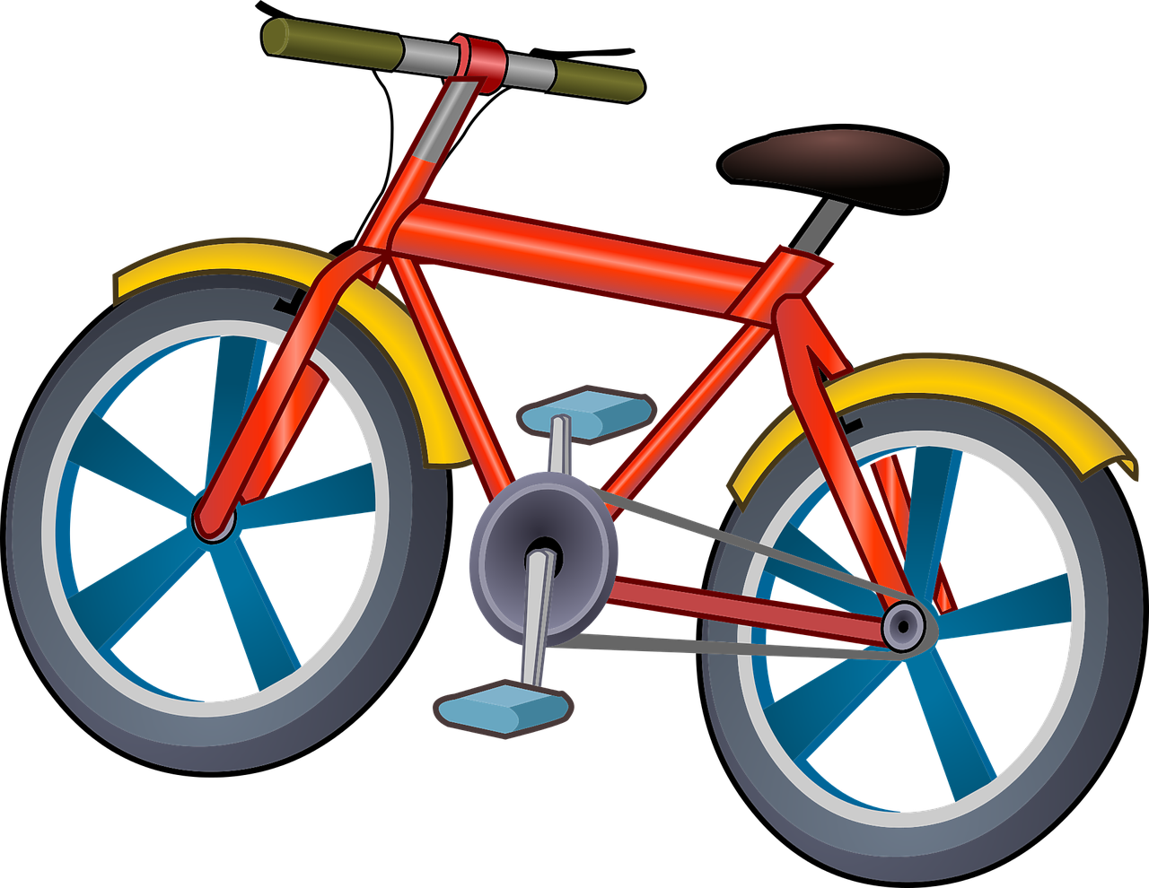
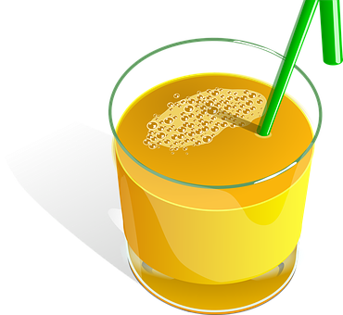
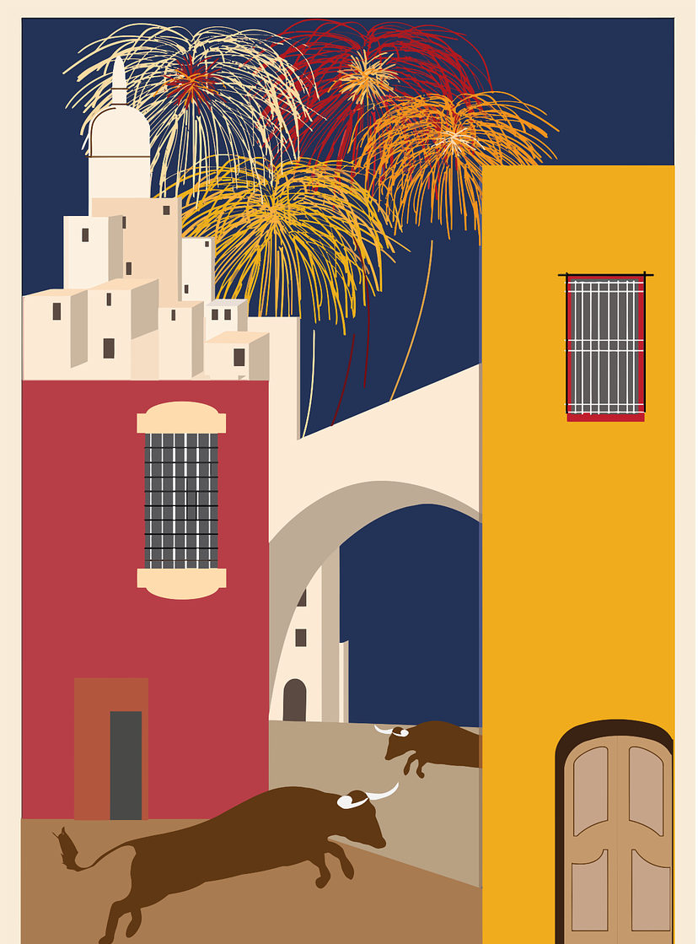
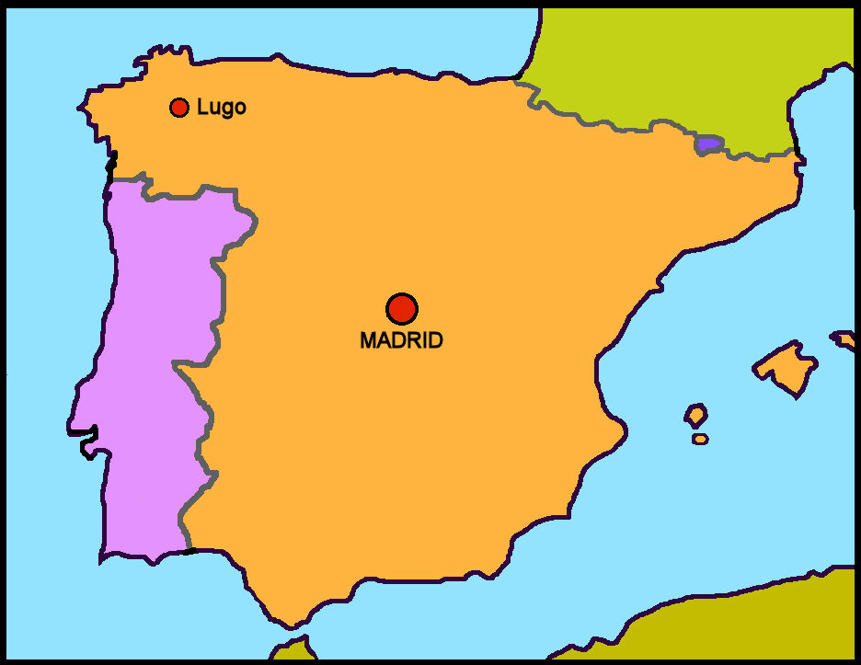
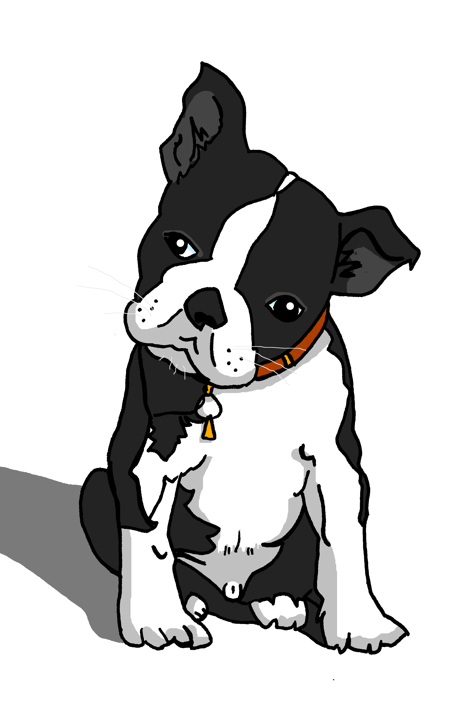
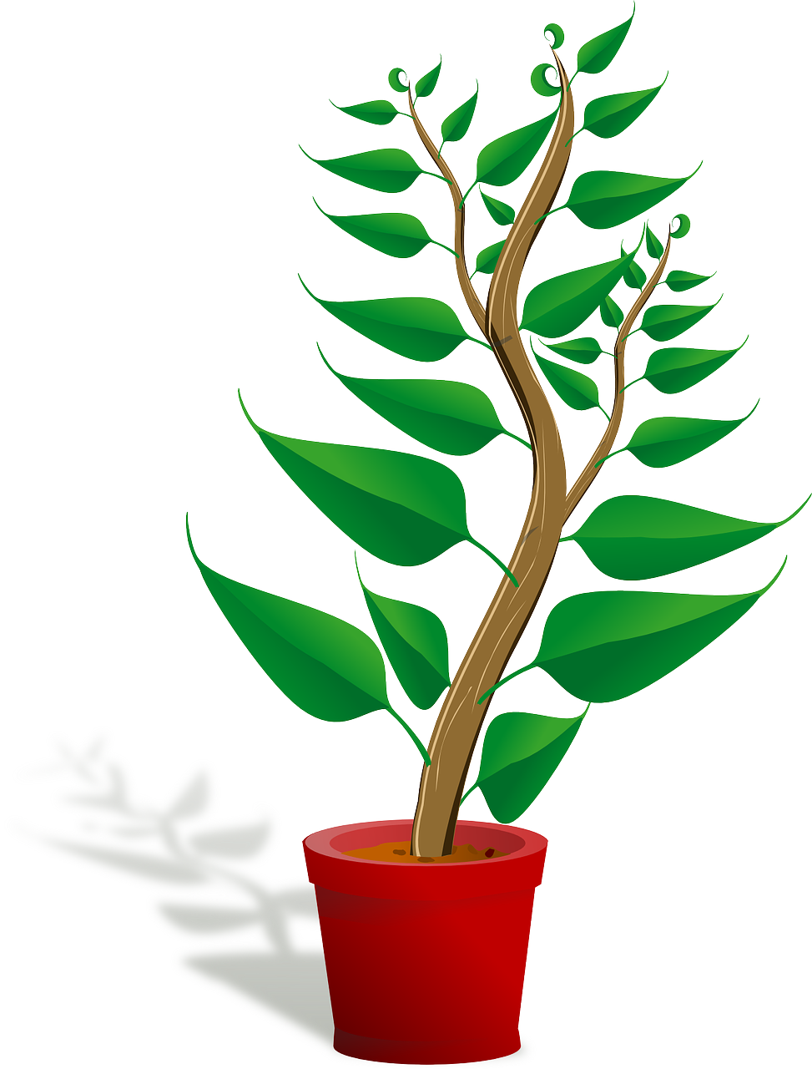
Amarillo Knowledge Organiser - Autumn Term B
En clase (in class)
tener – to have|having
tengo – I have
tienes – you have
tiene – s/he, it has
un, una – a/an (m), a/an (f)
dibujo (m) – drawing
hoja (f) – sheet
idea (f) – idea
lápiz (m) - pencil
libro (m) – book
mensaje (m) - message
palabra (f) - word
profesor (m) – teacher (m)
profesora (f) – teacher (f)
puerta (f) – door
regla (f) – ruler
En casa (at home)
animal (m) – animal
barco (m) – boat
bolsa (f) - bag
caballo (m) – horse
cama (f) – bed
cosa (f) – thing
instrumento (m) – instrument
hermano (m) - brother
hermana (f) – sister
mesa (f) – table
papel (m) - paper
perro (m) – dog
planta (f) - plant
nuevo, nueva – new (m), new (f)
raro, rara – strange (m), strange (f)
viejo, vieja – old (m), old (f)
Phonics
[ca]
cama
cantar
música
boca
cansado
[co]
contar
barco
con
correcto
un poco
[to count]
[cu]
cucaracha
escuchar
cultura
curioso
escuela
[ci]
centro
princesa
cerdo
celebrar
dulce
decir
[ci]
[to say, tell]
cocina
cinco
cine
bici
[z]
zapato
manzana
brazo
zona
zumo
Clic, clac
Castañuelas Un instrumento típico de España
Gender of nouns In Spanish, things, as well as people and animals, are either masculine or feminine. We say that they have gender. This is grammatical, not biological gender! A word (una palabra) is not female, it is a feminine noun. | Indefinite articles – ‘a’ To say a (or an) in Spanish use un before a masculine noun and una before a feminine noun. un perro una planta | Saying what people have with the verb tener
Asking yes/no questions | Adjectives after the noun In Spanish, many adjectives follow the noun: papel viejo old paper una planta sana a healthy plant
Villancico is the Spanish word for Christmas carol. One of the most popular Spanish Christmas carols is called Los peces en el río (the fish in the river).
The words are about Mary washing her child’s clothes in the river. pez (m) = a fish peces (mpl) = fish (plural)
Change a statement into a question by raising your voice at the end.
tengo
tienes
you have
tiene
I have
s/he, it has
tener
Tiene una regla.
➜
to have|having
He has a ruler.
➜
¿Tiene una regla?
Does he have a ruler?

