Slide 1
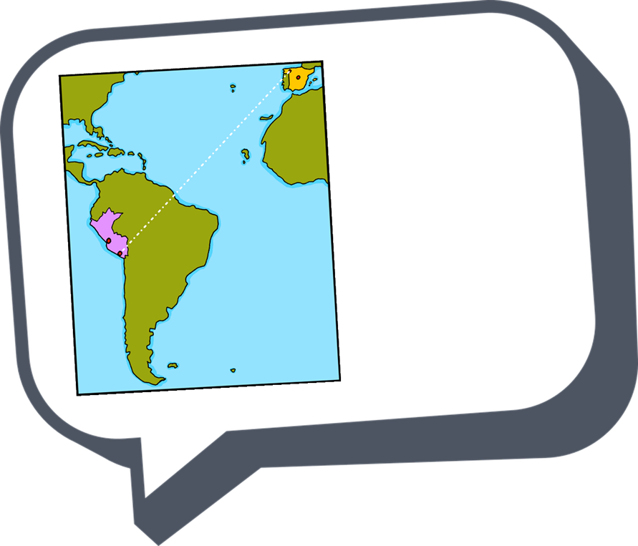




español - cover
Amarillo Term 1
¡hola!
español
Nombre : ……………………………………………….
Profesor (a) : ……………………………………..
Clase : ……………………………………………..

Slide 2
Contents
Contents | page
Introduction: La familia Mamani Flores | 1
Fonética | 2
Term 1 Learning Overview | 3
1. Greeting and responding to the register | 4-6
2. Greeting and responding to the register | 7-9
3. Describing how I’m feeling | 10-12
4. Describing how someone else is feeling; asking questions | 13-16
5. Describing how someone else is feeling; asking questions | 17-19
6. Describing myself, describing someone else | 20-22
7. Describing myself, describing someone else; talking about origin | 23-26
8. Saying what day of the week it is today | 27-34
9. Saying what I have | 30-35
10. Saying what I have and someone else has | 34-36
11. Talking about having, asking yes/no questions | 37-40
12. Talking about having, me and others; describing things | 41-44
13 & 14. Christmas in Spain | 45-48

Slide 3

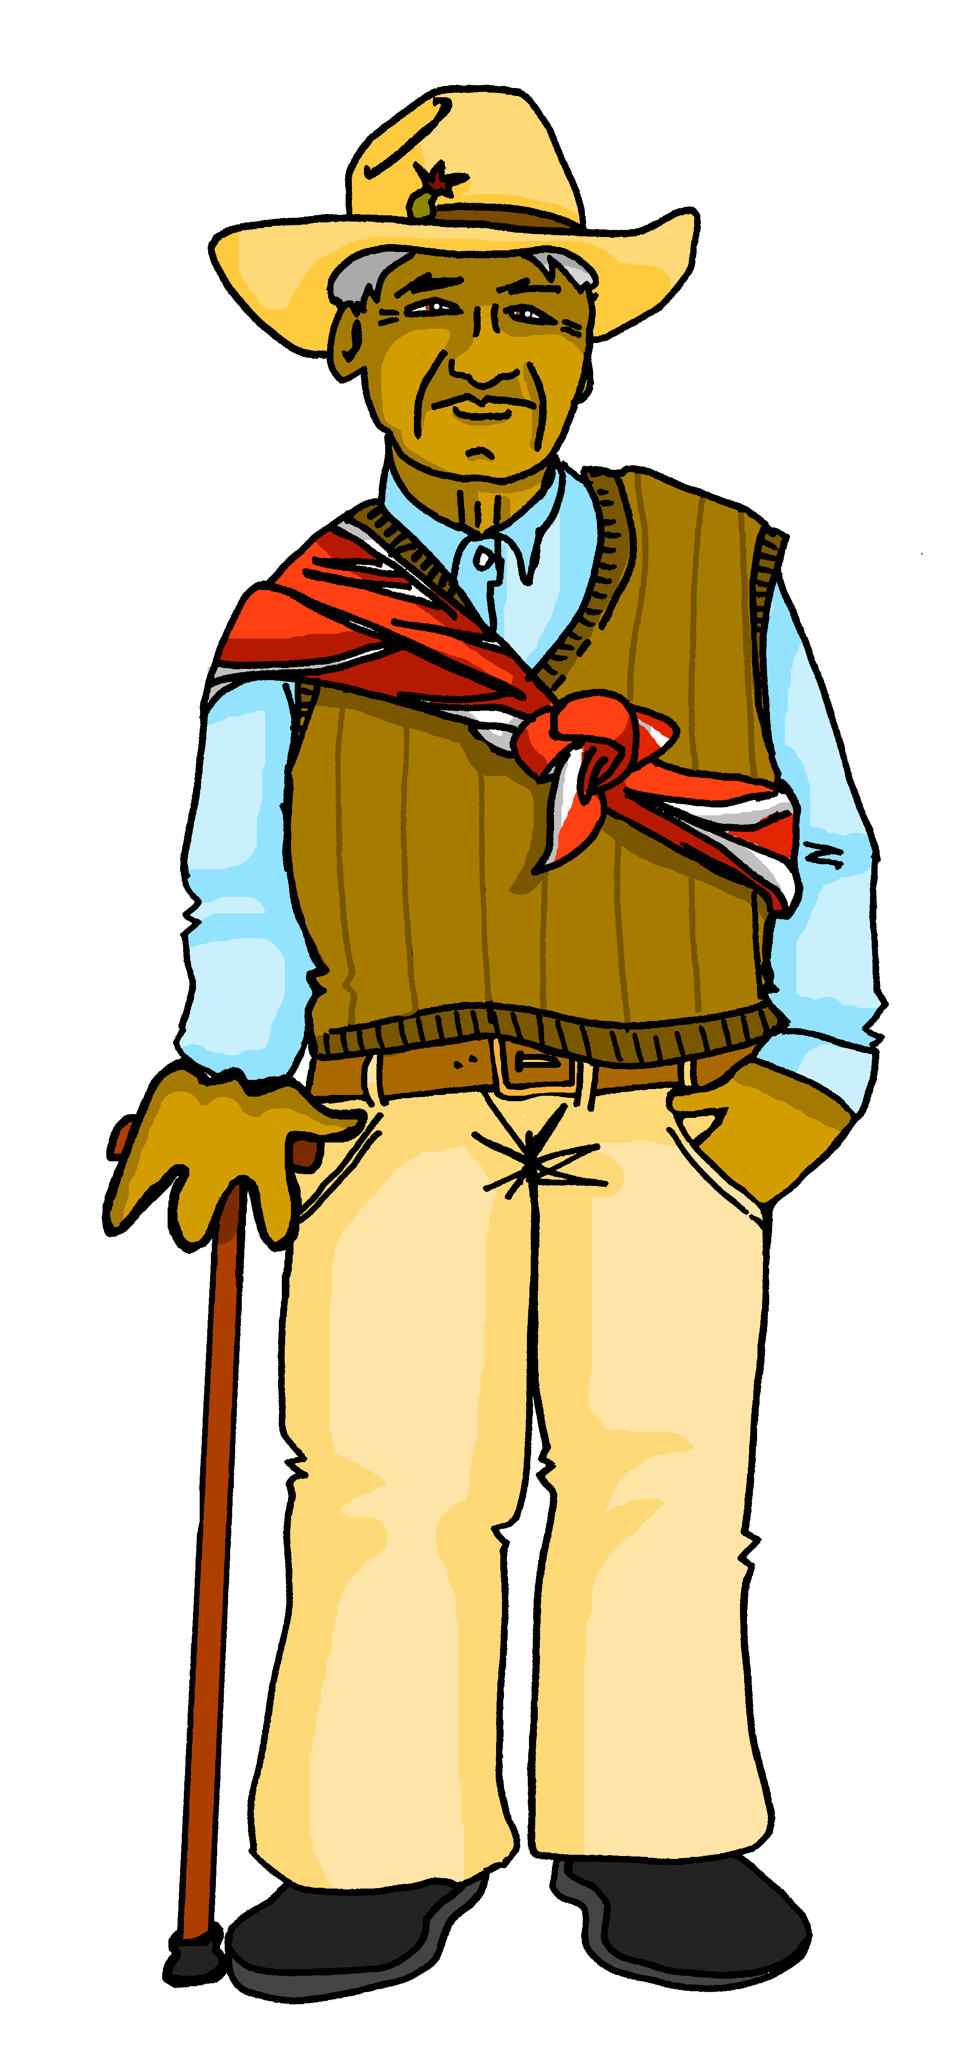
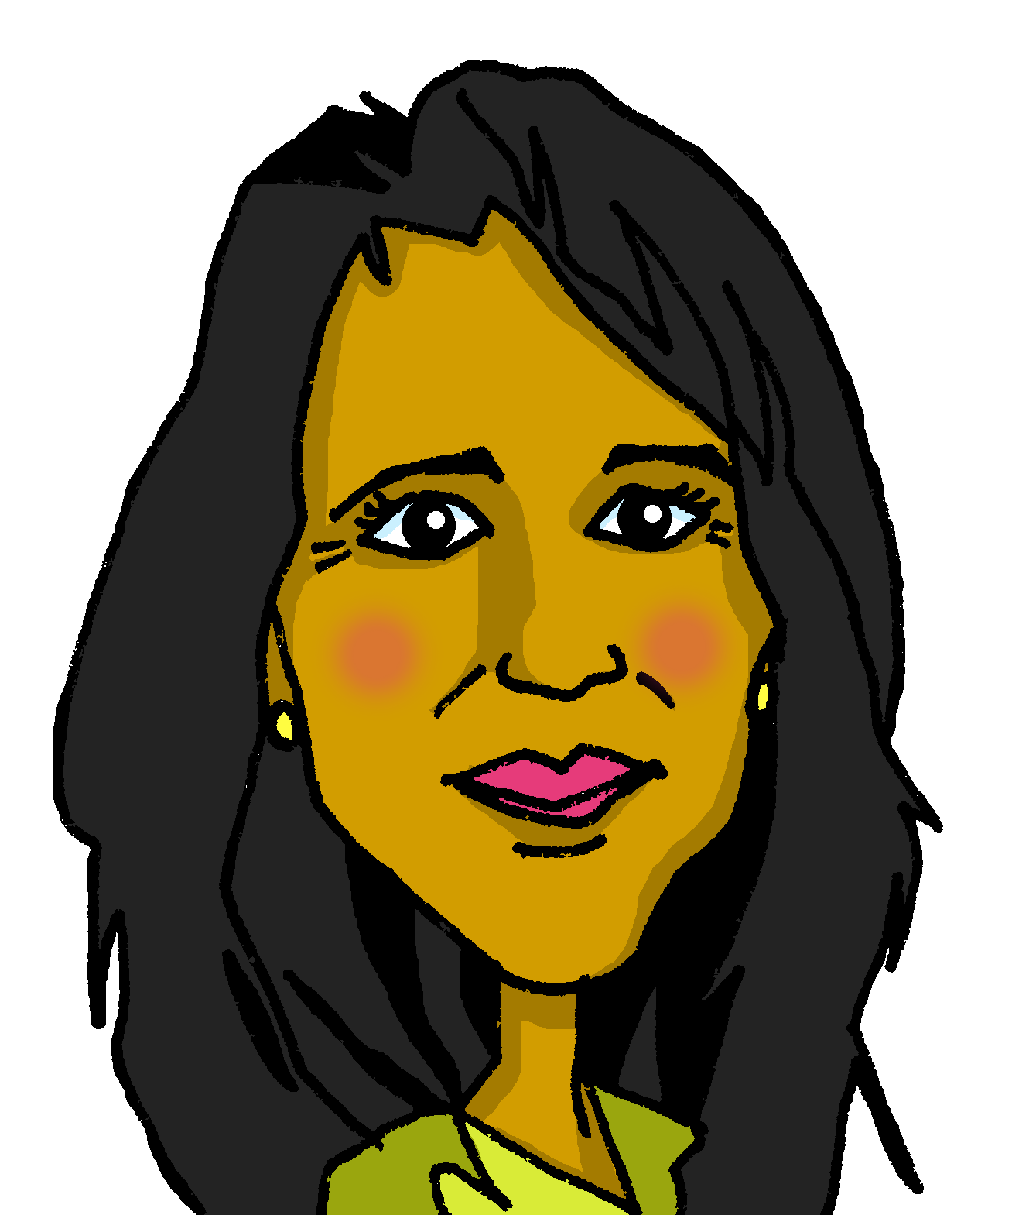
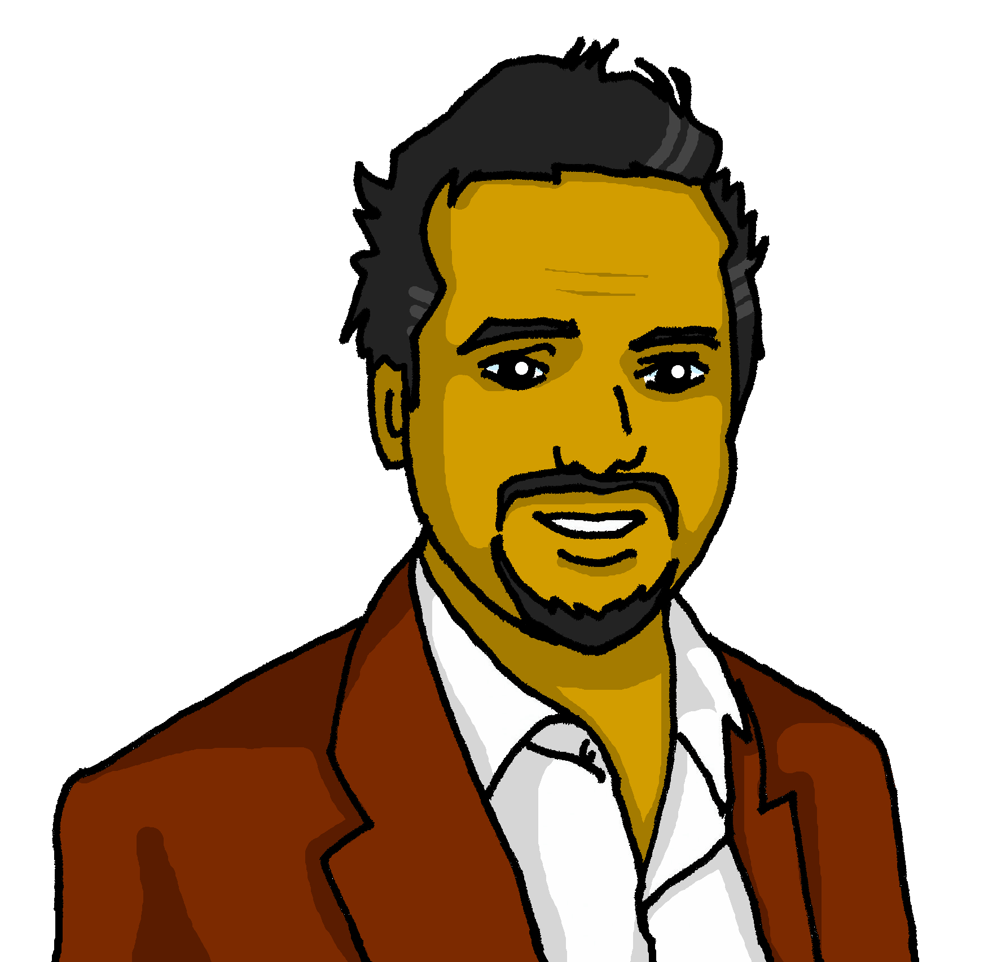

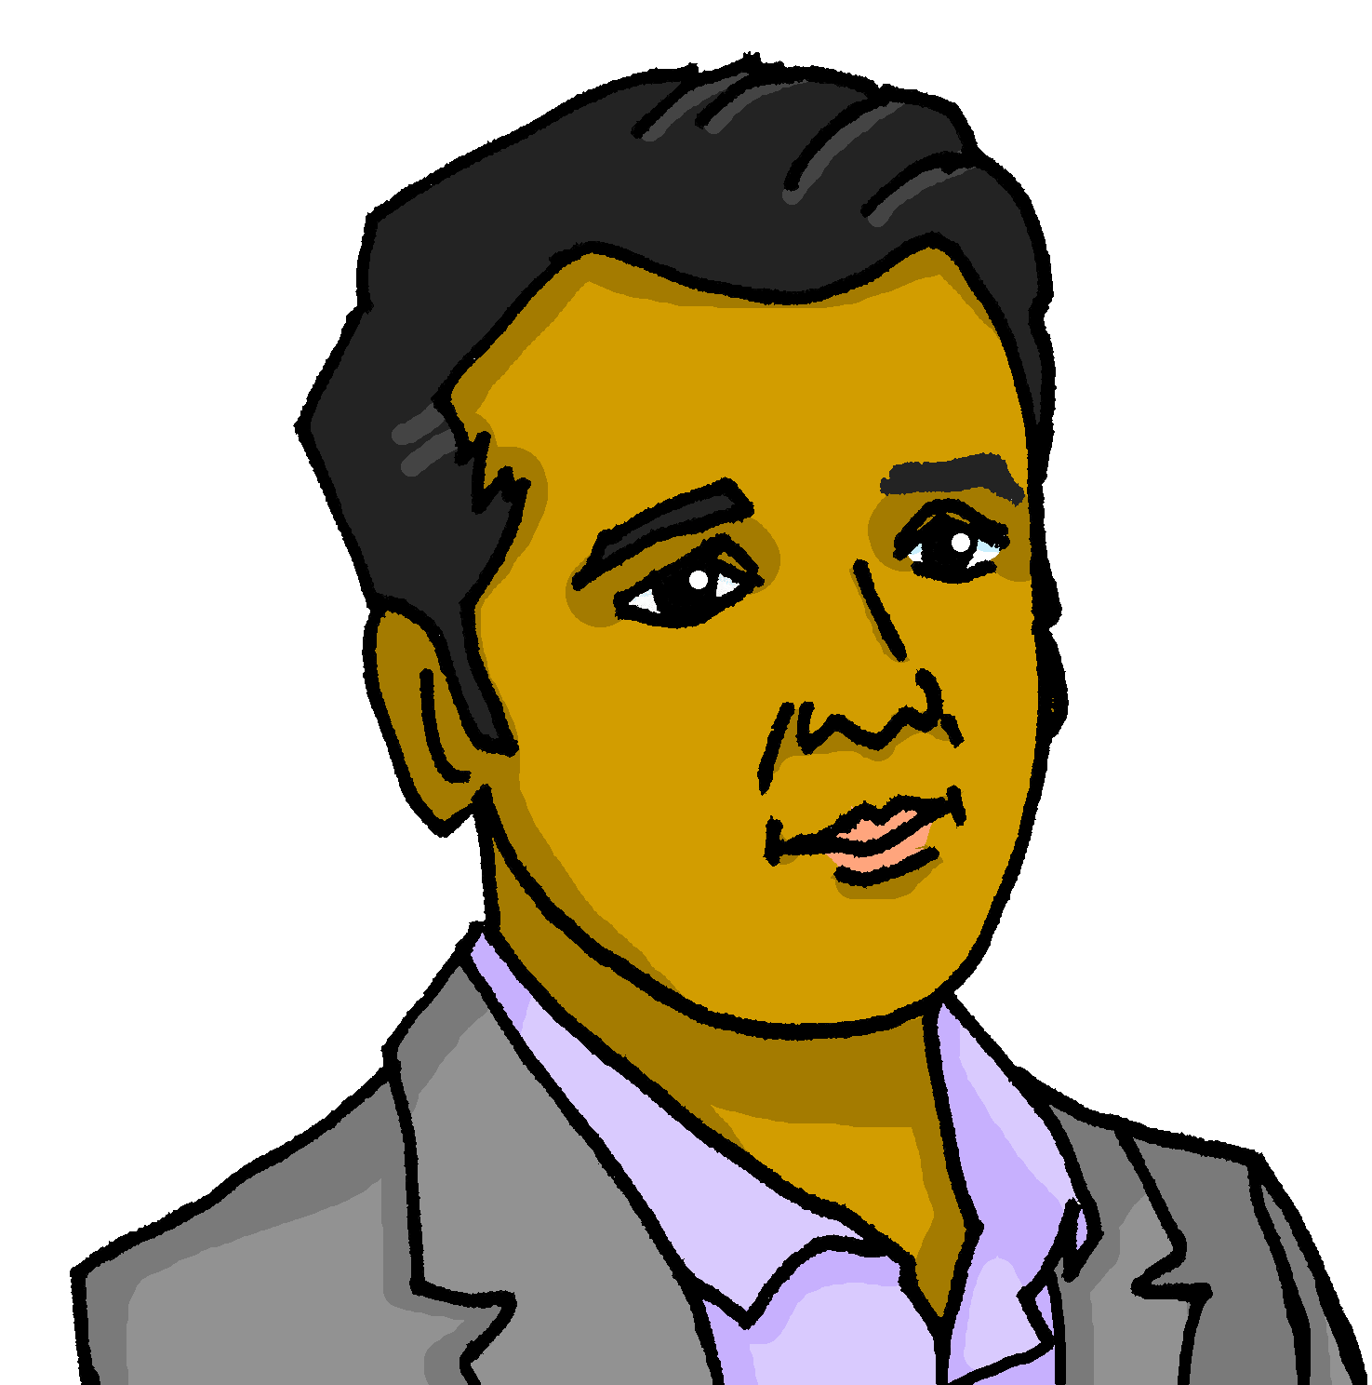
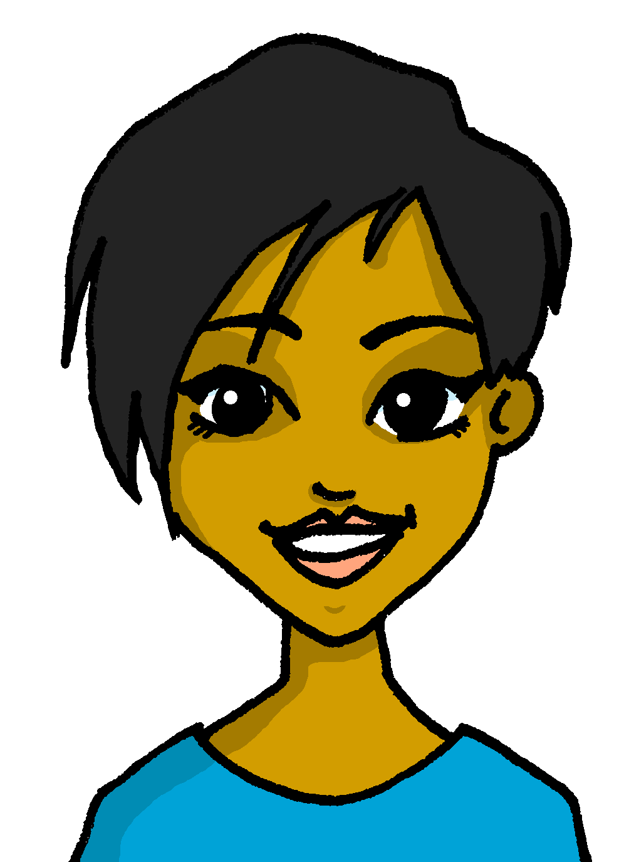



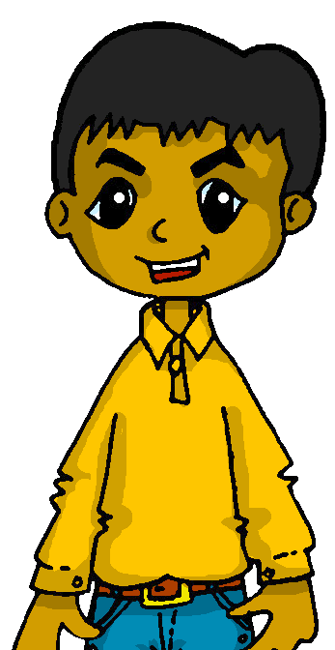
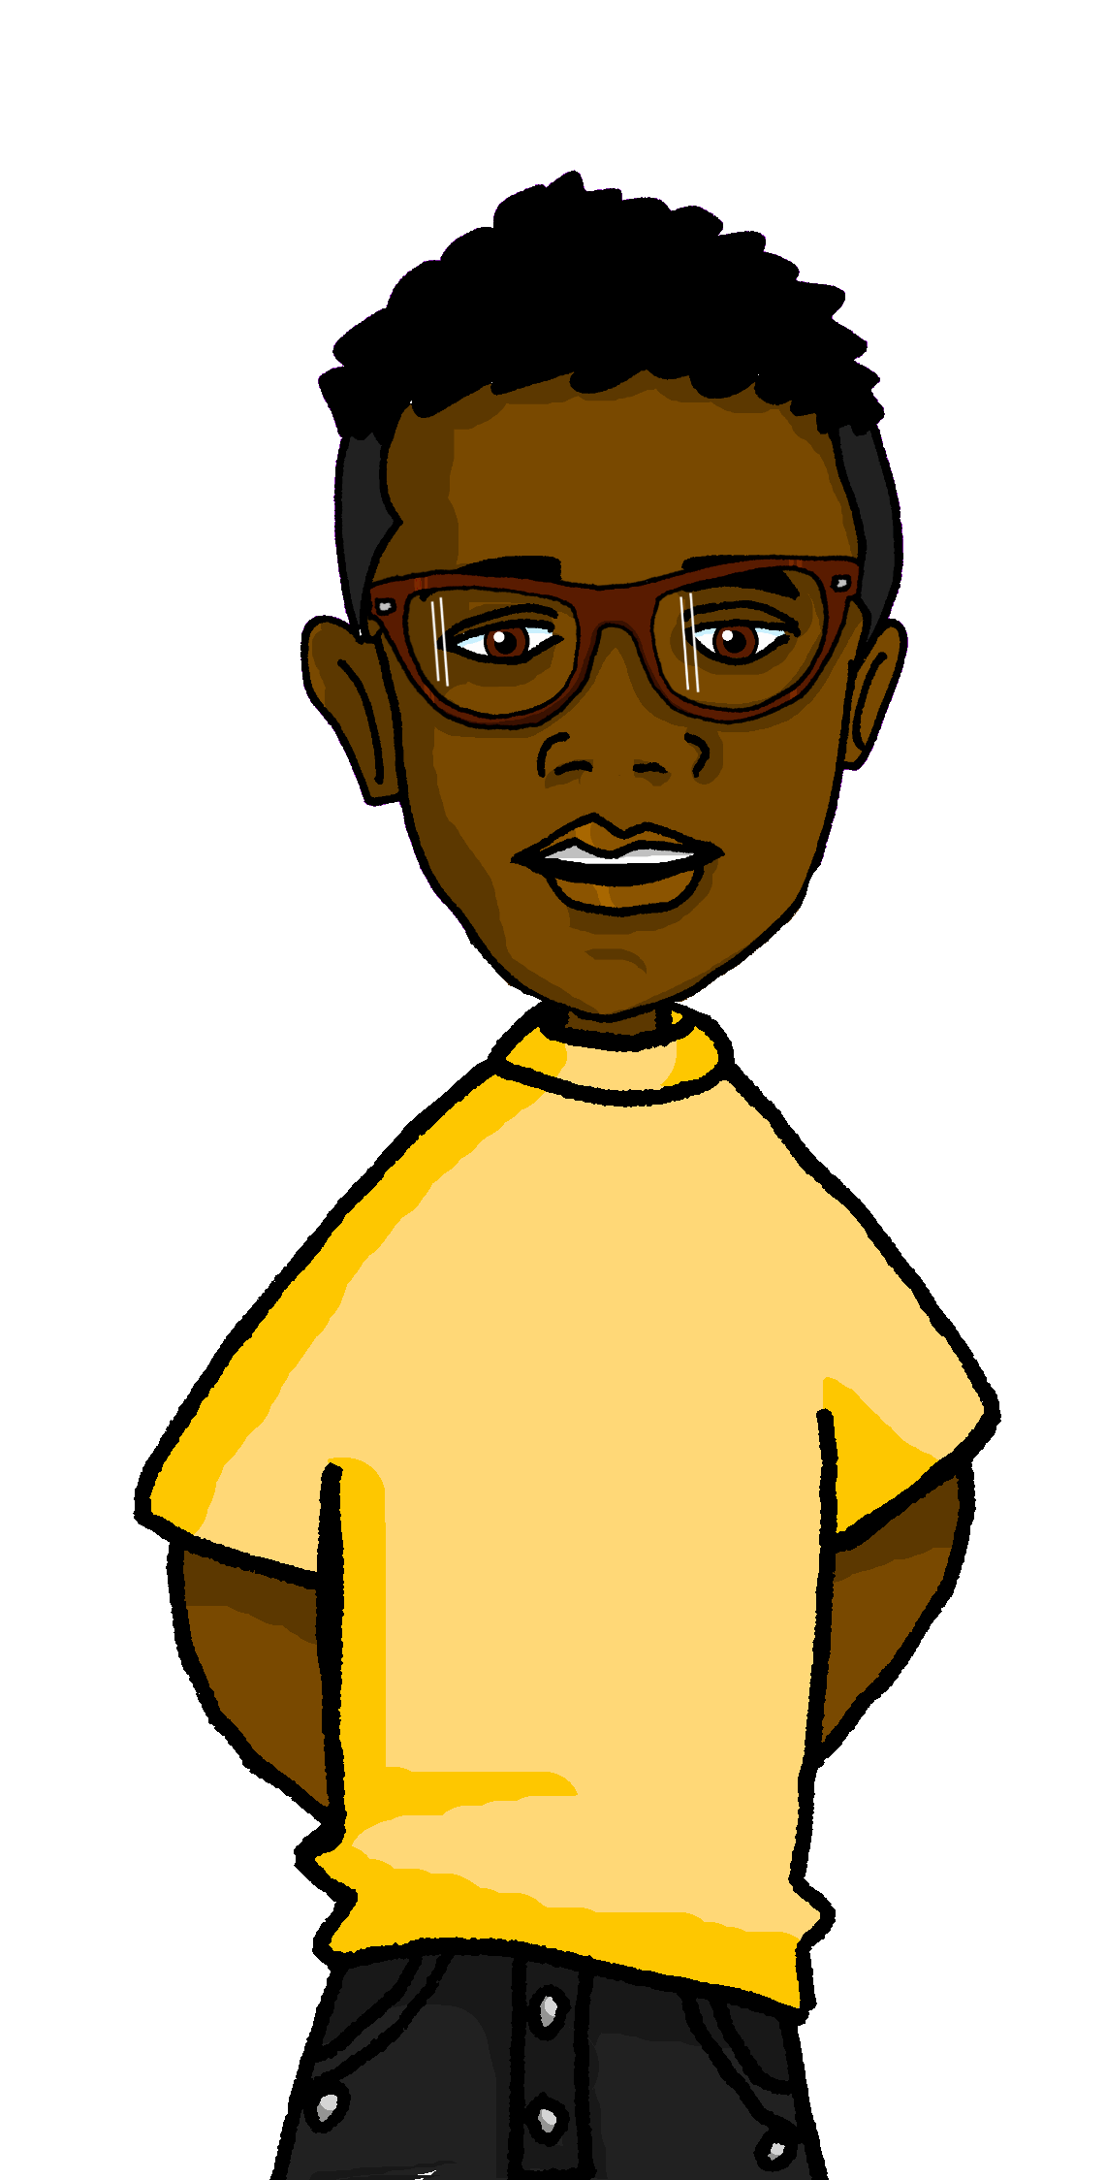

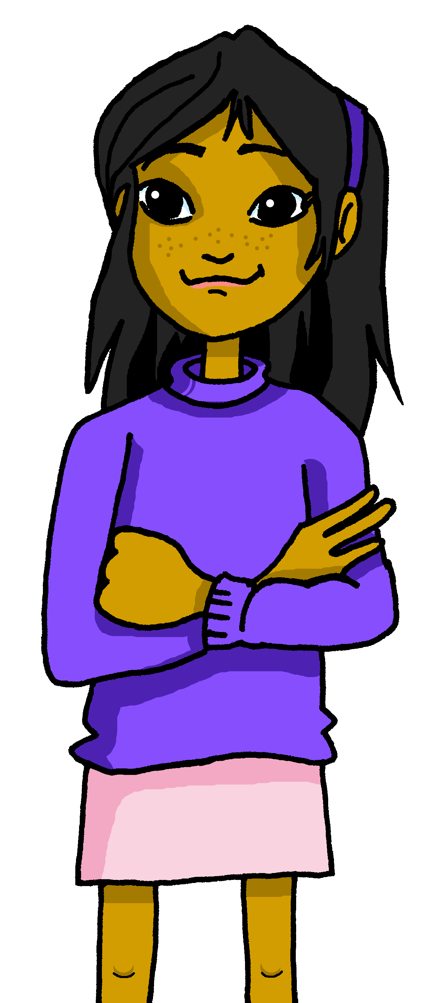
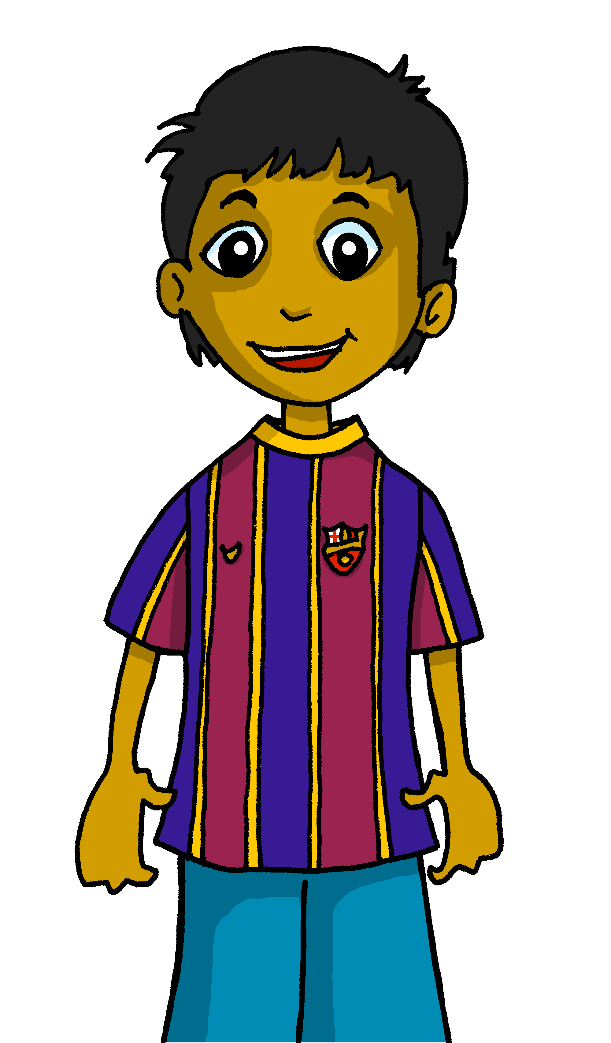
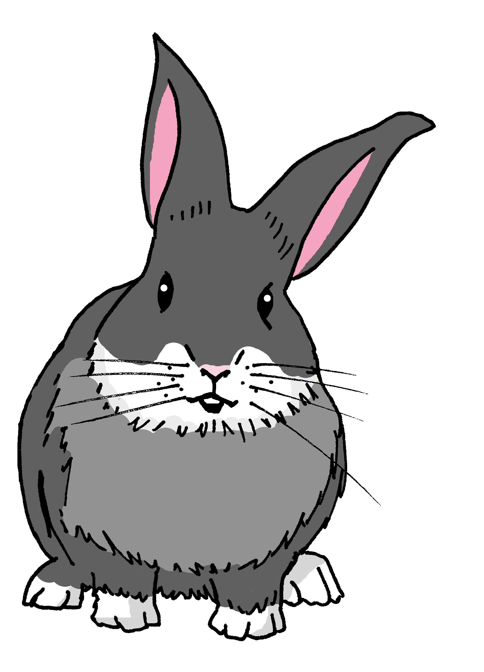
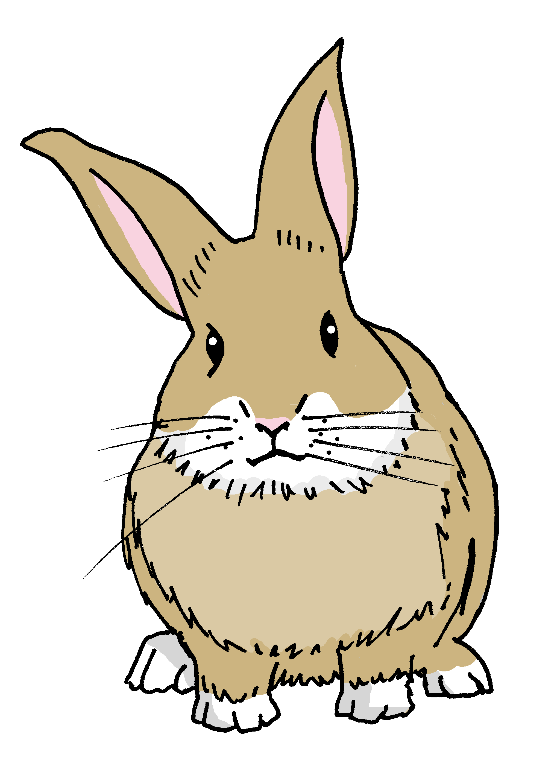
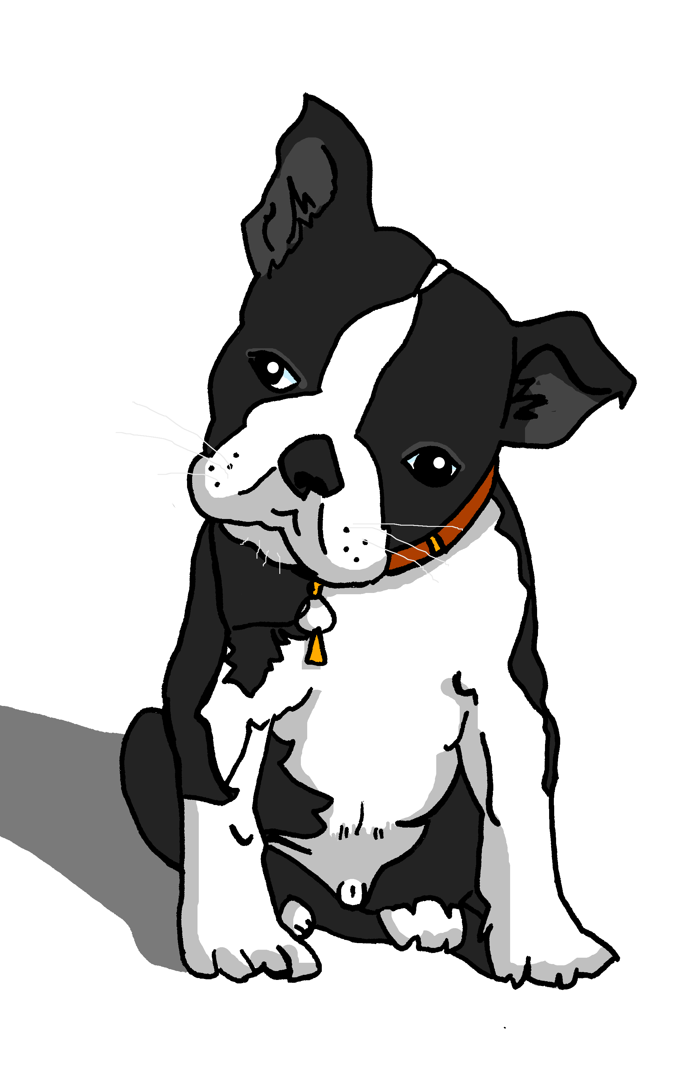
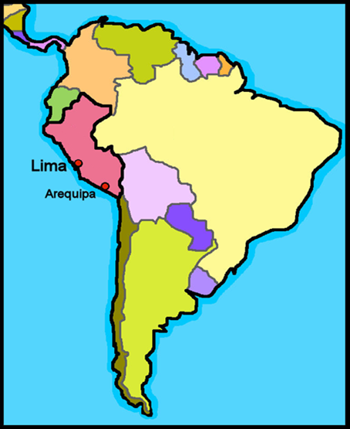
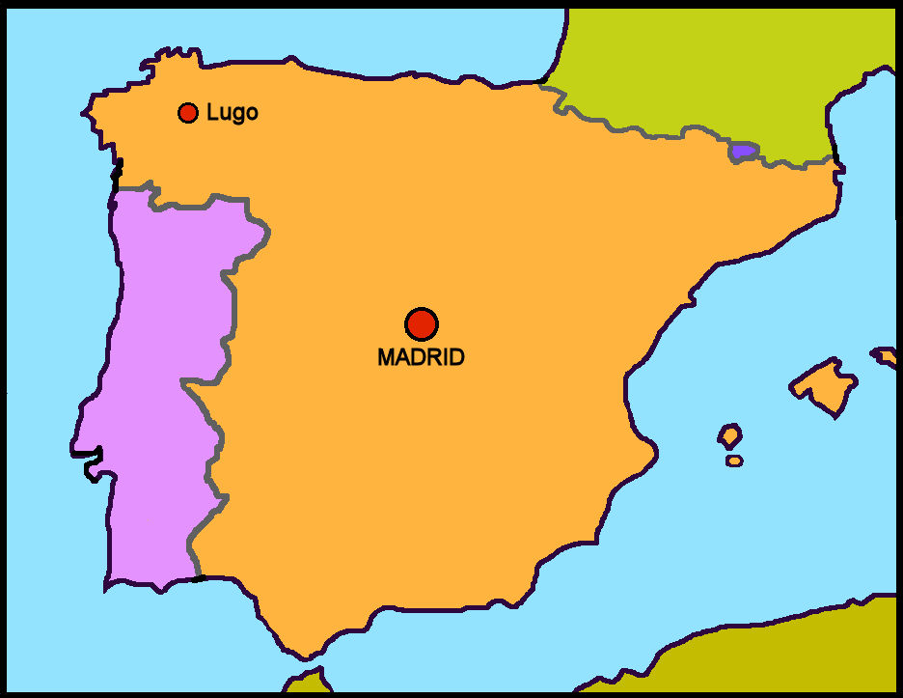
Characters
La familia Mamani Flores
Valeria
Miguel
Elena
Pedro
Hugo
Jorge
Ceci
Quique
Sofía
Luis
amigos
mascotas
Ángela
Pancho
Rubén
Max
Manchita
Santi
España
Barcelona
Perú
Valencia
Granada
We say ‘Hispanic World’ to mean Spanish-speaking peoples and countries.
Spanish is the official language of 20 countries across. 18 of these countries are in America, 1 in Europe (Spain) and 1 in Africa (Equatorial Guinea).

Slide 4
Term overview
Term 1 learning
UNIT | Context CommunicationCulture | Key ideas (GRAMMAR) | PHONICS | VOCABULARY
Unit 1 (W1-8) | Describing me and others in class in Perú and in Spain | Talking about being Essential verb: to be, being – ESTAR I am – estoy you are – estás he is – está she is – está it is, it’s – está Essential verb: to be, being – SER I am – soy you are – eres he is – es she is – es it is, it’s – es Adjective agreement for masculine/feminine Yes/no questions with raised intonation | Vowels [a] [e] [i] [o] [u] SSC [ca] [co] [cu] | Simple greetings Verb estar Range of adjectives Days of the week
Unit 2 (W9-12) | Saying what I and others have at home with friends (Max, from England) Eco club | Talking about having Essential verb: to have, having – TENER I have – tengo you have – tienes he has – tiene she has –tiene Indefinite, singular Post-nominal adjective gender agreement Yes/no questions with raised intonation | SSC [ce] SSC [ci] SSC [z] | Verb tener Range of singular masculine and feminine nouns
Unit 3 (W13-14) | Revision Christmas | Revisit key ideas | Revisit SSC | Revisit vocabulary

Slide 5



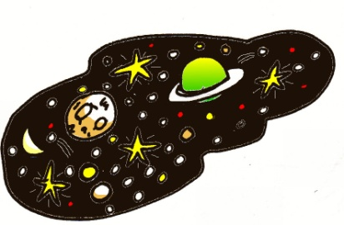


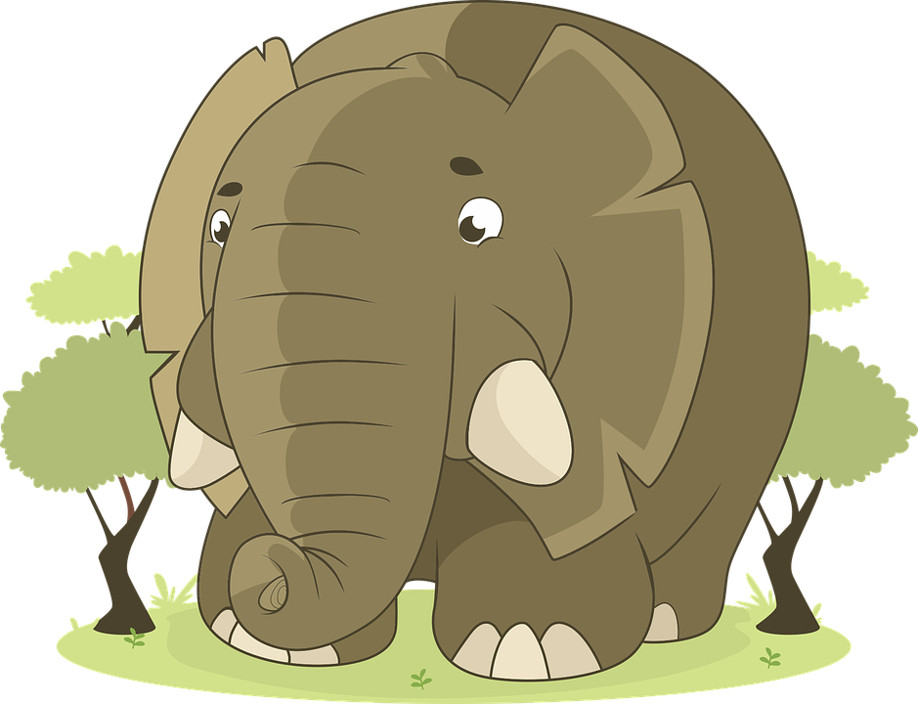








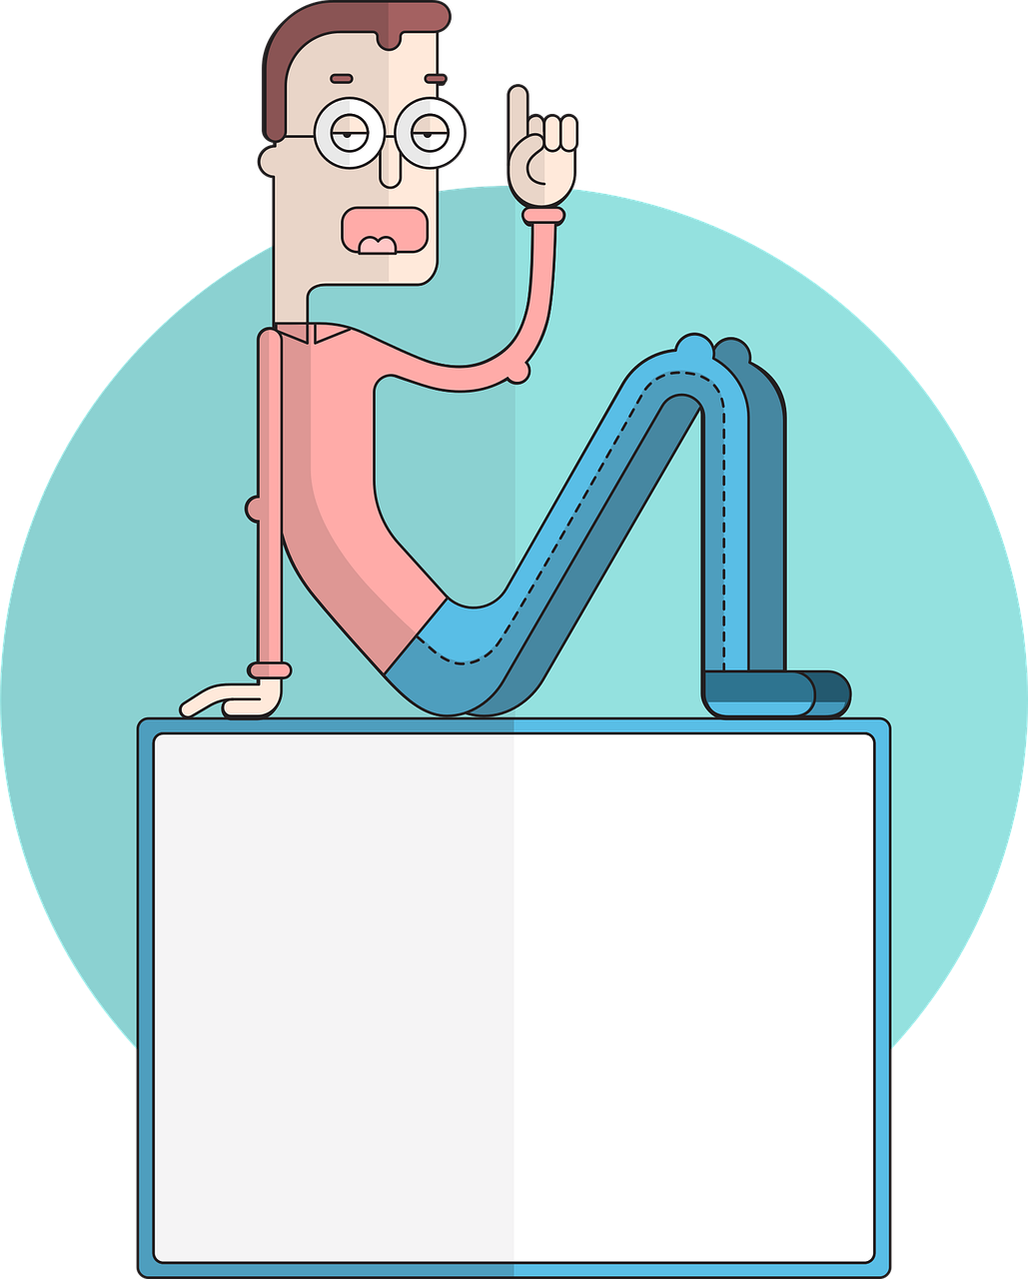

Phonics
Phonics
[a]
[o]
[u]
Spanish vowels are usually short and open!
casa
dos
universo
[e]
[i]
elefante
idea
[ca]
[co]
[cu]
These 3 sound like [k]
cama
[to count]
contar
cucaracha
[ce]
[ci]
[z]
These 3 sound like [th] in ‘theatre’.
centro
[to say, tell]
decir
zapato

Slide 6










Amarillo term 1 week 1
Describing me and others
1
amarillo term 1
pronunciar
Greetings
Understanding and responding to the register in class
[a]
[o]
casa
dos
Write down the key language for this week.
vocabulario
presente |  | estar
ausente |  | estoy
aquí |  | está
allí |  | hola
‘estar’ [to be | being] (with location)
gramática
In Spanish the verb estar means ‘to be’ when describing location.
Estoy
I am
he is ,
she is
=
Está
It is,
=
Translate the examples.
Estoy presente. → _______________________________.
Está presente. → _______________________________.
4

Slide 7


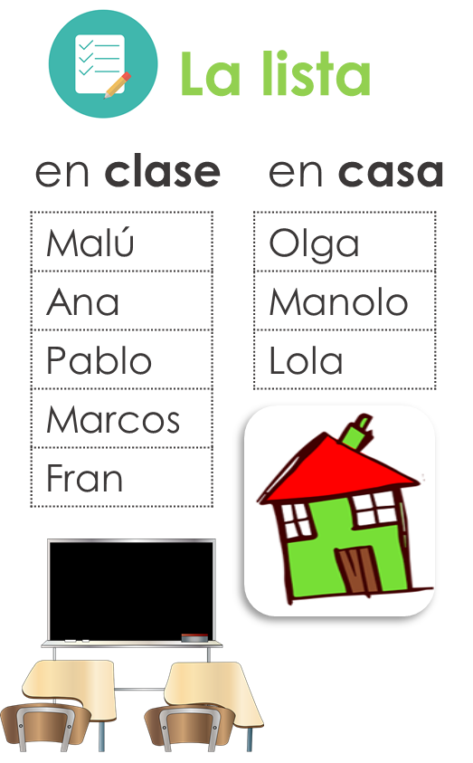






Amarillo term 1 week 1
Describing me and others
1
amarillo term 1
leer
El señor Mora has taken the register.
Circle the correct answer.
E | Malú está | ausente. | presente.
1 | Ana está | ausente. | presente.
2 | Manolo está | ausente. | presente.
3 | Marcos está | ausente. | presente.
4 | Fran está | ausente. | presente.
5 | Lola está | ausente. | presente.
6 | Pablo está | ausente. | presente.
7 | Olga está | ausente. | presente.
El señor Mora =
Mr Mora
escuchar
Now la señora Cano takes the register.
Tick the correct box.
 |  | The pupil (I) | Someone else (S/he)
E | Coral
1 | Lara
2 | Lorna
3 | Tamara
4 | Carlos
5 | Paloma
6 | Gaspar
verb | inglés
estoy
La señora Cano =
Mrs Cano
hablar
Tell a classmate who is in the class.
¡Hola! | Estoy | presente.
 | Está | ausente.
 |  | aquí.
 |  | allí.
5
Notes:
gramática

Slide 8


Amarillo term 1 week 1
Describing me and others
1
amarillo term 1
escribir
Write the word that you would not need when translating the following sentences into Spanish.
1. He is present. ➡ _______________.
Example: I am here ➡ I am here
English uses pronouns (I, she, we)
to indicate the person who is carrying out the action of the verb.
I am present.- Estoy presente.
S/he, it is present. - Está presente.
2. She is absent. ➡ _______________.
3. I am there. ➡ _______________.
In Spanish, we often don’t need to use the pronoun.
4. It is here. ➡ _______________.
5. She is here. ➡ _______________.
escuchar
[A] Listen and circle the word that is mentioned.
E
absent | here | present
3
here | in | class
1
here | I am | s/he is
4
absent | I am | present
2
present | here | I am
5
absent | class | s/he is
escribir
Use the words to translate the sentences. There are extra ones!
está
estoy
aquí
allí
1 | I am here.
2 | She is absent.
3 | I am present.
4 | He is there.
5 | She is in class.
clase
estoy
está
ausente
hablar
presente
clase
está
estoy
Be ready to respond to the register in Spanish!
You can
en
está
allí
estoy
prepare your
answer first, and
practise saying
it aloud a few times.
está
en
está
estoy
clase
1 | Hello! I am here.
2 | [Name] is absent.
6
Notes:
gramática

Slide 9
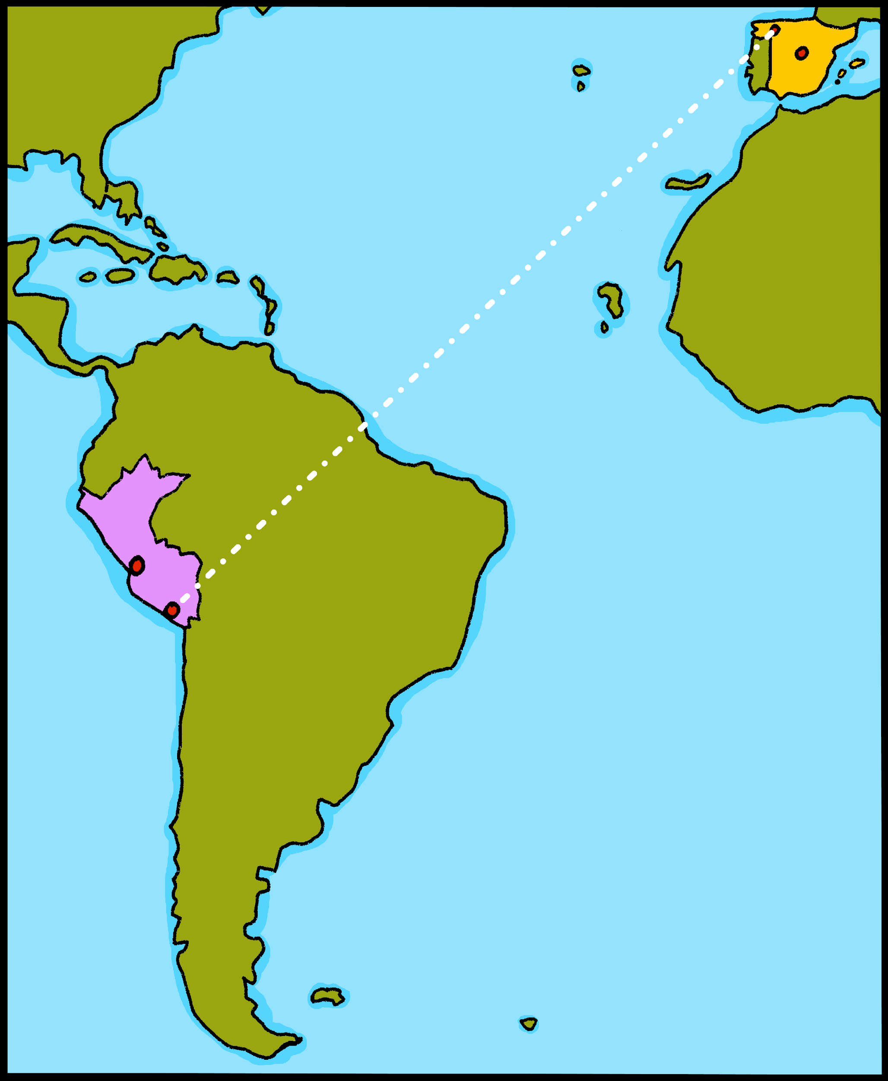



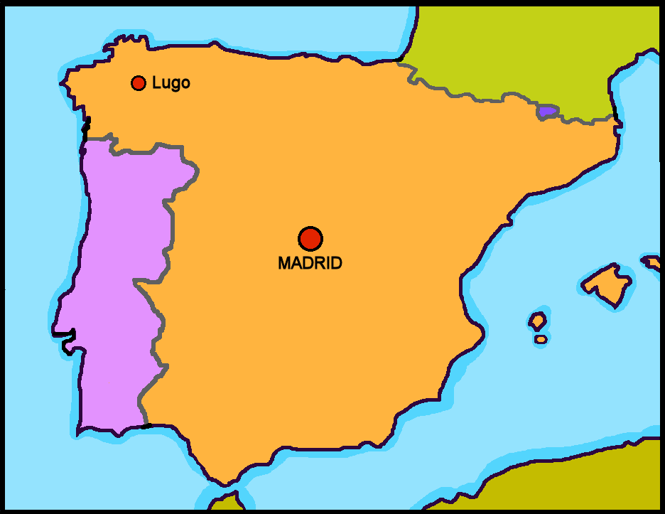




Amarillo term 1 week 2
Describing me and others
2
amarillo term 1
pronunciar
España
Perú
Greetings
Understanding and responding to the register in class
[u]
¡hola!
Asking questions
universo
Quique
vocabulario
Write down the key language for this week.
vocabulario
sí |  | ¡Buenos días!
no |  | ¿dónde?
en |  | estás
¡Buenos días! |  | adiós
‘estar’ [to be | being] (with location)
gramática
In Spanish the verb estar means ‘to be’ when describing location.
Estás
You are
=
To change a statement into a question, raise your voice at the end.
Estás presente.
¿Estás presente?
You are present.
Are you present?
Translate the examples.
Estás en España. → _______________________________.
¿Estás en España? → _______________________________.
7

Slide 10
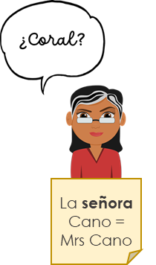

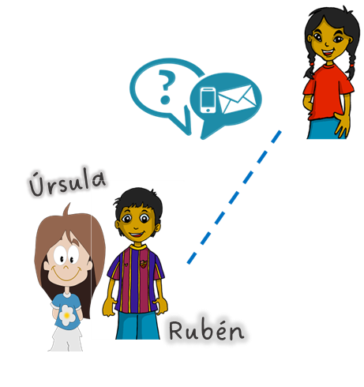
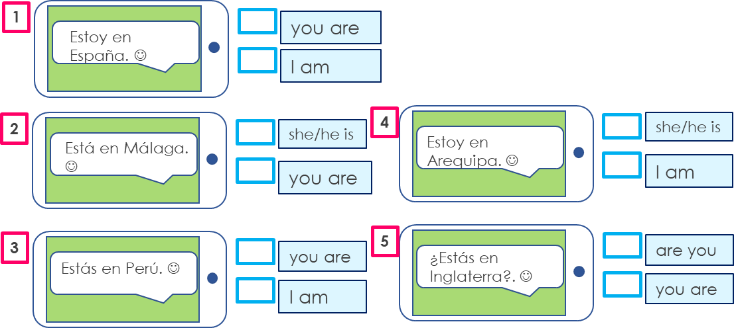

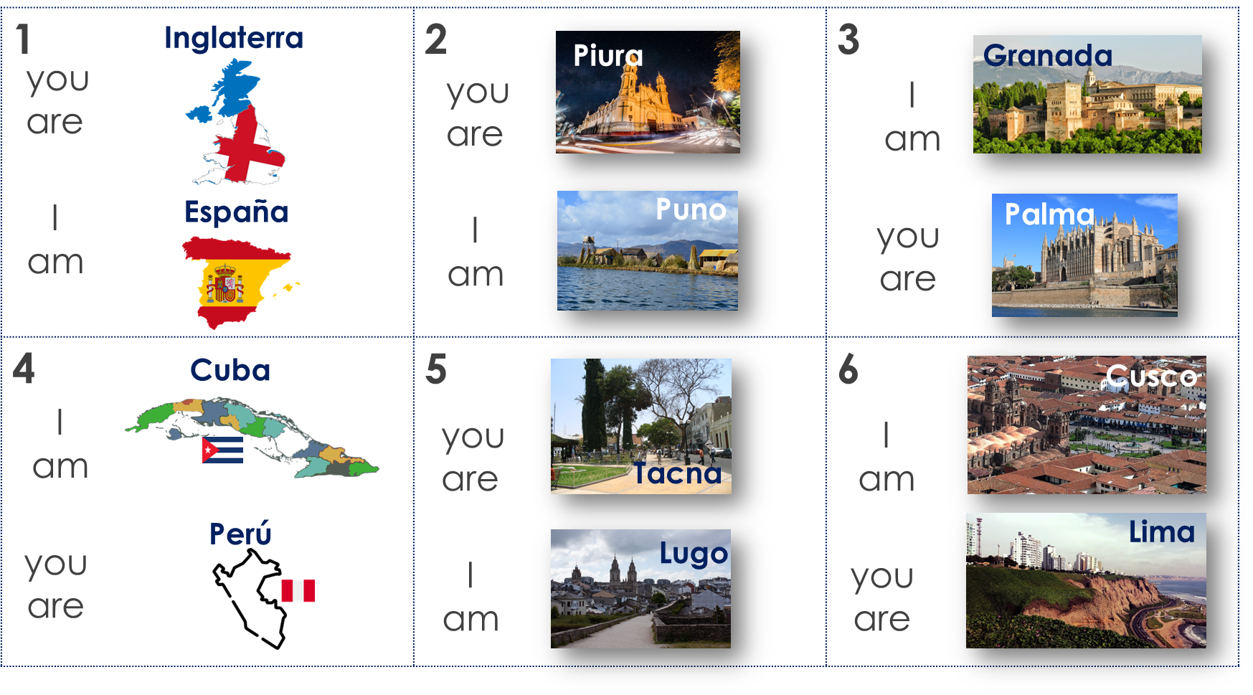
Amarillo term 1 week 2
Describing me and others
2
amarillo term 1
escuchar
Escucha a la señora Mora. Write ¿…? or .
.
 | Luis, estás presente
 | Tula, estás presente |  | Bruno, estás aquí
 | Alonso, estás allí |  | Raúl, estás presente
 | Manu, estás presente |  | Rubio, estás allí
leer
Quique gets lots of messages. What do they mean?
hablar
Person A. (Person B – turn to the next page.)
Start each sentence in Spanish. Write the city or country your partner says.
Now your turn to listen to your partner. Do you hear estoy or estás? Say the correct city or country.
1 | I am …………………..
2 | I am …………………..
3 | you are …………………..
4 | I am …………………..
5 | you are …………………..
6 | you are …………………..
8

Slide 11
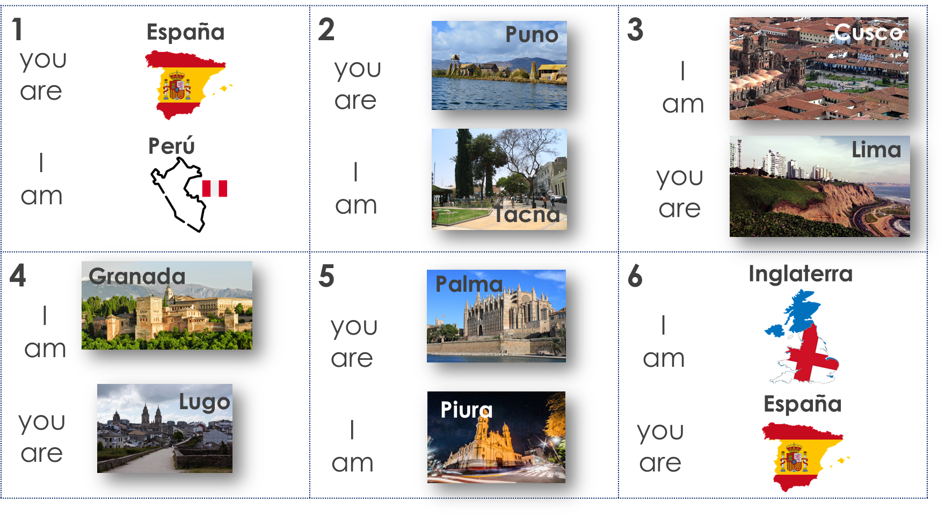
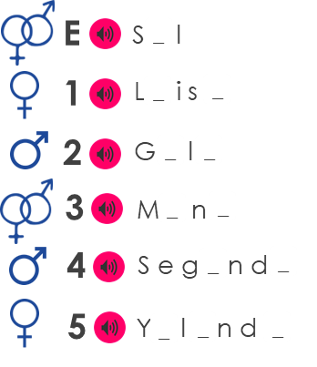
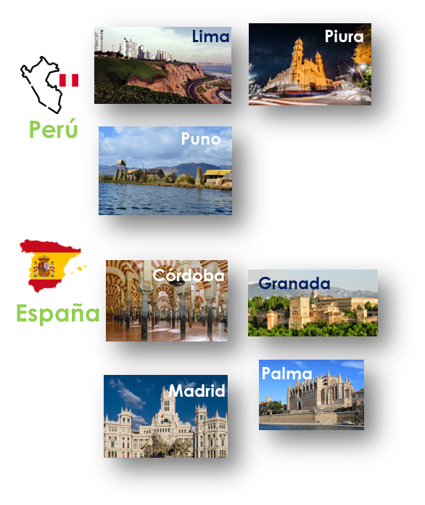

Amarillo term 1 week 2
Describing me and others
2
amarillo term 1
hablar
Person B. (Person A – see previous page.)
Listen to your partner. Do you hear estoy or estás? Say the correct city or country.
Now your turn to start each sentence in Spanish. Write the city or country your partner says.
1 | I am …………………..
2 | you are …………………..
3 | I am …………………..
4 | you are …………………..
5 | I am …………………..
6 | you are …………………..
escuchar
C Fill the gaps with [a], [o] or [u].
A Escucha. Listen
and write down the number.
B Draw it!
o
Proper
nouns start
with a capital letter!
‘Universo’ is number ______.
‘Casa’ is number ______.
escribir
Escribe. Choose the city and country.
1 _________________________________.
(You are in____________).
2 _________________________________.
(I am in____________).
3 _________________________________.
How can
you turn these statements into questions?
(She is in____________).
9

Slide 12

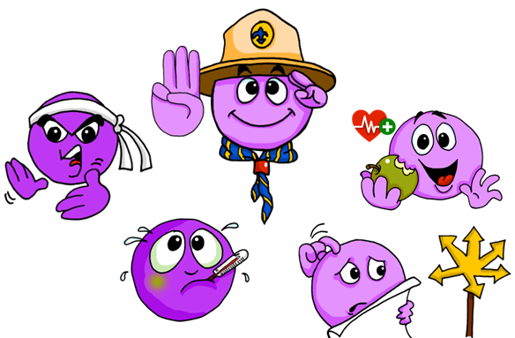
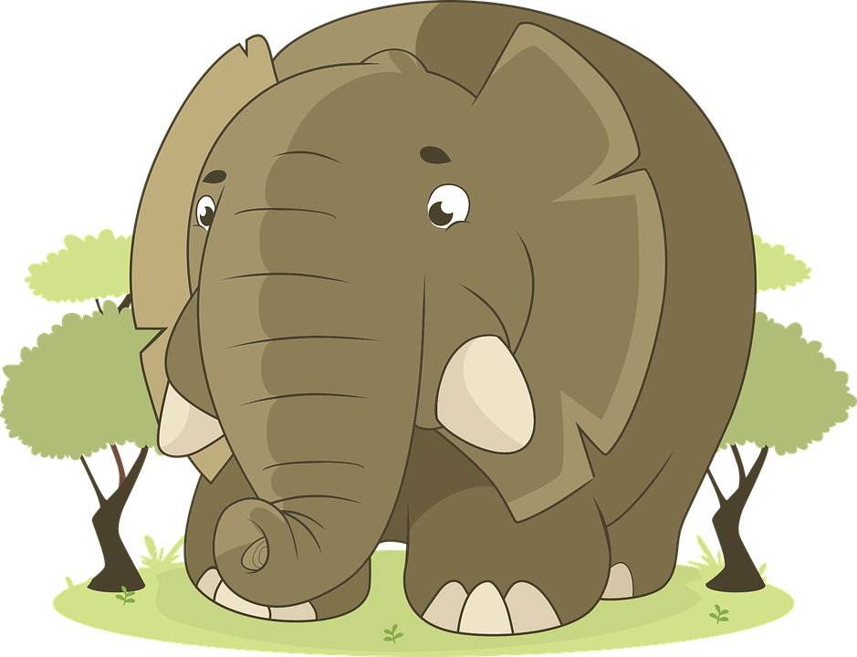
Amarillo term 1 week 3
Describing me and others
3
amarillo term 1
pronunciar
¡hola!
Greetings
Understanding and responding to the register in class
[e]
Asking questions
elefante
Sofía
Rubén
Write down the key language for this week.
vocabulario
activo |  | preparado
enfermo |  | sano
está |  | hoy
perdido |  | ¿cómo?
‘estar’ [to be | being] (with location)
gramática
In Spanish the verb estar means ‘to be’ when
describing location, mood or temporary states.
To change a statement into a question, raise your voice at the end.
‘estar’ [to _____ | being]
Translate the examples.
estoy - ____ am
¿Estoy preparado?
→ _________________________.
estás - ____ are
Sofía ¿Estás en Perú?
está - she _______
→ _________________________.
¿Estás enfermo?
está - ____ _______
→ _________________________.
10

Slide 13

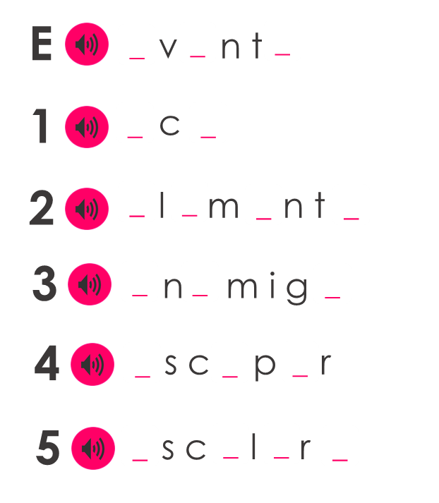

Amarillo term 1 week 3
Describing me and others
3
amarillo term 1
escuchar
Escucha. Who does Rubén describe?
A) Marca .
B) Escucha y escribe el número (E-6).
Write down the number.
 | I | You | He
E
1
2
3
4
5
6
ill
lost
ready
healthy
active
Rubén
Q
pronunciar
Fill the gaps with [e], [a] or [u].
Sometimes we refer to people by
name
in a sentence:
Eduardo is here.
He is ready.
Here we use the pronoun he because we don’t need to repeat Eduardo.
In Spanish, we often don’t need to use the pronoun.
Eduardo está aquí.
Está preparado.
[is]
[He is]
This means that está can mean is and
he is, she is, it is.
leer
Lee. Write the meaning of ‘está’ for each sentence.
1
Elena está en clase. ________ ________ ___ __________.
Emanuel está en casa. Está enfermo.
________ _____ ___ _______. _______ ________.
¿Eva? No, está ausente. ______ ? ___ ____ _____ __________.
¿Cómo está Edgar? Está activo hoy.
_____ ______ _______? ______ _________ ________.
¿ Enrique está enfermo? No, está sano.
___ __________ _________? ____ ________ _______.
Elena
in
2
class
at
ill
Emanuel
home
3
Eva
No
4
absent
How
Edgar
active now
5
Enrique
ill
No
healthy
11

Slide 14




Amarillo term 1 week 3
Describing me and others
3
amarillo term 1
escribir
¿Qué es diferente? Escribe.
Change the Spanish sentence to match the English sentence.
1 | Estoy en la clase. (You are in the classroom).
2 | Está preparado. (He is ill)
3 | Elena ¿estás aquí? (Elena, are you there?)
4 | Está activo hoy. (I am active today)
5 | ¿Cómo está hoy? (How are you today?)
qué - what
leer
Escribe en inglés 📝. Can you get at least 15 points?
 | aquí | allí | estoy
 | hola | presente | ausente
 | sí | España | ¿dónde?
 | en | Buenos días | Buenas tardes
 | enfermo | estás | hoy
 | está | ¿cómo? | serio
 | preparado | sano | activo
x3
x2
x1
hablar
Escribe y habla.
How are you feeling?
12

Slide 15



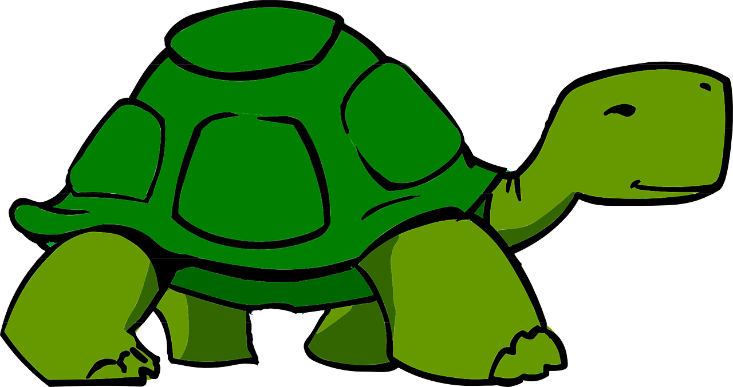
Amarillo term 1 week 3
Describing me and others
4
amarillo term 1
pronunciar
Describing how I’m feeing
[i]
Describing how someone else is feeling
Asking questions
idea
Santi
Manchita
Irene
Pancho
vocabulario
Write down the key language for this week.
clase |  | ahora
cómodo/a |  | pesado/a
positivo/a |  | en clase
Gender and agreement on adjectives
gramática
In Spanish, adjectives change depending on
whether the person or animal they describe is male or female.
Adjectives that are masculine (end in ‘o’) change to an ‘a’
when the person or animal being described is female.
Translate the examples.
Manchita
is a female rabbit, so the adjective also ends in –a.
Pancho está enfermo. → _________________________.
Manchita está enferma → ___________________________.
Santi está pesado → _______________________________.
Irene está positiva → _______________________________.
13

Slide 16
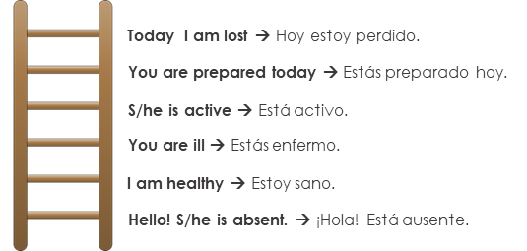

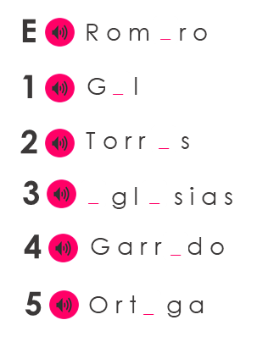
Amarillo term 1 week 4
Describing me and others
4
amarillo term 1
hablar
Person A. (Person B – turn to the next page.)
Read the sentence in English.
If your partner answers correctly, ask for the following sentence. You can help your partner 😊!
Now your turn to be the student. Translate the sentences your partner is going to ask you (you can use the hints ⬇). If you make a mistake, you will start from the bottom again!
H _ _ e_t_ p_rd_d_.
E_t_ s e_f_rm_ h_y.
E_t_ y s_n_.
E_t_ pr_ p_rad_.
E_t_ a_ t_ v_.
¡H_l_! E_t_ y pr_s_nt_.
escuchar
Escucha. Circle the correct adjective. Who is it?
 |  |  |  |  | Sofía | Quique
E | positivo | positiva | perdido | perdida
1 | perdido | perdida | pesado | pesada
2 | cómodo | cómoda | positiva | positivo
3 | sano | sana | enfermo | enferma
4 | activo | activa | sano | sana
5 | cómodo | cómoda | activo | activa
6 | pesado | pesada | sana | sano
Ángela
pronunciar
Don’t
e
forget capital letters and full stops!
Escucha. Fill the gaps with [e] or [i].
These are all popular surnames in Spain!
14

Slide 17
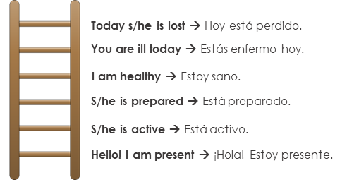
Amarillo term 1 week 4
Describing me and others
4
amarillo term 1
hablar
Person B. (Person A – see previous page.)
Translate the sentences your partner is going to ask you (you can use the hints ⬇). If you make a mistake, you will start from the bottom again!
Now your turn to be the teacher. Read the sentence in English.
If your partner answers correctly, ask for the following sentence. You can help your partner 😊!
H_ _ e_t_y p_rd_d_.
E_t_ _ pr_p_r_d_ h_y.
E_t_ a_t_v_.
E_t_ _ en_ _ rm_.
E_t_y s_n_.
¡H_l_! E_t_ aus_nt_.
leer
Escribe. Write the English meaning of está for each sentence:
1
Pedro está allí.
__________________________________________________.
Pedro there.
2
El señor Valero está en clase. Está preparado.
__________________________________________________.
Mr Valero in class. ready.
3
¿Rita? No, está en casa.
__________________________________________________.
¿Rita? No, at home.
4
¿Cómo está Martín? Está positivo hoy.
__________________________________________________.
How Martin today? positive today.
5
¿Belén está preparada? No, está perdida.
__________________________________________________.
Belen ready? No, lost.
15

Slide 18
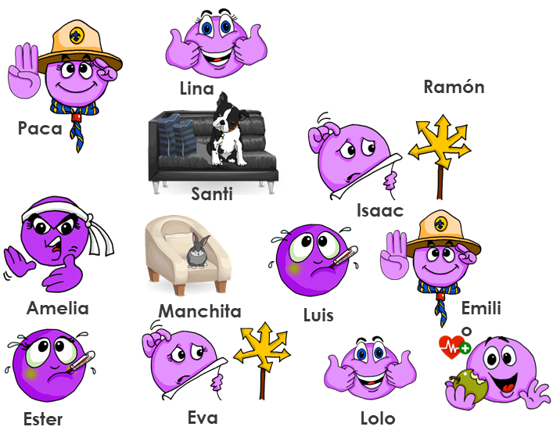
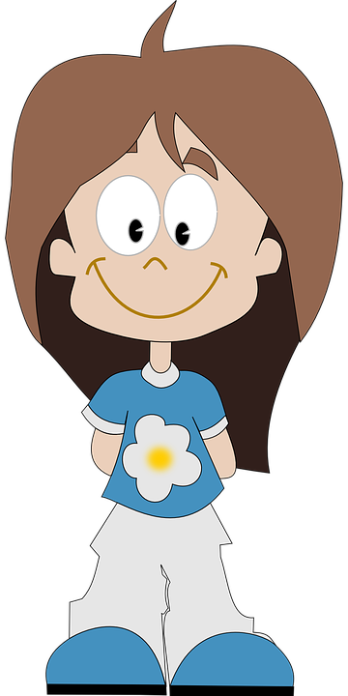
Amarillo term 1 week 4
Describing me and others
4
amarillo term 1
hablar
Habla y describe* a la persona*.
enfermo | enferma
perdido | perdida
pesado | pesada
cómodo | cómoda
preparado | preparada
activo | activa
sano | sana
describe = describe
la = the persona = person
Pay careful
attention to ensure you use the correct ending (-o OR –a)
escribir
Escribe. Translate the sentences.
1
Manchita is ill today.
__________________________________________________.
2
Santi is annoying at home.
__________________________________________________.
3
Rubén is positive now.
__________________________________________________.
4
Ángela is comfortable in class.
__________________________________________________.
5
Úrsula is ready now.
__________________________________________________.
¿Cómo estás hoy en clase?
[I am]…
16

Slide 19
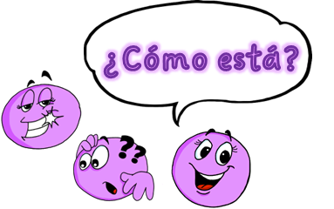

Amarillo term 1 week 5
Describing me and others
5
amarillo term 1
pronunciar
Describing how I’m feeing
[a]
[o]
[u]
Describing how someone else is feeling
Asking questions
casa
dos
universo
Pedro
Elena
Write down the key language for this week.
vocabulario
imposible |  | ¿dónde?
increíble |  | está
feliz |  | estoy
Gender and agreement on adjectives
gramática
Adjectives that are masculine (end in ‘o’)
change to an ‘a’ when the person or animal being described is female.
When an adjective ends in –e or -z it can describe a female and male person or animal. It does not change.
Translate the examples.
Quique está increíble. → _________________________.
Sofía está increíble. → _______________________________.
Pancho está feliz. → _______________________________.
Manchita está feliz. → _______________________________.
17

Slide 20
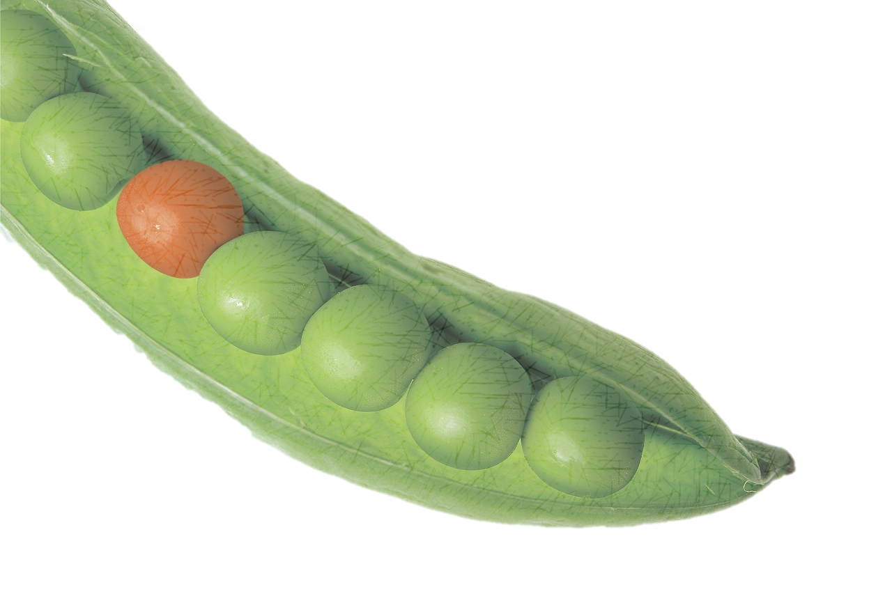
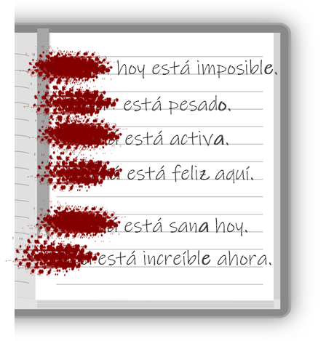





Amarillo term 1 week 5
Describing me and others
5
amarillo term 1
leer
Lee. ¿Dónde está el instruso?
el instruso = the odd one out
E | sano | enfermo | hoy
1 | positivo | pesada | perdida
2 | ¿cómo? | cómoda | ¿dónde?
3 | activa | pesada | sano
4 | hoy | preparado | ahora
5 | perdido | activo | enferma
leer
Lee. Is it Elena, Pedro or could it be either?
adjetivo | Elena | Pedro | either | inglés
imposible
impossible
escuchar
Escucha. Who is it?
Yes / No questions
Write the statement/question.
In Spanish, change a statement into a question by raising your voice at the end:
 | Asking someone [?] | Reporting back to Sr. Cano [.] | 🏆
E
1
2
3
4
5
6
Estás feliz.
¿Estás feliz?
You are happy.
¿Estás feliz?
Are you happy?
In writing,
Spanish uses 2
question marks. The one at the front is upside down!
18

Slide 21

Amarillo term 1 week 5
Describing me and others
5
amarillo term 1
leer
Escribe en inglés. Can you get at least 15 points?
 | está | aquí | cómodo
 | sano | ¿cómo? | allí
 | ¡Buenos días! | perdido | ¡Buenas tardes!
 | sí | hoy | estás
 | increíble | ¿dónde? | ahora
 | estoy | feliz | positivo
 | pesado | en clase | imposible
x3
x2
x1
hablar
Completa la encuesta*.
You can
prepare your
answer first, and
practise saying
it aloud a few times.
Ask as many people as possible!
¿Cómo estás?
Estoy …
happy | incredible | comfortable | positive | ready | impossible | annoying | negative | lost
Write your favourite words in Spanish, here.
19

Slide 22

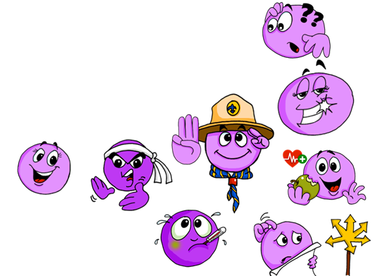

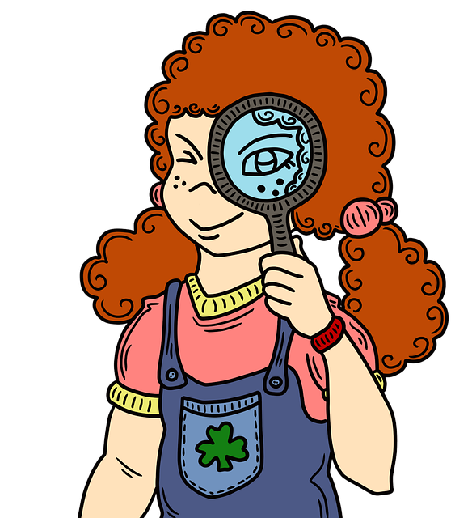
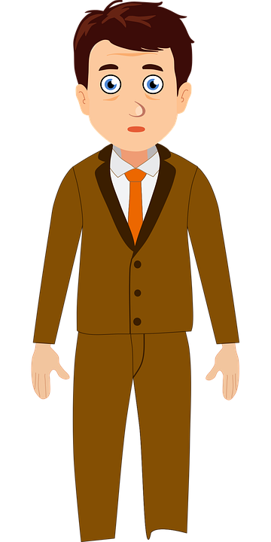
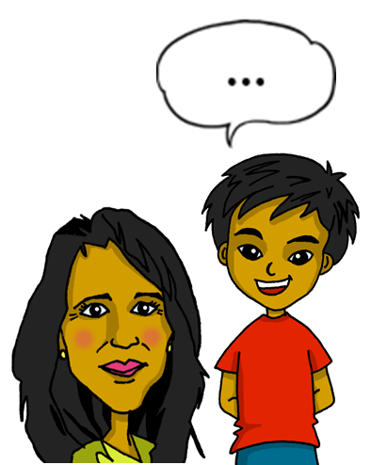

Amarillo term 1 week 6
Describing me and others
6
amarillo term 1
pronunciar
Describing what I’m like
[e]
[i]
Describing what someone else is like
tres
interesante
Write down the key language for this week.
vocabulario
¿cómo? |  | siempre
soy |  | normalmente
ser |  | es
Ser [to be, being]
gramática
In Spanish, the verb ser means ‘to be’ when describing general traits.
To mean I am for general traits, use soy.
To mean she, he or it is for general traits use es.
Translate the examples.
Soy feliz. → _________________________.
el señor Valero
Es sano. → ________________________.
escuchar
Quique habla. Escucha.
Who is she describing?
habla = he talks
 | Quique [himself] | or [s/he]
E
1
2
 | Quique [himself] | or [s/he]
4
5
¿en inglés ?
20

Slide 23
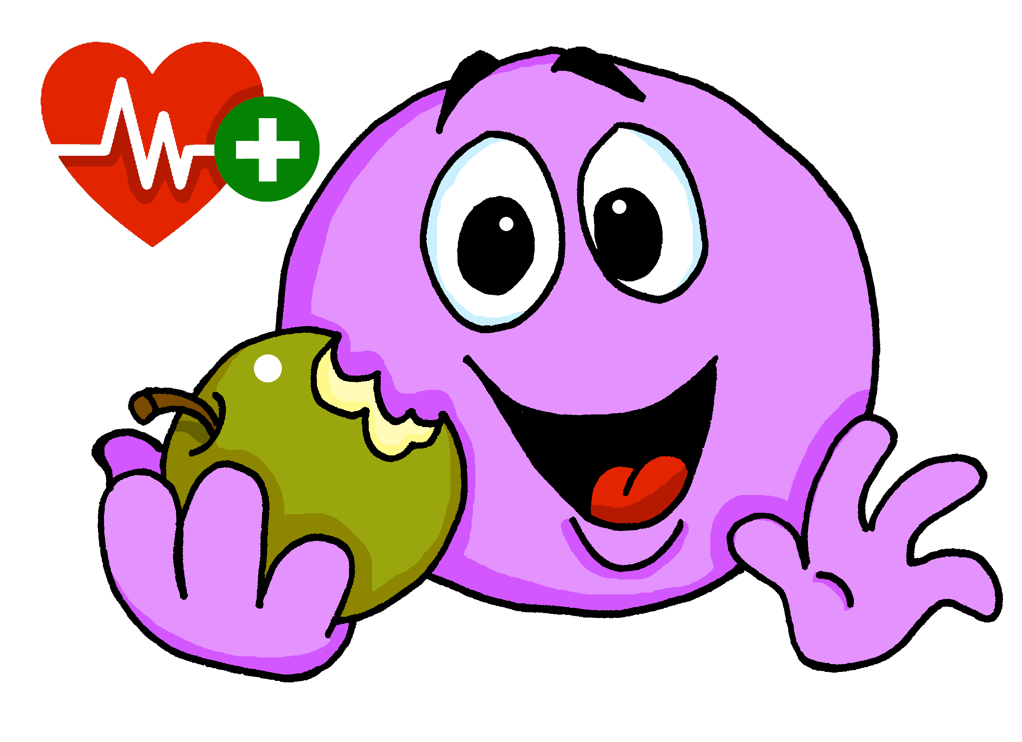

Amarillo term 1 week 6
Describing me and others
6
amarillo term 1
escuchar
Escucha y escribe.
soy
I am
normally
active
1 | Normalmente _____ activo.
2
3
4
leer
Write the English meaning of es for each sentence.
Ejemplo [1]: Iker es siempre tranquilo ➡ Iker is always calm.
2 | Normalmente Irene es feliz.
3 | ¿Es Isabel activa? ¡Sí! Es imposible.
4 | ¿Cómo es Quique? Siempre es feliz.
5 | ¿Es positiva? No, Eva es pesada.
Sometimes we refer to people by
namein a sentence:
Quique is always healthy.
He is (generally)happy.
Here we use the pronoun he because we don’t need to repeat Quique.
In Spanish, we often don’t need to use the pronoun.
Quique está aquí.
Está feliz.
[is]
[He is]
This means that está can mean is and
he is, she is, it is.
hablar
Person A: (Person B – turn to the next page.)
Your turn to be the teacher! Read the sentences to your partner.
Now listen to your partner and write M (male), F (female) or M/F (male/female) if it could be either.
Pupil B
1 | Es positivo.
2 | Es imposible.
3 | Es sana.
4 | Es feliz.
5 | Es pesada.
6 | Es activo.
1
2
3
4
5
6
21

Slide 24



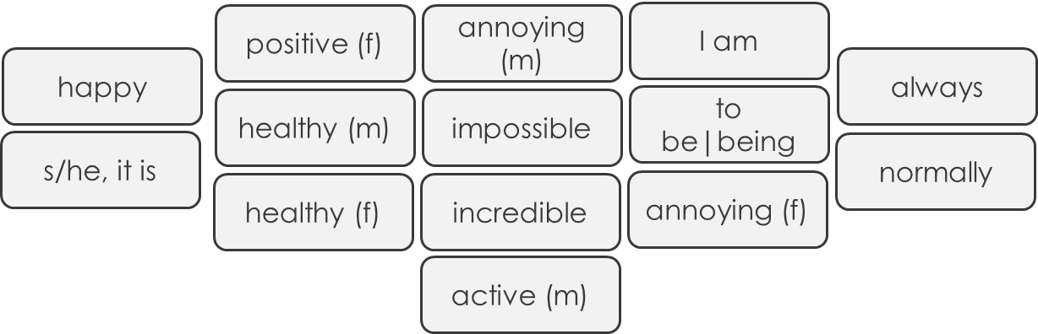
Amarillo term 1 week 6
Describing me and others
6
amarillo term 1
hablar
Person B. (Person A – see previous page.)
Listen to your partner and write M (male), F (female) or M/F (male/female) if it could be either.
Now your turn to be the teacher! Read the sentences to your partner.
Pupil A
1 | Es sano.
2 | Es feliz.
3 | Es positiva.
4 | Es increíble.
5 | Es activa.
6 | Es pesado.
1
2
3
4
5
6
hablar
Translate the words and find a quick route to the finish line.
Salida
activo
feliz
active (m)
happy
impossible
imposible
pesada
positiva
annoying (f)
incredible
positive (f)
increíble
sano
healthy (m)
I am
s/he, it is
to be|being
soy
es
pesado
ser
annoying (m)
normalmente
siempre
sana
normally
always
healthy (f)
Fin
22

Slide 25

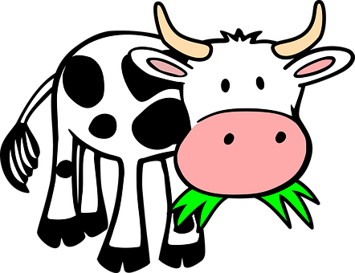
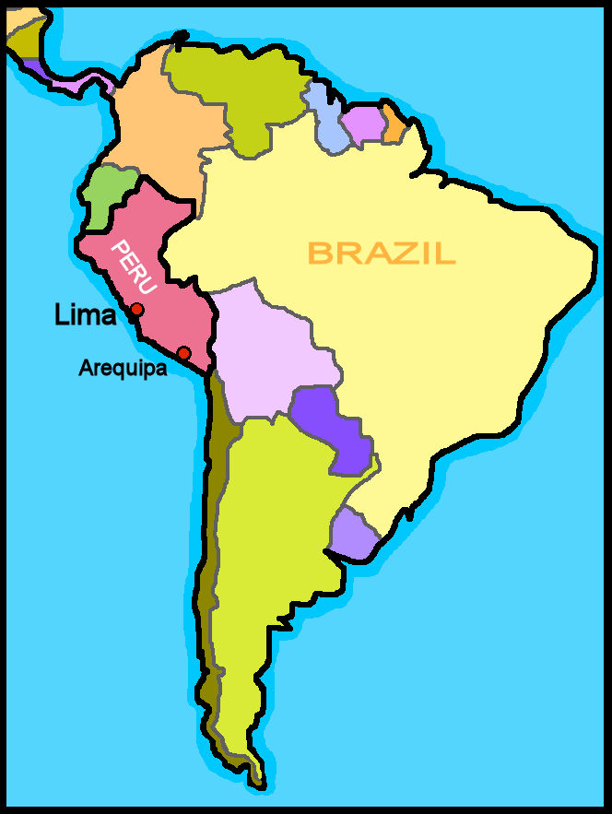


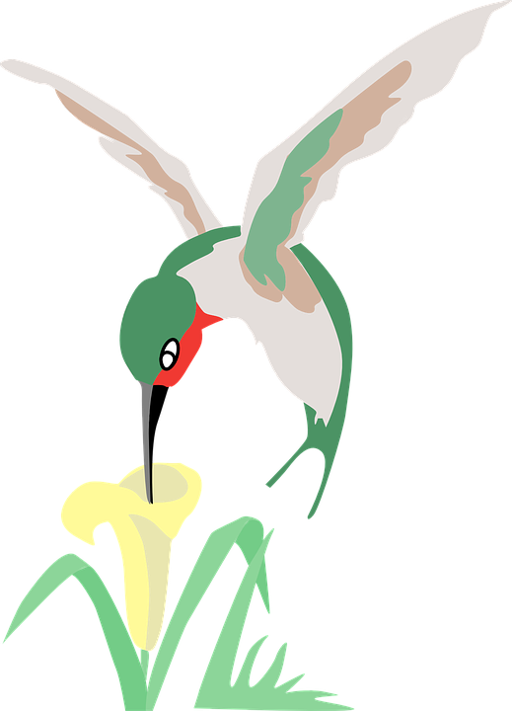




Amarillo term 1 week 7
Describing me and others
7
amarillo term 1
pronunciar
Describing what me and someone else is like
Con a, vaca
con e, pez
con i, colibrí
con o, ratón
con u, ñu.
Talking about origin (where you are from).
Write down the key language for this week.
vocabulario
eres |  | España
de1 |  | Perú
Inglaterra
Ser [to be, being]
gramática
In Spanish, the verb ser means ‘to be’ when
describing general traits.
Soy feliz.
Soy de España y Perú.
Spanish uses,
I am happy
I am from Spain and Peru.
2 question
marks. The one at
the front is upside down!
To mean you are for general traits, use eres.
‘ser’ [to _____ | being]
Translate the examples.
soy - ____ am
¡Eres de España!
→ ___________________________.
eres - ____ _____
¿Eres de Perú?
es - ____ _______
→ ___________________________.
es - ____ _______
Perú está en Latinoamérica.
23

Slide 26

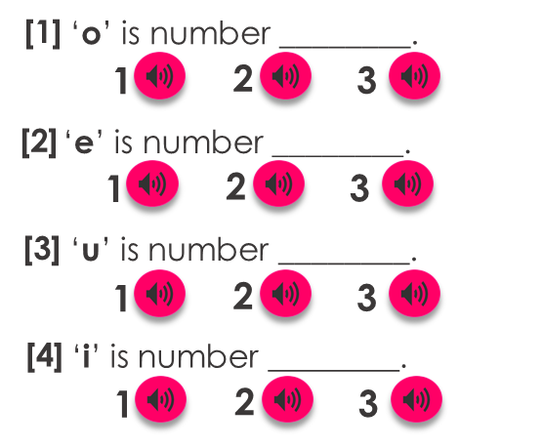



Amarillo term 1 week 7
Describing me and others
7
amarillo term 1
escuchar
Quique habla con papá Pedro. Escucha.
 | verbo | Quique [I] | Papá Pedro [you] | Ángela [she]
E
1
2
3
4
5
Who is she describing?
¿en inglés ?
es
positive
leer
Escribe en inglés. Can you get at least 15 points?
 | estoy | perdido | ¿dónde?
 | aquí | está | preparada
 | activo | ahora | positiva
 | ¿cómo? | hoy | siempre
 | es | normalmente | positivo
 | soy | España | eres
 | Inglaterra | active/activa | de
x3
x2
x1
escuchar
[A] Escucha. ¿Qué palabra es?
[B] Complete the poem with a word that rhymes.
Maca
Con a, la vaca __________.
Con e, el bebé __________.
Con i, el colibrí __________.
Con o, el ratón __________.
Con u, el unicornio __________.
Enrique marrón Maca único aquí Ugo Soli Camarón verde blanca
24

Slide 27










Amarillo term 1 week 7
Describing me and others
7
amarillo term 1
escuchar
[A] Escucha.
[B] Escucha y escribe. Use the correct words to translate the sentences. There are extra ones!
Write down the number in the correct column.
E
I am | You are | S/he, it is
1
2
3
4
hablar
Pregunta y adivina. Ask your partner questions to guess their secret character.
Frida Kahlo
Paco
Picasso
Quique
Colombia
Spain
México
Spain
& Peru
Pedro
Ángela
Irene
El señor Valero
Peru
Spain
Costa Rica
Chile
¿Eres de…?
¡No!
¿Eres de Inglaterra? Write down where you are from!
¡Sí, soy de…!
25

Slide 28
Amarillo term 1 week 7
Describing me and others
7
amarillo term 1
escribir
Escribe en español. Can you get at least 15 points?
1 | I am healthy
2 | You are from Perú.
3 | S/he is from Spain.
4 | I am from England.
Can you make these sentences into a question?
escribir
Escribe en español. Can you get at least 15 points?
 | Where? | I am (state) | ready (m + f)
 | S/he is (state) | here | lost (m + f)
 | now | always | How?
 | annoying (m + f) | today | comfortable (m + f)
 | normally | I am (origin) | active
 | you are (origin) | England | s/he, it is (origin)
 | Spain | from | positive (m + f)
x3
x2
x1
26

Slide 29




Amarillo term 1 week 8
Describing me and others
8
amarillo term 1
pronunciar
Saying what day of the week it is today.
[ca]
[co]
[cu]
cama
contar
cucaracha
Write down the key language for this week.
vocabulario
qué |  | martes |  | viernes
día |  | miércoles |  | sábado
lunes |  | jueves |  | domingo
Ser [to be, being]
gramática
We use ser when talking about what day it is.
To say ‘it is’ + day of the week, use es.
Hoy es martes.
Es martes.
Today is Tuesday.
It is Tuesday.
Translate the examples.
Days of the
week are not
capitalised in
Spanish.
Hoy es jueves. → ________________________.
Es jueves. → ___________________________.
¿Qué día es hoy? → ___________________________.
pronunciar
Make any gesture. Your partner says the day.
27

Slide 30


Amarillo term 1 week 8
Describing me and others
8
amarillo term 1
escuchar
Sofía habla con mamá Elena. Escucha.
E | Tuesday | Wednesday | Monday | Thursday | Tuesday
1 | Wednesday | Friday | Thursday | Saturday | Wednesday
2 | Tuesday | Sunday | Wednesday | Thursday | Tuesday
3 | Friday | Saturday | Monday | Wednesday | Friday
4 | Thursday | Friday | Sunday | Tuesday | Thursday
5 | Sunday | Monday | Tuesday | Saturday | Sunday
leer
Escribe en inglés. Can you get at least 15 points?
 | estás | cómodo | perdido
 | soy | enfermo | eres
 | sano | hoy | ahora
 | imposible | increíble | es
 | día | viernes | sábado
 | jueves | ¿Qué? | estoy
 | lunes | martes | miércoles
x3
x2
x1
escuchar
[A] Escucha y marca .
 | [ca] | [co] | [cu]
E |  |  |  | _ _ le
1 |  |  |  | _ _ n
2 |  |  |  | _ _ ma
3 |  |  |  | _ _ enta
4 |  |  |  | _ _ ando
5 |  |  |  | _ _ bra
el trabalenguas = tonguetwister
co
[B] ¡Habla!
Cuando Carmen
come coles
en en el cole
Cata cuenta cabras
en la cama.
28

Slide 31





Amarillo term 1 week 8
Describing me and others
8
amarillo term 1
escuchar
[A] Escucha y escribe en inglés.
[B] Esucha. Fill in the gaps with the missing English word.
1. Today is __________. I am (feeling) __________.
2. _________ are you? _______ is Monday!
3. ___ ___ Thursday? Or _________?
4. It is ___________ and ___ ___ (feeling) sad.
5. ____ ____ feeling incredible _______.
6. You are (looking) ______ today! _____ day is it?
Sunday
leer
Lee. ¿Qué día es? Complete the sentences.
y = and
muy = very
Quique is (feeling) ____________ on Thursday, and he is present ___ ______.
1
healthy
2
On ______________ he is _____________ at home.
3
Quique is feeling very lost on _________.
4
On _______ he is feeling impossible.
escribir
Escribe. Make a note of how you’re feeling each day this week.
 | Today is...
 | I am (feeling…)
Hoy es lunes
Estoy feliz.
29

Slide 32

Amarillo term 1 week 9
Saying what I and others have
9
amarillo term 1
pronunciar
Saying what I have
[ce]
centro
Write down the key language for this week.
vocabulario
tener |  | caballo |  | planta
tengo |  | cama |  | un
barco |  | libro |  | una
bolsa
Gender | Indefinite articles (a/an)
gramática
In Spanish, things as well as people and animals, are either masculine or feminine. We say that they have gender.
To say a (or an) in Spanish use un before a masculine and una before a feminine noun.
Most
masculine
nouns end in -o and most feminine nouns end in -a.
Translate the examples.
una cama → ______________.
una cama → ______________.
una idea → _____________.
una idea. → _____________.
una planta → ______________.
una casa → ______________.
30

Slide 33












Amarillo term 1 week 9
Saying what I and others have
9
amarillo term 1
escuchar
La cama de Sofía. Sofía needs to tidy up her bed.
¿Es ‘un’ o ‘una’?
E | un | una | planta | teléfono
1 | un | una | libro | fruta
2 | un | una | instrumento | bolsa
3 | un | una | cama | barco
4 | un | una | caballo | cucaracha
¡Qué desastre, Sofía!
leer
Escribe dos listas en inglés .
hablar
Persona A: (Person B – turn to the next page.)
Your turn to speak! Say ‘tengo’ and the correct article (un/una).
Now listen to your partner and tick the correct noun.
Round 1
Round 2
 |  | un / una
1 | Tengo |  | caballo
2 | Tengo |  | cama
3 | Tengo |  | bolsa
4 | Tengo |  | libro
5 | Tengo |  | barco
 | Which noun must it be?
1
2
3
4
5
31

Slide 34






Amarillo term 1 week 9
Saying what I and others have
9
amarillo term 1
hablar
Persona B. (Person A – see previous page.)
Now listen to your partner and tick the correct noun.
Your turn speak! Say ‘tengo’ and
the correct article (un/una).
Round 1
Round 2
 | Which noun must it be?
1
2
3
4
5
 |  | un / una
1 | Tengo |  | planta
2 | Tengo |  | barco
3 | Tengo |  | libro
4 | Tengo |  | cama
5 | Tengo |  | bolsa
pronunciar
¡Practica!
Albacete
Cáceres
cebra
Ceuta is a Spanish city
on the north coast of Africa and it borders with Morocco!
cosa
Ceuta
cero
cena
Barcelona
maceta
pecera
cerdo
leer
Clasifica las palabras.
un
una
libro
bolsa
___________
___________
instrumento
caballo
___________
___________
fruta
barco
___________
___________
idea
___________
___________
planta
cama
___________
___________
32

Slide 35






Amarillo term 1 week 9
Saying what I and others have
9
amarillo term 1
escuchar
[A] Escucha.
[B] Escucha y escribe. Use the correct words to write the sentences. There are extra ones!
¿Qué palabra es?
E
I have | he is (t) | I am (t)
E
1
bed | boat | horse
2
to have, having | I have | to be, being (t)
1
3
Tuesday | Wednesday | Friday
2
4
ready | lost | impossible
3
4
escribir
Escribe en español. Can you get at least 15 points?
 | you are (state) | here | normally
 | healthy (f) | there | I am (state)
 | to be, being (trait) | I am (trait) | always
 | incredible (m/f) | normally | s/he, it is (trait)
 | to have, having | a bed | a/an (f)
 | a bag | a/an (m) | a horse
 | a boat | I have | a plant
x3
x2
x1
33

Slide 36






Amarillo term 1 week 10
Saying what I and others have
amarillo term 1
10
pronunciar
Saying what someone else has
Soy Max
[ci]
Un amigo de Inglaterra
decir
Write down the key language for this week.
vocabulario
tiene |  | hermana |  | profesor
dibujo |  | mesa |  | profesora
hermano |  | perro |  | puerta
tener [to have, having]
gramática
The verb tener means ‘to have’ or ‘having’.
To say I have, use ‘tengo’.
To say s/he or it has, use ‘tiene’.
Translate the examples.
Tengo un amigo. → ________________________.
Tiene una amiga. → ________________________.
Write your favourite words in Spanish, here.
34

Slide 37








Amarillo term 1 week 10
Saying what I and others have
amarillo term 1
10
leer
Lee y escribe en español.
Escribe la letra (a-g).
Quique (I) | Max (he)
a
e
teacher (m)
b
c
f
d
g
escuchar
¿Es Max o Quique? Escribe el objeto en inglés .
objeto
escuchar
 | Quique (I)
E
1
2
3
4
Max
(he)
Escucha y cuenta el sonido [ci] .
a pen
 | [ci]
E
1
2
3
4
leer
Escribe en inglés. Can you get at least 15 points?
 | hola | estoy | presente
 | aquí | estar | allí
 | España | eres | de
 | preparada | cómodo | Inglaterra
 | un perro | una mesa | tengo
 | una profesora | una puerta | un dibujo
 | tiene | una hermana | un profesor
x3
x2
x1
35

Slide 38
Amarillo term 1 week 10
Saying what I and others have
amarillo term 1
10
escuchar
escribir
Escucha y escribe.
1 | _______ un dibujo y un barco.
2
3
4
5
Tengo
s/he
drawing
boat
escribir
Escribe en español. Can you get at least 15 points?
 | there | s/he, it is (state) | here
 | hello | I am (state) | present
 | from | Spain | comfortable (m)
 | England | you are (trait) | ready (f)
 | s/he has | I have | a dog
 | a door | a table | a teacher (m)
 | a drawing | a teacher (f) | a sister
x3
x2
x1
escribir
Escribe en español.
When translating a / an, consider the gender of the noun.
Don’t
forget capital letters and full stops!
_________________________________.
1
I have a table.
Rubén has a (male) dog.
She has a sister.
I have a horse and a plant.
Quique has a drawing and a book.
2
_________________________________.
3
_________________________________.
4
______________________________.
5
_____________________________.
36

Slide 39



Amarillo term 1 week 11
Saying what I and others have
amarillo term 1
11
pronunciar
Asking what someone else has
[ce]
[ci]
centro
decir
Write down the key language for this week.
vocabulario
hoja |  | mensaje
idea |  | palabra
lápiz |  | regla
Yes/no questions
gramática
Turn a statement into a yes/no question by making your voice go up at the end.
Tengo un lápiz.
I have a pencil.
¿Tengo un lápiz?
Do I have a pencil?
tener [to have, having]
Translate the examples.
tengo - ____ have
Tienes un caballo.
→ ________________________.
tienes - ____ have
¿Tienes un caballo?
tiene - ____ _______
→ ________________________.
tiene - ____ _______
37

Slide 40










Amarillo term 1 week 11
Saying what I and others have
amarillo term 1
11
leer
¿Es ‘un’ o ‘una’?
¿Es posible [P] o imposible [I] ?
Tengo ____ perro.
Tengo ____ hermana.
Tengo ____ libro.
Tengo ____ hoja.
Tengo ____ lápiz.
Tengo ____ regla.
Tengo ____ mensaje.
escuchar
Do I have…? | Do you have…? | objeto en inglés
E
a plant
1
2
3
4
5
6
hablar
Escribe un número en secreto. Tu compañero/a adivina.
‘Do you have…..?’
(el) compañero/a = male/female partner
adivina = s/he guesses
un | caballo
 | mensaje
 | libro
 | lápiz
 | perro
 | barco
una | palabra
 | hoja
 | puerta
 | regla
 | planta
38

Slide 41









Amarillo term 1 week 11
Saying what I and others have
amarillo term 1
11
hablar
Persona A: (Person B – turn to the next page.)
Round 1
Round 2
Your turn to speak! Say the word in Spanish. Then listen to your partner and write the missing sentence beginning in English.
Now listen to your partner and reply with the full sentence, using either tengo or tienes.
1. _____ _______ a sheet.
2. _____ _______ a pencil.
3. _____ _______ a boat.
4. _____ _______ a horse.
5. _____ _______ a word.
1
2
3
4
5
Tengo…
Tienes…
Escucha. ¿Es [ce] o [ci]?
pronunciar
escuchar
E | _ _ sne
1 | _ _ elo
2 | _ _ leste
3 | _ _ en
4 | pe_ _ s
5 | co_ _ nero
6 | impa_ _ente
[sky-blue]
100
😤
leer
Escribe en inglés. Can you get at least 15 points?
 | estás | ¡Buenas tardes! | ¡Buenos días!
 | viernes | lunes | en
 | jueves | sábado | miércoles
 | ¿qué? | un día | martes
 | una hoja | un lápiz | tengo
 | una palabra | un mensaje | una regla
 | tienes | una idea | tiene
x3
x2
x1
39

Slide 42

Amarillo term 1 week 11
Saying what I and others have
amarillo term 1
11
hablar
Persona B. (Person A – see previous page.)
Round 1
Round 2
Listen to your partner
Your turn to speak! Say the word in Spanish. Then listen to your partner and write the missing sentence beginning in English.
and reply with the full sentence, using either tengo or tienes.
1
2
3
4
5
Tengo…
Tienes…
1. _____ _______ a dog.
2. _____ _______ a (female) teacher.
3. _____ _______ an idea.
4. _____ _______ a bottle.
5. _____ _______ a ruler.
escribir
Escribe en español. Can you get at least 15 points?
 | Monday | good afternoon | good morning
 | you are (state) | Friday | in
 | Tuesday | Wednesday | Thursday
 | a day | what? | Saturday
 | I have | a message | a pencil
 | a ruler | he/she/it has | an idea
 | a word | a sheet | You have
x3
x2
x1
40

Slide 43






Amarillo term 1 week 12
Saying what I and others have
amarillo term 1
12
El club del planeta
pronunciar
Talking about having
[z]
describing things
zapato
Write down the key language for this week.
vocabulario
animal |  | papel
cosa |  | raro
instrumento |  | nuevo
viejo
Adjectives following the noun
gramática
In Spanish, many adjective follow the noun.
un instrmento raro
In English the adjective comes before the noun.
Spanish
a weird instrument
tells you what it is, and then how it is.
Translate the examples.
Una profesora nueva
→ ________________________.
un amigo feliz
→ ________________________.
41

Slide 44





Amarillo term 1 week 12
Saying what I and others have
amarillo term 1
12
leer
Lee la lista. Escribe en inglés .
In English
adjective comes before the noun.
E
un instrumento pesado
1
una hoja vieja
an annoying instrument
E
1
2
3
4
5
2
una cosa rara
3
una palabra nueva
4
un animal perdido
5
una amiga positiva
escuchar
Quique y Sofía bring items to the eco club.
rojo
Escucha y
rodea el adjetivo.
 | descripción | objeto
E | rojo / roja
1 | cómodo /cómoda
2 | nuevo / nueva
3 | raro / rara
4 | sano / sana
5 | viejo / vieja
I have | you have
a pencil
crear
Un instrumento: castañuelas
tiras* de cartón* y papel (12cm x 4cm)
pegamento
dos chapas* de botella
¿Qué es? Un instrumento típico* de España
cartón = cardboard
chapa = cap
tiras = strips
típico = typical
42

Slide 45







Amarillo term 1 week 12
Saying what I and others have
amarillo term 1
12
escuchar
[z] sounds
the same as [c] in front of [e] [i].
[A] Escucha y marca .
 | z [th] | s
E |  |  | co _ _
1 |  |  | _ _ mpoña
2 |  |  | pe _ _
3 |  |  | _ _ eco
4 |  |  | ro _ _ l
5 |  |  | _ _ mbomba
[B] Escribe en la espalda y adivina.
[thing]
¿Tienes [__] ?
Do you have…?
adivina = guess
la espalda = the back
leer
Put the adjectives in the correct group.
The ending changes when the noun is masculine/feminine | The ending is the same for a masculine/feminine noun
raro
feliz
enfermo
sana
imposible
preparada
increíble
leer
Escribe en inglés. Can you get at least 15 points?
 | perdido | enferma | hoy
 | sano | preparada | how?
 | tener | un barco | un libro
 | tengo | una | una silla
 | una cosa | raro | nuevo
 | un animal | viejo | un instrumento
 | papel | tiene | tienes
x3
x2
x1
43

Slide 46


Amarillo term 1 week 12
Saying what I and others have
amarillo term 1
12
escribir
Escribe en español. Can you get at least 15 points?
 | lost (m) | today | How?
 | ready (f) | healthy (m) | ill, sick (f)
 | I have | a book | a boat
 | to have, having | a bag | a/an (feminine)
 | an animal | a thing | you have
 | paper | new | odd, weird
 | an instrument | old | s/he has
x3
x2
x1
Empareja la imagen con el instrumento.
Do you remember where they are typically from?
b
castañuelas
zampoña
zambomba
Perú (1)
España (2)
a
c
La zambomba es un instrumento típico* de Navidad
escribir
¿Qué tienes? Escribe en español.
Write your favourite items in Spanish, here.
44

Slide 47






Rojo term 1 week 13
¡Feliz Navidad!
amarillo term 1
13
escuchar
A ‘huayno’ is a popular type of music and dance from Peru that goes back more than 500 years.
[A] Escucha el huayno.
Un huayno: Niño Manuelito
Niño Manuelito ¿qué quieres comer?
Niño Manuelito ¿qué quieres comer?
Torrejitas fritas envueltas en miel,
Torrejitas fritas envueltas en miel,
[Estribillo]
Mi canchita te la traigo,
molidita te la traigo
aquí te traigo el buen café
para María y San José. (x 2)
Baby Jesus, what do you want to eat?
Baby Jesus, what do you want to eat?
French toasts covered in honey,
French toasts covered in honey,
[Chorus]
My corn I bring you,
all ground up I bring it to you
here I bring you good coffee
for Mary and Joseph. (x 2)
Me as a shepherdess, I bring you my sheep
Me as a shepherdess, I bring you my sheep some shorn and some without ears
some shorn and some without ears
[Chorus]
My corn I bring you,
all ground up I bring it to you
here I bring you good coffee
for Mary and Joseph. (x 2)
Yo como pastora, te traigo mis ovejas Yo como pastora, te traigo mis ovejas
unas trasquiladas y otras sin orejas
unas trasquiladas y otras sin orejas
[Estribillo] (chorus)
Mi canchita te la traigo,
molidita te la traigo
aquí te traigo el buen café
para María y San José (x 2)
This is a Christmas ‘huayno’. In the mountains of Peru they call Baby Jesus ‘Niño Manuelito’- Manuelito is the pet name from Manuel, short for Emmanuel, another name for Jesus in the bible.
[B] Canta el hayno 🎤 .
45

Slide 48







Rojo term 1 week 14
¡Feliz Navidad!
amarillo term 1
14
leer
El Roscón de Reyes
¡Es un donut gigante!
A ‘Roscón de Reyes’ is a traditional
Spanish brioche-like sweet bread eaten the night before or morning of Reyes or King’s Day (6th January).
Hidden inside, there are a small toy and a small dried kidney bean. The person who finds the small toy will be crowned king for the day and the lucky person who finds the bean has the honour of paying for the whole cake!
el haba
el juguete
A ‘corona’ also accompanies the Roscón, and the king or queen gets to wear it. 😊
hablar
In secret, choose a space and draw your ‘haba’ and ‘juguete’.
1 Do you have…?
2 S/he has …
3 You have …
4 I have
a |  | b
English | Spanish | English | Spanish
a boat | un barco | a drawing | un dibujo
a bag | una bolsa | a brother | un hermano
a horse | un caballo | a sister | una hermana
a bed | una cama | a table | una mesa
a book | un libro | a dog | un perro
a plant | una planta | a door | una puerta
c |  | d
English | Spanish | English | Spanish
a sheet | una hoja | an animal | un animal
an idea | una idea | a thing | una cosa
a pencil | un lápiz | an instrument | un instrumento
a message | un mensaje | a male teacher | un profesor
a word | una palabra
a ruler | una regla | a female teacher | una profesora
46

Slide 49











Rojo term 1 week 14
¡Feliz Navidad!
amarillo term 1
14
leer
Vocabulario de Navidad.
Sopa de letras
(el) ángel
(la) corona
(la) campana
(el) regalo
(la) estrella
Find the following words in the puzzle. Words are hidden ➡ and ⬇ .
(la) bola de Navidad
(el) árbol de Navidad
The ‘Roscón de Reyes’ can be bought in any bakery
or supermarkets. They all come with a paper crown so the lucky person who finds the toy wears it.
crear
Una corona 👑 para el Roscón
1 Decora la corona.
You can also write ‘Feliz Día de Reyes’.
2 Corta.
3 Pega
corona = crown
para = for
cortar = to cut out
colorear = to colour
pegar = to glue
People in Spain typically say ‘Feliz Día de Reyes’ (happy King’s Day) on this day.
47

Slide 50

Rojo term 1 week 14 - materials
¦
¦
¦
¦
¦
¦
¦
¦
¦
¦
¦
¦
¦
¦
¦
¦
¦
¦
¦
¦
¦
¦
¦
¦
¦
¦
¦
¦
¦
¦
¦
¦
¦
¦
¦
Amarillo term 1
48

