Slide 1
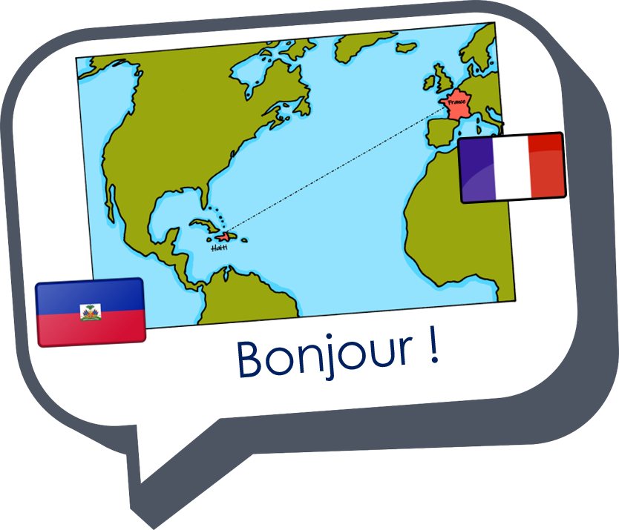
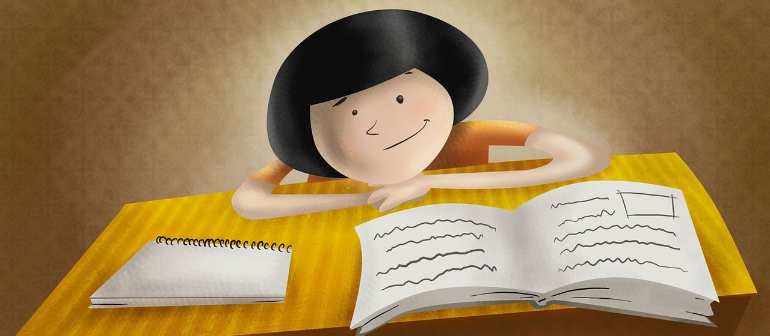
Expressing likes and saying what I and others do
Je révise !
vert
Révision
Notes:
Artwork by Steve Clarke. Pronoun pictures from NCELP (www.ncelp.org). All additional pictures selected from Pixabay and are available under a Creative Commons
license, no attribution required.
Phonics: Revisit SSC from this term and from previous learning: [-tion] [qu] [-s-] [h] [-ien] [j/g] [ç/c] [SFC] [u] [ou] [(a)in] open [eu] [ch] [(e)au]
Vocabulary: Revisit vocabulary (new words in bold) from this term and from previous learning.
Revisit 1: aimer [242] corde [3784] danse [2964] football [2602] guitare [>5000] piano [4967] sport [2011] tennis [3687]
amusant [4695] sympa [4164] intéressant [1244] parce que [NA] pourquoi [193]
Revisit 2: tu vas je vais [53] tu es je suis [5] à (meaning ‘at/in/to’) [4] café [1886] campagne [666] centre commercial [n/a] église [1782] ile [1245] magasin [1736] maison
[325] marché [280] montagne [1732] plage [2693] pont [1889] port [1304]
Londsale, D., & Le Bras, Y. (2009). A Frequency Dictionary of French: Core vocabulary for learners London: Routledge.
The frequency rankings for words that occur in this PowerPoint which have been previously introduced in these resources are given in the SOW and in the resources that
first introduced and formally re-visited those words.
For any other words that occur incidentally in this PowerPoint, frequency rankings will be provided in the notes field wherever possible.
The frequency rankings for words that occur in this PowerPoint which have been previously introduced in these resources are given in the SOW and in the resources that
first introduced and formally re-visited those words.
For any other words that occur incidentally in this PowerPoint, frequency rankings will be provided in the notes field wherever possible.
1

Slide 2
prononcer
Prononce les mots.
[è|ê]
[SFe]
[é|-er|ez]
météo
sorcière
perte
[weather forecast]
[witch]
[loss]
Notes:
Timing: 5 minutes (five slides)
Aim: to revisit read aloud 24 of this year’s SSC.
Procedure:
Click to bring up the first flashcard.
Elicit choral read aloud.
If desired, click on the word to listen to the pronunciation.
Continue with the remaining flashcards.
Go on to the next slide and repeat.
Frequency of unknown words and cognates:
météo [4574] perte [1080] sorcière [4582]
Londsale, D., & Le Bras, Y. (2009). A Frequency Dictionary of French: Core vocabulary for learners London: Routledge.
2

Slide 3
prononcer
Prononce les mots.
[-tion]
[on]
[-ien]
sélection
oncle
technicien
[uncle]
[technician]
Notes:
[2/8]
oncle [3628] selection [2403] technicien [2461]
3

Slide 4
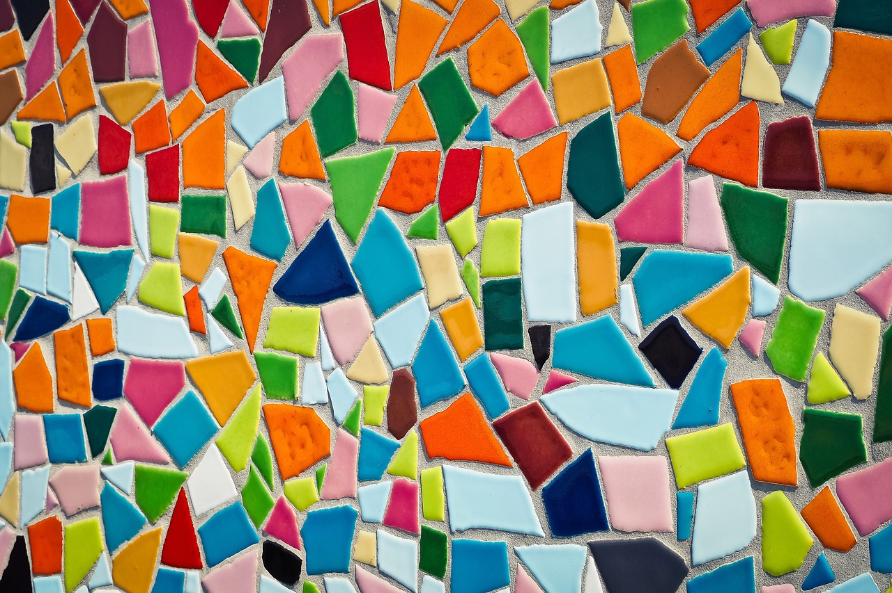
prononcer
Prononce les mots.
[u]
[ou]
[(e)au]
lacune
pouce
morceau
[(knowledge) gap]
[thumb]
[piece, bit]
Notes:
[3/8]
lacune [4268] morceau [2118] pouce [3298]
4

Slide 5
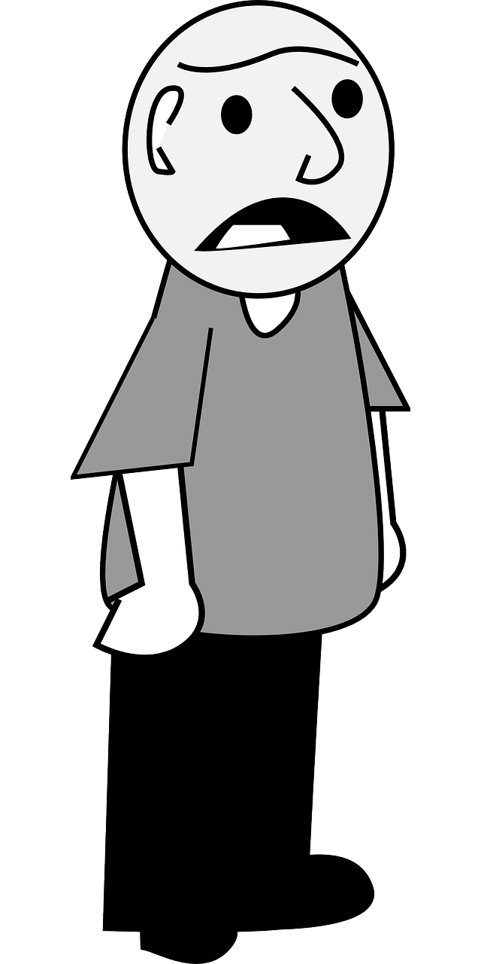
prononcer
Prononce les mots.
[ai]
[(a)in]
[en|an]
se taire
plainte
carburant
[to keep quiet]
[moan]
[fuel]
Notes:
[4/8]
carburant [3633] plainte [1851] (se) taire [1853]
5

Slide 6
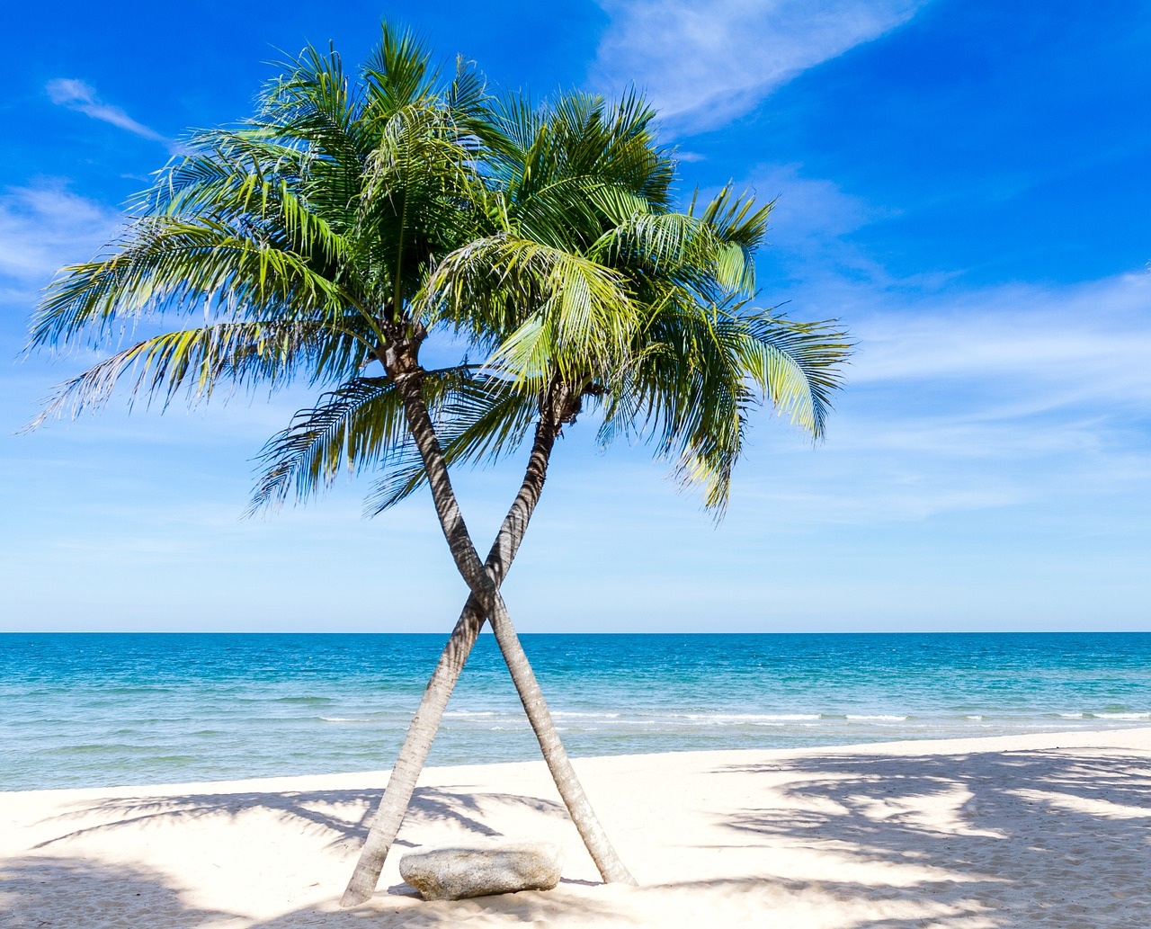
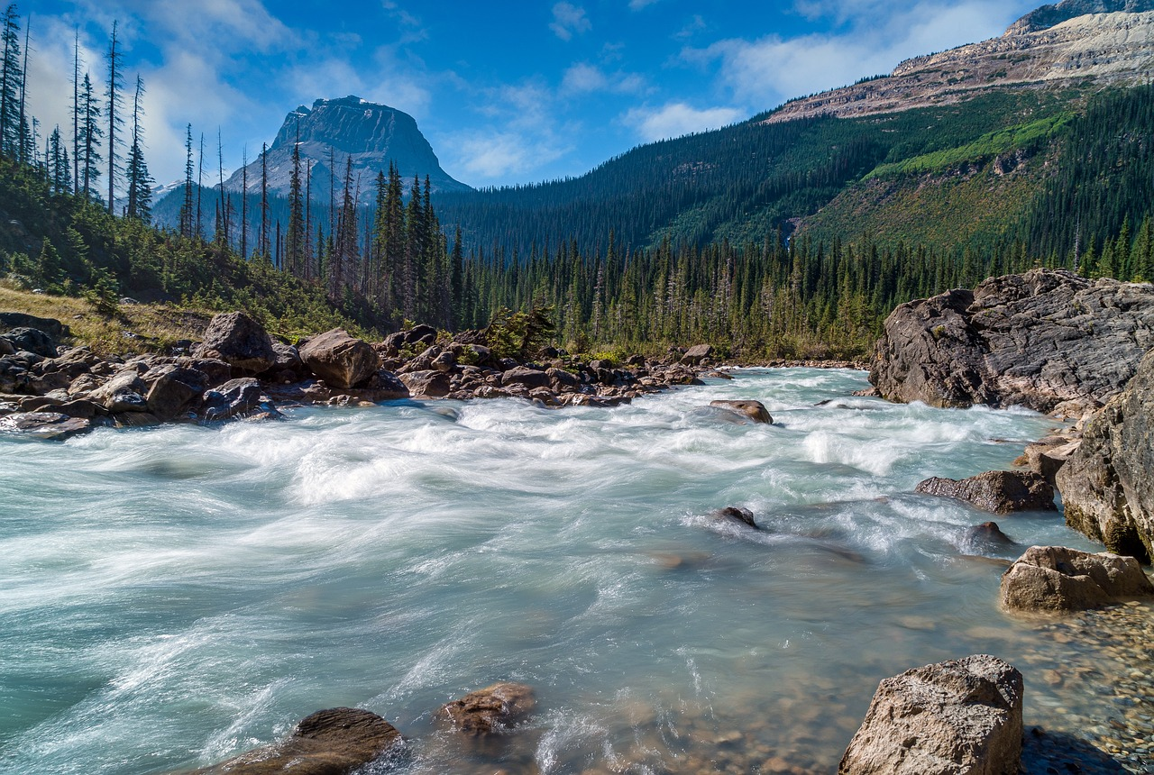
prononcer
Prononce les mots.
[SFC-s]
[SFC-t]
[liaison]
des escargots
paradis
flot
[paradise]
[stream, flow]
[some snails]
Notes:
[5/8]
escargot [>5000] paradis [2952] flot [2092]
6

Slide 7
prononcer
Prononce les mots.
[_{open} eu]
[oi]
[r]
serveur
chinois
rappeler
[waiter]
[Chinese]
[to recall]
Notes:
[6/8]
chinois [1914] rappeler [208] serveur [4377]
7

Slide 8
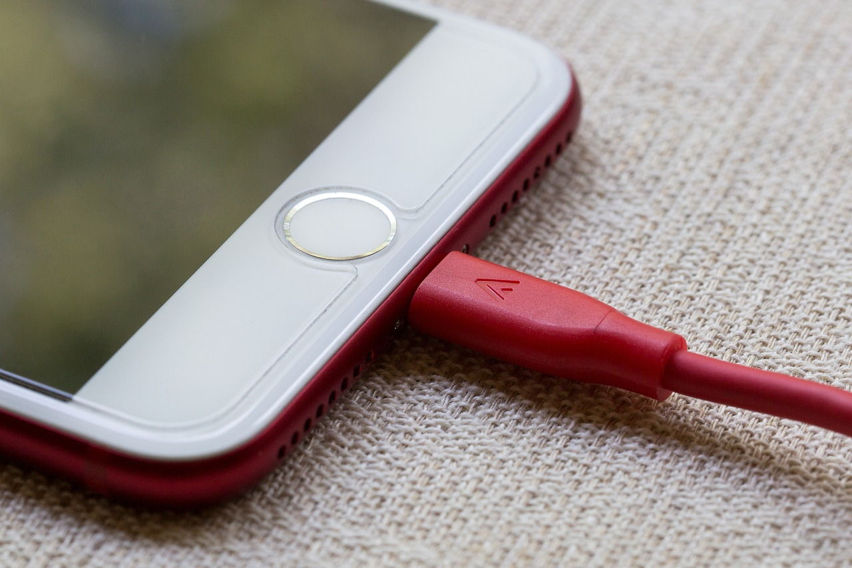
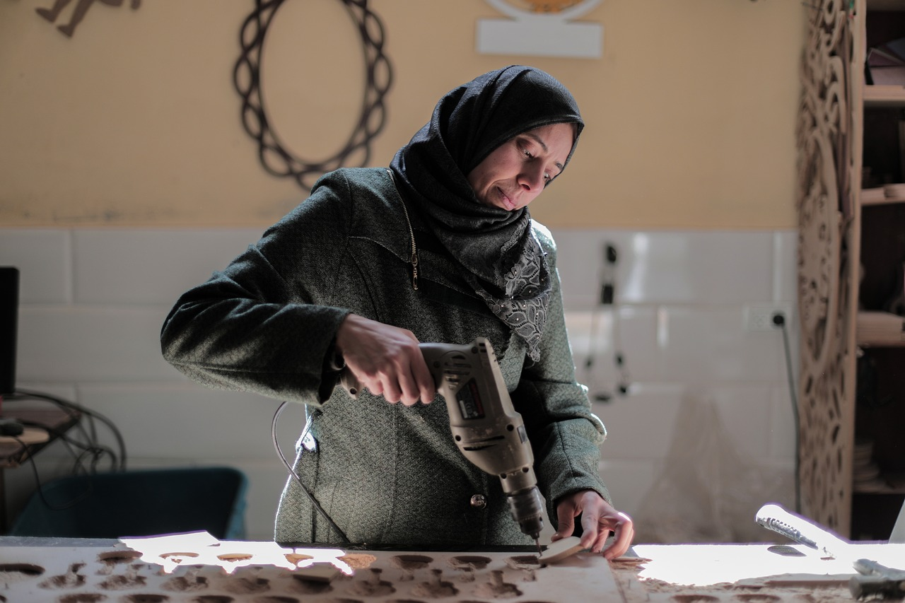
prononcer
Prononce les mots.
[ch]
[_{soft} c|ç]
[_{soft} g|j]
recharger
percer
sondage
[to recharge]
[to drill]
[survey]
Notes:
[7/8]
percer [3644] recharger [>5000] sondage [2231]
8

Slide 9
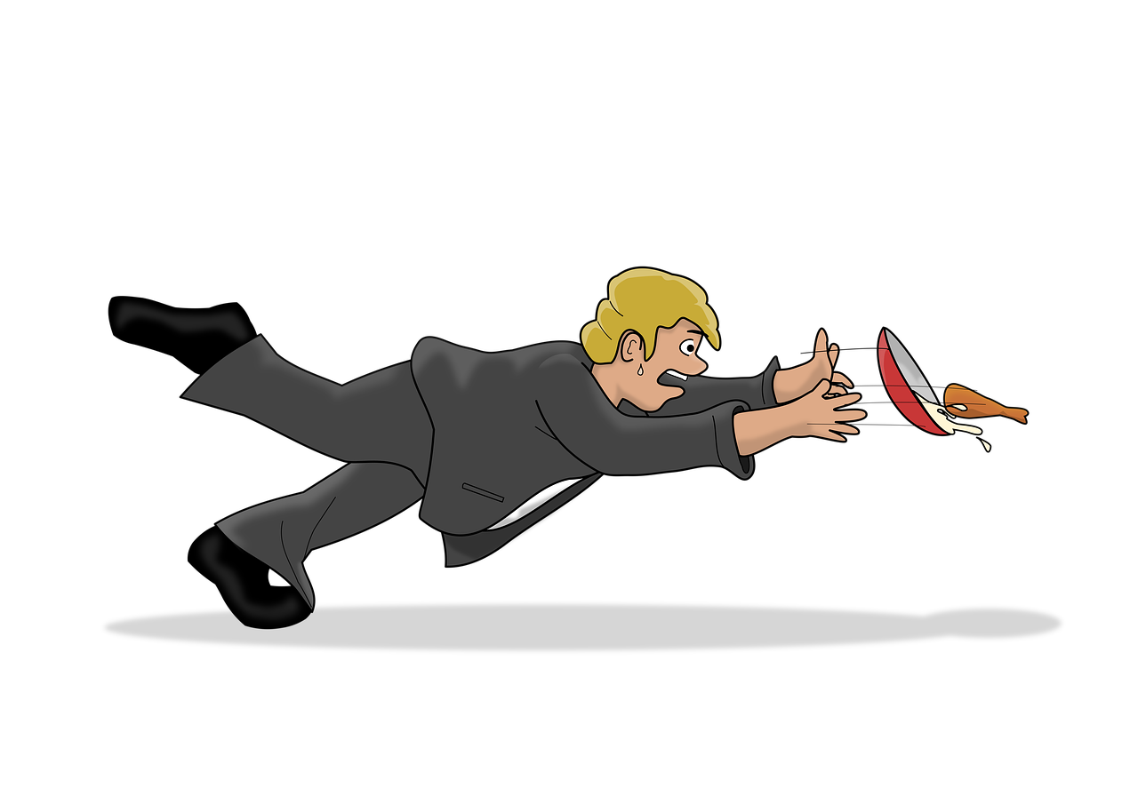
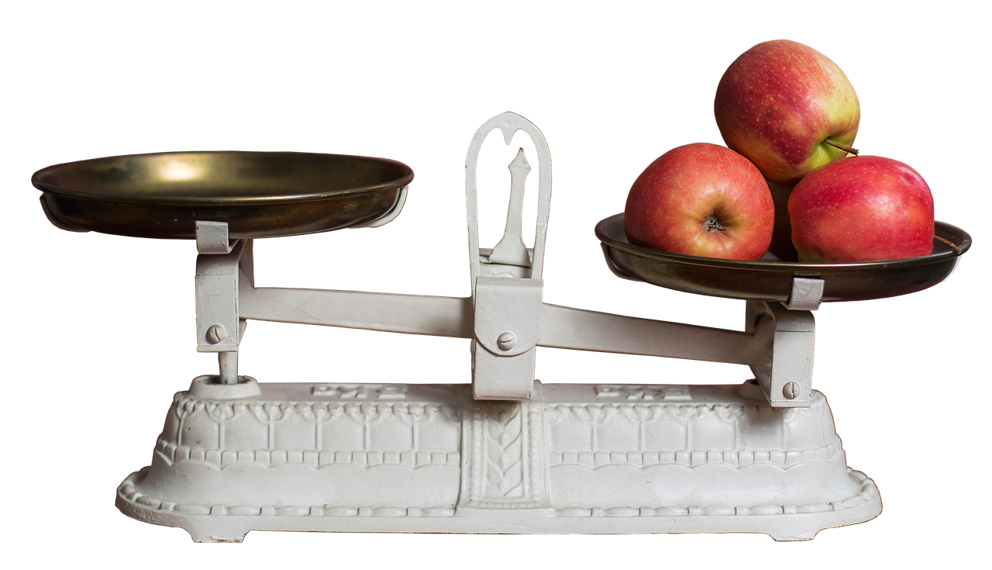
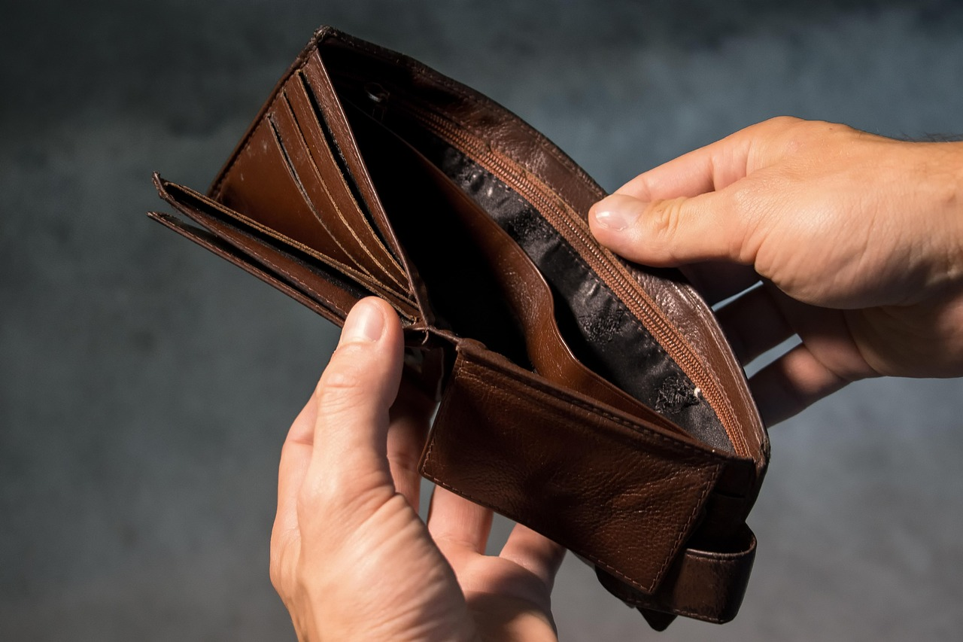
prononcer
Prononce les mots.
[qu]
[-s-]
[h]
manquer
peser
hélas
[to be missing]
[to weigh]
[unfortunately]
Notes:
[8/8]
manquer [583] peser [1584] hélas [>5000]
9

Slide 10
vocabulaire
Un mur de mots
mots
.
Qu’est-ce que c’est, en anglais ?
la piscine
loin (de)
demain
le soleil
the swimming pool
far (from)
tomorrow
the sun
le matin
quoi ?
la Grande-Bretagne
il fait
he does (it is – weather)
(the) morning
what?
Great Britain
moi
la famille
aujourd’hui
près (de)
me
(the) family
today
near (to)
une semaine
le vent
l’Espagne
passer
to spend (time)
a week
(the) wind
Spain
je fais
le côté
l’exercice
à côté de
I do, make
(the) side
(the) exercise
next (to)
Notes:
Timing: 5 minutes
Aim: this slide practises read aloud, meaning and spoken production of 20 revisited words with timed spoken comprehension.
Procedure: the activity is designed like a scratch card. On clicks, the English translation appears following the horizontal (left to right) order of the display.
Click to select a word (the word will change colour). Pupils read the word aloud.
Ask Qu’est-ce que c’est, en anglais ? and click again to trigger a 6-second ‘scratch’ animation, which slowly reveals the English equivalent. Pupils turn to their partner and say the word meaning before it is revealed.
Ask Qu’est-ce que c’est, en français ? to elicit the French meaning again.
When all English meanings are displayed, if time allows, ask Comment dit-on [to play, playing] en français ? etc. to elicit oral recall of a few of the French meanings again.
Frequency of unknown words and cognates: mur [1335]
Note: if pupils have done Bleu, then they will have been taught ‘mur’ already.
10

Slide 11
jouer (to play) faire (to do)
Use jouer + à + le/la to say what sport you play:
⚠ Remember: à + le → au
Je joue au football.
I play football.
Elle joue à la corde.
She plays skipping.
Use jouer + de + le/la to say what instrument you play:
Je joue du piano.
⚠ Remember: de + le → du
I play the piano.
Elle joue de la guitare.
She plays the guitar.
Use faire de + le/la to say what sport you do:
Je fais du sport.
I do (some) sport.
Tu fais de la danse.
You do (some) dance/dancing.
Notes:
Timing: 2 minutes
Aim: to recap jouer à to say you play a sport, jouer de to say you play an instrument and faire de to say you do a sport.
Procedure:
Click through the animations to present the information.
Elicit English translations for the French examples provided.

Slide 12
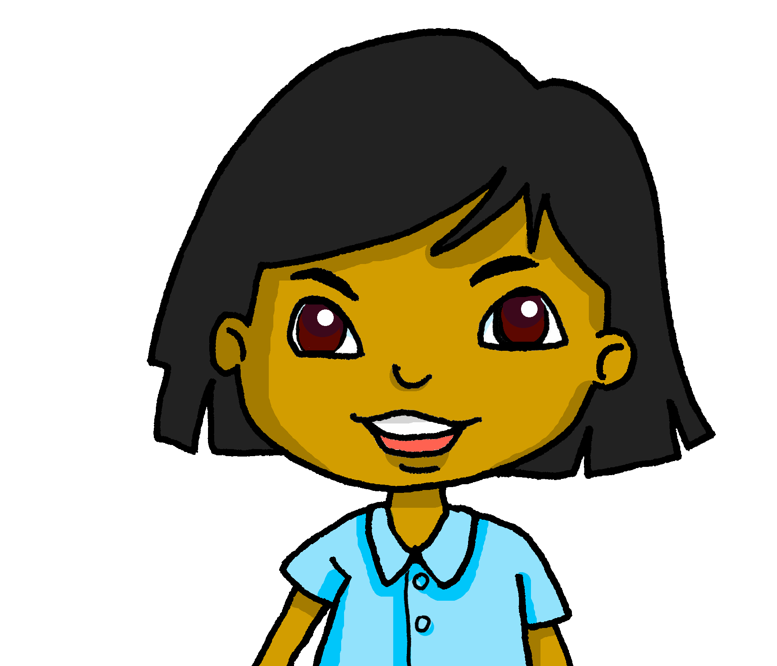
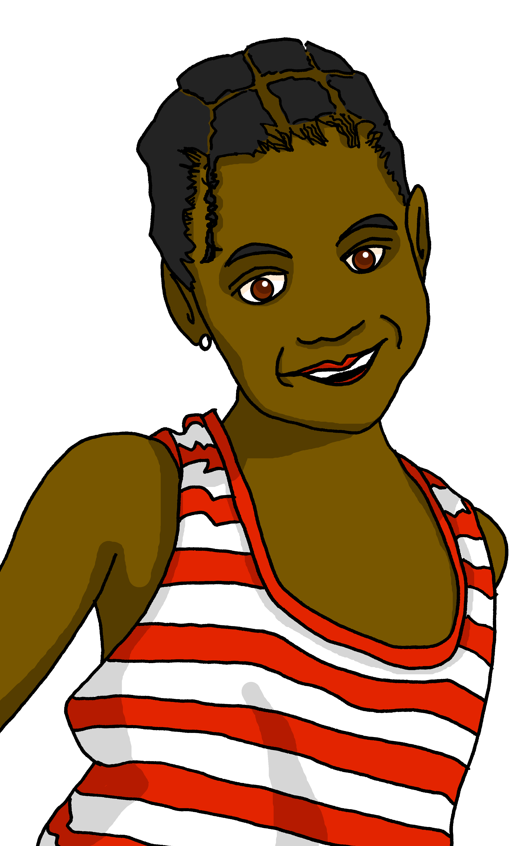
lire
Clémentine écrit un message à Sanaya.
It is common to say il y a du soleil (there is sun), too.
Il y a un problème avec l’ordinateur ! Lis le message et écris les bons articles (1-8).
Salut, Sanaya ! Ça va ? J’adore les vacances* ! Il fait du soleil ici. J’aime jouer au tennis mais aujourd’hui je voudrais aller à la piscine parce qu’il fait chaud ! Qu’est-ce que tu aimes faire quand il fait chaud ? Chez moi, je joue de la guitare et J-M joue du piano. Quand nous sommes à la plage, j’aime nager et manger une glace. Et toi, est-ce que tu aimes faire de l’ exercice en aout ? Bisous, C
1. Write three locations that are mentioned.
2. Write two details about the weather there.
3. Write the two questions that Clémentine asks Sanaya.


pool, home, beach





sunny, hot

What do you like doing when it’s hot? Do you like doing exercise in August?
les vacances – holidays
Notes:
Timing: 10 minutes
Aim: written comprehension of key vocabulary and grammar from Term 3.
Procedure:
Teacher to read the context and ensure this is clear.
Pupils to read the message aloud in pairs.
First, they need to write all the articles that are missing.
Then they answer the questions in English, one point for each item in Q1 and 2, and 2 points for each questions correctly translating. (Award 2 – full communication, 1 – partial communication, 0 – no communication). Total /9.
Elicit answers from pupils and click to bring up answers.
Note: in the audio version, click on the message to hear it in full.

Slide 13
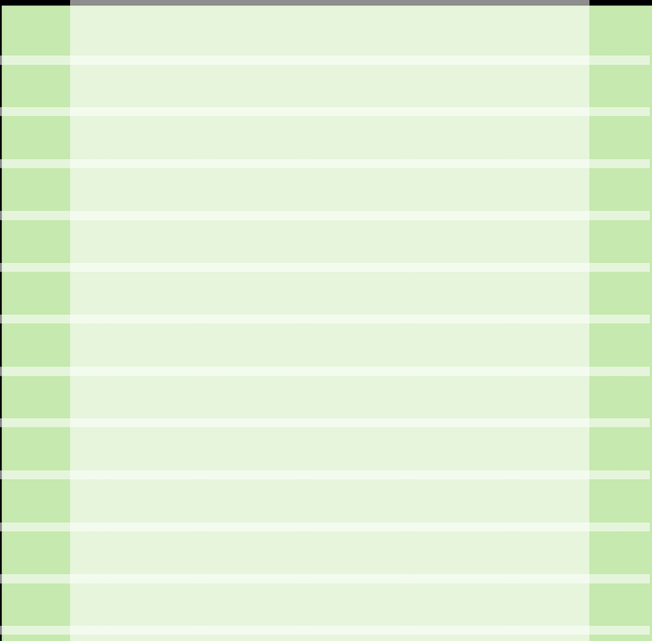
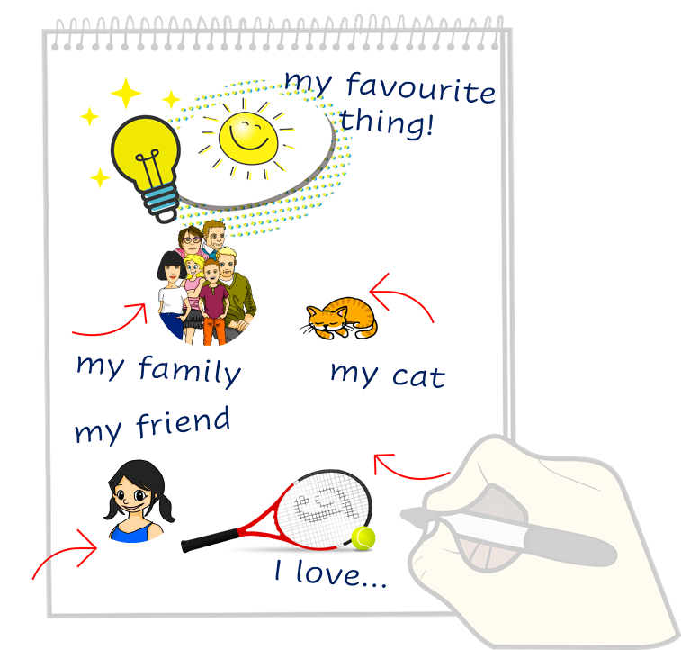
écrire
Lis le texte. Écris des mots en français.
Just have a go! Write any of these English words in French. You can add different words, too.
Adèle writes to Sanaya in English. Sanaya wants to reply in French. Can you help her?
lire
Hello! How are you?
I like writing in English!
It is sunny here. Today I’m going to the beach with my family.
I love swimming.
But I hate doing a race when it is hot!
What do you do in August?
Notes:
Timing: 6 minutes
Aim: to practise written production of vocabulary and structures.
Aim: to practise written production of this term’s vocabulary and to practise written production of short sentences.
Note: This is a less challenging version of the activity, where pupils are encouraged to write any word and/or phrases they can in French.
Procedure:
Pupils read the message from Adèle in the blue text box.
Pupils use Adèle’s message and the words and pictures on the notebook to the right as inspiration. They use the lines on the left and the empty notepad to write any words or sentences in French that they could use to reply to Adèle.
13

Slide 14
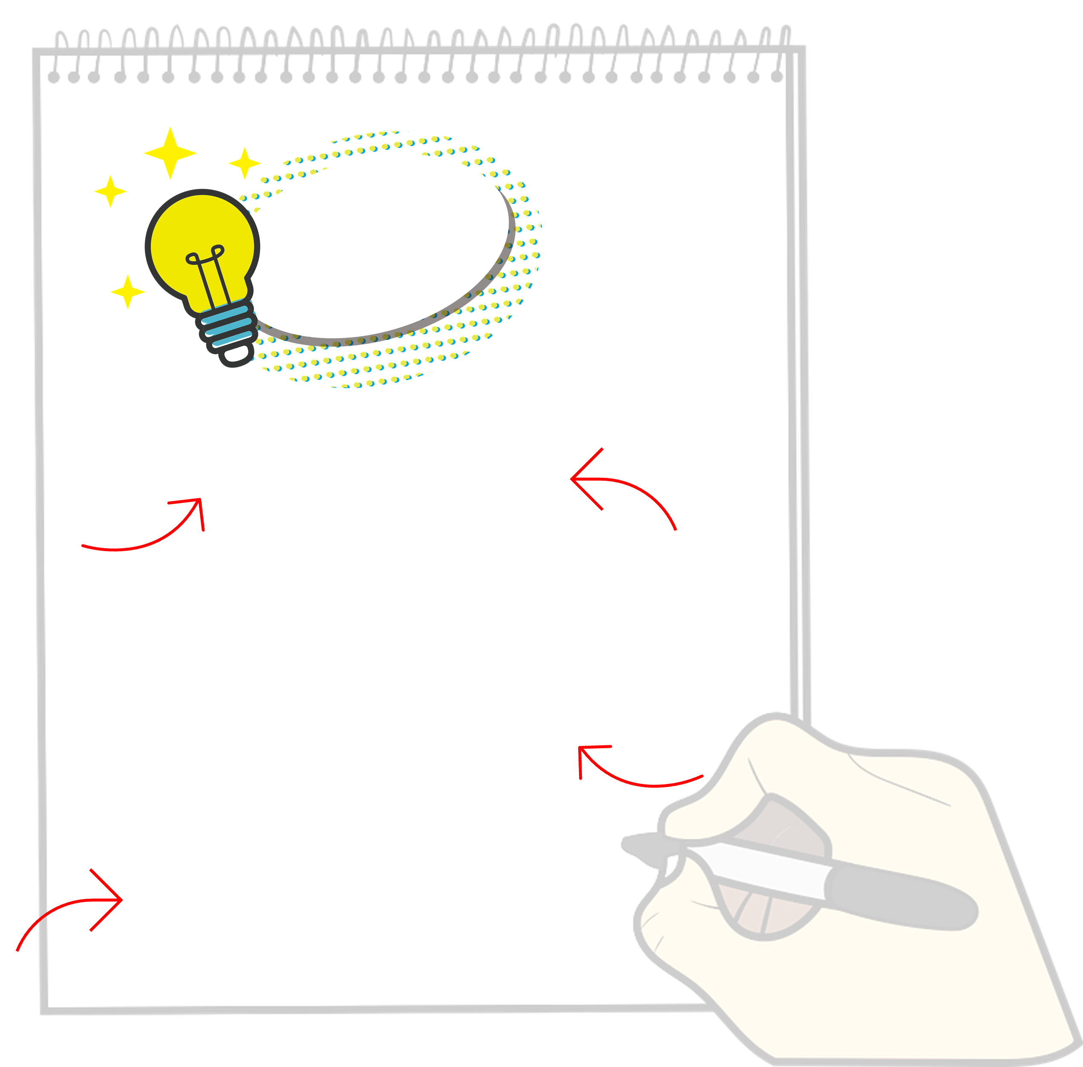
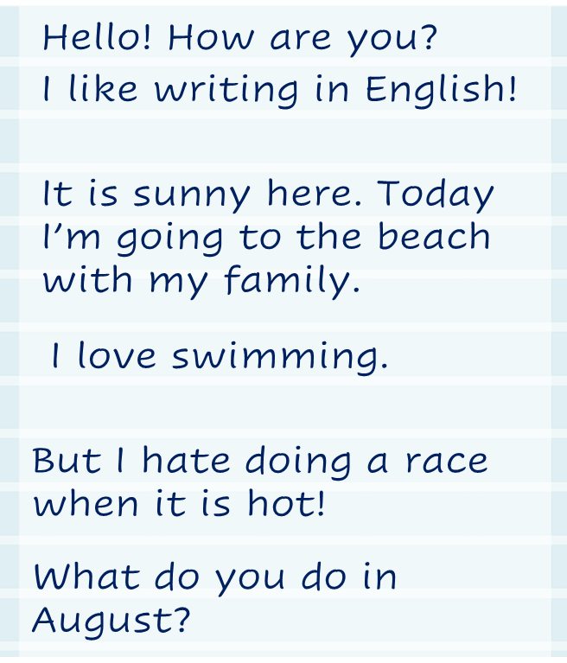
écrire
Écris en français.
Write a message to Adèle in French. Write anything you like. You can write short sentences or words or a mixture, like Adèle did.
Adèle writes to Sanaya in English. Sanaya wants to reply in French. Can you help ?
lire
Notes:
Timing: 8 minutes
Aim: to practise written production of this term’s vocabulary and to practise written production of short sentences.
Note: This is a more challenging version of the activity, where pupils are encouraged to write a mixture of sentences and words. A more straightforward version of the activity can be found on the previous slide, where pupils are asked to write individual words.
Procedure:
Pupils read the message from Adèle in the blue text box.
Pupils use Adèle’s message and the words and pictures on the notebook to the right as inspiration. They use the lines on the left and the empty notepad to write any words or sentences in French that they could use to reply to Adèle.
14

Slide 15
Au revoir !
vert
Notes:
15

