Slide 1
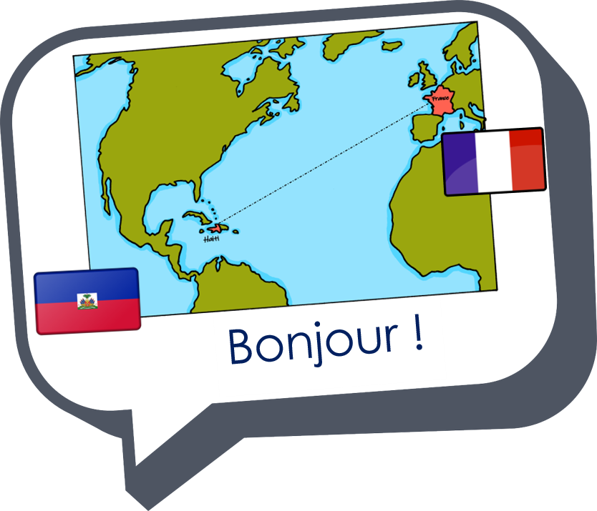

Expressing likes and saying what I and others do
Partitive du, de la,
de l’, des
je/tu voudrais, il/elle voudrait
SSC [h] muet
vert
Notes:
Artwork by Steve Clarke. Pronoun pictures from NCELP (www.ncelp.org). All additional pictures selected from Pixabay and are available under a Creative Commons
license, no attribution required.
Phonics: h heure [99] histoire [263] hôpital [1308] hôtel [1774] hiver [1586]
Vocabulary: manger [1338] je voudrais, tu voudrais, il/elle voudrait [57] chocolat [4556] eau [475] fromage [4475] gâteau [4845] glace [2580] jus [>5000] pizza
[>5000]
Revisit 1: ami [467] corde [3784] famille [172] football [2602] parent [546] tennis [3687] mes [60] tes [330]
Revisit 2: aller [53] je vais il/elle va à (meaning ‘at/in/to’)[4] campagne [666] ile [1245] montagne [1732] plage [2693] port [1304]
Londsale, D., & Le Bras, Y. (2009). A Frequency Dictionary of French: Core vocabulary for learners London: Routledge.
The frequency rankings for words that occur in this PowerPoint which have been previously introduced in these resources are given in the SOW and in the resources that
first introduced and formally re-visited those words.
For any other words that occur incidentally in this PowerPoint, frequency rankings will be provided in the notes field wherever possible.
1

Slide 2




[h]
prononcer
heure
Notes:
Timing: 1 minute
Aim: To consolidate SSC [h]
Procedure:
1. Present the letter(s) [h] and click for the ‘silence’ icon, bringing your finger to your lips to show that the [h] muet is not pronounced.
2. Bring up the word ”heure” on its own, say it, pupils repeat it, so that they have the opportunity to focus all of their attention on the connection between the written word and its SSC.
3. Roll back the animations and work through 1-3 again, but this time, dropping your voice completely to listen carefully to the pupils pronouncing ”heure” and, if using, doing the gesture.
Gesture suggestion:
https://www.signbsl.com/sign/hour (first video, top left of webpage)
The sign is left hand pointing up and palm facing inwards, index finger of the right hand traces a round clock face on the palm.
Word frequency (1 is the most frequent word in French):
heure [99]
Source: Londsale, D., & Le Bras, Y. (2009). A Frequency Dictionary of French: Core vocabulary for learners London: Routledge.
2

Slide 3
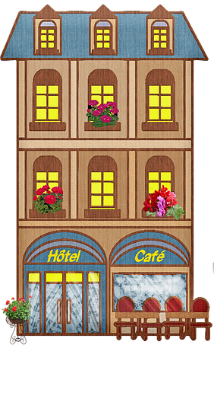



[h]
prononcer
histoire
hôtel
heure
winter
hôpital
hiver
Notes:
Timing: 2 minutes
Aim: To introduce SSC [j/soft g]
Procedure:
1. Introduce and elicit the gesture of ‘silence’ for [h] muet and pronunciation and then the source word again ‘heure’ (with gesture, if using).
2. Then present and elicit the pronunciation of the four cluster words.
The cluster words have been chosen for their high-frequency, from a range of word classes, with the SSC (where possible) positioned within a variety of syllables within the words (e.g. initial, 2nd, final etc.). Additionally, we have tried to use words that build cumulatively on previously taught SSCs (see the Phonics Teaching Sequence document) and do not include new SSCs. Where new SSCs are used, they are often consonants which have a similar symbol-sound correspondence in English.
Word frequency:
heure [99] histoire [263] hôpital [1308] hôtel [1774] hiver [1586]
Source: Londsale, D., & Le Bras, Y. (2009). A Frequency Dictionary of French: Core vocabulary for learners London: Routledge.
3

Slide 4









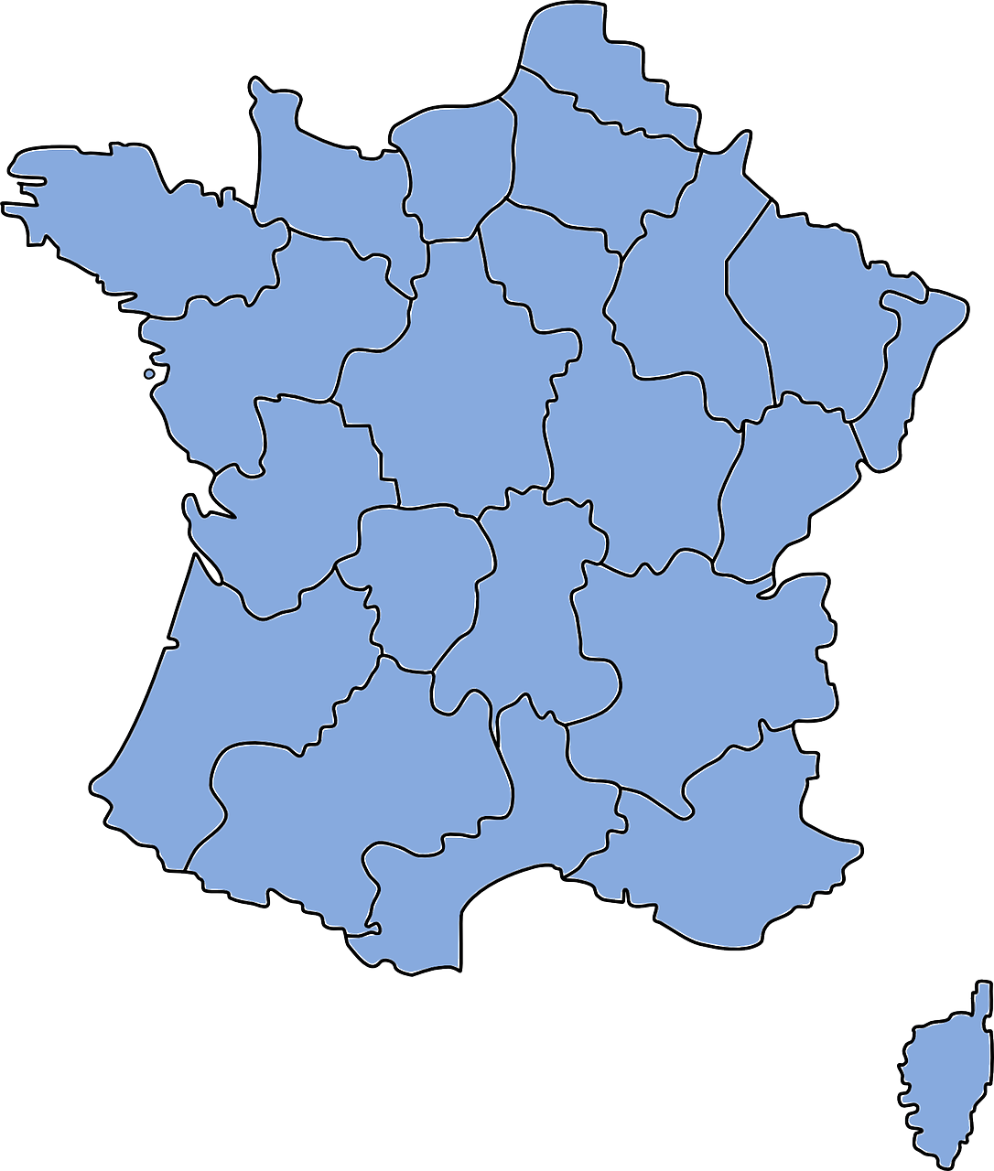

prononcer
Prononce les mots.
30
hockey
Hollande
hostile
hamburger
hôpital
S
hymne
horreur
horoscope
Halloween
hiver
Le Havre
hamster
0
DÉBUT
Notes:
Timing: 5 minutes
Aim: To practise pronunciation of words with [h] muet, particularly cognates which are pronounced with an audible ‘h’ in English.
Procedure:
Pupil A chooses 4 of the 12 words.
Pupil B must pronounce all 12 words correctly in the 30 second time limit in order to identity his/her partner’s 4 words.
If B pronounces a word with audible ‘h’, A can give a 3 x second penalty.
Swap roles and repeat the activity.
hamster [>5000] Halloween [>5000] hamburger [>5000] hockey [>5000] horoscope [>5000] horreur [2565] hostile [3091] hymne [4862]
Londsale, D., & Le Bras, Y. (2009). A Frequency Dictionary of French: Core vocabulary for learners London: Routledge.
4

Slide 5


The partitive article
du, de la, de l’, des
We already know the words for ‘the’ and ‘a’ in French. These are called articles:
noun (m)
noun (f)
noun (m/f before a vowel)
definite (the)
le fromage
la pizza
l’eau
the cheese
the pizza
the water
It is common to say ‘une eau minérale’, for example.
indefinite (a/an)
un fromage
une pizza
une eau
a cheese
a pizza
a water
We use it in French for an ‘unspecified amount or ‘part’.
This article doesn’t exist in English.
To say ‘some’ we use the partitive article:
partitive (some)
du fromage
de la pizza
de l’eau
some cheese
some pizza
some water
Notes:
Timing: 2 minutes
Aim: to introduce the partitive article and revisit definite and indefinite articles.
Procedure:
Click through the animations to present the information.
Elicit English translations for the French examples provided.

Slide 6
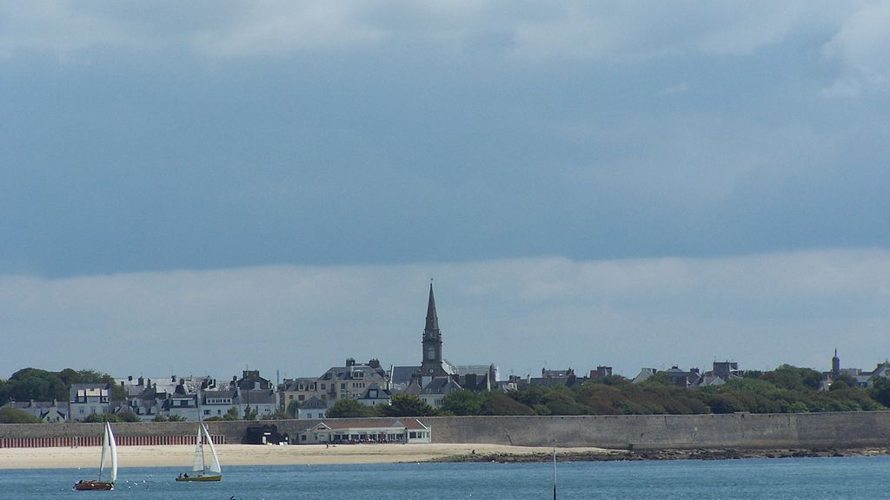
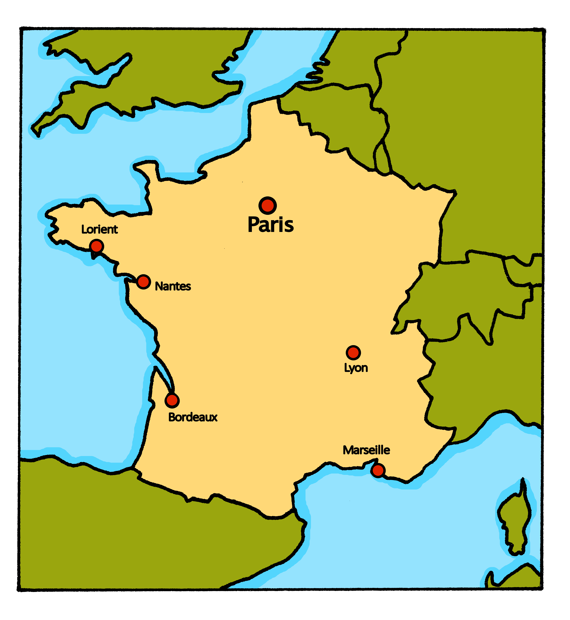

La famille Kergosien à Lorient
La famille Kergosien ne va pas en Espagne pour les vacances. Elle reste à Lorient en juillet et en aout. La famille est en vacances à la maison !
Lorient est à côté de la mer et il y a de bonnes plages. La famille aime passer la journée à la plage. Aujourd’hui, Adèle veut faire un pique-nique. Elle va au supermarché avec Pierre…
les vacances – holidays
la journée – day
Notes:
Timing: 1-2 minutes
Aim: to introduce the context of the family’s staycation in Lorient.
Procedure:
Click to hear the text.
Read the information with pupils.
Ensure puplis’ understanding.
Picture attribution:
LPLT, CC BY-SA 3.0 via Wikimedia Commons

Slide 7
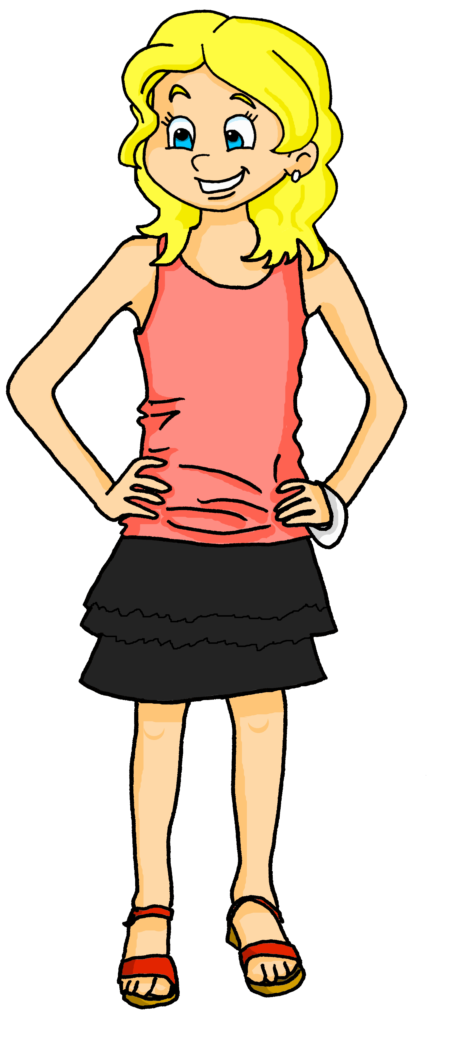

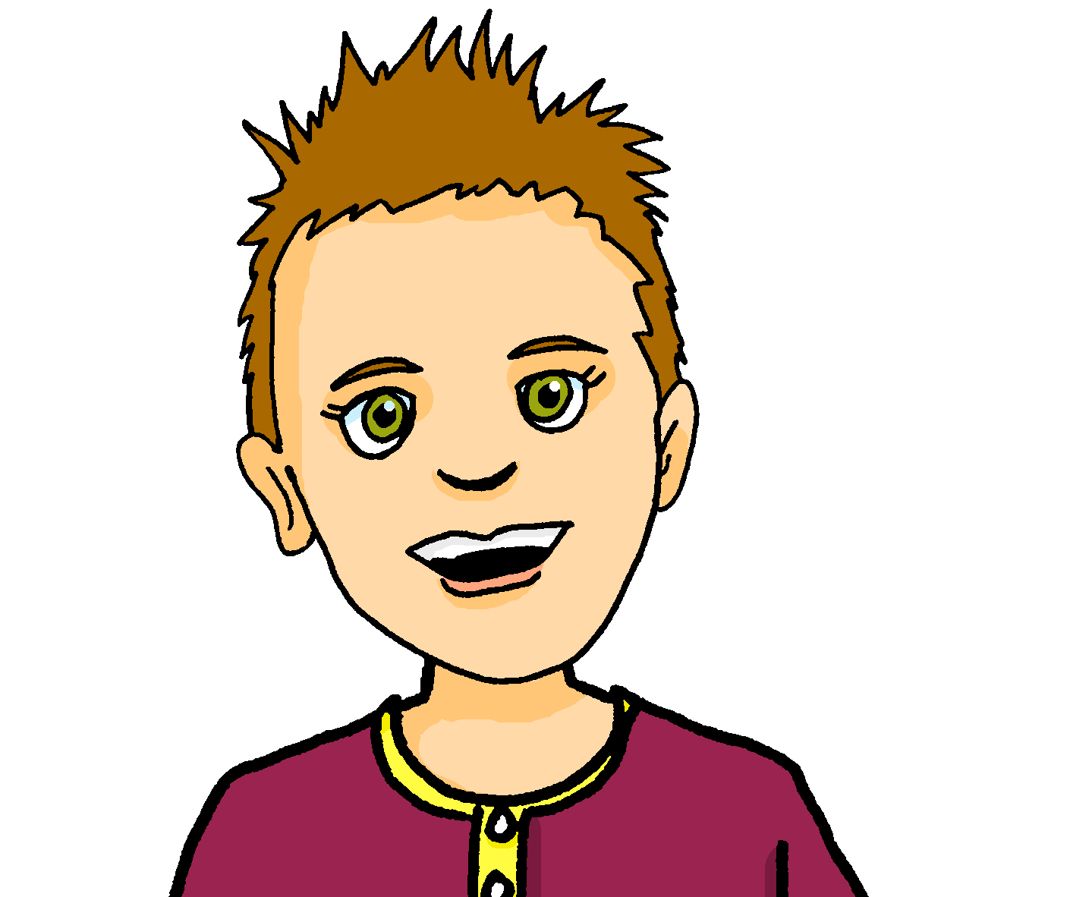
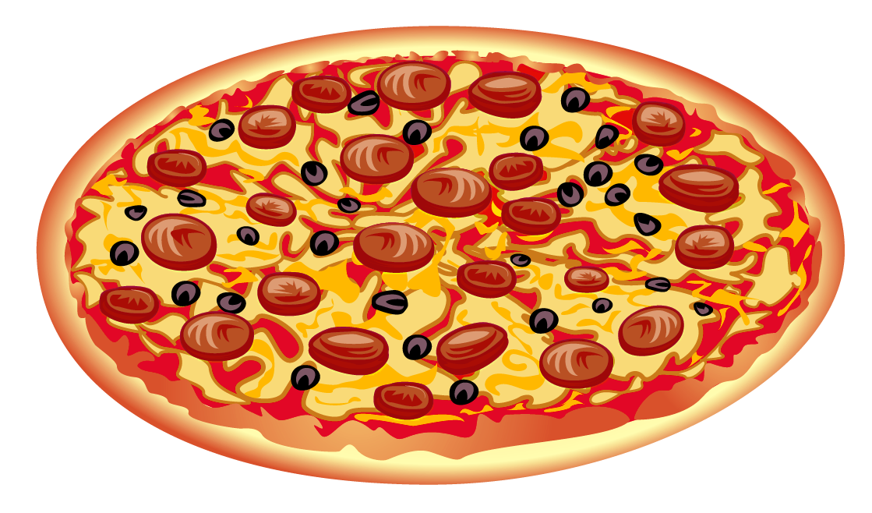
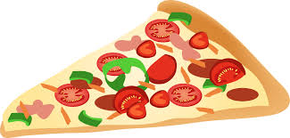







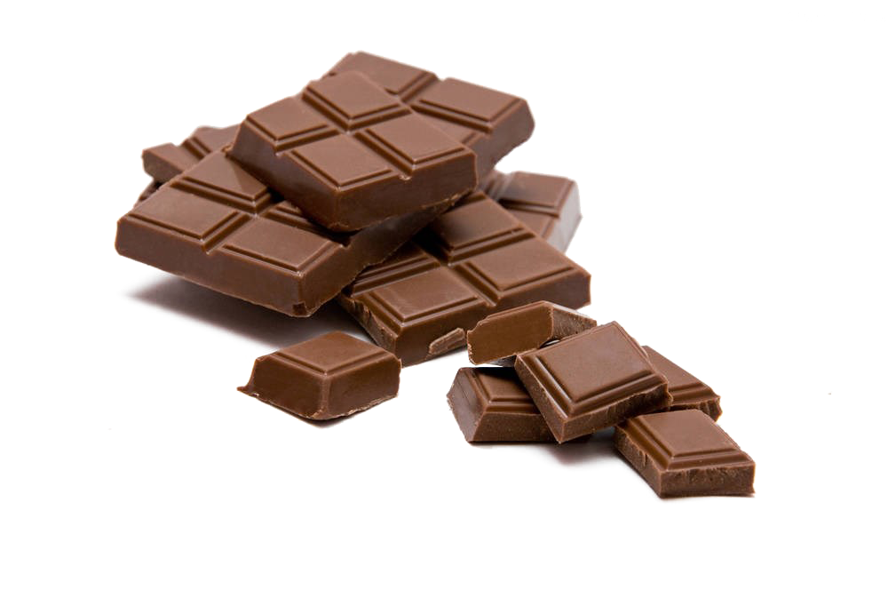


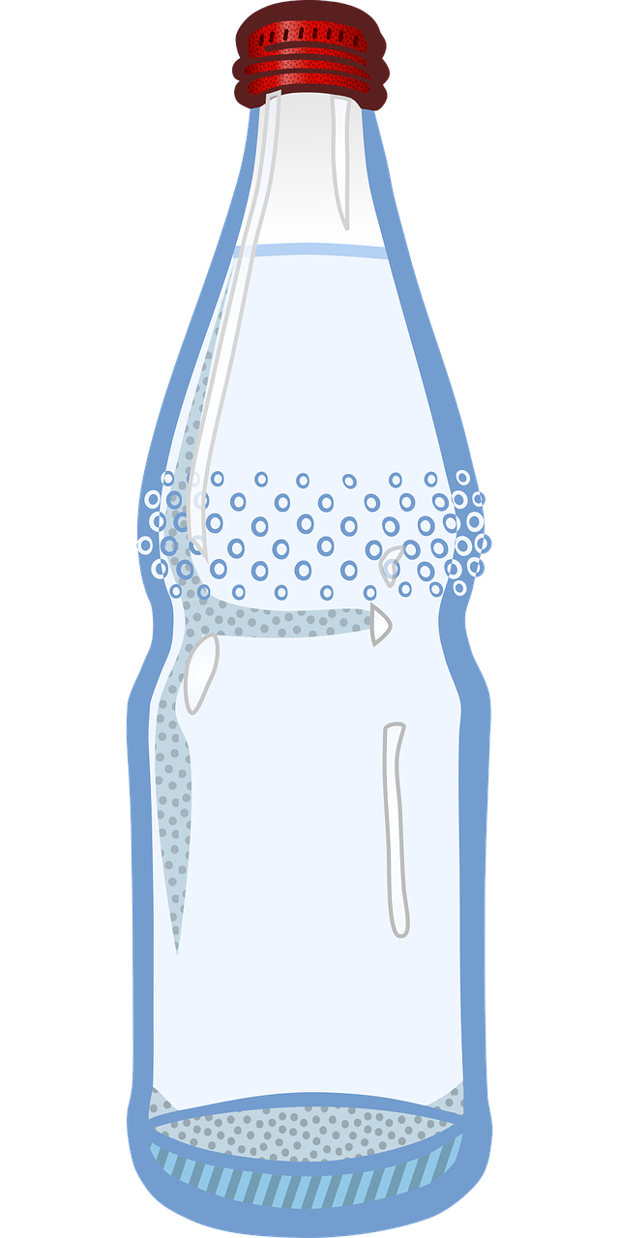


lire
Au supermarché
 | A | B
Adèle et Pierre sont au supermarché.
Lis et choisis la bonne image.
1
une pizza
2
du jus de pomme
3
un fromage
4
du chocolat
de la glace
5
de l’eau
6
Notes:
Timing: 7 minutes
Aim: to practise written recognition of the partitive article to indicate a ‘part’ or portion.
Procedure:
Remind pupils that un/une means ‘a/an’ and indicates a whole something, whilst the partitive article du/de la/de l’/des indicates a ‘part’ of a whole, so ‘some’ of something.
Ask pupils to write 1-6 and for each item on the shopping list, they decide which picture fits and write A or B. Is it a whole or a part?
Elicit answers from pupils and click to confirm them.
7

Slide 8

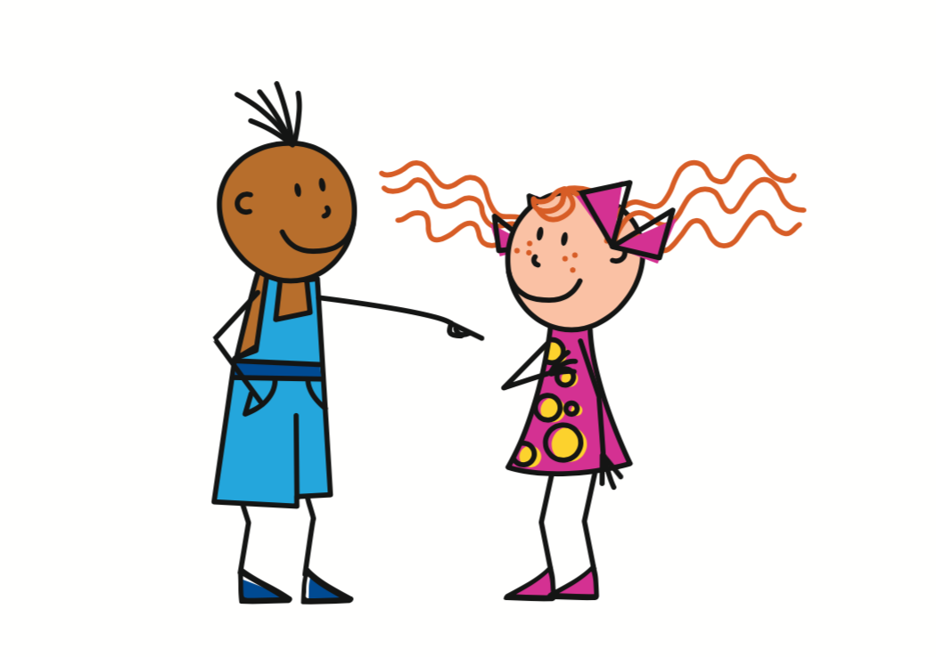

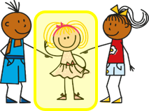
vouloir (to want)
To say ‘would like’ use these forms of vouloir:
The ‘je’ and the ‘tu’ forms
are the same.
The ‘je’ and the ‘tu’ forms
are the same.
You know how to say ‘want’:
je veux
I want
je voudrais
I would like
tu veux
you want
tu voudrais
you would like
il veut
he wants
il voudrait
he would like
elle veut
she wants
elle voudrait
she would like
Notes:
Timing: 2 minutes
Procedure:
Consolidate the singular present forms of vouloir.
Present the singular conditional forms of vouloir.
Elicit English translation for the French examples provided.
8

Slide 9


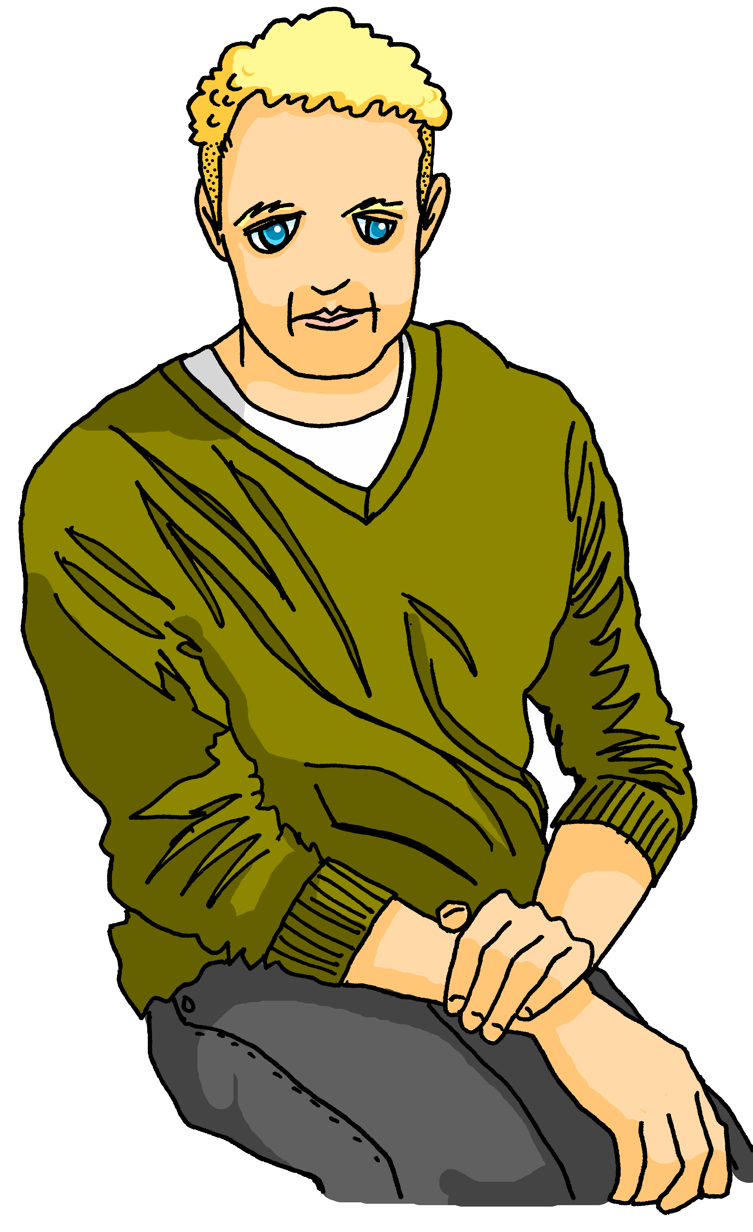






écouter
Au café
Maman parle avec Adèle au téléphone. Elle arrive au café dans dix minutes. Qu’est-ce que Maman voudrait manger et boire ?
Écoute. C’est Maman (I) ou Hervé (he) ? Choisis la bonne image.
Remember! un/une indicates a whole,
du/de la/de l’ indicates a part or ‘some’.
 | I | he | A | B
 | I | he | A | B
1
4
2
5
3
6
Notes:
Timing: 5 minutes
Aim: to practise aural recognition of the partitive article to indicate a ‘part’ or portion.
Procedure:
1. Click the numbers to play the audio.
2. Students write 1-6 and use the presence or absence of the indefinite/partitive article to choose a or b.
3. Click to reveal the answers.
Transcript:
Je voudrais un chocolat chaud.
Il voudrait de la pizza.
Je voudrais du gâteau.
Il voudrait une eau minérale.
Il voudrait du fromage.
Je voudrais une glace.
9

Slide 10
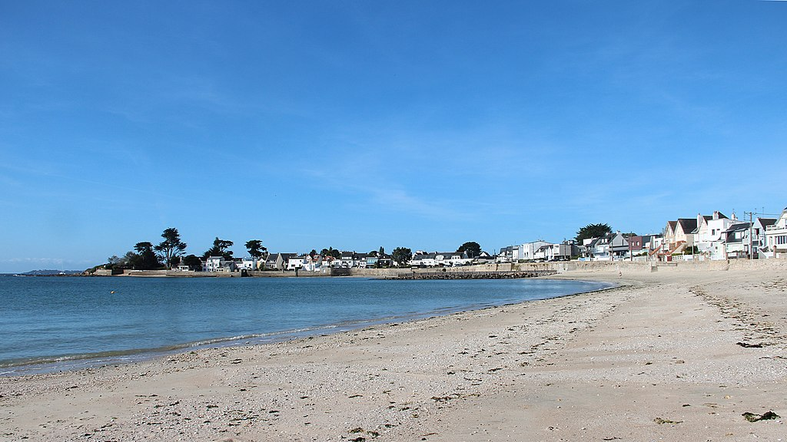

La famille Kergosien à la plage
Lis les messages. C’est Adèle (je) ou Hervé (il) ?
Ou c’est impossible de savoir* ?
savoir – to know
 |  | Adèle (I) | Hervé (he) | ???
 | Il fait du sport.
 | j’/il joue au volleyball.
 | Je veux de l’eau.
 | il voudrait une glace.
 | Je voudrais un sandwich au fromage.
 | Je/Il mange de la pizza.
1
2
3
4
5
6
Notes:
Timing: 7 minutes
Aim: to practise written recognition of singular parts of the new verbs (and previously taught verbs) and connect them with their meaning.
Procedure:
Remind pupils that they need to pay attention to the verb endings to decide if it is Adèle, Hervé or if it is impossible to tell.
Click to listen and check the responses (note that for the –ER verbs both versions of the answers are recorded because you cannot tell from the verb ending) OR elicit the responses orally from pupils and click to confirm the answers.
Elicit English meanings of each phrase.
Transcript:
Il fait du sport.
je joue au volleyball. Il joue au volleyball.
Je veux de l’eau.
Il voudrait une glace.
Je voudrais un sandwich au fromage.
Je mange de la pizza. Il mange de la pizza.

Slide 11
Au revoir !
vert
Notes:
11

