Slide 1
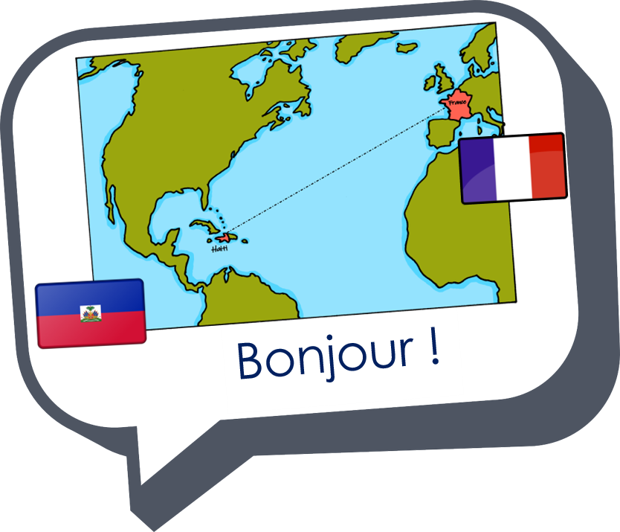

Expressing likes and saying what I and others do
vert
Follow ups 1-5
Notes:
Artwork by Steve Clarke. Pronoun pictures from NCELP (www.ncelp.org). All additional pictures selected from Pixabay and are available under a Creative Commons license, no
attribution required.
Phonics: h heure [99] histoire [263] hôpital [1308] hôtel [1774] hiver [1586]
Vocabulary: manger [1338] je voudrais, tu voudrais, il/elle voudrait [57] chocolat [4556] eau [475] fromage [4475] gâteau [4845] glace [2580] jus [>5000] pizza [>5000]
Revisit 1: ami [467] corde [3784] famille [172] football [2602] parent [546] tennis [3687] mes [60] tes [330]
Revisit 2: aller [53] je vais il/elle va à (meaning ‘at/in/to’)[4] campagne [666] ile [1245] montagne [1732] plage [2693] port [1304]
Londsale, D., & Le Bras, Y. (2009). A Frequency Dictionary of French: Core vocabulary for learners London: Routledge.
The frequency rankings for words that occur in this PowerPoint which have been previously introduced in these resources are given in the SOW and in the resources that first
introduced and formally re-visited those words.
For any other words that occur incidentally in this PowerPoint, frequency rankings will be provided in the notes field wherever possible.

Slide 2





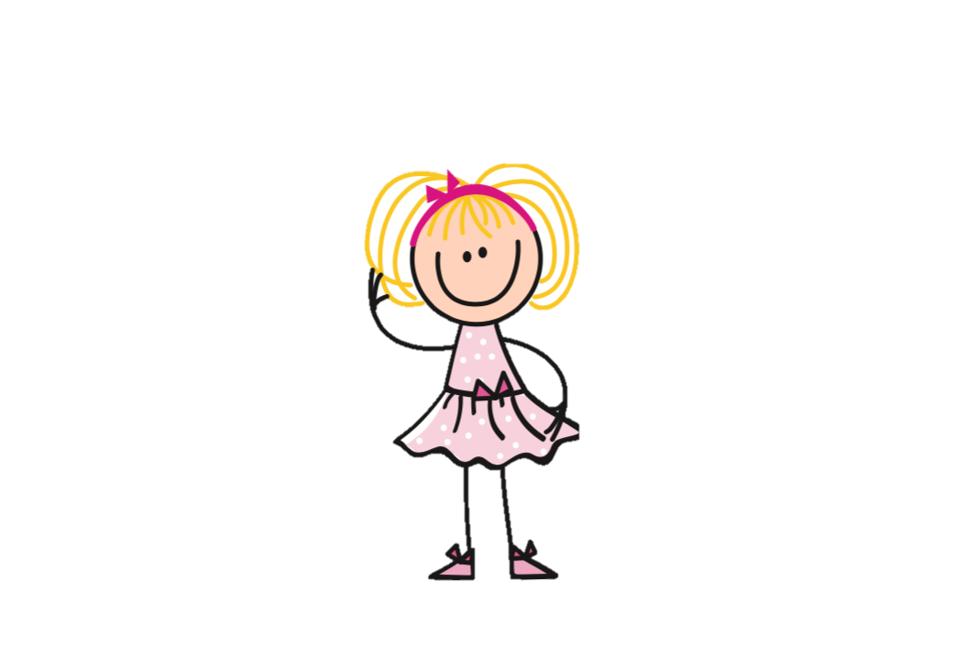











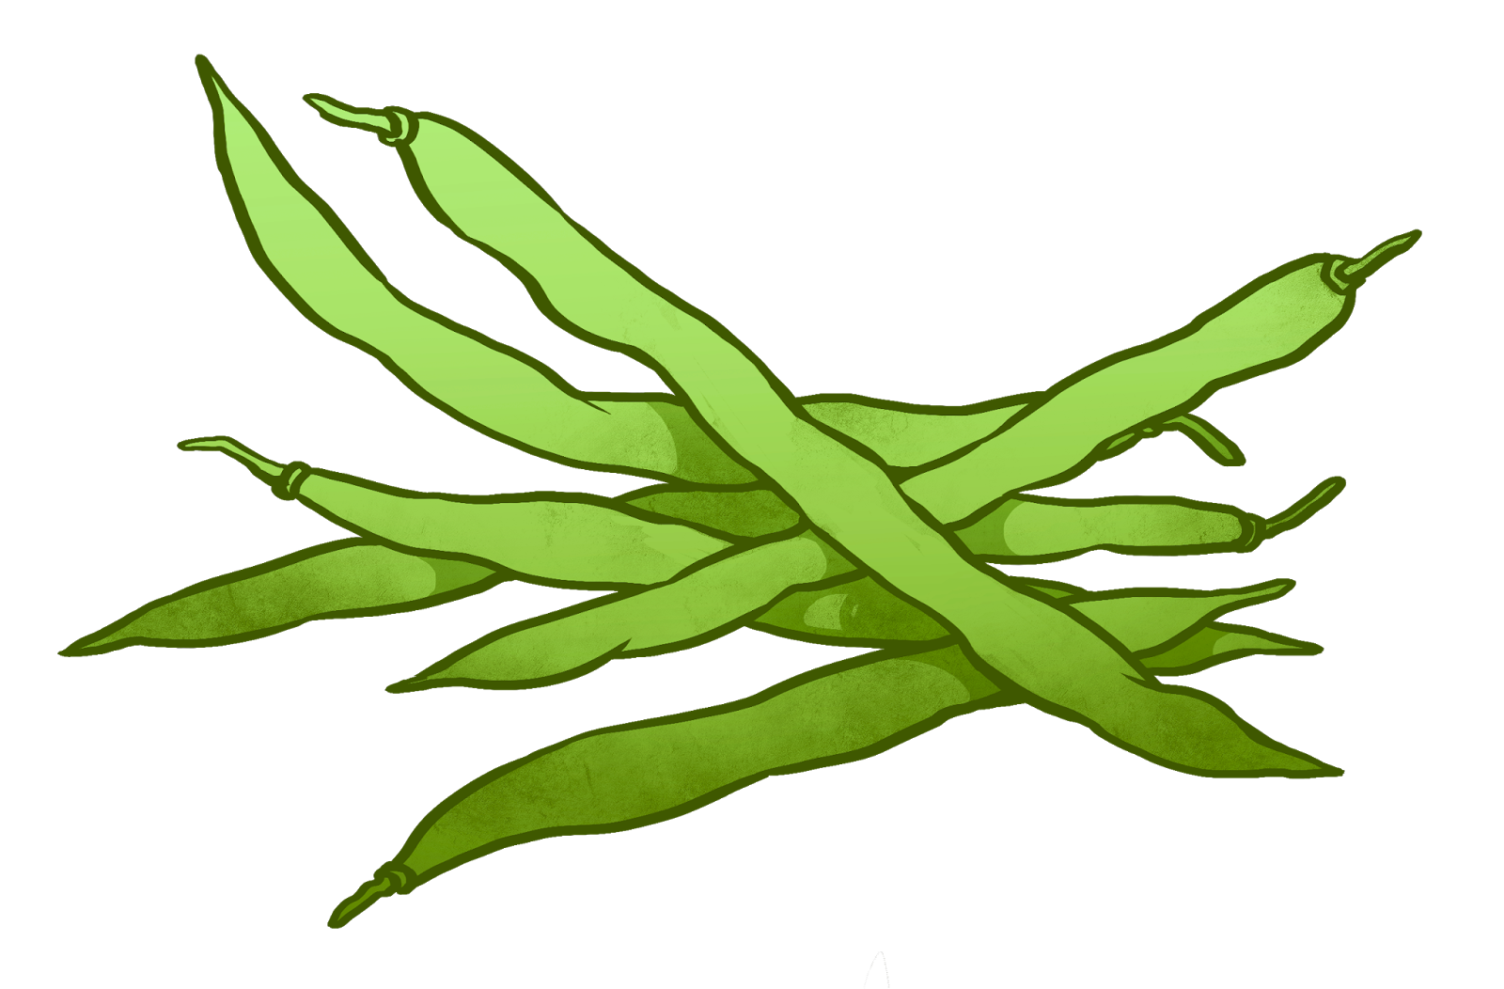
Follow up 1:
Prononce les phrases. Qui fait quoi ?
Henri
Hakim
Honore
Hervé
Hilde
Hélène
Hélène
1
Henri
2
Honore
3
… chante l’hymne national d’Haïti en harmonie avec Lucie.
…est honorable et hônnete.
… veut jouer dehors avec Éloi le hamster.
Hervé
4
Hilde
5
Hakim
6
…voudrait manger un hamburger avec des haricots verts.
…porte un déguisement d’horreur pour le Halloween.
…veut voyager en Hollande en hélicoptère.
Notes:
Timing: 5 minutes
Aim: to consolidate knowledge of SSC [h]; to practise comprehension of some previously taught vocabulary.
Procedure:
Pupils read the phrases aloud in pairs and match them to each person.
Click on buttons to play the audio.
Pupils listen and check their answers.
Click to reveal answers.
Transcript:
1. Hélène chante l’hymne national d’Haïti en harmonie avec Lucie.
2. Henri est honorable et hônnete.
3. Honore veut jouer dehors avec Éloi le hamster.
4. Hervé voudrait manger un hamburger avec des haricots verts.
5. Hilde porte un déguisement d’horreur pour le Halloween.
6. Hakim veut voyager en Hollande en hélicoptère.

Slide 3

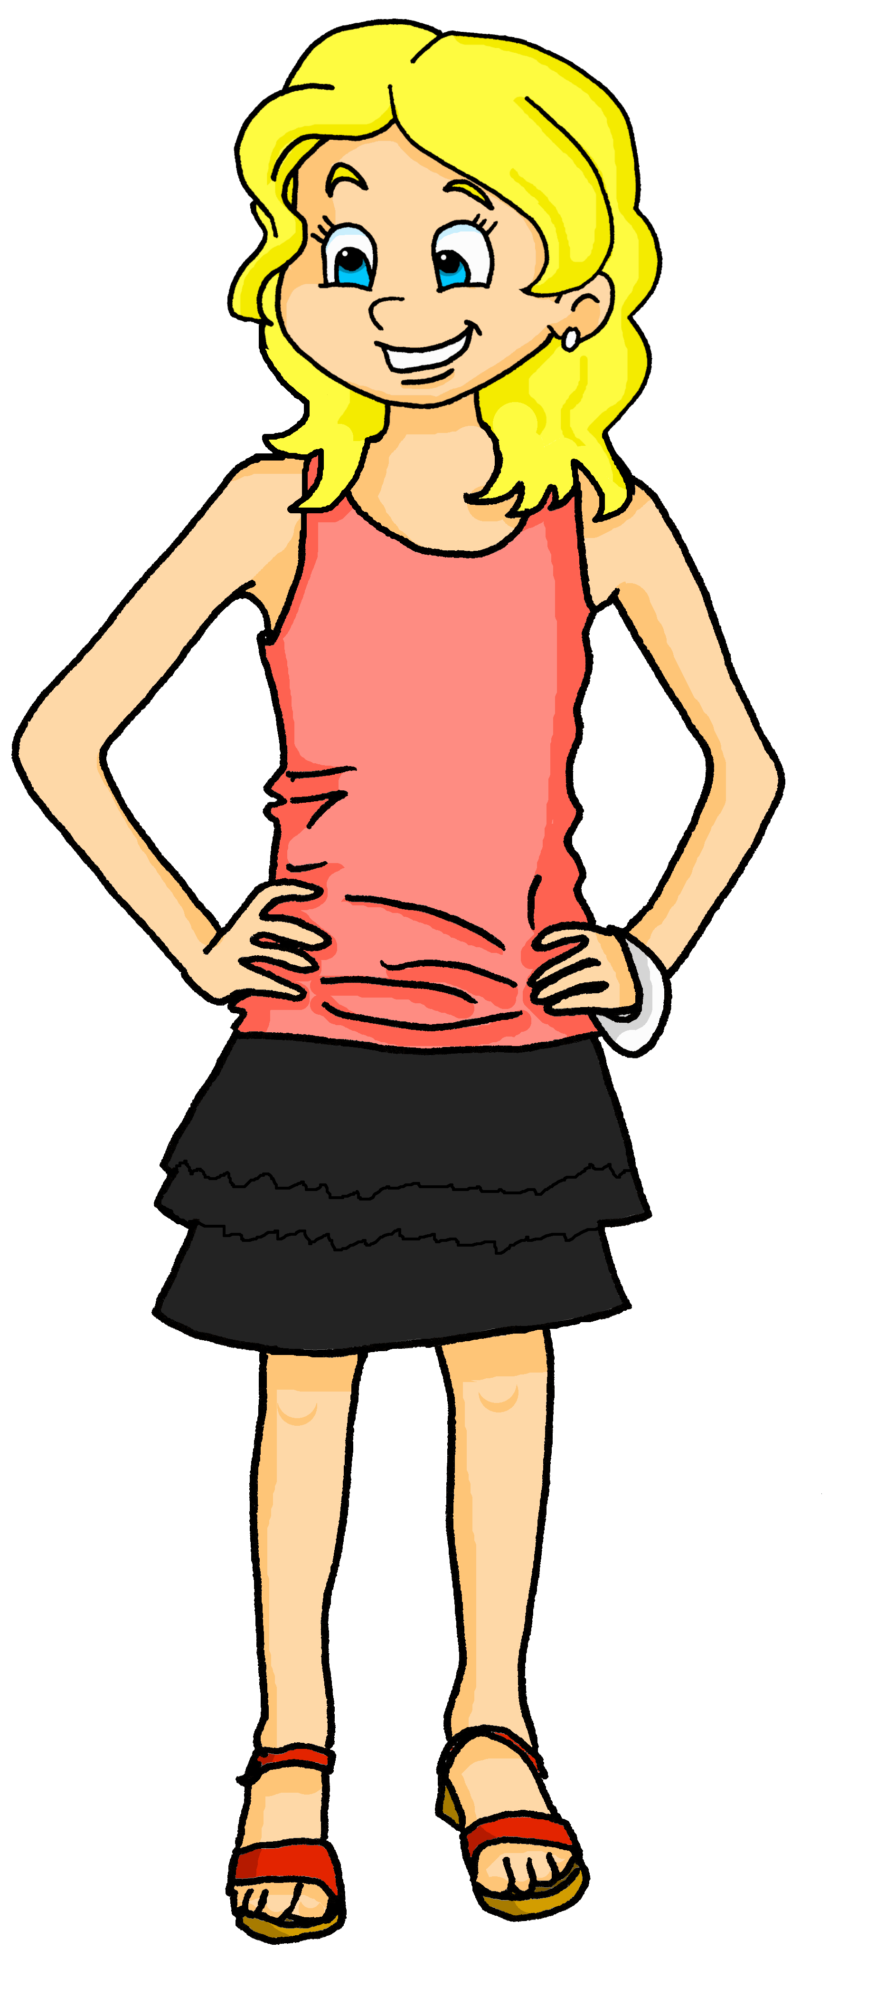

Follow up 2
cocher – to tick
Écoute, coche* et écris les activités.
écouter
Adèle parle de la semaine de vacances.
Elle aime faire quoi ? Elle voudrait faire quoi ?
 | likes (doing) | would like (to do) | activity
 |  |  | playing tennis
 |  |  | do a (running) race
 |  |  | to dance
 |  |  | playing skipping
 |  |  | going to the countryside
 |  |  | go cycling
 |  |  | go horseriding
 |  |  | playing football
1
2
3
4
5
6
7
8
Notes:
Timing: 5 minutes
Aim: to practise aural comprehension of this week’s new and previously taught language.
Procedure:
Click the numbered buttons to listen. Pupils may need to listen to each sentence more than once.
Pupils select ‘likes’ or ‘would like’ for each sentence and then write the activity in English.
Click to correct after each one, to give pupils instant feedback.
If time allows, elicit the French sentences from pupils chorally and click again for the audio, to listen and check.
Transcript:
1. J’aime jouer au tennis.
2. Je voudrais faire une course à pied.
3. Aussi, je voudrais faire de la danse.
4. J’aime jouer à la corde.
5. J’aime aller à la campagne.
6. Je voudrais faire du vélo.
7. Je voudrais aussi monter à cheval.
8. J’aime jouer au foot.

Slide 4











écrire
Follow up 3
Les idées de vacances
.
Tu aimes faire quoi ? Qu’est-ce que tu voudrais faire ? Écris deux phrases.
Exemple (je)
1. J’aime aller à la montagne.
2. Je voudrais faire du vélo.
aimer
Mes phrases
1. Je … 2.
vouloir
.
Parle avec un(e) partenaire. Il/elle aime/voudrait faire quoi ? Écris deux phrases.
Exemple (il/elle)
Elle voudrait aller à la plage.
Elle aime manger de la glace.
vouloir
Mon/ma partenaire
1. Elle … 2.
aimer
Notes:
Timing: 8 minutes
Aim: Semi-structured writing exercise to practise independent production of structures with verbs vouloir and aimer.
Procedure:
1. Pupils use the pictures on the storyboard to practise writing example sentences with modal verbs in the first person.
2. Pupils then write two additional sentences of their own using aimer and vouloir to say what they like and would like to do during the holidays.
3. Click to bring up the second task instruction.
4. Pupils use the pictures on the storyboard to practise writing example sentences with aimer and vouloir in the 3rd person singular.
5. Pupils exchange their je sentences orally with a partner, taking notes on what their partner has said.
6. Pupils then write two sentences in the third person to convey what their partner likes and would like to do in the holidays.
4

Slide 5











parler
Follow up 4:
Find what your partner would like to do on holiday to sink their ships!
Exemple : Personne A
. Écoute les
Lundi | Mardi | Mer. | Jeudi | Ven. | Sam. | Dim. | Aujourd’ -hui
B: Non !
A: Est-ce que tu voudrais jouer au foot le lundi ?
B: Est-ce que tu voudrais faire du sport le samedi ?
Lundi | Mardi | Mer. | Jeudi | Ven. | Sam. | Dim. | Aujourd’ -hui
A: Oui !
Draw your pictures on any day of the week in the top table. This is just an example. Keep your drawings hidden from your partner!
B: Oui !
A: Est-ce que tu voudrais faire de la danse le jeudi ?
football x
Notes:
Handout at end of presentation
Timing: 10 minutes
Aim: to practise oral production of questions using ‘voudrais’ in combination with a range of previously taught infinitive verbs and other vocabulary.
NOTE: We will also include a version of this activity in next week’s revision week resources, so it is worth pupils becoming familiar with it this week.
Procedure:
Give pupils a copy of the handout and explain that the top table is for them to draw/note down an activity for each day, and the bottom table is for them to keep track of their partner’s activities/ships. It is important that pupils use the verbs/activities on the board, not their own, as otherwise their partner has no chance of guessing, and may not have the French to do so.
Click through the animations on this slide to show pupils a) to draw their pictures (if this takes too long they can just write words e.g. swim; listen song) b) how to conduct the conversation, reminding them of ‘Est-ce que’ questions and ‘tu voudrais’ for you would like and c) how to keep track of what they have asked their partner. If they ‘sink’ their partner’s ship by guessing the correct activity on the correct day, they can tick/cross/draw a ship in that box.
NOTE: 1) This game has the potential to last a long time, so it could be the first to sink X number of ships! 2) Infinitive French verbs are given on the handout to help pupils but they can be removed (or folded over) if pupils can challenge themselves.
Additional Activities:
Pupils could make positive and negative sentences in the 3rd person to tell another pair what they have found out about their partner. E.g. Sam voudrait jouer au football. Alternatively, pupils might like to have real conversations now about themselves using these and other verbs/activities of their choice. This could be done as a survey around the class: ‘Est-ce que tu voudrais …?’ ‘Oui/Non…’.
5

Slide 6




vocabulaire
Follow up 5a - Écris en anglais : Can you get at least 15 points?
mots
 | le port | je vais | la plage
 | à | il/elle va | aller
 | l’ile | la campagne | la montagne
 | le tennis | le football | la corde
 | mes | tes | le parent
 | le jus | tu voudrais | je voudrais
 | le fromage | il/elle voudrait | le chocolat
(the) port
I go, am going
(the) beach
to, in, at, on
he/she goes, is going
to go, going
x3
(the) island
(the) countryside
(the) mountain
x2
(the) tennis
(the) football
(the) rope
my (pl)
your (pl)
(the) parent
x1
(the) juice
you would like
I would like
(the) cheese
he/she would like
(the) chocolate
Notes:
Timing: 5-10 minutes
Aim: to practise written production of vocabulary from this week and two revisited weeks.
Procedure:
1. Give pupils a blank grid. They fill in the English meanings of any of the words they know, trying to reach 15 points in total.
2. Remind pupils that adjectives can refer to male or female persons and they should note this in their translations. E.g. pleased (f), short (m).
Note:
The most recently learnt and practised words are pink, words from revisit 1 are green and those from revisit 2 are blue, thus more points are awarded for them, to recognise that memories fade and more effort (heavy lifting!) is needed to retrieve them.
6

Slide 7
vocabulaire
Follow up 5b - Écris en français : Can you get at least 15 points?
mots
 | to, in, at, on | s/he goes, is going | (the) beach
 | (the) island | I go, am going | (the) mountain(s)
 | (the) port | (the) country(sie) | to go, going
 | (the) rope | (the) football | my (pl)
 | your (pl) | (the) parent | (the) tennis
 | (the) cheese | you would like | (the) juice
 | I would like | S/he would like | (the) chocolate
à
elle/il va
la plage
l’ile
je vais
la montagne
x3
le port
la campagne
aller
x2
la corde
le football
mes
tes
le parent
le tennis
x1
le fromage
tu voudrais
le jus
je voudrais
elle/il voudrait
le chocolat
Notes:
Timing: 5-10 minutes
Aim: to practise written comprehension of vocabulary from this week and previous weeks.
Procedure:
Give pupils a blank grid. They fill in the French meanings of any of the words they know, trying to reach 15 points in total.
Note:
The most recently learnt and practised words are pink, words from the previous week are green and those from earlier are blue, thus more points are awarded for them, to recognise that memories fade and more effort (heavy lifting!) is needed to retrieve them.
7

Slide 8
Follow up 4:
Draw your activities in the first table.
Use the second table to keep track of which of your partner’s
ships you have sunk and what you have already asked.
Lundi | Mardi | Mer. | Jeudi | Ven. | Sam. | Dim. | Aujourd’ -hui
parler
faire de la danse
jouer de la guitare
faire du sport
aller à la montagne
rester à la maison
regarder un film
jouer du piano
jouer au football
Lundi | Mardi | Mer. | Jeudi | Ven. | Sam. | Dim. | Aujourd’ -hui
Notes:
HANDOUT

Slide 9
vocabulaire
Follow up 5a - Écris en anglais : Can you get at least 15 points?
mots
 | le port | je vais | la plage
 | à | il/elle va | aller
 | l’ile | la campagne | la montagne
 | le tennis | le football | la corde
 | mes | tes | le parent
 | le jus | tu voudrais | je voudrais
 | le fromage | il/elle voudrait | le chocolat
x3
x2
x1
Notes:
HANDOUT
9

Slide 10
vocabulaire
Follow up 5b - Écris en français : Can you get at least 15 points?
mots
 | to, in, at, on | s/he goes, is going | (the) beach
 | (the) island | I go, am going | (the) mountain(s)
 | (the) port | (the) country(sie) | to go, going
 | (the) rope | (the) football | my (pl)
 | your (pl) | (the) parent | (the) tennis
 | (the) cheese | you would like | (the) juice
 | I would like | S/he would like | (the) chocolate
x3
x2
x1
Notes:
HANDOUT
10

