Slide 1
Expressing likes and saying what I and others do
vert
Follow ups 1-5
Notes:
Artwork by Steve Clarke. Pronoun pictures from NCELP (www.ncelp.org). All additional pictures selected from Pixabay and are available under a Creative Commons license, no attribution required.
Phonics: j (soft g) jour [78] j’ai [8 - avoir] génial [3872] gymnastique [>5000] déjà [58]
Vocabulary: vouloir [57] je veux, tu veux, il/elle veut [57]
Revisit 1: Il fait [25] Allemagne [n/a] Belgique [n/a] Canada [n/a] Grande-Bretagne [n/a] Espagne [n/a] France [n/a] Italie [n/a] Luxembourg [n/a] Suisse [n/a] chaud [1852] froid [1307]
soleil [1713] vent [1387] quand [119] à [4] en [7]
Revisit 2: il y a un [3] deux [41] trois [115] quatre [253] cinq [288] six [450] sept [905] huit [877] neuf [787] dix [372] onze [2447] douze [1664] des [2] combien [800] treize [3285], quatorze [3359],
quinze [1472] seize [3285] dix-sept [3812] dix-huit [3592] dix-neuf [4851] vingt [1273] vingt-et-un [1273/6/3] vingt-deux, vingt-trois, vingt-quatre, vingt-cinq, vingt-six, vingt-sept, vingt-huit,
vingt-neuf, trente [1646]
Londsale, D., & Le Bras, Y. (2009). A Frequency Dictionary of French: Core vocabulary for learners London: Routledge.
The frequency rankings for words that occur in this PowerPoint which have been previously introduced in these resources are given in the SOW and in the resources that first introduced and formally re-visited those words.
For any other words that occur incidentally in this PowerPoint, frequency rankings will be provided in the notes field wherever possible.

Slide 2
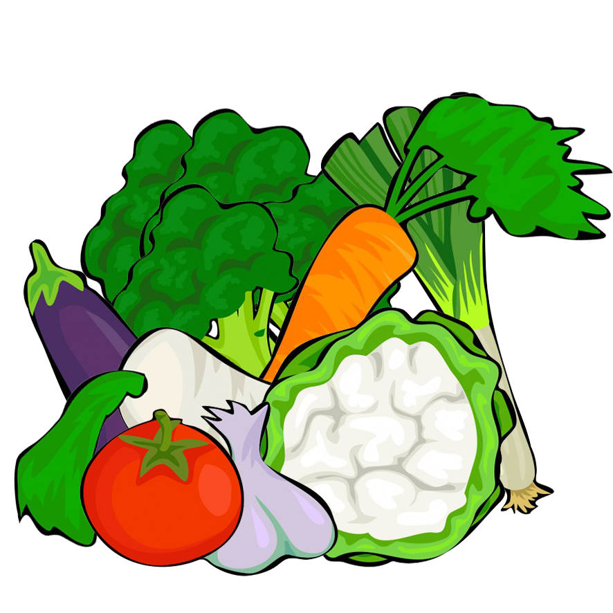
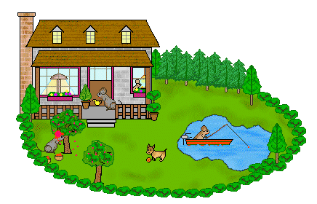
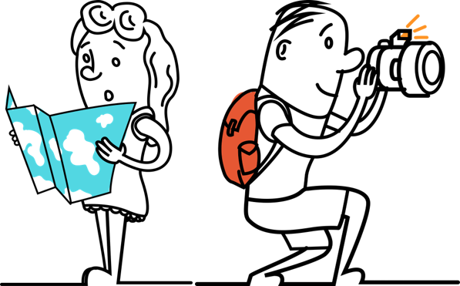
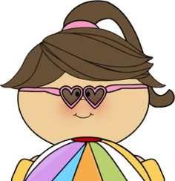
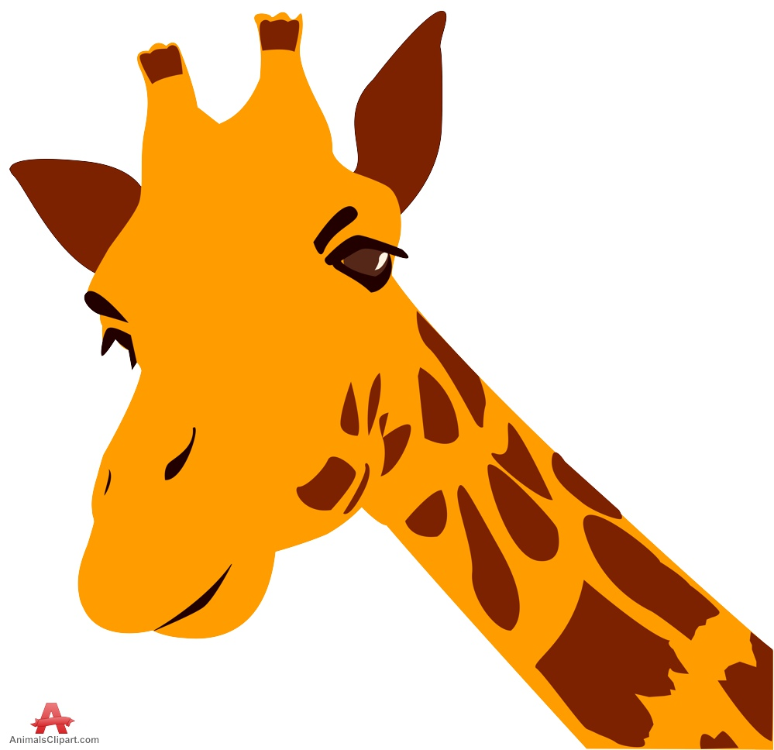
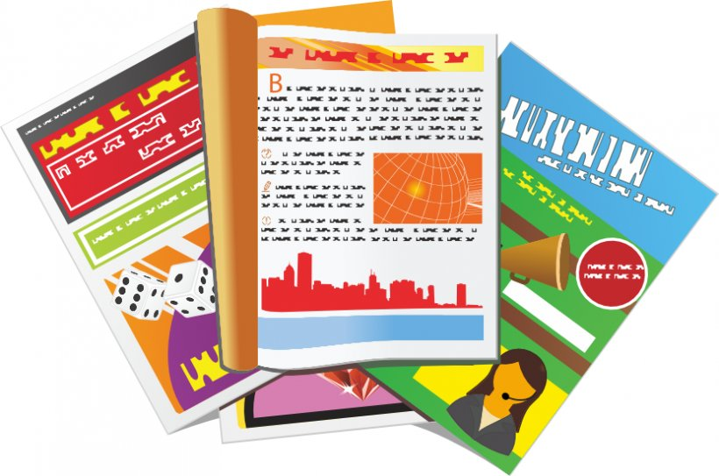
Follow up 1:
. Écoute les noms des animaux
Écoute. Il y a combien de [j/soft g] et de [g] ?
A
B
 | Julien mange des légumes dans le jardin.
 | Morgane fait de la gymnastique pour gagner un prix.
 | Margot organise une visite au village de Gassin.
[j/soft g]
[g]
///
/
/
//
/
///
A
B
 | Gaëlle nage dans la neige – c’est génial !
 | Gérard habite à Gavarnie. Il partage un appartement avec Jean.
 | Jacqueline la girafe regarde les magazines dans le magasin.
[j/soft g]
[g]
///
/
///
/
//
///
Notes:
Timing: 5 minutes
Aim: to practise read aloud and aural distinction of the SSC [j/soft g] and [g]; to practise comprehension of mainly previously taught words and a few cognates.
Procedure:
Click to show that Pupil B needs to turn away from the board (image B revolves).
Click to bring up the table of 3 sentences.
Pupil A reads the sentences. Pupil B tallies the number of [j/soft g] and [g] sounds s/he hears.
Pupil B turns back to the board.
Elicit the tally answers – Il y a combien de [j] dans la phrase ? Il y a combien de [g] ?
Click to reveal the tally answers, and to bring up an audio button.
Listen to the sentences, if required.
Click to bring up the images and elicit the meaning of each sentence in English.
Click to show that Pupil A needs to turn away.
Repeat steps 2 –8.
Transcript Part A: [1] Julien mange des légumes dans le jardin.
[2] Morgane fait de la gymnastique pour gagner un prix.
[3] Margot organise une visite du village de Gassin.
Part B:
[1] Gaëlle nage dans la neige – c’est génial !
[2] Gérard habite à Gavarnie. Il partage un appartement avec Jean.
[3] Jacqueline la girafe regarde les magazines dans le magasin.

Slide 3
Follow up 2
Écoute et écris les bonnes lettres.
A I | E like(s) | I to go, going | N sport
B you | F want(s) | J to ride, riding (a) | O (at) home
C he | G hate(s) | K to do, make, doing, making | P horse
D she | H prefer(s) | L to play, playing | Q to/at the pool
 |  | M to stay, staying | R to/at the cinema
 |  |  | S bike, cycling
 |  |  | T football
 |  |  | U to/at the shopping centre
écouter
1
D
E
J
P
5
A
E
J
S
2
A
H
I
U
6
C
F
M
Q
3
C
G
L
T
7
B
H
I
R
4
B
F
K
S
8
D
G
K
N
Notes:
Timing: 5 minutes Aim: to practise aural comprehension of this week’s new and previously taught language.
Procedure:
Click the numbered buttons to listen. Pupils may need to listen to each sentence several times.
Pupils select 4 letters for each sentence.
Click to correct after each one, to give pupils instant feedback.
If time allows, elicit the French sentences from pupils chorally and click again for the audio, to listen and check.
Transcript:
1. Elle aime monter à cheval. 2. Je préfère aller au centre commercial. 3. Il déteste jouer au foot. 4. Tu veux faire du vélo.
5. Moi, j’aime aussi monter à vélo.
6. Il veut rester à la piscine.
7. Tu préfères aller au cinéma.
8. Elle déteste faire du sport.

Slide 4
Follow up 3
Écoute et écris les nombres.
écouter
1
quatorze
Comment dit-on ça en français ?
2
trente
3
treize
4
vingt
5
dix-sept
6
vingt-neuf
Notes:
Timing: 5 minutes Aim: to practise aural transcription and written comprehension of previously taught numbers; to practise oral recall of other previously taught numbers.
Procedure:
Click the numbered buttons to listen. Pupils may need to listen to each sentence several times.
Pupils write the number down in words, and then also write the digits.
Click to correct after each one, to give pupils instant feedback.
Click to bring up additional numbers in digits, and elicit spoken production of the numbers.
Click on these numbers, if required, to hear the audio.
Transcript:
Part 1:
quatorze
trente
Treize
vingt
dix-sept
vingt-neuf
Part 2:
quinze
vingt-trois
trente-et-un
dix-neuf
vingt-six
vingt-quatre
seize
vingt-et-un
vingt-sept
vingt-cinq
dix-huit
vingt-huit
vingt-deux

Slide 5
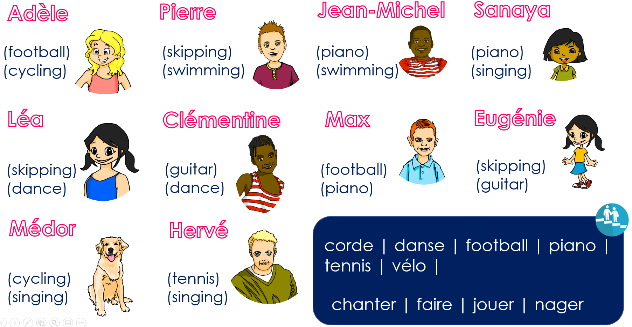
Follow up 4
Parle en français. Pose des questions.
Ask your partner questions to guess their secret character.
A : Est-ce que tu veux jouer de la guitare ?
B : Non.
parler
Remember to use ‘Est-ce que’ to ask yes/no questions.
B : Non.
A : Est-ce que tu veux nager ?
B : Oui !
A : Est-ce que tu veux faire de la danse ?
B : Oui !
A : Est-ce que tu es Léa ?
Notes:
Time: 8-10 minutes
Aim: To ask and understand 2-verb questions and answers using ‘est-ce que tu veux…’ and ‘je veux’ structures.
Read the title in French and click to bring a brief explanation of the instructions.
Tell pupils they are going to work in pairs. Partners take it in turns to ask yes/no questions to try to figure out the other player’s character.
Click x3 to bring the speech bubbles to make sure students are clear about what the exchange should look like Est-ce que tu veux jouer de la guitare ? / No). There is a callout to reminder them to use raised intonation.
Animation appears on click to allow teachers to narrow down the options together with the whole class. Who wants to play the guitar? Clémentine and Eugénie. Click to bring up crosses.
Click x2 to model another example (Est-ce que tu veux jouer au foot ? / Non !). Show students on the board how that means Pierre and Jean-Michel are not the secret character & click to bring X shapes to cover them.
Click x2 to trigger the next question Est-ce que tu veux faire de la danse ?’. The response is “Yes” so this can only be Léa.
7. Click x2 to bring further question Est-ce que tu es Léa ?’ and the answer ‘yes’. This means Léa is the secret character.
Teachers can model another round with the whole class (getting students to ask the questions) before getting them started in pairs.
3. Give students 30 seconds to write down 4 names (mixture of male/female).
4. The aim is to work with your partner, to identify all 8 people as quickly as possible.
NB. Print the template slide (slide 12) in A5 so that students can cross out as they play.

Slide 6
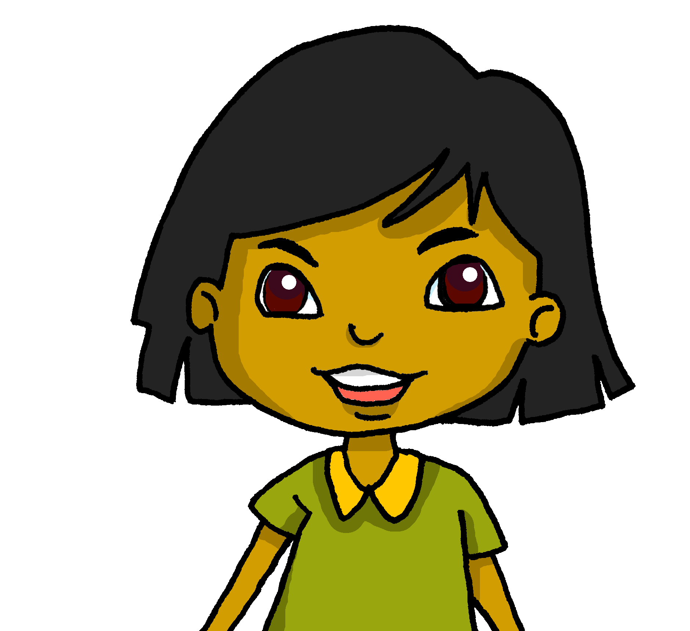
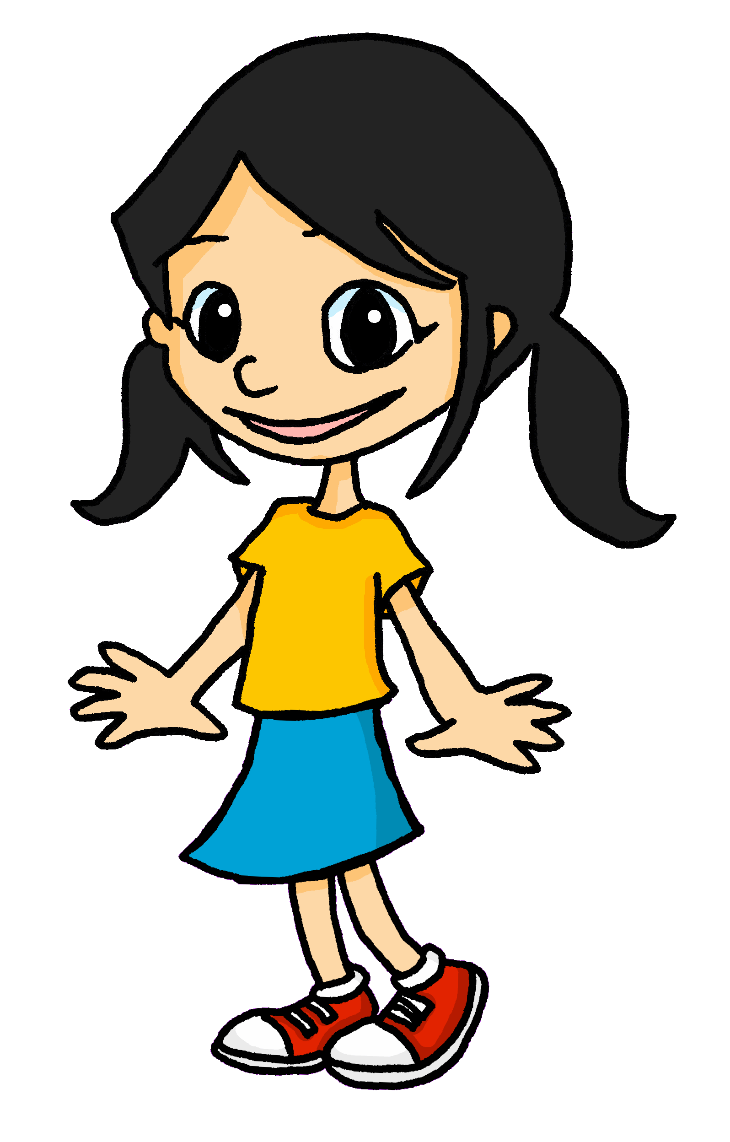
Follow up 4
Parle en français. Pose des questions.
Adèle
Pierre
Jean-Michel
Sanaya
parler
(football)
(cycling)
(skipping)
(swimming)
(piano)
(swimming)
(piano)
(singing)
Léa
Clémentine
Max
Eugénie
(skipping)
(dance)
(guitar)
(dance)
(football)
(piano)
(skipping)
(guitar)
Médor
Hervé
corde | danse | football | piano | tennis | vélo |
(cycling)
(singing)
(tennis)
(singing)
chanter | faire | jouer | nager
Notes:
Master slide for guess who game. Print the template slide in A5 so that students can cross out as they play.

Slide 7
vocabulaire
Follow up 5a - Écris en anglais : Can you get at least 15 points?
mots
 | dix-neuf | il y a | trente-et-un
 | vingt-huit | vingt-deux | quinze
 | la Suisse | le Luxembourg | la Belgique
 | l’Italie | la Grande-Bretagne | l’Allemagne
 | Il fait (weather) | le soleil | le vent
 | il veut | elle veut | l’Espagne (f)
 | vouloir | je veux | tu veux
there is, there are
31
19
x3
28
22
15
Switzerland
Luxembourg
Belgium
x2
Italy
Great Britain
Germany
it is
(the) sun
(the) wind
x1
he wants
she wants
Spain
to want
I want
you want
Notes:
Timing: 5-10 minutes
Aim: to practise written production of vocabulary from this week and two revisited weeks.
Procedure: 1. Give pupils a blank grid. They fill in the English meanings of any of the words they know, trying to reach 15 points in total. 2. Remind pupils that adjectives can refer to male or female persons and they should note this in their translations. E.g. pleased (f), short (m).
Note: The most recently learnt and practised words are pink, words from revisit 1 are green and those from revisit 2 are blue, thus more points are awarded for them, to recognise that memories fade and more effort (heavy lifting!) is needed to retrieve them.
7

Slide 8
vocabulaire
Follow up 5b - Écris en français : Can you get at least 15 points?
mots
 | 17 | there is, there are | 21
 | 12 | 30 | 20
 | (the) Italy | (the) Luxembourg | (the) wind
 | (the) Germany | (the) Switzerland | it is (weather)
 | (the) sun | (the) Great Britain | (the) Belgium
 | I want | to want | (the) Spain
 | he wants | you want | she wants
dix-sept
il y a
vingt-et-un
x3
douze
trente
vingt
l’Italie
le Luxembourg
le vent
x2
l’Allemagne
la Suisse
il fait
le soleil
la Grande-Bretagne
la Belgique
x1
je veux
vouloir
l’Espagne
il veut
tu veux
elle veut
Notes:
Timing: 5-10 minutes
Aim: to practise written comprehension of vocabulary from this week and previous weeks.
Procedure: Give pupils a blank grid. They fill in the French meanings of any of the words they know, trying to reach 15 points in total.
Note: The most recently learnt and practised words are pink, words from the previous week are green and those from earlier are blue, thus more points are awarded for them, to recognise that memories fade and more effort (heavy lifting!) is needed to retrieve them.
8

Slide 9
vocabulaire
Follow up 5a - Écris en anglais : Can you get at least 15 points?
mots
 | dix-neuf | il y a | trente-et-un
 | vingt-huit | vingt-deux | quinze
 | la Suisse | le Luxembourg | la Belgique
 | l’Italie | la Grande-Bretagne | l’Allemagne
 | Il fait (weather) | le soleil | le vent
 | il veut | elle veut | l’Espagne (f)
 | vouloir | je veux | tu veux
x3
x2
x1
Notes:
HANDOUT
9

Slide 10
vocabulaire
Follow up 5b - Écris en français : Can you get at least 15 points?
mots
 | 17 | there is, there are | 21
 | 12 | 30 | 20
 | (the) Italy | (the) Luxembourg | (the) wind
 | (the) Germany | (the) Switzerland | it is (weather)
 | (the) sun | (the) Great Britain | (the) Belgium
 | I want | to want | (the) Spain
 | he wants | you want | she wants
x3
x2
x1
Notes:
HANDOUT
10

