Slide 1
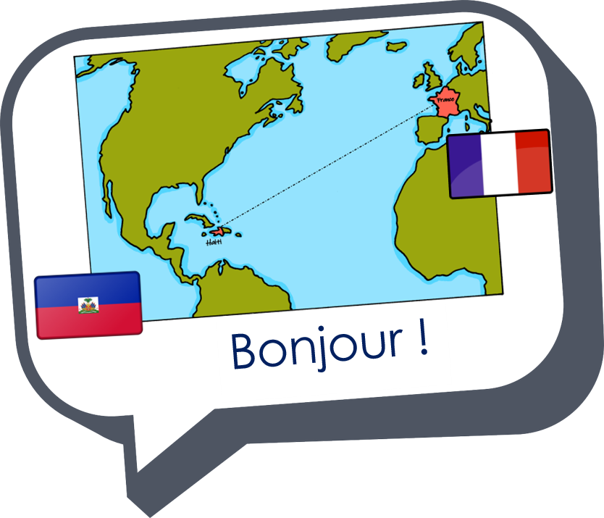
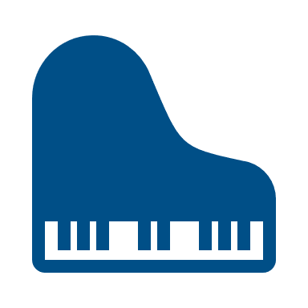


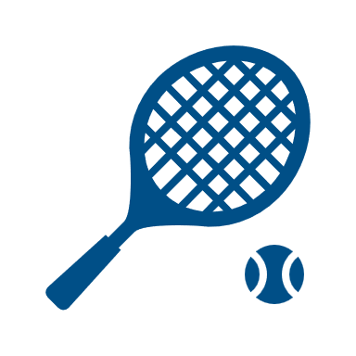
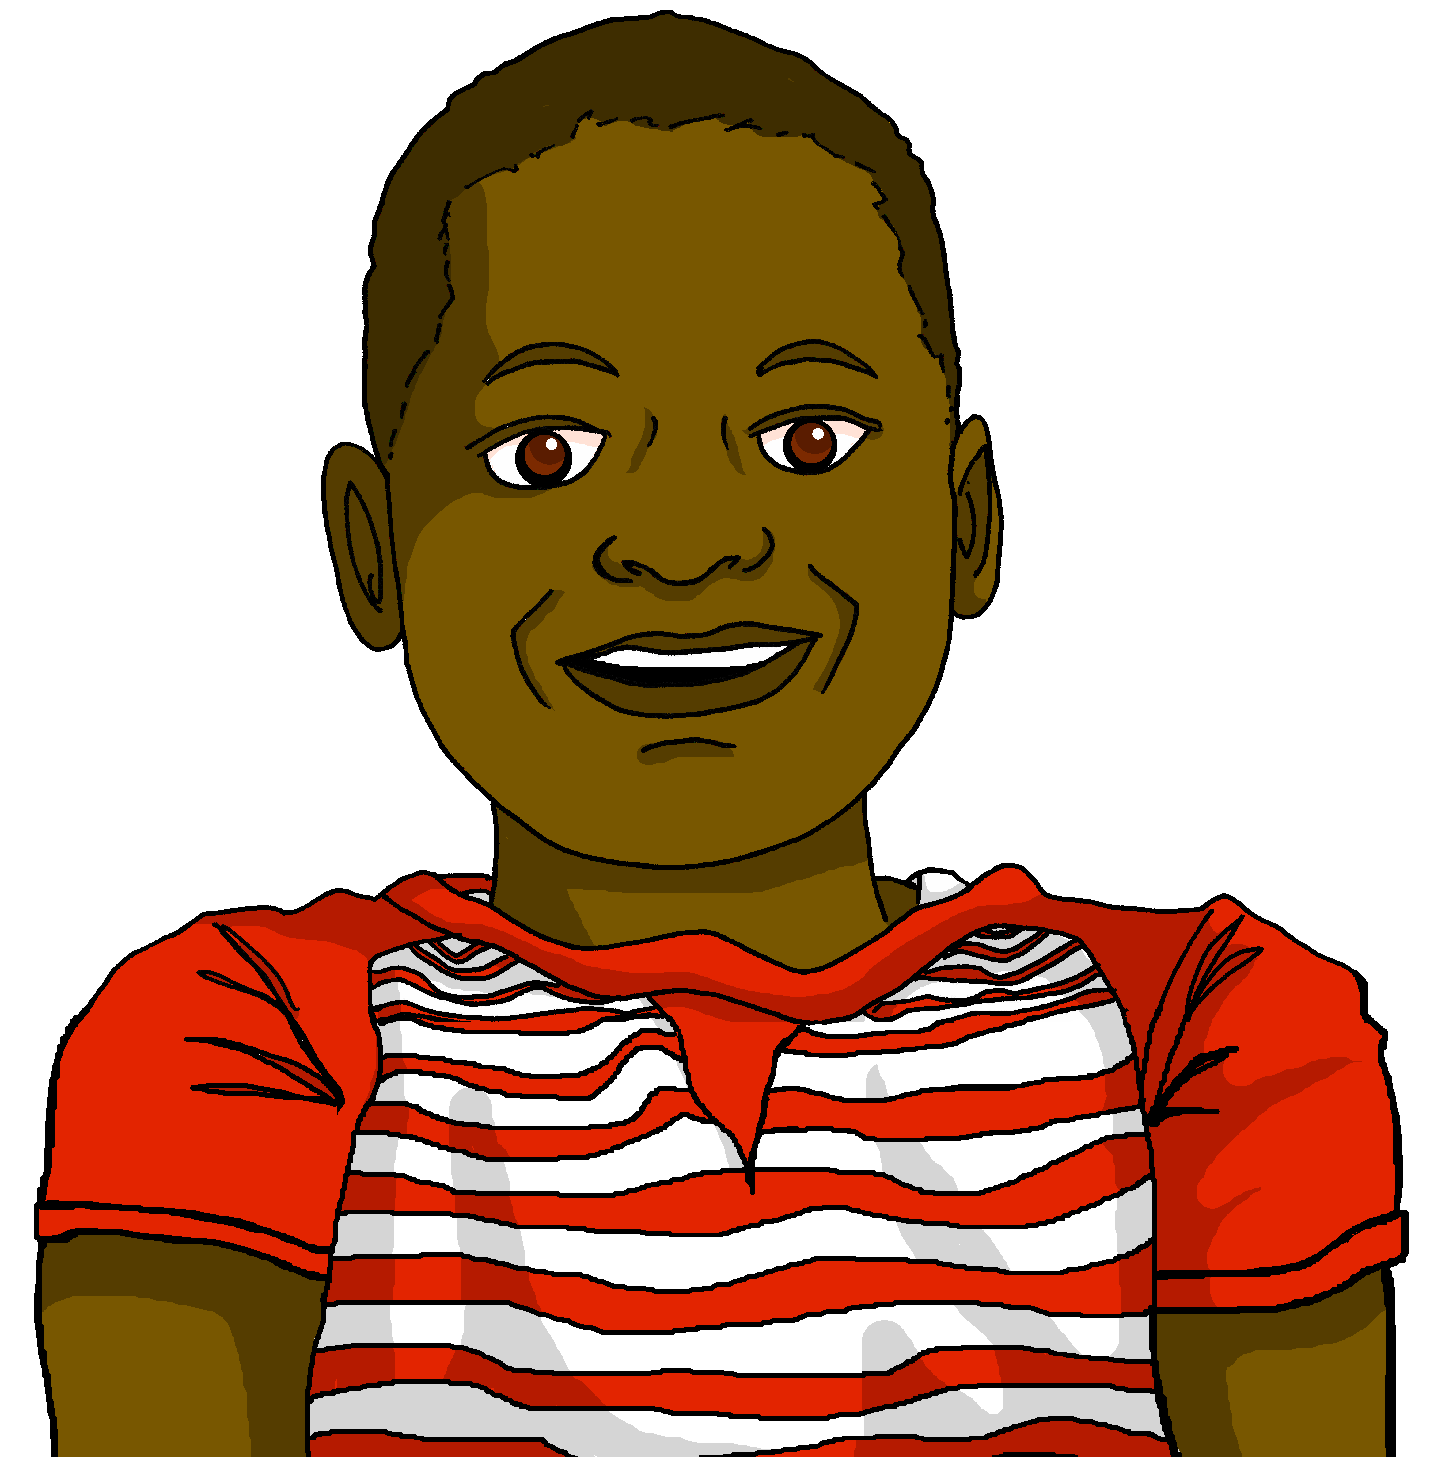




Saying what I and others do
vert
jouer à / de
faire de
SSC [qu]
Notes:
Artwork by Steve Clarke. Pronoun pictures from NCELP (www.ncelp.org). All additional pictures selected from Pixabay and are available under a Creative Commons license, no
attribution required.
Phonics: Revisit SSC [-s-] maison [325] chose [125] magasin [1736] église [1782] cuisine [2618]
Vocabulary: ami [467] corde [3784] famille [172] football [2602] parent [546] tennis [3687] mes [60] tes [330]
Revisit 1: faire [25] je fais il/elle fait activité [452] course à pied [n/a] chanson [2142] dessin [2624] film [848] gâteau [4845] matin [442] soir [397] spectacle [1687] ville
[360] visite [1072] weekend [2475] demain [871]
Revisit 2: chanter [1820] chercher [336] créer [332] danser [2934] donner [46] écouter [429] manger [1338] organiser [791] préparer [368] porter [105] regarder [425] trouver
[83] utiliser [345]
Londsale, D., & Le Bras, Y. (2009). A Frequency Dictionary of French: Core vocabulary for learners London: Routledge.
The frequency rankings for words that occur in this PowerPoint which have been previously introduced in these resources are given in the SOW and in the resources that first
introduced and formally re-visited those words.
For any other words that occur incidentally in this PowerPoint, frequency rankings will be provided in the notes field wherever possible.
1

Slide 2


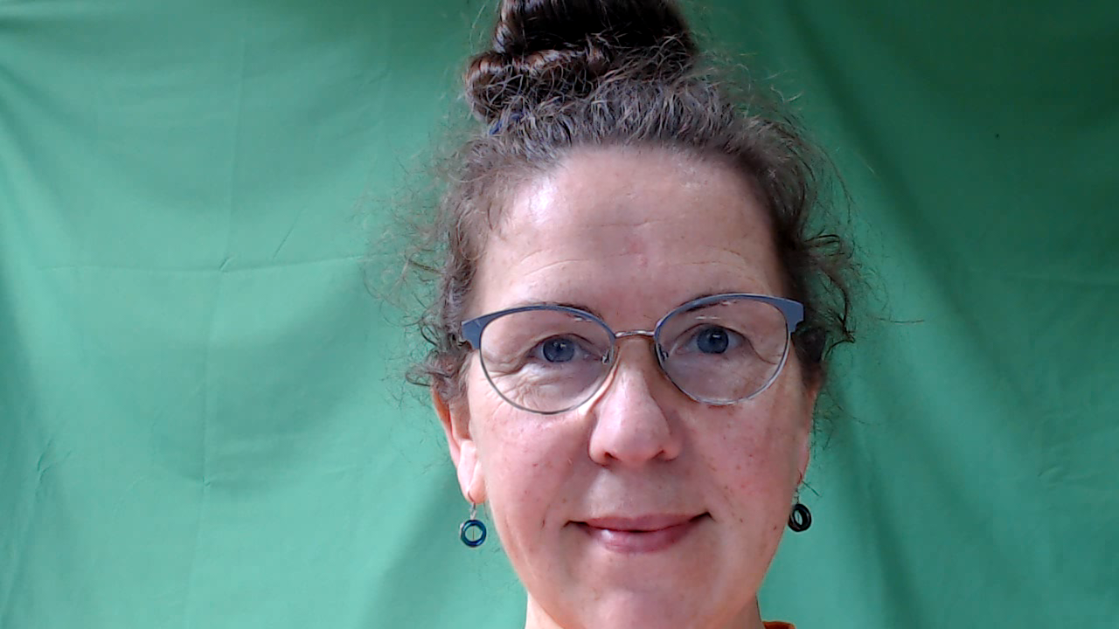
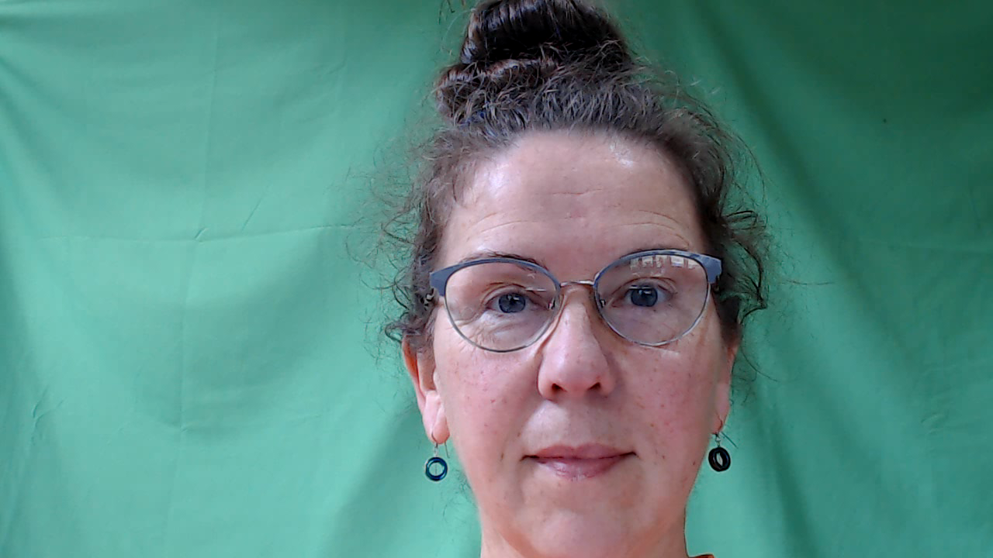
[qu]
prononcer
question
Notes:
Timing: 1 minute
Aim: To consolidate SSC [qu]
Procedure:
1. Present the letter(s) and say the [qu] sound first, on its own. Students repeat it with you.
2. Bring up the word ”question” on its own, say it, students repeat it, so that they have the opportunity to focus all of their attention on the connection between the written word and its sound.
3. Say the word and do the gesture, if using.
4. Roll back the animations and work through 1-3 again, but this time, dropping your voice completely to listen carefully to the students saying the [qu] sound, pronouncing ”question” and, if using, doing the gesture.
Gesture: https://www.signbsl.com/sign/question
The 2nd video from the left – trace the shape of a question mark in the air
Word frequency (1 is the most frequent word in French):
question [144]
Source: Londsale, D., & Le Bras, Y. (2009). A Frequency Dictionary of French: Core vocabulary for learners London: Routledge.
2

Slide 3
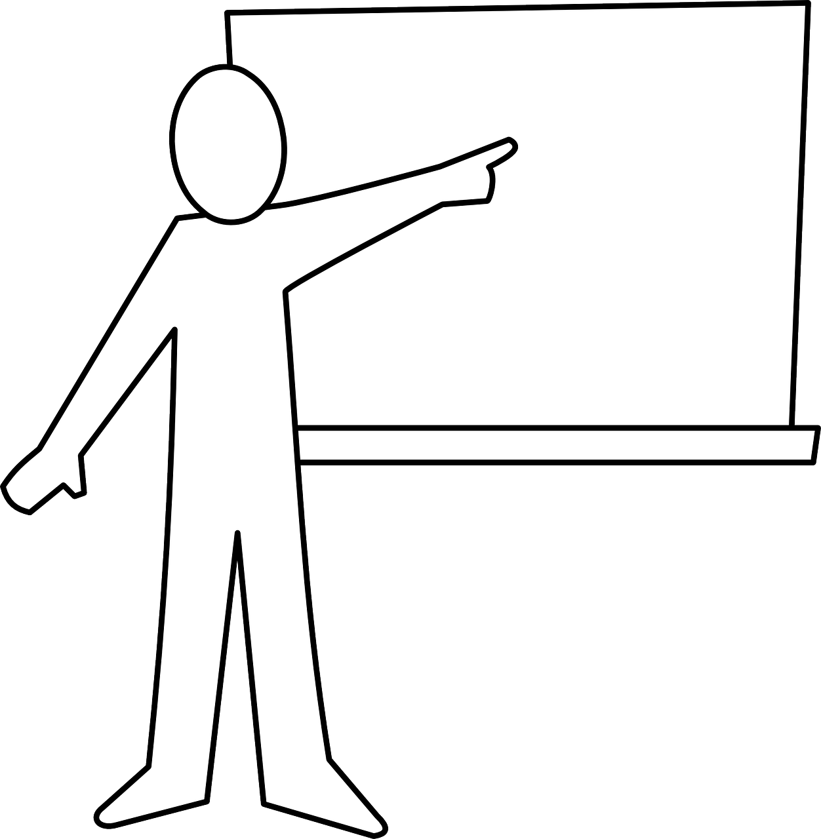
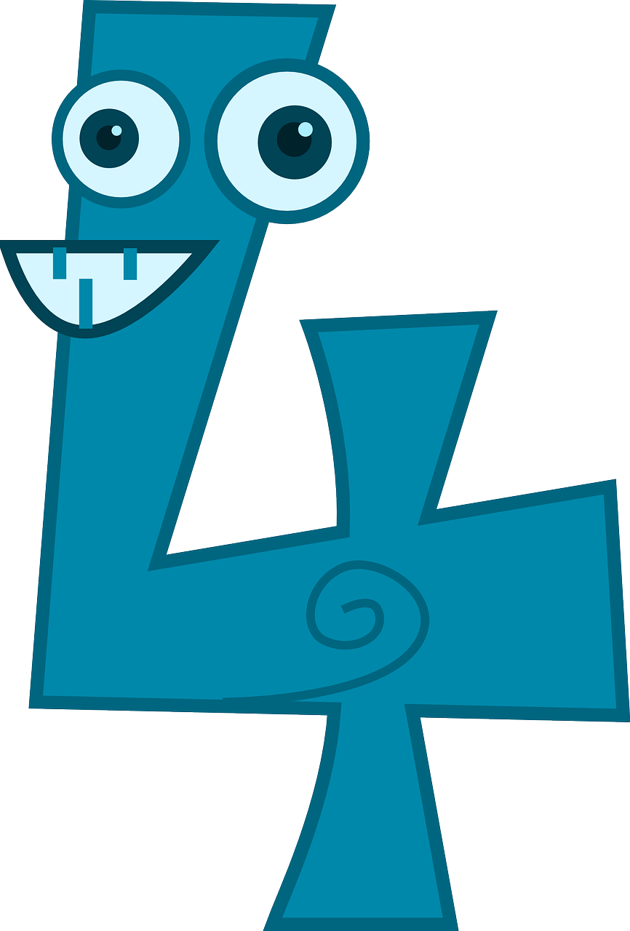
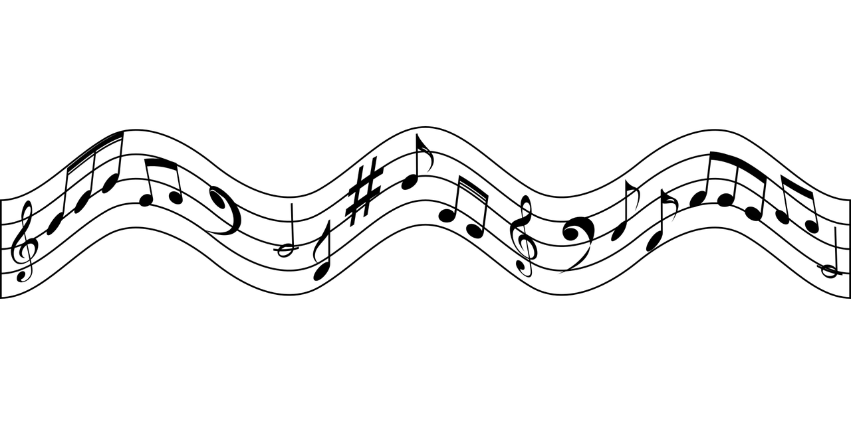
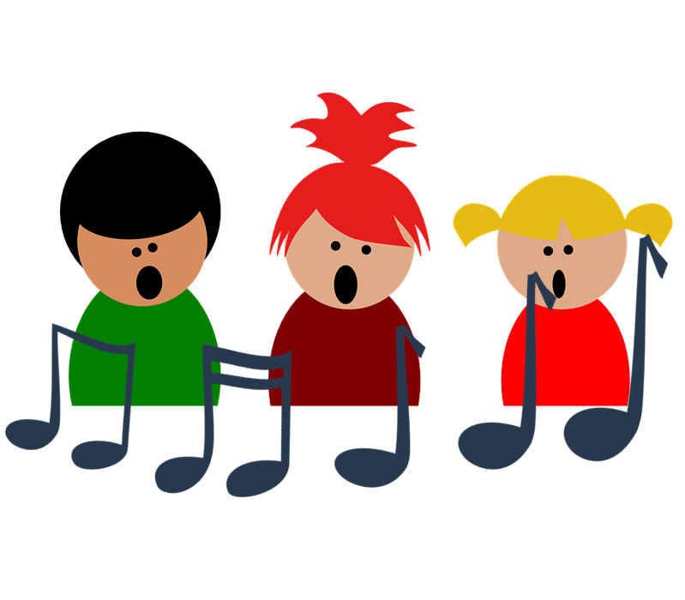
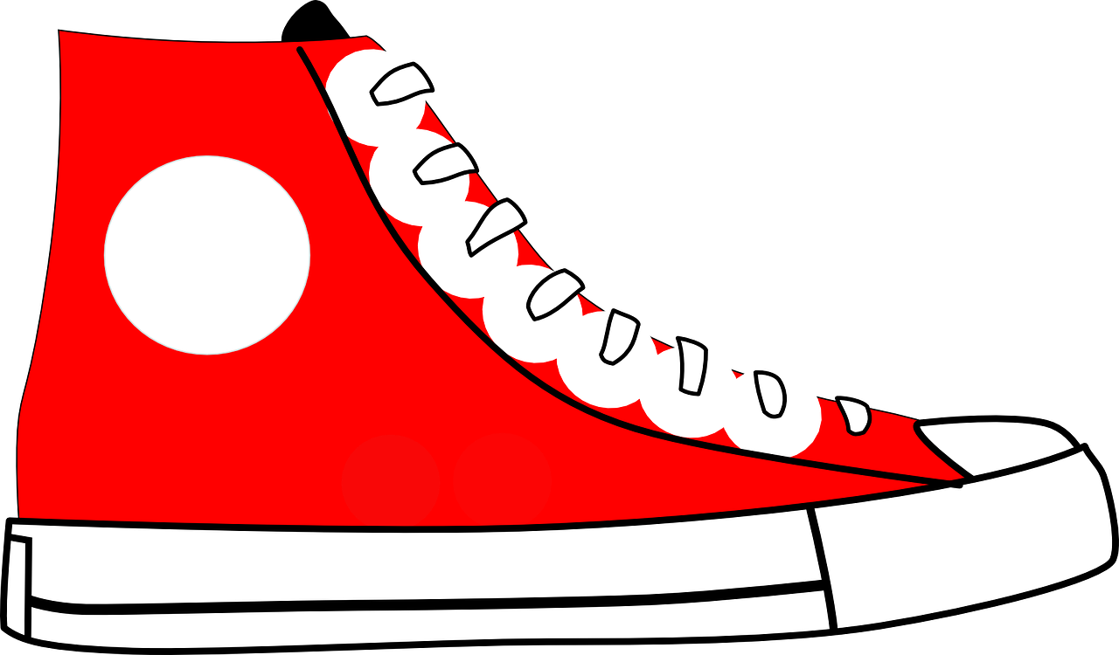
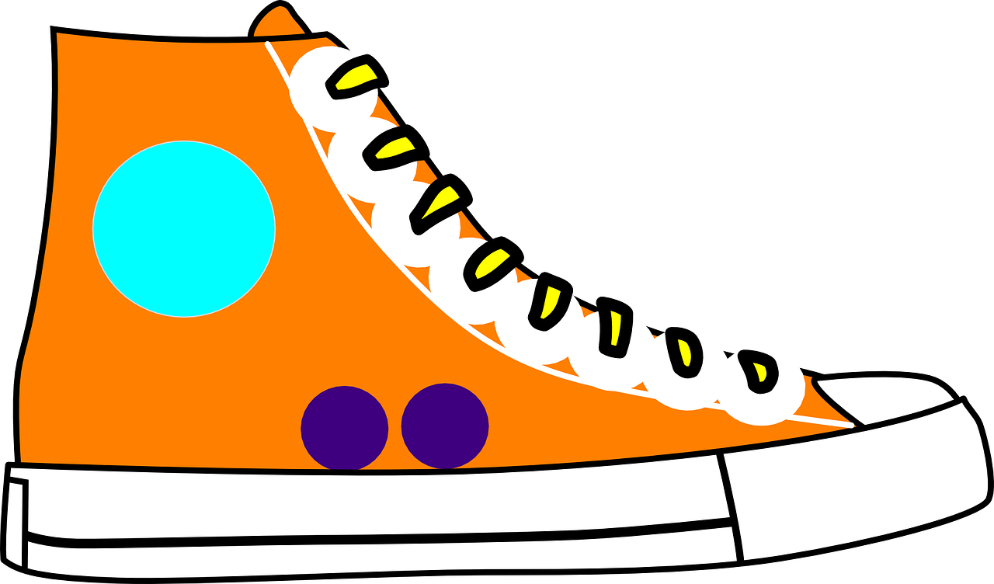
[qu]
prononcer
to explain
quatre
expliquer
question
musique
unique
Notes:
Timing: 2 minutes
Aim: To consolidate SSC [qu]
Procedure:
1. Introduce and elicit the pronunciation of the individual SSC [qu] and then the source word again ‘question’ (with gesture, if using).
2. Then present and elicit the pronunciation of the four cluster words.
The cluster words have been chosen for their high-frequency, from a range of word classes, with the SSC (where possible) positioned within a variety of syllables within the words (e.g. initial, 2nd, final etc.). Additionally, we have tried to use words that build cumulatively on previously taught SSCs (see the Phonics Teaching Sequence document) and do not include new SSCs. Where new SSCs are used, they are often consonants which have a similar symbol-sound correspondence in English.
Word frequency:
quatre [283] musique [1139] expliquer [252] unique [402] question [144]
Source: Londsale, D., & Le Bras, Y. (2009). A Frequency Dictionary of French: Core vocabulary for learners London: Routledge.
3

Slide 4

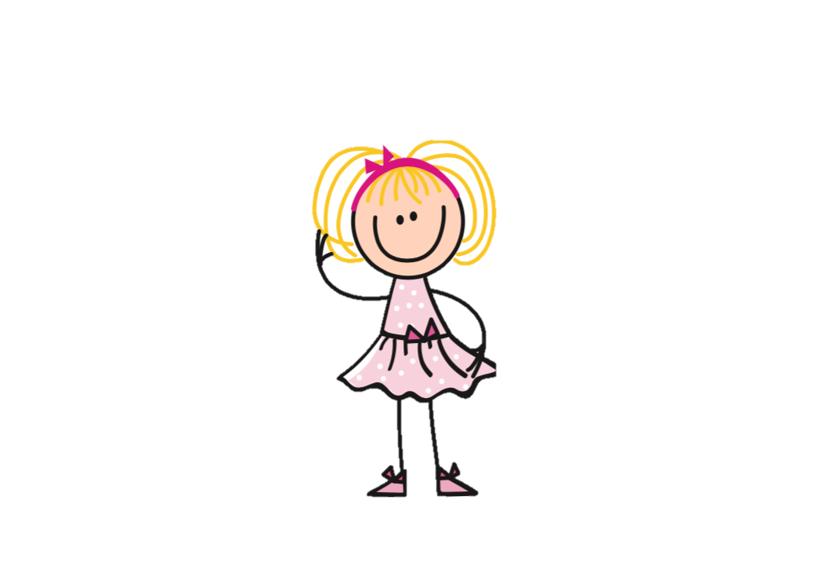
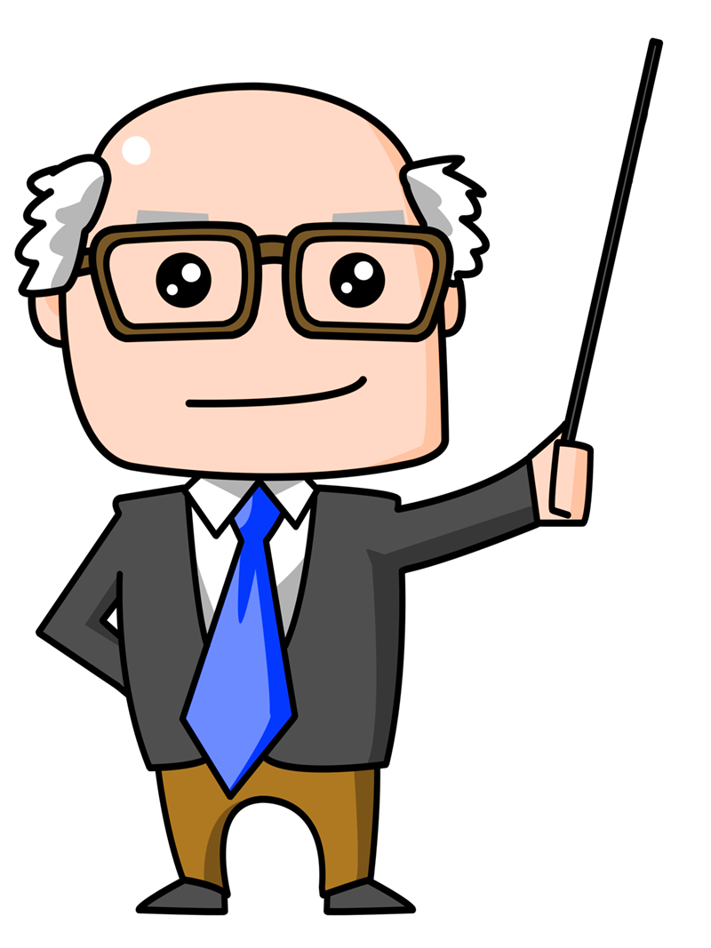
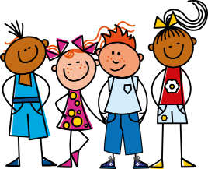

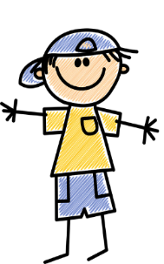

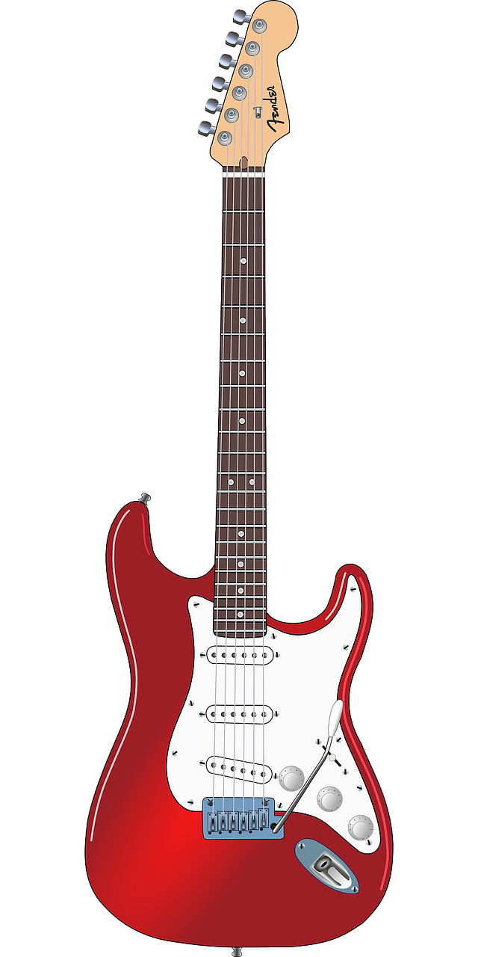

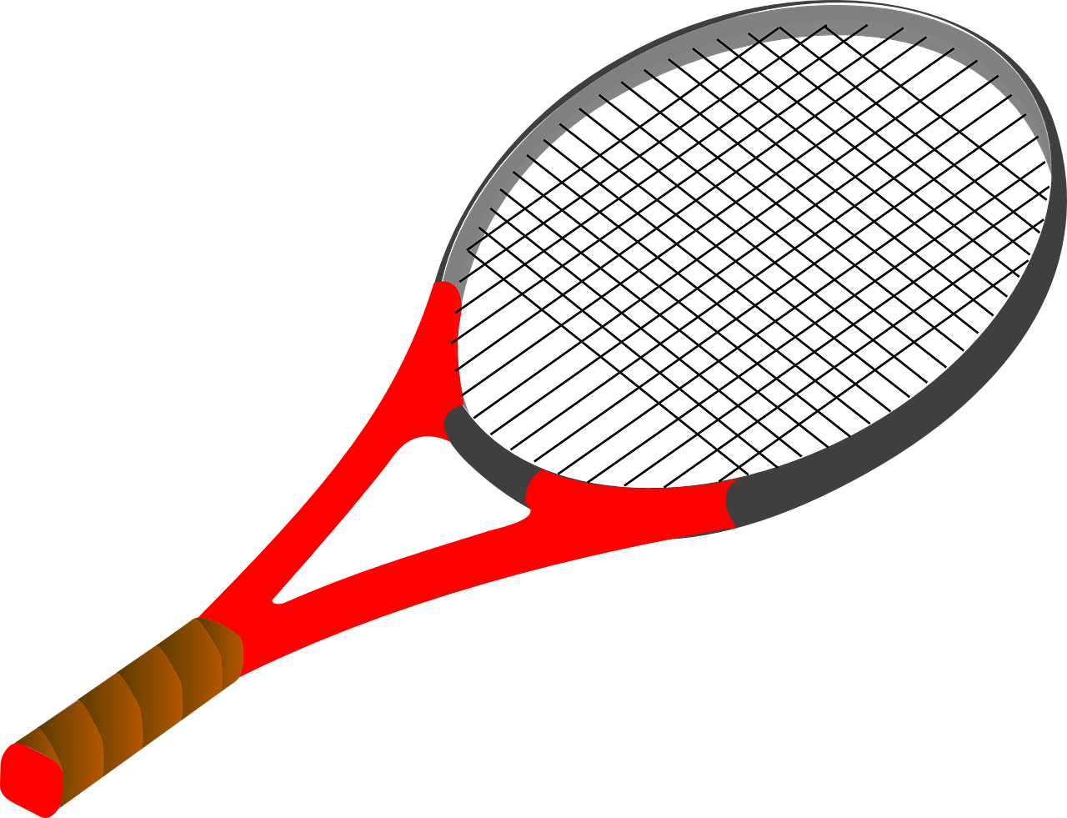



prononcer
Prononce. Qui va avec chaque phrase ?
4
Monsieur Bacque
Monique
Dominique
Jacques
Véronique
Jacquet
Véronique
1
2
3
…joue de la guitare électrique. Elle est fantastique !
Monique
Jacques
…a quatre questions pour le prof de musique.
…joue au tennis avec une grande raquette.
…ne porte pas de casquette, quand il fait du vélo.
4
Jacquet
5
6
Dominique
Monsieur Bacque
…va à la bibliothèque chaque jour.
…explique qu’il habite en Belgique.
Notes:
Timing: 5 minutes
Aim: Consolidation of SSC [qu]
Procedure:
Students read the phrases aloud in pairs and match them to each person.
Click on buttons to play the audio.
Students listen and check their answers.
Click to reveal answers.
Transcript:
Véronique joue de la guitare électrique. Elle est fantastique !
Monique a quatre questions pour le prof de musique.
Jacques joue au tennis avec une grande raquette.
Dominique va à la bibliothèque chaque jour.
Jacquet ne porte pas de casquette.
Monsieur Bacque explique qu’il habite en Belgique.
Word frequency of cognates used (1 is the most frequent word in French):
bibliothèque [2511] casquette [>5000] électrique [2067] expliquer [252] fantastique [4107] raquette [>5000]
Source: Lonsdale, D., & Le Bras, Y. (2009). A Frequency Dictionary of French: Core vocabulary for learners London: Routledge.

Slide 5



vocabulaire
Vocabulaire
mots
Comment dit-on ça en français ?
avec
intéressant
quand
la danse
il fait
la guitare
because
it is (weather)
dance
to like, liking
interesting
with
when
fun, funny
why?
nice
sun
guitar
parce que
sympa(thique)
amusant
le soleil
aimer
pourquoi ?
Notes:
Timing: 4 minutes
Aim: to practise written recognition and read aloud of important revisited vocabulary that we will work with this lesson, and the one new word ‘parce que’.
Procedure:
1. Click for an English word to appear in the middle. Elicit the French translation from pupils. Emphasis here is on good pronunciation as well as finding the correct word.
2. Continue until all the words have been practised.
3. Elicit choral pronunciation of all words again, clicking to provide an emphasis animation. Encourage pupils to focus on pronunciation and avoid anglicism of the cognates.
5

Slide 6


aimer (to like)
jouer (to play)
⚠ We leave out ‘the’ in English.
Use aimer + le/la to say what you like:
J’aime le football.
I like football.
Il aime le tennis.
He likes tennis.
Use jouer + à + le/la to say what sport you play:
⚠ Remember:
à + le → au
Je joue au football.
I play football.
Elle joue à la corde.
She plays skipping.
Use jouer + de + le/la to say what instrument you play:
Je joue du piano.
⚠ Remember:
de + le → du
I play the piano.
Elle joue de la guitare.
She plays the guitar.
Notes:
Timing: 2 minutes
Aim: to recap aimer meaning and its use with definite articles and recap jouer à to say you play a sport and jouer de to say you play an instrument.
Procedure:
Click through the animations to present the information.
Elicit English translations for the French examples provided.

Slide 7


écouter
Écoute. C’est ‘aimer’ ou ‘jouer’ ?
⚠ Attention ! The verb is missing. Listen to what follows to work out if the meaning is liking or playing.
Is Jean-Michel talking about liking or playing?
 | like(s) | play(s) | en anglais
1
2
3
4
5
6
7
8
1
Clémentine likes the guitar.
1
2
Mum likes tennis.
2
3
Dad also plays tennis.
3
4
I play the piano.
4
5
My aunt Mylène likes football.
5
6
She also plays tennis with my mum.
6
7
Clémentine plays guitar at school.
7
8
My friend likes football.
8
Notes:
Timing: 6 minutes
Aim: to practise aural recognition of the ‘le/la’ and ‘au/à la,’, ‘du/de la’ and understand their connection to the use and meaning of the two verbs aimer and jouer.
Procedure:
Pupils listen to each phrase.
Attending to the word following the beep (which obscures the verb) pupils decide if the meaning is liking or playing.
On the 2nd time of listening, pupils write the English meaning of the sentences.
Click to reveal answers.
Teachers may want to challenge pupils to produce (chorally, not individually) the French for the English sentence answers they can see. If so, they can click on the 2nd set of audio buttons to listen and check with the full sentences.
Note: if pupils need more support with this task, gapped versions of the English answers could be provided.
Transcript:
Clémentine [aime] la guitare.
Maman [aime] le tennis.
Papa [joue] aussi au tennis.
Je [joue] du piano.
Ma tante Mylène [aime] le football.
Elle [joue] aussi au tennis avec ma mère.
Clémentine [joue] de la guitare à l’école.
Mon ami [aime] le football.
7

Slide 8
faire de with sports
Remember! To say ‘do’ with sports, use faire de:
Je fais du sport.
⚠ This use of ‘de’ + article is called the partitive.
I do (some) sport.
⚠ de + le → du
Tu fais de la danse.
You do (some) dance/dancing.
Remember you can use faire un/une with other nouns:
Je fais un cadeau.
I make/am making a present.
Il fait une activité.
He does/ is doing an activity.
Notes:
Timing: 2 minutes
Aim: to revisit the partitive article ‘de’ with sports and contrast it with faire + un/une + nouns.
Procedure:
Click through the animations.
Elicit English from pupils following the ?.
Note: in weeks 8 and 9 pupils will also learn to use the partitive with other nouns (food and drink).

Slide 9

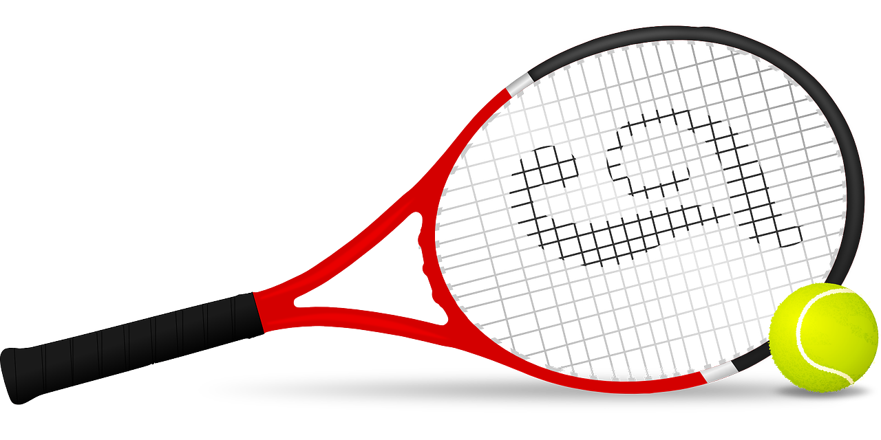


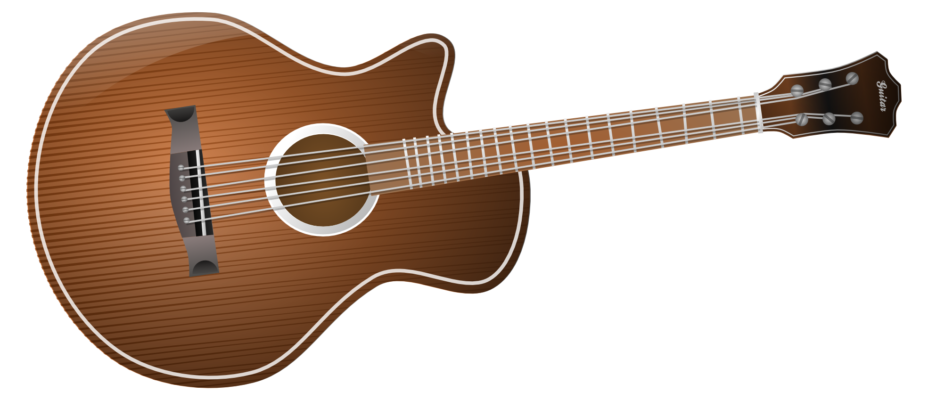

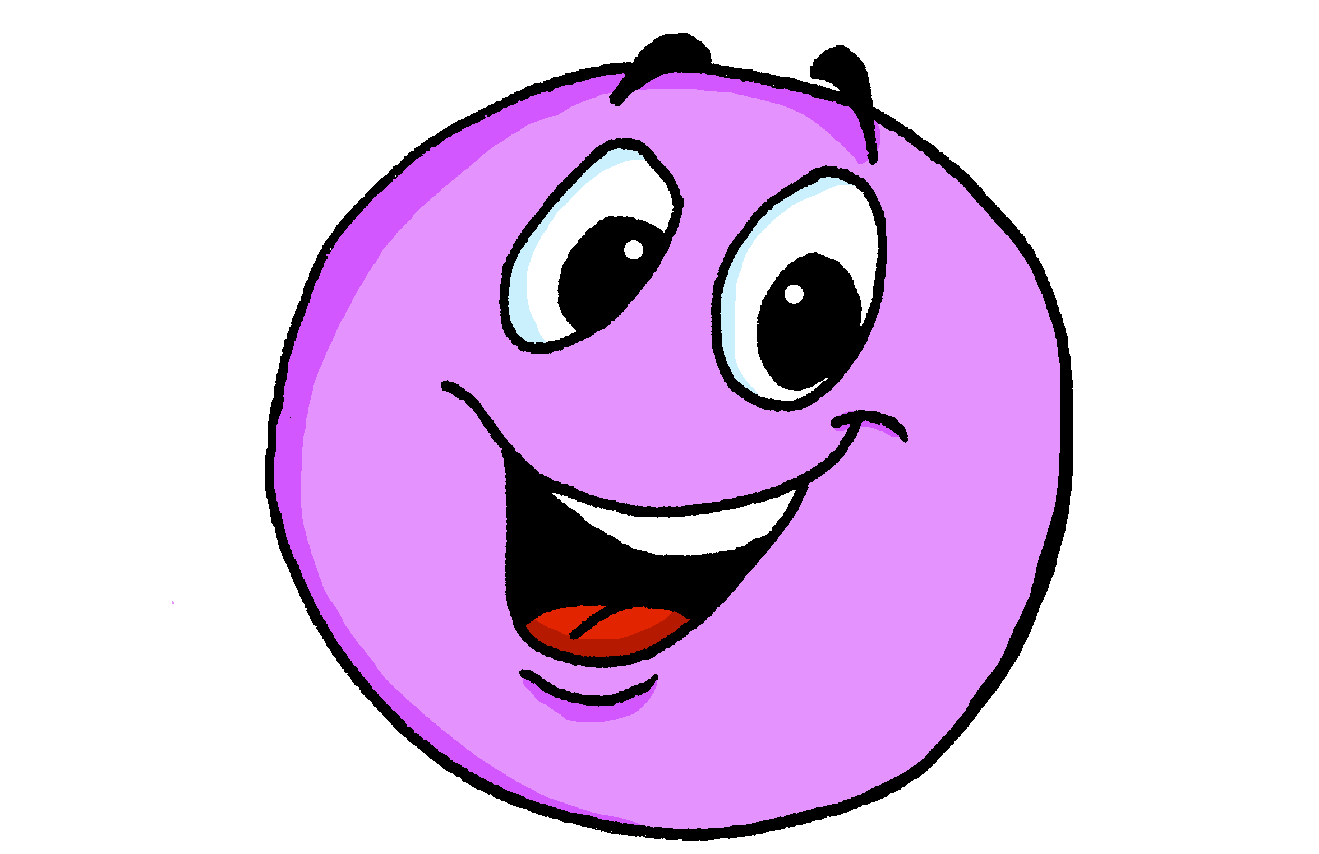
Making longer sentences
You can join two clauses together to make longer sentences:
⚠ Put a comma here to represent the pause when you say it.
Quand il fait du soleil, je joue au tennis.
When it is sunny, I play tennis.
You can use these two clauses the other way around, too:
⚠ A comma is optional here.
Je fais de la danse quand il fait froid.
I do/go dancing when it is cold.
Use parce que (because) for a longer sentence giving a reason:
Je joue de la guitare parce que c’est créatif.
I play the guitar because it’s creative.
Notes:
Timing: 2 minutes
Aim: to recap il fait meaning ‘it is’ for weather and introduce longer sentences, using quand.
Procedure:
Click through the animations to present the information.
Elicit English translations for the French examples provided.

Slide 10


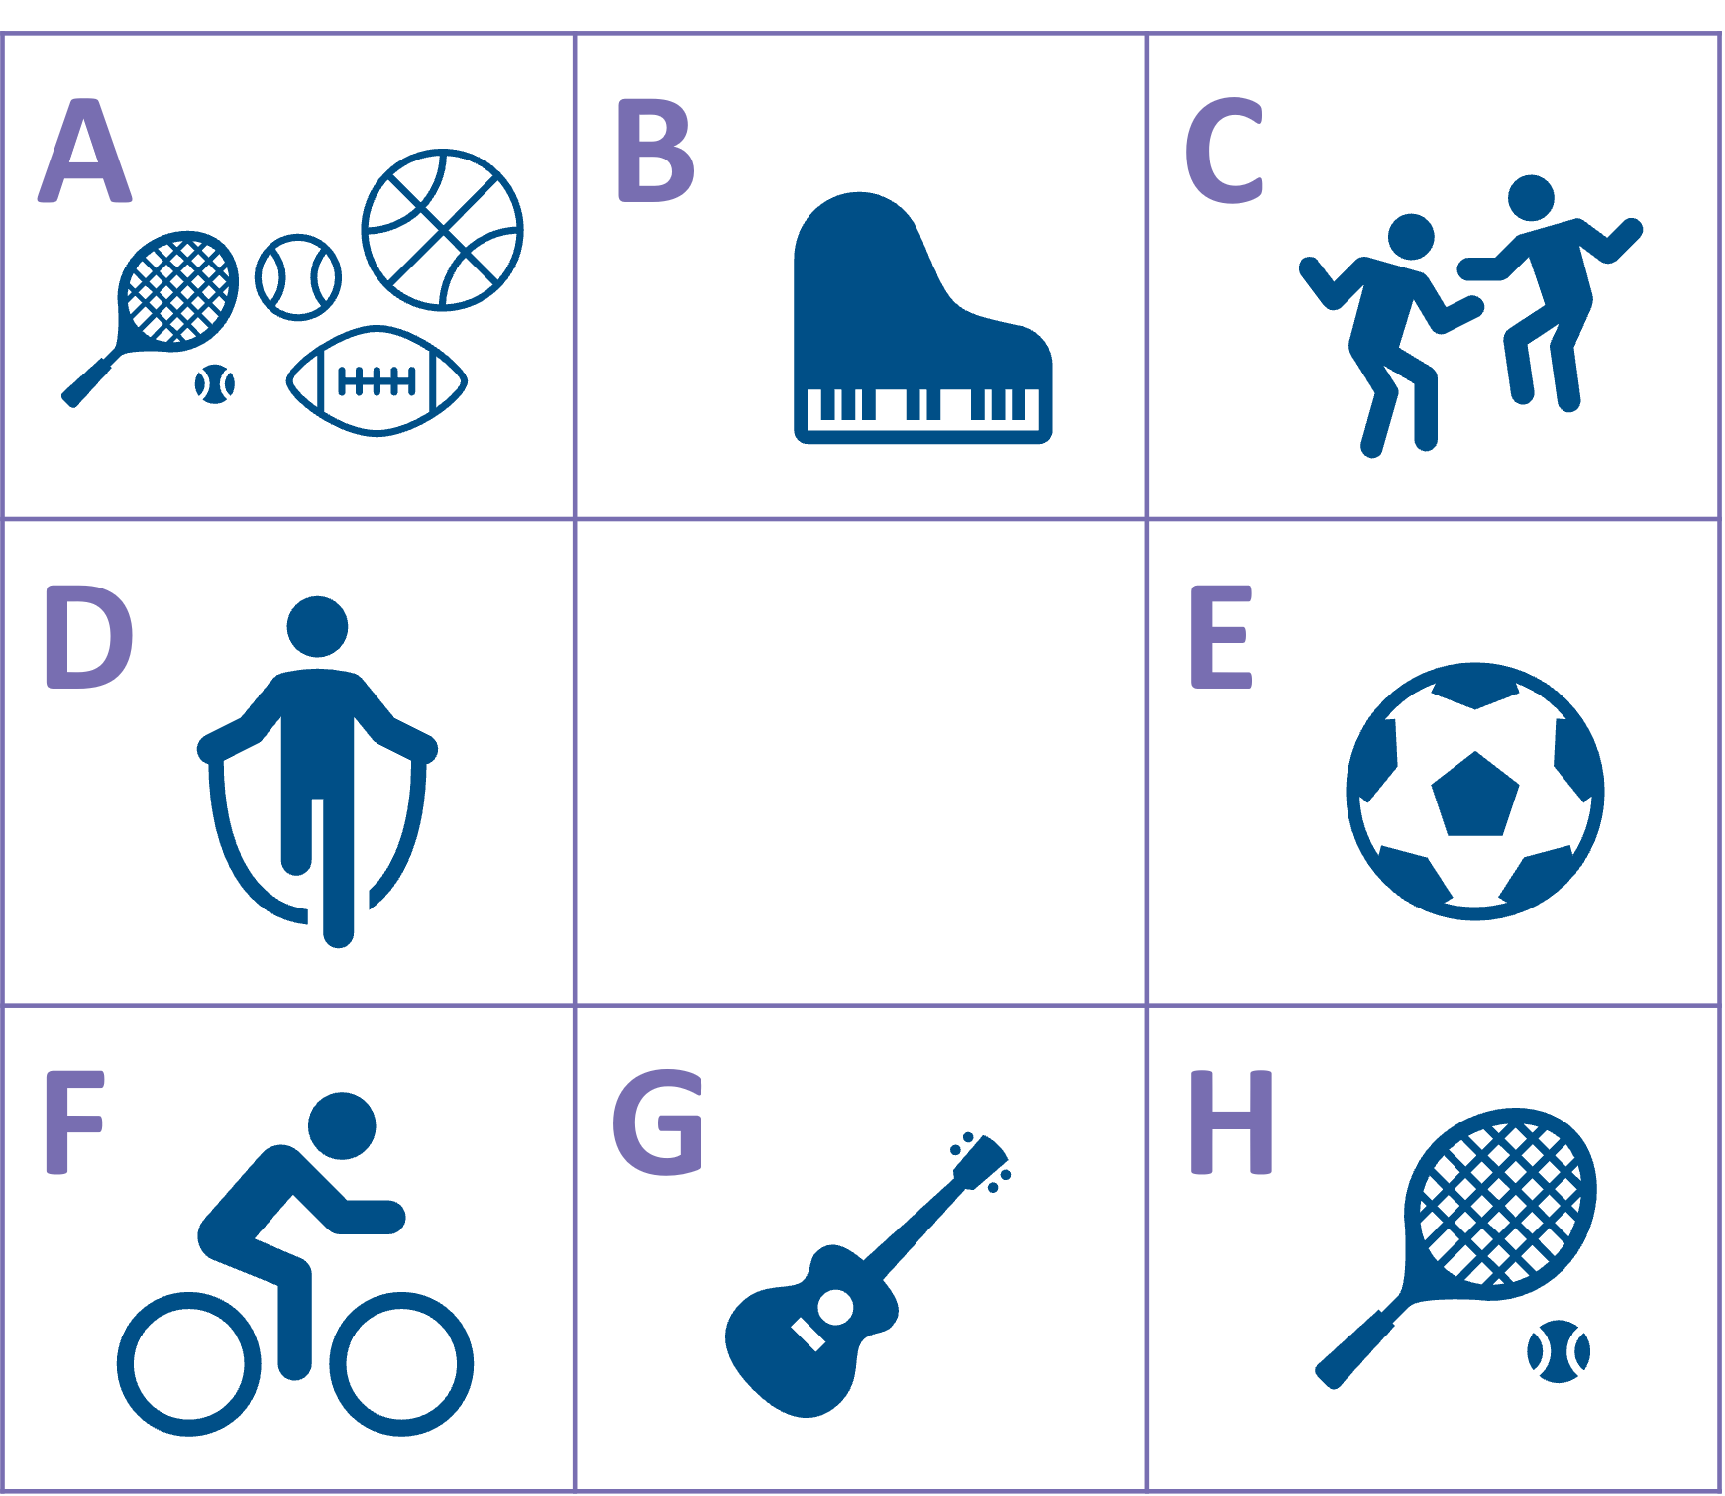
lire
Lis les phrases et identifie l’image correspondante.
Écris le verbe correct. C’est ‘jouer’ ou ‘faire’ ?
écouter
écrire
1 | Il fait du sport…
2 | Tu joues au tennis…
3 | Elle fait de la danse…
4 | Je fais du vélo…
5 | Je joue à la corde…
6 | Il joue au foot…
7 | Elle joue de la guitare…
8 | Je joue du piano…
1
___
A
because it’s fun
2
____
H
when it’s sunny
3
____
C
because it’s creative
4
____
F
at the weekend with my family
5
____
D
when it’s cold
6
____
E
with (some) friends
Écoute et écris les autres* détails en anglais.
7
G
because she likes music
____
8
B
*other
____
because it’s interesting
Notes:
Timing: 10 minutes
Aim: to practise written distinction between singular forms of jouer à, jouer de and faire de with previously taught language; to practise aural comprehension of longer sentences with quand and parce que.
Procedure:
1. Read the rubric and ensure that pupils understand the task.
2. Pupils read the sentences and note down the letter of the picture. (1=A etc.)
3. Answers revealed on clicks.
4. Pupils then write the correct form of the missing verb (jouer or faire).
5. Click to reveal the correct answers.
6. Finally, click the numbered buttons to hear the full sentences which include 2nd clauses.
7. Pupils write in the detail of the additional clause.
8. Click to reveal the answers.
Transcript:
1. Il fait du sport parce que c’est amusant.
2. Tu joues au tennis quand il fait du soleil.
3. Elle fait de la danse parce que c’est créatif.
4. Je fais du vélo le weekend avec ma famille.
5. Je joue à la corde quand il fait froid.
6. Il joue au foot avec des amis.
7. Elle joue de la guitare parce qu’elle aime la musique.
8. Je joue du piano parce que c’est intéressant.

Slide 11
Au revoir !
vert
Notes:
11

