Slide 1
Describing me and others
vert
Follow ups 1-5
Notes:
Artwork by Steve Clarke. Pronoun pictures from NCELP (www.ncelp.org). All additional pictures selected from Pixabay and are available under a Creative Commons license, no attribution required.
Phonics: Revisit SSC [qu] question[144] quatre[283] musique [1139] expliquer [252] unique [402]
Vocabulary: aimer [242] corde [3784] danse [2964] football [2602] guitare [>5000] piano [4967] sport [2011] tennis [3687]
amusant [4695] sympa [4164] intéressant [1244] parce que [NA] pourquoi [193]
Revisit 1: tu fais [25] jouer [219] danse [2964] guitare [>5000] instrument [1650] piano [4967] sport [2011]
Revisit 2: --
Londsale, D., & Le Bras, Y. (2009). A Frequency Dictionary of French: Core vocabulary for learners London: Routledge.
The frequency rankings for words that occur in this PowerPoint which have been previously introduced in these resources are given in the SOW and in the resources that first introduced and formally re-visited those words.
For any other words that occur incidentally in this PowerPoint, frequency rankings will be provided in the notes field wherever possible.

Slide 2
[qu]
prononcer
question
Notes:
Timing: 1 minute
Aim: To introduce SSC [qu]
Procedure: 1. Present the letter(s) and say the [qu] sound first, on its own. Students repeat it with you. 2. Bring up the word ”question” on its own, say it, students repeat it, so that they have the opportunity to focus all of their attention on the connection between the written word and its sound.
3. Say the word and do the gesture, if using.
4. Roll back the animations and work through 1-3 again, but this time, dropping your voice completely to listen carefully to the students saying the [qu] sound, pronouncing ”question” and, if using, doing the gesture.
Gesture: https://www.signbsl.com/sign/question
The 2nd video from the left – trace the shape of a question mark in the air
Word frequency (1 is the most frequent word in French):
question [144]
Source: Londsale, D., & Le Bras, Y. (2009). A Frequency Dictionary of French: Core vocabulary for learners London: Routledge.
2

Slide 3
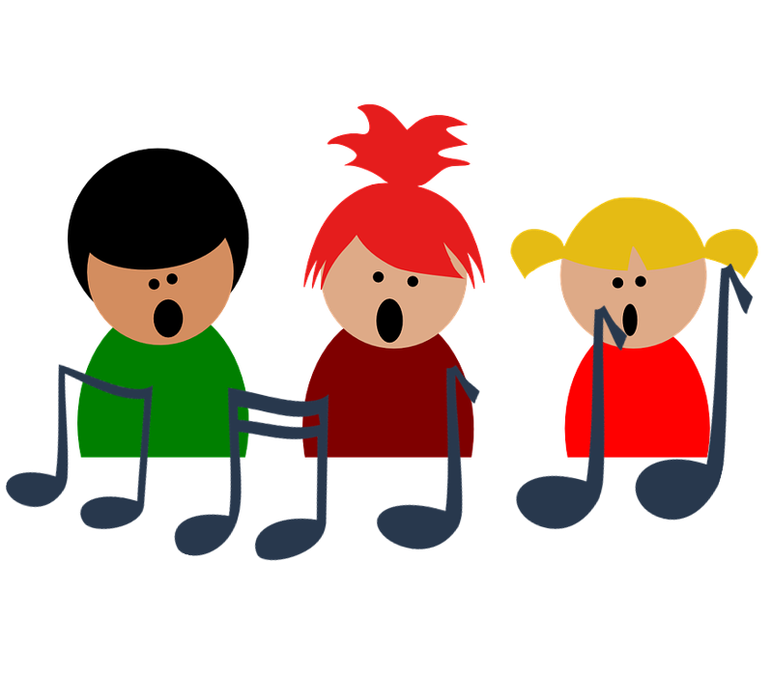
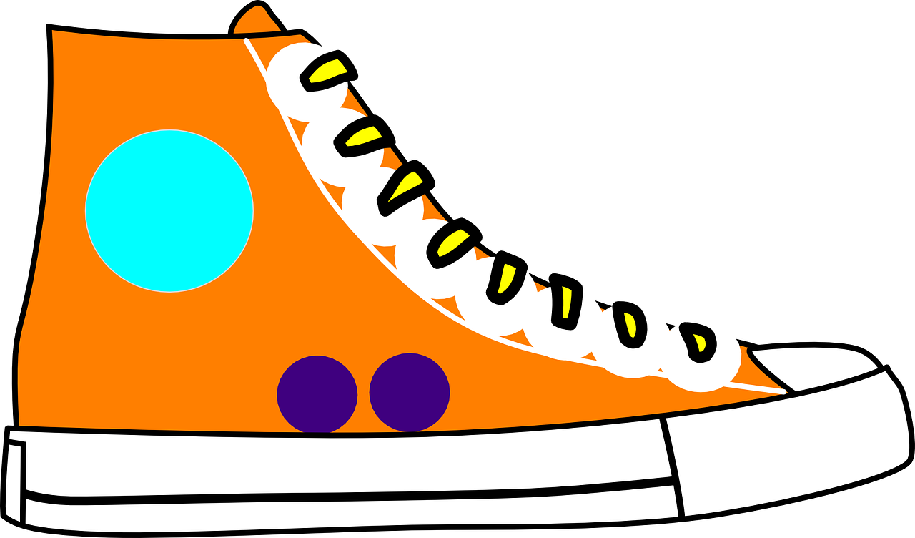
[qu]
prononcer
to explain
quatre
expliquer
question
musique
unique
Notes:
Timing: 2 minutes
Aim: To introduce SSC [qu]
Procedure:
1. Introduce and elicit the pronunciation of the individual SSC [qu] and then the source word again ‘question’ (with gesture, if using). 2. Then present and elicit the pronunciation of the four cluster words.
The cluster words have been chosen for their high-frequency, from a range of word classes, with the SSC (where possible) positioned within a variety of syllables within the words (e.g. initial, 2nd, final etc.). Additionally, we have tried to use words that build cumulatively on previously taught SSCs (see the Phonics Teaching Sequence document) and do not include new SSCs. Where new SSCs are used, they are often consonants which have a similar symbol-sound correspondence in English.
Word frequency: quatre [283] musique [1139] expliquer [252] unique [402] question [144] Source: Londsale, D., & Le Bras, Y. (2009). A Frequency Dictionary of French: Core vocabulary for learners London: Routledge.
3

Slide 4
prononcer
Follow up 1
Prononce les questions.
Remember! Use est-ce que to ask a yes/no question.
Est-ce que tu aimes la musique ?
Quand est-ce que tu joues au foot ?
Add a question word to make an information question.
Où est-ce que tu vas chaque matin ?
Pourquoi est-ce que tu joues au tennis ?
Pour (for) + quoi (what) → for what? This is how to say why in French.
Qu’est-ce que tu fais chaque soir ?
Notes:
Timing: 5 minutes
Aim: to practise oral production of [-qu-] in previously taught and new questions.
Procedure:
Present the and listen to the recap of Est-ce que.
Click to bring up all of the other questions with the [qu] highlighted.
Pupils practise pronunciation.
Click on each question icon to hear the questions pronounced.
Pupils practise in pairs saying a question – the listening partner has to make the appropriate gesture to show their understanding.
4

Slide 5
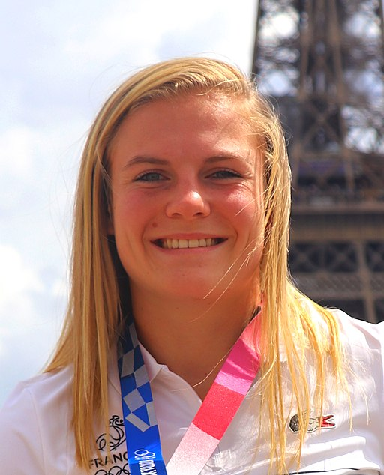
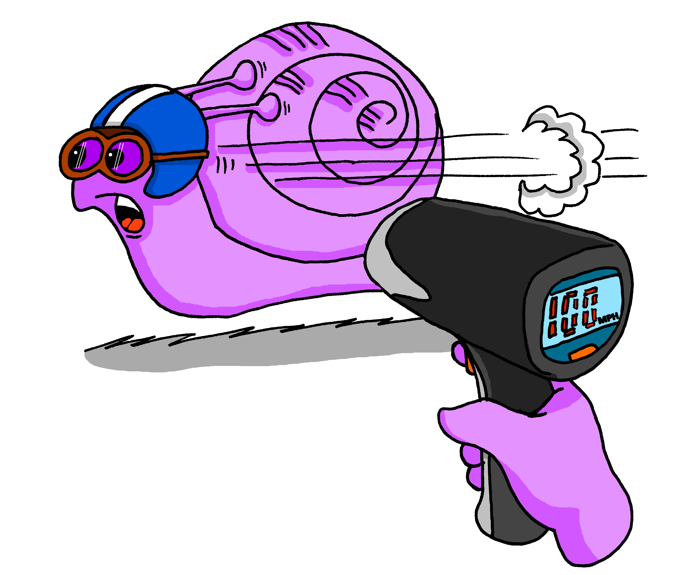
Follow up 2
Écoute bien. C’est quelles images ?
écouter
B, I, D
A | B | C
D | E | F
G | H | I
1
Chloé Jacquet a 20 ans. Elle joue au rugby avec l’équipe de France. En 2020 elle participe
aux Jeux Olympiques.
2
E, F, C
3
G, A, D, H
fast
l’équipe - team
Notes:
Timing: 5 minutes
Aim: to practise aural comprehension of longer sentences with familiar language.
Procedure:
Teacher clarifies pupils need to work out which three images match to each listening passage.
Pupils can be encouraged to make notes in English to help them.
When pupils have suggested their answers, click to reveal.
Read the short text about Chloé Jacquet, a member of the French national Women’s Rugby 7s team. Ensure understanding.
Ask pupils to read the text aloud – pay attention to their pronunciation of the SSC [qu].
Transcript:
1. Est-ce que tu joues au foot ? Non, je joue au rugby. 2. Où est-ce que tu habites ? J’habite à Lyon. 3. Pourquoi est-ce que tu aimes le rugby ? Parce que c’est rapide !
Picture attribution:
Sivolc, CC BY-SA 4.0 via Wikimedia Commons

Slide 6
Follow up 3:
Adèle lit un profil de Chloé Jacquet dans un magazine.
Lis le texte. Pose des questions à la personne qui est Chloé.
lire
Salut ! Je suis Chloé Jacquet. J’ai vingt ans. J’habite à Lyon, en France. J’étudie à l’université et j’aime beaucoup le sport.
J’aime le foot mais j’adore le rugby parce que c’est rapide. Je joue au rugby tous les jours. Je joue aussi avec l’équipe de France.
Par exemple, je regarde un film à la télé ou j’écoute de la musique dans ma chambre. Et toi ? Qu’est-ce que tu fais le weekend ?
parler
Le weekend, je préfère être dehors, quand il fait du soleil. Je fais du vélo avec mes amis parce que c’est sympa. Quand il fait froid, je fais des activités chez moi.
l’équipe - team
Notes:
Timing: 5 minutes
Aim: written comprehension of a range of previously taught language in a longer text; oral production of questions to elicit the information in the text.
Procedure:
Teacher to read the context and ensure this is clear.
Pupils to read the text aloud in pairs.
Then either a pupil or the teacher takes the hotseat, facing away from the text. The other pupils ask questions to try to elicit all of the information from the text.
Optional: click again to bring up 12 possible questions and use them for pupils to respond to, chorally. This can serve as an immediate repetition of the speaking task, but with a different format, and involving all pupils at once.
Questions pupils could ask (and answers from the text): 1. Tu as quel âge ? J’ai vingt ans.
2. Où est-ce que tu habites ? J’habite à Lyon.
3. Qu’est-ce que tu fais à l’université ? J’étudie à l’université.
4. Est-ce que tu aimes le sport ? Oui, j’aime beaucoup le sport.
5. Est-ce que tu aimes le foot ? Oui, j’aime le foot mais je préfère le rugby.
6. Qu’est-ce que tu préfères le foot ou le rugby? J’aime le foot mais je préfère le rugby.
7. Pourquoi est-ce que tu aimes le rugby ? J’aime le rugby parce que c’est rapide !
8. Quand est-ce que tu joues au rugby ? Je joue au rugby tous les jours. 9. Qu’est-ce que tu fais le weekend ? Le weekend je fais du vélo avec mes amis. 10. Qu’est-ce que tu fais quand il fait du soleil ? Je fais du vélo avec mes amis. 11. Pourquoi est-ce que tu fais du vélo ? Je fais du vélo avec mes amis parce que c’est sympa. 12. Qu’est-ce que tu fais quand il fait froid ? Je fais des activités chez moi. Par exemple, je regarde un film ou j’écoute de la musique.
Note: in the audio version, click on the text to hear it in full.

Slide 7
Follow up 4
Parle en français.
le tableau – table
Écris cinq phrases en anglais. Utilise les mots du tableau.
Ton/ta partenaire dit tes phrases en français.
parler
Je/j’ Tu Il Elle | fais fait joue joues joue | un une au à la du de la | dessin gâteau course foot tennis corde piano guitare | avec | mon ton ma ta mes tes | ami amie frère sœur famille parents | quand il fait | chaud froid du soleil
30
S
parce que | c’est | super. genial. intéressant. sympa. fantastique.
0
DÉBUT
Notes:
Timing: 5 minutes Aim: to practise written comprehension and spoken production using vocabulary and grammar from this week to communicate a range of messages about free time activities.
Procedure:
Both pupils write 5 sentences (in English) made up of words with equivalent meanings from the table.
They swap sentences.
Partner A tries to say all B’s sentences in French within 30 seconds (without or without using the support).
Then Partner B tries to say all A’s sentences in French within 30 seconds.
Adaptions: 1. Teachers could give English sentences to pupils (a couple of words at a time) and pupils write them using mini whiteboards.
2. Teachers could ask questions in French for pupils to answer (either chorally, or individually) – e.g., Qu’est-ce que tu fais ? Qu’est-ce que tu joues ? Avec qui ? Quand est-ce que tu fais ça ? Pourquoi est-ce que tu fais ça ?

Slide 8
vocabulaire
Follow up 5a - Écris en anglais : Can you get at least 15 points?
mots
 | seize | onze | trente-deux
 | vingt-quatre | treize | quatorze
 | le sport | le piano | l’instrument
 | jouer | la danse | la guitare
 | elle fait | je fais | quand
 | parce que | tu fais | pourquoi ?
16
11
32
x3
24
13
14
(the) sport
(the) piano
(the) instrument
x2
to play, playing
(the) dance
(the) guitar
she does, makes
I do/make
when
x1
because
you do, make
why?
Notes:
Timing: 5-10 minutes
Aim: to practise written production of vocabulary from this week and two revisited weeks.
Procedure: 1. Give pupils a blank grid. They fill in the English meanings of any of the words they know, trying to reach 15 points in total. 2. Remind pupils that adjectives can refer to male or female persons and they should note this in their translations. E.g. pleased (f), short (m).
Note: The most recently learnt and practised words are pink, words from revisit 1 are green and those from revisit 2 are blue, thus more points are awarded for them, to recognise that memories fade and more effort (heavy lifting!) is needed to retrieve them.
8

Slide 9
vocabulaire
Follow up 5b - Écris en français : Can you get at least 15 points?
mots
 | 18 | 15 | 17
 | 12 | 30 | 21
 | (the) sport | to play, playing | (the) guitar
 | (the) dance | (the) instrument | (the) piano
 | when | she does, makes | I do, make
 | you do, make | because | why
dix-huit
quinze
dix-sept
x3
douze
trente
vingt-et-un
le sport
jouer
la guitare
x2
la danse
l’instrument
le piano
quand
elle fait
je fais
x1
tu fais
parce que
pourquoi ?
Notes:
Timing: 5-10 minutes
Aim: to practise written comprehension of vocabulary from this week and previous weeks.
Procedure: Give pupils a blank grid. They fill in the French meanings of any of the words they know, trying to reach 15 points in total.
Note: The most recently learnt and practised words are pink, words from the previous week are green and those from earlier are blue, thus more points are awarded for them, to recognise that memories fade and more effort (heavy lifting!) is needed to retrieve them.
9

Slide 10
vocabulaire
Follow up 5a - Écris en anglais : Can you get at least 15 points?
mots
 | seize | onze | trente-deux
 | vingt-quatre | treize | quatorze
 | le sport | le piano | l’instrument
 | jouer | la danse | la guitare
 | elle fait | je fais | quand
 | parce que | tu fais | pourquoi ?
x3
x2
x1
Notes:
HANDOUT
10

Slide 11
vocabulaire
Follow up 5b - Écris en français : Can you get at least 15 points?
mots
 | 18 | 15 | 17
 | 12 | 30 | 21
 | (the) sport | to play, playing | (the) guitar
 | (the) dance | (the) instrument | (the) piano
 | when | she does, makes | I do, make
 | you do, make | because | why
x3
x2
x1
Notes:
HANDOUT
11

