Slide 1
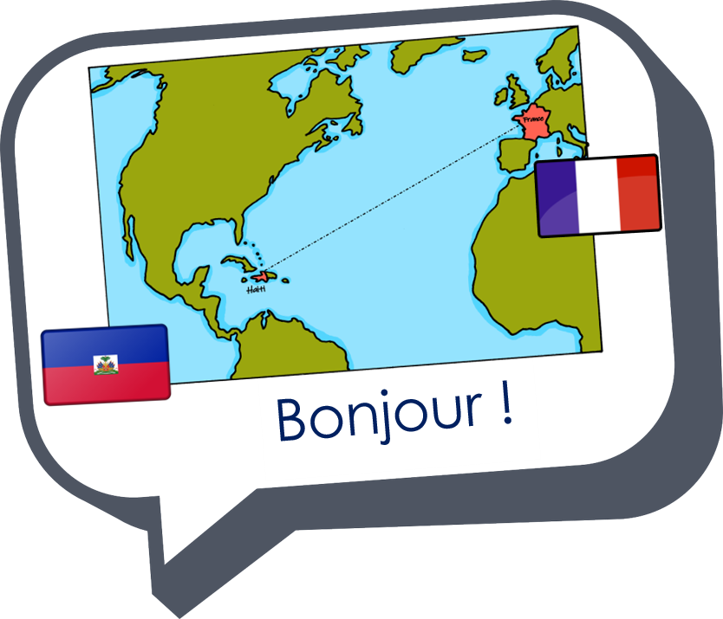

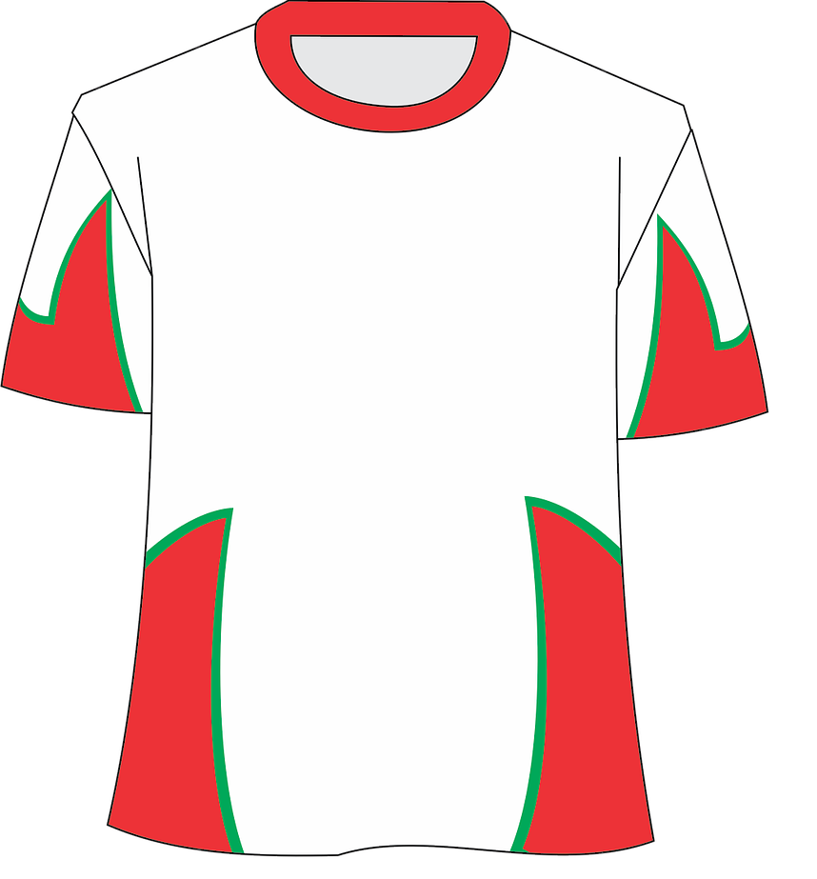
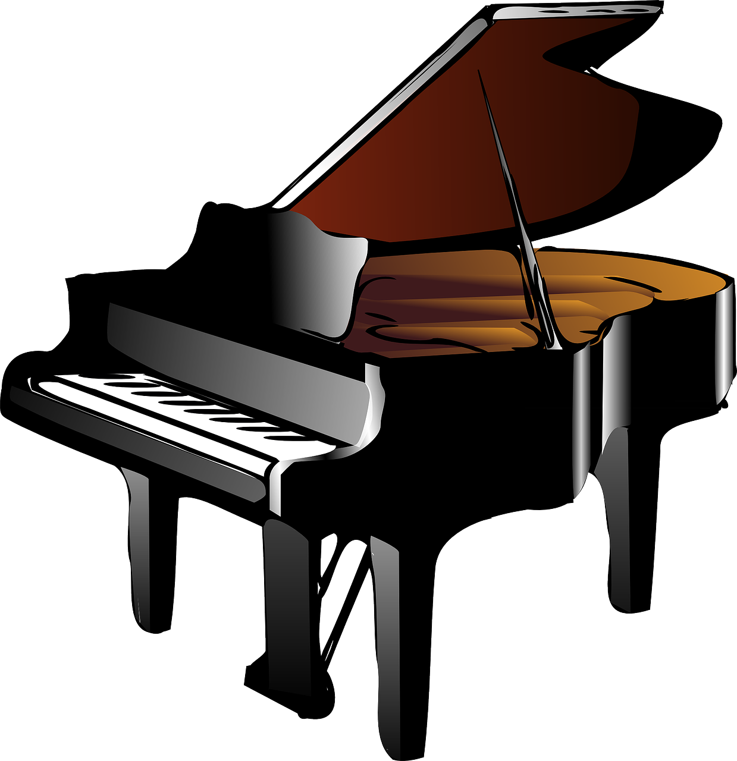


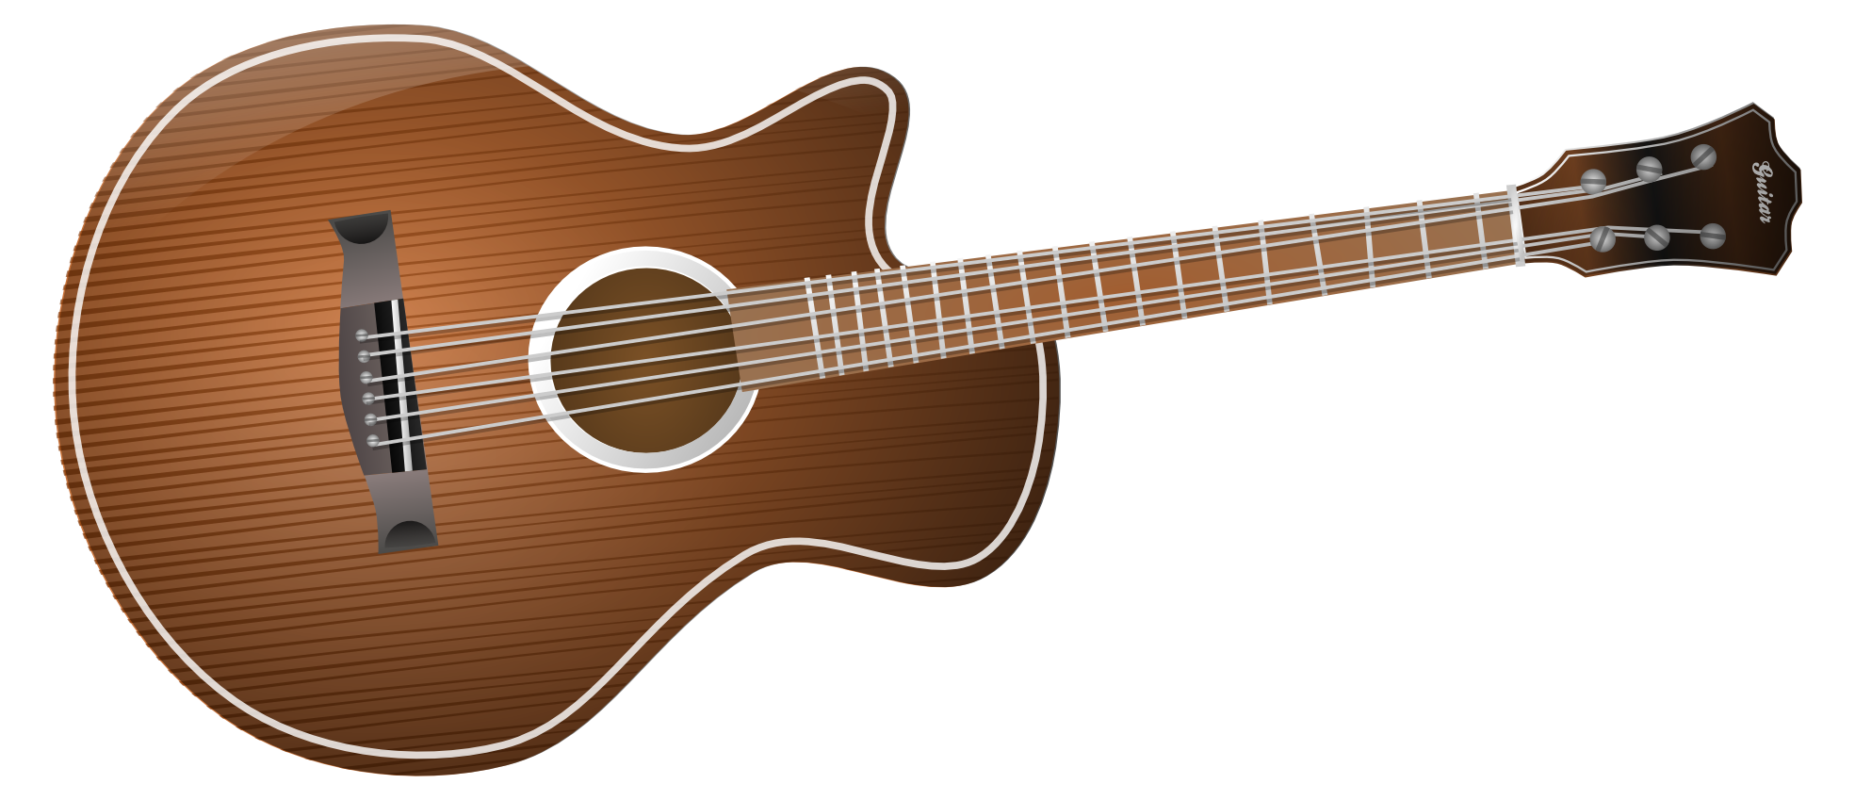
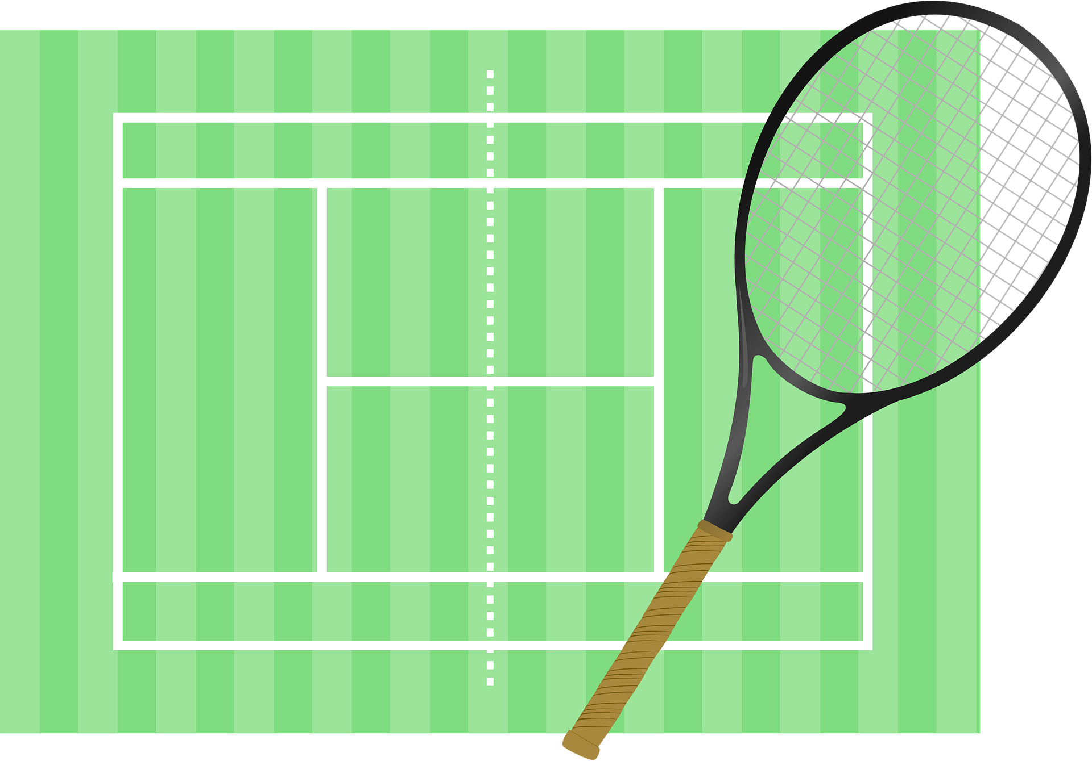
Saying what I and others do
jouer à with sports, jouer de with instruments
mon, ma, mes
SSC [-s-]
vert
Notes:
Artwork by Steve Clarke. Pronoun pictures from NCELP (www.ncelp.org). All additional pictures selected from Pixabay and are available under a Creative Commons license, no
attribution required.
Phonics: Revisit SSC [-s-] maison [325] chose [125] magasin [1736] église [1782] cuisine [2618]
Vocabulary: ami [467] corde [3784] famille [172] football [2602] parent [546] tennis [3687] mes [60] tes [330]
Revisit 1: faire [25] je fais il/elle fait activité [452] course à pied [n/a] chanson [2142] dessin [2624] film [848] gâteau [4845] matin [442] soir [397] spectacle [1687] ville
[360] visite [1072] weekend [2475] demain [871]
Revisit 2: chanter [1820] chercher [336] créer [332] danser [2934] donner [46] écouter [429] manger [1338] organiser [791] préparer [368] porter [105] regarder [425] trouver
[83] utiliser [345]
Londsale, D., & Le Bras, Y. (2009). A Frequency Dictionary of French: Core vocabulary for learners London: Routledge.
The frequency rankings for words that occur in this PowerPoint which have been previously introduced in these resources are given in the SOW and in the resources that first
introduced and formally re-visited those words.
For any other words that occur incidentally in this PowerPoint, frequency rankings will be provided in the notes field wherever possible.
1

Slide 2


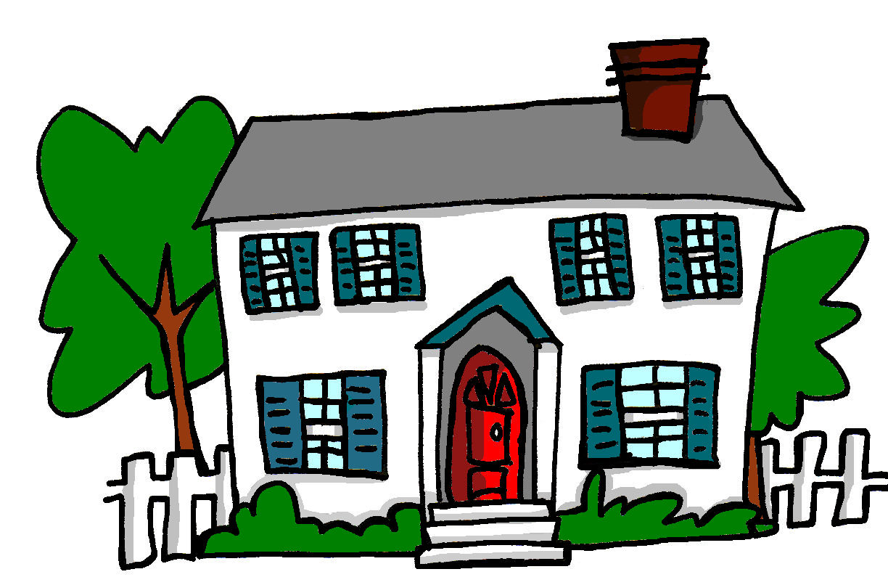

[-s-]
prononcer
maison
Notes:
Timing: 1 minute
Aim: To introduce SSC [-s-]
Procedure:
1. Present the letter(s) and say the [-s-] sound first, on its own. Students repeat it with you.
2. Bring up the word ”maison” on its own, say it, students repeat it, so that they have the opportunity to focus all of their attention on the connection between the written word and its sound.
3. A possible gesture for this would be to trace the outline of a house in the air with two fingers (see BSL video, link below).
4. Roll back the animations and work through 1-3 again, but this time, dropping your voice completely to listen carefully to the students saying the [-s- between vowels] sound, pronouncing ”maison” and, if using, doing the gesture.
Gesture: https://www.signbsl.com/sign/house
British Sign language for house traces the outline of a house in the air with two fingers, starting together at the top and drawing outwards and downwards.
Word frequency (1 is the most frequent word in French):
maison [325]
Source: Londsale, D., & Le Bras, Y. (2009). A Frequency Dictionary of French: Core vocabulary for learners London: Routledge.
2

Slide 3

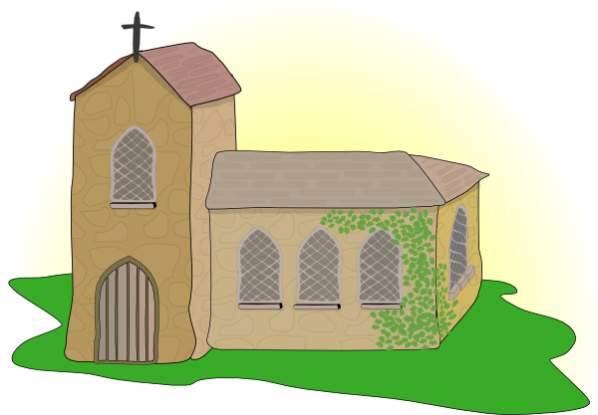

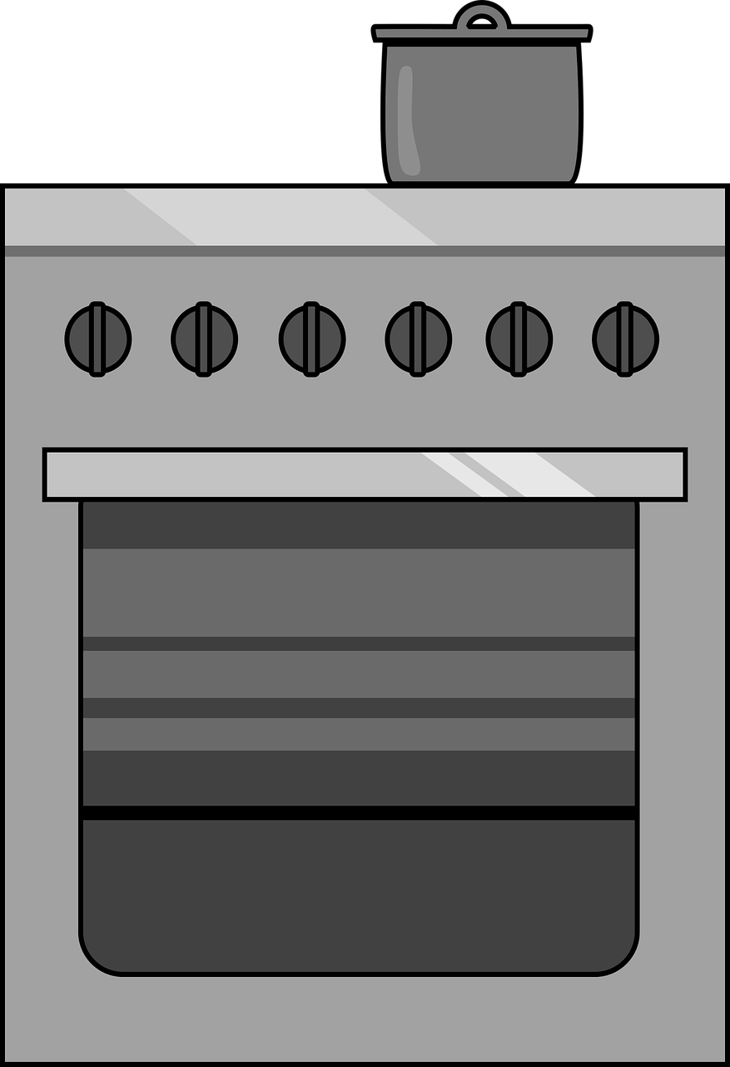
[-s-]
prononcer
magasin
église
maison
[thing]
chose
cuisine
Notes:
Timing: 2 minutes
Aim: To introduce SSC [-s-]
Procedure:
Introduce and elicit the pronunciation of the individual SSC [-s-] and then the source word again ‘maison’ (with gesture, if using).
Then present and elicit the pronunciation of the five cluster words.
The cluster words have been chosen for their high-frequency, from a range of word classes, with the SSC (where possible) positioned within a variety of syllables within the words (e.g. initial, 2nd, final etc.). Additionally, we have tried to use words that build cumulatively on previously taught SSCs (see the Phonics Teaching Sequence document) and do not include new SSCs. Where new SSCs are used, they are often consonants which have a similar symbol-sound correspondence in English.
Word frequency:
maison [325] chose [125] magasin [1736] église [1782] cuisine [2618]
Source: Londsale, D., & Le Bras, Y. (2009). A Frequency Dictionary of French: Core vocabulary for learners London: Routledge.
3

Slide 4

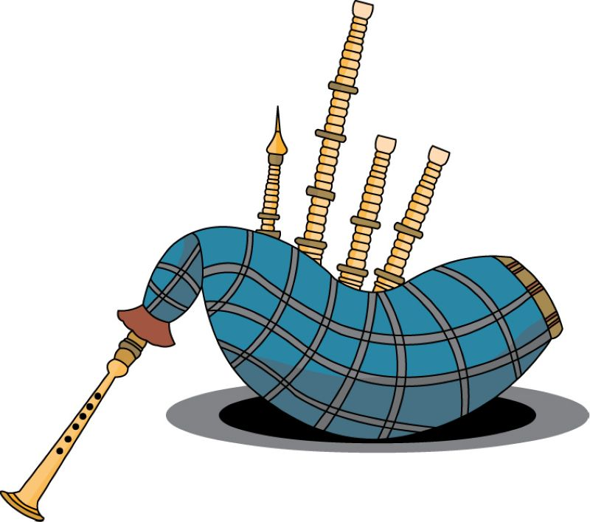
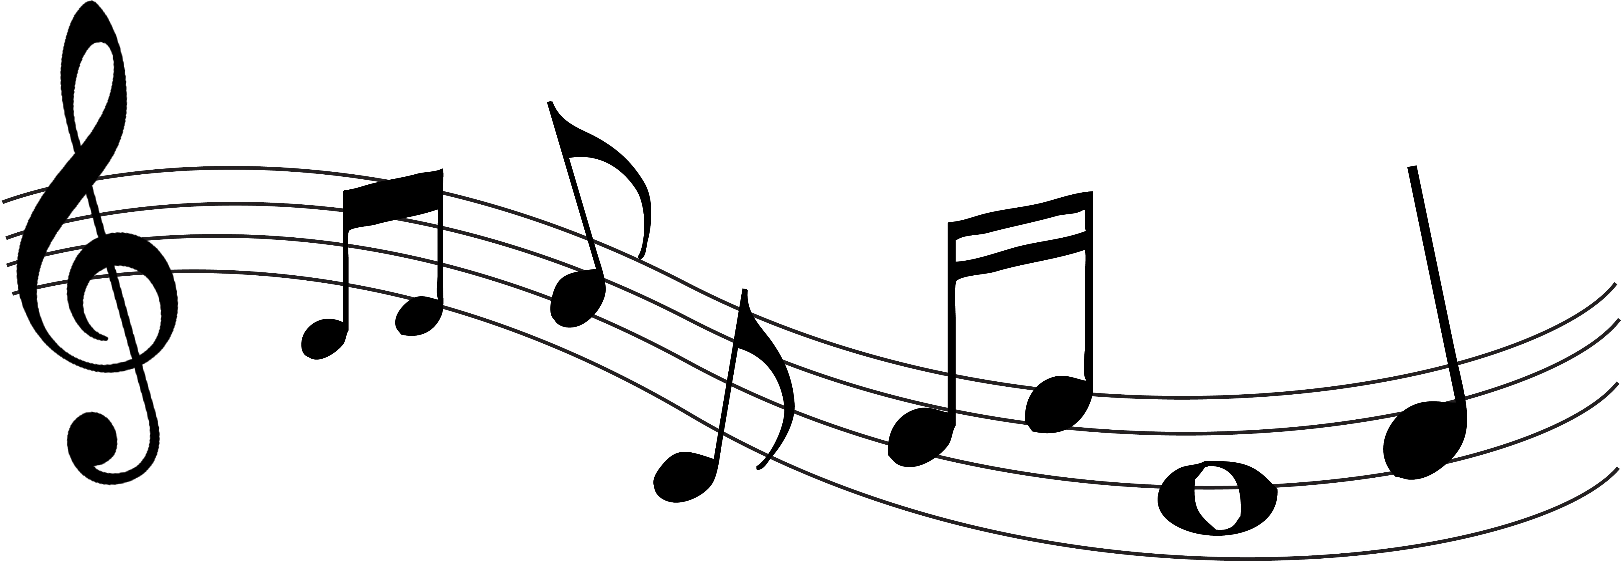

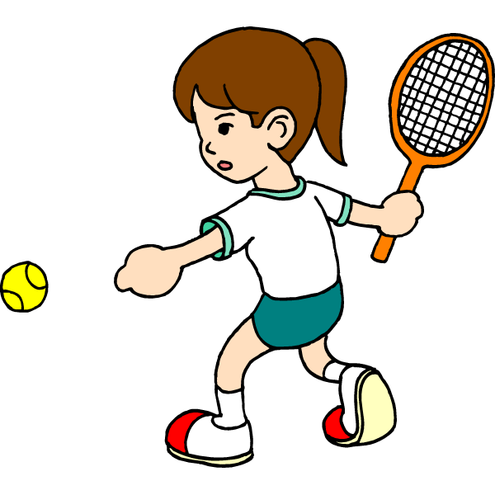




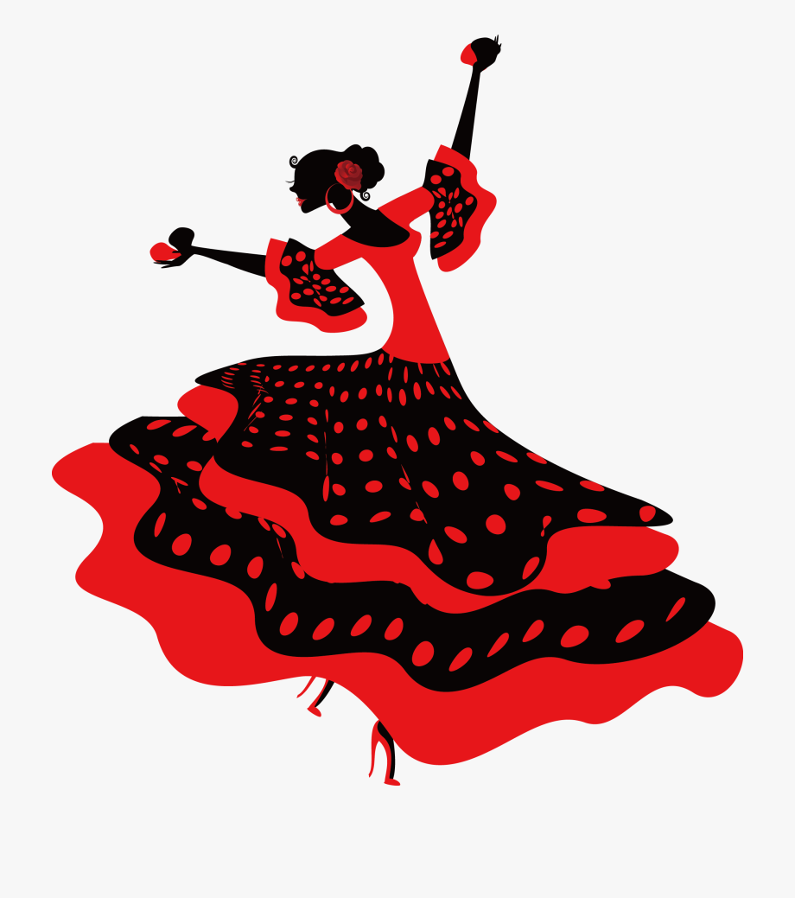
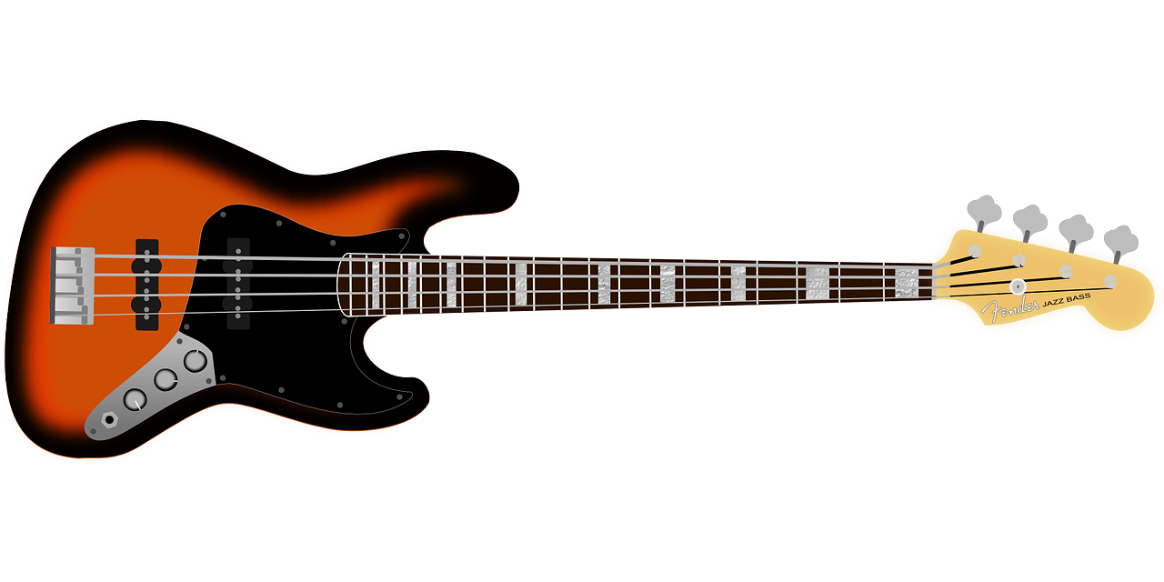
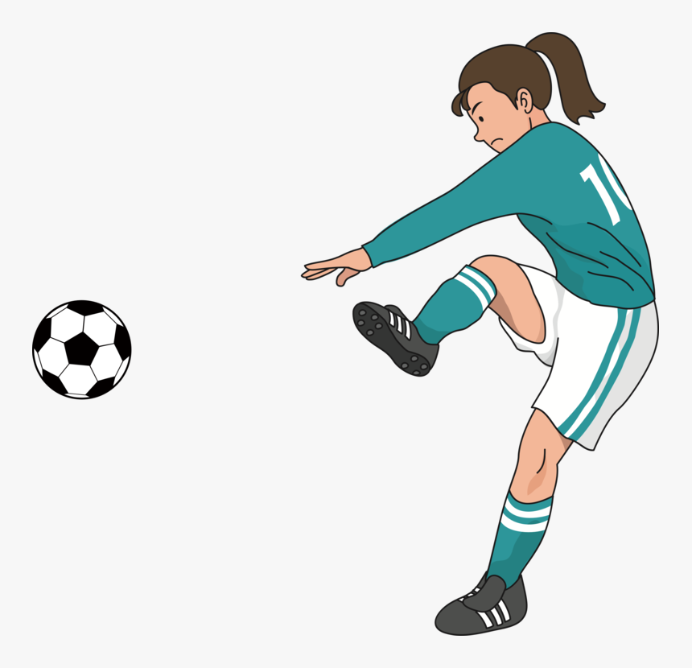
prononcer
Des instruments et des sports
Écoute. C’est [s-/ss] ou [-s-] ?
Puis, prononce les mots.
[s-/ss] [-s-]
[s-/ss] [-s-]
la musique
la joueuse de tennis
la gymnastique
la basse
la cornemuse
le basketball
les castagnettes
la footballeuse
1
5
2
6
7
3
4
8
Notes:
Timing: 5 minutes
Aim: to practise aural distinction between words with [s-/ss] and [-s-] sounds.
Procedure:
Read the instruction.
Do the first one with pupils. Remind them that [-s-] between two vowels sounds like ‘z’.
Elicit responses chorally and click to reveal the answers.
Transcript:
la musique
la joueuse de tennis
la gymnastique
la basse
la cornemuse
le basketball
les castagnettes
la footballeuse
Frequency of unknown words and cognates:
basketball [>5000] basse [>5000] castagnette [>5000] cornemuse [>5000] footballeur [>5000] gymnastique [>5000] joueur [2003] musique [1139]
Source: Lonsdale, D., & Le Bras, Y. (2009). A Frequency Dictionary of French: Core vocabulary for learners London: Routledge.

Slide 5






jouer de and jouer à
⚠ We just use ‘the’ in English.
Use jouer + de to say what instrument you play:
⚠ Remember: de + le → du
Je joue du piano.
I play the piano.
Elle joue de la guitare.
She plays the guitar.
Use jouer + à to say what sport you play:
⚠ In English we don’t use any article here.
⚠ Remember: à + le → au
Je joue au football.
I play football.
Il joue à la corde.
He plays skipping.
Notes:
Timing: 2 minutes
Aim: to recap jouer de to say you play an instrument and jouer à to say you play a sport.
Procedure:
Click through the animations to present the information.
Elicit English translations for the French examples provided.

Slide 6
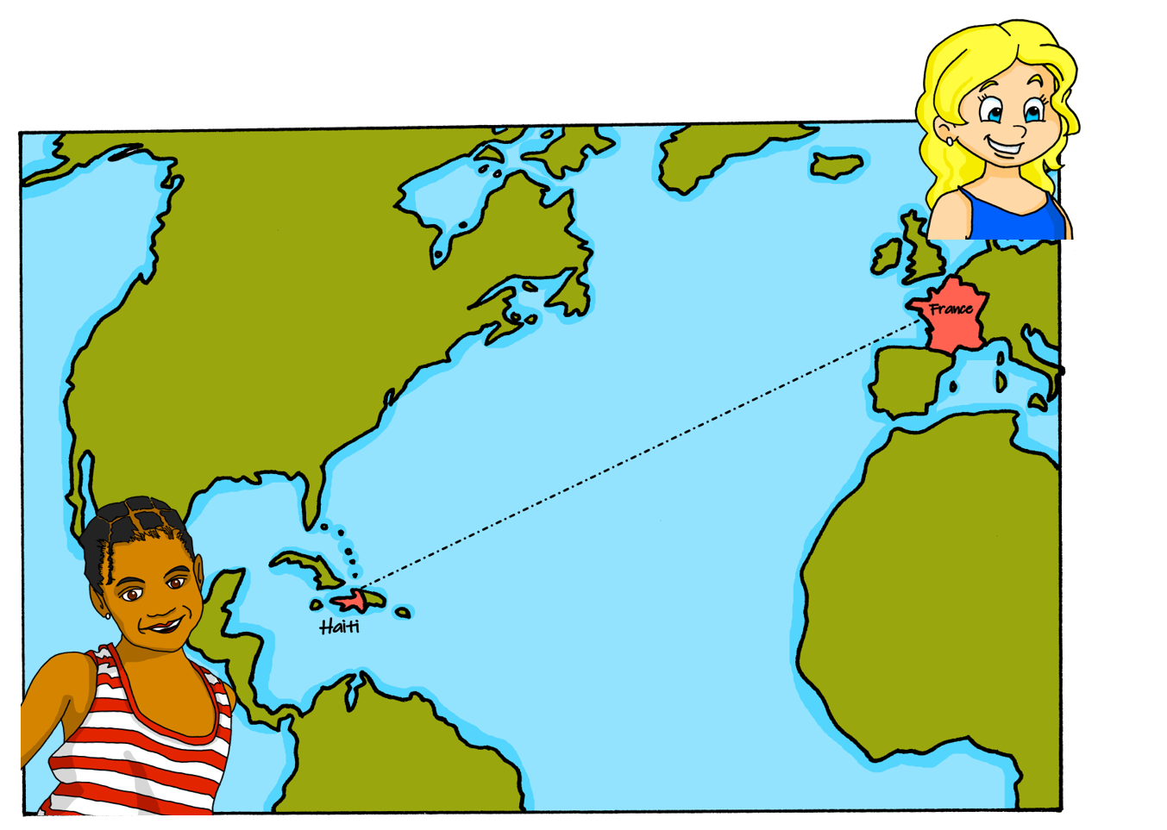

lire
Clémentine écrit des messages à Adèle.
.
Lis. Il y a un problème ! C’est un sport ou un instrument ?
1
4
football
Jean-Michel joue du ❗▲▼❗
piano
Je joue au ❗▲▼❗
piano
rugby
2
5
corde
pétanque*
Maman joue de la ❗▲▼❗
Mon amie joue de la❗▲▼❗
guitare
clarinette
3
6
saxophone
golf
Papa joue au ❗▲▼❗
Adèle, tu joues au ❗▲▼❗ ?
tennis
piano
*la pétanque is a French sport like bowls.
Notes:
Timing: 5 minutes
Aim: to practise written comprehension of jouer à and jouer de, associating each with a sport or instrument, respectively.
Procedure:
Pupils write 1-6 and the correct French option from the two options given.
Click to reveal answers.
Elicit meanings of the full sentences in English.
Click the numbers to hear the full French phrases, if desired.
6

Slide 7




écouter
Sauter* à la corde
Jouer à la corde est très populaire à l’école primaire en France. Mais ce n’est pas seulement* une activité pour les enfants.
C’est une forme d’exercice cardio et c’est donc* un sport idéal pour rester en bonne santé*.
lire
Voici une chanson française pour sauter à la corde.
Mardi gras est mort
Il faut l'enterrer
Sa femme qui pleure
Il faut la consoler
En une, en deux, en trois,
Saute Mardi gras.
Mardi gras is dead,
We must bury him.
His wife is crying,
We must comfort her.
In one, in two, in three,
Jump, Mardi gras!
Écoute et chante.
*sauter – to jump
seulement – only
donc – therefore
la santé - health
Mama Lisa’s World
Notes:
Timing: 6 minutes
Aim: to introduce pupils to a French skipping song; to practise the comprehension of previously taught language in a text about skipping and to begin to develop pupils’ lexical inferencing ability, guiding
them to use the words they know and some cognates to infer plausible meanings of words they don’t know.
Procedure:
Read the text aloud, so pupils can follow. (Click on the text to hear the audio, if preferred).
Elicit the meaning of the text from pupils, referring them to the glossed vocabulary, if needed.
Introduce the skipping song.
Play the audio and encourage pupils to sing along. Note: the English translation of the song is provided as there are many unknown words in it.
Frequency of unknown words and cognates:
donc [145] santé [641] sauter [2114] seulement [130] mort [276] falloir [68] enterrer [2870] femme [154] pleurer [2253] consoler [>5000]
Song source: https://www.mamalisa.com/?t=es&p=2440
YouTube animated version with frog singing: https://www.youtube.com/watch?v=9HYZ6UPJ83c
7

Slide 8
mon, ma, mes | ton, ta, tes
Remember we use mon to mean my for masculine nouns and ma for feminine:
To mean ‘my’ with plural nouns, use mes.
my brothers
mes frères
my brother
my sisters
mon frère
mes sœurs
my sister
ma sœur
Use tes to mean ‘your’ with plural nouns:
Remember we also use mon (my) or ton (your) for nouns beginning with a vowel or silent ‘h’:
your female friends
tes amis
your male friend
your female friend
ton ami
your male friends
tes amies
ton amie
⚠ Remember liaison here, too.
⚠ Remember liaison, here.
mes parents
my hotel
my female cousins
mon hôtel
my parents
mes cousines
my history, story
mon histoire
Notes:
Timing: 2 minutes
Aim: to recap mon/ma, ton/ta and introduce mes, tes.
Procedure:
Click through the animations.
Elicit English from pupils following the ?.
Note: the liaison is also highlighted, and will be practised in the slides that follow.

Slide 9
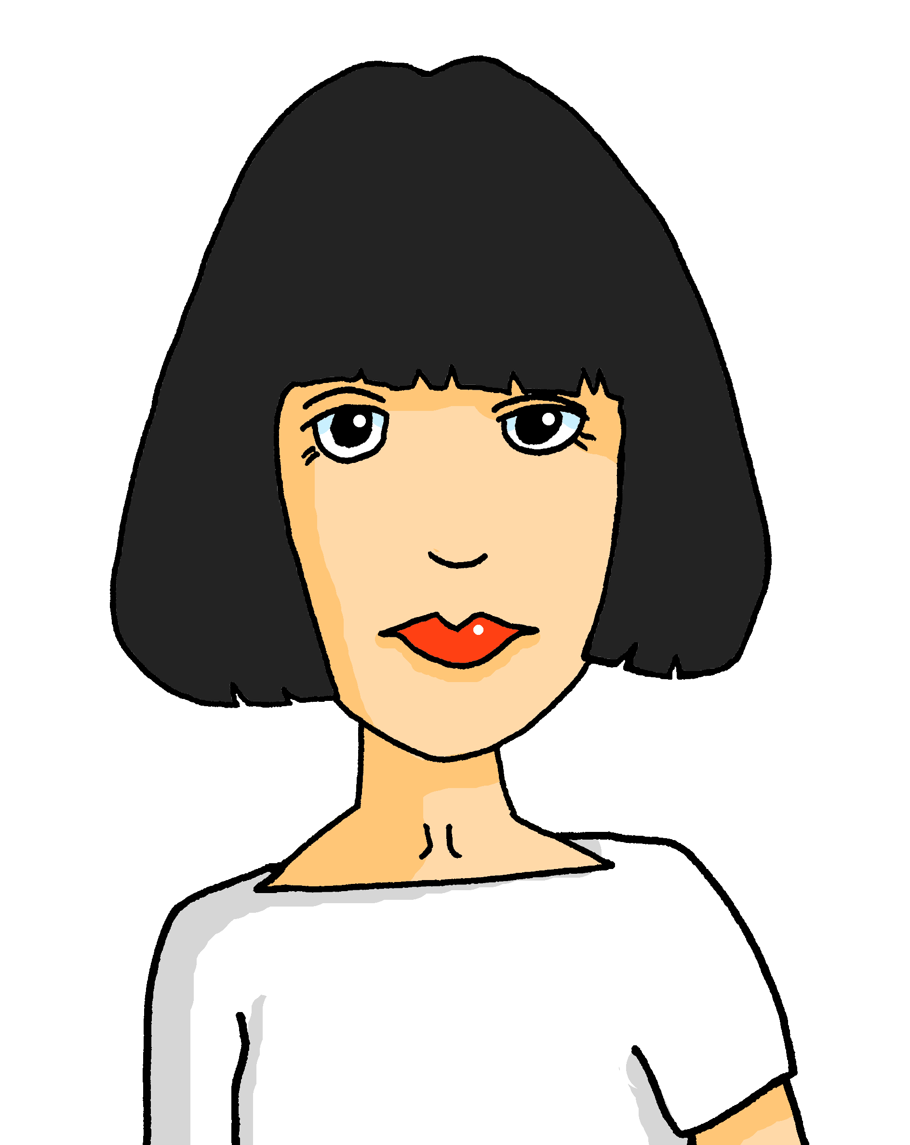
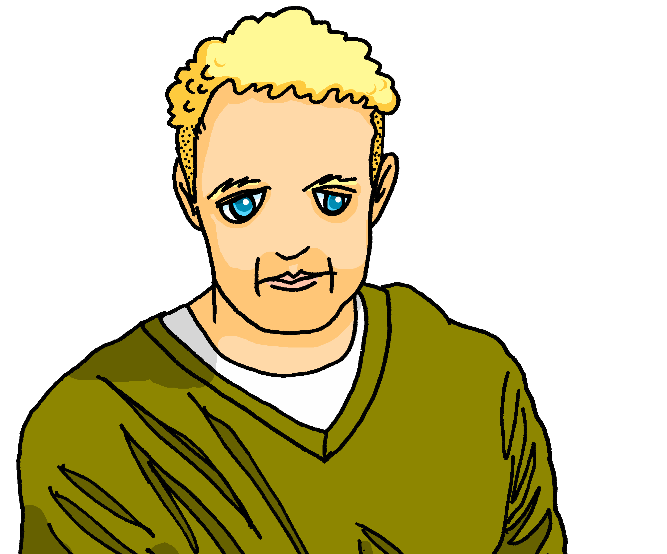
Prononce et vérifie.* Qui parle à qui ?
*vérifier – to check
prononcer
Ils sont tes parents.
They are your parents.
1
Notes:
[1/10]
Timing: 8 minutes (10 slides)
Aim: to practise pronunciation with mon/ton, mes/tes (+ liaison) and to practise comprehension of previously taught language.
Procedure:
Click to bring up the sentence.
Pupils read the sentence aloud, chorally.
Click to listen and check.
Repeat pronunciation, as needed.
Elicit the English meaning of the sentence.
Click to reveal the translation.
Repeat steps 1-6 for the remaining 9 slides.
Note: An additional step is for pupils to work out who is talking to whom? (Jean-Michel is talking to Pierre) – this first sentence makes it clear it is Adèle or Pierre, but we need more sentences to work out which of them it is.)
Transcript:
Ils sont tes parents.

Slide 10

Prononce et vérifie.* Qui parle à qui ?
*vérifier – to check
prononcer
C’est ma tortue.
This is my tortoise.
2
Notes:
[2/10]
Transcript:
C’est ma tortue.

Slide 11

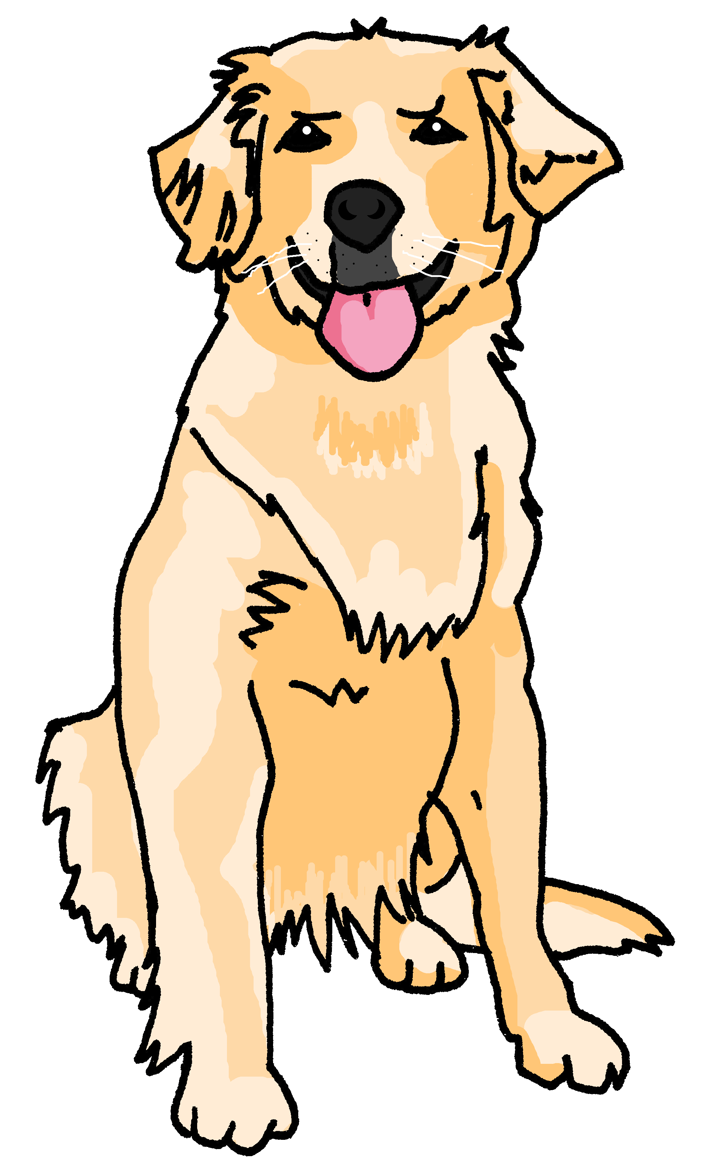
Prononce et vérifie.* Qui parle à qui ?
*vérifier – to check
prononcer
C’est ton animal.
C’est ton animal.
This is your pet.
3
Notes:
[3/10]
Transcript:
C’est ton animal.

Slide 12

Prononce et vérifie.* Qui parle à qui ?
*vérifier – to check
prononcer
C’est ton école.
C’est ton école.
This is your school.
4
Notes:
[4/10]
Transcript:
C’est ton école.

Slide 13
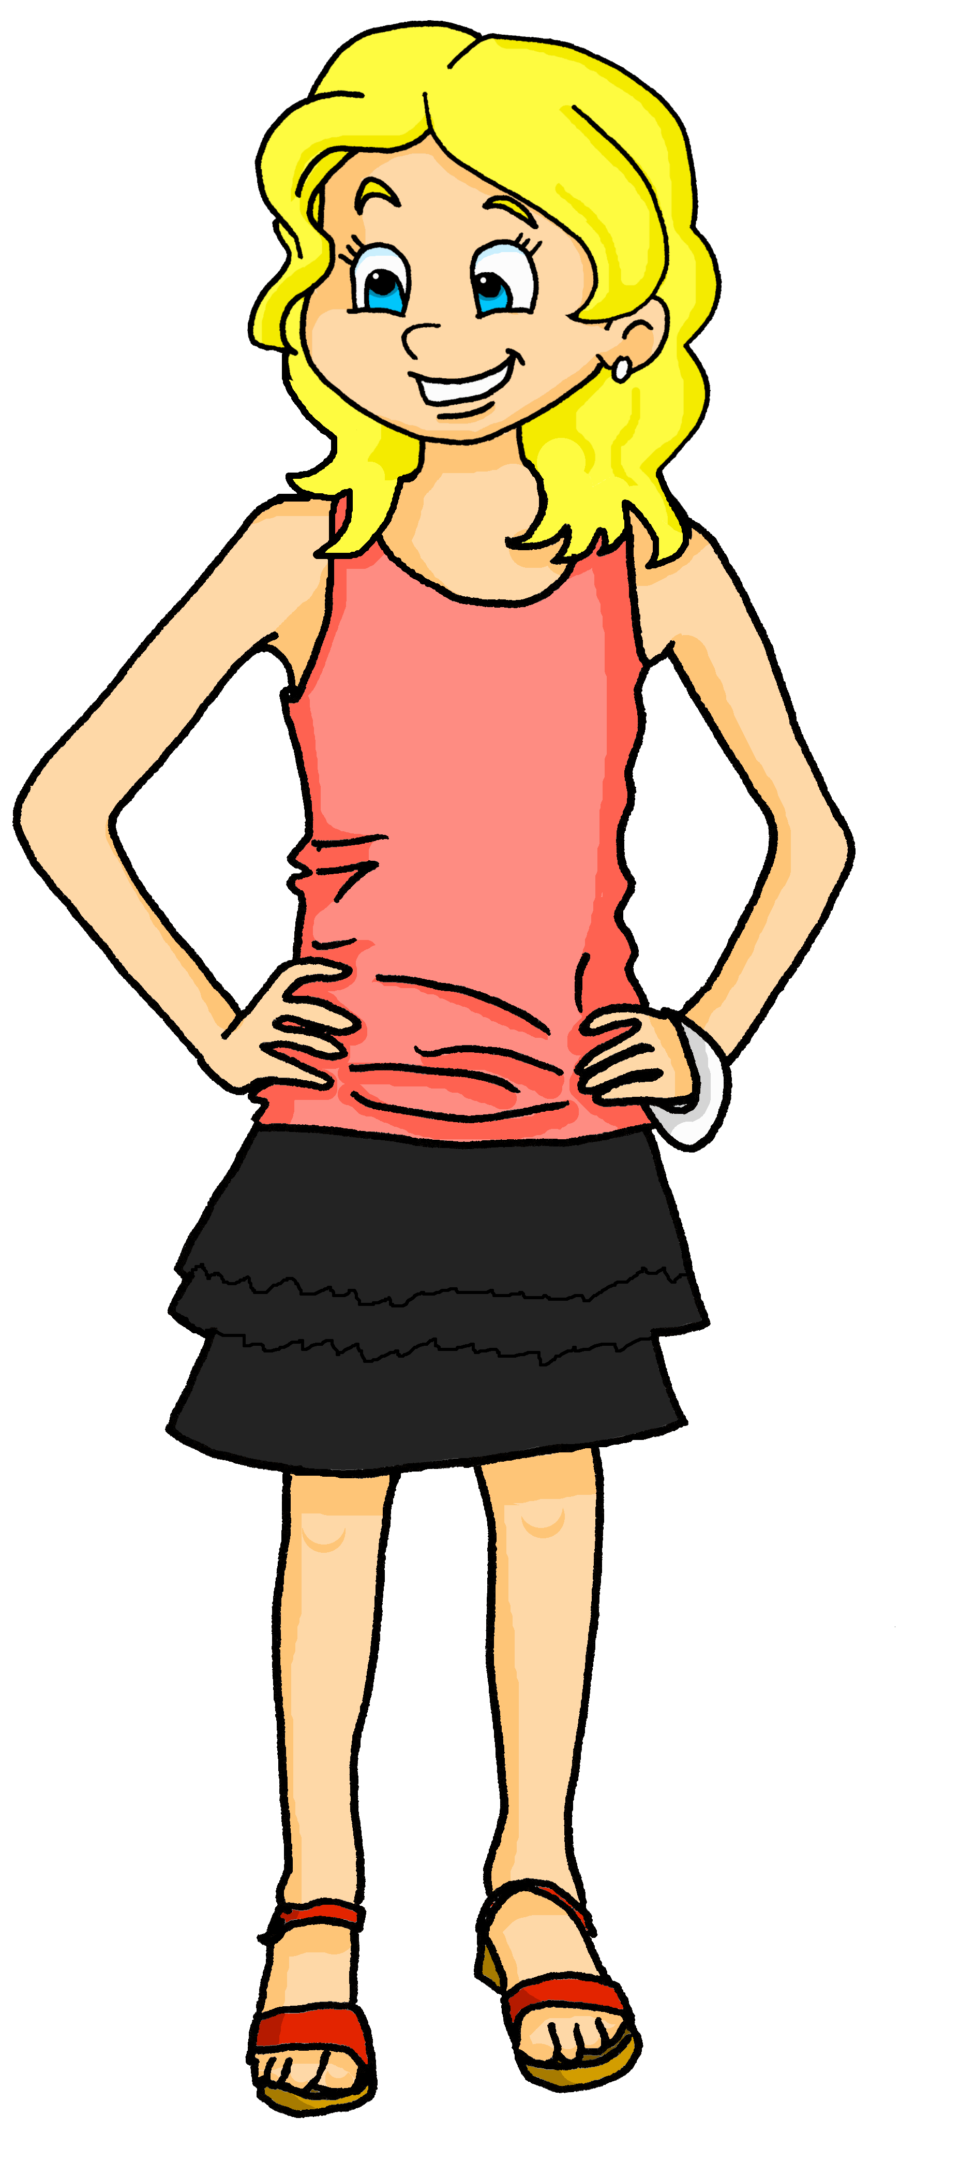
Prononce et vérifie.* Qui parle à qui ?
*vérifier – to check
prononcer
Elle est ma cousine.
She is my cousin.
5
Notes:
[5/10]
Transcript:
Elle est ma cousine.

Slide 14
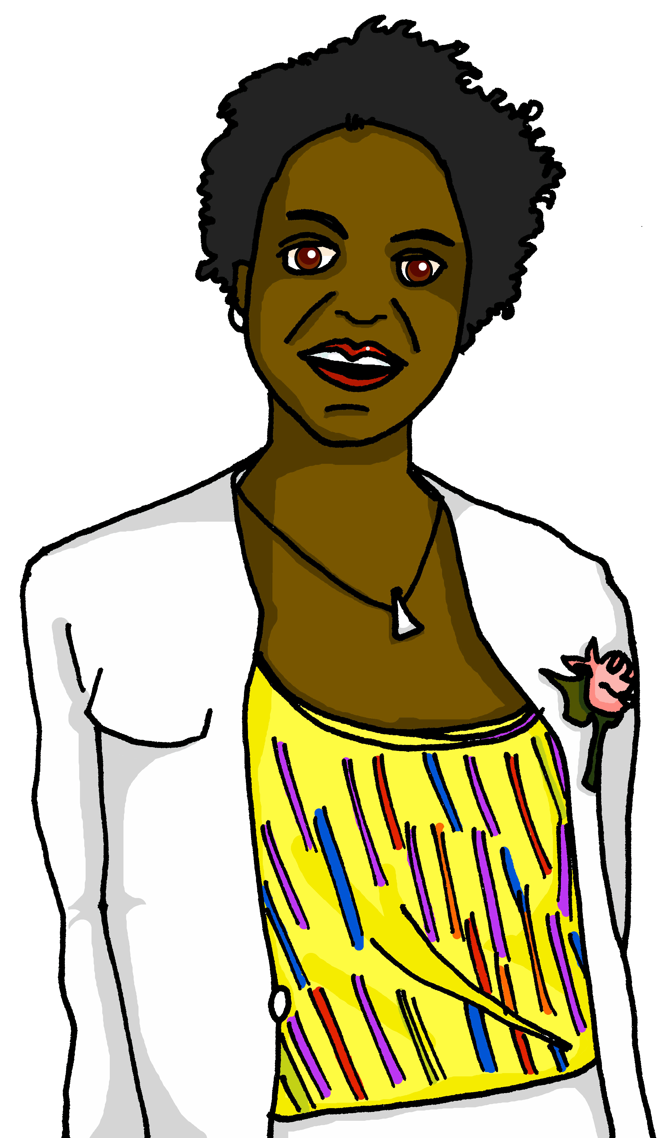
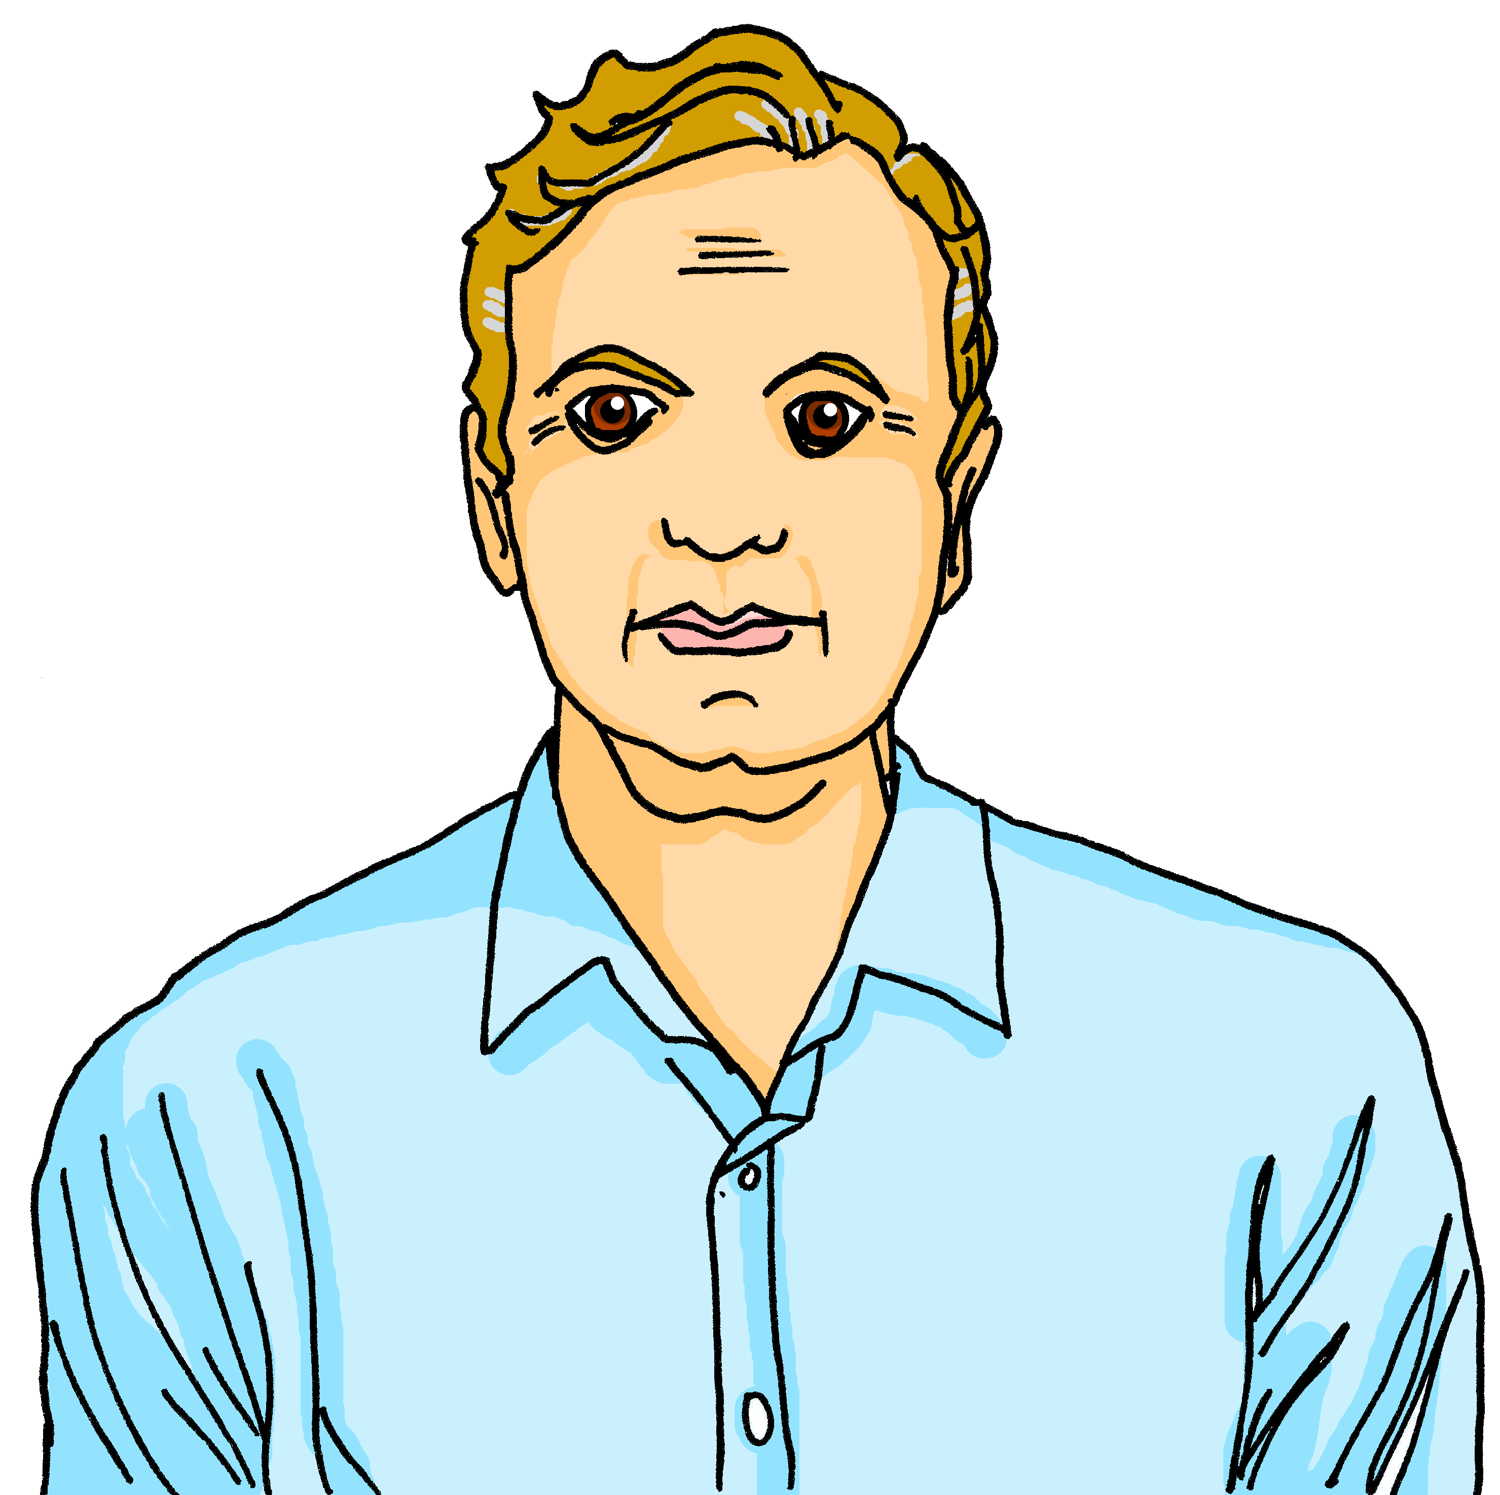
Prononce et vérifie.* Qui parle à qui ?
*vérifier – to check
prononcer
Ils sont mes parents.
They are my parents.
6
Notes:
[6/10]
Transcript:
Ils sont mes parents.

Slide 15
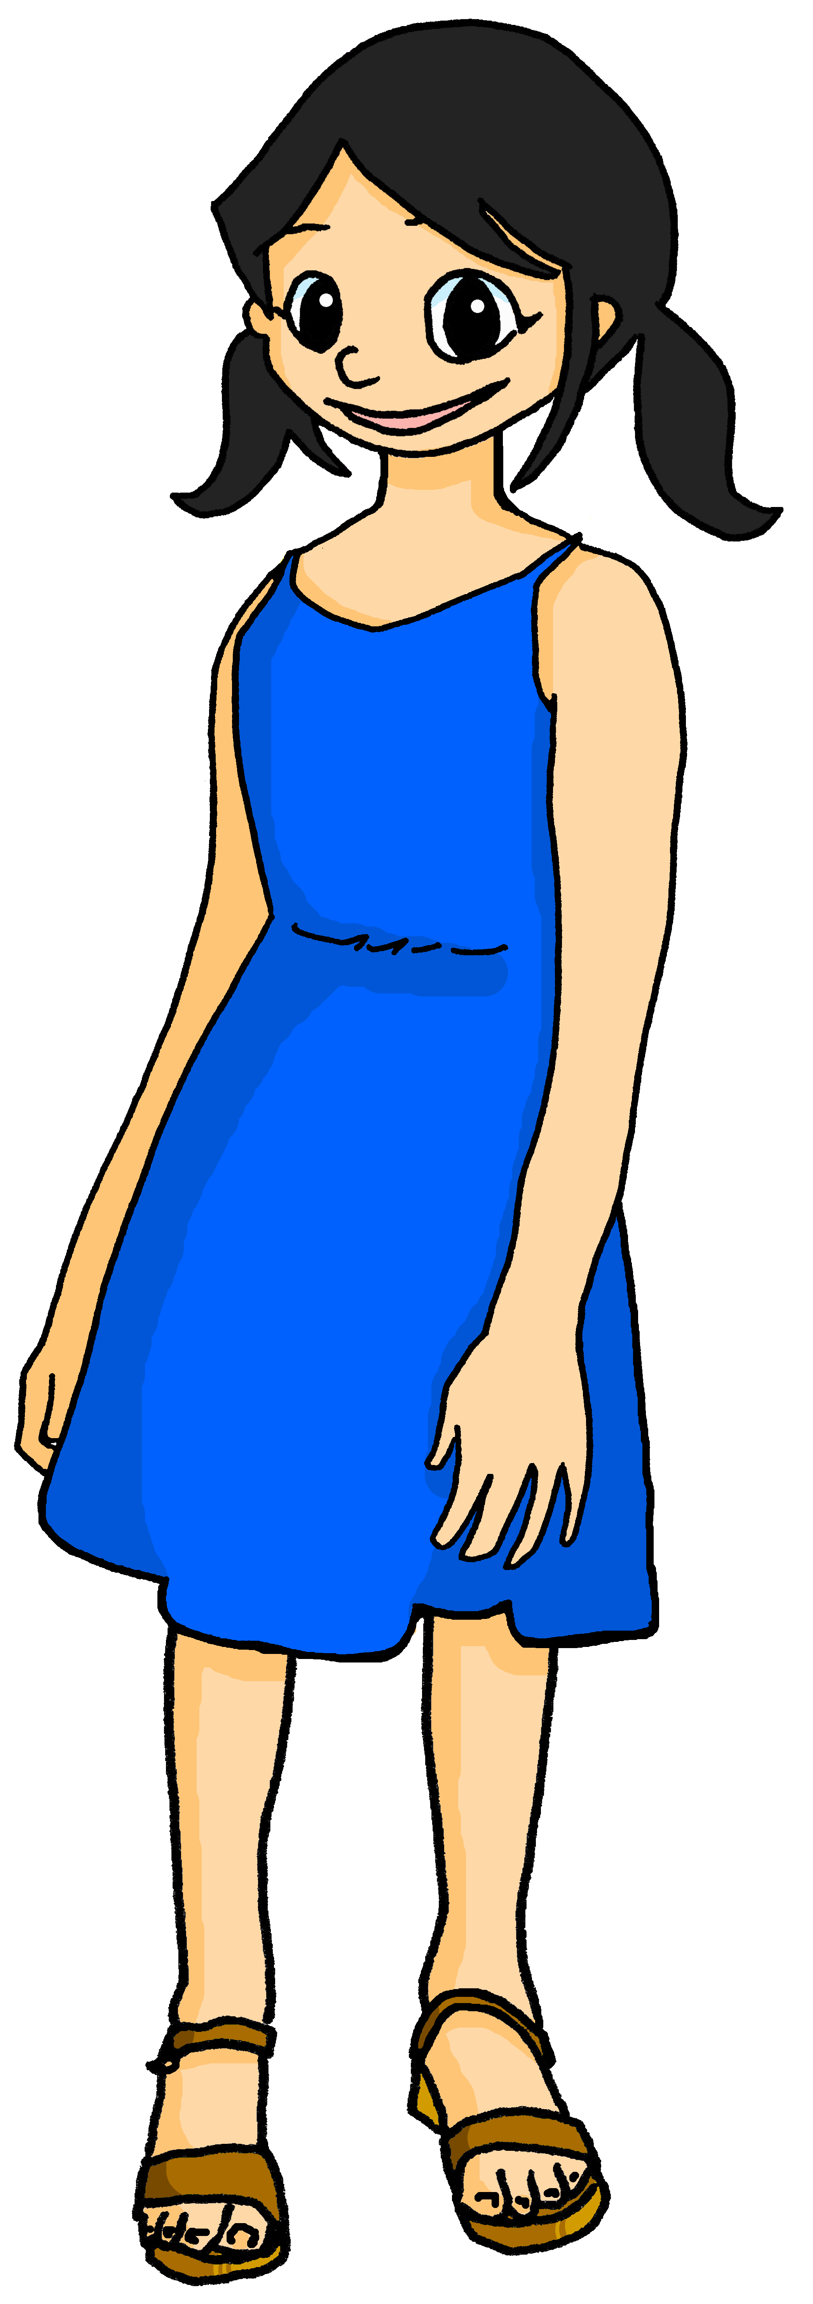
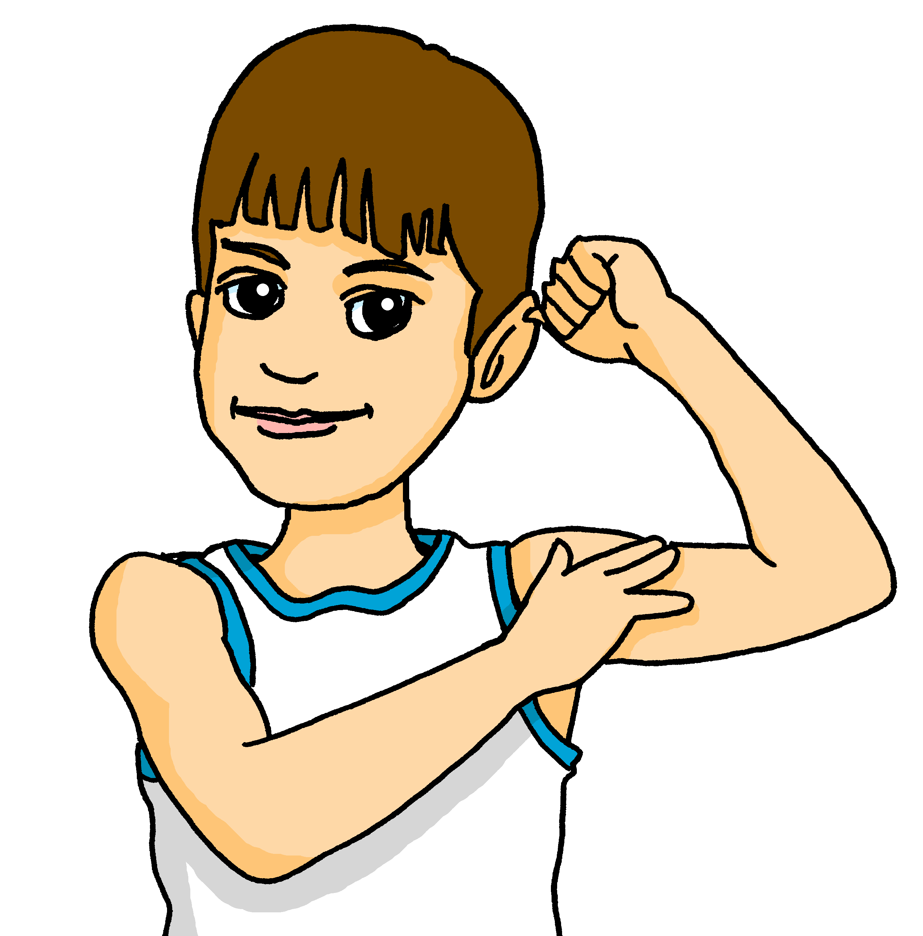
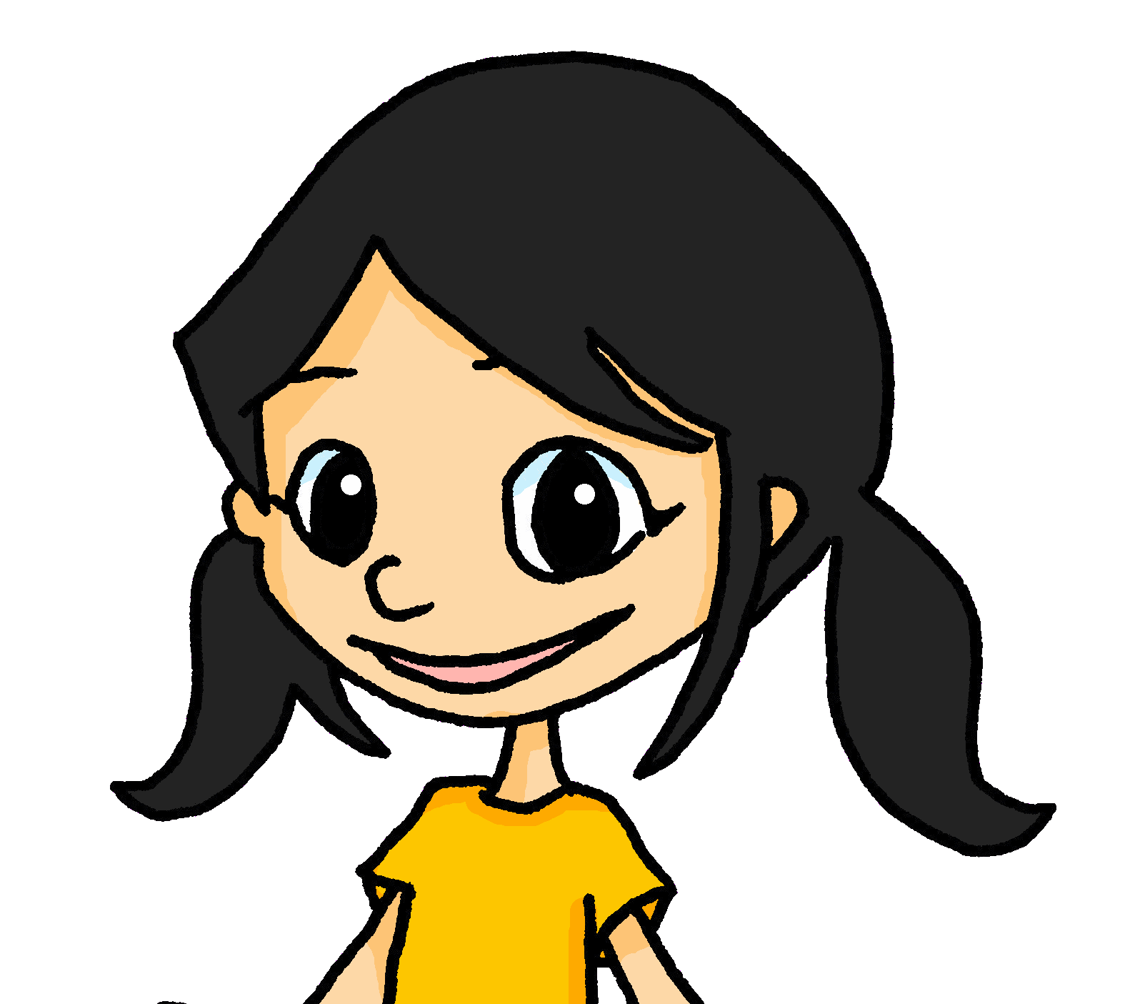
Prononce et vérifie.* Qui parle à qui ?
*vérifier – to check
prononcer
Ils sont tes amis.
Ils sont tes amis.
They are your friends.
7
Notes:
[7/10]
Transcript:
Ils sont mes amis.

Slide 16
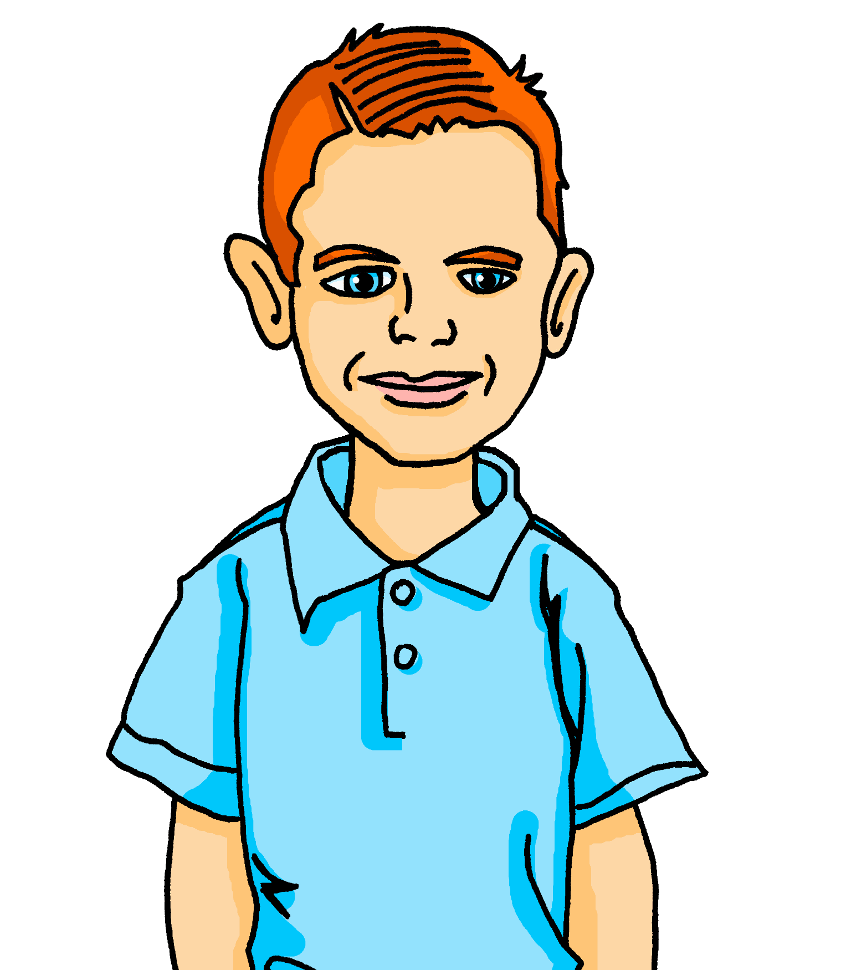
Prononce et vérifie.* Qui parle à qui ?
*vérifier – to check
prononcer
Il est ton ami anglais.
Il est ton ami anglais.
He is your English (male) friend.
8
Notes:
[8/10]
Transcript:
Il est ton ami anglais.

Slide 17
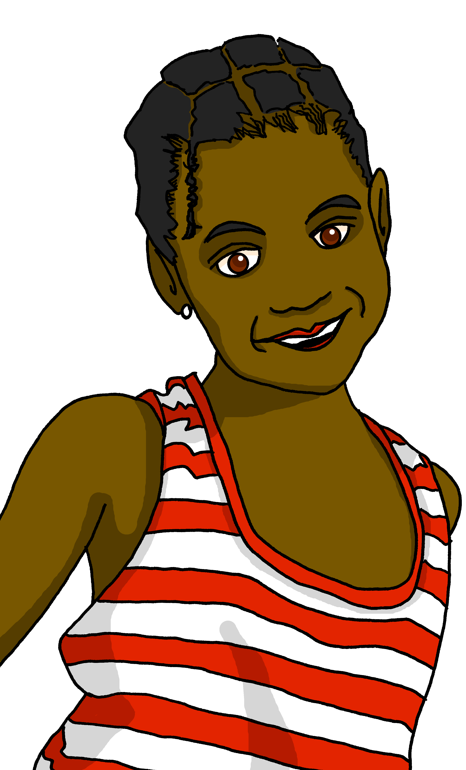
Prononce et vérifie.* Qui parle à qui ?
*vérifier – to check
prononcer
Elle est ma sœur.
She is my sister.
9
Notes:
[9/10]
Transcript:
Elle est ma sœur.

Slide 18
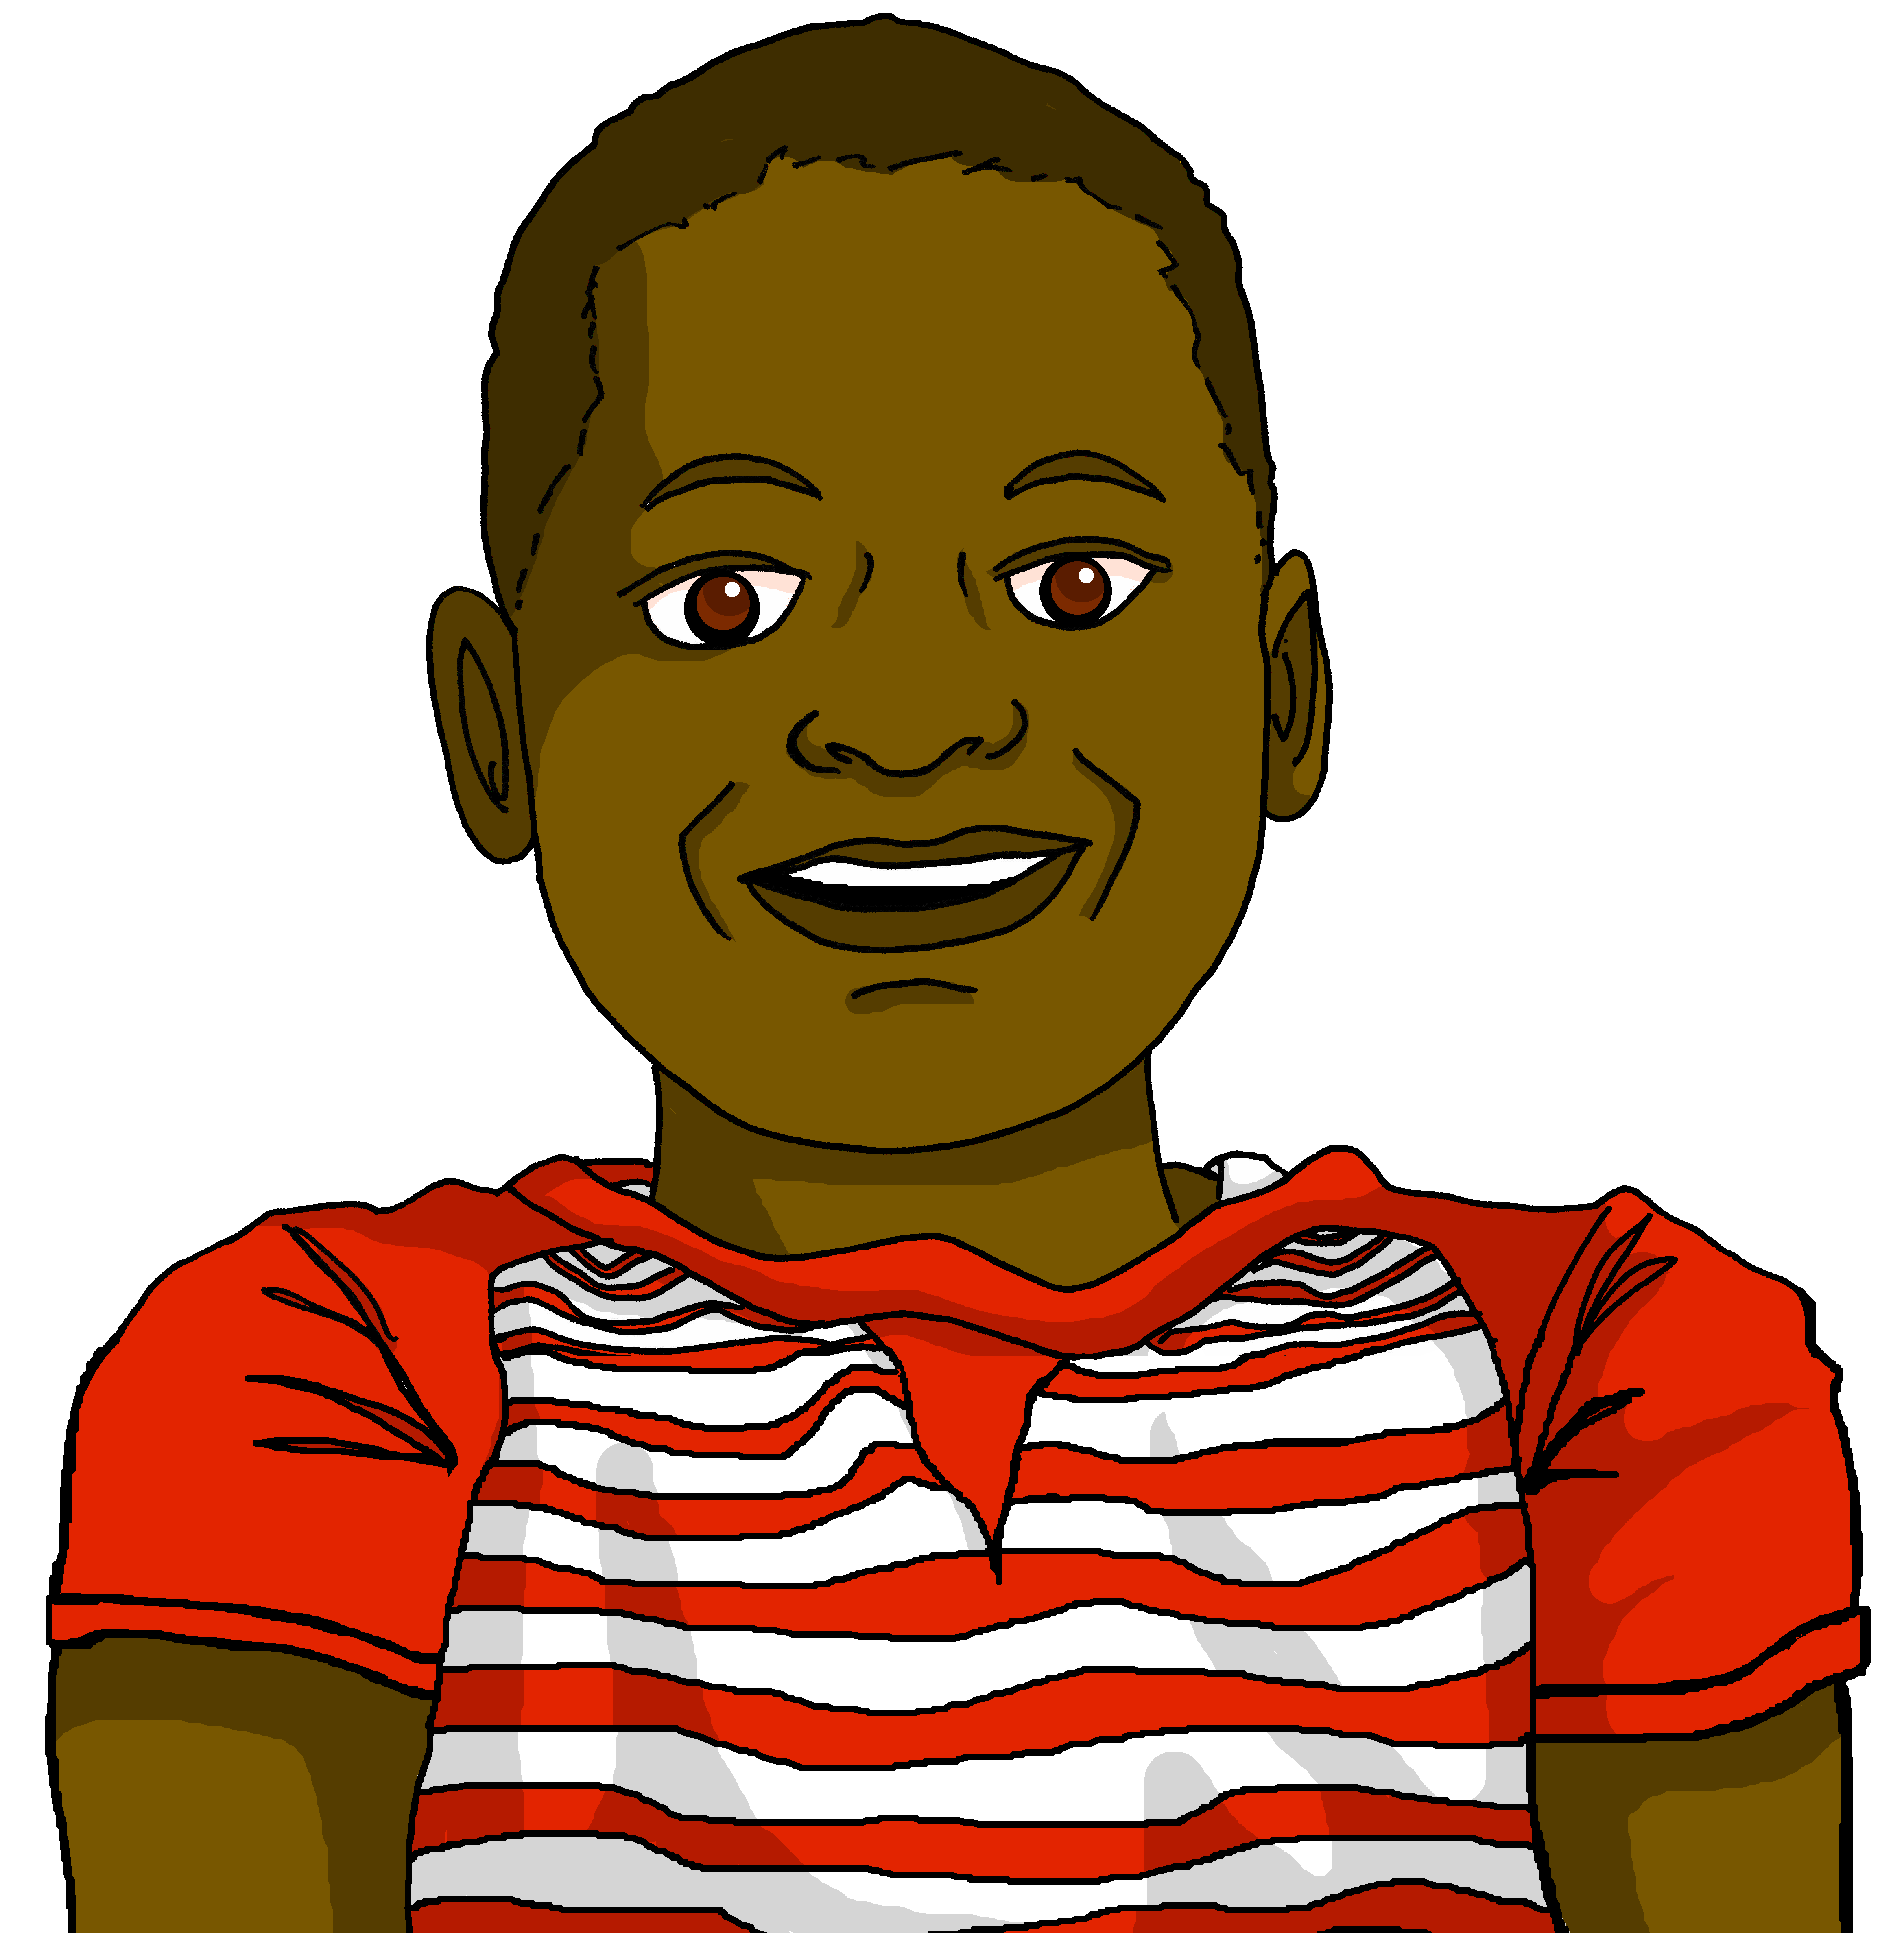
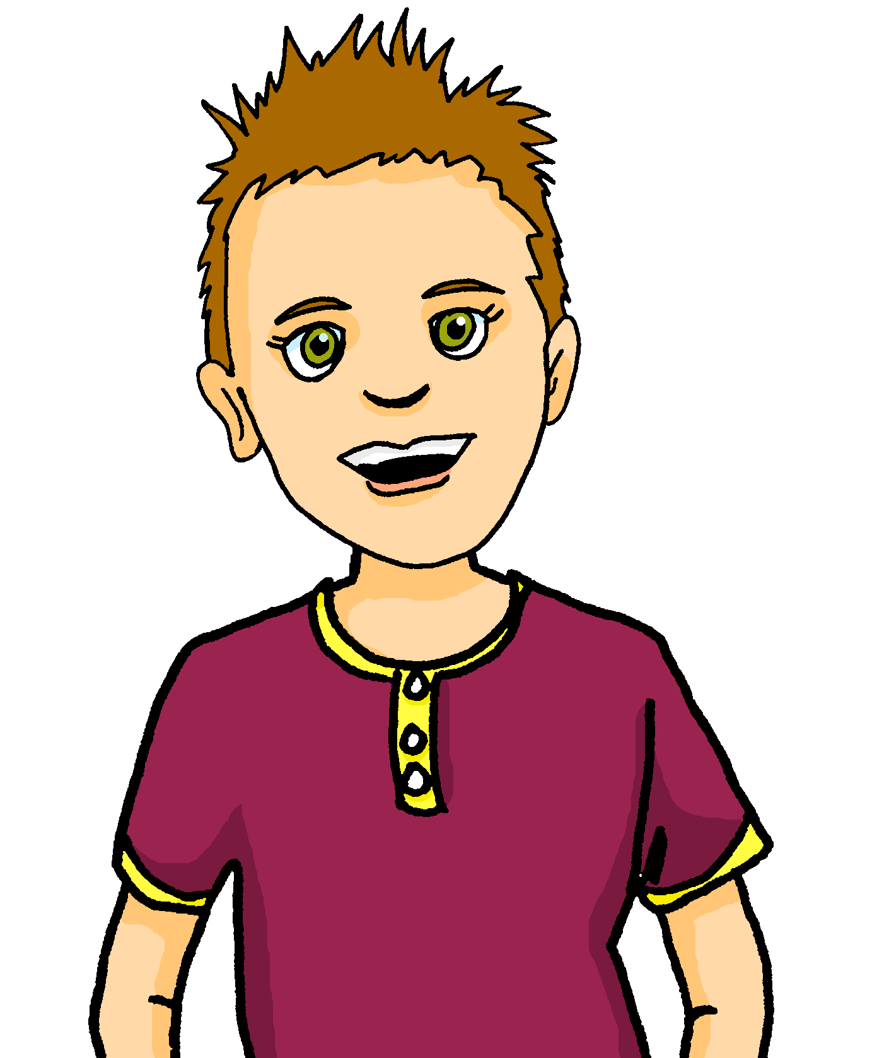
Prononce et vérifie.* Qui parle à qui ?
*vérifier – to check
prononcer
Elle est ta sœur.
She is your sister.
Qui parle à qui ?
Jean-Michel parle à Pierre.
10
Notes:
[10/10]
Transcript:
Elle est ta sœur.

Slide 19
écouter
Écoute. Clémentine parle à Adèle. Écris le mot correct.
⚠ Attention ! The final word is missing. Listen to what goes before to work out who Clémentine is talking about.
Clémentine
Adèle
1 | amie | mère
2 | famille | frère
3 | amis | parents
4 | parents | père
1 | parents | amis
2 | frère | amie
3 | famille | père
4 | père | mère
1
1
5
5
2
2
6
6
3
3
7
7
4
4
8
8
Notes:
Timing: 5 minutes
Aim: To practise aural comprehension of mon/ma/mes and ton/ta/tes, including before vowels and plural nouns.
Procedure:
Students write 1-8 and write the noun that matches each possessive adjective.
Click the number to play the audio.
Answers and the full audio (including the noun) are provided with the 2nd set of audio buttons.
Transcript:
Je joue du piano avec ma [mère].
Je ne joue pas au football avec mon [frère].
Je joue à la corde avec mes [amis].
Je ne joue pas de la guitare avec mon [père].
Tu chantes des chansons avec tes [parents].
Tu joues à la corde avec ton [amie|frère].
Tu ne joues pas au tennis avec ta [famille].
Tu joues de la guitare avec ton [père].
19

Slide 20
Au revoir !
vert
Notes:
20

