Slide 1
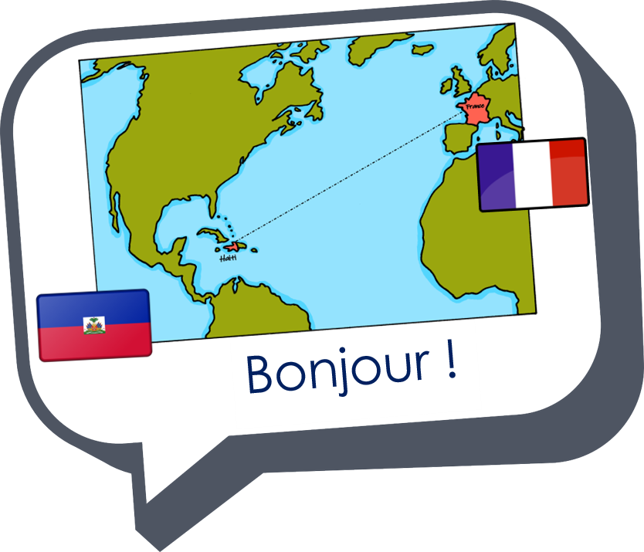

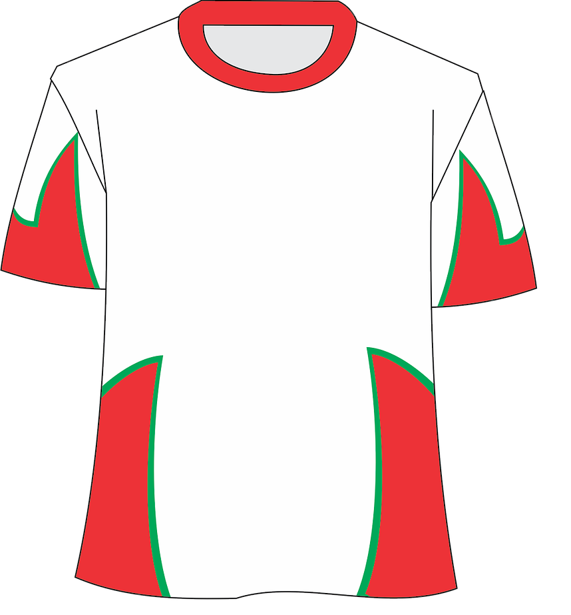
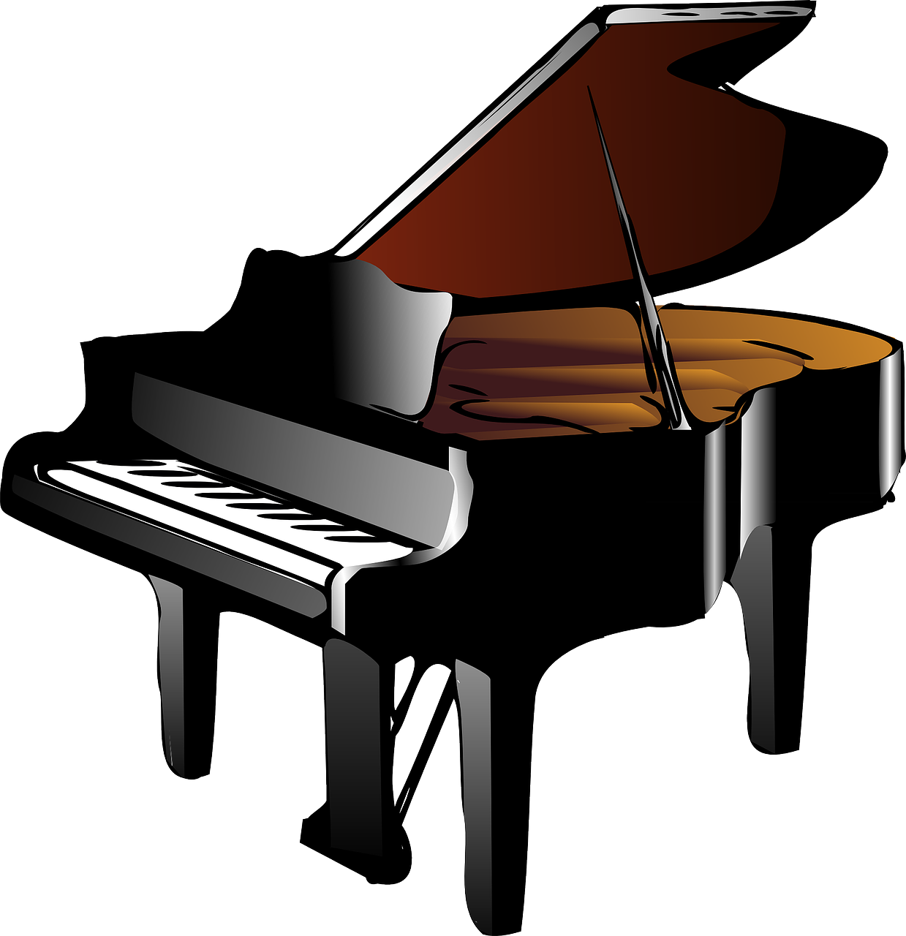


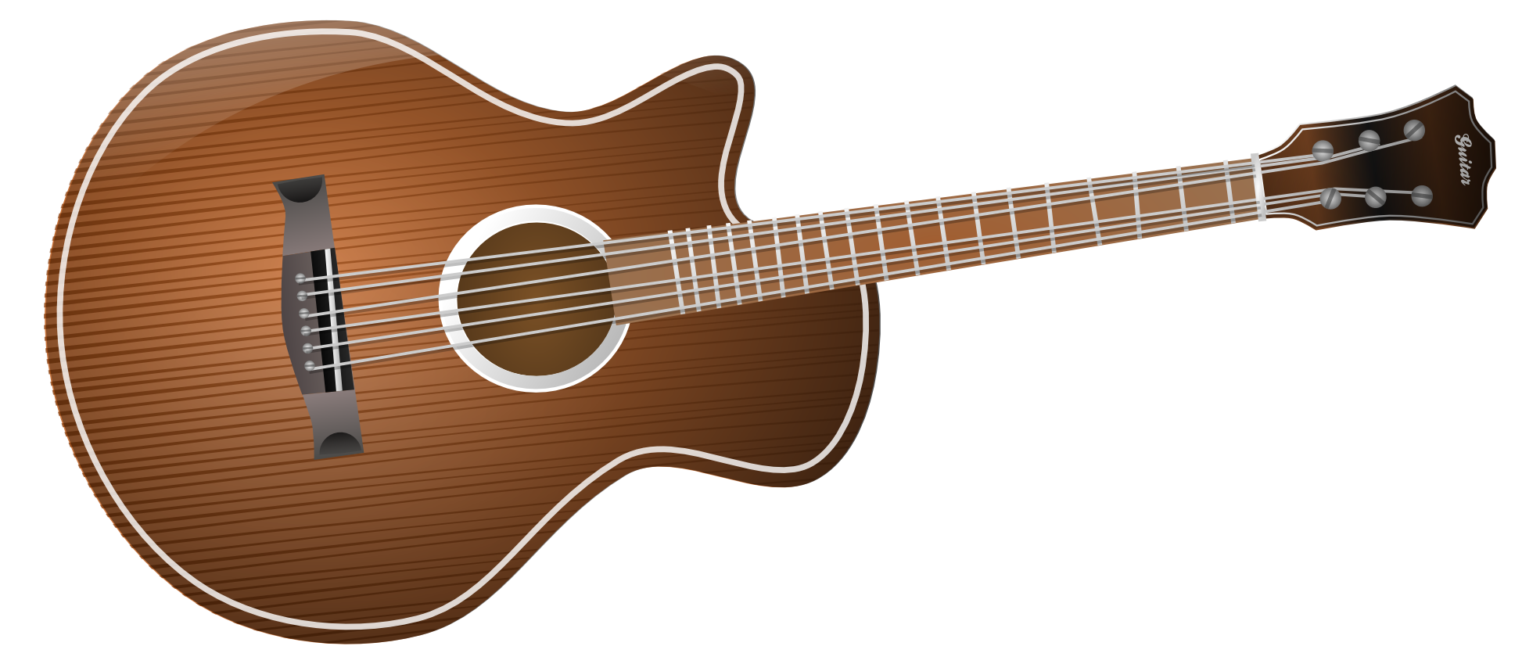
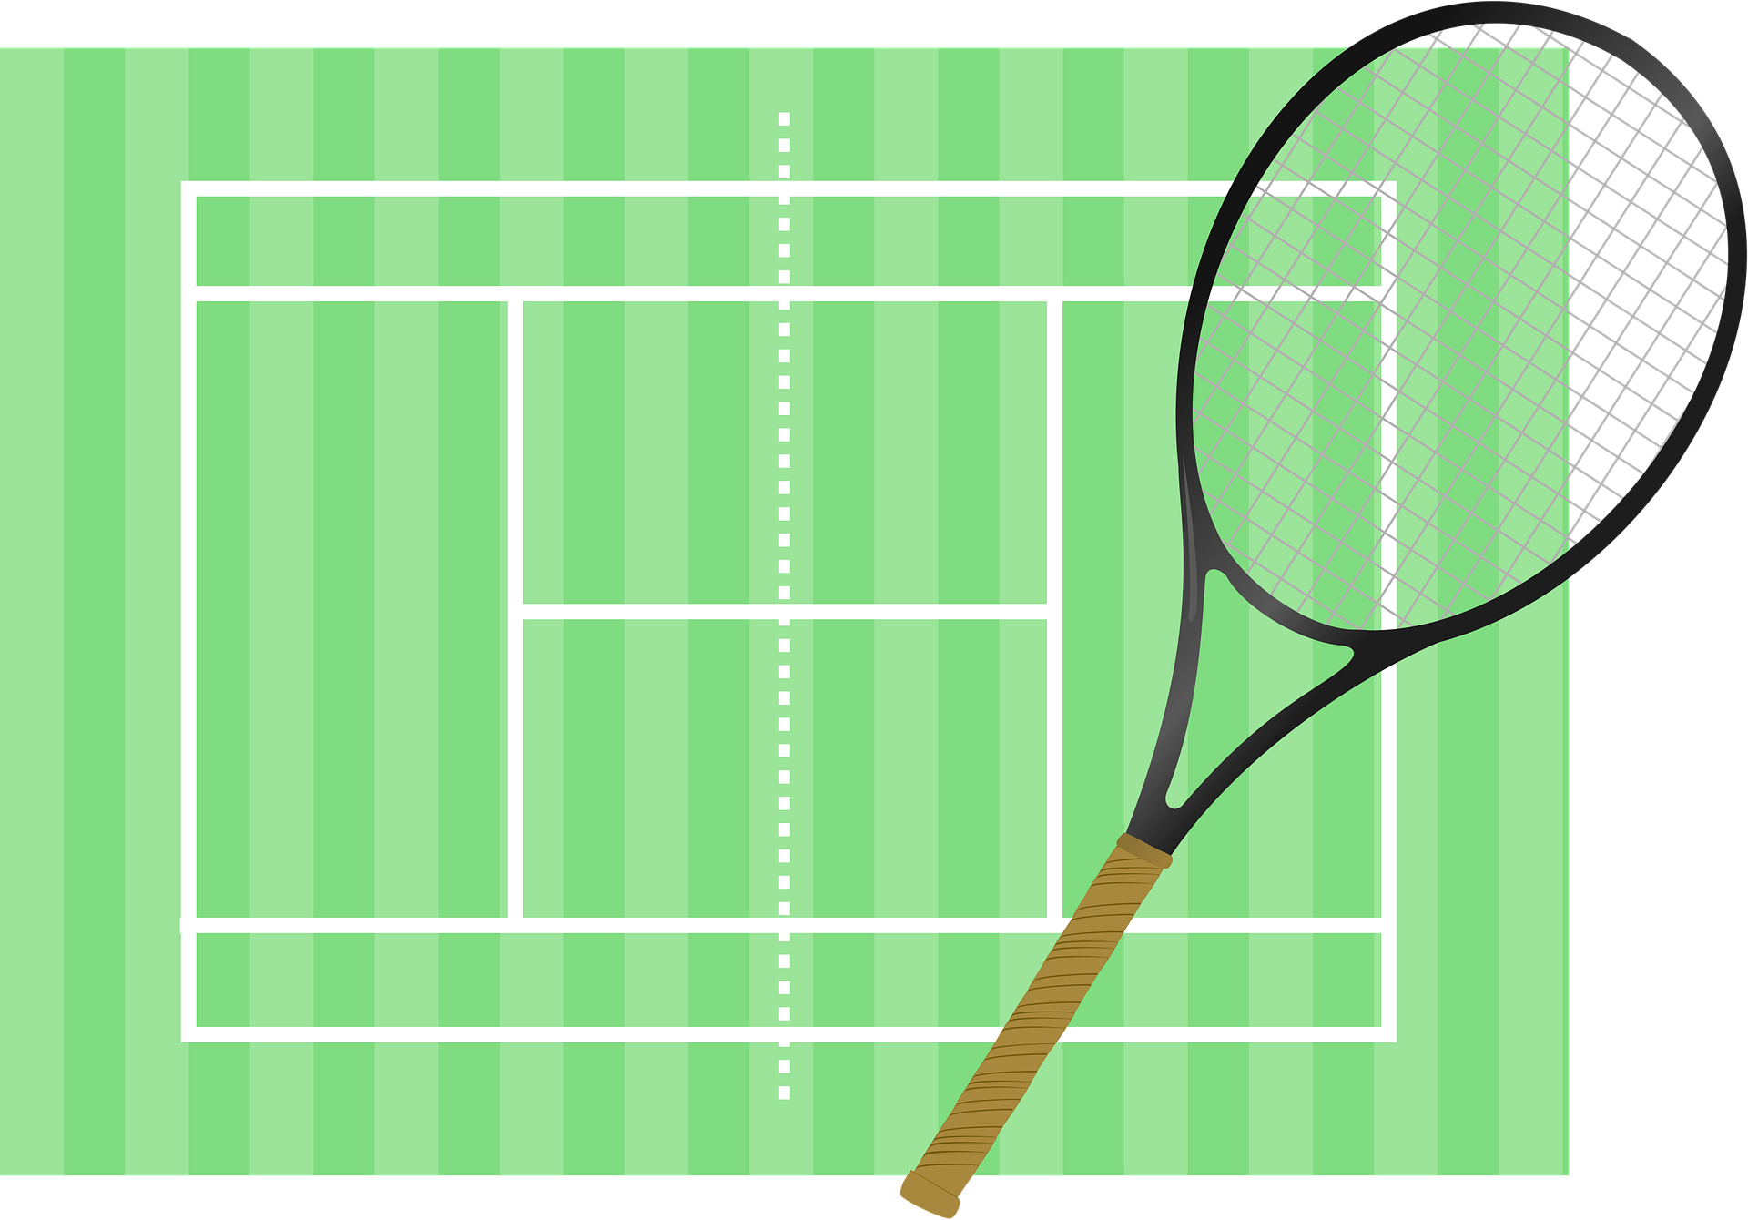
Describing me and others
vert
Follow ups 1-5
Notes:
Artwork by Steve Clarke. Pronoun pictures from NCELP (www.ncelp.org). All additional pictures selected from Pixabay and are available under a Creative Commons license, no attribution required.
Phonics: Revisit SSC [-s-] maison [325] chose [125] magasin [1736] église [1782] cuisine [2618]
Vocabulary: ami [467] corde [3784] famille [172] football [2602] parent [546] tennis [3687] mes [60] tes [330]
Revisit 1: faire [25] je fais il/elle fait activité [452] course à pied [n/a] chanson [2142] dessin [2624] film [848] gâteau [4845] matin [442] soir [397] spectacle [1687] ville
[360] visite [1072] weekend [2475] demain [871]
Revisit 2: chanter [1820] chercher [336] créer [332] danser [2934] donner [46] écouter [429] manger [1338] organiser [791] préparer [368] porter [105] regarder [425] trouver
[83] utiliser [345]
Londsale, D., & Le Bras, Y. (2009). A Frequency Dictionary of French: Core vocabulary for learners London: Routledge.
The frequency rankings for words that occur in this PowerPoint which have been previously introduced in these resources are given in the SOW and in the resources that first introduced and formally re-visited those words.
For any other words that occur incidentally in this PowerPoint, frequency rankings will be provided in the notes field wherever possible.

Slide 2

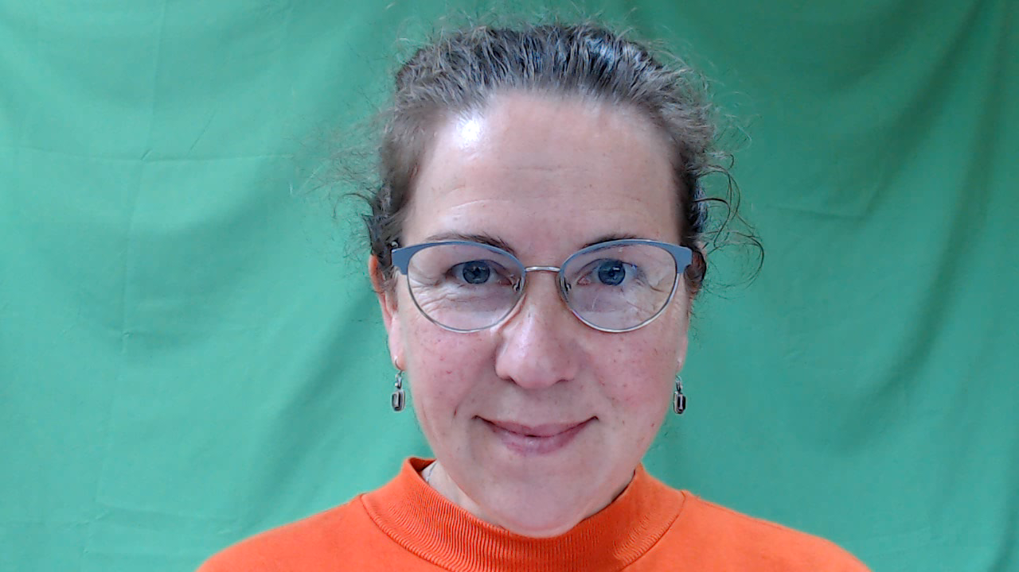
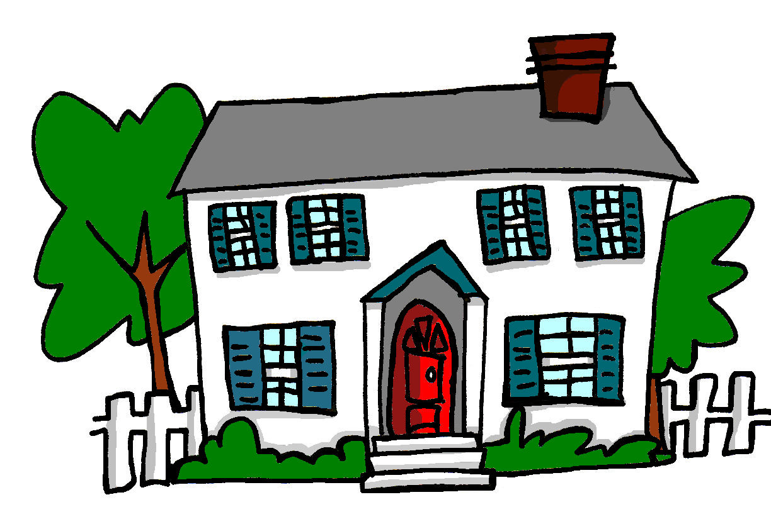
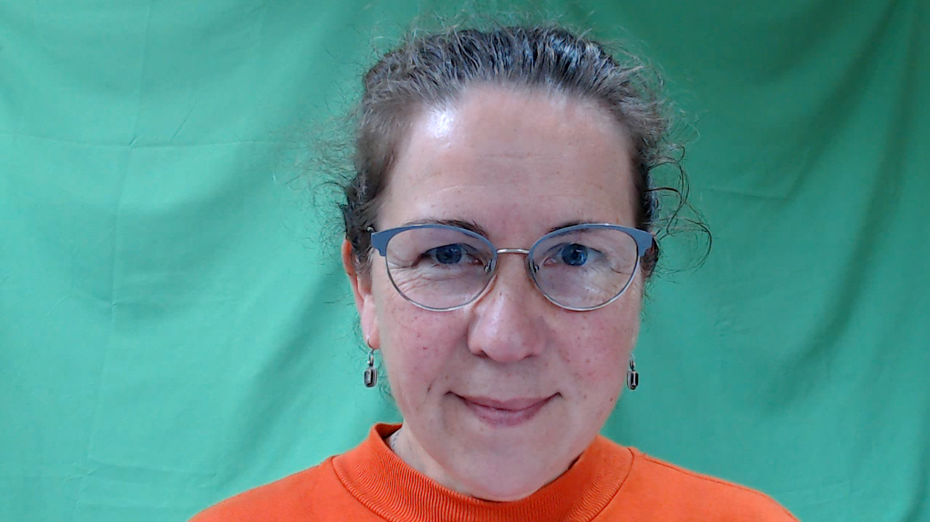
[-s-]
prononcer
maison
Notes:
Timing: 1 minute
Aim: To introduce SSC [-s-]
Procedure:
1. Present the letter(s) and say the [-s-] sound first, on its own. Students repeat it with you.
2. Bring up the word ”maison” on its own, say it, students repeat it, so that they have the opportunity to focus all of their attention on the connection between the written word and its sound.
3. A possible gesture for this would be to trace the outline of a house in the air with two fingers (see BSL video, link below).
4. Roll back the animations and work through 1-3 again, but this time, dropping your voice completely to listen carefully to the students saying the [-s- between vowels] sound, pronouncing ”maison” and, if using, doing the gesture.
Gesture: https://www.signbsl.com/sign/house
British Sign language for house traces the outline of a house in the air with two fingers, starting together at the top and drawing outwards and downwards.
Word frequency (1 is the most frequent word in French):
maison [325]
Source: Londsale, D., & Le Bras, Y. (2009). A Frequency Dictionary of French: Core vocabulary for learners London: Routledge.
2

Slide 3

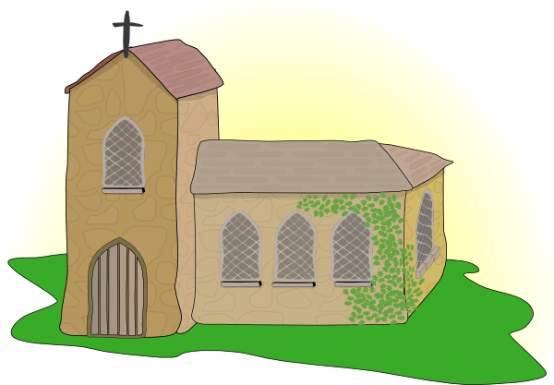

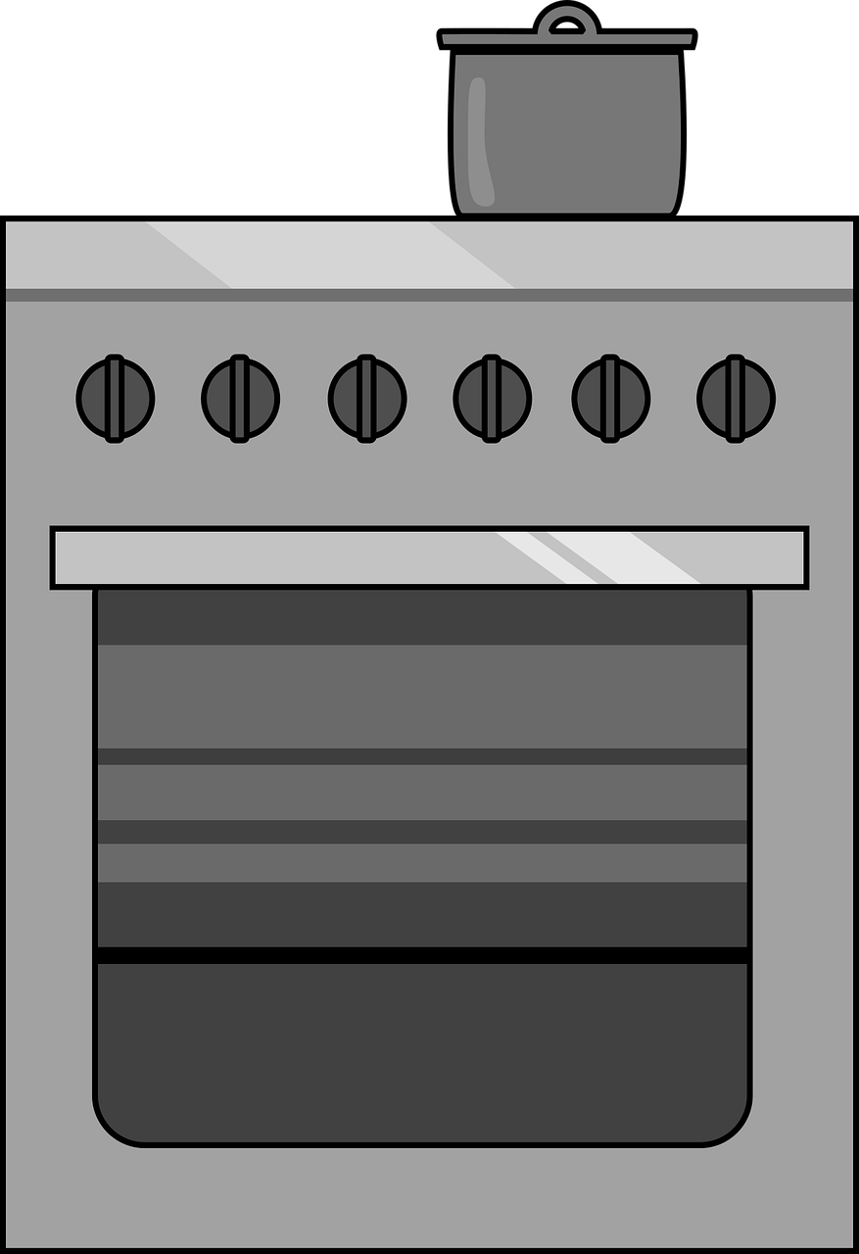
[-s-]
prononcer
magasin
église
maison
[thing]
chose
cuisine
Notes:
Timing: 2 minutes
Aim: To introduce SSC [-s-]
Procedure:
Introduce and elicit the pronunciation of the individual SSC [-s-] and then the source word again ‘maison’ (with gesture, if using).
Then present and elicit the pronunciation of the five cluster words.
The cluster words have been chosen for their high-frequency, from a range of word classes, with the SSC (where possible) positioned within a variety of syllables within the words (e.g. initial, 2nd, final etc.). Additionally, we have tried to use words that build cumulatively on previously taught SSCs (see the Phonics Teaching Sequence document) and do not include new SSCs. Where new SSCs are used, they are often consonants which have a similar symbol-sound correspondence in English.
Word frequency:
maison [325] chose [125] magasin [1736] église [1782] cuisine [2618]
Source: Londsale, D., & Le Bras, Y. (2009). A Frequency Dictionary of French: Core vocabulary for learners London: Routledge.
3

Slide 4

prononcer
Follow up 1: Hard or soft [-s-]?
We know that hard s in French sounds like ‘z’.
The French s is hard when it is between two vowels, including in a liaison.
Exemple:
mes amis
The French s is soft when:
Exemples:
la soupe
it is at the beginning of a word or syllable
it is before or after a consonant
there is a double [s]
insister
le poisson
Notes:
Timing: 2 minutes
Aim: to recap spelling rules governing SSC [-s-]
Procedure:
1. Click to present the information.
2. Check understanding.
4

Slide 5






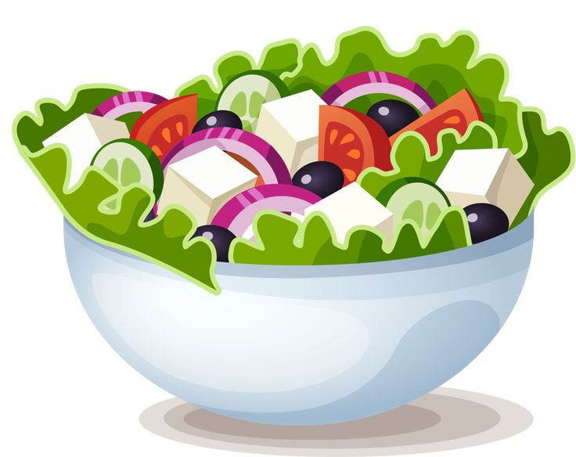




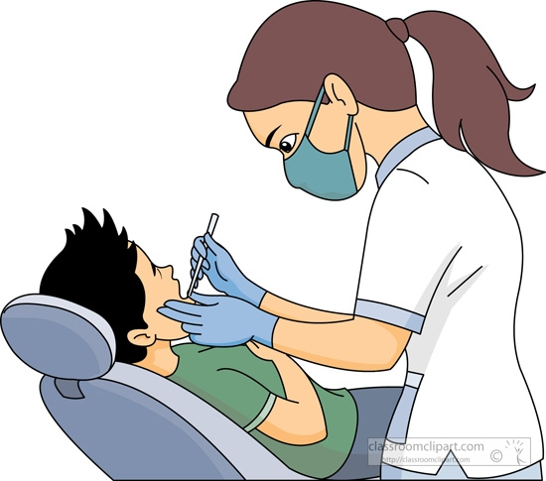

prononcer
Follow up 1
Prononce les mots français. Le son ‘s’, c’est différent en anglais ?
possible
rose
considérer
invisible
positif
réserver
salade
sculpture
exister
dentiste
laser
refuser
Notes:
Timing: 5 minutes
Aim: to practise oral production of [-s-] in cognates. Pupils need to apply the rules from the previous slide and then decide if the [s] sound is the same or different from English.
Note for teachers: All of these words have the same sound in both English and French.
Procedure:
Ensure that pupils know these are all French words that are similar or identical to English words.
Pupils pronounce all the words and decide if the [s] sound is the same as or different from English.
Elicit pupils’ pronunciations. All of these words have the same [s] sound in both English and French. Teachers may like to elicit suggestions from pupils as to sounds which are not the same – e.g., [r], [in], [en], [er] [u], [e] [o].
Click on each word to hear the audio, if desired.
Frequency of unknown words and cognates:
considérer [255] dentist [>5000] exister [269] invisible [3369] laser [>5000] positif [949] possible [175] refuser [271] réserver [695] rose [2671] salade [>5000] sculpture [>5000]
Londsale, D., & Le Bras, Y. (2009). A Frequency Dictionary of French: Core vocabulary for learners London: Routledge.
5

Slide 6

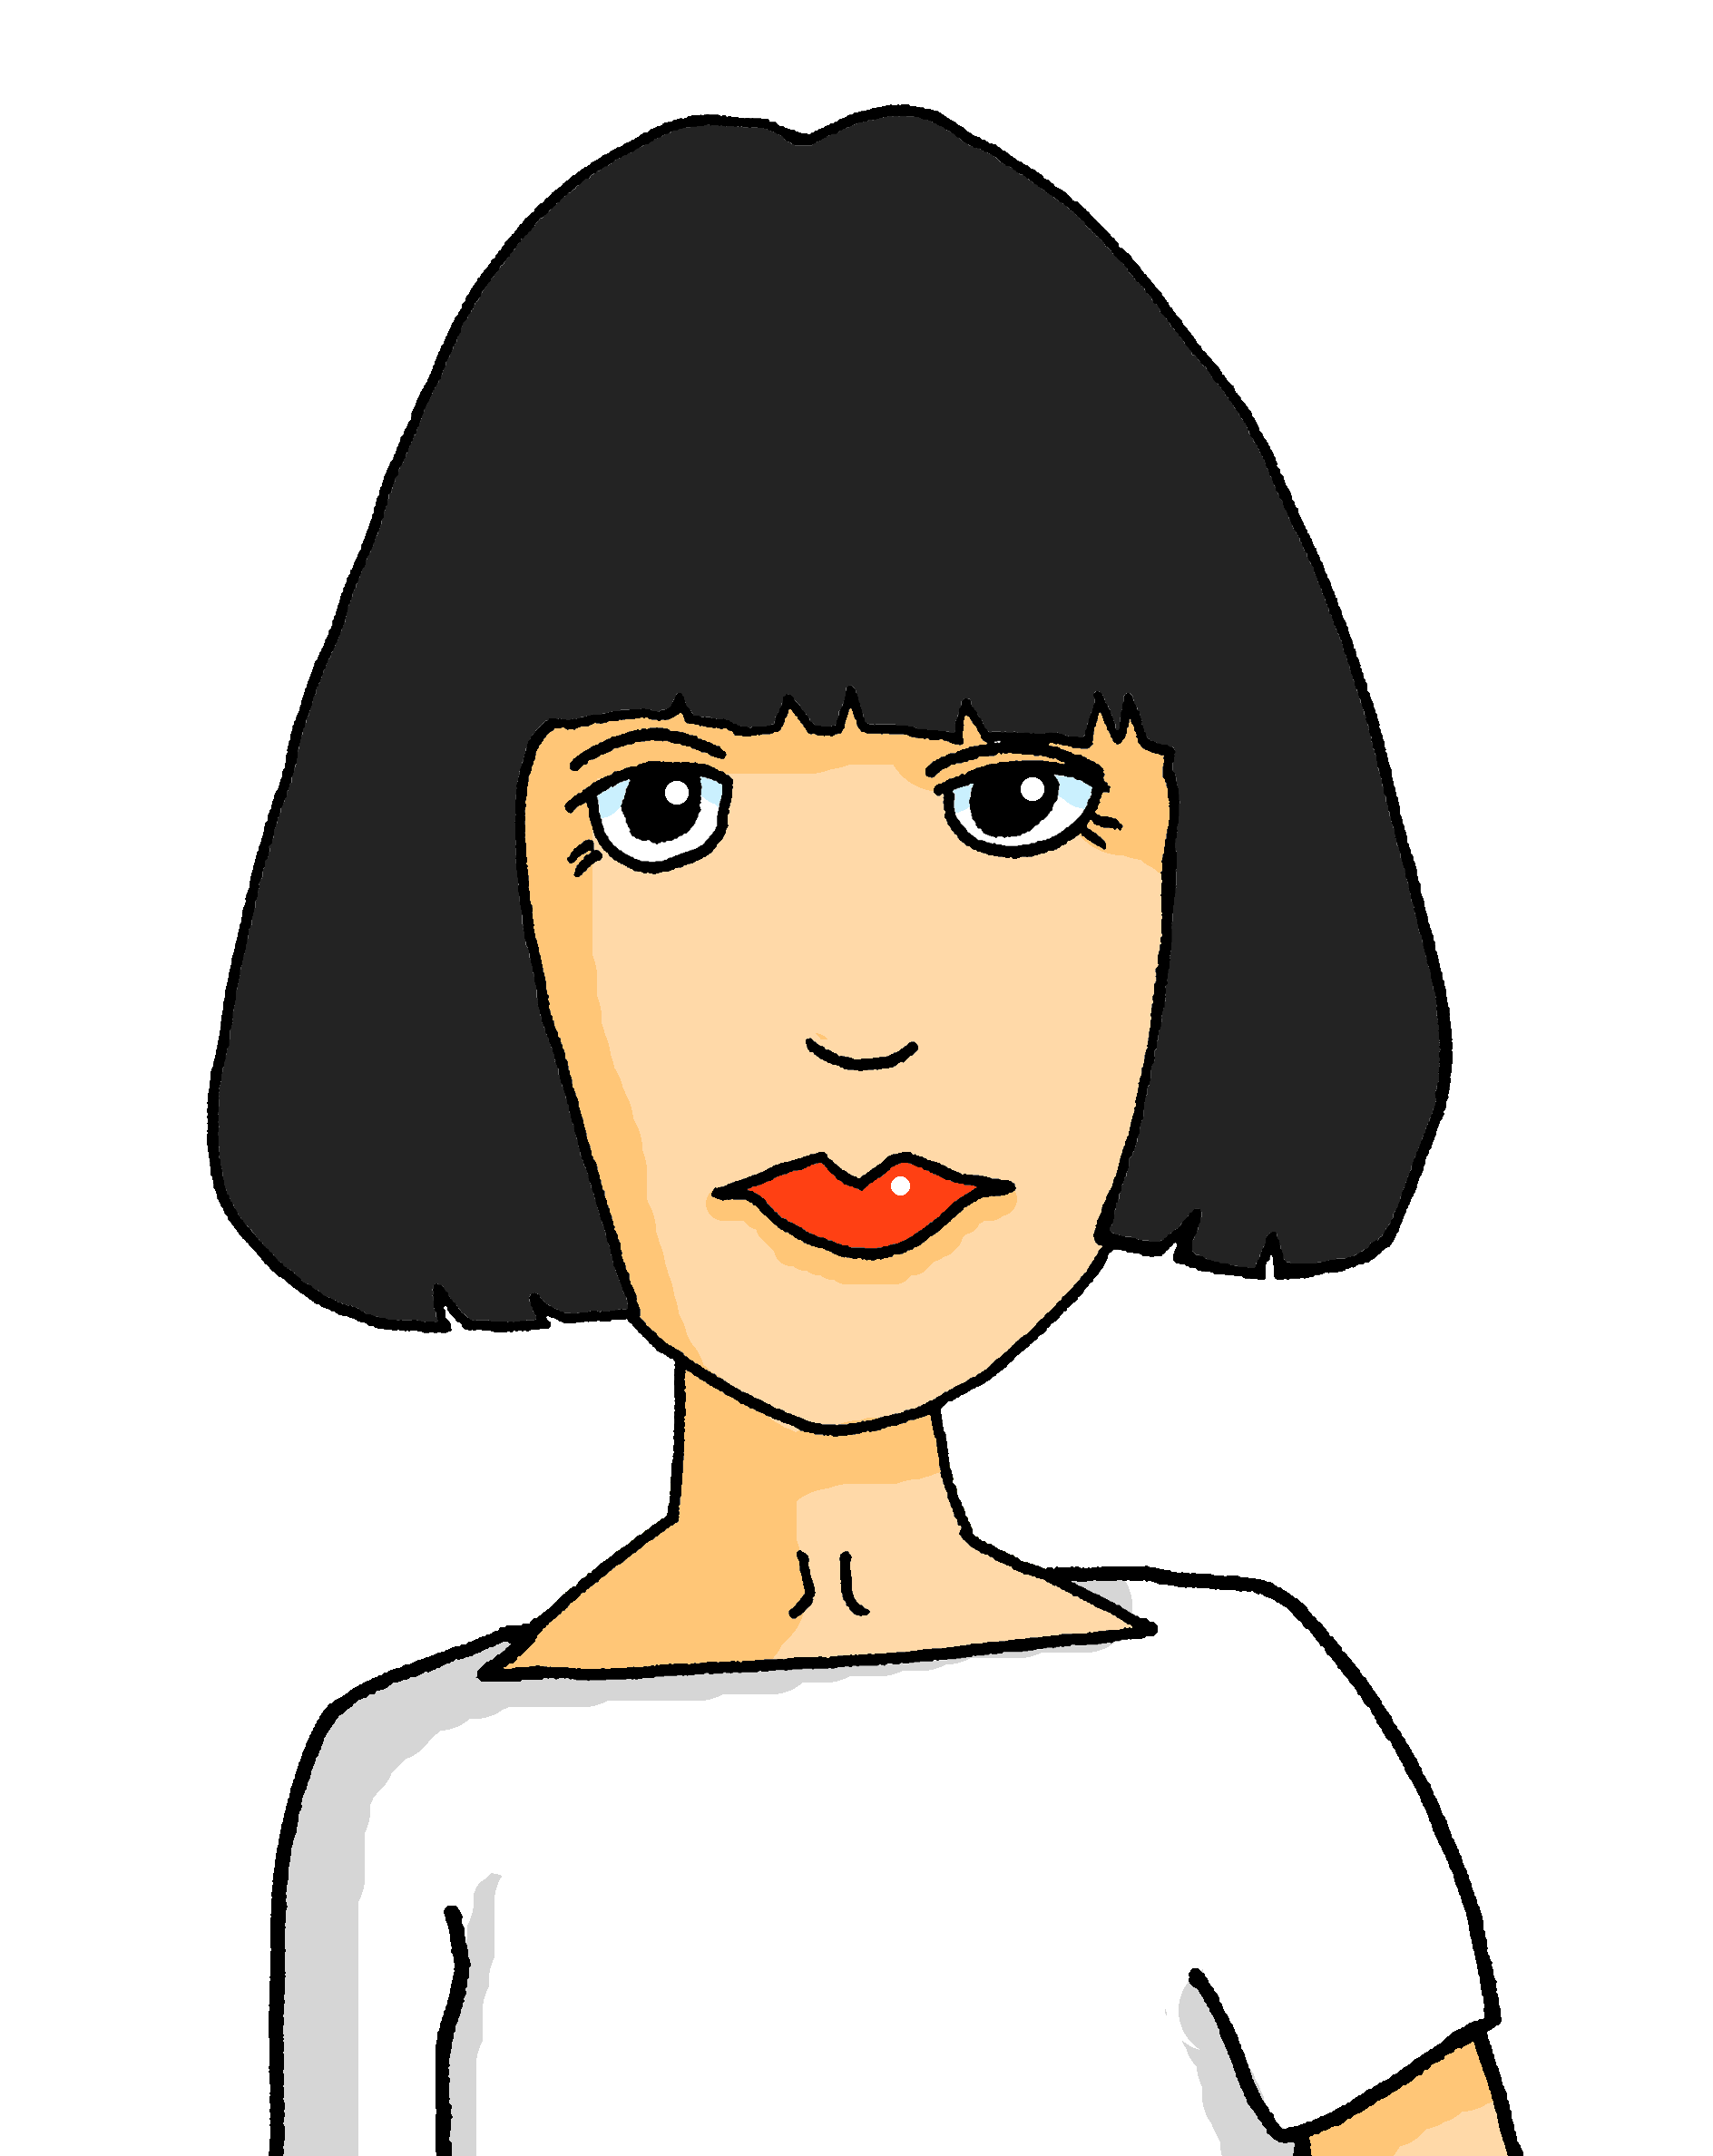
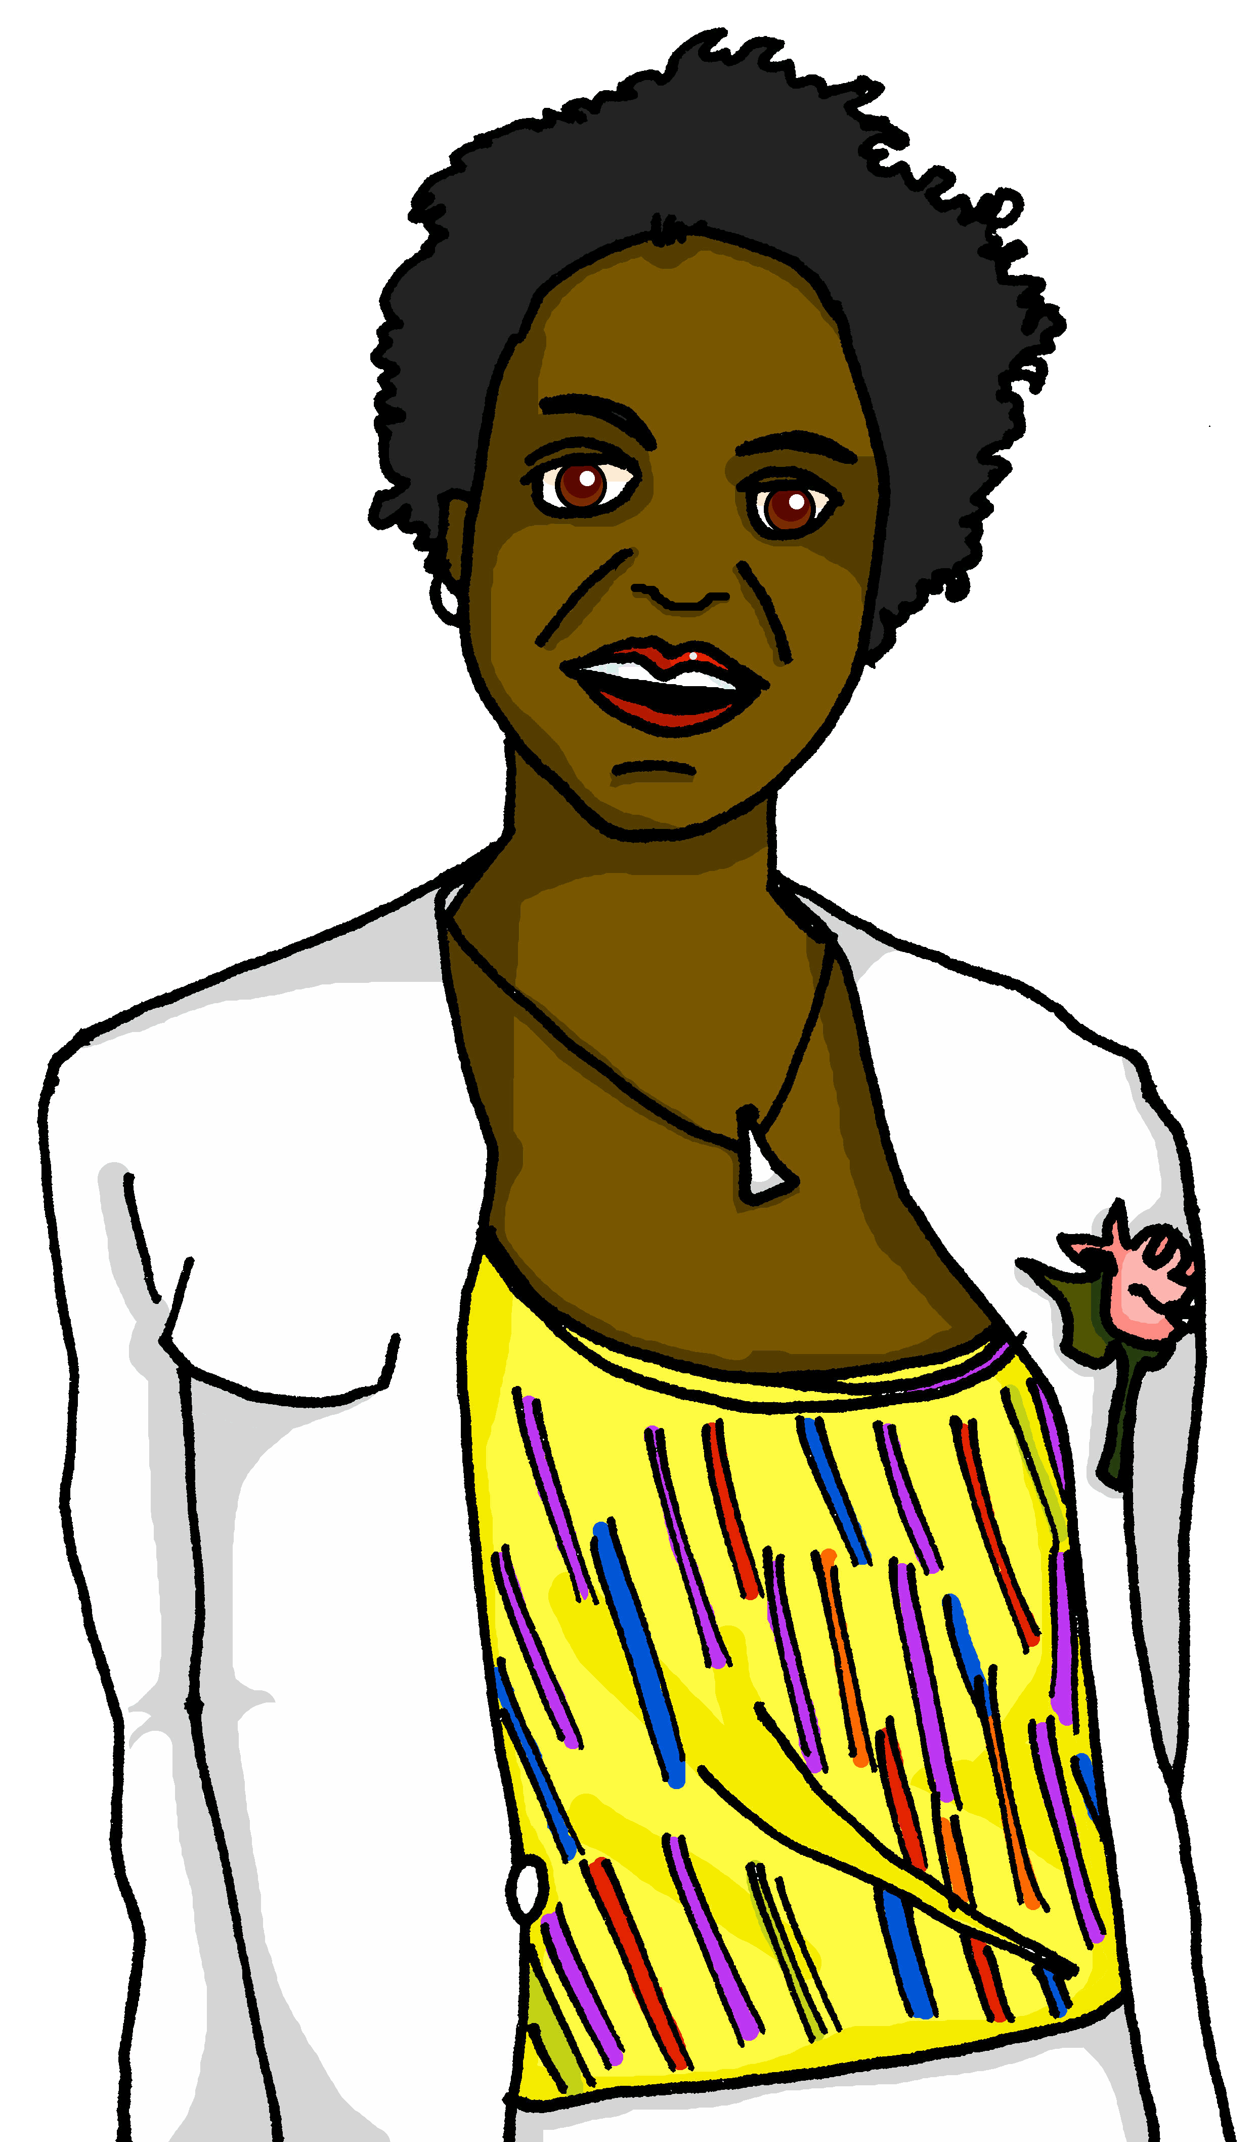
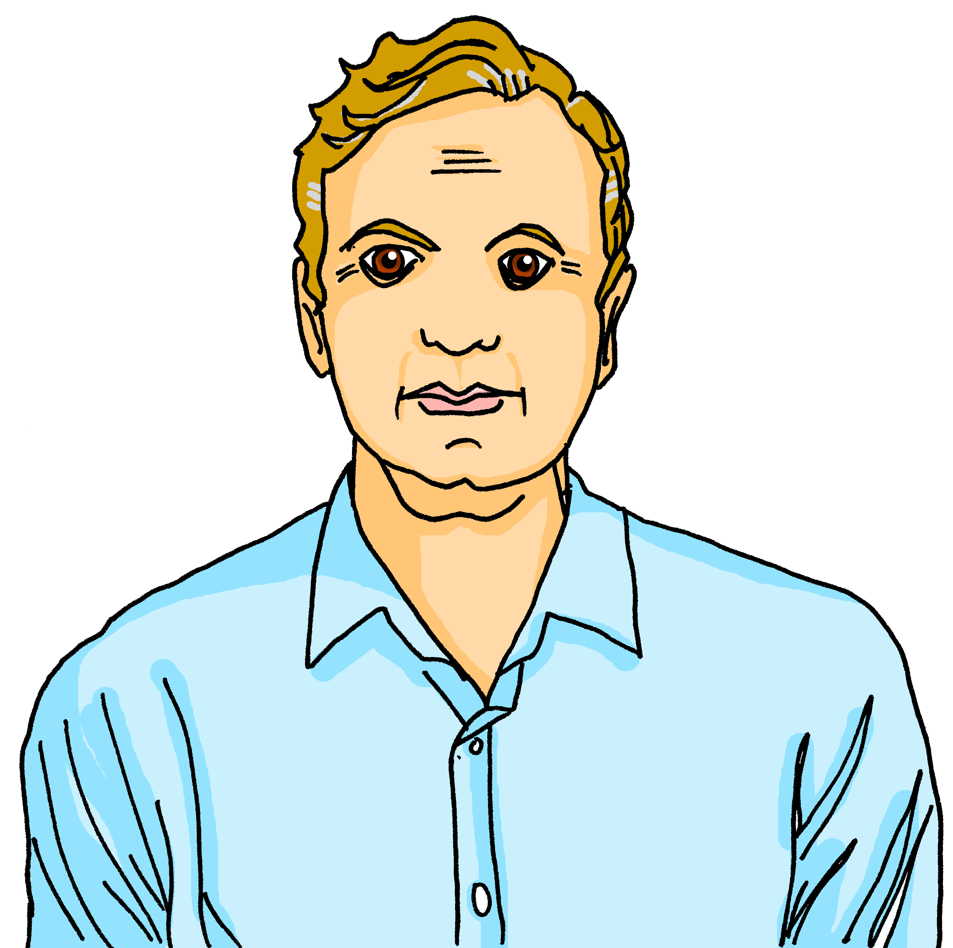

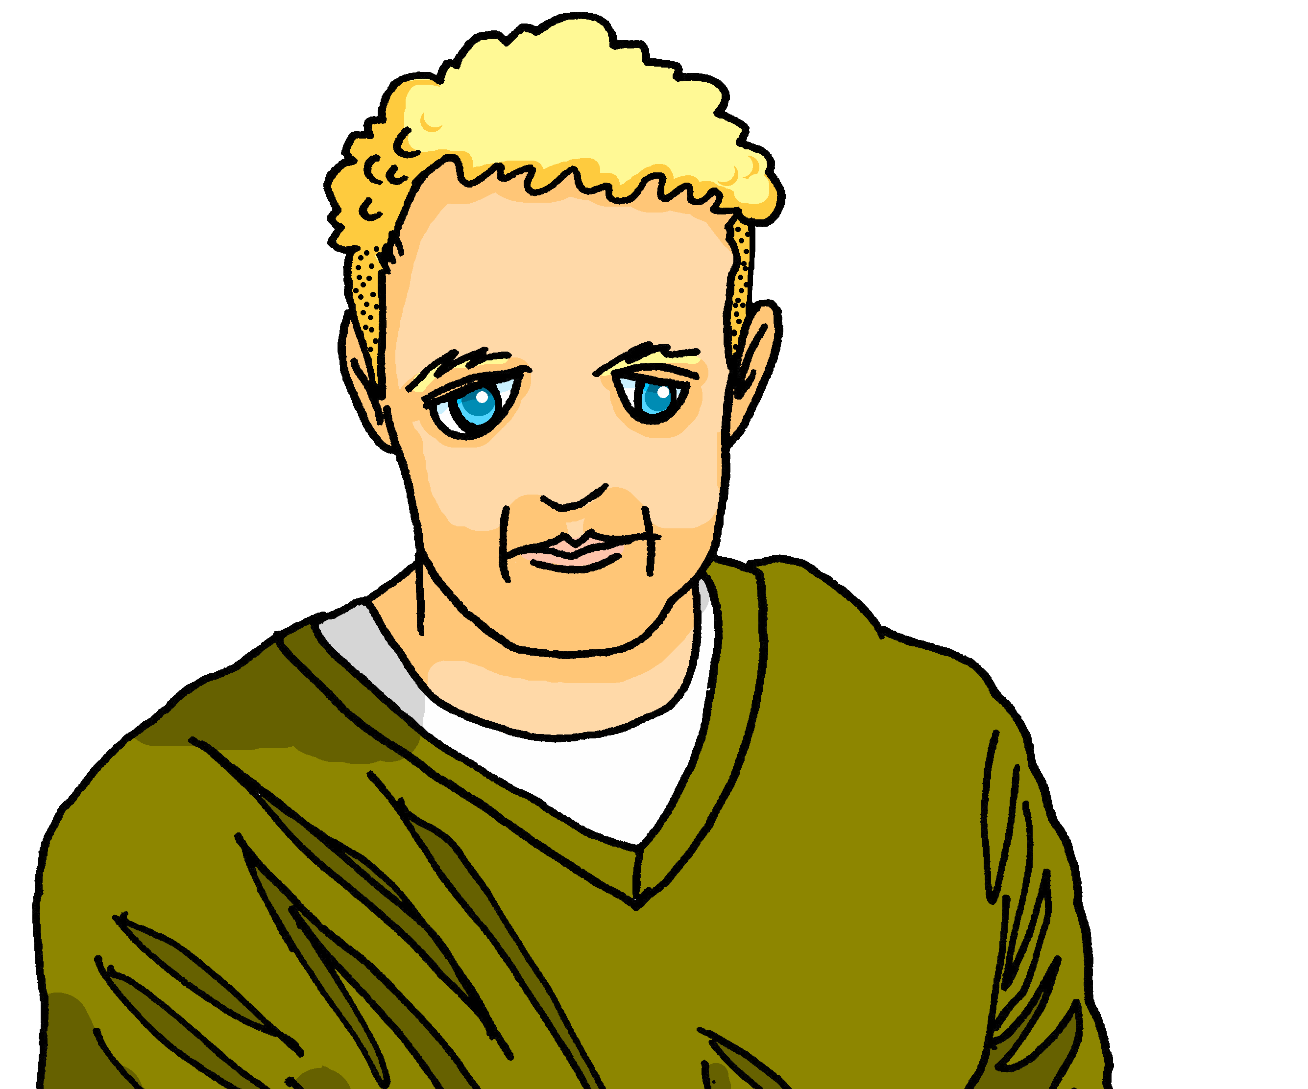
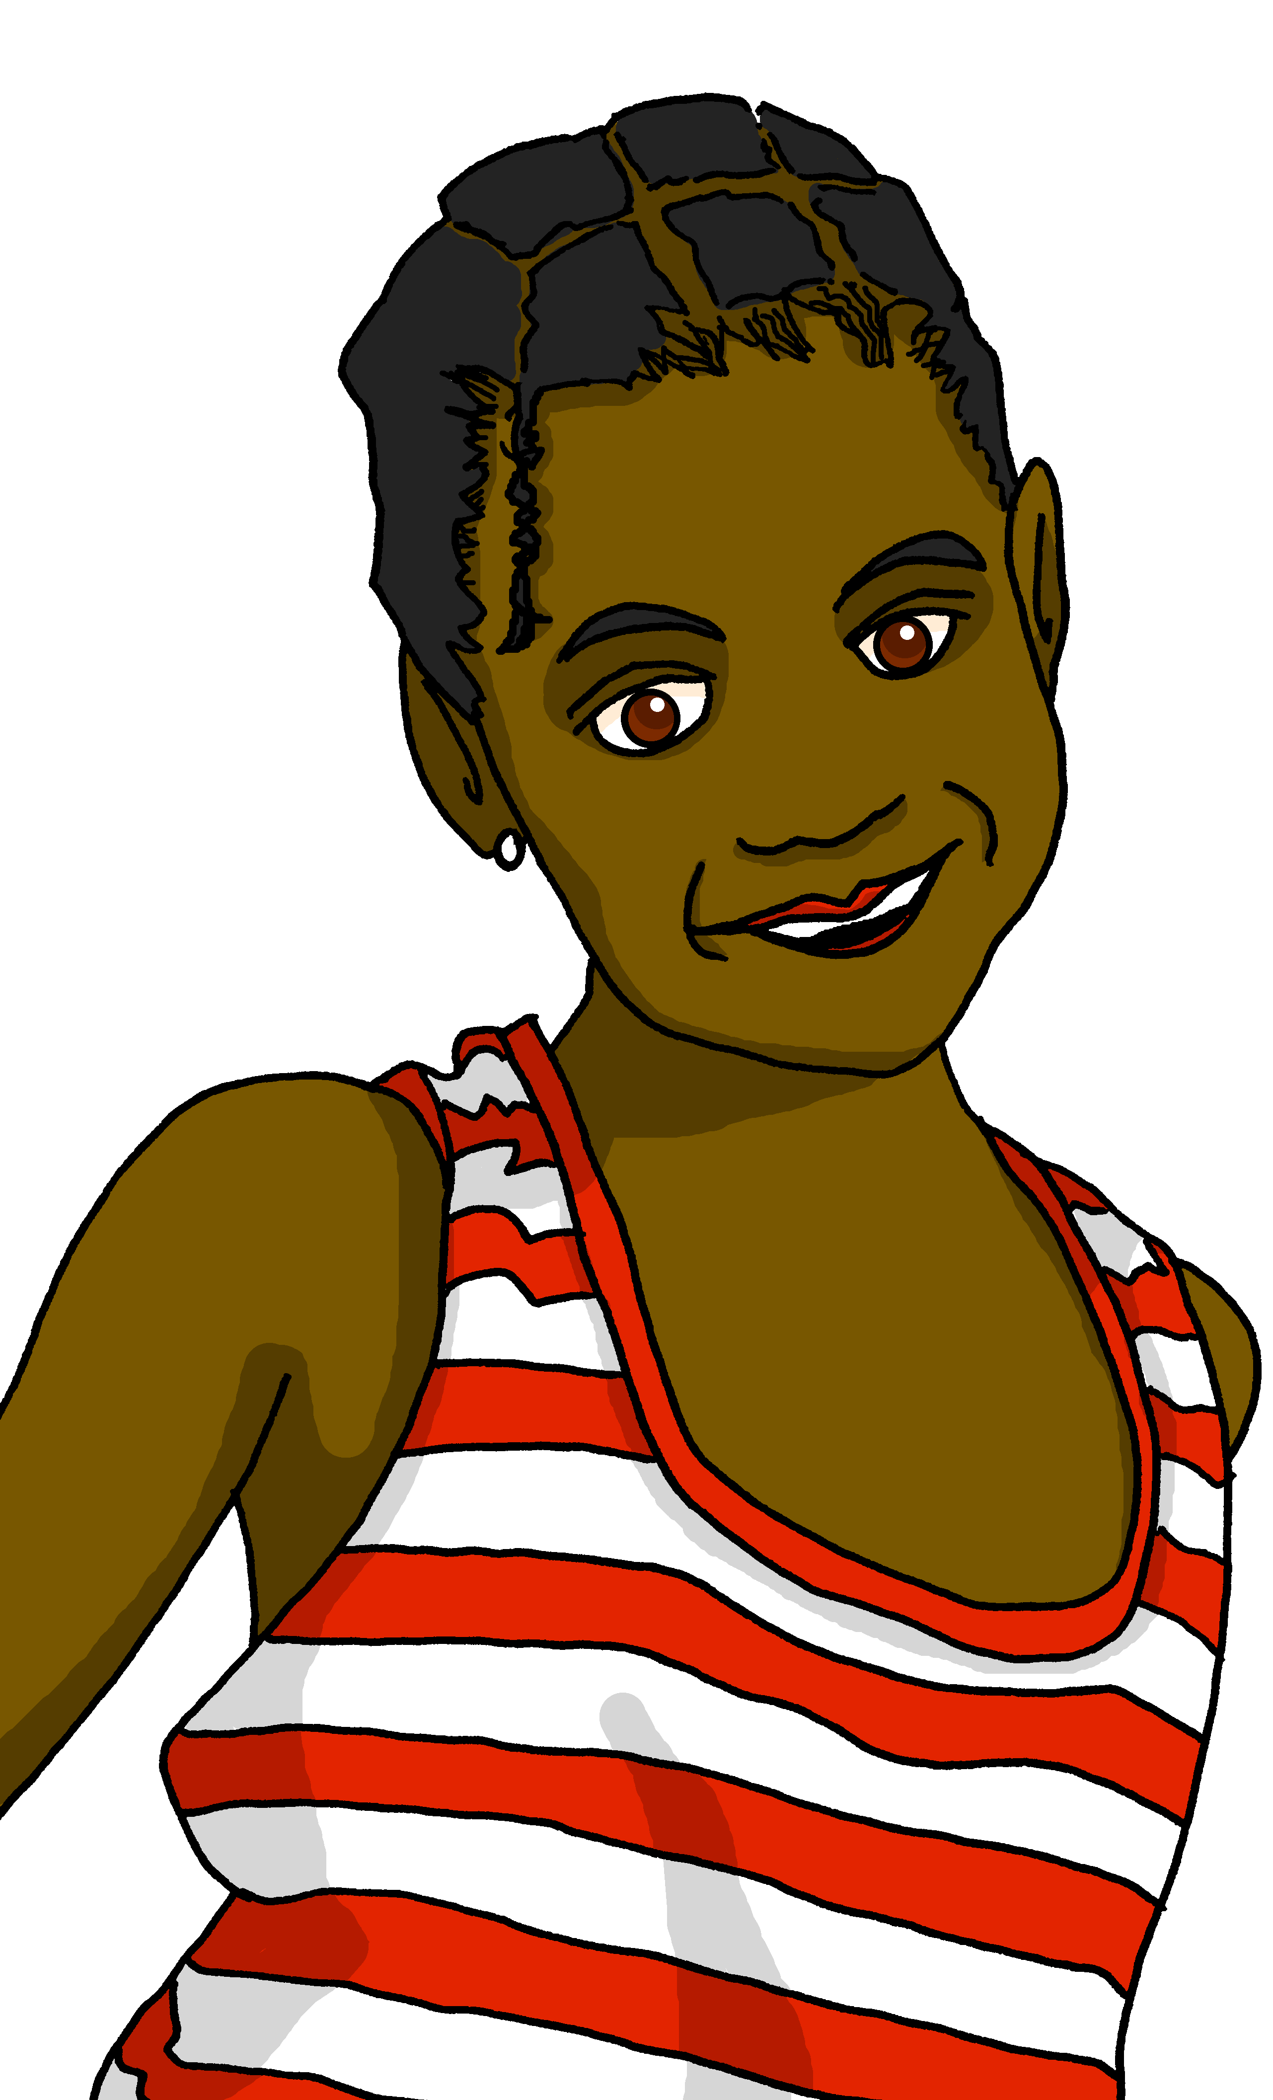
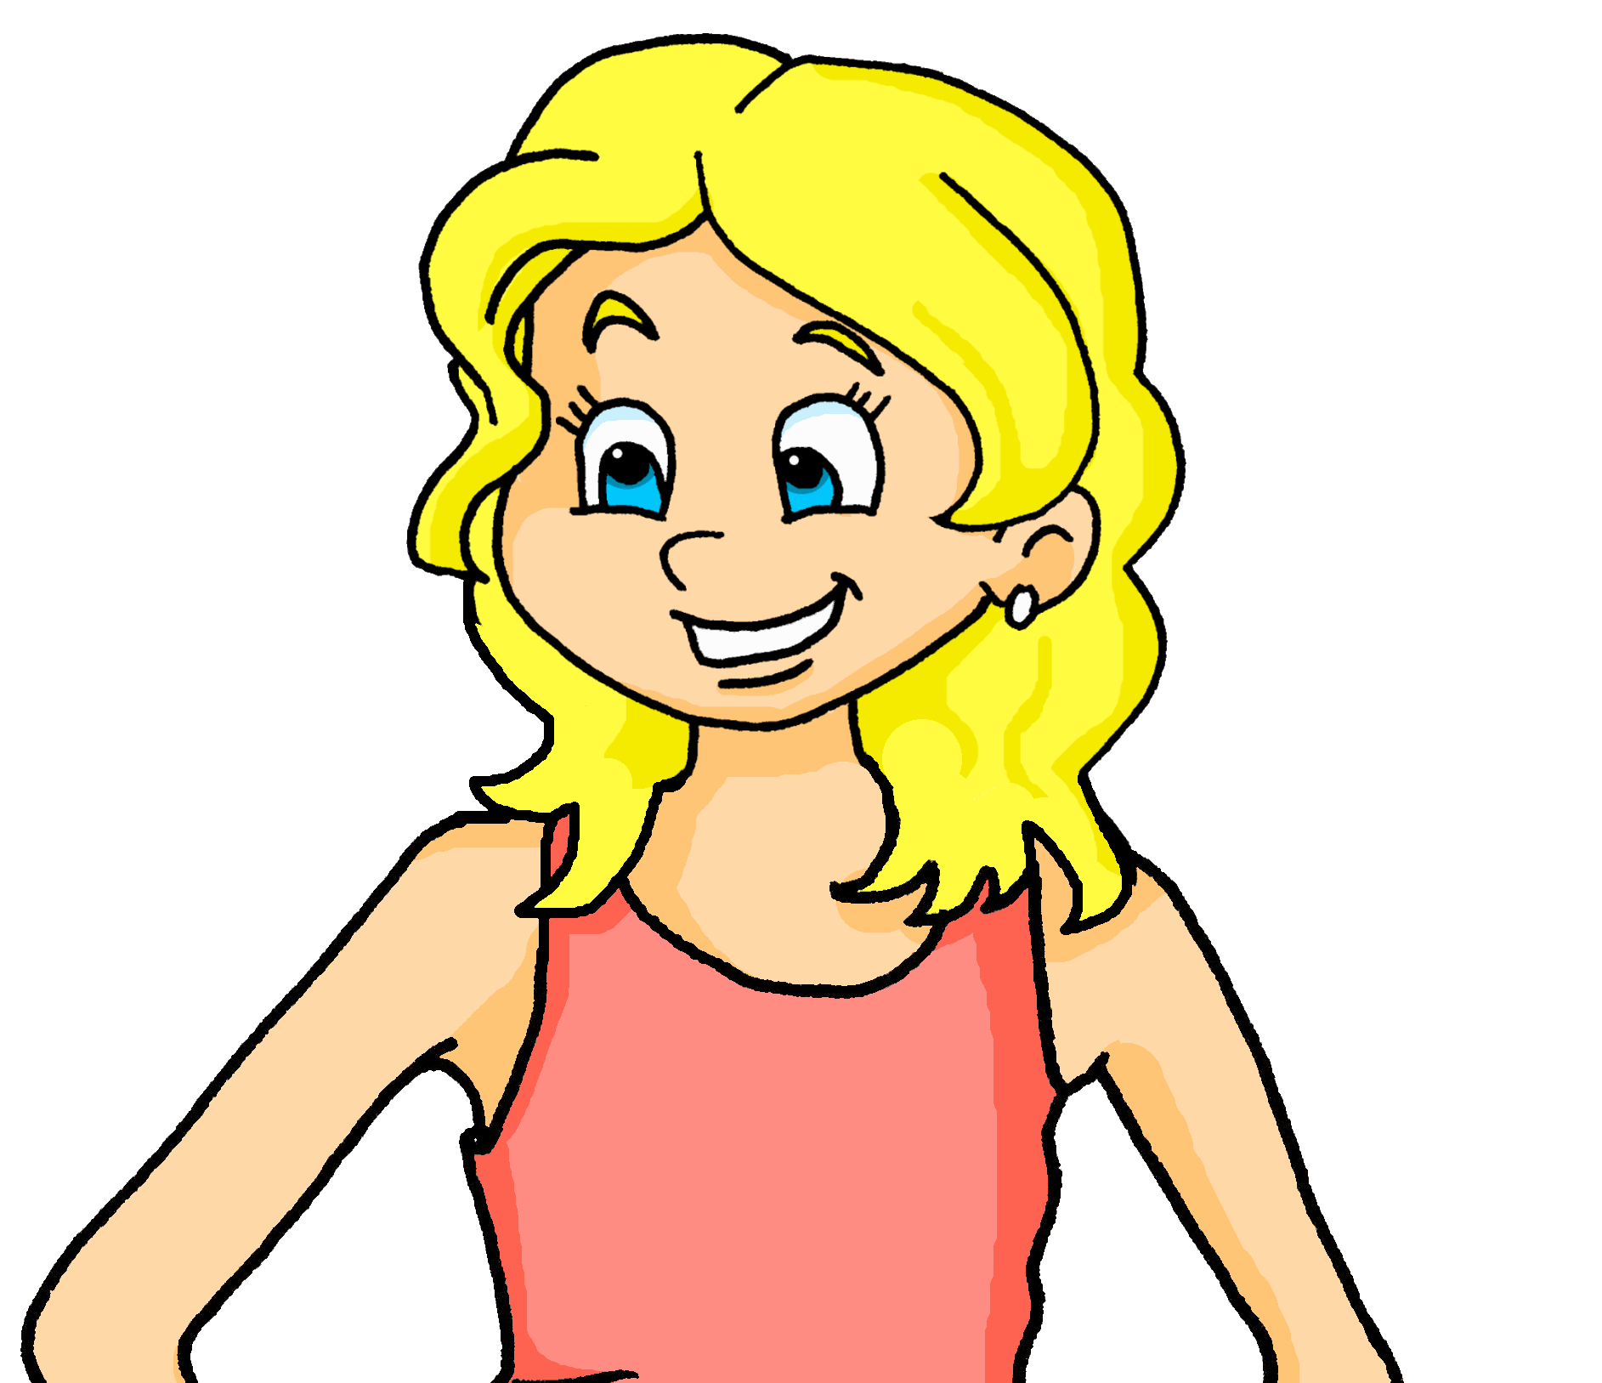
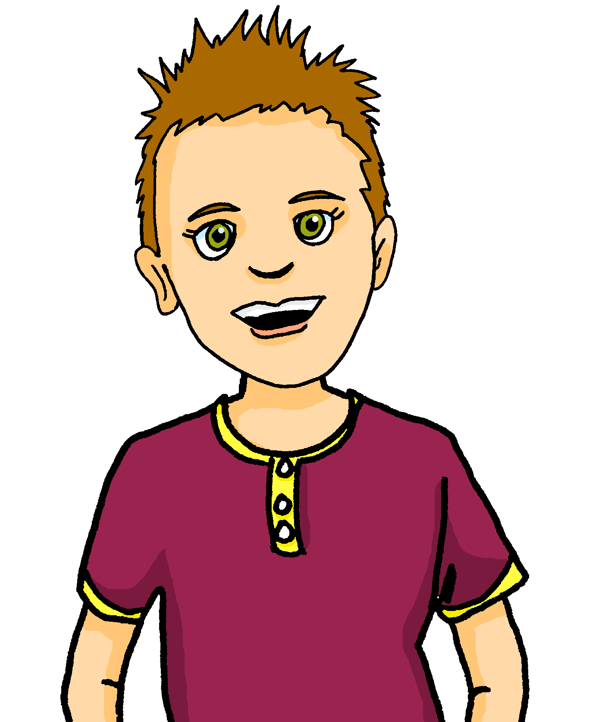
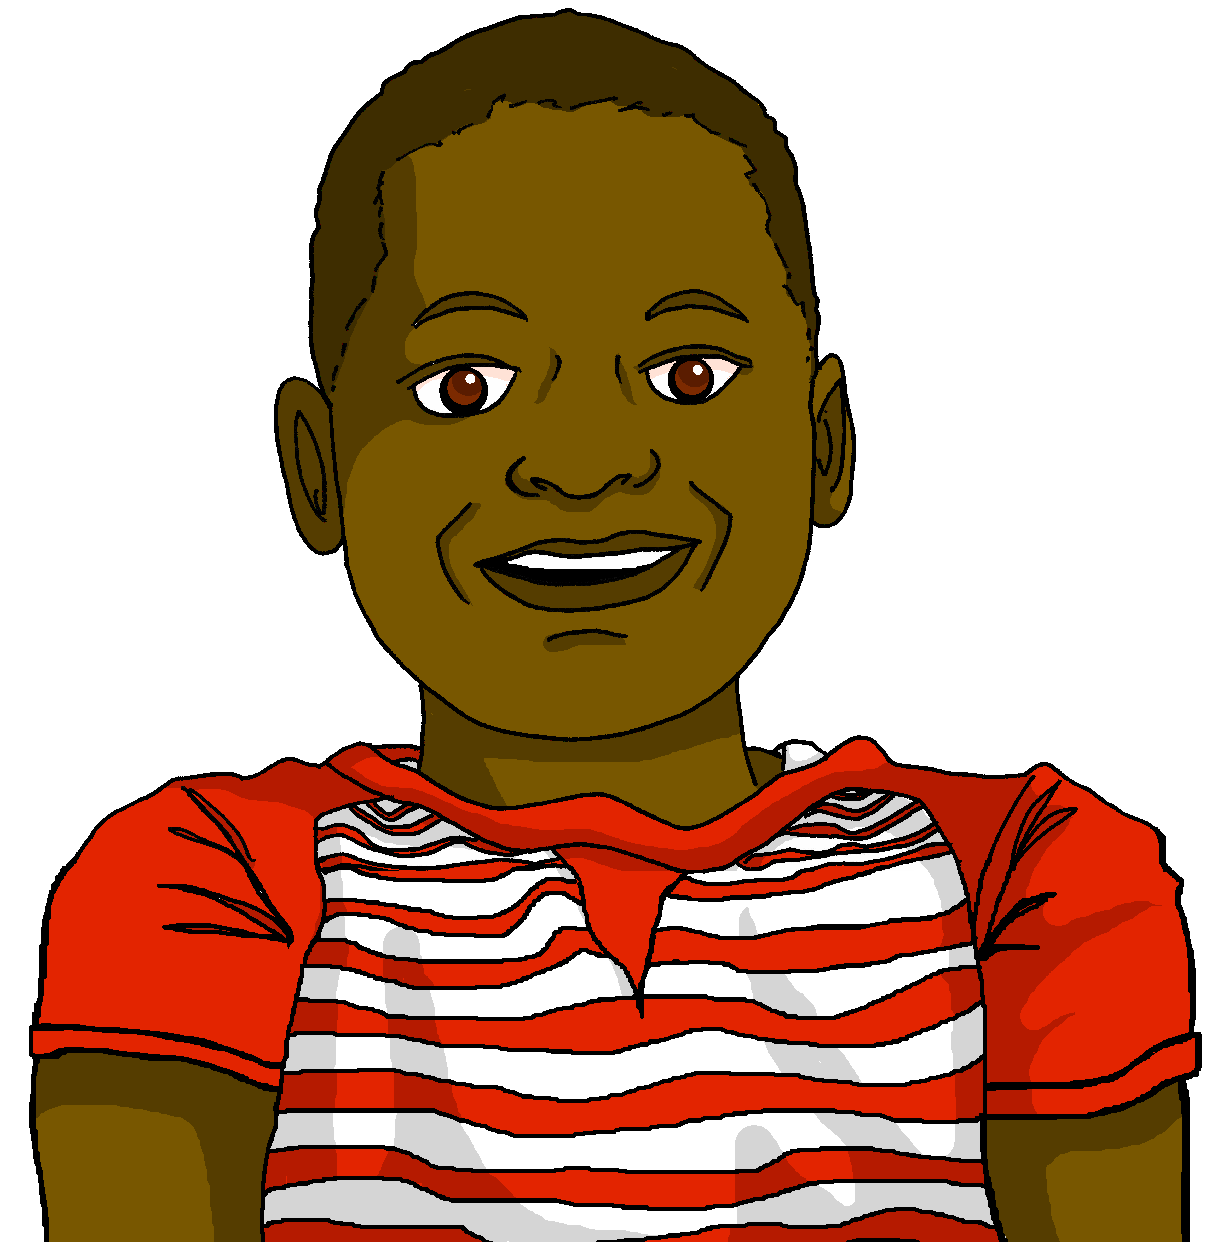
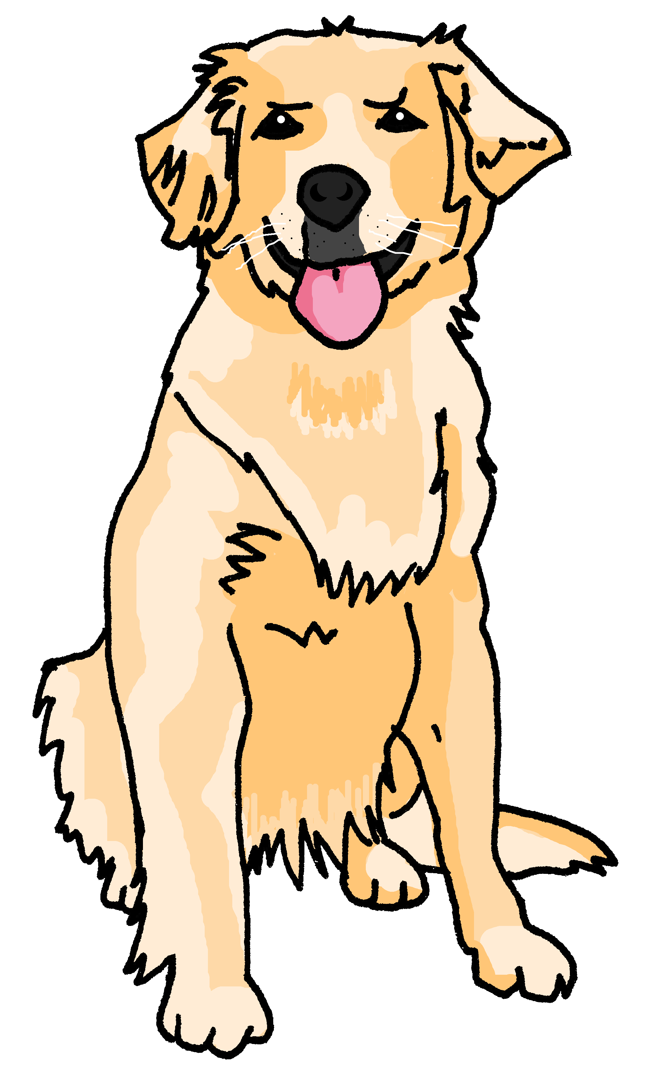
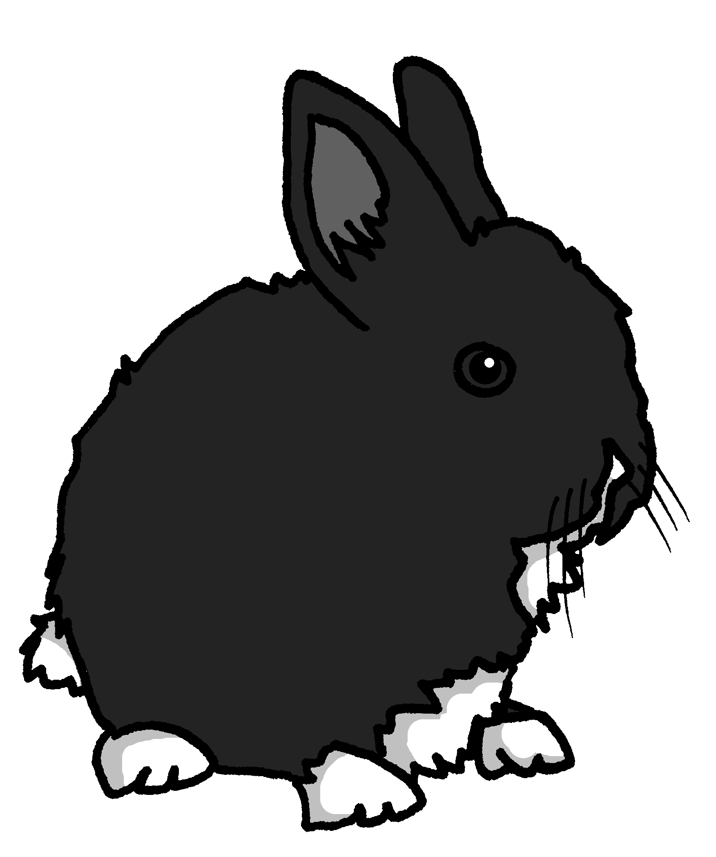

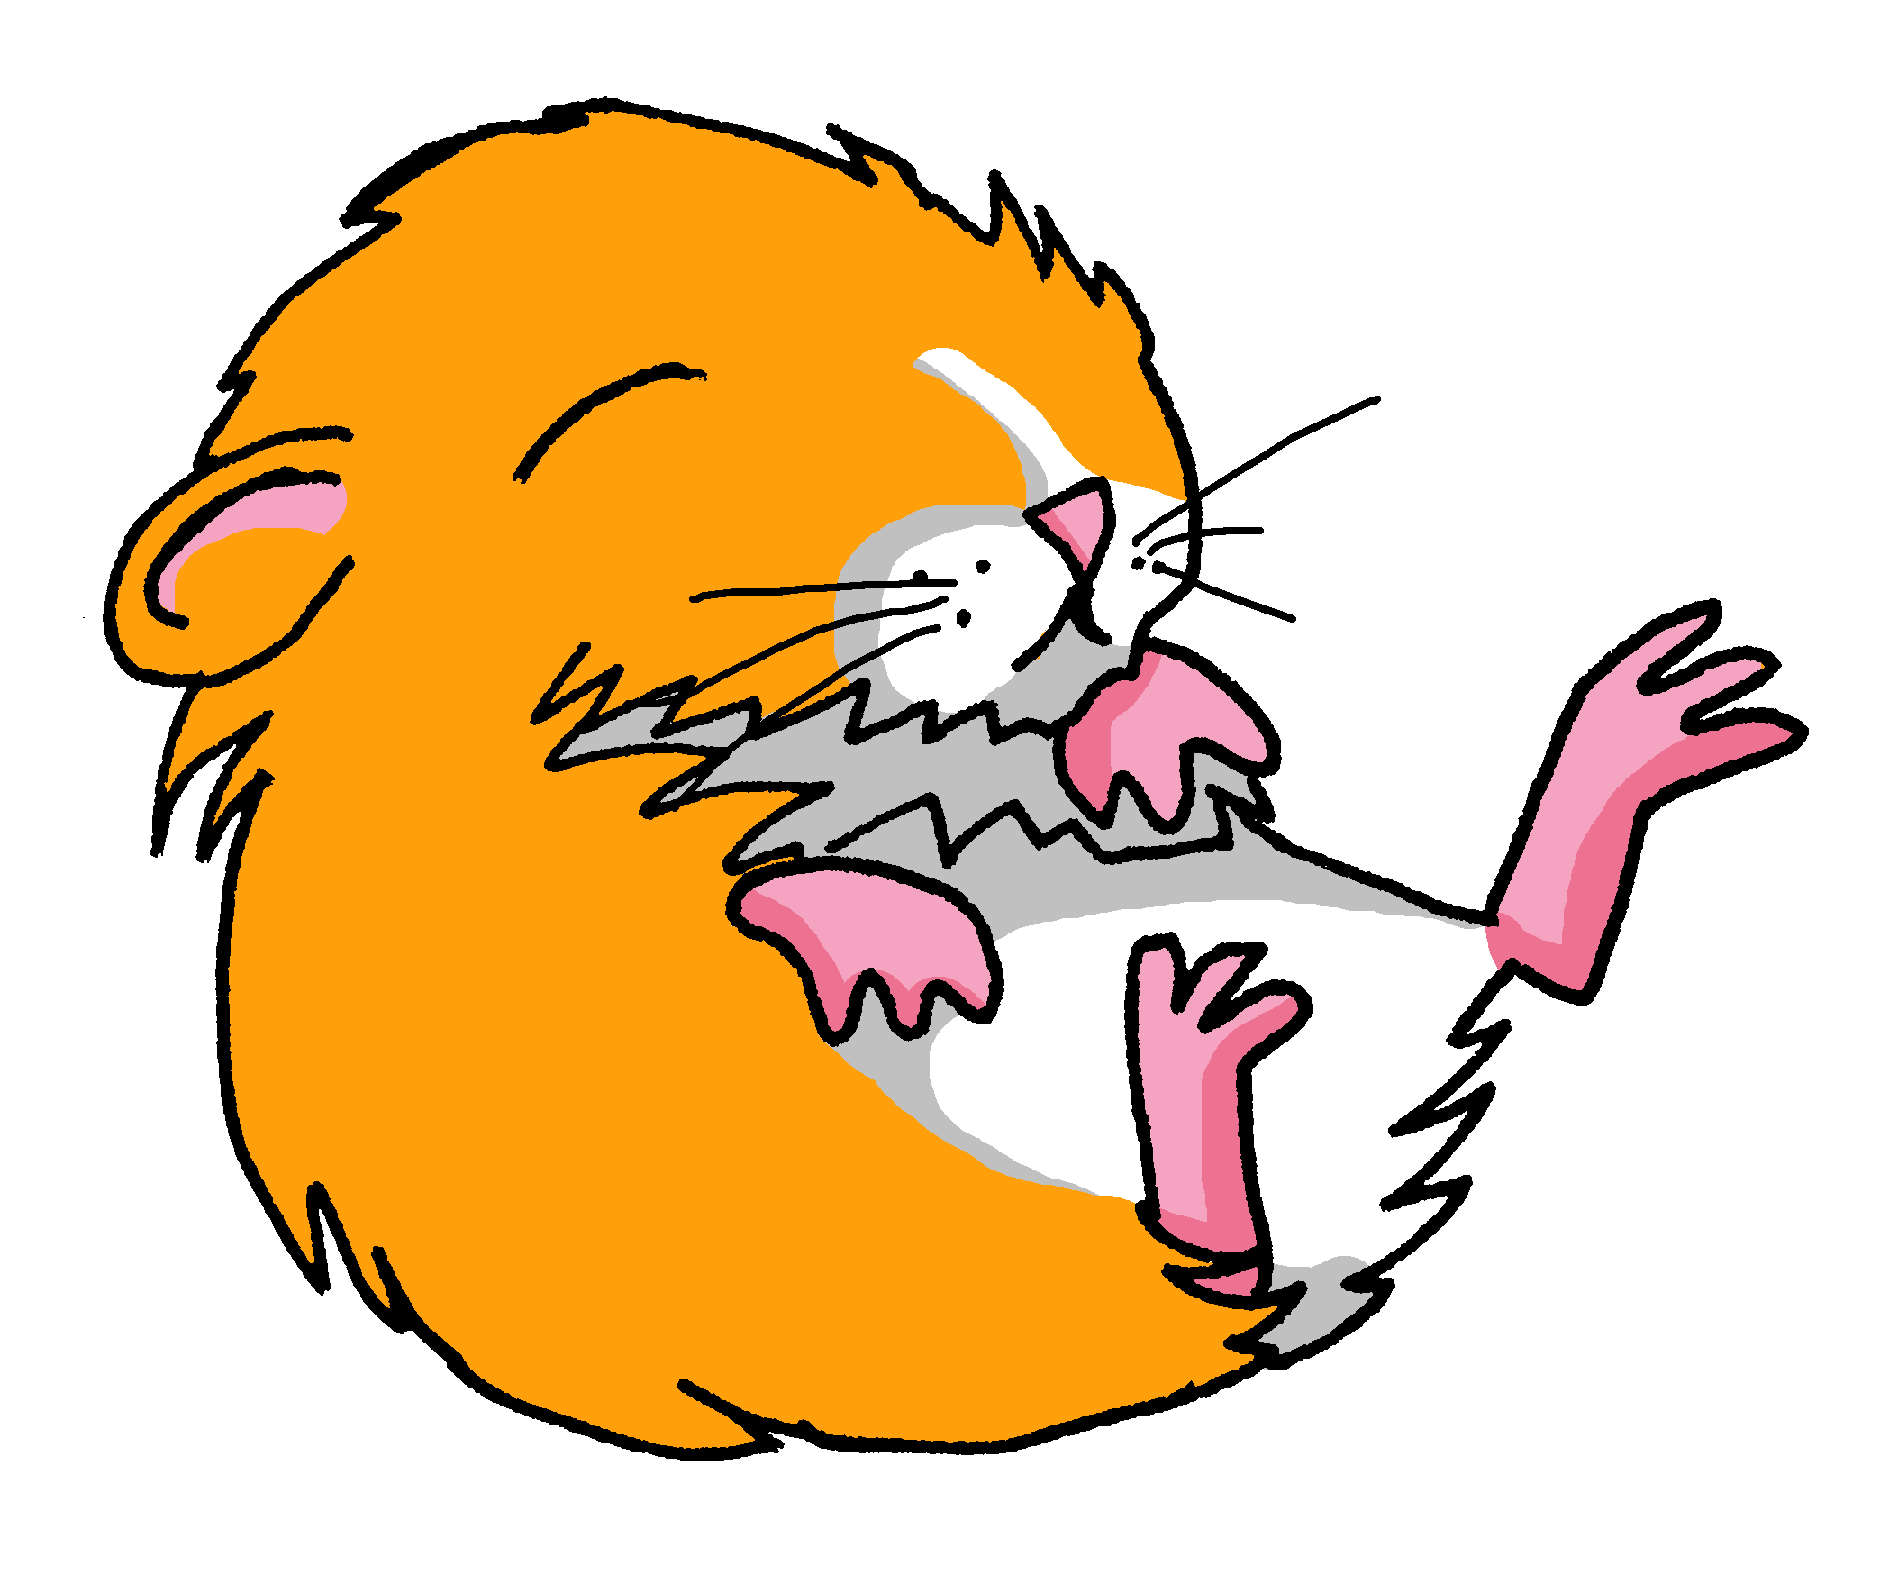
Follow up 2
Écoute bien. Qui parle ?
la famille Kergosien
1
2
3
écouter
4
5
6
7
8
A n n i c k
J a c q u e s
M y l è n e
H e r v é
C l a u d i n e
C l é m e n t i n e
J e a n – M i c h e l
A d è l e
P i e r r e
L u l u
É l o i
C h o u c h o u
M é d o r
Notes:
Timing: 5 minutes
Aim: to practise aural comprehension of full sentences with familiar language.
Procedure:
Teacher clarifies pupils need to work out who is speaking by listening to 8 sentences.
Pupils can be encouraged to make notes in English to help them.
Alternatively, the teacher can provide more support by eliciting the English sentence meanings one by one.
When pupils have suggested their answer, click to reveal.
Answer: Pierre
Transcript:
Clémentine, tu es ma cousine.
Lulu est ta tortue.
Éloi est ton animal.
Hervé et Claudine sont mes parents.
Jean-Michel est ton frère.
Annick et Jacques sont tes parents.
Médor est mon chien.
Adèle est ma sœur.

Slide 7






jouer de and jouer à
⚠ We just use ‘the’ in English.
Use jouer + de to say what instrument you play:
⚠ Remember: de + le → du
Je joue du piano.
I play the piano.
Elle joue de la guitare.
She plays the guitar.
Use jouer + à to say what sport you play:
⚠ In English we don’t use any article here.
⚠ Remember: à + le → au
Je joue au football.
I play football.
Il joue à la corde.
He plays skipping.
Notes:
Timing: 2 minutes
Aim: to recap jouer de to say you play an instrument and jouer à to say you play a sport.
Procedure:
Click through the animations to present the information.
Elicit English translations for the French examples provided.

Slide 8
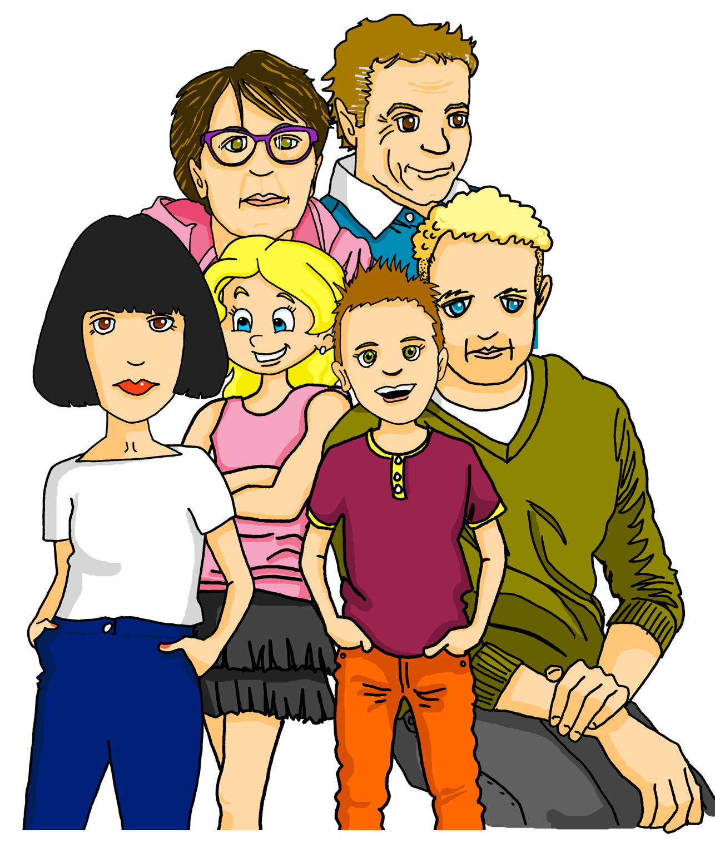







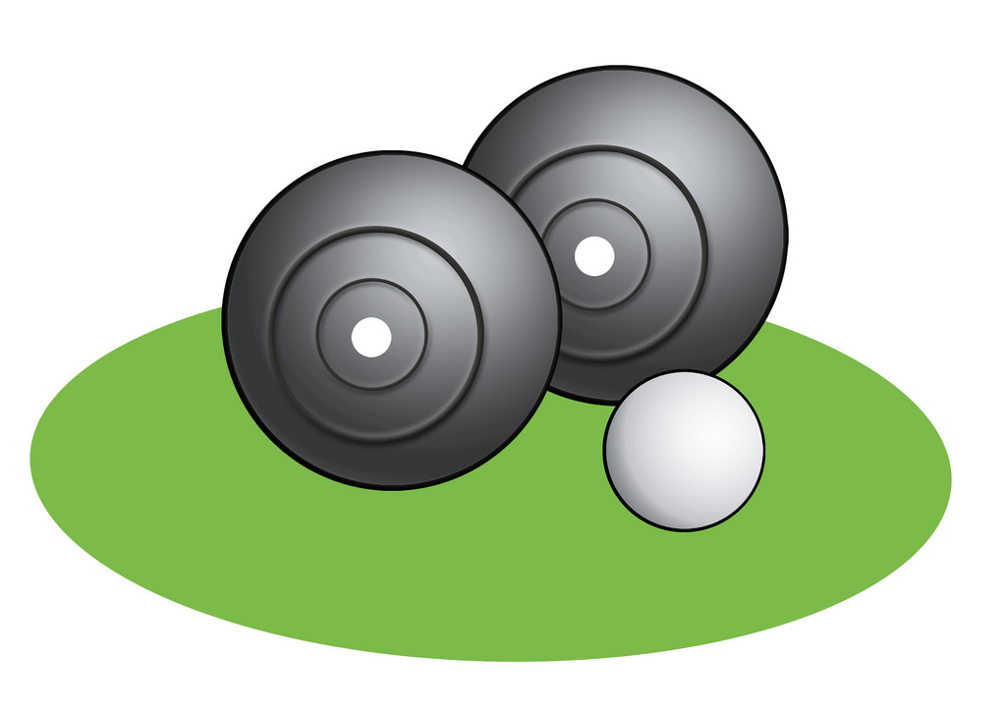

Follow up 3
Écoute Pierre. C’est A ou B ? Puis, écris en anglais.
écouter
A
sport
B
instrument
en anglais
1
I often play basketball with my friends.
1
2
I play tennis with my mum.
2
Adèle plays the violin with my grandma.
3
3
My dad plays the guitar. He is a music teacher.
4
4
At the weekend, my friends play football with me in the park.
5
5
6
My grandad plays the trumpet. He love it!
6
Notes:
Timing: 5 minutes
Aim: to practise aural comprehension, connecting jouer à to sports and jouer de to instruments; to practise comprehension of previously taught language and structures.
Procedure:
Pupils listen to a set of sentences and have to work out whether a sport or instrument is being talked about, depending on the preposition they hear.
Then they listen again and try to write the meaning of the full sentence in English.
Click to bring up a 2nd set of audio buttons, with full sentence audio.
Click to correct part 1, then part 2, listening to the audio, if required.
Transcript:
Je joue souvent au [basket] avec mes amis.
Je joue au [tennis] avec ma mère.
Adèle joue du [violon] avec ma grand-mère.
Mon père joue de la [guitare]. Il est professeur de musique.
Le weekend, mes amis jouent au foot avec moi dans le parc.
Mon grand-père joue de la [trompette]. Il adore ça !

Slide 9
quel | quelle
Remember! To ask ‘which’ with a masculine noun, use quel:
Tu joues quel sport ?
Which sport do you play?
Je joue au foot.
I play football.
⚠ You need de in the question, here.
⚠ You can shorten le football to le foot.
Tu joues de quel instrument ?
Which instrument do you play?
Je joue du piano.
I play the piano.
To mean ‘which’ with a feminine noun, use quelle:
Tu fais quelle activité ?
Which activity do you do?
Je fais une course (à pied).
I do a (running) race.
Notes:
DO THIS BEFORE FOLLOW UP 4
Timing: 2 minutes
Aim: to recap quel/quelle
Procedure:
Click through the animations.
Elicit English from pupils following the ?.

Slide 10

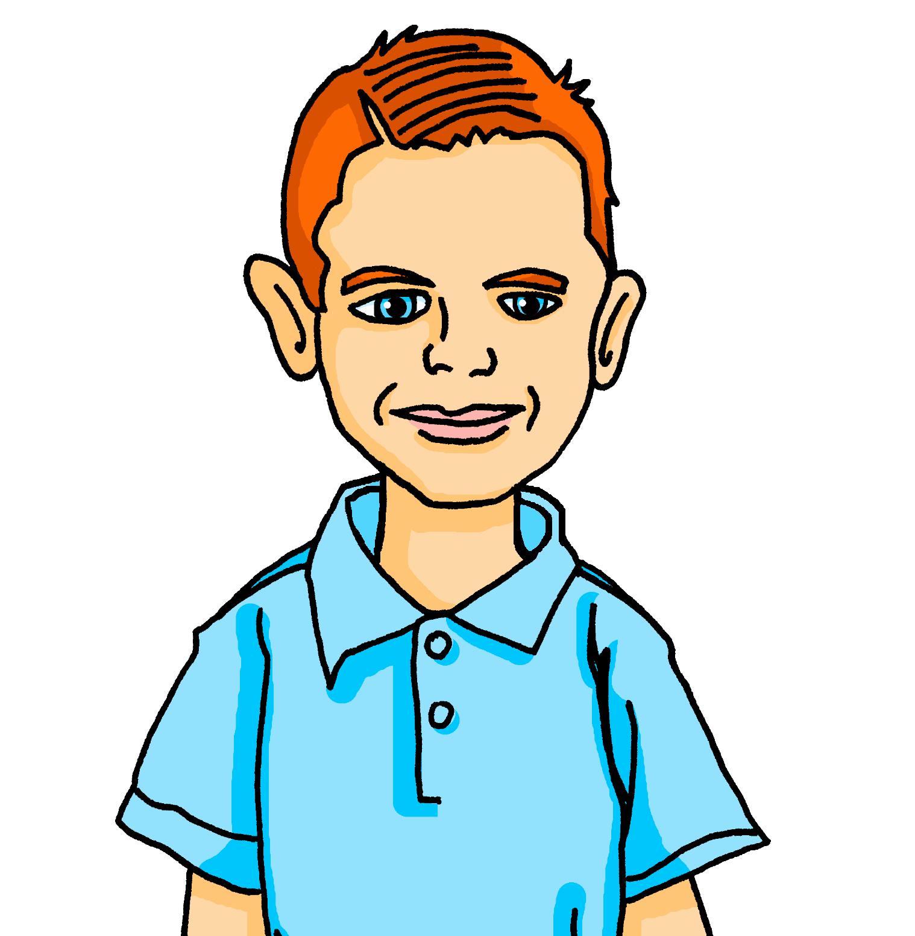
Follow up 4:
Max a un problème avec les devoirs de français.
Lis et complète les phrases. Écris 1C, 2?, etc...
lire
1 | Tu joues de quel…
2 | Il …
3 | Tu fais…
4 | Je joue du…
5 | Tu joues quel…
6 | Elle fait une…
7 | Il joue…
8 | Elle joue à
A | quelle activité ?
B | course à pied.
C | instrument ?
D | la corde.
E | fait un film.
F | sport ?
G | de la guitare.
H | piano.
1
2
3
4
5
6
7
8
Notes:
Timing: 5 minutes
Aim: to practise written comprehension of questions and answers about different activities, based on secure knowledge of the prepositions à, de and interrogatives quel/quelle and their connection to verbs and nouns respectively.
Procedure:
Explain the task using the title and instruction given.
Work through item 1 as an example. Elicit from pupils the reasons why the sentence ending cannot be F or H, for example.
Click to confirm the answer.
Allow pupils to work through items 2-8.
Elicit responses and click to provide answers.

Slide 11










Follow up 5a:
Partenaire A pose des questions.
Partenaire B répond. C’est A ou B ?
1
2
3
parler
A | B
A | B
A | B
60
2
5
6
S
A | B
A | B
A | B
Choose an appropriate question to ask:
Tu joues quel sport ? Tu joues de quel instrument ?
Tu fais quelle activité ?
0
DÉBUT
Notes:
Timing: 5 minutes (two slides)
Aim: to practise asking and answering questions about activities; to listen out carefully for the question in order to know how to respond.
Procedure:
Explain the task. Model item one with the class. Ask them ‘Tu joues quel sport ?’ and elicit the response ‘Je joue au foot’ (B). Then ask ‘Tu fais quelle activité ?’ and elicit ‘je fais un film’.
Make it clear that pupils can ask any appropriate question and that pupils need to listen out carefully to the question to know whether to answer with picture A or B prompts.
Complete all 6 items.
Swap roles – move to the next slide.
Note: Tell pupils asking the questions that they will have chosen the answer (A or B) for their partner (but without telling them) and will ask the appropriate question. Responding pupils should know from the question how to answer. As should flag to their partner if they get a different answer from the one expected, and the two pupils should try to work out where it went wrong.

Slide 12
Follow up 5b:
Partenaire B pose des questions.
Partenaire A répond. C’est A ou B ?
1
2
3
parler
A | B
A | B
A | B
45
2
5
6
S
A | B
A | B
A | B
Choose an appropriate question to ask:
Tu joues quel sport ? Tu joues de quel instrument ?
Tu fais quelle activité ?
0
DÉBUT
Notes:
Procedure:
For the 2nd round, teachers might like to a) put the timer on and/or b) remove the question prompts. Click on the teacher icon to remove the question prompts.

Slide 13




vocabulaire
Follow up Extra - Écris en anglais : Can you get at least 15 points?
mots
 | chercher | créer | regarder
 | utiliser | porter | danser
 | l’activité | faire | il fait
 | elle fait | le matin | je fais
 | le parent | le foot(ball) | le tennis
 | mes | la corde | tes
to look for
to create, creating
to look, watch
x3
to use, using
to wear, wearing
to dance, dancing
(the) activity
to do, make
he does, makes
x2
she does/makes
(the) morning
I do, make
(the) parent
(the) football
(the) tennis
x1
my (pl)
(the) rope
your (pl)
Notes:
Timing: 5-10 minutes
Aim: to practise written production of vocabulary from this week and two revisited weeks.
Procedure:
1. Give pupils a blank grid. They fill in the English meanings of any of the words they know, trying to reach 15 points in total.
2. Remind pupils that adjectives can refer to male or female persons and they should note this in their translations. E.g. pleased (f), short (m).
Note:
The most recently learnt and practised words are pink, words from revisit 1 are green and those from revisit 2 are blue, thus more points are awarded for them, to recognise that memories fade and more effort (heavy lifting!) is needed to retrieve them.
13

Slide 14
vocabulaire
Follow up Extra - Écris en français : Can you get at least 15 points?
mots
 | to find, finding | to sing, singing | to give, giving
 | to eat, eating | to dance, dancing | to wear, wearing
 | I do, make | (the) activity | she does, makes
 | he does/makes | to do, make | (the) morning
 | (the) tennis | my (pl) | your (pl)
 | (the) rope | (the) football | (the) parent
trouver
chanter
donner
x3
manger
danser
porter
je fais
l’activité
elle fait
x2
il fait
faire
le matin
le tennis
mes
tes
x1
la corde
le foot(ball)
le parent
Notes:
Timing: 5-10 minutes
Aim: to practise written comprehension of vocabulary from this week and previous weeks.
Procedure:
Give pupils a blank grid. They fill in the French meanings of any of the words they know, trying to reach 15 points in total.
Note:
The most recently learnt and practised words are pink, words from the previous week are green and those from earlier are blue, thus more points are awarded for them, to recognise that memories fade and more effort (heavy lifting!) is needed to retrieve them.
14

Slide 15
vocabulaire
Follow up Extra - Écris en anglais : Can you get at least 15 points?
mots
 | chercher | créer | regarder
 | utiliser | porter | danser
 | l’activité | faire | il fait
 | elle fait | le matin | je fais
 | le parent | le foot(ball) | le tennis
 | mes | la corde | tes
x3
x2
x1
Notes:
HANDOUT Extra 1
15

Slide 16
vocabulaire
Follow up Extra - Écris en français : Can you get at least 15 points?
mots
 | to find, finding | to sing, singing | to give, giving
 | to eat, eating | to dance, dancing | to wear, wearing
 | I do, make | (the) activity | she does, makes
 | he does/makes | to do, make | (the) morning
 | (the) tennis | my (pl) | your (pl)
 | (the) rope | (the) football | (the) parent
x3
x2
x1
Notes:
HANDOUT Extra 2
16

