Slide 1
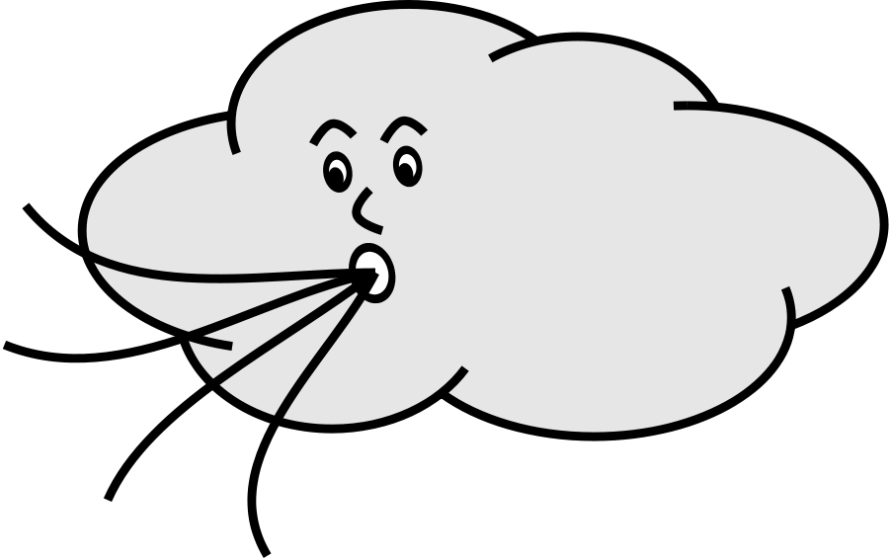
Saying what I and others do
vert
faire (il fait) for weather
SSC [-ien]
Notes:
Artwork by Steve Clarke. Pronoun pictures from NCELP (www.ncelp.org). All additional pictures selected from Pixabay and are available under a Creative Commons
license, no attribution required.
Phonics: [-ien] chien [1744] ancien [392] bientôt [1208] combien? [800] bien [47]
Vocabulary: Il fait² [25] Belgique [n/a] Canada [n/a] Grande-Bretagne [n/a] Espagne [n/a] France [n/a] Italie [n/a] Luxembourg [n/a] Suisse [n/a] chaud [1852] froid [1307] soleil [1713] vent [1387] à [4]
en [7]
Revisit 1: de² [2] côté [123] près [341] loin [341] piscine [>5000] théâtre [1701] stade [1967]
Revisit 2: la lumière [1059] le soir [397]
Londsale, D., & Le Bras, Y. (2009). A Frequency Dictionary of French: Core vocabulary for learners London: Routledge.
The frequency rankings for words that occur in this PowerPoint which have been previously introduced in these resources are given in the SOW and in the resources
that first introduced and formally re-visited those words.
For any other words that occur incidentally in this PowerPoint, frequency rankings will be provided in the notes field wherever possible.
1

Slide 2
[ien]
prononcer
good, well
bien
Notes:
Timing: 1 minute
Aim: to recap SSC [ien]
Procedure: 1. Present the letter(s) and say the [ien] sound first, on its own. Students repeat it with you. 2. Bring up the word ”bien” on its own, say it, students repeat it, so that they have the opportunity to focus all of their attention on the connection between the written word and its sound.
3. A possible gesture for this would be to give a thumbs up sign. 4. Roll back the animations and work through 1-3 again, but this time, dropping your voice completely to listen carefully to the students saying the [ien] sound, pronouncing ”bien” and, if using, doing the gesture.
Word frequency (1 is the most frequent word in French):
bien [47]
Source: Londsale, D., & Le Bras, Y. (2009). A Frequency Dictionary of French: Core vocabulary for learners London: Routledge.
2

Slide 3
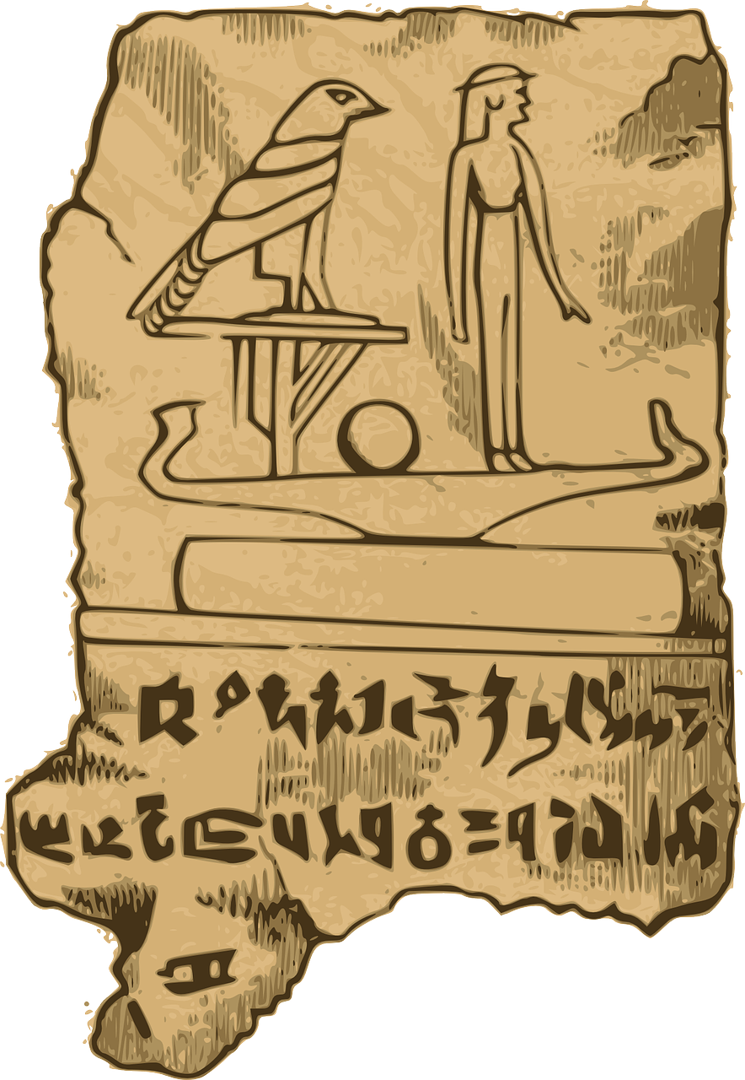
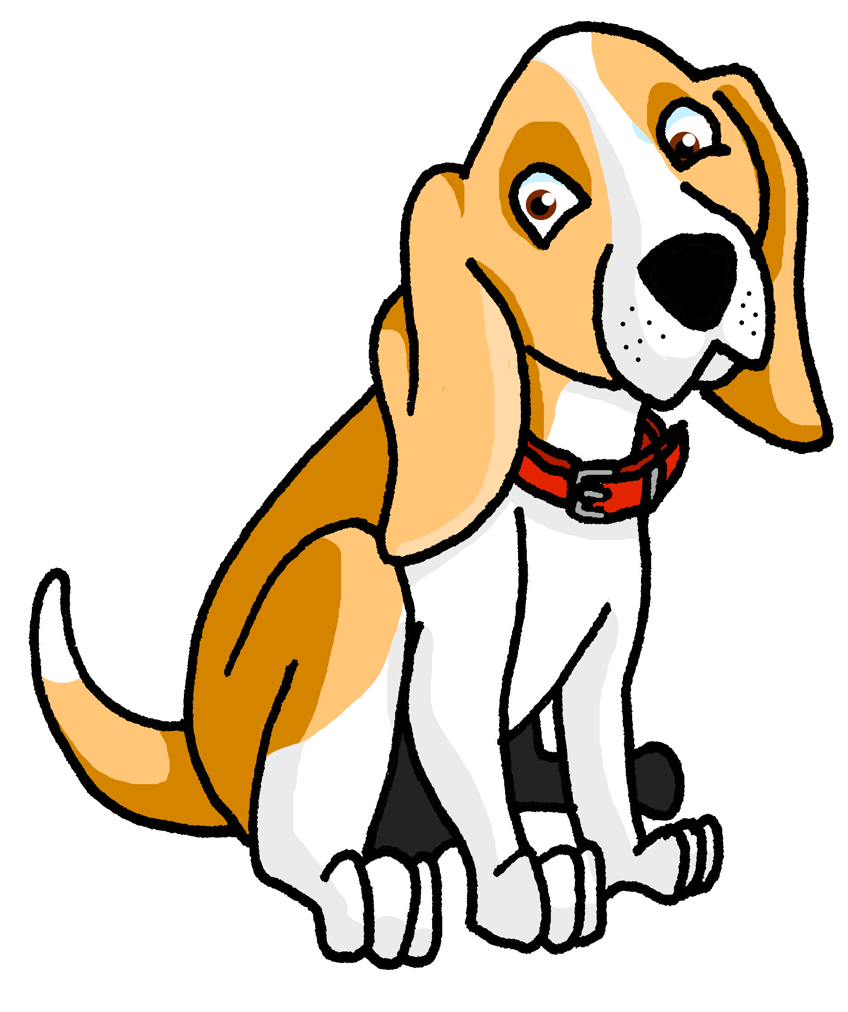
[ien]
prononcer
chien
ancien
bien
€ ?
bientôt
combien
Notes:
Timing: 2 minutes
Aim: to revisit SSC [ien]
Procedure:
1. Introduce and elicit the pronunciation of the individual SSC [ien] and then the source word again ‘bien’ (with gesture, if using). 2. Then present and elicit the pronunciation of the five cluster words.
The cluster words have been chosen for their high-frequency, from a range of word classes, with the SSC (where possible) positioned within a variety of syllables within the words (e.g. initial, 2nd, final etc.). Additionally, we have tried to use words that build cumulatively Word frequency (1 is the most frequent word in French): ancien [392] bien [47] bientôt [1208] chien [1744] combien? [800] Source: Londsale, D., & Le Bras, Y. (2009). A Frequency Dictionary of French: Core vocabulary for learners London: Routledge.
3

Slide 4
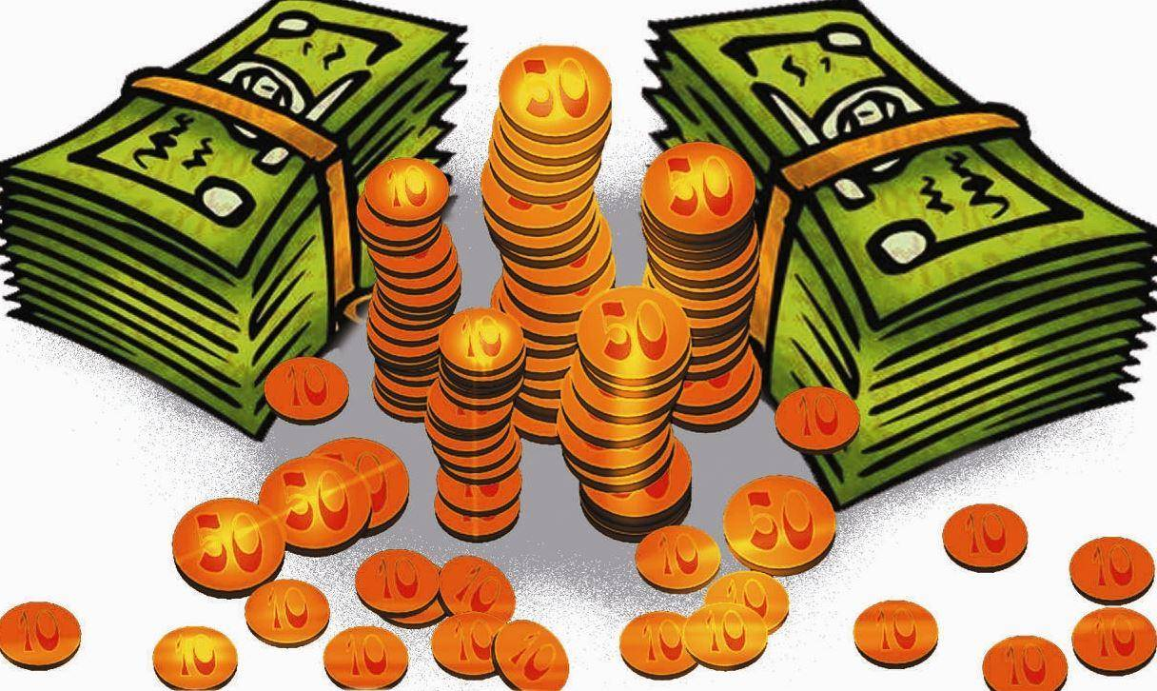
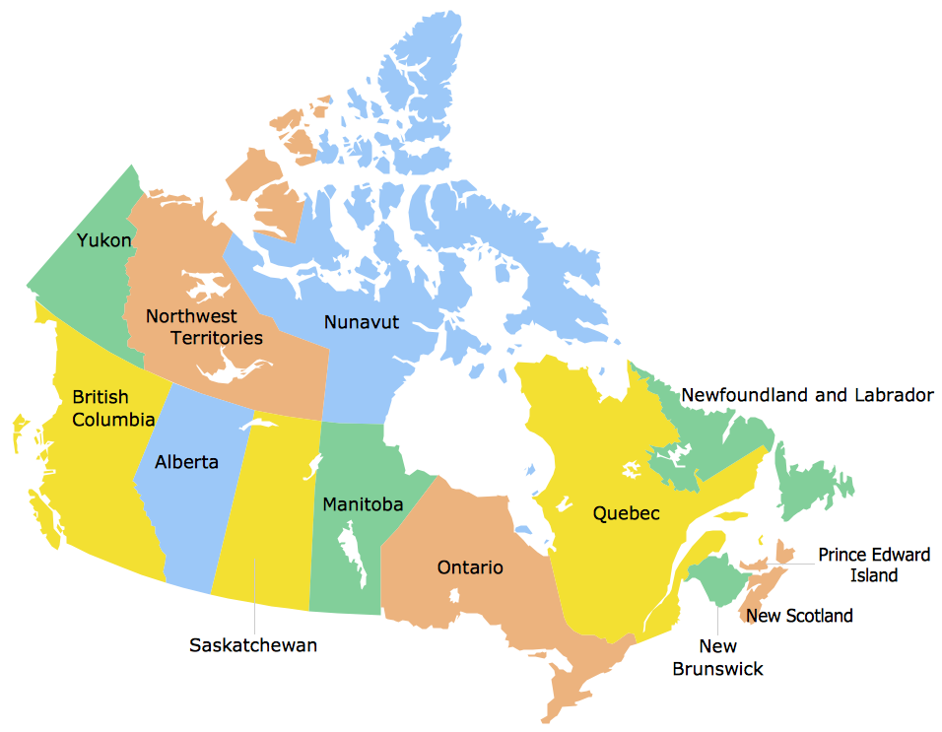
prononcer
Écoute. C’est [ien] ou [ion] ?
Puis, prononce les mots.
[ien] [ion]
[ien] [ion]
c h a m p i o n
e s p i o n
i t a l i e n
p a r i s i e n
b i l l i o n
h a ï t i e n
r é g i o n
c a n a d i e n
1
_____
5
______
2
______
6
______
______
7
______
3
4
______
8
______
Notes:
Timing: 5 minutes
Aim: to practise aural distinction between words with [ien] and [ion].
Procedure:
Read the instruction.
Do the first one with pupils. Remind them that [ien] and [ion] are both nasal sounds with the additional ‘i’ sound the graphemes.
Elicit responses chorally and click to reveal the answers.
Transcript:
champion
espion
italien
parisien
billion
haïtien
région
canadien
Frequency of unknown words and cognates: billion [>5000] canadien [611] champion [2443] espion [>5000] haïtien [>5000] italien [1477] parisien [2529] région [241] Londsale, D., & Le Bras, Y. (2009). A Frequency Dictionary of French: Core vocabulary for learners London: Routledge.

Slide 5
vocabulaire
Vocabulaire
mots
Écoute et prononce bien.
le soleil
chaud
le vent
froid
hot
cold
Notes:
Timing: 7 minutes (three slides)
Aim: to present and practise written comprehension and read aloud of previously taught vocabulary and the eight new words for this week (over two slides).
Procedure: 1. Click to bring up the French word and say the word together with the pupils.
2. Click to bring up the English meaning and/or image.
3. Click to animate the French word again and elicit repetition of the word.
4. Repeat with all 4 items and then proceed to the next slide.
5

Slide 6
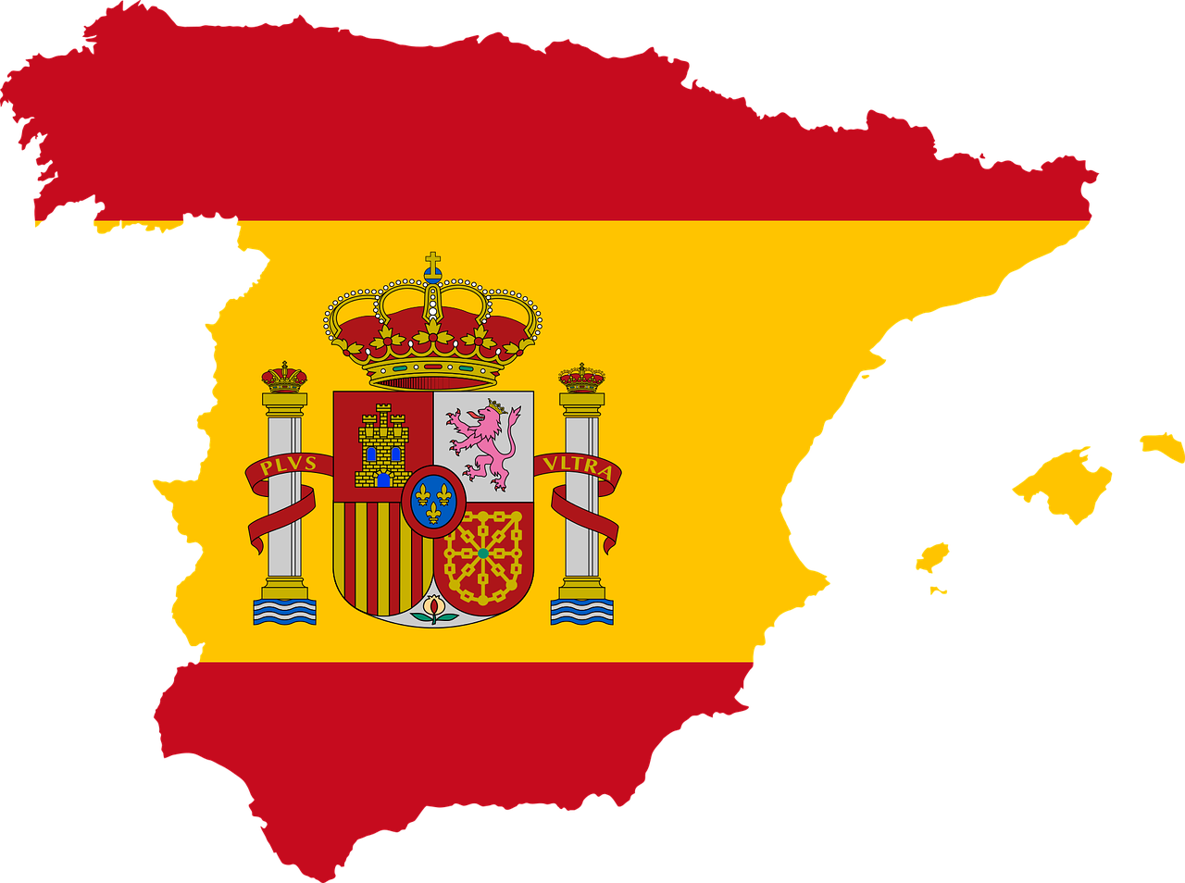
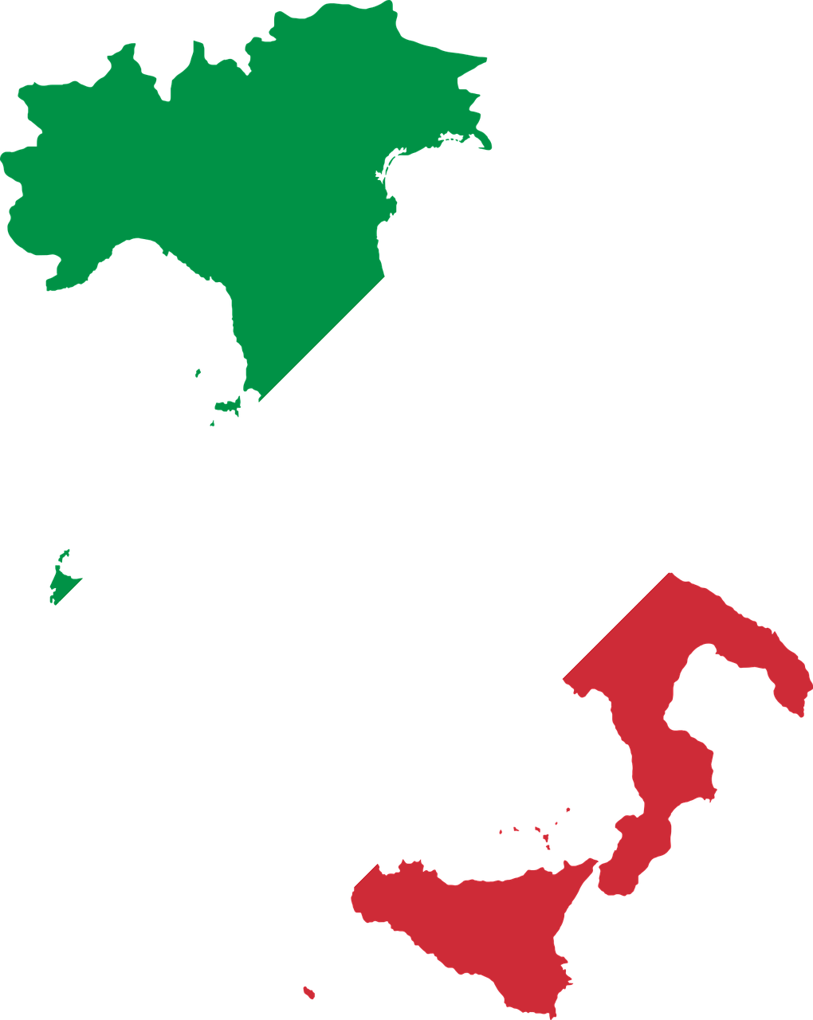
vocabulaire
Vocabulaire
mots
Écoute et prononce bien.
la Grande-Bretagne
la Belgique
la Suisse
l’Allemagne
l’Espagne
l’Italie
le Luxembourg
Notes:
[2/3]
Procedure: 1. Click to bring up the French word for pupils to look at and read in their heads, briefly.
2. Click to bring up the country image (with the audio in the audio version). Pupils repeat the word.
3. Click to animate the French word again and elicit repetition of the word again from pupils.
4. Repeat with all 7 items and then proceed to the next slide.
6

Slide 7
vocabulaire
Comment dit-on ça en français ?
mots
la Suisse
le soleil
l’Allemagne
le vent
l’Italie
froid
le Luxembourg
hot
la Belgique
chaud
la Grande-Bretagne
l’Espagne
Notes:
[3/3]
Aim: to practise written comprehension and read aloud of previously taught vocabulary and the eight new words for this week.
Procedure: 1. Click to bring up an English picture/word prompt.
2. Pupils find the corresponding French word and read it aloud, chorally.
3. Repeat with all items.
4. In the audio version, the audio is activated on appearance of the answer.
7

Slide 8
faire (for weather)
You know to use ‘il fait’ to mean ‘he does/is doing’:
Il fait un dessin.
He does/is doing a drawing.
Also use ‘il fait’ to mean ‘it is’ with weather:
⚠ This is a new meaning of ‘il fait’.
Il fait chaud.
It is hot.
⚠ Note that we use du (de + le) for these weather expressions in French because there is a (masculine) noun afterwards.
Il fait froid.
It is cold.
Il fait du soleil.
It is sunny.
Il fait du vent.
It is windy.
Notes:
Timing: 2 minutes
Aim: to recap il fait meaning ‘he does, is doing’ and introduce it to mean ‘it is’ for weather.
Procedure:
Click through the animations to present the information.
Elicit English translations for the French examples provided.

Slide 9
écouter
Écoute. Is it what Jean-Michel is doing or about the weather?
⚠ Attention ! Il fait = he does, makes|is doing, is making AND = it is …(weather)
 |  |  | en anglais
1
2
3
4
5
6
7
8
Or we could say ‘goes|is going cycling.
1
He does|is doing cycling.
2
It is windy.
3
It is cold.
4
He makes|is making a film.
Or we could say ‘goes|is going running.
5
He does|is doing running.
6
It is hot.
7
It is sunny.
8
He does|is doing sport.
Notes:
Timing: 6 minutes
Aim: to practise aural recognition of vocabulary and its connection with two meanings of ‘il fait’.
Procedure:
Pupils listen to each phrase.
Attending to the vocabulary following ‘il fait’ pupils decide between Pierre’s activity and a weather expression.
On the 2nd time of listening, pupils write the English meaning of the sentences.
Click to reveal answers.
Transcript:
Il fait du vélo. Il fait du vent. Il fait froid. Il fait un film. Il fait de la course à pied.
Il fait chaud. Il fait du soleil. Il fait du sport.
9

Slide 10
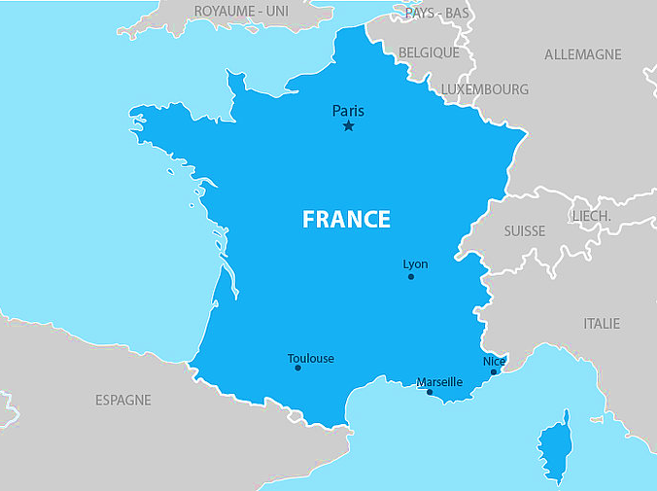
écouter
Les sept pays voisins de la France
Grande-Bretagne
Belgique
Allemagne
Luxembourg
Suisse
Italie
Espagne
*voisin - neighbouring
Notes:
Timing: 3 minutes (two slides)
Aim: to formally introduce the seven countries that neighbour France.
Procedure:
Click to see and hear the French names of the countries once more.
Pupils repeat.
10

Slide 11
Les sept pays voisins* de la France
La France a sept pays voisins
La France a sept pays voisins
Le Luxembourg, la Grande-Bretagne
La Belgique et l’Allemagne
La Suisse, l’Italie et l’Espagne
*voisin – neighbouring
Notes:
Procedure:
Click to play the song.
Pupils join in and sing along.
11

Slide 12
Au revoir !
vert
Notes:
12

