Slide 1
Describing me and others
vert
Follow ups 1-5
Notes:
Artwork by Steve Clarke. Pronoun pictures from NCELP (www.ncelp.org). All additional pictures selected from Pixabay and are available under a Creative Commons license, no attribution required.
Phonics: [-ien] chien [1744] ancien [392] bientôt [1208] combien? [800] bien [47]
Vocabulary: Il fait² [25] Allemagne [n/a] Belgique [n/a] Canada [n/a] Grande-Bretagne [n/a] Espagne [n/a] France [n/a] Italie [n/a] Luxembourg [n/a] Suisse
[n/a] chaud [1852] froid [1307] soleil [1713] vent [1387] à [4] en [7]
Revisit 1: de² [2] côté [123] près [341] loin [341] piscine [>5000] théâtre [1701] stade [1967]
Revisit 2: la lumière [1059] le soir [397]
Londsale, D., & Le Bras, Y. (2009). A Frequency Dictionary of French: Core vocabulary for learners London: Routledge.
The frequency rankings for words that occur in this PowerPoint which have been previously introduced in these resources are given in the SOW and in the resources that first introduced and formally re-visited those words.
For any other words that occur incidentally in this PowerPoint, frequency rankings will be provided in the notes field wherever possible.

Slide 2
Follow up 1
Écoute. Écris le numéro correspondant pour chaque image.
écouter
1
2
3
4
5
6
7
8
9
E
H
C
I
A
F
B
D
G
A | B | C
D | E | F
G | H | I
Notes:
Timing: 5 minutes
Aim: to practise recognition of the newly learnt expressions with ‘faire’ in the oral modality.
Procedure:
Click on the numbers to play the audio.
Pupils write 1 = A etc… (To challenge higher proficiency learners, ask them to record who is doing the action or just weather.
Click to provide answers.
Transcript:
Tu fais du vélo. Il fait du soleil. Je fais du sport. Il fait de la danse.
Il fait chaud. je fais un film.
Il fait du vent. Il fait froid. Elle fait de la course.

Slide 3
lire
Follow up 2
Lis les phrases. Identifie l’image correspondante.
1 | Il fait du soleil.
2 | Je fais de la danse.
3 | Il fait chaud.
4 | Il fait froid.
5 | Tu fais de la course.
6 | Elle fait du vélo.
7 | Il fait du vent.
8 | Il fait du sport.
A | B | C
D |  | E
F | G | H
1
C
2
H
3
G
4
F
5
D
6
E
7
A
8
B
Notes:
Timing: 6 minutes
Aim: to practise written recognition of the singular forms of ‘faire’ and connect these with meaning – differentiating between weather and activity expressions with faire.
Procedure:
1. Read the rubric and ensure that pupils understand the task.
2. Pupils read the sentences and note down the letter of the picture. (1=A etc.)
3. Answers revealed on clicks.
4. Optional – click the numbered buttons to hear the full sentences.
5. Ask additional questions to assess comprehension of the verb forms – e.g., who is doing the shopping?

Slide 4
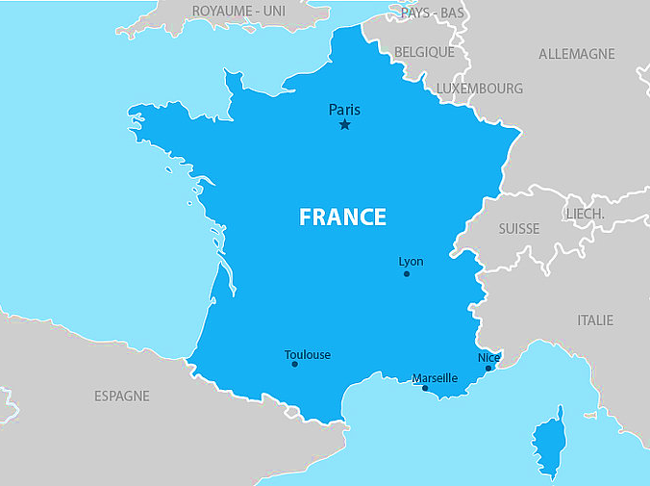
Les sept pays voisins* de la France
La France a sept pays voisins
La France a sept pays voisins
Le Luxembourg, la Grande-Bretagne
La Belgique et l’Allemagne
La Suisse, l’Italie et l’Espagne
*voisin – neighbouring
Notes:
Procedure:
Click to play the song.
Pupils join in and sing along.
4

Slide 5
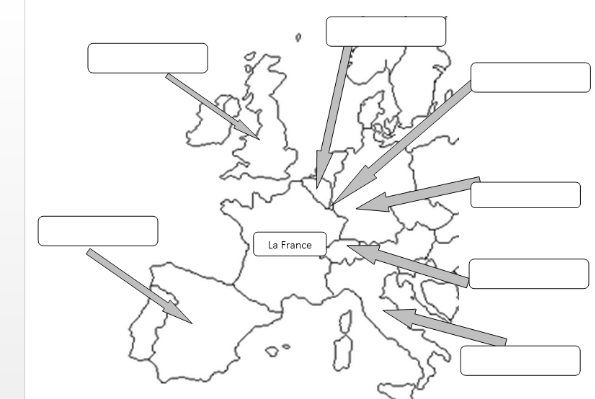
Follow up 3b
Écris les pays.
la Belgique
la
B_ _ _ _ _ _e
la Grande-Bretagne
la
lire
le Luxembourg
le
I_ _ _ _e
A_ _ _ _ _ _ _e
écrire
L_ _ _ _ _ _ _ _ g
l’Allemagne
l’
l’Espagne
l’
S_ _ _ _e
la Suisse
la
E_ _ _ _ _e
l’Italie
l’
G_ _ _ _ _-_ _ _ _ _ _ _e
Notes:
Procedure:
Pupils label the countries on the handout. (Alternatively they can number 1-7, starting with GB and going clockwise and write the country names).
Click to reveal the answers.
Click on each country word to hear it pronounced, if desired.

Slide 6
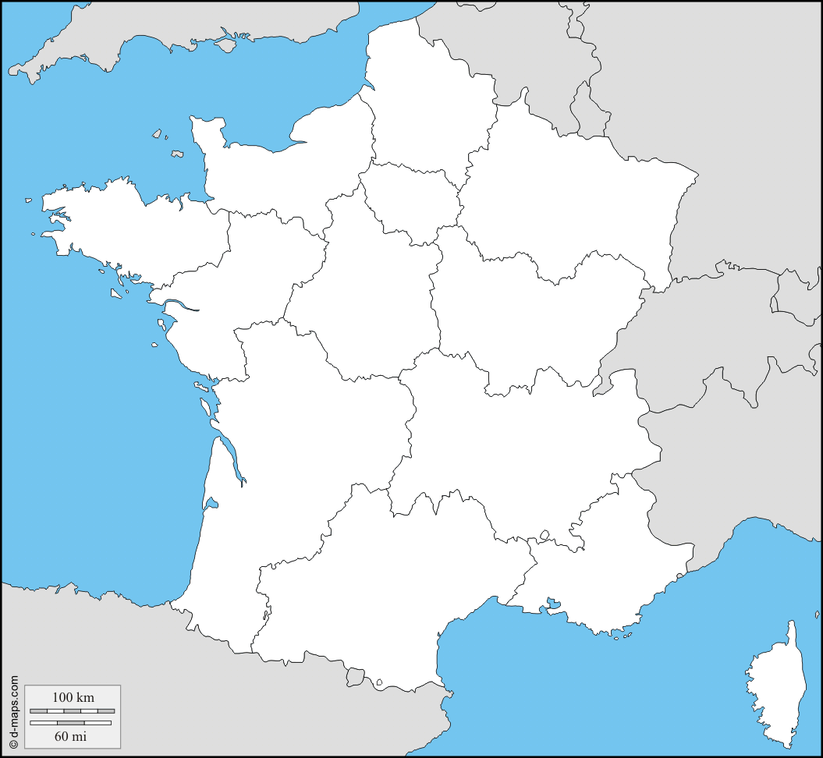
Follow up 4:

Écris huit phrases.
1 _____________________________
2
Il fait du vent en France.
3
écrire
4
Il fait froid en Grande-Bretagne.
2 _____________________________
5
Il fait ??? en Belgique.
1
3 _____________________________
6
4 _____________________________
Il fait chaud au Luxembourg.
7
5 _____________________________
Il fait du soleil en Allemagne.
en = in for feminine countries. Use au for le Luxembourg.
8
6 _____________________________
Il fait froid en Suisse.
7 _____________________________
Il fait ??? en Italie.
8 ________________________________________
Il fait chaud en Espagne.
Notes:
Timing: 5 minutes
Aim: to practise written production of ‘il fait’ and the four weather items from this week’s vocabulary, and the eight countries from this week.
Procedure:
1. Teacher models the task with sentence 1, using a ‘think aloud’ to interpret the picture, and eliciting suggestions from pupils as to a suitable sentence (perhaps initially in English and then French, or just in French).
2. Tell pupils that items 2-8 follow the same pattern. For numbers 3 and 7, pupils decide on the weather themselves. Click to bring up the information about ‘en/au’.
3. Click to provide the correct sentences.
Note: Teachers can differentiate the task, providing more support to lower proficiency learners by: i. shortening the task (choose 3 of the 7 sentences to write). ii. providing the initial letters of each word as prompts. iii. enabling pupils to look at the four vocabulary words (chaud, froid, du soleil, du vent) first and practise those on mini whiteboards etc..
iv. allowing pupils to use their handout from follow up 3 for support with the countries OR the KO for this half-term.

Slide 7
vocabulaire
Follow up 5b - Écris en anglais : Can you get at least 15 points?
mots
 | le soir | la lumière | le pays
 | le théâtre | le stade | la piscine
 | loin (de) | à côté de | près (de)
 | le soleil | la Belgique | le vent
 | la Suisse | la Grande-Bretagne | l’Espagne
 | l’Allemagne | le Luxembourg | l’Italie
x3
(the) evening
(the) light
(the) country
(the) theatre
(the) stadium
(the) pool
x2
far (from)
next to, beside
near (to)
(the) sun
Belgium
(the) wind
Switzerland
Great Britain
Spain
x1
Germany
Luxemburg
Italy
Notes:
Timing: 5-10 minutes
Aim: to practise written comprehension of vocabulary from this week and previous weeks.
Procedure: Give pupils a blank grid. They fill in the French meanings of any of the words they know, trying to reach 15 points in total.
Note: The most recently learnt and practised words are pink, words from the previous week are green and those from earlier are blue, thus more points are awarded for them, to recognise that memories fade and more effort (heavy lifting!) is needed to retrieve them.
7

Slide 8
vocabulaire
Follow up 5b - Écris en français : Can you get at least 15 points?
mots
 | (the) country | (the) light | (the) evening
 | (the) pool | (the) theatre | (the) stadium
 | next to, beside | far (from) | near (to)
 | Italie | Luxemburg | Switzerland
 | Spain | Great Britain | Germany
 | the sun | the wind | Belgium
x3
le pays
la lumière
le soir
la piscine
le théâtre
le stade
x2
à côté de
loin (de)
près de
l’Italie
le Luxembourg
la Suisse
l’Espagne
la Grande-Bretagne
l’Allemagne
x1
le soleil
le vent
la Belgique
Notes:
Timing: 5-10 minutes
Aim: to practise written production of vocabulary from this week and previous weeks.
Procedure: Give pupils a blank grid. They fill in the French meanings of any of the words they know, trying to reach 15 points in total.
Note: The most recently learnt and practised words are pink, words from the previous week are green and those from earlier are blue, thus more points are awarded for them, to recognise that memories fade and more effort (heavy lifting!) is needed to retrieve them.
8

Slide 9
vocabulaire
Follow up 5a - Écris en anglais : Can you get at least 15 points?
mots
 | le soir | la lumière | le pays
 | le théâtre | le stade | la piscine
 | loin (de) | à côté de | près (de)
 | le soleil | la Belgique | le vent
 | la Suisse | la Grande-Bretagne | l’Espagne
 | l’Allemagne | le Luxembourg | l’Italie
x3
x2
x1
Notes:
HANDOUT
9

Slide 10
vocabulaire
Follow up 5b - Écris en français : Can you get at least 15 points?
mots
 | (the) country | (the) light | (the) evening
 | (the) pool | (the) theatre | (the) stadium
 | next to, beside | far (from) | near (to)
 | Italy | Luxemburg | Switzerland
 | Spain | Great Britain | Germany
 | (the) sun | (the) wind | Belgium
x3
x2
x1
Notes:
HANDOUT
10

