Slide 1
Saying what I and others do
vert
faire de + sports
jouer de + instruments
SSC
Notes:
Artwork by Steve Clarke. Pronoun pictures from NCELP (www.ncelp.org). All additional pictures selected from Pixabay and are available under a Creative Commons
license, no attribution required.
Phonics: [-tion] attention [482] motion [855] population [509] pollution [3073] solution [608]
Vocabulary: tu fais [25] jouer [219] danse [2964] guitare [>5000] instrument [1650] piano [4967] sport [2011] vélo [4594]
Revisit 1: aimer [242] apporter [339] arriver [174] organiser [701] porter [105] préparer [368] créer [332] marcher [1532] monter [853] quitter [507] gens [236] puis
[230]
Revisit 2: tu vas je vais [53] tu es je suis [5] à (meaning ‘at/in/to’)[4] café [1886] campagne [666] centre commercial [n/a] église [1782] ile [1245] magasin [1736]
maison [325] marché [280] montagne [1732] plage [2693] pont [1889] port [1304]
Londsale, D., & Le Bras, Y. (2009). A Frequency Dictionary of French: Core vocabulary for learners London: Routledge.
The frequency rankings for words that occur in this PowerPoint which have been previously introduced in these resources are given in the SOW and in the resources
that first introduced and formally re-visited those words.
For any other words that occur incidentally in this PowerPoint, frequency rankings will be provided in the notes field wherever possible.
1

Slide 2
[-tion]
prononcer
Attention !
Notes:
Timing: 1 minute
Aim: To consolidate SSC [-tion]
Procedure: 1. Present the letter(s) and say the [-tion] sound first, on its own. Pupils repeat it with you. 2. Bring up the word ”Attention” on its own, say it, pupils repeat it, so that they have the opportunity to focus all of their attention on the connection between the written word and its sound.
3. Clarify the meaning (Watch out! Take care!).
3. A possible gesture for this word would be to hold up the right index finger up and waggle it quickly from side to side as a gesture of warning. 4. Roll back the animations and work through 1-3 again, but this time, dropping your voice completely to listen carefully to the pupils saying the [-tion] sound, pronouncing ”Attention” and, if using, doing the gesture.
2

Slide 3
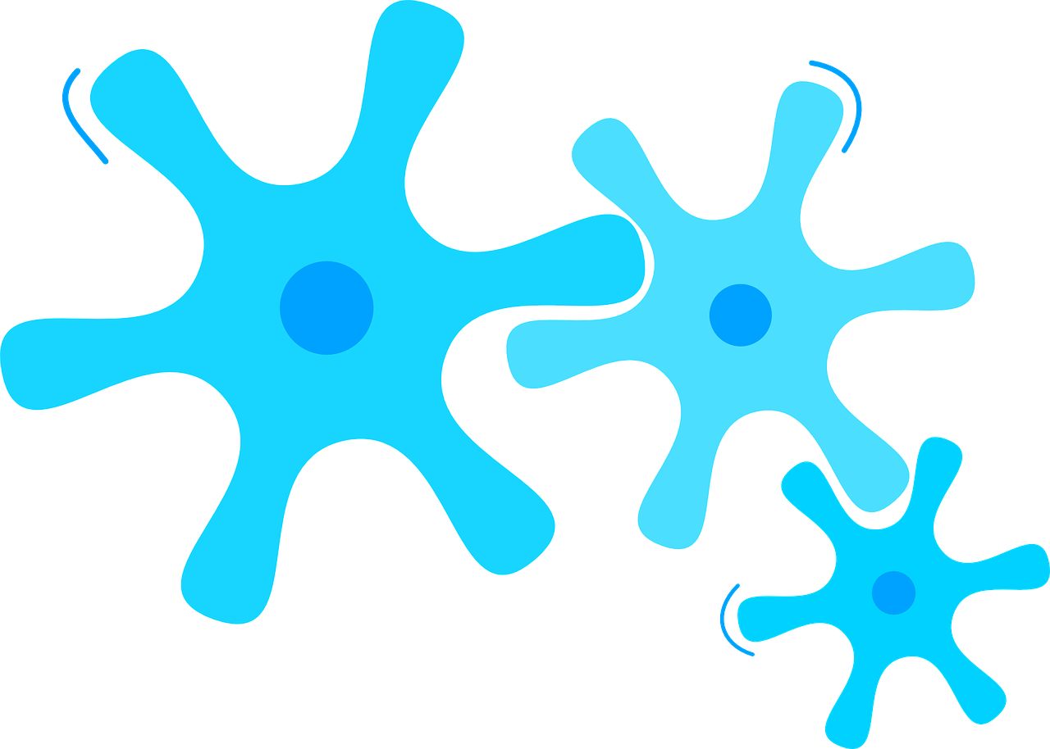
[-tion]
prononcer
motion
pollution
Attention !
solution
population
Notes:
Timing: 2 minutes
Aim: to consolidate SSC [-tion]
Procedure:
1. Introduce and elicit the pronunciation of the individual SSC [-tion] and then the source word again ‘Attention !’ (with gesture, if using). 2. Then present and elicit the pronunciation of the four cluster words.
The cluster words have been mainly chosen for their high-frequency, from a range of word classes, with the SSC (where possible) positioned within a variety of syllables within the words (e.g. initial, 2nd, final etc.). Additionally, we have tried to use words that build cumulatively on previously taught SSCs (see the Phonics Teaching Sequence document) and do not include new SSCs. Where new SSCs are used, they are often consonants which have a similar symbol-sound correspondence in English.
Word frequency (1 is the most frequent word in French): attention [482] motion [855] pollution [3073] population [509] solution [608] Source: Londsale, D., & Le Bras, Y. (2009). A Frequency Dictionary of French: Core vocabulary for learners London: Routledge.
3

Slide 4
prononcer
Écoute. C’est -tion ou -çon ?
Puis, prononce les mots.
-tion -çon
-tion -çon
l e ç o n
a c t i o n
f a ç o n
m a ç o n
s o l u t i o n
m u s c u l a t i o n
n a t a t i o n
g a r ç o n
1
______
5
______
2
______
6
______
______
way, manner
7
______
3
4
______
8
______
Notes:
Timing: 5 minutes
Aim: to practise aural distinction between words with ç and c before a, o, u.
Procedure:
Read the instruction.
Do the first one with pupils. Remind them that if they hear the a soft ‘c’ sound, the spelling is ç. Otherwise it is ‘c’.
Elicit responses chorally and click to reveal the answers.
Transcript:
leçon
action façon maçon solution musculation natation garçon
Frequency of unknown words and cognates: action [355] façon [4029] leçon [1300] maçon [>5000] solution [608] situation [223] natation [>5000] garçon [1599] Londsale, D., & Le Bras, Y. (2009). A Frequency Dictionary of French: Core vocabulary for learners London: Routledge.

Slide 5
vocabulaire
Vocabulaire
mots
Écoute et répète.
le piano
la guitare
l’instrument
le vélo
la danse
tu fais
Notes:
Timing: 5 minutes (three) slides
Aim: to present and practise new vocabulary for this week, with one revisited word, le vélo (taught in Rouge Term 3 Week 1).
Procedure: 1. Click for a French word. Elicit pronunciation from pupils.
2. Click for the English meaning and picture prompt. Elicit the French word again.
3. Present all six words like this, in order.
4. Move to the next slide.
5

Slide 6
vocabulaire
Vocabulaire
mots
Comment dit-on ça en anglais ?
?
?
?
le piano
la guitare
l’instrument
?
?
?
le vélo
la danse
tu fais
Notes:
Procedure: 1. Elicit English meanings from pupils one by one in order left to right, top to bottom.
2. Move to the next slide.
6

Slide 7
vocabulaire
Vocabulaire
mots
Comment dit-on ça en français ?
?
?
?
le piano
la guitare
l’instrument
?
?
?
le vélo
la danse
tu fais
Notes:
Procedure: Elicit French meanings from pupils one by one in order left to right, top to bottom.
7

Slide 8
faire (to do, make); faire de
Use faire + le/la/les to say a specific activity you do, make:
Je fais le film.
I make/am making the film.
Il fait la course à pied.
He does/is doing the race/running.
⚠ We don’t use anything here in English.
Use faire + de + le/la/les to say a sport you do in general:
⚠ Remember: de + le → du
Je fais du vélo.
I do/am doing cycling.
Il fait de la danse.
He does/is doing dance.
Tu fais du sport ?
Do you do sport?
⚠ Remember: you do/make is the same form as I do/make → fais.
Notes:
Timing: 2 minutes
Aim: to recap faire meaning and its use with definite articles and introduce faire de to say you do a sport.
Procedure:
Click through the animations to present the information.
Elicit English translations for the French examples provided.

Slide 9
jouer (to play) and jouer de
⚠ We just use ‘the’ in English.
Use jouer + de to say what instrument you play:
⚠ Remember: de + le → du
Je joue du piano.
I play the piano.
Elle joue de la guitare.
She plays the guitar.
Est-ce que tu joues
d’un instrument ?
Do you play an instrument?
⚠ To talk about playing instruments in French, always use jouer de.
Notes:
Timing: 2 minutes
Aim: to recap jouer meaning and its use with definite articles and introduce jouer de to say you play an instrument.
Procedure:
Click through the animations to present the information.
Elicit English translations for the French examples provided.

Slide 10
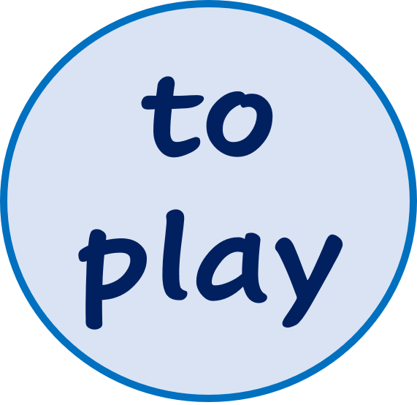
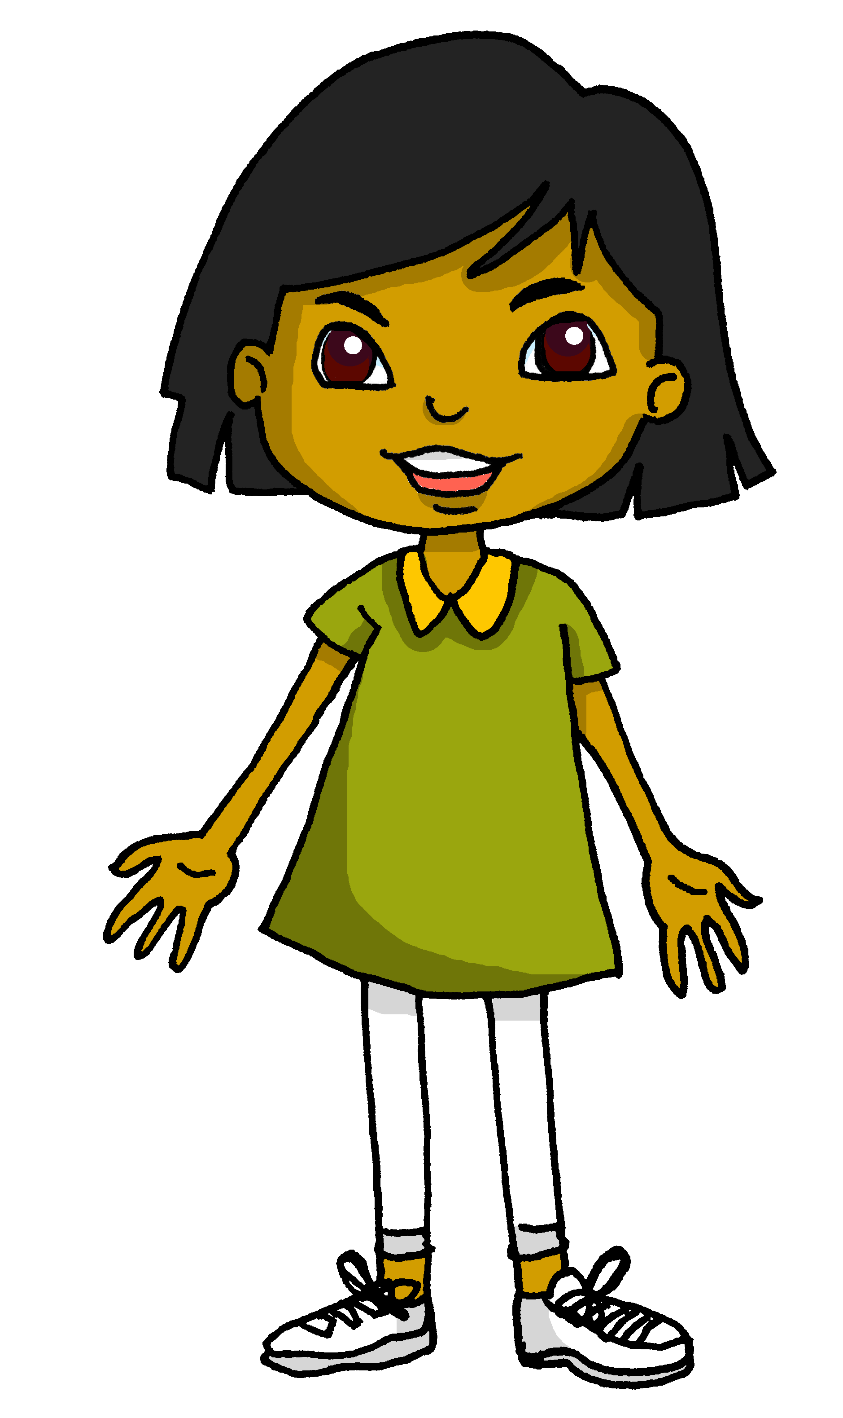
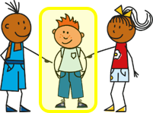
lire
C’est le weekend. Sanaya fait les devoirs de français.
Lis les phrases. C’est ‘jouer’ ou ‘faire’ ? L’activité, c’est quoi ?
1
Tu joues | fais du vélo.
2
Elle fait| joue du piano.
Tu fais | joues du jogging.
3
Tu joues | fais du ski.
4
Il joue | fait de la guitare.
5
Tu joues | fais de la danse.
6
*les devoirs = homework
Notes:
Timing: 5 minutes
Aim: to practise written recognition of correct verb meaning based on the meaning of the noun that follows.
Procedure:
1. Pupils read the sentences and decide which verb is correct. They should use their knowledge of verb and noun meaning to decide.
2. Answers revealed on clicks.
3. Optional – click the numbered buttons to hear the full sentences.

Slide 11
écouter
Est-ce que tu fais du sport ? Est-ce que tu joues d’un instrument ?
Écoute. C’est quelle activité ? A ou B ?
A
B
 | guitare (f) | saxophone (m)
 | trompette (f) | piano (m)
 | sport (m) | course à pied (f)
 | jogging (m) | danse (f)
 | flûte à bec (f) | piano (m)
 | vélo (m) | boxe (f)
1
2
3
4
5
6
Notes:
Timing: 5 minutes
Aim: to practise aural comprehension of du/de la and their connection with masculine and feminine nouns, including this week’s vocabulary. Note that the genders of the nouns are given to reduce the cognitive load, and that additional cognate nouns are also used in the activity.
Procedure:
Pupils listen to each phrase.
Pupils note the correct instrument or activity based on the form of de + article they hear.
Click to reveal the answers.
Then elicit full phrases from pupils: Comment dit-on ‘I play the guitar’ etc..
Click on the pictures for full sentence audio, if required.
Transcript:
Je joue de la [guitare].
Je joue du [piano].
Je fais de la [course à pied].
Je fais du [jogging].
Je joue de la [flûte].
Je fais du [vélo].
11

Slide 12
Au revoir !
vert
Notes:
12

