Slide 1
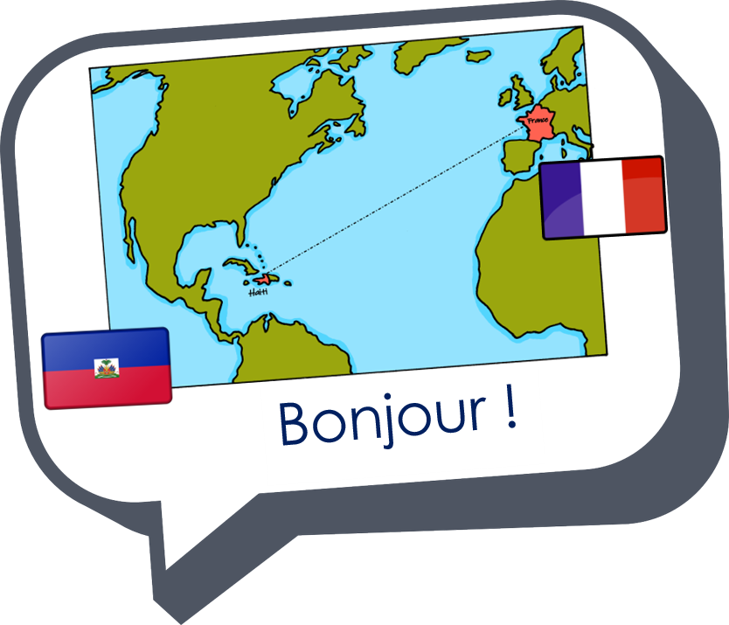











Saying what I and others do
vert
Follow ups 1-5
Notes:
Artwork by Steve Clarke. Pronoun pictures from NCELP (www.ncelp.org). All additional pictures selected from Pixabay and are available under a Creative Commons license, no attribution required.
Phonics: [-tion] attention [482] motion [855] population [509] pollution [3073] solution [608]
Vocabulary: tu fais [25] jouer [219] danse [2964] guitare [>5000] instrument [1650] piano [4967] sport [2011] vélo [4594]
Revisit 1: aimer [242] apporter [339] arriver [174] organiser [701] porter [105] préparer [368] créer [332] marcher [1532] monter [853] quitter [507] gens [236] puis
[230]
Revisit 2: tu vas je vais [53] tu es je suis [5] à (meaning ‘at/in/to’)[4] café [1886] campagne [666] centre commercial [n/a] église [1782] ile [1245] magasin [1736]
maison [325] marché [280] montagne [1732] plage [2693] pont [1889] port [1304]
Londsale, D., & Le Bras, Y. (2009). A Frequency Dictionary of French: Core vocabulary for learners London: Routledge.
Londsale, D., & Le Bras, Y. (2009). A Frequency Dictionary of French: Core vocabulary for learners London: Routledge.
The frequency rankings for words that occur in this PowerPoint which have been previously introduced in these resources are given in the SOW and in the resources that first introduced and formally re-visited those words.
For any other words that occur incidentally in this PowerPoint, frequency rankings will be provided in the notes field wherever possible.

Slide 2

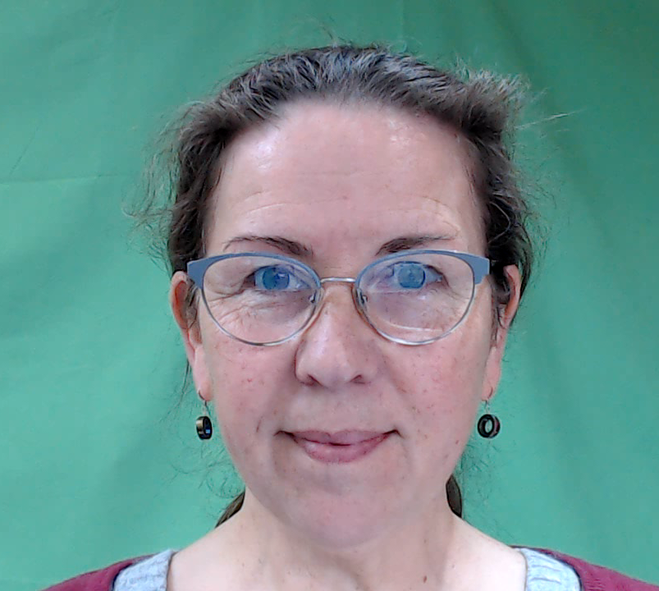


[-tion]
prononcer
Attention !
Notes:
Timing: 1 minute
Aim: To consolidate SSC [-tion]
Procedure:
1. Present the letter(s) and say the [-tion] sound first, on its own. Pupils repeat it with you.
2. Bring up the word ”Attention” on its own, say it, pupils repeat it, so that they have the opportunity to focus all of their attention on the connection between the written word and its sound.
3. Clarify the meaning (Watch out! Take care!).
3. A possible gesture for this word would be to hold up the right index finger up and waggle it quickly from side to side as a gesture of warning.
4. Roll back the animations and work through 1-3 again, but this time, dropping your voice completely to listen carefully to the pupils saying the [-tion] sound, pronouncing ”Attention” and, if using, doing the gesture.
2

Slide 3




[-tion]
prononcer
motion
pollution
Attention !
solution
population
Notes:
Timing: 2 minutes
Aim: to consolidate SSC [-tion]
Procedure:
1. Introduce and elicit the pronunciation of the individual SSC [-tion] and then the source word again ‘Attention !’ (with gesture, if using).
2. Then present and elicit the pronunciation of the four cluster words.
The cluster words have been mainly chosen for their high-frequency, from a range of word classes, with the SSC (where possible) positioned within a variety of syllables within the words (e.g. initial, 2nd, final etc.). Additionally, we have tried to use words that build cumulatively on previously taught SSCs (see the Phonics Teaching Sequence document) and do not include new SSCs. Where new SSCs are used, they are often consonants which have a similar symbol-sound correspondence in English.
Word frequency (1 is the most frequent word in French):
attention [482] motion [855] pollution [3073] population [509] solution [608]
Source: Londsale, D., & Le Bras, Y. (2009). A Frequency Dictionary of French: Core vocabulary for learners London: Routledge.
3

Slide 4








prononcer
Follow up 1:
émotion
Prononce les mots.
motivation
natation
60
organisation
équitation
musculation
option
S
position
motion
condition
direction
0
compétition
DÉBUT
Notes:
Timing: 5 minutes [2 rounds]
Aim: to practise the pronunciation of French words with the SSC [-tion].
Procedure:
Pupils work in pairs to practise pronunciation. They can choose where to start and have one minute to pronounce as many words as possible.
Click to start the timer. Pupils may have time for each partner to pronounce all the words within a minute.
Click on each word to hear it pronounced, as required.
Frequency of unknown words and cognates:
competition [2651] condition [281] direction [582] émotion [1854] equitation [>5000] motivation [3522] motion [855] musculation [>5000] natation [>5000] option [2156] organisation [570] position [383]
4

Slide 5


Asking questions using Est-ce que…
-ER verbs: tu (you), vous (you, formal)
Remember! To make it clear that a yes/no question is being asked, we can add Est-ce que (‘Is it that…?’) at the start of any statement:
Est-ce qu’il fait du vélo ?
Oui, il fait du vélo.
Does he do/go cycling?
Yes, he does/goes cycling.
Is he doing/going cycling?
Yes, he is doing/going cycling.
To ask a ‘what’ question, we can add Qu’est-ce que (‘What is it that…?’) at the start of any statement:
Qu’est-ce que tu fais ?
Je fais de la course.
What do you do, make?
I do/go running.
What are you doing, making?
I’m going/going running.
Notes:
Do this recap before Follow up 4.
Timing: 2 minutes
Aim: to recap the use of Est-ce que to ask questions and introduce Qu’ est-ce que
(Remember that pupils have already also been taught Où est-ce que)
Procedure:
Click through the animations to present the information.
Elicit English translations for the French examples provided.

Slide 6
Asking questions using ‘Qu’est-ce que…
The ‘s’ sound is the soft ‘c’.
Let’s practise saying Qu’est-ce que questions:
The –st are silent.
1
Qu’est-ce que tu fais ?
2
Qu’est-ce que tu fais ?
What do you do, make?
What are you doing, making?
What do you do, make?
What are you doing, making?
When you say it slowly there are five separate syllables.
In conversation we speed up and there are four syllables.
Notes:
Timing: 2 minutes
Aim: to practise pronouncing Qu’est-ce que
Procedure:
Click through the animations to present the information.
Click each audio button to hear Qu’est-ce que at two different speeds.

Slide 7

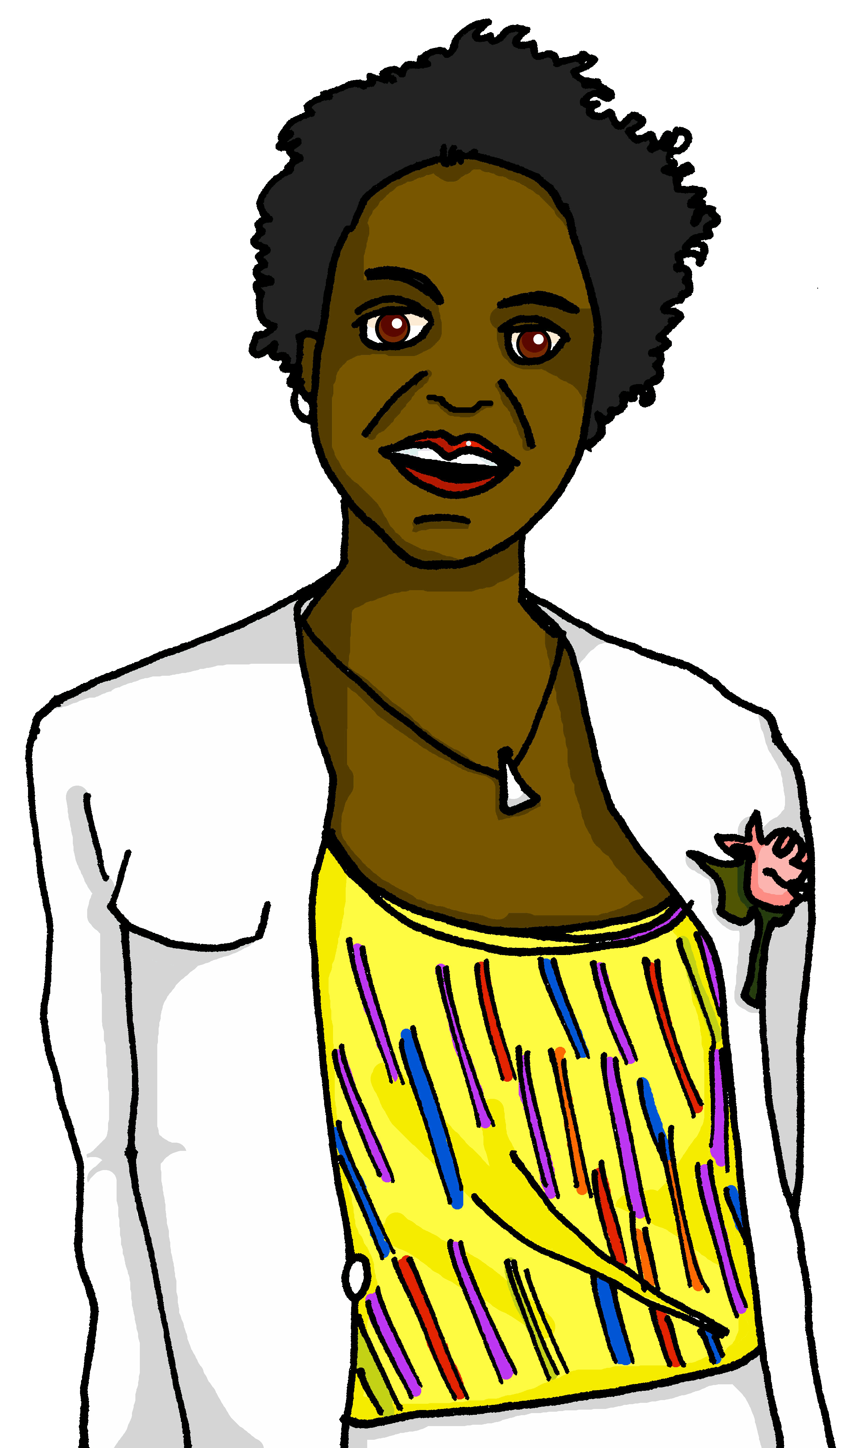
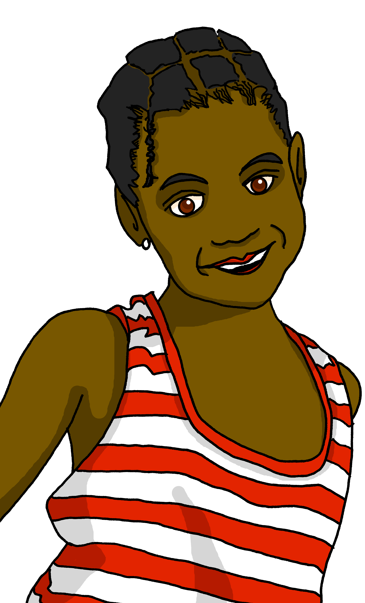
Follow up 2
Écoute. Quelle est la réponse correspondante ?
1
2
3
4
5
écouter
A
B
1
Oui, je fais de la course à pied.
Je fais de la course à pied.
2
Je fais de la danse.
Non, je ne fais pas de la danse.
3
Je joue du piano.
Oui, à la maison.
4
Je joue de la guitare.
Oui, je joue de la guitare.
5
Non, je ne joue pas du violon.
Je joue du violon.
Notes:
Timing: 5 minutes
Aim: to practise aural comprehension of and differentiation between ‘qu’est-ce que’ and ‘est-ce que’ questions.
Procedure:
Read the instruction in French. Explain that Est-ce que (is/are) questions are ‘yes/no’ questions, but that qu’est-ce que (what) questions require information and can’t be answered with a yes/no.
Do [1] with the pupils. Click to listen. Pupils write A or B, depending on the question they hear.
Click for answer.
Complete items 2-5 and click to correct with the class.
Transcript:
Qu’est-ce que tu fais le weekend ?
Est-ce que tu fais de la danse avec moi ?
Est-ce que tu joues du piano ?
Qu’est-ce que tu fais le samedi ?
Est-ce que tu joues du violon ?

Slide 8

Follow up 3:
Parle avec ton/ta partenaire.
B: Ask your partner: What are you doing?
parler
Qu’est-ce que tu fais ?
A: Tell your partner: I am doing or playing… and the 3 activities on your card.
Je fais means I do/make AND I am doing/making; je joue means
I play/am playing.
B: Ask your partner: What am I doing?
Qu’est-ce que je fais ?
A: Tell your partner: You are doing or playing… and the 3 activities on your card.
Then swap roles!
B: Make sure you write down all six activities.
Notes:
Timing: 5 minutes
Aim: to practise oral production and comprehension of positive and negative statements with je fais and tu fais and previously taught nouns.
Procedure:
1. Pupil A has Handout A (see end of this lesson PPT).
2. Pupil B listens to Pupil A and writes the three activities that start ‘You are doing/making…’ and the three that start ‘I am doing/making…’
3. Swap roles and move to the next slide.

Slide 9

Follow up 4A:
Réponses
A: Parle.
B: Écris.
Say: ‘You are doing/making …’ 3 activities
and ‘I am doing/making’… 3 activities.
parler
Listen and write the six activities.
Tu…
Tu…
Tu…
Je…
Je…
Je…
I am …
I am …
I am …
You are …
You are …
You are …
joues de la guitare.
playing the guitar.
fais de la danse.
doing dance.
fais du sport.
doing sport.
joue d’un instrument.
playing an instrument.
joue du piano.
playing the piano.
fais du vélo.
doing/going cycling.
Notes:
ANSWERS – DO NOT DISPLAY DURING THE ACTIVITY
Procedure:
Elicit French from partner As and English from partner Bs.
Click to reveal written answers.
Continue with the answers for 4B on the next slide.

Slide 10
Follow up 4B:
Réponses
B: Parle.
A: Écris.
Tell your partner: ‘You are going …’ to 3 places and ‘I am going’… to 3 places.
parler
Listen and write the six places.
Tu…
Tu…
Tu…
Je…
Je…
Je…
I am …
I am …
I am …
You are …
You are …
You are …
fais de la course (à pied).
doing/going running.
joues du piano.
playing the piano.
fais du vélo.
doing/going cycling.
fais du sport.
doing sport.
fais de la danse.
doing dance.
joue de la guitare.
playing the guitar.
Notes:
ANSWERS – DO NOT DISPLAY DURING THE ACTIVITY

Slide 11










Follow up 4A:
Parle avec ton/ta partenaire.
A: Parle.
A: Écris.
Say: ‘You are doing/making …’ 3 activities
and ‘I am doing/making’… 3 activities.
Listen and write the six activities with either ‘doing’ or ‘making’.
parler
Tu…
Tu…
Tu…
Je…
Je…
Je…
I am …
I am …
I am …
You are …
You are …
You are …
Notes:
HANDOUT PARTENAIRE A

Slide 12

Follow up 4B:
Parle avec ton/ta partenaire.
B: Écris.
B: Parle.
parler
Listen and write the six activities with either ‘doing’ or ‘making’.
Say: ‘You are doing/making …’ 3 activities
and ‘I am doing/making’… 3 activities.
I am …
I am …
I am …
You are …
You are …
You are …
Tu…
Tu…
Tu…
Je…
Je…
Je…
Notes:
HANDOUT PARTENAIRE B

Slide 13




vocabulaire
Follow up 4a - Écris en anglais : Can you get at least 15 points?
mots
 | aller | le vélo | la maison
 | tu es | tu vas | à
 | les gens | quitter | créer
 | marcher | monter | puis
 | tu fais | la danse | faire
 | la guitare | l’instrument | le piano
to go, going
(the) bicycle
(the) house
x3
you are
you go, are going
to, at, in, on
x2
(the) people
to leave somewhere
to create
to walk, walking
to ride, climb up/on/into
then
you do, make
(the) dance
to do, to make
x1
(the) guitar
(the) instrument
(the) piano
Notes:
Timing: 5-10 minutes
Aim: to practise written production of vocabulary from this week and two revisited weeks.
Procedure:
1. Give pupils a blank grid. They fill in the English meanings of any of the words they know, trying to reach 15 points in total.
2. Remind pupils that adjectives can refer to male or female persons and they should note this in their translations. E.g. pleased (f), short (m).
Note:
The most recently learnt and practised words are pink, words from revisit 1 are green and those from revisit 2 are blue, thus more points are awarded for them, to recognise that memories fade and more effort (heavy lifting!) is needed to retrieve them.
13

Slide 14
vocabulaire
Follow up 4b - Écris en français : Can you get at least 15 points?
mots
 | you are | (the) house | at, in, to, on
 | you go | to go, going | (the) bicycle
 | then | to ride, climb up/on/into | (the) people
 | to create | to walk, walking | to leave somewhere
 | (the) guitar | (the) instrument | (the) piano
 | to do, to make | you do, make | (the) dance
tu es
la maison
à
x3
tu vas
aller
le vélo
x2
puis
monter
les gens
créer
marcher
quitter
la guitare
l’instrument
le piano
x1
faire
tu fais
la danse
Notes:
Timing: 5-10 minutes
Aim: to practise written comprehension of vocabulary from this week and previous weeks.
Procedure:
Give pupils a blank grid. They fill in the French meanings of any of the words they know, trying to reach 15 points in total.
Note:
The most recently learnt and practised words are pink, words from the previous week are green and those from earlier are blue, thus more points are awarded for them, to recognise that memories fade and more effort (heavy lifting!) is needed to retrieve them.
14

Slide 15

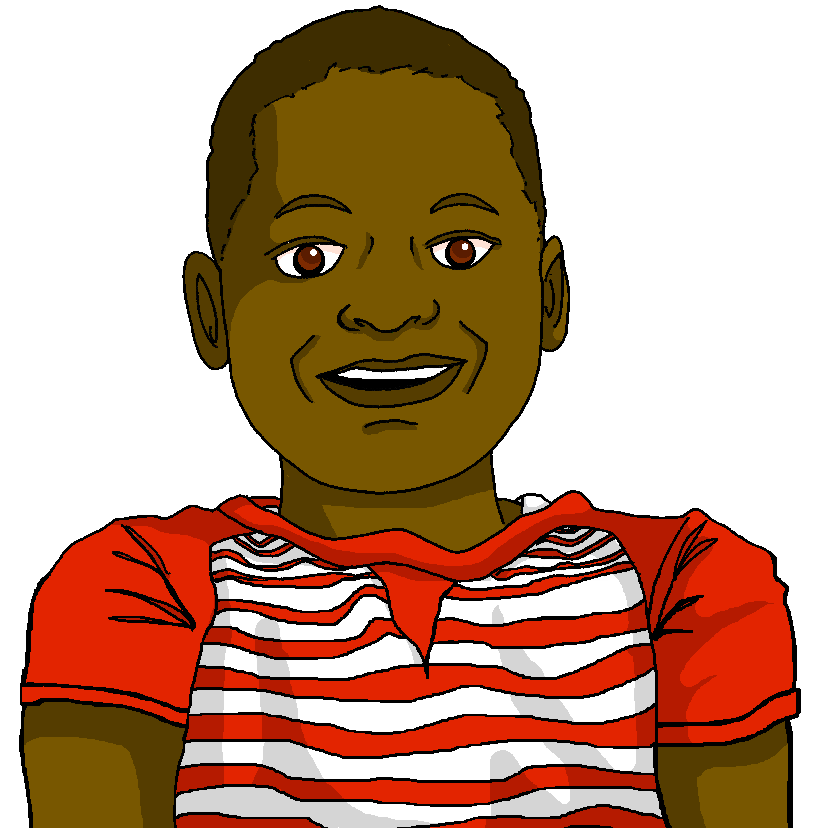
Follow up 5
Tu es Clémentine et tu organises ta semaine.
Tu écris des messages à ton frère. Écris cinq phrases avec
‘je’ (Clémentine) ou ‘tu’ (Jean-Michel).
écrire
4
2
5
1
3
1
Je fais du sport.
⚠ Remember: you do/make is the same form as I do/make → tu fais.
2
Tu fais de la danse.
3
Je joue du piano.
4
Je fais de la course (à pied).
5
Tu joues de la guitare.
Notes:
Timing: 5 minutes
Aim: to practise written production of vocabulary and the first and third person singular forms of faire + de and jouer de + de.
Procedure:
Check understanding of the rubric, given in French. Pupils know these words from previous learning.
Use stressed intonation and strategic pointing (i.e. at Clémentine and Jean-Michel) to ensure that the instruction for the task is fully understood.
Do the first one together as an example, ensuring pupils focus on the verb ending as well as the pronoun, when feedback on the first answer is given.
Then give students time to do questions 2-5, before checking them together.
15

Slide 16
vocabulaire
Follow up 4a - Écris en anglais : Can you get at least 15 points?
mots
 | aller | le vélo | la maison
 | tu es | tu vas | à
 | les gens | quitter | créer
 | marcher | monter | puis
 | tu fais | la danse | faire
 | la guitare | l’instrument | le piano
x3
x2
x1
Notes:
HANDOUT
16

Slide 17
vocabulaire
Follow up 4b - Écris en français : Can you get at least 15 points?
mots
 | you are | (the) house | at, in, to, on
 | you go | to go, going | (the) bicycle
 | then | to ride, climb up/on/into | (the) people
 | to create | to walk, walking | to leave somewhere
 | (the) guitar | (the) instrument | (the) piano
 | to do, to make | you do, make | (the) dance
x3
x2
x1
Notes:
HANDOUT
17

