Slide 1
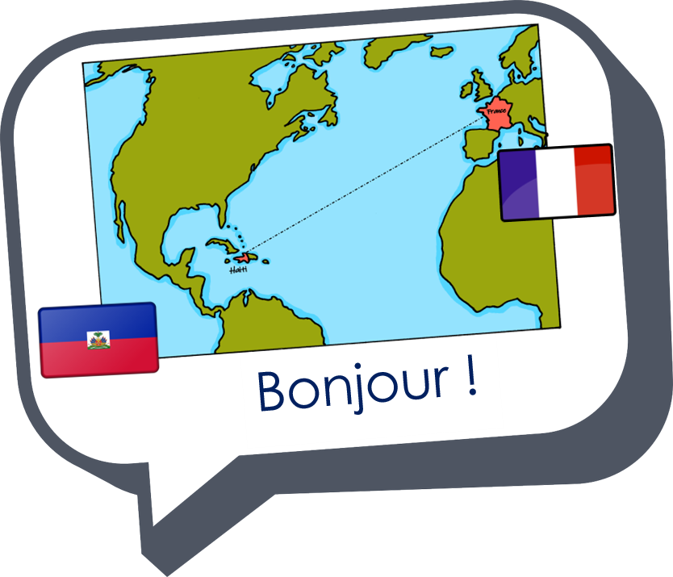

Saying what I and others do
vert
Follow ups 1-5
Notes:
Artwork by Steve Clarke. Pronoun pictures from NCELP (www.ncelp.org). All additional pictures selected from Pixabay and are available under a Creative Commons license, no attribution required.
Phonics: ç (and soft -c) ici [167] français [251] garçon [1599] cinéma [1623] décider [165]
Vocabulary: faire [25] je fais il/elle fait activité [452] course à pied [n/a] chanson [2142] dessin [2624] film [848] gâteau [4845] matin [442] soir [397] spectacle
[1687] ville [360] visite [1072] weekend [2475] demain [871]
Revisit 1: aller [53] je vais il/elle va à (meaning ‘at/in/to’)[4] campagne [666] Île [1245] montagne [1732] plage [2693] port [1304]
Revisit 2: nager [n/a] chanter [1820] jouer [219] participer (à) [670] porter [105] animal [1002] cadeau [2298] chapeau [2908] château [3510] cheval [2220] course
[1289] défilé [>5000] feu d'artifice [n/a] gâteau [4845] glace² [2580] jeu [291] lieu [117] neige [1824] trâineau [n/a] Québec [n/a]
Londsale, D., & Le Bras, Y. (2009). A Frequency Dictionary of French: Core vocabulary for learners London: Routledge.
The frequency rankings for words that occur in this PowerPoint which have been previously introduced in these resources are given in the SOW and in the resources that first introduced and formally re-visited those words.
For any other words that occur incidentally in this PowerPoint, frequency rankings will be provided in the notes field wherever possible.

Slide 2



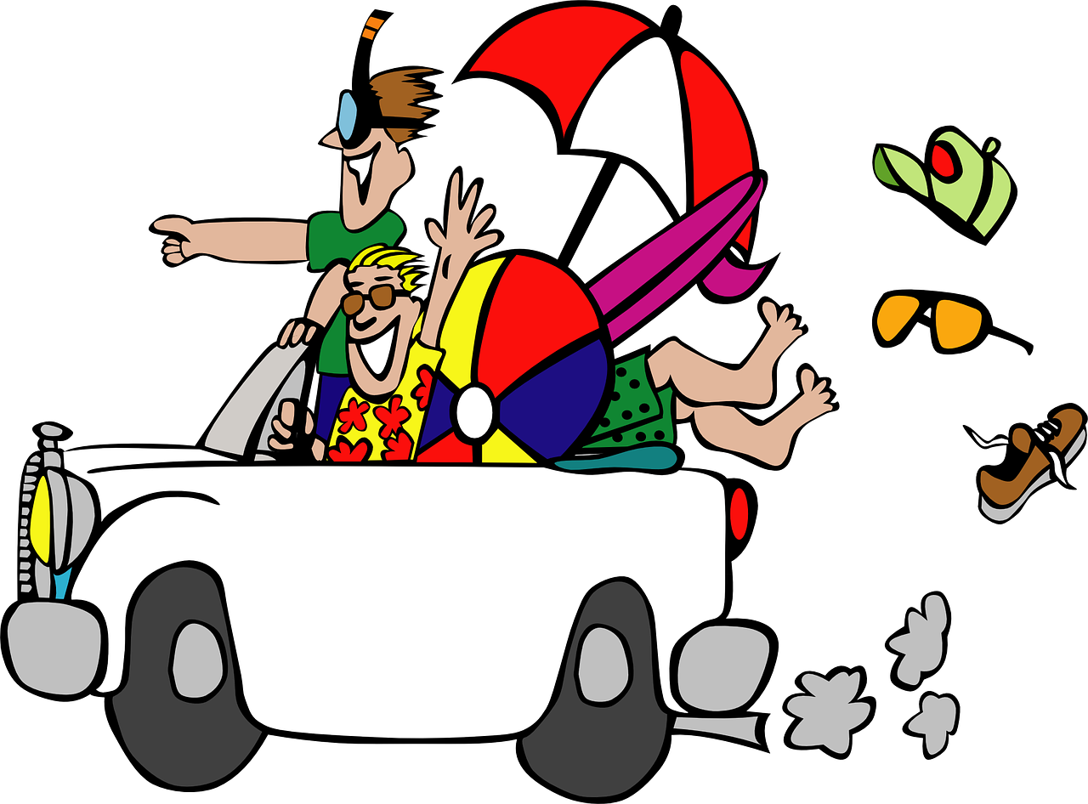

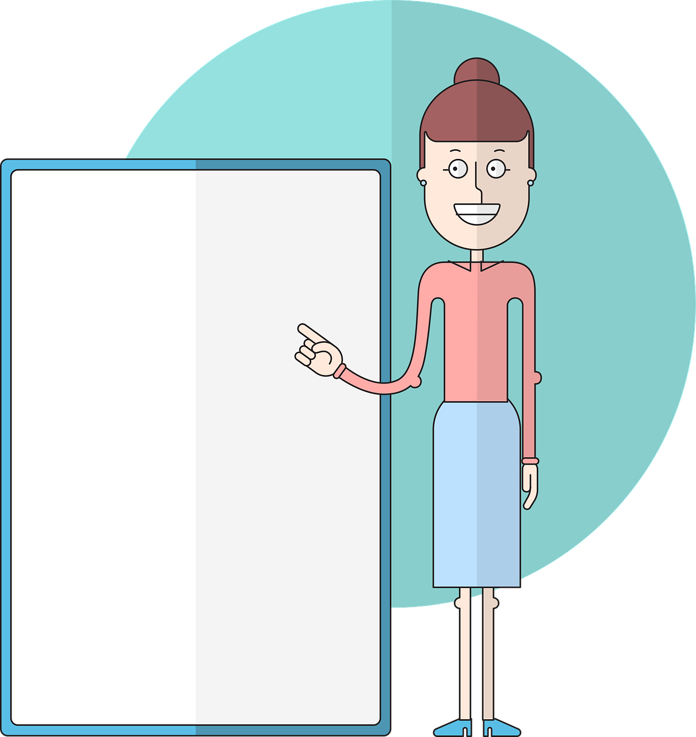
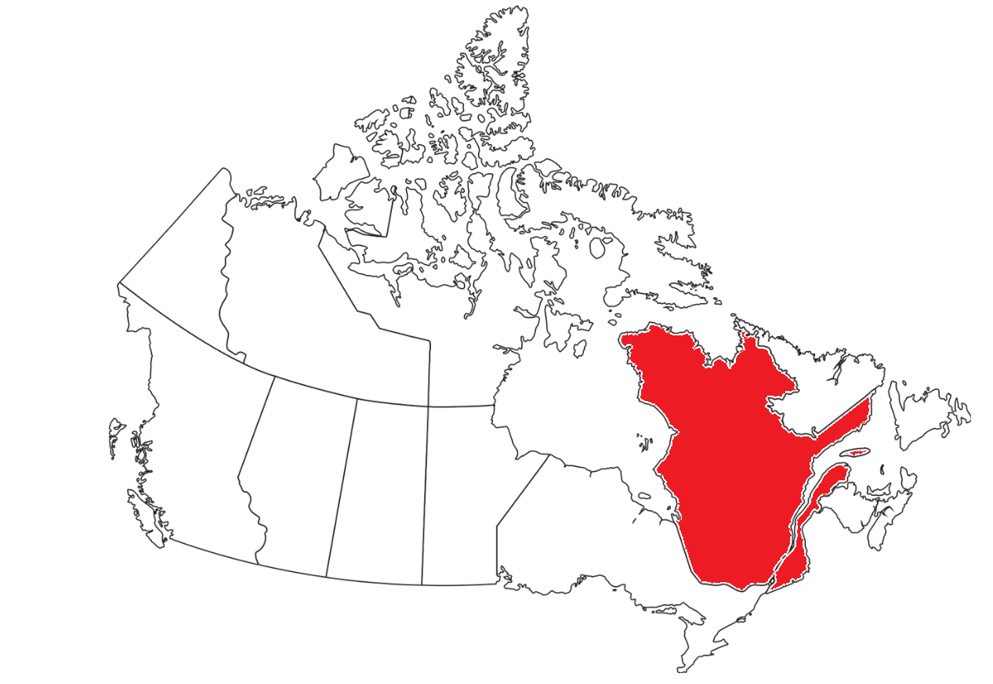

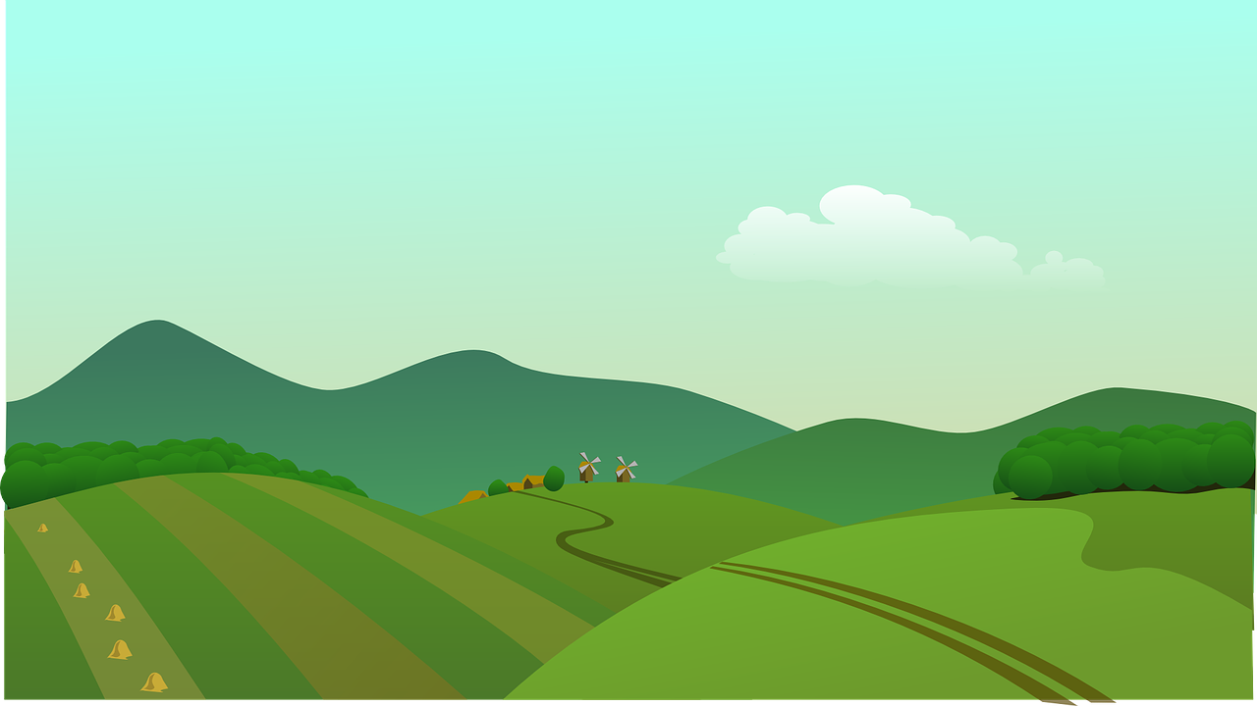


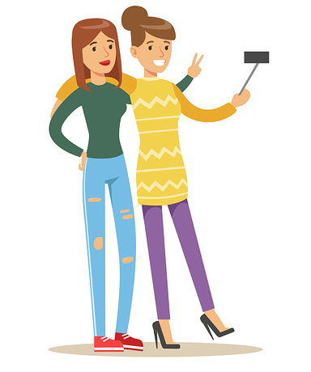






prononcer
Follow up 1
Prononce bien les mots dans l’ordre alphabétique.
vacance
camion
leçon
Québec
campagne
glace
copine
garçon
course
français
participer à
maçon
Notes:
Timing: 5 minutes (two slides)
Aim: to correctly pronounce unknown words containing hard and soft [c] sounds in decreasing amounts of time, helping automatisation of SSC production.
Procedure:
1. Pupils pair up.
2. Both pupils speak together and try to say the words in alphabetical order.
3. If they say a different word, they need to pause, work out where they went wrong, and start from the beginning.
4. Make it clear that this is teamwork and there is no time limit – it is the ‘training’ before the game on the next slide.
5. Click on the pictures to hear the words pronounced. Pupils repeat.
6. This is a mixture of known and unknown words. The 7 previously taught words are for revisiting this week, so pupils could be asked which words they know.
7. Move onto the next slide.
Frequency of unknown words and cognates:
camion [2542] copain [>5000] maçon [>5000] leçon [1300] vacance [1746]
Londsale, D., & Le Bras, Y. (2009). A Frequency Dictionary of French: Core vocabulary for learners London: Routledge.
Alphabetical order:
camion
campagne
copine
course
français
garçon
glace
leçon
maçon
participer à
Québec
vacance
2

Slide 3
prononcer
Follow up 1
Prononce les mots vite mais bien.
camion
leçon
20
Québec
campagne
glace
S
copine
garçon
course
français
participer à
maçon
0
DÉBUT
Notes:
Timing: 5 minutes
Aim: to correctly pronounce unknown words containing hard and soft [c] sounds in decreasing amounts of time, helping automatisation of SSC production.
Procedure:
1. Teacher starts 20 second timer.
2. Pupil A tries to say the words focusing on the hard and soft [c] sounds in particular.
3. Pupil B makes speaker pause for 3 seconds if the [c] sound is wrong.
4. Complete before 20 seconds runs out.
6. Swap roles and play the game again.
Frequency of unknown words and cognates:
copain [>5000] crêpe [>5000] drap [>5000] effort [388] part [86] pont [1889] pot [3648] voisin [979]
Londsale, D., & Le Bras, Y. (2009). A Frequency Dictionary of French: Core vocabulary for learners London: Routledge.
3

Slide 4





vocabulaire
Follow up 2a - Écris en anglais : Can you get at least 15 points?
mots
 | la glace | le Québec | la course
 | la neige | le château | le lieu
 | nager | participer (à) | le défilé
 | la campagne | la montagne | le port
 | je vais | aller | l’ile
 | la plage | elle va | il va
 | demain | le matin | l’activité
 | faire | je fais | il/elle fait
(the) ice, ice-cream
(the) Quebec
(the) race
(the) snow
(the) castle
(the) place
x3
to swim
to participate (in)
(the) parade, procession
(the) country(side)
(the) mountain(s)
(the) port
I go, am going
to go, going
(the) island
x2
(the) beach
she goes, is going
he goes, is going
x1
tomorrow
(the) morning
(the) activity
to do, make
I do, make
he/she does, makes
Notes:
Timing: 5-10 minutes
Aim: to practise written production of vocabulary from this week and two revisited weeks.
Procedure:
1. Give pupils a blank grid. They fill in the English meanings of any of the words they know, trying to reach 15 points in total.
2. Remind pupils that adjectives can refer to male or female persons and they should note this in their translations. E.g. pleased (f), short (m).
Note:
The most recently learnt and practised words are pink, words from revisit 1 are green and those from revisit 2 are blue, thus more points are awarded for them, to recognise that memories fade and more effort (heavy lifting!) is needed to retrieve them.
4

Slide 5
vocabulaire
Follow up 2b - Écris en français : Can you get at least 15 points?
mots
 | (the) place | to swim, swimming | (the) castle
 | (the) Quebec | to participate (in) | (the) race
 | (the) snow | (the) ice, ice-cream | (the) parade
 | (the) port | (the) beach | (the) mountain(s)
 | I go, am going | (the) island | (the) countryside
 | to go, going | he goes, is going | she goes, is going
 | to do, make | he/she does, makes | I do, make
 | (the) morning | (tomorrow) | (the) activity
le lieu
nager
le château
le Québec
participer (à)
la course
x3
la neige
la glace
le défilé
le port
la plage
la montagne
je vais
l’ile
la campagne
x2
aller
il va
elle va
x1
faire
il/elle fait
je fais
le matin
demain
l’activité
Notes:
Timing: 5-10 minutes
Aim: to practise written comprehension of vocabulary from this week and previous weeks.
Procedure:
Give pupils a blank grid. They fill in the French meanings of any of the words they know, trying to reach 15 points in total.
Note:
The most recently learnt and practised words are pink, words from the previous week are green and those from earlier are blue, thus more points are awarded for them, to recognise that memories fade and more effort (heavy lifting!) is needed to retrieve them.
5

Slide 6


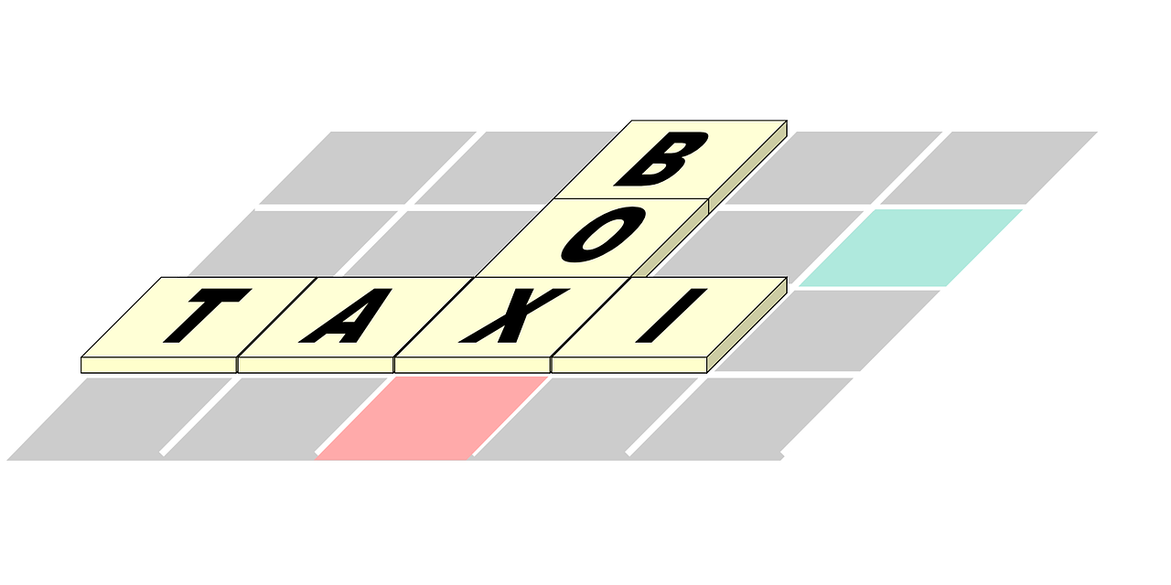

Follow up 3:
Parle ou écris en français.
C’est qui ? C’est quoi ?
parler
Je fais l’activité.
Notes:
Timing: 5 minutes for seven slides
Aim: to practise written or spoken production of vocabulary and grammar learned this week and last week.
Procedure:
Click to reveal an image representing a pronoun and an imagine representing an activity.
Pupils write or say the French.
Note: these sentences all use definite articles. Elicit the English translation for the first sentence (I do, am doing the activity) and make sure that pupils understand to use the word for ‘the’ each time.

Slide 7



Follow up 3:
Parle ou écris en français.
C’est qui ? C’est quoi ?
parler
Il fait le dessin.
Notes:
[2/7]

Slide 8
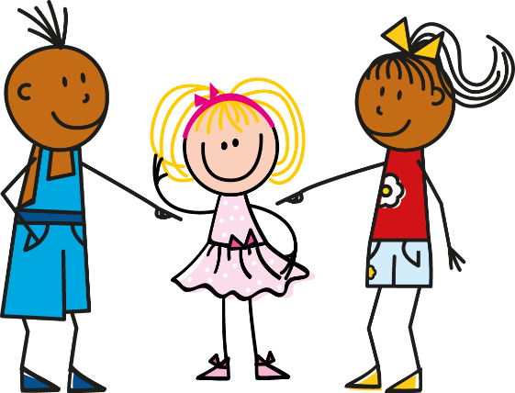


Follow up 3:
Parle ou écris en français.
C’est qui ? C’est quoi ?
parler
Elle fait la chanson.
Notes:
[3/7]

Slide 9

Follow up 3:
Parle ou écris en français.
C’est qui ? C’est quoi ?
parler
Il fait la visite.
Notes:
[4/7]

Slide 10
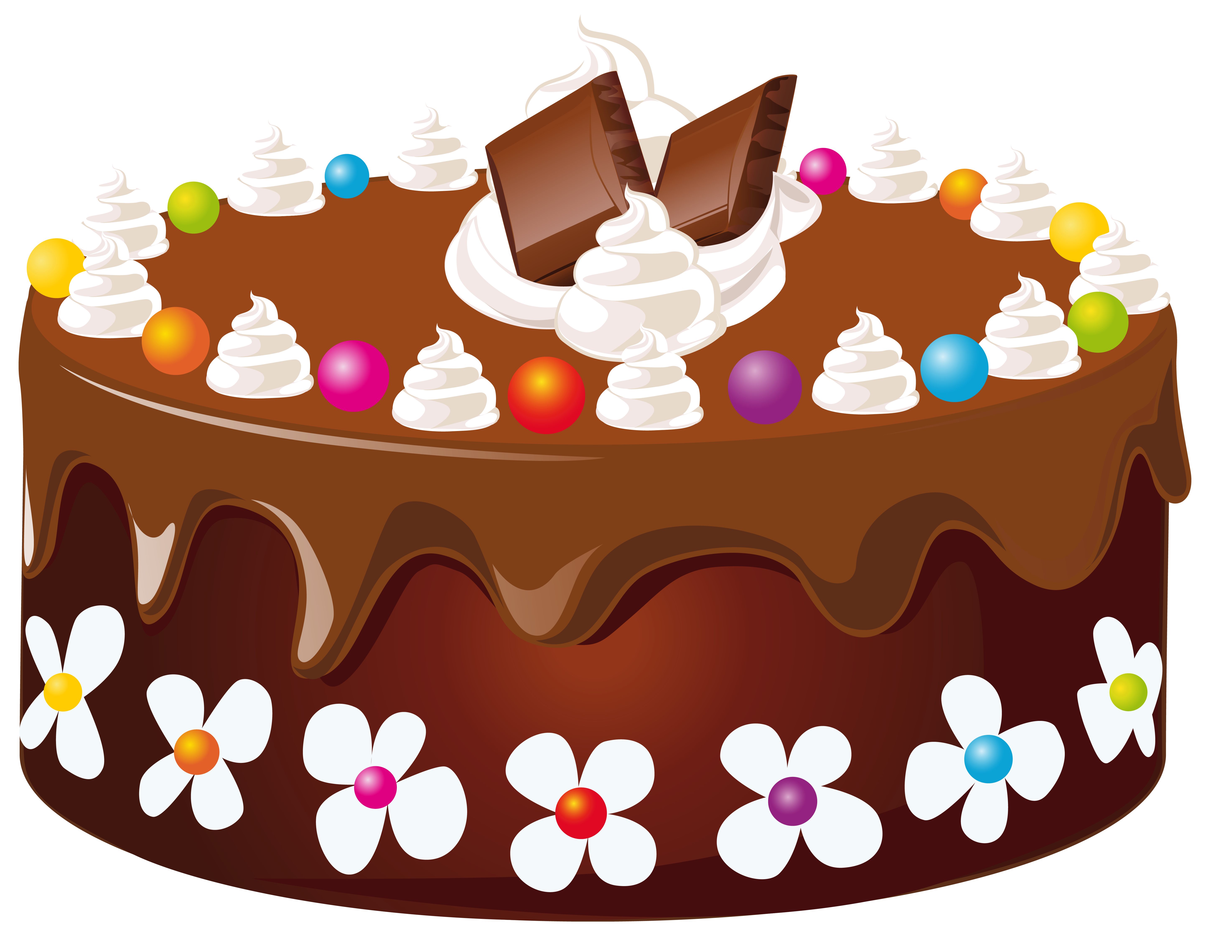
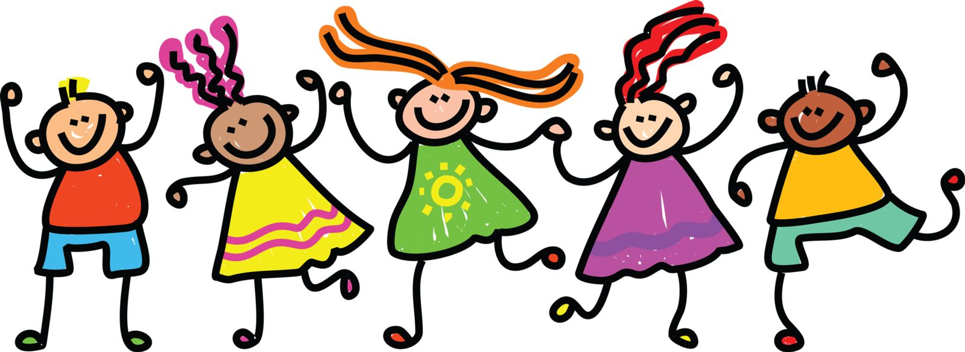
Follow up 3:
Parle ou écris en français.
C’est qui ? C’est quoi ?
parler
Je fais le gâteau (pour mon ami).
Notes:
[5/7]

Slide 11


Follow up 3:
Parle ou écris en français.
C’est qui ? C’est quoi ?
parler
Elle fait le film
(pour l’école).
Notes:
[6/7]

Slide 12
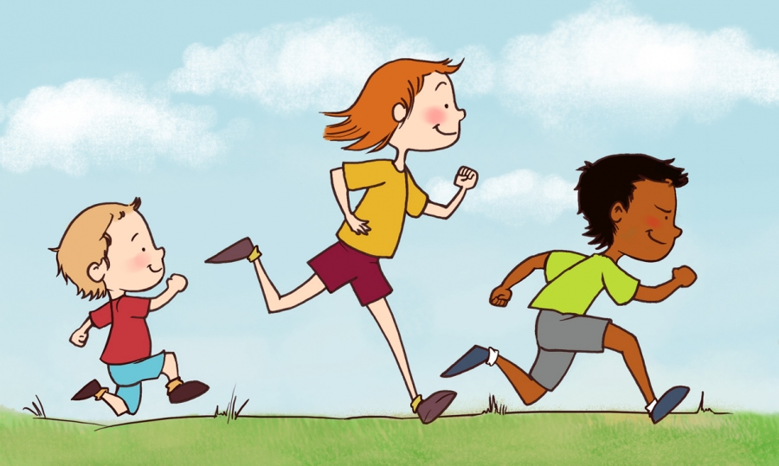
Follow up 3:
Parle ou écris en français.
C’est qui ? C’est quoi ?
parler
Il fait la course à pied.
Notes:
[7/7]

Slide 13

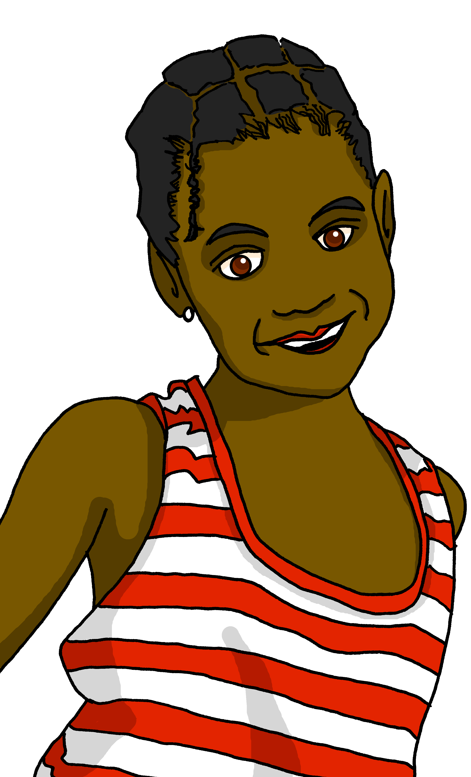
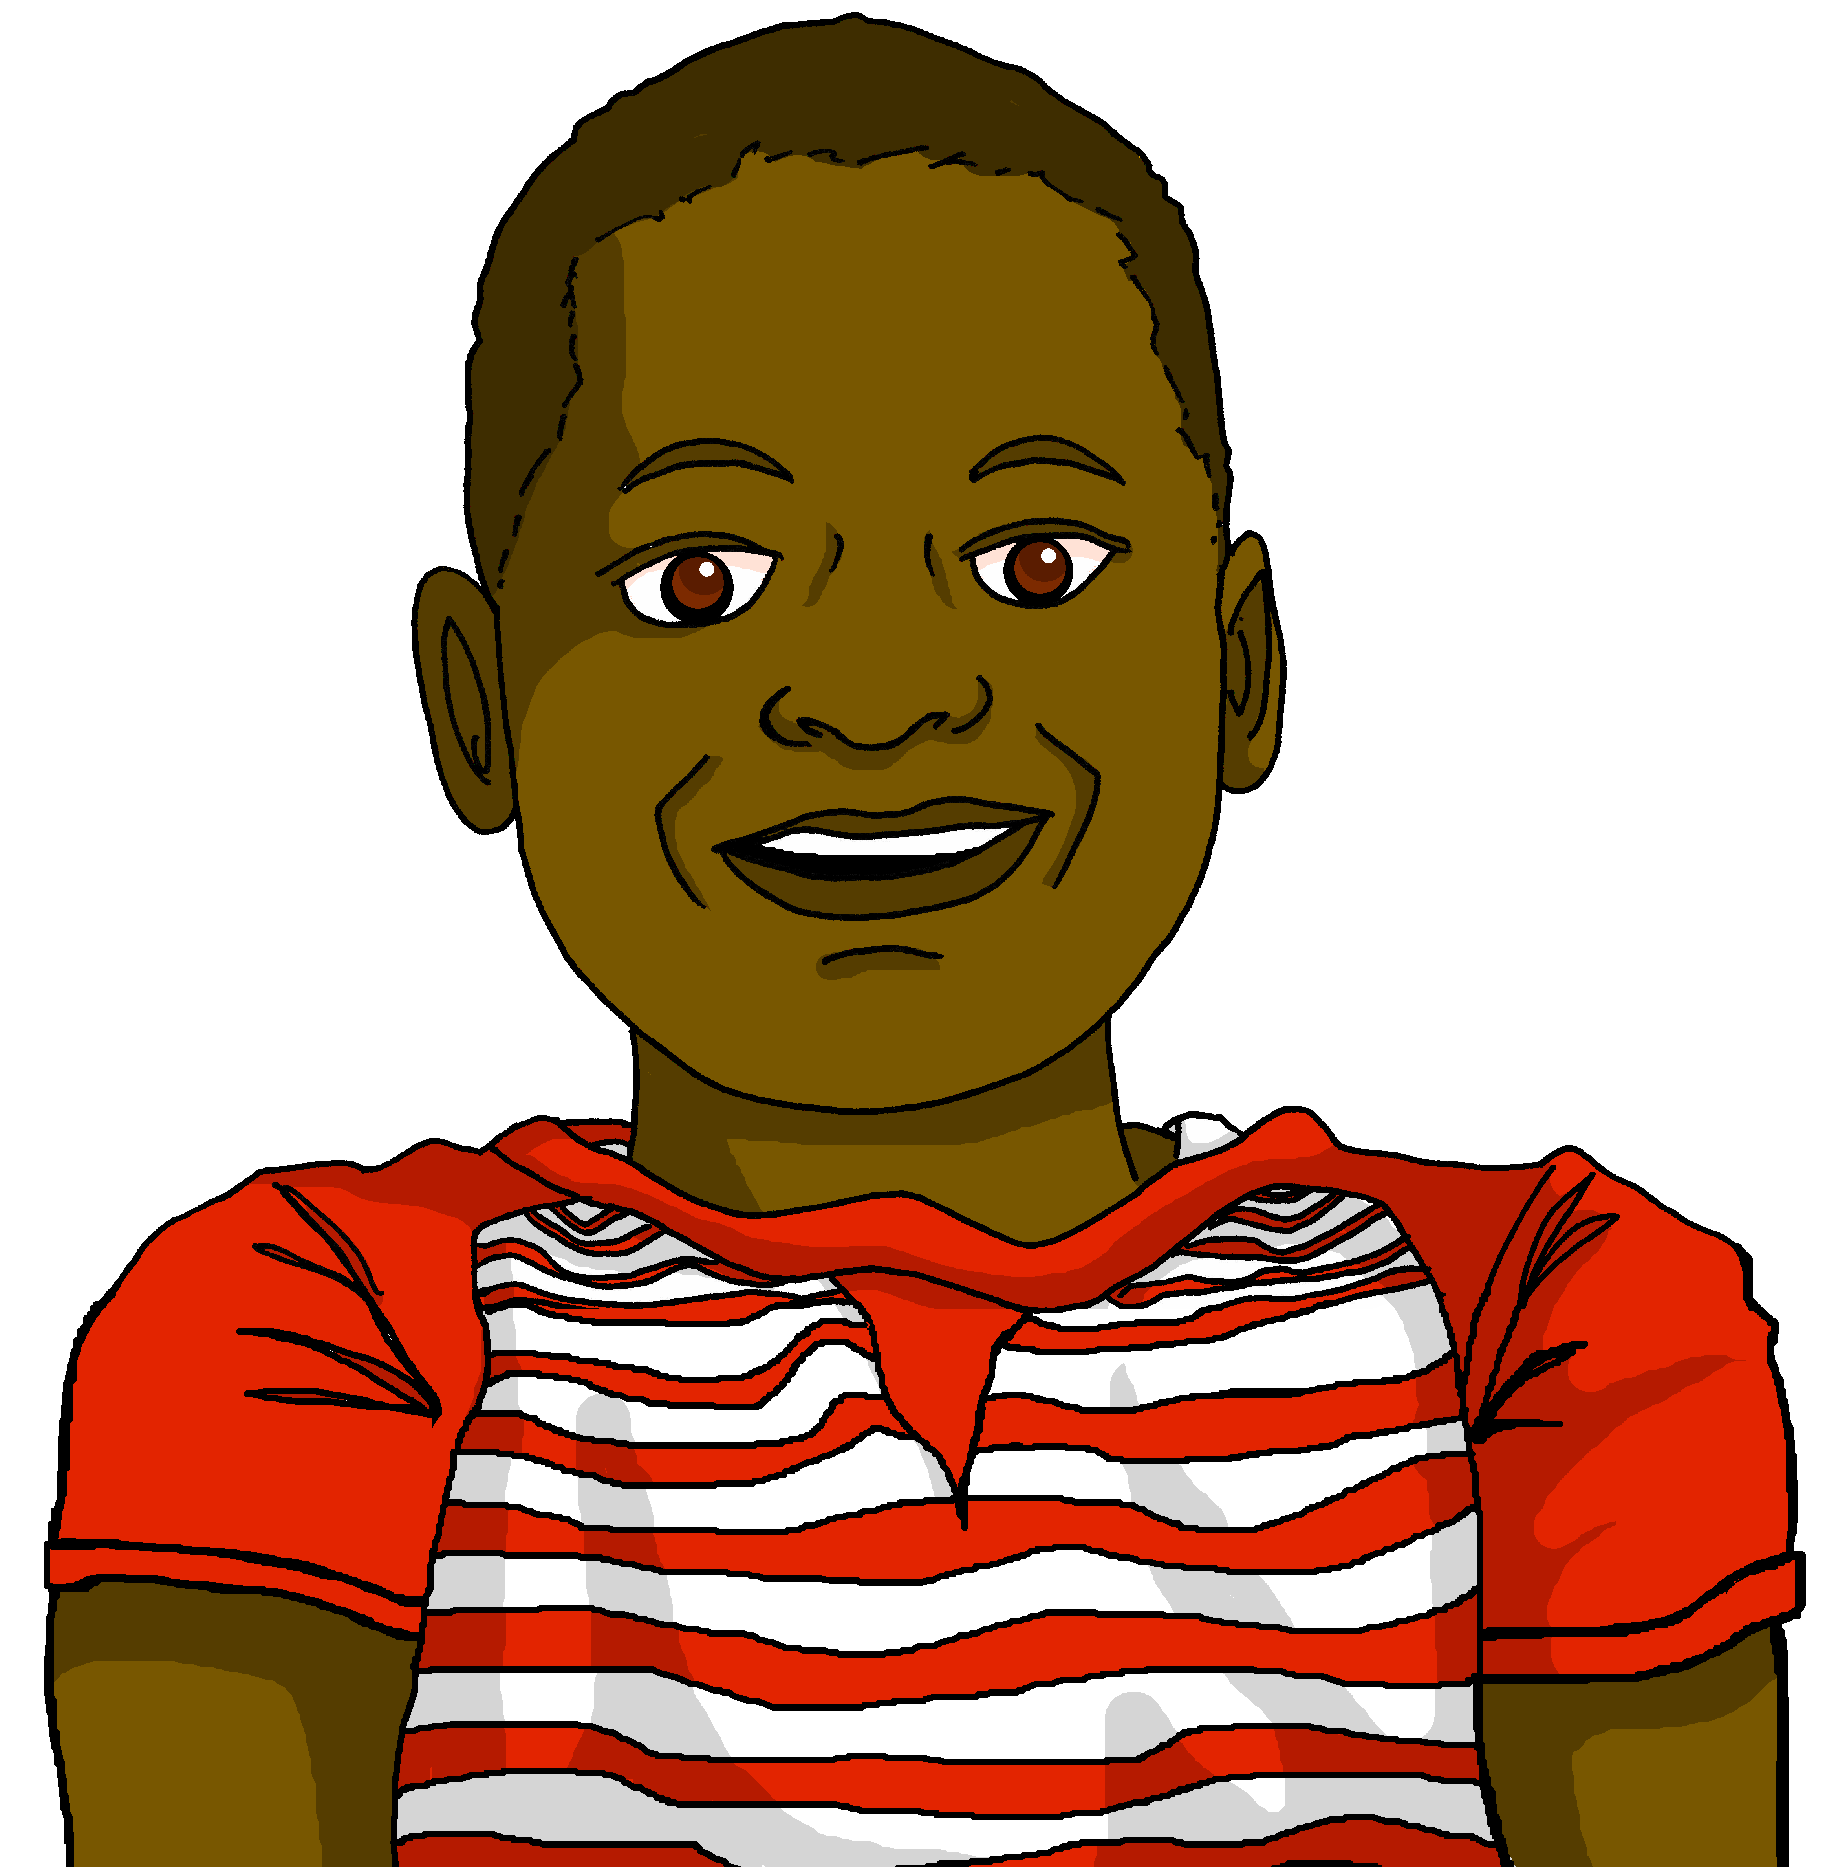


Making sentences negative
ne…pas
⚠
Remember that in English…
However, in French…
I’m making the film.
I’m not making the film.
Je fais le film.
Je ne fais pas le film.
…add not before the verb to make the sentence negative.
…add ne before the verb and pas after the verb to make the sentence negative.
Note: ‘je fais’ also means ‘I make’ so ‘je ne fais pas’ can mean
‘ I don’t make’, too.
Notes:
Timing: 1 minute
Aim: Recap ne…pas negation with single-verb structures and draw attention to differences between French and English negation structure. (Pupils were introduced to this last term – T2 Week 5).
Procedure:
Click through the animations to present the information.
Elicit English translations for the French examples provided.

Slide 14


Follow up 4:
What are Clémentine and Jean-Michel doing/not doing this weekend?
Lis et coche* la liste.
Write ? if the activity isn’t mentioned.
lire
1) …………………………………
2) …………………………………
3) …………………………………
4) …………………………………
5) …………………………………
6) …………………………………
7)………………………………….
8)………………………………….
Il fait la visite le samedi avec Maman.
?
making the film
making the song
doing the race
doing the drawing
going on the visit
doing the activity
Le dimanche, elle fait le film.
Il fait la chanson.
?
Elle ne fait pas la visite.
?
?
Il ne fait pas l’activité pour Maman.
Demain, elle fait l’activité en ville.
Elle fait aussi la chanson.
Il ne fait pas la course à pied.
cocher – to tick
Notes:
Timing: 5 minutes
Aim: to practise written comprehension of ne…pas and vocabulary from this and previous weeks.
Note: the answers are not in the order of the text.
Procedure:
1. Pupils can write the six categories and Cl | JM as two column headers.
2. Pupils read the sentences and tick if either or both characters do the activity, cross if they don’t and put ? if there is no mention of the activity for one or both of them.
3. For feedback of answers click to to complete the table and to highlight the answer in the text itself.

Slide 15

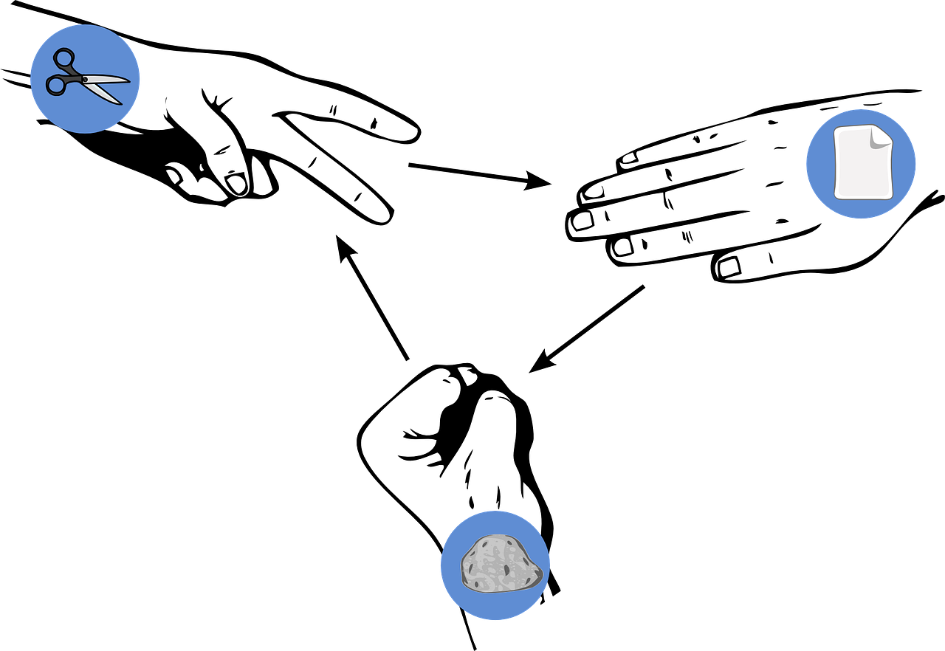


Follow up 5
Pierre-papier-ciseaux*
Choose four activities and write four sentences in French saying what you do OR don’t do: ‘I do…’ / ‘I don’t…’
écrire
parler
Read your sentences. If your partner has exactly the same sentence as you, play rock-paper-scissors. The loser must write/say a different sentence. Play until you have successfully said all your sentences.
Exemple:
Je ne fais pas le film.
Je ne fais pas le film !
Je fais la chanson !
Partenaire A
Partenaire B
*Rock-paper-scissors
Notes:
Timing: 5-10 minutes (two rounds of speaking activity)
Aim: to practise oral production and comprehension of negative sentences with 1st person of faire, and vocabulary from this week.
Note: This slide shows how the speaking task is intended to work. The stages are animated to support the teacher in modelling the task.
Procedure:
After modelling this example, display the next slide with 6 item choices (which gives 12 possible sentences, as each one can also be negative).
Partner As read first and Bs answer.
Then swap roles for Round 2.

Slide 16

Follow up 5
pierre-papier-ciseaux*
Remember you can make your sentences negative, too.
écrire
parler
the cake
the test
the drawing
the activity
the race
the song
the film
the visit
*rock-paper-scissors
Notes:
DISPLAY THIS SLIDE FOR PUPILS DURING THE TASK.
Note: In the audio version, if desired, click on the pictures to hear the French phrases (as affirmative and negative statements).

Slide 17
vocabulaire
Follow up 2a - Écris en anglais : Can you get at least 15 points?
mots
 | la glace | le Québec | la course
 | la neige | le château | le lieu
 | nager | participer (à) | le défilé
 | la campagne | la montagne | le port
 | je vais | aller | l’ile
 | la plage | elle va | il va
 | demain | le matin | l’activité
 | faire | je fais | il/elle fait
x3
x2
x1
Notes:
HANDOUT
17

Slide 18
vocabulaire
Follow up 2b - Écris en français : Can you get at least 15 points?
mots
 | (the) place | to swim, swimming | (the) castle
 | (the) Quebec | to participate (in) | (the) race
 | (the) snow | (the) ice, ice-cream | (the) parade
 | (the) port | (the) beach | (the) mountain(s)
 | I go, am going | (the) island | (the) countryside
 | to go, going | he goes, is going | she goes, is going
 | to do, make | he/she does, makes | I do, make
 | (the) morning | (tomorrow) | (the) activity
x3
x2
x1
Notes:
HANDOUT
18

