Slide 1
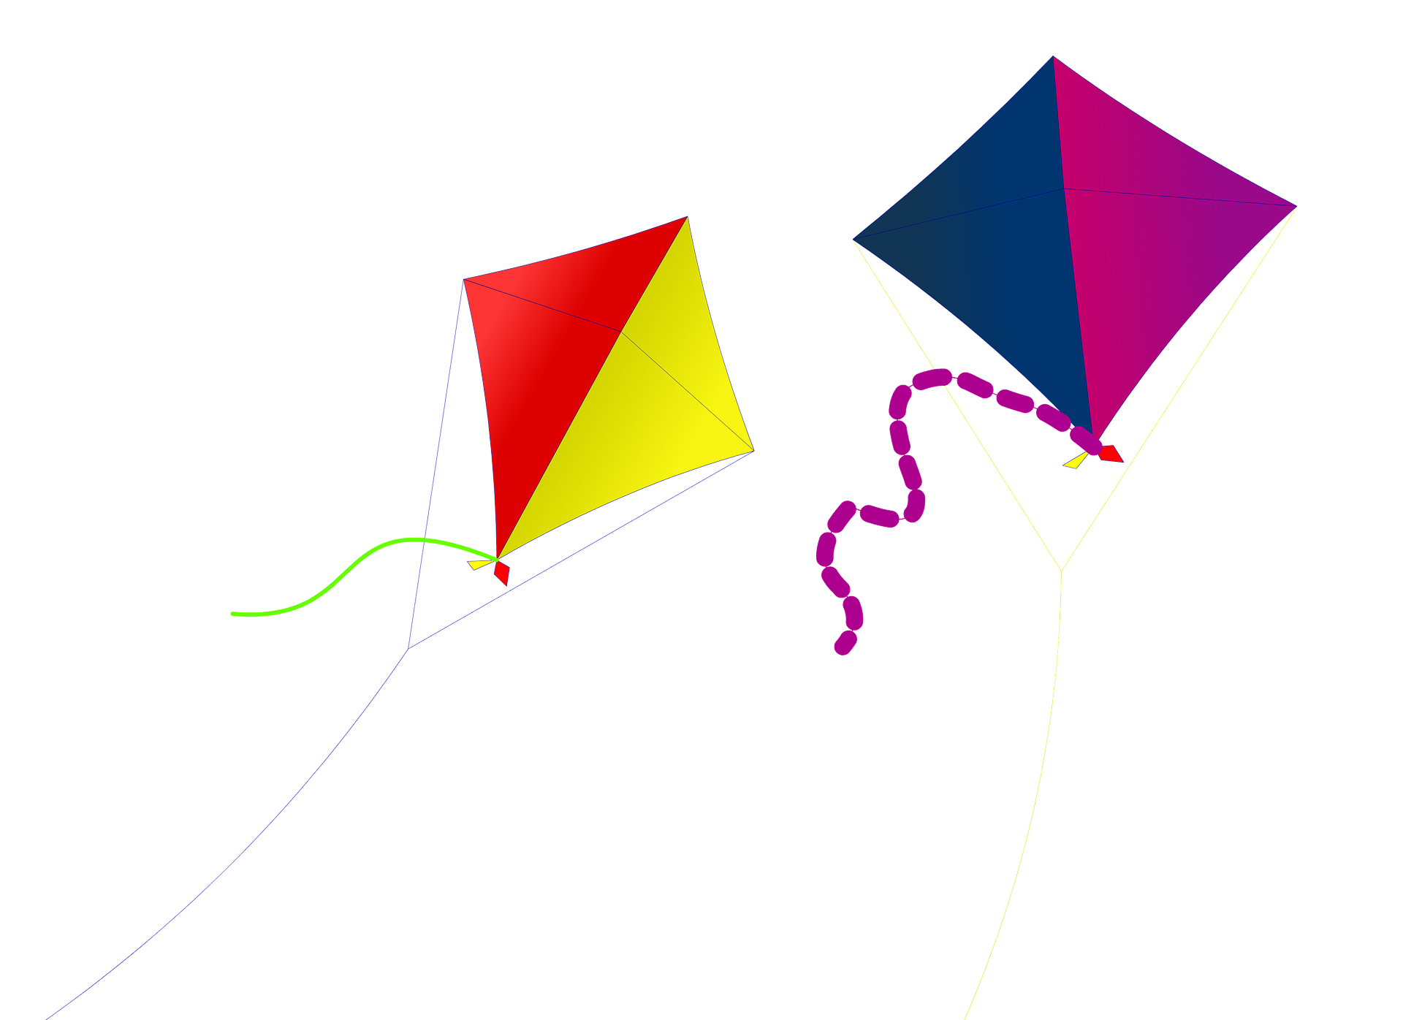
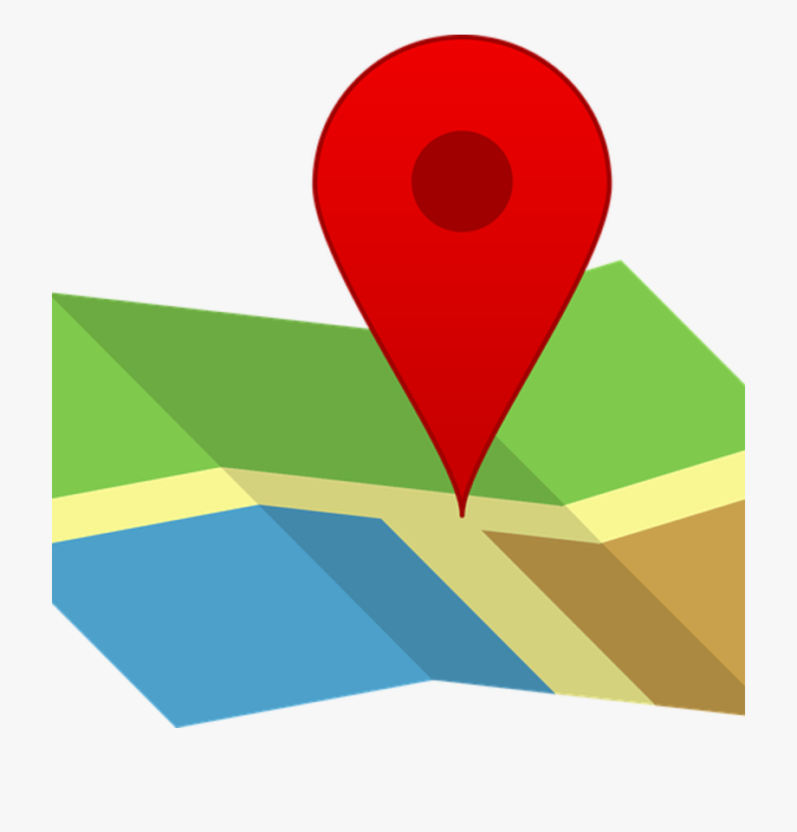
Saying what I and others do
vert
location phrases with de
SFe and SFC
Notes:
Artwork by Steve Clarke. Pronoun pictures from NCELP (www.ncelp.org). All additional pictures selected from Pixabay and are available under a Creative Commons license, no
attribution required.
Phonics: SFe (or SFC) timide [3835] monde [77] moderne [1239] centre [491] douze [1664]
Vocabulary: de² [2] côté [123] près [341] loin [341] piscine [>5000] théâtre [1701] stade [1967]
Revisit 1: il y a un [3] deux [41], trois [115], quatre [253], cinq [288], six [450], sept [905], huit [877], neuf [787], dix [372], onze [2447], douze [1664] des [2] combien [800] treize [3285], quatorze [3359], quinze [1472], seize [3285], dix-sept [3812], dix-huit
[3592], dix-neuf [4851], vingt [1273], vingt-et-un [1273/6/3], vingt-deux, vingt-trois, vingt-quatre, vingt-cinq, vingt-six, vingt-sept, vingt-huit, vingt-neuf, trente [1646]
Revisit 2: étudier [960] gagner [258] cacher [914] pratiquer [1268] présenter [209] prononcer [706] trouver [83] école [477] porte [696] pays [114] carte [955] dictionnaire [4094] prix [310] salle [812] sur [16] à (meaning ‘at’)[4]
Londsale, D., & Le Bras, Y. (2009). A Frequency Dictionary of French: Core vocabulary for learners London: Routledge.
The frequency rankings for words that occur in this PowerPoint which have been previously introduced in these resources are given in the SOW and in the resources that first
introduced and formally re-visited those words.
For any other words that occur incidentally in this PowerPoint, frequency rankings will be provided in the notes field wherever possible.
1

Slide 2
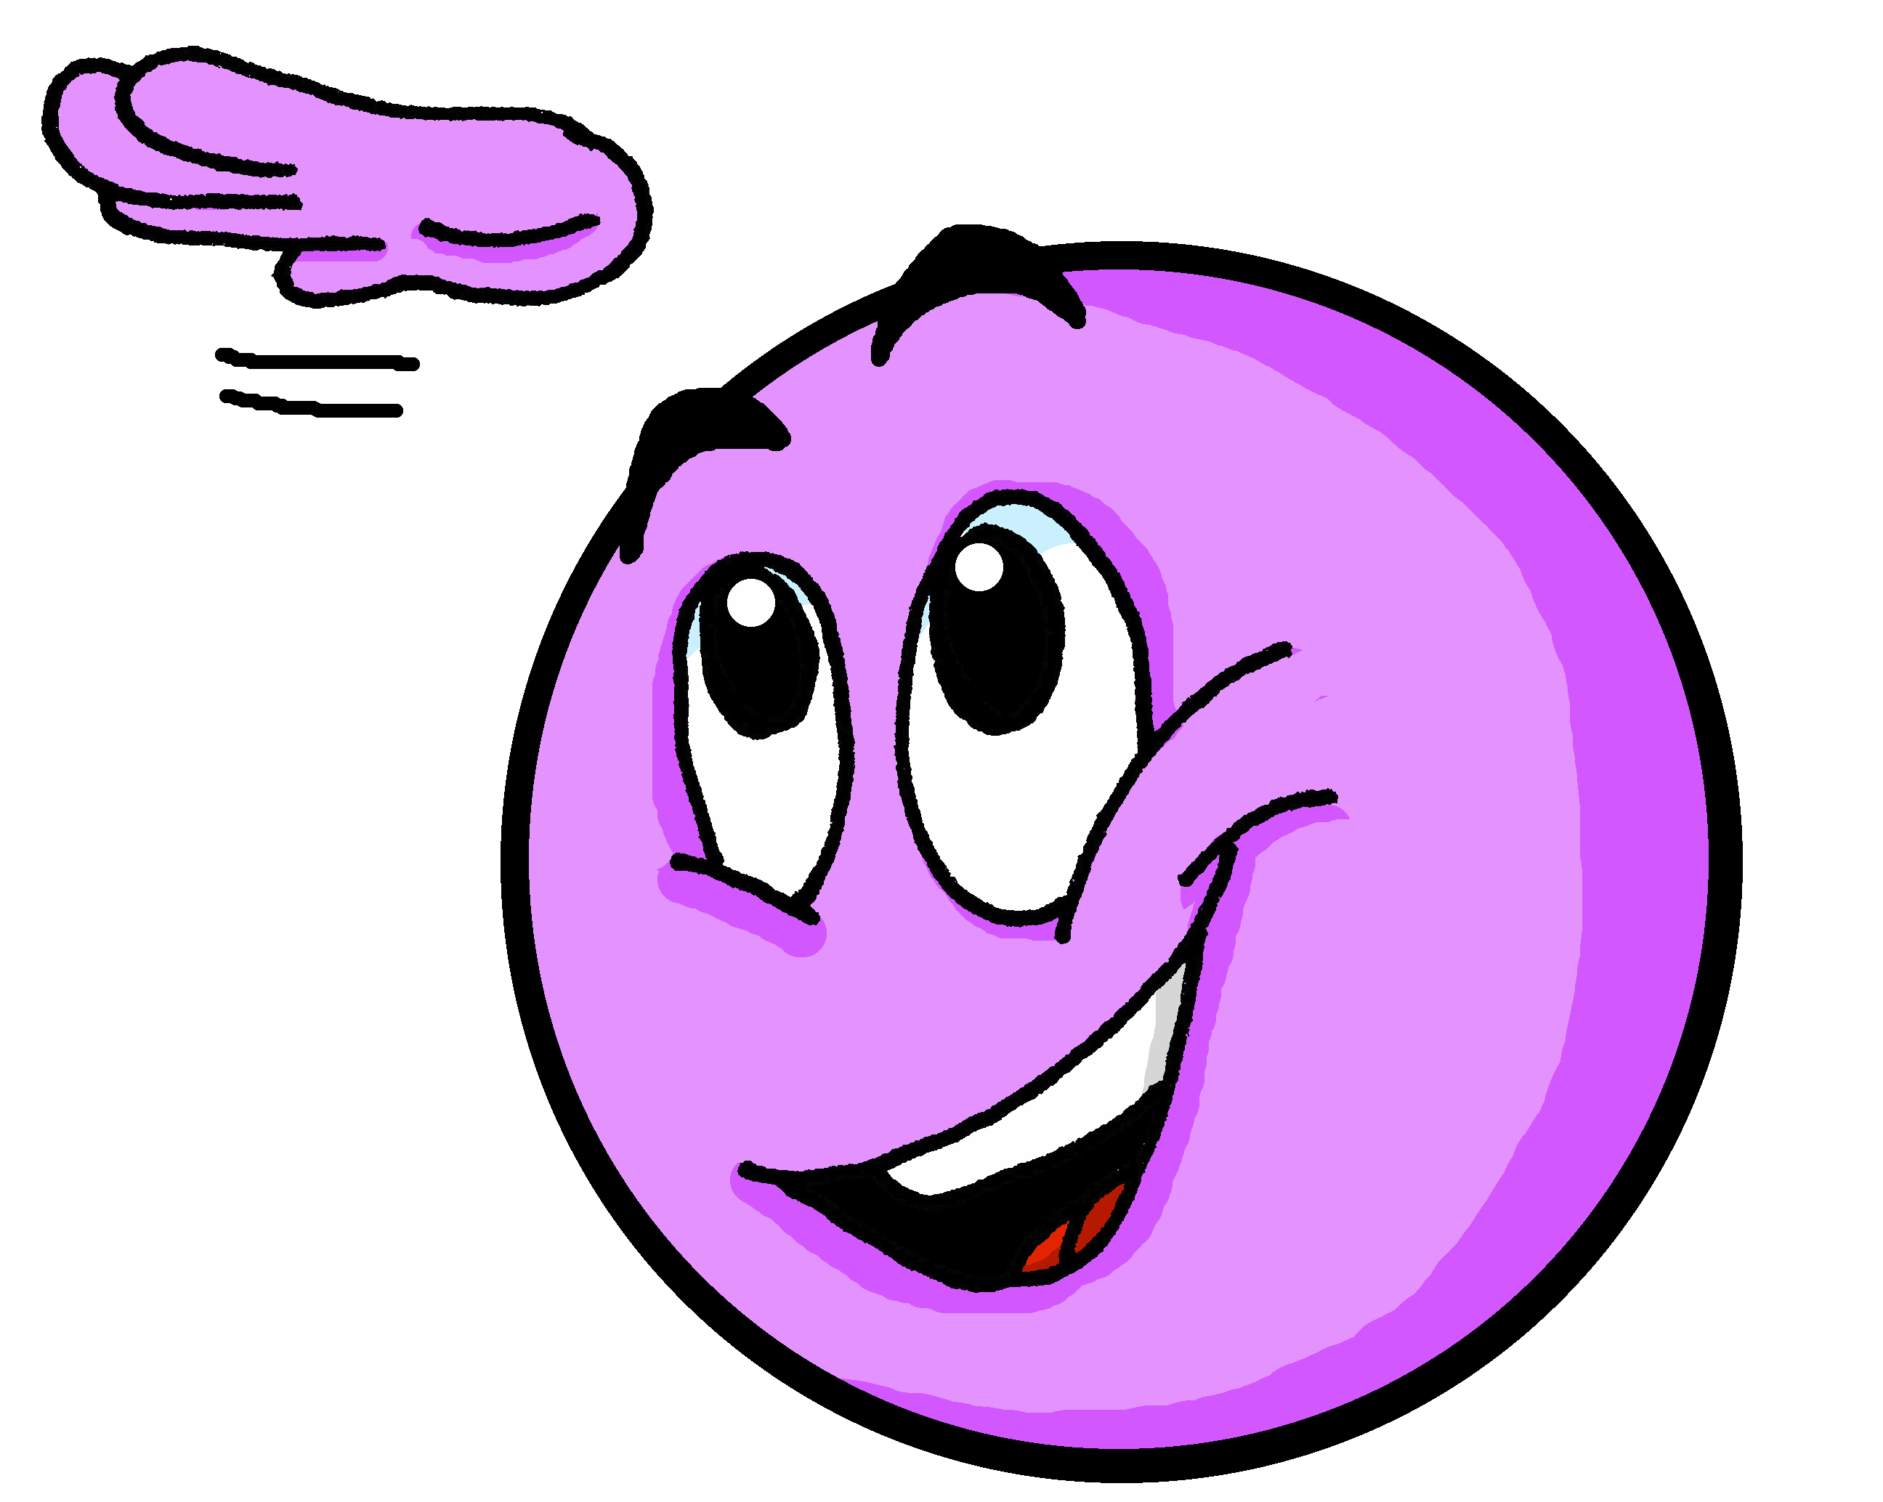
[SFC] Silent final consonant
prononcer
You know that in French we often don’t pronounce the final consonant:
petit
mais
grand
deux
[but]
Notes:
Timing: 1 minute
Aim: to recap [SFC] with –t, -s, -d, -x and introduce awareness of consonants –c, -r, -f, and –l, which are often pronounced.
Procedure:
Click through the animations to present the information.
2

Slide 3
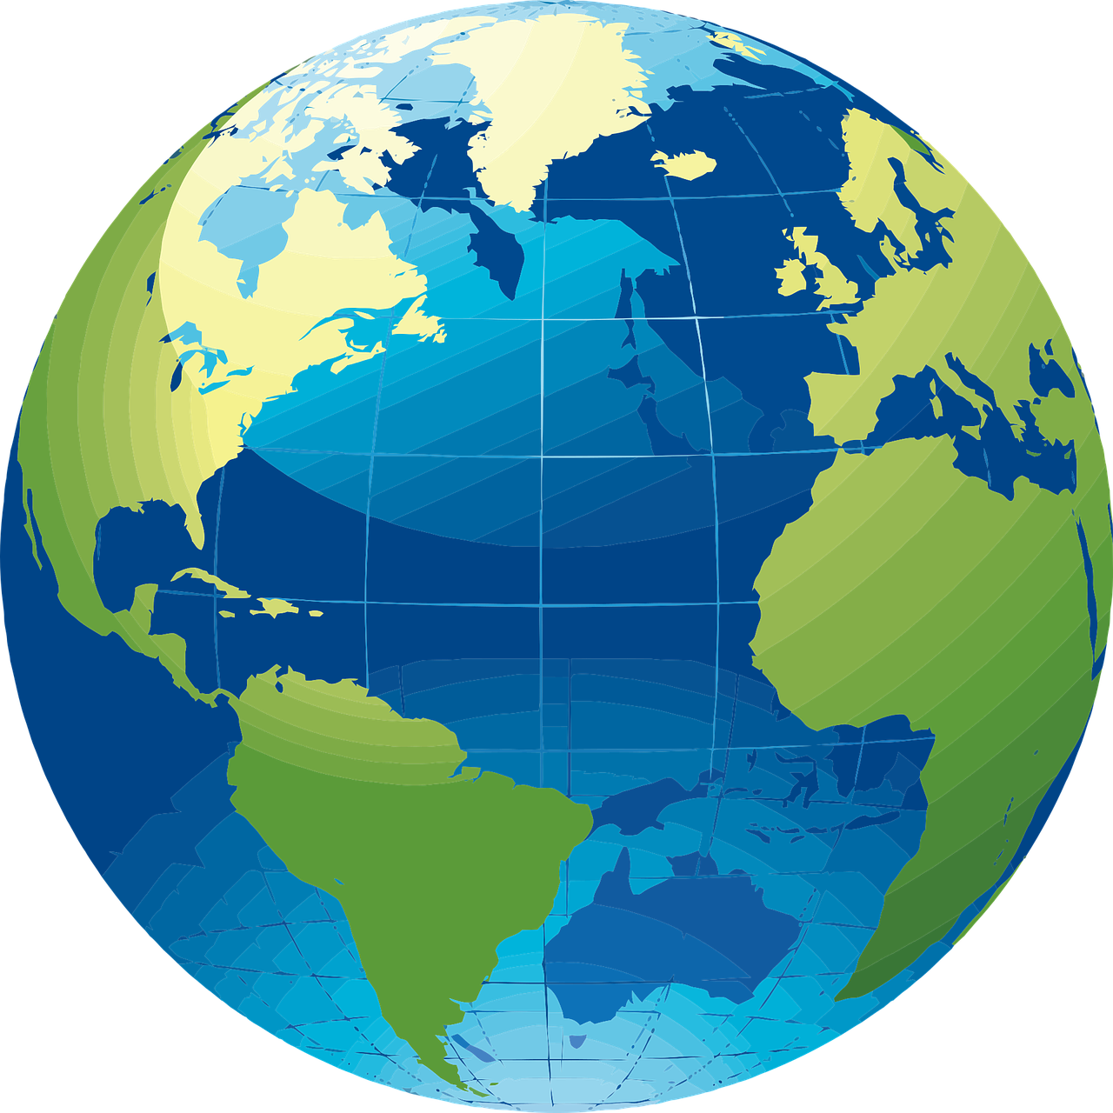
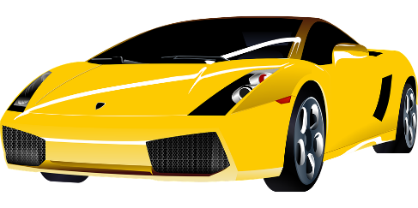
prononcer
[SFe]
monde
timide
douze
[shy]
centre
moderne
Notes:
Timing: 2 minutes
Aim: To introduce/consolidate SSC [SFe]
Procedure:
1. Practise the pronunciation of the individual SSC [SFe] and then the source word again ‘timide’ (with gesture, if using). 2. Then present and elicit the pronunciation of the four cluster words.
Frequency: monde [77] moderne [1239] centre [491] vie [132] douze [1664] timide [3835] Source: Londsale, D., & Le Bras, Y. (2009). A Frequency Dictionary of French: Core vocabulary for learners London: Routledge.
3

Slide 4
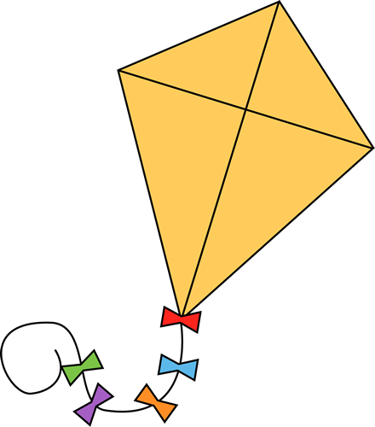
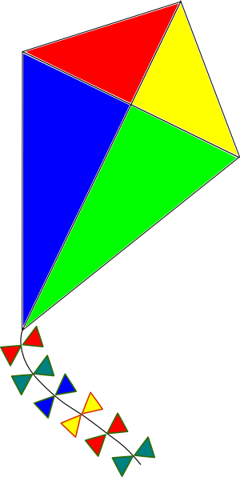
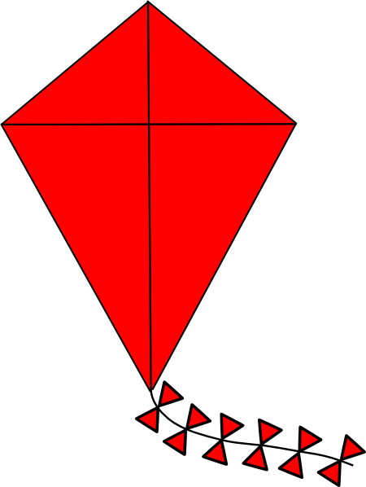
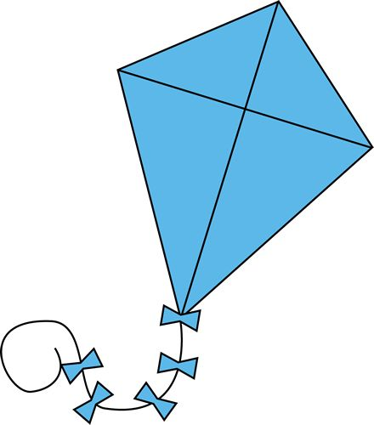
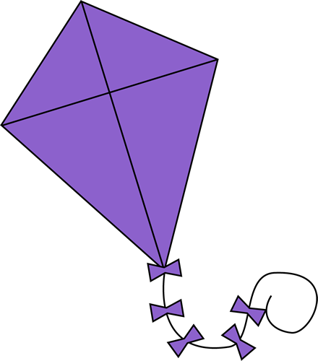
SFe ou SFC ?
Écoute. C’est avec ‘e’ ou sans ‘e’ ?
prononcer
Puis, prononce les mots.
4
2
accident
agent
3
dynamite
1
paradis
8
6
léopard
5
guide
profit
7
cousine
Notes:
Timing: 5 minutes
Aim: to practise aural distinction between words with SFe and SFC.
Procedure:
Read the instruction. Tell pupils these words are cognates – similar or identical to English words. Do they end in ‘e’ or not?
Do the first one with pupils. Remind them that if they hear the final consonant pronounced there is a SFe.
They can write down either [e] or [--].
Elicit responses chorally, and click to reveal the answers (i.e. by disappearing the kites)
Transcript:
paradis
agent
dynamite
accident
cousine
guide
léopard
profit
Frequency of unknown words and cognates: paradis [2952] agent [885] dynamite [>5000] accident [1227] cousine [3387] guide [2392] léopard [>5000] profit [1032]
Londsale, D., & Le Bras, Y. (2009). A Frequency Dictionary of French: Core vocabulary for learners London: Routledge.

Slide 5
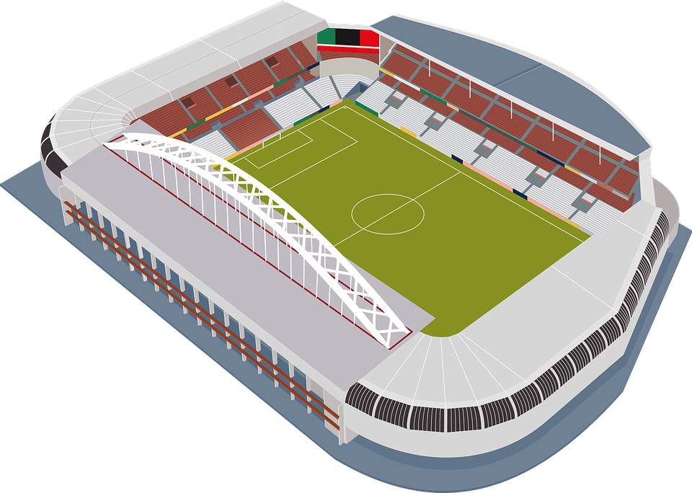
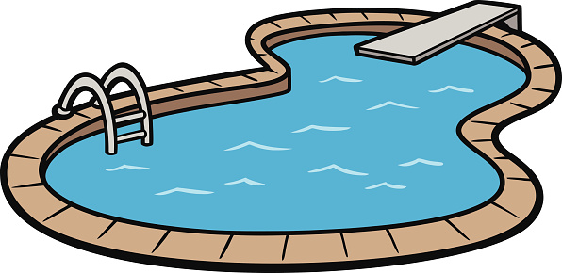
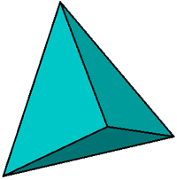
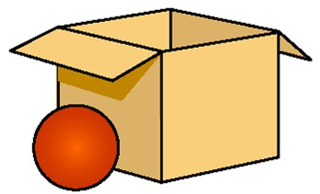
vocabulaire
.
Écoute et répète.
mots
le théâtre
le stade
la piscine
[theatre]
[stadium]
[pool]
è
près (de)
loin (de)
[near (to)]
[far (from)]
le côté
à côté de
[side]
[next to, beside]
Notes:
Timing: 8 minutes (three slides)
Aim: to present and practise new vocabulary
Procedure:
1.Teacher introduces items one by one (word, picture & English) and pupils practise pronunciation aloud.
2. Move to next slide.
5

Slide 6
vocabulaire
Comment dit-on ça en français ?
mots
à côté de
la piscine
loin (de)
près (de)
le théâtre
[pool]
[next to, beside]
[near (to)]
[side]
[far (from)]
[stadium]
[theatre]
le côté
le stade
de
Notes:
[2/3]
Procedure:
1.Teacher clicks to bring up a prompt.
2. Pupils identify and read the French word aloud, chorally.
3. Continue until all 8 items have been correctly identified and pronounced.
6

Slide 7
vocabulaire
Comment dit-on ça en français ?
mots
le théâtre
le t_____e
le s___e
la p_____e
le stade
la piscine
[theatre]
[stadium]
[pool]
p__s (de)
è
près (de)
l__n (de)
loin (de)
[near (to)]
[far (from)]
le c__é
le côté
à côté de
à c__é de
[side]
[next to, beside]
Notes:
[3/3]
Procedure:
Click to bring up the English prompt/picture and the gapped French word.
Elicit the French word orally from pupils.
7

Slide 8
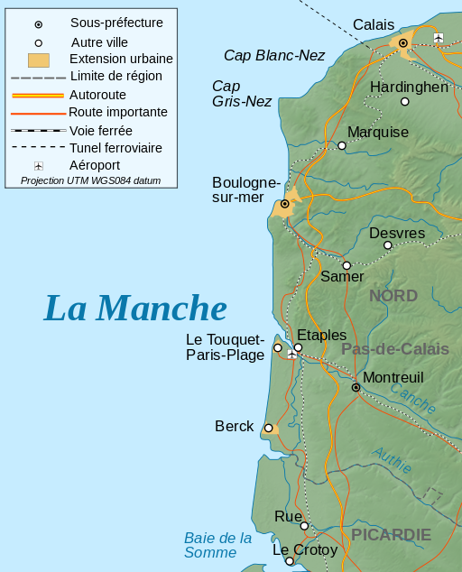
Le festival des cerfs-volants*
Berck-sur-Mer est une ville au nord de la France, près de Boulogne. Ce n’est pas loin de Calais.
Berck est à côté de la mer*. La ville est connue pour sa plage et son festival des cerfs-volants, qui attire plus de 500 000 personnes chaque avril.
le cerf-volant – kite la mer – sea connu – known attirer – to attract
Notes:
Timing: 4 minutes (three slides)
Aim: to introduce information about a kite festival in Berck-sur-mer in France; to use three of the new vocabulary items in context.
Procedure:
Click to hear the phrase ‘Le festival des cerfs volants’.
Read the information with pupils.
Elicit and ensure pupil understanding of the text. A translation of the text is below:
Berck-on-Sea is a town in the north of France, near to Boulogne. It is not far from Calais. Berck is next to the sea. The town is known for its beach and its kite festival, which attracts more than 500,000 people every April.
Picture attribution:
Roland45, CC BY-SA 4.0 via Wikimedia Commons
Bourrichon - fr:Bourrichon), CC BY-SA 4.0 via Wikimedia Commons

Slide 9
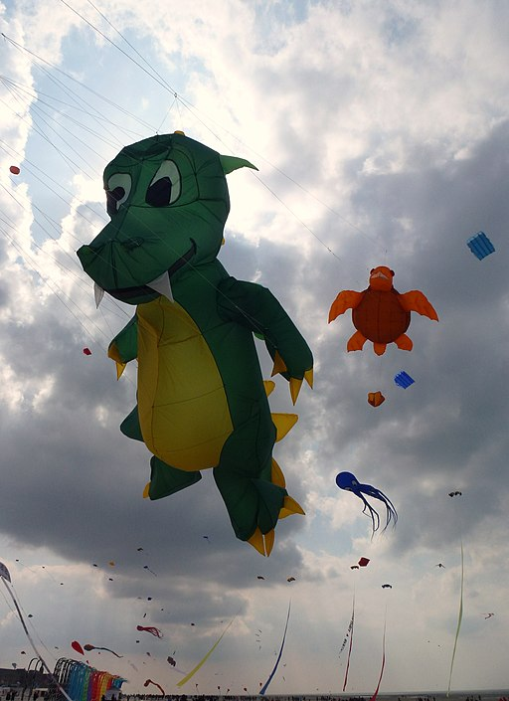
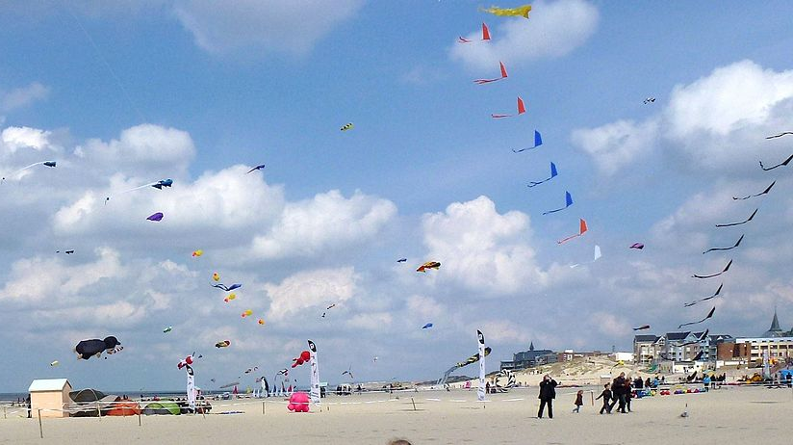
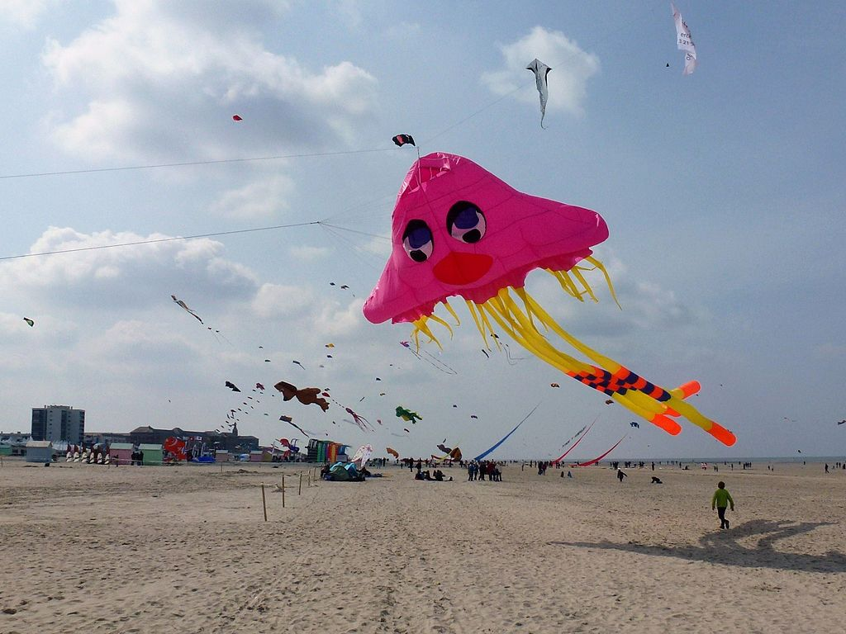
culture
Notes:
[2/3]
Procedure:
Click to reveal images on this and the next slide.
Image attribution:
Berckplage cerfvolant.JPG : Bateloupreautderivative work : Barbe-sauvage, CC BY-SA 3.0 via Wikimedia Commons
Ibex73, CC BY-SA 4.0 via Wikimedia Commons
PIERRE ANDRE LECLERCQ, CC BY-SA 4.0 via Wikimedia Commons
9

Slide 10
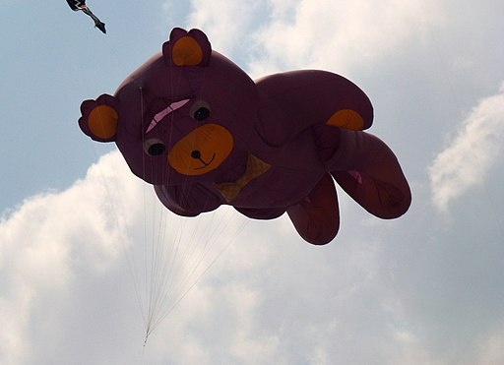
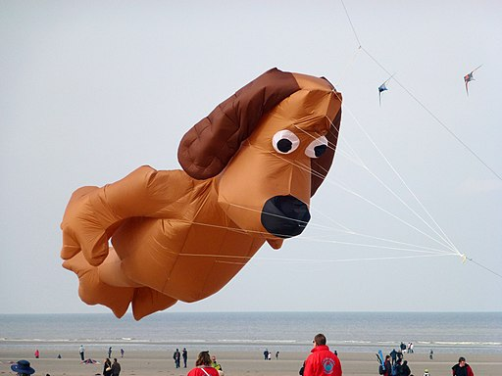
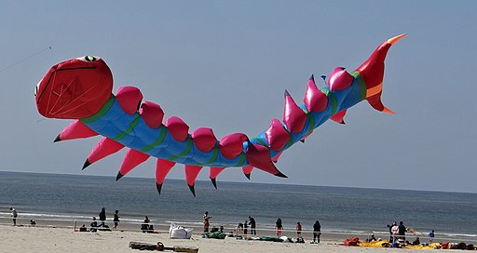
Notes:
[3/3]
PIERRE ANDRE LECLERCQ, CC BY-SA 4.0 via Wikimedia Commons

Slide 11
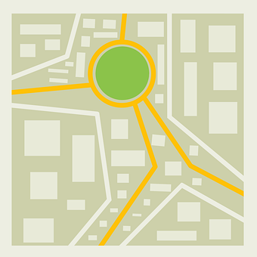
près (de), loin (de), à côté (de)
Note: we use de for all these expressions in French but we say nothing, ‘from’ or ‘to’ in English.
To say something is near to, use près de:
Le stade est près de la plage.
The stadium is near (to) the beach.
For far from, use loin de:
Le théâtre est loin de la plage.
The theatre is far from the beach.
For next to, use à côté de:
Le café est à côté de la piscine.
The café is next to the pool.
Notes:
Timing: 2 minutes
Procedure:
Read the grammar explanation about the three adverbial expressions.
Elicit English translation for the French examples provided. This is another opportunity to hear and see some of our new vocabulary.
11

Slide 12
Using ‘du’ & ‘de la’
Remember: before a noun beginning with a vowel or h muet, use l’: près de l’église.
To mean ‘near to the / far from the’ before a singular feminine noun, use ‘de la’.
To mean ‘near to the / far from the’ before a singular masculine noun, use de + le → du.
près de la piscine.
près du stade.
Near (to) the pool.
near (to) the stadium.
loin de la plage.
loin du théâtre.
Far from the beach.
Far from the theatre.
Notes:
Timing: 3 minutes
Aim: to introduce the contraction ‘du’.
Procedure:
Read the grammar explanation on ‘(to) the/from the’.
Elicit English translations for the French examples provided.
Note: in the audio version the full phrase is heard as the preposition + article combination is highlighted.

Slide 13
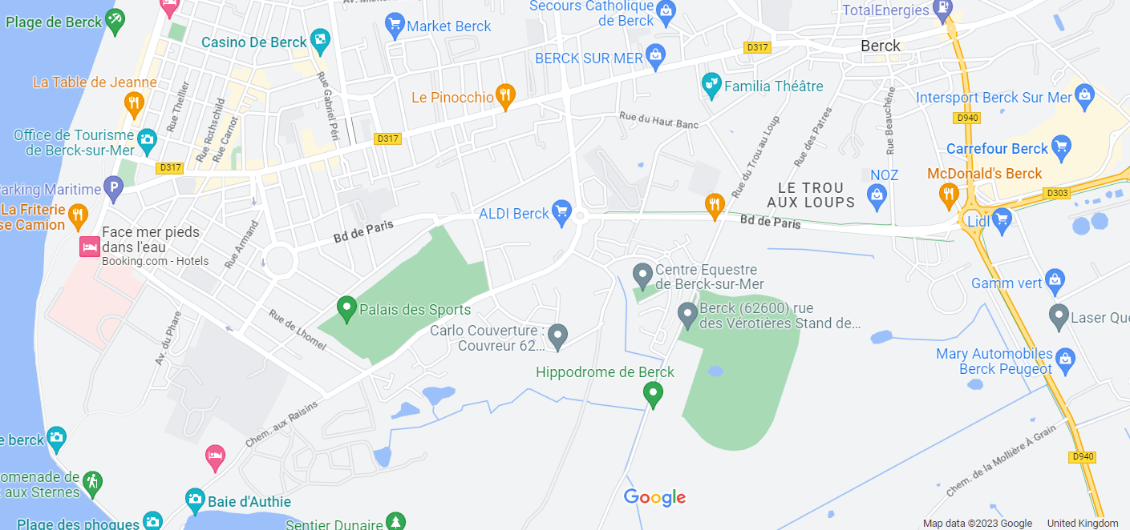
lire
. Écoute les noms des animaux. C’est [ien] ou [(a)in]?
Lis la phrase. C’est du ou de la ?
la plage
la piscine
le marché
le café
le théâtre
le musée
l’église
le centre commercial
l’hôpital
le centre sportif
1. Le marché est près du | de la théâtre.
Notes:
Timing: 8 minutes (six slides)
Aim: to practise identification of the correct preposition + article combination.
Procedure:
Introduce the task. Remind pupils that we are in the town of Berck-sur-Mer this week, and this is a plan / map of the town.
Draw pupils’ attention to gender of the noun (théâtre = masculine).
Give pupils 20-30 seconds to read the sentence aloud in pairs and decide on the correct preposition + article combination.
Elicit response from pupils.
There are 6 sentences in total, including the example.
Transcript:
Le marché est près du théâtre.
13

Slide 14
lire
. Écoute les noms des animaux. C’est [ien] ou [(a)in]?
Lis la phrase. C’est du ou de la ?
la plage
la piscine
le marché
le café
le théâtre
le musée
l’église
le centre commercial
l’hôpital
le centre sportif
2. L’hôpital est loin de la | du centre commercial.
Notes:
[2/6]
Transcript:
2. L’hôpital est loin du centre commercial.
14

Slide 15
lire
. Écoute les noms des animaux. C’est [ien] ou [(a)in]?
Lis la phrase. C’est du ou de la ?
la plage
la piscine
le marché
le café
le théâtre
le musée
l’église
le centre commercial
l’hôpital
le centre sportif
3. La piscine est à côté du | de la plage.
Notes:
[3/6]
Transcript:
3. La piscine est à côté de la plage.
15

Slide 16
lire
. Écoute les noms des animaux. C’est [ien] ou [(a)in]?
Lis la phrase. C’est du ou de la ?
la plage
la piscine
le marché
le café
le théâtre
le musée
l’église
le centre commercial
l’hôpital
le centre sportif
4. Le musée est près de de l’ | du église.
Notes:
[4/6]
Transcript:
4. Le musée est près de de l’église.
16

Slide 17
lire
. Écoute les noms des animaux. C’est [ien] ou [(a)in]?
Lis la phrase. C’est du ou de la ?
assez - quite
la plage
la piscine
le marché
le café
le théâtre
le musée
l’église
le centre commercial
l’hôpital
le centre sportif
5. Le centre sportif est assez* loin de l’ | de la piscine.
Notes:
[5/6]
Transcript:
5. Le centre sportif est assez* loin de la piscine.
17

Slide 18
lire
. Écoute les noms des animaux. C’est [ien] ou [(a)in]?
Lis la phrase. C’est du ou de la ?
la plage
la piscine
le marché
le café
le théâtre
le musée
l’église
le centre commercial
l’hôpital
le centre sportif
6. L’église est près de la | du café.
Notes:
[6/6]
Transcript: 6. L’église est près du café.
18

Slide 19
Au revoir !
vert
Notes:
19

