Slide 1
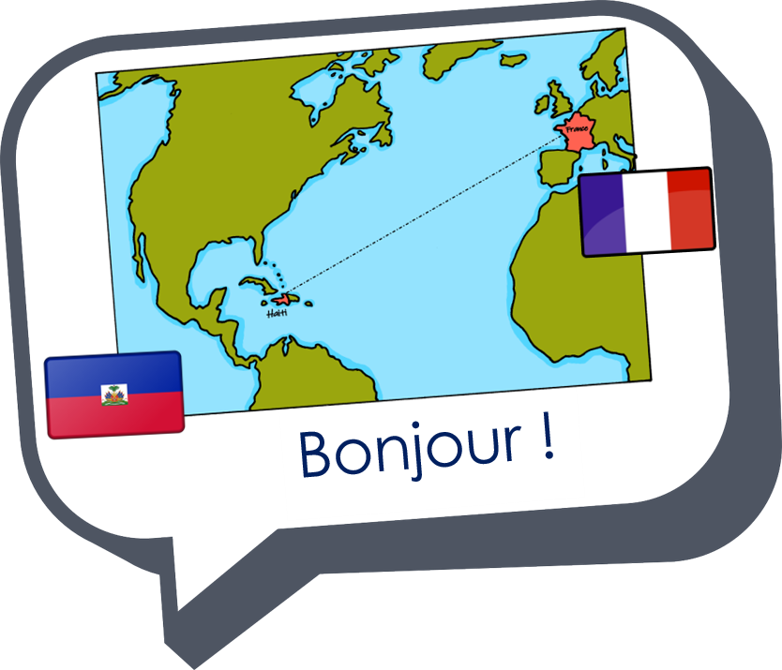

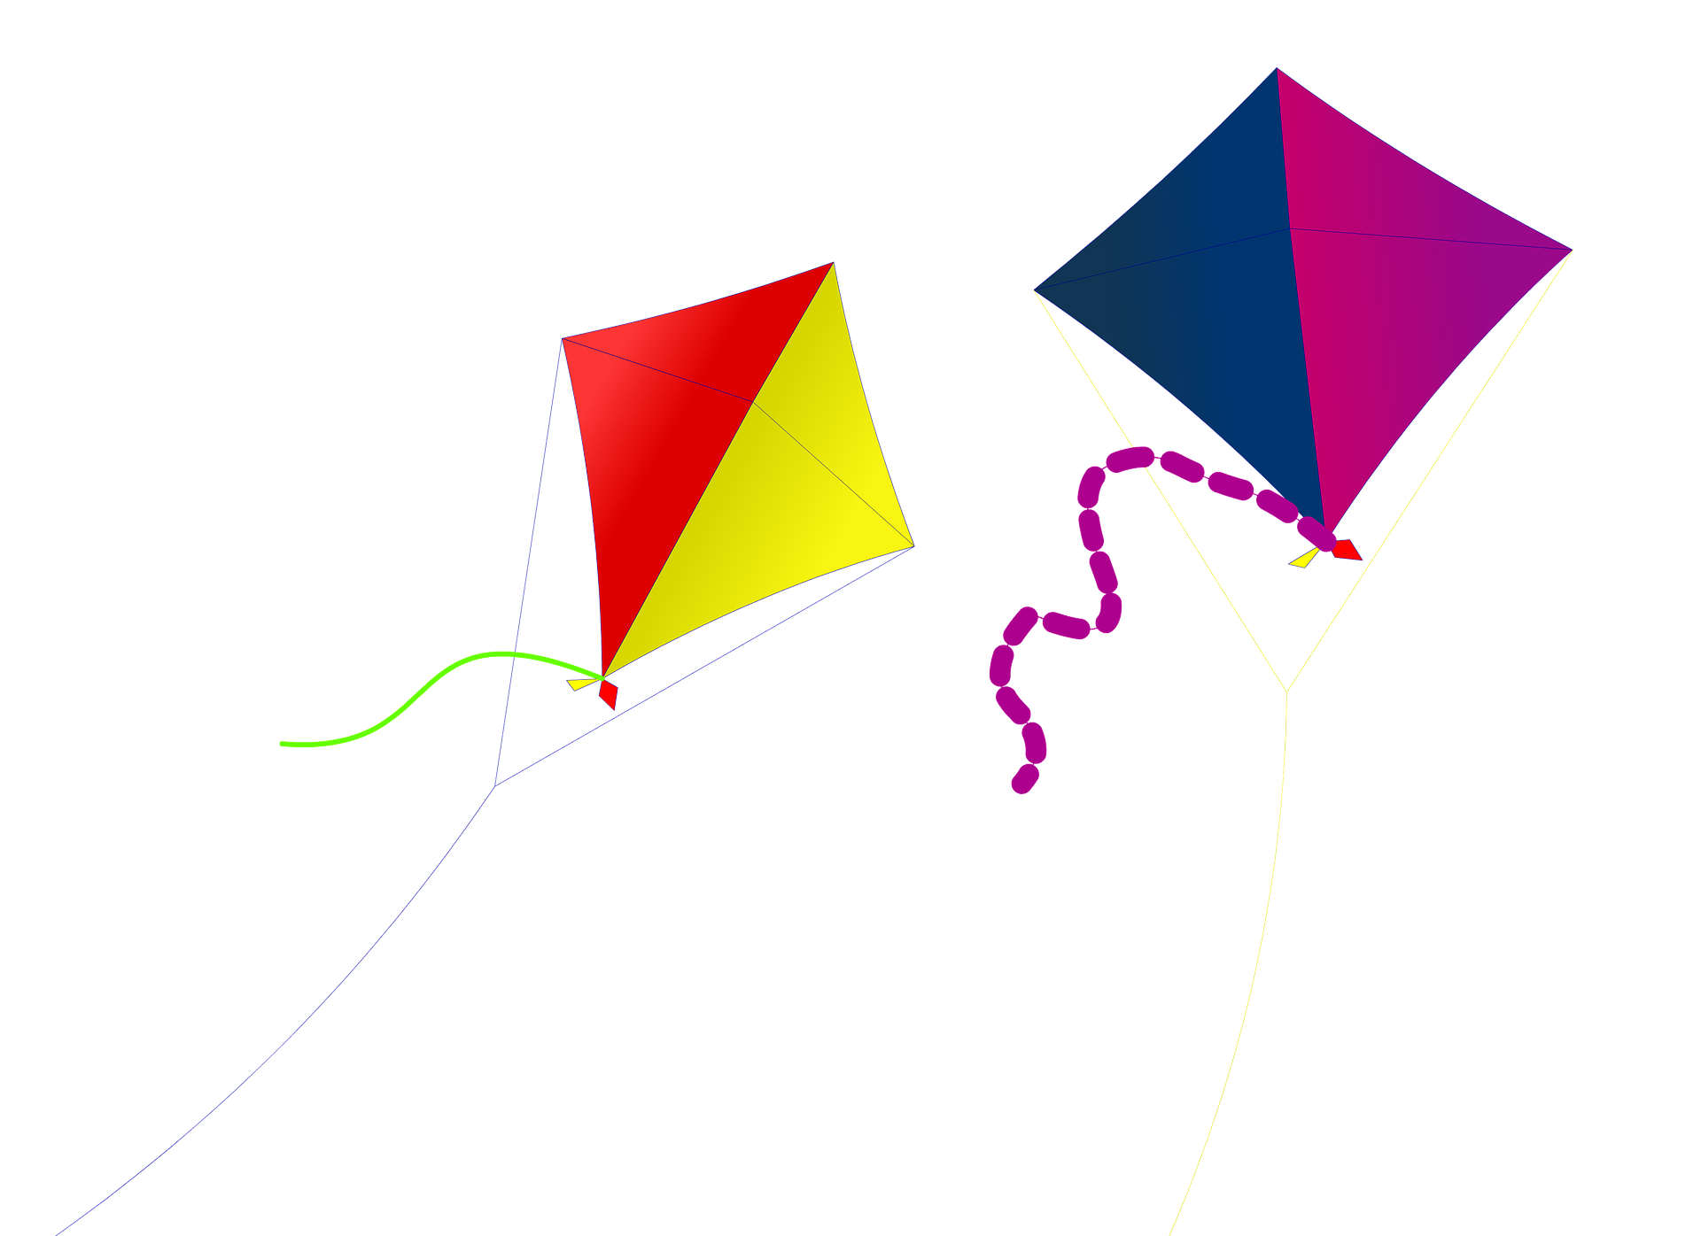

Saying what I and others do
vert
Follow ups 1-5
Notes:
Artwork by Steve Clarke. Pronoun pictures from NCELP (www.ncelp.org). All additional pictures selected from Pixabay and are available under a Creative Commons license, no attribution required.
Phonics: SFe (or SFC) timide [3835] monde [77] moderne [1239] centre [491] douze [1664]
Vocabulary: de² [2] côté [123] près [341] loin [341] piscine [>5000] théâtre [1701] stade [1967]
Revisit 1: il y a un [3] deux [41], trois [115], quatre [253], cinq [288], six [450], sept [905], huit [877], neuf [787], dix [372], onze [2447], douze [1664] des [2] combien [800] treize [3285], quatorze [3359], quinze [1472], seize [3285], dix-sept [3812],
dix-huit [3592], dix-neuf [4851], vingt [1273], vingt-et-un [1273/6/3], vingt-deux, vingt-trois, vingt-quatre, vingt-cinq, vingt-six, vingt-sept, vingt-huit, vingt-neuf, trente [1646]
Revisit 2: étudier [960] gagner [258] cacher [914] pratiquer [1268] présenter [209] prononcer [706] trouver [83] école [477] porte [696] pays [114] carte [955] dictionnaire [4094] prix [310] salle [812] sur [16] à (meaning ‘at’)[4]
Londsale, D., & Le Bras, Y. (2009). A Frequency Dictionary of French: Core vocabulary for learners London: Routledge.
The frequency rankings for words that occur in this PowerPoint which have been previously introduced in these resources are given in the SOW and in the resources that first introduced and formally re-visited those words.
For any other words that occur incidentally in this PowerPoint, frequency rankings will be provided in the notes field wherever possible.

Slide 2



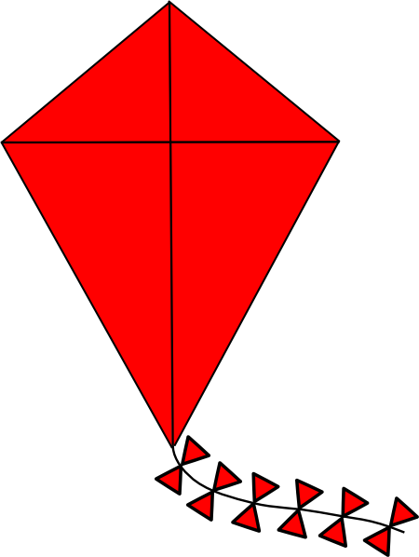
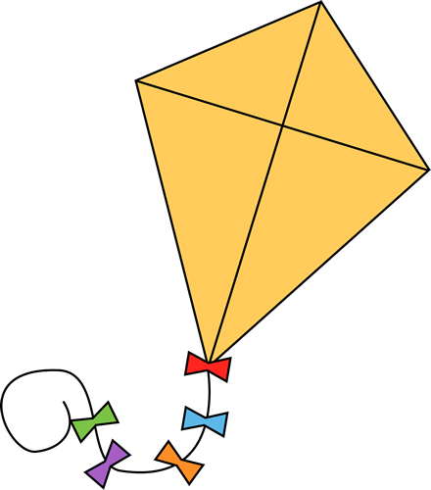
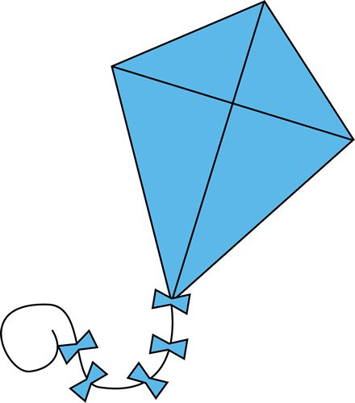
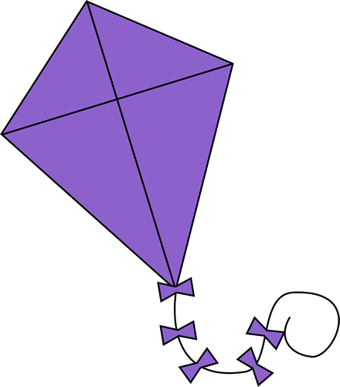
Follow up 1:
.
Prononce les mots.
satellite
profit
part
trampoline
secret
océan
support
minute
Notes:
Timing: 5 minutes
Aim: to practise read aloud of cognates with SFC and SFe.
Procedure:
Tell pupils that these are cognates: French words which are identical or very similar to English words.
Click to bring up the first word. Pupils have to read it aloud before it disappears. If they have time they can say it more than once.
Continue with items 2-8.
There is no audio on this slide. Go to the next slide, if required, to see and hear all the words again.

Slide 3
Follow up 1:
Prononce les mots.
minute
support
profit
satellite
océan
secret
trampoline
part
Notes:
ANSWER SLIDE
Procedure:
Click on each word to hear it pronounced, as required.

Slide 4


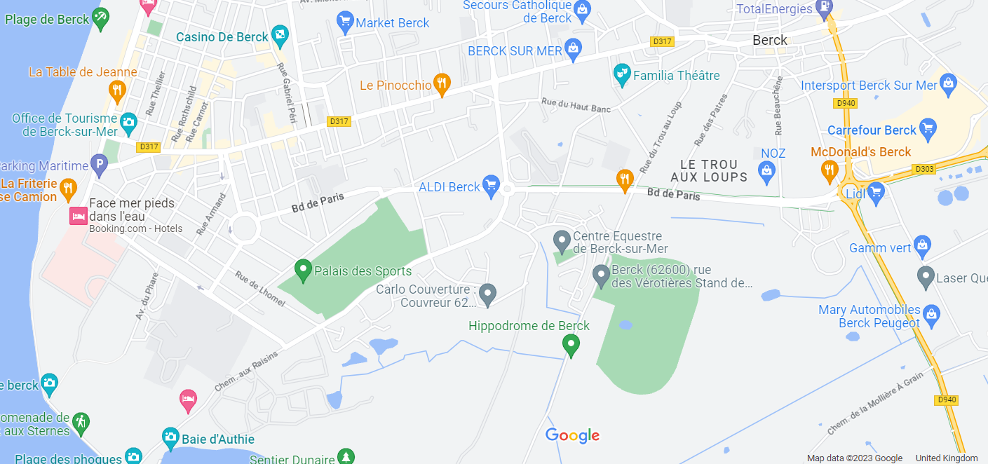


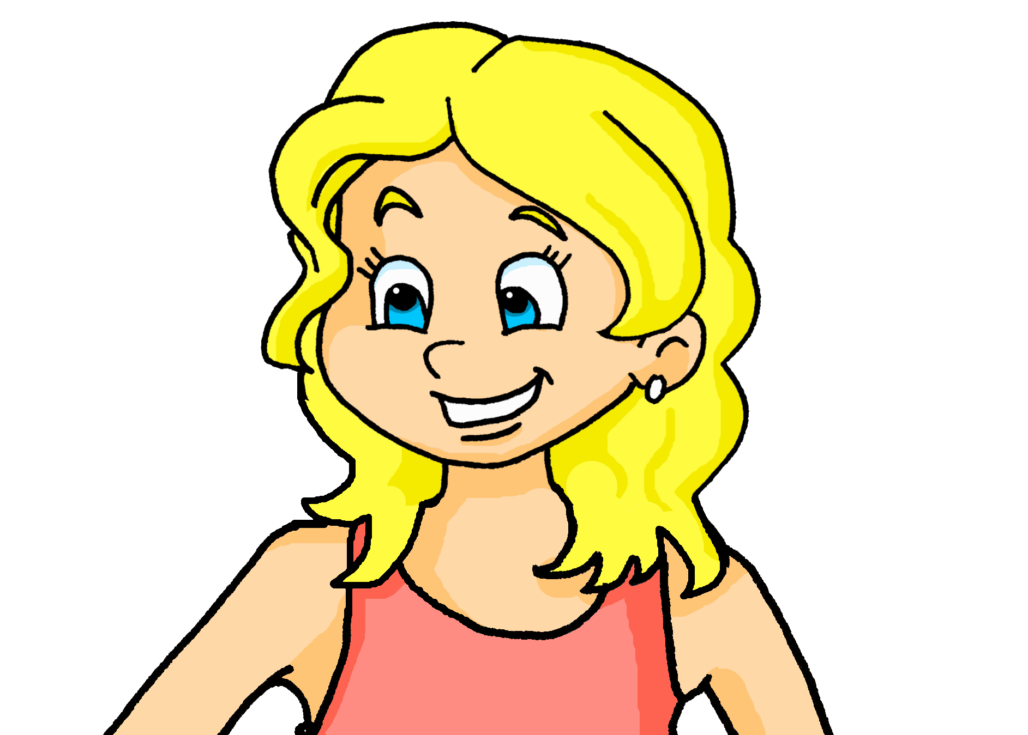
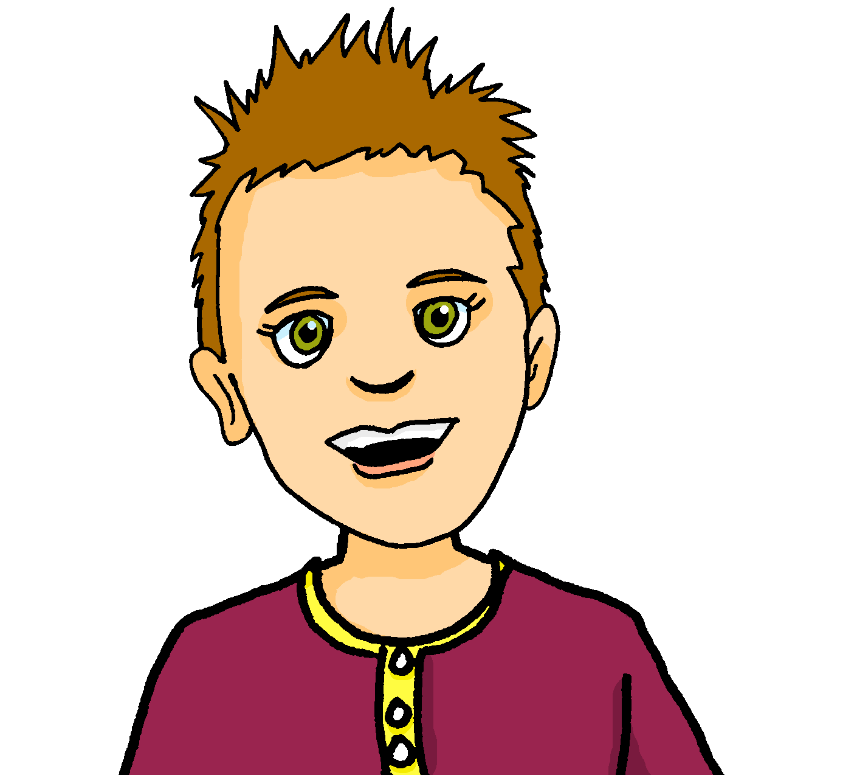
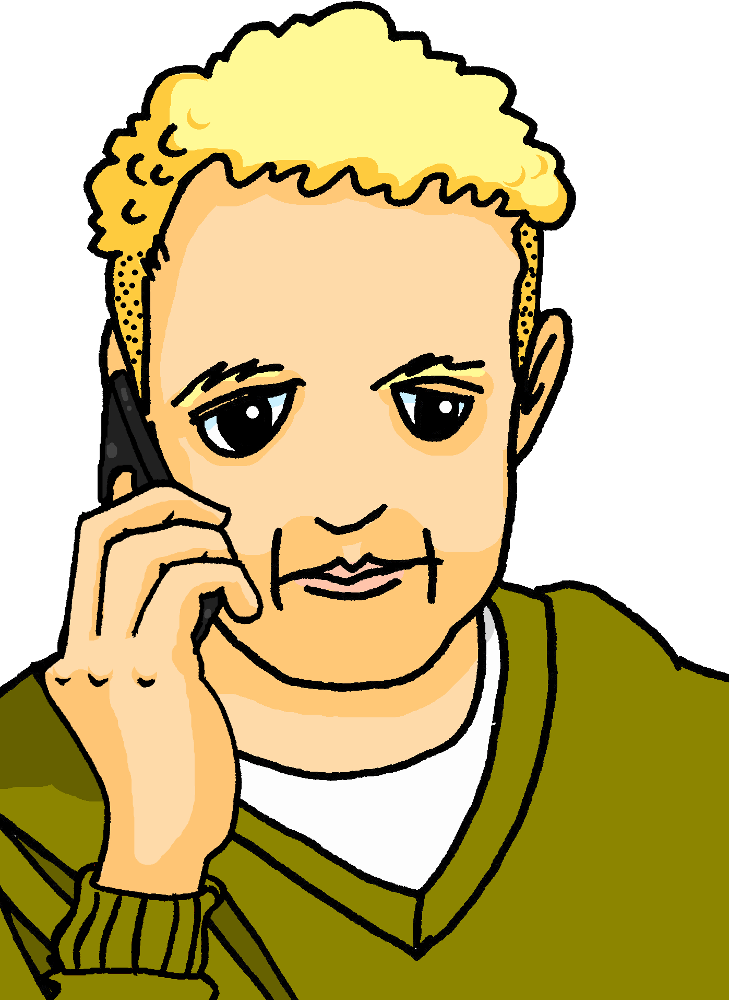
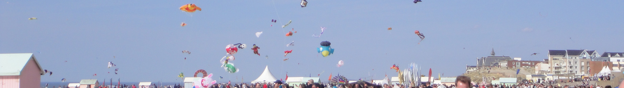
Follow up 2:
La famille Kergosien est à Berck-sur-Mer.
Écoute. Adèle parle à Pierre. Qui va où ?
écouter
plage | café
poste | stade
marché | piscine
plage | église
hôpital | théâtre
cinéma | hôtel
1
café
beach
2
3
4
5
post office
hotel
6
Notes:
Timing: 5 minutes
Aim: to practise aural comprehension of simple sentences with locations; to practise correctly associating au/à la/à l’ with previously taught nouns.
Procedure:
Click to listen to each sentence.
Pupils decide where each person is going, based on the preposition + article they hear.
Click to reveal answers. Note: the full sentence is triggered by the answer tick.
Transcript:
Je vais au [café].
Tu vas à la [poste] ?!!!
Est-ce que Maman va au [marché] ?
Non, elle va à la [plage].
Je ne vais pas au [théâtre].
Papa va à l’ [hôtel].
Image attribution:
Berckplage cerfvolant.JPG : Bateloupreautderivative work : Barbe-sauvage, CC BY-SA 3.0 via Wikimedia Commons

Slide 5






est | n’est pas
Remember, to say ‘it is’ use il/elle est:
To say ‘it isn’t’ use il/elle n’est pas:
Voici un musée. Il est près d’ici.
Il n’est pas près d’ici !
Here’s a museum. It is near here.
It isn’t near here!
Voici une piscine. Mais elle est très loin d’ici.
Elle n’est pas loin d’ici !
It isn’t far from here!
Here’s a pool. But it is
very far from here!
⚠ Remember: to mean ‘it’, use ‘il’ for masculine and ‘elle’ for feminine nouns.
Notes:
Timing: 2 minutes
Aim: to remind pupils about negation.
Procedure:
Click through the animations to present the information.
Elicit English translations for the French examples provided.

Slide 6



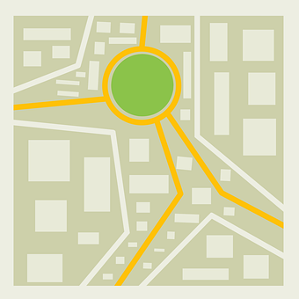







écrire
C’est faux !
Follow up 3
.
Écris bien les phrases.
1. Le centre commercial est à côté du centre sportif.
1. Le centre commercial est loin du centre sportif.
2. Le marché est près de l’église.
lire
2. Le théâtre est près de l’église.
3. La plage est loin du stade.
3. La plage n’est pas loin du stade.
4. La piscine est à côté du café.
4. La piscine est loin du café.
.
Écris deux phrases.
5. ________________________________________
5. La plage est loin du théâtre.
6. ________________________________________
6. La piscine n’est pas près du stade.
Notes:
Timing: 8 minutes
Aim: to practise written comprehension and scaffolded production of sentences using adverbial expressions of location.
Procedure:
Pupils read the sentences and look at the map.
They correct each phrase to match the information on the map, changing the parts in bold each time.
Click to provide answers. Note that items 5 & 6 are just suggestions – there are many different possible sentences. Encourage pupils to write one negative sentence.
6

Slide 7

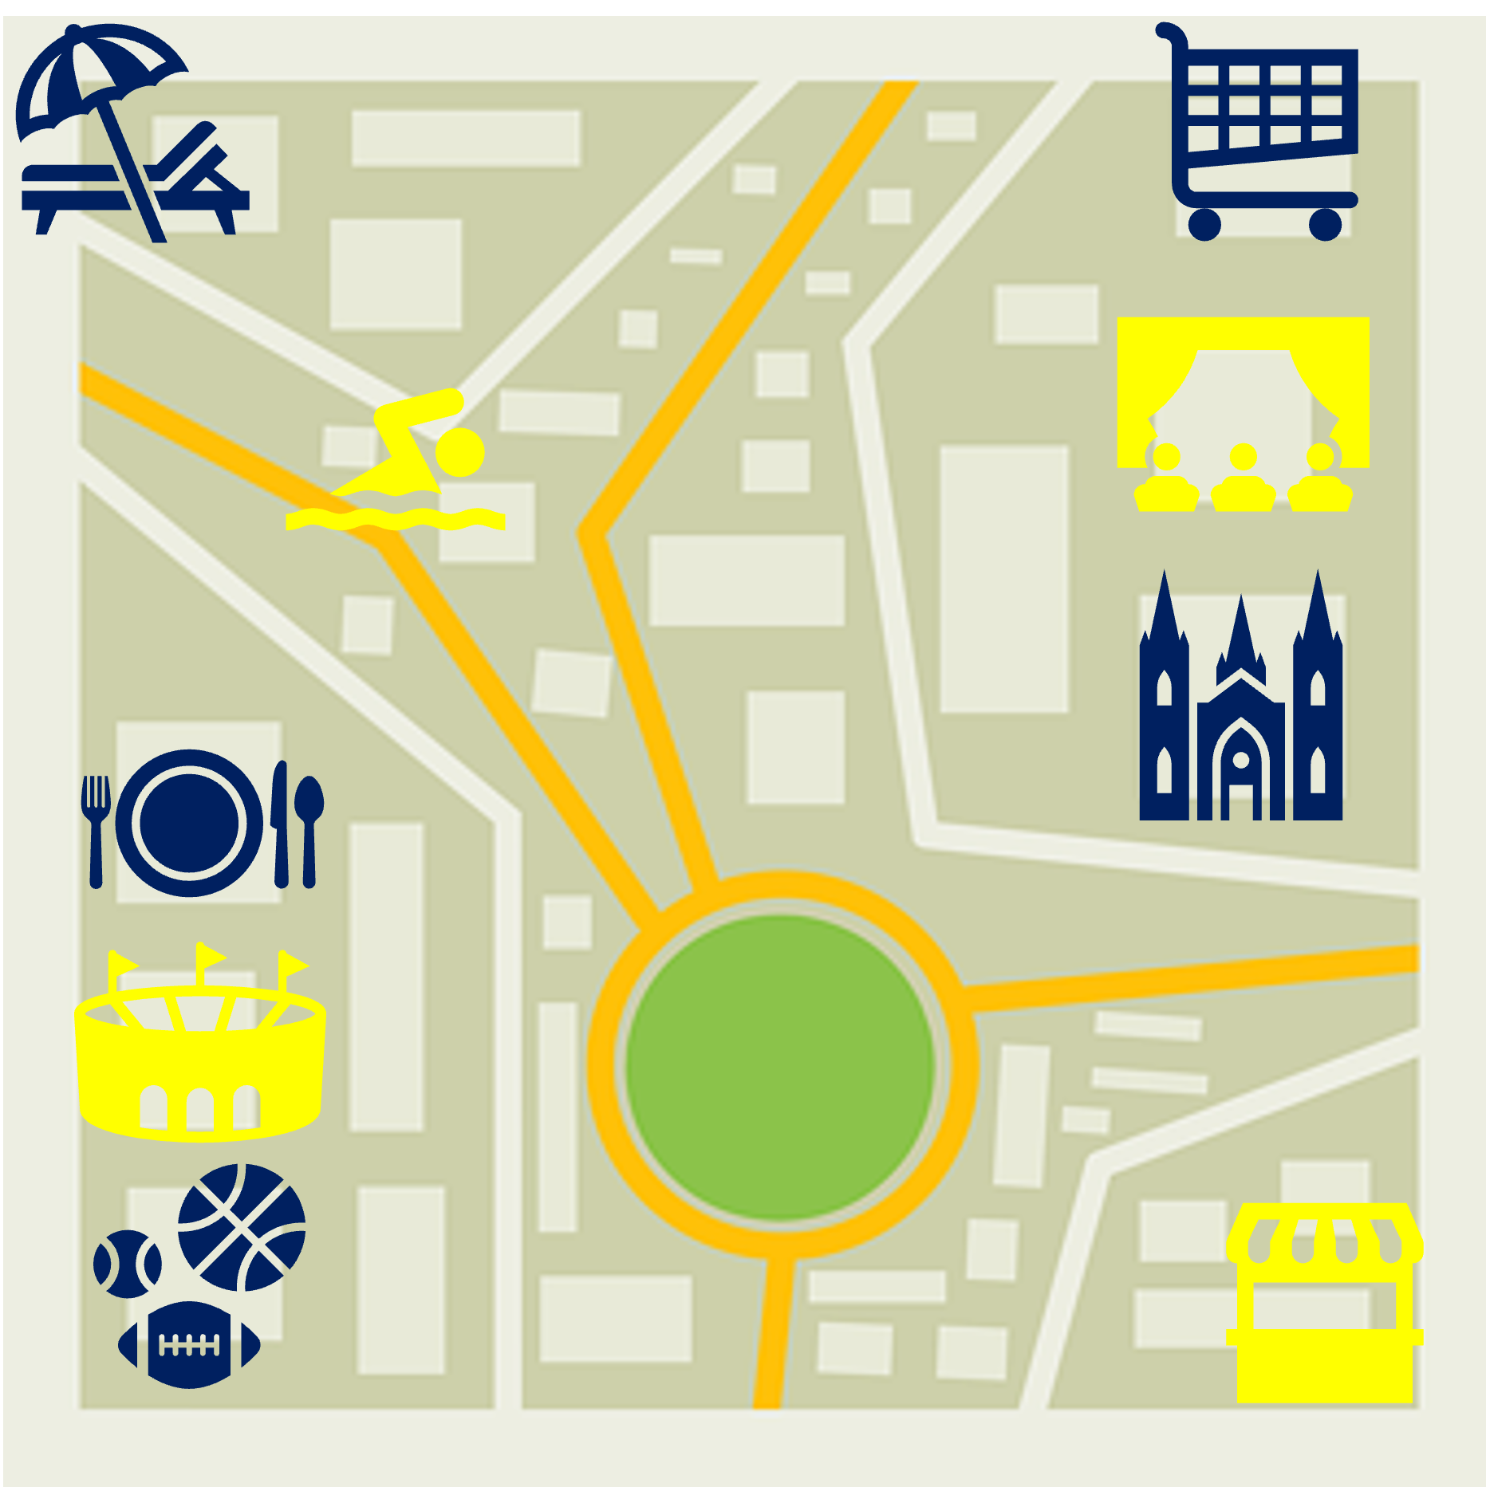
Follow up 4
C’est où ? Round 1
. Écoute les noms des animaux. C’est [ien] ou [(a)in]?
Parle avec ton ou ta partenaire.
Partenaire B:
Listen and identify the four places.
parler
Partenaire A:
Tell your partner where these places are.
1. The stadium
2. The theatre
3. The pool
4. The market
B
A
C
D
Notes:
Timing: 5 minutes (two slides + handouts)
Note: do not click on this slide until pupils have completed the task.
Aim: to exchange information about the location of different places in the town.
Procedure:
1. Give each pupil a handout (either A or B).
2. Pupil A starts by saying where the four places are.
3. Partner B listens and identifies each place (A, B, C, D)
4. Pupils swap roles for round 2. (See next slide)
5. Use this slide and the next slide to provide answers, after both rounds are finished.
6. Click on each letter – A, B, C, D – to hear the sentences. Note: these are just suggested answers. Other answers are possible.
Transcript:
La piscine est près de la plage.
Le théâtre est à côté de l’église. Le théâtre est à côté du centre commercial.
Le stade est à côté du café. Le stade est à côté du centre sportif.
Le marché est loin de la plage.

Slide 8
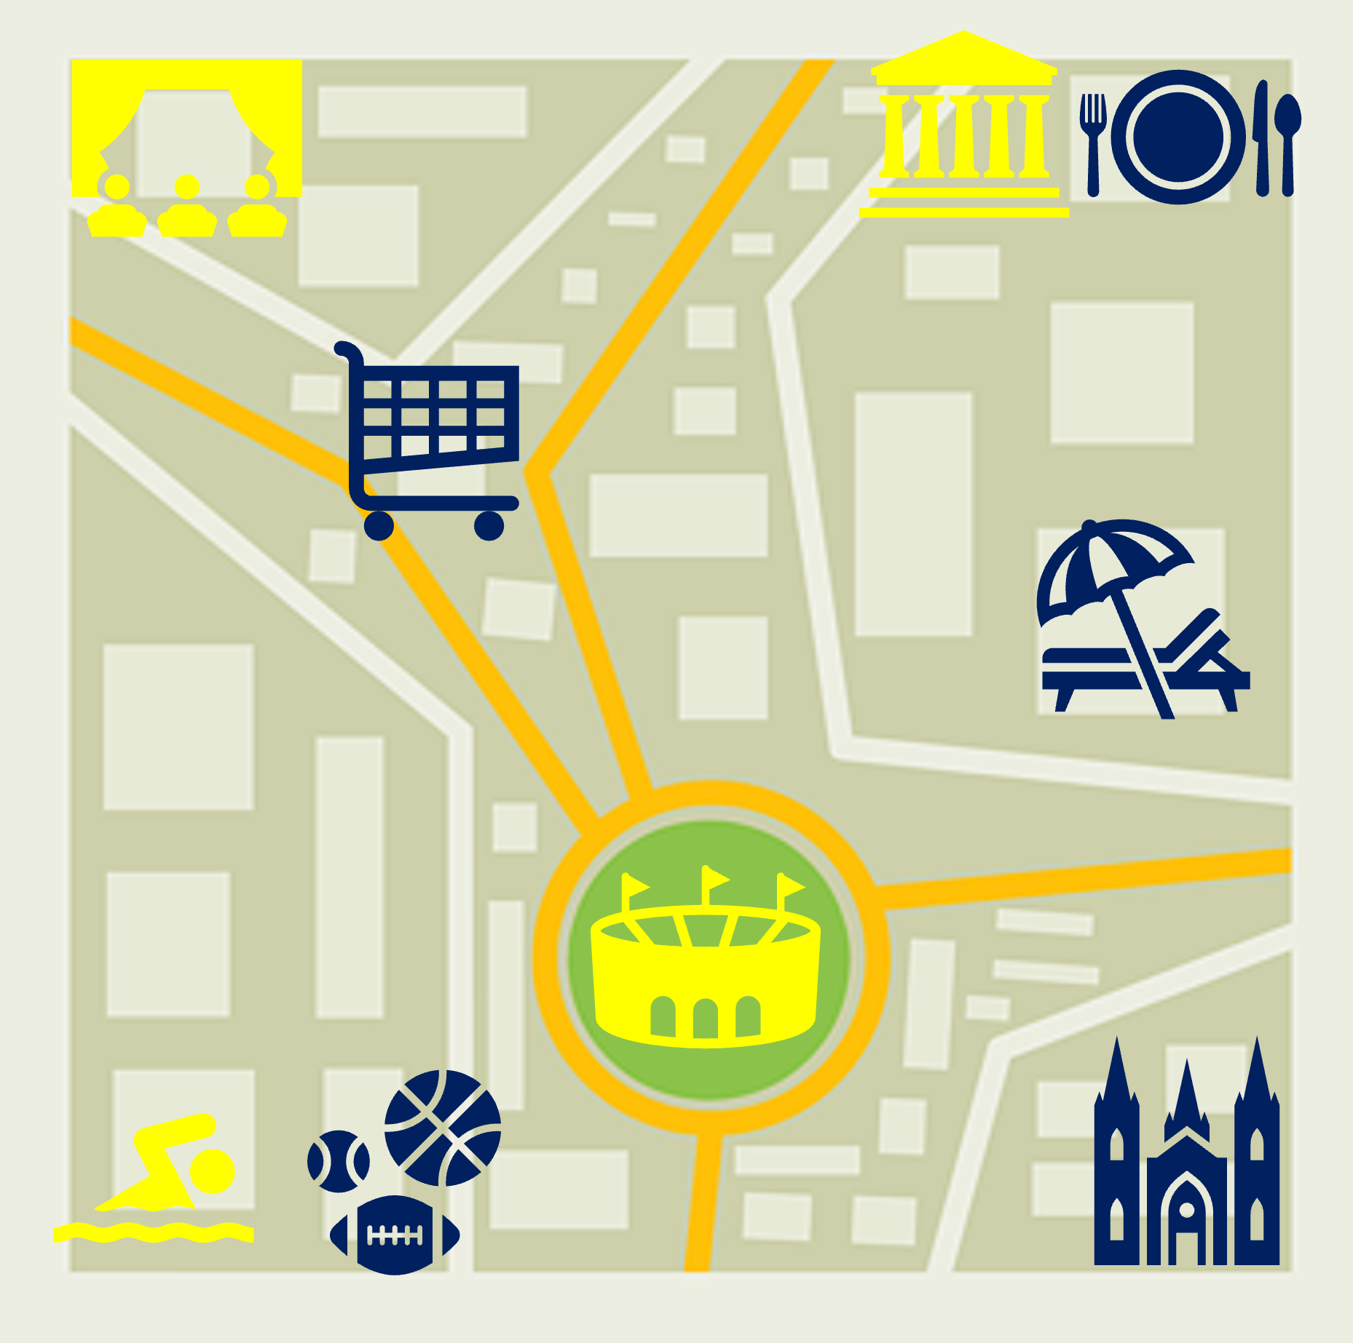
Follow up 4
C’est où ? Round 2
Partenaire A:
Listen and identify the four places.
parler
Partenaire B:
Tell your partner where these places are:
1. The museum
2. The theatre
3. The stadium
4. The pool
A
B
C
D
Notes:
ANSWERS – Round 2
Transcript:
Le théâtre est près du centre commercial.
Le musée est à côté du café.
Le stade est près du centre sportif.
La piscine est loin du musée.

Slide 9




vocabulaire
Follow up 5a - Écris en anglais : Can you get at least 15 points?
mots
 | quatorze | gagner | pratiquer
 | dix-neuf | le dictionnaire | vingt-trois
 | de | le côté | combien
 | vingt-cinq | Il n’y a pas | trente-et-un
 | la piscine | à côté de | le stade
 | près (de) | le théâtre | loin (de)
14
to win, winning
to practise
x3
19
(the) dictionary
23
x2
of, from (to)
(the) side
how many
25
there isn’t, there aren’t
31
(the) pool
next to, beside
(the) stadium
x1
near (to)
(the) theatre
far (from)
Notes:
Timing: 5-10 minutes
Aim: to practise written production of vocabulary from this week and two revisited weeks.
Procedure:
1. Give pupils a blank grid. They fill in the English meanings of any of the words they know, trying to reach 15 points in total.
2. Remind pupils that adjectives can refer to male or female persons and they should note this in their translations. E.g. pleased (f), short (m).
Note:
The most recently learnt and practised words are pink, words from revisit 1 are green and those from revisit 2 are blue, thus more points are awarded for them, to recognise that memories fade and more effort (heavy lifting!) is needed to retrieve them.
9

Slide 10
vocabulaire
Follow up 5b - Écris en français : Can you get at least 15 points?
mots
 | 13 | to practise, practising | 15
 | 24 | to win, winning | (the) dictionary
 | 18 | there isn’t, there aren’t | 30
 | of, from (to) | there is, there are | 27
 | near (to) | far (from) | next (to), beside
 | (the) pool | (the) stadium | (the) theatre
x3
treize
pratiquer
quinze
vingt-quatre
gagner
le dictionnaire
x2
dix-huit
Il n’y a pas
trente
de
Il y a
vingt-sept
près (de)
loin (de)
à côté (de)
x1
la piscine
le stade
le théâtre
Notes:
Timing: 5-10 minutes
Aim: to practise written comprehension of vocabulary from this week and previous weeks.
Procedure:
Give pupils a blank grid. They fill in the French meanings of any of the words they know, trying to reach 15 points in total.
Note:
The most recently learnt and practised words are pink, words from the previous week are green and those from earlier are blue, thus more points are awarded for them, to recognise that memories fade and more effort (heavy lifting!) is needed to retrieve them.
10

Slide 11
Follow up 4
Handout A
. Écoute les noms des animaux. C’est [ien] ou [(a)in]?
Parle avec ton ou ta partenaire.
parler
Partenaire A:
Listen and identify the four places.
Partenaire A:
Tell your partner where these places are.
1. The stadium
2. The theatre
3. The pool
4. The market
A
B
C
D
Notes:
HANDOUT A

Slide 12
Follow up 4
Handout B
. Écoute les noms des animaux. C’est [ien] ou [(a)in]?
Parle avec ton ou ta partenaire.
Partenaire B:
Listen and identify the four places.
Partenaire B:
Tell your partner where these places are:
1. The museum
2. The theatre
3. The stadium
4. The pool
parler
B
A
C
D
Notes:
HANDOUT B

Slide 13
vocabulaire
Follow up 5a - Écris en anglais : Can you get at least 15 points?
mots
 | quatorze | gagner | pratiquer
 | dix-neuf | le dictionnaire | vingt-trois
 | de | le côté | combien
 | vingt-cinq | Il n’y a pas | trente-et-un
 | la piscine | à côté de | le stade
 | près (de) | le théâtre | loin (de)
x3
x2
x1
Notes:
HANDOUT
13

Slide 14
vocabulaire
Follow up 5b - Écris en français : Can you get at least 15 points?
mots
 | 13 | to practise, practising | 15
 | 24 | to win, winning | (the) dictionary
 | 18 | there isn’t, there aren’t | 30
 | of, from (to) | there is, there are | 27
 | near (to) | far (from) | next (to), beside
 | (the) pool | (the) stadium | (the) theatre
x3
x2
x1
Notes:
Timing: 5-10 minutes
Aim: to practise written comprehension of vocabulary from this week and previous weeks.
Procedure:
Give pupils a blank grid. They fill in the French meanings of any of the words they know, trying to reach 15 points in total.
Note:
The most recently learnt and practised words are pink, words from the previous week are green and those from earlier are blue, thus more points are awarded for them, to recognise that memories fade and more effort (heavy lifting!) is needed to retrieve them.
14

