Slide 1
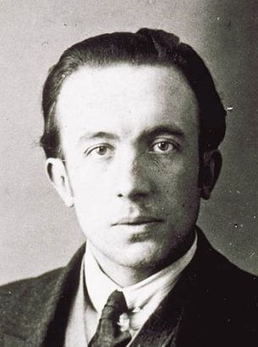
Describing me and others
vert
Follow ups 1-5
Term 3 Week 13
Notes:
Artwork by Steve Clarke. Pronoun pictures from NCELP (www.ncelp.org). All additional pictures selected from Pixabay and are available under a Creative Commons
license, no attribution required.
Phonics: revisit several SSC
Vocabulary: revisit
Revisit 1: manger [1338] je voudrais, tu voudrais, il/elle voudrait [57] chocolat [4556] eau [475] fromage [4475] gâteau [4845] glace [2580] jus [>5000] pizza [>5000]
Revisit 2: faire [25] je fais il/elle fait activité [452] course à pied [n/a] chanson [2142] dessin [2624] film [848] gâteau [4845] matin [442] soir [397] spectacle [1687] ville [360] visite [1072]
weekend [2475] demain [871]
Londsale, D., & Le Bras, Y. (2009). A Frequency Dictionary of French: Core vocabulary for learners London: Routledge.
The frequency rankings for words that occur in this PowerPoint which have been previously introduced in these resources are given in the SOW and in the resources that first
introduced and formally re-visited those words.
For any other words that occur incidentally in this PowerPoint, frequency rankings will be provided in the notes field wherever possible.

Slide 2
écrire
Follow ups
Écris un poème.
Dans Paris il y a une rue;
L'oiseau renversa l'œuf;
Dans cette rue il y a une maison;
L'œuf renversa le nid;
Dans cette maison il y a un escalier;
Le nid renversa la cage;
Dans cet escalier il y a une chambre;
La cage renversa le tapis;
Dans cette chambre il y a une table;
Le tapis renversa la table;
Sur cette table il y a un tapis;
La table renversa la chambre;
Sur ce tapis il y a une cage;
La chambre renversa l'escalier;
Dans cette cage il y a un nid;
L'escalier renversa la maison;
Dans ce nid il y a un œuf,
la maison renversa la rue;
le nid - nest
renverser – to overturn
le tapis – carpet
Dans cet œuf il y a un oiseau.
la rue renversa la ville de Paris.
Notes:
Timing: 2 minutes
Aim: to re-introduce the idea of writing a new version of the poem, with different nouns.
Procedure:
Tell pupils that during this week they will be writing a new version of this poem, with their choice of vocabulary.
They can either work alone on in pairs.
Move to the next slide to show them where they can write the new nouns that they want to use to replace the words in bold.
Frequency of unknown words and cogates: nid [>5000] renverser [2079] tapis [3783]

Slide 3
écrire
Écris un poème.
Choose 10 French nouns to include in your version of the poem. You can choose a mixture of words you know and don’t yet know.
French | English | (a) un or une | (b) ce/cet/ cette | (c) le/ la/ l’
1
2
3
4
5
6
7
8
9
10
Notes:
HANDOUT

Slide 4
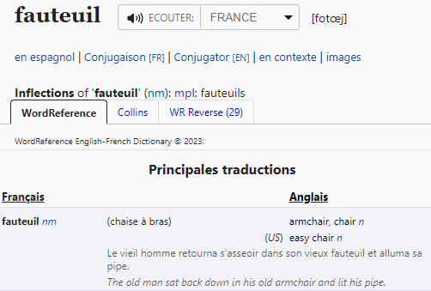
Using reference materials [nouns]
[understanding symbols]
www.wordreference.com
When using an online or paper dictionary, you find symbols with useful information (type of word – e.g., noun, adjective, and gender – i.e. masculine and feminine).
n = noun
m = masculine
f = feminine
Cherche le mot dans un dictionnaire.
masculine noun
This helps us find out the grammatical gender of a noun).
un
______ fauteuil [an armchair]
______ fauteuil [the armchair]
Exemple: fauteuil
le
Notes:
Timing: 4 minutes (two slides)
Aim: to recap reference skills – looking up English to French; understanding codes in a dictionary in order to find out the gender of a noun; applying grammatical knowledge of the definite articles.
Procedure:
Teachers click to go through the slide.

Slide 5
vocabulaire
Cherche les mots dans un dictionnaire.
mots
Écris aussi le symbole.
le tapis
carpet, rug
corner
floor
bookcase
snake
dragonfly
nm
nm
le coin
Make sure you select the correct direction (English to French).
nm
le sol
nfpl
la bibliothèque
You may already know some or most of these words.
nm
le serpent
nf
la libellule
Of course, you can search for your own words. These are just ideas.😉
Notes:
Timing: flexible (to include follow ups for this week, plus any additional ‘spare’ curriculum time for them to work on their poems).
Aim: to practise reference skills – applying understanding of codes in a dictionary in order to find out the gender of a noun.
Procedure:
Pupils will need paper dictionaries or access to laptops / tablets to access an online dictionary.
Read the instruction and check understanding.
Click x1 to bring up further instruction.
Click x1 to bring up speech bubble that reminds pupils about choosing the correct default language.
Click to bring up the other two call outs.
Note: there are no answers provided here as these are just ideas.
5

Slide 6
vocabulaire

Follow up 5
Écris en anglais. Can you get at least 15 points?
mots
 | le gâteau | le weekend | la ville
 | demain | le spectacle | la visite
 | le matin | le dessin | le soir
 | faire | tu fais | le jus
 | manger | l’eau | elle voudrait
 | le fromage | la glace | je voudrais
(the) cake
(the) weekend
(the) town
x3
tomorrow
(the) show
(the) visit
(the) morning
(the) drawing
(the) evening
x2
to do, make
you do, make
(the) juice
(the) water
she would like
to eat, eating
x1
(the) cheese
(the) ice cream
I would like
Notes:
Timing: 5 minutes
Aim: to practise written comprehension of vocabulary.
Procedure: 1. Give pupils a blank grid. They fill in the English meanings of any of the words they know, trying to reach 15 points in total. 2. Remind pupils that adjectives can refer to male or female persons and they should note this in their translations. E.g. pleased (f), short (m).
Note: The most recently learnt and practised words are pink, words from the previous week are green and those from week 1 are blue, thus more points are awarded for them, to recognise that memories fade and more effort (heavy lifting!) is needed to retrieve them.
6

Slide 7
vocabulaire

Follow up 5
Écris en français. Can you get at least 15 points?
mots
 | (the) visit | (the) cake | (the) show
 | (the) town | tomorrow | (the) weekend
 | (the) drawing | (the) morning | (the) evening
 | (the) juice | to do, make | you do, make
 | (the) water | (the) cheese | (the) ice cream
 | to eat, eating | I would like | she would like
la visite
le gâteau
le spectacle
x3
la ville
demain
le weekend
le dessin
le matin
le soir
x2
le jus
faire
tu fais
l’eau
le fromage
la glace
x1
manger
je voudrais
elle voudrait
Notes:
Timing: 5 minutes
Aim: to practise written comprehension of vocabulary from week 1, last week and this week.
Procedure: 1. Give pupils a blank grid. They fill in the English meanings of any of the words they know, trying to reach 15 points in total. 2. Remind pupils that adjectives can refer to male or female persons and they should note this in their translations. E.g. pleased (f), short (m).
Note: The most recently learnt and practised words are pink, words from the previous week are green and those from week 1 are blue, thus more points are awarded for them, to recognise that memories fade and more effort (heavy lifting!) is needed to retrieve them.
7

Slide 8
vocabulaire

Follow up 5
Écris en anglais. Can you get at least 15 points?
mots
 | le gâteau | le weekend | la ville
 | demain | le spectacle | la visite
 | le matin | le dessin | le soir
 | faire | tu fais | le jus
 | manger | l’eau | elle voudrait
 | le fromage | la glace | je voudrais
x3
x2
x1
Notes:
HANDOUT
8

Slide 9
vocabulaire

Follow up 5
Écris en français. Can you get at least 15 points?
mots
 | (the) visit | (the) cake | (the) show
 | (the) town | tomorrow | (the) weekend
 | (the) drawing | (the) morning | (the) evening
 | (the) juice | to do, make | you do, make
 | (the) water | (the) cheese | (the) ice cream
 | to eat, eating | I would like | she would like
x3
x2
x1
Notes:
HANDOUT
9

