Slide 1
What do I know now?
vert
Phonics quiz
Notes:
Artwork by Steve Clarke. Pronoun pictures from NCELP (www.ncelp.org). All additional pictures selected from Pixabay and are available under a Creative Commons license, no
attribution required.
This lesson contains a phonics quiz to assess knowledge of the SSC (sound-symbol correspondences) taught and practised so far. 50% of the items contain SSC practised this term, 50% are drawn from previous learning in terms 1 and 2. Almost all of the
SSC from the KS2 course are included.
cesser [462] dose [4229] doute [362] écrivain [1738] hostile [3091] italien [1477] liquide [3520] minute [375] orage [4788] poche [1940] publication [1421] repos [2731] réseau [721] visiteur [2266]
Londsale, D., & Le Bras, Y. (2009). A Frequency Dictionary of French: Core vocabulary for learners London: Routledge.
1

Slide 2
prononcer
[-tion]
[qu]
prononcer
la publication
le liquide
Notes:
Phonics quiz
Timing: flexible during Week 11 Procedure:
Print out one set of these 14 phonics cards.
Working with one pupil at a time, elicit the pronunciation of each word.
Say: You have not learnt these words, but you have learnt how to read aloud these sounds, so just have a go at reading each word aloud.
Focus only on the accurate pronunciation of the target SSC and tolerate any other inaccuracies.
Use the pupil scoring sheet at the end of this presentation to assess SSC knowledge and give feedback.
Note: Whilst working with individual children, others can be doing the independent activities at the end of this presentation.
2

Slide 3
prononcer
[-s-]
[h]
prononcer
la dose
hostile
Notes:
3

Slide 4
prononcer
[-ien]
[j/g]
prononcer
italien
l’orage
Notes:
4

Slide 5
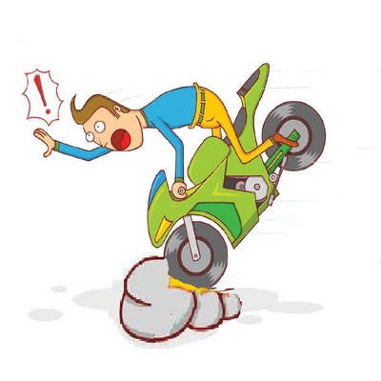
prononcer
[ç/c]
[SFC]
prononcer
cesser
le repos
[to stop, cease]
Notes:
5

Slide 6
prononcer
[u]
[ou]
prononcer
la minute
le doute
Notes:
6

Slide 7
prononcer
open
[(a)in]
[eu]
prononcer
l’écrivain
le visiteur
[(the) writer]
Notes:
7

Slide 8
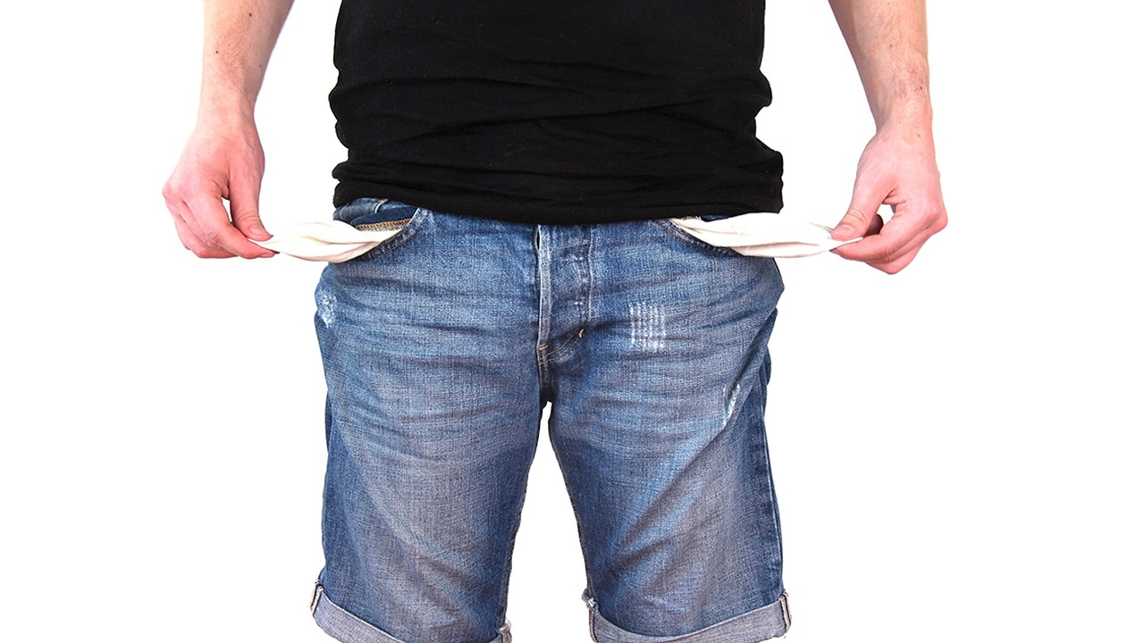
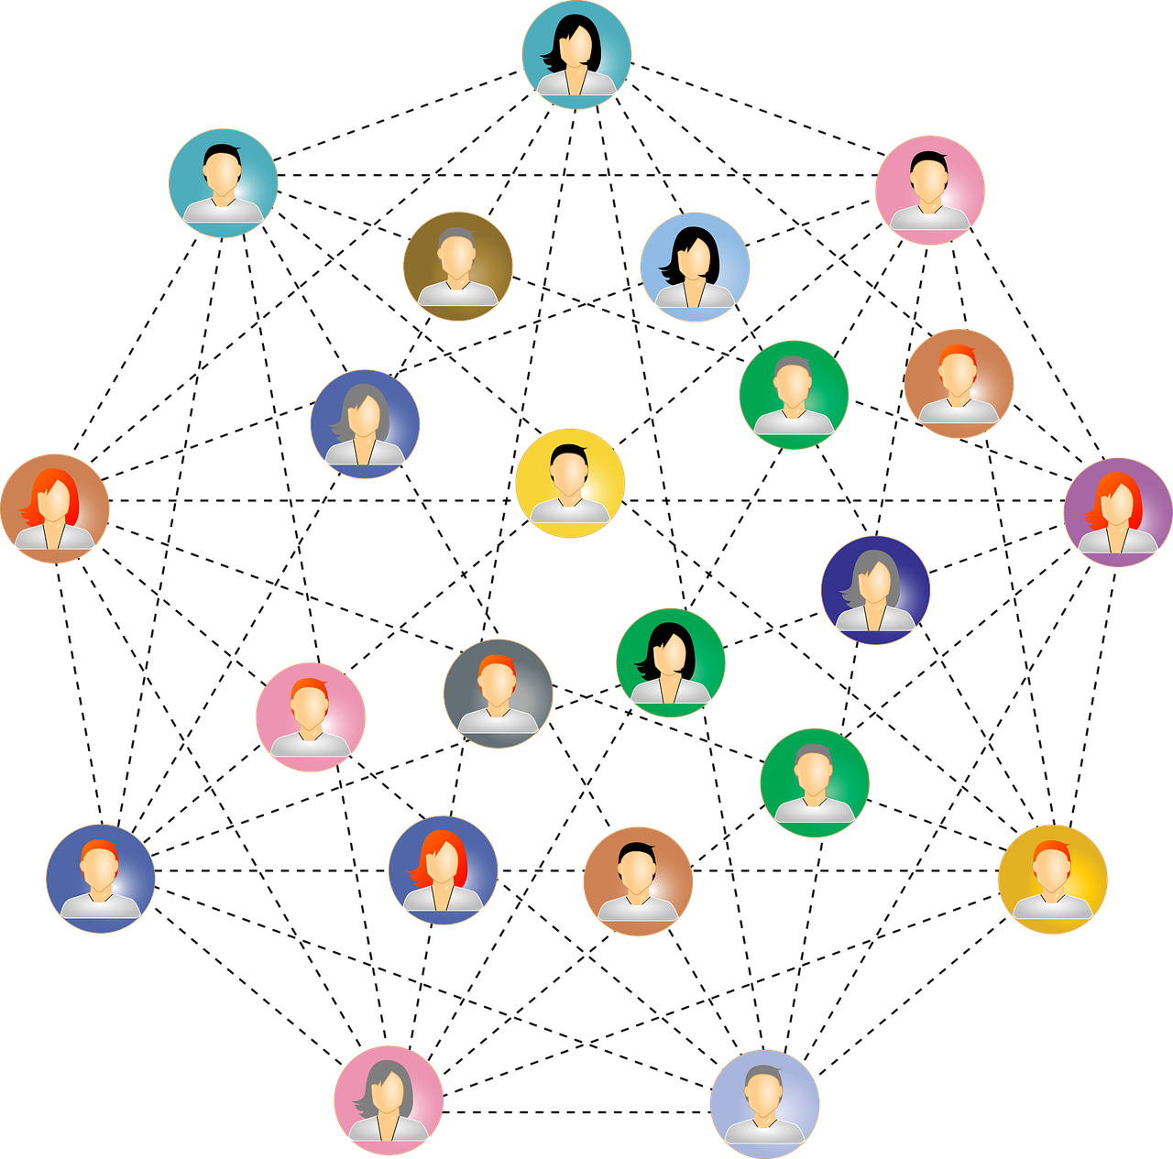
prononcer
[ch]
[(e)au]
prononcer
la poche
le réseau
[(the) network]
Notes:
8

Slide 9
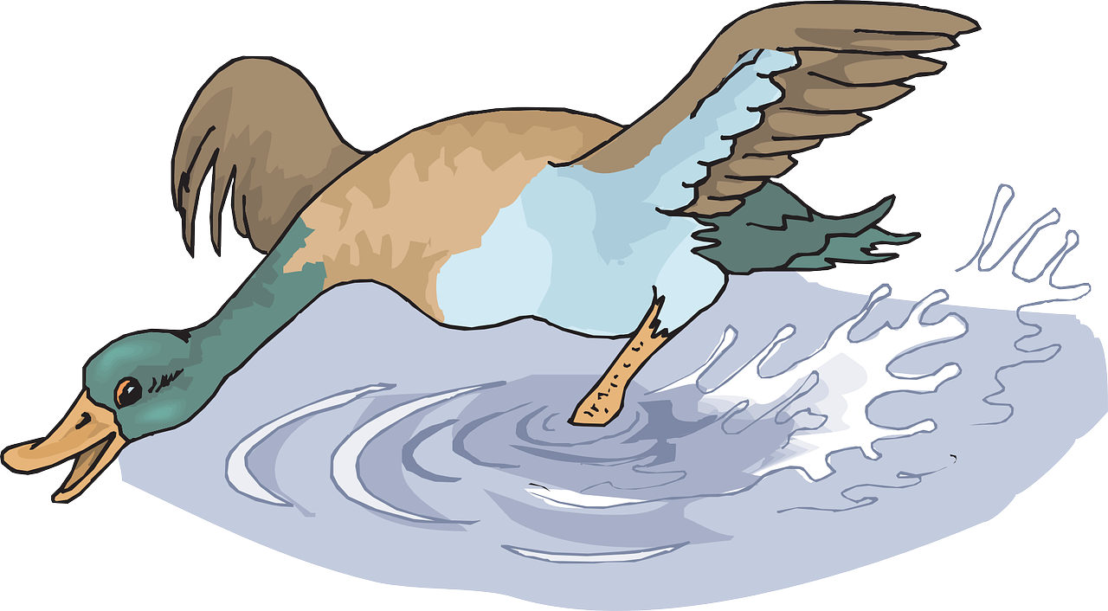
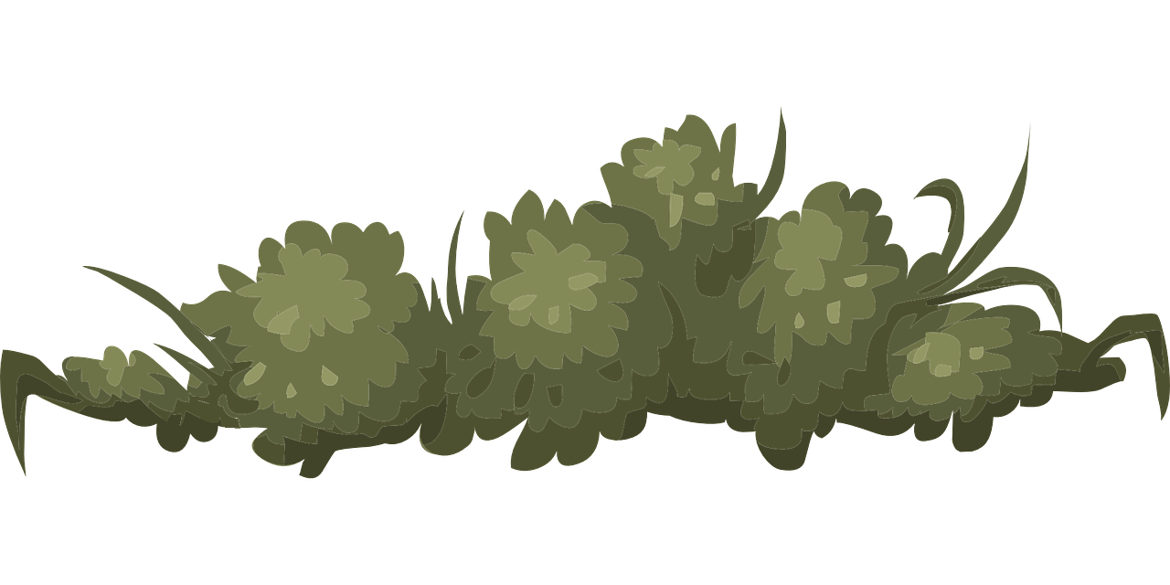
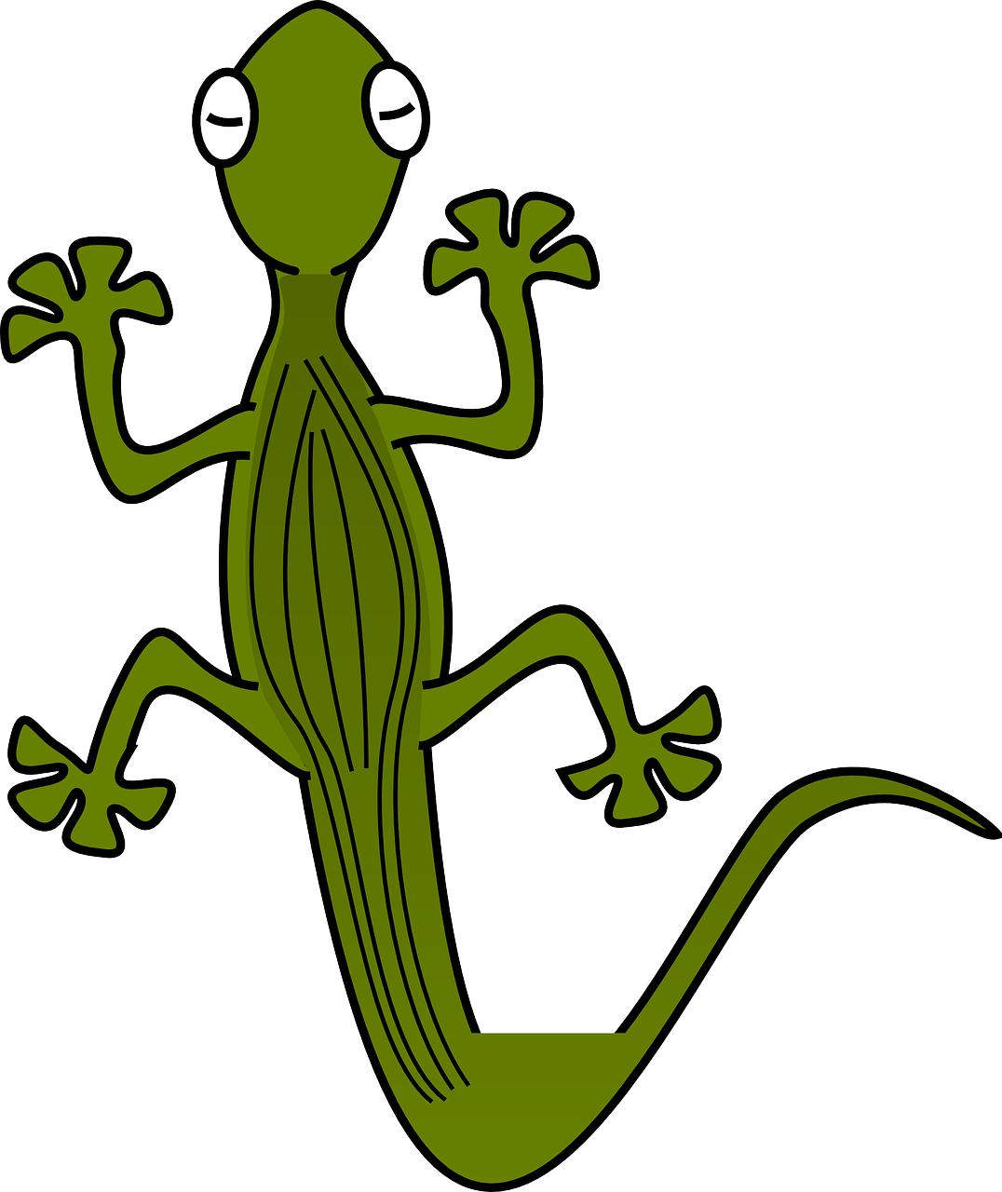
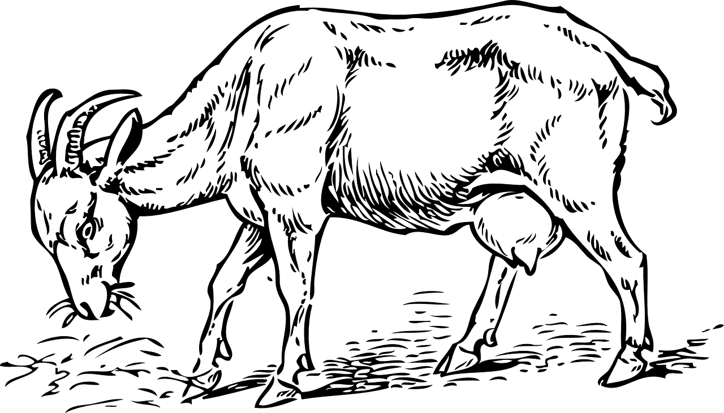
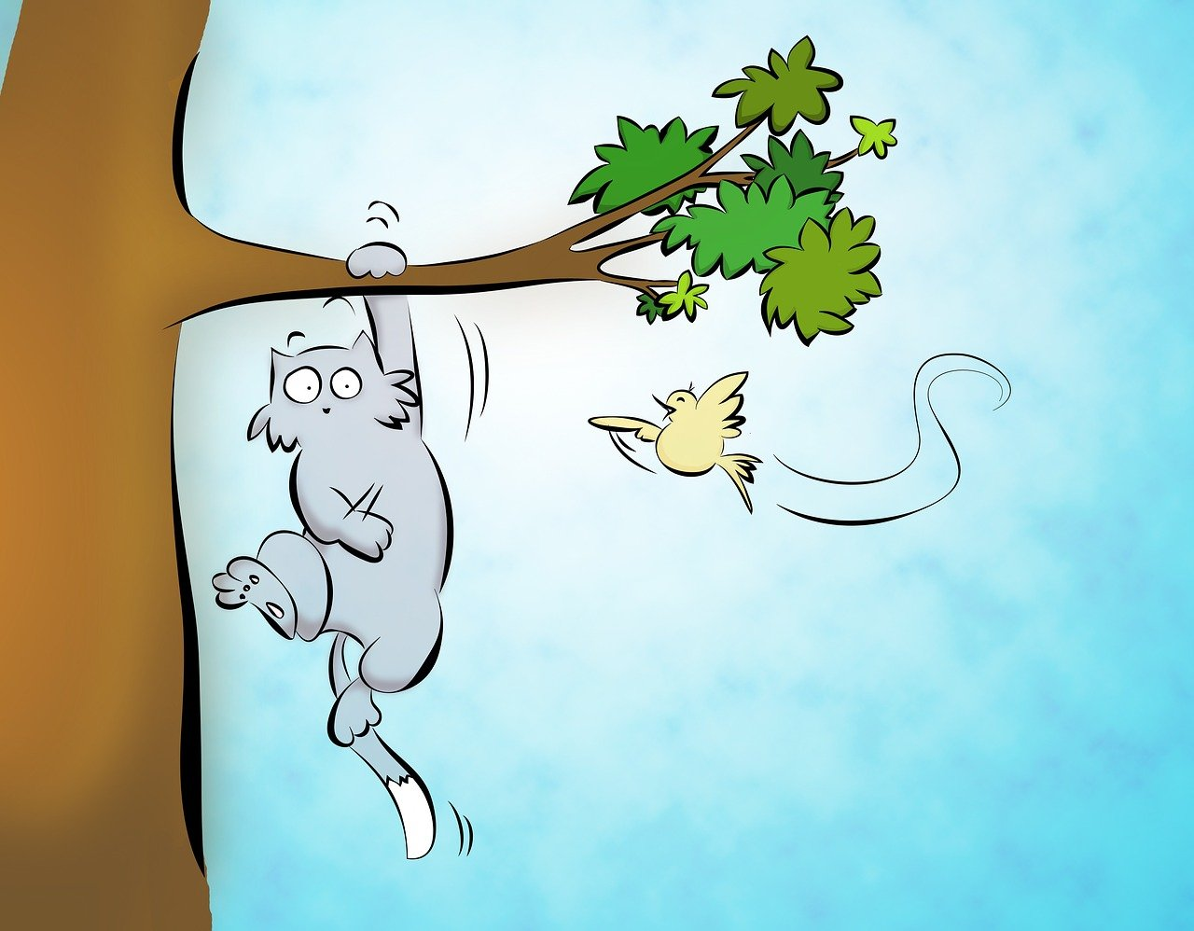
prononcer
1. Le canard boit de l'eau fraiche.
2. Le lézard se cache dans les buissons.
3. La chèvre mange du foin dans la cour.
4. Le chat chasse les oiseaux dans le jardin.
5. Le lion bondit en rugissant dans la savane.
Notes:
Optional additional sentence read aloud [10 points]
9

Slide 10
Au revoir !
vert
Notes:
10

Slide 11
prononcer
Pupil name:
Pupil name:
SSC and word | px
la publication
le liquide
la dose
hostile
italien
l’orage
cesser
le repos
la minute
le doute
l’ écrivain
le visiteur
la poche
le réseau
SSC and word | px
la publication
le liquide
la dose
hostile
italien
l’orage
cesser
le repos
la minute
le doute
l’ écrivain
le visiteur
la poche
le réseau
Notes:
Pupil feedback and assessment sheet [14 points]
11

Slide 12
Teacher audio version for checking
SSC and wordc | px
la publication
le liquide
la dose
hostile
italien
l’orage
cesser
le repos
la minute
le doute
l’ écrivain
le visiteur
la poche
le réseau
prononcer
1. Le canard boit de l'eau fraiche.
2. Le lézard se cache dans les buissons.
3. La chèvre mange du foin dans la cour.
4. Le chat chasse les oiseaux dans le jardin.
5. Le lion bondit en rugissant dans la savane.
Notes:
Note: the final sentence has two examples of each sound but each sound = 1 point.
12

