Slide 1
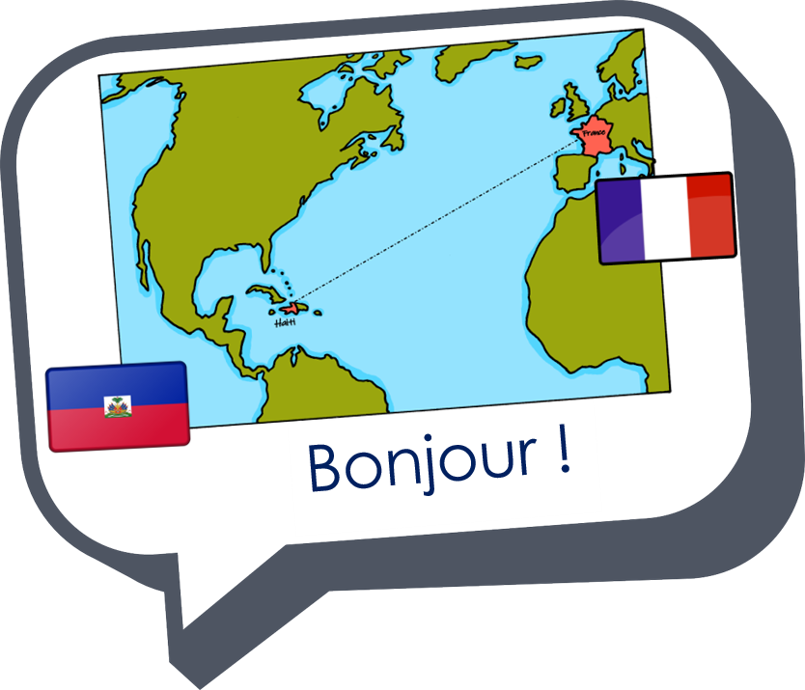
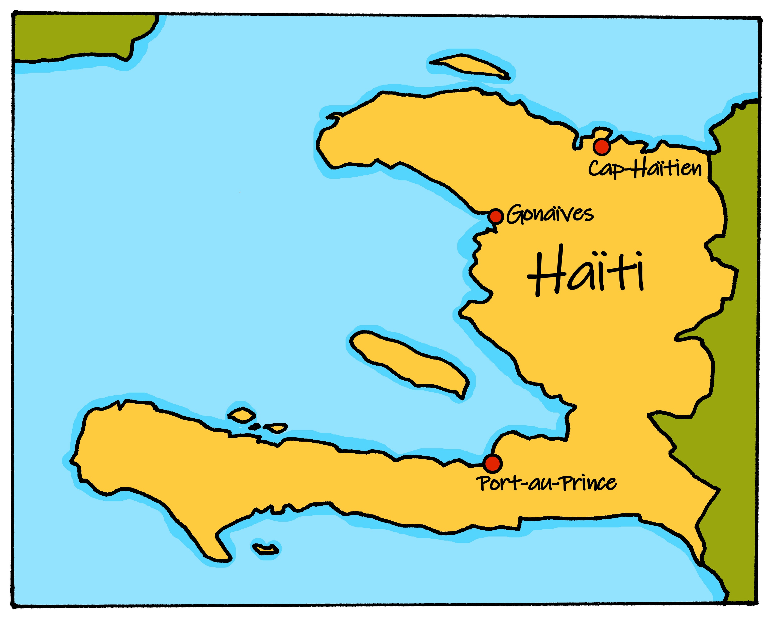
Describing me and others
vert
aller (je vais, tu vas)
SSC [ai] & [a]
Notes:
Artwork by Steve Clarke. Pronoun pictures from NCELP (www.ncelp.org). All additional pictures selected from Pixabay and are available under a Creative Commons license, no
attribution required.
Phonics: ai vs a vrai [292] maison [325] aider [413] raison [72] aimer [242] semaine [245]
Vocabulary: tu vas je vais [53] tu es je suis [5] à (meaning ‘at/in/to’)[4] café [1886] campagne [666] centre commercial [n/a] église [1782] ile [1245] magasin [1736] maison [325] marché [280] montagne [1732] plage [2693] pont [1889] port [1304]
Revisit 1 + 2: revisit vocabulary from term 2
Londsale, D., & Le Bras, Y. (2009). A Frequency Dictionary of French: Core vocabulary for learners London: Routledge.
The frequency rankings for words that occur in this PowerPoint which have been previously introduced in these resources are given in the SOW and in the resources that first
introduced and formally re-visited those words.
For any other words that occur incidentally in this PowerPoint, frequency rankings will be provided in the notes field wherever possible.
1

Slide 2

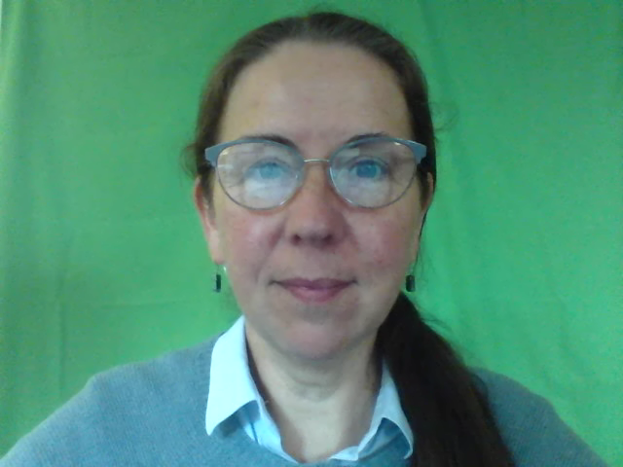
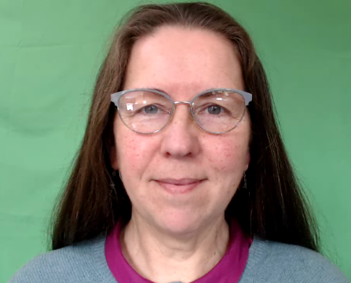
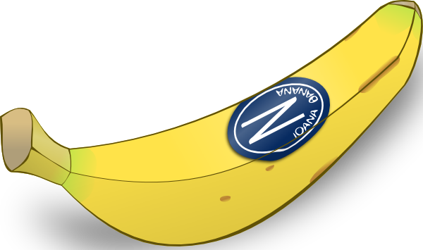
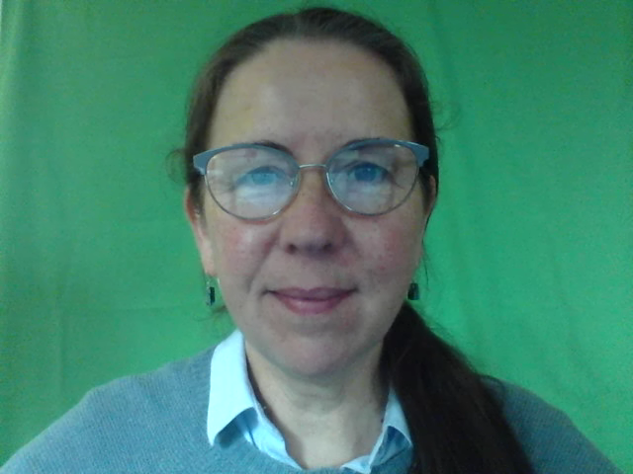

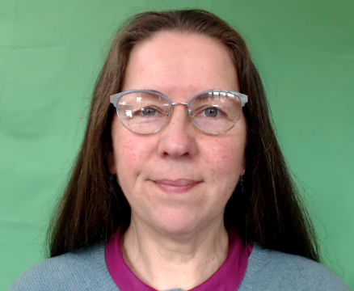
[a]
[ai]
prononcer
banane
vrai
Notes:
Timing: 1 minute
Aim: To recap SSC [a] and [ai].
Procedure:
Introduce and elicit the pronunciation of the individual SSC [a] and then the source word ‘banane’ (with gesture, if using).
Click to bring on the picture and get students to repeat (with gesture, if using).
Present the letter(s) and say the [ai] sound first, on its own. Students repeat it with you.
Bring up the word ”vrai” on its own, say it, students repeat it, so that they have the opportunity to focus all of their attention on the connection between the written word and its sound.
Repeat again, along with the picture, and with gesture, if using.
Suggested gestures:
gesture for ‘banana’ – we suggest making the shape of a banana with both hands – start with finger tips together in the middle, pull them apart and upwards to trace the shape of a banana (like the shape of a smile).
gesture for vrai – either mime a tick
Or use the BSL (4th video is the best one): https://www.signbsl.com/sign/true
2

Slide 3




prononcer
Quel mot a le son [ai] ? [1/6]
Écoute et identifie le mot correct.
A
B
lait
là
__
__
Notes:
[1/6]
Timing: 5 minutes for 6 slides
Aim: to practise aural recognition of SSC [ai] with a mixture of known and unknown words.
Procedure:
1. Click the images to play the audio.
2. Students choose which word has [ai].
3. Students could also complete the word with the correct spelling
4. Answers revealed on a click.
Transcript:
lait
là
Word frequency (1 is the most frequent word in French):
lait [2507] là [109]
Source: Londsale, D., & Le Bras, Y. (2009). A Frequency Dictionary of French: Core vocabulary for learners London: Routledge.
3

Slide 4
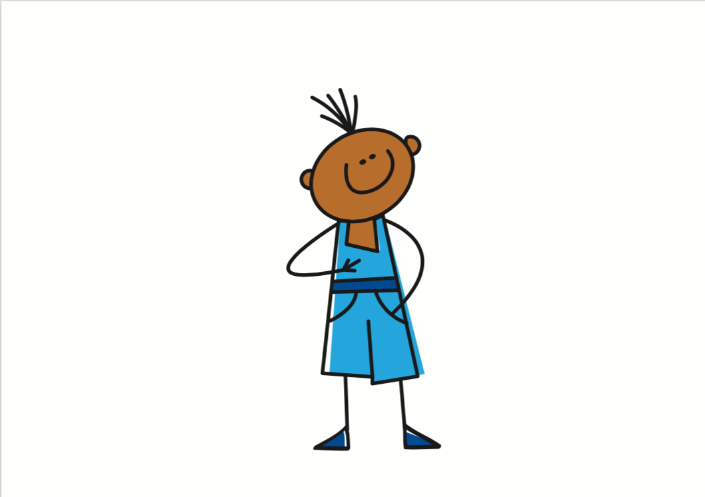
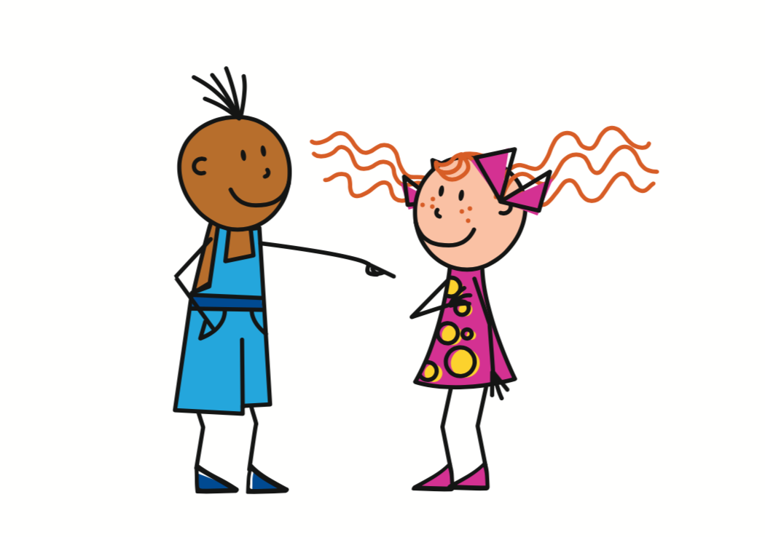

prononcer
Quel mot a le son [ai] ? [2/6]
Écoute et identifie le mot correct.
A
B
vais
vas
__
__
Notes:
[2/6]
Timing: 5 minutes for 6 slides
Transcript:
vais
vas
4

Slide 5

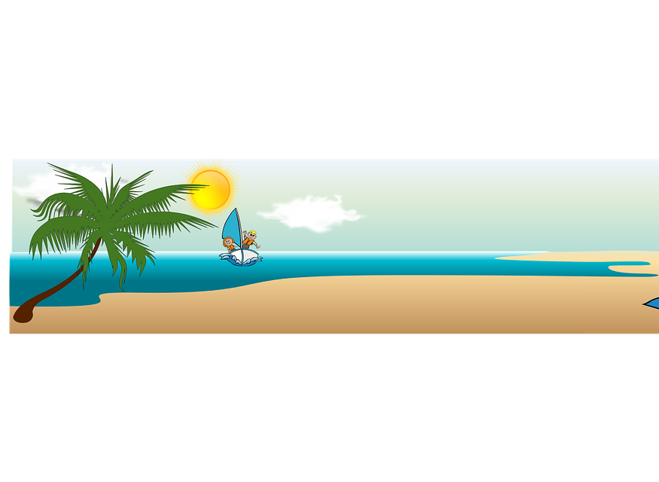
prononcer
Quel mot a le son [ai] ? [3/6]
Écoute et identifie le mot correct.
A
B
[bay]
[at the bottom]
en bas
baie
__
__
Notes:
[3/6]
Timing: 5 minutes for 6 slides
Transcript:
en bas
baie
Word frequency (1 is the most frequent word in French):
baie [3719] bas [468]
Source: Londsale, D., & Le Bras, Y. (2009). A Frequency Dictionary of French: Core vocabulary for learners London: Routledge.
5

Slide 6
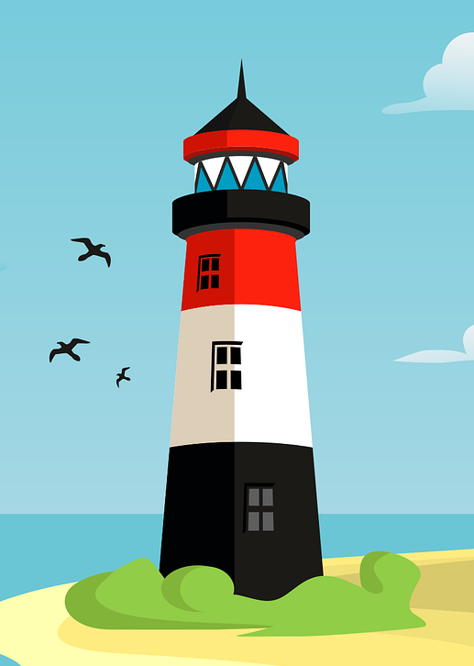

prononcer
Quel mot a le son [ai] ? [4/6]
Écoute et identifie le mot correct.
A
B
phare
faire
__
__
Notes:
[4/6]
Timing: 5 minutes for 6 slides
Transcript:
phare
faire
Word frequency (1 is the most frequent word in French):
phare [3884] faire [25]
Source: Londsale, D., & Le Bras, Y. (2009). A Frequency Dictionary of French: Core vocabulary for learners London: Routledge.
6

Slide 7

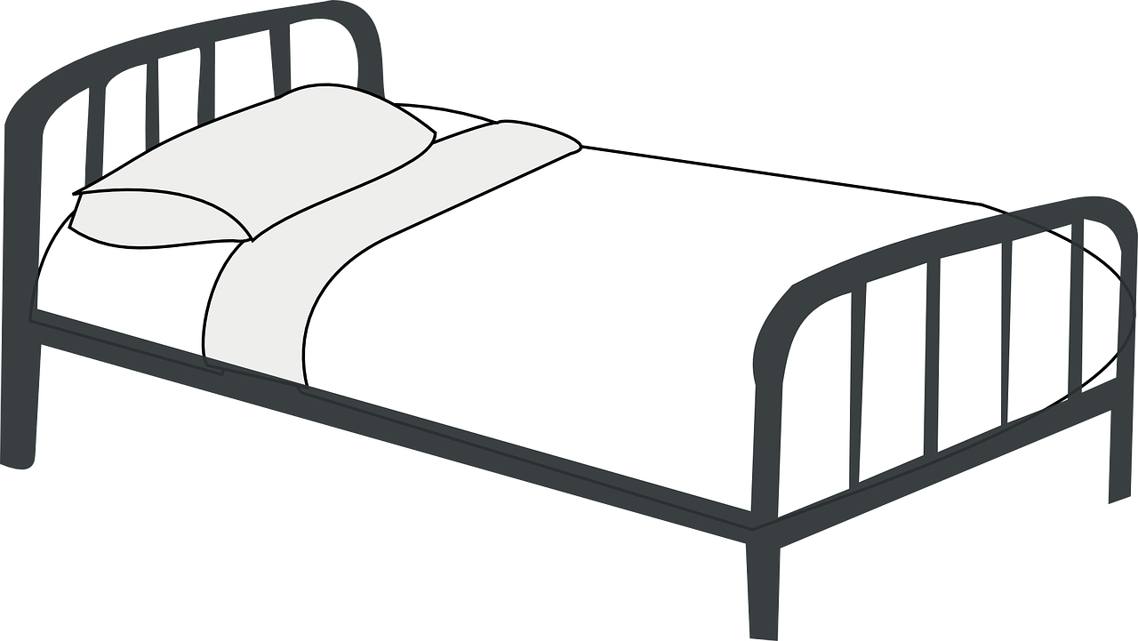
prononcer
Quel mot a le son [ai] ? [5/6]
Écoute et identifie le mot correct.
A
B
[pillow case]
[pile]
taie
tas
__
__
Notes:
[5/6]
Timing: 5 minutes for 6 slides
Transcript:
taie
tas
Word frequency (1 is the most frequent word in French):
taie [>5000] tas [2723]
Source: Londsale, D., & Le Bras, Y. (2009). A Frequency Dictionary of French: Core vocabulary for learners London: Routledge.
7

Slide 8


prononcer
Quel mot a le son [ai] ? [6/6]
Écoute et identifie le mot correct.
A
B
[peace]
[step]
paix
pas
__
__
Notes:
[6/6]
Timing: 5 minutes for 6 slides
Transcript:
paix
pas
Word frequency (1 is the most frequent word in French):
paix [579] pas [18]
Source: Londsale, D., & Le Bras, Y. (2009). A Frequency Dictionary of French: Core vocabulary for learners London: Routledge.
8

Slide 9


aller (to go, to be going)
Aller is an irregular verb meaning to go, to be going.
⚠ The –s is a Silent Final Consonant (SFC).
Je vais
I go|I am going
⚠ Here –s is sometimes pronounced because it is followed by a vowel. Pronounce the –s like English ‘z’.
This is an example of optional liaison.
Je vais à Haïti.
I go|I am going to Haiti.
Tu vas à Haïti.
You go | You are going to Haiti.
⚠ It is also optional to liaise after tu vas.
Notes:
Timing: 2 minutes
Aim: to introduce two forms of the irregular verb aller.
Procedure:
Click through the animations to present the information. Stress the highly irregular nature of aller and perhaps ask pupils if they can think of another highly irregular verb e.g. être (je suis, il/elle est).
Elicit English translations for the French examples provided.

Slide 10
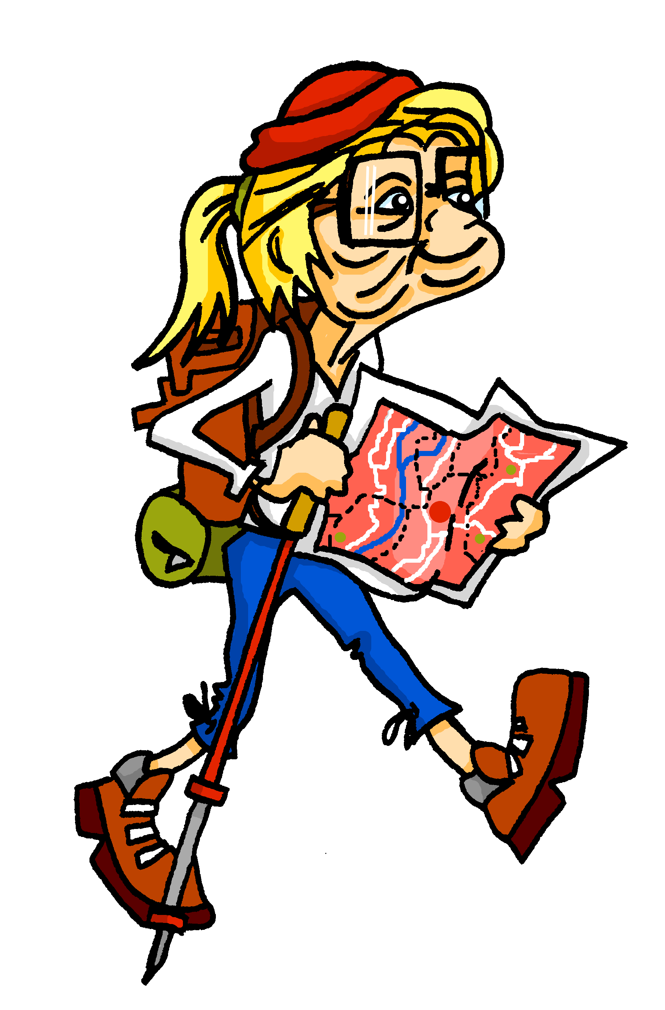


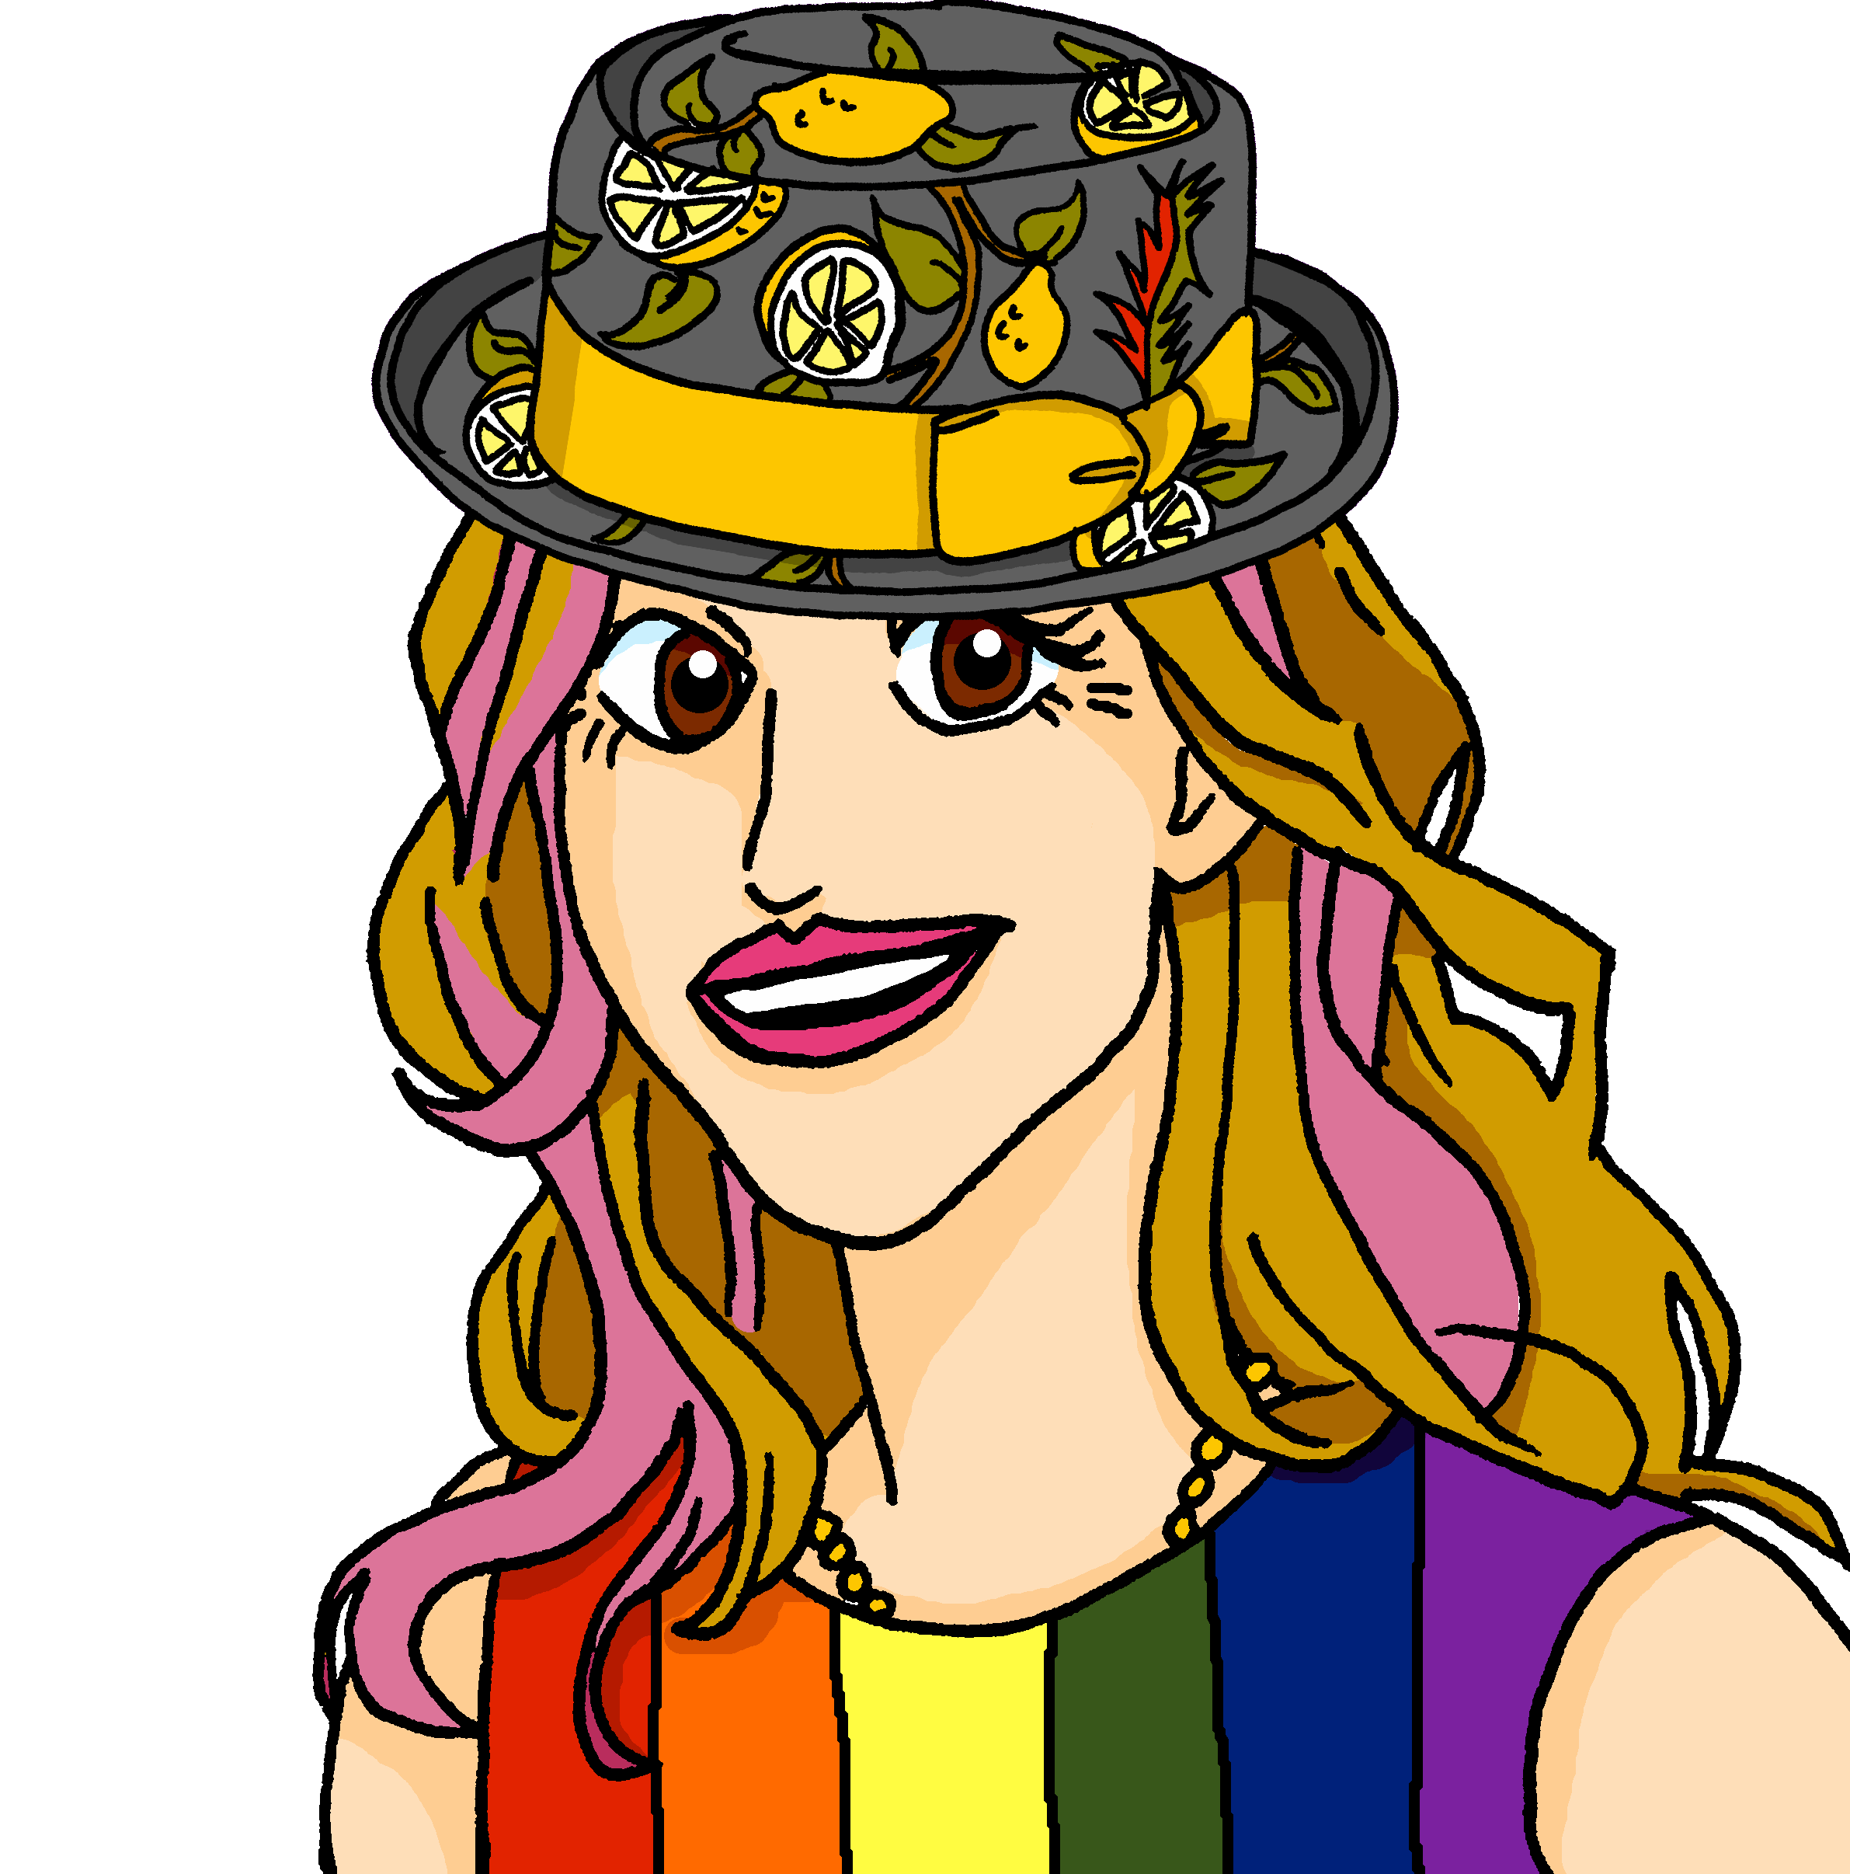
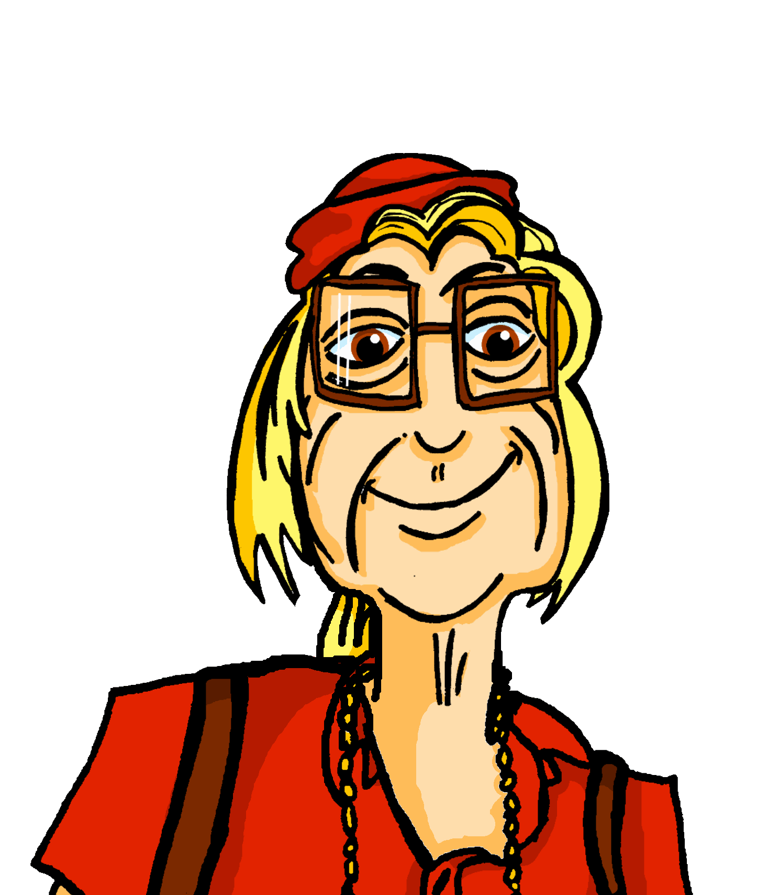

écouter
À Haïti. Mylène parle à Renée.
Écoute. Qui va où ? C’est Mylène (je) ou Renée (tu) ?
 | Mylène (je) | Renée (tu)
 | Mylène (je) | Renée (tu)
1
1
5
5
2
2
6
6
3
7
3
7
4
8
4
8
Notes:
Timing: 5 minutes
Aim: to practise aural comprehension of the two forms of aller, vais and vas, without the support of the pronouns je and tu.
Procedure:
Click to listen to the sentence, with pronoun obscured.
Pupils write the numbers 1-6 and for each item the answer ‘je’ or ‘tu’ depending on the form of aller they hear.
Click to reveal the answers. An audio button appears for each answer, so pupils can listen to the full sentence and check, if desired.
Note: these are all places in Haiti.
Transcript:
[Tu] vas à Balou.
[Je] vais à Jacmel.
[Je] vais à Moron.
[Je] vais à La Croix.
[TU] vas à Port-Margot.
[Tu] vas à Limbe.
[Je] vais à Cabaret.
[Tu] vas à Abricot.
Transcript 2:
Tu vas à Balou.
Je vais à Jacmel.
Je* vais à Moron.
Je vais à La Croix.
Tu vas à Port-Margot.
Tu vas à Limbe.
Je vais à Cabaret.
Tu vas à Abricot.
10

Slide 11





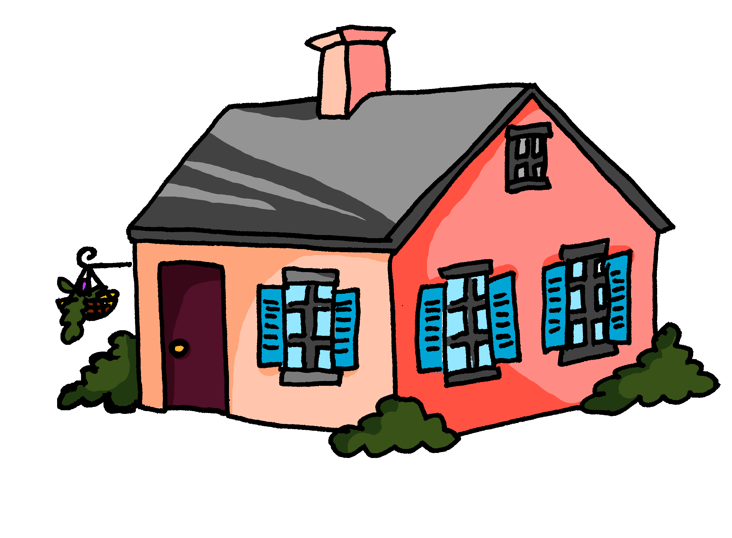

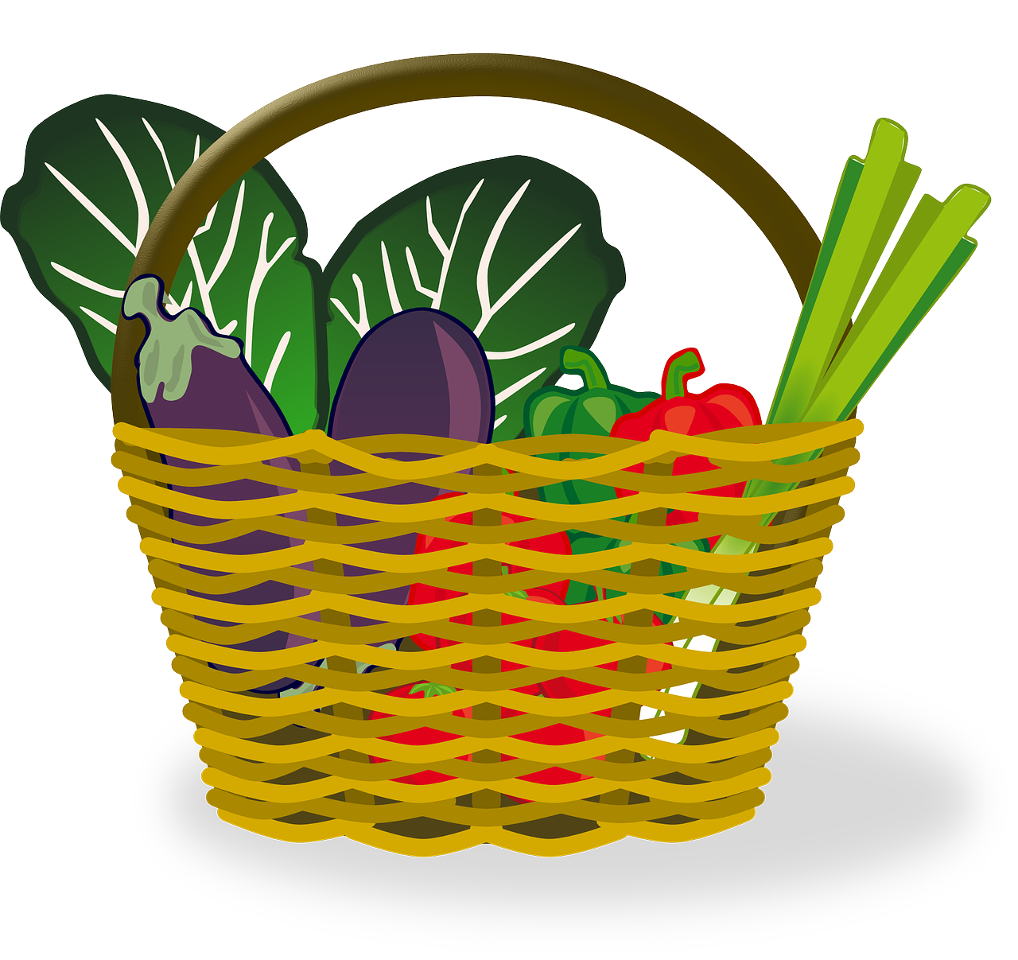
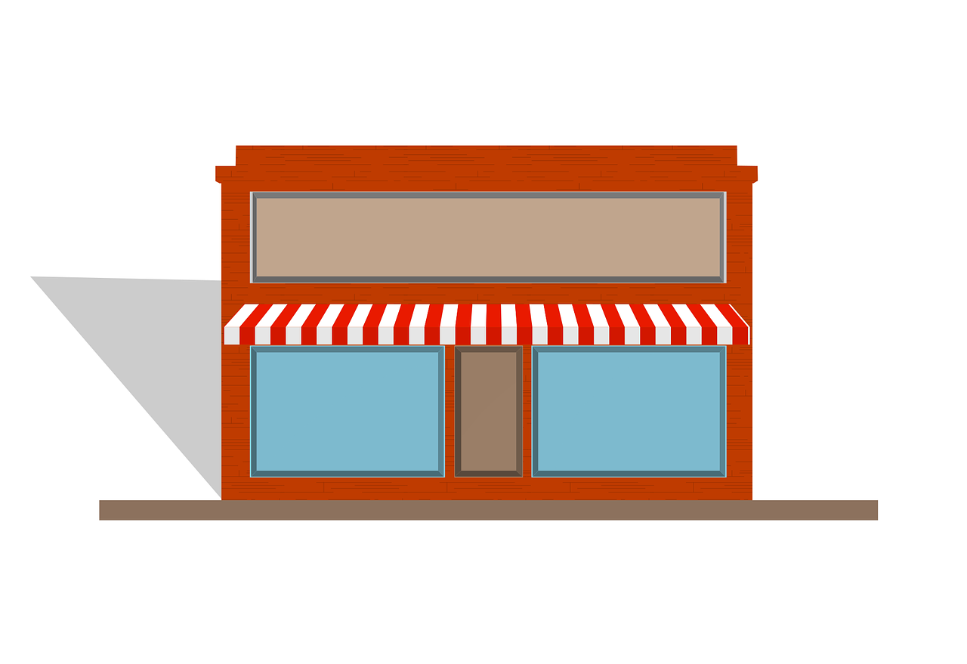

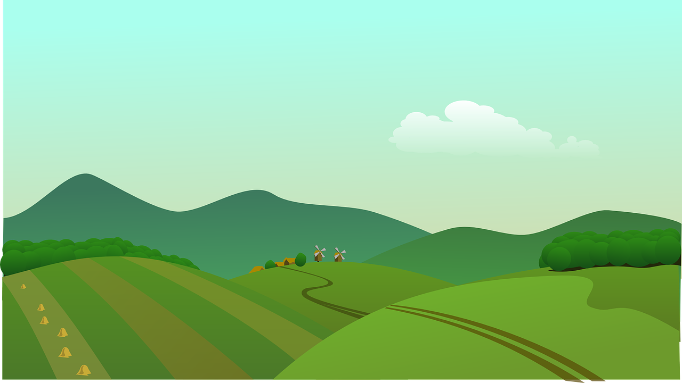


vocabulaire
Vocabulaire
mots
Comment dit-on ça en français ?
le marché
le port
la plage
la maison
le pont
le centre commercial
le magasin
la montagne
l’église
la campagne
bridge
port
church
market
countryside
shop
house
shopping centre
mountain(s)
beach
Notes:
Timing: 3 minutes
Aim: to practise written recognition and read aloud of 10 previously taught nouns.
Procedure:
Click for English prompt.
Elicit French from pupils.
Click to confirm.
Repeat with all items.
11

Slide 12
Saying ‘to (the)’ in French
Remember: use au to mean ‘to the…’ in French before a masculine noun:
⚠ use au not
à + le for ‘to the’.
au magasin
to the shop
au marché
to the market
To mean ‘to (the)’ before a feminine noun, we use à la:
à la montagne
to the mountain(s)
à la plage
to the beach
When the noun starts with a vowel or ‘h’, we use à l’:
à l’église
to the church
à l’ile
to the island
Notes:
Timing: 2 minutes
Aim: to recap the three ways to say ‘to (the)’ in French.
Procedure:
Click through the animations to present the information.
Elicit English translations for the French examples provided.

Slide 13

Mylène écrit à Adèle.
Où va Mylène (je) ? Où va Renée (tu) ?
C’est ‘au’ ou ‘à la’ ?
lire
1
Je vais à la campagne.
Mylène is going to the..
1.
2.
3.
4.
countryside
2
Je vais au pont.
bridge
beach
3
Tu vas au magasin.
house (home)
4
Je vais à la plage.
Renée is going to the..
1.
2.
3.
5
shop
Tu vas au port.
port
6
market
Tu vas au marché.
7
Je vais à la maison.
Notes:
Timing: 5 minutes
Aim: to practise written understanding of vocabulary; to practise connecting ‘au’ and ‘à la’ with masculine and feminine nouns.
Procedure:
Clarify French instruction.
Model number [1] with pupils
Pupils look at the verb ‘vais’ or ‘vas’ to determine whether it is Mylène (je) or Renée (tu) going.
Elicit answer and click to reveal ‘je’ or ‘tu’
Elicit the place, and click to reveal.
Pupils finally decide if it is ‘au’ or ‘à la’.
Click to reveal the answer. If desired, click on the audio button to hear the full message.
Pupils complete numbers 2-7.
Conduct feedback as above.
Transcript:
Je vais à la campagne.
Je vais au pont.
Tu vas au magasin.
Je vais à la plage.
Tu vas au port.
Tu vas au marché.
Je vais à la maison.

Slide 14
Au revoir !
vert
Notes:
14

