Slide 1
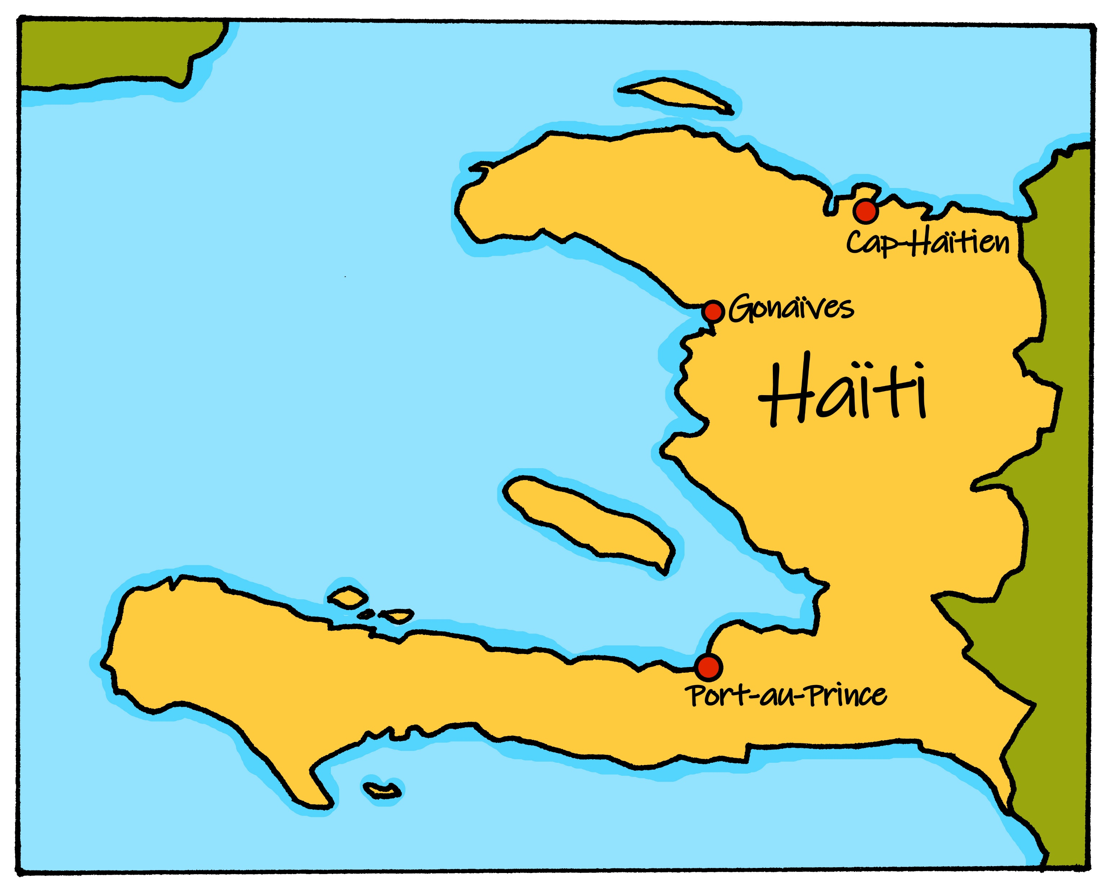
Describing me and others
vert
Follow ups 1-5
Notes:
Artwork by Steve Clarke. Pronoun pictures from NCELP (www.ncelp.org). All additional pictures selected from Pixabay and are available under a Creative Commons license, no attribution required.
Phonics: ai vs a vrai [292] maison [325] aider [413] raison [72] aimer [242] semaine [245]
Vocabulary: tu vas je vais [53] tu es je suis [5] à (meaning ‘at/in/to’)[4] café [1886] campagne [666] centre commercial [n/a] église [1782] ile [1245] magasin [1736] maison [325] marché [280] montagne [1732] plage [2693] pont [1889] port
[1304]
Revisit 1 + 2: revisit vocabulary from term 2
Londsale, D., & Le Bras, Y. (2009). A Frequency Dictionary of French: Core vocabulary for learners London: Routledge.
The frequency rankings for words that occur in this PowerPoint which have been previously introduced in these resources are given in the SOW and in the resources that first introduced and formally re-visited those words.
For any other words that occur incidentally in this PowerPoint, frequency rankings will be provided in the notes field wherever possible.

Slide 2
prononcer
Follow up 1
Écoute. L’intrus, c’est quoi ?
Here we revisit some SSC vowels: [a] [ai] [(a)in] [i] [oi] [é] [è].
A
B
C
60
 | vais | vas | va
 | pain | semaine | train
 | cousine | vingt | dessiner
 | voiture | avoir | vase
 | travailler | préféré | lumière
 | trente | onze | danse
1
2
3
4
5
6
0
DÉBUT
Notes:
Timing: 5 minutes
Aim: to practise applying knowledge of several SSC with mainly previously taught words and a few unfamiliar words.
Procedure: 1. Click to listen. Pupils identify the Odd One Out in each row, based on finding two words with a common SSC vowel and one that is different.
2. Click to bring up answers and discuss as a class. 3. Ask pupils to try and pronounce all 18 words against the 60 second timer.
4. Check pronunciation by pressing the blue numbers (optional).
Word frequency of unknown words and cognates (1 is the most frequent word in French):
pain [2802] train [232] vase [>5000] Source: Londsale, D., & Le Bras, Y. (2009). A Frequency Dictionary of French: Core vocabulary for learners London: Routledge.
2

Slide 3
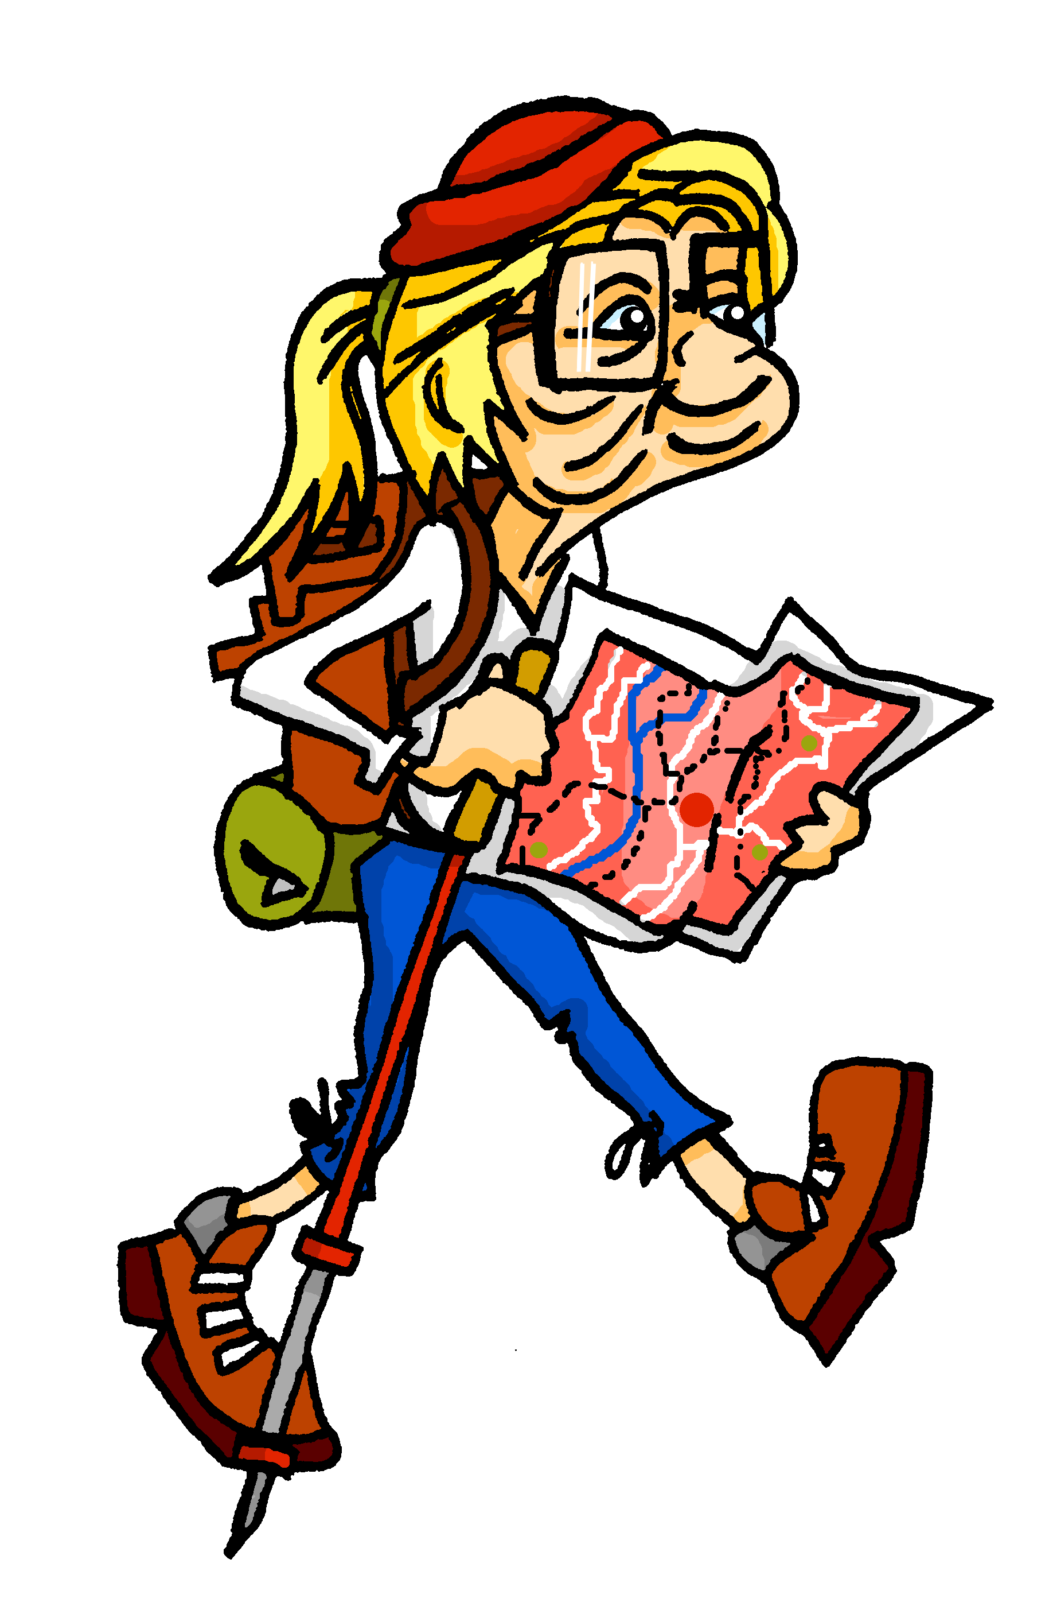
écouter
Follow up 2
A busy day for Mylène and Renée. Where do they finally meet up?
Mylène parle à Renée.
Écoute. Qui va où ? C’est Mylène (je) ou Renée (tu) ?
 | Mylène (I) | Renée (you)
 |  |  | campagne | centre commercial
 |  |  | magasin | maison
 |  |  | plage | marché
 |  |  | maison | parc
 |  |  | pont | église
 |  |  | montagne | café
1
Tu es au café. Salut, Renée !
1
2
2
3
3
4
4
5
5
6
6
Notes:
Timing: 5 minutes
Aim: to practise aural connection of au and à la with familiar masculine and feminine nouns.
Procedure:
Click to listen to the sentence, with final noun missing.
Pupils write the numbers 1-6 and for each item they note M or R and the place each goes to, depending on whether they hear ‘au’ or à la’.
Click to reveal a new set of audio buttons. Listen to each full sentence to check the answer, and click to reveal.
At the end click for the final speech bubble – Mylène and Renée meet up at the pool.
Transcript:
Je vais au [centre commercial]
Tu vas au [magasin]
Je vais à la [plage]
Tu vas à la [maison]
Tu vas à l’ [église]
Je vais au [café].
Tu es au café. Salut, Renée !
3

Slide 4
vocabulaire
Follow up 3a - Écris en anglais : Can you get at least 15 points?
mots
 | la salle | gagner | nager
 | le lieu | la neige | le prix
 | puis | marcher | les gens
 | monter | quitter | le soir
 | vingt-neuf | seize | douze
 | je vais | tu vas | aller
(the) room
to win, winning
to swim, swimming
x3
(the) place
(the) snow
(the) prize
x2
then
to walk, walking
(the) people
to ride, climb up/on/into
to leave somewhere
(the) evening
29
16
12
x1
I go, I am going
you go, you are going
to go, going
Notes:
Timing: 5-10 minutes
Aim: to practise written production of vocabulary from this week and two revisited weeks.
Procedure: 1. Give pupils a blank grid. They fill in the English meanings of any of the words they know, trying to reach 15 points in total. 2. Remind pupils that adjectives can refer to male or female persons and they should note this in their translations. E.g. pleased (f), short (m).
Note: The most recently learnt and practised words are pink, words from revisit 1 are green and those from revisit 2 are blue, thus more points are awarded for them, to recognise that memories fade and more effort (heavy lifting!) is needed to retrieve them.
4

Slide 5
vocabulaire
Follow up 3b - Écris en français : Can you get at least 15 points?
mots
 | (the) snow | to swim, swimming | (the) place
 | (the) prize | to win, winning | (the) (class)room
 | (the) evening | to ride, climb up/on/into | (the) people
 | then | to leave somewhere | to walk, walking
 | to go, going | I go, I am going | he goes, he is going
 | you go, you are going | fifteen | eight
la neige
nager
le lieu
x3
le prix
gagner
la salle
x2
le soir
monter
les gens
puis
quitter
marcher
aller
je vais
il va
x1
tu vas
quinze
huit
Notes:
Timing: 5-10 minutes
Aim: to practise written comprehension of vocabulary from this week and previous weeks.
Procedure: Give pupils a blank grid. They fill in the French meanings of any of the words they know, trying to reach 15 points in total.
Note: The most recently learnt and practised words are pink, words from the previous week are green and those from earlier are blue, thus more points are awarded for them, to recognise that memories fade and more effort (heavy lifting!) is needed to retrieve them.
5

Slide 6
Asking questions using Est-ce que…
To make it clear that a yes/no question is being asked, we can add Est-ce que (‘Is it that…?’) at the start of any statement:
Est-ce qu’il va à la plage ?
Oui, il va à la plage.
Does he go to the beach?
Yes, he goes to the beach.
Is he going to the beach?
Yes, he is going to the beach.
To ask a ‘where’ question, we can add Où est-ce que (‘Where Is it that…?’) at the start of any statement:
Où est-ce qu’il va ?
Il va à la plage.
Where does he go?
He goes to the beach.
Where is he going?
He is going to the beach.
Notes:
Timing: 2 minutes
Aim: to recap the use of Est-ce que to ask questions and introduce Où est-ce que
Procedure:
Click through the animations to present the information.
Elicit English translations for the French examples provided.

Slide 7
Asking questions using Où est-ce que …
The ‘s’ sound is the soft ‘c’.
Let’s practise saying Où est-ce que questions:
The –st are silent.
1
Où est-ce que tu vas ?
2
Où est-ce que tu vas ?
Where do you go, are you going?
Where do you go, are you going?
When you say it slowly there are six separate syllables.
In conversation we speed up and there are five syllables.
3
Où est-ce que je vais ?
4
Où est-ce que je vais?
Where do I go, am I going?
Where do I go, am I going?
Notes:
Timing: 2 minutes
Aim: to practise pronouncing Où est-ce que
Procedure:
Click through the animations to present the information.
Click each audio button to hear Où est-ce que at two different speeds.

Slide 8
Follow up 4:
Parle avec ton/ta partenaire.
Use au or à la to mean ‘to the’.
parler
B: Ask your partner: Where are you going?
Où est-ce que tu vas ?
A: Tell your partner: I am going… and the 3 places on your card.
Then swap roles!
B: Ask your partner: Where am I going?
Où est-ce que je vais ?
A: Tell your partner: You are going… and the 3 places on your card.
B: Make sure you write down all six places.
Notes:
Timing: 5 minutes
Aim: to practise oral production and comprehension of positive and negative statements with il y a/il n’y a pas and previously taught nouns.
Procedure:
1. Pupil A has Handout A (see end of this lesson PPT).
2. Pupil B listens to Pupil A and compares the three classroom pictures with what s/he hears.
3. B identifies the correct room and teacher clicks to reveal the answer.
Note: every sentence must be listened to in order to identify the correct classroom.
4. Swap roles and move to the next slide.

Slide 9
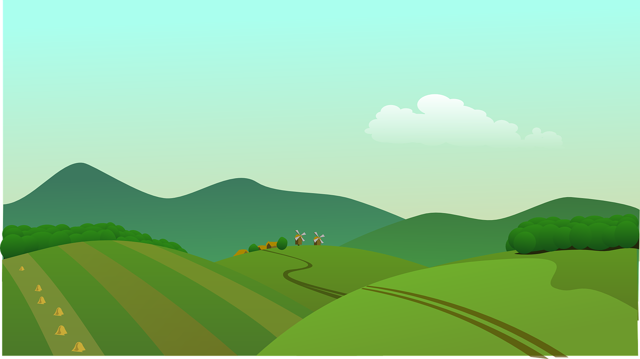
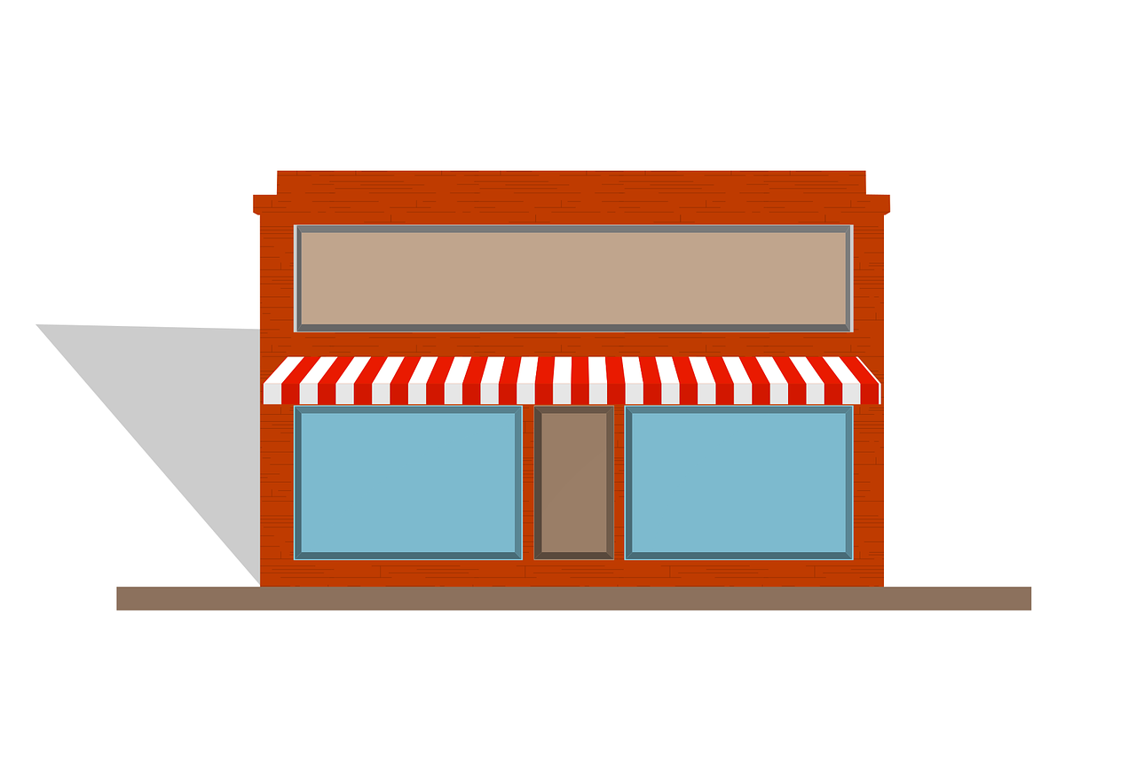
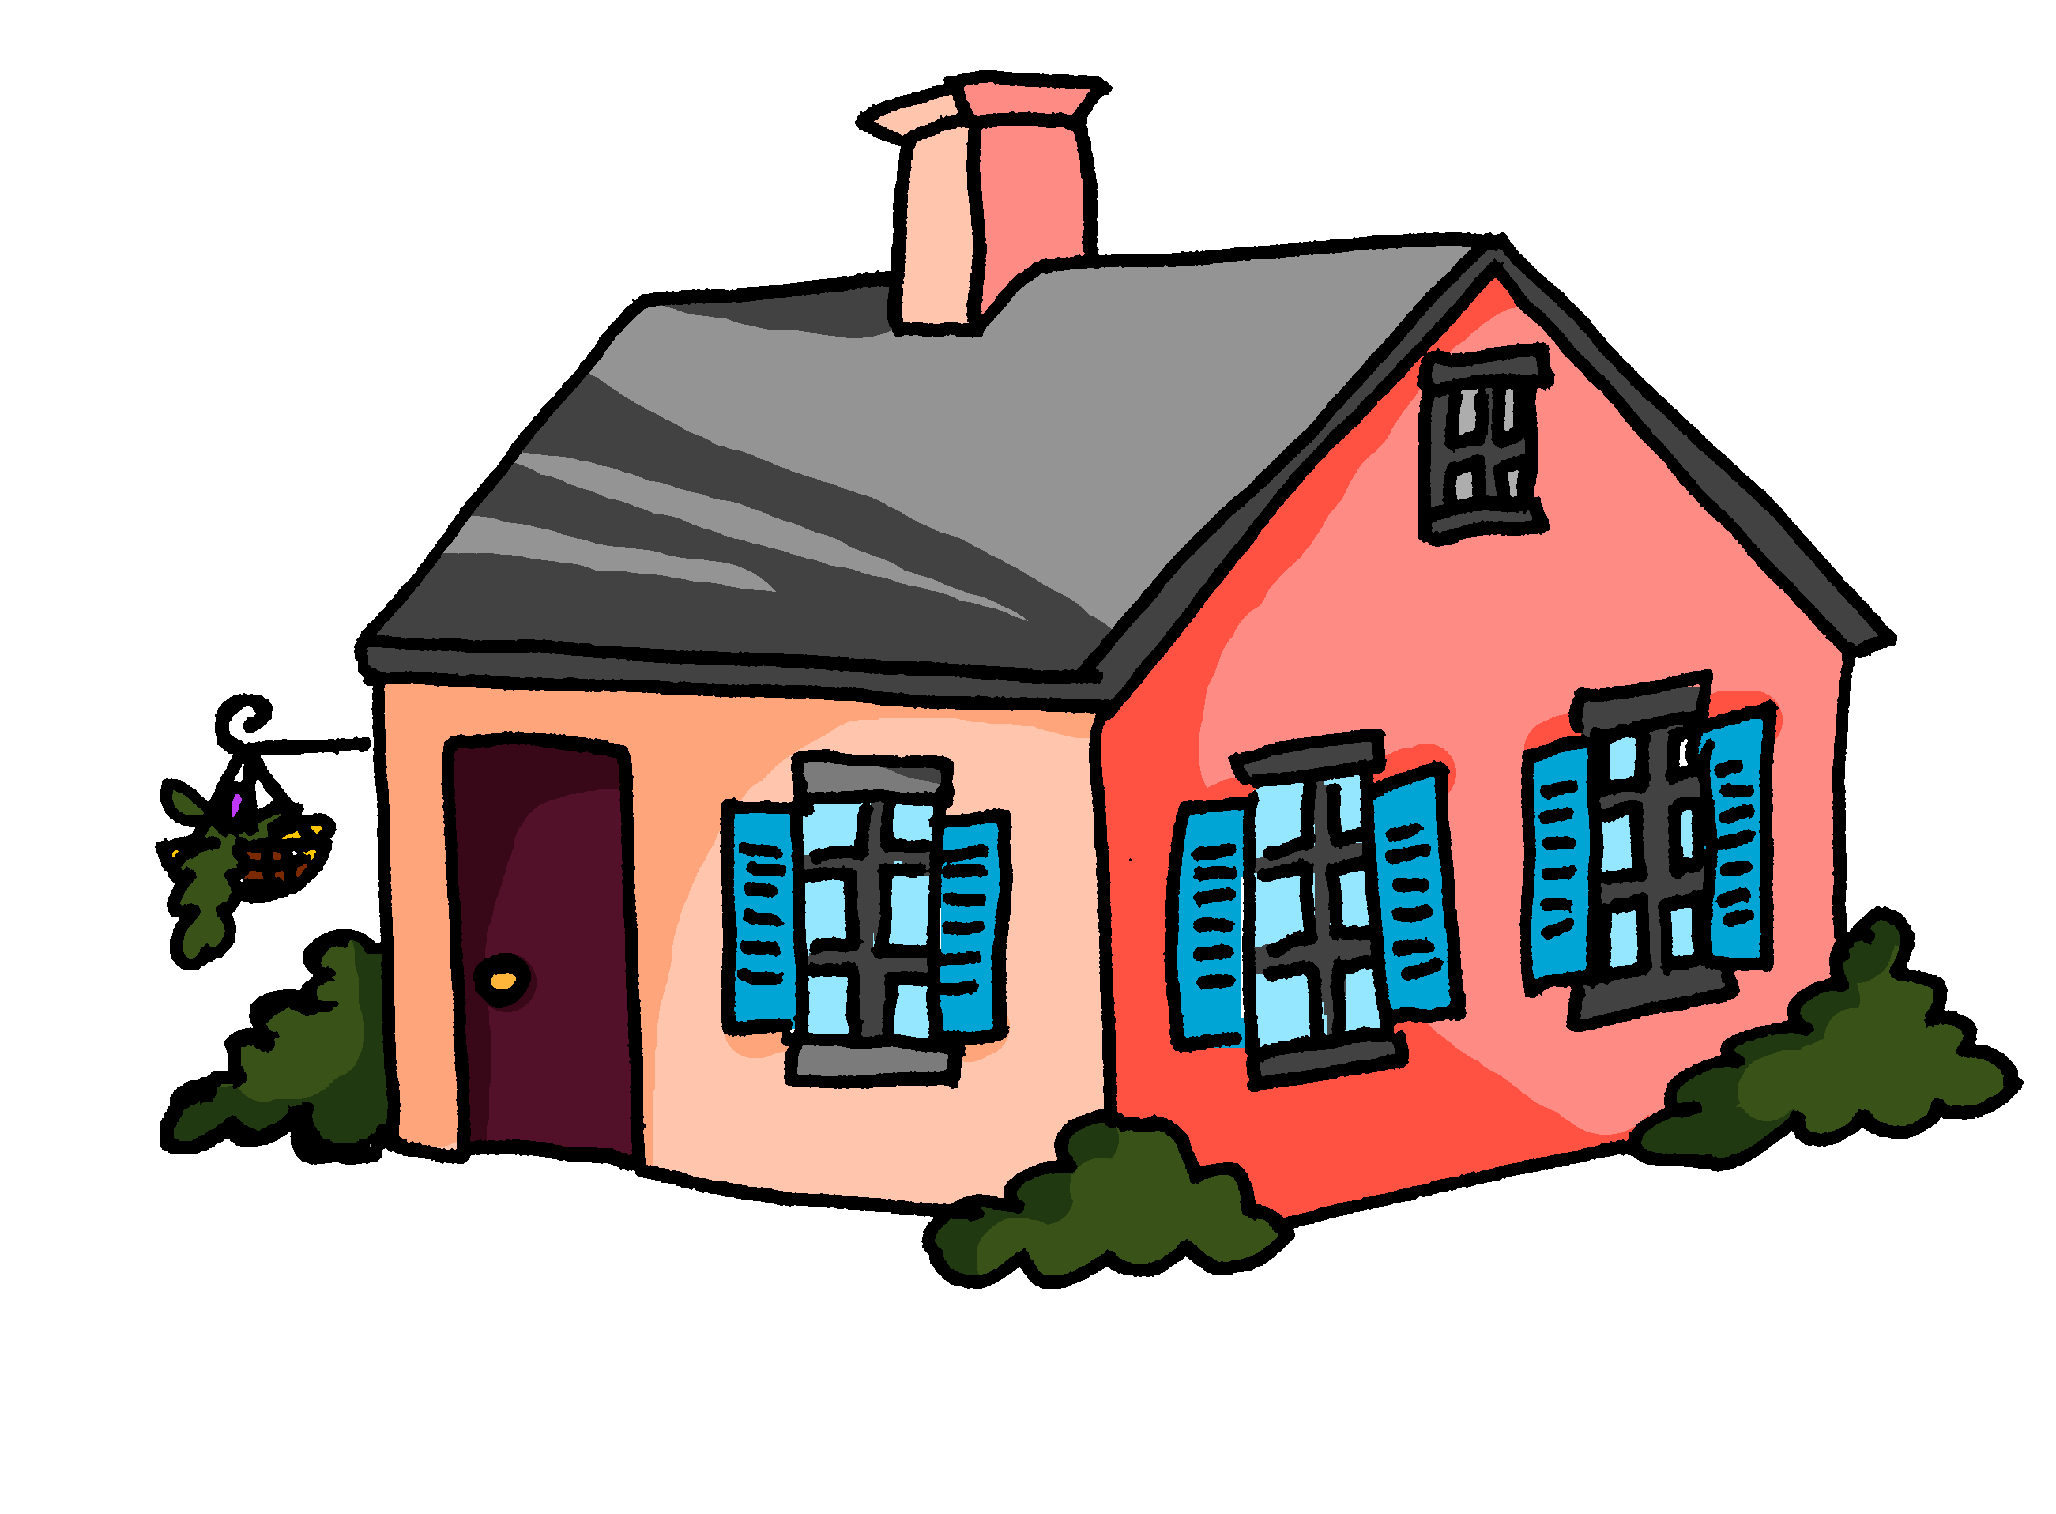
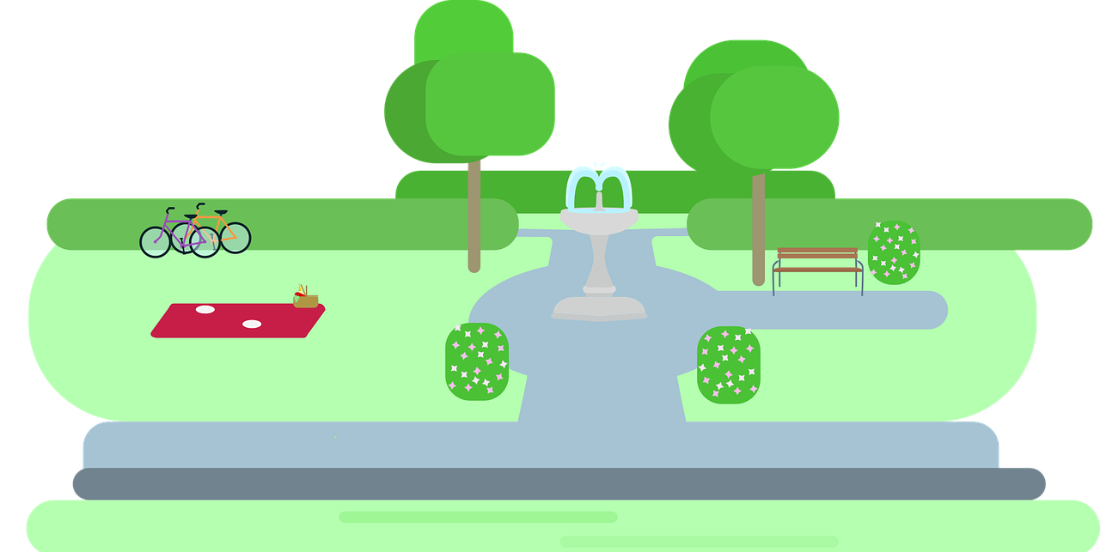
Follow up 4A:
Réponses
A: Parle.
B: Écris.
Tell your partner: ‘You are going …’ to 3 places and ‘I am going’… to 3 places.
parler
Listen and write the six places.
Tu…
Tu…
Tu…
Je…
Je…
Je…
I am going…
I am going…
I am going…
You are going…
You are going…
You are going…
vas à l’église.
to (the) church.
vas à la campagne.
to the countryside.
vas au magasin.
to the shop.
vais à la maison.
to the house.
vais à la plage.
to the beach.
vais au parc.
to the park.
Notes:
ANSWERS – DO NOT DISPLAY DURING THE ACTIVITY
Procedure:
Elicit French from partner As and English from partner Bs.
Click to reveal written answers.
Continue with the answers for 4B on the next slide.

Slide 10
Follow up 4B:
Réponses
A: Écris.
B: Parle.
Tell your partner: ‘You are going …’ to 3 places and ‘I am going’… to 3 places.
parler
Listen and write the six places.
Tu…
Tu…
Tu…
Je…
Je…
Je…
I am going…
I am going…
I am going…
You are going…
You are going…
You are going…
vas au port.
to the port.
vas au marché.
to the market.
vas à l’école.
to (the) school.
vais à la montagne.
to the mountain(s).
vais au pont.
to the bridge.
vais au centre commercial.
to the shopping centre.
Notes:
ANSWERS – DO NOT DISPLAY DURING THE ACTIVITY

Slide 11
Follow up 5:

Écris les mots correspondants en français et en anglais.
Tu quittes ___ ______, aujourd’hui ?
___ ______ souvent __ ___ ___________.
___________ elle va ___ __ _________ ?
__ _______, il reste ___ ___ __________.
_______ il mange ___ ____________.
_________________ tu vas ?
Are you leaving
écrire
_____ ____ ___________the room, __________?
I _______ go to the countryside.
Does ____ ______ to (the) church?
In the evening __ _______ at home.
Then ____ _________ at the market.
Where ____ _____ _________?
la salle
today
Je vais
à la campagne
often
Est-ce qu’
à l’ église
she go
Le soir
à la maison
he stays
Puis
au marché
he eats
Où est-ce que
are you going
Notes:
Timing: 5-10 minutes
Aim: to practise written production of singular forms of aller, this week’s new vocabulary and written comprehension of other new and revisited vocabulary.
This is a jigsaw translation task.
Procedure:
Students write the missing words in both French and English to complete the sentences.
Teacher clicks to provide the written answers and/or clicks the audio buttons to hear the full French sentences.
Differentiation: 1. For a different challenge (i.e. to practise spelling rather than full written recall of the missing French words), the task could be completed as a transcription task initially, by listening to the full sentences and writing the words.
2. Then pupils could complete the English part of the jigsaw.
Transcript: 1. Tu quittes la salle, aujourd’hui ?
2. Je vais souvent à la campagne. 3. Est-ce qu’elle va à l’église ? 4. Le soir il reste à la maison.
5. Puis il mange au marché. 6. Où est-ce que tu vas ?

Slide 12
Follow up 4A:
Parle avec ton/ta partenaire.
A: Parle.
A: Écris.
Tell your partner: ‘You are going …’ to 3 places and ‘I am going’… to 3 places.
parler
Listen and write the six places.
Tu…
Tu…
Tu…
Je…
Je…
Je…
I am going…
I am going…
I am going…
You are going…
You are going…
You are going…
Notes:
HANDOUT PARTENAIRE A

Slide 13
Follow up 4B:
Parle avec ton/ta partenaire.
B: Écris.
B: Parle.
Tell your partner: ‘You are going …’ to 3 places and ‘I am going’… to 3 places.
parler
Listen and write the six places.
I am going…
I am going…
I am going…
You are going…
You are going…
You are going…
Tu…
Tu…
Tu…
Je…
Je…
Je…
Notes:
HANDOUT PARTENAIRE B

Slide 14
vocabulaire
Follow up 3a - Écris en anglais : Can you get at least 15 points?
mots
 | la salle | gagner | nager
 | le lieu | la neige | le prix
 | puis | marcher | les gens
 | monter | quitter | le soir
 | vingt-neuf | seize | douze
 | je vais | tu vas | aller
x3
x2
x1
Notes:
HANDOUT
14

Slide 15
vocabulaire
Follow up 3b - Écris en français : Can you get at least 15 points?
mots
 | (the) snow | to swim, swimming | (the) place
 | (the) prize | to win, winning | (the) (class)room
 | (the) evening | to ride, climb up/on/into | (the) people
 | then | to leave somewhere | to walk, walking
 | to go, going | I go, I am going | he goes, he is going
 | you go, you are going | fifteen | eight
x3
x2
x1
Notes:
Timing: 5-10 minutes
Aim: to practise written comprehension of vocabulary from this week and previous weeks.
Procedure: Give pupils a blank grid. They fill in the French meanings of any of the words they know, trying to reach 15 points in total.
Note: The most recently learnt and practised words are pink, words from the previous week are green and those from earlier are blue, thus more points are awarded for them, to recognise that memories fade and more effort (heavy lifting!) is needed to retrieve them.
15

