Slide 1
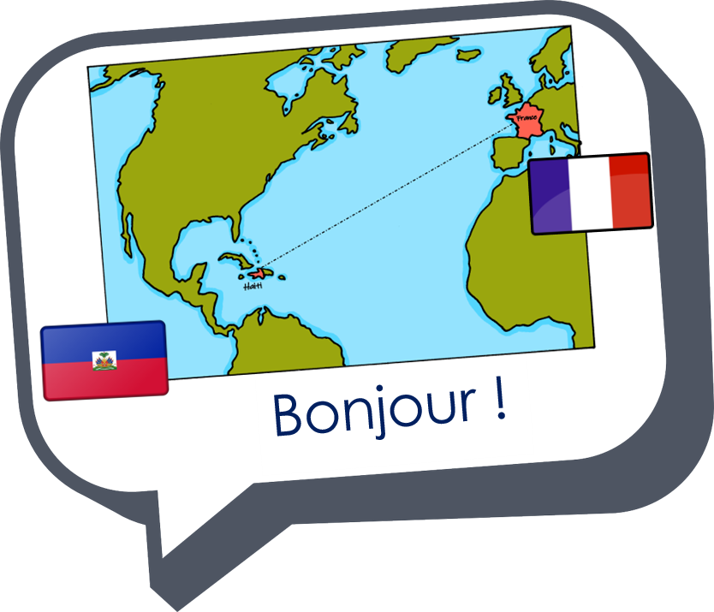
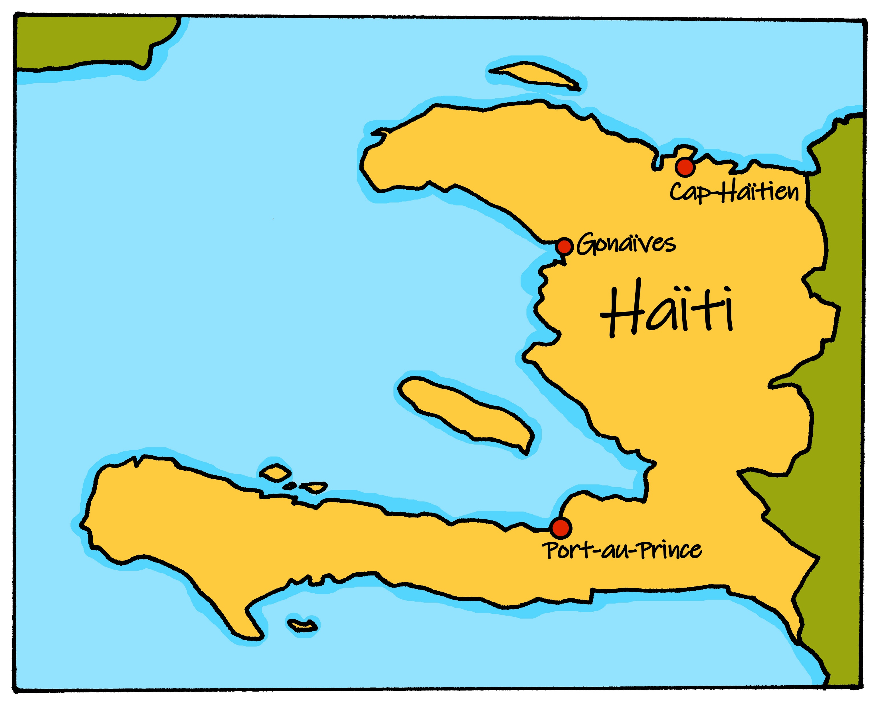
Saying where you are going and what there is there
vert
aller (je vais, il/elle va)
au, à la, à l’
SSC [ai] & [(a)in]
Notes:
Artwork by Steve Clarke. Pronoun pictures from NCELP (www.ncelp.org). All additional pictures selected from Pixabay and are available under a Creative Commons license, no
attribution required.
Phonics: Revisit SSC [ai] - vrai [292] maison [325] aider [413] raison [72] aimer [242] semaine [245]
and [(a)in] - train [232] fin [111] matin [442] vingt [1273] main [418]
Vocabulary: aller [53] je vais il/elle va à (meaning ‘at/in/to’)[4] campagne [666] Île [1245] montagne [1732] plage [2693] port [1304]
Revisit 1: chanter [1820] chercher [336] créer [332] danser [2934] donner [46] écouter [429] manger [1338] organiser [791] préparer [368] porter [105] regarder [425] trouver [83] utiliser [345]
Revisit 2: -
Londsale, D., & Le Bras, Y. (2009). A Frequency Dictionary of French: Core vocabulary for learners London: Routledge.
The frequency rankings for words that occur in this PowerPoint which have been previously introduced in these resources are given in the SOW and in the resources that first
introduced and formally re-visited those words.
For any other words that occur incidentally in this PowerPoint, frequency rankings will be provided in the notes field wherever possible.
1

Slide 2

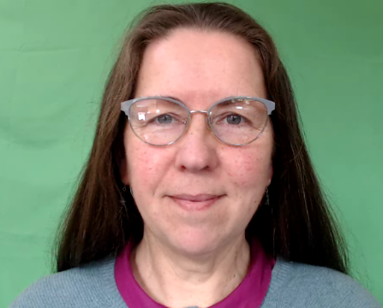
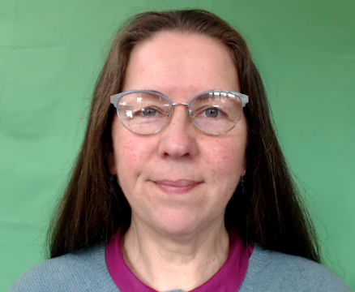

prononcer
[ai]
vrai
Notes:
Timing: 3 minutes (two slides)
Aim: to present [ai]
Procedure:
Present the letter(s) and say the [ai] sound first, on its own. Students repeat it with you.
2. Bring up the word ”vrai” on its own, say it, students repeat it, so that they have the opportunity to focus all of their attention on the connection between the written word and its sound.
3. Repeat again, along with the picture, and with gesture, if using.
4. Roll back the animations and work through 1-3 again, but this time, dropping your voice completely to listen carefully to the students saying the [ai] sound, pronouncing ”vrai” and, if using, doing the gesture.
Suggested gesture:
gesture for vrai – either mime a tick
Or use the BSL (4th video is the best one): https://www.signbsl.com/sign/true
Word frequency (1 is the most frequent word in French):
vrai [292]
Source: Londsale, D., & Le Bras, Y. (2009). A Frequency Dictionary of French: Core vocabulary for learners London: Routledge.
2

Slide 3



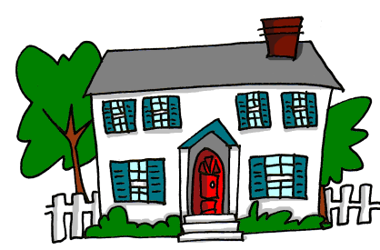
prononcer
[ai]
vrai
to like, liking
to help, helping
aimer
aider
week
maison
semaine
Notes:
Aim: To consolidate SSC [ai]
Procedure:
1. Introduce and elicit the pronunciation of the individual SSC [ai] and then the source word again ‘vrai’ (with gesture, if using).
2. Then present and elicit the pronunciation of the five cluster words.
Word frequency (1 is the most frequent word in French):
aider [413] aimer [232] maison [325] semaine [245] vrai [292]
Source: Londsale, D., & Le Bras, Y. (2009). A Frequency Dictionary of French: Core vocabulary for learners London: Routledge.
Word frequency (1 is the most frequent word in French):
vrai [292].
Source: Londsale, D., & Le Bras, Y. (2009). A Frequency Dictionary of French: Core vocabulary for learners London: Routledge.
3

Slide 4



prononcer
[(a)in]
train
Notes:
Timing: 1 minute
Aim: To re-introduce SSC [(a)in]
Procedure:
Introduce and elicit the pronunciation of the individual SSC [(a)in] and then the source word ‘train’ (with gesture, if using).
Click to bring on the picture and get students to repeat (with gesture, if using).
Note: gesture for train – fist closed, arm by side, forearm at right angle to body, thrust fist forward miming the movement of a fast train
https://www.signbsl.com/sign/train – scroll down to the noun train videos.
Word frequency (1 is the most frequent word in French):
train [232].
Source: Londsale, D., & Le Bras, Y. (2009). A Frequency Dictionary of French: Core vocabulary for learners London: Routledge.
4

Slide 5



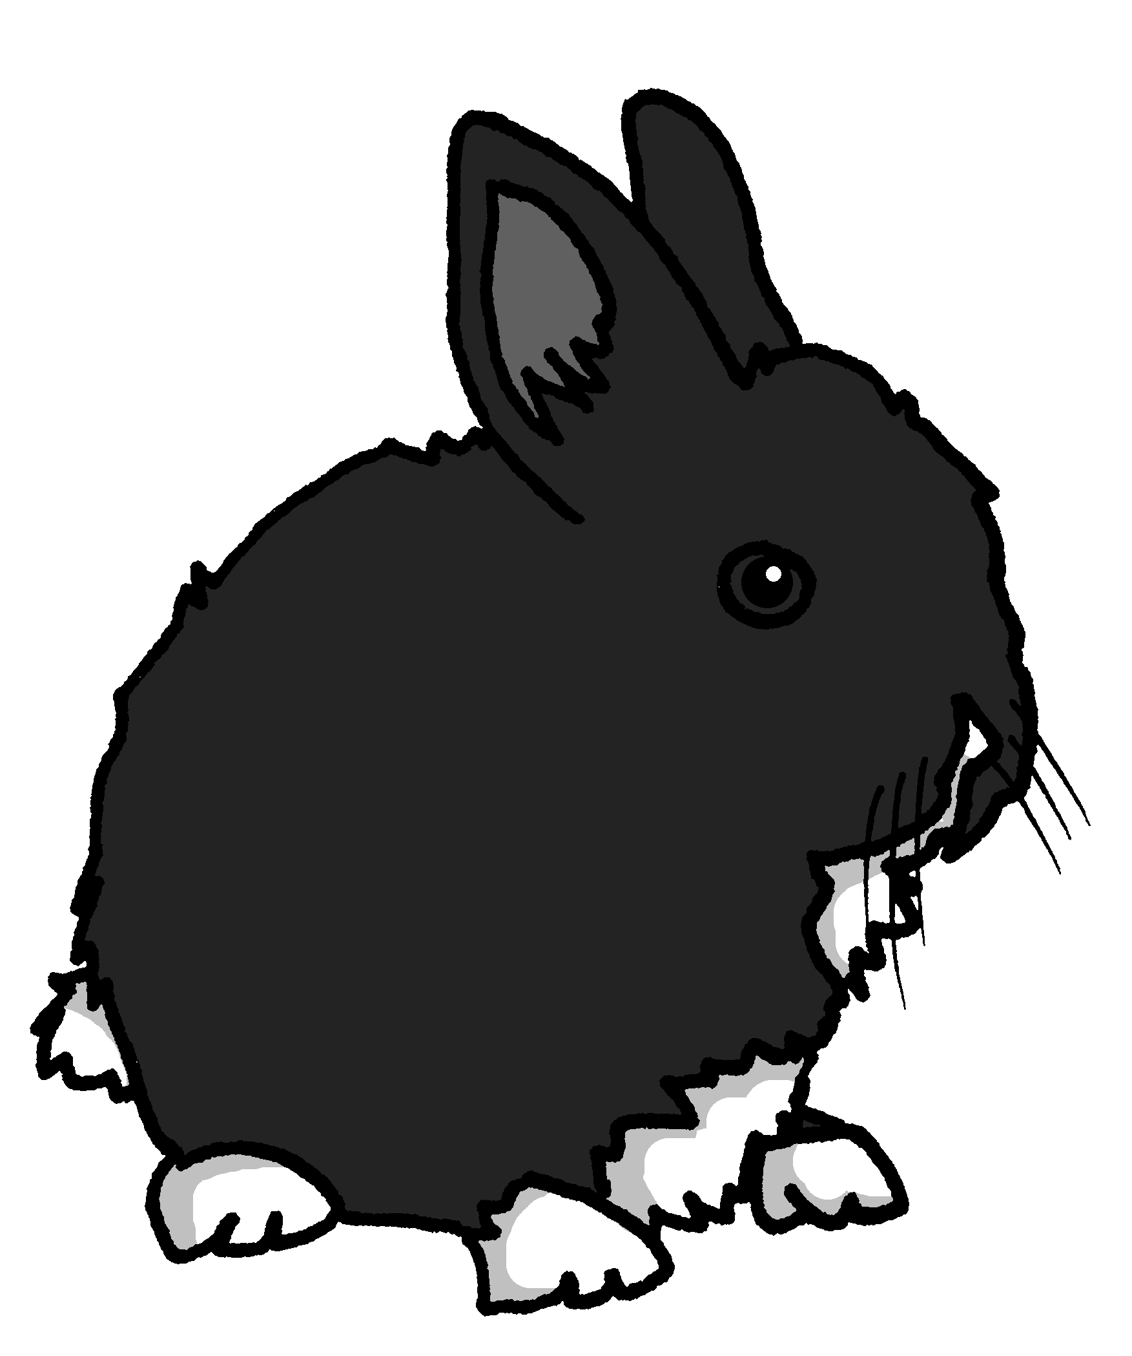
prononcer
[(a)in]
train
vingt
fin
main
lapin
Notes:
Timing: 2 minutes
Aim: To consolidate SSC [ain/in].
Procedure:
1. Introduce and elicit the pronunciation of the individual SSC [(a)in] and then the source word again ‘train’ (with gesture, if using).
2. Then present and elicit the pronunciation of the five cluster words.
The cluster words have mainly been chosen for their high-frequency, from a range of word classes, with the SSC (where possible) positioned within a variety of syllables within the words (e.g. initial, 2nd, final etc.).
Note: gesture for train – fist closed, arm by side, forearm at right angle to body, thrust fist forward miming the movement of a fast train
https://www.signbsl.com/sign/train – scroll down to the noun train videos.
Word frequency (1 is the most frequent word in French):
fin [111] lapin [>5000] main [418] train [232] vingt[1273]
Source: Londsale, D., & Le Bras, Y. (2009). A Frequency Dictionary of French: Core vocabulary for learners London: Routledge.
5

Slide 6



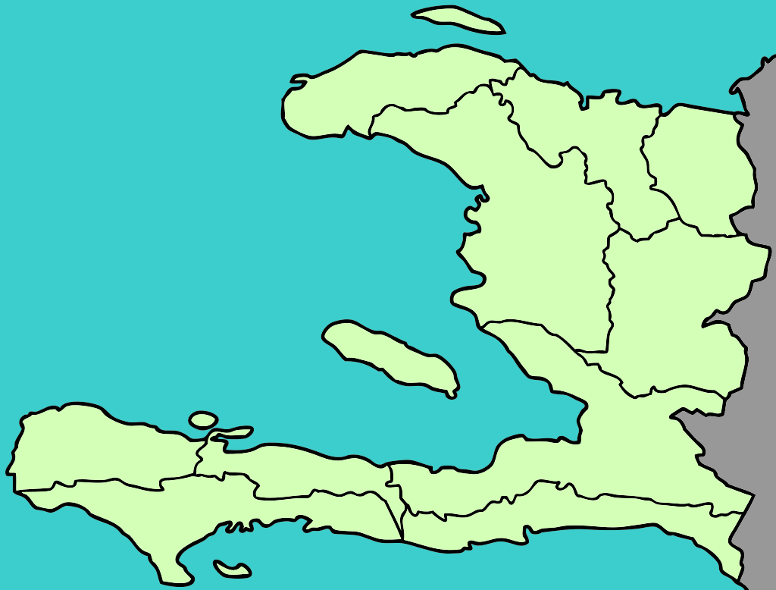
À Haïti
. Écoute les noms des animaux. C’est [ien] ou [(a)in]?
Prononce le nom* des villes. C’est le son [ai] ou [(a)in] ?
Port-de-Paix
Baie de Henne
Saint-Marc
prononcer
Hinche
Port-au-Prince
Port-au-Prince est la capitale d’Haïti. Un port, c’est quoi ?
Mirebalais
Les Anglais
Trouin
Bainet
⚠ Note: when [(a)in] is followed by SFe, the sound changes to [ai], as in semaine.
Notes:
Timing: 3 minutes
Aim: to practise oral production of place names containing SSC [ai] and [(a)in]; to learn about place names in Haïti.
Procedure:
1. Explain to pupils that Haiti has two official languages – Haitian Creole and French and that many place names contain French sounds.
2. Each click brings up a town/city name, starting with Baie de Henne, going left to right around the country and ending with the capital city, Port-au-Prince.
3. After each click, pupils try to say the name (focusing on SSCs [ai] and [(a)in])
4. Click on the speech bubbles to hear the towns pronounced by a native speaker of French.
5. Pupils repeat.
Transcript:
Baie de Henne
Port-de-Paix
Saint-Marc
Hinche
Mirebalais
Trouin
Bainet
Les Anglais
Port-au-Prince
Image attribution:
Siebrand, Vincedevries and Golbez, CC BY-SA 3.0 via Wikimedia Commons

Slide 7


aller (to go, to be going)
Aller is an irregular verb meaning to go, to be going.
⚠ The –s is a Silent Final Consonant (SFC).
Je vais
⚠ Here –s is often pronounced (like English ‘z’) because it is followed by a vowel. This is optional liaison.
I go|I am going
Je vais à Port-au-Prince.
I go|I am going to Port-au-Prince.
Elle va à Port-au-Prince.
She goes|is going to Port-au-Prince.
Il va aussi à Port-au-Prince.
He also goes|is also going to Port-au-Prince.
Notes:
Timing: 2 minutes
Aim: to introduce two forms of the irregular verb aller.
Procedure:
Click through the animations to present the information. Stress the highly irregular nature of aller and perhaps ask pupils if they can think of another highly irregular verb e.g. être (je suis, il/elle est).
Elicit English translations for the French examples provided.

Slide 8

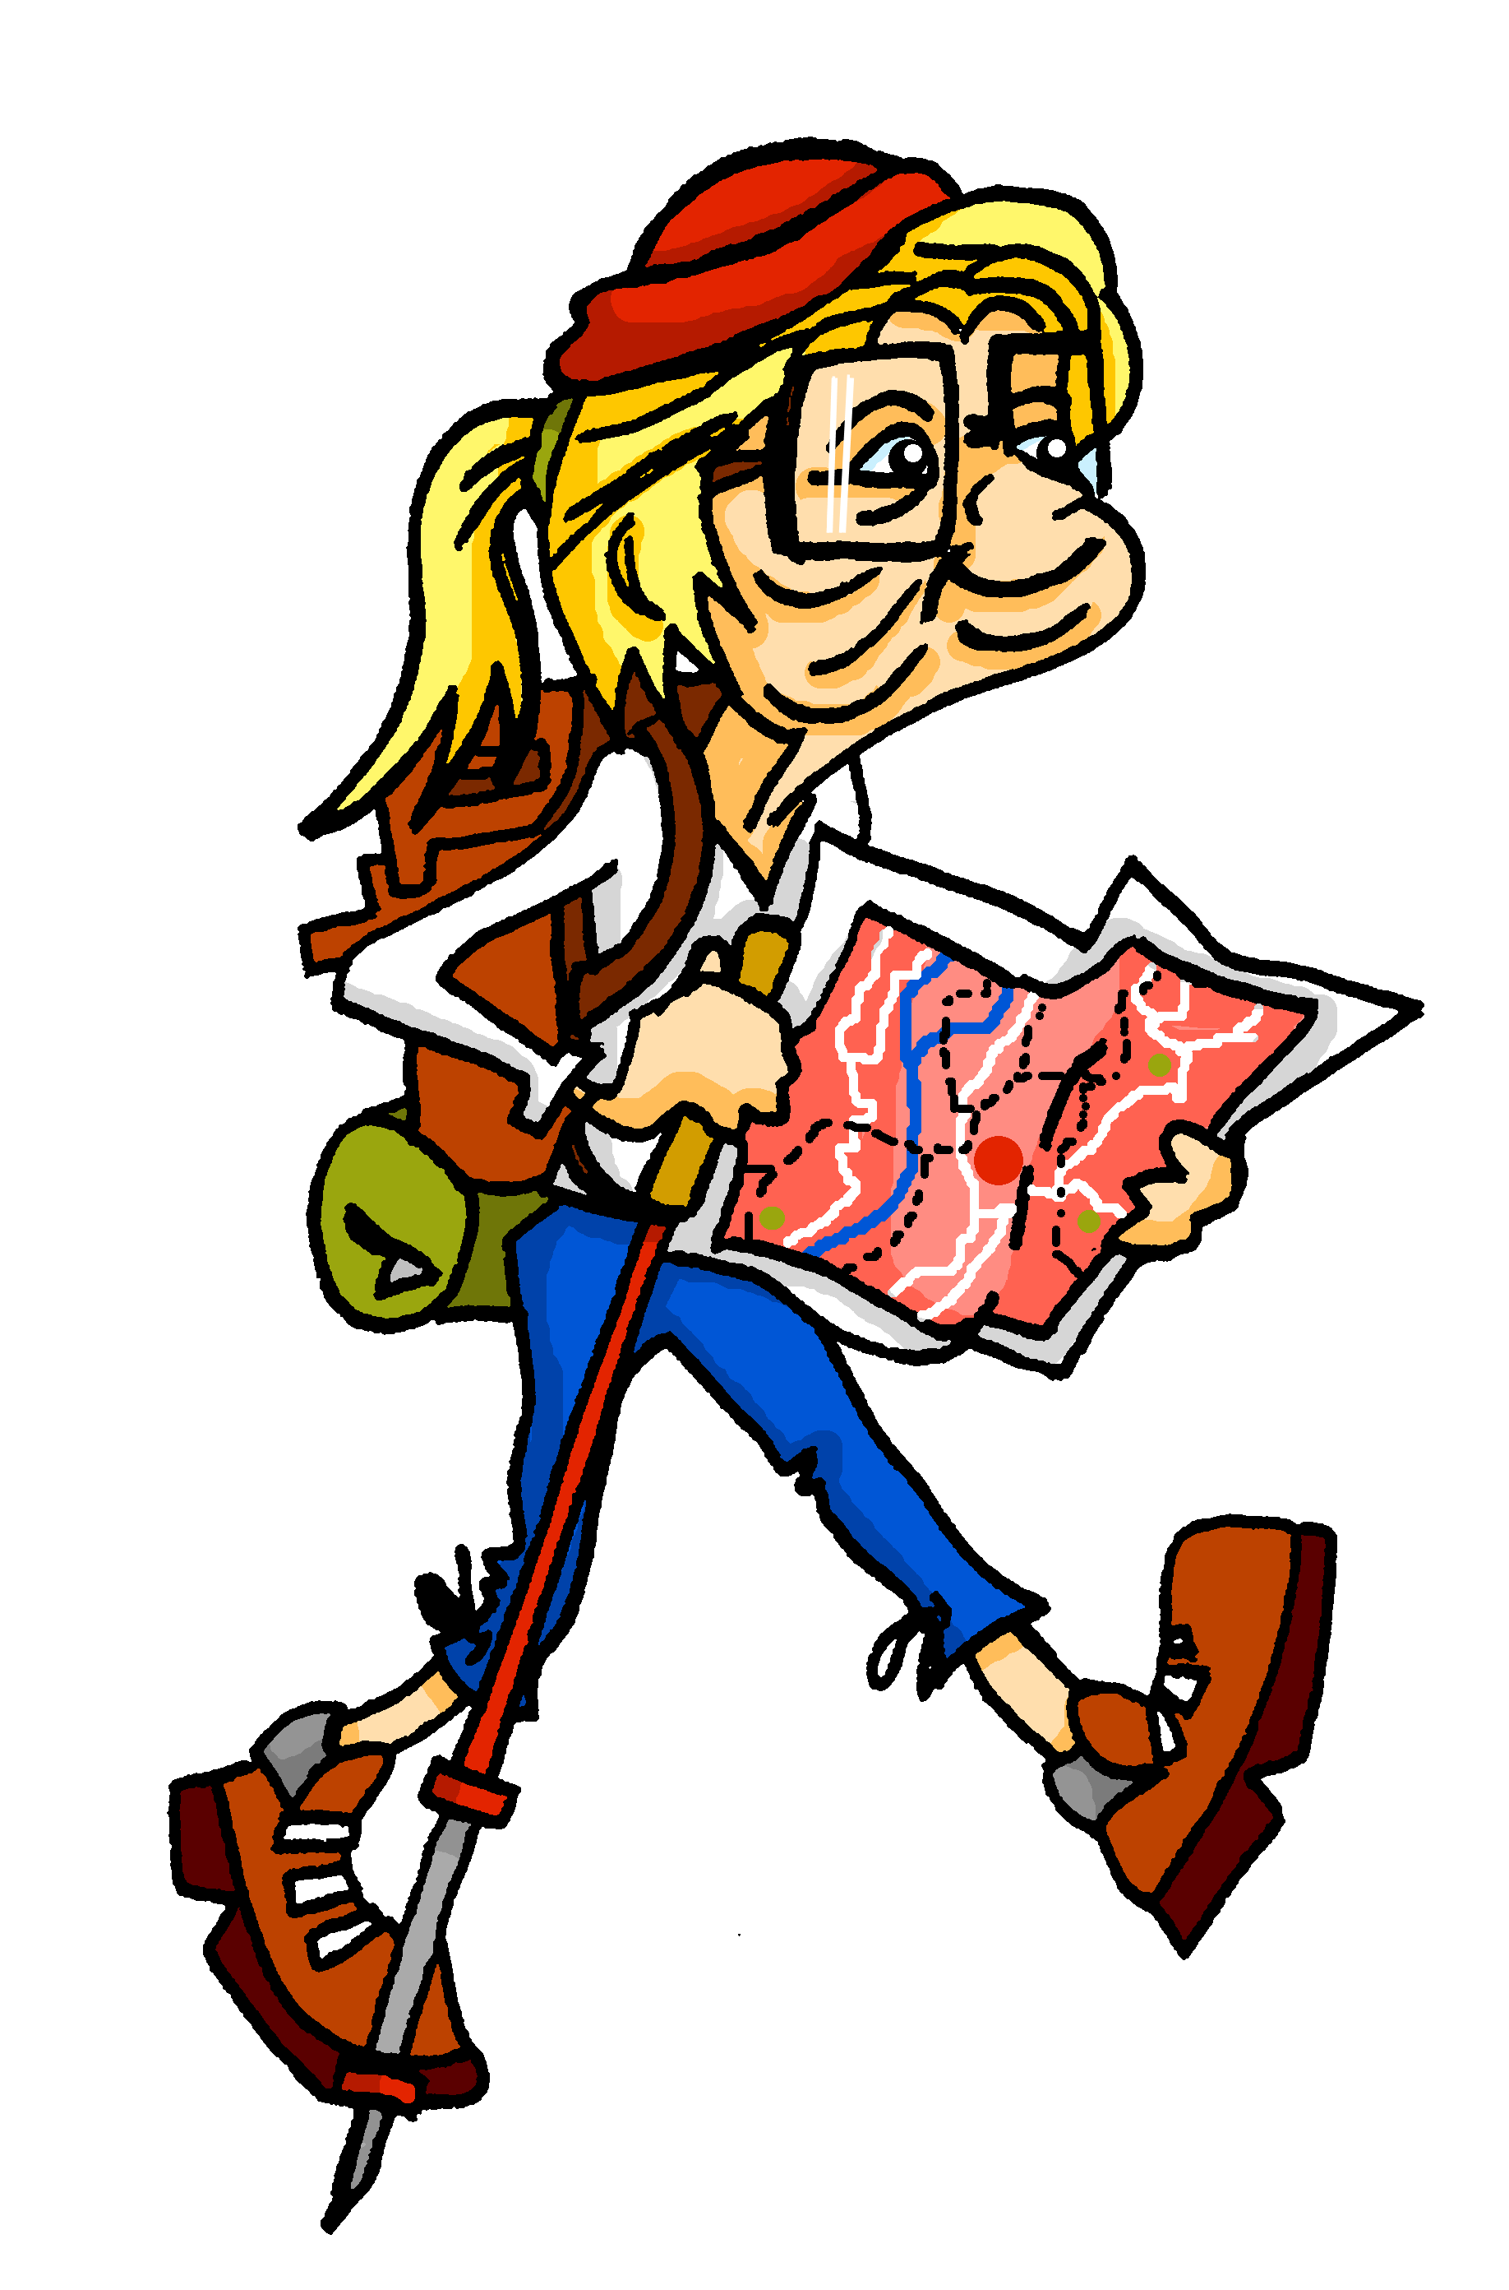
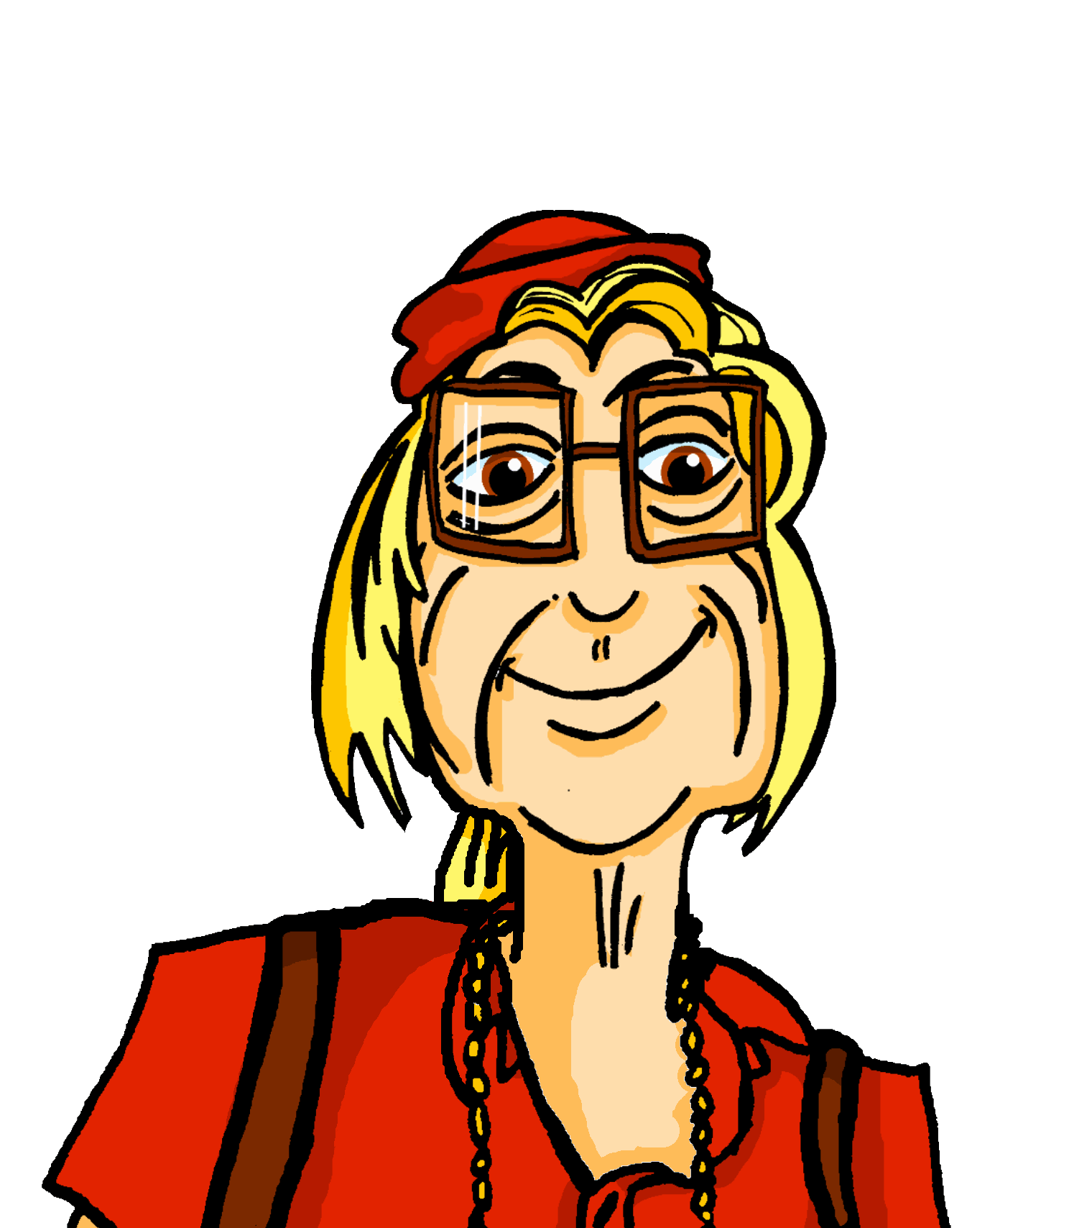


lire
Renée va à Haïti et Mylène, aussi.
. Écoute les noms des animaux. C’est [ien] ou [(a)in]?
Renée écrit des messages. Qui va où exactement ?
1
… vais à l’Ile de la Tortue.
2
… va à Plaisance.
Renée (je) | Mylène (elle)
3
… va à Milot.
[1]
[2]
4
… vais à Saint-Raphaël.
[3]
[4]
5
… vais à Verrettes.
[5]
6
… va à Chantal.
[6]
Notes:
Timing: 5 minutes
Aim: to pay attention to two forms of the verb aller to identify who is going where.
Procedure:
Pupils write down 1-6.
Model number 1 with the class, so pupils are clear that they select the person (je) or (elle) based on the form of aller. Note that the pronoun is missing.
Click the number to listen and check the full sentence and/or click to reveal the full written sentence.
Pupils complete 2 – 6.
Teacher clicks to correct.
If desired, click on the numbers to hear the full sentences.
Transcript:
Je vais à l’Ile de la Tortue.
Aujourd’hui, elle va à Plaisance.
Puis, elle va à Milot.
Moi, je vais à Saint-Raphaël.
Puis je vais à Verrettes.
Le mercredi, elle va à Chantal.
8

Slide 9



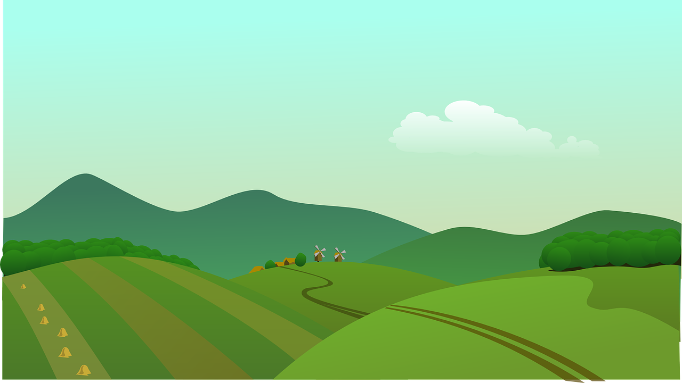



vocabulaire
.
Écoute et répète.
mots
le port
la montagne
la campagne
countryside
la plage
l’ile
beach
island
Notes:
[1/2]
Timing: 8 minutes (two slides)
Aim: to present and practise new vocabulary
Procedure:
Click to present the French word. Listen and repeat the word.
Click to bring up the English meaning/picture.
Click to disappear the English meaning/picture. Elicit these from pupils. Click for each to reappear each time.
Click to disappear the French meanings. Elicit these from pupils. Click for each to reappear.
9

Slide 10

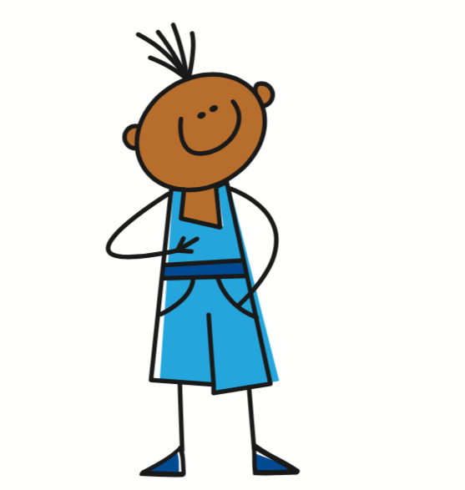
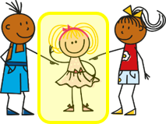
vocabulaire
.
Écoute. C’est quoi en français ?
mots
elle va
je vais
la campagne
aller
l’ile
le port
la plage
la montagne
1
2
3
4
5
6
7
8
Notes:
[2/2]
Procedure:
1. Pupils match the French nouns to the pictures in their heads.
2. The teacher gives the pupils a number and the pupils must say the correct word in French. The number prompts are the trigger (i.e. click on the number) for the lines to connect the correct word to the picture.
3. Click to make each French word disappear in turn. Can pupils recall the French words?
4. If desired, click on each picture to hear the word pronounced.
10

Slide 11
Saying ‘to, at, in (the)’ in French
When we mean ‘to (the)…’ in French before a noun, we use au if the noun is masculine:
⚠ use au not
à + le for ‘to the’.
au port
to the port
au parc
to the park
To mean ‘to (the)’ before a feminine noun, we use à la:
à la montagne
to the mountain(s)
à la campagne
to the country(side)
When the noun starts with a vowel or ‘h’, we use à l’:
à l’ile
to the island
à l’ hôtel
to the hotel
Notes:
Timing: 2 minutes
Aim: to present the three ways to say ‘to (the)’ in French.
Procedure:
Click through the animations to present the information.
Elicit English translations for the French examples provided.

Slide 12

écouter
Mylène fait des visites et Renée, aussi.
l’endroit - place
Mylène parle au téléphone.
Écoute. Qui va où ?
C’est Mylène (je) ou Renée (elle) ? Écris l’endroit* en anglais.
 | Mylène (je) | Renée (elle) | où ?
 |  |  | campagne
 |  |  | ile
 |  |  | port
 |  |  | plage
 |  |  | hôtel
 |  |  | montagne
 | Mylène (je) | Renée (elle) | où ?
 |  |  | parc
 |  |  | campagne
 |  |  | ile
 |  |  | plage
 |  |  | montagne
 |  |  | plage
1
4
1
4
2
5
2
5
3
6
3
6
Notes:
Timing: 5 minutes
Aim: to practise aural comprehension of the two forms of aller (with pronouns je/elle) and to work out the destination based on the version of à + article they hear.
Procedure:
Click to listen to the sentence, without the place.
Pupils write the numbers 1-6 and for each item the answer ‘je’ or ‘elle’ and the place, depending on the version of à + article. Note that in the final item both answers are feminine and therefore both are possible.
Elicit answers and click to reveal.
Click again for a 2nd set of audio buttons to listen to the full sentences.
Pupils volunteer the English meanings of the full sentences.
Transcript:
Elle va à la [campagne].
Elle va aussi au [port].
Je vais à la [montagne].
Puis, je vais au [parc].
Le weekend, elle va à l’[ile].
Et je vais à la [montagne et à la plage].
12

Slide 13
Au revoir !
vert
Notes:
13

