Slide 1
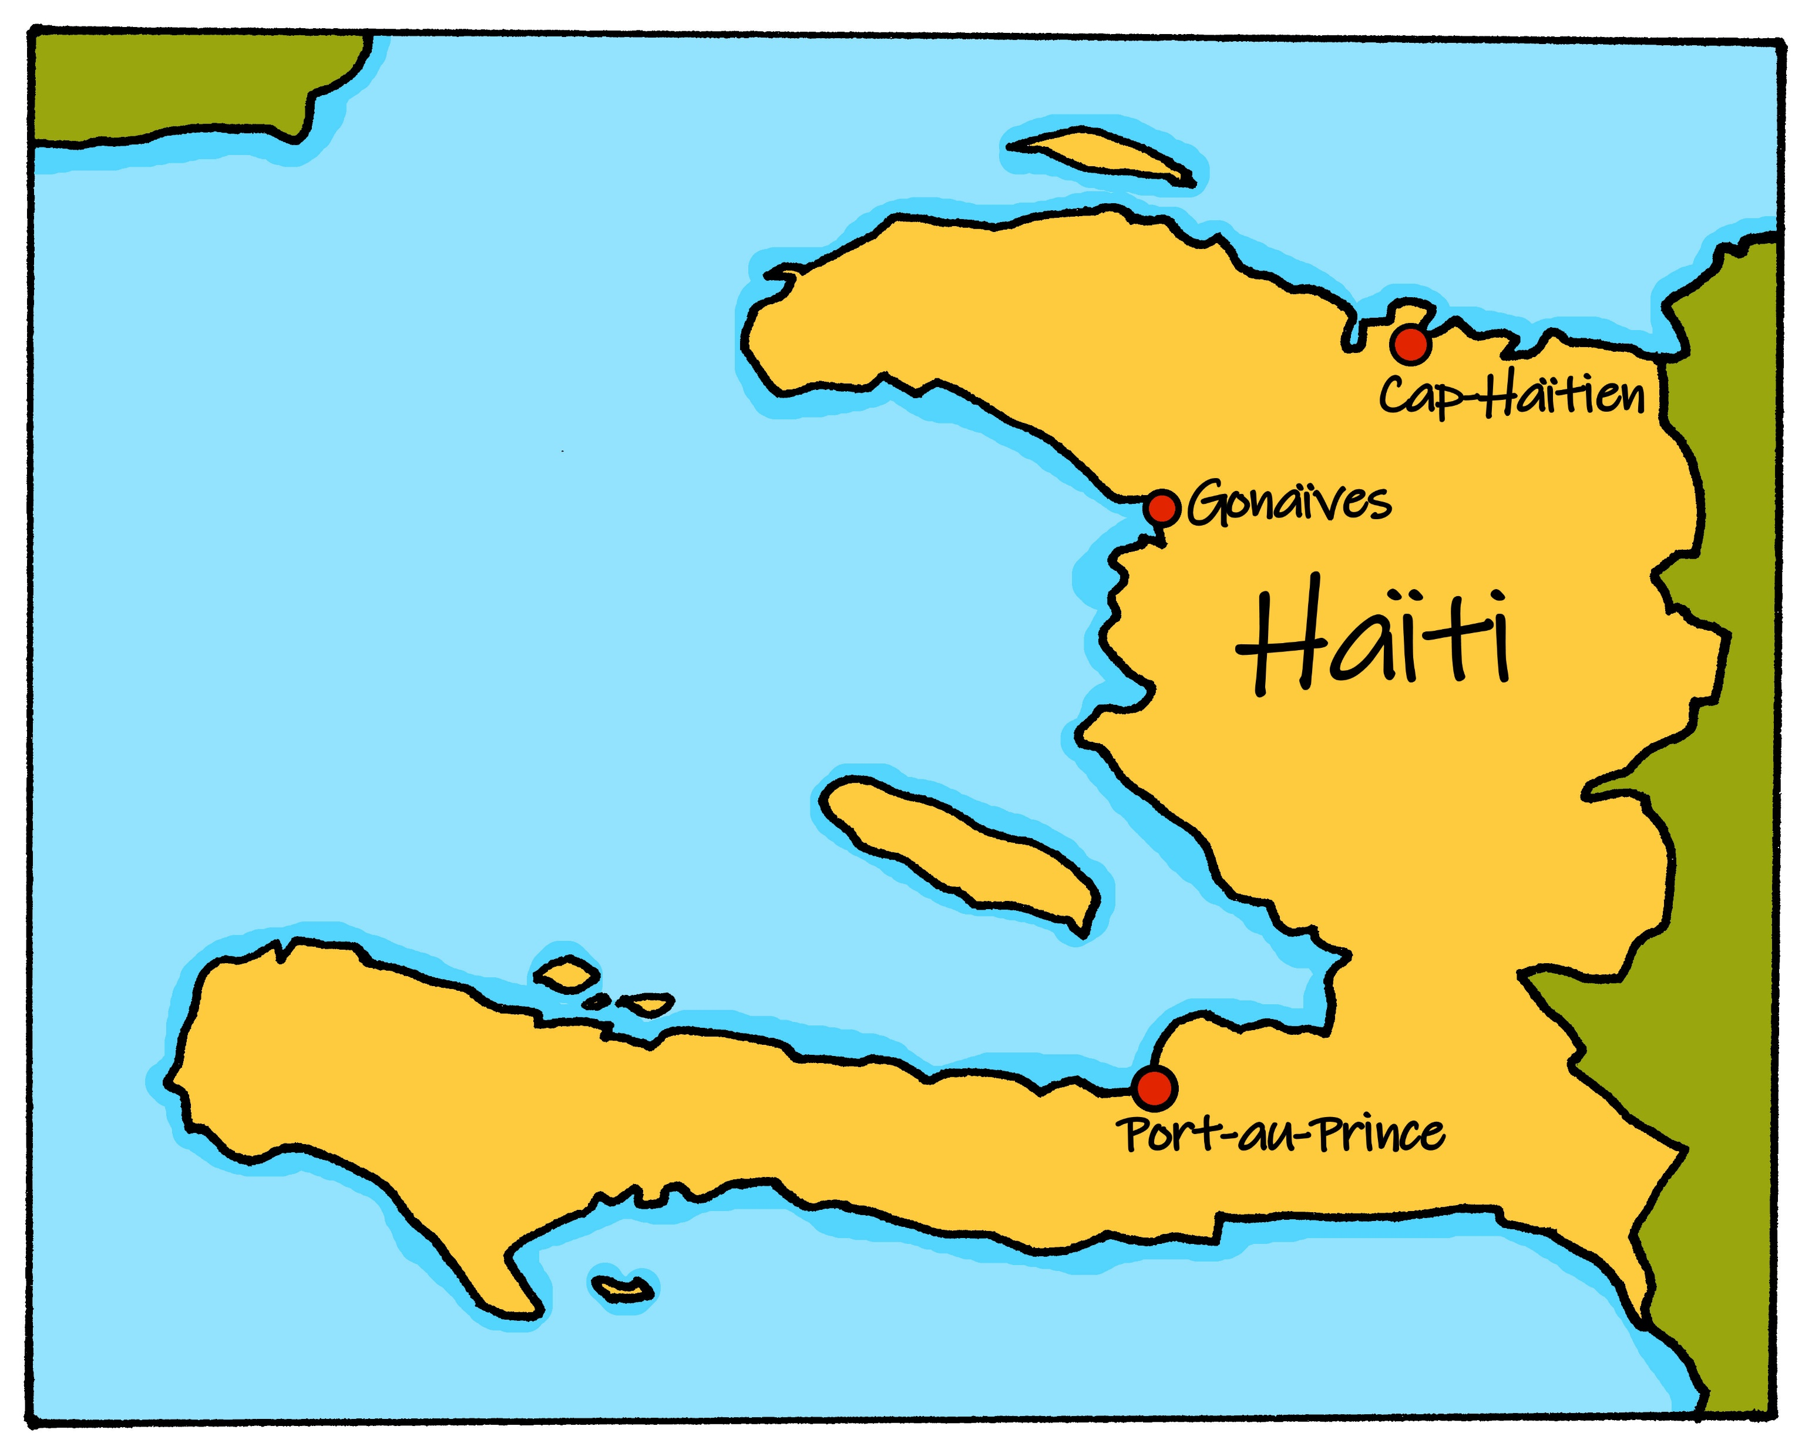
Saying where you are going and what there is there
vert
Follow ups 1-5
Notes:
Artwork by Steve Clarke. Pronoun pictures from NCELP (www.ncelp.org). All additional pictures selected from Pixabay and are available under a Creative Commons license, no attribution required.
Phonics: Revisit SSC [ai] - vrai [292] maison [325] aider [413] raison [72] aimer [242] semaine [245] and [(a)in] - train [232] fin [111] matin [442] vingt [1273] main [418]
Vocabulary: aller [53] je vais il/elle va à (meaning ‘at/in/to’)[4] campagne [666] Île [1245] montagne [1732] plage [2693] port [1304]
Revisit 1: chanter [1820] chercher [336] créer [332] danser [2934] donner [46] écouter [429] manger [1338] organiser [791] préparer [368] porter [105] regarder [425] trouver [83] utiliser [345]
Revisit 2: -
Londsale, D., & Le Bras, Y. (2009). A Frequency Dictionary of French: Core vocabulary for learners London: Routledge.
The frequency rankings for words that occur in this PowerPoint which have been previously introduced in these resources are given in the SOW and in the resources that first
introduced and formally re-visited those words.
For any other words that occur incidentally in this PowerPoint, frequency rankings will be provided in the notes field wherever possible.

Slide 2
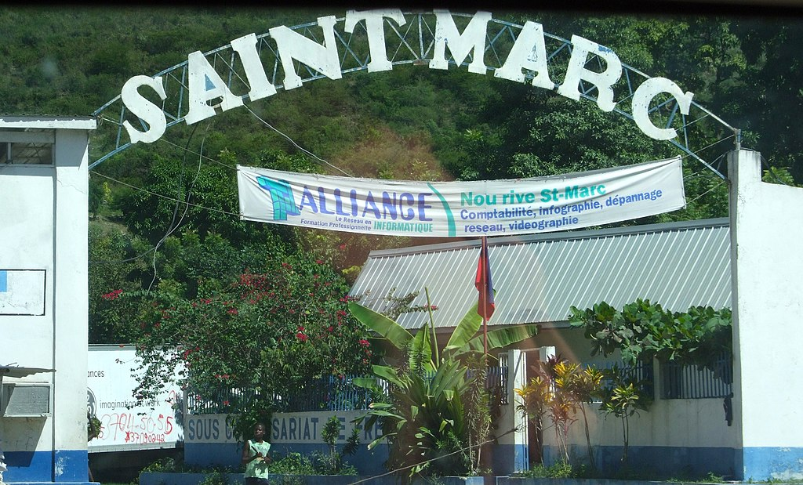
Follow up 1: la liaison
. Écoute les noms des animaux. C’est [ien] ou [(a)in]?
Prononce les phrases🗣.
prononcer
Je vais à Saint-Marc.
I go/I am going to Saint-Marc.
1
Notes:
Timing: 3 minutes (6 slides)
Aim: to consolidate s- liaison after ‘je vais’ alternating with no liaison after ‘il/elle va’.
Procedure:
Click to play the audio.
Pupils repeat.
Elicit the English meaning.
Ask pupils to read the phrase aloud again.
Transcript: Je vais à Saint-Marc.
Picture attribution: Didier Moïse, CC BY-SA 4.0 via Wikimedia Commons

Slide 3
Follow up 1: la liaison
. Écoute les noms des animaux. C’est [ien] ou [(a)in]?
Prononce les phrases🗣.
Association Sportive Mirebalais est un club de football professionnel à Haïti.
prononcer
Elle va à Mirebalais.
She goes/she is going to Mirebalais.
2
Notes:
[2/6]
Picture use: fair use policy
Details here: https://en.wikipedia.org/wiki/File:AS_Mirebalais.png
Transcript: Elle va à Mirebalais.

Slide 4
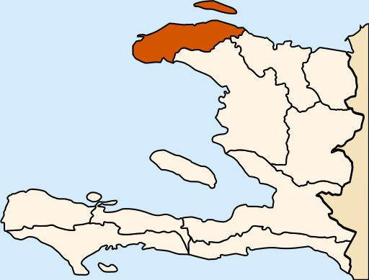
Follow up 1: la liaison
. Écoute les noms des animaux. C’est [ien] ou [(a)in]?
Prononce les phrases🗣.
prononcer
Remember! à can mean ‘to’ and ‘in’.
Elle est à Port-de-Paix.
She is in Port-de-Paix.
3
Notes:
[3/6]
Transcript: Elle est à Port-de-Paix.
Picture attribution:
NielsF talk/overleg/discussion/discussione, via Wikimedia Commons

Slide 5
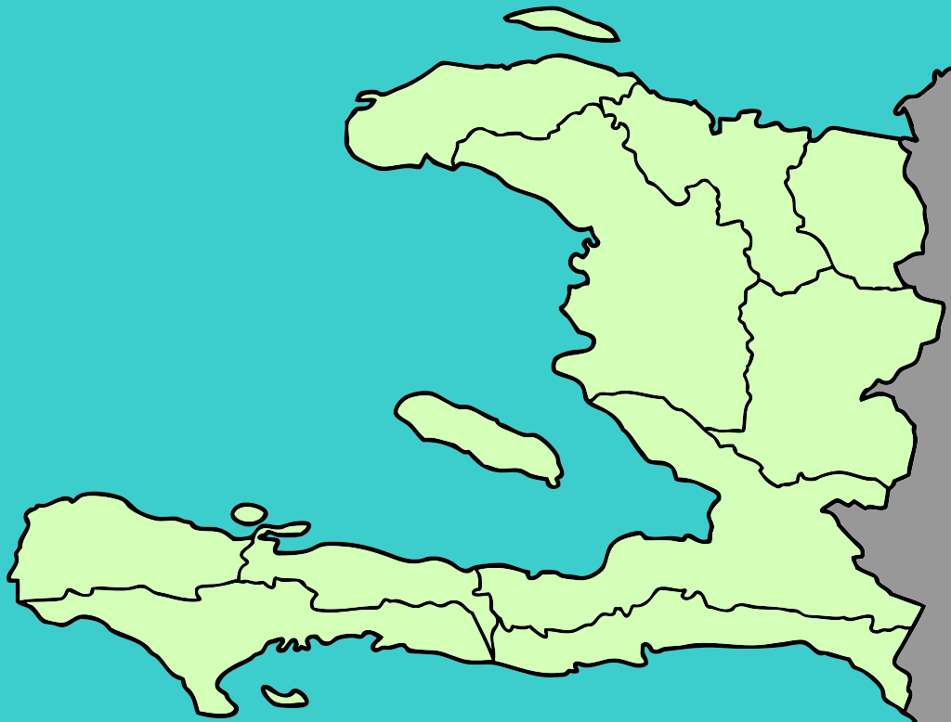
Follow up 1: la liaison
. Écoute les noms des animaux. C’est [ien] ou [(a)in]?
Prononce les phrases🗣.
prononcer
Trouin
Je suis à Trouin.
I am in Trouin.
4
Notes:
[4/6]
Transcript: Je suis à Trouin.

Slide 6
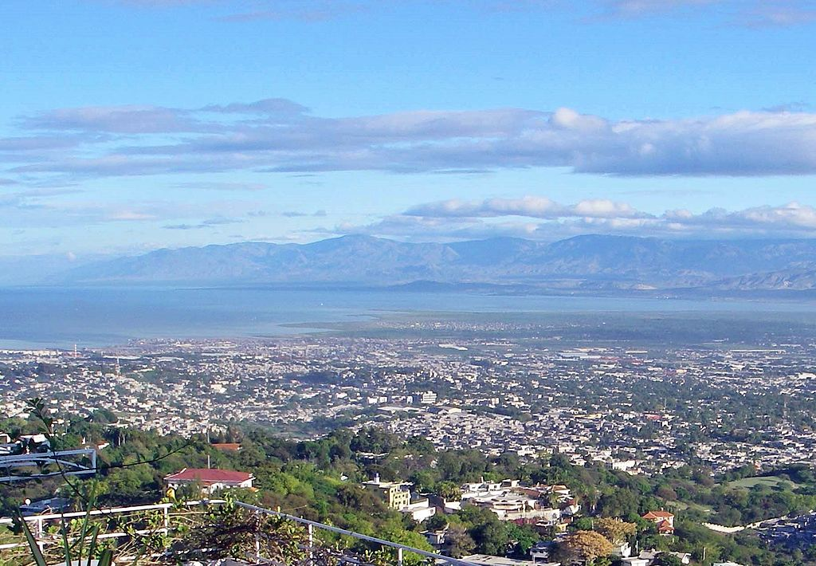
Follow up 1: la liaison
. Écoute les noms des animaux. C’est [ien] ou [(a)in]?
Prononce les phrases🗣.
prononcer
Je vais à Port-au-Prince.
I go/am going to Port-au-Prince.
5
Notes:
[5/6]
Transcript: Je vais à Port-au-Prince.
Picture attribution:
Elena Heredero, CC BY 2.0 via Wikimedia Commons

Slide 7
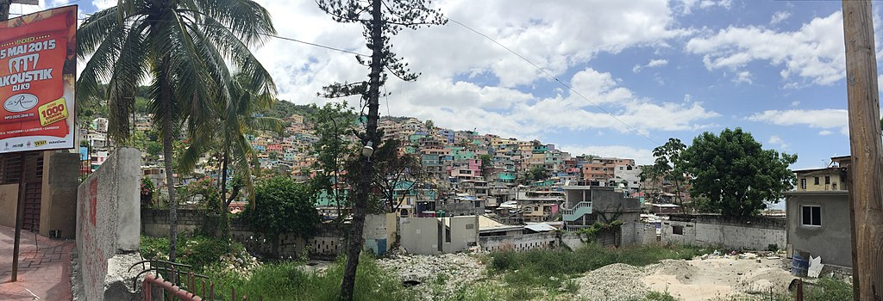
Follow up 1: la liaison
. Écoute les noms des animaux. C’est [ien] ou [(a)in]?
Prononce les phrases🗣.
Port-au-Prince est la capitale d’Haïti.
prononcer
Elle va aussi à Port-au-Prince.
She goes/is going to Port-au-Prince.
6
Notes:
[6/6]
Transcript: Elle va aussi à Port-au-Prince.
Picture attribution:
Yoni Rubin, CC BY 3.0 <https://creativecommons.org/licenses/by/3.0>, via Wikimedia Commons

Slide 8
Saying ‘to’ and ‘in’ [1/2]
Remember we use the preposition à to talk about going to or being/arriving in a town/city:
Je vais…
à Port-au-Prince.
Je suis…
à Port-au-Prince.
I go/am going to Port-au-Prince.
I am …
in Port-au-Prince.
J’arrive…
à Port-au-Prince.
⚠ It is the verb that tells us whether à means to or in.
I am/ I am arriving …
in Port-au-Prince.
Notes:
Timing: 2 minutes (two slides)
Aim: to revisit meanings and uses of à.
Procedure:
Click through the animations to present the information.
Elicit English translations for the French examples provided.

Slide 9
Saying ‘to’, ‘in’ and ‘at’ the… [2/2]
Before a noun au, à la and à l’ can mean ‘to’, ‘in’ or ‘at’ the:
Je vais…
au port.
Je suis…
au port.
I go/am going to the port.
I am …
at the port.
J’arrive…
à la montagne.
I am/ I am arriving …
⚠ It is the verb that tells us whether à means to, in or at.
in the mountains.
Je reste…
à l’hôtel.
Don’t worry! Just choose the English word that sounds right to you.
I stay/ I am staying …
at/in the hotel.
Notes:
[2/2]
Aim: to revisit meanings and uses of à combined with definite articles.
Procedure:
Click through the animations to present the information. Remind pupils that it au is for masculine, à la for feminine, and à l’ for nouns starting with a vowel or silent ‘h’.
Elicit English translations for the French examples provided.

Slide 10
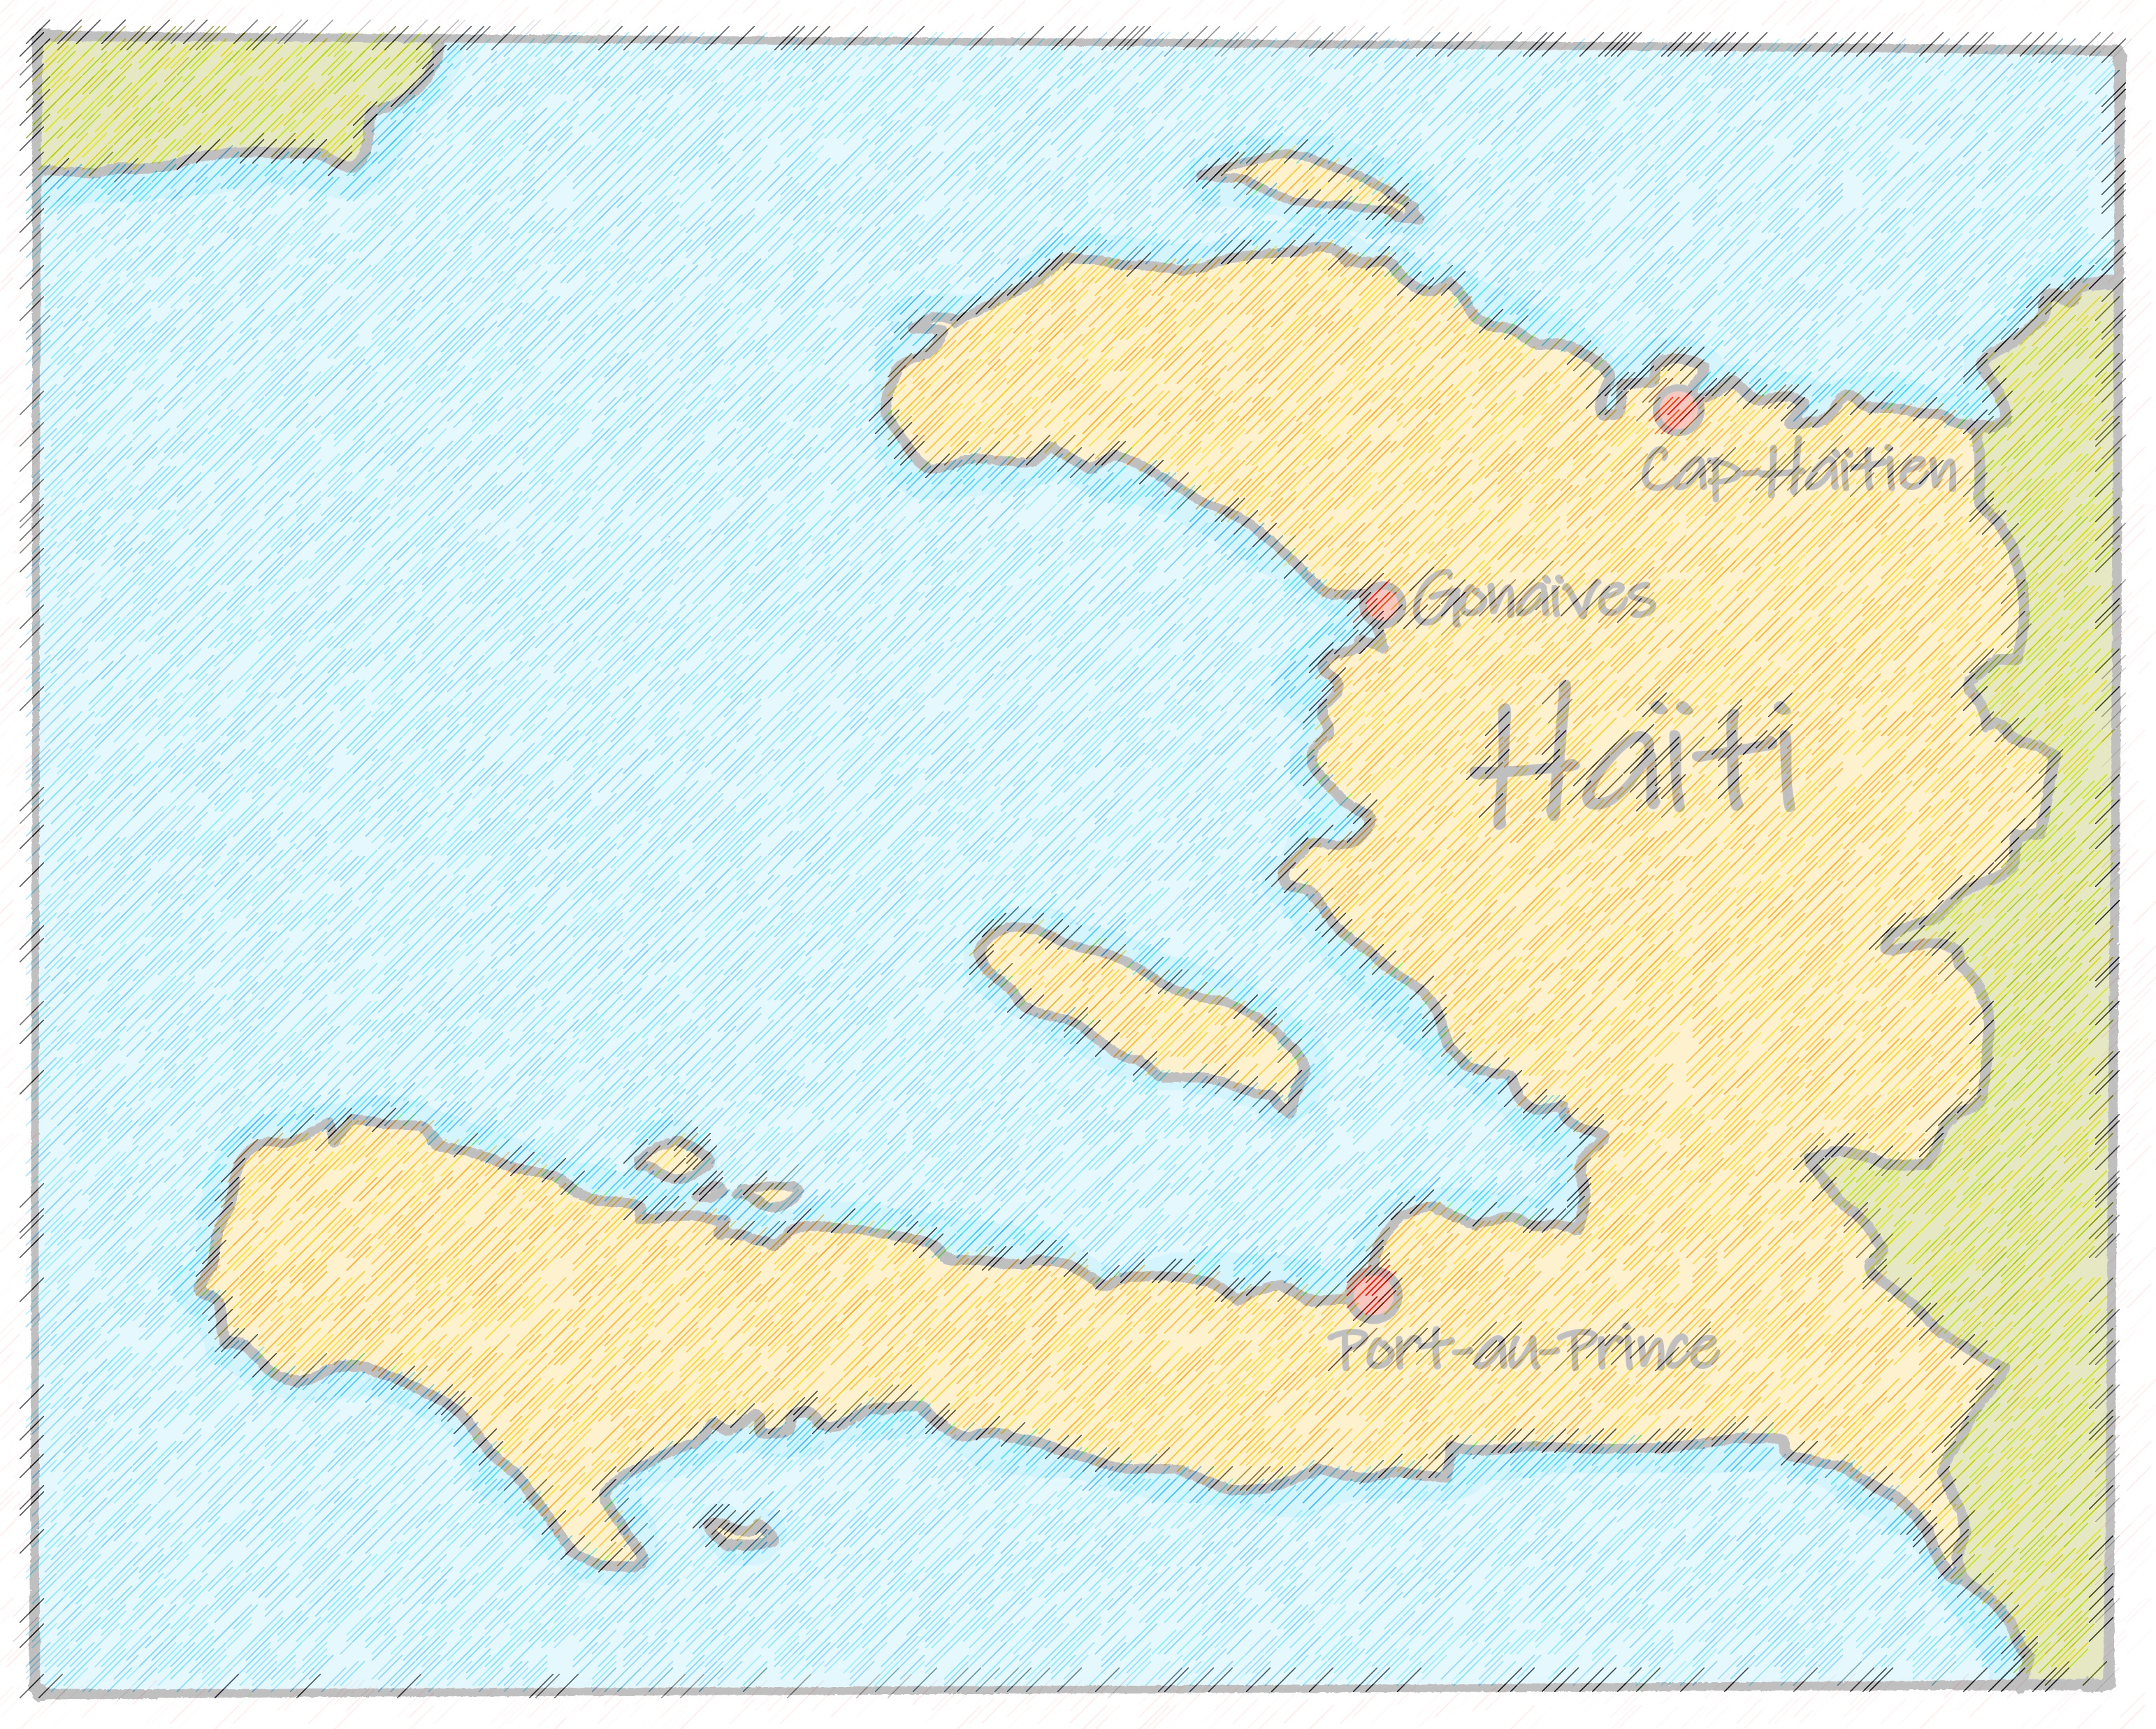
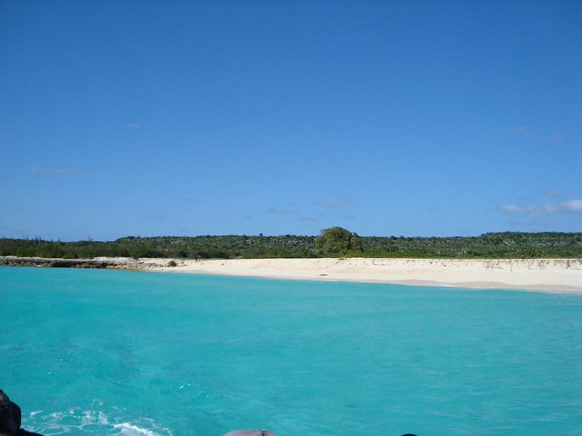
Follow up 2:
Renée et Mylène sont à Haïti pour voir la famille.
.
Lis les messages de Mylène.
lire
Vendred, j’organise une visite à l’Ile de la Tortue.
Mercredi, je regarde un spectacle. J-M danse à l’école.
v | Mylène
Mon
Tues
Wed
Thurs
Fri
Sat
Sun
Samedi, je cherche des souvenirs au centre commercial.
I’m giving a present to Clémentine.
L’Ile de la Tortue a une population d’environ 35 000 habitants. Le nom ‘tortue’ est pour la forme de l’ile.
Mardi, j’écoute une émission importante à la radio.
I’m listening to an important programme on the radio.
I’m watching a show. J-M is dancing at school.
Lundi, je donne un cadeau à Clémentine. ☺
I’m going to the countryside and I’m eating at/in a/the restaurant.
Dimanche, je suis à la plage avec J-M et Clémentine.
I’m organising a visit to Turtle Island.
I’m looking for souvenirs at/in the shopping centre.
Jeudi, je vais à la campagne et je mange au restaurant.
I’m at the beach with J-M and Clémentine.
Notes:
Timing: 5 minutes
Aim: to pay attention to the preposition (preposition + article) used for cities/named places, and feminine and masculine nouns, and to practise aural comprehension of vocabulary for this week.
Procedure:
Pupils write down 1-6 and headings ‘destination’ and ‘English’.
Model number 1 with the class, so pupils are clear that they select the destination based on the preposition à plus article that they hear in combination with the verb.
Click the number to listen to the sentence beginning.
Pupils write the destination. Then they write the meaning of the whole sentence, if able. They might need to listen twice to do this. Less proficient learners can be asked to write the English for any words they hear, rather than the full sentence.
Click to listen and check the full sentence and reveal the answers.
Pupils complete 2 – 6.
Teacher clicks to correct.
Ask pupils to say which sentence/destination they would most like to apply to them.
Picture attribution: Ambassade de France en Haïti Ambafranceht
https://www.flickr.com/photos/41309185@N03/4568829782

Slide 11
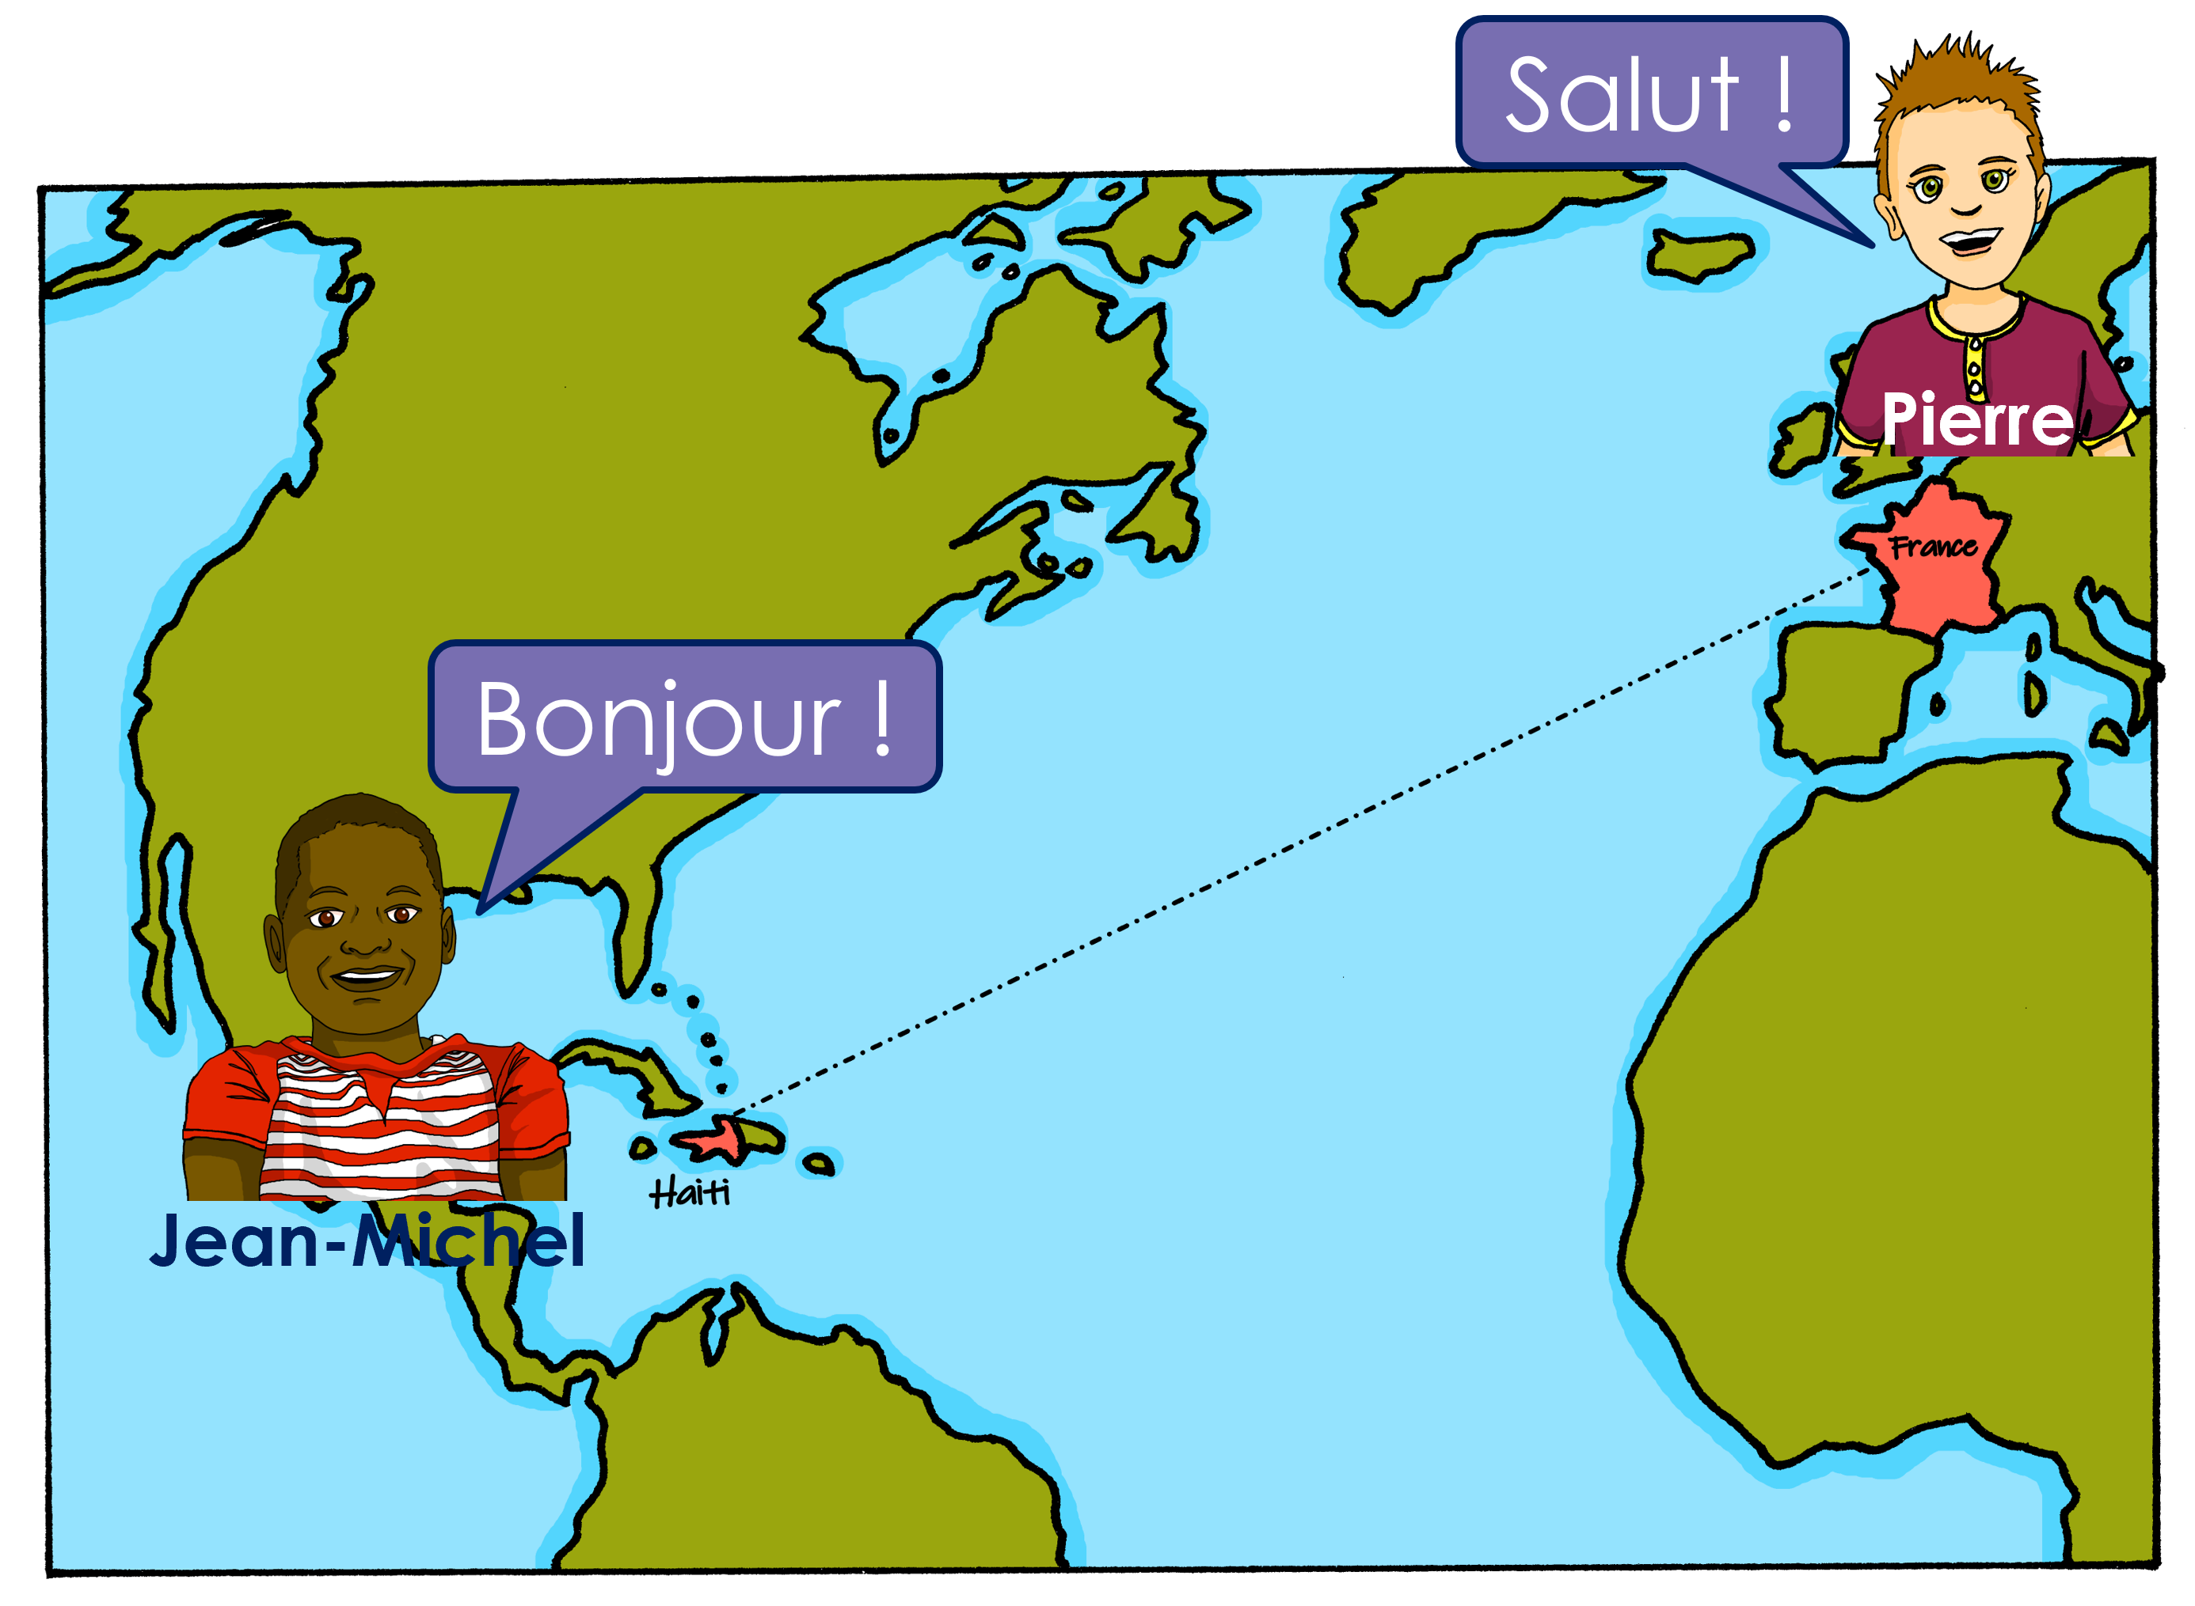
Follow up 3
Écoute. Choisis le mot correct pour compléter la phrase.
écouter
 | C’est quelle destination ? |  | phrase en anglais
 | port | plage
 | école | campagne
 | hôtel | maison
 | télé | café
 | plage | parc
 | amie | professeur
1
She goes/is going to the port.
1
2
I am in the countryside.
2
3
Is he staying at/in the hotel?
3
4
4
He is watching a programme on tv.
5
Are you at the beach?
5
She gives/is giving a response
to the teacher.
6
6
Notes:
Timing: 5 minutes
Aim: to pay attention to the preposition (preposition + article) used for cities, and feminine and masculine nouns, and to practise aural comprehension of vocabulary for this week.
Procedure:
Pupils write down 1-6 and headings ‘destination’ and ‘English’.
Model number 1 with the class, so pupils are clear that they select the destination based on the preposition à plus article that they hear in combination with the verb.
Click the number to listen to the sentence beginning.
Pupils write the destination. Then they write the meaning of the whole sentence, if able. They might need to listen twice to do this. Less proficient learners can be asked to write the English for any words they hear, rather than the full sentence.
Click to listen and check the full sentence and reveal the answers.
Pupils complete 2 – 6.
Teacher clicks to correct.
Ask pupils to say which sentence/destination they would most like to apply to them.
Transcript 1: 1. Elle va au [beep].
2. Je suis à la [beep]
3. Est-ce qu’il reste à l‘ [beep] ?
4. Oui, il regarde une émission à la [beep] 5. Tu es à la [beep]
6. Elle donne une réponse au [beep]
Transcript 2:
1. Elle va au port.
2. Je suis à la campagne.
3. Est-ce qu’il reste à l‘hôtel ?
4. Oui, il regarde une émission à la télé. 5. Tu es à la plage ?
6. Elle donne une réponse au professeur.

Slide 12
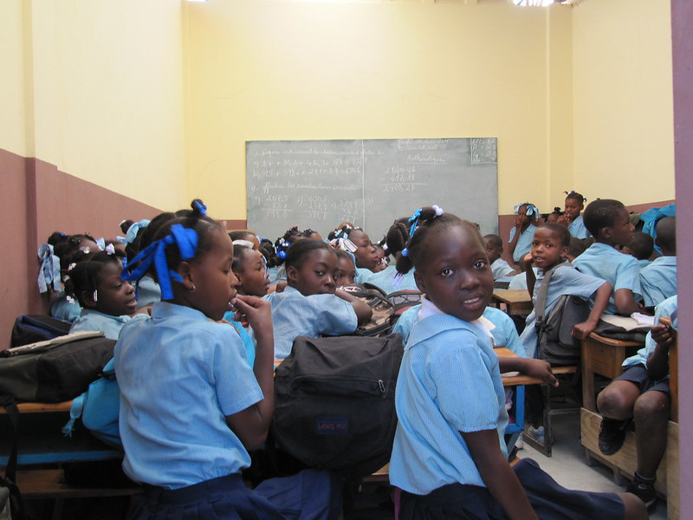
Follow up 4:

Écris les mots correspondants en français et en anglais.
Aujourd’hui, __ ______ à Haïti.
Renée ____ ___ ____ campagne.
Clémentine ___ ____ ___ école.
Elle ______ ___ uniforme.
Je suis ___ port.
_______ I am going __ _________.
Renée is going to the_________________.
Clémentine is going to _______.
___ wears/is wearing a ________.
____ _____ at the _______.
écrire
je vais
Today
to Haiti.
À Haïti les enfants portent un uniforme pour aller à l’école, comme en Angleterre. En France, on ne porte pas d’uniforme.
va à la
countryside
va à l’
school
She
porte un
uniform
au
I am
port
Notes:
Timing: 5-10 minutes
Aim: to practise written production of this week’s two verb forms, new vocabulary and written comprehension of other new and revisited vocabulary.
This is a jigsaw translation task.
Procedure:
Pupils write the missing words in both French and English to complete the sentences.
Teacher clicks to provide the written answers and/or clicks the audio buttons to hear the full French sentences.
Differentiation: 1. For a different challenge (i.e. to practise spelling rather than full written recall of the missing French words), the task could be completed as a transcription task initially, by listening to the full sentences and writing the words.
2. Then pupils could complete the English part of the jigsaw.
Picture attribution: Ambassade de France en Haïti Ambafranceht
https://www.flickr.com/photos/41309185@N03/5556120262/in/album-72157626215139849/

Slide 13
vocabulaire
Follow up 5 - Écris en anglais : Can you get at least 15 points?
mots
 | utiliser | créer | chanter
 | le port | la montagne | danser
 | la campagne | la plage | l’ile
 | elle va | à la | au
 | aller | je vais | il va
x3
to use, using
to create, creating
to sing, singing
x2
(the) port
(the) mountain
to dance, dancing
(the) country(side)
(the) beach
(the) island
x1
she goes, is going
to, in, at the (f)
to, in, at the (m)
to go, going
I go, am going
he goes, is going
Notes:
Timing: 5-10 minutes
Aim: to practise written production of vocabulary from this week and two revisited weeks.
Procedure: 1. Give pupils a blank grid. They fill in the English meanings of any of the words they know, trying to reach 15 points in total. 2. Remind pupils that adjectives can refer to male or female persons and they should note this in their translations. E.g. pleased (f), short (m).
Note: The most recently learnt and practised words are pink, words from revisit 1 are green and those from revisit 2 are blue, thus more points are awarded for them, to recognise that memories fade and more effort (heavy lifting!) is needed to retrieve them.
13

Slide 14
vocabulaire
Follow up 5b - Écris en français : Can you get at least 15 points?
mots
 | to use, using | to sing, singing | to create, creating
 | (the) island | to dance, dancing | (the) countryside
 | (the) port | (the) mountain(s) | (the) beach
 | she goes, is going | to, in, at the (m) | to, in, at the (f)
 | to go, going | I go, am going | he goes, is going
x3
utiliser
chanter
créer
x2
l’ile
danser
la campagne
le port
la montagne
la plage
x1
elle va
au
à la
aller
je vais
il va
Notes:
Timing: 5-10 minutes
Aim: to practise written comprehension of vocabulary from this week and previous weeks.
Procedure: Give pupils a blank grid. They fill in the French meanings of any of the words they know, trying to reach 15 points in total.
Note: The most recently learnt and practised words are pink, words from the previous week are green and those from earlier are blue, thus more points are awarded for them, to recognise that memories fade and more effort (heavy lifting!) is needed to retrieve them.
14

Slide 15
vocabulaire
Follow up 5 - Écris en anglais : Can you get at least 15 points?
mots
 | utiliser | créer | chanter
 | le port | la montagne | danser
 | la campagne | la plage | l’ile
 | elle va | à la | au
 | aller | je vais | il va
x3
x2
x1
Notes:
HANDOUT
15

Slide 16
vocabulaire
Follow up 5b - Écris en français : Can you get at least 15 points?
mots
 | to use, using | to sing, singing | to create, creating
 | (the) island | to dance, dancing | (the) countryside
 | (the) port | (the) mountain(s) | (the) beach
 | she goes, is going | to, in, at the (m) | to, in, at the (f)
 | to go, going | I go, am going | he goes, is going
x3
x2
x1
Notes:
HANDOUT
16

