Slide 1
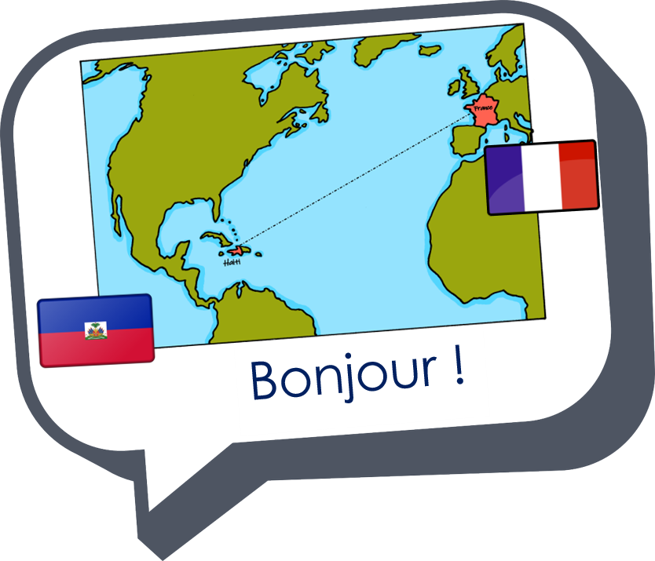










Saying where you are going and what there is there
Les nombres
vert
Numbers 1-31
Il n’y a pas de
SSC [oi] & [(a)in]
Notes:
Artwork by Steve Clarke. Pronoun pictures from NCELP (www.ncelp.org). All additional pictures selected from Pixabay and are available under a Creative Commons license, no
attribution required.
Phonics: Revisit SSC [oi] - voir [69] avoir [8] au revoir [4/1274] pourquoi ? [193] trois [115]
and [(a)in] - train [232] fin [111] matin [442] vingt [1273] main [418]
Vocabulary (new words in bold): il y a un [3] deux [41], trois [115], quatre [253], cinq [288], six [450], sept [905], huit [877], neuf [787], dix [372], onze [2447], douze [1664] des [2] combien [800] treize [3285], quatorze [3359], quinze [1472], seize [3285], dix-sept [3812], dix-huit [3592], dix-neuf [4851], vingt [1273], vingt-et-un [1273/6/3], vingt-deux, vingt-trois, vingt-quatre, vingt-cinq, vingt-six, vingt-sept, vingt-huit, vingt-neuf, trente [1646]
Revisit 1: la lumière [1059] le soir [397]
Revisit 2: ont [8] ils [13] elles [38] bâtiment [1952] café [1886] cinéma [1623] école [477] église [1782] hôtel [1774] magasin [1738] musée [2216] parc [1240] pont [1889] poste [489] rue [598] université [1192] beau belle [393] bon bonne [94] mauvais [274] nouveau nouvelle [52] vieux vieille [671]
Londsale, D., & Le Bras, Y. (2009). A Frequency Dictionary of French: Core vocabulary for learners London: Routledge.
The frequency rankings for words that occur in this PowerPoint which have been previously introduced in these resources are given in the SOW and in the
resources that first introduced and formally re-visited those words.
For any other words that occur incidentally in this PowerPoint, frequency rankings will be provided in the notes field wherever possible.
1

Slide 2

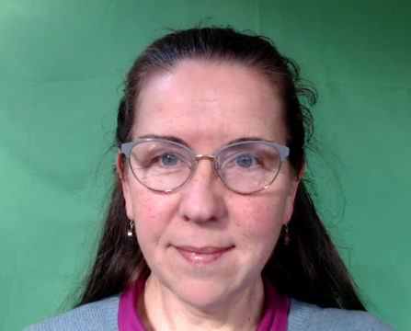

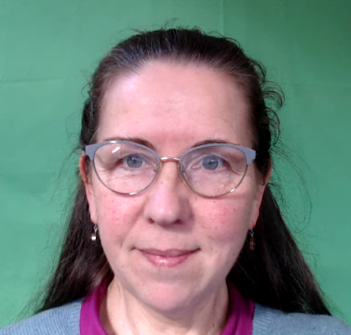
prononcer
[oi]
voir
[to see, seeing]
Notes:
Timing: 3 minutes (two slides)
Aim: to recap SSC [oi].
Procedure:
Introduce and elicit the pronunciation of the individual SSC [oi] and the source word ‘voir’.
Click to bring on the picture and get students to repeat (with gesture, if using).
Present and practise the cluster words.
Gesture:
gesture for voir
https://www.signbsl.com/sign/see (scroll down to the correct definition of ‘see’ and we recommend the 1st video of these three) – right index finger comes up to the eye and then points away from the body as if tracing the path of sight from the eyes towards an object in view.
2

Slide 3
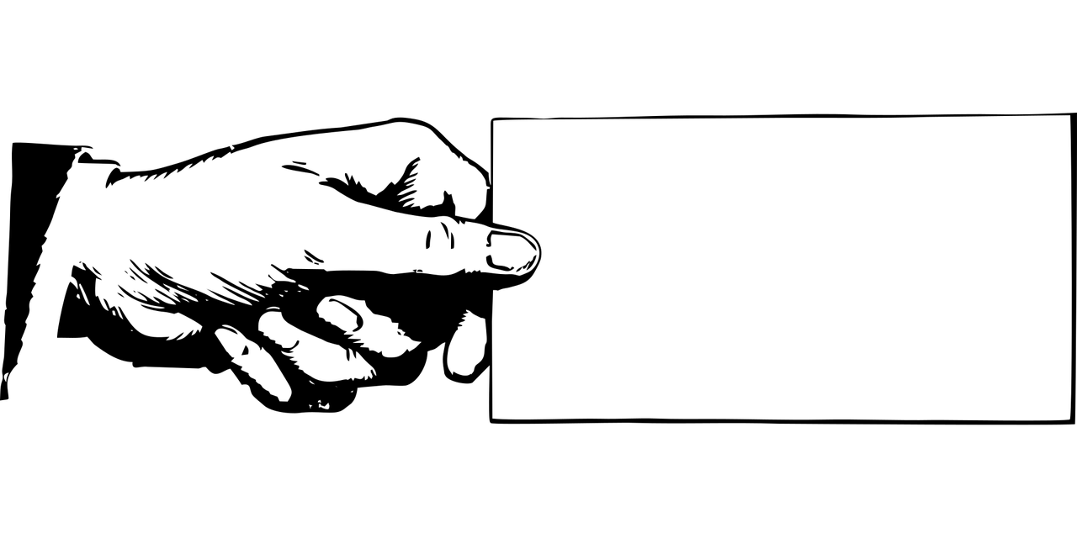

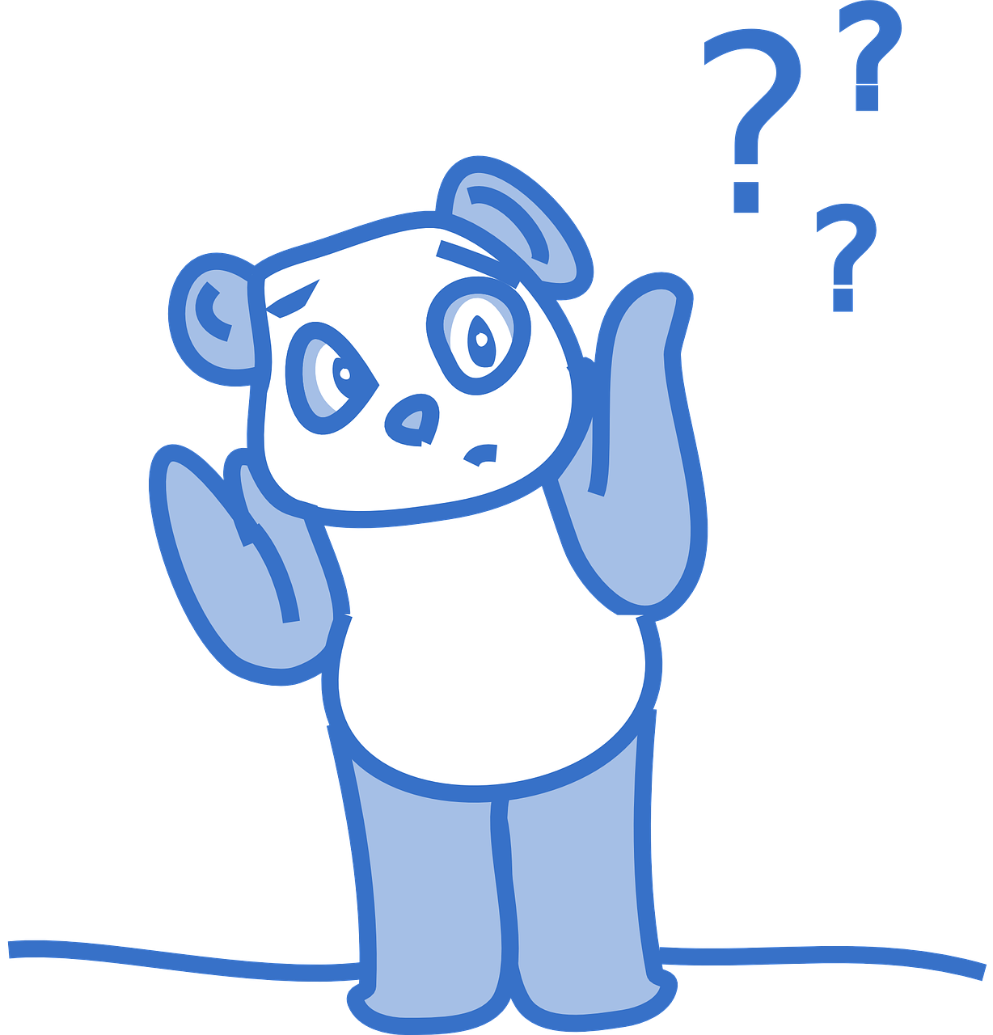

prononcer
[oi]
voir
to have, having
avoir
Au revoir !
[to see, seeing]
[why?]
trois
pourquoi ?
Notes:
Timing: 2 minutes
Aim: to recap SSC [oi].
Procedure:
Introduce and elicit the pronunciation of the individual SSC [oi] and the source word ‘voir’.
Click to bring on the picture and get students to repeat (with gesture, if using).
Present and practise the cluster words.
Gesture:
gesture for voir
https://www.signbsl.com/sign/see (scroll down to the correct definition of ‘see’ and we recommend the 1st video of these three) – right index finger comes up to the eye and then points away from the body as if tracing the path of sight from the eyes towards an object in view.
3

Slide 4


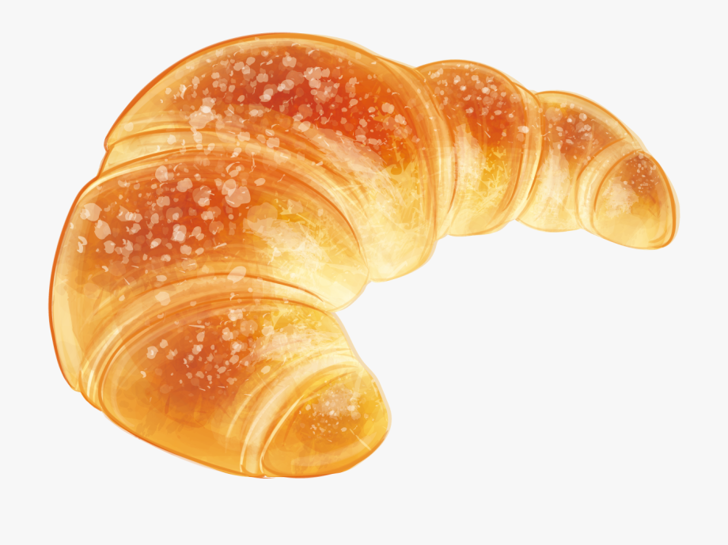
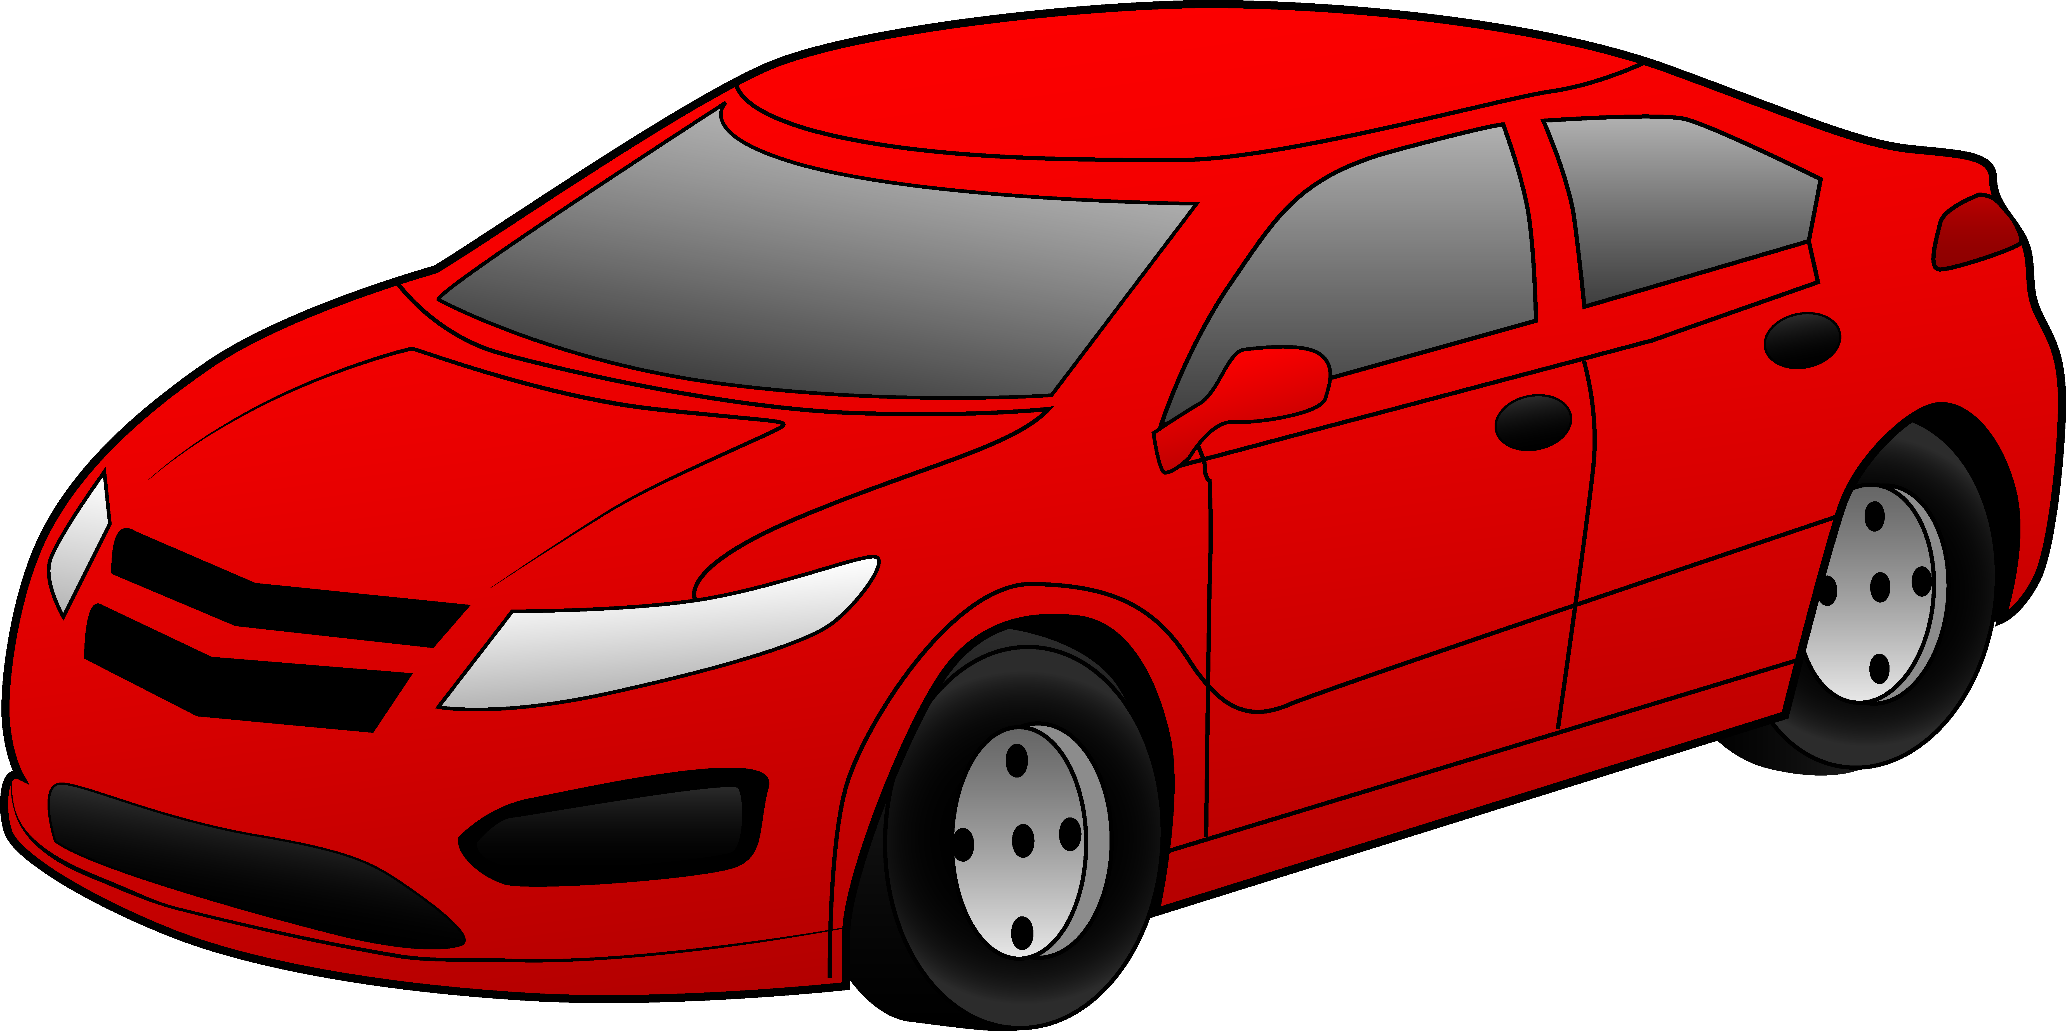

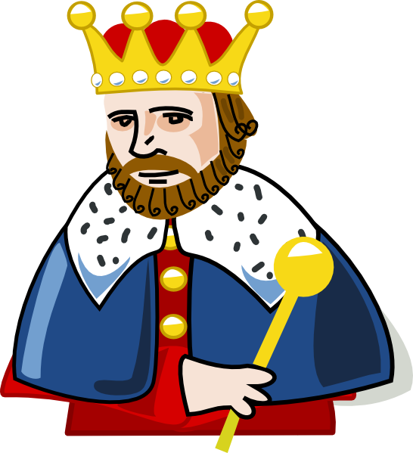
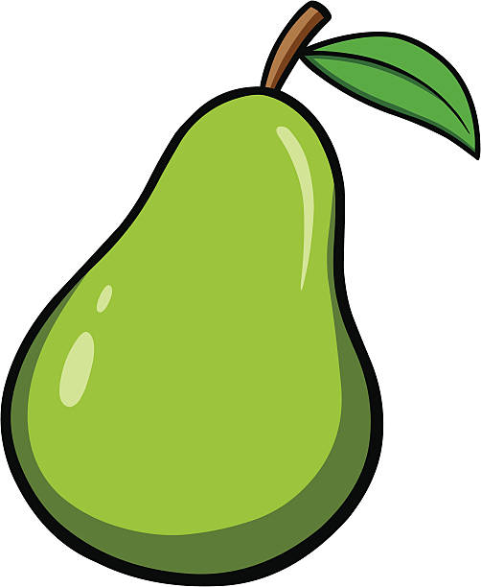



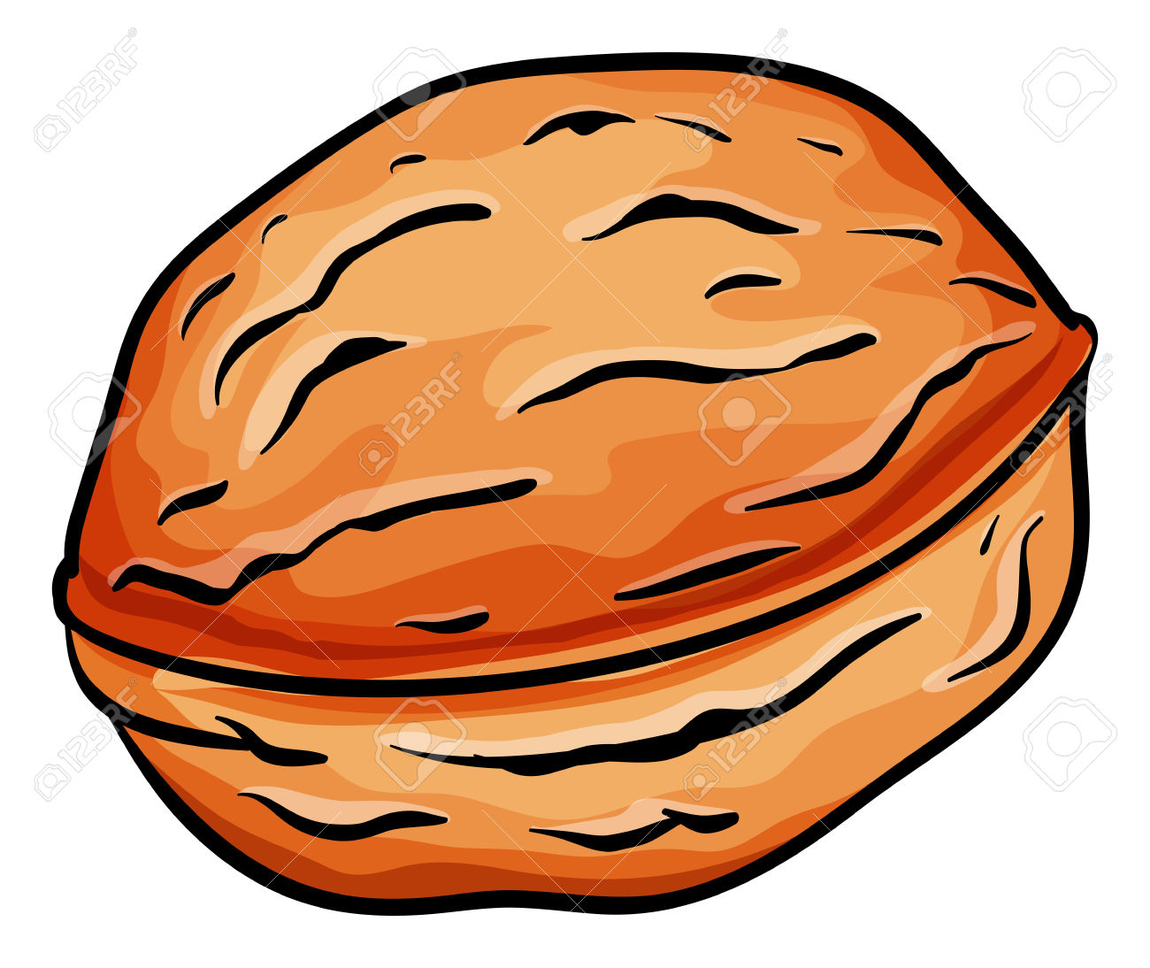
prononcer
[oi]
Parle avec ton ou ta partenaire.
un poisson | voit | trois | croissants.
 |  |  | voitures.
un roi |  |  | poires.
 |  |  | étoiles.
un oiseau |  |  | poivrons.
 |  |  | noix.
40
S
0
DÉBUT
Notes:
Timing: 3 minutes
Aim: to recap SSC [oi].
Procedure:
Pupils work in pairs. Pupil A creates an English sentence (e.g. a fish sees three nuts).
Pupil B translates the sentence into French, focusing on the pronunciation of the [oi] sound.
Pupil A listens to check pronunciation and the correct word selection.
They swap roles.
Pupils note how many sentence they can create in 40 seconds.
3 rounds of the game can be played.
In the audio version of the lesson, click on the picture to hear each word.
4

Slide 5


Il y a
⚠ Remember: un/une means a/an and one.
Remember, to say how many of something there are, use __ __ __ + number or des (some):
Il y a
Il y a un marché.
Il y a une poste.
⚠ Liaison s-, x- if the noun starts with a vowel or h-.
There is a/one market.
There is a/one post office.
Il y a huit magasins.
Il y a trois églises.
There are eight shops.
There are three churches.
Il y a des animaux.
⚠ Remember: many French nouns add –s for plural but nouns ending in –al change to –aux and nouns ending in -eau add –x, e.g., châteaux.
There are some animals.
Notes:
Timing: 2 minutes
Aim: To revisit il y a + number or + des, and plural noun formation.
Procedure:
Click through the animations to present the information.
Elicit English translations for the French examples provided.

Slide 6





écouter
Écoute. Il y a quoi ? [1/6]
Écoute la phrase et écris le nombre et l’objet en anglais. ✍.
1
Notes:
Timing: 5 minutes
Aim: to practise aural comprehension of numbers and previously taught vocabulary that we are revisiting this week.
Procedure:
Click to listen to the sentence.
Pupils write the number (in digits) and the item in English. (e.g. 13 bottles)
Click to highlight the number answer and reveal the noun.
Repeat for the follow 5 sentences.
Differentiation:
For more challenge in terms of comprehension remove the number options (or in a mixed proficiency class, some pupils can turn away from the board).
For additional transcription practice, ask pupils to transcribe the sentence and then translate it.
Transcription:
Il y a treize ponts.
6

Slide 7
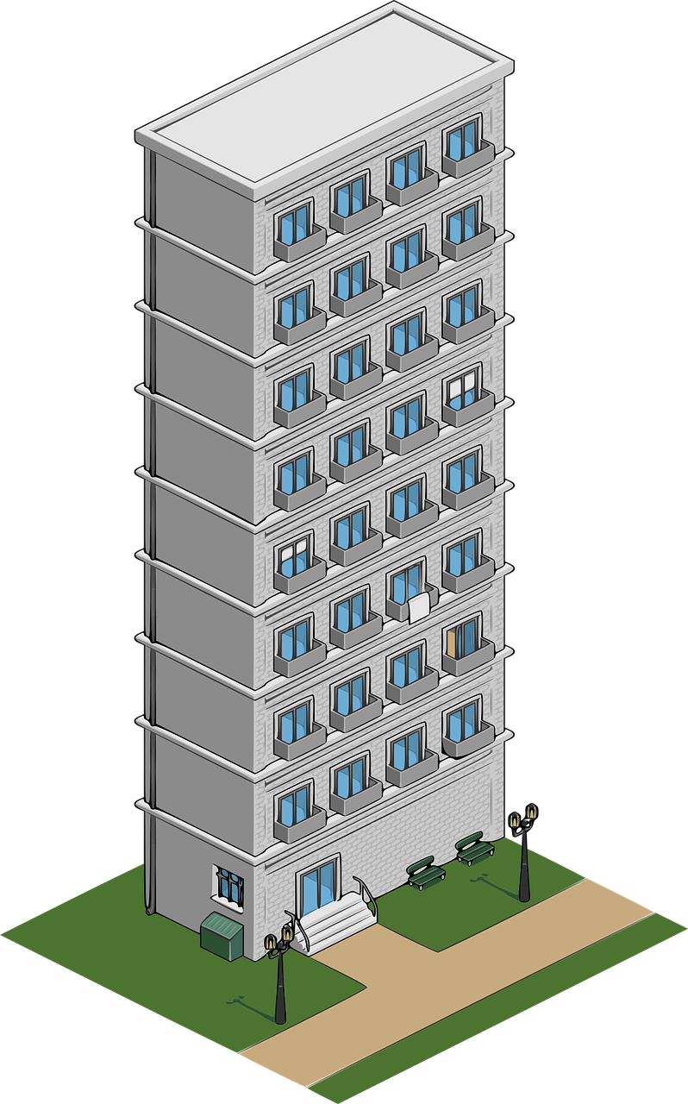




écouter
Écoute. Il y a quoi ? [2/6]
Écoute la phrase et écris le nombre et l’objet en anglais. ✍.
2
Notes:
2/6
Transcription:
Il y a des bâtiments.
7

Slide 8


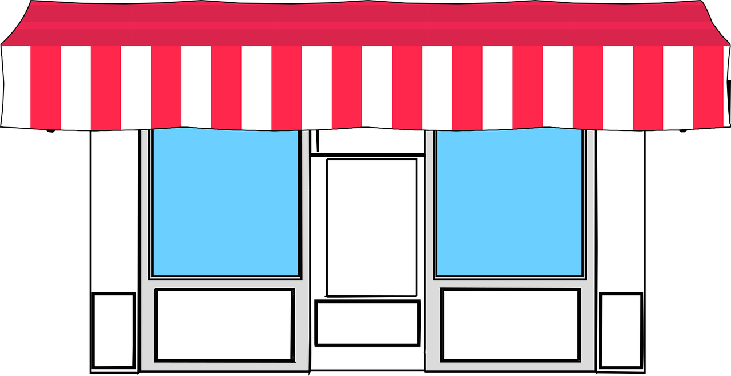


écouter
Écoute. Il y a quoi ? [3/6]
Écoute la phrase et écris le nombre et l’objet en anglais. ✍.
3
Notes:
3/6
Transcription:
Il y a quinze magasins.
8

Slide 9
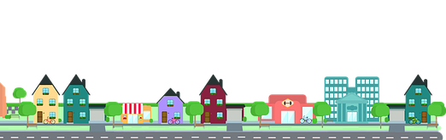




écouter
Écoute. Il y a quoi ? [4/6]
Écoute la phrase et écris le nombre et l’objet en anglais. ✍.
4
⚠ Note that vingt-et-un is vingt-et-une with feminine nouns.
Notes:
4/6
Transcription:
Il y a vingt-et-une rues.
9

Slide 10



écouter
Écoute. Il y a quoi ? [5/6]
Écoute la phrase et écris le nombre et l’objet en anglais. ✍.
5
Notes:
5/6
Transcription:
Il y a quatre cinémas.
10

Slide 11


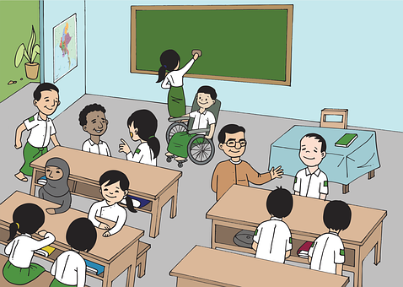
écouter
Écoute. Il y a quoi ? [6/6]
Écoute la phrase et écris le nombre et l’objet en anglais. ✍.
6
Notes:
6/6
Transcription:
Il y a dix écoles.
11

Slide 12


Il y a | Il n’y a pas de
⚠ Note that pas is always followed by de (or d’after a vowel/h’), not un/une/des.
⚠ Ne changes to n’ before a verb starting with a vowel;
‘y’ can be a vowel in French, with the same sound as [i].
Remember, to say ‘there is a/an’ or ‘there are some’, use il y a un/une or il y a des:
To say ‘there isn’t a/an’ or ‘there aren’t any’, use il n’y a pas de/d’:
Il y a une poste.
Il n’y a pas de poste.
There is a post office.
There isn’t a post office.
Il y a un parc.
Il n’y a pas de parc.
There is a parc.
There isn’t a park.
Il y a des hôtels.
Il n’y a pas d’ hôtels.
There are some hotels.
There aren’t any hotels.
Notes:
Timing: 2 minutes
Aim: to introduce il n’y a pas de.
Procedure:
Click through the animations to present the information.
Elicit English translations for the French examples provided.

Slide 13

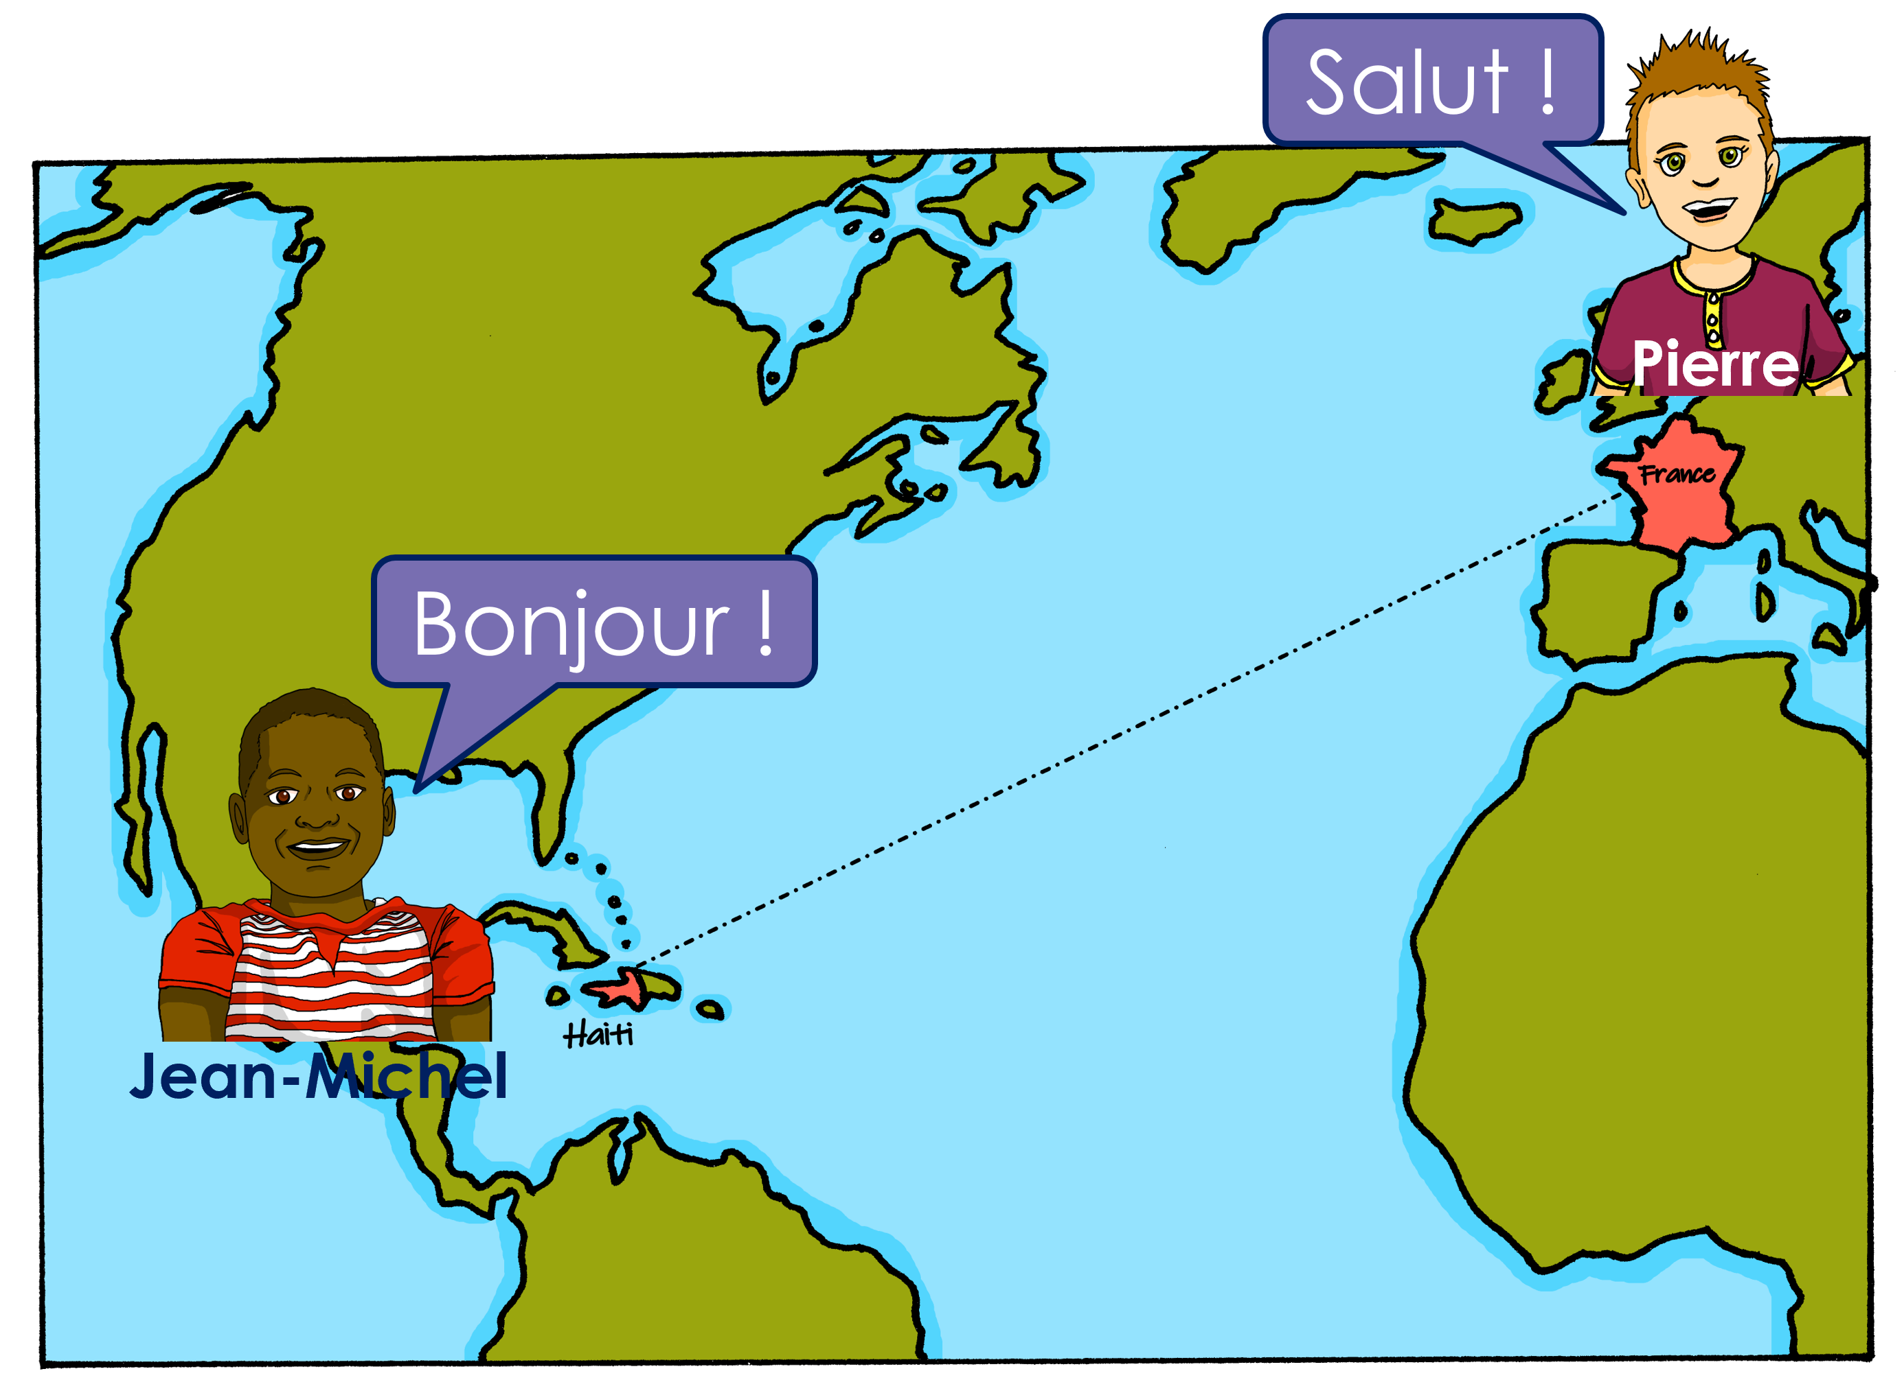
lire
Jean-Michel décrit sa* ville à Pierre mais il y a un problème avec Whatsapp !
*sa = his
Il y a quoi ? Il n’y a pas quoi ?
1
¶»ƨ†łʏΰǈǔθ des bâtiments.
Il y a des bâtiments.
2
¶»ƨ†łʏΰǈǔθ d’hôtels.
Il n’y a pas d’hôtels.
¶»ƨ†łʏΰǈǔθ des magasins.
3
Il y a des magasins.
Il y a une église.
4
¶»ƨ†łʏΰǈǔθ une église.
5
¶»ƨ†łʏΰǈǔθ de centre commercial.
Il n’y a pas de centre commercial.
6
¶»ƨ†łʏΰǈǔθ de parcs.
Il n’y a pas de parcs.
7
¶»ƨ†łʏΰǈǔθ de cinéma.
Il n’y a pas de cinéma.
8
Il y a des cafés.
¶»ƨ†łʏΰǈǔθ des cafés.
Notes:
Timing: 8 minutes
Aim: to pay attention to the form of the article for affirmative and negative sentences, and practise written distinction between simple positive and negative sentence structures.
Procedure:
Students write down 1-8.
Model number 1 with the class, so pupils are clear that they select the sentence beginning (il y a or il n’y a pas) based on the form of the article before the noun.
Click the number to listen and check the full sentence and/or click to reveal the full written sentence.
Pupils complete 2 – 8.
Teacher clicks to correct.
Give pupils a minute in pairs to make a list of what there is and isn’t in J’M’s town. Ask them to decide if anything seems odd about any of the details (e.g. there are parks).
Transcript:
Il y a des bâtiments.
Il n’y a pas d’hôtels.
Il y a des magasins.
Il y a une église.
Il n’y a pas de centre commercial.
Il n’y a pas de parcs.
Il n’y a pas de cinéma.
Il y a des cafés.
Answers:
There is/are: buildings, shops, a church, cafés.
There isn’t/are not: hotels, shopping centre, parks, cinema.

Slide 14

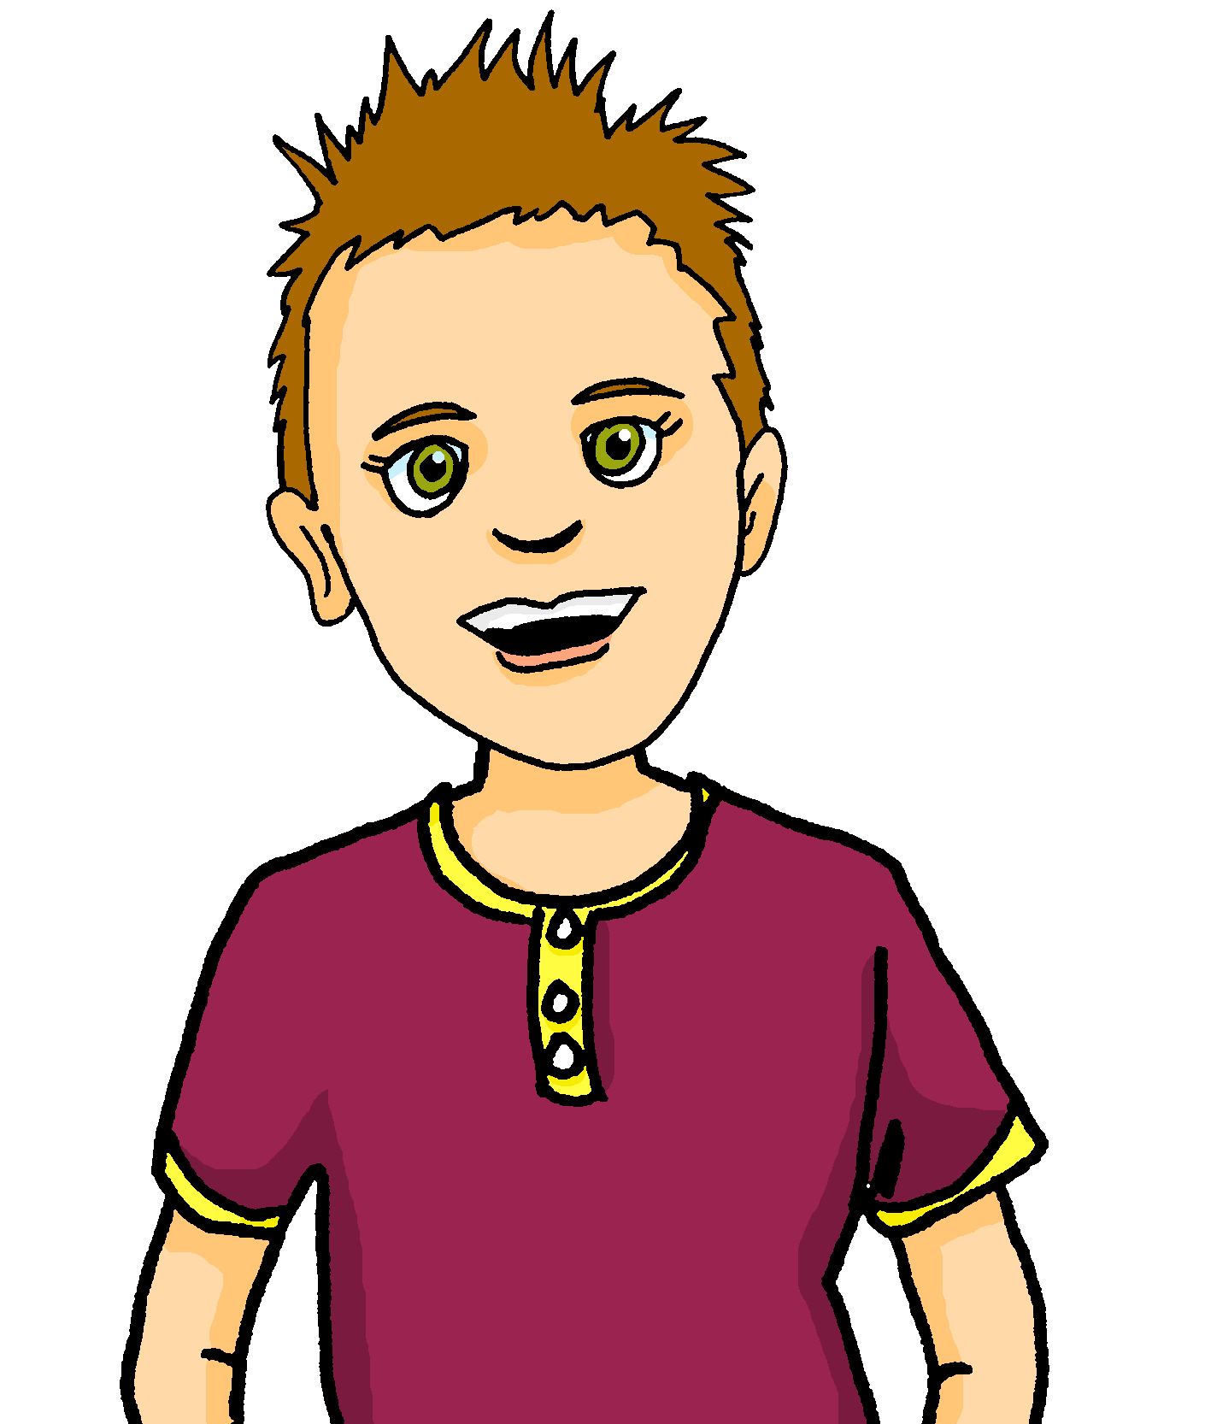
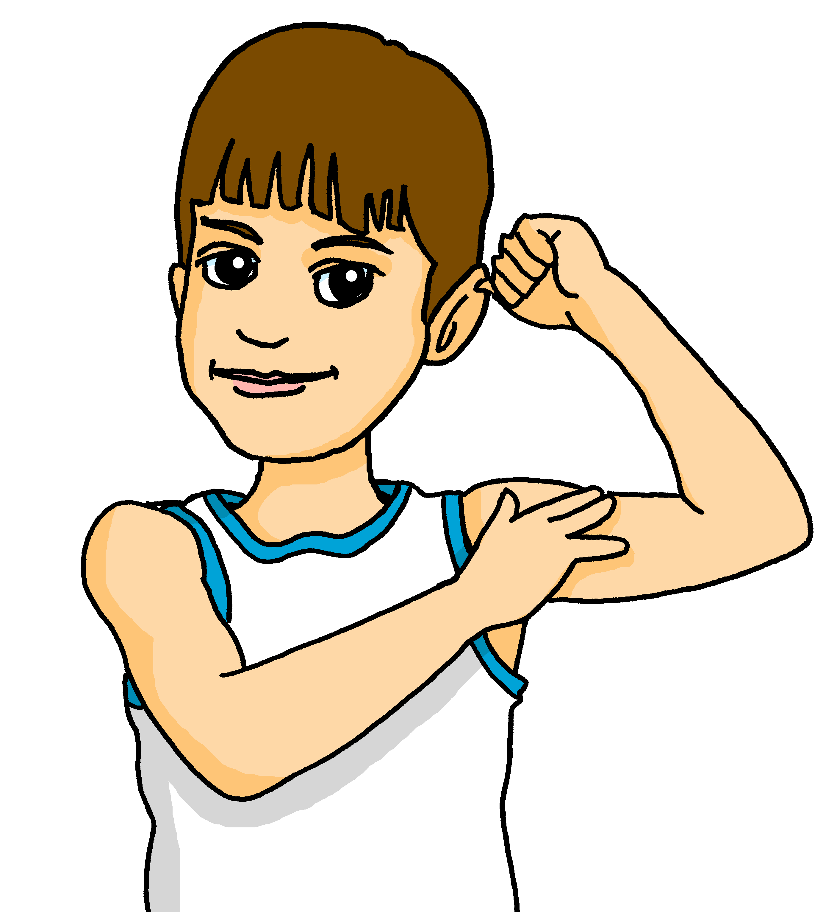
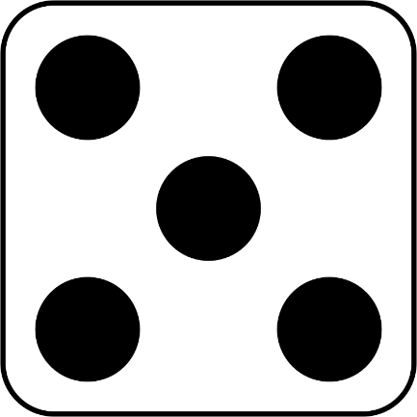
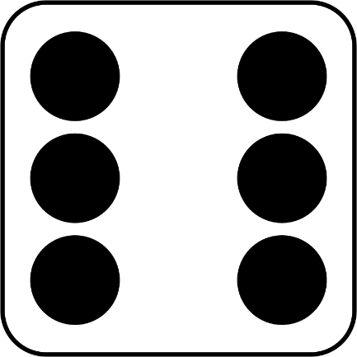
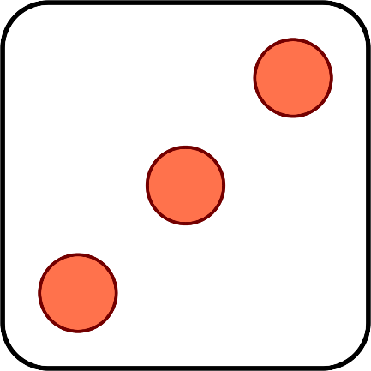
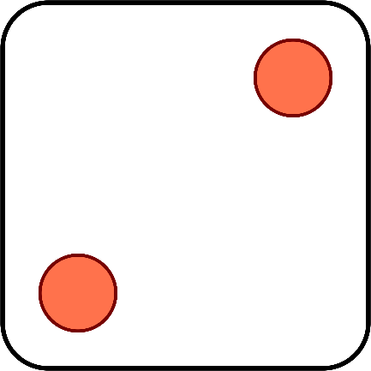
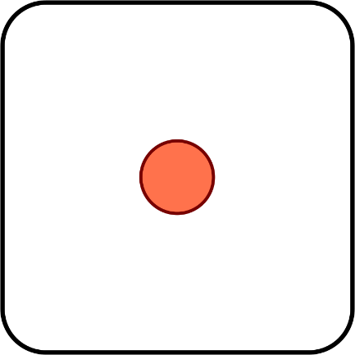
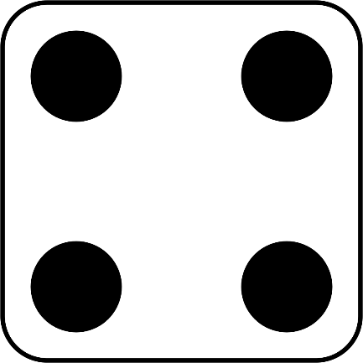
parler
Pierre et Yves inventent un jeu amusant.
Ils ont combien de points au total ? Parle en français.
quinze
seize
vingt-trois
vingt-et-un
dix-huit
quatorze
treize
dix-sept
Notes:
Timing: 2 minutes
Aim: to practise oral recall of numbers.
Procedure:
1. Click to ‘roll’ the dice for Pierre and Yves.
2. Students say the total shown on the two dice in French.
3. Click again to move on to the next number.
Word frequency of unknown words and cognates used (1 is the most frequent word in French):
point [97]
Source: Londsale, D., & Le Bras, Y. (2009). A Frequency Dictionary of French: Core vocabulary for learners London: Routledge
14

Slide 15
Au revoir !
vert
Notes:
15

