Slide 1











Saying where you are going and what there is there
Les nombres
vert
Follow ups 1-5
Notes:
Artwork by Steve Clarke. Pronoun pictures from NCELP (www.ncelp.org). All additional pictures selected from Pixabay and are available under a Creative Commons license, no attribution required.
Phonics: Revisit SSC [oi] - voir [69] avoir [8] au revoir [4/1274] pourquoi ? [193] trois [115]
and [(a)in] - train [232] fin [111] matin [442] vingt [1273] main [418]
Vocabulary (new words in bold): il y a un [3] deux [41], trois [115], quatre [253], cinq [288], six [450], sept [905], huit [877], neuf [787], dix [372], onze [2447], douze [1664] des [2] combien [800] treize [3285], quatorze [3359], quinze [1472], seize [3285], dix-sept [3812], dix-huit [3592], dix-neuf [4851], vingt [1273], vingt-et-un [1273/6/3], vingt-deux, vingt-trois, vingt-quatre, vingt-cinq, vingt-six, vingt-sept, vingt-huit, vingt-neuf, trente [1646]
Revisit 1: la lumière [1059] le soir [397]
Revisit 2: ont [8] ils [13] elles [38] bâtiment [1952] café [1886] cinéma [1623] école [477] église [1782] hôtel [1774] magasin [1738] musée [2216] parc [1240] pont [1889] poste [489] rue [598] université [1192] beau belle [393] bon bonne [94] mauvais [274] nouveau nouvelle [52] vieux vieille [671]
Londsale, D., & Le Bras, Y. (2009). A Frequency Dictionary of French: Core vocabulary for learners London: Routledge.
The frequency rankings for words that occur in this PowerPoint which have been previously introduced in these resources are given in the SOW and in the resources that first introduced and formally re-visited those words.
For any other words that occur incidentally in this PowerPoint, frequency rankings will be provided in the notes field wherever possible.

Slide 2


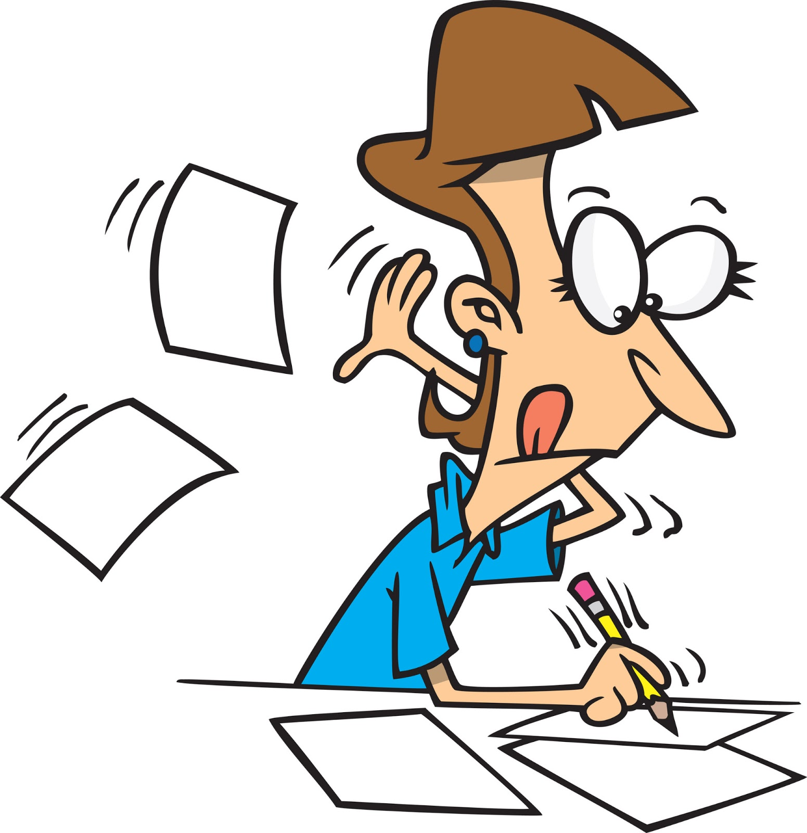


Follow up 1:
Le poète a des problèmes ! [1/6]
Écoute le poème. La rime est bonne ou mauvaise ?
prononcer
1
Je joue à Croix.
Tu joues à ________
Blois.
La rime est bonne.
La rime est mauvaise.
Notes:
Timing: 5 minutes for 6 slides
Aim: oral recognition of this week’s SSC [on] in contrast to the similar-sounding SSC [au / eau / o]
Procedure:
First, check students’ understanding of the L2 instructions. Draw attention to the near-cognates “poète” and “rime”, which have not been previously encountered. The feminine “bonne” and “mauvaise” have are for revisiting this week and were taught at the end of Term 1.
Students write 1-6 in their workbooks.
Click the number button to play the audio – the number of times may vary depending on the needs and level of the class.
Students draw a smiley face if the two lines rhyme (if the second line ends with [oi]), or a sad face if they do not (if the second line ends with [[a(i)n] – no need to transcribe the missing word. Place names are used to limit reliance on vocabulary knowledge – the focus is simply on recognising the SSC.
The slides are animated so that the smiley or sad face is highlighted first, then the missing word appears on the next click. Pronunciation can be practised at this stage.
Transcript:
Je joue à Croix. Tu joues à Blois.
Frequency for unknown words and cognates:
poète [2307], rime [>5000]
Source: Londsale, D., & Le Bras, Y. (2009). A Frequency Dictionary of French: Core vocabulary for learners London: Routledge

Slide 3
Follow up 1:
Le poète a des problèmes. [2/6]
Écoute le poème. La rime est bonne ou mauvaise ?
prononcer
2
Je danse avec Benoit.
Tu danses avec ________
Alain.
La rime est bonne.
La rime est mauvaise.
Notes:
[2/6]
Transcript:
Je danse avec Benoit. Tu danses avec Alain.

Slide 4
Follow up 1:
Le poète a des problèmes. [3/6]
Écoute le poème. La rime est bonne ou mauvaise ?
prononcer
3
J’habite à Groix.
Tu habites à ________
Carhaix.
La rime est bonne.
La rime est mauvaise.
Notes:
[3/6]
Transcript:
J’habite à Groix. Tu habites à Carhaix.

Slide 5
Follow up 1:
Le poète a des problèmes ! [4/6]
Écoute le poème. La rime est bonne ou mauvaise ?
prononcer
4
Je chante avec toi.
Tu chantes avec _____ .
moi
La rime est bonne.
La rime est mauvaise.
Notes:
[4/6]
Transcript:
Je chante avec toi . Tu chantes avec moi.

Slide 6
Follow up 1:
Le poète a des problèmes ! [5/6]
Écoute le poème. La rime est bonne ou mauvaise ?
prononcer
5
Moi, je reste chez
mon oncle Éloi.
Toi, tu restes chez
ta tante à _____ .
Foix
La rime est bonne.
La rime est mauvaise.
Notes:
[5/6]
Transcript:
Moi, je reste chez mon oncle Éloi. Toi, tu restes chez ta tante à Foix.

Slide 7
Follow up 1:
Le poète a des problèmes. [6/6]
Écoute le poème. La rime est bonne ou mauvaise ?
prononcer
6
Moi, j’arrive à Londres à seize heures trente-trois.
Toi, tu arrives à Haïti à treize heures ________.
vingt
La rime est bonne.
La rime est mauvaise.
Notes:
[6/6]
Transcript:
Moi, j’arrive à Londres à seize heures trente-trois.
Toi, tu arrives à Haïti à treize heures vingt.

Slide 8


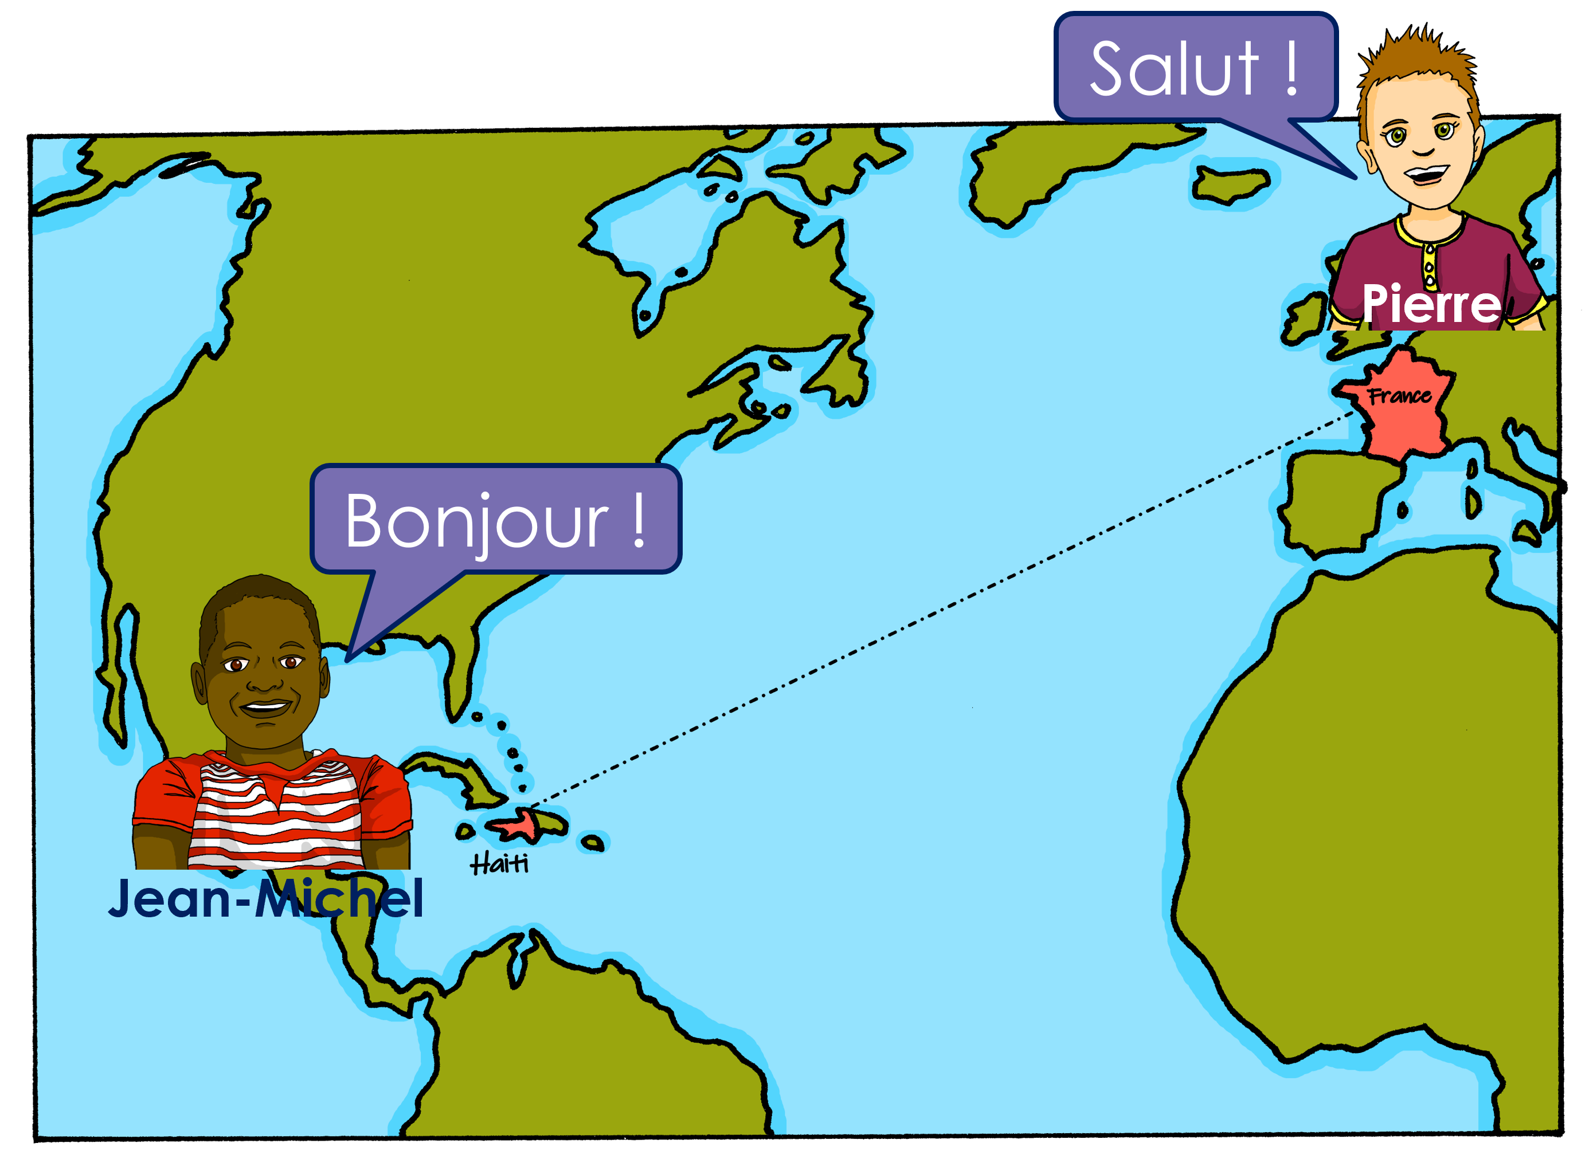

Follow up 2
Jean-Michel décrit sa ville à Pierre.
Il y a quoi ? Il n’y a pas quoi ?
écouter
 | Il y a | il n’y a pas | en anglais
1
a market
1
2
(some) animals
2
3
(any) hotels
3
4
(any) museums
4
5
(some) churches
5
6
(some) shops
6
7
(any) cinema
7
8
(any) university
8
Notes:
Timing: 5 minutes
Aim: to pay attention to the form of the article for affirmative and negative sentences, and practise aural comprehension of simple positive and negative sentences with il y a/il n’y a pas.
Procedure:
Students write down 1-8 and headings ‘il y a’ and ‘il n’y a pas’
Model number 1 with the class, so pupils are clear that they select il y a or il n’y a pas based on the form of the article before the noun. (if they hear un, une, des it is an affirmative statement, if they hear de/d’ it is a negative sentence.
Click the number to listen to the sentence ending.
Pupils tick and also write the noun in English. They might need to listen twice to do this.
Click to listen and check the full sentence and reveal the answers.
Pupils complete 2 – 8.
Teacher clicks to correct.
Transcript 1:
[Il y a] un marché.
[Il y a] des animaux.
[Il n’y a pas] d’hôtels.
[Il n’y a pas] de musées !
[Il y a] des églises.
[Il y a] des magasins.
[Il n’y a pas] de cinéma.
[Il n’y a pas] d’université.
Transcript 2:
Il y a un marché.
Il y a des animaux.
Il n’y a pas d’hôtels.
Il n’y a pas de musées !
Il y a des églises.
Il y a des magasins.
Il n’y a pas de cinéma.
Il n’y a pas d’université.
Answers:
There is/are: a post office, markets, churches, shops
There isn’t/are not: animals, teachers, chairs, green space

Slide 9


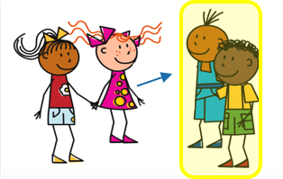
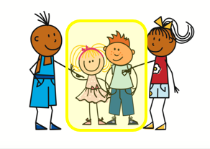
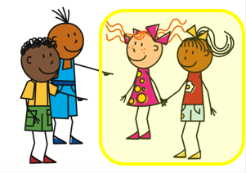
They have and they are
⚠ liaison here!
ils ont
elles ont
Remember, to mean ‘they have’ use ___ _____ or _____ _____.
ils sont
elles sont
To mean ‘they are’ use ___ _____ or _____ _____.
⚠ Remember: ‘they’ needs to match the gender of the noun it describes: they
(the churches) = elles
(les églises (fpl).
Ils ont des églises mais elles sont vieilles.
They have some churches but they are old.
⚠ ils = all male or mixed male and female group.
⚠ Adjectives match the gender and number of the noun.
vieux = m, mpl
vieille = f, vieilles = fpl
Elles ont des magasins mais ils sont vieux.
They have some shops but they are old.
⚠ elles = all female group.
Notes:
Timing: 2 minutes
Aim: to revisit ils/elles ont and ils/elles sont meanings, uses and forms of the pronouns ‘they’ and adjectival agreement.
Procedure:
Click through the animations to present the information.
Elicit English translations for the French examples provided.

Slide 10
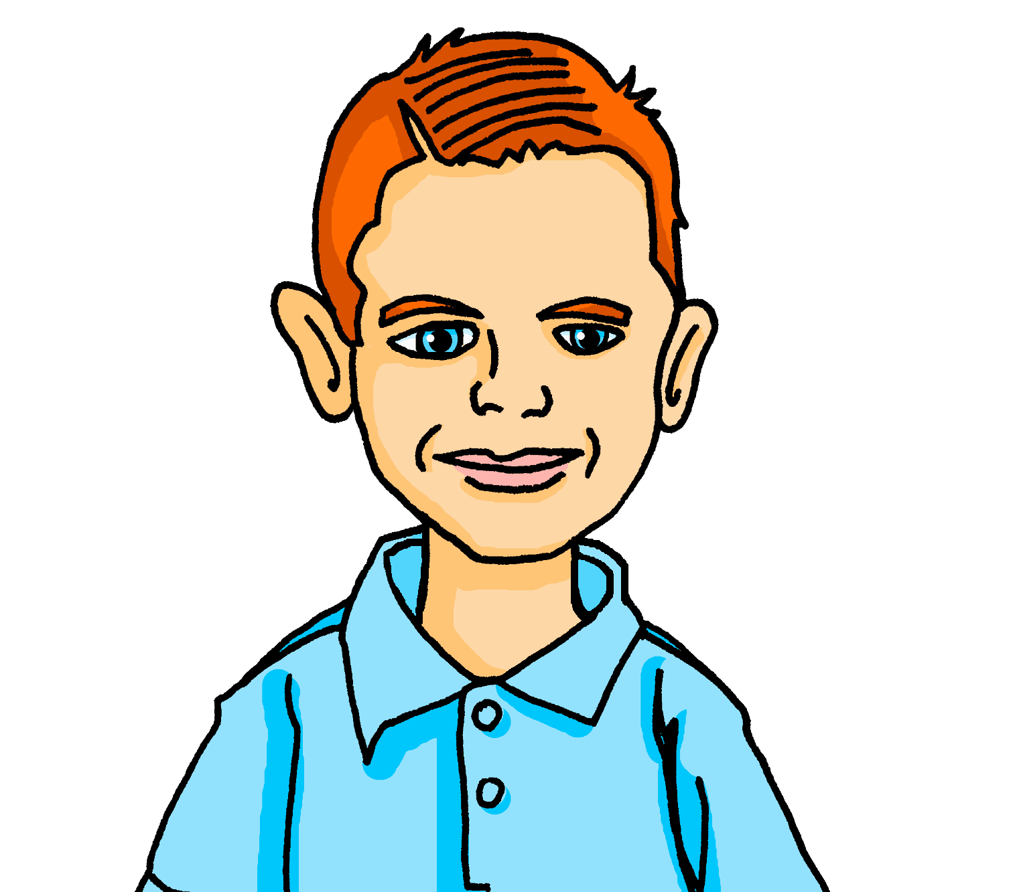



Follow up 3 Pierre parle à Max.
Pierre talks to Max about J-M’s town who makes notes for his French homework.
Oh no! He has spilt his hot chocolate and needs your help with the adjectives.
lire
beau | belle
petites | petits
nouvelles | nouveaux
grand | grande
beaux | belles
vieux | vieille
1. Ils ont un marché et il est .
They have a market and it is beautiful.
2. Ils ont des magasins mais ils sont .
They have some shops but they are small.
3. Ils ont des bâtiments et ils sont .
They have some buildings and they are new.
4. Ils ont un café et il est .
They have a café and it is big.
5. Ils ont des églises et elles sont .
They have some churches and they are beautiful.
6. Ils ont une poste mais elle est .
They have a post office but it is old.
Notes:
Timing: 5 slides
Aim: to revisit previously taught vocabulary including irregular adjectives; to practise written comprehension of longer, compound sentences.
Procedure:
Pupils read the scenario.
They write 1-6 and for each sentence they select the correct form of the adjective.
Click to listen and check, and click to reveal answers.
Give pupils two minutes in pairs to work out translations of the sentences.
Elicit the English meanings chorally from pupils and click to reveal the English translations.

Slide 11


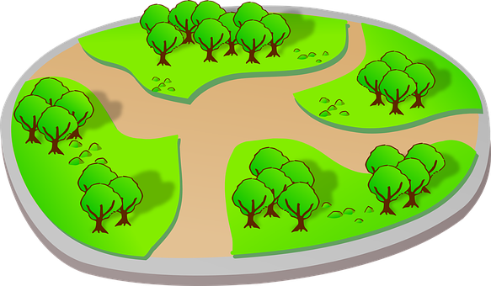
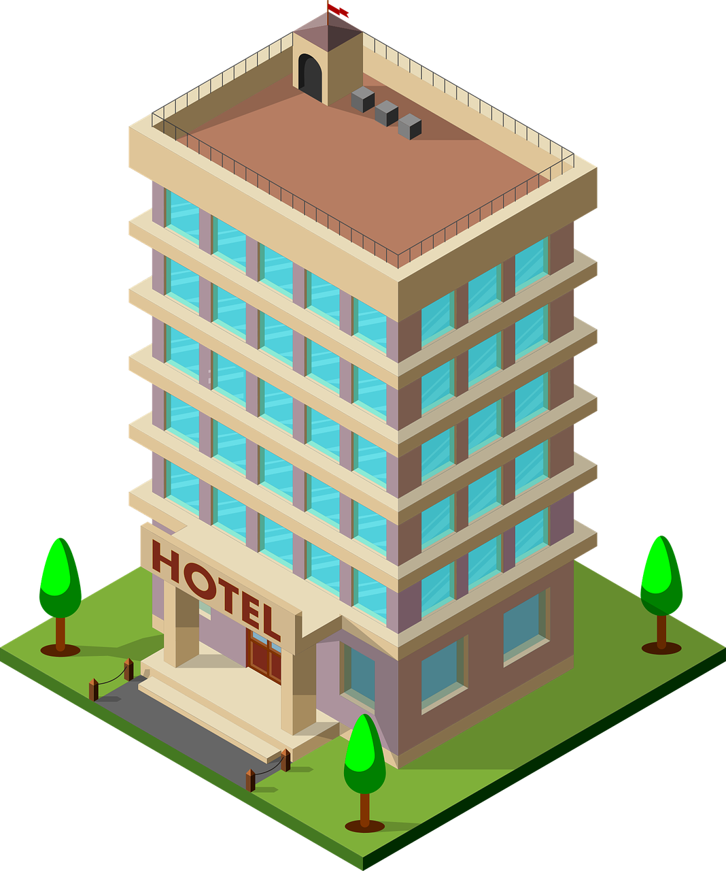
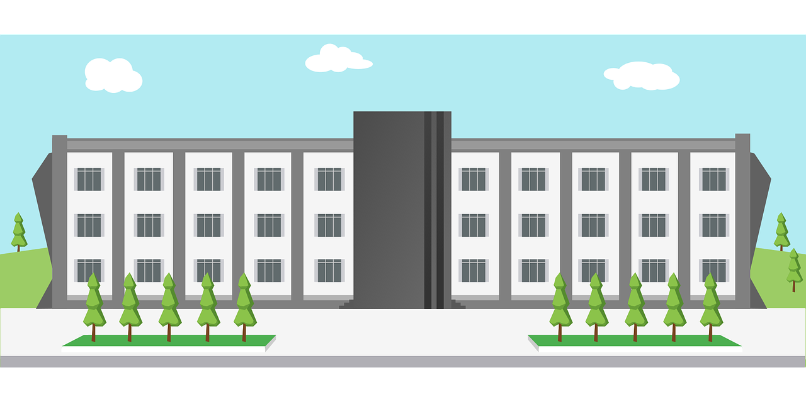


Follow up 4:
Parle avec ton/ta partenaire. C’est quelle ville ? 1/2
A: Décris la ville. B: Identifie la ville. C’est A, B ou C ?
parler
A
Bonjour tout le monde!
B
C
Bonjour tout le monde!
x 10
Bonjour tout le monde!
x 10
x 10
Notes:
Timing: 5 minutes
Aim: to practise oral production and comprehension of positive and negative statements with il y a/il n’y a pas and previously taught nouns.
Procedure:
1. Pupil A has Handout A (see end of this lesson PPT).
2. Pupil B listens to Pupil A and compares the three classroom pictures with what s/he hears.
3. B identifies the correct room (C) and teacher clicks to reveal the answer.
Note: every sentence must be listened to in order to identify the correct classroom.
4. Swap roles and move to the next slide.

Slide 12
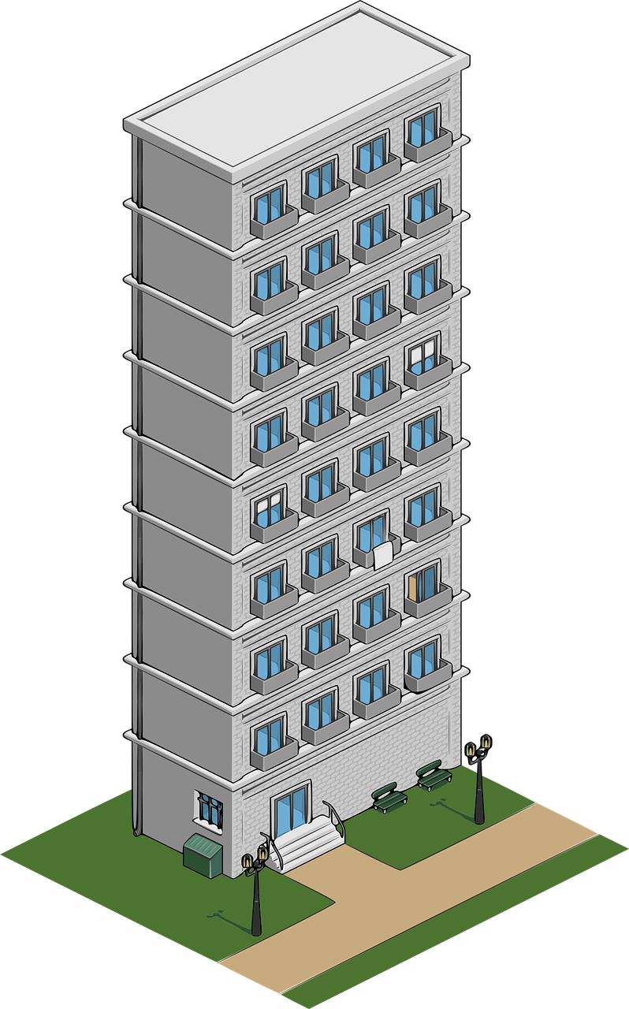

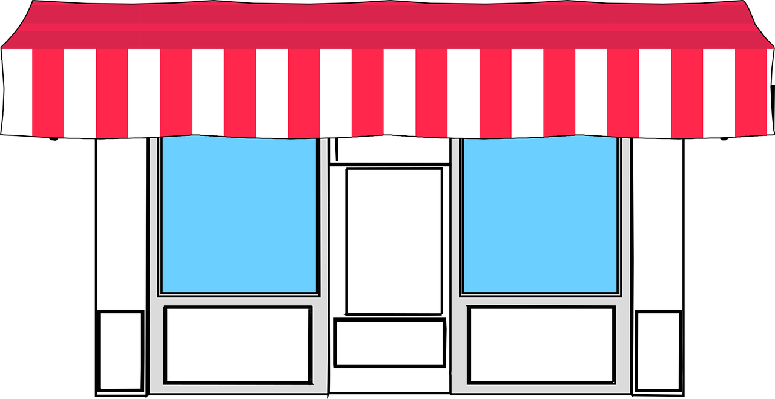
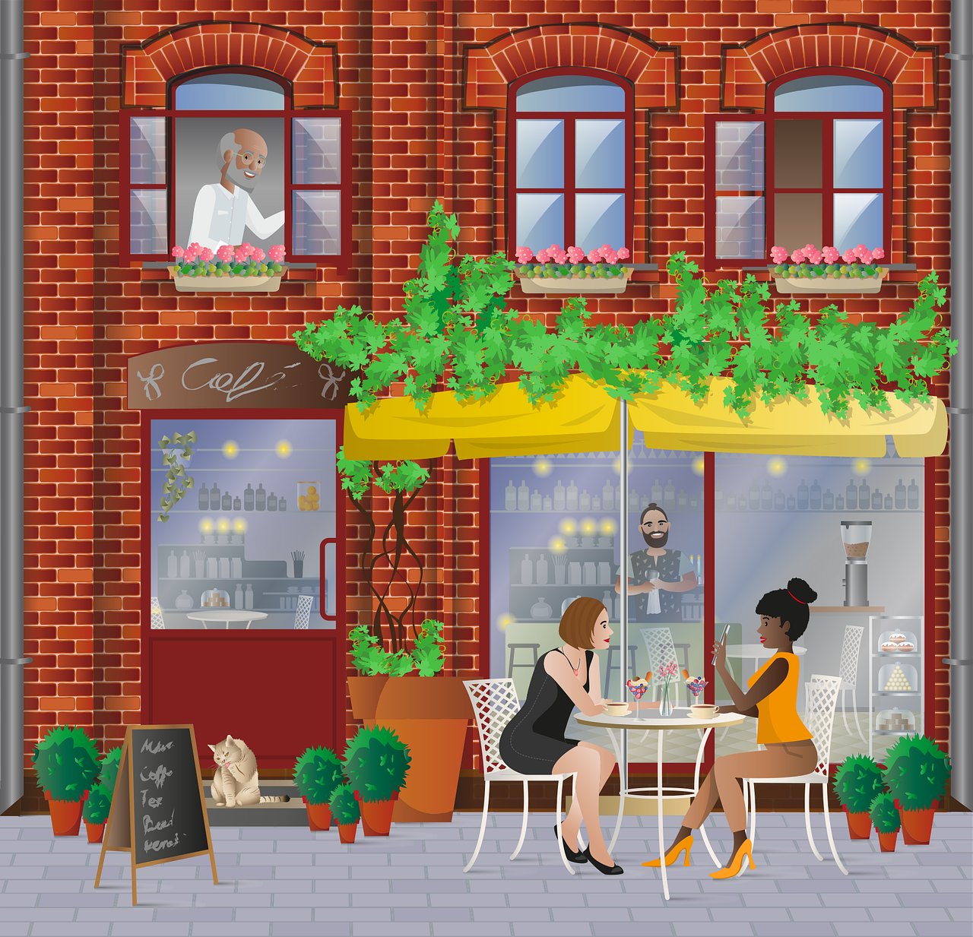
Follow up 4:
Parle avec ton/ta partenaire. C’est quelle ville ? 2/2
B: Décris la ville. A: Identifie la ville. C’est A, B ou C ?
parler
A
B
C
Il y a quoi ?
Il y a quoi ?
Il y a quoi ?
Il y a quoi ?
Il y a quoi ?
Il y a quoi ?
Il y a quoi ?
Notes:
2/2

Slide 13
Follow up 4:
Handout
Personne A: Décris une ville.
Personne B: Décris une ville.
parler
There are two churches.
There are ten hotels.
There isn’t any post office.
There isn’t a university.
There are six parks.
There are two buildings.
There are six shops.
There aren’t any cafés.
There isn’t any post office.
There are four bridges.
Il y a deux églises.
Il y a deux bâtiments.
Il y a dix hôtels.
Il y a six magasins.
Il n’y a pas de poste.
Il n’y a pas de cafés.
Il n’y a pas d’université.
Il n’y a pas de poste.
Il y a six parcs.
Il y a quatre ponts.
Notes:
Follow up 4: ANSWERS

Slide 14




vocabulaire
Follow up 5 - Écris en anglais : Can you get at least 15 points?
mots
 | nouvelle | vieux | vieille
 | nouveau | mauvais | bonne
 | bon | belle | beau
 | Ils ont | elles ont | la rue
 | le soir | la lumière | l’école
 | trente-et-un | vingt-trois | seize
 | dix-neuf | vingt-sept | quatorze
 | Il y a | des | combien
new (f)
old (m)
old (f)
x3
new (f)
old (m)
old (f)
new (m)
bad (m)
good (f)
x2
they have (m)
they have (f)
(the) street
(the) evening
(the) light
(the) school
31
23
13
19
27
14
x1
there is/there are
some
how many
Notes:
Timing: 5-10 minutes
Aim: to practise written production of vocabulary from this week and two revisited weeks.
Procedure:
1. Give pupils a blank grid. They fill in the English meanings of any of the words they know, trying to reach 15 points in total.
2. Remind pupils that adjectives can refer to male or female persons and they should note this in their translations. E.g. pleased (f), short (m).
Note:
The most recently learnt and practised words are pink, words from revisit 1 are green and those from revisit 2 are blue, thus more points are awarded for them, to recognise that memories fade and more effort (heavy lifting!) is needed to retrieve them.
14

Slide 15
vocabulaire
Follow up 5b - Écris en français : Can you get at least 15 points?
mots
 | new (f) | old (m) | old (f)
 | new (m) | bad (m) | good (f)
 | good (m) | beautiful (f) | beautiful (m)
 | (the) school | (the) light | (the) street
 | they have (f) | they have (m) | (the) evening
 | eighteen | thirty | eleven
 | fifteen | twenty-five | two
 | there is/there are | some | how many
nouvelle
vieux
vieille
x3
nouveau
mauvais
bonne
bon
belle
beau
x2
l’école
la lumière
la rue
Ils ont
elles ont
le soir
dix-huit
trente
onze
quinze
vingt-cinq
deux
x1
il y a
des
combien
Notes:
Timing: 5-10 minutes
Aim: to practise written comprehension of vocabulary from this week and previous weeks.
Procedure:
Give pupils a blank grid. They fill in the French meanings of any of the words they know, trying to reach 15 points in total.
Note:
The most recently learnt and practised words are pink, words from the previous week are green and those from earlier are blue, thus more points are awarded for them, to recognise that memories fade and more effort (heavy lifting!) is needed to retrieve them.
15

Slide 16
Follow up 4:
Handout
Personne A: Décris une ville.
Personne B: Décris une ville.
parler
There are two churches.
There are ten hotels.
There isn’t any post office.
There isn’t a university.
There are six parks.
There are two buildings.
There are six shops.
There aren’t any cafés.
There isn’t any post office.
There are four bridges.
Notes:
Follow up 4: Handout

Slide 17
vocabulaire
Follow up 5 - Écris en anglais : Can you get at least 15 points?
mots
 | nouvelle | vieux | vieille
 | nouveau | mauvais | bonne
 | bon | belle | beau
 | Ils ont | elles ont | la rue
 | le soir | la lumièere | l’école
 | trente-et-un | vingt-trois | seize
 | dix-neuf | vingt-sept | quatorze
 | Il y a | des | combien
x3
x2
x1
Notes:
HANDOUT
17

Slide 18
vocabulaire
Écris en français : Can you get at least 15 points?
mots
 | new (f) | old (m) | old (f)
 | new (m) | bad (m) | good (f)
 | good (m) | beautiful (f) | beautiful (m)
 | (the) school | (the) light | (the) street
 | they have (f) | they have (m) | (the) evening
 | eighteen | thirty | eleven
 | fifteen | twenty-five | two
 | there is/there are | some | how many
vieille
x3
bonne
x2
x1
Notes:
HANDOUT
18

