Slide 1

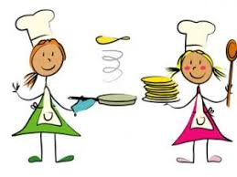

Describing me and others
vert
Negation
Est-ce que questions
SSC [é,er,ez,et], [è|ê]
Notes:
Artwork by Steve Clarke. Pronoun pictures from NCELP (www.ncelp.org). All additional pictures selected from Pixabay and are available under a
Creative Commons license, no attribution required.
Phonics
Revisit é(et, ez, er) - répéter [630] écrire [382] bébé [2271] donner [46] parler [106] et [6] nez [2661]
Revisit è / ê - fête [1490] tête [343] frère [1043] être [5] problème [188]
Vocabulary: chanter [1820] chercher [336] danser [2934] donner [46] écouter [429] manger [1338] organiser [791] préparer [368] porter [105]
regarder [425] trouver [83] utiliser [345]
Revisit 1: aimer [242] apporter [339] arriver [174] organiser [701] porter [105] préparer [368] créer [332] marcher [1532] monter [853] quitter
[507] gens [236] puis [230]
Revisit 2: avons [8] avez [8] nous [31] vous [50] bâtiment [1952] marché [280] derrière [805] devant [198] entre [55] où [48] dans [11] sur [16]
sous [122] ici [167]
Londsale, D., & Le Bras, Y. (2009). A Frequency Dictionary of French: Core vocabulary for learners London: Routledge.
The frequency rankings for words that occur in this PowerPoint which have been previously introduced in these resources are given in the SOW
and in the resources that first introduced and formally re-visited those words.
For any other words that occur incidentally in this PowerPoint, frequency rankings will be provided in the notes field wherever possible.
1

Slide 2





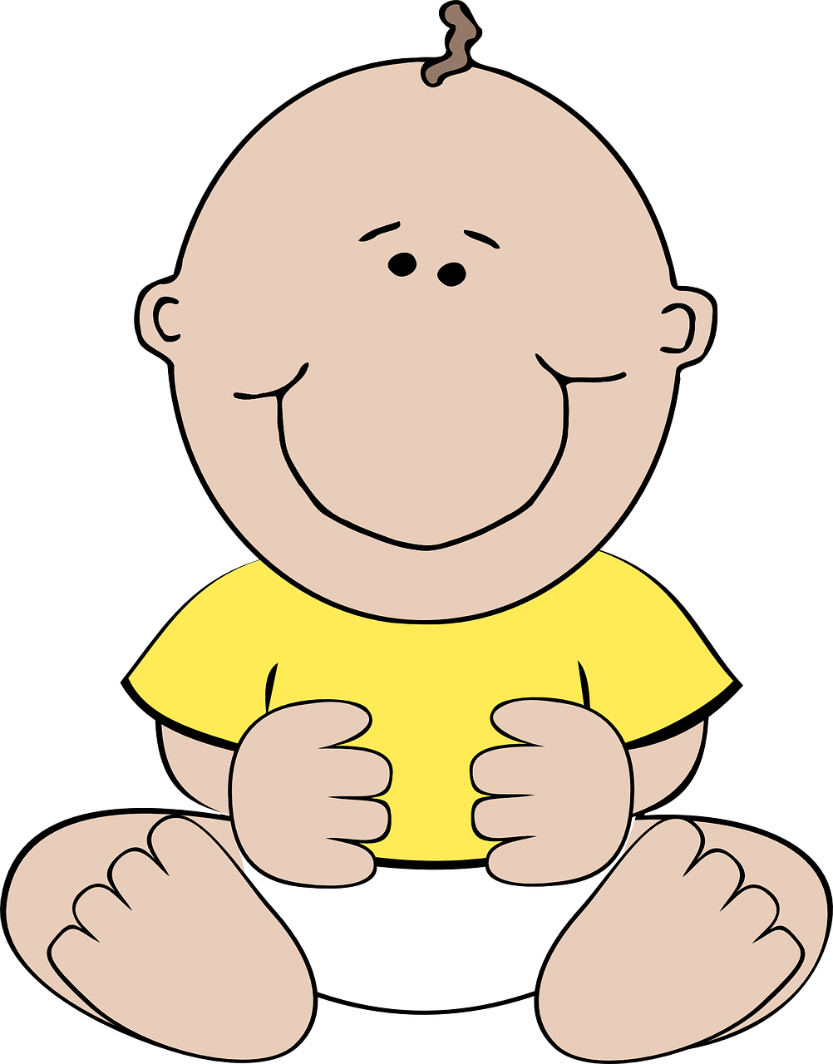
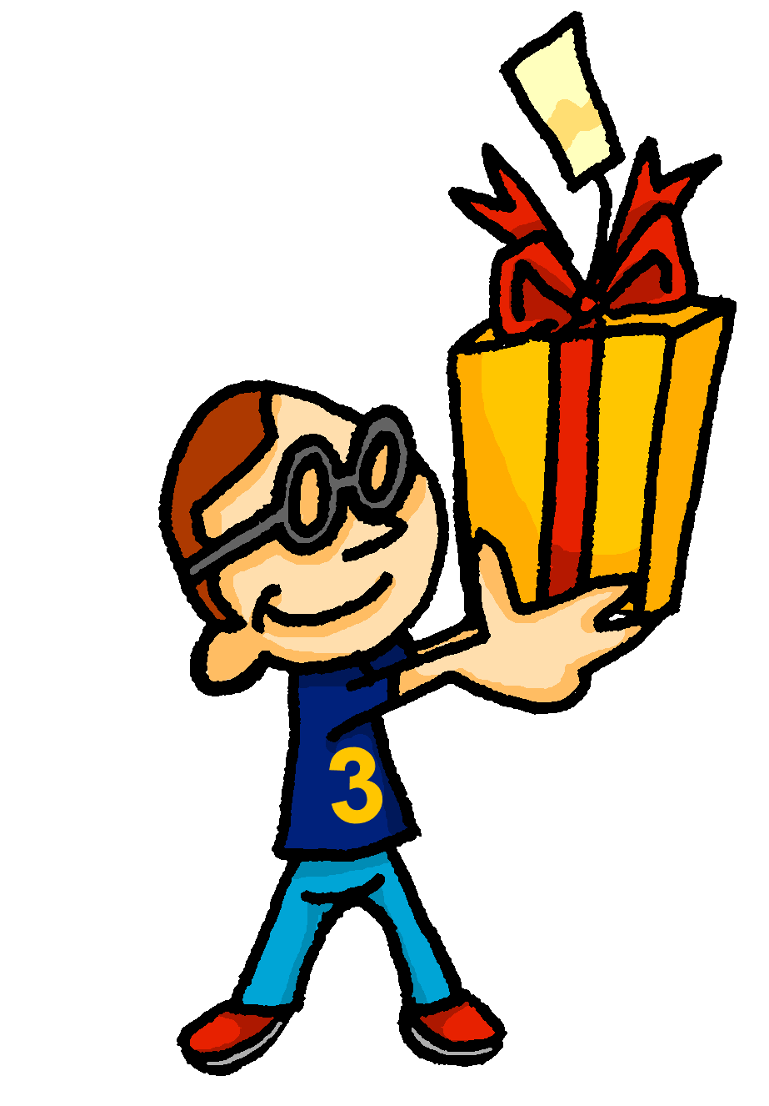

prononcer
[é]
[er]
[et]
[ez]
Remember that
[é], [er],[et] and [ez] sound the same.
répéter
[and]
écrire
parler
et
bébé
donner
nez
[to give]
Notes:
Timing: 2 minutes
Aim: to recap SSC [é] [er] [et] [ez], which are the same sound written differently.
Procedure:
Introduce and elicit the pronunciation of the individual SSC [é, et, et, ez] and the source word ‘répéter’, which has both spellings of the sound.
Click to bring on the picture and get students to repeat (with gesture, if using).
Present and practise the cluster words.
Gesture:
gesture for répéter – hand with thumb and two fingers pointing forwards doing a three downwards motions, one for each syllable of the word.
https://www.signbsl.com/sign/repeat (the 2nd video marked again: repeat with the female signer)
2

Slide 3
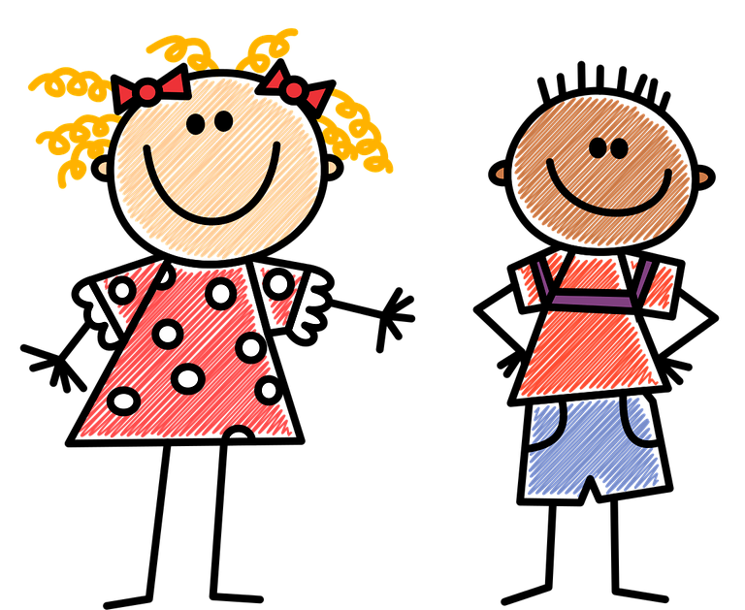


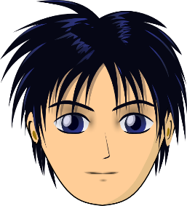

prononcer
[è|ê]
[è] and [ê]
sound almost the same. [ê] is a little longer and deeper.
to be, being
fête
être
frère
(brother)
(party, celebration)
tête
problème
(head)
Notes:
Timing: 2 minutes
Aim: to recap SSC [è] and [ê] which are almost the same sound.
Procedure:
Introduce and elicit the pronunciation of the individual SSC [è] and the source word ‘xxx’, which has both spellings of the sound.
Click to bring on the picture and get students to repeat (with gesture, if using).
Present and practise the cluster words.
Gesture:
gesture for fête: raise both hands in the air (middle three fingers facing down in a partial fist, with thumb and pinkie facing upwards) and move up and down alternate left and right to suggest a celebration-style dance.
Source: https://www.signbsl.com/sign/party (the 3rd video from the right is the best one, in my view)
3

Slide 4
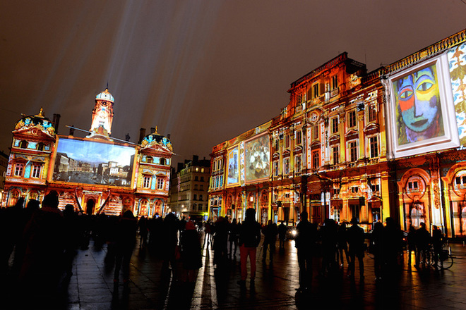

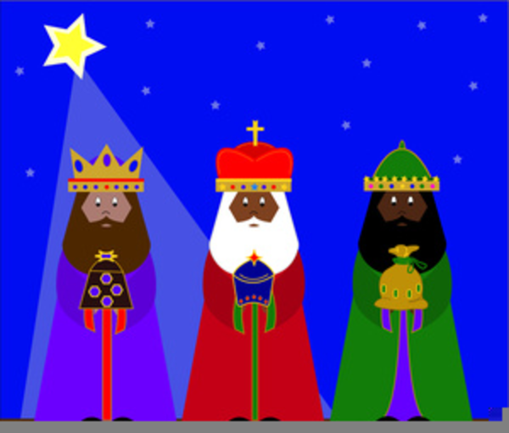
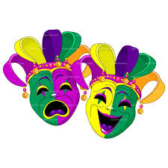

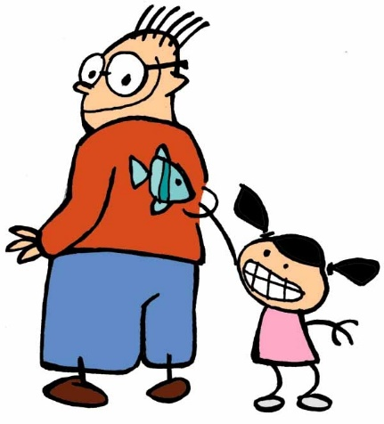



prononcer
Les fêtes en France
[è|ê] ou [é|er]
Écoute et écris les mots en français. Puis, prononce le texte.
En [1] décembre, la Fête des [2] Lumières a lieu à Lyon. Le six [3] janvier, c’est la [4] Fête des Rois. Au Mardi Gras les gens portent des [5] vêtements multicolores. En [6] février la Fête des fruits a lieu à Nice. Le [7] premier avril, tout le monde [8] crée des poissons en [9] papier. La [10] Fête Nationale c’est le 14 [11] juillet. En novembre le jour de l’Armistice [12] commémore les soldats.
________
_______
______
___
_________
_____
_____
___
_____
___
_____
___________
a lieu – takes place
Notes:
Timing: 8 minutes
Aim: to consolidate SSC [è|ê] and [é|er].
Procedure:
Tell pupils that all of the missing words have either the SSC [è|ê] or [é|er] and that there some words they have met before and a few words they don’t know. They should just listen and have a go at writing down what they hear.
Pupils number 1 – 12 in their books.
Click to listen to each sentence. Pupils write the missing words (or just SSC letters – see below).
They may need to listen to each sentence several times.
Click to reveal and check answers.
Teachers elicit pupils’ understanding of the text (Note that there are resources about the Fête des Rois and the Fête des fruits in Y3/4 lessons, plus the Fête des Lumières from last week so the contexts may be familiar to them).
If time allows, pupils can read the text aloud again in pairs.
Differentiation:
For learners who need more support, just the SSC letters can be gapped, instead.
Frequency:
avoir lieu [n/a] commémorer [>5000] multicolore [>5000] papier [951] poisson [1616] vêtement [2383]
Source: Londsale, D., & Le Bras, Y. (2009). A Frequency Dictionary of French: Core vocabulary for learners London: Routledge.
4

Slide 5



vocabulaire
Vocabulaire
mots
5
S
chercher
trouver
0
DÉBUT
Notes:
[1/3]
Aim: to practise spoken recall of previously taught vocabulary
Procedure:
1. Click for two picture prompts.
2. Start the 5 second timer.
3. Pupils say the words to a partner.
4. Teacher elicits the two words chorally from pupils.
5. Click to confirm the written answers.
6. Continue for the next two slides.
5

Slide 6


vocabulaire
Vocabulaire
mots
5
S
donner
utiliser
0
DÉBUT
Notes:
[2/3]
6

Slide 7


vocabulaire
Vocabulaire
mots
5
S
aimer
détester
0
DÉBUT
Notes:
[3/3]
7

Slide 8


vocabulaire
Vocabulaire
mots
5
S
chanter
danser
0
DÉBUT
Notes:
[4/4]
Note: danser is a new verb for this week but is the only new item of vocabulary this week and is a cognate, so introduced here.
8

Slide 9




Making sentences negative
ne…pas
⚠ Ne changes to n’ before a verb starting with a vowel (or a silent h).
For example: je n’aime pas [I don’t like]
In English…
In French…
I speak.
I don’t speak.
Je parle.
Je ne parle pas.
…add don’t before the verb to make the sentence negative.
…add ne before the verb and pas after the verb to make the sentence negative.
Notes:
Timing: 2 minutes
Aim: Introduce ne…pas negation with single-verb structures and draw attention to differences between French and English negation structure
Procedure:
Click through the animations to present the information.
Elicit English translations for the French examples provided.

Slide 10


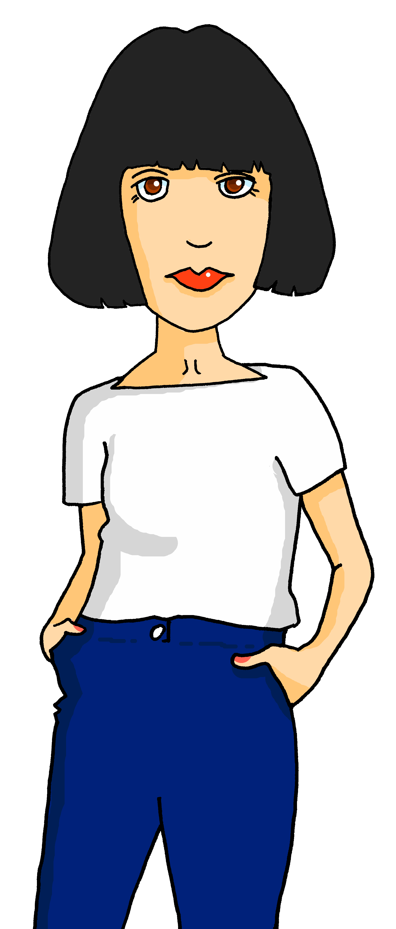


lire
La Chandeleur
Les phrases sont négatives ou positives ?
1
Elle ne prépare pas
Elle donne
5
2
Elle ne trouve pas
Elle ne trouve pas
6
3
Elle n’ aime pas
Elle n’ est pas contente !
7
4
Elle utilise
Le deux février, c’est la Chandeleur et la mère d’Adèle prépare des crêpes. C’est la tradition. Elle cherche la recette pour les crêpes mais où est la recette ?! Elle déteste les crêpes mais Adèle et Pierre adorent les crêpes. Elle organise des ingrédients. Elle utilse des œufs. Elle prépare des crêpes. Elle donne une crêpe à Pierre. Bon appétit, Pierre ! Mais où est Adèle ?! ☹
Notes:
THIS IS THE MORE CHALLENGING VERSION
Timing: 5 minutes
Aim: to pay attention to the position of ne..pas and practise written distinction between simple positive and negative sentence structures, using the previous text about La Chandeleur as the source of information.
Differentiation: note that there is a simpler version of this task on the next slide. There are picture prompts with ticks and crosses for each sentence to indicate positive and negative.
Procedure:
Students write down 1-7. Ensure that pupils know that all the sentence items are asking about Claudine (she-elle).
Using the text as a prompt, students decide for each and they write either ne/n’… pas OR (–), meaning the splodges are hiding nothing.
Click to highlight the text where each answer is. Answers splodges disappear one by one on clicks.
Teachers can elicit the answers from students in French by asking e.g. ‘Est-ce que Claudine prépare ?’ → students reply yes or no.
Note: in the audio version the verb phrases are attached to the 2nd disappearing splodge in each sentence. To hear the full text click on the purple text box.

Slide 11
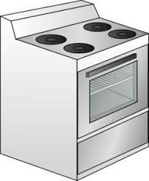
lire
La Chandeleur
Les phrases sont négatives ou positives ?
1
Elle ne prépare pas
Elle donne
5
2
Elle ne trouve pas
Elle ne trouve pas
6
3
Elle n’ aime pas
Elle n’ est pas contente !
7
4
Elle utilise
Notes:
THIS IS THE MORE SUPPORTED VERSION
Timing: 5 minutes
Aim: to pay attention to the position of ne..pas and practise written distinction between simple positive and negative sentence structures, using the previous text about La Chandeleur as the source of information.
Differentiation: this is an more supported version of the task for lower proficiency learners.
Procedure:
Students write down 1-7. Ensure that pupils know that all the sentence items are asking about Claudine (she-elle).
Using the pictures and ticks/crosses as a prompt, students decide for each and they write either ne/n’…pas OR (–), meaning the splodges are hiding nothing.
Answers splodges disappear one by one on clicks.
Teachers can elicit the answers from students in French by asking e.g. ‘Est-ce que Claudine prépare?’ → students reply yes or no.

Slide 12

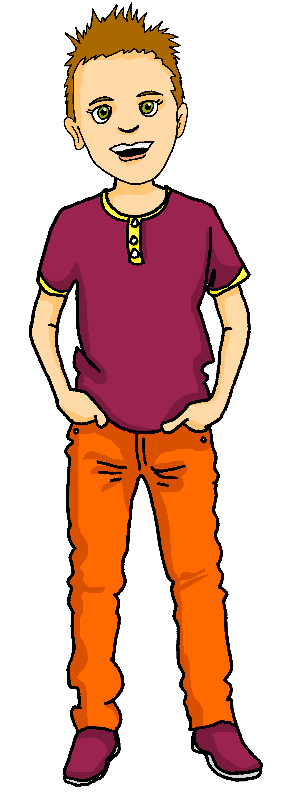

écouter
Écoute.
Pierre likes festivals, but there are some activities he doesn’t do.
What does Adèle say? Does he do or not do each activity?
 |  | Écris en anglais
 |  | He doesn’t sing.
 |  | He doesn’t create decorations.
 |  | He doesn’t dance.
 |  | He eats specialities.
 |  | He listens to songs.
 |  | He doesn’t prepare crepes.
 |  | He watches shows.
Ex
1
2
3
4
5
6
Notes:
Timing: 5 minutes
Aim: to practise aural distinction of positive and negative sentences in the 1st person present; to practise comprehension of several previously taught verbs.
Procedure:
1. Ensure pupils are clear about the task.
2. Click to play the example. Ask pupils to either tick or cross. Click to listen again. This time pupils write down the English meaning.
3. Click to reveal the answers.
4. Continue with items 1-7.
Transcript:
Il ne chante pas.
Il ne crée pas des décorations.
Il ne danse pas.
Il mange des specialités.
Il écoute des chansons.
Il ne prépare pas des crêpes.
Il regarde des spectacles.
12

Slide 13



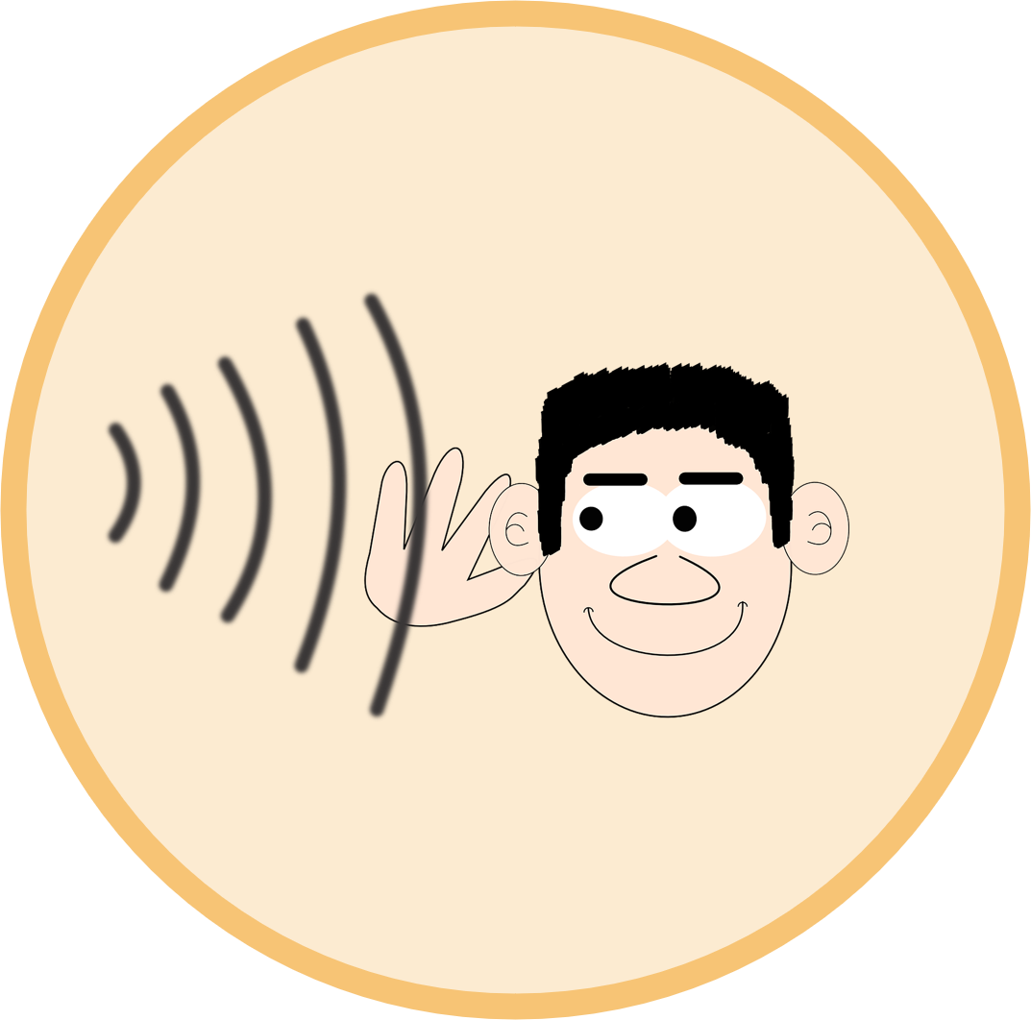

parler
Lis la description et trouve l’image.
lire
C’est vrai ? Ce n’est pas vrai ?
1
Je chante.
C’est vrai !
5
Je regarde.
Ce n’est pas vrai !
Ce n’est pas vrai !
2
Je mange.
6
J’écoute.
C’est vrai !
Ce n’est pas vrai !
7
Je joue.
Ce n’est pas vrai !
3
Je prononce.
8
Je prépare.
Ce n’est pas vrai !
4
Je danse.
C’est vrai !
Notes:
Timing: 5 minutes
Aim: to practise written comprehension of a variety of short verb phrases, and respond orally as to their correct/incorrectness, using c’est vrai and ce n’est pas vrai.
Procedure:
Teacher to draw attention to the fact that vrai comes after pas – i.e. ne and pas always surround the verb, and pas is not necessarily the last thing in the sentence.
Teacher elicits responses (That’s true, That isn’t true) by making a statement about each picture. E.g., je chante.
Students respond orally, using c’est vrai or ce n’est pas vrai only at this stage. Answers appear on clicks.
Note: in the follow ups this week, pupils will use these same prompts to practise writing simple negative sentences.
13

Slide 14
Au revoir !
vert
Notes:
14

