Slide 1
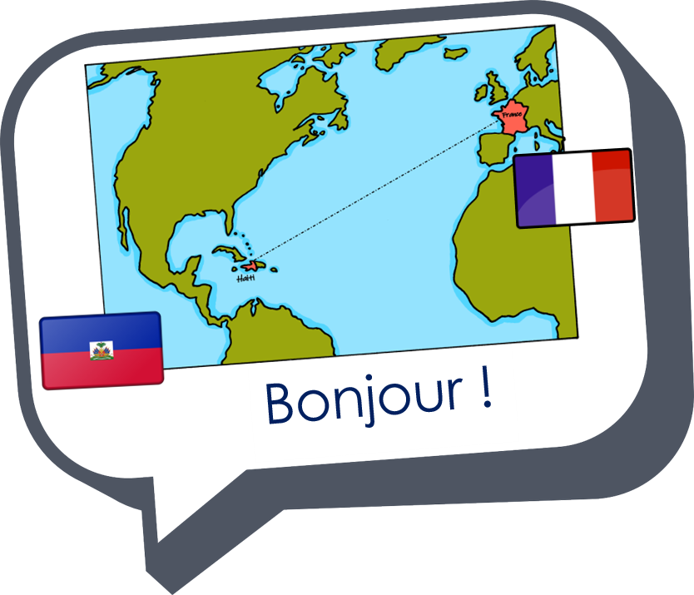
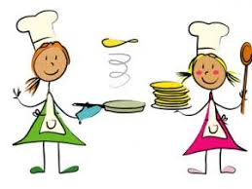

Describing me and others
vert
Follow ups 1-5
Notes:
Artwork by Steve Clarke. Pronoun pictures from NCELP (www.ncelp.org). All additional pictures selected from Pixabay and are available under a
Creative Commons license, no attribution required.
Phonics
Revisit é(et, ez, er) - répéter [630] écrire [382] bébé [2271] donner [46] parler [106] et [6] nez [2661]
Revisit è / ê - fête [1490] tête [343] frère [1043] être [5] problème [188]
Vocabulary: chanter [1820] chercher [336] danser [2934] donner [46] écouter [429] manger [1338] organiser [791] préparer [368] porter [105]
regarder [425] trouver [83] utiliser [345]
Revisit 1: aimer [242] apporter [339] arriver [174] organiser [701] porter [105] préparer [368] créer [332] marcher [1532] monter [853] quitter
[507] gens [236] puis [230]
Revisit 2: avons [8] avez [8] nous [31] vous [50] bâtiment [1952] marché [280] derrière [805] devant [198] entre [55] où [48] dans [11] sur [16]
sous [122] ici [167]
Londsale, D., & Le Bras, Y. (2009). A Frequency Dictionary of French: Core vocabulary for learners London: Routledge.
The frequency rankings for words that occur in this PowerPoint which have been previously introduced in these resources are given in the SOW
and in the resources that first introduced and formally re-visited those words.
For any other words that occur incidentally in this PowerPoint, frequency rankings will be provided in the notes field wherever possible.

Slide 2





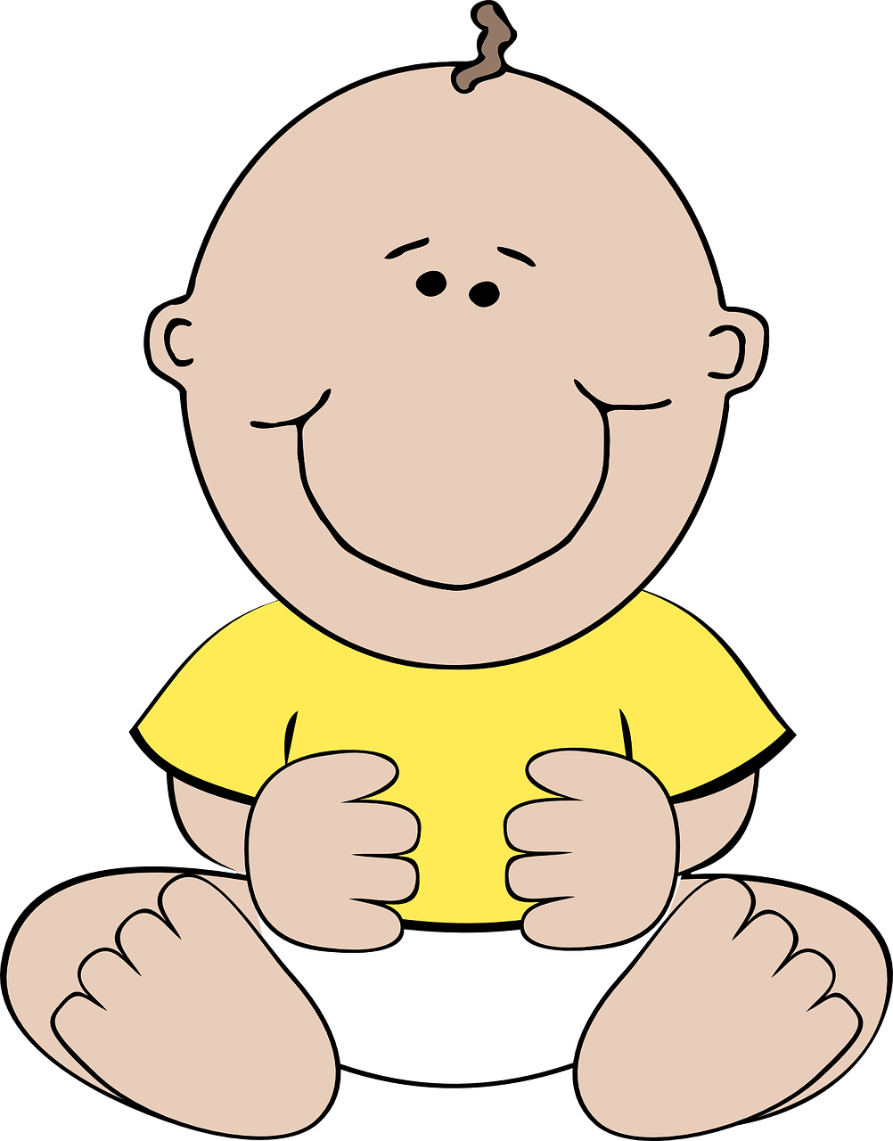
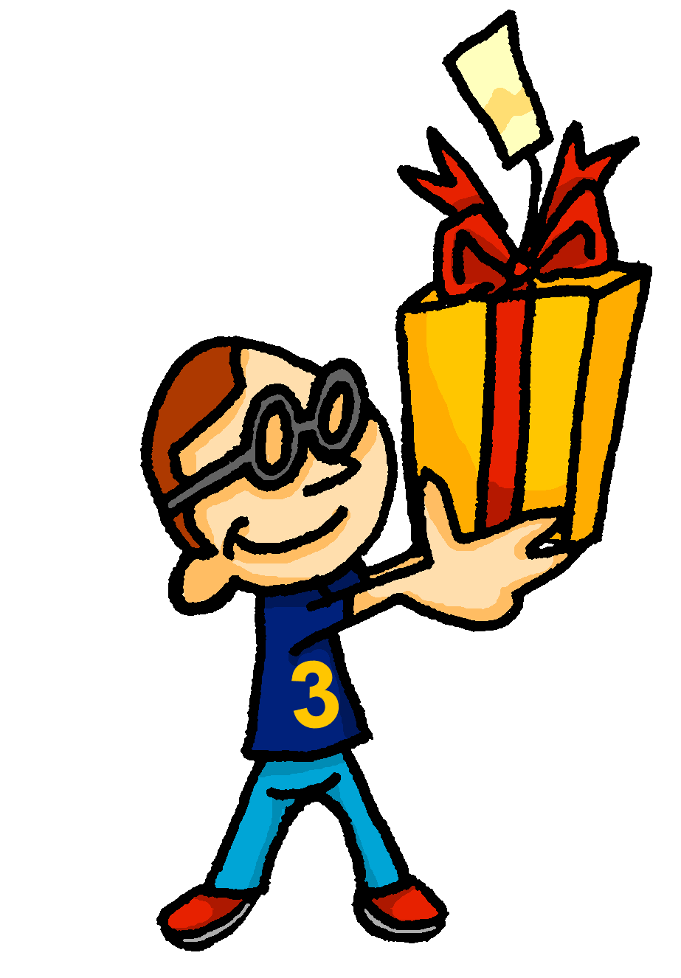

prononcer
[é]
[er]
[et]
[ez]
Remember that
[é], [er],[et] and [ez] sound the same.
répéter
[and]
écrire
parler
et
bébé
donner
nez
[to give]
Notes:
Timing: 2 minutes
Aim: to recap SSC [é] [er] [et] [ez], which are the same sound written differently.
Procedure:
Introduce and elicit the pronunciation of the individual SSC [é, et, et, ez] and the source word ‘répéter’, which has both spellings of the sound.
Click to bring on the picture and get students to repeat (with gesture, if using).
Present and practise the cluster words.
Gesture:
gesture for répéter – hand with thumb and two fingers pointing forwards doing a three downwards motions, one for each syllable of the word.
https://www.signbsl.com/sign/repeat (the 2nd video marked again: repeat with the female signer)
2

Slide 3
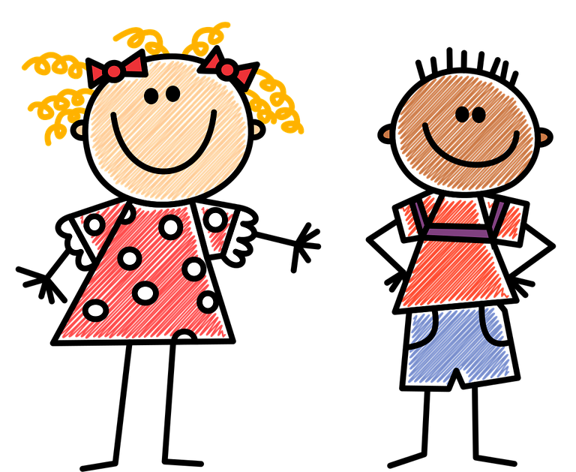




prononcer
[è|ê]
[è] and [ê]
sound almost the same. [ê] is a little longer and deeper.
fête
to be, being
être
frère
(brother)
(party, celebration)
tête
problème
(head)
Notes:
Timing: 2 minutes
Aim: to recap SSC [è] and [ê] which are almost the same sound.
Procedure:
Introduce and elicit the pronunciation of the individual SSC [è] and the source word ‘xxx’, which has both spellings of the sound.
Click to bring on the picture and get students to repeat (with gesture, if using).
Present and practise the cluster words.
Gesture:
gesture for fête: raise both hands in the air (middle three fingers facing down in a partial fist, with thumb and pinkie facing upwards) and move up and down alternate left and right to suggest a celebration-style dance.
Source: https://www.signbsl.com/sign/party (the 3rd video from the right is the best one, in my view)
3

Slide 4


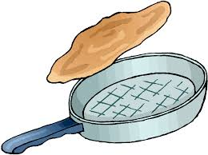

Follow up 1:
. Écoute les noms des animaux. C’est [ien] ou [(a)in]?
Prononce la chanson. Puis, chante.
Je prépare des crêpes
à la Chandeleur
Je prépare des crêpes
à la Chandeleur
C’est le deux février
Et j’adore cuisiner*
Je prépare des crêpes
à la Chandeleur.
I prepare pancakes
prononcer
on Shrove Tuesday.
I prepare pancakes
on Shrove Tuesday.
You know that
[er] sounds
the same
as [é], too.
La Chandeleur is like Pancake Day but its date is fixed – 40 days after Christmas, on 2nd February.
It’s the 2nd February
and I love cooking
I prepare pancakes
on Shrove Tuesday.
cuisiner – to cook
Notes:
[Sung to tune of ‘If you’re happy and you know it’]
Timing: 5 minutes
Aim: to practise pronunciation of different sounds represented by the letter ‘e’.
Procedure:
Pupils work in pairs to pronounce the song first of all.
Tell pupils that the song goes with the tune ‘if you’re happy and you know it’.
Encourage pupils to sing the song with you.

Slide 5








Follow up 2
C’est vrai ?
. Écoute les noms des animaux. C’est [ien] ou [(a)in]?
Écris cinq phrases négatives en français.
écrire
1
Je chante.
Je regarde.
Je ne regarde pas.
C’est vrai !
5
Ce n’est pas vrai !
Je ne mange pas.
Ce n’est pas vrai !
2
Je mange.
6
J’écoute.
C’est vrai !
Je ne prononce pas.
Ce n’est pas vrai !
Ce n’est pas vrai !
7
Je joue.
Je ne joue pas.
3
Je prononce.
Je ne prépare pas.
8
Je prépare.
Ce n’est pas vrai !
4
Je danse.
C’est vrai !
Notes:
Timing: 5 minutes
Aim: to practise written production of simple negative sentences.
Note: The reading and speaking elements of this task were done in the lesson. Pupils will hopefully recognise that they responded ‘ce n’est pas vrai’ to five of the statements. Those are the focus for this writing task.
Procedure:
Pupils write negative sentences for the five incorrect statements.
Elicit answers orally from pupils and click to reveal written answers.

Slide 6



Knowing who does what [1/2]
It is also the form of a verb you see in a dictionary.
[–er verbs: ‘we’ and ‘you (plural)’]
We know the infinitive verb tells us the general meaning:
préparer
to prepare, preparing
Remember: to mean ‘we’ with a verb, remove –er and add –ons:
Nous préparons des crêpes.
Nous aimons les crêpes !
We prepare pancakes.
And to mean ‘you (plural)’ with a verb:
Vous préparez aussi des crêpes.
You prepare pancakes, too.
Remember! Vous means you (all) AND you (formal).
Notes:
Complete before Follow up 3
[1/2]
Timing: 2 minutes (two slides)
Aim: to introduce 1st and 2nd persons plural for –er verbs.
Procedure:
Click through the animations to present the new information.
Elicit English translations for the French examples provided.

Slide 7

Knowing who does what [2/2]
[–er verbs: ‘we’ and ‘you (plural)’]
manger
to eat, eating
Remember: verbs with stems ending in –g need an ‘e’ in the nous form.
Nous mangeons des crêpes.
We eat pancakes.
And to mean ‘you (plural/formal)’ eat:
Vous mangez aussi des crêpes.
You (all) eat pancakes, too.
Notes:
[2/2]
Procedure:
Click through the animations to present the new information.
Elicit English translations for the French examples provided.

Slide 8




Follow up 3
. Écoute les noms des animaux. C’est [ien] ou [(a)in]?
Pratique les verbes avec nous et vous.
marcher
parler
manger
danser
[to dance, dancing]
[to eat, eating]
utiliser
avoir
aimer
[to like, liking]
Notes:
Timing: 3 minutes (three slides)
Aim: to reinforce the specific production and pronunciation of 1st and 2nd persons plural, along with the subject pronouns nous and vous.
Procedure:
Click to bring up each infinitive on its own and elicit the pronunciation from students.
Elicit choral responses of the infinitive form from students by clicking to disappear the five verbs at random.

Slide 9
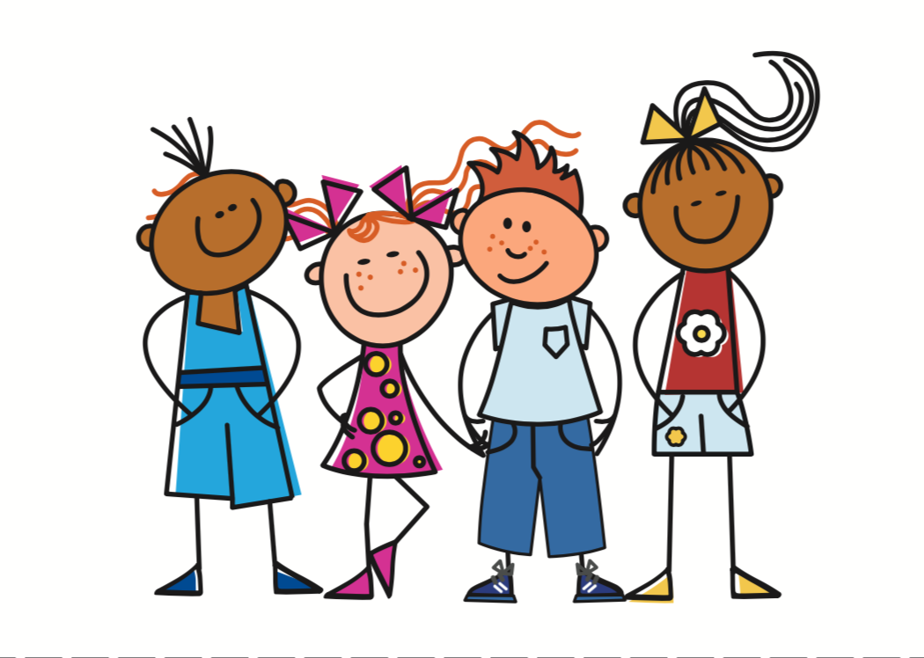
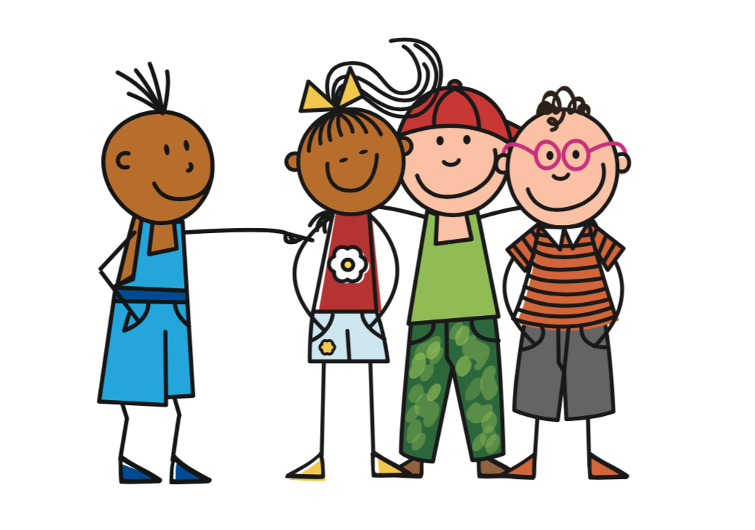
Follow up 3
. Écoute les noms des animaux. C’est [ien] ou [(a)in]?
Pratique les verbes avec nous et vous.
marcher
==
parler
manger
==
danser
==
nous
vous
Avoir is irregular, but the we and you forms have the same endings as –er verbs.
utiliser
avoir
==
aimer
==
Remember the liaison –s before verbs starting with vowels.
Notes:
Procedure:
Click to bring up the nous pronoun.
Click again to trigger nous and a verb stem to disappear (slow animation of 3 seconds). Pupils need to give the nous OR vous form of the verb before the verb disappears e.g. nous dansons.
Continue until all 6 verbs have disappeared.

Slide 10

Follow up 4 [1/7]
Écoute la question.
Donne une réponse en français.
. Écoute les noms des animaux. C’est [ien] ou [(a)in]?
parler
1
Non, il ne chante pas.
Notes:
[1/7]
Timing: 5 minutes (7 slides)
Aim: to practise aural comprehension of est-ce que questions and respond with affirmative or negative sentences.
Procedure:
Teacher says (or clicks for the audio of) the question.
Pupils respond, chorally, with a short sentence.
Click to bring up a written and audio version of the response, for listen and check.
Transcript:
Est-ce qu’ il chante ?

Slide 11

Follow up 4 [2/7]
Écoute la question.
Donne une réponse en français.
. Écoute les noms des animaux. C’est [ien] ou [(a)in]?
parler
2
Non, elle ne danse pas.
Notes:
[2/7]
Transcript:
Est-ce qu’elle danse ?

Slide 12
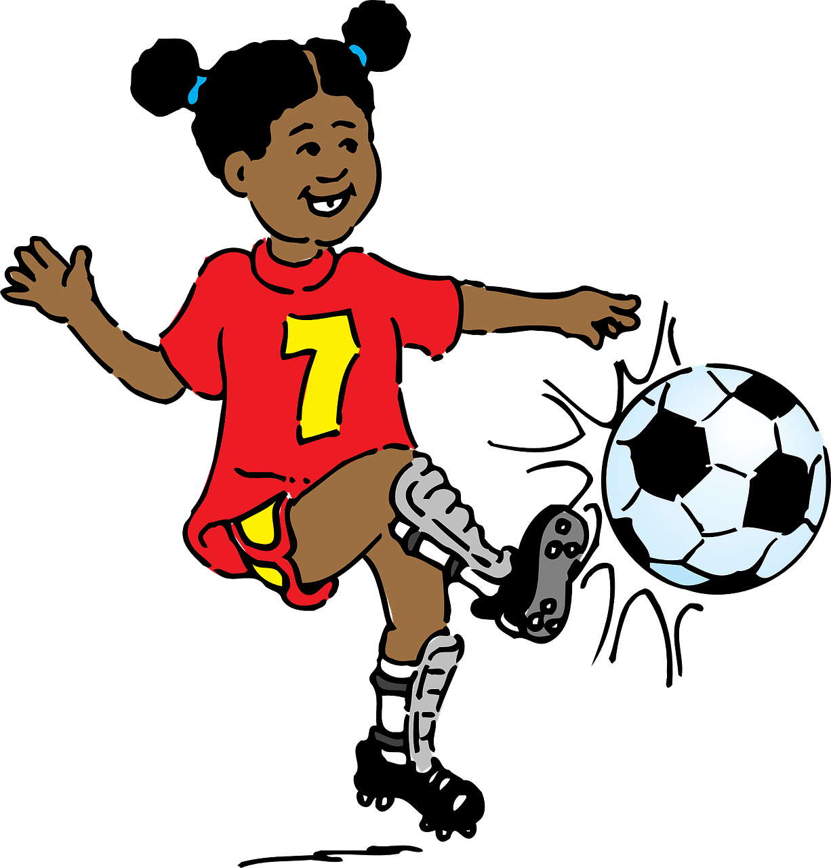
Follow up 4 [3/7]
Écoute la question.
Donne une réponse en français.
. Écoute les noms des animaux. C’est [ien] ou [(a)in]?
parler
3
Oui, elle joue.
Notes:
[3/7]
Transcript:
Est-ce qu’elle joue ?

Slide 13
Follow up 4 [4/7]
Écoute la question.
Donne une réponse en français.
. Écoute les noms des animaux. C’est [ien] ou [(a)in]?
parler
4
Oui, elle mange.
Notes:
[4/7]
Transcript:
Est-ce qu’elle mange ?

Slide 14
Follow up 4 [5/7]
Écoute la question.
Donne une réponse en français.
. Écoute les noms des animaux. C’est [ien] ou [(a)in]?
parler
5
Non, il n’écoute pas.
Notes:
[5/7]
Transcript:
Est-ce qu’il écoute ?

Slide 15
Follow up 4 [6/7]
Écoute la question.
Donne une réponse en français.
. Écoute les noms des animaux. C’est [ien] ou [(a)in]?
parler
6
Non, il ne donne pas.
Notes:
[6/7]
Transcript:
Est-ce qu’il donne ?

Slide 16
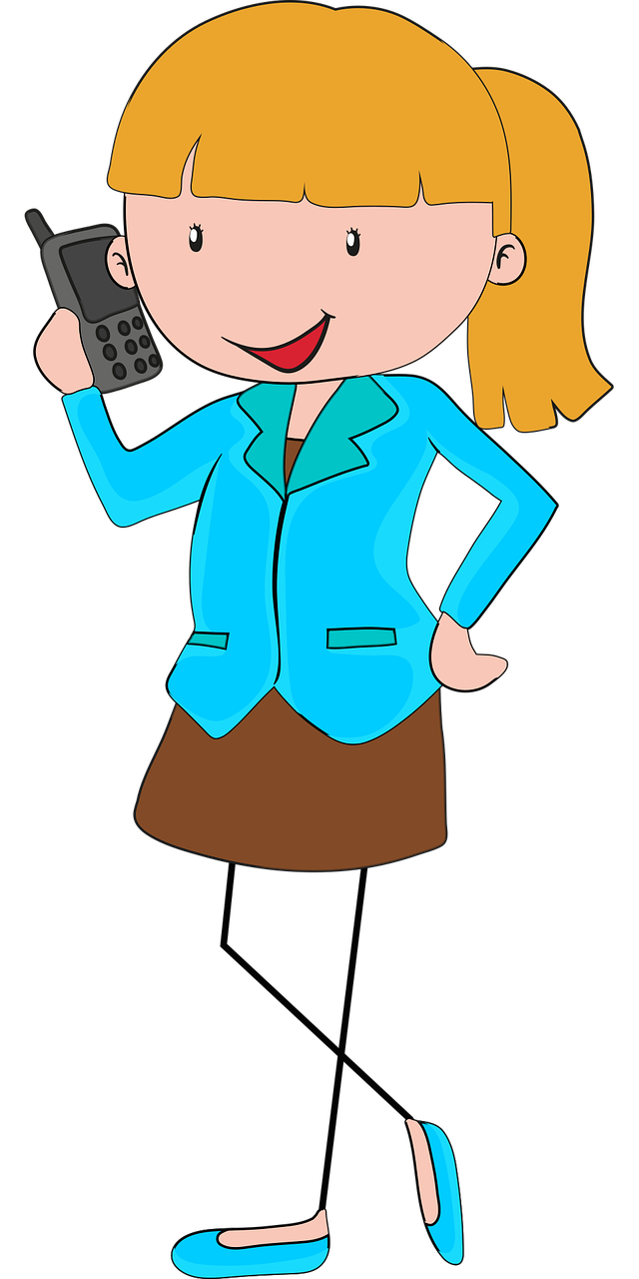
Follow up 4 [7/7]
Écoute la question.
Donne une réponse en français.
. Écoute les noms des animaux. C’est [ien] ou [(a)in]?
parler
7
Oui, elle parle.
Notes:
[7/7]
Transcript:
Est-ce qu’elle parle ?

Slide 17




vocabulaire
Follow up 5 - Écris en anglais : Can you get at least 15 points?
mots
 | entre | devant | derrière
 | le bâtiment | vous avez | nous avons
 | puis | dans | sur
 | ici | sous | les gens
 | créer | apporter | aimer
 | porter | quitter | monter
 | danser | marcher | chercher
between
in front of
behind
x3
(the) building
we have
you (pl) have
then
in
on (top of)
x2
here
under(neath)
(the) people
to create, creating
to take, bring
to like, liking
x1
to ride,
climb (up, on, into)
to wear, wearing
to leave (somewhere)
to dance, dancing
to walk, walking
to look for
Notes:
Timing: 5-10 minutes
Aim: to practise written production of vocabulary from this week and two revisited weeks.
Procedure:
1. Give pupils a blank grid. They fill in the English meanings of any of the words they know, trying to reach 15 points in total.
2. Remind pupils that adjectives can refer to male or female persons and they should note this in their translations. E.g. pleased (f), short (m).
Note:
The most recently learnt and practised words are pink, words from revisit 1 are green and those from revisit 2 are blue, thus more points are awarded for them, to recognise that memories fade and more effort (heavy lifting!) is needed to retrieve them.
17

Slide 18
vocabulaire
Follow up 5 - Écris en anglais : Can you get at least 15 points?
mots
 | entre | devant | derrière
 | le bâtiment | vous avez | nous avons
 | puis | dans | sur
 | ici | sous | les gens
 | créer | apporter | aimer
 | porter | quitter | monter
 | danser | marcher | chercher
x3
x2
x1
Notes:
HANDOUT
18

Slide 19
vocabulaire
Follow up 5 - Écris en français : Can you get at least 15 points?
mots
 | (the) building | we have | you (pl) have
 | behind | in front of | between
 | on (top of) | under(neath) | in
 | (the) people | then | here
 | to leave (somewhere) | to ride, climb (up, on, into) | to look for
 | to wear, wearing | to create, creating | to walk, walking
 | to dance, dancing | to like, liking | to take, bring
le bâtiment
nous avons
vous avez
x3
entre
derrière
devant
sur
sous
dans
x2
puis
ici
les gens
quitter
monter
chercher
x1
porter
créer
marcher
aimer
apporter
danser
Notes:
Timing: 5-10 minutes
Aim: to practise written production of vocabulary from this week and two revisited weeks.
Procedure:
1. Give pupils a blank grid. They fill in the French meanings of any of the words they know, trying to reach 15 points in total.
2. Remind pupils that adjectives can refer to male or female persons and they should note this in their translations. E.g. pleased (f), short (m).
Note:
The most recently learnt and practised words are pink, words from revisit 1 are green and those from revisit 2 are blue, thus more points are awarded for them, to recognise that memories fade and more effort (heavy lifting!) is needed to retrieve them.
19

Slide 20
vocabulaire
Follow up 5 - Écris en français : Can you get at least 15 points?
mots
 | (the) building | we have | you (pl) have
 | behind | in front of | between
 | on (top of) | under(neath) | in
 | (the) people | then | here
 | to leave (somewhere) | to ride, climb (up, on, into) | to look for
 | to wear, wearing | to create, creating | to walk, walking
 | to dance, dancing | to like, liking | to take, bring
x3
x2
x1
Notes:
HANDOUT
20

