Slide 1
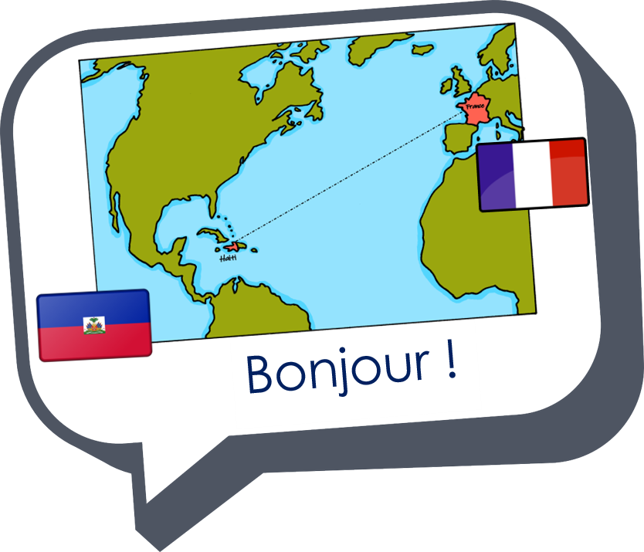


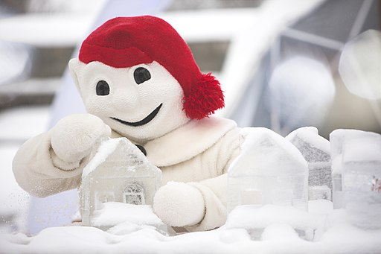

Saying what I and others do
vert
Follow ups 1-5
Notes:
Artwork by Steve Clarke. Pronoun pictures from NCELP (www.ncelp.org). All additional pictures selected from Pixabay and are available under a Creative Commons license, no
attribution required.
Phonics: [è | ê] fête [1490] tête [343] frère [1043] être [5] problème [188]
Frequency of new words:
Vocabulary: aimer [242] apporter [339] arriver [174] organiser [701] porter [105] préparer [368] créer [332] marcher [1532] monter [853] quitter [507] puis [230]
Revisit 1: cheveu [2296] acteur [1552] actrice [1552] nez [2661] œil, yeux [474] visage [1292] bleu [1216] blond [4585] brun [>5000] court [545] crépu [>5000] gris [2769] long [202] noir [572] ovale [>5000] rond [2268] roux [>5000] vert
[1060]
Revisit 2: avoir [8] j’ai [8] quoi [297] un [3] une [3] café [1886] cinéma [1623] hôtel [1774] poste [489] école [477] très [66] utile [1003] différent [350] idéal [1429] important [215] indépendant [954] moderne [1239] propre [237] sale [2906]
Londsale, D., & Le Bras, Y. (2009). A Frequency Dictionary of French: Core vocabulary for learners London: Routledge.
The frequency rankings for words that occur in this PowerPoint which have been previously introduced in these resources are given in the SOW and in the resources that first
introduced and formally re-visited those words.
For any other words that occur incidentally in this PowerPoint, frequency rankings will be provided in the notes field wherever possible.
Image attribution:
Logo - Stagiairec, CC BY-SA 4.0 via Wikimedia Commons
Bonhomme Carnaval - Laserpdb, CC BY-SA 3.0 via Wikimedia Commons
Bonhomme Carnaval (2) - Stagiairec, CC BY-SA 4.0 via Wikimedia Commons

Slide 2

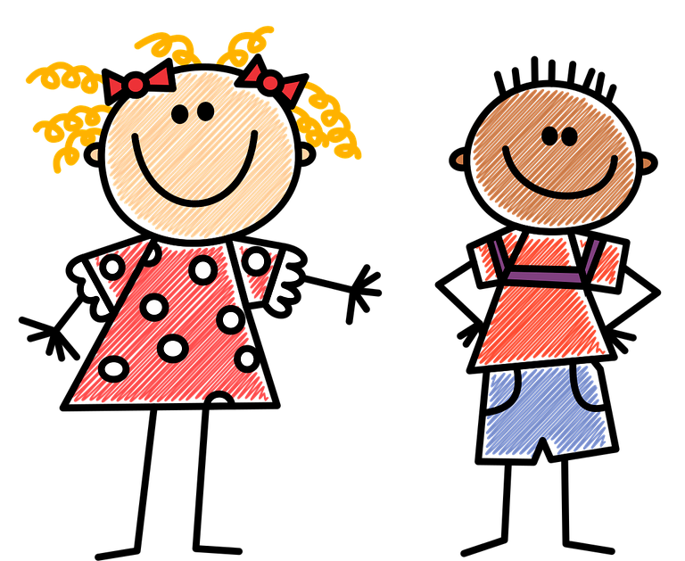


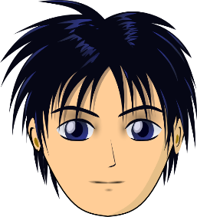

prononcer
[è|ê]
[è] and [ê]
sound almost the same. [ê] is a little longer and deeper.
to be, being
fête
être
frère
(brother)
(party, celebration)
tête
problème
(head)
Notes:
Timing: 2 minutes
Aim: to recap SSC [è] and [ê] which are almost the same sound.
Procedure:
Introduce and elicit the pronunciation of the individual SSC [è] and the source word ‘xxx’, which has both spellings of the sound.
Click to bring on the picture and get students to repeat (with gesture, if using).
Present and practise the cluster words.
Gesture:
gesture for fête: raise both hands in the air (middle three fingers facing down in a partial fist, with thumb and pinkie facing upwards) and move up and down alternate left and right to suggest a celebration-style dance.
Source: https://www.signbsl.com/sign/party (the 3rd video from the right is the best one, in my view)
2

Slide 3


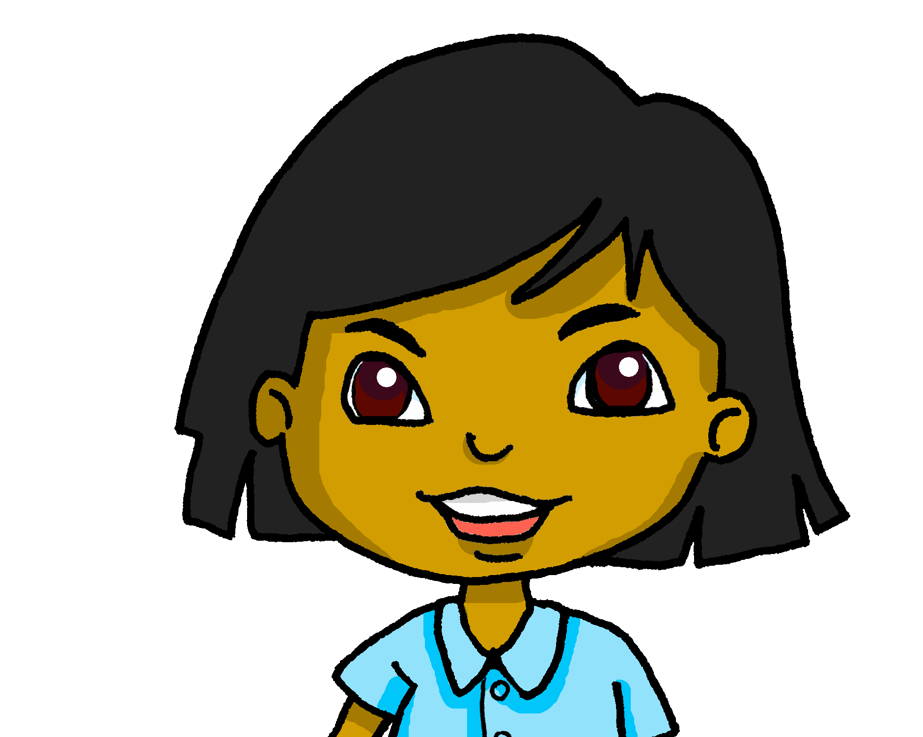

Follow up 1:
Écoute les messages de Sanaya.
. Écoute les noms des animaux. C’est [ien] ou
Il y a combien de sons [è | ê] dans chaque phrase ?
. Écoute les noms des animaux. C’est [ien] ou [(a)in]?
écouter
 | ////
 | // | Elles adorent manger de la tire sur la neige.
 | /// | Elles marchent deux kilomètres dans la neige.
 | / | Puis, elles montent à cheval.
 | // | Elles sont très contentes.
 | /// | La fête, c’est super !
Notes:
Timing: 5 minutes
Aim: to practise aural recognition of the [è | ê] sound in a tally task.
Procedure:
Click on each number to listen to the sentence.
Pupils tally the number of times they hear the [è | ê]
Click to correct.
Elicit English meanings from pupils orally.
Transcript:
Elles adorent manger de la tire sur la neige.
Elles marchent deux kilomètres dans la neige.
Puis, elles montent à cheval.
Elles sont très contents.
La fête, c’est super !
ANSWERS:
They love eating maple candy.
They walk two km on the snow.
Then they ride horses.
They are very happy.
The festival is super!

Slide 4
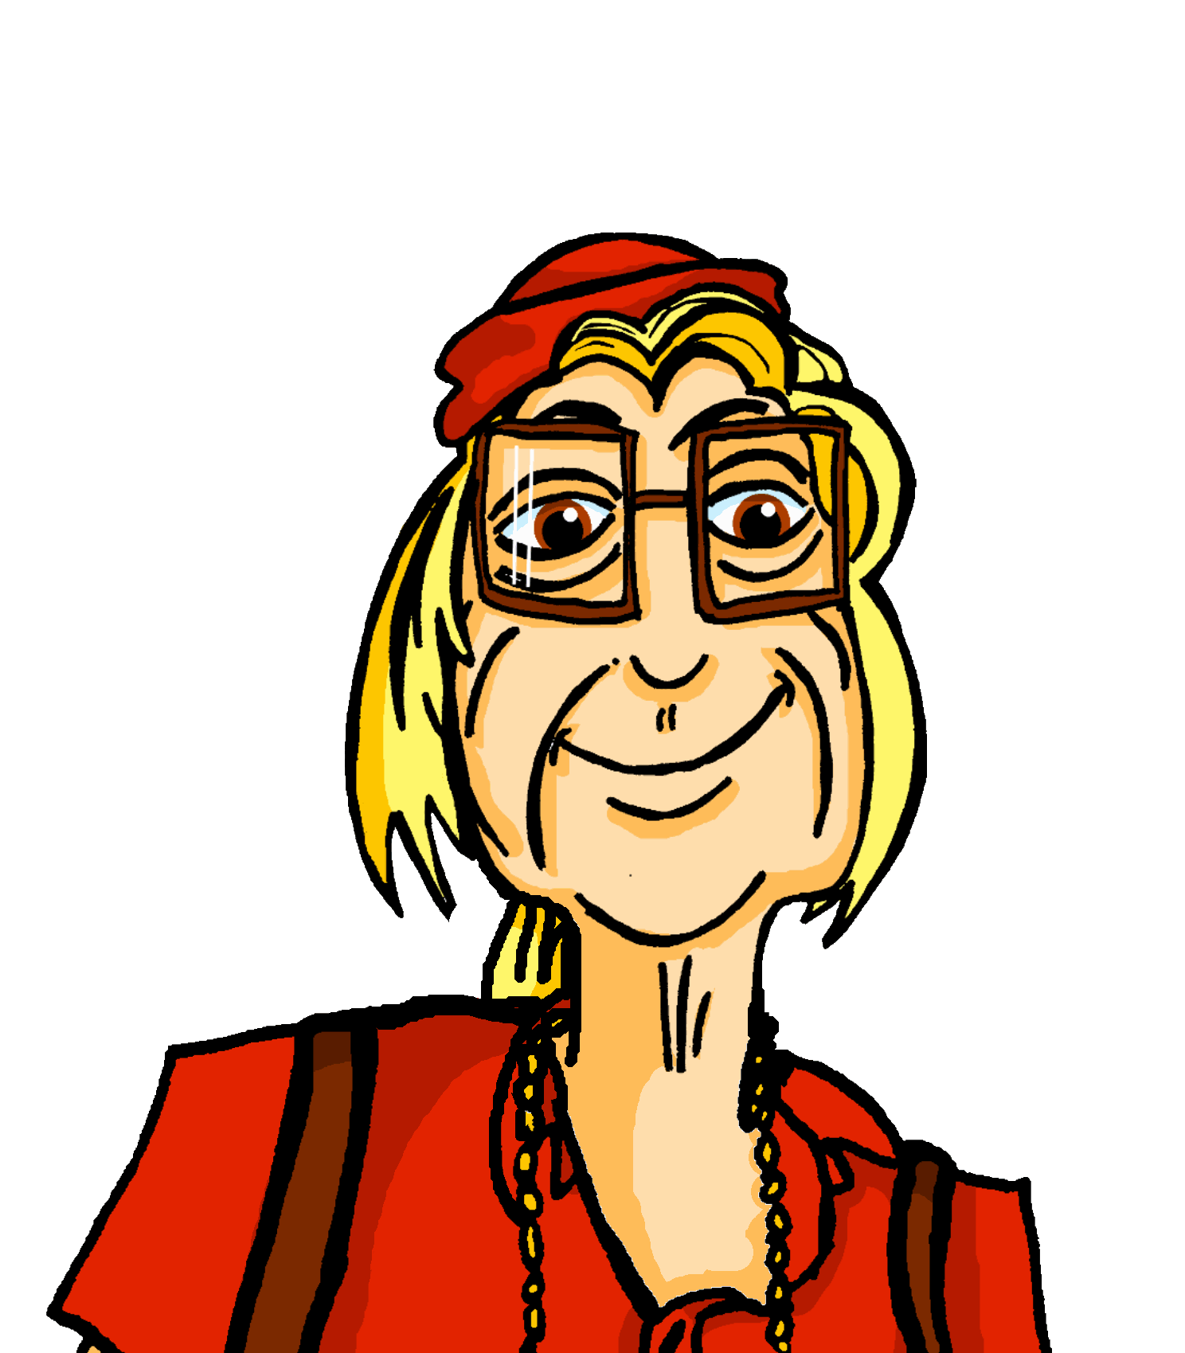

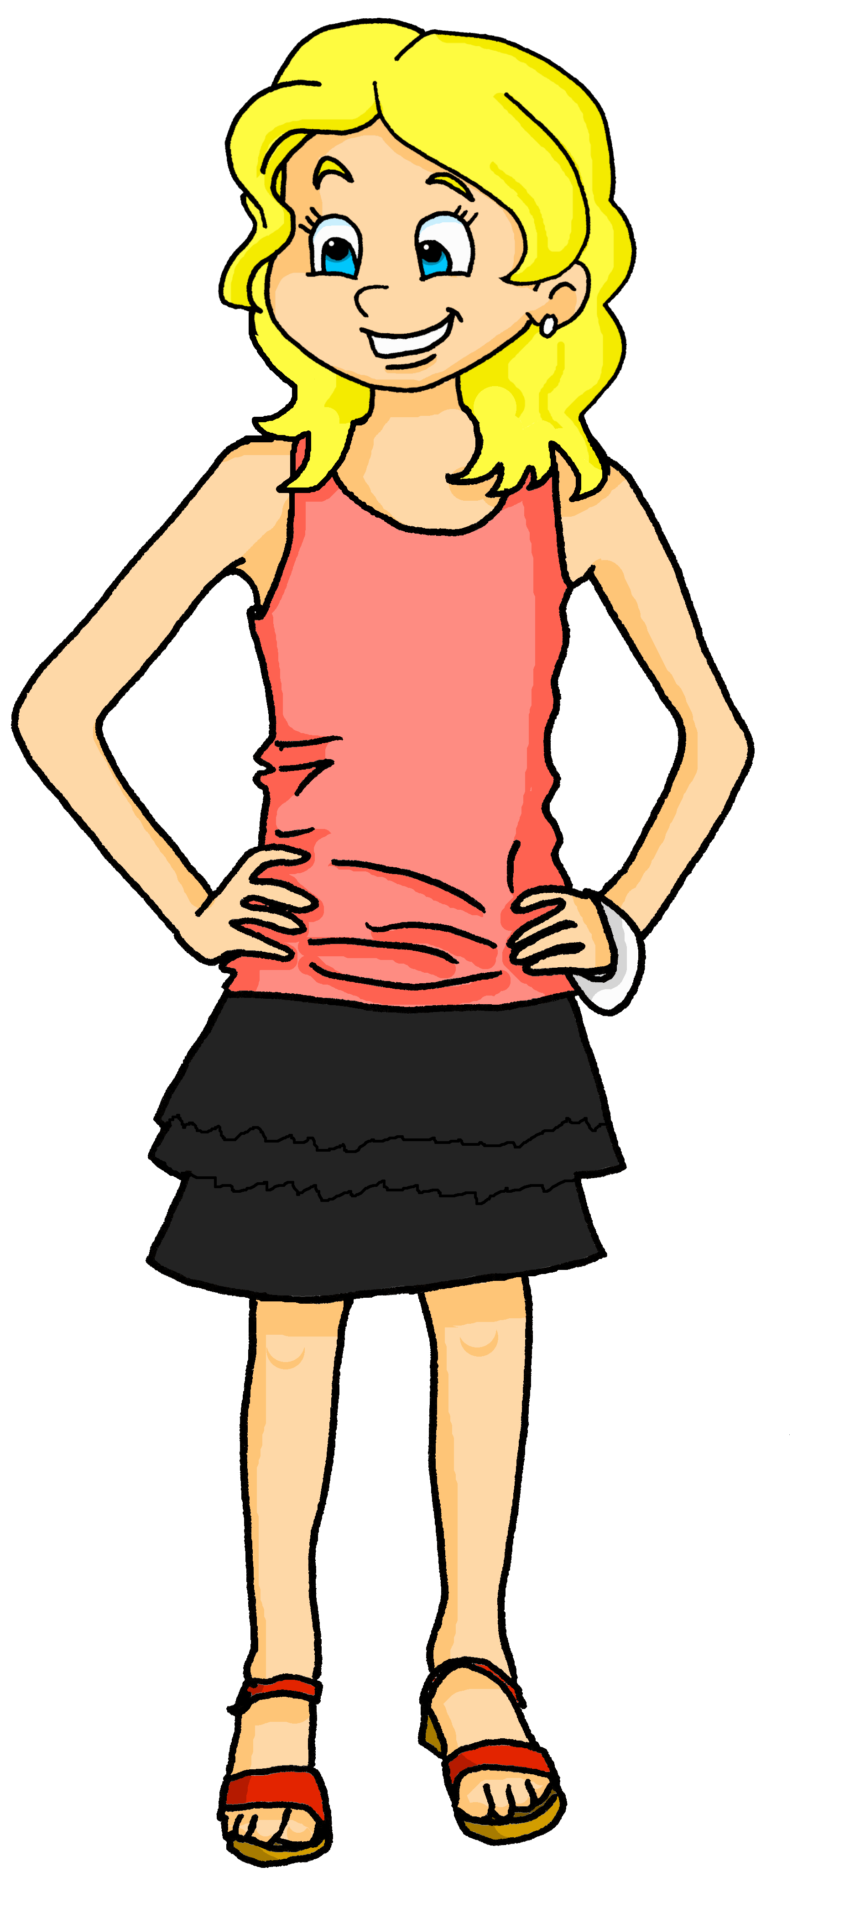

Follow up 2:
. Écoute les noms des animaux. C’est [ien] ou
Écoute les questions de Sanaya.
Elle parle à Adèle ou à Renée, la tante d’Adèle ?
. Écoute les noms des animaux. C’est [ien] ou [(a)in]?
écouter
 | Tu | Vous
 |  |  | Do you…
 |  |  | Do you…
 |  |  | Do you…
 |  |  | Do you…
 |  |  | Do you…
 |  |  | Do you…
 |  |  | Do you…
 |  |  | Do you…
Écris en anglais.
1
like the Quebec carnival?
2
play in a giant football game?
3
wear a special hat?
4
watch a horse race on the snow?
5
visit the ice hotel?
6
prepare a chocolate cake?
7
swim on the snow?
8
watch the parade?
Notes:
Timing: 5 minutes
Aim: to practise oral differentiation of tu and vous verb forms and their connection with meaning.
Procedure:
Ensure that pupils understand the scenario; that Sanaya uses formal vous with Adèle’s aunt and the tu form with Adèle.
Click to listen to the first question. Pupils decide, based on the verb form, if it is the tu or vous form of you.
Click to listen again. This time, pupils try to write the meaning of the question in English.
Click to correct.
Continue with items 2- 8.
Transcript:
[Vous] aimez le Carnaval de Québec ?
[Tu] joues dans un jeu de football géant ?
[Vous] portez un chapeau spécial ?
[Vous] regardez une course de chevaux dans la neige ?
[Tu] visites le château de glace ?
[Vous] préparez un gâteau en chocolat ?
[Vous] nagez sur la neige ?
[Tu] regardes le défilé ?

Slide 5















Follow up 2
Écoute.
.
écouter
Il ou ils ?
Elle ou elles ?
Écoute, regarde et écris en français.
écrire
Exemple
H
H
ils quittent
Notes:
Timing: 5 minutes (seven slides)
Aim: This is an example of a bimodal task which connects the spoken form with the written form simultaneously, as in this case listening alone does not indicate singular or plural.
It is useful to practise bimodal tasks in this case because pupils practise the idea that you can only tell which verb ending to use in writing when you know whether the person is singular or plural – so, here the pupils get a visual cue (the picture) and this tells them what the written verb ending would be (the oral verb ending doesn’t help!).
Procedure:
1. Use this slide to model the task instructions.
2. Click to bring up the image and again for the audio. Pupils will hear a verb (e.g., ils quittent). At the same time a circle will appear around the picture to indicate whether it is 3rd person singular or 3rd person plural.
3. Once they have heard the audio and seen whether it is singular or plural, students write the correct form.
4. Click to reveal the correct written form.
Transcript:
ils quittent
Note: Teachers need to mouse click on the ‘Exemple’ box, which triggers the audio to play the word ‘exemple’
If this step is missed, the first verb may not play in full.

Slide 6

Follow up 2
[1/6]
écouter
écrire
elle nage
Notes:
[1/6]
Transcript:
elle nage

Slide 7
Follow up 2
[2/6]
écouter
écrire
Elles marchent
Notes:
[2/6]
Transcript:
Elles marchent

Slide 8

Follow up 2
[3/6]
écouter
écrire
Il monte
Notes:
[3/6]
Transcript:
Il monte

Slide 9

Follow up 2
[4/6]
écouter
écrire
ils regardent
Notes:
[4/6]
Transcript:
ils regardent

Slide 10
Follow up 2
[5/6]
écouter
écrire
elles visitent
Notes:
[5/6]
Transcript:
Elles visitent

Slide 11

Follow up 2
[6/6]
écouter
écrire
elle crée
Notes:
[6/6]
Transcript:
elle crée

Slide 12


Knowing who does what
-ER verbs: 3rd person singular and plural
Remember! To say ‘everyone’ + ER verb, use tout le monde and the s/he, it ending –e.
Tout le monde regarde le défilé.
Everyone watches the parade.
To say ‘the people’ + -ER verb in French, use les gens and the verb ending –ent.
Les gens regardent le défilé.
The people watch the parade.
Notes:
Timing: 1 minute
Aim: to connect ‘tout le monde’ (everyone) and ‘les gens’ (the people) with the correct verb form in French.
Procedure:
Click through the animations to present the information.
Elicit English translations for the French examples provided.

Slide 13

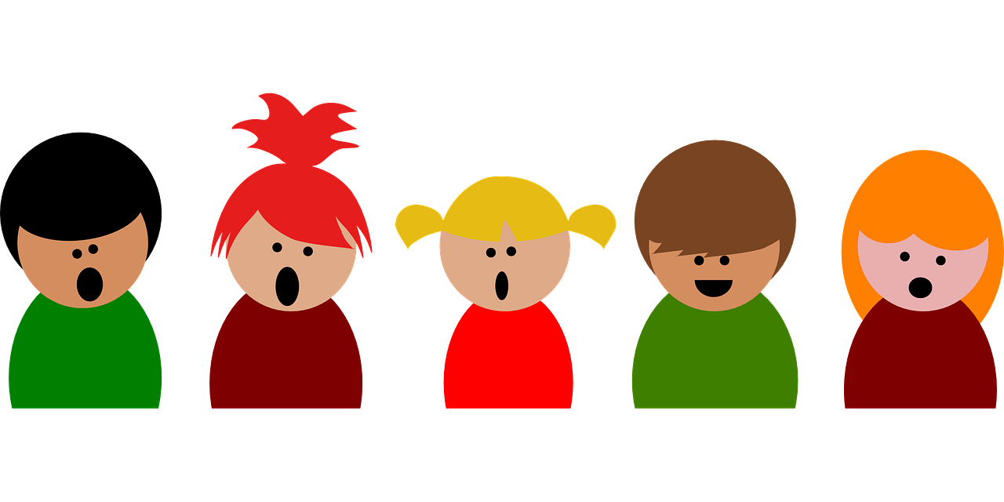

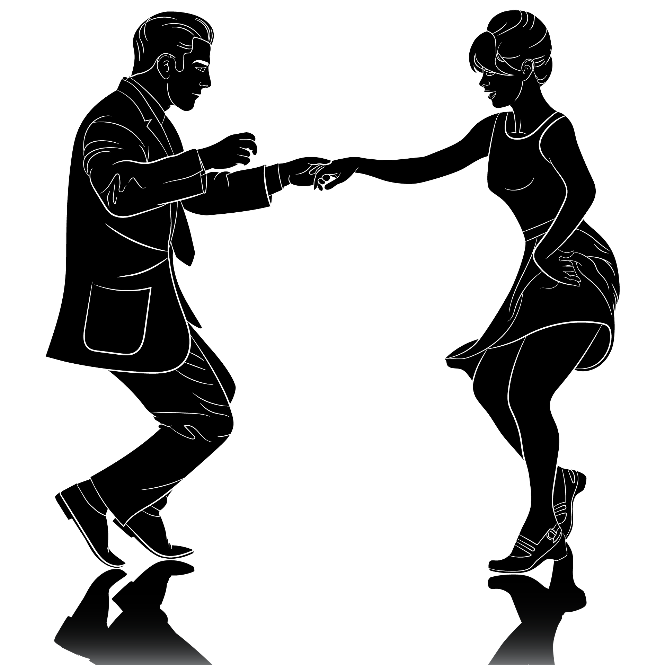
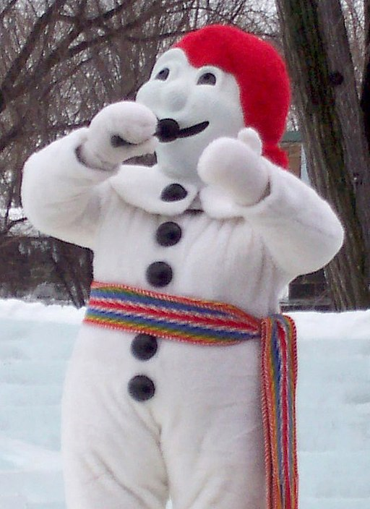



Follow up 3:
Écoute et écris le verbe.
Ici, c’est super ! Tout le monde chante et danse avec
le Bonhomme Carnaval.
écouter
Les gens portent des bikinis et nagent dans la neige !
Now note down in English everything you know about the Quebec Carnival.
Tout le monde prépare la tire sur la neige ! C’est une tradition délicieuse pour tous* !
écrire
Ils créent des sculptures en glace et montent sur des traîneaux.
Bisous (kisses) is a way to sign off your messages to close friends and family.
Tout le monde marche derrière le défilé. Les gens quittent
le Carnaval très tard*, mais ils sont très heureux.
tous = all
tard = late
Bisous, Renée
Notes:
Timing: 5 minutes
Aim: to practise written distinction and production of 3rd person singular and plural verb forms.
Procedure:
1. Pupils can number 1-8 to avoid copying the full text (or have a gapped handout).
2. Click to listen to each sentence.
3. Paying careful attention to the subject - is it ‘tout le monde’ (everyone) or ‘les gens’ (people), pupils write the verb they hear in either the 3rd person singular (-e ending) or 3rd person plural (-ent ending).
4. Click to reveal the answers and hear each sentence again.
Differentiation: for more challenge, pupils could write the verbs before listening (meaning they must recall the verbs themselves, rather than only the endings).
Image attribution:
Photo par / taken by User:Boréal., CC BY-SA 2.5 <https://creativecommons.org/licenses/by-sa/2.5>, via Wikimedia Commons

Slide 14




Follow up 4:
Parle avec ton/ta partenaire.
Personne A parle.
Personne B identifie l’image correspondante.
parler
Personne A
He walks
Personne B
[A] [B] [C]
Il marche
B
A
Notes:
Timing: 5-10 minutes
Aim: to practise receptive and productive knowledge of third person singular and plural of –er verbs in present tense.
Procedure:
1. Use this slide to model the task.
2. Pupil A produces the verb and pronoun in French.
3. Pupil B identifies the correct picture – A, B or C.
4. Complete items 1-5.
5. Then pupils swap roles and repeat the task.
6. See next slides for answers, and handouts at the end of the presentation.

Slide 15




parler
Round 1
Personne B
Personne A
1) He walks
……………………………….
2) They danse (mixed group)
……………………………….
3) They leave (mixed group)
……………………………….
4) She prepares
……………………………….
5) They create (mixed group)
………………………………..
[A] [B] [C]
parler
1)
Il marche
2)
Ils dansent
3)
Ils quittent
Elle prépare
4)
Elles créent
5)
Notes:
ANSWERS ROUND 1
15

Slide 16

parler
Round 2
Personne A
Personne B
1) They listen (all girls)
……………………………….
2) He rides on
……………………………….
3) She swims
……………………………….
4) They watch (mixed group)
……………………………….
5) They organise (all girls)
………………………………..
[A] [B] [C]
parler
1)
Elles écoutent
2)
Il monte
3)
Elle nage
Ils regardent
4)
Elles organisent
5)
Notes:
ANSWERS ROUND 2
16

Slide 17




vocabulaire
Follow up 5 - Écris en anglais : Can you get at least 15 points?
mots
 | utile | propre | sale
 | avoir | très | l’école
 | court | ovale | roux
 | l’œil | les yeux | le visage
 | marcher | l’acteur | l’actrice
 | puis | elles | ils
 | monter | créer | quitter
useful
clean
dirty
x3
to have, having
very
school
short
oval
ginger hair
x2
eye
eyes
face
to walk
actor (m)
actor (f)
then
they (fpl)
they (mpl)
x1
to go onto/to climb
to create, creating
to leave, leaving
Notes:
Timing: 5-10 minutes
Aim: to practise written production of vocabulary from this week and two revisited weeks.
Procedure:
1. Give pupils a blank grid. They fill in the English meanings of any of the words they know, trying to reach 15 points in total.
2. Remind pupils that adjectives can refer to male or female persons and they should note this in their translations. E.g. pleased (f), short (m).
Note:
The most recently learnt and practised words are pink, words from revisit 1 are green and those from revisit 2 are blue, thus more points are awarded for them, to recognise that memories fade and more effort (heavy lifting!) is needed to retrieve them.
17

Slide 18
vocabulaire
Follow up 5 - Écris en français : Can you get at least 15 points?
mots
 | useful | clean | dirty
 | to have, having | very | school
 | short | oval | ginger hair
 | eye | eyes | face
 | to walk, walking | actor (m) | actor (f)
 | then | they (fpl) | they (mpl)
 | to go onto/climb | to create, creating | to leave, leaving
utile
propre
sale
x3
avoir
très
l’école
court
ovale
roux
x2
l’œil
les yeux
le visage
marcher
l’acteur
l’actrice
puis
elles
ils
x1
monter
créer
quitter
Notes:
Timing: 5-10 minutes
Aim: to practise written production of vocabulary from this week and two revisited weeks.
Procedure:
1. Give pupils a blank grid. They fill in the French meanings of any of the words they know, trying to reach 15 points in total.
2. Remind pupils that adjectives can refer to male or female persons and they should note this in their translations. E.g. pleased (f), short (m).
Note:
The most recently learnt and practised words are pink, words from revisit 1 are green and those from revisit 2 are blue, thus more points are awarded for them, to recognise that memories fade and more effort (heavy lifting!) is needed to retrieve them.
18

Slide 19
parler
Round 1
Round 2
Personne A
Personne A
1) He walks
……………………………….
2) They danse (mixed group)
……………………………….
3) They leave (mixed group)
……………………………….
4) She prepares
……………………………….
5) They create (mixed group)
………………………………..
[A] [B] [C]
parler
1)
2)
3)
4)
5)
Notes:
HANDOUT Personne A
19

Slide 20
parler
Round 1
Round 2
Personne B
[A] [B] [C]
Personne B
1) They listen (all girls)
……………………………….
2) He rides on
……………………………….
3) She swims
……………………………….
4) They watch (mixed group)
……………………………….
5) They organise (all girls)
………………………………..
Remember the liaison!
parler
1)
2)
3)
4)
5)
Remember the liaison!
Notes:
HANDOUT Personne B
20

Slide 21
vocabulaire
Follow up 5 - Écris en anglais : Can you get at least 15 points?
mots
utile | propre | sale
avoir | très | L’école
court | ovale | roux
l’œil | les yeux | le visage
marcher | l’acteur | l’actrice
puis | elles | ils
monter | créer | quitter
x3
x2
Notes:
HANDOUT
21

Slide 22
vocabulaire
Follow up 5 - Écris en français : Can you get at least 15 points?
mots
useful | clean | dirty
to have, having | very | school
short | oval | ginger hair
eye | eyes | face
to walk, walking | actor (m) | actor (f)
then | they (fpl) | they (mpl)
to go onto/climb | to create, creating | to leave, leaving
x3
x2
Notes:
HANDOUT
22

