Slide 1
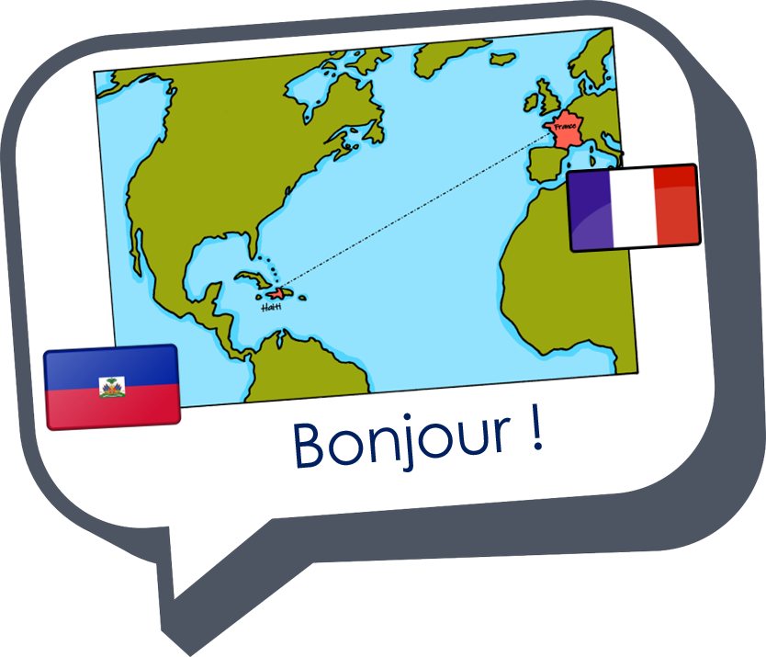
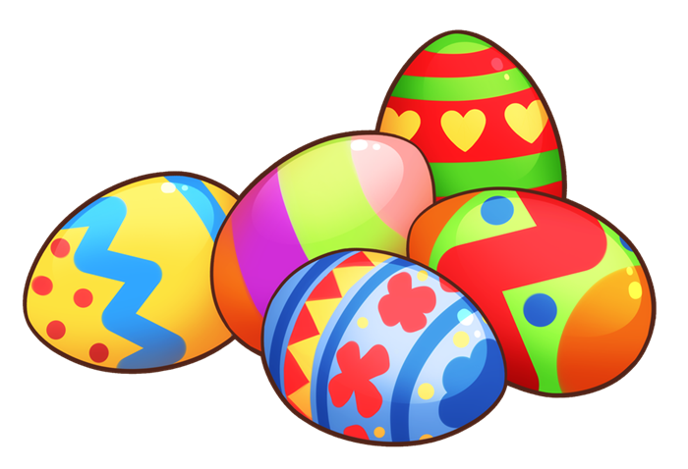
Saying where you are going and what there is there
vert
Phonics Quiz
Notes:
Artwork by Steve Clarke. Pronoun pictures from NCELP (www.ncelp.org). All additional pictures selected from Pixabay and are
available under a Creative Commons license, no attribution required.
This lesson contains vocabulary and grammar assessments to check progress in the words and structures introduced and practised in the first 12 weeks of this year’s course, as well as those from the previous two years. The ratio of old to new language in the quiz is very approximately 50:50.
1

Slide 2
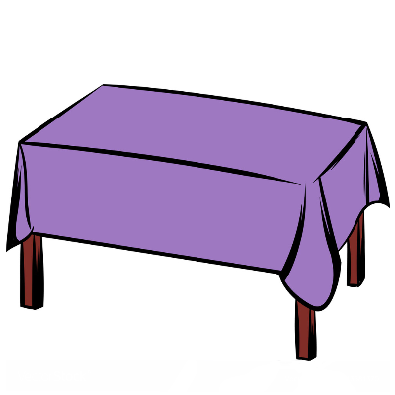
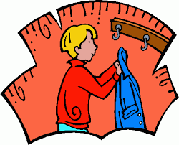
prononcer
[ch]
[ou]
prononcer
[to hang up, stick on]
accrocher
[to cover]
couvrir
Notes:
Phonics quiz
Timing: flexible during Week 11 Procedure:
Print out one set of these 14 phonics cards.
Working with one pupil at a time, elicit the pronunciation of each word.
Say: You have not learnt these words, but you have learnt how to read aloud these sounds, so just have a go at reading each word aloud.
Focus only on the accurate pronunciation of the target SSC and tolerate any other inaccuracies.
Use the pupil scoring sheet at the end of this presentation to assess SSC knowledge and give feedback.
Note: Whilst working with individual children, the rest of the class can be making an Easter card or completing a different activity.
Word frequency (1 is the most frequent word in French):
accrocher [2802] couvrir [682]
Source: Londsale, D., & Le Bras, Y. (2009). A Frequency Dictionary of French: Core vocabulary for learners London: Routledge.
2

Slide 3
prononcer
[(e)au]
open
[eu]
prononcer
[curtain]
rideau
moteur
Notes:
Word frequency (1 is the most frequent word in French):
rideau [2802] moteur [1164]
Source: Londsale, D., & Le Bras, Y. (2009). A Frequency Dictionary of French: Core vocabulary for learners London: Routledge.
3

Slide 4
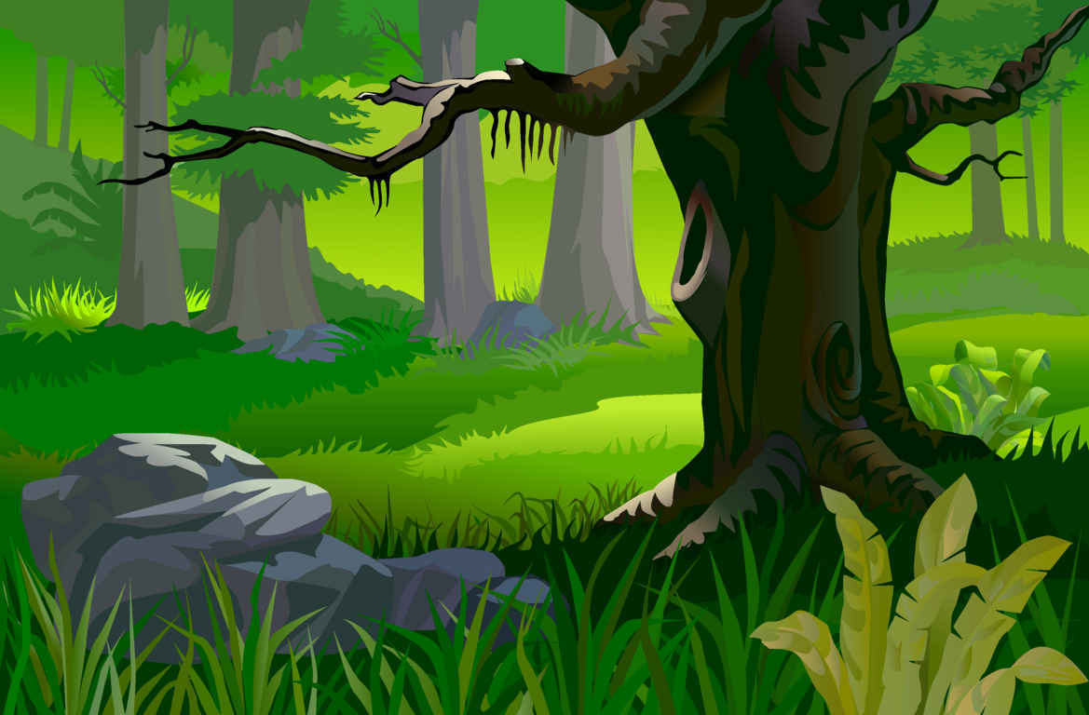
prononcer
[en|an]
[oi]
prononcer
[together]
ensemble
bois
Notes:
Word frequency (1 is the most frequent word in French):
ensemble [124] bois [1425]
Source: Londsale, D., & Le Bras, Y. (2009). A Frequency Dictionary of French: Core vocabulary for learners London: Routledge.
4

Slide 5
prononcer
[SFC]
[ai]
prononcer
[Polish]
minuit
polonais
Notes:
Word frequency (1 is the most frequent word in French):
minuit [3453] polonais [3663]
Source: Londsale, D., & Le Bras, Y. (2009). A Frequency Dictionary of French: Core vocabulary for learners London: Routledge.
5

Slide 6
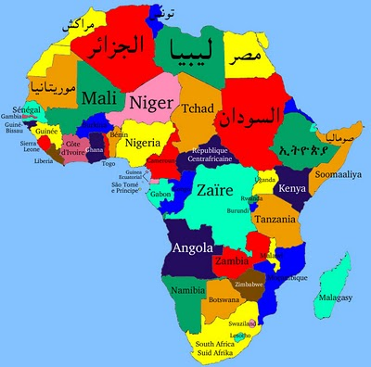
prononcer
[on]
[(a)in]
prononcer
[boss]c
patron
africain
Notes:
Word frequency (1 is the most frequent word in French):
patron [1706] africain [2289]
Source: Londsale, D., & Le Bras, Y. (2009). A Frequency Dictionary of French: Core vocabulary for learners London: Routledge.
6

Slide 7
prononcer
Pupil name:
Pupil name:
SSC and word | px
accrocher
couvrir
rideau
moteur
ensemble
bois
minuit
polonais
patron
africain
SSC and word | px
accrocher
couvrir
rideau
moteur
ensemble
bois
minuit
polonais
patron
africain
Notes:
Pupil feedback and assessment sheet [10 points]
7

Slide 8
prononcer
prononcer
1. Nous avons un cochon.
1. Nous avons un cochon.
2. Il y a trois étoiles.
2. . Il y a trois étoiles.
3. Je vais à Nantes .
3. Je vais à Nantes .
4. Chantal va à Pau .
4. Chantal va à Pau .
5. La mairie est à Tours.
5. La mairie est à Tours.
Notes:
Optional additional sentence read aloud [10 points]
8

Slide 9
Teacher audio version for checking
SSC and word | px
accrocher
couvrir
rideau
moteur
ensemble
bois
minuit
polonais
patron
africain
prononcer
1. Nous avons un cochon.
2. Il y a trois étoiles.
3. Je vais à Nantes .
4. Chantal va à Pau .
5. La mairie est à Tours.
Notes:
9

