Slide 1
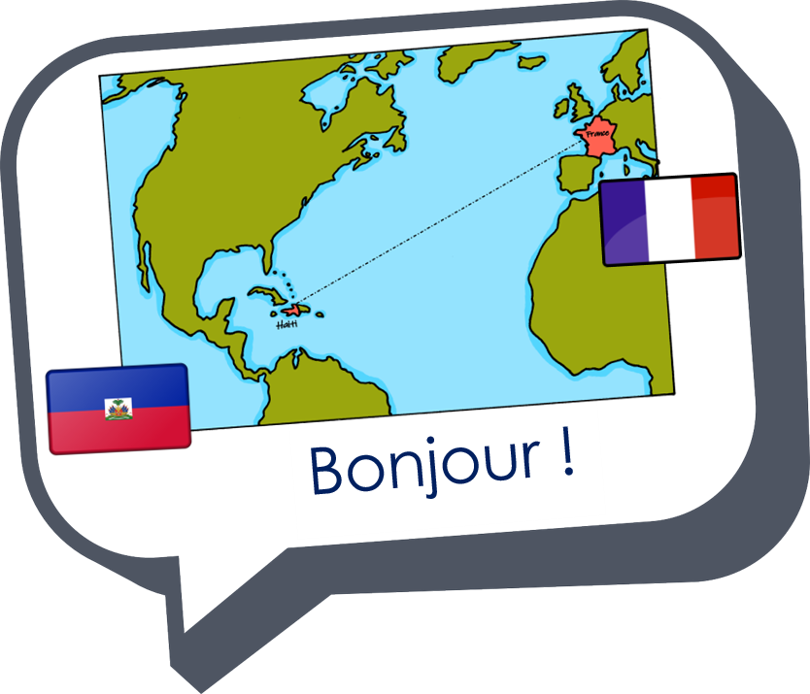

Interactions
Échange en ligne
vert
des (some)
plural adjectives
SSC [au]
Notes:
Artwork by Steve Clarke. Pronoun pictures from NCELP (www.ncelp.org). All additional pictures selected from Pixabay and are available under a Creative Commons
license, no attribution required.
Phonics: revisit au/eau/o: gauche [607] faux [555] eau [475] photo [1412] aussi [44]
Vocabulary: centre commercial [491/908] église [1782] magasin [1738] pont [1889] rue [598] excellent [1225] différent [350] idéal [1429] important [215]
indépendant [954] moderne [1239] propre [237] sale [2906] des [de-2]
Revisit 1: sont [5] ils [13] elles [38] dangereux [713] ennuyeux [>5000] heureux [764] sérieux [412] travailleur [1341] aussi [44] et [6] mais [30]
Londsale, D., & Le Bras, Y. (2009). A Frequency Dictionary of French: Core vocabulary for learners London: Routledge.
The frequency rankings for words that occur in this PowerPoint which have been previously introduced in these resources are given in the SOW and in the resources that
first introduced and formally re-visited those words.
For any other words that occur incidentally in this PowerPoint, frequency rankings will be provided in the notes field wherever possible.
1

Slide 2


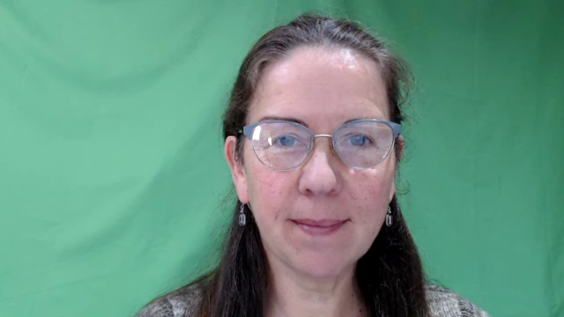
[au]
[au / eau / o]
prononcer
gauche
Notes:
Timing: 2 minutes
Aim: to present SSC [au].
Procedure:
Click to bring up the SSC [au]. Repeat the SSC [au] and the source word gauche with the class. Introduce the gesture, if using.
Click to bring up the picture.
Pupils to practise saying the SSC and source word several times.
Suggested gesture:
https://www.signbsl.com/sign/left
Tap the left forearm with the right hand.

Slide 3


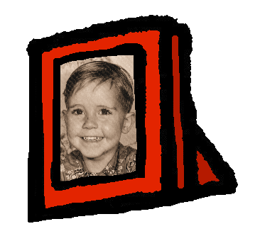
[au]
[au / eau / o]
gauche
prononcer
faux
eau
photo
aussi
[also]
Notes:
Timing: 2 minutes
Aim: To introduce SSC [au]
Procedure:
1. Introduce and elicit the pronunciation of the individual SSC [au] and then the source word again ‘gauche’ (with gesture, if using).
2. Then present and elicit the pronunciation of the five cluster words.
Frequency:
gauche [607] faux [555] eau [475] photo [1412] aussi [44]
Londsale, D., & Le Bras, Y. (2009). A Frequency Dictionary of French: Core vocabulary for learners London: Routledge.

Slide 4



écouter
Écoute. C’est [(e)au] ou [ou] ?
Écris les numéros 1 et 2 dans le bon ordre.
ou
1 | 2
faux | fou _{[mad]}
beau_{[fine, beautiful]} | bout_{[end, tip]}
tôt | tout
vous | veau_{[veal]}
pou_{[flea]} | peau_{[skin]}
1
1
2
2
1
2
3
2
1
4
2
1
5
2
1
Notes:
Timing: 5 minutes
Aim: to practise aural recognition of SSC [(e)au, o] and differentiation between [(e)au, o] and SSC [ou] in unknown words.
Procedure
Pupils listen to the pairs of words.
They write down the order that they hear the words in, either 1-2 or 2-1
Click to reveal the answers.
Transcript:
faux, fou
beau, bout
tout, tôt
veau, vous
peau, pou
Frequency of unknown words and cognates:
beau [393] bout [508] fou [1357] peau [2122] pou [>5000] veau [>5000]
Source: Londsale, D., & Le Bras, Y. (2009). A Frequency Dictionary of French: Core vocabulary for learners London: Routledge.
4

Slide 5

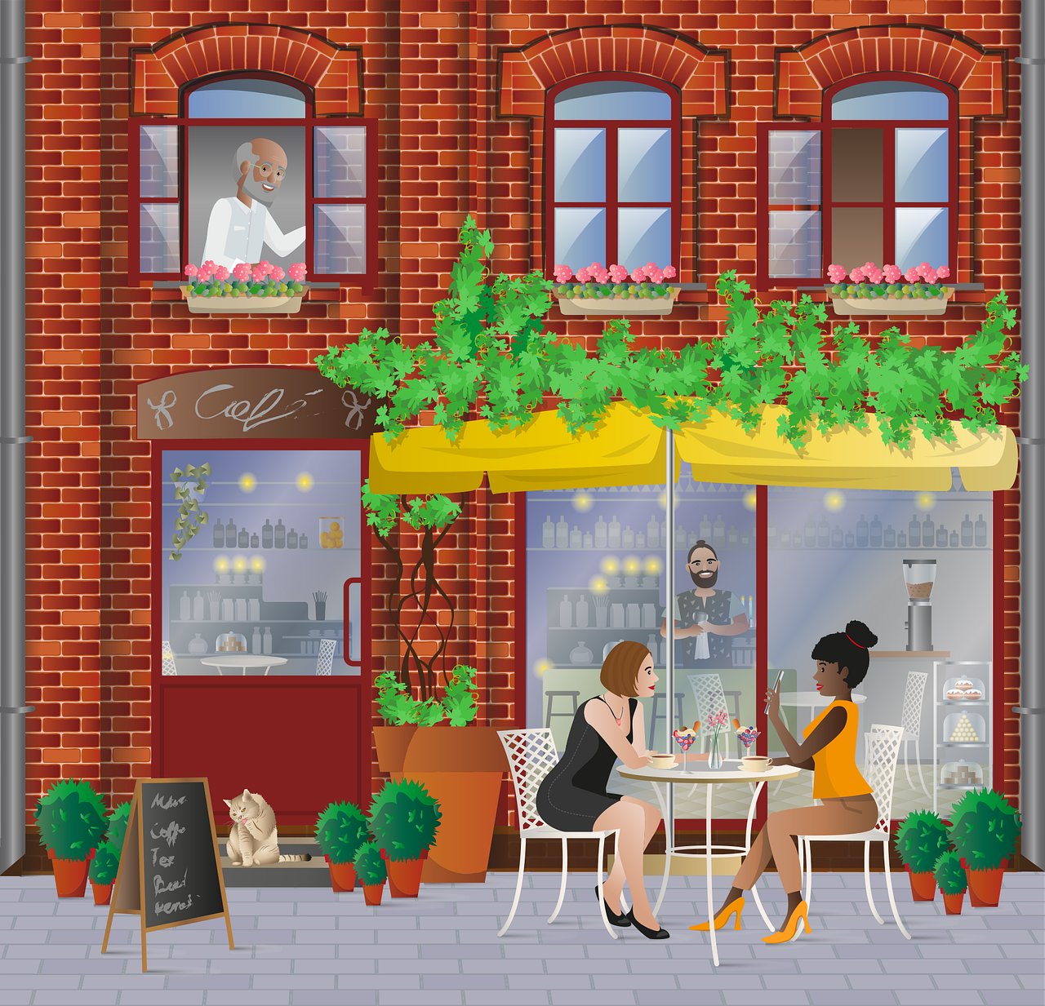

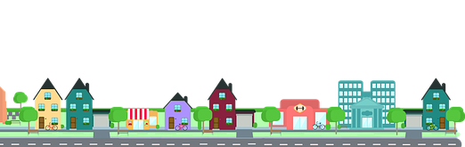
Some | des
un, une = a/an, one
des = some
des
To say ‘some’ (plural), use _______.
il y a
Remember! To say ‘there are’, use __________.
Il a des cafés.
Il y a des cafés.
He has some cafés.
There are some cafés.
Il a des rues.
Il y a des rues.
He has (some) streets.
There are (some) streets.
⚠ In English we can miss out ‘some’ but we always need des in French.
⚠ In French, he has (il a) and there are (il y a) look and sound a bit similar.
Notes:
Timing: 2 minutes
Aim: to revisit the indefinite article ‘des’ (some).
Procedure:
Click through the animations to present the information.
Elicit English translations for the French examples provided.

Slide 6

écouter
Écoute. C’est au singulier ou au pluriel ?
Écris 1 – 6 et ‘one’ ou ‘some’.
Écoute encore. C’est ‘he has’ ou ‘there is/are’ ?
 | Il y a une poste.
 | Il y a des maisons.
 | Il a des parcs.
 | Il a un centre commercial.
 | Il y a des magasins.
 | Il a un pont.
 | Il y a un église.
 | Il y a des rues.
one | some
he has | there is /are
1
2
3
4
5
6
7
8
Notes:
Timing: 5 minutes
Aim: to practise aural recognition of one or more than one, from the indefinite article.
Remind pupils that the article is the only way to tell – the –s on the written form of a plural French noun is not pronounced (i.e. is a silent final consonant)!
Procedure
Student listen to the short sentences and decide if they hear un/une or des.
Click to elicit and reveal the answers.
Now, pupils listen again to decide if they hear ‘he has’ or ‘there is/as’
Click to elicit and reveal the answers.
Finally, click to reveal the full sentences and elicit English meanings.
In addition, the pictures at the bottom could be used to elicit ‘un livre’, ‘des livres’ etc.. for additional practice.
Transcript:
Il y a une poste.
Il y a des maisons.
Il a des parcs.
Il a un centre commercial.
Il y a des magasins.
Il a un pont.
Il y a une église.
Il y a des rues.
6

Slide 7



Vocabulaire
. Écoute les noms des animaux. C’est [ien] ou [(a)in]?
Comment dit-on ça en français ?
mots
le centre commercial
le magasin
propres
sale
excellente
(the) shopping centre
des
clean
(m/f pl)
(the) church
clean
(m/f)
excellent (mpl)
(the) street
(the) bridge
dirty (m/f)
some
Excellent !
excellent (f)
(the) shop
dirty (mfpl)
l’église (f)
le pont
propre
excellents
sales
la rue
Notes:
Timing: 8 minutes
Aim: to present and practise new vocabulary and revisited words.
Procedure:
Click for an English prompt.
Pupils say the French translation chorally.
Click to highlight the correct French word.
Continue until all the words have been practised.
7

Slide 8
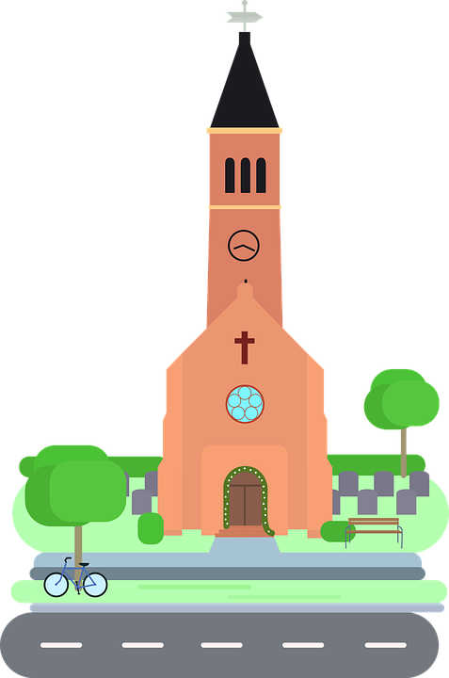
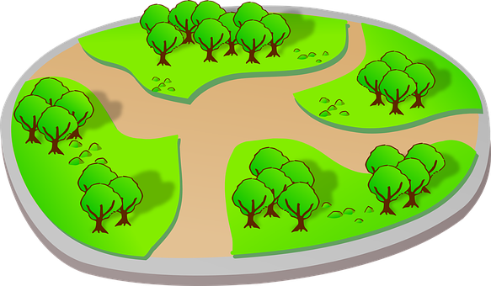


Plural adjectives
Singular and plural adjectives sound the same.
As you know many adjectives add -s for plural:
Il y a un parc vert.
Il y a une église importante.
There is a green parc.
There is an important church.
Il y a des parcs verts.
Il y a des églises importantes.
There are some green parcs.
There are some important churches.
You don’t hear the difference between singular and plural adjectives because of SFC, so you need to listen out for the article.
Notes:
Timing: 2 minutes
Aim: to recap patterns of plural adjective agreement; to establish that you can often hear gender difference with adjectives but not number difference, so the article is very important.
Procedure:
Click to present the information.
Elicit English translation for the French examples provided.
8

Slide 9


parler
Parle avec ton/ta partenaire.
Say there are these things.
Write what your partner says there is in English.
A
B
It is saying un/une or des which makes your meaning clear.
Il y a des ponts intéressants.
 | a/an | some
1
2
3
4
5
interesting bridges
Il y a __________ intéressants.
Many singular and plural adjectives and nouns sound the same.
Notes:
Timing: 7 minutes (including modelling slide)
Aim: to practise spoken production and aural comprehension of correct indefinite articles un/une and des.
Procedure:
Click through the animations to present the information and to model the task.
Partner Bs then turn away from the board, having copied the table headings and numbered 1-5 as per the table on this slide.
9

Slide 10



parler
Parle avec ton/ta partenaire.
Say there are these things.
Write what your partner says there is in English.
A
B
 | a/an | some
1
2
3
4
5
Il y a sale.
dirty cinema
independent cafés
Il y a indépendants
Il y a importantes.
important streets
Il y a moderne.
modern shopping centre
different church
Il y a différente.
Notes:
Round 1
Aim: to practise spoken production and aural comprehension of correct indefinite articles un/une and des.
Procedure:
Partner Bs turn away.
Partner As say each of the 5 sentences.
Partner Bs note the item and whether it is a/an (singular) or some (plural).
Partner Bs turn back to the board.
Click to reveal answers.
Move to the next slide to swap roles.
Note: if desired, teachers can click on the dark blue text boxes to hear the full sentences.
10

Slide 11

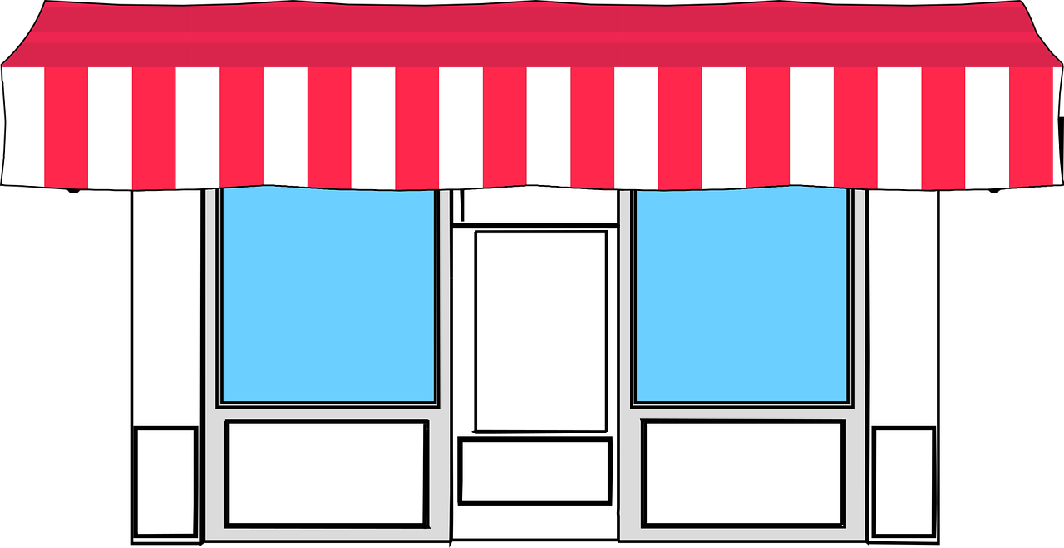
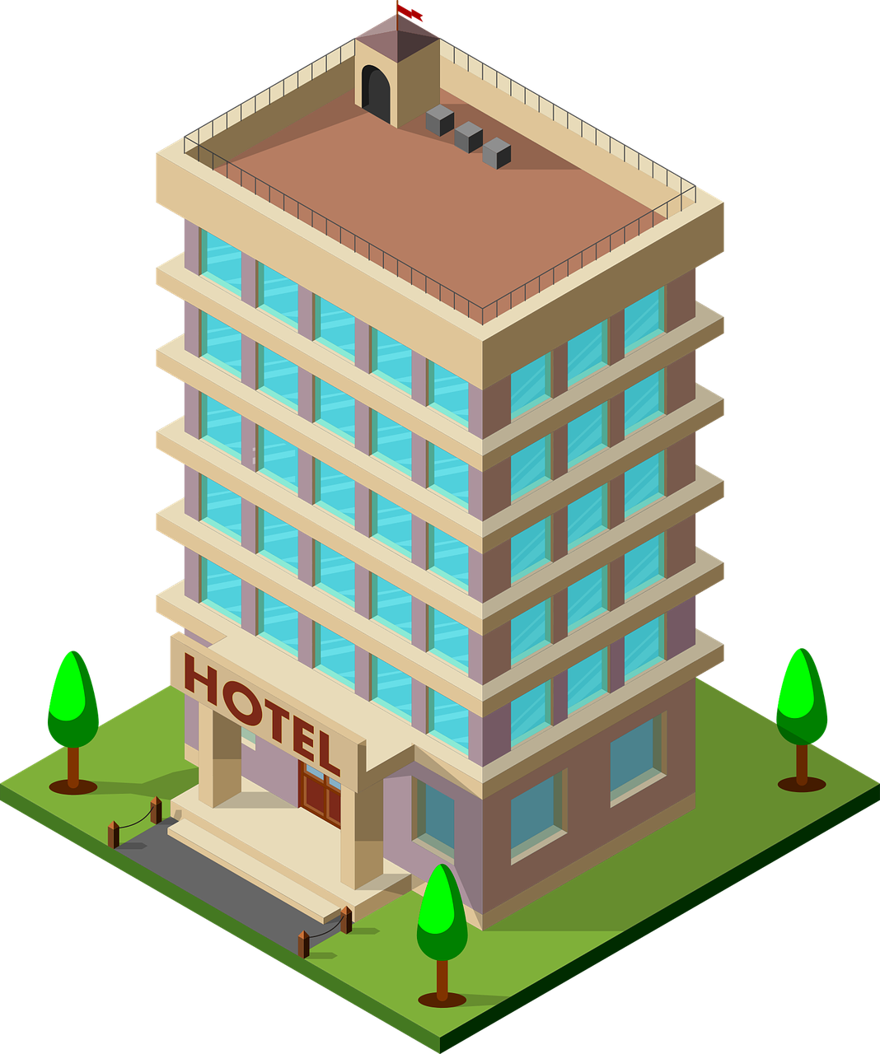
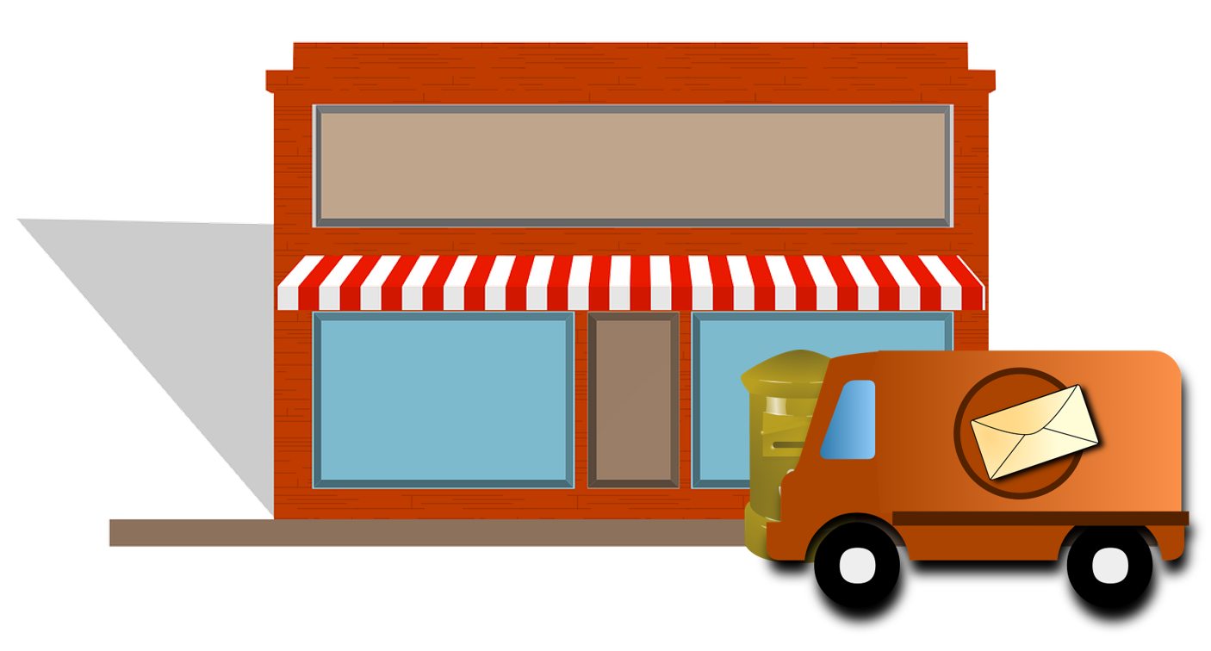
parler
Parle avec ton/ta partenaire.
Say there are these things.
Write what your partner says there is in English.
B
A
 | a/an | some
1
2
3
4
5
Il y a gris.
grey bridge
important shops
Il y a importants.
Il y a différents.
different hotels
Il y a propres.
clean parks
useful post office
Il y a utile.
Notes:
Round 2
Aim: to practise spoken production and aural comprehension of correct indefinite articles un/une and des.
Procedure:
Partner As turn away.
Partner Bs say each of the 5 sentences.
Partner As note the item and whether it is a/an (singular) or some (plural).
Partner As turn back to the board.
Click to reveal answers.
Note: if desired, teachers can click on the dark blue text boxes to hear the full sentences.
11

Slide 12
Au revoir !
bleu
Notes:
12

