Slide 1


Interactions
Échange en ligne
« avoir » j’ai, il a,
elle a
adjective agreement (singular)
SSC silent final [e]
vert
Notes:
Artwork by Steve Clarke. Pronoun pictures from NCELP (www.ncelp.org). All additional pictures selected from Pixabay and are available under a Creative Commons license, no
attribution required.
Phonics: revisit SFe (Silent Final [e])
Vocabulary: avoir [8] j’ai [8] quoi [297] un [3] une [3] café [1886] cinéma [1623] hôtel [1774] poste [489] école [477] très [66] re-use adjectives: différent, idéal, important, parfait, propre, sale, terrible, moderne, utile, gris, rouge, jaune, bleu, vert, fort, jeune,
Revisit 1: êtes [5] vous [50] ensemble [124] tôt [513] en retard [1279] ici [167] là [109] pour [10]
Revisit 2: -
Londsale, D., & Le Bras, Y. (2009). A Frequency Dictionary of French: Core vocabulary for learners London: Routledge.
The frequency rankings for words that occur in this PowerPoint which have been previously introduced in these resources are given in the SOW and in the resources that first
introduced and formally re-visited those words.
For any other words that occur incidentally in this PowerPoint, frequency rankings will be provided in the notes field wherever possible.
1

Slide 2



prononcer
[SFe]
Silent final -e
timide
⚠ Remember: The Silent Final -e means you pronounce the final consonant.
[shy]
Notes:
Timing: 1 minute
Aim: to present and practise SSC Silent Final –e.
Procedure:
Introduce and elicit the pronunciation of the individual SSC [SFe] the source word ‘timide’ with gesture, if using.
Click to bring on the picture and get pupils to repeat (with gesture, if using).
Move to the next slide to present and practise the cluster words.
Suggested gesture:
Bring up the palm of one hand in a gesture of covering / hiding the face.
This is like the 4th video on the BSL site, here: https://www.signbsl.com/sign/shy
2

Slide 3







prononcer
[SFe]
monde
timide
douze
[shy]
centre
moderne
Notes:
Timing: 2 minutes
Aim: To introduce/consolidate SSC [SFe]
Procedure:
1. Practise the pronunciation of the individual SSC [SFe] and then the source word again ‘timide’ (with gesture, if using).
2. Then present and elicit the pronunciation of the four cluster words.
Frequency:
monde [77] moderne [1239] centre [491] vie [132] douze [1664] timide [3835]
Source: Londsale, D., & Le Bras, Y. (2009). A Frequency Dictionary of French: Core vocabulary for learners London: Routledge.
3

Slide 4

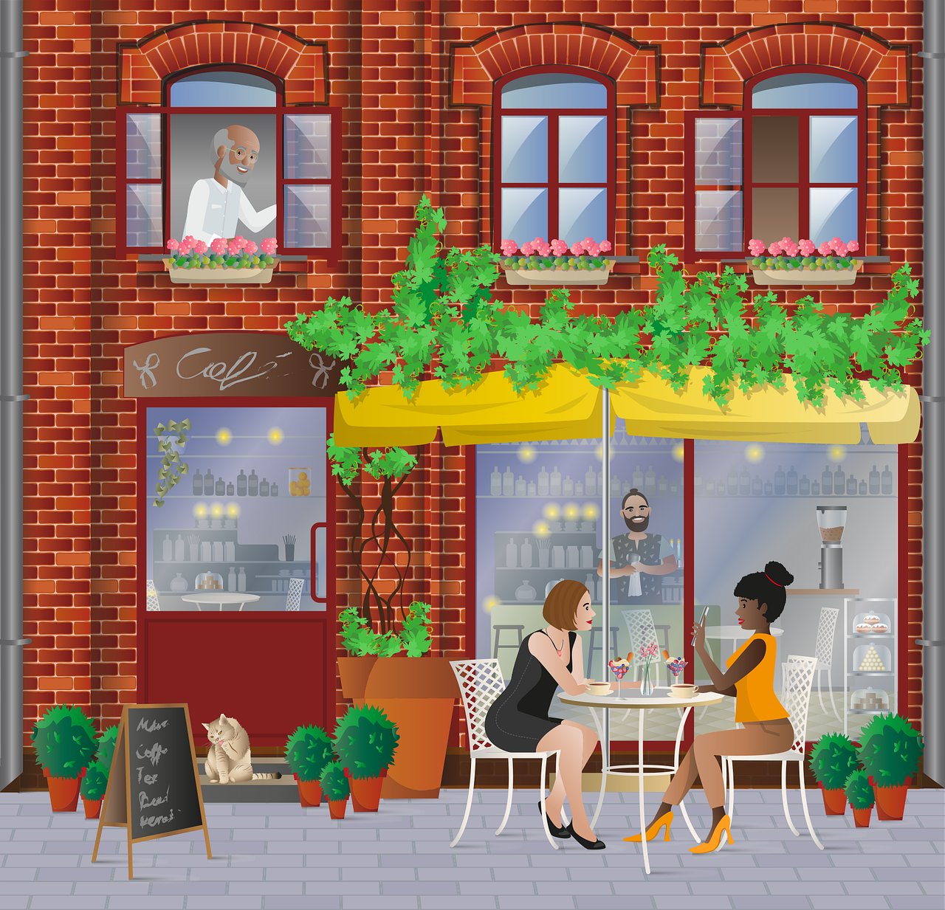



Avoir: I have | s/he, it has
[to have, having]
to have
In French the verb avoir means ___________.
Remember that it is an irregular verb:
Elle a un café.
J’ai une poste.
I have a post office.
She has a café.
Il a un cinéma.
He has a cinema.
Notes:
Timing: 2 minutes
Aim: to revisit 1st and 3rd person singular of ‘avoir’.
Procedure:
Click to present the information.
Elicit English translations for the Spanish examples provided.

Slide 5



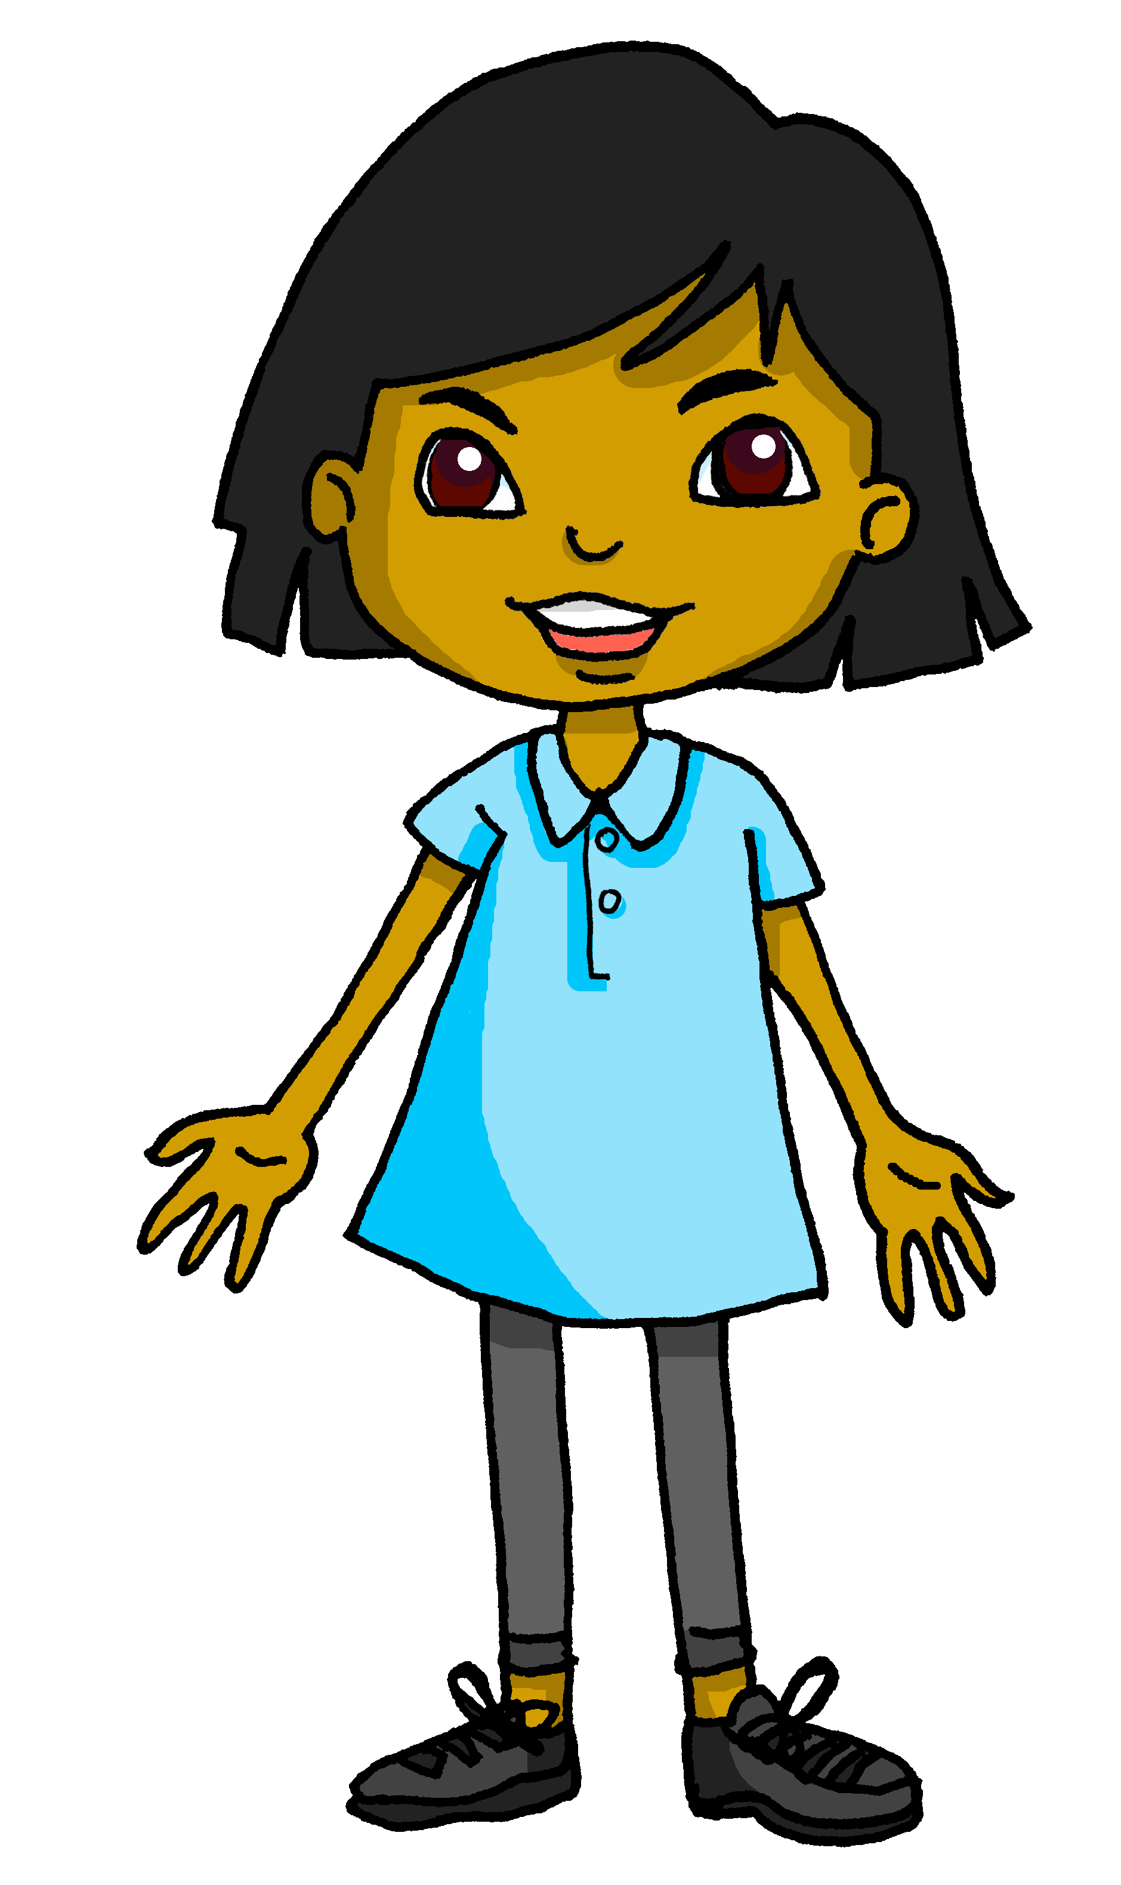
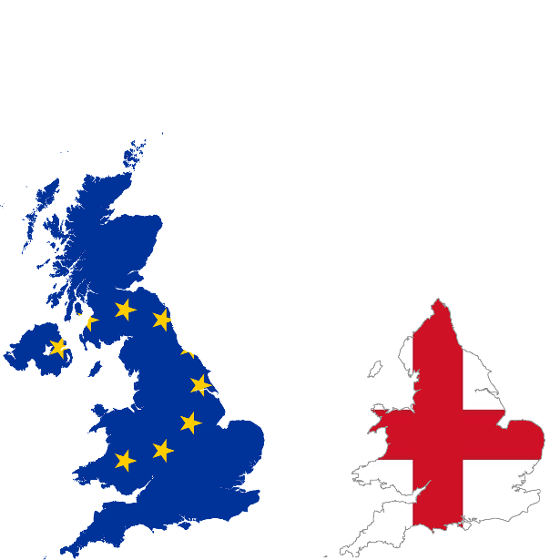
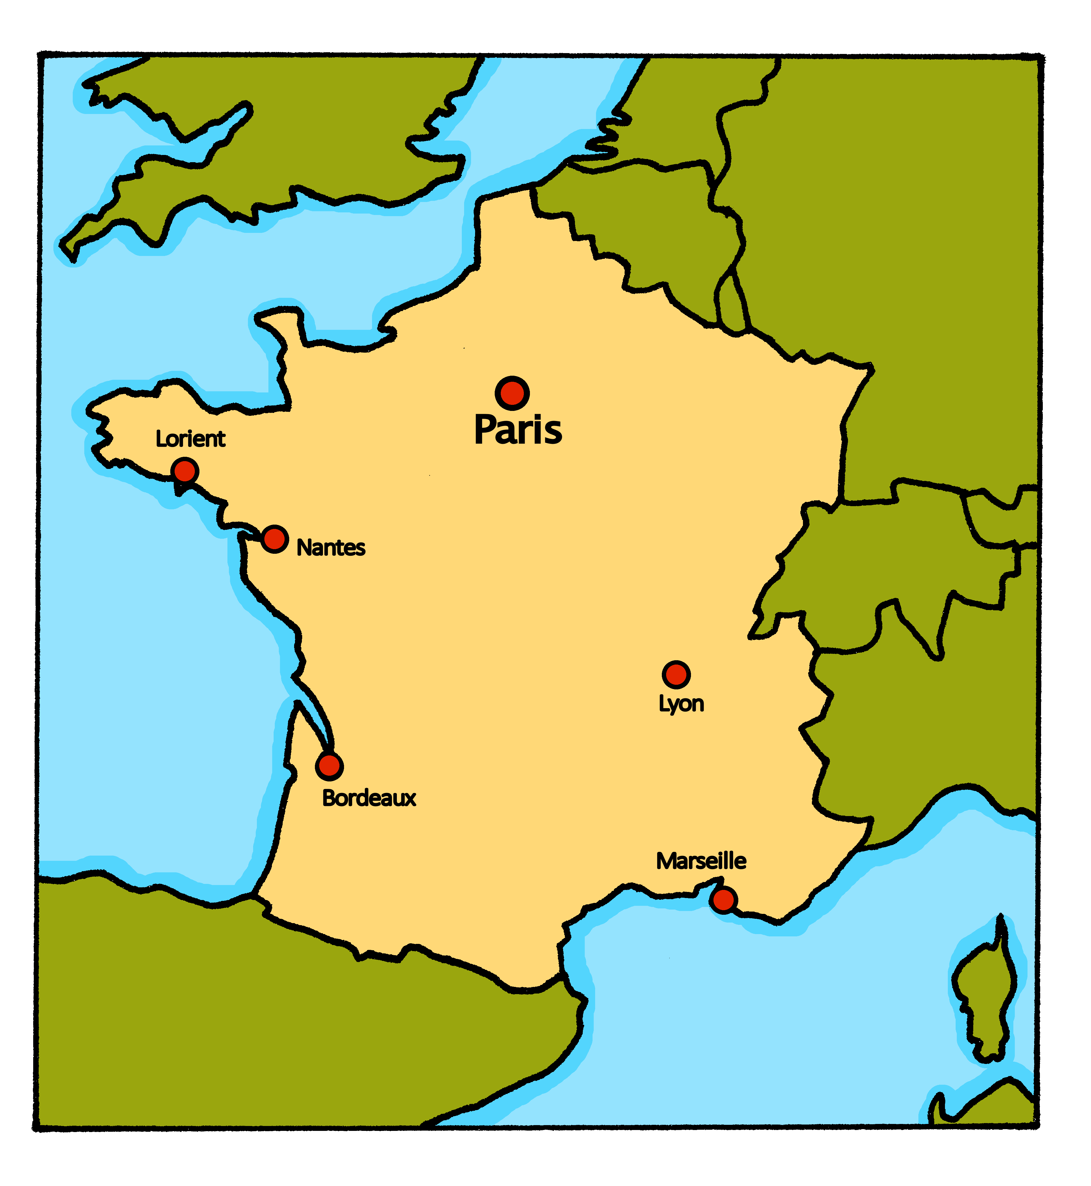
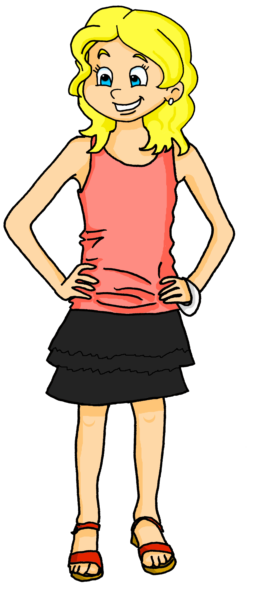
lire
Adèle a une amie, Sanaya, en Angleterre
J’ai une amie en Angleterre !
Salut !
Je suis Sanaya.
Notes:
Time: 1 minute
Aim: to introduce Sanaya, Adèle’s pen friend from the UK.
Procedure:
Read the context and clarify meaning.
Click to bring up speech bubbles and elicit translations from pupils.

Slide 6


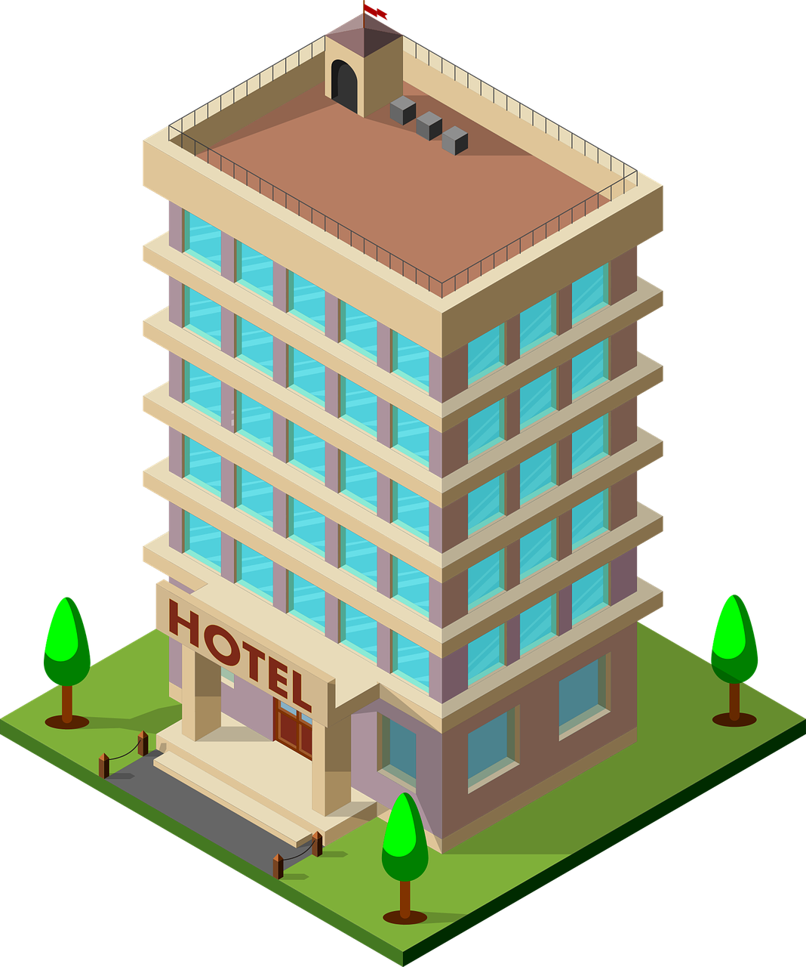
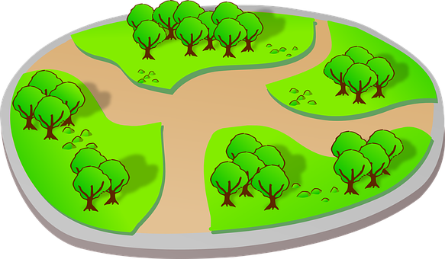
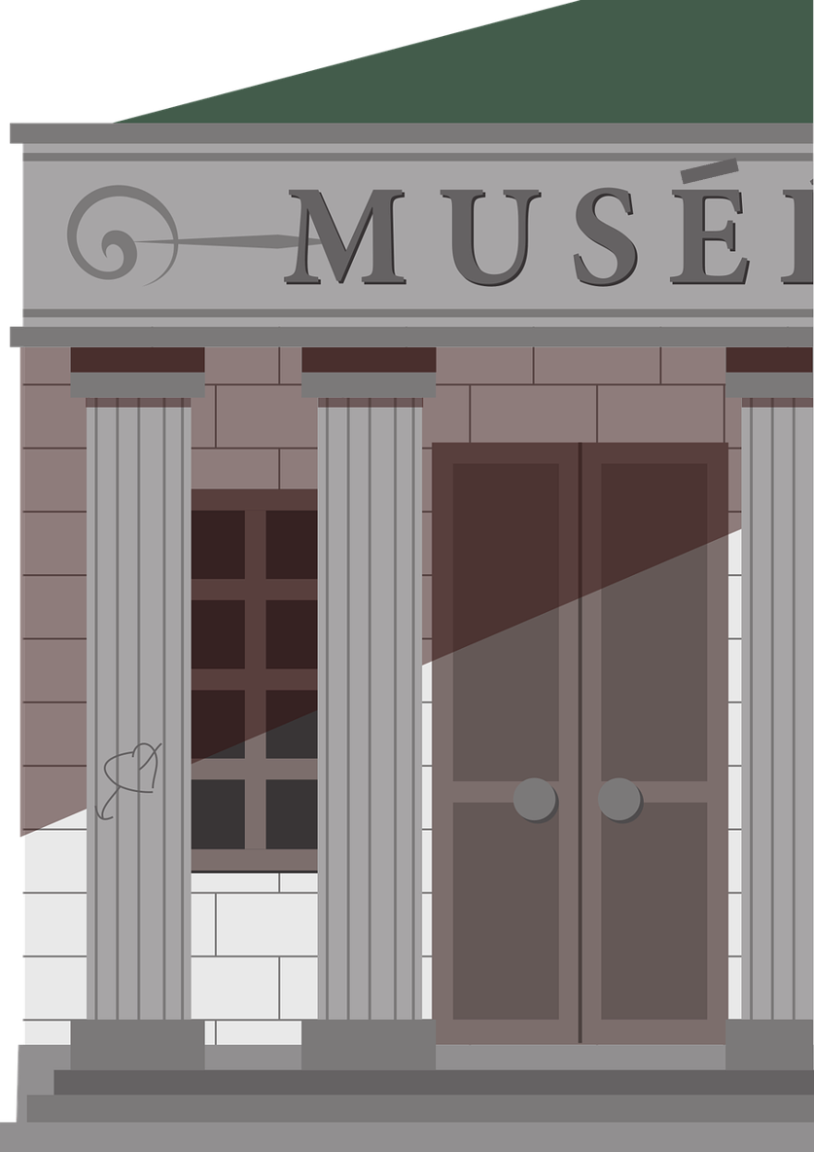
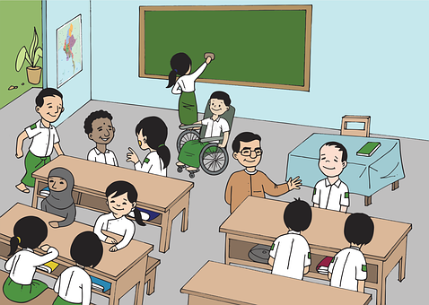
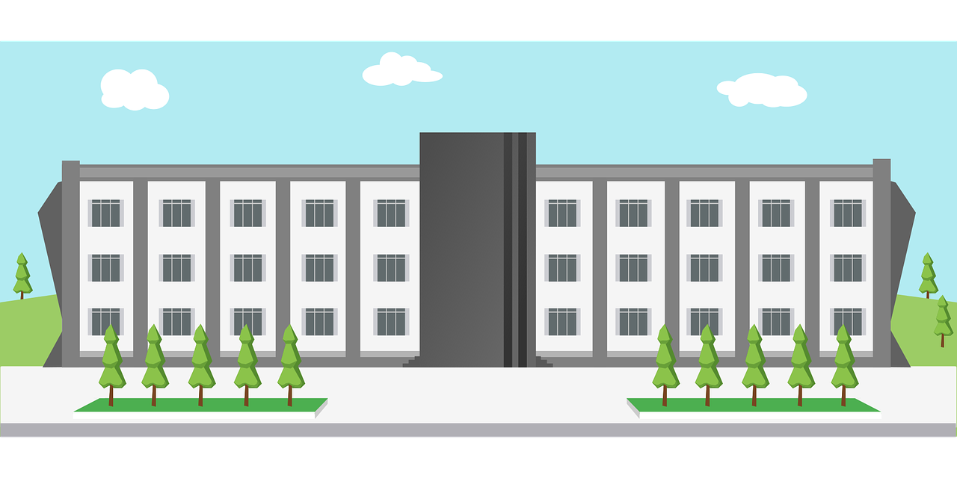
lire
Adèle décrit. Qui a quoi ?
You don’t need all the pictures!
Lis les phrases. C’est Adèle (I) ou Sanaya (she) ? C’est quelle image ? Écris Je ou Elle et la bonne lettre A – H.
1
Elle
a un hôtel.
C
A
B
C
2
ai un cinéma.
J’
D
3
ai une poste.
D
E
J’
F
4
Elle
a un musée.
B
5
F
G
H
Elle
a une université.
H
6
ai un café.
J’
E
Notes:
Time: 8 minutes
Aim: to practise written comprehension of ‘ai’ and ‘a’ and (re)introduce a range of previously taught and four new cognate vocabulary items (hôtel, cinéma, poste, café).
Procedure:
Read the context and clarify meaning.
Do number 1 together with pupils to model the task.
Pupils complete 2 – 6.
Click each number to listen to full sentences and correct.
Elicit the French for the two unused vocabulary items – un parc, une école.
Transcript:
1. Elle a un hôtel.
2. J’ai un cinéma.
3. J’ai une poste.
4. Elle a un musée.
5. Elle a une université.
6. J’ai un café.

Slide 7
Adjectives following the noun
In French, most adjectives follow the noun:
In English the adjective comes before the noun.
J’ai une poste importante.
I have an important post office.
⚠ Remember: Adjectives that end in -e stay the same to describe all singular nouns.
Elle a un café moderne.
She has a modern café.
⚠ You can also use ‘on a’ (literally ‘one has’) to mean ‘you/people in general have’.
Il a un cinéma idéal.
He has an ideal cinema.
Notes:
Timing: 2 minutes
Aim: to revisit postnominal adjective agreement.
Procedure:
Click through the animations to present the information.
Elicit English translations for the French examples provided.
Callout 1 highlights the difference between English and French.
Callout 2 reminds pupils about gender agreement of adjectives ending in –e.

Slide 8


écouter
Adèle décrit Lorient
⚠ Remember: Adjectives that end in -e stay the same to describe all singular nouns.
Écoute. Lorient a quoi ?
1
À Lorient on a une école | un café importante.
2
À Lorient on a un cinéma | une université indépendant.
3
À Lorient on a un parc | une poste différent.
4
À Lorient on a un hôtel | une école moderne.
5
À Lorient on a une poste | un café utile.
utile - useful
Notes:
Timing: 8 minutes
Aim: to practise aural recognition of masculine and feminine adjectives and their connection to masculine and feminine nouns.
Procedure:
Read the title and instructions and ensure the task scenario is understood. Adèle describes Lorient, where she lives.
Pupils write the correct noun for items 1-6, based on whether they hear the final consonant of the adjective pronounced or not – this practises SFe our SSC focus for this week.
Note: it’s important for pupils to remember that if the adjective ends in –e it can describe a masculine or feminine noun, so some answers could be both places.
Click to reveal answers and elicit English meanings of the phrases.
Transcript 1:
1. Lorient a [beep] importante.
2. Lorient a [beep] indépendant.
3. Lorient a [beep] différent.
4. Lorient a [beep] moderne.
5. Lorient a [beep] utile.
Transcript 2:
1. Lorient a une école importante.
2. Lorient a un cinéma indépendant.
3. Lorient a un parc différent.
4. Lorient a un hôtel moderne. | Lorient a une école moderne.
5. Lorient a une poste utile. | Lorient a un café utile.
8

Slide 9





vocabulaire
Écris en anglais : Can you get at least 15 points?
mots
 | vous êtes | en retard | ensemble
 | ici | là | tôt
 | pour | l’école (f) | indépendante
 | sale | propre | idéal
 | l’hôtel (m) | la poste | elle a
 | j’ai | le cinéma | très
 | avoir | utile | le café
you (all) are
late
together
x3
here
there
early
for
(the) school
independent (f)
x2
dirty (m/f)
clean (m/f)
ideal (m)
(the) hotel
(the) post office
she has
I have
(the) cinema
very
x1
to have | having
useful (m/f)
(the) café
Notes:
Timing: 6 minutes
Aim: to practise written comprehension of vocabulary from this week and two revisited weeks.
Procedure:
1. Give pupils a blank grid. They fill in the English meanings of any of the words they know, trying to reach 15 points in total.
2. Remind pupils that adjectives can refer to male or female persons and they should note this in their translations. E.g. pleased (f), short (m).
Note:
The most recently learnt and practised words are pink, words from revisit 1 are green and those from revisit 2 are blue, thus more points are awarded for them, to recognise that memories fade and more effort (heavy lifting!) is needed to retrieve them.
9

Slide 10
Au revoir !
vert
Notes:
10

Slide 11
vocabulaire
Handout - Écris en anglais : Can you get at least 15 points?
mots
 | vous êtes | en retard | ensemble
 | ici | là | tôt
 | pour | l’école (f) | indépendante
 | sale | propre | idéal
 | l’hôtel (m) | la poste | elle a
 | j’ai | le cinéma | très
 | avoir | utile | le café
x3
x2
x1
Notes:
HANDOUT
11

