Slide 1
Interactions
Échange en ligne
« être » ils / elles sont (they are)
adjective agreement (plural)
SSC closed and open [eu]
vert
Notes:
Artwork by Steve Clarke. Pronoun pictures from NCELP (www.ncelp.org). All additional pictures selected from Pixabay and are available under a Creative Commons license, no
attribution required.
Phonics: revisit closed [eu(t,x,s)] un peu [91] vs open [eu(r,l,f,ne,ve)] peur [755] fleur [2305] jeune [152] neuf [787] acteur [1552] seul [102]
Vocabulary: activité [452] chaise [3419] chanson [2142] garçon [1599] fille [629] jeu [291] langue [712] règle2 [488] spectacle [1687]
Revisit 1: sommes [5] nous [31] quel, quelle [146] date [660] jour [78] semaine [245] saison [1667] lundi [1091], mardi [1044] mercredi [1168] jeudi [1112] vendredi [1086] samedi [1356] dimanche [1235] aujourd’hui [233]
Revisit 2: -
Londsale, D., & Le Bras, Y. (2009). A Frequency Dictionary of French: Core vocabulary for learners London: Routledge.
The frequency rankings for words that occur in this PowerPoint which have been previously introduced in these resources are given in the SOW and in the resources that first
introduced and formally re-visited those words.
For any other words that occur incidentally in this PowerPoint, frequency rankings will be provided in the notes field wherever possible.
1

Slide 2
closed [eu]
open [eu]
prononcer
un peu
peur
It sounds like the ‘ur’ in ‘hurt’.
[a bit]
[fear]
This is a closed vowel. When you say this sound, your tongue is near the top of your mouth.
This is an open vowel. When you say this sound, your tongue is near the bottom of your mouth.
Notes:
Timing: 2 minutes
Aim: to revisit closed [eu] and introduce open [eu].
Procedure:
Click to bring up the closed [eu]. Repeat the SSC [eu] with the class.
Click to bring up the phrase ‘un peu’ (with gesture, if using).
Click to bring up the English translation and picture.
Pupils to practise saying the phrase several times.
Click to bring up the callout about closed vowel tongue position.
Click to bring up the open [eu]. Repeat the SSC with the class.
Click to bring up the word ‘peur’ (with gesture, if using).
Click to bring up the English translation and picture, and the callout hint about ‘hurt’.
Say this SSC several times with the class.
Click to bring up the call out about open SSC [eu].
Practise alternating between ‘peu’ and ‘peur’ several times.

Slide 3
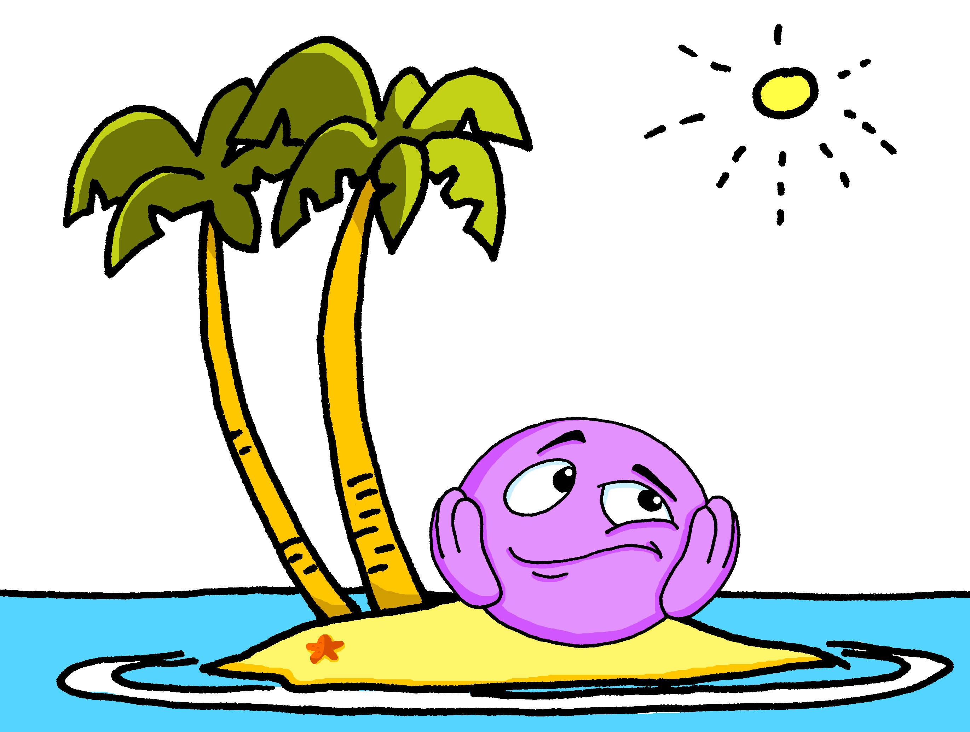
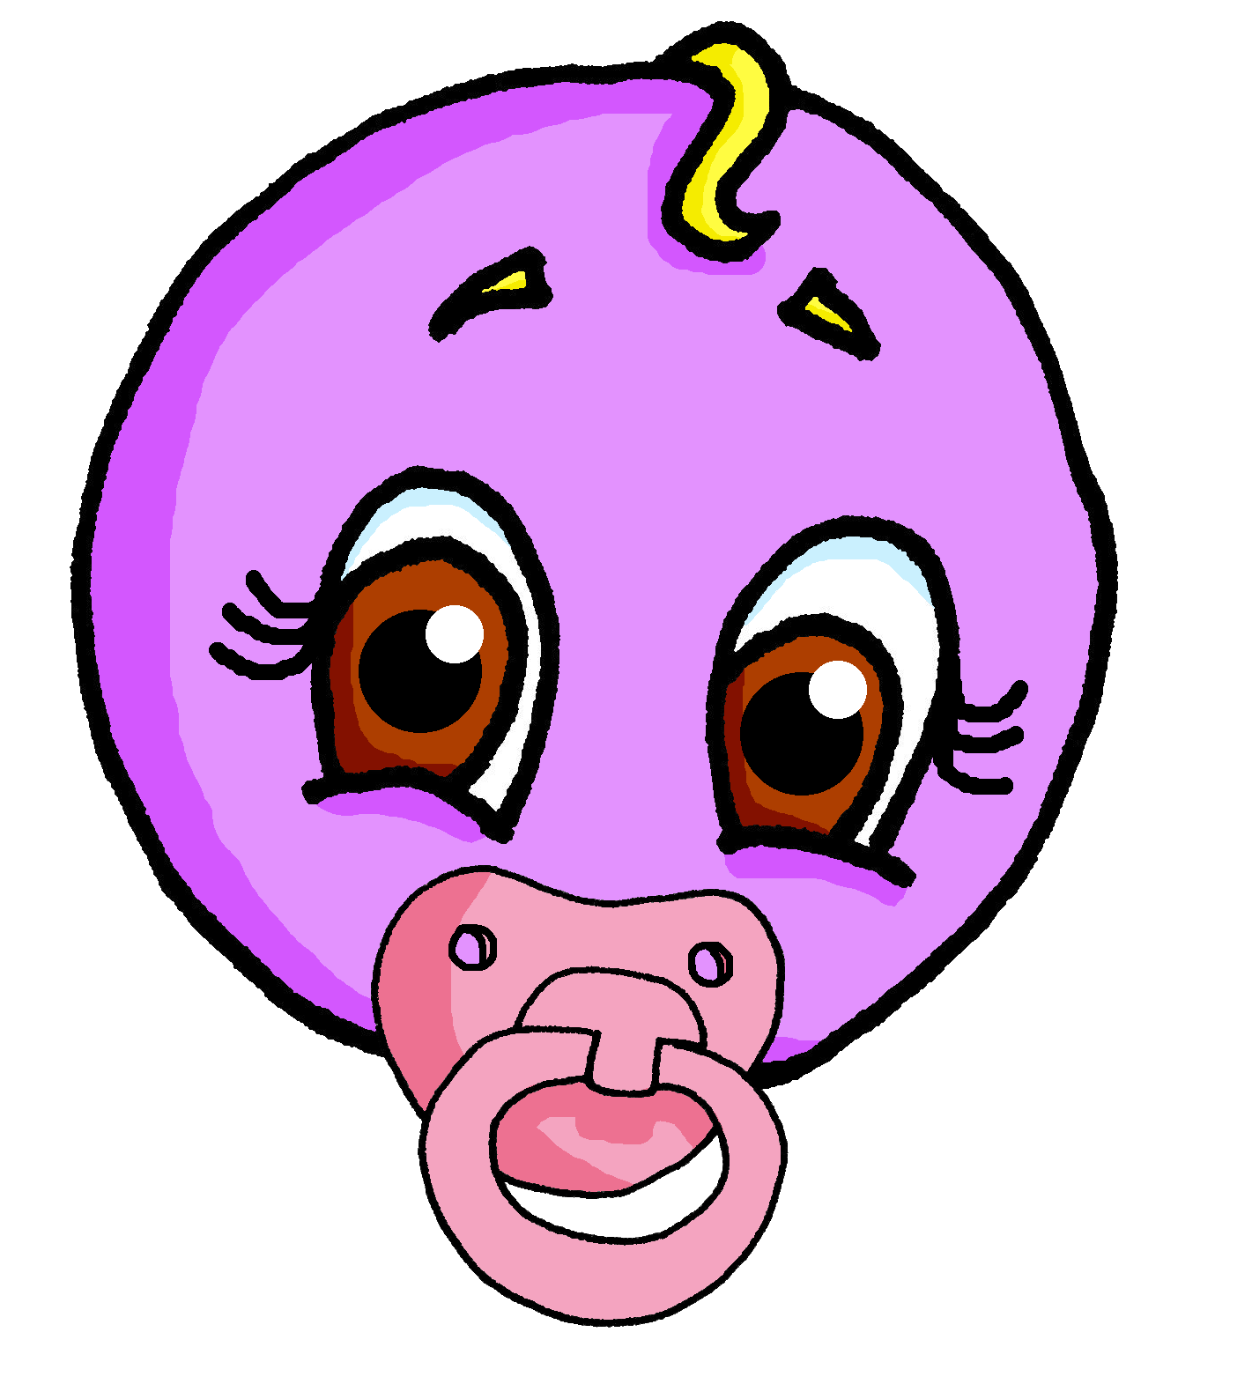
prononcer
open[eu]
fleur
jeune
seul
[eu] is often open when followed by final r, f, l, but closed before final x, s.
neuf
acteur
Notes:
Timing: 2 minutes
Aim: to practise open SSC [eu] in words where [eu] is followed by –l, -f, -r, -n(e).
Procedure:
Elicit the pronunciation of the individual SSC [eu].
Click to bring on the first picture and word and elicit the pronunciation from pupils.
Click again to bring up four cluster words to practise the sound. Repeat the words several times. Note: jeune, neuf and seul are already known.
Finally, click to bring up the callout.
3

Slide 4
écouter
Pierre écrit un poème.
. Écoute les noms des animaux. C’est [ien] ou [(a)in]?
Écoute. C’est avec [eu] comme ‘un peu’ ou avec [eu] comme ‘peur’ ?
 | Elle a deux yeux bleus,
 | beaucoup de cheveux.
 | Elle adore les fleurs
 | et elle aime les jeux.
 | Elle est travailleuse
 | et elle est ma sœur.
[eu] un peu | [eu] peur
le cheveu – hair la fleur - flower
1
v
2
v
3
v
4
v
5
v
6
v
Notes:
Timing: 5 minutes
Aim: to practise aural recognition of and differentiation between closed and open [eu].
Procedure
Student listen to the short sentences and decide if they hear closed [eu] or open [eu].
Click to check and reveal the written sentences.
Now, pupils are challenged read each sentence aloud chorally.
Teacher corrects, as necessary, or replays the audio, as preferred.
Transcript:
Elle a deux yeux bleus
Beaucoup de cheveux
Elle adore les fleurs et elle aime les jeux. Elle est travailleuse
et elle est ma sœur.
Frequency of unknown words and cognates: cheveu [2296] fleur [2305]
Source: Londsale, D., & Le Bras, Y. (2009). A Frequency Dictionary of French: Core vocabulary for learners London: Routledge.
4

Slide 5
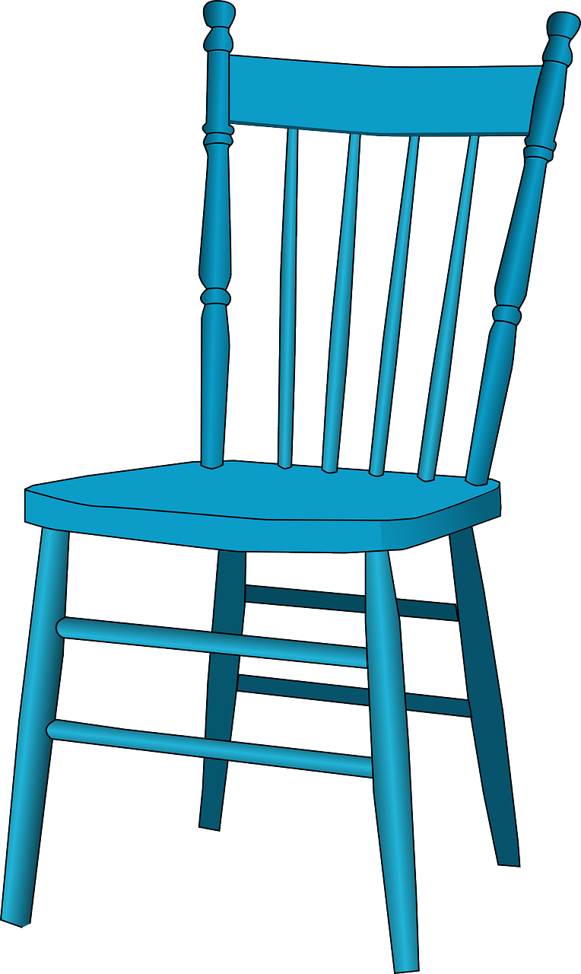
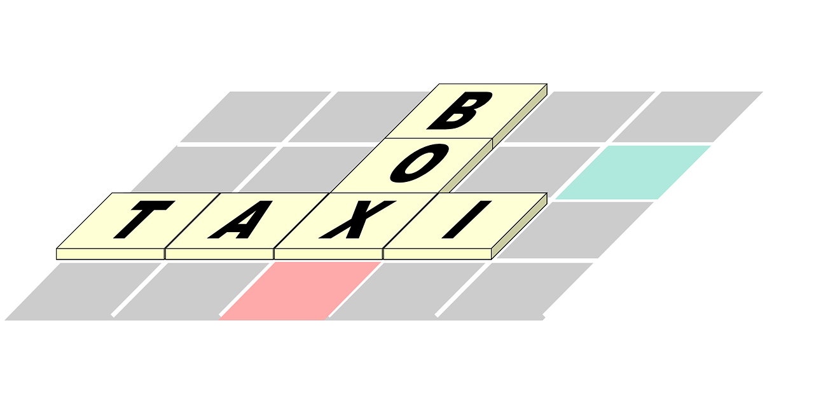
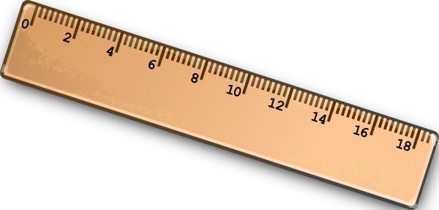
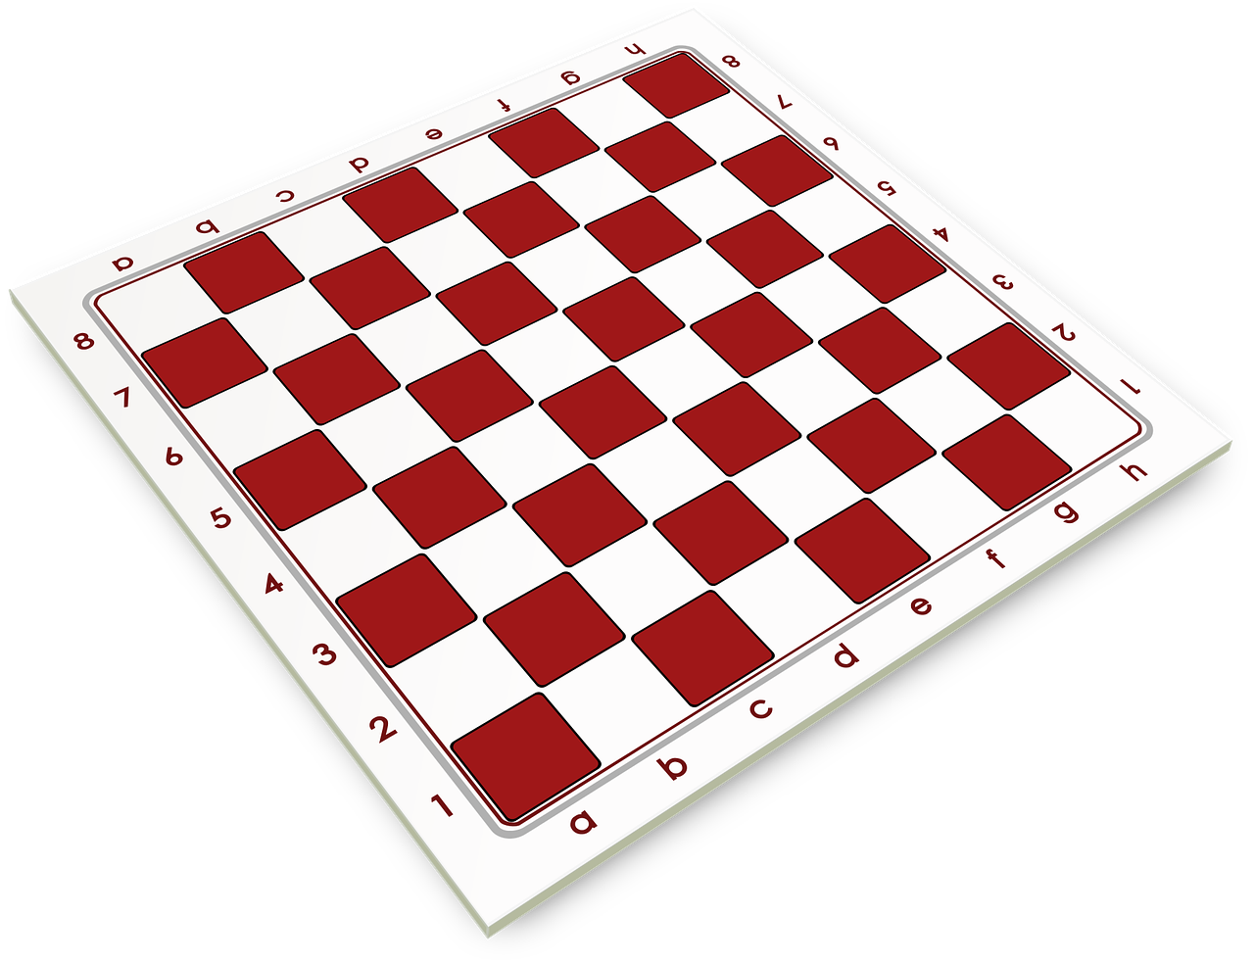
vocabulaire
Écoute et répète.
mots
le spectacle
la fille
la chaise
l’activité
la langue
la règle
(the) Wednesday
(the) language
(the) activity
(the) game
(the) girl
(the) song
(the) show
(the) chair
ruler, rule
Salut !
(the) boy
le mercredi
le garçon
la chanson
le jeu
Wed
Notes:
Timing: 4 minutes
Aim: to revisit previously taught vocabulary.
Procedure: 1. Click for an English prompt.
2. Elicit the French article from pupils (le, la, l’) and the French word. In most cases, pupils will recognise and be able to read the word aloud independently, as they have previously learnt the words. They may need a reminder, of course! 3. Continue until all 10 items have been seen and heard.
5

Slide 6
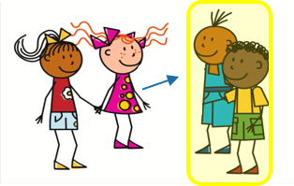
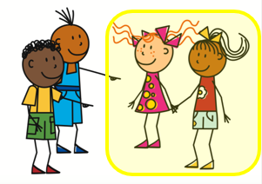
ils / elles:
the pronouns ‘they’
[they]
You know to use ils or elles to mean ‘they’ for people:
Ils sont contents.
Elles sont contentes.
They (m) are pleased.
They (f) are pleased.
Also use ils to mean ‘they’ for all masculine nouns:
And use elles to mean ‘they’ for all feminine nouns:
Ils sont verts.
Elles sont jaunes.
They (m) are green.
They (f) are yellow.
Notes:
Timing: 2 minutes
Aim: to recap use of 3rd person plural pronouns ils and elles for people, and introduce their use for other nouns.
Procedure:
Click to present the information.
Elicit English translation for the French examples provided.
6

Slide 7
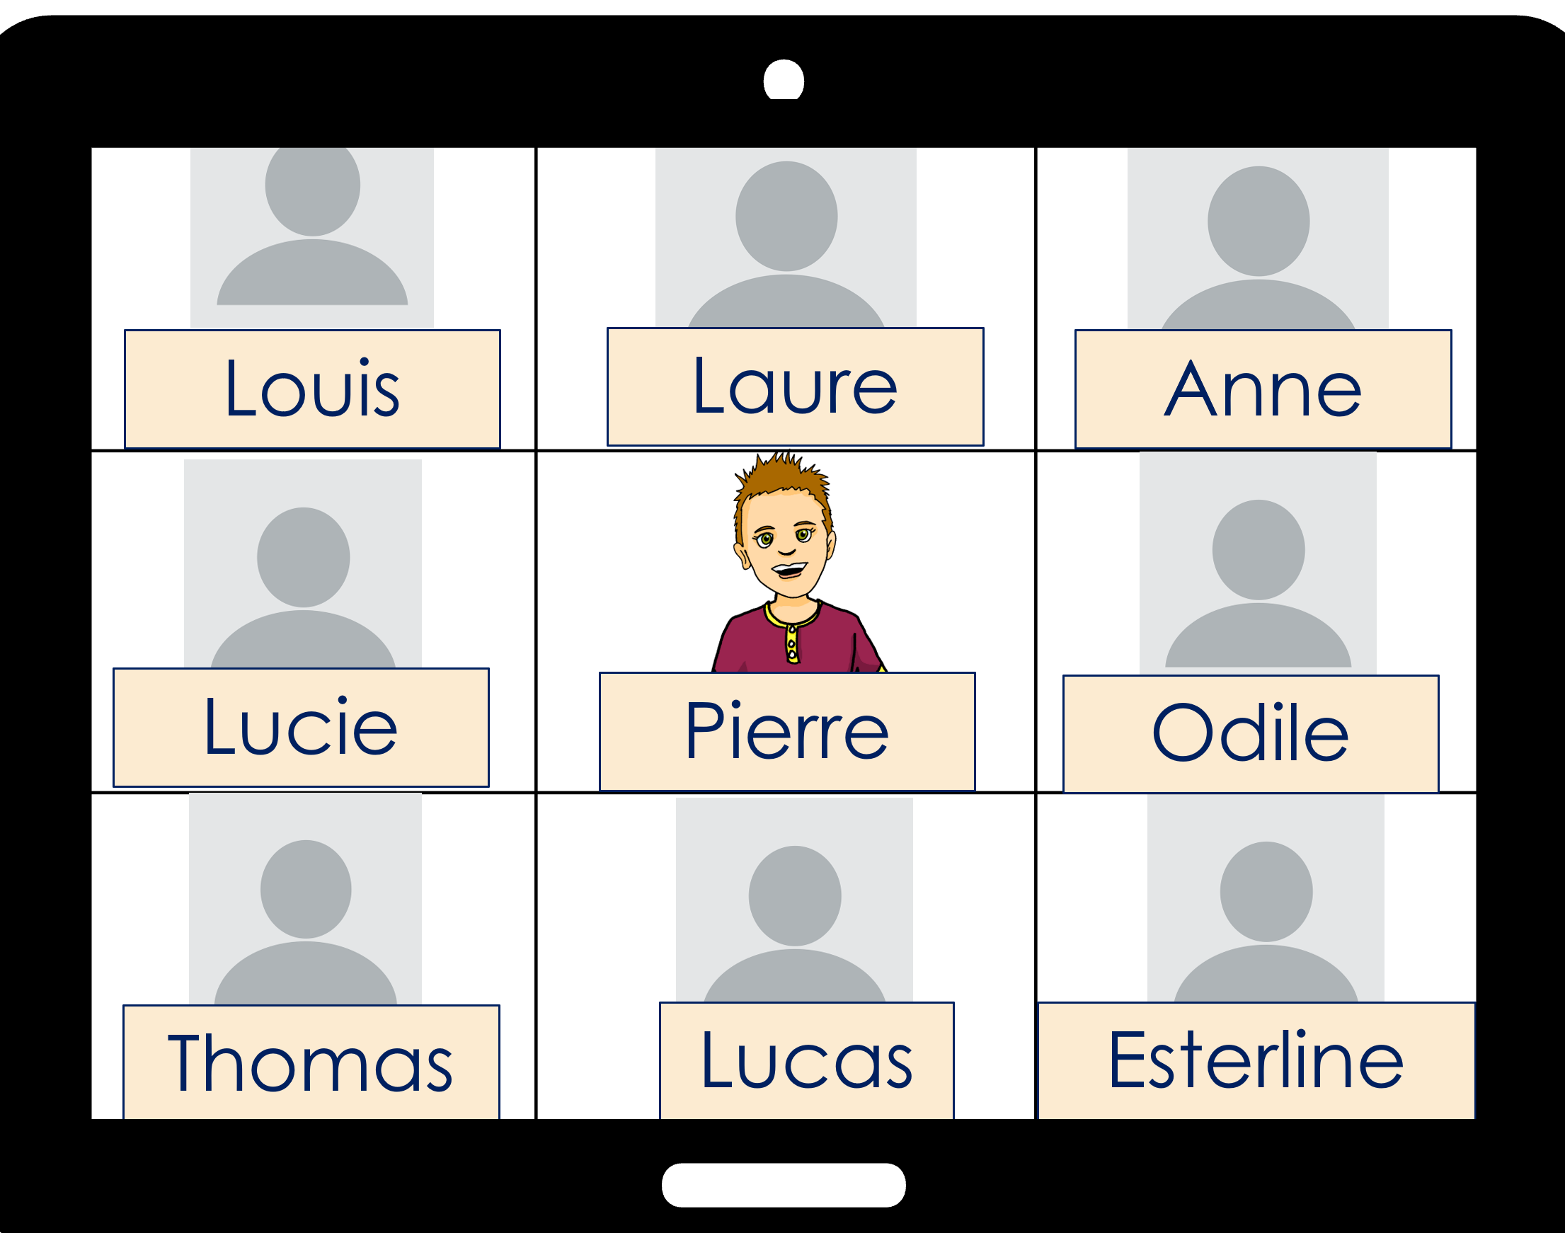
Pierre décrit l’école.
. Écoute les noms des animaux. C’est [ien] ou [(a)in]?
Pierre parle de l’école. Mais c’est quelle image ?
. Écoute les noms des animaux. C’est [ien] ou [(a)in]?
Ils sont importants.
Notes:
Timing: 1 minute
Aim: to introduce the context for the next activity.
Procedure:
Read the instructions and scenario.
Click to hear the phrase ‘Ils sont importants’.
Ask pupils to identify what is being described.
Click to reveal the answer and the transcript. Tell pupils they will need to pay attention to the pronoun ‘ils’ or ‘elles’ to identify what is being described each time.

Slide 8
écouter
C’est quelle image ?
1
Elles sont modernes.
(They are modernes.)
Notes:
Timing: 5 minutes (6 slides)
Aim: to practise distinguishing aurally between ils and elles and connecting the two pronouns for ‘they’ with meaning (nouns of the correct gender).
Procedure:
1. Click the button to play audio.
2. Students use their knowledge of ils and elles and the gender of the two nouns shown to decide which picture is being described.
3. They then write the English meaning of the adjective used in each sentence (to force vocabulary recall).
4. Answers appear upon clicking the mouse.
Transcript:
Elles sont modernes.
8

Slide 9
écouter
C’est quelle image ?
2
Wed
Wed
Ils sont ennuyeux.
(They are boring.)
Notes:
[2/6]
Transcript:
Ils sont ennuyeux.
9

Slide 10
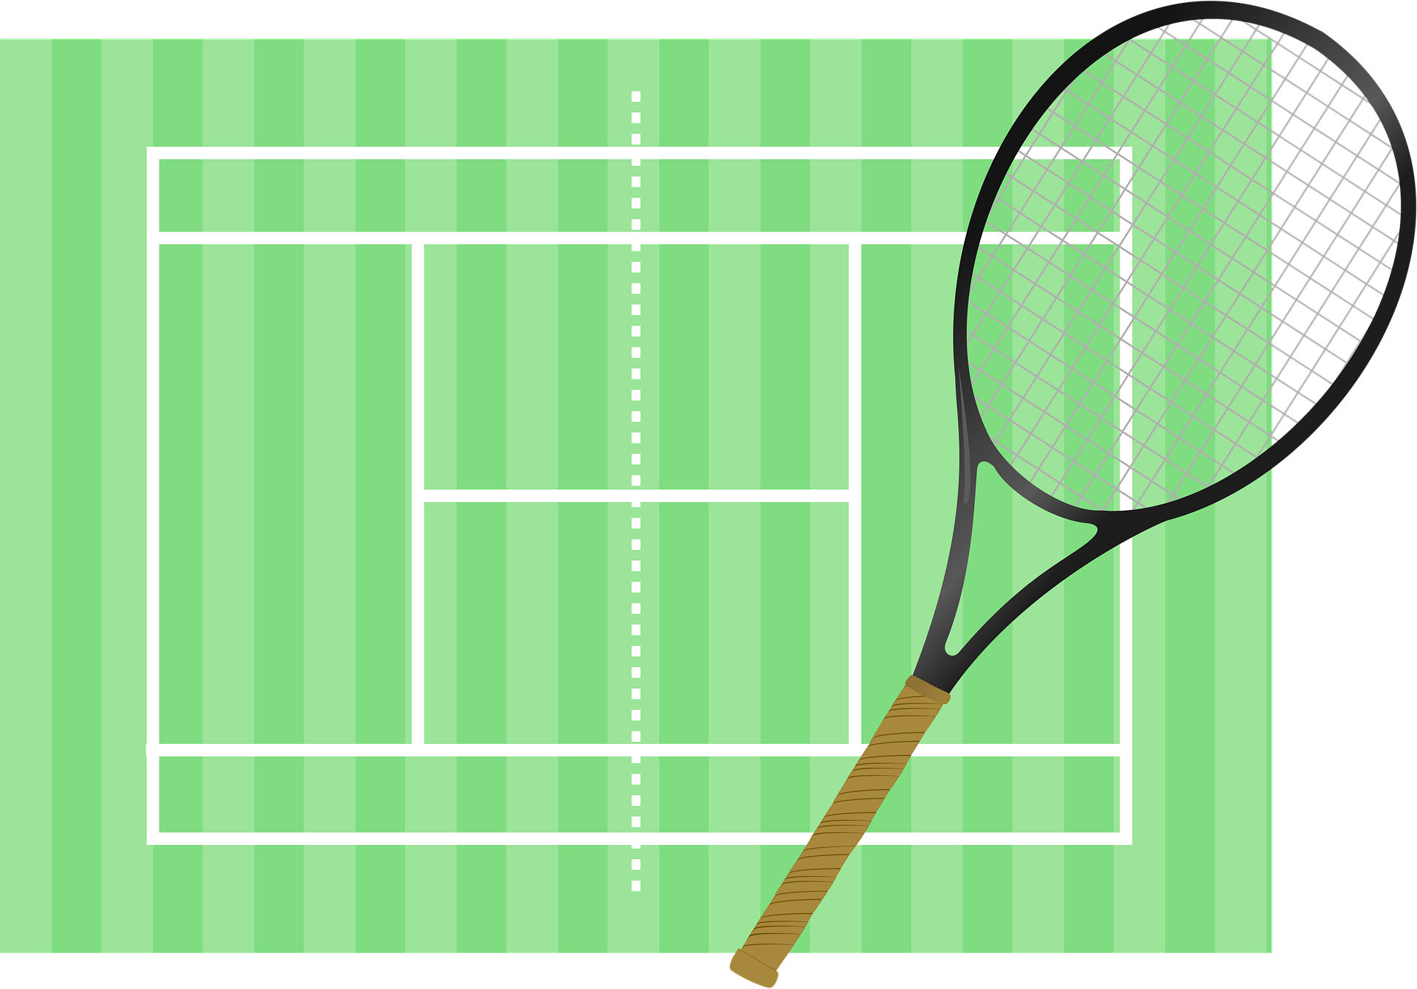
écouter
C’est quelle image ?
3
Ils sont importants à l’école.
(They are important at school.)
Notes:
[3/6]
Transcript:
Ils sont importants à l’école.
10

Slide 11
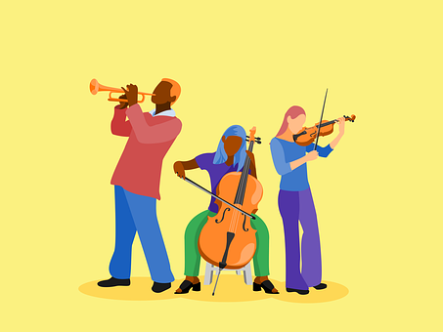
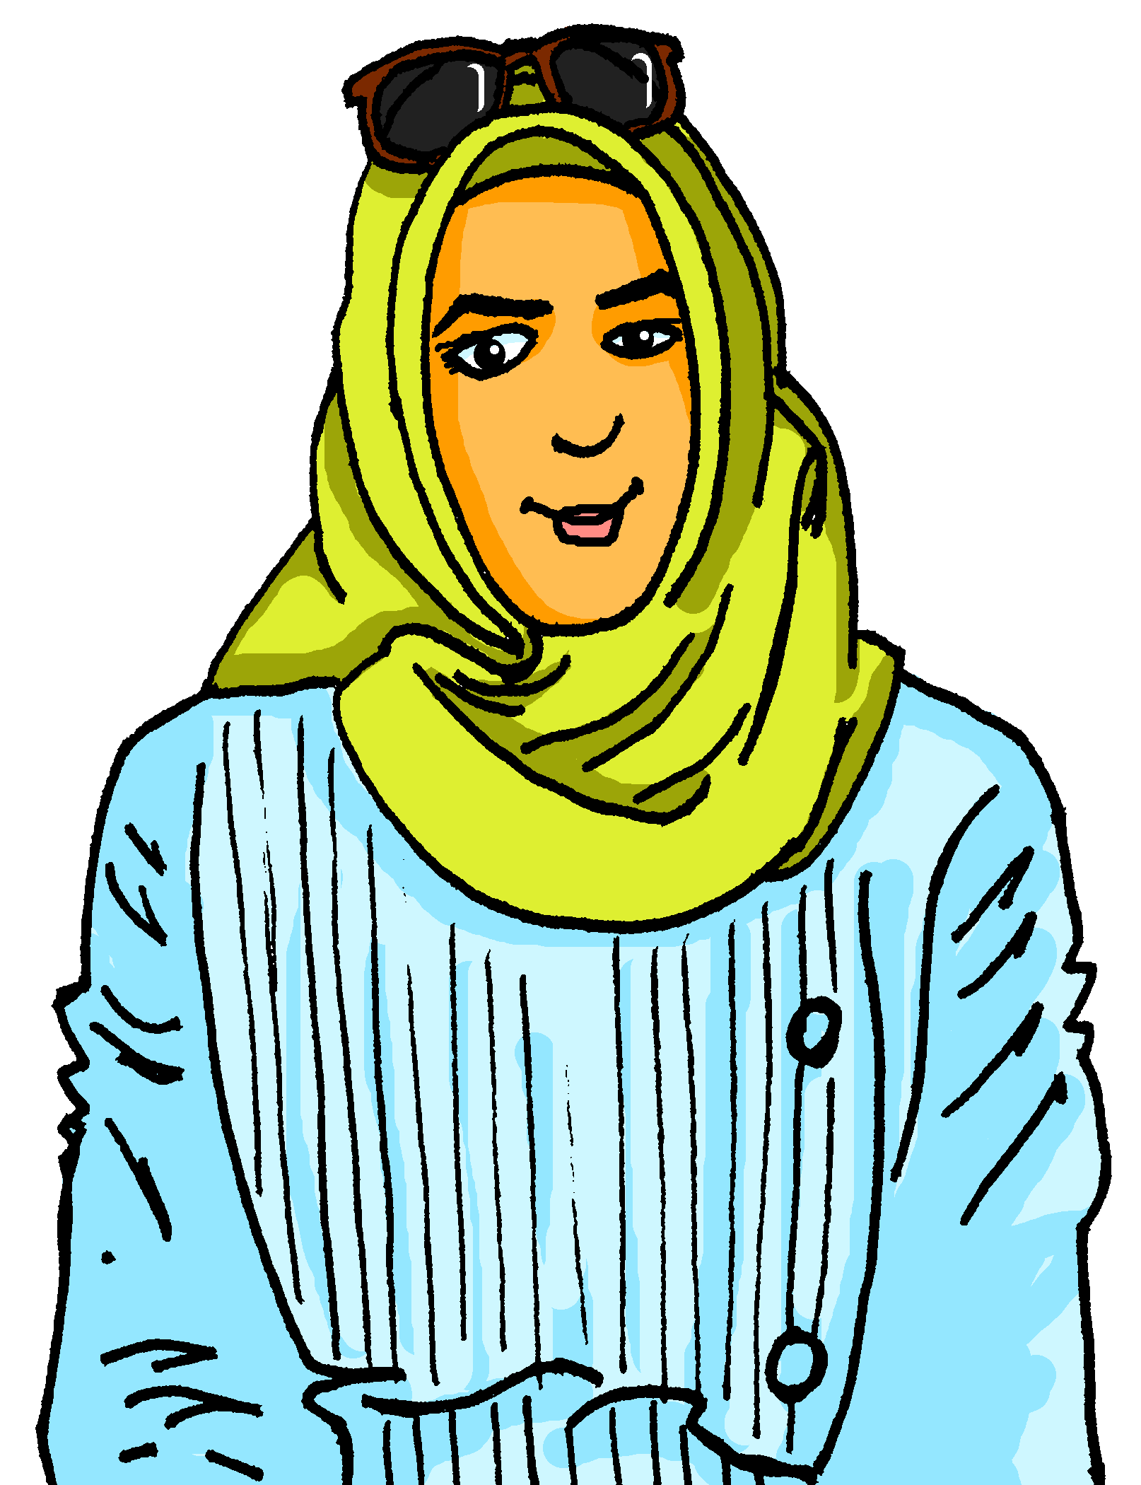
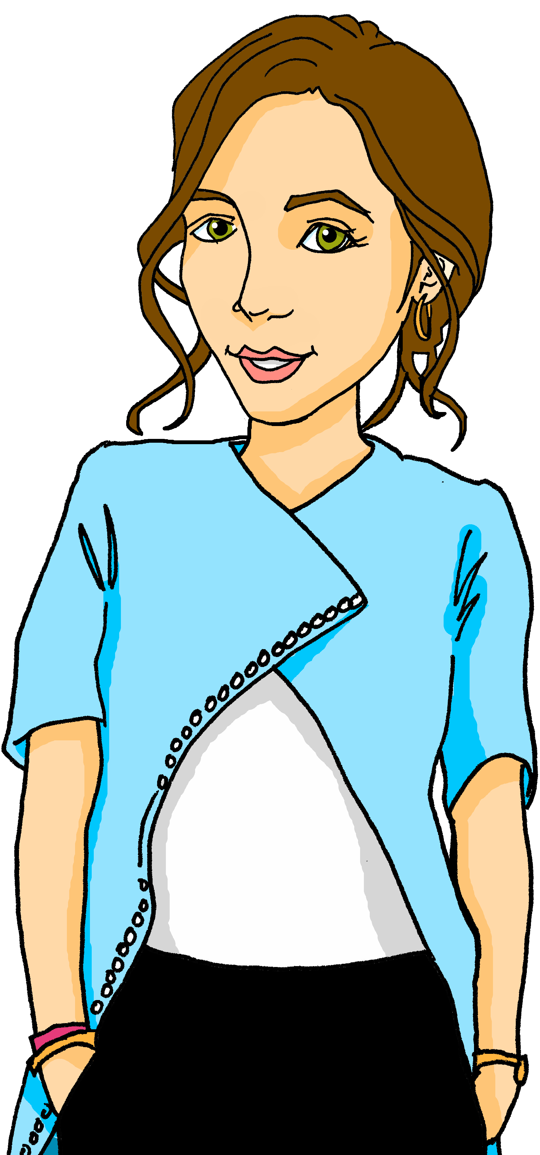
écouter
C’est quelle image ?
4
Ils sont amusants.
(They are fun.)
Notes:
[4/6]
Transcript:
Ils sont amusants.
11

Slide 12
écouter
C’est quelle image ?
5
Elles sont parfaites.
(They are perfect.)
Notes:
[5/6]
Transcript:
Elles sont parfaites.
12

Slide 13
écouter
C’est quelle image ?
6
Elles sont courageuses.
(They are braves.)
Notes:
[6/6]
Transcript:
Elles sont courageuses.
13

Slide 14
lire
Pierre décrit l’école.
. Écoute les noms des animaux. C’est [ien] ou [(a)in]?
Lis les phrases. C’est quel mot ?
. Écoute les noms des animaux. C’est [ien] ou [(a)in]?
Écris 1-6 et choisis le mot qui correspond au sens de la phrase.
1
J’aime les jeux | activités. Elles sont …
2
Je déteste les lundis| règles. Elles sont ….
3
J’aime les langues| livres. Elles sont …
4
J’aime les fêtes | spectacles. Ils sont …
5
Je déteste les chansons | concerts. Elles sont …
6
J’aime les activités | sports. Ils sont…
Notes:
Timing: 5 minutes
Aim: to practise written recognition of 3rd person plural subject pronouns and their connection to masculine and feminine plural nouns.
Procedure:
Read the title and instructions and ensure the task scenario is understood.
Complete the example with the class.
Pupils write the correct noun for items 1-6.
Click to reveal answers and elicit English meanings of the phrases.
Note: The activity on the next slide focuses on understanding sentence meanings.
14

Slide 15
écrire
. Écoute les noms des animaux. C’est [ien] ou [(a)in]?
Écris des phrases pour décrire l’école de Pierre.
1
J’aime les activités.
Elles sont intéressantes.
créatif
parfait
2
Je déteste les règles.
important
positif
3
J’aime les langues.
sérieux
intéressant
4
J’aime les spectacles.
difficile
5
ennuyeux
Je déteste les chansons.
négatif
facile
6
J’aime les sports.
amusant
Notes:
Timing: 5 minutes
Aim: to practise written production of adjectives, pronouns and ‘sont’.
Procedure:
Read the instruction.
Pupils write a 2nd sentence for each of the items.
Remind pupils to use the correct pronoun and to agree the adjective.
Click to provide a selection of adjectives, if required. Remind pupils that they will need to think carefully about the adjective endings.
Click to provide an example for the first item.
Note: as this is an open-ended task, (audio) answers are not provided.
15

Slide 16
Au revoir !
vert
Notes:
16

