Slide 1
Interactions
Échange en ligne
« être » ils / elles sont (they are)
adjective agreement (plural)
SSC [on] and [om]
vert
Term 1 Week 6
Notes:
Artwork by Steve Clarke. Pronoun pictures from NCELP (www.ncelp.org). All additional pictures selected from Pixabay and are available under a Creative Commons license, no
attribution required.
Phonics: revisit [on] and introduce [om] - non ! [72] crayon [>5000] onze [2447] monde [77] pont [1889] nom [171] combat [1062] tomber [547]
Vocabulary (new words in bold): sont [5] ils [13] elles [38] dangereux [713] ennuyeux [>5000] heureux [764] sérieux [412] travailleur [1341] aussi [44] et [6] mais [30]
Revisit 1: anniversaire [2043] mois [179] janvier [939] février [1139] mars [868] avril [1022] mai [943] juin [931] juillet [1326] aout [1445] séptembre [944] octobre [826] novembre [982] décembre [891] quand [119] treize
[3285] quatorze [3359] quinze [1472] seize [3285] dix-sept [3812] dix-huit [3592] dix-neuf [4851] vingt [1273] vingt-et-un [1273/6/3] vingt-deux, vingt-trois vingt-quatre vingt-cinq vingt-six vingt-sept vingt-huit vingt
neuf trente [1646] concert [1697] fête [1490] spectacle [1687]
Revisit 2: adorer [2322] apporter [339] jeu [291] matin [442] langue [712] les [1]
Londsale, D., & Le Bras, Y. (2009). A Frequency Dictionary of French: Core vocabulary for learners London: Routledge.
The frequency rankings for words that occur in this PowerPoint which have been previously introduced in these resources are given in the SOW and in the resources that first
introduced and formally re-visited those words.
For any other words that occur incidentally in this PowerPoint, frequency rankings will be provided in the notes field wherever possible.
1

Slide 2
prononcer
[on]
non !
crayon
monde
pont
onze
Notes:
Timing: 1 minute
Aim: to present and practise SSC [on]
Procedure:
Introduce and elicit the pronunciation of the individual SSC [on] the source word ‘Non !’ with gesture, if using.
Click to bring on the picture and get pupils to repeat (with gesture, if using).
Click again to bring up four cluster words to practise the sound. Repeat the words several times.
Note: gesture for Non ! – moving your index finger in a ‘wagging’ motion left to right in an exaggerated way.
2

Slide 3
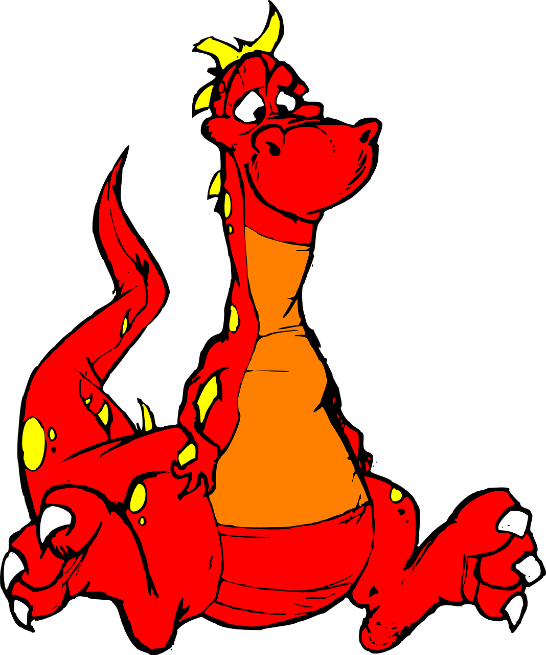
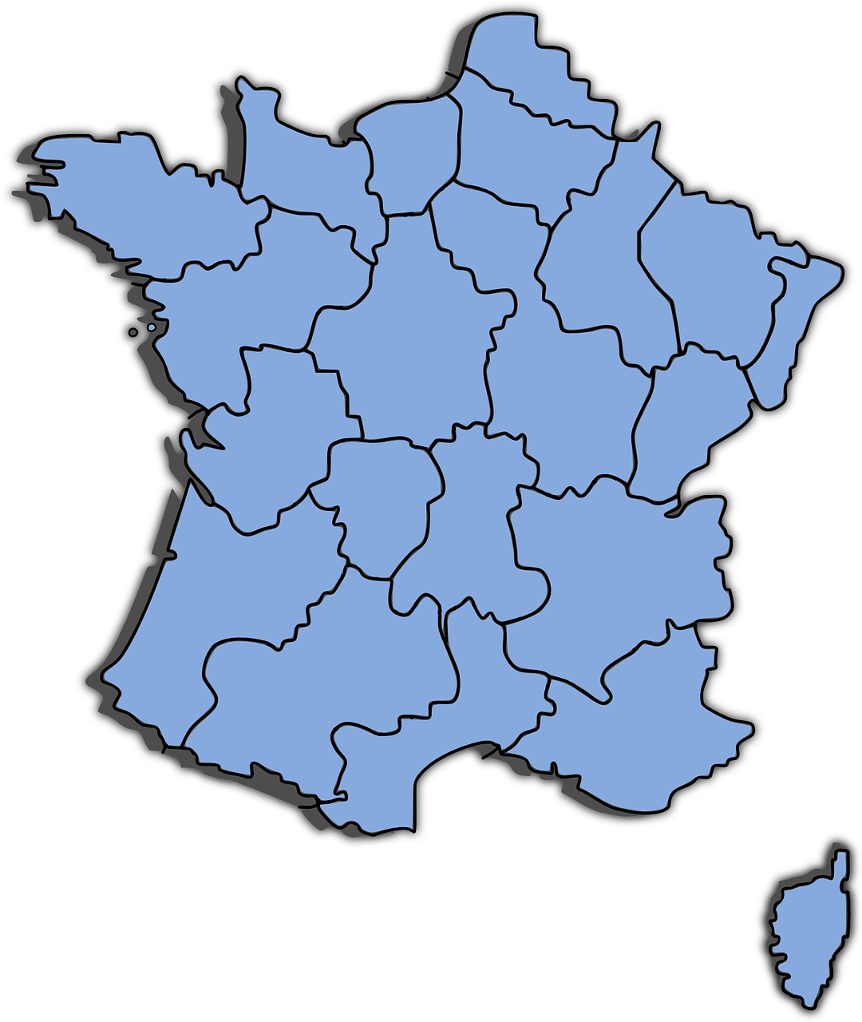
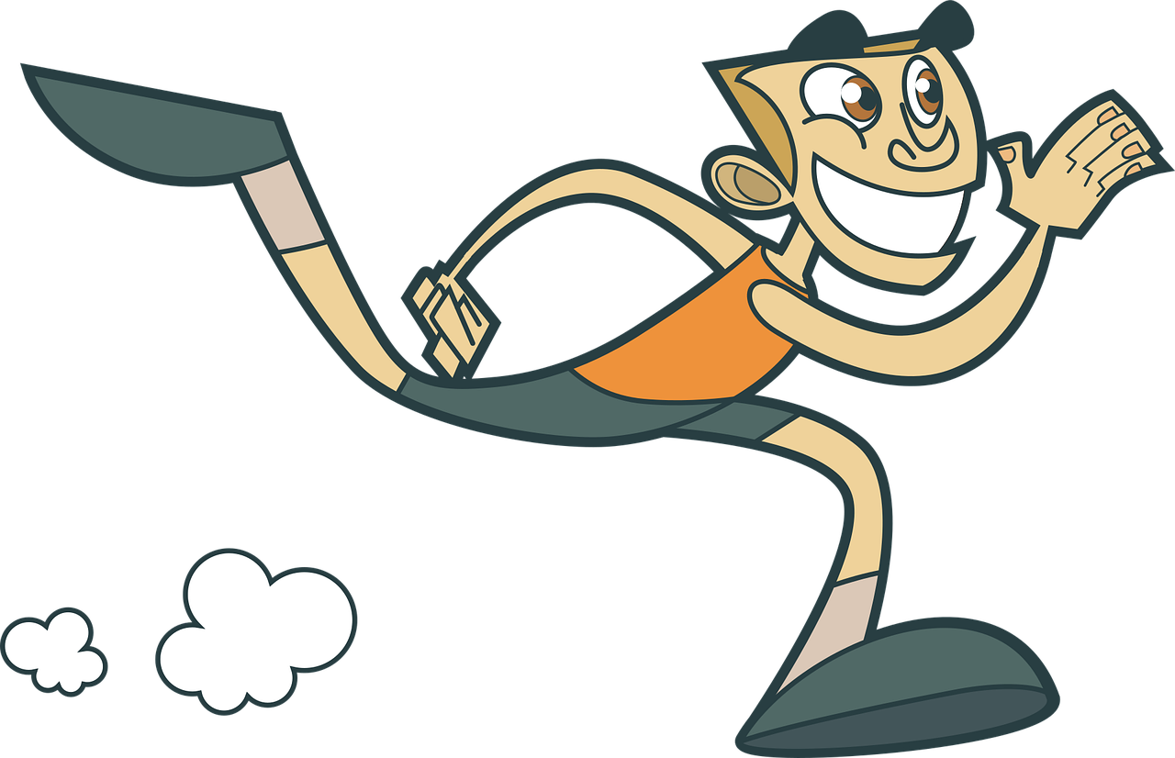
[on]
Prononce les mots. [1/3]
prononcer
These words look like English but have SSC [on] in French. How do they sound?
30
1M
Sorry!
million
Pardon !
melon
dragon
S
meeting
lion
0
région
marathon
réunion
DÉBUT
Notes:
Timing: 3 minutes (three slides)
Aim: to correctly pronounce cognates and near-cognates containing [on] in decreasing amounts of time, helping automatisation of SSC production; to raise awareness of the difference in the English and French pronunciation of this SSC.
Procedure:
Pupils pair up and take turns trying to say all the words in 30 seconds (run the timer twice).
Click on the pictures to hear the words pronounced by a native speaker. Pupils repeat.
Move on to the next slide, where the timer is at 20 seconds, and again to the third slide where the timer is at 15 seconds.
Frequency of unknown words and cognates: prison [1010] blond [4585] contact [894] opinion [777] coton [4516] concert [1697] salon [2729] révision [2748]
Source: Londsale, D., & Le Bras, Y. (2009). A Frequency Dictionary of French:], Core vocabulary for learners London: Routledge.
3

Slide 4
[on]
Prononce les mots. [2/3]
prononcer
These words look like English, but have SSC [on] in French. How do they sound?
20
1M
Sorry!
million
Pardon !
melon
dragon
S
meeting
lion
0
région
marathon
réunion
DÉBUT
Notes:
[2/3]
4

Slide 5
[on]
Prononce les mots. [3/3]
prononcer
These words look like English, but have SSC [on] in French. How do they sound?
15
1M
Sorry!
million
Pardon !
melon
dragon
S
meeting
lion
0
région
marathon
réunion
DÉBUT
Notes:
[3/3]
5

Slide 6
prononcer
[om]
nom
Pierre
tomber
combat
[to fall]
[name]
Notes:
Timing: 2 minutes (two slides)
Aim: to present and practise SSC [om]
Procedure:
Introduce and elicit the pronunciation of the individual SSC [om] the source word ‘nom’ with gesture, if using.
Click to bring on the picture and get pupils to repeat (with gesture, if using).
Click again to bring up two cluster words to practise the sound. Repeat the words several times.
Note: gesture for nom – tap the top of your head.
6

Slide 7
prononcer
[on]
[om]
[on] and [om] sound exactly the same!
non !
nom
When this nasal vowel appears in front of ‘p’ or ‘b’ it is spelt [om] instead of [on].
Pierre
[name]
Notes:
Aim: to recap SSC [on] and [om] making clear that they are exactly the same sound.
Procedure:
Introduce and elicit the pronunciation of the individual SSC [on] and [om] the source words ‘Non !’ and nom with gestures, if using.
Click to bring on the picture and get pupils to repeat (with gestures, if using).
Click to bring up the information about these two SSC.
Repeat the words several times.
Note: i) gesture for Non ! – moving your index finger in a ‘wagging’ motion left to right in an exaggerated way. ii) gesture for nom – tap the top of your head.
7

Slide 8
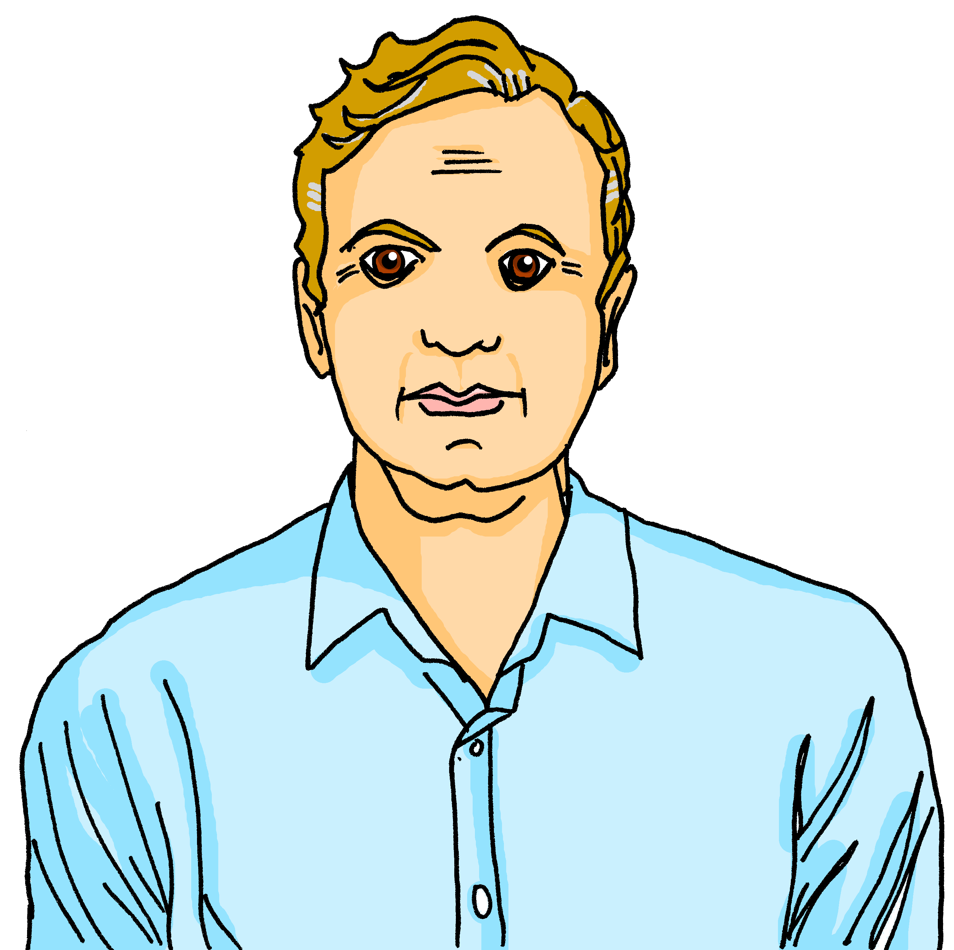
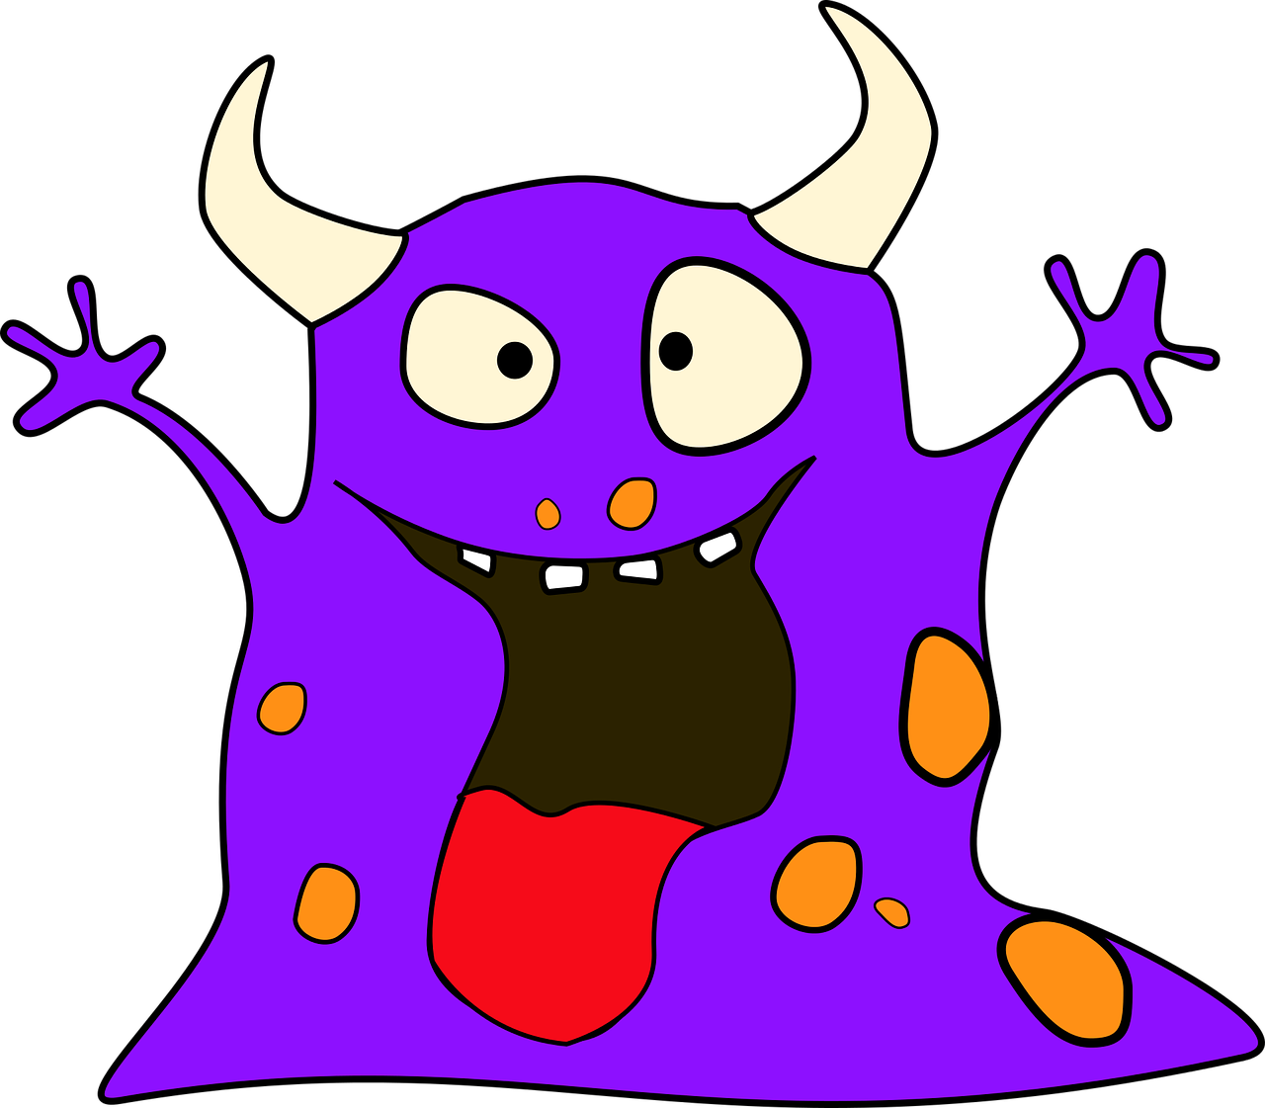
écouter
[on] and [om] sound exactly the same.
. Écoute les noms des animaux. C’est [ien] ou [(a)in]?
Écoute. Comment ça s'écrit ? Avec [on] ou [om] ? Complète et prononce les mots !
prononcer
 | t r o m p e t t e
 | o m b r e l l e
 | o n c l e
 | m o n s t r e
 | c o m p a s
 | c o n f é r e n c e
[on] | [om]
Ex
_ _
1
_ _
2
_ _
3
_ _
4
_ _
5
_ _
Notes:
Timing: 4 minutes
Aim: to apply knowledge of the spelling rules governing SSCs [on] and [om] and production of these two SSCs.
Procedure
Student read the words and decide based on the presence of absence of a ‘p’ or ‘b’ after the gap when [on] or [om] is needed.
Click to check.
Now, pupils are challenged to say all six words and pronounce the SSCs in the same way each time. It will be tempting for pupils to add an ‘n’ or ‘m’ after the vowel! Pupils should work in pairs and monitor each other for this.
Pupils try to say the words out loud. Teacher corrects and / or click to listen.
Transcript:
Exemple: trompette
ombrelle
oncle
monstre
compas
conférence
Frequency of unknown words and cognates: compas [>5000] conférence [1094] monstre [3353] ombrelle [>5000] oncle [3628] trompette [>5000]
Source: Londsale, D., & Le Bras, Y. (2009). A Frequency Dictionary of French: Core vocabulary for learners London: Routledge.
8

Slide 9
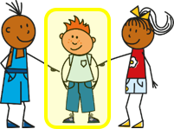
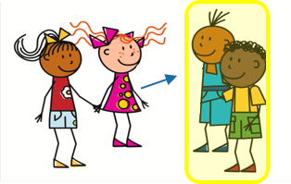
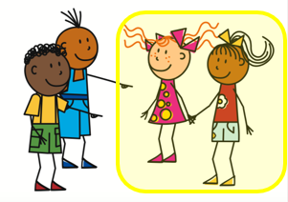
Être
Describing others – they are
The ‘e’ makes you pronounce the ‘t’.
[to be | being]
You know how to describe one other person:
Il est content.
Elle est contente.
He is pleased.
A plural noun needs a plural adjective.
She is pleased.
To say ‘they are’:
Pronounce the ‘t’ but the ‘s’ is a SFC.
Ils sont contents.
Elles sont contentes.
They (m) are pleased.
They (f) are pleased.
To say ‘they’ for mixed groups use ‘ils’.
Notes:
Timing: 2 minutes
Aim: to recap 3rd person singular of être (he is / she is) and to present the 3rd person plural (they are).
Procedure:
Click to present the information about être.
Make sure pupils are clear about the they pictures as these will come up in future lessons.
Elicit English translation for the French examples provided.
9

Slide 10
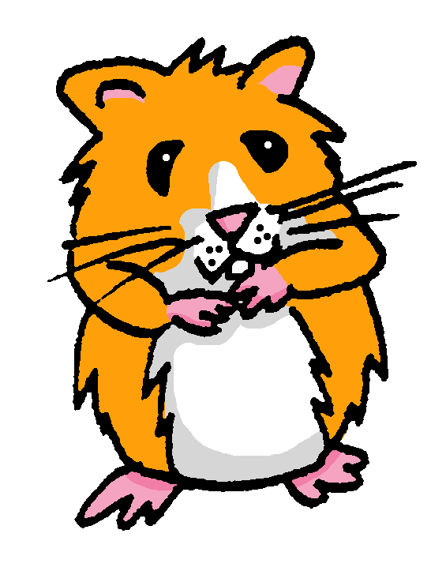
lire
Éloi mange le journal de Jean-Michel !
Miam miam !
Lis les phrases. J-M décrit une personne ou deux ?
Écris de1 à 6 il/elle ou ils/elles.
. Écoute les noms des animaux. C’est [ien] ou [(a)in]?
Exemple:
… est triste.
 | il / elle (he/she) | ils / elles (they)
Ex.
1
2
3
4
5
6
1
4
… sont malades.
… est rapide.
2
5
… sont seuls.
… sont faibles.
3
6
… est difficile.
… sont calmes.
Notes:
Timing: 5 minutes
Aim: to practise written comprehension of 3rd person singular and plural of être (and written recognition of singular and plural adjectives).
Procedure:
Read the title and instructions and ensure the task scenario is understood.
Complete the example with the class.
Pupils write il/elle or ils/elles for items 1-6.
Click to reveal answers and elicit English meanings of the phrases.
Note: Here pupils focus only on the singular / plural distinction using adjectives that are the same for both genders.
10

Slide 11
Plural adjectives
Singular and plural adjectives sound the same.
As you know many adjectives add -s for plural:
Il est positif.
Elle est positive.
Ils sont positifs.
Elles sont positives.
Masculine adjectives ending in -eux don’t change for plural:
But add –s to -euse for feminine plural:
Ils sont ennuyeux.
Elles sont ennuyeuses.
They are boring.
They are boring.
You don’t hear the difference between singular and plural adjectives because of SFC, so you need to listen out for the verb.
Notes:
Timing: 2 minutes
Aim: to present patterns of plural adjective agreement; to establish that you can often hear gender difference with adjectives but not number difference, so the verb form is very important.
Procedure:
Click to present the information.
Elicit English translation for the French examples provided.
11

Slide 12
écouter
Il ou ils ?
1
creative
Notes:
Timing: 6 minutes (8 slides)
Aim: to practise distinguishing aurally between the third person singular and third person plural forms of ‘être’.
Procedure:
1. Click the button to play audio with the pronoun obscured.
2. Students should note whether the first word of each sentence must be ‘il’ or ‘ils’.
3. They then write the English meaning of the adjective used in each sentence (to force vocabulary recall).
4. Answers appearing upon clicking the mouse.
Transcript:
[…] est créatif.
12

Slide 13
écouter
Il ou ils ?
2
German
Notes:
[2/8]
Transcript:
[…] sont allemands.
13

Slide 14
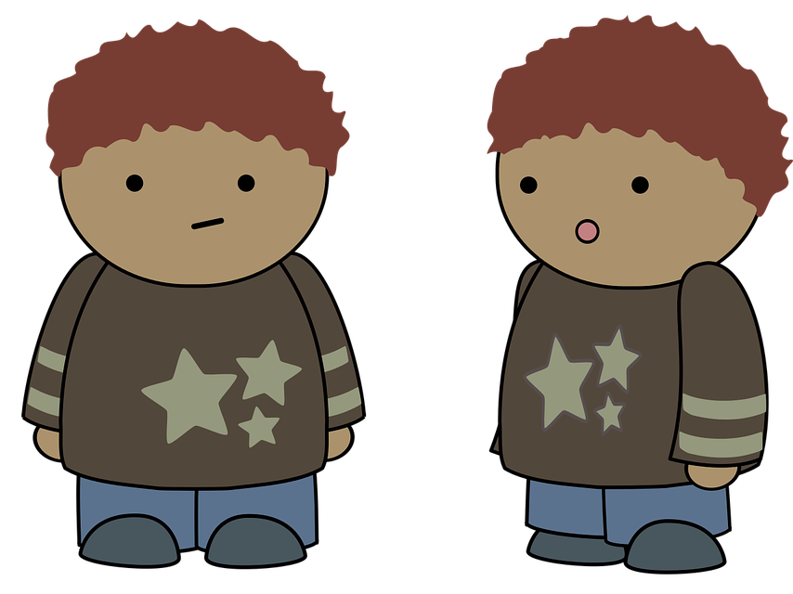
écouter
Il ou ils ?
3
boring
Notes:
[3/8]
Transcript:
[…] sont ennuyeux.
14

Slide 15
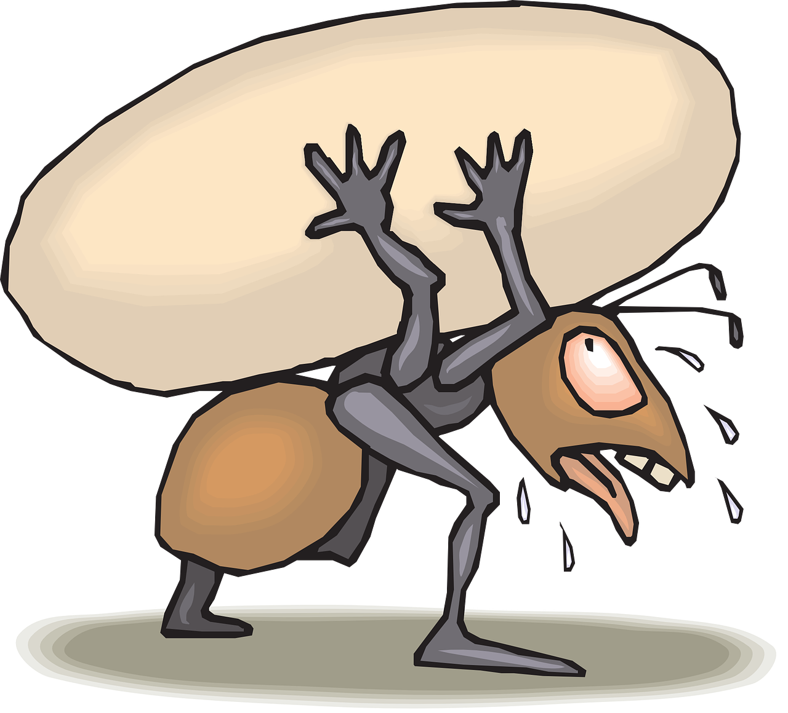
écouter
elle ou elles ?
4
hard-working
Notes:
[4/8]
Transcript:
[…] sont travailleures.
15

Slide 16
écouter
elle ou elles ?
5
dangerous
Notes:
[5/8]
Transcript:
[…] est dangereuse.
16

Slide 17
écouter
elle ou elles ?
6
independent
Notes:
[6/8]
Transcript:
[…] sont indépendantes.
17

Slide 18
écouter
Il ou ils ?
7
sporty
Notes:
[7/8]
Transcript:
[…] est sportif.
18

Slide 19
écouter
elle ou elles ?
8
serious
Notes:
[8/8]
Transcript:
[…] sont sérieuses.
19

Slide 20
lire
C’est une opinion bizarre ou normale?
. Écoute les noms des animaux. C’est [ien] ou [(a)in]?
L’opinion de la mère de J-M et Clémentine, c’est quoi ?
Lis les opinions. Écris 1-5 et choisis le bon mot. Puis traduis* en anglais.
*traduis - translate
lire
1
. Écoute les noms des animaux. C’est [ien] ou [(a)in]?
.
Les jeux sont ennuyeux | dangereuses.
2
4
. Écoute les noms des animaux. C’est [ien] ou [(a)in]?
. Écoute les noms des animaux. C’est [ien] ou [(a)in]?
Les lundis sont intéressants | ennuyeuse.
Les langues sont mystérieuses | créatifs.
.
.
3
5
. Écoute les noms des animaux. C’est [ien] ou [(a)in]?
. Écoute les noms des animaux. C’est [ien] ou [(a)in]?
Les hamsters sont sérieuses | travailleurs.
Les filles sont heureux | fortes.
le hamster
Notes:
Timing: 8 minutes
Aim: to practise written comprehension of plural adjective endings and their connection to noun gender; to revisit some of the vocabulary for this week.
Procedure:
Explain that Annick, (J-M and Clémentine’s mum) has very strong, sometimes strange, opinions.
Pupils read the messages and decide the gender of each noun based on the form of the adjective in the message.
Click to correct.
Question the class orally to assess understanding of the messages – which opinions do they think are a bit strange? (games are boring? mornings are interesting?)
Note: pupils may remember the genders of some of the nouns but they haven’t seen any of these words for a considerable time and we know that genders are easily forgotten. If they need reminders, teachers can provide the genders of the nouns.
Frequency of unknown words and cognates: mystérieux [3312]
Londsale, D., & Le Bras, Y. (2009). A Frequency Dictionary of French: Core vocabulary for learners London: Routledge.
20

Slide 21
Au revoir !
vert
Notes:
21

