Slide 1
Interactions
Échange en ligne
vert
Follow ups 1-5
Term 1 Week 6
Notes:
Artwork by Steve Clarke. Pronoun pictures from NCELP (www.ncelp.org). All additional pictures selected from Pixabay and are available under a Creative Commons license, no attribution required.
Phonics: revisit [on] and introduce [om] - non ! [72] crayon [>5000] onze [2447] monde [77] pont [1889] nom [171] combat [1062] tomber [547]
Vocabulary (new words in bold): sont [5] ils [13] elles [38] dangereux [713] ennuyeux [>5000] heureux [764] sérieux [412] travailleur [1341] aussi [44] et [6] mais [30]
Revisit 1: anniversaire [2043] mois [179] janvier [939] février [1139] mars [868] avril [1022] mai [943] juin [931] juillet [1326] aout [1445] séptembre [944] octobre [826] novembre [982] décembre [891] quand [119]
treize [3285] quatorze [3359] quinze [1472] seize [3285] dix-sept [3812] dix-huit [3592] dix-neuf [4851] vingt [1273] vingt-et-un [1273/6/3] vingt-deux, vingt-trois vingt-quatre vingt-cinq vingt-six vingt-sept vingt
huit vingt neuf trente [1646] concert [1697] fête [1490] spectacle [1687]
Revisit 2: adorer [2322] apporter [339] jeu [291] matin [442] langue [712] les [1]
Londsale, D., & Le Bras, Y. (2009). A Frequency Dictionary of French: Core vocabulary for learners London: Routledge.
The frequency rankings for words that occur in this PowerPoint which have been previously introduced in these resources are given in the SOW and in the resources that first introduced and formally re-visited those words.
For any other words that occur incidentally in this PowerPoint, frequency rankings will be provided in the notes field wherever possible.

Slide 2
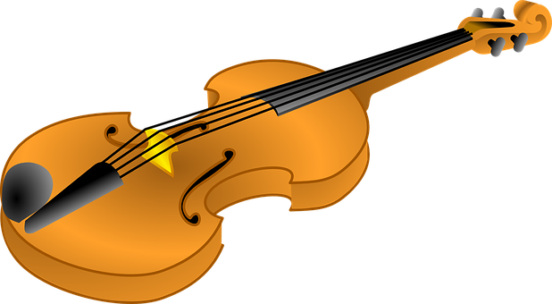
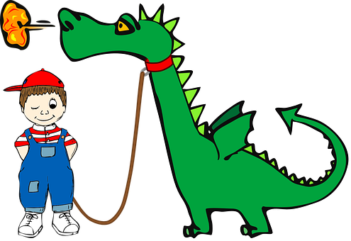
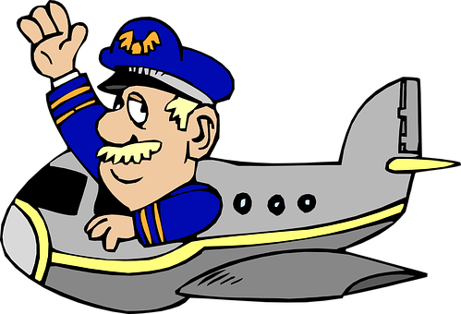
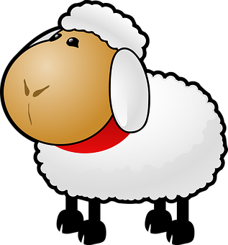
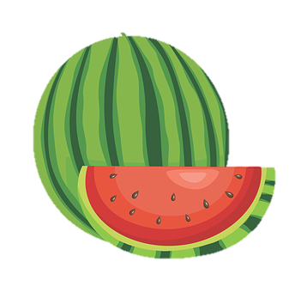
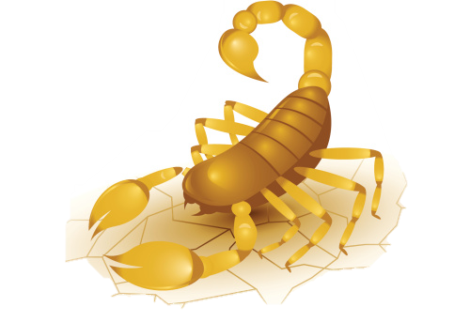
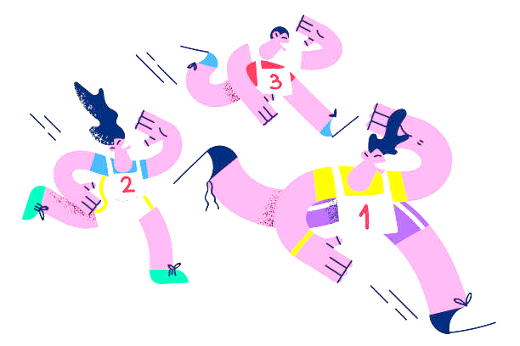
Follow up 1:
. Écoute les noms des animaux. C’est [ien] ou [(a)in]?
Lis et pronounce la comptine.
prononcer
Je regarde un lion
jouer du violon.
Je regarde un cochon
chanter une chanson.
Je regarde un dragon
arriver en avion.
Je regarde un mouton
manger du melon.
Je regarde un scorpion
faire un marathon.
Notes:
Timing: 5 minutes
Aim: to practise spoken production of SSC [on].
Procedure:
Pupils practise reading the poem in pairs.
Click on each line to hear it pronounced.
Note that whilst a few words are unknown, there are many previously taught words in this rhyme and with the support of the images, pupils are likely to work out the meaning.
If time allows, teachers may want to prompt for this.
Frequency of unknown words and cognates (1 is the most frequent word in French):
avion [1409] cochon [4947] dragon [>5000] lion [>5000] marathon [>5000] melon [>5000] mouton [4175] scorpion [>5000] violon [>5000] Source: Londsale, D., & Le Bras, Y. (2009). A Frequency Dictionary of French: Core vocabulary for learners London: Routledge.
Rough translation: I watch a lion
Playing a violin
I watch a pig
Singing a song
I watch a dragon
Arriving by plane
I watch a sheep
Eating a melon
I watch a scorpion
Doing a marathon

Slide 3
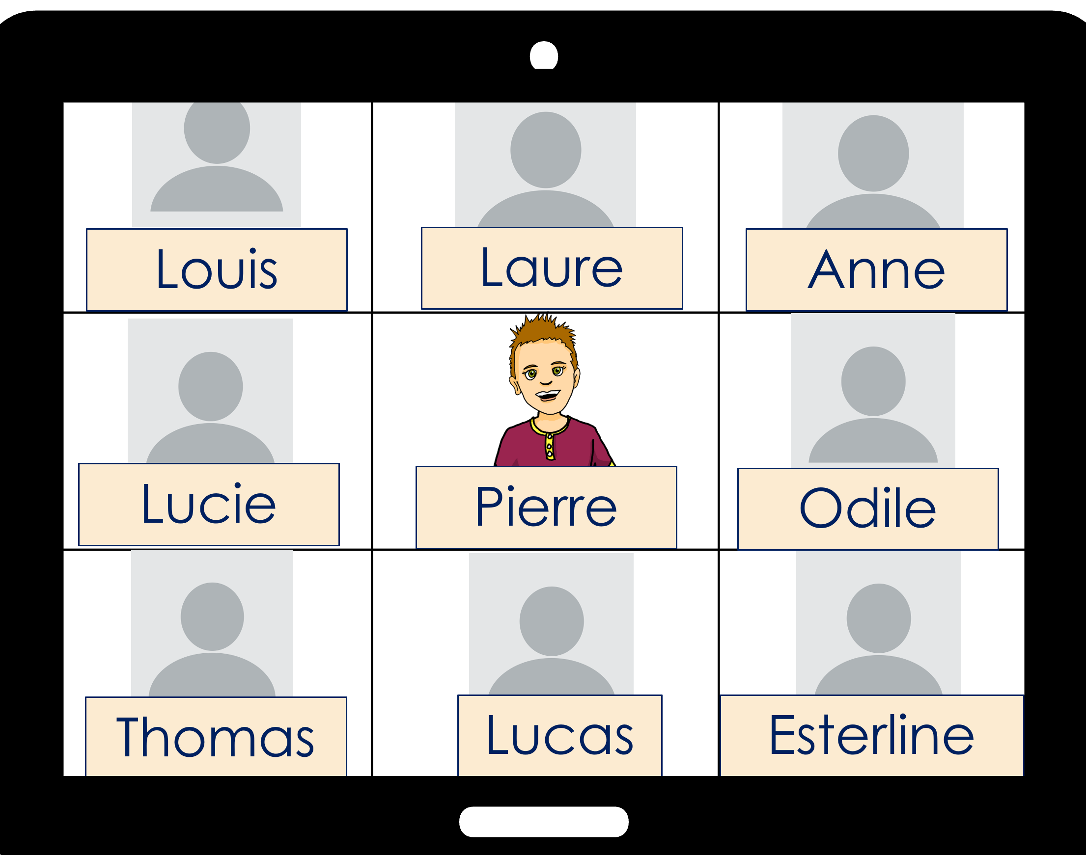
Follow up 2:
J-M and his class have asked Pierre’s class when their birthdays are.
. Écoute les noms des animaux. C’est [ien] ou [(a)in]?
écouter
Écoute les dates des anniversaires. Écris les noms.
1
……………..
Laure
29.03
13.08
02.12
Esterline
2
……………..
……………..
03.06
30.01
3
Lucas
4
Louis
……………..
27.11
16.07
22.12
……………..
5
Odile
6
Thomas
……………..
Notes:
Timing: 5 minutes
Aim: to practise aural comprehension of numbers and months.
Procedure:
Click each number to listen.
Pupils write down the person’s name whose birthday date matches what they hear.
Click to reveal the answers.
Note: pupils could note down the dates but the written dates would need removing from the slide after step 3.
Transcript:
Mon anniversaire est le treize aout.
Mon anniversaire est le vingt-deux décembre.
Mon anniversaire est le seize juillet.
Mon anniversaire est le vingt-neuf mars.
Mon anniversaire est le trente janvier.
Mon anniversaire est le vingt-sept novembre.

Slide 4
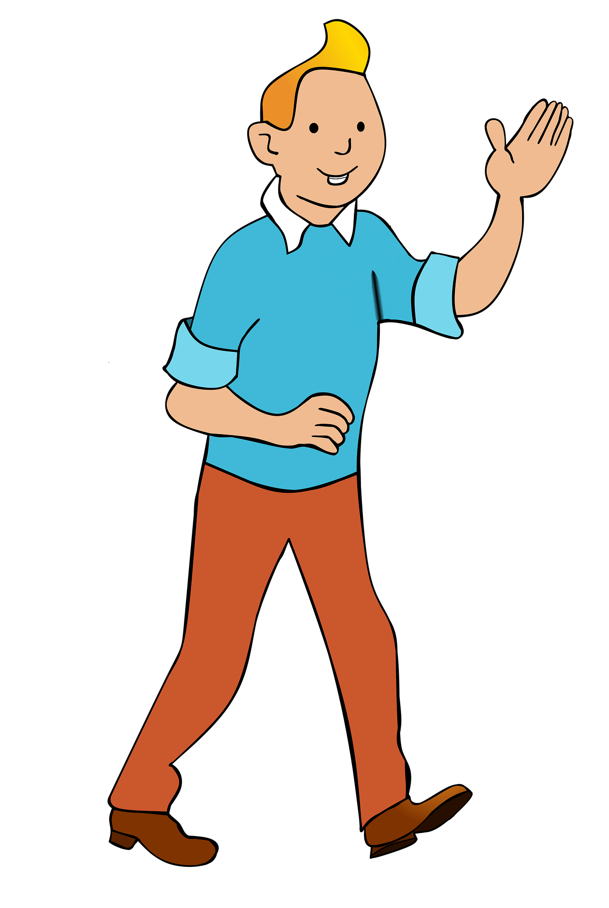
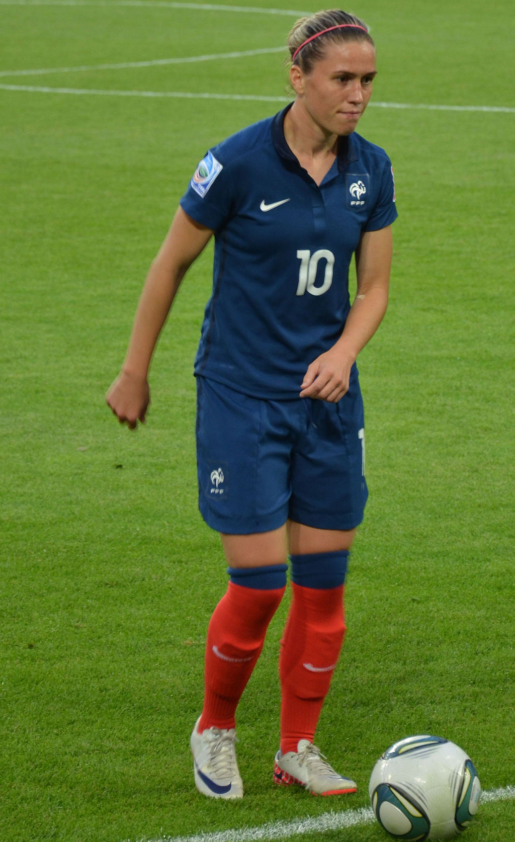
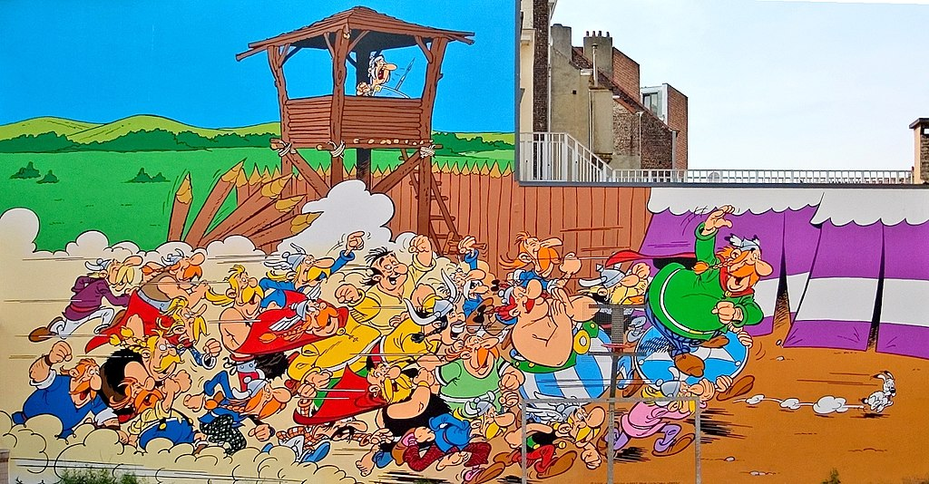
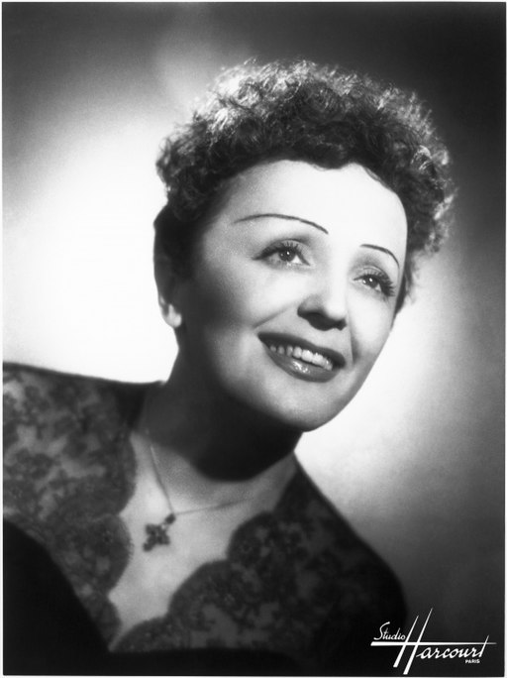
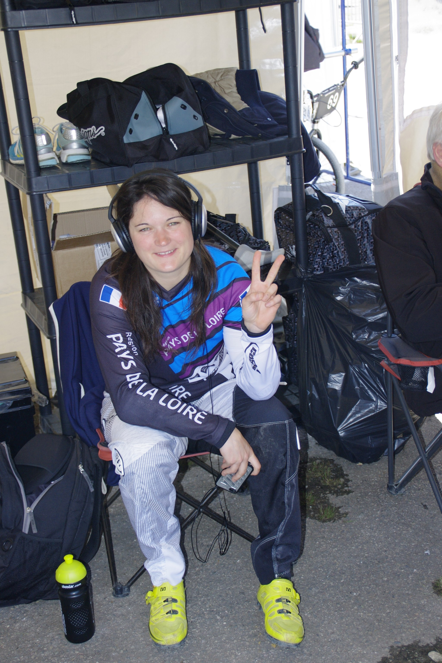
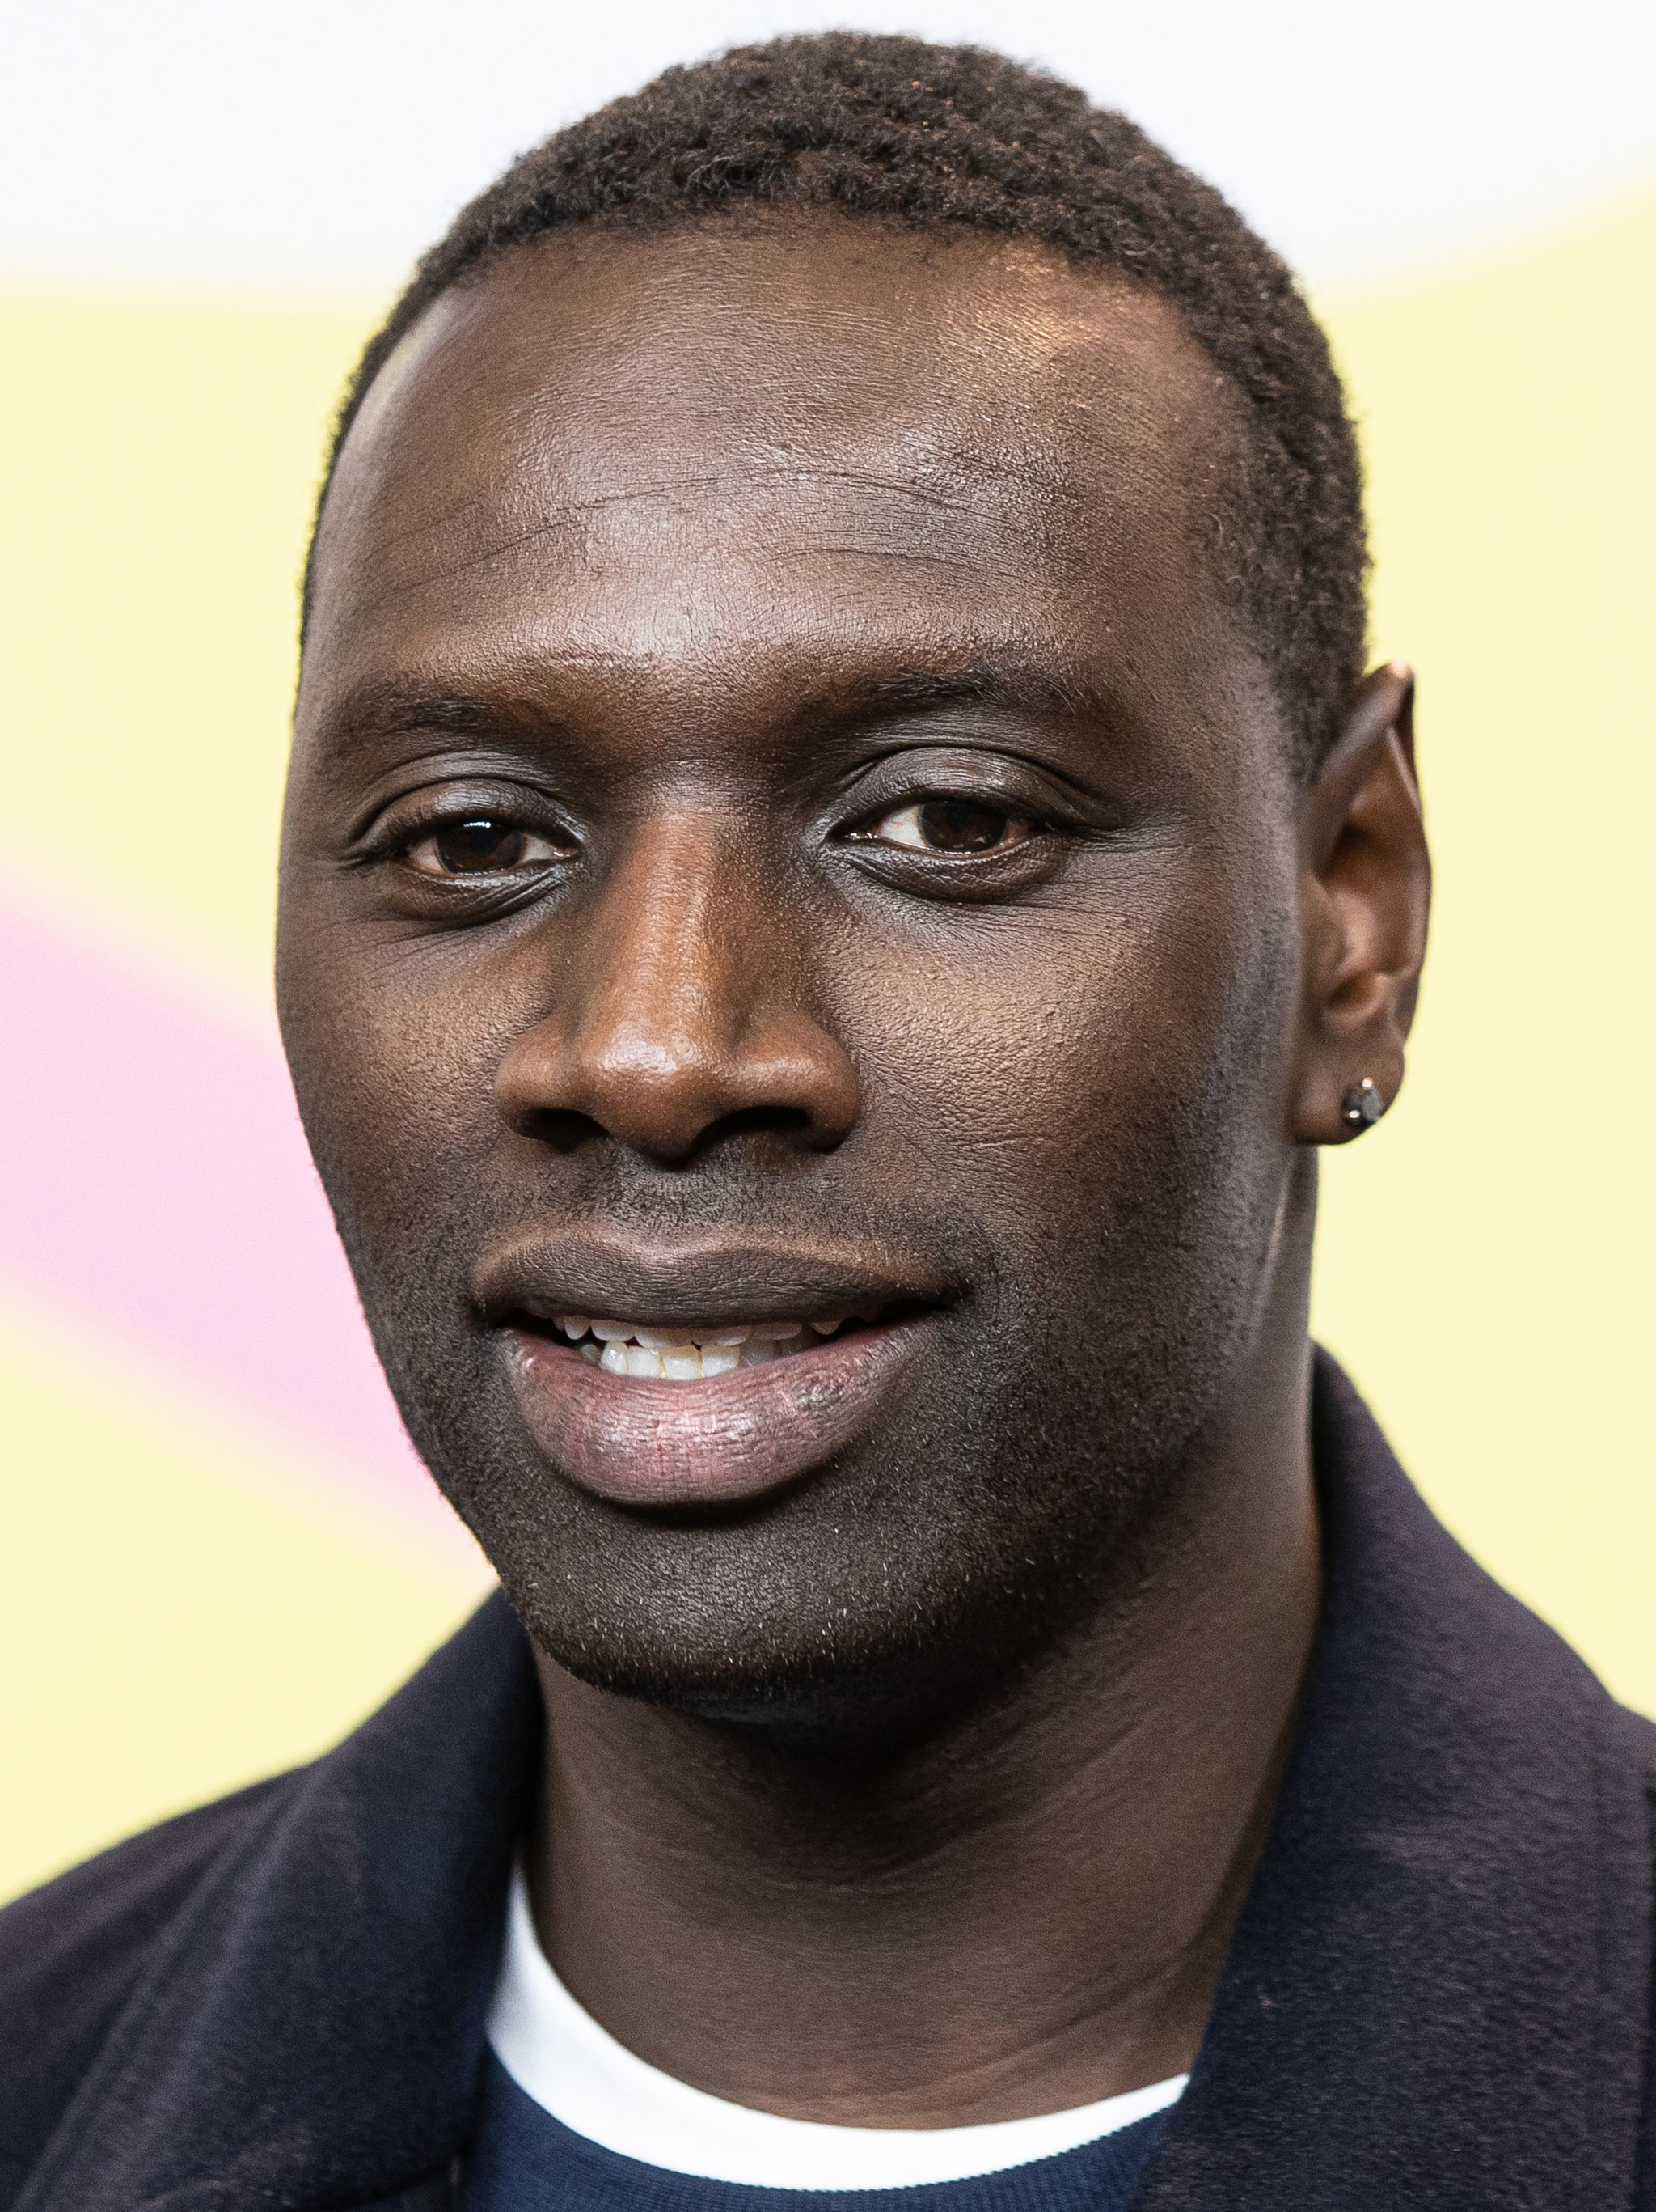
Follow up 3:
Édith Piaf (1915 – 1963) est une chanteuse et actrice très célèbre. Ses chansons classiques sont: La vie en rose, Non, je ne regrette rien et Hymne à l’amour.
Écris les dates des anniversaires en français.
Mon anniversaire est le dix janvier.
Tintin
écrire
10.01
Mon anniversaire est le cinq décembre.
Camille Abily
05.12
Mon anniversaire est le vingt-neuf octobre.
29.10
Astérix
Mon anniversaire est le le dix-neuf décembre.
Edith Piaf
19.12
16.03
Mon anniversaire est le seize mars.
Magalie Pottier
20. 01
Mon anniversaire est le vingt janvier.
Omar Sy
Notes:
Timing: 5-10 minutes
Aim: to practise written production of dates.
Procedure: 1. Explain that all of these are or were important and well-known French citizens. 2. Pupils write a sentence for each giving his/her birthday, writing the numbers in words to practise accuracy spelling. 3. Click to bring up written sentences.
Photo attributions:
Camille Abily - NatiSythen, CC BY-SA 3.0 via Wikimedia Commons
Magalie Pottier - Christophe DELORME, CC BY-SA 4.0 via Wikimedia Commons
Harald Krichel, CC BY-SA 3.0 via Wikimedia Commons
Edith Piaf - Studio Harcourt, Public domain, via Wikimedia Commons Asterix - Lin Mei, CC BY 2.0 <https://creativecommons.org/licenses/by/2.0>, via Wikimedia Commons
Source:
https://www.wikifame.org/wiki/Camille-Abily
https://fr.wikipedia.org/wiki/Magalie_Pottier
https://fr.wikipedia.org/wiki/Omar_Sy
https://en.wikipedia.org/wiki/Tintin
https://en.wikipedia.org/wiki/%C3%89dith_Piaf
https://en.wikipedia.org/wiki/Asterix

Slide 5
Follow up 4:
Pierre décrit un spectacle à J-M.

. Écoute les noms des animaux. C’est [ien] ou [(a)in]?
Il manque des informations.* Écris bien les phrases en français.
écrire
. Écoute les noms des animaux. C’est [ien] ou [(a)in]?
Aujourd’hui, c’est dimanche 30 octobre – Cirque du Soleil !
1
Today it’s Sunday 30th October – Cirque du Soleil ! .
La musique est forte et rapide.
2
The music is loud and fast!
Les activités sont dangereuses !
3
The activities are dangerous!
Ma mère et mon père sont aussi là.
4
My mum and my dad are also there.
Nous sommes très heureux.
5
Il manque des informations – some information is missing
We are very happy! ☺
Notes:
Timing: 5 minutes
Aim: to practise written production of different persons of être.
Procedure:
Pupils need to write the missing words.
Click to reveal and check answers.
Note: to add a further element of challenge, remove the English translations.
Image source: https://en.wikipedia.org/wiki/File:New_Cirque_du_Soleil_Logo.png (fair use policy)

Slide 6
Follow up 5
.]?
Improvise des phrases.
Les amis … …
parler
60
Les activités … …
Les parents … …
S
Les professeures … …
Les matins … …
0
Les langues … …
DÉBUT
Notes:
Timing: 5 minutes
Aim: to practise freer oral production of sentences with 3rd person plural être and adjectives.
Procedure:
Take it in turns with a partner saying a phrase with one of the sentence starters. (E.g. Les amis sont importants).
Pupils should take care to agree the adjectives (2, 4, 6 are feminine and we should hear the consonant before the ‘e’).
Pupils aim to complete all 6 sentences within one minute.
Repeat the task 1-2 times to improve confidence and speed in production.

Slide 7
vocabulaire
Follow up 5 - Écris en anglais : Can you get at least 15 points?
mots
 | le jeu | apporter | le matin
 | adorer | la langue | les
 | treize | quatorze | trente
 | quinze | le spectacle | vingt
 | sont | elles | ils
 | ennuyeux | dangereuses | travailleuse
(the) game
to bring, bringing
(the) morning
x3
to love, loving
(the) language
the (pl)
13
14
30
x2
15
(the) show
20
are (they)
are (we)
we
x1
boring (m, mpl)
dangerous (fpl)
hard-working (f)
Notes:
Timing: 5 minutes
Aim: to practise written comprehension of vocabulary from this week and two revisited weeks.
Procedure: 1. Give pupils a blank grid. They fill in the English meanings of any of the words they know, trying to reach 15 points in total. 2. Remind pupils that adjectives can refer to male or female persons and they should note this in their translations. E.g. pleased (f), short (m).
Note: The most recently learnt and practised words are pink, words from revisit 1 are green and those from revisit 2 are blue, thus more points are awarded for them, to recognise that memories fade and more effort (heavy lifting!) is needed to retrieve them.
7

Slide 8
vocabulaire
Follow up 5 - Écris en français : Can you get at least 15 points?
mots
 | (the) morning | (the) language | the (pl)
 | to love, loving | to bring, bringing | (the) game
 | 30 | 13 | 15
 | (the) show | 20 | 14
 | dangerous (mpl) | boring (fpl) | hard-working (m)
 | they (mpl) | they (fpl) | are (they)
le matin
la langue
les
x3
adorer
apporter
le jeu
trente
treize
quinze
x2
le spectacle
vingt
quatorze
dangereux
ennuyeuses
travailleur
x1
ils
elles
sont
Notes:
Timing: 5 minutes
Aim: to practise written comprehension of vocabulary from this week and two revisited weeks.
Procedure: 1. Give pupils a blank grid. They fill in the English meanings of any of the words they know, trying to reach 15 points in total. 2. Remind pupils that adjectives can refer to male or female persons and they should note this in their translations. E.g. pleased (f), short (m).
Note: The most recently learnt and practised words are pink, words from revisit 1 are green and those from revisit 2 are blue, thus more points are awarded for them, to recognise that memories fade and more effort (heavy lifting!) is needed to retrieve them.
8

Slide 9
vocabulaire
Follow up 5 - Écris en anglais : Can you get at least 15 points?
mots
 | le jeu | apporter | le matin
 | adorer | la langue | les
 | treize | quatorze | trente
 | quinze | le spectacle | vingt
 | sont | elles | ils
 | ennuyeux | dangereuses | travailleuse
x3
x2
x1
Notes:
HANDOUT
9

Slide 10
vocabulaire
Follow up 5 - Écris en français : Can you get at least 15 points?
mots
 | (the) morning | (the) language | the (pl)
 | to love, loving | to bring, bringing | (the) game
 | 30 | 13 | 15
 | (the) show | 20 | 14
 | dangerous (mpl) | boring (fpl) | hard-working (m)
 | they (mpl) | they (fpl) | are (they)
x3
x2
x1
Notes:
HANDOUT
10

