Slide 1
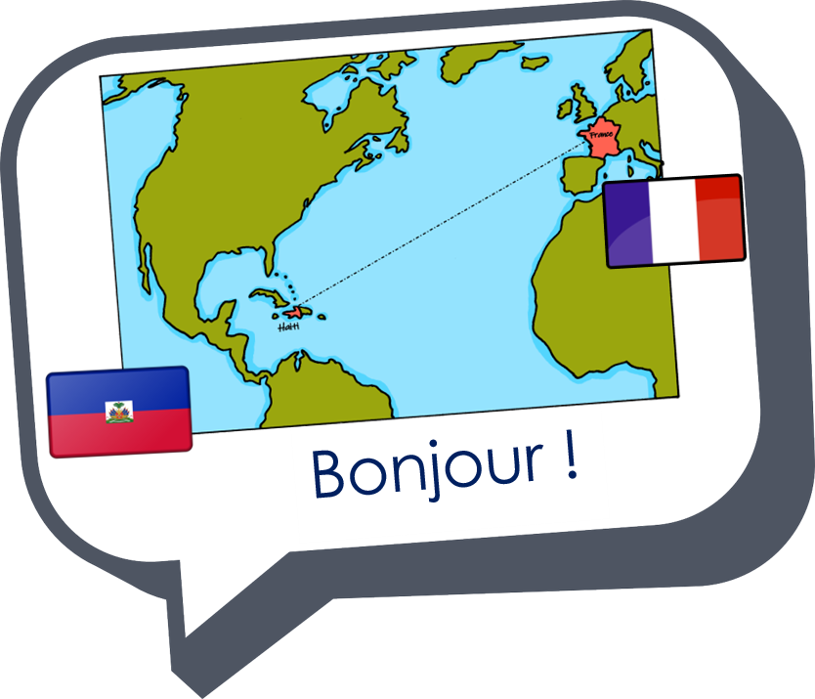

Interactions
Échange en ligne
« être » vous êtes
(you all are, plural)
adjective agreement (plural)
Revisit [u] and [ou]
vert
Term 1 Week 5
Notes:
Artwork by Steve Clarke. Pronoun pictures from NCELP (www.ncelp.org). All additional pictures selected from Pixabay and are available under a Creative Commons license, no
attribution required.
Phonics: Revisit [u] vs [ou]: tu [12] nous [31]
Vocabulary (new words in bold): êtes [5] vous [50] ensemble [124] tôt [513] en retard [1279] ici [167] là [109] pour [10]
Revisit 1: sommes [5] nous [31] allemand [844] espagnol [1666] amusant [4695] calme [1731] différent [350] difficile [296] facile [822] important [215] indépendant [954] jeune [152]
malade [1066] méchant [3184] prudent [1529] seul [102]
Revisit 2: détester [2898] écouter [429] étudier [960] lire [278] parler [106]
Londsale, D., & Le Bras, Y. (2009). A Frequency Dictionary of French: Core vocabulary for learners London: Routledge.
The frequency rankings for words that occur in this PowerPoint which have been previously introduced in these resources are given in the SOW and in the resources that first
introduced and formally re-visited those words.
For any other words that occur incidentally in this PowerPoint, frequency rankings will be provided in the notes field wherever possible.
1

Slide 2






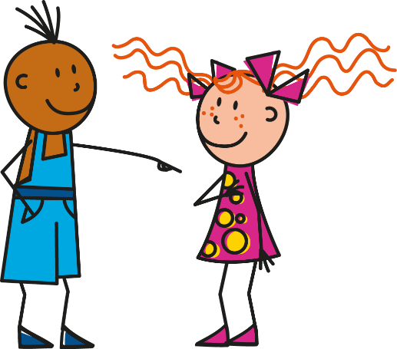
[u]
[ou]
prononcer
tu
nous
Notes:
Timing: 1 minute
Aim: to recap SSC [u] and [ou]
Procedure:
Introduce and elicit the pronunciation of the individual SSC [u] and [ou] and then the source words ‘tu’ and ‘nous’(with gestures, if using).
Click to bring on the picture and get students to repeat (with gesture, if using).
Note:
i) gesture for tu – pointing away to an imaginary person in front of you.
ii) gesture for nous – spreading arms out in front palms down, do a sweeping motion (similar to a breastroke in swimming), motioning inclusivity ‘we’.
2

Slide 3















prononcer
. Écoute les noms des animaux. C’est [ien] ou [(a)in]?
Écoute. C’est [u] ou [ou] ?
c
One of the chests contains buried treasure. All the others contain poison!
Listen carefully to the secret code and follow the arrows to find the treasure.
w
vue
pull
vue
vous
poule
vous
h
z
tu
bouche
roue
v
tout
bûche
rue
bouche
poule
roue
tu
vue
bûche
pull
rue
tout
vous
k
vue
bouche
roue
pull
vue
i
vous
bûche
rue
poule
vous
every-thing
vue
pull
roue
pull
vue
r
vous
poule
rue
poule
vous
vue
1
y
j
q
vous
Notes:
Slide 1 of 3
Timing: 5 minutes (three slides)
This slide and the two that follow are three versions of the activity with different solutions.
The game makes use of minimal pairs of unknown words (unknown words are used so that pupils focus on the sound. Definitions are given on a later slide).
Starting on the red square, pupils listen to the words and decide whether they hear /u/ or /ou/. They follow the arrows indicated by their choice to finish at one of the chests. There is only one correct route per slide, so pupils must correctly identify all words to find the treasure. The order or /u/ and /ou/ changes (i.e. sometimes /u/ is on the white square and sometimes on the blue) so the pupils must read the spellings.
Pupils can follow the slide on the projector, or the slide can be printed so they can trace the route with a pen/finger.
Teacher clicks on the chests they say to reveal treasure (or not!)
Audio plays on clicking the pink play button. Pupils will probably need to hear the audio at least three times.
Note: Each treasure chest is triggered to reveal what is underneath. You see a hand icon appear when you mouse over it – click and the chest disappears. Each slide only has one treasure chest – the rest reveal skulls.
Transcript:
tu, bouche, roue, poule, vous
Treasure is located in chest W.
Word frequency (1 is the most frequent word in French):
bouche [1838] bûche [n/a] pull [n/a] poule [4321] roue [3916] rue [598] tout [24] tu [122] vous [50] vue [191]
Source: Londsale, D., & Le Bras, Y. (2009). A Frequency Dictionary of French: Core vocabulary for learners London: Routledge.
3

Slide 4
prononcer
. Écoute les noms des animaux. C’est [ien] ou [(a)in]?
Écoute. C’est [u] ou [ou] ?
c
One of the chests contains buried treasure. All the others contain poison!
Listen carefully to the secret code and follow the arrows to find the treasure.
w
vue
pull
vue
vous
poule
vous
h
z
tu
bouche
roue
v
tout
bûche
rue
bouche
poule
roue
tu
vue
bûche
pull
rue
tout
vous
k
vue
bouche
roue
pull
vue
i
vous
bûche
rue
poule
vous
every-thing
vue
pull
roue
pull
vue
r
vous
poule
rue
poule
vous
vue
2
y
j
q
vous
Notes:
[2/3]
Transcript:
tout, bûche, rue, poule, vous
Treasure is located in chest Y.
Word frequency (1 is the most frequent word in French):
bouche [1838] bûche [n/a] pull [n/a] poule [4321] roue [3916] rue [598] tout [24] tu [122] vous [50] vue [191]
Source: Londsale, D., & Le Bras, Y. (2009). A Frequency Dictionary of French: Core vocabulary for learners London: Routledge.
4

Slide 5
prononcer
. Écoute les noms des animaux. C’est [ien] ou [(a)in]?
Écoute. C’est [u] ou [ou] ?
c
One of the chests contains buried treasure. All the others contain poison!
Listen carefully to the secret code and follow the arrows to find the treasure.
w
vue
pull
vue
vous
poule
vous
h
z
tu
bouche
roue
v
tout
bûche
rue
bouche
poule
roue
tu
vue
bûche
pull
rue
tout
vous
k
vue
bouche
roue
pull
vue
i
vous
bûche
rue
poule
vous
every-thing
vue
pull
roue
pull
vue
r
vous
poule
rue
poule
vous
vue
3
y
j
q
vous
Notes:
[3/3]
Transcript:
tu, bûche, rue, pull, vue
Treasure is located in chest R.
Word frequency (1 is the most frequent word in French):
bouche [1838] bûche [n/a] pull [n/a] poule [4321] roue [3916] rue [598] tout [24] tu [122] vous [50] vue [191]
Source: Londsale, D., & Le Bras, Y. (2009). A Frequency Dictionary of French: Core vocabulary for learners London: Routledge.
5

Slide 6


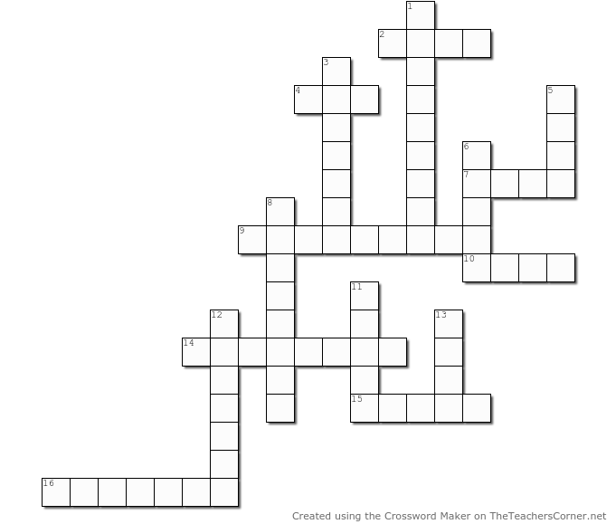

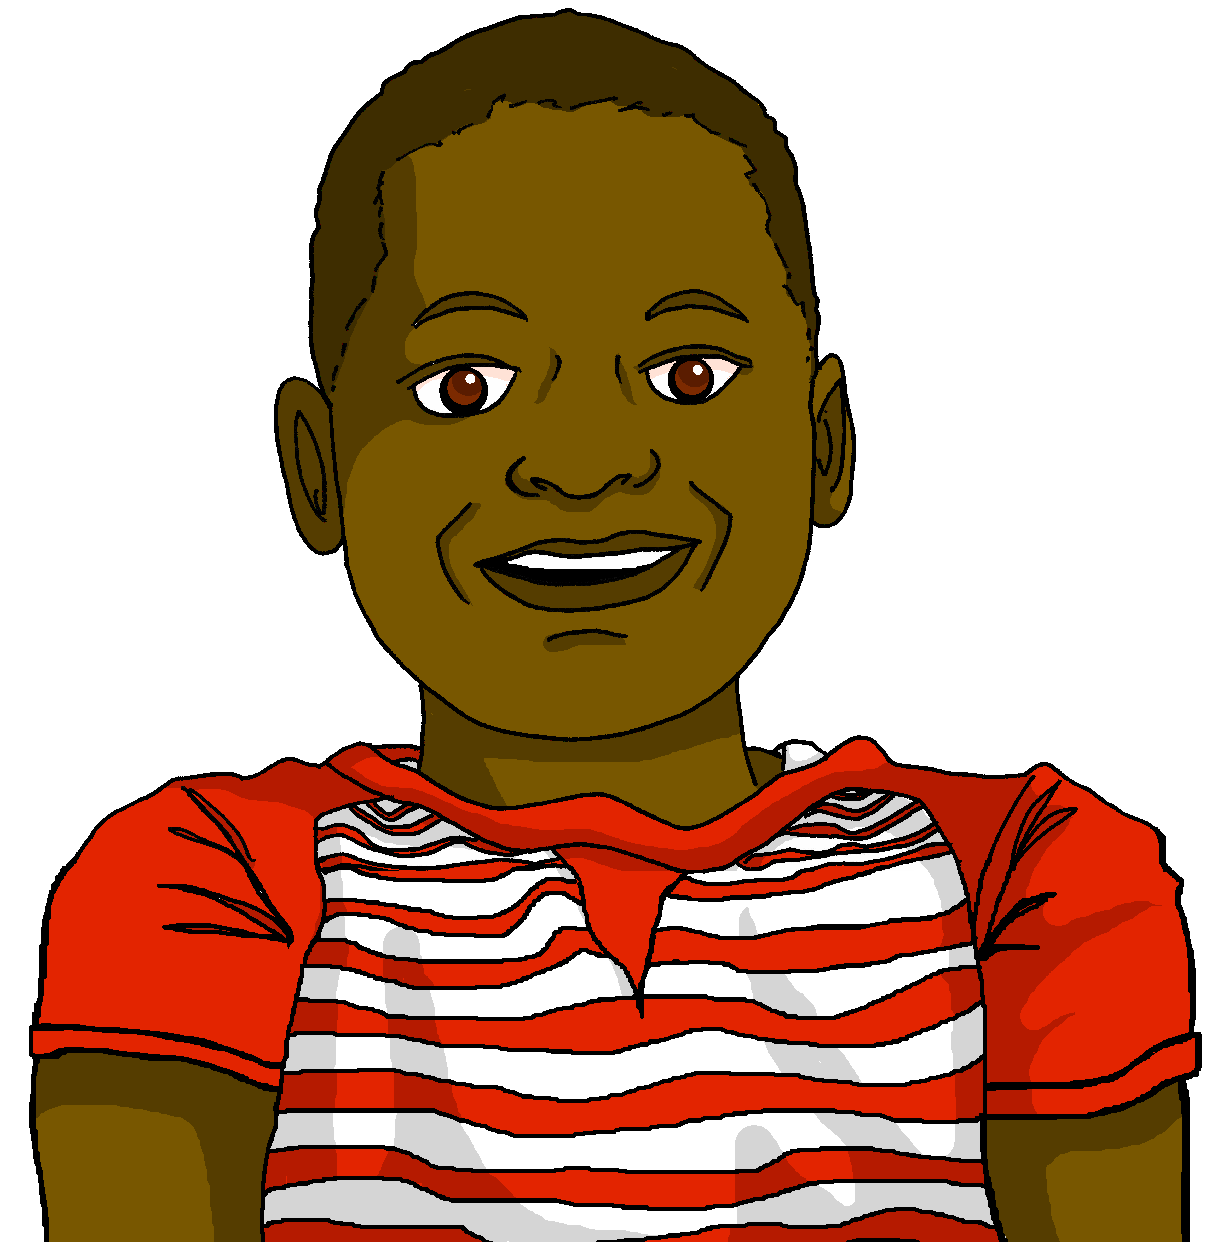
vocabulaire
Jean-Michel prépare un jeu de vocabulaire pour la classe en Angleterre.
mots
d
Écris en anglais.
s
i
c
k
.
y
f
Fill in the crossword with the English translations of the French vocabulary.
Horizontale:
2. malade
4. tu
7. en retard
9. écouter
10. facile
14. ensemble
15. tôt
16. détester
y
o
u
f
h
u
i
e
c
a
r
a
u
l
a
t
e
t
l
l
o
Leave a space if the answer is two words.
t
o
l
i
s
t
e
n
e
a
s
y
s
t
Verticale:
1. difficile
3. vous
5. ici
6. seul
8. parler
11. là
12. aimer
13. bien
t
p
h
w
t
o
g
e
t
h
e
r
e
a
r
l
l
k
e
a
r
l
y
i
k
t
o
h
a
t
e
Notes:
Timing: 8 minutes
Aim: to present and practise new and revisited vocabulary from this week.
Procedure:
Pupils complete the crossword, reading the clues in French, and writing or saying the answers in English. Students could write the clue numbers and complete the crossword individually, or work in groups to contribute answers orally.
Click to reveal the English translation of each word in sequence.
here, ici
there, là
you, tu
you (all), vous
to speak, parler
to listen, écouter
to like, aimer
to hate, détester
together, ensemble
alone, seul
well, bien
sick, malade
difficult, difficile
easy, facile
early, tôt
late, en retard
6

Slide 7

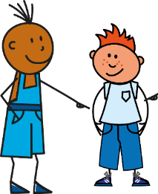

Être
[to be | being]
You already know how to say you are to one person:
être
Tu es grand. | You are tall.
Or when you need to use formal speech!
___ _______ _______.
To say ‘you’ + être to more than one person, say:
(z)
Vous êtes grands. | You (all) are tall.
Vous êtes grand(s).
___ _______ _______.
You hear the ‘s’
(like ‘z’) on ‘vous’ because of the ‘e’. This liaison is always made.
Plural ‘you’ (vous) needs a plural adjective when there is more than more person.
Notes:
Timing: 2 minutes
Aim: to revise the 2nd person singular of être and to present the 2nd person plural vous êtes.
Procedure:
Elicit the French ‘tu es grand’ from pupils.
Click to present vous êtes and elicit the English meaning.
Click to tell pupils about liaison between vous and êtes.
Click to draw attention to the plural adjective ending and the formal speech that French natives use when using vous.
7

Slide 8

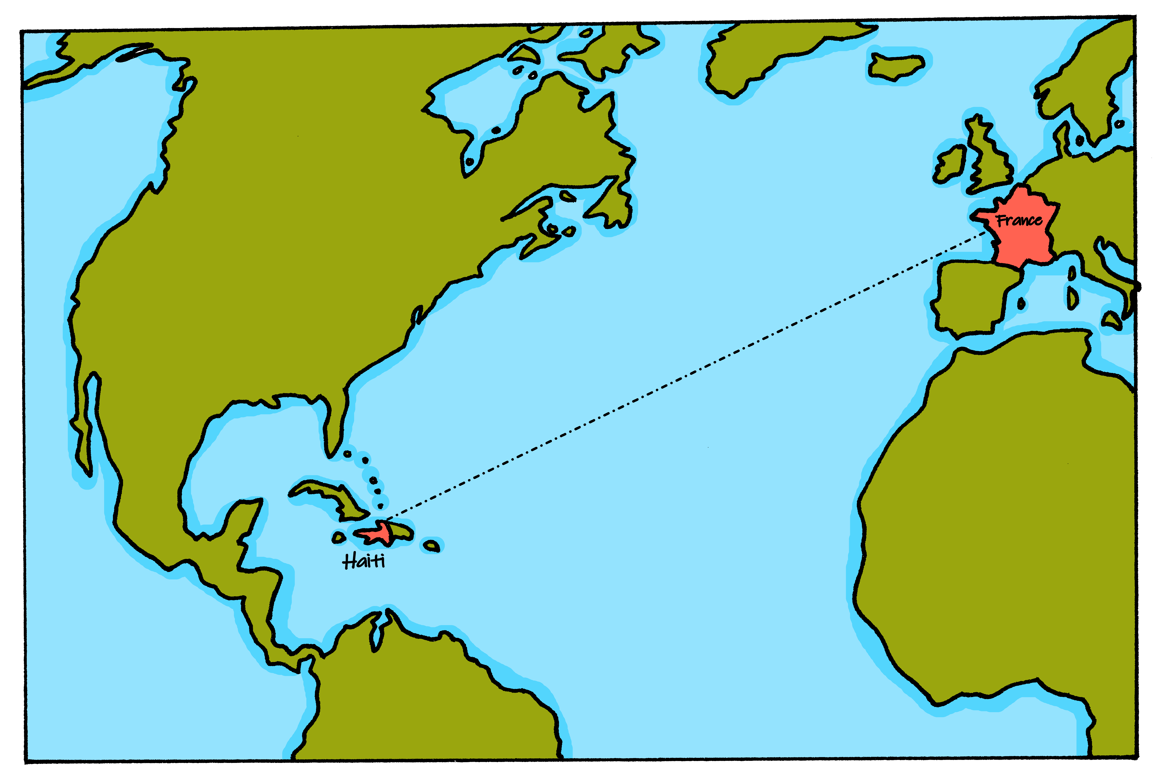


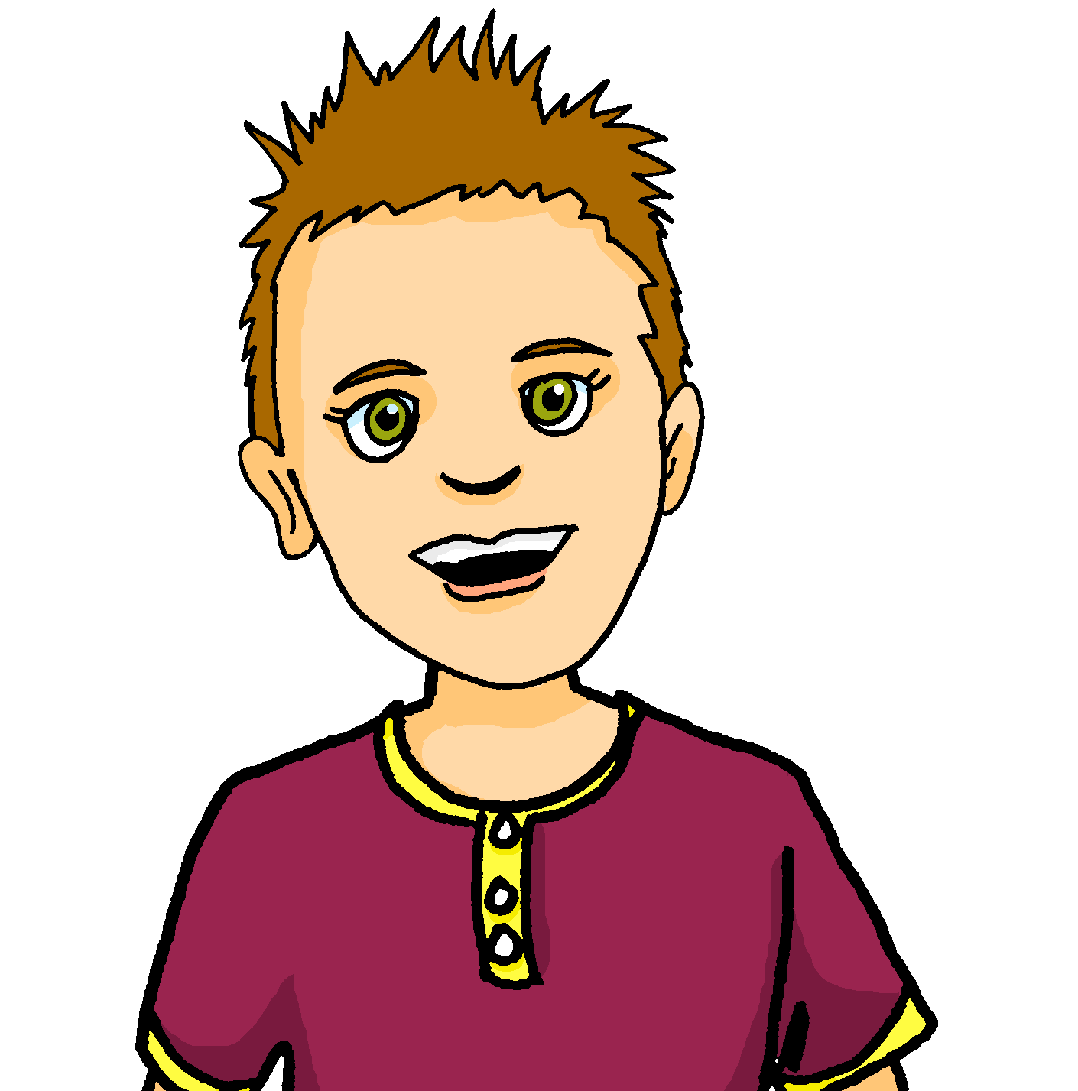


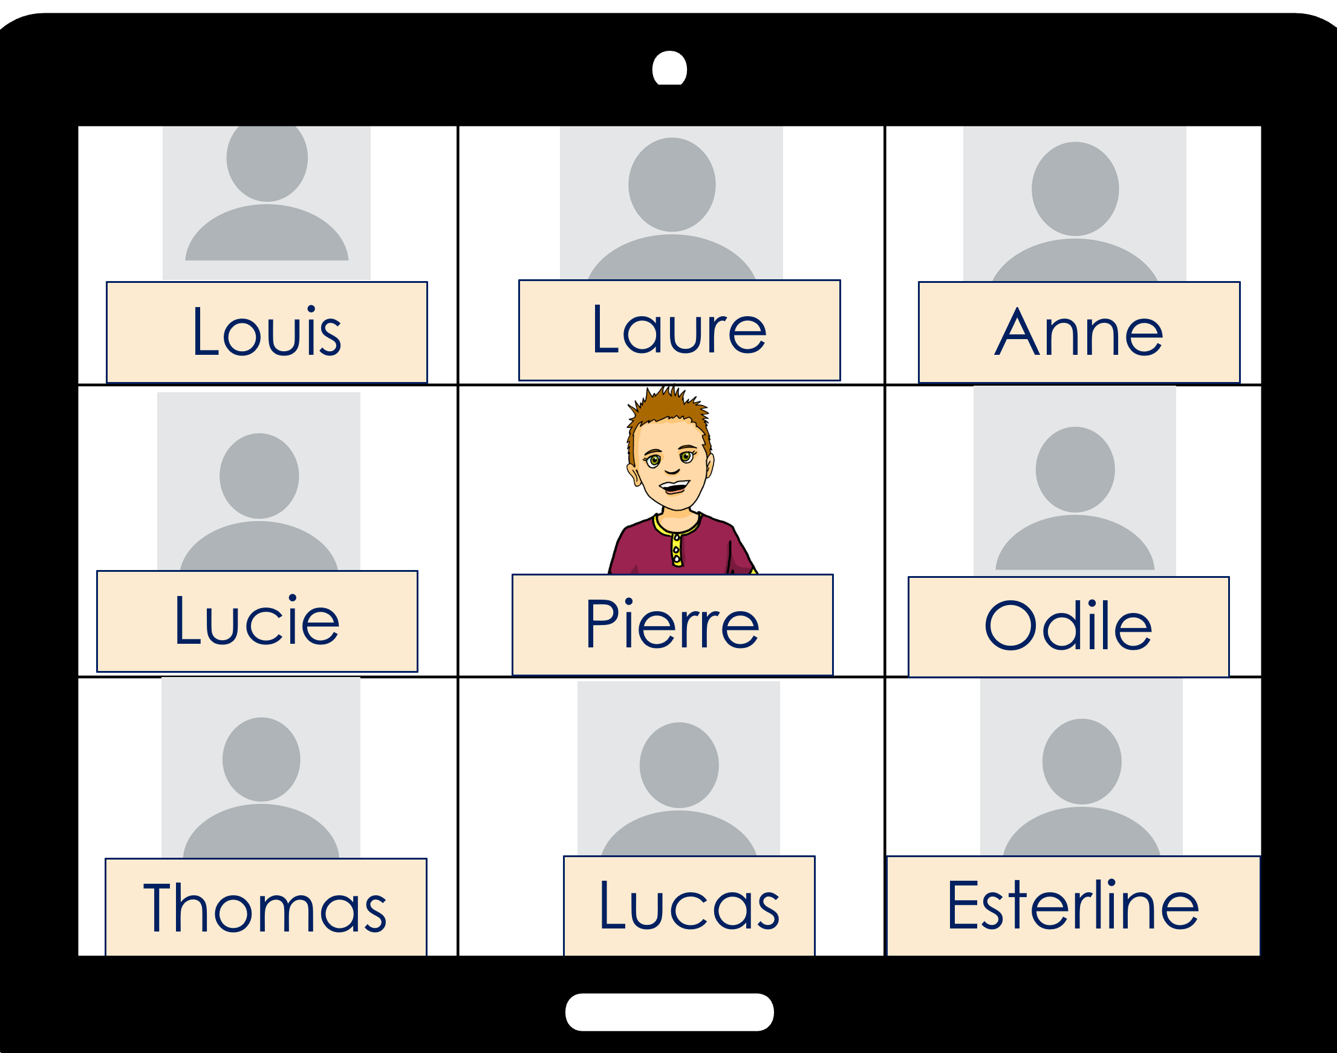
écouter
. Écoute les noms des animaux. C’est [ien] ou [(a)in]?
Écoute. Jean-Michel parle à Pierre (tu) ou à Pierre et la classe (vous) ?
vous (you all)
tu (you))
détails
Ex
there
Ex
1
early
1
2
late
2
3
sick?
3
4
here
4
5
calm
5
6
funny
6
Notes:
Timing: 8 minutes
Aim: to practise aural distinction between ‘tu’ and ‘vous’ forms of être.
Procedure:
Do the example with pupils first. Click to play audio. Pupils decide whether they hear ‘êtes’ or ‘es’ and write the corresponding pronoun ‘vous’ or ‘tu’. Click to reveal answers.
Click to listen again and pupils write the additional detail in English. Click to reveal it.
Repeat for items 1-6.
Finally, if time allows, click for a 2nd set of audio buttons. Elicit the French sentences from pupils using the answer ticks and English prompts.
Transcript:
Exemple: ...... êtes là.
...... êtes tôt.
...... es en retard.
...... es malade ?
...... êtes ici.
...... es calme.
……êtes amusants !
8

Slide 9



lire
Jean-Michel écrit un message à la classe de Pierre.
Zut ! Il fait des erreurs ! Écris les mots en français.
À : tout le monde
Salut tout le monde !
Ça va ?
Nous sommes tous* ensemble, en classe. Et vous ? Vous êtes où ?
Port-au-Prince, Haïti
écrire
ℓ≠∂ФΘ
ℓ≠∂ФΘ
À Haïti tout le monde parle créole haïtien – environ 11 millions de personnes. La langue a beaucoup de mots français mais il y a des différences de prononciation, de grammaire et aussi de vocabulaire. Par exemple, le mot « ou » c’est « tu » et « nou » c’est « vous ».
J’étudie le français. J’aime ça, mais c’est difficile pour moi.
Chez moi, je parle créole haïtien.
Et vous ? Vous êtes forts en français ?
Aujourd’hui, nous sommes samedi 15 octobre. C’est super, demain c’est le weekend ! ☺ Je suis heureux !
Et vous, vous êtes contents ?
Bisous,
Jean-Michel
ℓ≠∂ФΘ
ℓ≠∂ФΘ
ℓ≠∂ФΘ
ℓ≠∂ФΘ
ℓ≠∂ФΘ
ℓ≠∂ФΘ
tous – all
demain – tomorrow
Notes:
Timing: 8 minutes
Aim: to practise written production of known parts of être and understanding of a longer text.
Procedure:
Pupils write 1-8 and the correct French verb (part of être).
Click audio (player bottom right of phone screen) to listen to the whole message and check answers. Click to reveal written answers, too.
Teacher uses questioning to ensure pupils’ understanding of the text. E.g. What questions does Jean-Michel ask? How does he feel about learning French? Why? How is he feeling? Why? Which three questions does he ask the class?
Transcript:
Salut tout le monde!
Ça va ?
Nous sommes ensemble, en classe. Et vous ? Vous êtes où ?
J’étudie le français. J’aime ça, mais c’est difficile. Chez moi, je parle créole haïtien.
Et vous ? Vous êtes forts en français ?
Aujourd’hui, nous sommes samedi 15 octobre. C’est super, demain c’est le weekend ! ☺ Je suis heureux ! Et vous, vous êtes contents ?
Bisous,
Jean-Michel
9

Slide 10
Au revoir !
vert
Notes:
10

