Slide 1
Interactions
Échange en ligne
vert
Follow ups 1-5
Term 1 Week 4
Notes:
Artwork by Steve Clarke. Pronoun pictures from NCELP (www.ncelp.org). All additional pictures selected from Pixabay and are available under a Creative Commons license, no attribution required.
Phonics: revisit SSC [an|en] enfant [138] and introduce [am|em] temps [64]
Vocabulary (new words in bold): sommes [5] nous [31] quel, quelle [146] date [660] jour [78] mois [179] saison [1667] semaine [245] lundi [1091], mardi [1044] mercredi [1168] jeudi [1112] vendredi [1086] samedi [1356] dimanche [1235] aujourd’hui [233]
Revisit 1: être [5] suis, est, es [5] je [22] tu [112] il [13] elle [38] qui ? [14] ami(e) [467] école [477] monsieur [79] madame [294] professeur(e) [110] absent [2016] actif [1219] anglais [784] content [1841] créatif [>5000] grand [59] français [251] indépendant [954] intelligent [2509] négatif [1520] petit [138] positif [949] présent [216] sportif [2670] triste [1843] bien [47] mal [277] Salut ! [2205] Ça va ? [54/53] Oui [284] Non [75] Bonjour ! [1972] Au revoir [n/a] Revisit 2: chaud [1852] froid [1307] peur [755] mal [277]
Londsale, D., & Le Bras, Y. (2009). A Frequency Dictionary of French: Core vocabulary for learners London: Routledge.
The frequency rankings for words that occur in this PowerPoint which have been previously introduced in these resources are given in the SOW and in the resources that first introduced and formally re-visited those words.
For any other words that occur incidentally in this PowerPoint, frequency rankings will be provided in the notes field wherever possible.

Slide 2
[an|en]
[am|em]
prononcer
Where the [an|en] sound is followed by ‘p’ or ‘b’, it is written [am|em]. The sound is the same.
enfant
temps
[time]
Notes:
DO THESE TWO SLIDES AS PART OF FOLLOW UP 1.
Timing: 1 minute
Aim: to revisit SSC [an|en] and introduce pupils to [am|em].
Procedure:
Elicit the pronunciation of the individual SSC [an|en]. Practise saying it several times.
Click to bring up the source word ‘enfant’ (with gesture, if using). Say the word several times.
Click to bring up the picture and get pupils to repeat the words (with gesture, if using).
Bring up the callout about [am|em].
Introduce the source word ‘temps’. Repeat the word several times.

Slide 3
[am|em]
prononcer
camp
temps
chambre
[bedroom]
ensemble
printemps
[together]
[spring]
[time]
Notes:
Timing: 2 minutes
Aim: to practise [em/am]
Procedure:
Introduce and elicit the pronunciation of the individual SSC [em/am] and then the source word again ‘temps’ (with gesture, if using).
Then present and elicit the pronunciation of the four cluster words.
Frequency of cluster words: camp [1084] chambre [633] ensemble [124] printemps [1288] temps [65] Source: Londsale, D., & Le Bras, Y. (2009). A Frequency Dictionary of French: Core vocabulary for learners London: Routledge.

Slide 4
Follow up :
. Écoute les noms des animaux. C’est [ien] ou [(a)in]?
Prononce les mots.
médicament
novembre
parler
arranger
60
environnement
trembler
plante
S
lampe
camping
équipement
employeur
0
DÉBUT
Notes:
Timing: 2 minutes
Aim: to practise oral production of SSC [an|am|en|em] in a read aloud task.
Procedure:
Start the timer.
Pupils tried to say as many words as they can correctly in twenty seconds.
Pupil B listens carefully and stops his/her partner for a count of 3 every time s/he pronounces a word with an English sound.
Pupils swap roles and the timer is restarted.
The person who has pronounced the greatest number of words correctly wins. If there is a tie, the student with the greatest amount of time remaining wins.
Click on the words to hear them said by a native speaker. Pupils repeat.
Time allowing, go over the meaning of the words. These are all cognates or near-cognates, purposefully chosen for unlearning the connection between the SSC and the English sound.
Frequency of unknown words and cognates: arranger [2932] camping [n/a] employeur [2633] environnement [945] équipement [1704] lampe [4699] médicament [1954] novembre [982] plante [2702] trembler [4225]
Source: Londsale, D., & Le Bras, Y. (2009). A Frequency Dictionary of French: Core vocabulary for learners London: Routledge.

Slide 5
Follow up 2:
. Écoute les noms des animaux. C’est [ien] ou [(a)in]?
Écoute. C’est quel mot ?
écouter
Monday | today | Thursday
E
negative | pleased | sad
1
where? | who? | how?
2
3
month | day | date
Monsieur Charles
Spanish | Mr., Sir (teacher) | German
4
5
you | he | she
6
hot | cold | ill
Notes:
Timing: 5 minutes (two slides)
Aim: to practise aural and written comprehension of this week’s new vocabulary and revisited vocabulary sets.
Procedure:
Click to listen. Pupils circle the correct word (if they have the sheet printed). If not, they can use numbers 1-6 and A, B, C to identify the answers. Alternatively, they can transcribe the words.
Click for answers.
Transcript:
Exemple: Aujourd’hui, le professeur est positif. 1. Mon ami est négatif. 2. Salut ! Ça va bien ? Qui est absent ? 3. Nous sommes quelle date ? 4. Monsier Charles a une leçon de français ou d’anglais, aujourd’hui ? 5. Il est toujours calme mais actif. 6. J’aime l’école mais aujourd’hui j’ai mal !

Slide 6
Using ‘le’ with dates
[the/on the]
Remember, we use the definite article ‘le’ to mean ‘the’ or ‘on the’ with dates with numbers.
Par exemple :
Noël est le 25 décembre.
Christmas day is on the 25th December.
Le Jour du Drapeau d’Haϊti est le 18 mai.
Haϊti’s Flag Day is on the 18th May.
Notes:
Use this recap slide ahead of Follow up 3.
Time: 2 minutes Aim: to recap the use of “le” with the meaning of “(on) the”
Procedure: 1. Click to present the information. It is animated to allow for a paced, interactive delivery. 2. Elicit the English translation from the examples.

Slide 7
Follow up 3: Le drapeau d’Haïti
flag
Le drapeau d’Haïti est bleu et rouge.
Il représente la République d’Haïti après la Révolution (1804).
Le bleu est pour les noirs et le rouge pour les mulâtres*.
* people of mixed African and European hertiage.
C’est comme le drapeau de la France mais le blanc est absent.
Le palmier représente l’indépendance.
motto
La devise* nationale est L’union fait la force (Unity makes strength).
Notes:
Timing: 3 minutes
Aim: to provide more detail about the Haitian flag.
Procedure:
Click to bring up each phrase (and, in the audio version, to hear it).
Read the information again with pupils. In line glosses of the trickier words are provided.
Sources: https://worldpopulationreview.com/countries/haiti/flag https://fr.wikipedia.org/wiki/Drapeau_d%27Ha%C3%AFti

Slide 8
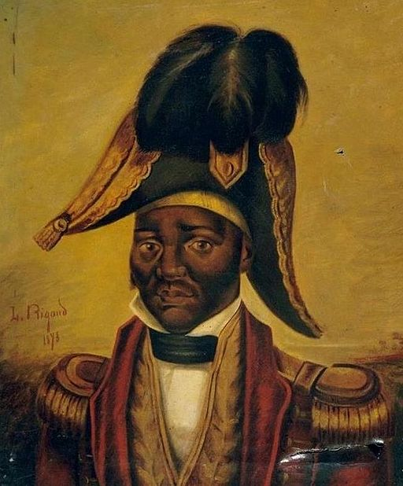
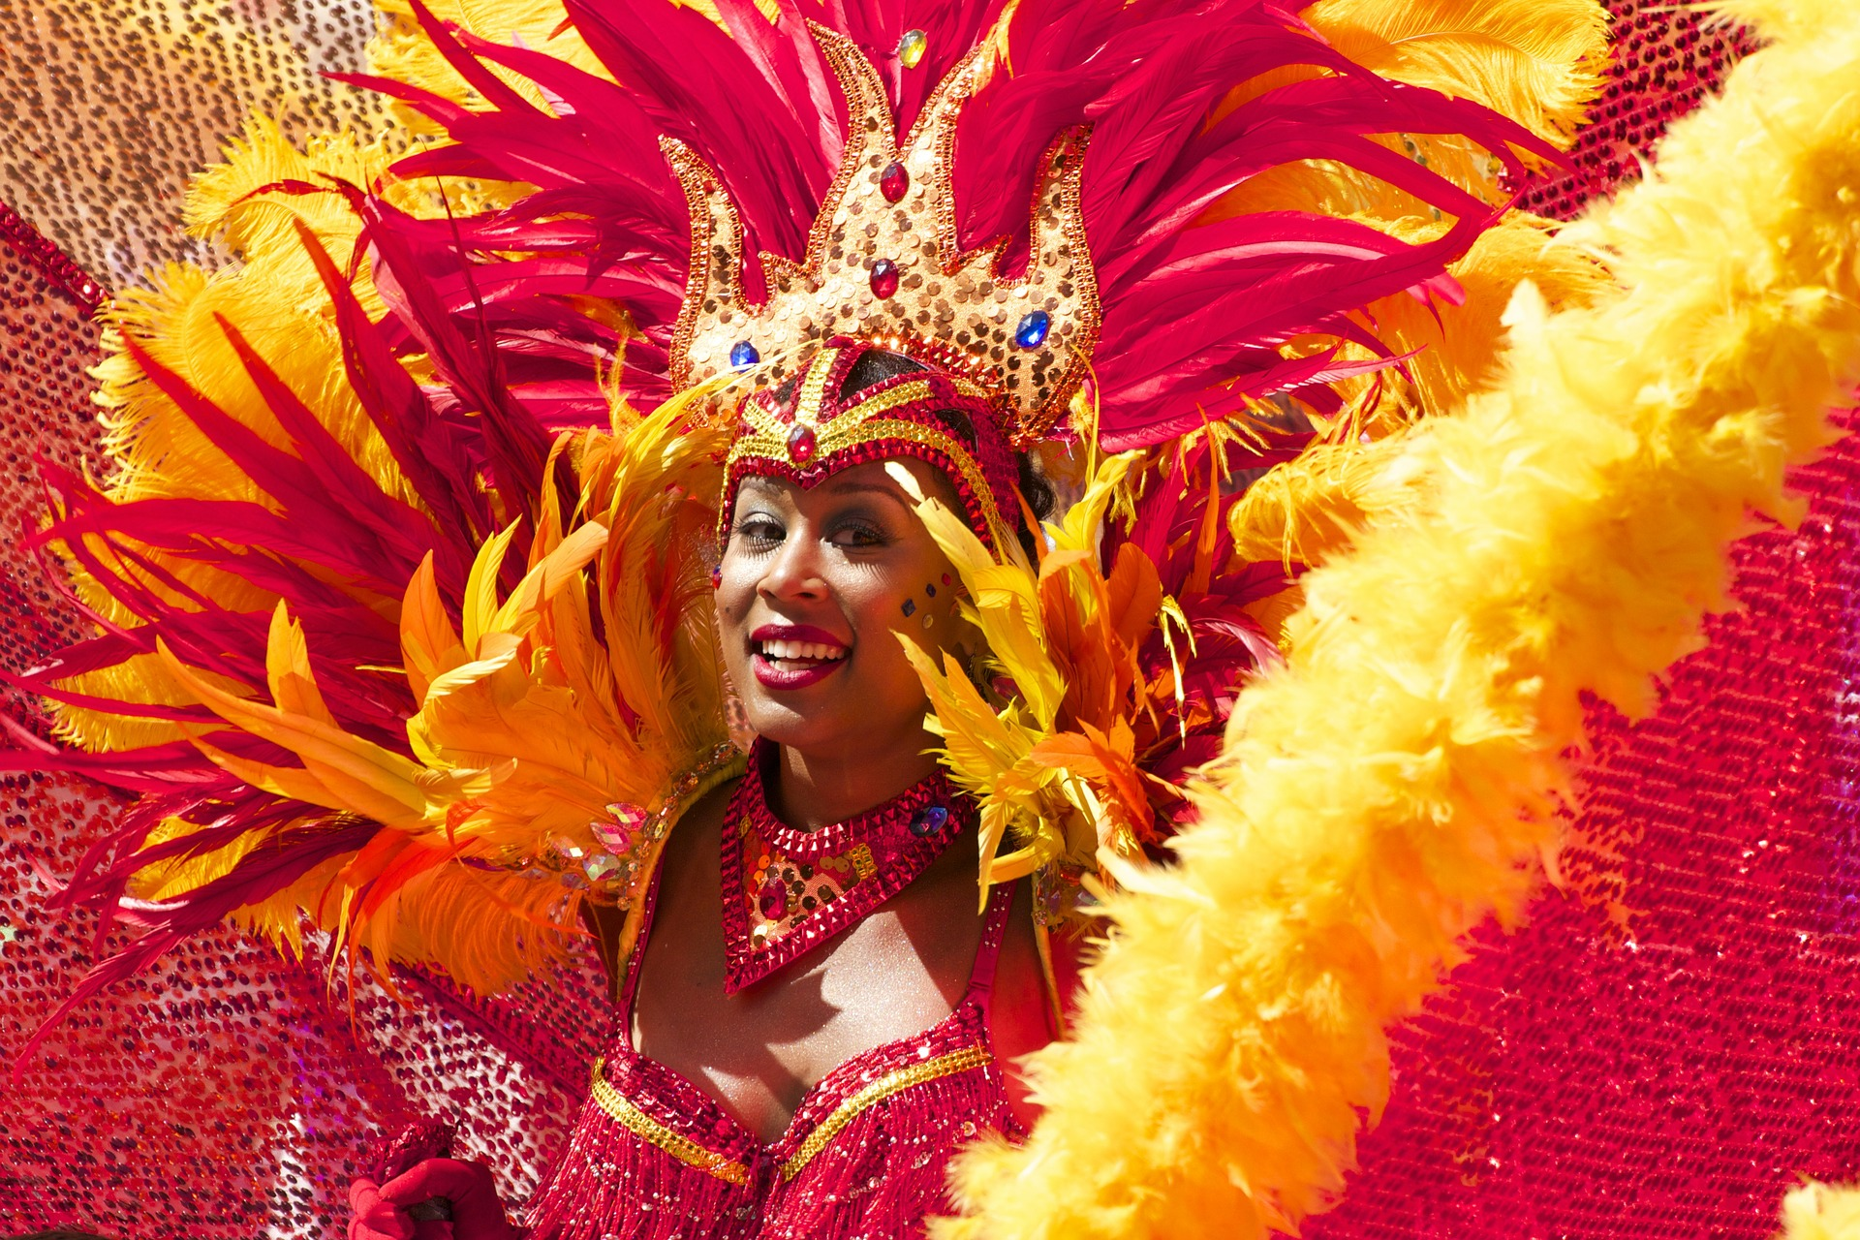
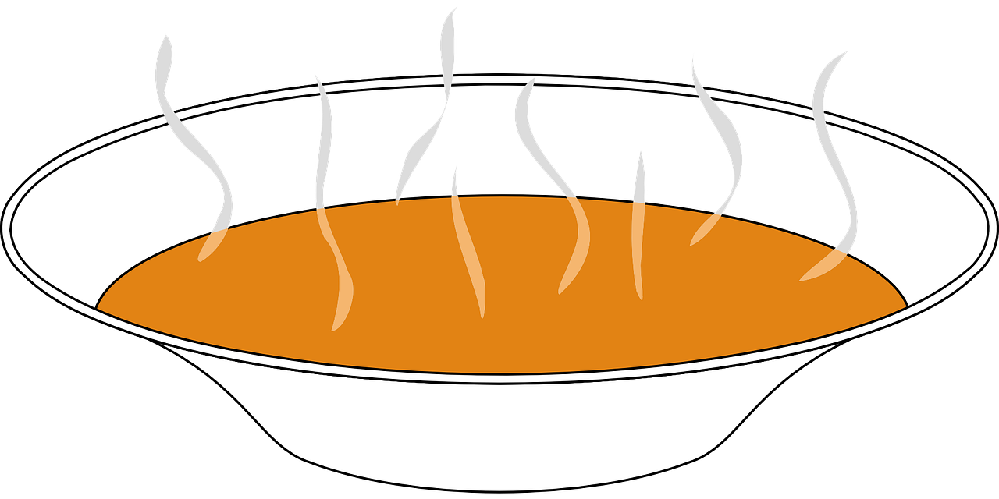
Follow up 4:
. Écoute les noms des animaux. C’est [ien] ou [(a)in]?
Écoute et lis les textes. Puis, complète le tableau.
leader
[1]
[2]
[3]
[4]
Le Jour de Dessalines est le 17 octobre. Jacques Dessalines est meneur* de la révolution d’Haïti. Il donne son nom à l’hymne national, La Dessalinienne.
lire
Fèt Gede est le 1er novembre. C’est une célébration pour honorer les morts*. La famille chante, danse et mange au cimetière*.
cemetery
the dead
La Fête de l’Indépendance d'Haïti est le 1er janvier. On mange de la soupe traditionnelle et il y a des petits cadeaux pour les enfants.
Le Carnaval d’Haïti est une fête en février. Il y a beaucoup de couleurs, de danses et de costumes.
event | date | month | extra
Le Carnaval
Fèt Gede
Le Jour de Dessalines
La Fête de l’Indépendance
Notes:
Time: 8 minutes (2 slides) Aim: to practise written comprehension of numbers, months and other vocabulary in longer sentence contexts; to learn key details about four important celebrations in Haïti.
Procedure: 1. Read instructions in French. 2. Pupils to copy the table.
3. Click to listen bring up each text and read (and in the audio version listen to) each text.
4. Pupils fill in the details in English. 5. Move to next slide to check answers.
Transcript:
[1] Le Jour de Dessalines est le 17 octobre. Jacques Dessalines est meneur* de la révolution d’Haïti. Il donne son nom à l’hymn national, La Dessalinienne.
[2] Fèt Gede est le 1er novembre. C’est une célébration pour honorer les morts*. La famille chante, danse et mange au cimetière*.
[3] La Fête de l’Indépendance d'Haïti est le 1er janvier. On mange de la soupe traditionnelle et il y a de petits cadeaux pour les enfants.
[4] Le Carnaval de Haïti est une fête en février. Il y a beaucoup de couleurs, de danses et de costumes.
Source: https://fr.wikipedia.org/wiki/Jean-Jacques_Dessalines https://visithaiti.com/festivals-events/fet-gede-haitian-day-of-the-dead/
Image attribution: Louis Rigaud, Public domain, via Wikimedia Commons

Slide 9
Follow up 4:
Les réponses.
event | date | month | extra
[1] Le Jour de Dessalines
[2] Fèt Gede
[3] La Fête de l’Indépendance d'Haïti
[4] Le Carnaval d’Haïti
lire
October
Dessalines led the revolution in Haiti. The national anthem is named after him.
17
honour dead family members / sing, dance, eat at cemetery.
1st
November
eat soup / little presents for children
1st
January
--
February
lots of colour, dances, costumes
Notes:
Procedure: Click to check pupil answers.

Slide 10
vocabulaire
Follow up 5 - Écris en anglais : Can you get at least 15 points?
mots
 | peur | chaud | froid
 | Monsieur | Madame | mal
 | l’amie | qui ? | l’école
 | négative | positif | l’ami
 | quelle ? | la date | la saison
 | quel ? | le jour | le mois
 | aujourd’hui | nous | sommes
fear
hot, heat
cold
x3
Mr., Sir
Mrs., Miss
bad
(the) friend (f)
who?
(the) school
x2
negative (f)
positive (m)
(the) friend (m)
which? (f)
(the) date
(the) season
which? (m)
(the) day
(the) month
x1
today
we
are
Notes:
Timing: 5 minutes
Aim: to practise written production of vocabulary from this week.
Procedure: 1. Give pupils a blank grid. They fill in the English meanings of any of the words they know, trying to reach 15 points in total.
10

Slide 11
vocabulaire
Follow up 5 - Écris en français : Can you get at least 15 points?
mots
 | bad | Mr., Sir (teacher) | Mrs., Miss (teacher)
 | hot, heat | cold | fear
 | (the) école | (the) friend (m) | (the) friend (f)
 | who? | negative (m) | positive (f)
 | we | are | today
 | (the) season | (the) day | (the) month
 | which? (m) | which? (f) | (the) date
mal
Monsieur
Madame
x3
chaud
froid
peur
l’école
l’ami
l’amie
x2
qui ?
négatif
positive
nous
sommes
aujourd’hui
la saison
le jour
le mois
x1
quel ?
quelle ?
la date
Notes:
Timing: 5 minutes
Aim: to practise written production of vocabulary from this week.
Procedure: 1. Give pupils a blank grid. They fill in the French meanings of any of the words they know, trying to reach 15 points in total.
11

Slide 12
vocabulaire
Follow up 5 - Écris en anglais : Can you get at least 15 points?
mots
 | peur | chaud | froid
 | Monsieur | Madame | mal
 | l’amie | qui ? | l’école
 | négative | positif | l’ami
 | quelle ? | la date | la saison
 | quel ? | le jour | le mois
 | aujourd’hui | nous | sommes
x3
x2
x1
Notes:
HANDOUT
12

Slide 13
vocabulaire
Follow up 5 - Écris en français : Can you get at least 15 points?
mots
 | bad | Mr., Sir (teacher) | Mrs., Miss (teacher)
 | hot, heat | cold | fear
 | (the) école | (the) friend (m) | (the) friend (f)
 | who? | negative (m) | positive (f)
 | we | are | today
 | (the) season | (the) day | (the) month
 | which? (m) | which? (f) | (the) date
x3
x2
x1
Notes:
HANDOUT
13

