Slide 1
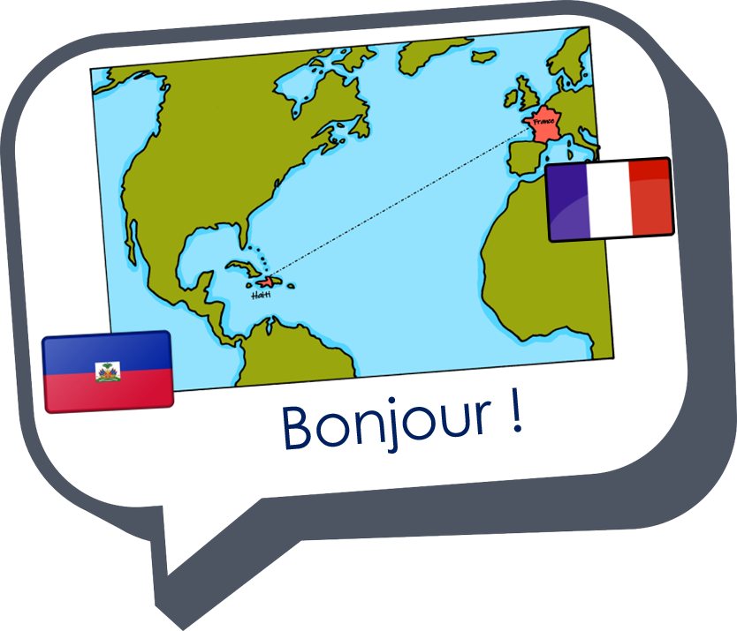
Describing me and others
Échange en ligne
vert
Follow ups 1-5
Term 1 Week 2
Notes:
Artwork by Steve Clarke. Pronoun pictures from NCELP (www.ncelp.org). All additional pictures selected from Pixabay and are available under a Creative Commons license, no attribution required.
Phonics: revisit [a] and [an|en] banane [>5000] enfant [126] maman [2168]
Vocabulary (new words in bold): sommes [5] nous [31] allemand [844] espagnol [1666] amusant [4695] calme [1731] différent [350] difficile [296] facile [822] important [215] indépendant [954] jeune [152]
malade [1066] méchant [3184] prudent [1529] seul [102]
Revisit 1: -
Revisit 2: elle2 [38] il2 [13] actif [1219] massif [1760] propre [237] sale [2906] sportif [2670] idéal [1429]
Londsale, D., & Le Bras, Y. (2009). A Frequency Dictionary of French: Core vocabulary for learners London: Routledge.
The frequency rankings for words that occur in this PowerPoint which have been previously introduced in these resources are given in the SOW and in the resources that first introduced and formally re-visited those words.
For any other words that occur incidentally in this PowerPoint, frequency rankings will be provided in the notes field wherever possible.

Slide 2
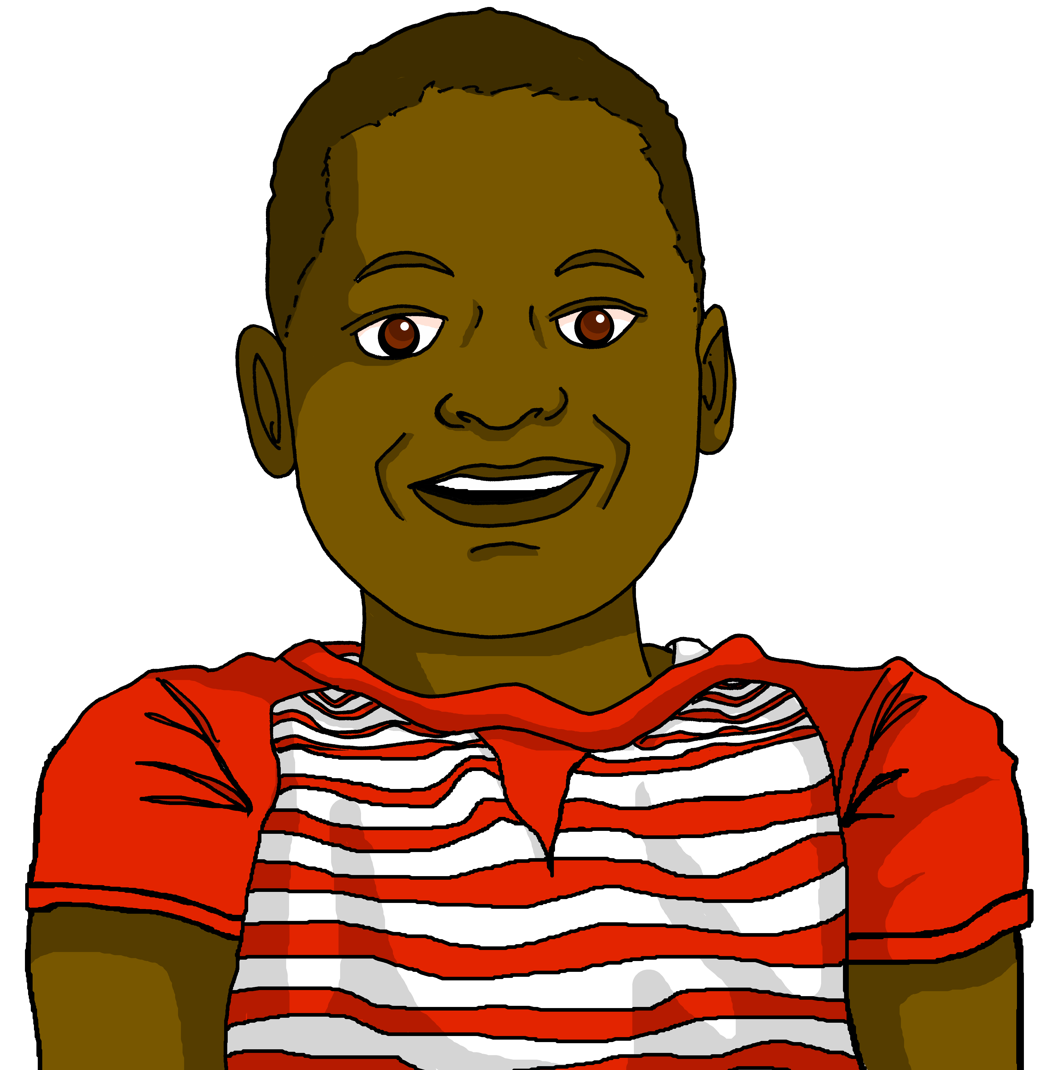
Follow up 1: [an|en]
Jean-Michel décrit deux personnes de sa classe.
. Écoute les noms des animaux. C’est [ien] ou [(a)in]?
prononcer
Elle est comment ? Il est comment ?
Personne A
Personne B
Mirlande…
Elle est…
Elle chante et…
Elle habite …
3
… elle danse souvent.
… à Grand-Boucan.
… est grande.
… une étudiante indépendante.
2
2
3
Personne B
Personne A
Jean...
Il chante en...
Il danse souvent...
Il habite...
3
… le dimanche.
… est un étudiant intéressant.
… à Chambellan.
… français et en allemand.
2
2
5
Notes:
Timing: 4 minutes
Aim: to practise spoken production of the SSC [an|en] and aural comprehension of previously taught vocabulary and structures and a few unknown words (place names and étudiant(e)).
Note: this is the ANSWER SLIDE. Don’t click until after pupils have completed the task.
Alternatively, to make the task less challenging in terms of comprehension, click to provide all the sentences up front, so that pupils read aloud and match the meanings, rather than rely on aural comprehension.
Procedure:
Give out the handout (see final slide).
Pupil A reads his/her sentence beginnings and Pupil B finishes the sentence with the appropriate ending.
They read the sentences again and between them tally the number of [an|en] sounds in each sentence.
Then they swap roles and repeat with the 2nd text.
Click this slide to show the full sentences, the number of [an|en] sounds and click the audio buttons to hear the lines read by a native speaker.
Transcript 1: Mirlande est grande. Elle est une étudiante indépendante. Elle chante et danse souvent. Elle habite à Grand-Boucan.
Transcript 2: Jean est un étudiant intéressant. Il chante en français et en allemand. Il danse souvent le dimanche. Il habite à Chambellan.
Information source: https://en.wikipedia.org/wiki/List_of_cities_in_Haiti

Slide 3
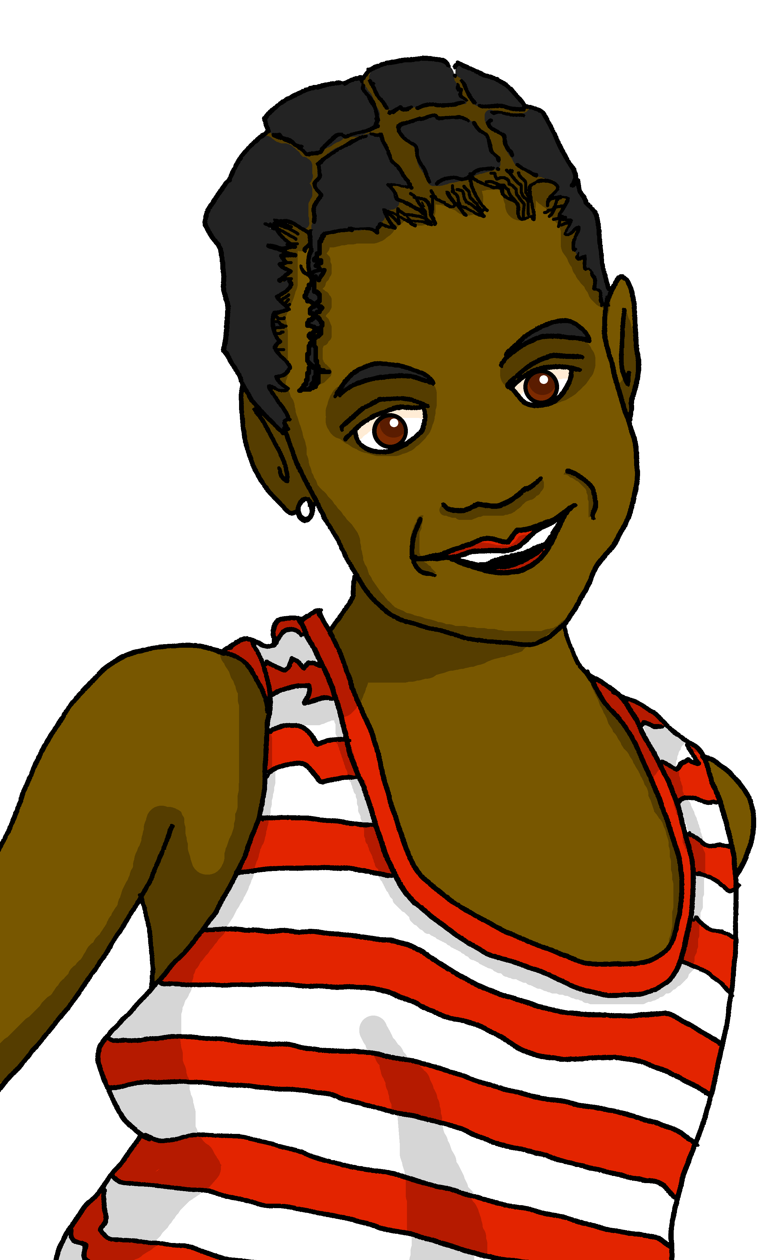
Follow up 2:
Écoute les phrases. Qui parle ?
. Écoute les noms des animaux. C’est [ien] ou [(a)in]?
 | nous | nous | en anglais
écouter
1
intelligent
2
active
3
creative
4
strong
5
careful
6
independent
naughty
7
8
different
Notes:
Timing: 5 minutes
Aim: to practise aural recognition of the distinction between masculine and feminine plural adjectives.
Procedure:
Click to listen.
Remind pupils that a masculine plural ending also applies to a mixed group, and a feminine ending only to an all-female group.
Pupils note nous (f) or nous (m, m/f) and the English meaning of the adjective.
Transcript: 1. Nous sommes intelligentes. 2. Nous sommes actifs. 3. Nous sommes créatives.
4. Nous sommes fortes. 5. Nous sommes prudents. 6. Nous sommes indépendants. 7. Nous sommes méchantes. 8. Nous sommes différents.

Slide 4
Follow up 3:
. Écoute les noms des animaux. C’est [ien] ou [(a)in]?
Lis les phrases. L’adjectif, c’est quoi ?
lire
Je suis J-M et je suis......
1 |  | actif | actifs
2 |  | content | contents
3 |  | drôle | drôles
4 |  | grande | grandes
5 |  | fortes | forte
6 |  | calme | calmes
7 |  | amusant | amusants
8 |  | positif | positifs
Il est ......
Elle est ......
Nous sommes ......
Adèle ! Tu es ......
Nous sommes ......
Il est ......
Nous sommes ......
Notes:
Timing: 5 minutes
Aim: to practise recognition of the different forms of être, and adjectives with number agreement.
Procedure:
1. Pupils focus on the subject pronoun and verb form to determine singular or plural.
2. Then select the correct form of the adjective.
3. Answers are revealed on clicks.

Slide 5
Follow up 4:
Parle avec ton/ta partenaire.
. Écoute les noms des animaux. C’est [ien] ou [(a)in]?
Choose four adjectives. Say four sentences to describe yourself and your friends (we).
parler
20
different
ill, sick
strong
alone
young
naughty
S
funny
careful
active
sporty
intelligent
0
independent
DÉBUT
Notes:
Timing: 5 minutes
Aim: to practise oral production of the newly-introduced ‘nous’ form of ‘être’ and known vocabulary.
Procedure:
1. Pupils split into pairs.
2. Teacher clicks to start the timer.
3. Pupils take turns to say sentences (two each) in the nous form, taking care not to pronounce the –s on the adjective. Pupils should use each adjective only once. They should repeat the task a couple of times to improve their confidence and speed in production.

Slide 6
Follow up 5:

Écris quatre phrases.
. Écoute les noms des animaux. C’est [ien] ou [(a)in]?

1 _____________________________
écrire
….
Here you are talking about yourself.
(You are ____________).


2 _____________________________
…
4 _____________________________
…
(I am ____________).
(We are ____________).

3 _____________________________
….
(She is ____________).
Notes:
Timing: 10 minutes
Aim: to practise free written production of the four known parts of être and adjectives.
Procedure:
Tell pupils to complete the English sentences first, with their own choice of adjectives.
Then write the four sentences in French.
Teacher circulates to offer support, as needed.

Slide 7
vocabulaire
Follow up 5 - Écris en anglais : Can you get at least 15 points?
mots
 | elle | il | massif
 | propre | sales | sportives
 | seul | difficiles | indépendantes
 | différentes | jeune | facile
 | importantes | malade | calmes
 | espagnole | prudents | méchante
 | nous | sommes | allemands
she, it
he, it
massive (m)
x3
clean (m/f)
dirty (m/f, pl.)
sporty (f, pl.)
alone (m)
difficult (m/f, pl.)
independent (f, pl.)
x2
different (f, pl.)
young (m/f)
easy (m/f)
important (f, pl.)
ill, sick (m/f)
calm (m/f, pl.)
Spanish (f)
careful (m, pl.)
naughty (f)
x1
we
are (we)
German (m, pl.)
Notes:
Timing: 5 minutes
Aim: to practise written comprehension of vocabulary from this week and the revisited set.
Procedure: 1. Give pupils a blank grid. They fill in the English meanings of any of the words they know, trying to reach 15 points in total. 2. Remind pupils that adjectives can refer to male or female persons and they should note this in their translations. E.g. pleased (f), short (m).
Note: The most recently learnt and practised words are pink, words from revisited set 1 are green and those from revisited set 2 are blue, thus more points are awarded for them, to recognise that memories fade and more effort (heavy lifting!) is needed to retrieve them.
7

Slide 8
vocabulaire
Follow up 5 - Écris en français : Can you get at least 15 points?
mots
 | clean (m/f) | massive (m) | sporty (f, pl.)
 | dirty (m/f, pl.) | she, it | he, it
 | young (m/f) | different (f, pl.) | alone (m)
 | independent (f, pl.) | easy (m/f) | difficult (m/f, pl.)
 | calm (m/f, pl.) | important (f, pl.) | ill, sick (m/f)
 | German (m, pl.) | naughty | Spanish (f)
 | are (we) | careful (m, pl.) | we
propre
massif
sportives
x3
sales
elle
il
jeune
différentes
seul
x2
indépendantes
facile
difficiles
calmes
importantes
malade
allemands
méchante
espagnole
x1
sommes
prudents
nous
Notes:
Timing: 5 minutes
Aim: to practise written comprehension of vocabulary from this week and the revisited set.
Procedure: 1. Give pupils a blank grid. They fill in the English meanings of any of the words they know, trying to reach 15 points in total. 2. Remind pupils that adjectives can refer to male or female persons and they should note this in their translations. E.g. pleased (f), short (m).
Note: The most recently learnt and practised words are pink, words from revisited set 1 are green and those from revisited set 2 are blue, thus more points are awarded for them, to recognise that memories fade and more effort (heavy lifting!) is needed to retrieve them.
8

Slide 9
handout
prononcer
Personne A [1]
Personne B [1]
Mirlande…
Elle est…
Elle chante et…
Elle habite …
… elle danse souvent.
… à Grand-Boucan.
… est grande.
… une étudiante indépendante.
Personne A [2]
Personne B [2]
… les dimanches.
… est un étudiant intéressant.
… à Chambellan.
… français et en allemand.
Jean...
Il chante en...
Il danse souvent...
Il habite...
Notes:
HANDOUT (editable)
9

Slide 10
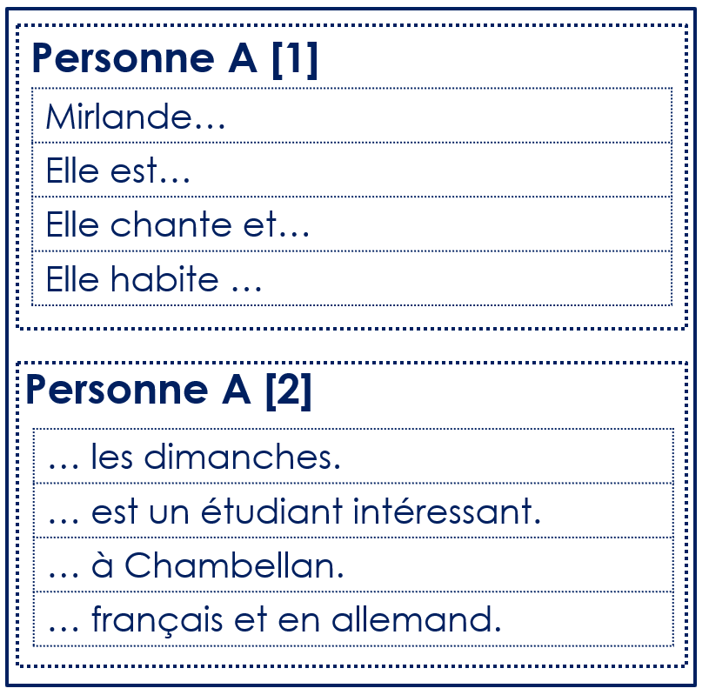
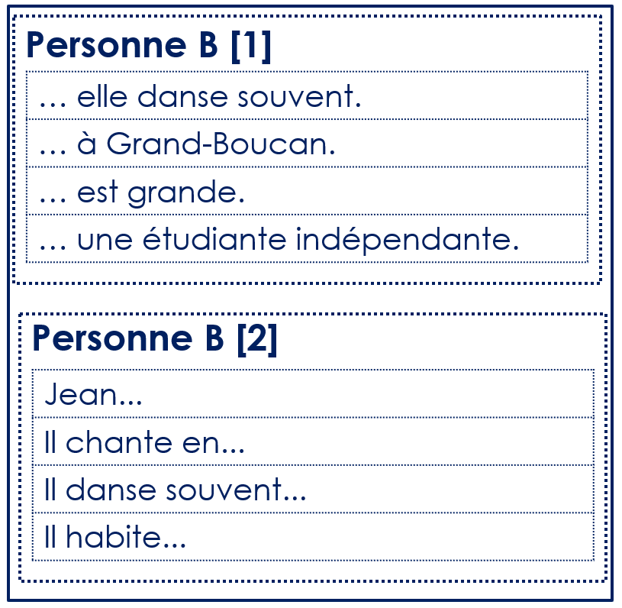
handout
handout
Notes:
HANDOUT (for printing)
10

Slide 11
vocabulaire
Follow up 5 - Écris en anglais : Can you get at least 15 points?
mots
 | elle | il | massif
 | propre | sales | sportives
 | seul | difficiles | indépendantes
 | différentes | jeune | facile
 | importantes | malade | calmes
 | espagnole | prudents | méchante
 | nous | sommes | allemands
x3
x2
x1
Notes:
Timing: 5 minutes
Aim: to practise written comprehension of vocabulary from this week and the revisited set.
Procedure: 1. Give pupils a blank grid. They fill in the English meanings of any of the words they know, trying to reach 15 points in total. 2. Remind pupils that adjectives can refer to male or female persons and they should note this in their translations. E.g. pleased (f), short (m).
Note: The most recently learnt and practised words are pink, words from revisited set 1 are green and those from revisited set 2 are blue, thus more points are awarded for them, to recognise that memories fade and more effort (heavy lifting!) is needed to retrieve them.
11

Slide 12
vocabulaire
Follow up 5 - Écris en français : Can you get at least 15 points?
mots
 | clean (m/f) | massive (m) | sporty (f, pl.)
 | dirty (m/f, pl.) | she, it | he, it
 | young (m/f) | different (f, pl.) | alone (m)
 | independent (f, pl.) | easy (m/f) | difficult (m/f, pl.)
 | calm (m/f, pl.) | important (f, pl.) | ill, sick (m/f)
 | German (m, pl.) | naughty | Spanish (f)
 | are (we) | careful (m, pl.) | we
x3
x2
x1
Notes:
Timing: 5 minutes
Aim: to practise written comprehension of vocabulary from this week and the revisited set.
Procedure: 1. Give pupils a blank grid. They fill in the English meanings of any of the words they know, trying to reach 15 points in total. 2. Remind pupils that adjectives can refer to male or female persons and they should note this in their translations. E.g. pleased (f), short (m).
Note: The most recently learnt and practised words are pink, words from revisited set 1 are green and those from revisited set 2 are blue, thus more points are awarded for them, to recognise that memories fade and more effort (heavy lifting!) is needed to retrieve them.
12

