Slide 1
Describing me and others
la rentrée à Haïti
vert
Follow ups 1-5
Term 1 Week 1
Notes:
Artwork by Steve Clarke. Pronoun pictures from NCELP (www.ncelp.org). All additional pictures selected from Pixabay and are available under a Creative Commons license, no attribution required.
Frequency of new words:
Phonics: petit [138] mais [30] grand [59] deux [41]
Vocabulary: new words in bold
être [5] suis, est, es [5] je [22] tu [112] il [13] elle [38] qui ? [14] ami(e) [467] école [477] monsieur [79] madame [294] professeur(e) [110] absent [2016] actif [1219] anglais [784] content [1841] créatif [>5000] grand [59] français [251] indépendant [954] intelligent [2509] négatif [1520] petit [138] positif [949] présent [216] sportif [2670] triste [1843] bien [47] mal [277] Salut ! [2205] Ça va ? [54/53] Oui [284] Non [75] Bonjour ! [1972] Au revoir [4/1274]
Revisit 1: - Revisit 2: fort [107] faible [723] moderne [1239] comment [234]
Londsale, D., & Le Bras, Y. (2009). A Frequency Dictionary of French: Core vocabulary for learners London: Routledge.
The frequency rankings for words that occur in this PowerPoint which have been previously introduced in these resources are given in the SOW and in the resources that first introduced and formally re-visited those words.
For any other words that occur incidentally in this PowerPoint, frequency rankings will be provided in the notes field wherever possible.

Slide 2
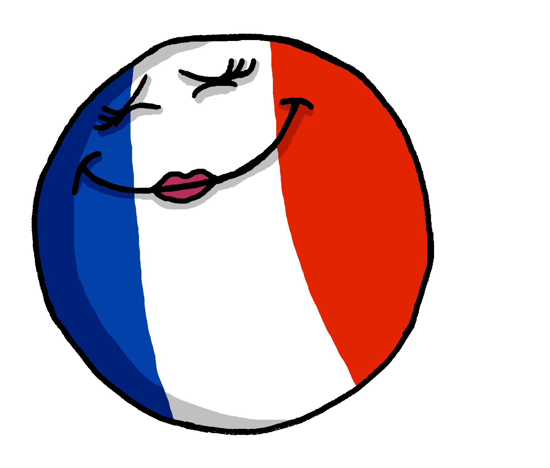
Follow up 1:
[SFC]
[SFe]
You know that final consonants are often silent in French.
However, a final ‘e’ makes us pronounce the final consonant.
The SFe (Silent Final ‘e’) means that we pronounce the ‘s’
français
française
Notes:
Timing: 1 minute
Aim: to recap knowledge of SFC and Sfe.
Procedure:
Click to present the information.
Elicit the pronunciation of the words from pupils.

Slide 3
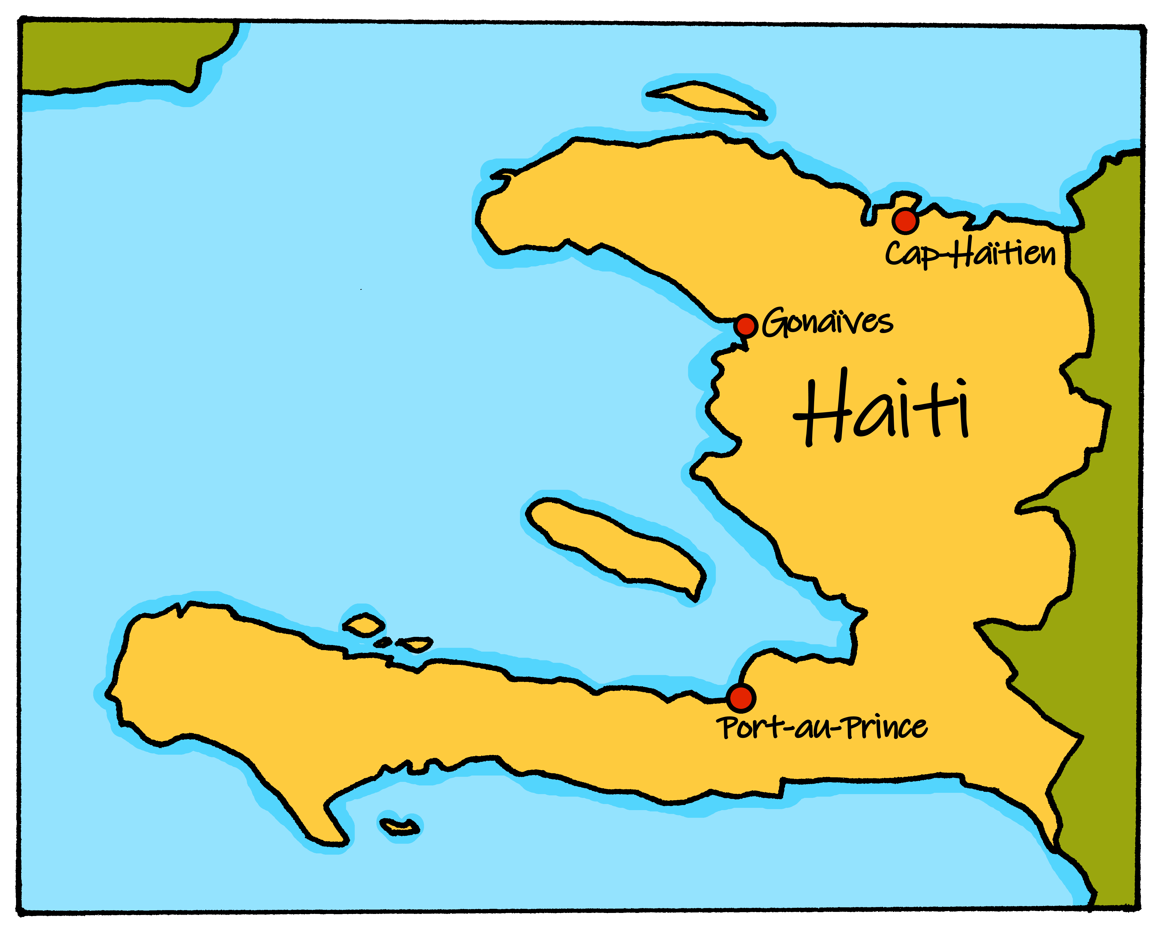
Noms de famille à Haïti
Every country has its own, most popular names.
Many popular surnames (noms de famille) in Haiti are the same as French male first names (prénoms):
C-a-R-e-F-u-L! These letters are often pronounced at the end of words.
Jean
Pierre
Michel
Thomas
Georges
Paul
Don’t forget SFC!
Don’t forget SFC!
Notes:
Timing: 1 minute
Aim: to present information about Haitian surnames and provide a context for the next activity.
Procedure:
Read the information with pupils.
Teachers could ask pupils which names they like or prefer (from two options).
Information source:
https://forebears.io/haiti/surnames

Slide 4
Follow up 1:
.
Écoute.
C’est SFC ou SFe ?
 | SFC ou SFe ?
Cadet
Moise
Bernard
Petit
Louissant
Fortune
 | SFC ou SFe ?
Antoine
Laurent
Jules
Jeune
Blaise
Toussaint
SFC
SFe
SFe
SFC
SFC
SFC
SFC
SFe
SFC
SFe
SFe
SFC
Notes:
Timing: 4 minutes
Aim: to practise aural recognition of SFC and SFe in unknown words.
Procedure:
Click on the pink audio button to hear the first name pronounced.
Pupils respond (in writing or orally) SFC or SFe, depending on whether they hear the final consonant pronounced.
Click on the rectangle shape to reveal the spelling of the word, with or without ‘e’ as the final letter.
Repeat for items 2-12.
Information source:
https://forebears.io/haiti/surnames

Slide 5
Lis le texte et écris les mots en anglais.
Follow up 2:
Jean-Michel dort*. Demain, c’est lundi… et c’est la rentrée !
lire
Thomas le rat arrive à une nouvelle école…
« J’aime l’école mais je cherche des amis.»
Thomas the rat arrives at a new school. He says that he likes school but he is looking for some friends.
______
______.
_____
____________
_____.
dort – sleeps / is sleeping
Notes:
Timing: 10 minutes (six slides)
Aim: to practise written comprehension of previously taught words in a longer context; to practise read aloud of SSC [ien] [on] [i] [an/en] in a story context.
Procedure:
1. Set the scene and ensure pupils understand the task. Jean-Michel is having a dream the night before school starts...
2. Pupils need to write the missing words from the right hand pages in English.
3. Click to reveal the answers.
4. Continue through the next five slides. On the next slides, pupils, first read the storylines aloud, then listen and check their pronunciation, then volunteer English answers for the gaps in the story.

Slide 6
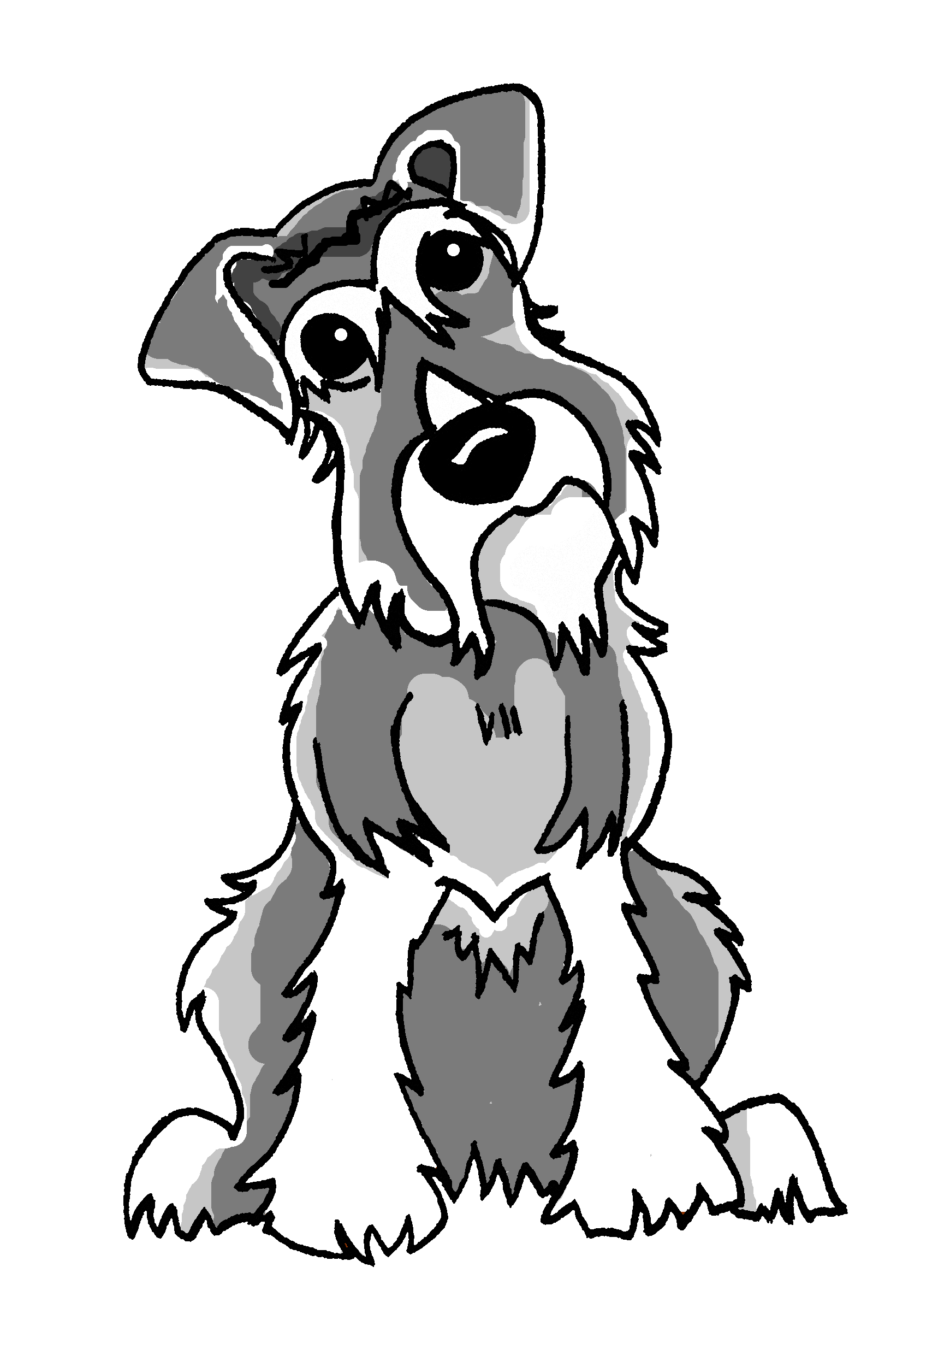
lire
[2/6]
« Ça va bien ? » dit Thomas.
« Salut ! Je suis Julien » dit un chien.
A dog says ‘Hello!‘. Thomas asks, ‘are you well?’.
____
______.
____________?
Notes:
Procedure:
Pupils read the story dialogue aloud, line by line, as per the animations.
Click on each speech bubble to hear each line pronounced by a native speaker.
Click to bring up the gapped English version and elicit the missing words.
6

Slide 7
lire
[3/6]
« Salut, Thomas ! Je suis Simon » dit un lion.
‘I am Simon’, says a lion.
‘What are you like?’
____
« Tu es comment ? »
__________________?
Notes:
Procedure:
Pupils read the story dialogue aloud, line by line, as per the animations.
Click on each speech bubble to hear each line pronounced by a native speaker.
Click to bring up the gapped English version and elicit the missing words.
7

Slide 8
lire
[4/6]
« Bonjour ! Je suis Pascal » dit un cheval.
« Ça va mal ? »
‘Hello! I am Pascal’, says a horse.
‘Are you feeling bad?’
____
____.
‘__________________?’
Notes:
Procedure:
Pupils read the story dialogue aloud, line by line, as per the animations.
Click on each speech bubble to hear each line pronounced by a native speaker.
Click to bring up the gapped English version and elicit the missing words.
8

Slide 9
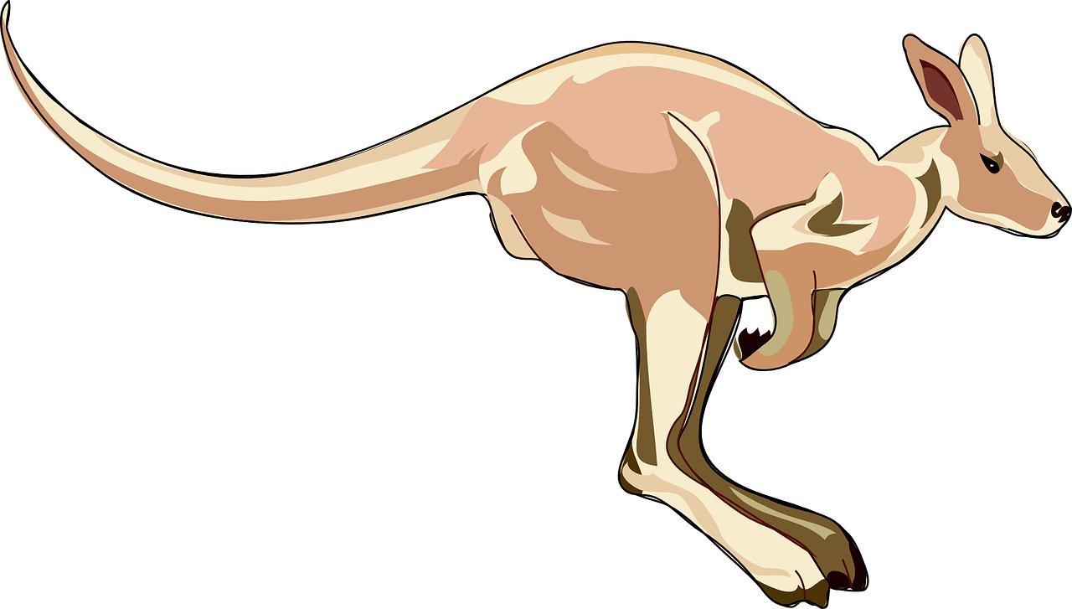
lire
[5/6]
« Salut ! Je suis Wesley » dit un wallaby.
« Je suis créatif mais triste, aujourd’hui. »
‘Hello! I am Wesley’, says a wallaby.
‘I am creative but sad, today.
________________.
Notes:
Procedure:
Pupils read the story dialogue aloud, line by line, as per the animations.
Click on each speech bubble to hear each line pronounced by a native speaker.
Click to bring up the gapped English version and elicit the missing words.
9

Slide 10
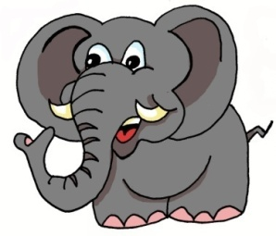
lire
[6/6]
« Salut, J-M ! C’est lundi ! Vite* ! Prépares-toi pour l’école ! »
« Salut ! Je suis Roman, » dit un éléphant.
‘Hi! I am Roman,’ says an elephant.
‘Oh! You are big and intelligent.’
________
« Oh ! Tu es grand et intelligent. »
vite – quick
Notes:
Procedure:
Pupils read the story dialogue aloud, line by line, as per the animations.
Click on each speech bubble to hear each line pronounced by a native speaker.
Click to bring up the gapped English version and elicit the missing words.
Click to bring up J-M’s mum Annick, who is waking him up to go to school.
Frequency of unknown words and cognates: vite [711]
Londsale, D., & Le Bras, Y. (2009). A Frequency Dictionary of French: Core vocabulary for learners London: Routledge.
10

Slide 11
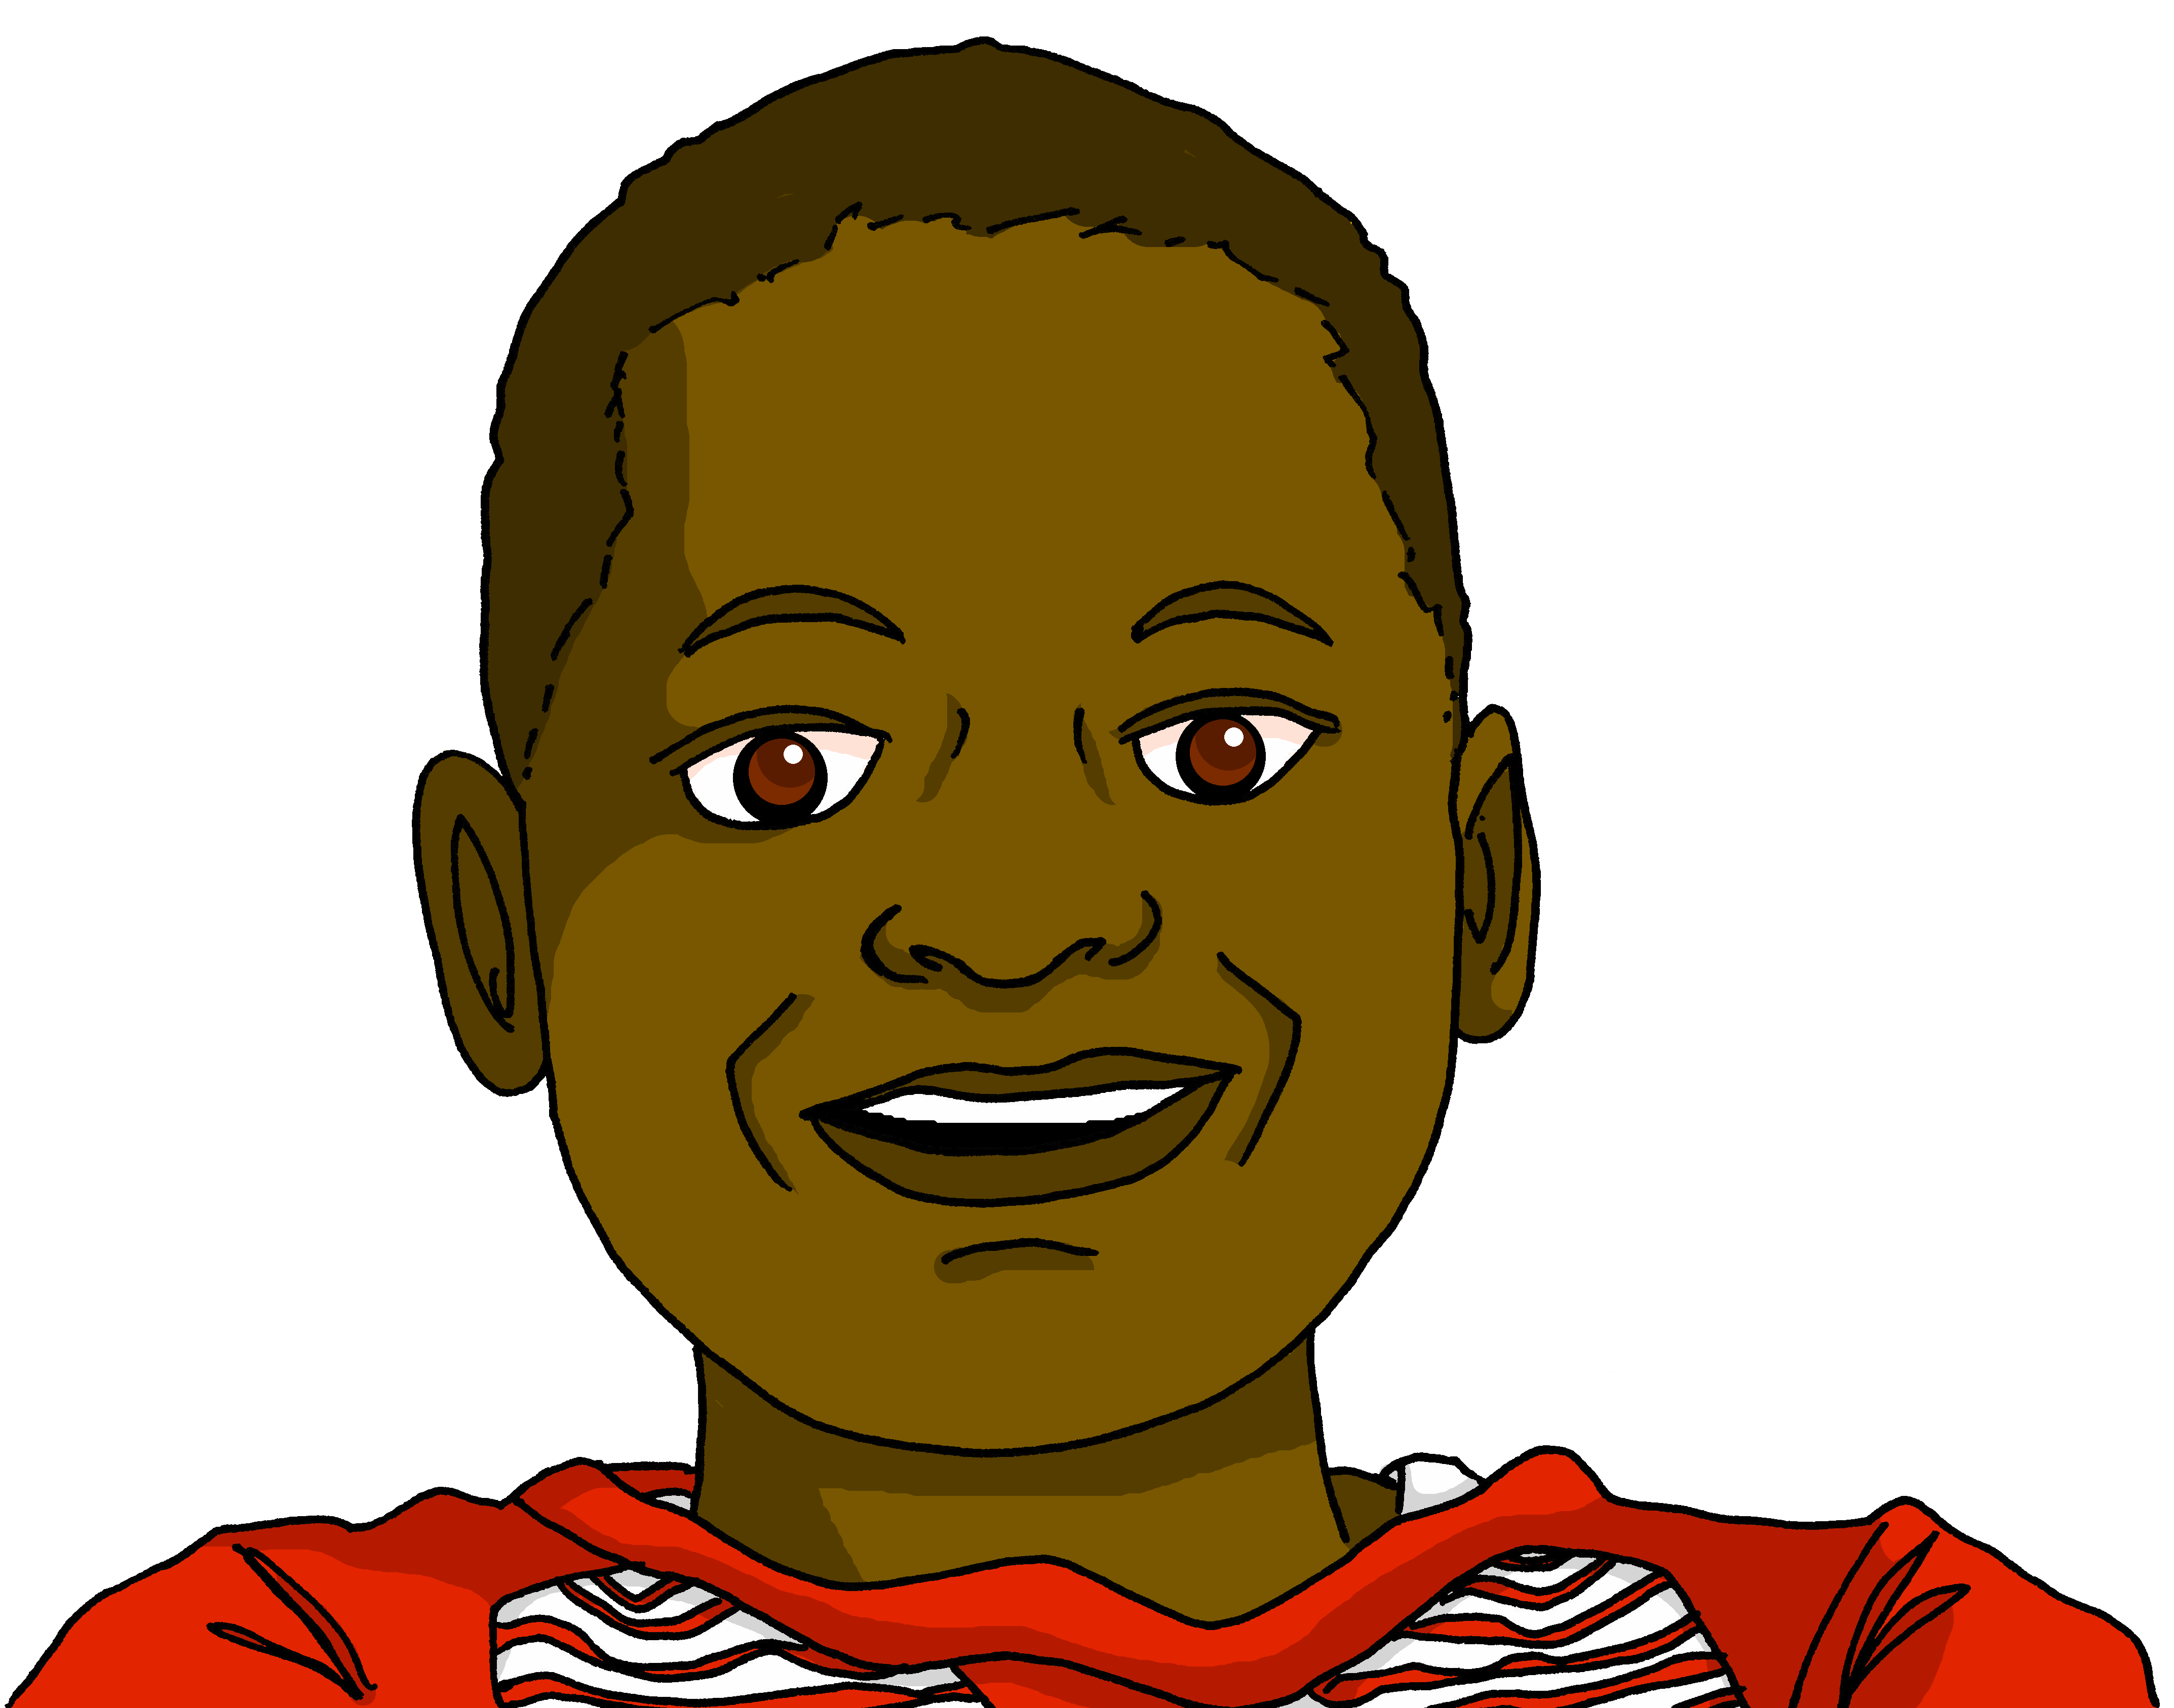
Follow up 3:
Lis le texte encore une fois.
Monsieur Charles is interested to hear Jean-Michel’s dream story. Can you read it aloud, too?
parler
lire
Thomas le rat arrive à une nouvelle école.
« J’aime l’école mais je cherche des amis.
« Salut ! Je suis Julien » dit un chien.
« Ça va bien ? » dit Thomas.
« Salut, Thomas ! Je suis Simon » dit un lion.
« Tu es comment ? »
« Bonjour ! Je suis Pascal » dit un cheval.
« Ça va mal ? »
« Salut ! Je suis Wesley » dit un wallaby.
« Je suis créatif mais triste, aujourd’hui. »
« Salut ! Je suis Roman » dit un éléphant.
« Oh ! Tu es grand et intelligent. »...
Notes:
Timing: 5 minutes Aim: to practise pronunciation and aural and/or written comprehension of previously taught words and familiar SSC (and intonation) in a short story context.
Procedure:
In pairs pupils practise reading a line aloud for their partner, who translates into English. If pupils who are translating face away from the board they practise aural comprehension, if they face the board they practise written comprehension.
They swap roles each line.
Teacher clicks the audio player. Pupils join in with the storyteller, reading the story aloud, chorally.

Slide 12
Follow up 4:

.
Écris en français.
- Bonjour, Jean-Michel !
- Bonjour, Monsieur Charles.
- Tu es comment ?
- Je suis positif et créatif, Monsieur.
[Hello]
écrire
[Hello]
[Mr Charles]
[how]
Monsieur Charles
[positive and creative, sir]
- Et qui est Nathalie ?
- Bonjour, Monsieur ! Je suis ici. Je suis active et positive.
- Thomas ?
- Il est absent, Monsieur. Il est malade, aujourd’hui.
[who]
[I am]
[active]
[positive]
[He is]
[He is]
Notes:
Timing: 10 minutes
Aim: to practise written production of the vocabulary and structures from this week’s learning.
Procedure: 1. Tell pupils this is a conversation on the first day of a new school year and the new class teacher is getting to know the class better. He has asked them to choose two adjectives to describe themselves. 2. Pupils write the French for the pink English prompts. 3. Click to reveal the French words. 4. Click the player to hear the conversation in full.
Transcript:
- Bonjour, Jean-Michel !
- Bonjour, Monsieur Charles.
- Tu es comment ?
- Je suis positif et créatif, Monsieur.
- Et qui est Nathalie ?
- Bonjour, Monsieur ! Je suis ici. Je suis active et positive.
- Thomas ?
- Il est absent, Monsieur. Il est malade, aujourd’hui.

Slide 13
vocabulaire
Follow up 5 - Écris en anglais : Can you get at least 15 points?
mots
 | triste | actif | petite
 | forte | faible | sportive
 | je suis | indépendant | au revoir
 | être | l’école | l’amie
 | tu es | mal | monsieur
 | qui ? | comment ? | elle est
 | créatif | négative | positif
sad (m/f)
active (m)
small, short (f)
x3
strong (f)
weak (m/f)
sporty (f)
I am
independent (m)
goodbye
x2
to be, being
(the) school
(the) friend (f)
you are
badly
Mr., Sir (teacher)
who?
how?
she is
x1
creative (m)
negative (f)
positive (m)
Notes:
Timing: 5 minutes
Aim: to practise written comprehension of vocabulary from this week and the two revisited weeks.
Procedure: 1. Give pupils a blank grid. They fill in the English meanings of any of the words they know, trying to reach 15 points in total. 2. Remind pupils that adjectives can refer to male or female persons and they should note this in their translations. E.g. pleased (f), short (m).
Note: The most recently learnt and practised words are pink, words from revisited set 1 are green and those from revisited set 2 are blue, thus more points are awarded for them, to recognise that memories fade and more effort (heavy lifting!) is needed to retrieve them.
13

Slide 14
vocabulaire
Follow up 5 - Écris en français : Can you get at least 15 points?
mots
 | small, short (f) | sporty (m) | modern (m/f)
 | strong (m) | weak (m/f) | fast (m/f)
 | to be, being | (the) school | (the) friend (f)
 | she is | independent (f) | (the) teacher (m)
 | creative (f) | I am | negative (m)
 | well | positive (f) | how?
 | you are | who? | Mrs, Miss (teacher)
petite
sportif
moderne
x3
fort
faible
rapide
être
l’école
l’amie
x2
elle est
indépendante
le professeur
créative
je suis
négatif
bien
positive
comment ?
x1
tu es
qui ?
Madame
Notes:
Timing: 5 minutes
Aim: to practise written production of vocabulary from this week and the two revisited weeks.
Procedure: 1. Give pupils a blank grid. They fill in the Spanish meanings of any of the words they know, trying to reach 15 points in total. 2. Remind pupils that adjectives can refer to male or female persons and they should note this in their translations. E.g. pleased (f), short (m).
Note: The most recently learnt and practised words are pink, words from revisited set 1 are green and those from revisited set 2 are blue, thus more points are awarded for them, to recognise that memories fade and more effort (heavy lifting!) is needed to retrieve them.
14

Slide 15
vocabulaire
Follow up 5 - Écris en anglais : Can you get at least 15 points?
mots
 | triste | actif | petite
 | forte | faible | sportive
 | je suis | indépendant | au revoir
 | être | l’école | l’amie
 | tu es | mal | monsieur
 | qui ? | comment ? | elle est
 | créatif | négative | positif
x3
x2
x1
Notes:
Timing: 5 minutes
Aim: to practise written production of vocabulary from this week and the two revisited weeks.
Procedure: 1. Give pupils a blank grid. They fill in the Spanish meanings of any of the words they know, trying to reach 15 points in total. 2. Remind pupils that adjectives can refer to male or female persons and they should note this in their translations. E.g. pleased (f), short (m).
Note: The most recently learnt and practised words are pink, words from revisited set 1 are green and those from revisited set 2 are blue, thus more points are awarded for them, to recognise that memories fade and more effort (heavy lifting!) is needed to retrieve them.
15

Slide 16
vocabulaire
Follow up 5 - Écris en français : Can you get at least 15 points?
mots
 | small, short (f) | sporty (m) | modern (m/f)
 | strong (m) | weak (m/f) | fast (m/f)
 | to be, being | (the) school | (the) friend (f)
 | she is | independent (f) | (the) teacher (m)
 | creative (f) | I am | negative (m)
 | well | positive (f) | how?
 | you are | who? | Mrs, Miss (teacher)
x3
x2
x1
Notes:
HANDOUT
16

