Slide 1
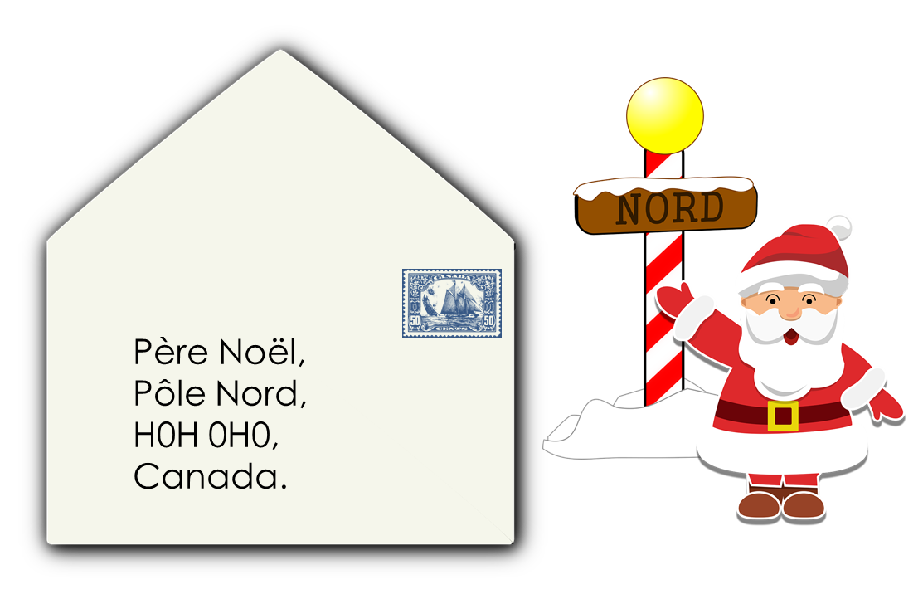
Describing me and others
vert
Phonics quiz
Christmas traditions in Canada
Notes:
Artwork by Steve Clarke. Pronoun pictures from NCELP (www.ncelp.org). All additional pictures selected from Pixabay and are
available under a Creative Commons license, no attribution required.
This lesson contains a phonics assessment to check progress in SSC practised in the first 12 weeks of this year’s course.
1

Slide 2
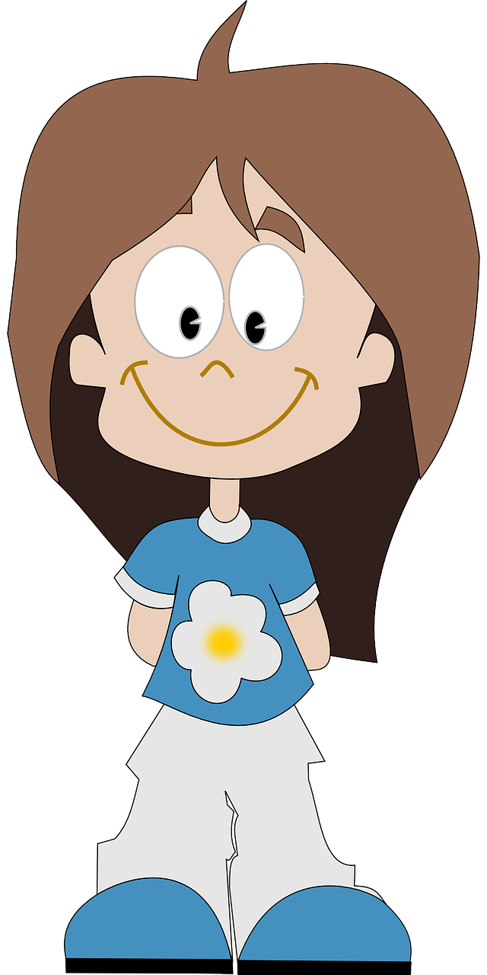
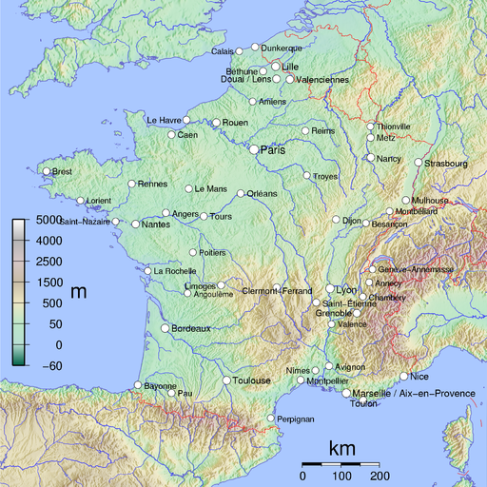
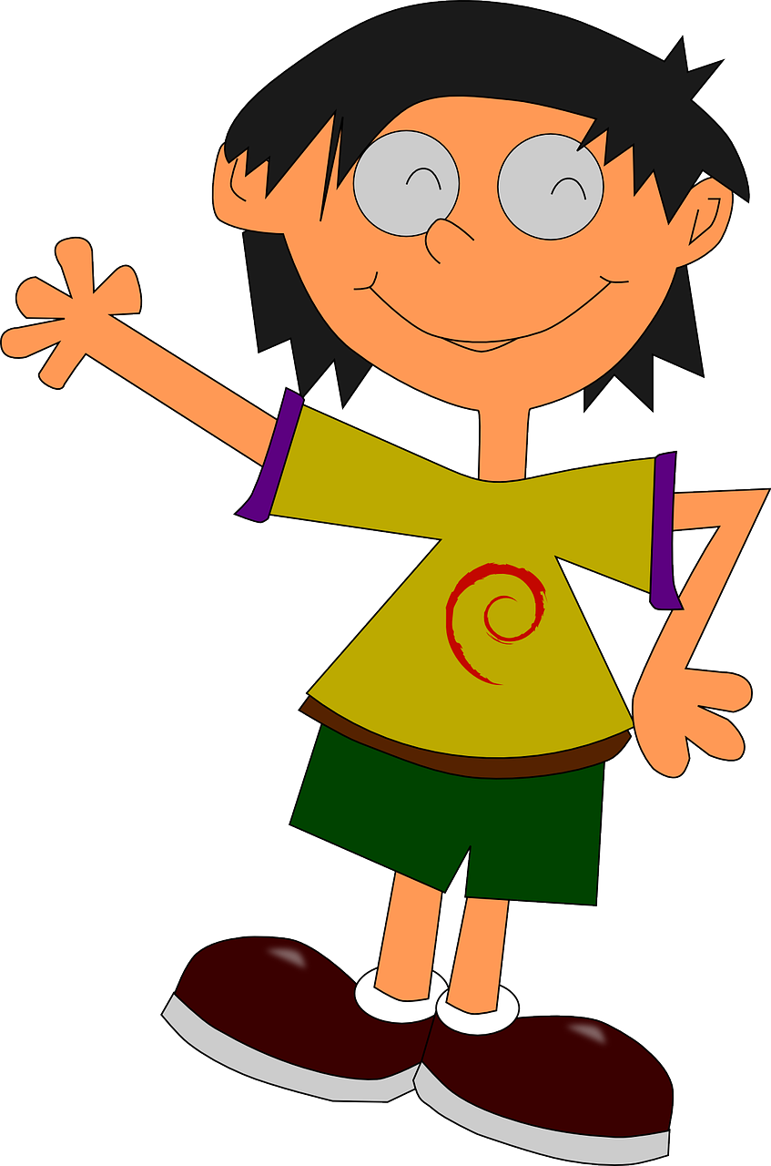
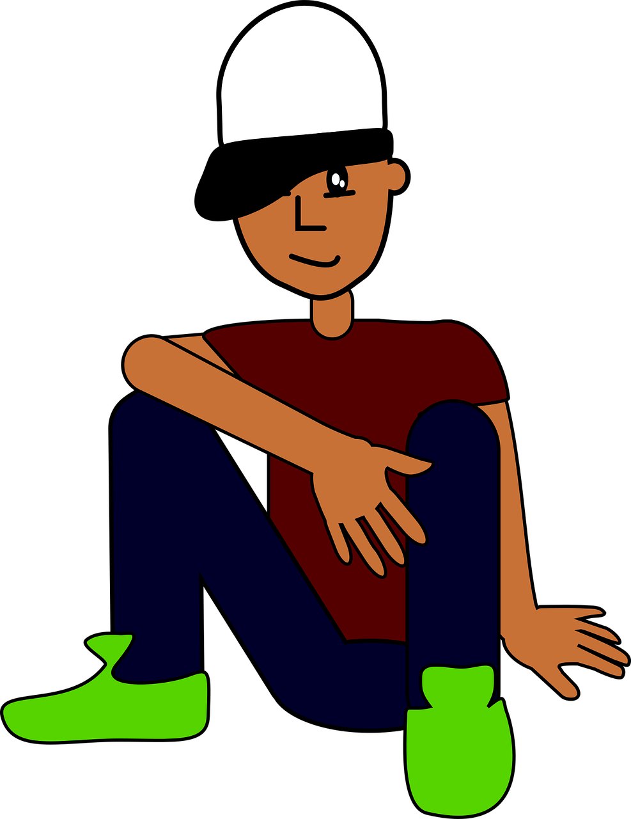
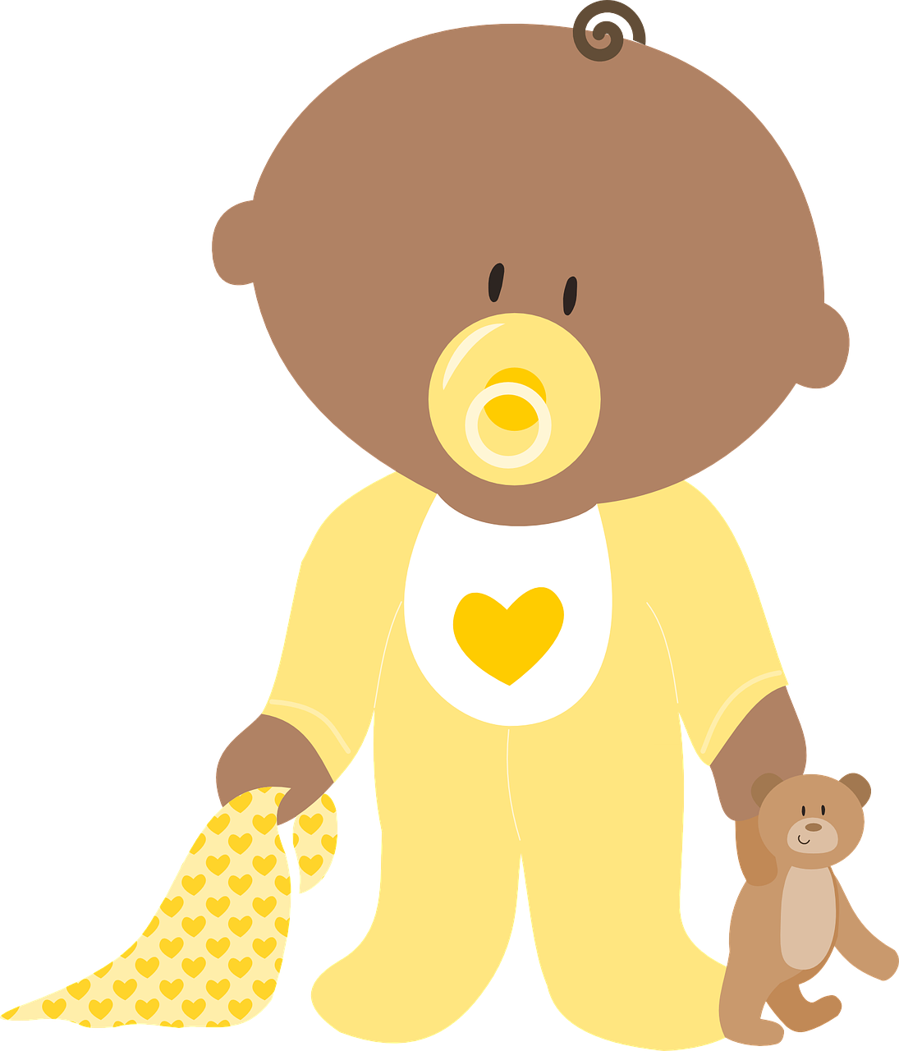
prononcer
En France
Read aloud the French name of each town/city and the name of the French person who lives there.
You have not learnt these words so just use what you know about how to pronounce French.
Remember Silent Final Consonants!
1 | 2 | 3 | 4
5 |  |  | 6
7 | 8 | 9 | 10
N i o r t
T a l e n c e
D e n a i n
C l u n y
Oriel
Clémence
Valentin
Lucie
V e r t o u
D r e u x
Lilou
Mathieu
T o u l o n
M e a u x
N a n t e s
C h i n o n
Marion
Marceau
Alexandre
Chiffon
Notes:
Timing: 1 minute per pupil
Aim: to assess pupils’ ability to read aloud the SSC practised this term. Procedure: 1. Use this slide to explain the phonics task. Tell pupils that you will give them the handout just before you hear each pupil so that the preparation time is the same for all.
2. Then give out the independent task activity sheets (and if desired, nominate a pupil monitor to be i/c of the PPT during the lesson). 3. Whilst pupils work on the independent tasks, listen to individual pupils reading the ten words aloud. Mark in real time, using the grid on the teacher version.
Note:
there are no follow up lessons this week, so it would be possible to continue the speaking assessments in the follow up time during this week, as needed.
if preferred, and the resources are available, pupils could record their answers (e.g. on computer or ipad) though this would involve the teacher listening back to assess them.
2

Slide 3
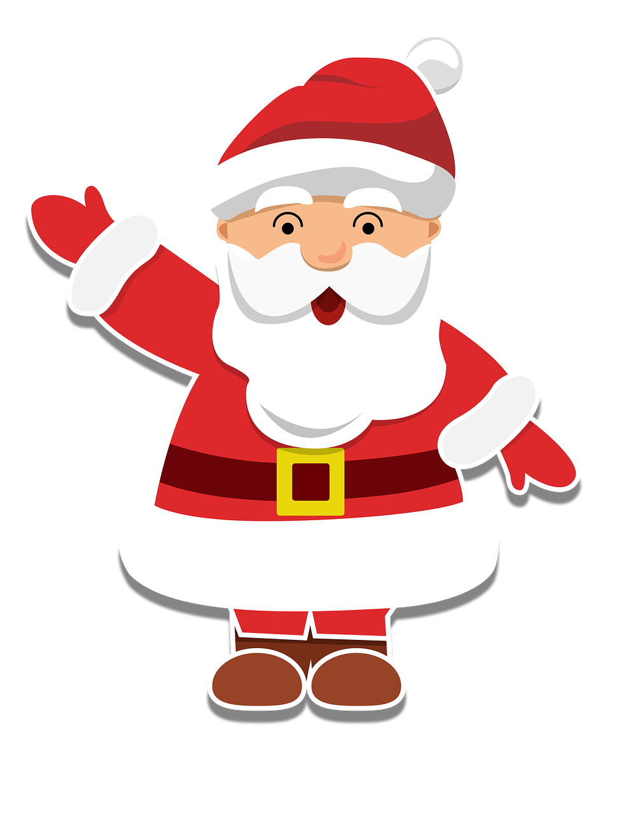
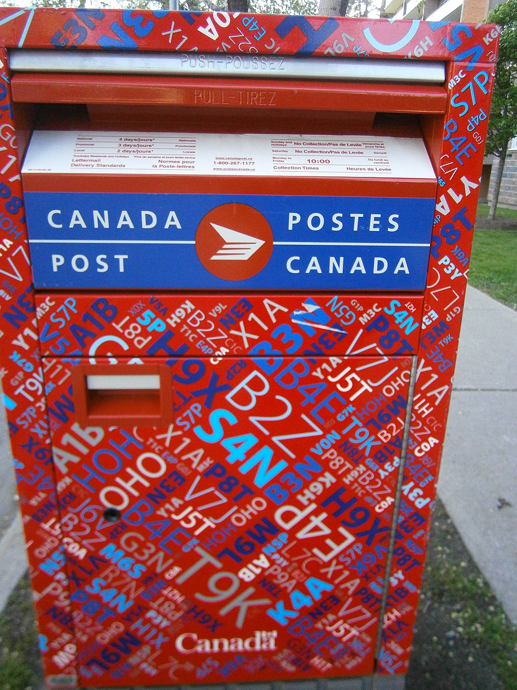
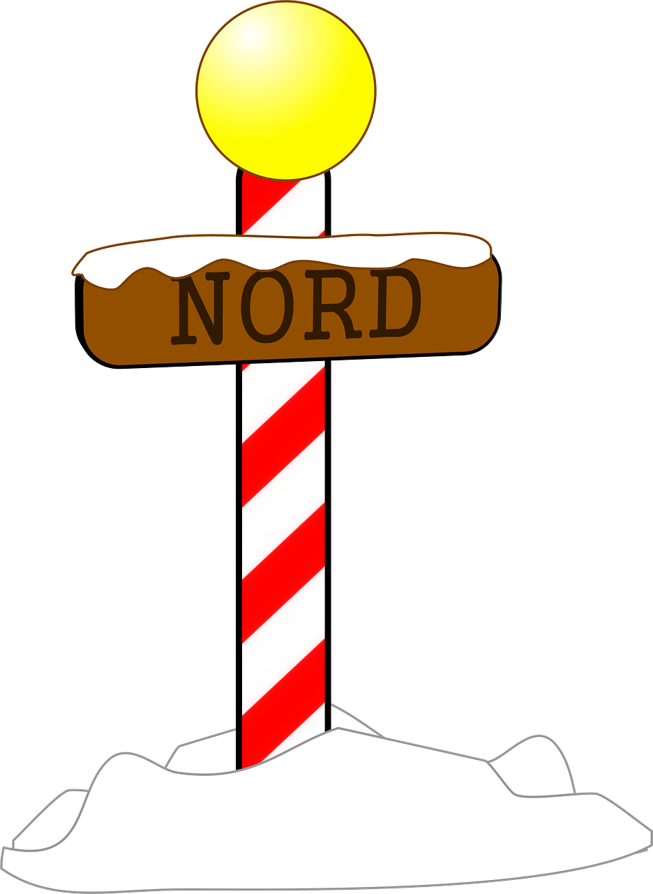
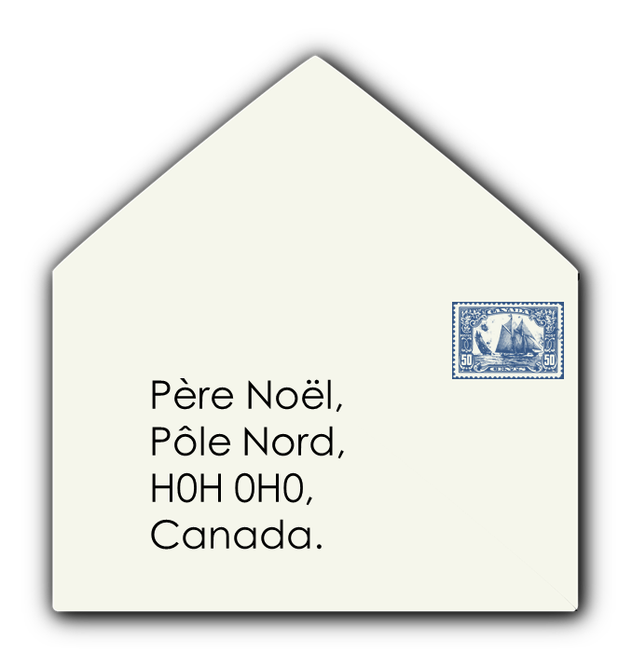
lire
Des lettres pour Père Noël au Canada
.
Lis le texte.
Chaque décembre, le père Noël reçoit* plus de 1,6 million de lettres.
Comme le Canada est multiculturel, le père Noël répond dans 39 langues, et aussi en braille.
Les enfants ont jusqu’au* 10 décembre pour écrire une lettre à l’adresse de Père Noël : Père Noël, Pôle Nord, H0H 0H0, Canada.
reçoit = receives | jusqu’au = until the
Notes:
Timing: 2 minutes
Aim: to introduce the context of this Christmas in Canada lesson: the letter to Father Christmas
Procedure:
Pupils read and translate the information in the blue text box.
Ensure that the meanings are clear.
Source of information:
https://ici.radio-canada.ca/nouvelle/1137989/le-pere-noel-attend-les-lettres-des-enfants-jusquau-10-decembre
Picture attribution:
Skimel, CC BY-SA 4.0 <https://creativecommons.org/licenses/by-sa/4.0>, via Wikimedia Commons
3

Slide 4
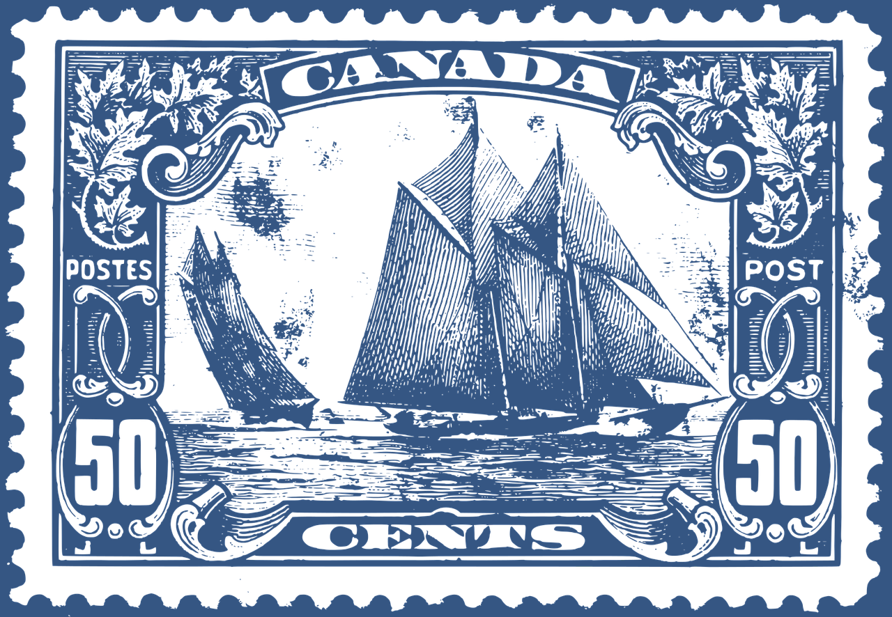
écrire
Une lettre
.
Écris une lettre à Père Noël.
Dear Santa Claus,
How are you? I’m very well. I’m not at school – hurrah! Christmas is great. I’m playing with Pierre, I’m talking with friends and I’m listening to the radio.
For me, a dog. Please! I love dogs! For my brother, a game.
For my mum, a bag and for my dad, a guitar.
Thank you !
Père Noël,
Pôle Nord,
H0H 0H0,
Canada.
Adèle
Hurrah! - Hourra !
Notes:
Timing: 10-20 minutes
Aim: to use the given model in order to write their own Christmas letter; to practise written production of articles and gender and number agreement.
Procedure:
Using the English model provided, pupils write their own version with what they wish for Christmas but in French.
Display on the board, whilst pupils are writing their own letter.
NB. Encourage pupils to use words from their active vocabulary and / or use K.O. for more ideas.
4

Slide 5
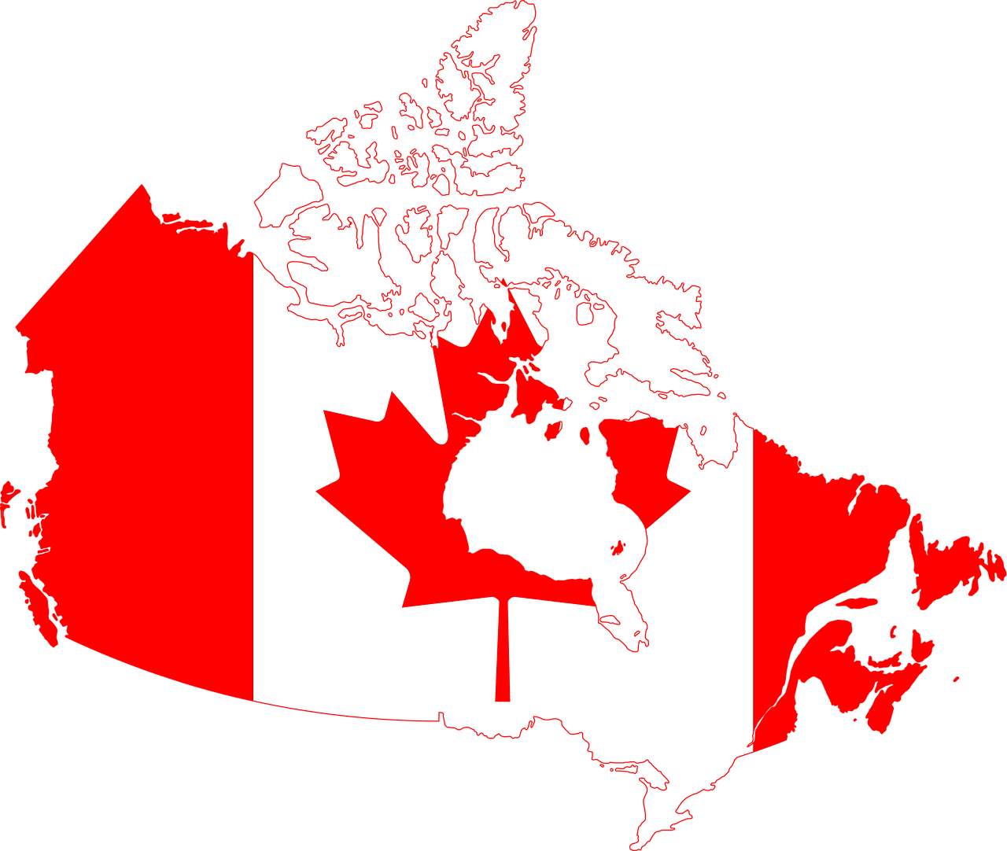
Noël au Canada
.
Regarde le video.
Notes:
5-minute video about different Christmas traditions in Canada. https://www.youtube.com/watch?v=umyZqYcvyU4
Some speakers speak French (with English subtitles), others speak English (with French subtitles) and one speaks an Inuit language - blanket term Inuktut - (with French and English subtitles)
Note: Inuit prefer to be called either Inuit or Inuk but not Eskimo, which the majority of Inuit people view as a racial slur.
There are about 70,000 Inuit living in Canada.
Timing: 10 minutes (to play video twice through)
Aim: to find out more about Canadian Christmas customs
Procedure:
Play the video through once.
Play the video again – pupils make a note of any tradition that is the same or different from one they know about from the UK.

Slide 6
Au revoir !
vert
Notes:
6

Slide 7
La France Read aloud the French name of each town/city and the name of the French person who lives there.
La France Read aloud the French name of each town/city and the name of the French person who lives there.
You have not learnt these words so just use what you know about how to pronounce French. ☺
You have not learnt these words so just use what you know about how to pronounce French. ☺
Remember Silent Final Consonants!
Remember Silent Final Consonants!
1 | 2 | 3 | 4
5 |  |  | 6
7 | 8 | 9 | 10
1 | 2 | 3 | 4
5 |  |  | 6
7 | 8 | 9 | 10
N i o r t
T a l e n c e
D e n a i n
C l u n y
N i o r t
T a l e n c e
D e n a i n
C l u n y
Oriel
Clémence
Valentin
Lucie
Oriel
Clémence
Valentin
Lucie
V e r t o u
D r e u x
V e r t o u
D r e u x
Lilou
Mathieu
Lilou
Mathieu
T o u l o n
M e a u x
N a n t e s
C h i n o n
T o u l o n
M e a u x
N a n t e s
C h i n o n
Marion
Marceau
Alexandre
Chiffon
Marion
Marceau
Alexandre
Chiffon
Notes:
Pupil handout To copy and cut in half
Note: There is a version with the city names only on the next slide, if preferred.
Image attribution: David Monniaux, CC BY-SA 3.0 via Wikimedia Commons

Slide 8
La France Read aloud the French name of each town/city and the name of the French person who lives there.
La France Read aloud the French name of each town/city and the name of the French person who lives there.
You have not learnt these words so just use what you know about how to pronounce French. ☺
You have not learnt these words so just use what you know about how to pronounce French. ☺
Remember Silent Final Consonants!
Remember Silent Final Consonants!
1 | 2 | 3 | 4
5 |  |  | 6
7 | 8 | 9 | 10
1 | 2 | 3 | 4
5 |  |  | 6
7 | 8 | 9 | 10
N i o r t
T a l e n c e
D e n a i n
C l u n y
N i o r t
T a l e n c e
D e n a i n
C l u n y
V e r t o u
D r e u x
V e r t o u
D r e u x
T o u l o n
M e a u x
N a n t e s
C h i n o n
T o u l o n
M e a u x
N a n t e s
C h i n o n
Notes:
Alternative version with city names only.
Image attribution: David Monniaux, CC BY-SA 3.0 via Wikimedia Commons

Slide 9
La France Read aloud the French name of each town/city and the name of the French person who lives there.
Pupil name: ___________________________________
Total score: _____ / 14
 | City name | Person name | SSC | p/ x
1 | Niort | Oriel | [i] + SFC-t
2 | Talence | Clémence | [en/an]
3 | Denain | Valentin | [(a)in]
4 | Cluny | Lucie | [u]
5 | Vertou | Lilou | [ou]
6 | Dreux | Mathieu | [eu] + SFC -x
7 | Toulon | Marion | [on]
8 | Meaux | Marceau | [eau/au/o]
9 | Nantes | Alexandre | [an/en] + SFe + SFC –s
10 | Chinon | Chiffon | [ch]
You have not learnt these words so just use what you know about how to pronounce French. ☺
Remember Silent Final Consonants!
1 | 2 | 3 | 4
5 |  |  | 6
7 | 8 | 9 | 10
N i o r t
T a l e n c e
D e n a i n
C l u n y
Oriel
Clémence
Valentin
Lucie
V e r t o u
D r e u x
Lilou
Mathieu
T o u l o n
M e a u x
N a n t e s
C h i n o n
Note: Teachers award one point for each SSC, one or two points per item, as per SSC list above.
Marion
Marceau
Alexandre
Chiffon
Notes:
Teacher handout
Audio provided for teacher preparation, if required.

Slide 10
Cher ________,
Cher ________,
Notes:
Template for letter, if desired.

