Slide 1
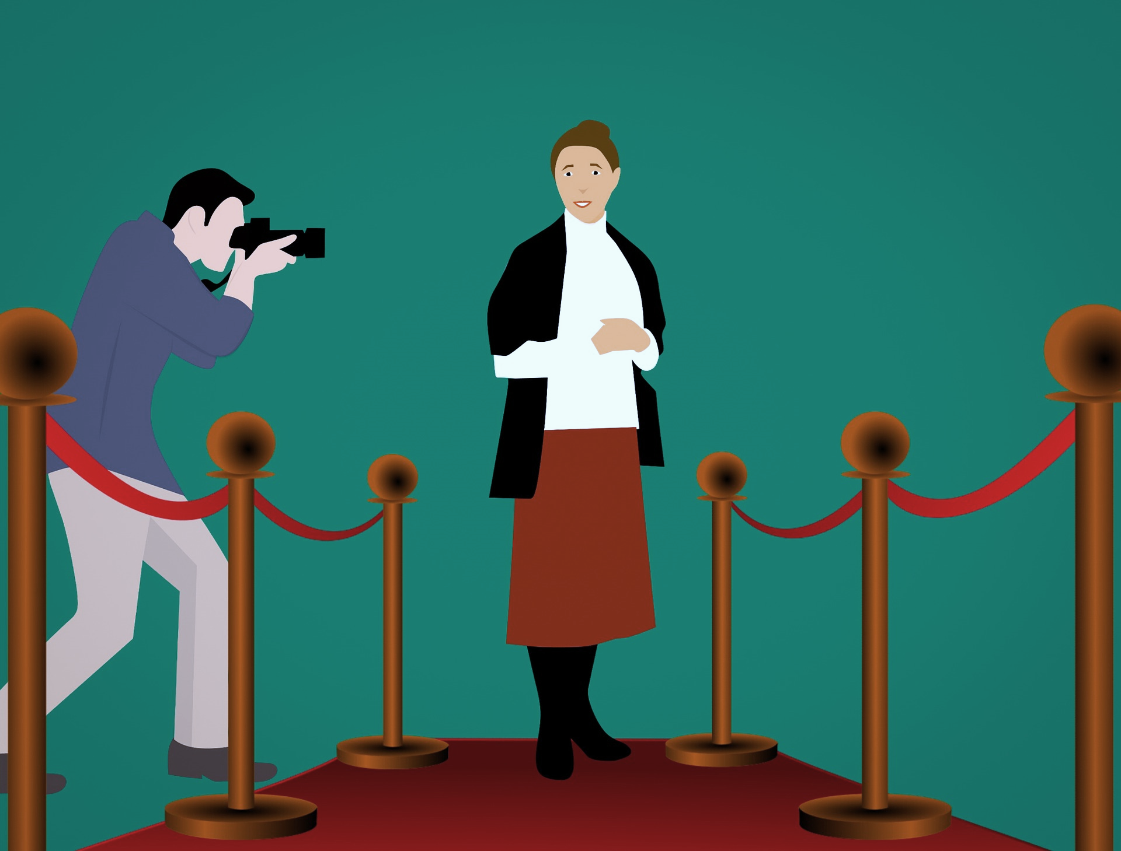
Interactions
Le festival de Cannes
vert
physical description
singular and plural adjective agreement
SSC [ch]
Notes:
Artwork by Steve Clarke. Pronoun pictures from NCELP (www.ncelp.org). All additional pictures selected from Pixabay and are available under a
Creative Commons license, no attribution required.
Phonics: [ch] dimanche [1235] marché [280] chercher [336] chat [3138] bouche [1838]
Vocabulary: cheveu [2296] acteur [1552] actrice [1552] nez [2661] œil, yeux [474] visage [1292] bleu [1216] blond [4585] brun [>5000] court [545] crépu [>5000] gris [2769] long [202] noir [572] ovale [>5000] rond [2268] roux [>5000] vert
[1060]
Revisit 1: centre commercial [491/908] église [1782] magasin [1738] pont [1889] rue [598] excellent [1225] différent [350] idéal [1429] important [215] indépendant [954] moderne [1239] propre [237] sale [2906] des [de-2]
Revisit 2: anniversaire [2043] mois [179] janvier [939] février [1139] mars [868] avril [1022] mai [943] juin [931] juillet [1326] aout [1445] septembre [944] octobre [826] novembre [982] décembre [891] quand [119] treize [3285] quatorze [3359] quinze [1472]
seize [3285] dix-sept [3812] dix-huit [3592] dix-neuf [4851] vingt [1273] vingt et un [1273/6/3] vingt-deux, vingt-trois vingt-quatre vingt-cinq vingt-six vingt-sept vingt-huit vingt-neuf trente [1646] concert [1697] fête [1490] spectacle [1687]
Londsale, D., & Le Bras, Y. (2009). A Frequency Dictionary of French: Core vocabulary for learners London: Routledge.
The frequency rankings for words that occur in this PowerPoint which have been previously introduced in these resources are given in the SOW and in the resources that first
introduced and formally re-visited those words.
For any other words that occur incidentally in this PowerPoint, frequency rankings will be provided in the notes field wherever possible.
1

Slide 2
[ch]
prononcer
chercher
[un] is nasal before a consonant and at the end of words.
[to look for]
Notes:
Timing: 2 minutes
Aim: to recap SSC [ch].
Procedure:
Click to bring up the SSC [ch]. Repeat the SSC [ch] and the source word chercher with the class.
Click to bring up the English translation and picture.
Pupils to practise saying the SSC and source word several times.

Slide 3
[ch]
chercher
prononcer
bouche
chat
marché
dimanche
[to look for]
Sun
Notes:
Timing: 2 minutes
Aim: to practise the pronunciation of SSC [ch] in four cluster words.
Procedure:
Click to bring up the SSC [ch]. Repeat the SSC [ch] with the class and the source word chercher.
Click to bring up the English translation and picture. Do the gesture, if using.
Click to bring up each cluster word in turn: bouche, chat, marché, dimanche. The pictures appear after the words to give a further opportunity for word repetition.
Suggested gesture: The 3rd video (the woman)’s version is the one I like the best for search, look for: https://www.signbsl.com/sign/search

Slide 4
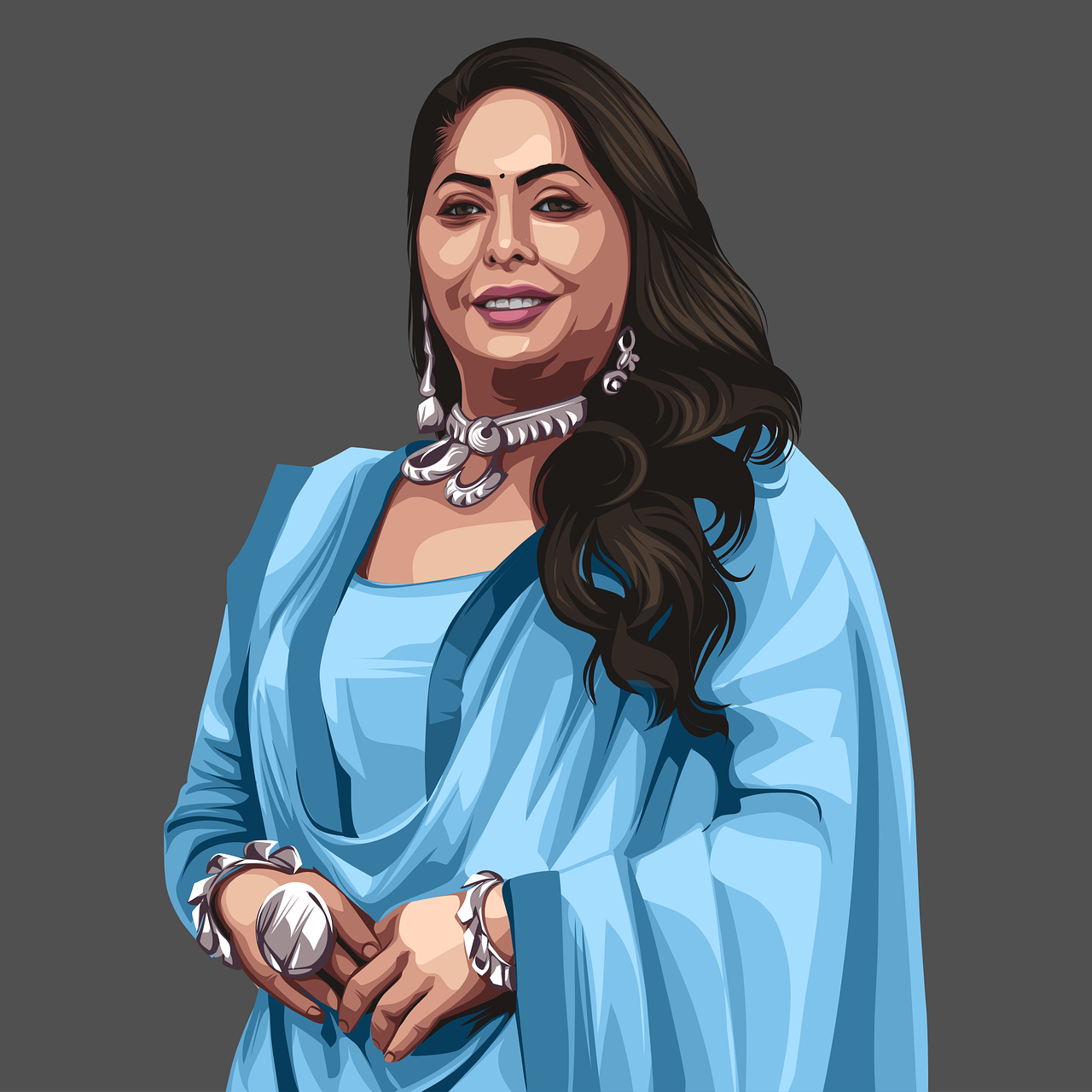
[ch]
Prononce les mots avec [ch].
prononcer
15
spécial
chocolat
chanter
X
S
chaise
centre
Chine
cinéma
actrice
Sun
dimanche
glace
chapeau
0
DÉBUT
Notes:
Timing: 2 minutes
Aim: to practise SSC [ch]
Procedure:
Clarify the context of the task to pupils.
Click to bring up the instruction and check understanding.
Pupils work in pairs to say aloud the words with [ch] sound in order to help Jean-Michel cross the river.
Elicit answer answers from students – click to bring up animations and connect words with [ch]
Frequency of unknown words and cognates: Chine [>5000] glace [2580]

Slide 5
Definite articles: singular & plural
Or use l’ before a noun that begins with a vowel. E.g. l’œil (eye).
This is grammatical, not biological gender! A house (une maison) is not female, it is a feminine noun.
[the]
Remember! In French, things, as well as people and animals, are either masculine or feminine. We say that they have gender.
To say the before a singular noun, you use ‘le’ (m) or ‘la’ (f).
To say the before all plural nouns (more than one), use ‘les’.
Masculine
Feminine
___ femmes
les
___ femme
the woman
Remember that the plural of eye is irregular: l’œil (eye) → les yeux.
la
the women
le
___ cheveux
les
___ cheveu
the hair
the hair(s)
la
the songs
___ chansons
the song
___ chanson
___ chat
les
le
___ chats
les
the cats
the cat
les
l’
___ œil
___ yeux
the eye
___ actrices
les
the actresses
___ actrice
the eyes
l’
the actress
Notes:
Timing: 2 minutes
Aim: to recap pupil knowledge of definite articles.
Procedure:
Click through the animations to present the information.
Elicit English meanings of French examples.
Ensure meanings are understood.

Slide 6
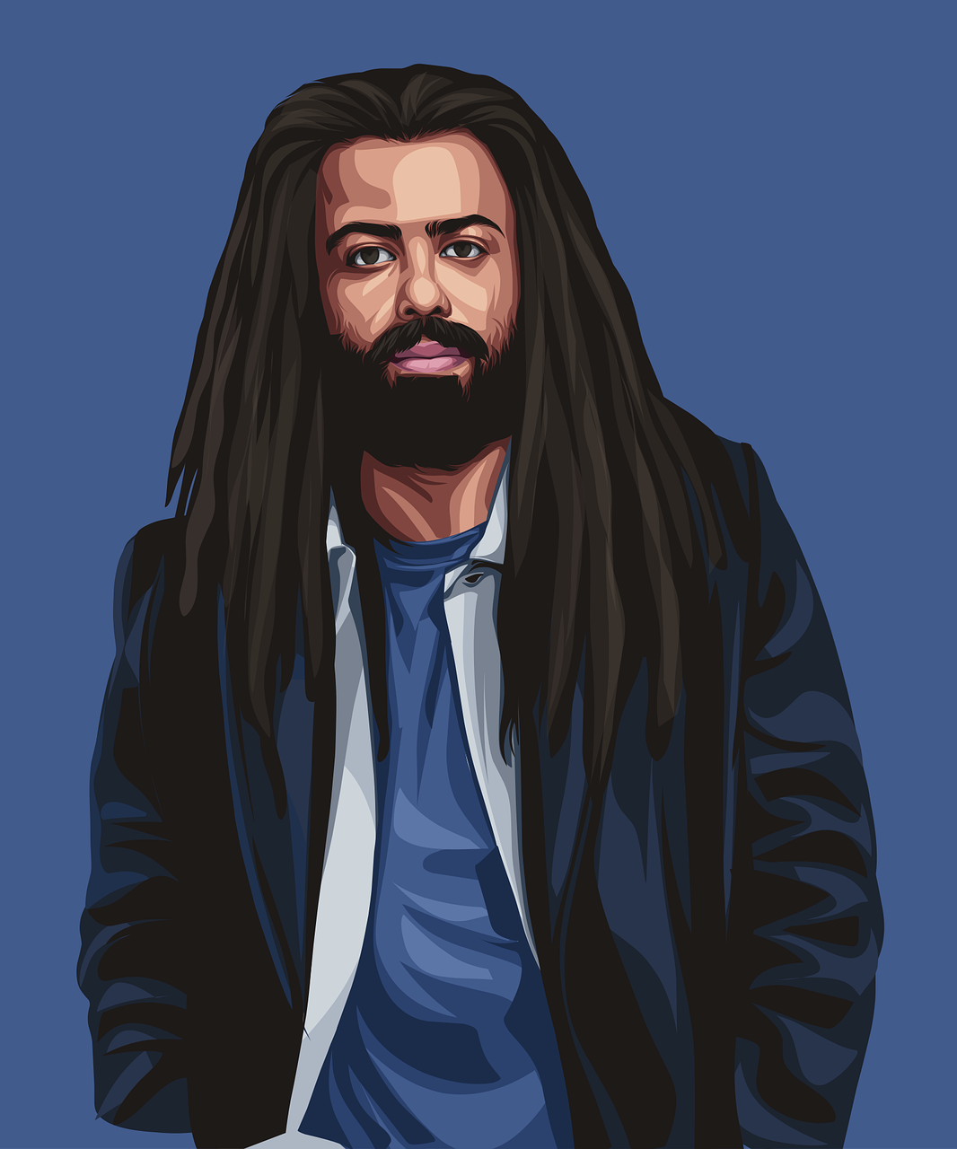
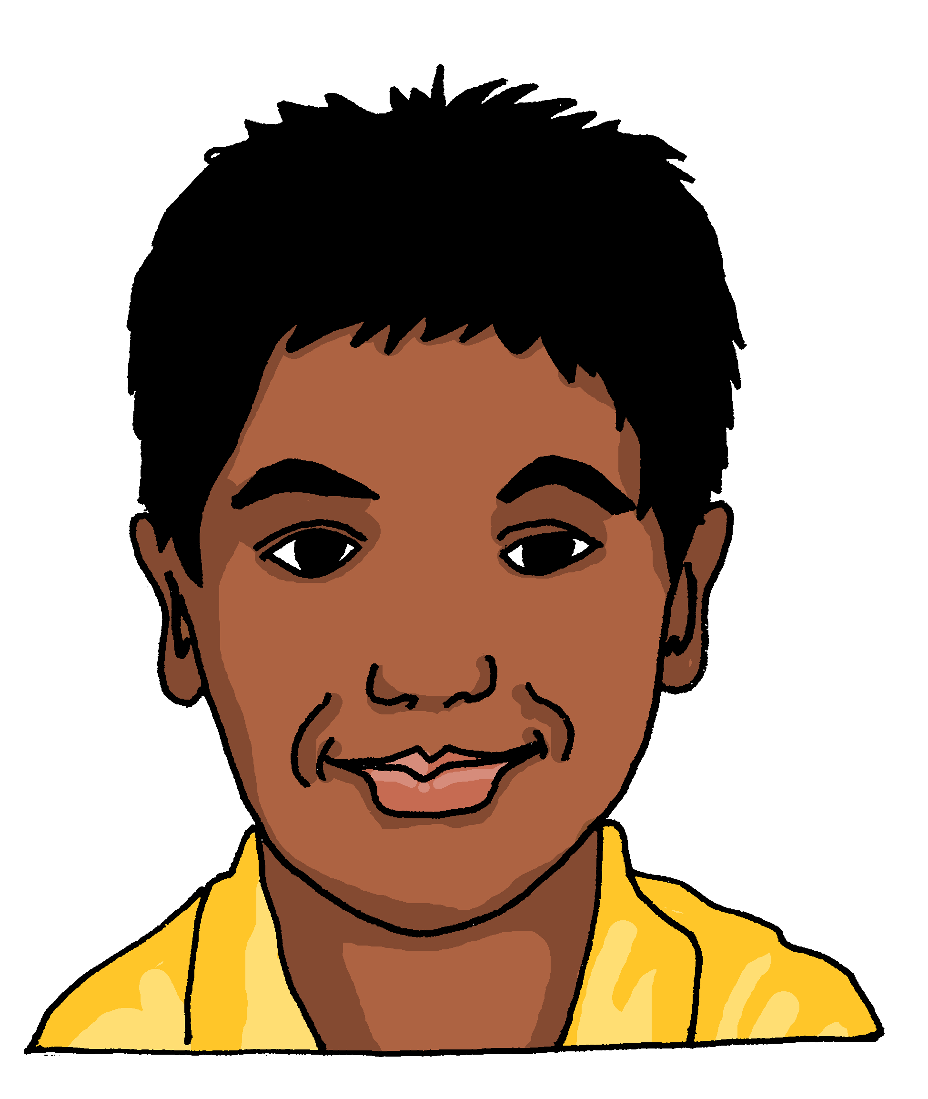
vocabulaire
C’est le, la ou les ?
mots
le,l’
la, l’
___ tête
[the] head
___ actrices
[the] actresses
___ cheveu [the] (single) hair
___ nez [the] nose
___ visage
[the] face
___ actrice [the] actress
___ bouche
[the] mouth
___ cheveux
[the] hair(s)
___ œil [the] eye
___ yeux [the] eyes
___ acteurs
[the] actors
___ acteur
[the] actor
les
Notes:
Timing: 5 minutes
Aim: to revisit vocabulary from Y3/4 and introduce new vocabulary from this week.
Procedure:
Click for each word to appear with audio (without article).
Pupils say ‘le’, ‘la’, ‘les’ depending previous knowledge of the word gender. For the new words, the images will support this.
Click again for it to disappear into the corresponding pacperson’s mouth.
Transcript 1: nez
actrice yeux
cheveu
oeil
cheveux
acteur
actrices
visage
acteurs
tête bouche
Transcript 2:
le nez
l’actrice les yeux
le cheveu
l’oeil
les cheveux
l’acteur
les actrices
le visage
les acteurs
la tête
la bouche
6

Slide 7
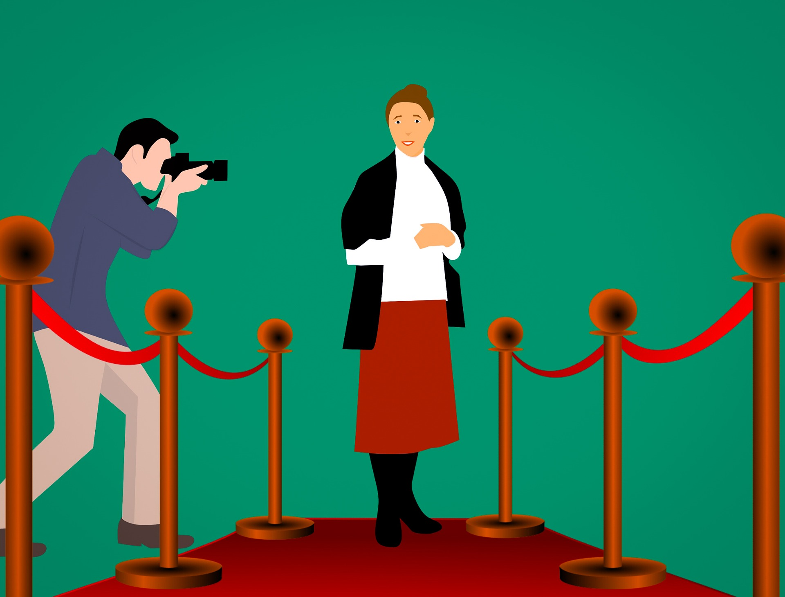
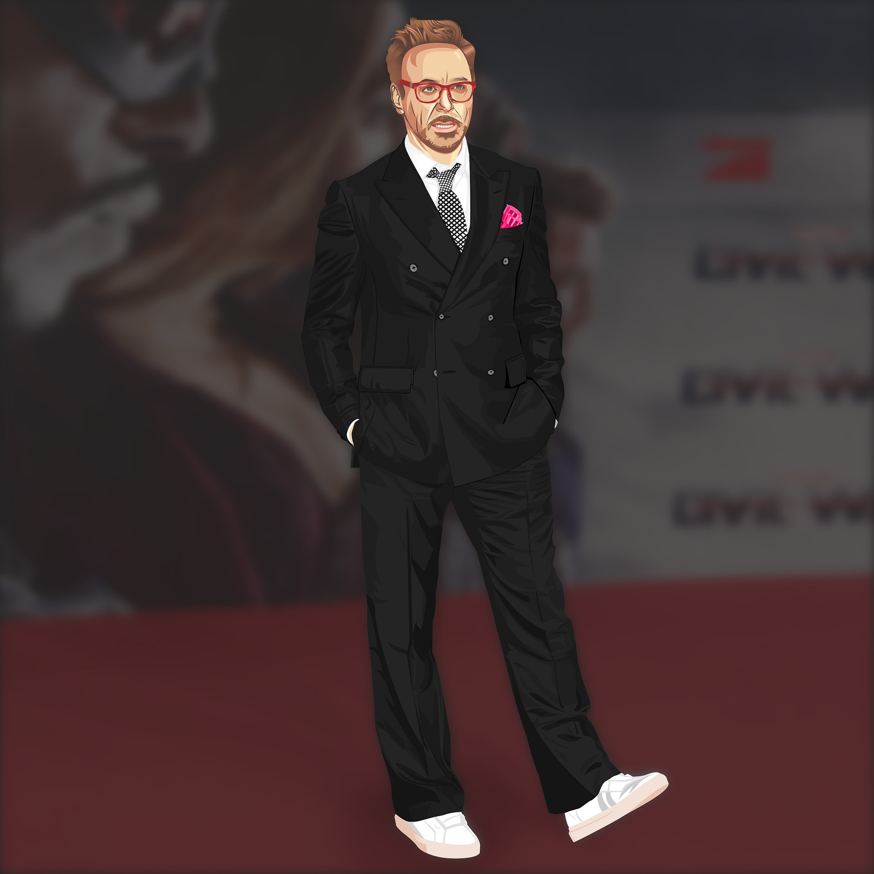
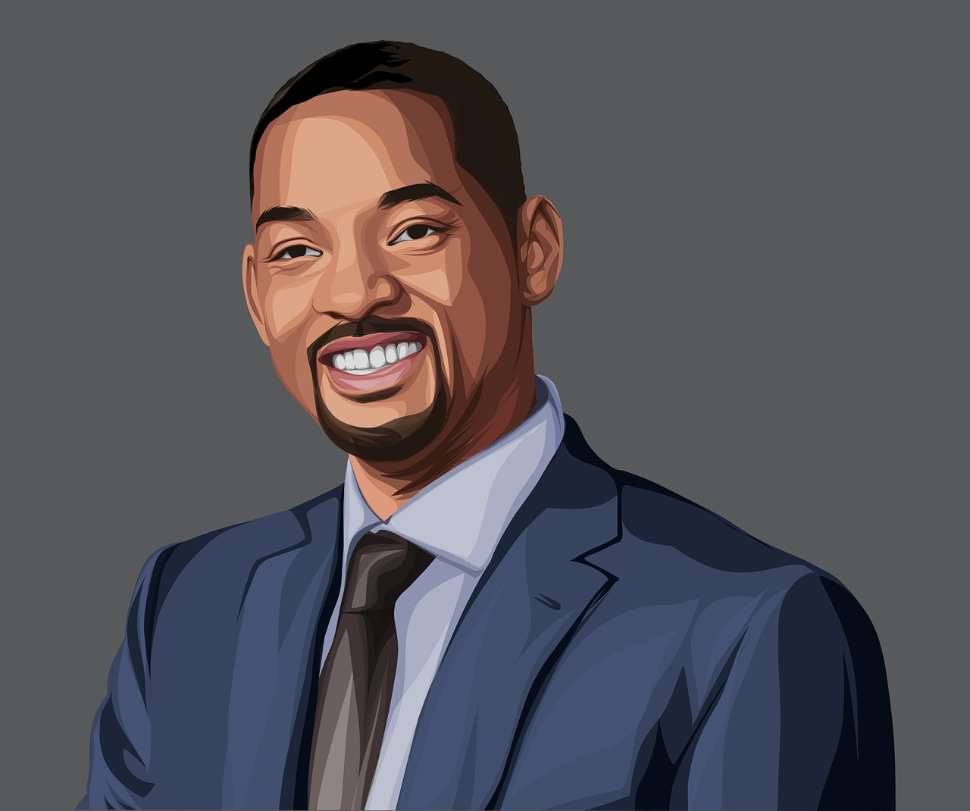
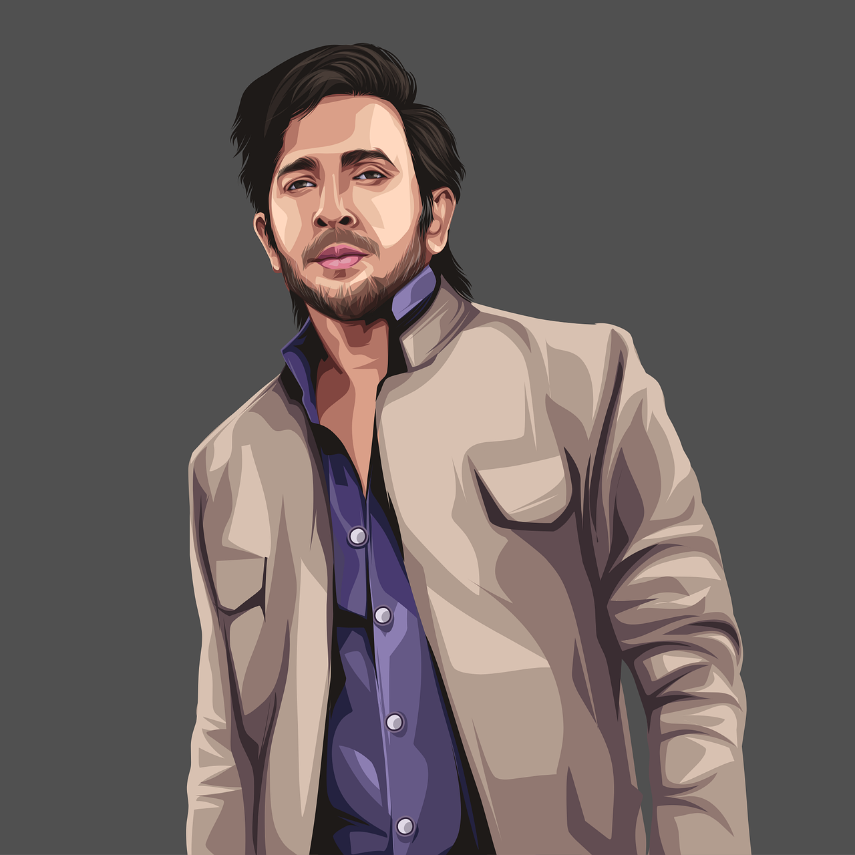
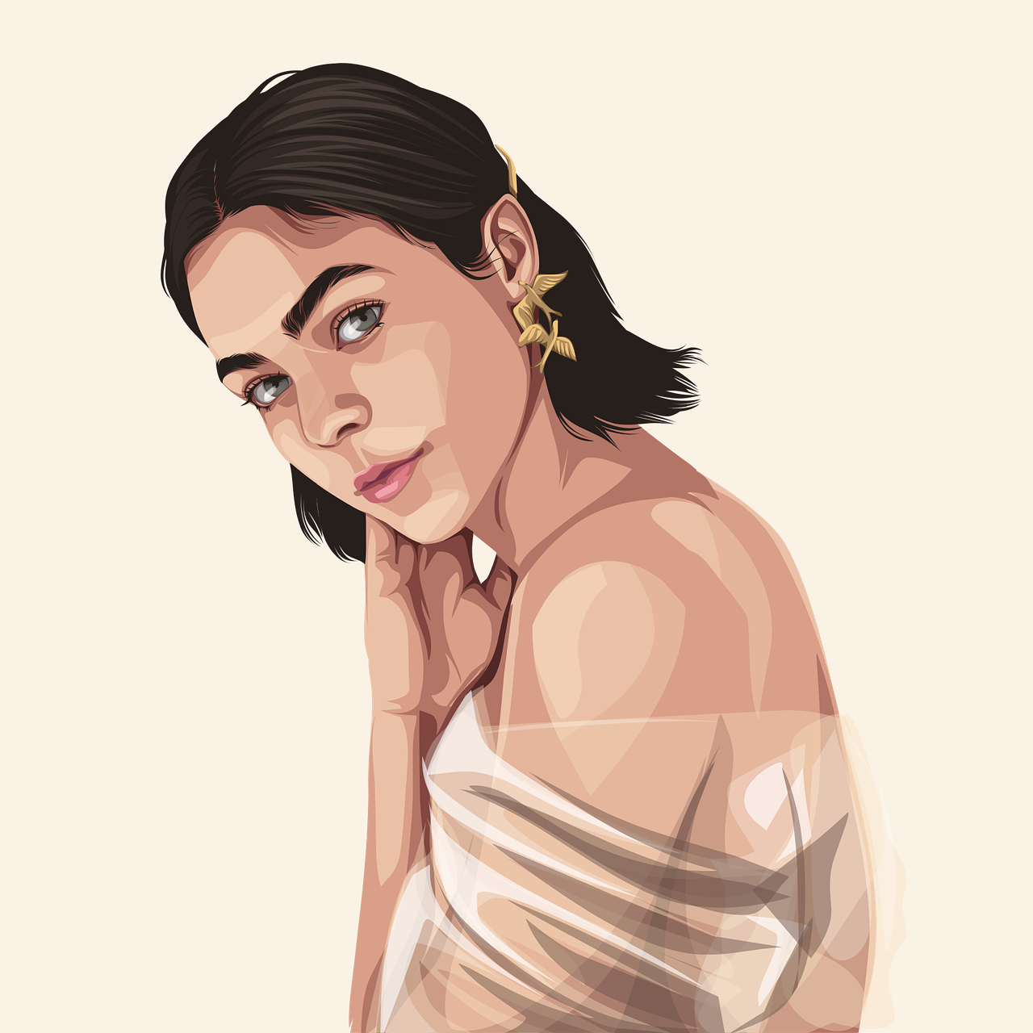
Le festival de Cannes
Le festival de Cannes est un festival de cinéma international. Le grand prix est pour le meilleur film de l’année.
Il y a d’autres prix pour le meilleur acteur et la meilleure actrice.
Cannes est une belle ville située au sud-est de la France.
meilleur(e) – best | l’année – year | autre - other
Notes:
Timing: 1 minute
Aim: to introduce two of this week’s new words (acteur / actrice); to present information about the most famous film festival which takes place every year in France.
Procedure:
Click to bring up the text.
Read the information with pupils (click the speech bubble to hear the audio in the audio version).
Support pupils to work out the meaning in English.
Draw attention in particular to the two new words (l’acteur/l’actrice).
Picture attribution (Cannes):
Alberto Fernandez Fernandez, CC BY-SA via Wikimedia Commons Frequency of unknown words and cognates: année [102] autre [28] est [4603] international [282] meilleur [194] prix [310] situer [815] sud [1242] Note: all unknown words are on the NCELP/Eduqas GCSE word list, and année, est and sud are taught in the Bleu SOW, so if pupils have already completed Bleu, this will be revisiting for them. Prix is a phonics cluster word which is also taught as vocabulary in Vert Term 2 Week 1.

Slide 8
écouter
Clémentine regarde le festival de Cannes à la télé.
. Écoute les noms des animaux. C’est [ien] ou [(a)in]?
Elle décrit des acteurs et actrices. Écoute. C’est le, la ou les ? Elle décrit quoi ?
 | le | les | visage | yeux
 | le | la | nez | tête
 | la | les | tête | cheveux
 | le | la | visage | bouche
 | les | le | yeux | nez
 | les | la | bouche | cheveux
1
1
2
2
3
3
4
4
5
5
6
6
Notes:
Timing: 5 minutes
Aim: to practise aural recognition of definite articles and their connection to nouns of the appropriate gender/number.
Procedure
Pupils listen to the short sentences and decide which noun they are describing, based on the form of the article.
Click to check.
Click again to bring up a 2nd set of audio buttons. Pupils listen again – this time to check their noun selection.
Click to reveal answers.
Transcript 1:
Elle a les [yeux bleus]. Il a le [nez rond]. Il a les [cheveux longs]. Elle a le [visage ovale]. Elle a les [yeux gris]. Il a la [bouche rouge].
Transcript 2:
Elle a les yeux [bleus]. Il a le nez [rond]. Il a les cheveux [longs]. Elle a le visage [ovale]. Elle a les yeux [gris]. Il a la bouche [rouge].
8

Slide 9
Adjectives following the noun
Note: in French we often use the definite article ‘the’ in these descriptions. In English, we leave it out or use ‘a’, e.g., has a round face.
We know that many adjectives follow the noun.
Examples:
Il a le visage rond.
Il a le visage ovale.
When there are two adjectives after the noun, join them with ‘et’ (and).
He has a round face.
He has an oval face.
Il a les yeux ronds.
Il a les cheveux longs et bruns.
He has round eyes.
He has long, brown hair.
⚠ Remember: Adjectives agree (match) in gender and number with the noun they are describing.
Notes:
Timing: 2 minutes
Aim: to recap pupil knowledge of postnominal adjectives, singular and plural.
Procedure:
Click through the animations to present the information.
Elicit English meanings of French examples.
Ensure meanings are understood.

Slide 10
écouter
Clémentine regarde le festival de Cannes à la télé.
. Écoute les noms des animaux. C’est [ien] ou [(a)in]?
Écoute. Les acteurs sont comment ?
 | le | les | visage | yeux | has blue eyes
 | le | la | nez | tête | has a round nose
 | la | les | tête | cheveux | has long hair
 | le | la | visage | bouche | has an oval face
 | les | le | yeux | nez | has grey eyes
 | les | la | bouche | cheveux | has a red mouth
1
_____
2
_____
3
_____
4
_____
5
_____
6
_____
Notes:
Timing: 5 minutes
Aim: to practise aural comprehension of descriptive sentences with definite articles and postnominal adjectives.
Procedure:
Do number 1 as an example. The previous answers are fixed in place to remind pupils that they have listened to part of this information before. Now they listen to the whole sentence and complete the sentences in English. The gapped sentences provide support for comprehension and make the different syntax (word order) visually more concrete.
Click to correct the example.
Complete 2-6. Elicit answers from pupils and click to reveal written answers.
Transcript 1:
Elle a les yeux bleus. Il a le nez rond. Il a les cheveux longs. Elle a le visage ovale. Elle a les yeux gris. Il a la bouche rouge.
10

Slide 11
vocabulaire
Brun is for hair. For brown eyes, use marron, which doesn’t change for plural.
. Écoute les noms des animaux. C’est [ien] ou [(a)in]?
Ils ont les cheveux comment ?
mots
noirs
blonds
bruns
roux
[black]
[blond]
[brown]
[ginger, red]
courts
crépus
longs
[long]
[short]
[frizzy]
Notes:
Timing: 2 minutes
Aim: presentation of four new (blonds, crépus, roux, longs) and three previously taught vocabulary items.
Procedure:
Click to reveal the French word and picture. Say the word with pupils.
Elicit the English and click to reveal the written English meaning.
Click to animate the French word and picture again and elicit pupil repetition of the word (without first hearing the teacher voice, so that pupils connect the written form with the pronunciation more independently).
Repeat steps 1-3 for the remaining four items.

Slide 12
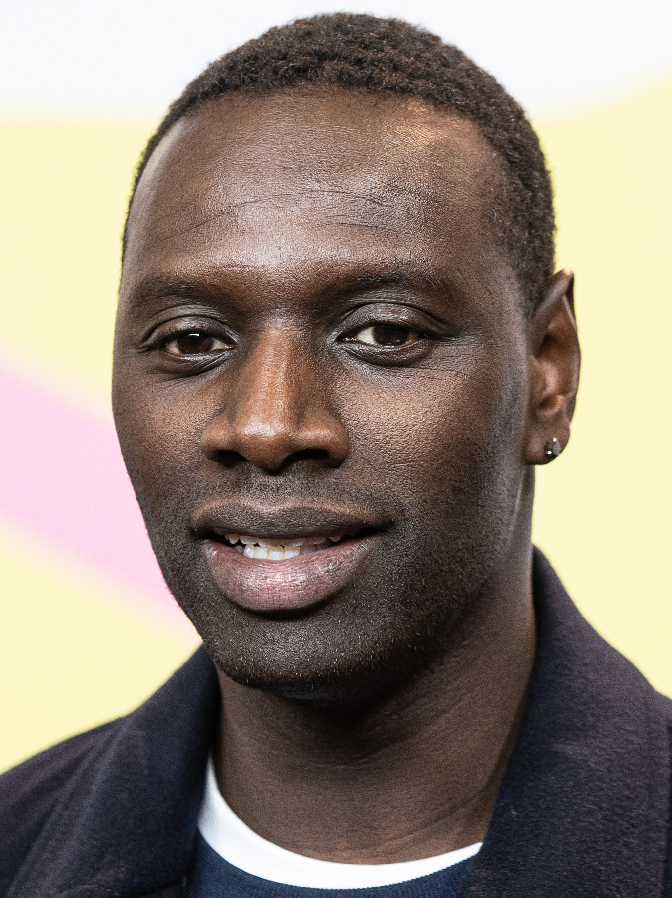
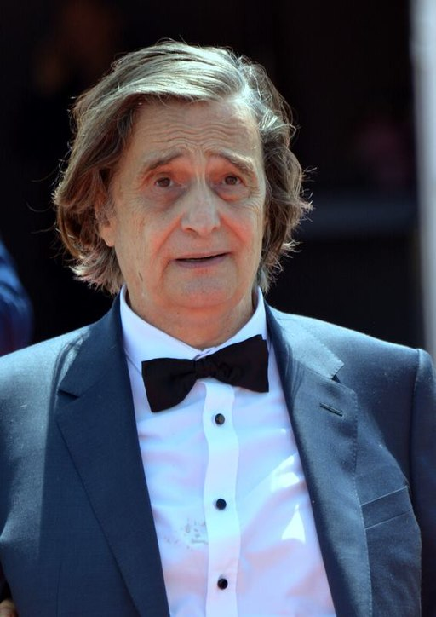
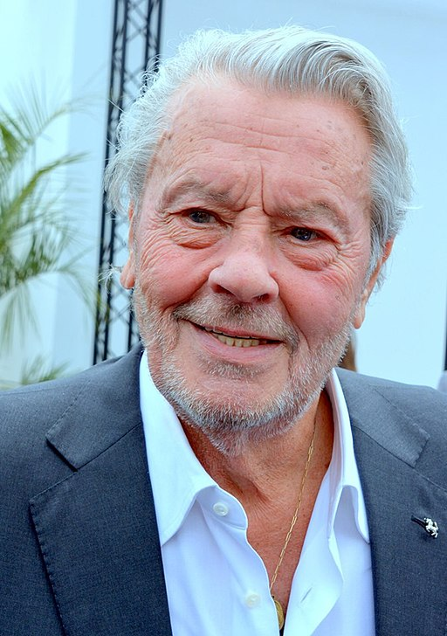
lire
Des acteurs et des actrices sont au festival de Cannes !
Écris 1-7 et la phrase.
. Écoute les noms des animaux. C’est [ien] ou [(a)in]?
1 | Omar Sy a les | visage | cheveux | crépus | ovale
2 | Jean-Pierre Léaud a les | yeux | nez | ronds | rond
3 | Garcelle Beauvais a le | visage | yeux | ovales | ovale
4 | Sophie Marceau a la | cheveux | bouche | roux | rouge
5 | Alain Delon a les | visage | cheveux | ovale | gris
6 | Catherine Deneuve a les | cheveux | nez | blonds| long
Notes:
Timing: 4 minutes (the 2nd (comprehension) part of this task is in the follow ups)
Aim: to practise connection of the definitive article with an appropriate noun and correct adjectival form; to practise comprehension this week’s vocabulary in sentence form.
Procedure: 1. Pupils select the correct noun based on the definite article.
2. They then select the correct form of the adjective.
3. Click to correct answers.
4. If desired, click on the green buttons to hear the answers, too. Note: the language in this task will be the focus of a comprehension task in the follow ups.
Attribution:
Photo – Alain Delon Georges Biard, CC BY-SA 3.0 via Wikimedia Commons Photo - Jean-Pierre Léaud Georges Biard, CC BY-SA 3.0 via Wikimedia Commons
Photo – Catherine Deneuve Elena Ringo CC BY 4.0 via Wikimedia Commons Photo – Sophie Marceau Georges Biard, CC BY-SA 3.0 via Wikimedia Commons
Photo – Omar Sy - Harald Krichel, CC BY-SA 3.0 via Wikimedia Commons
Photo – Garcelle Beauvais - Gage Skidmore, CC BY-SA 3.0 via Wikimedia Commons

Slide 13
Au revoir !
vert
Notes:
13

