Slide 1

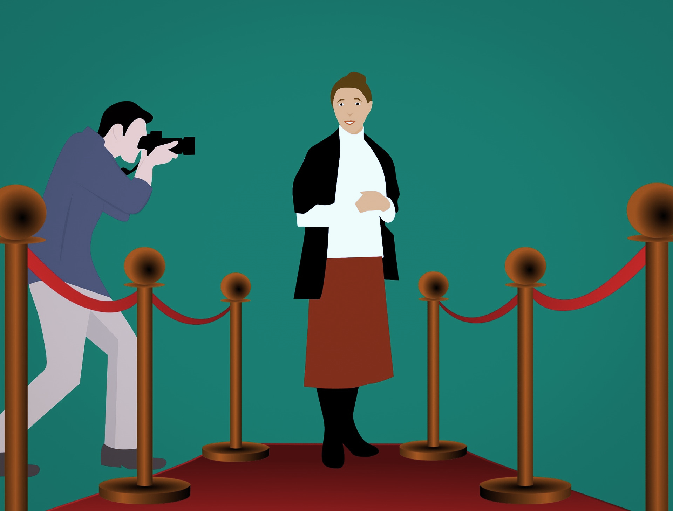

Interactions
vert
Le festival de Cannes
Follow ups 1-5
Notes:
Artwork by Steve Clarke. Pronoun pictures from NCELP (www.ncelp.org). All additional pictures selected from Pixabay and are available under a Creative Commons license, no attribution required.
Phonics: [ch] dimanche [1235] marché [280] chercher [336] chat [3138] bouche [1838]
Vocabulary: cheveu [2296] acteur [1552] actrice [1552] nez [2661] œil, yeux [474] visage [1292] bleu [1216] blond [4585] brun [>5000] court
[545] crépu [>5000] gris [2769] long [202] noir [572] ovale [>5000] rond [2268] roux [>5000] vert [1060]
Revisit 1: centre commercial [491/908] église [1782] magasin [1738] pont [1889] rue [598] excellent [1225] différent [350] idéal [1429]
important [215]
indépendant [954] moderne [1239] propre [237] sale [2906] des [de-2]
Revisit 2: anniversaire [2043] mois [179] janvier [939] février [1139] mars [868] avril [1022] mai [943] juin [931] juillet [1326] aout [1445] septembre [944] octobre
[826] novembre [982] décembre [891] quand [119] treize [3285] quatorze [3359] quinze [1472]
seize [3285] dix-sept [3812] dix-huit [3592] dix-neuf [4851] vingt [1273] vingt et un [1273/6/3] vingt-deux, vingt-trois vingt-quatre vingt-cinq vingt-six vingt-sept
vingt-huit vingt-neuf trente [1646] concert [1697] fête [1490] spectacle [1687]
Londsale, D., & Le Bras, Y. (2009). A Frequency Dictionary of French: Core vocabulary for learners London: Routledge.
The frequency rankings for words that occur in this PowerPoint which have been previously introduced in these resources are given in the SOW and in the
resources that first introduced and formally re-visited those words.
For any other words that occur incidentally in this PowerPoint, frequency rankings will be provided in the notes field wherever possible.
.

Slide 2


[ch]
prononcer
chercher
[un] is nasal before a consonant and at the end of words.
[to look for]
Notes:
Timing: 2 minutes
Aim: to recap SSC [ch].
Procedure:
Click to bring up the SSC [ch]. Repeat the SSC [ch] and the source word chercher with the class.
Click to bring up the English translation and picture.
Pupils to practise saying the SSC and source word several times.

Slide 3




[ch]
chercher
prononcer
bouche
chat
marché
dimanche
[to look for]
Sun
Notes:
Timing: 2 minutes
Aim: to practise the pronunciation of SSC [ch] in four cluster words.
Procedure:
Click to bring up the SSC [ch]. Repeat the SSC [ch] with the class and the source word chercher.
Click to bring up the English translation and picture. Do the gesture, if using.
Click to bring up each cluster word in turn: bouche, chat, marché, dimanche.
The pictures appear after the words to give a further opportunity for word repetition.
Suggested gesture:
The 3rd video (the woman)’s version is the one I like the best for search, look for: https://www.signbsl.com/sign/search

Slide 4


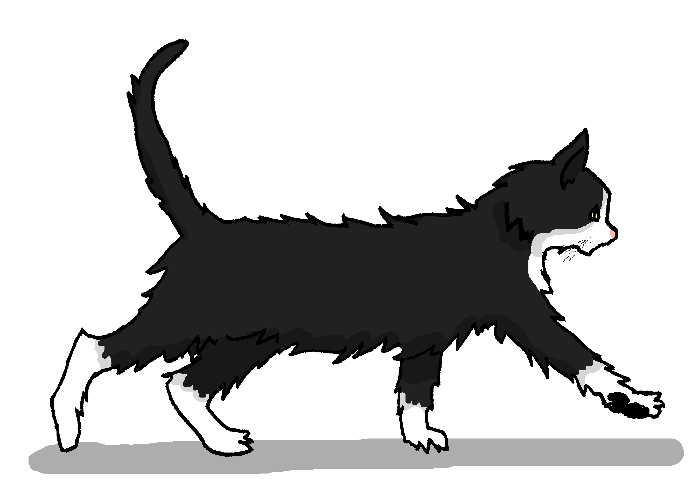

Follow up 1:
Un virelangue
Prononce le virelangue ! Puis, écoute et vérifie.
prononcer
Cinq chiens chassent six chats.
1
Cinq chiens chassent six chats.
2
Cinq chiens chassent six chats.
3
Notes:
Timing: 2 minutes
Aim: to practise oral production of the [ch] and soft [c] sounds in a well-known tongue twister.
Procedure:
Pupils practise first in pairs.
Then click to listen to the tongue twister said by a native speaker at three different speeds: slow, medium, fast.
Give pupils 30 seconds more to practise saying it.

Slide 5


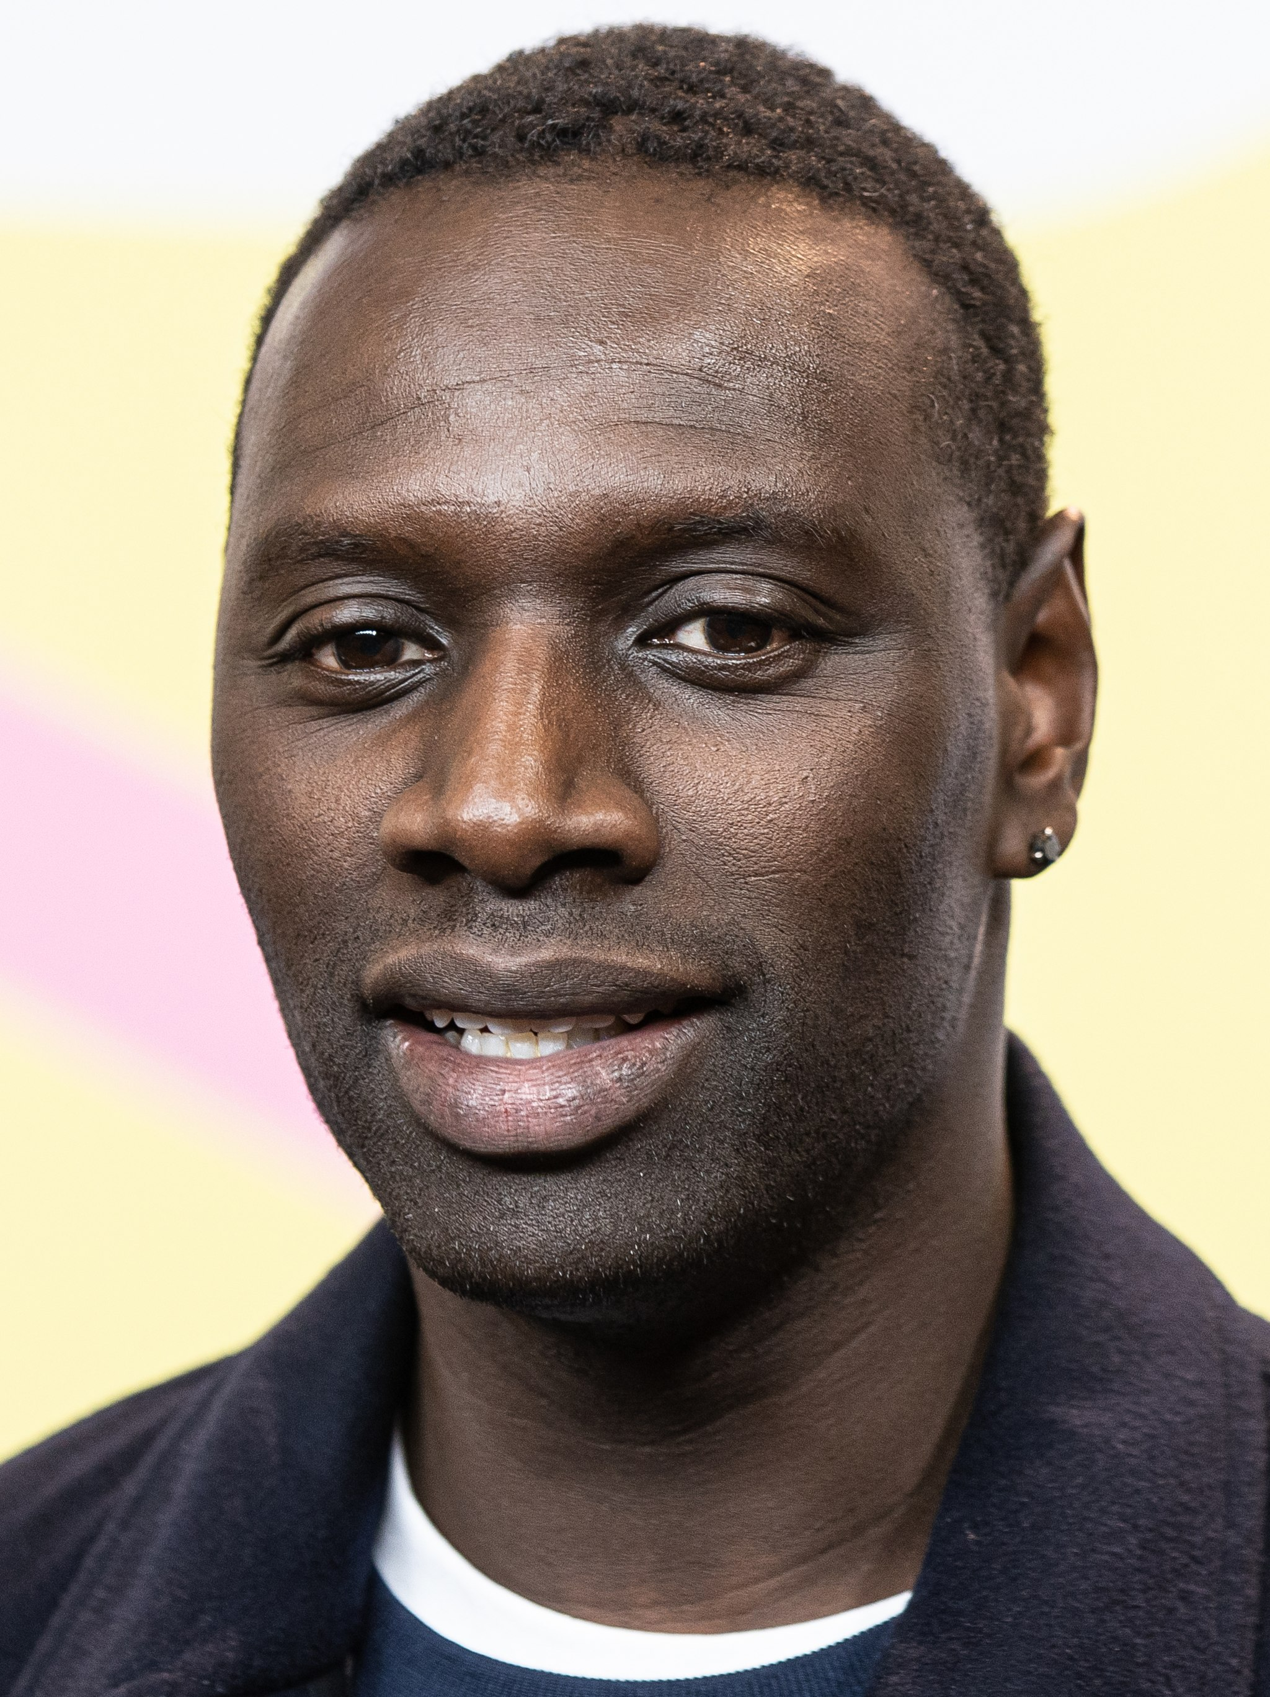
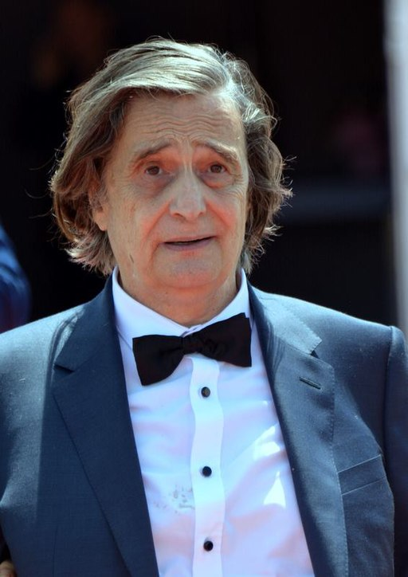

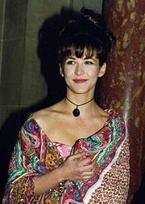
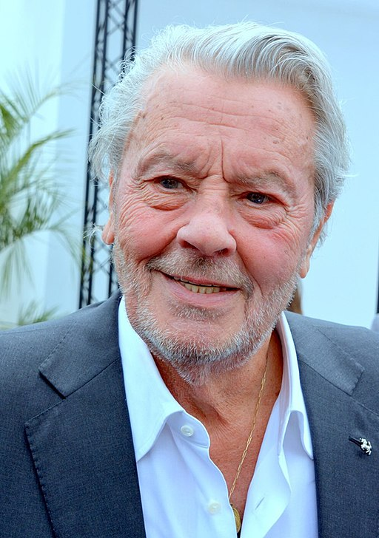
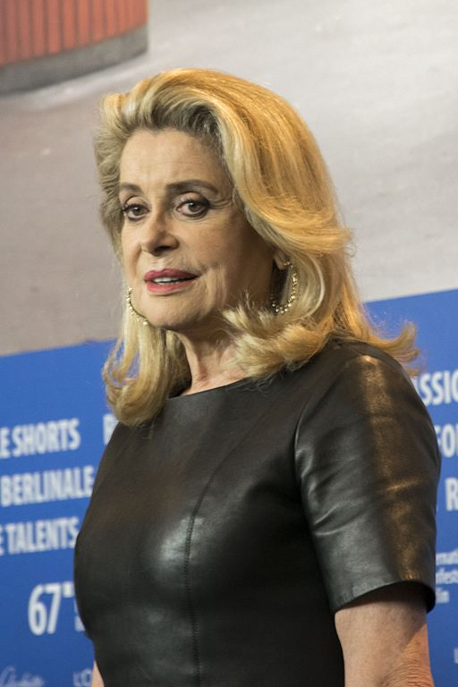
Follow up 2:
Les acteurs sont comment ?
Écris en anglais.
1 | Omar Sy a les cheveux crépus.
2 | Jean-Pierre Léaud a les yeux ronds.
3 | Garcelle Beauvais a le visage ovale.
4 | Sophie Marceau a la bouche rouge.
5 | Alain Delon a les cheveux gris.
6 | Catherine Deneuve a les cheveux blonds.
1
Omar Sy has frizzy hair.
lire
2
Jean-Pierre Léaud has round eyes.
3
Garcelle Beauvais has an oval face.
4
Sophie Marceau has a red mouth.
5
Alain Delon has grey hair.
6
Catherine Deneuve has blond hair.
Notes:
Timing: 4 minutes
Aim: to practise written comprehension of this week’s vocabulary in sentences.
Procedure:
Do the example with pupils. They write (or say) the English sentence meaning (they could do this on mini whiteboards).
Complete sentences 1-7 and click to correct them. The English sentence meanings appear on consecutive mouse clicks.

Slide 6



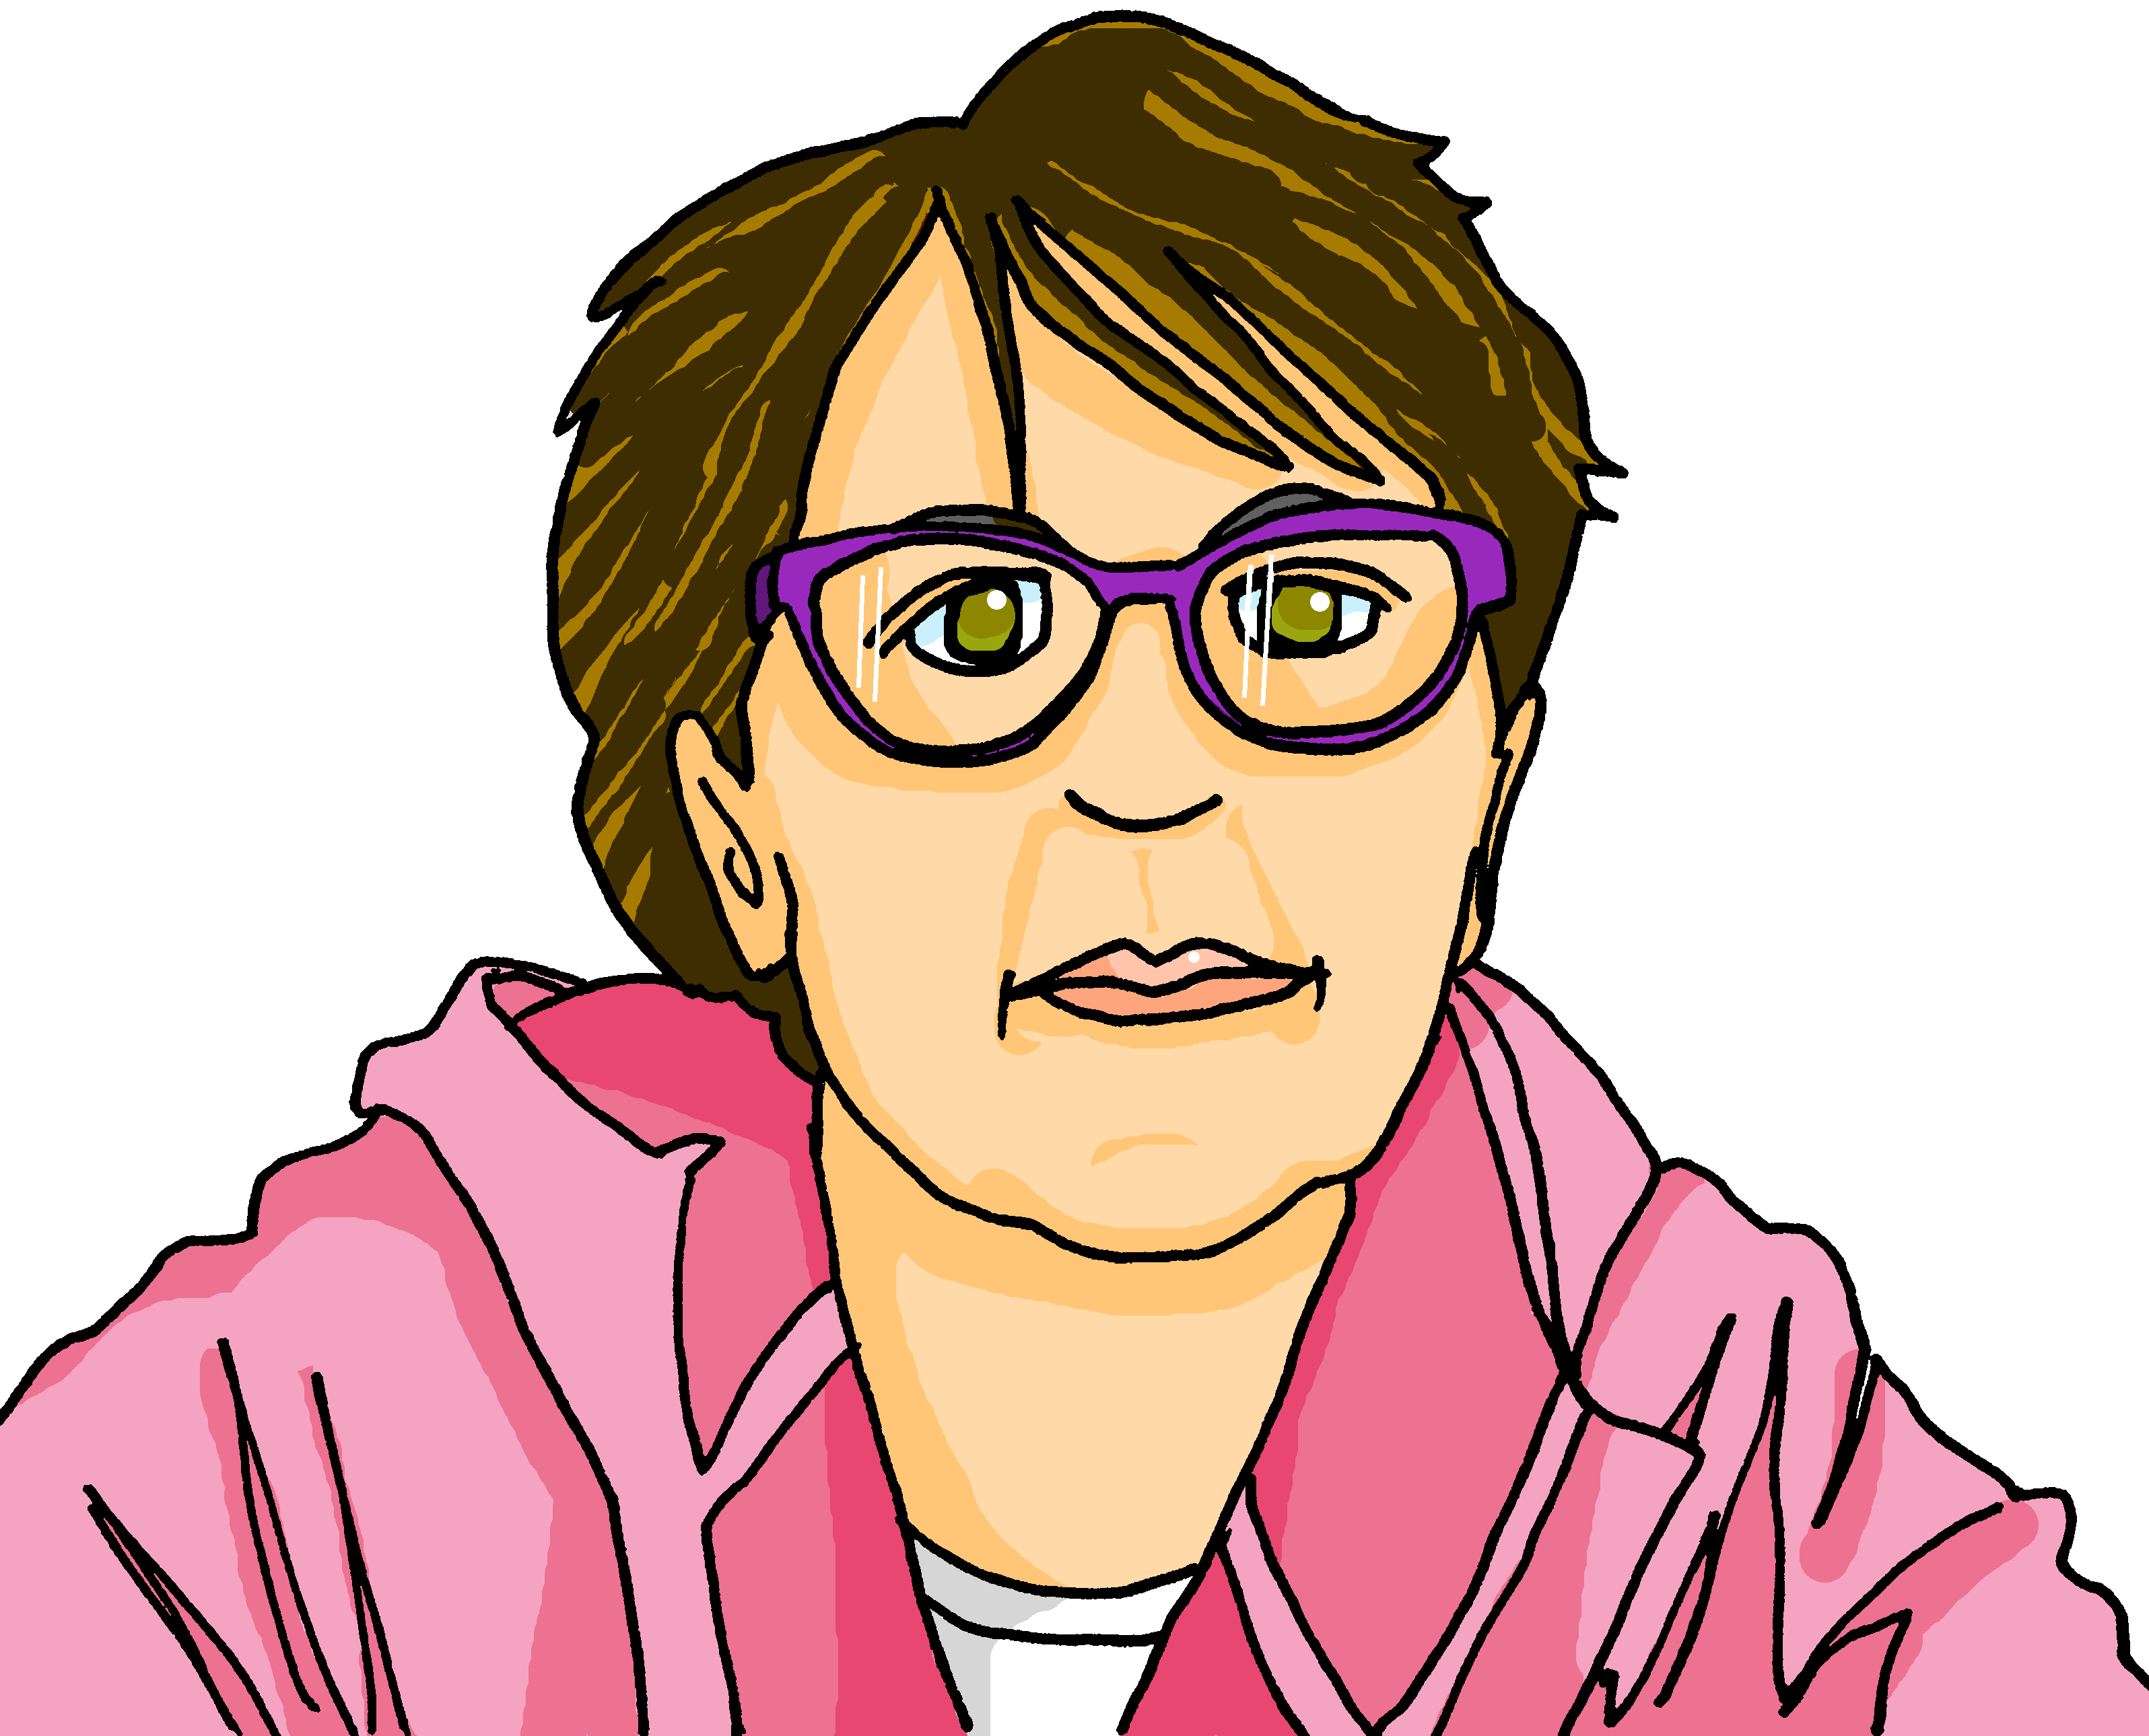
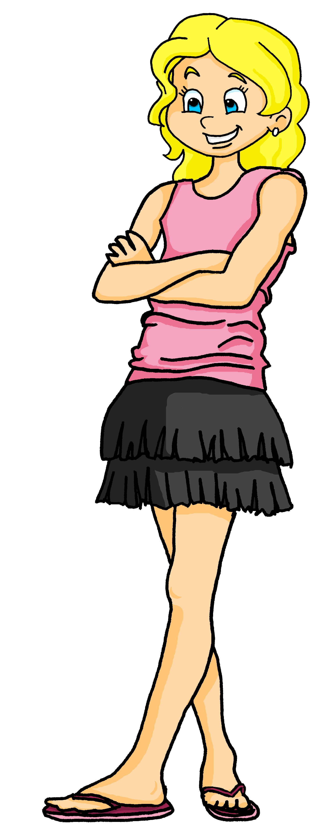
Follow up 3:
Écoute. Adèle décrit une personne de la famille.
Écris la description an anglais.
écouter
?
_____________________.
E
Today is Wednesday 15th December.
Marie-Ange
______
1
Whose birthday is it?
Elle est ma grand-mère.
____________.
2
She is French.
3
She has short, brown hair.
_____________________.
4
She has a round face.
_____________________________.
5
She has an important shop in a big street in Lorient.
_____________________________________________________________________.
6
She loves the Cannes festival.
_______________________________________.
7
She is the mother of my mother.
_______________________________________.
_______________________________________.
Notes:
Timing: 7 minutes
Aim: to practise aural comprehension of a wide variety of vocabulary from this and revisited weeks.
Procedure:
Click to listen to the example. Pupils complete the sentence in English.
For items 1 and 2, pupils can either turn away from the board and try to write the whole sentence, or use the written support on the board.
After each item, click to reveal the answers.
For items 3 – 7, pupils listen and translate the full sentence.
Click to reveal the answer each time.
The final click reveals Marie-Ange, and the speech bubble explaining that she is Adèle’s grandma.
Transcript:
Aujourd’hui, c’est mercredi 15 décembre.
C’est l’anniversaire de qui ?
Elle est française.
Elle a les cheveux courts et bruns.
Elle a le visage rond.
Elle a un magasin important sur une grande rue à Lorient.
Elle adore le festival de Cannes.
Elle est la mère de ma mère.

Slide 7


Follow up 4:
Écoute. Ils sont comment ?
C’est vrai ou faux ?
écouter
1
The actor has long, black hair.
The actor has round, black eyes.
2
The actress has long, blond hair.
The actress has short, grey hair.
3
We have green eyes.
4
She has a round nose.
He has an oval face.
5
She has an oval face.
6
The actresses have long, red hair.
Notes:
Timing: 5 minutes
Aim: to practise aural comprehension of a wide variety of vocabulary from this and revisited weeks in sentences.
Procedure:
Click to listen.
Pupils write vrai (true) or faux (false).
Click to correct.
Extra: for the incorrect items, pupils can provide a correct sentence.
Transcript:
L’acteur a les yeux ronds et noirs.
L’actrice a les cheveux courts et gris.
Nous avons les yeux verts.
Elle a le nez rond.
Il a un visage ovale.
Les actrices ont les cheveux longs et roux.

Slide 8





vocabulaire
Follow up 5 - Écris en anglais : Can you get at least 15 points?
mots
 | treize | vingt-et-un | quinze
 | seize | trente | quatorze
 | excellent | le centre commercial | le magasin
 | l’église | le pont | la rue
 | rond | roux | crépu
 | les yeux | le visage | ovale
 | les cheveux | l’acteur | le nez
13
21
15
x3
16
30
14
excellent
(the) shopping centre
(the) shop
x2
(the) church
(the) pont
(the) street
round
ginger, red
frizzy
(the) eyes
(the) face
oval-shaped
x1
(the) hair (pl)
(the) actor
(the) nose
Notes:
Timing: 5-10 minutes
Aim: to practise written production of vocabulary from this week and two revisited weeks.
Procedure:
1. Give pupils a blank grid. They fill in the English meanings of any of the words they know, trying to reach 15 points in total.
2. Remind pupils that adjectives can refer to male or female persons and they should note this in their translations. E.g. pleased (f), short (m).
Note:
The most recently learnt and practised words are pink, words from revisit 1 are green and those from revisit 2 are blue, thus more points are awarded for them, to recognise that memories fade and more effort (heavy lifting!) is needed to retrieve them.
8

Slide 9
vocabulaire
Follow up 5 - Écris en anglais : Can you get at least 15 points?
mots
 | treize | vingt-et-un | quinze
 | seize | trente | quatorze
 | excellent | le centre commercial | le magasin
 | l’église | le pont | la rue
 | rond | roux | crépu
 | les yeux | le visage | ovale
 | les cheveux | l’acteur | le nez
x3
x2
x1
Notes:
HANDOUT
9

